Slide 1

OP2.1 scrape-off layer transport experiments and results
Matt Kriete on behalf of the W7-X Team

Slide 2
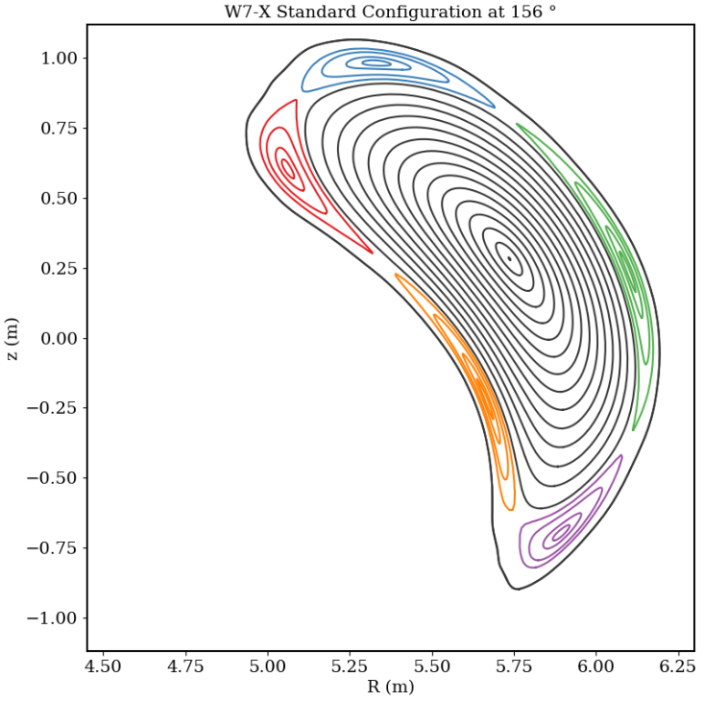
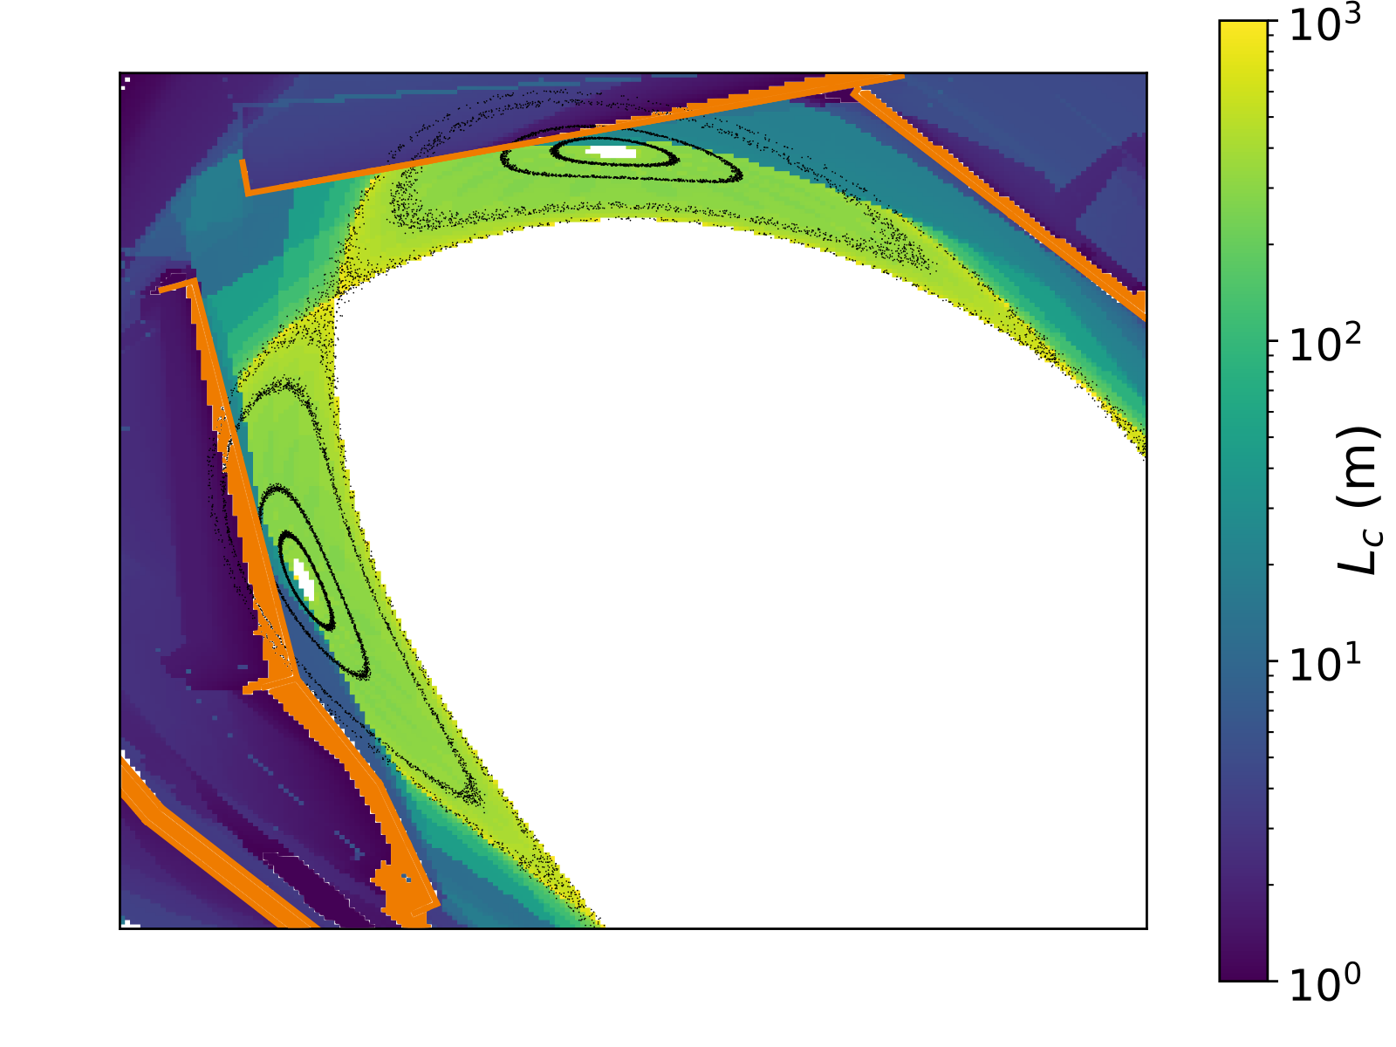
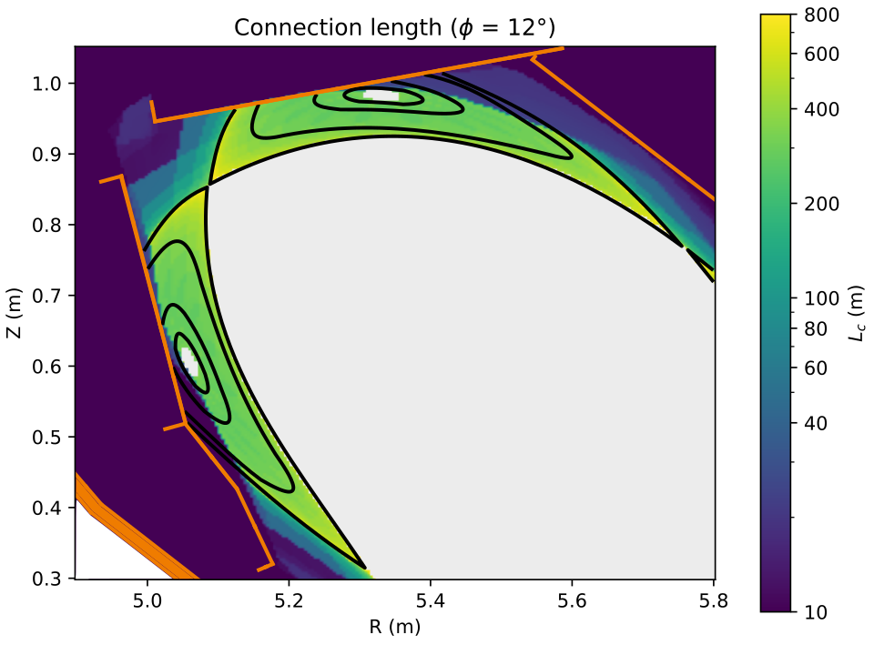
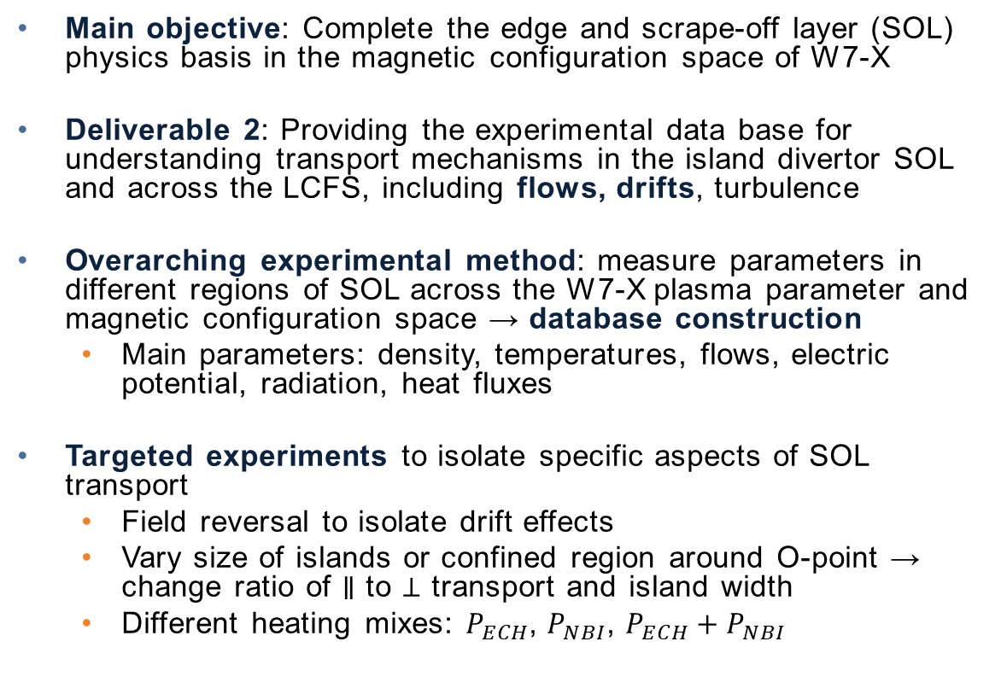
Scrape-off layer transport: why and how do we investigate it?
Main objective: Complete the edge and scrape-off layer (SOL) physics basis in the magnetic configuration space of W7-X
Deliverable 2: Providing the experimental data base for understanding transport mechanisms in the island divertor SOL and across the LCFS, including flows, drifts, turbulence
Overarching experimental method: measure parameters in different regions of SOL across the W7-X plasma parameter and magnetic configuration space → database construction
  Main parameters: density, temperatures, flows, electric potential, radiation, heat fluxes
Targeted experiments to isolate specific aspects of SOL transport
  Field reversal to isolate drift effects
  Vary size of islands or confined region around O-point → change ratio of $∥$ to $⊥$ transport and island width
  Different heating mixes: $P_{ECH}$, $P_{NBI}$, $P_{ECH}+P_{NBI}$

Slide 3
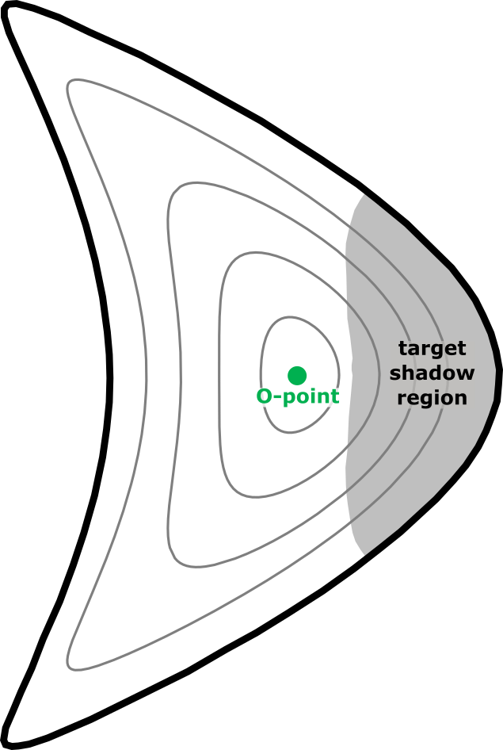
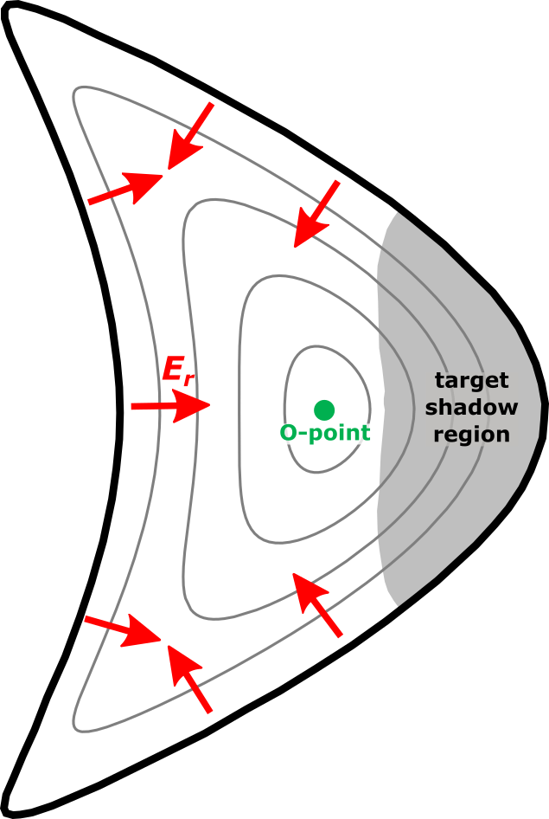
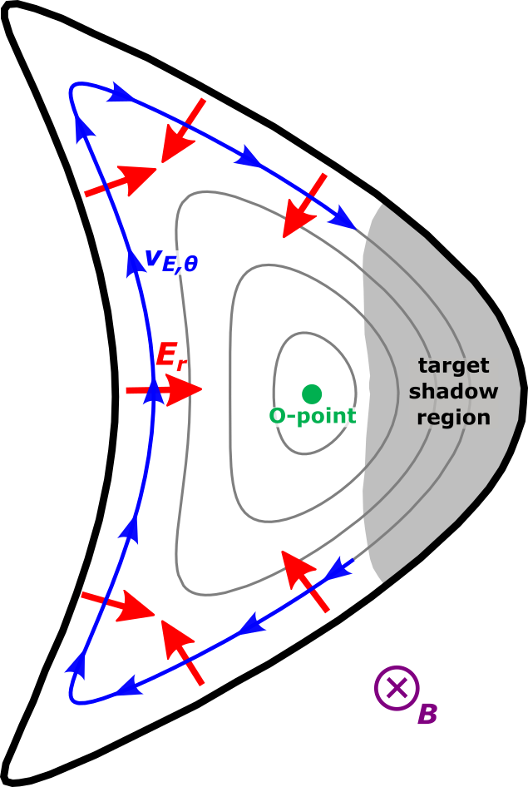
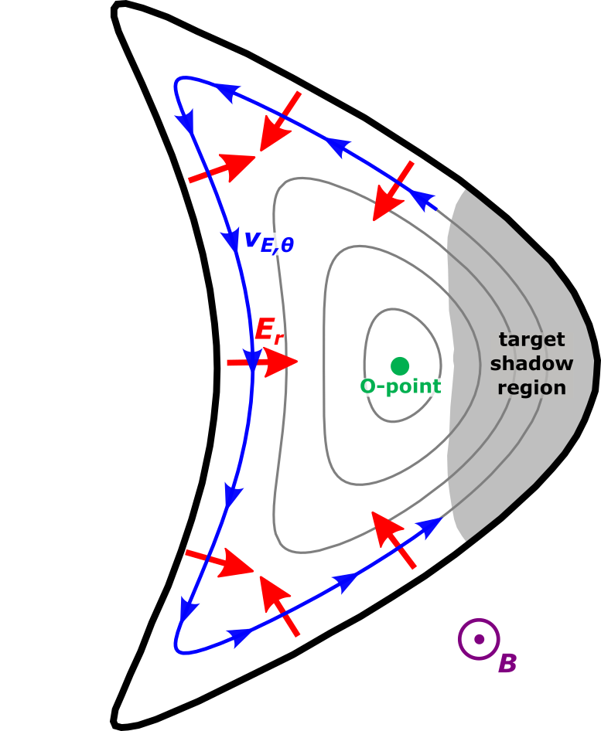
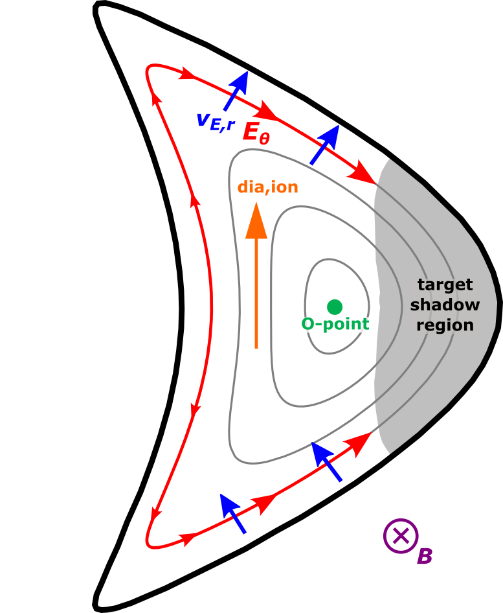
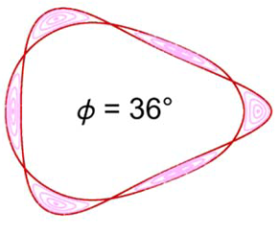
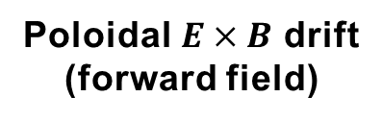
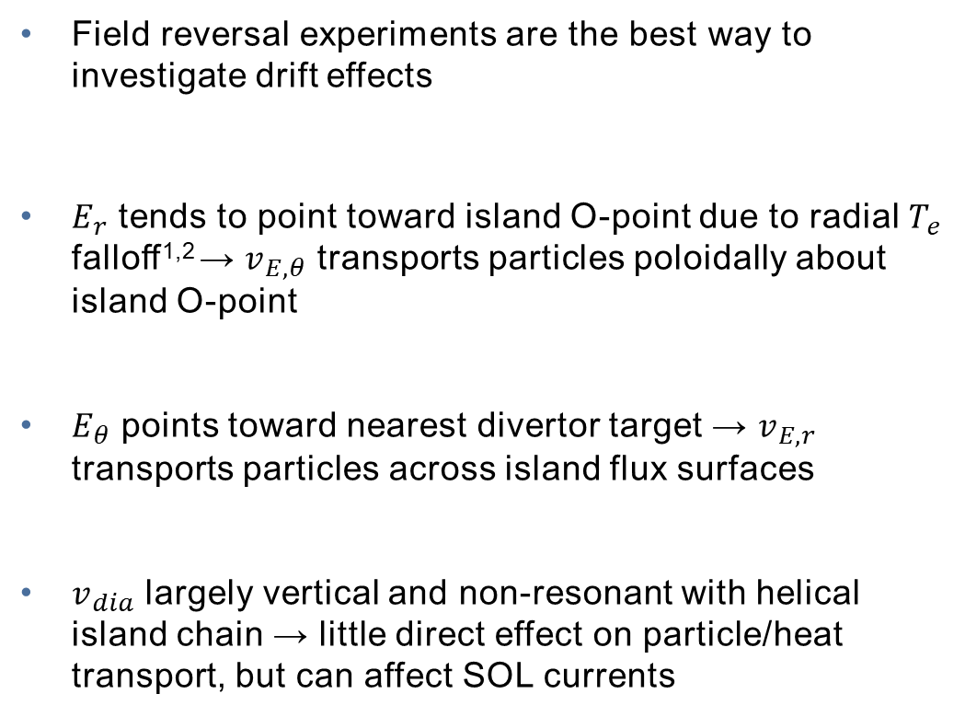
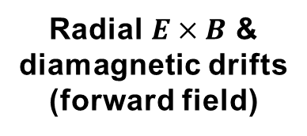
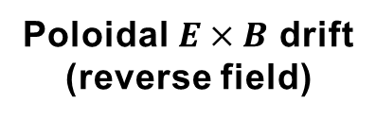
Field reversal experiments are invaluable for investigating SOL drifts
Field reversal experiments are the best way to investigate drift effects
$E_{r}$ tends to point toward island O-point due to radial $T_{e}$ falloff^{1,2} → $v_{E,θ}$ transports particles poloidally about island O-point
$E_{θ}$ points toward nearest divertor target → $v_{E,r}$ transports particles across island flux surfaces
$v_{dia}$ largely vertical and non-resonant with helical island chain → little direct effect on particle/heat transport, but can affect SOL currents
Radial $E×B$ & diamagnetic drifts (forward field)
Poloidal $E×B$ drift (forward field)
Poloidal $E×B$ drift (reverse field)
¹T. Barbui et al., NF 60 106014 (2020)
²E. Flom et al., submitted to NF

Slide 4
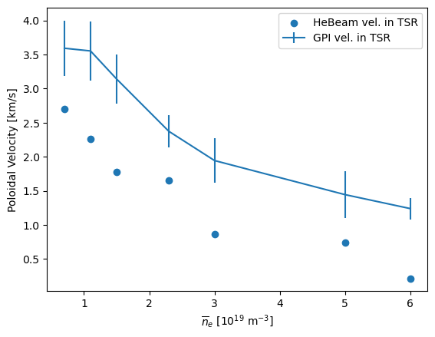
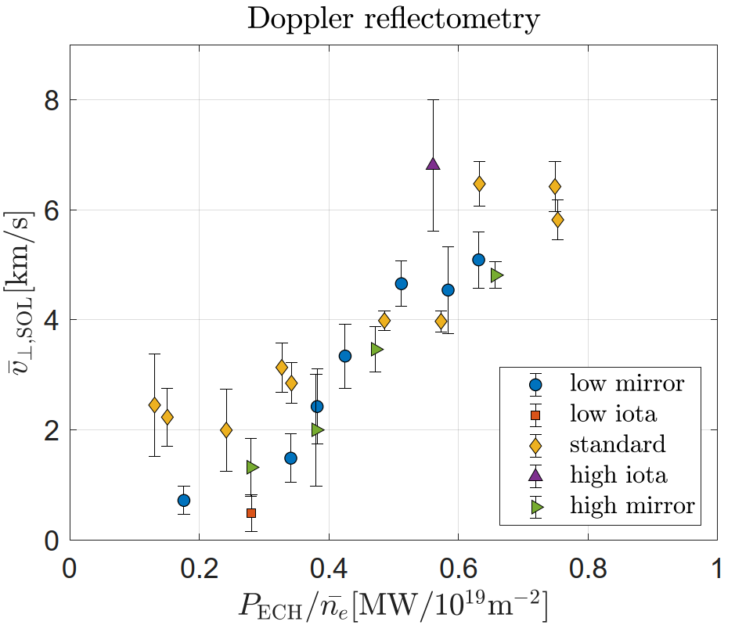
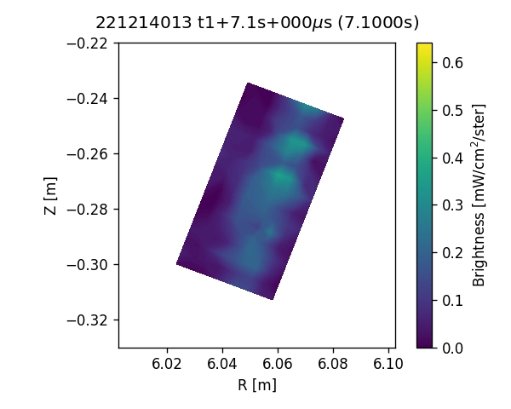
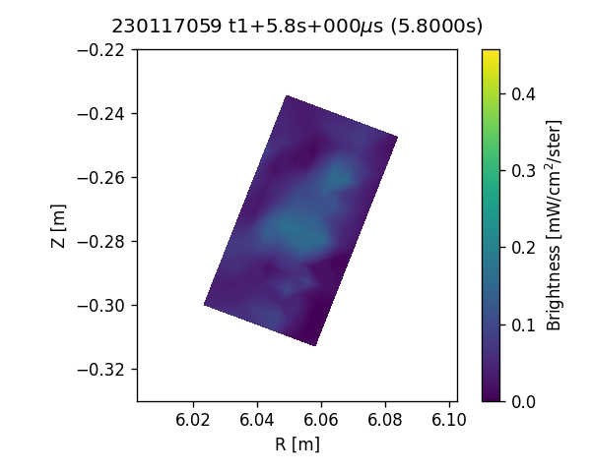
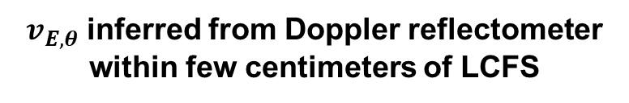

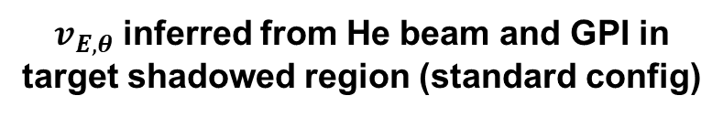
Multiple diagnostics observe poloidal $E×B$ drift flows
Multiple diagnostics find evidence for $v_{E,θ}=0.5−7 {\text{km}}/{\text{s}}$
  Gas puff imaging: from motion of gas puff emission
  He beam: from $T_{e}$ profile assuming $φ=3T_{e}$
  Doppler reflectomer: from Doppler shift of microwaves reflected off density fluctuations
$v_{E,θ}$ decreases with ${\overline{n}}_{e}$ and increases with power
$v_{E,θ}$ inferred from Doppler reflectometer within few centimeters of LCFS
$v_{E,θ}$ inferred from He beam and GPI in target shadowed region (standard config)
GPI forward field
(2 MW, 4 × 10¹⁹ m⁻²)
GPI reverse field
(2 MW, 3 × 10¹⁹ m⁻²)
[Data provided by M. Maragkoudakis & D. Carralero]
[Data provided by A. von Stechow, S. Ballinger, & E. Flom]

Slide 5
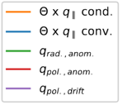
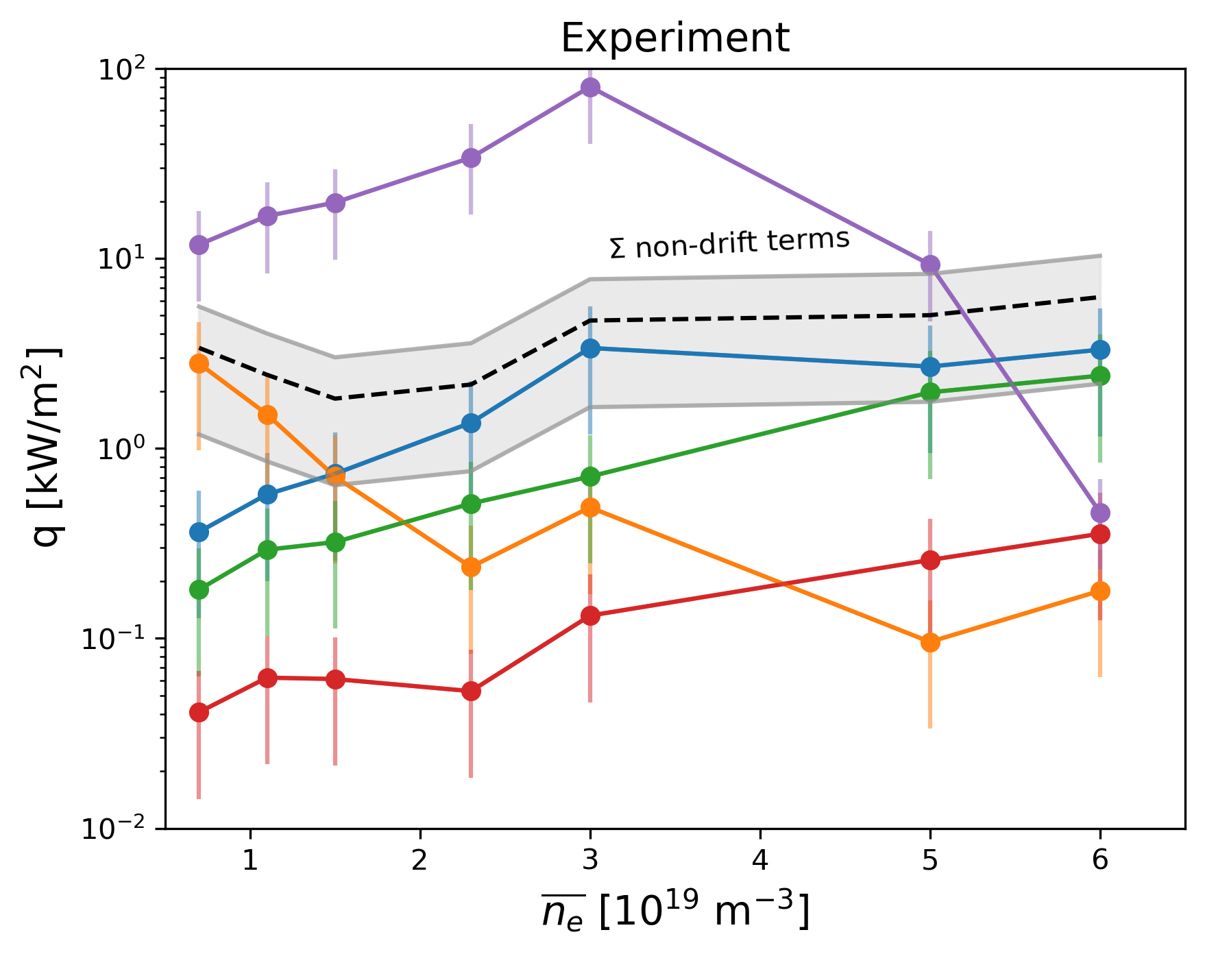
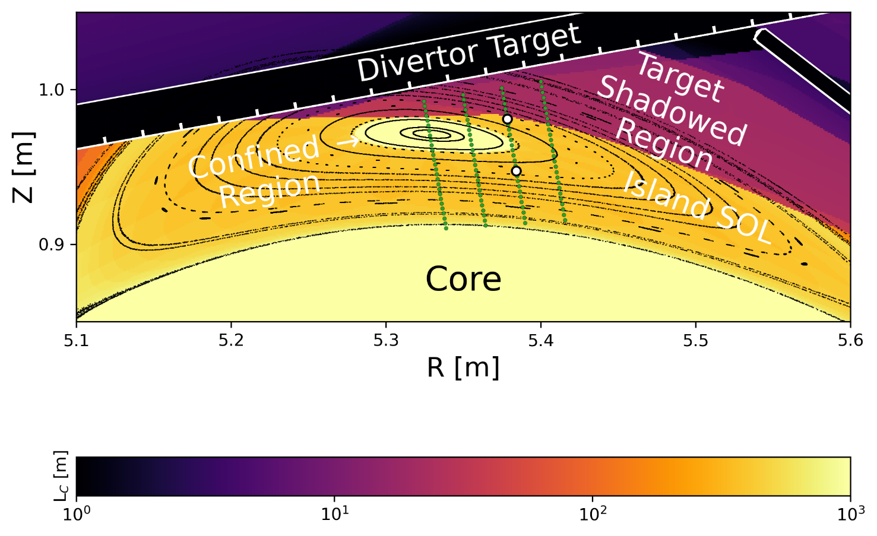
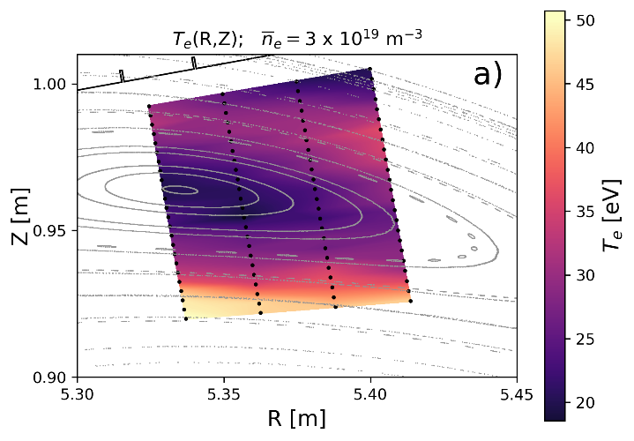
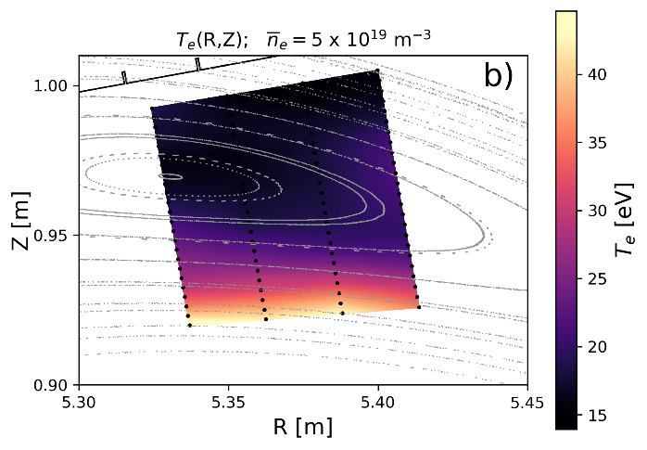


SOL transport transitions from a drift-dominated to an anomalous-dominated regime above a critical density
He beam used to evaluate relative magnitude of heat transport mechanisms within island
Future outlook:
fine density and power scan in transition region
Low density: hollow $T_{e}$ profile due to strong drift transport
Higher density: radial $T_{e}$ profile due to radial transport
  [E. Flom et al. APS Invited Talk and Submission to NF]

Slide 6
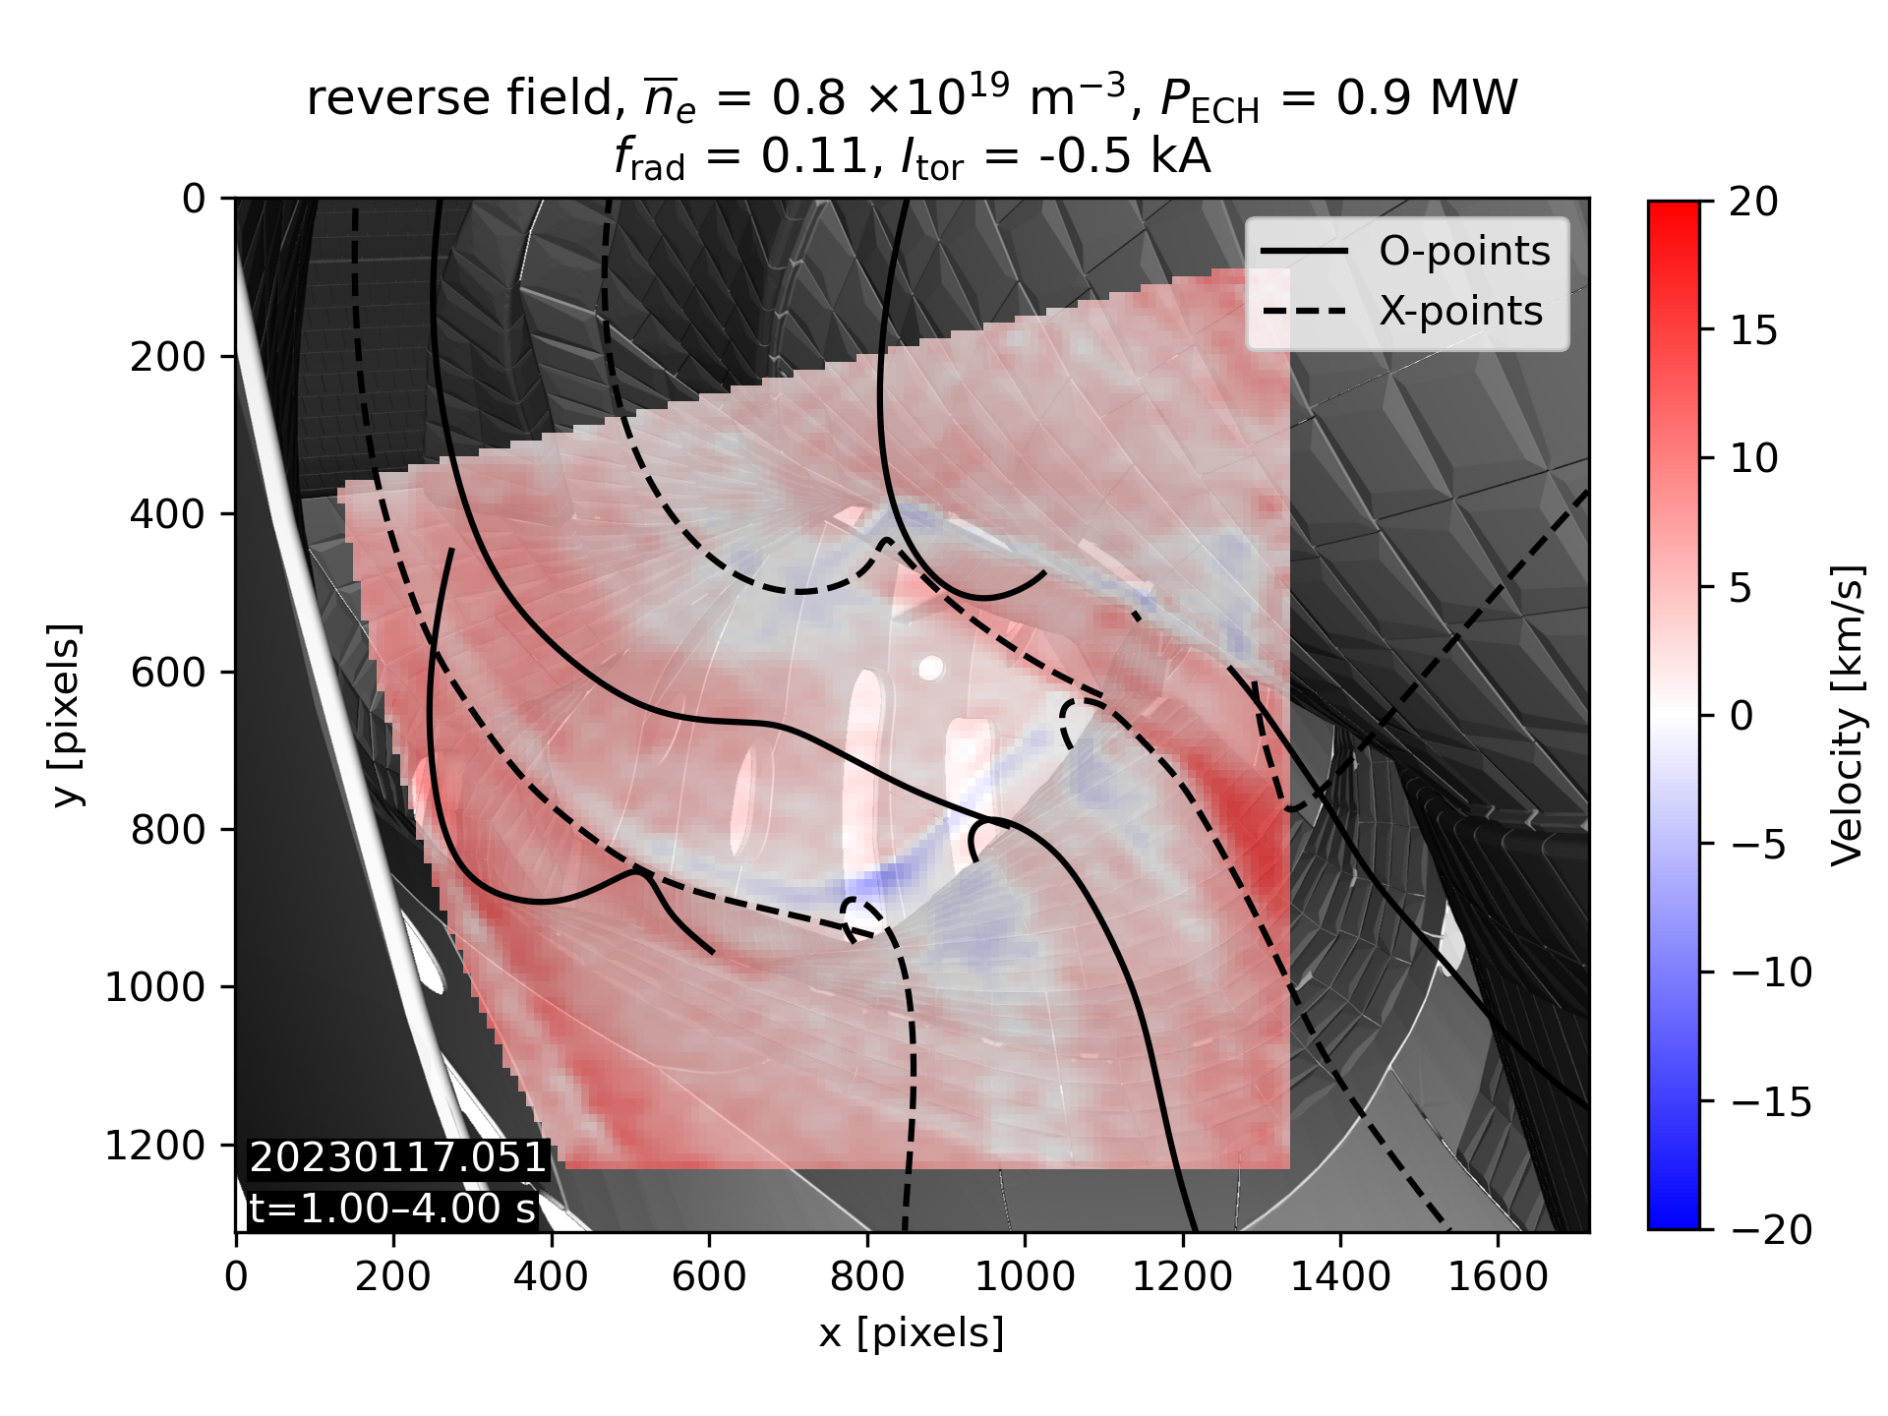
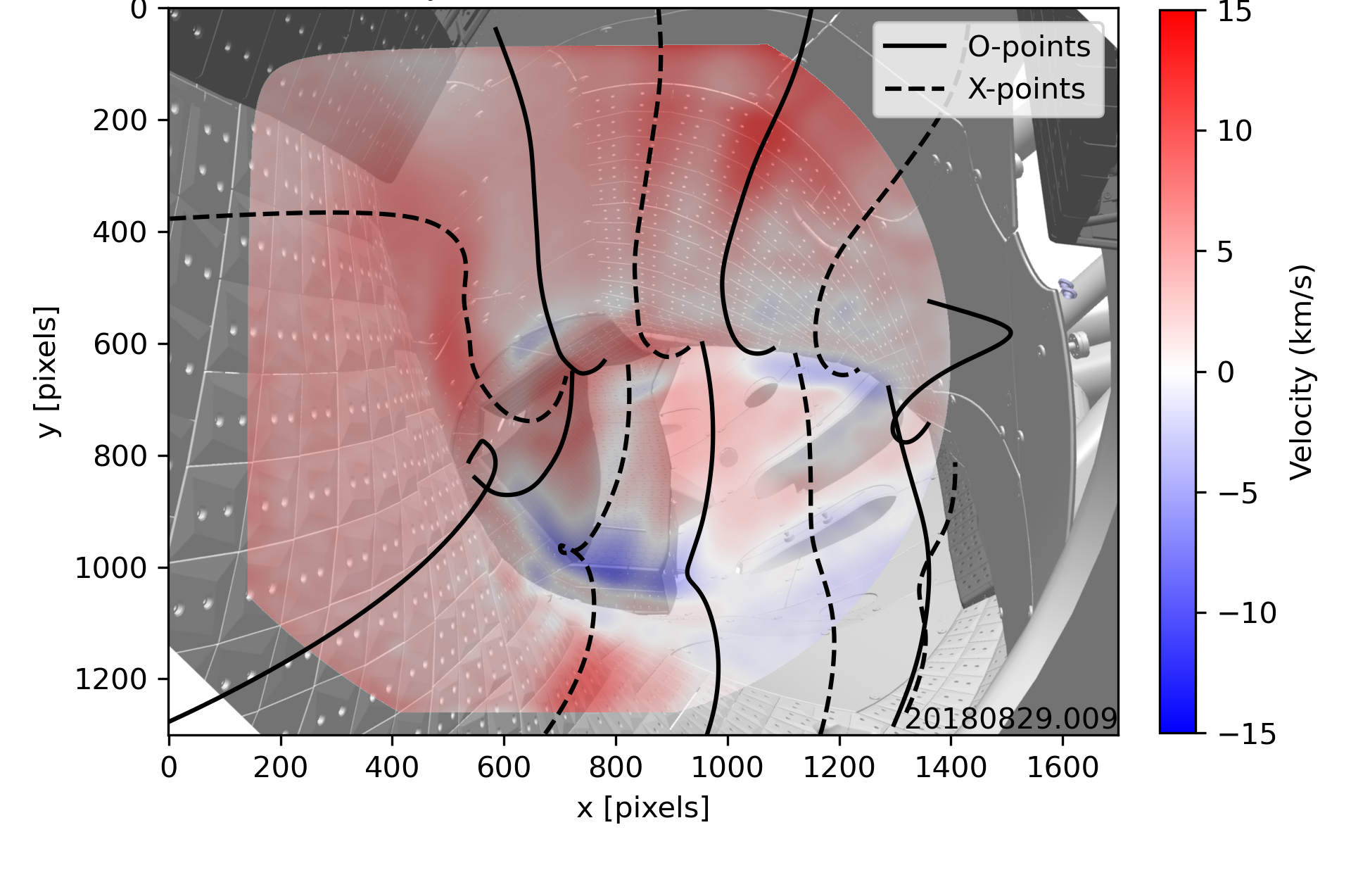
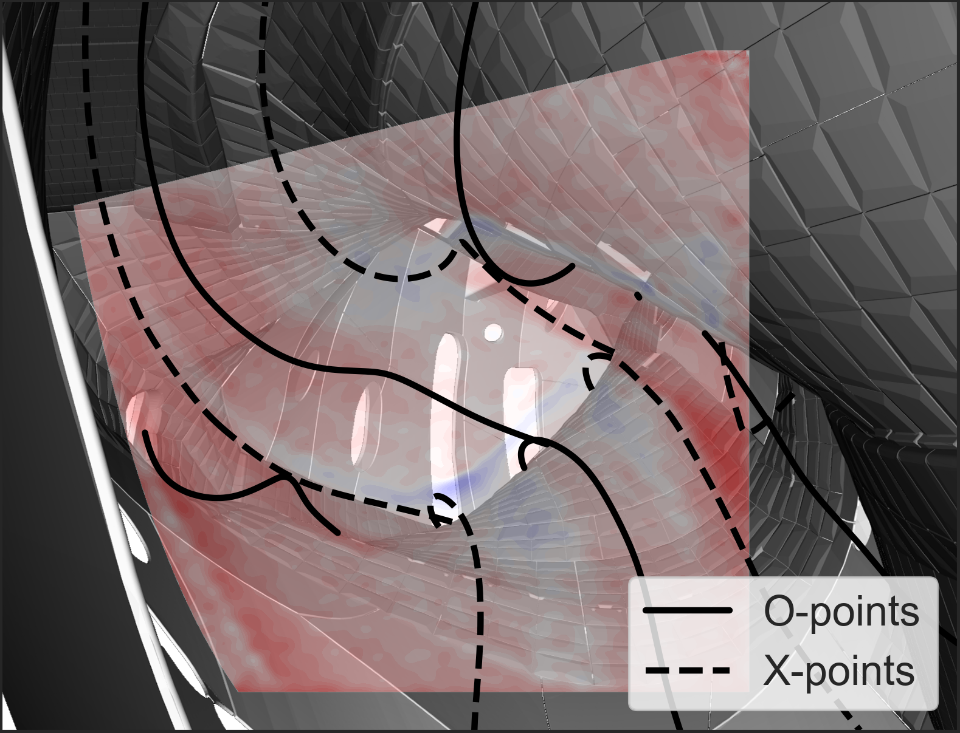


Drift effects on parallel flows are weaker in standard configuration than low iota
At low density, large drift velocity produces a near-unidirectional $v_{∥}$ throughout SOL
Low-iota ($L_{c}$ is 1.5x larger than standard)
Standard configuration
forward field, ${\overline{n}}_{e}=1.9×{10}^{19} {\text{m}}^{−3}$
20230117.051
t=1.00–4.00 s
Future outlook:
ultra-low density experiments in high-iota to determine whether unidirectional flow requires even lower densities than standard
Near-unidirectional flow¹ requires much lower ${\overline{n}}_{e}$ in standard than low iota → indirect evidence that drift effects get weaker with decreasing $L_{c}$
[Data provided by V. Perseo & M. Kriete]
¹D. M. Kriete et al., NF 63 026022 (2023)

Slide 7
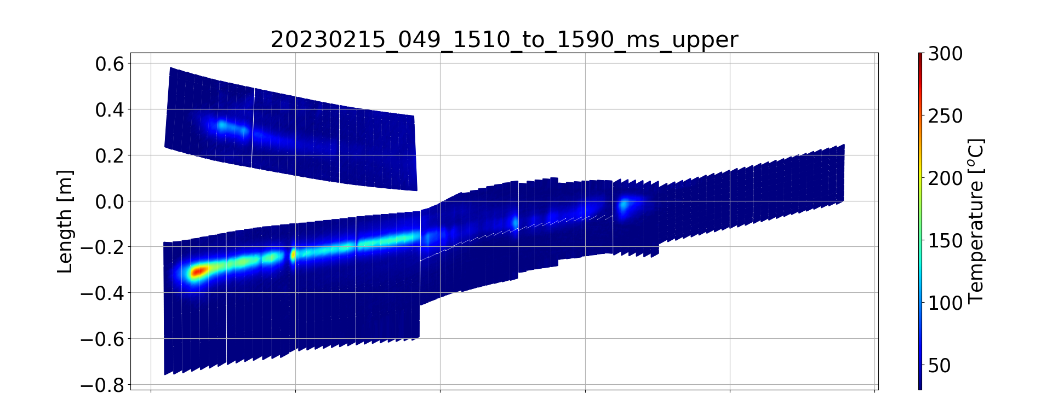

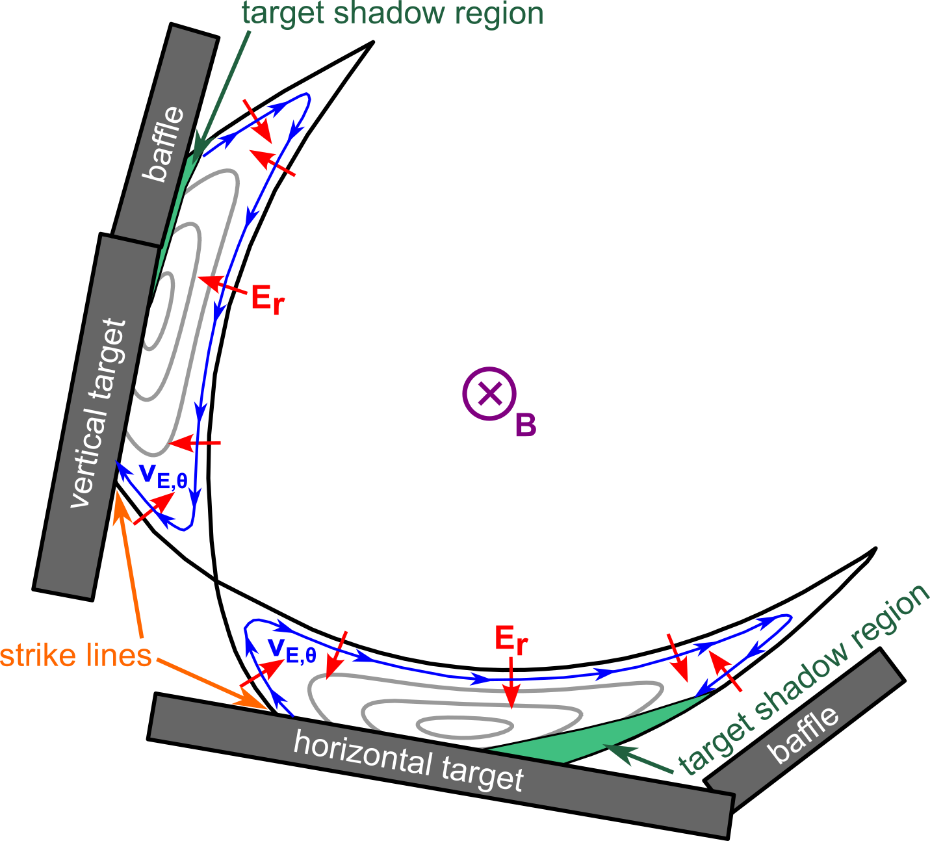


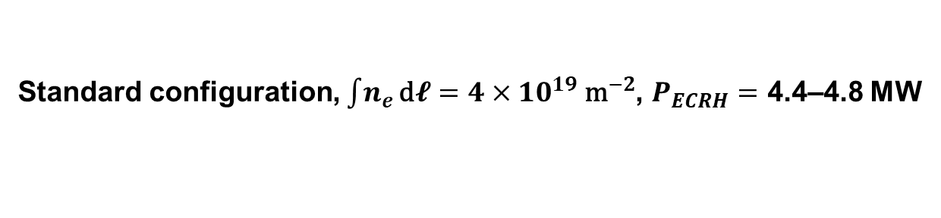
Divertor up/down heat flux asymmetries are consistent with poloidal $E×B$ drift transport
Standard configuration, $\int{n_{e}}\text{d}𝓵=4×{10}^{19} {\text{m}}^{−2}$, $P_{ECRH}=$ 4.4–4.8 MW
Forward field
Reverse field
upper targets
upper targets
lower targets
lower targets
Asymmetries consistent with drift picture in low-iota¹
[Data provided by Y. Gao]
¹K. C. Hammond et al., PPCF 61 125001 (2019)

Slide 8
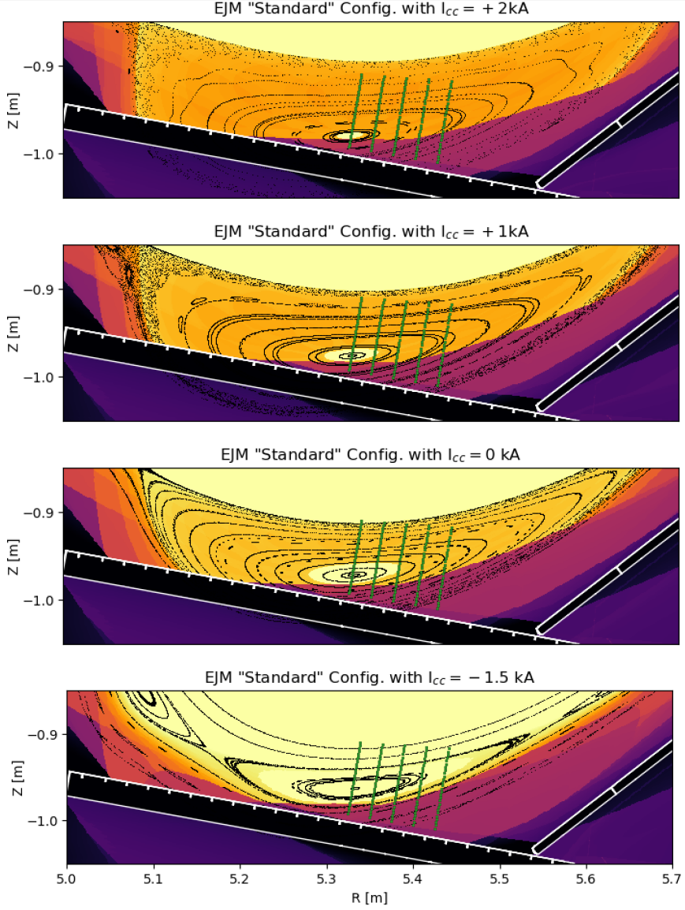
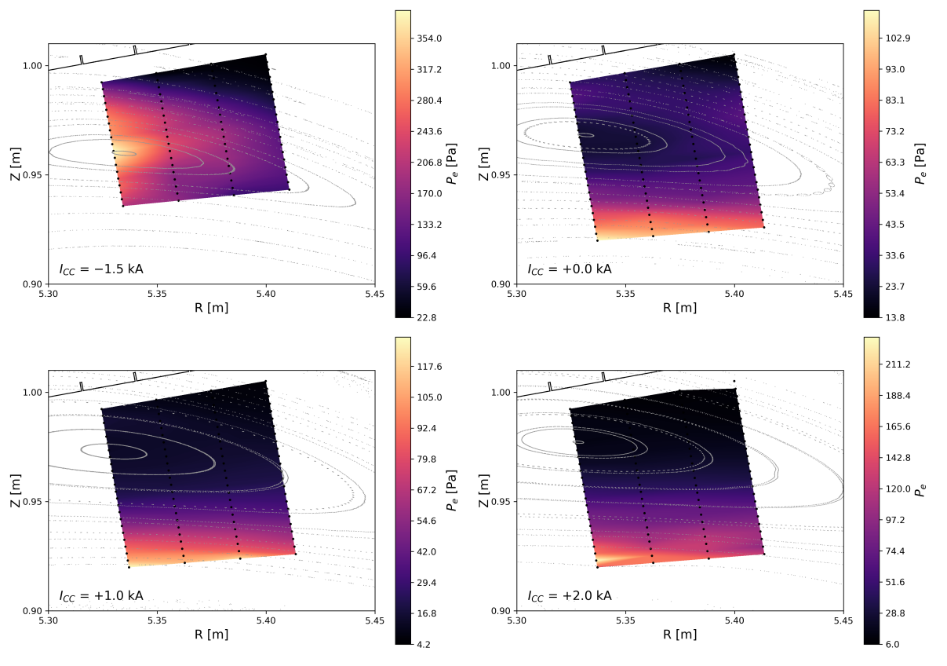
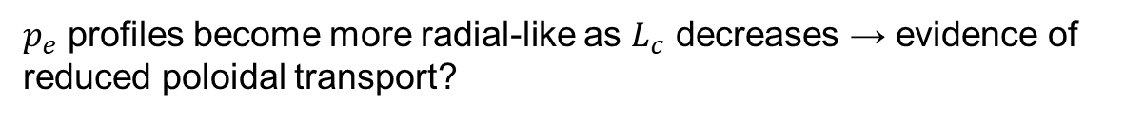

Increasing island size and/or decreasing connection length causes $p_{e}$ profiles to become more radial-like
Pressure minimum at O-point
Pressure peak at O-point
Future outlook:
finer control coil scans in the -1 to +1 kA range to probe transition between different profile shapes in more detail
Decreasing $L_{c}$ (~500 m → ~100 m)
Radial pressure profile
Radial pressure profile
10/10 island
$p_{e}$ profiles become more radial-like as $L_{c}$ decreases → evidence of reduced poloidal transport?
[Data provided by E. Flom]

Slide 9
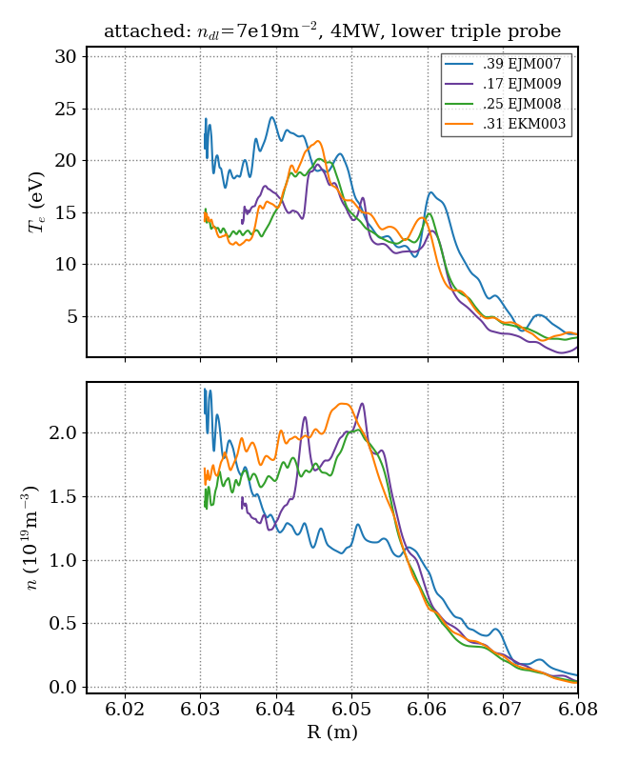
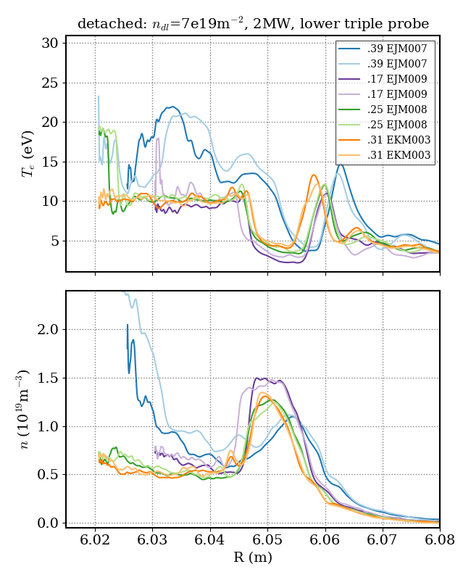
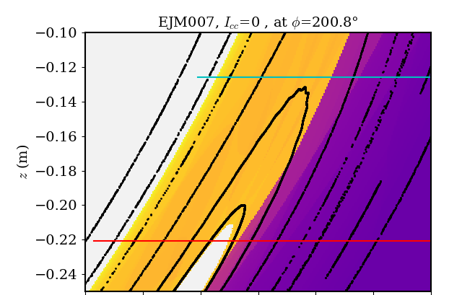
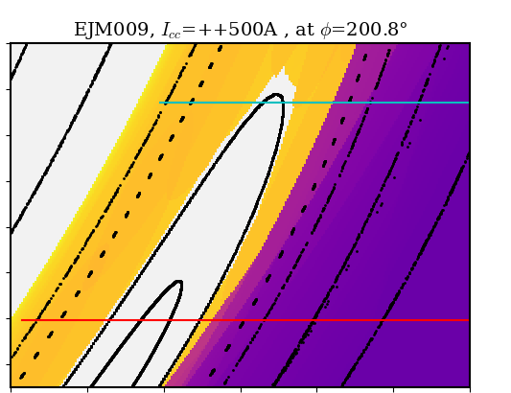
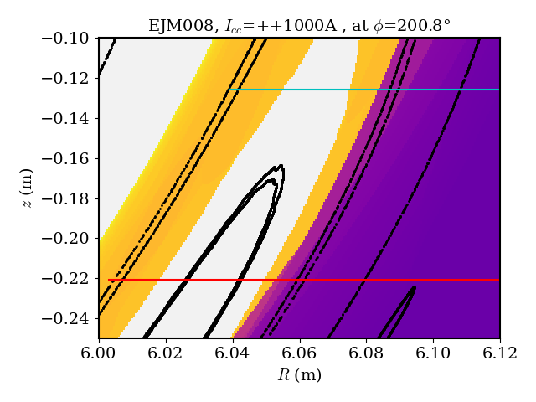
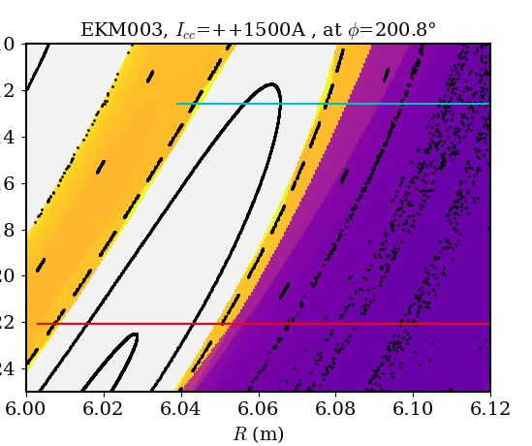



Increasing size of the closed field line region around the island O-point flattens $n_{e}$ and $T_{e}$ profiles upstream of divertor at high density
MPM profiles (attached)
MPM profiles (detached)
Connection length distribution during scan of confined region size
Smallest (standard)
2nd smallest
Future outlook:
largest jump occurs between two smallest sizes → future experiments should use finer resolution steps in the $I_{cc}=0–500 \text{A}$ range
increasing confined region size
Probe path
Probe path
2nd largest
largest
Flat $n$ & $T_{e}$ profiles in large closed field line region
$n$ peaks outside confined region
Probe path
Probe path
increasing confined region size
[Data provided by C. Killer]

Slide 10
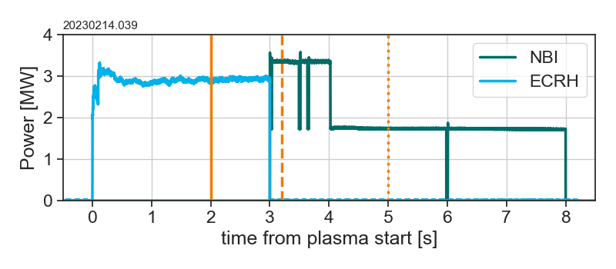
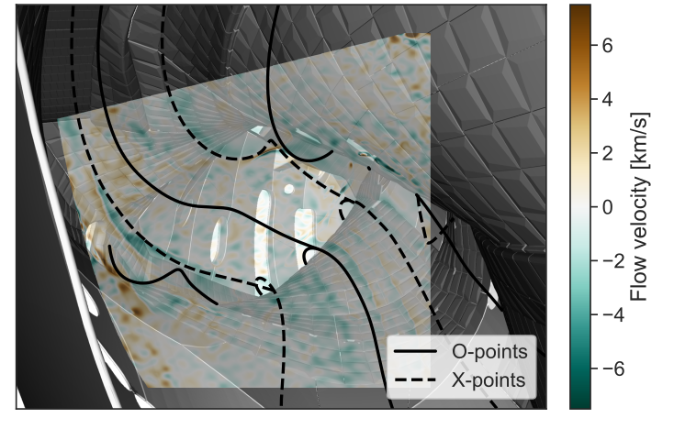
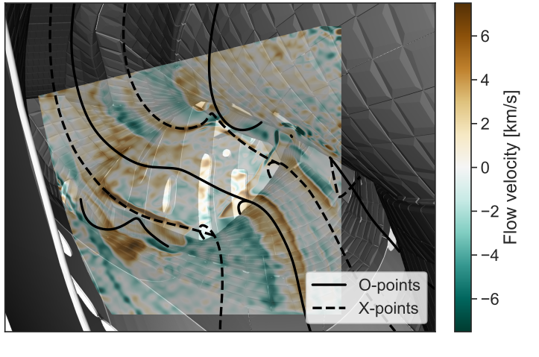
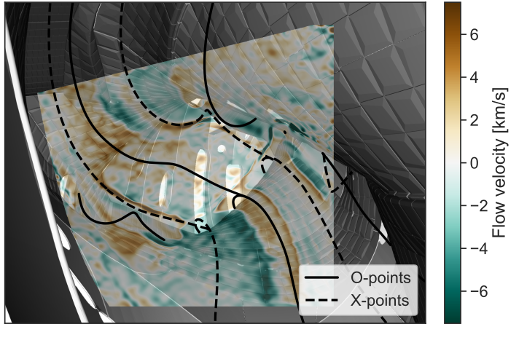
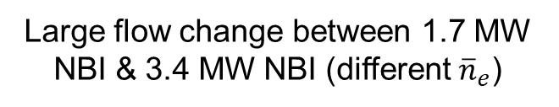
SOL flows are insensitive to type of heating (ECRH vs NBI)
Comparison between ECRH and NBI with similar heating powers
t1: only ECRH
t2: 2 NBI sources, one in CIS field of view
t3: 1 NBI source, not in CIS field of view
t1
t2
t3
Little change in flows between 3.4 MW NBI & 3 MW ECH
Large flow change between 1.7 MW NBI & 3.4 MW NBI (different ${\overline{n}}_{e}$)
Similarly large change in flows between 1.7 MW NBI & 3 MW ECH
t2 – t1
t3 – t2
t3 – t1
NBI SOL region
NBI does cause change in SOL carbon radiation localized to beam region
[Data provided by V. Perseo]

Slide 11
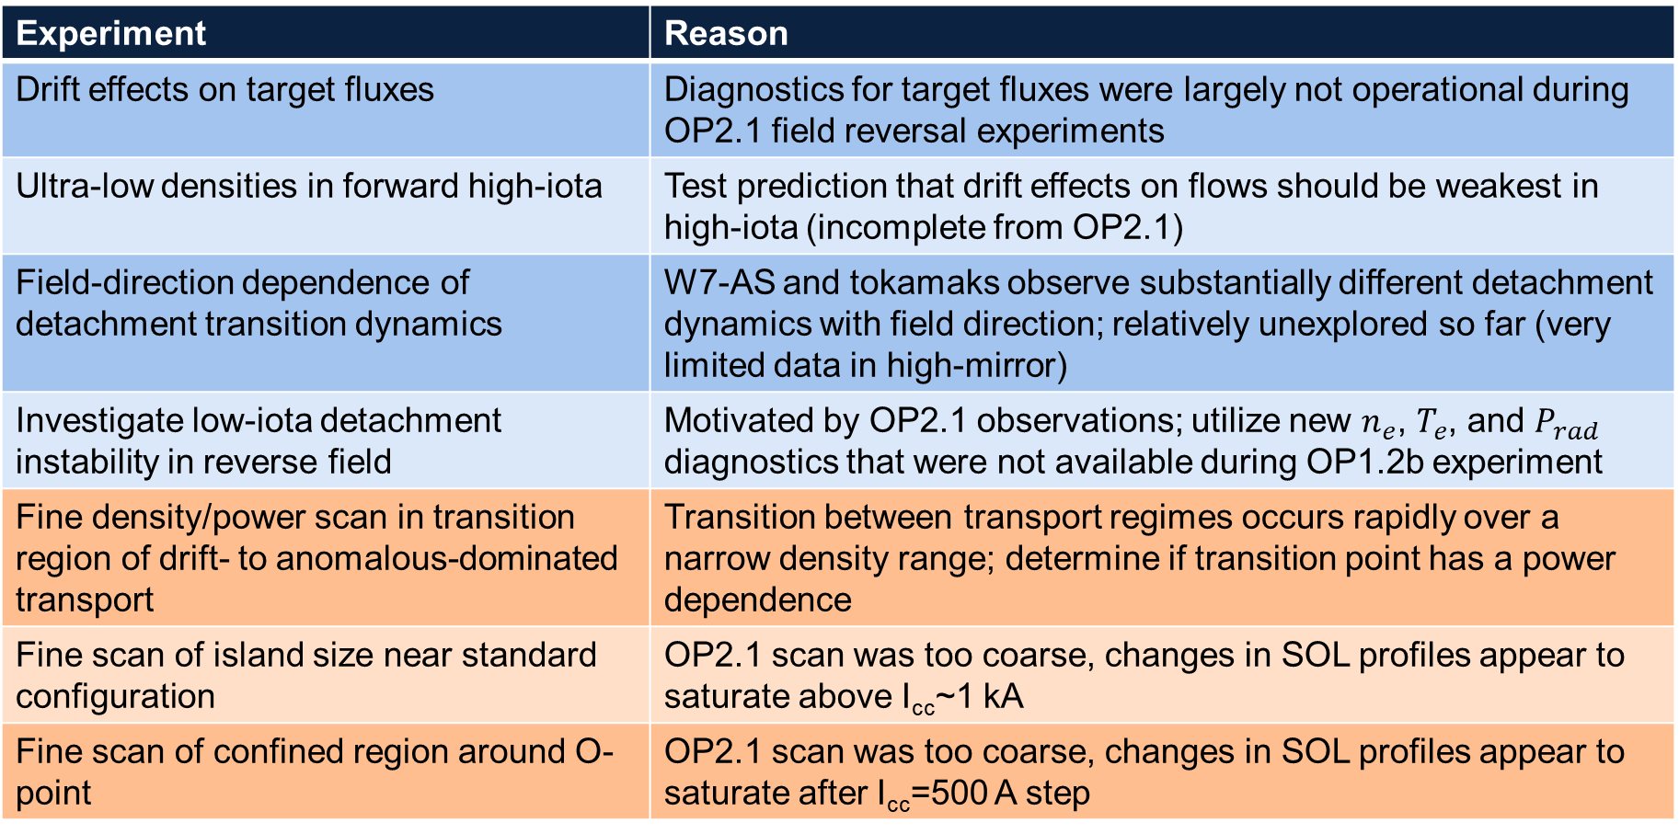
Future outlook for OP2.2/2.3 SOL transport experiments based on OP2.1 analysis so far (and missing OP2.1 data)
Experiment | Reason
Drift effects on target fluxes | Diagnostics for target fluxes were largely not operational during OP2.1 field reversal experiments
Ultra-low densities in forward high-iota | Test prediction that drift effects on flows should be weakest in high-iota (incomplete from OP2.1)
Field-direction dependence of detachment transition dynamics | W7-AS and tokamaks observe substantially different detachment dynamics with field direction; relatively unexplored so far (very limited data in high-mirror)
Investigate low-iota detachment instability in reverse field | Motivated by OP2.1 observations; utilize new $n_{e}$, $T_{e}$, and $P_{rad}$ diagnostics that were not available during OP1.2b experiment
Fine density/power scan in transition region of drift- to anomalous-dominated transport | Transition between transport regimes occurs rapidly over a narrow density range; determine if transition point has a power dependence
Fine scan of island size near standard configuration | OP2.1 scan was too coarse, changes in SOL profiles appear to saturate above I_{cc}~1 kA
Fine scan of confined region around O-point | OP2.1 scan was too coarse, changes in SOL profiles appear to saturate after I_{cc}=500 A step

Slide 12
Summary and future outlook
Large experimental database of multi-field SOL measurements across W7-X plasma parameter and magnetic configuration space is being developed
Gaps in the experimental SOL database
  Incomplete data on target fluxes (Langmuir probes, H-alpha cameras, IR cameras)
  Lack of upstream measurements
Future experiments to collect missing data and perform finer scans in regions showing interesting behavior
Many interesting observations so far regarding drifts, flows, and profiles → need to now move beyond characterizing SOL parameters toward developing comprehensive physics understanding of different transport mechanisms and how they scale
  Comparison with SOL codes is essential!
Additional SOL transport results that would not fit into main talk are in backup slides!

Slide 13
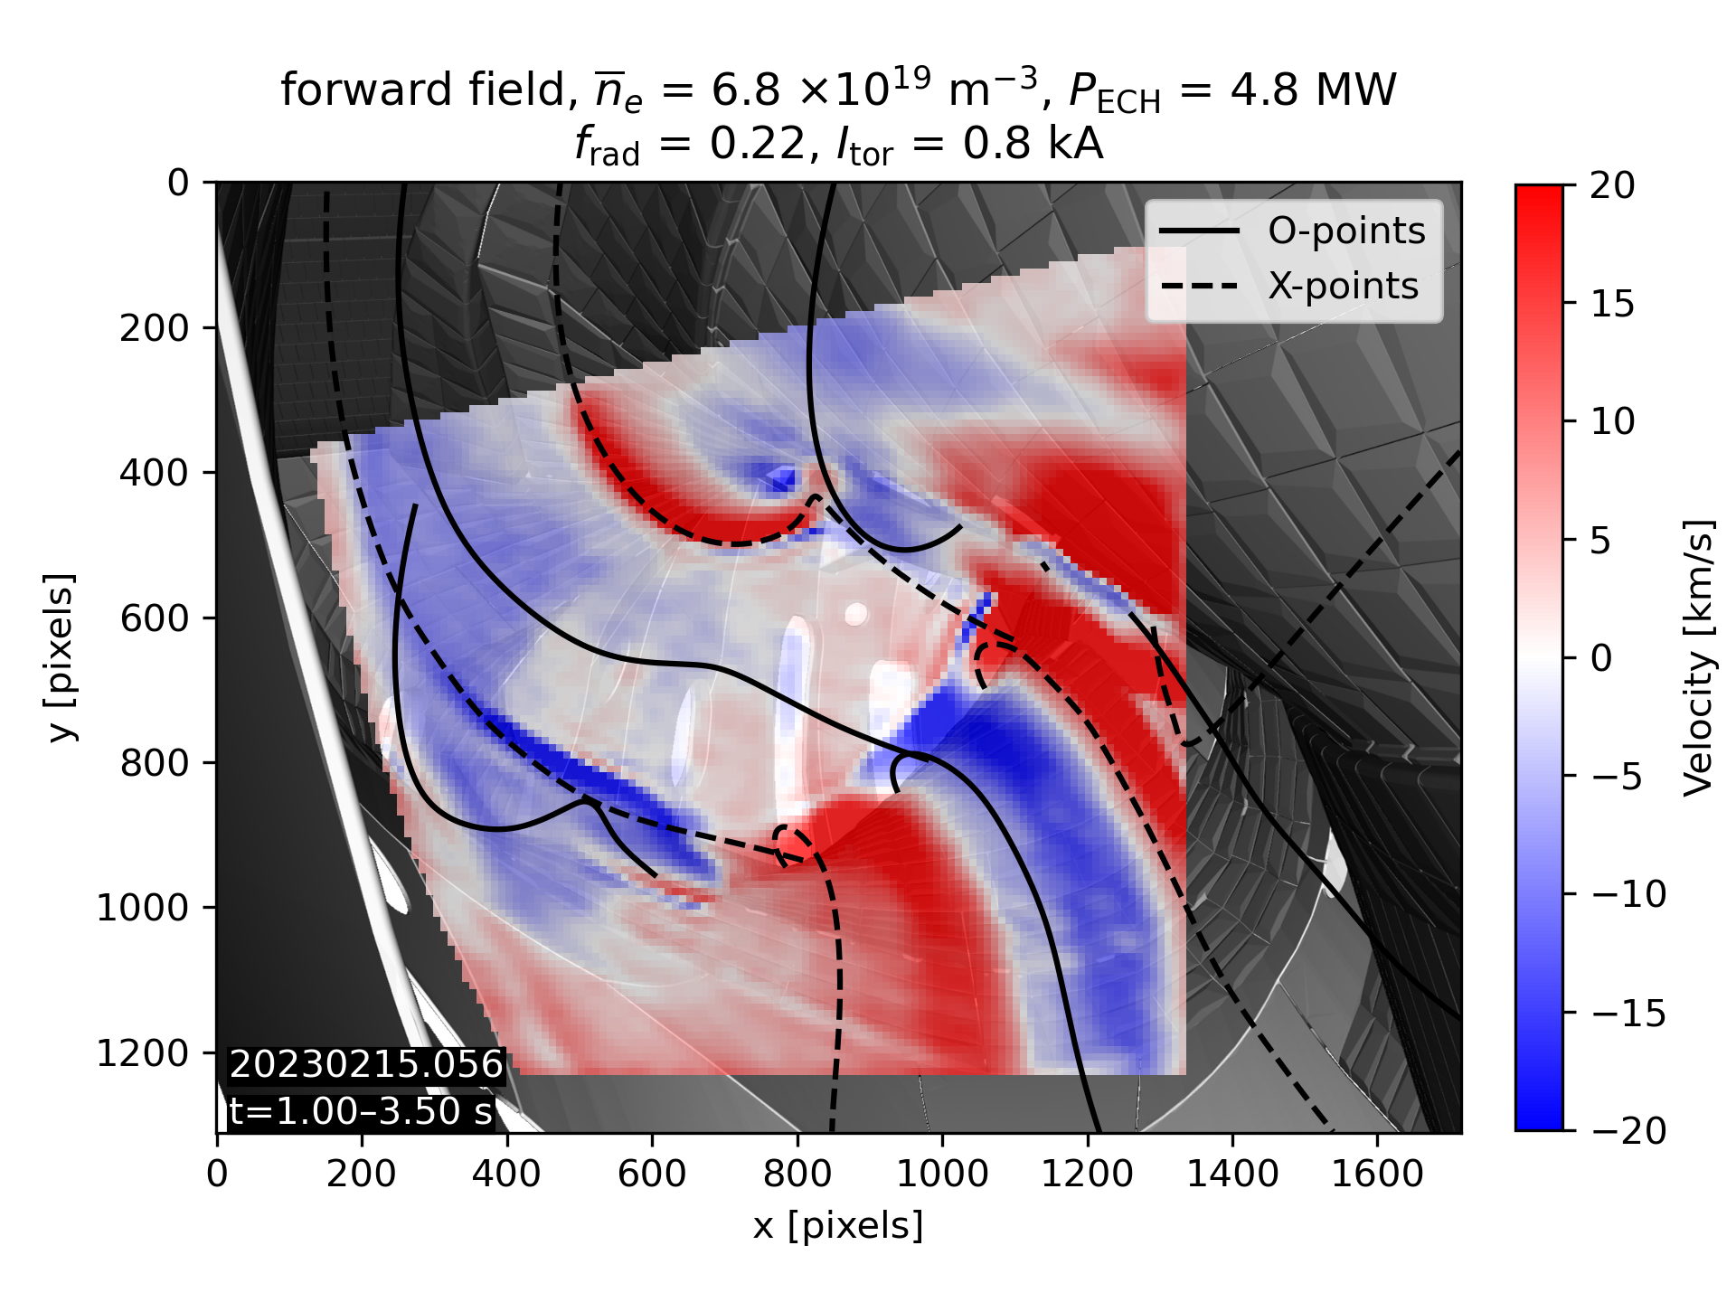
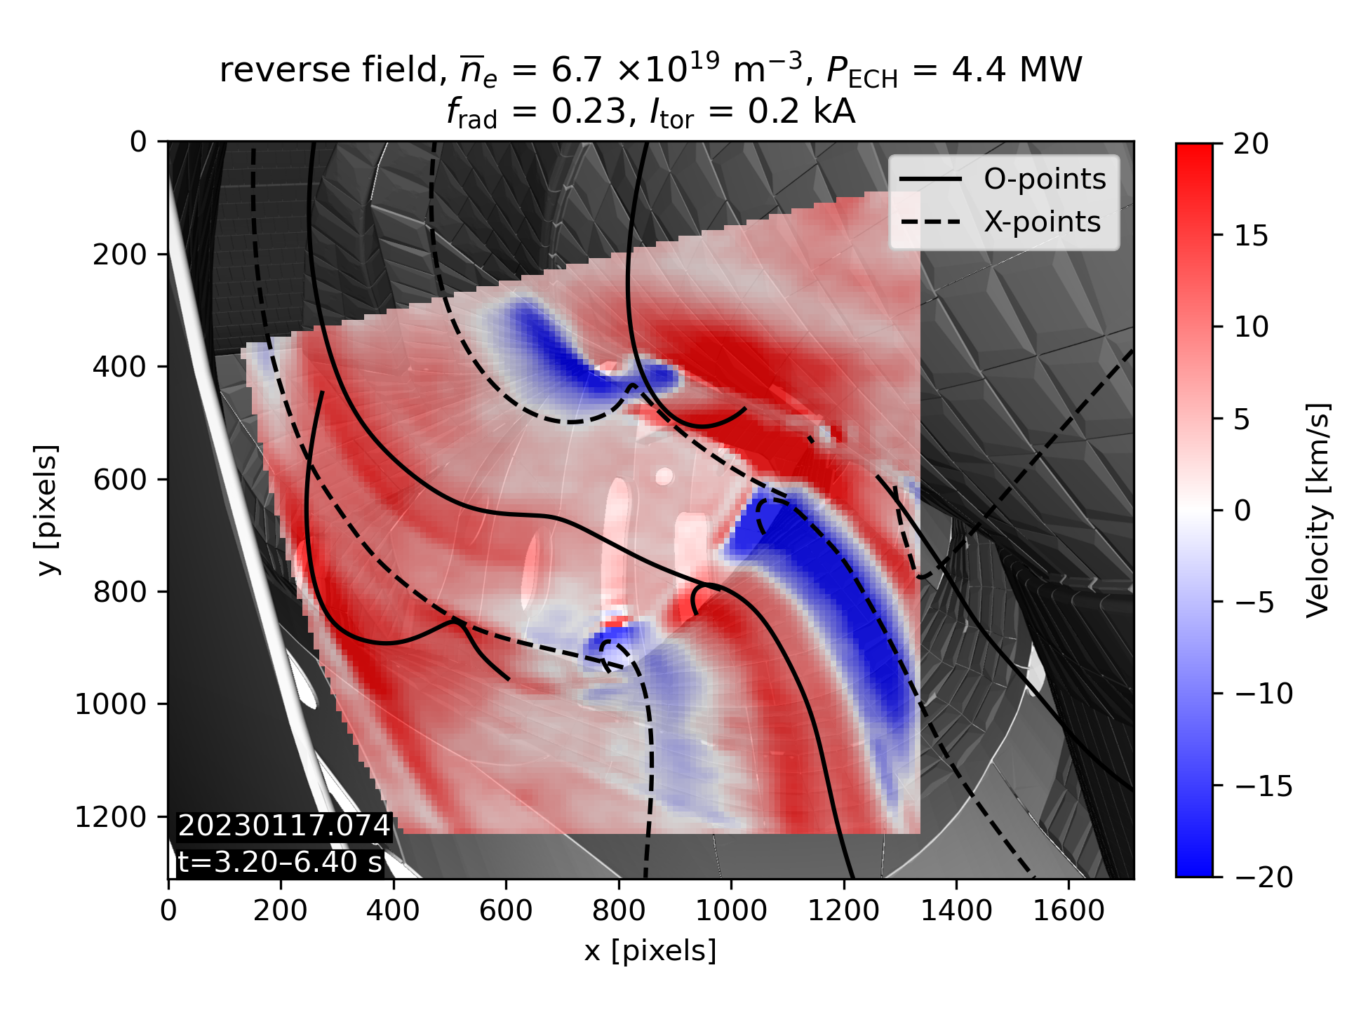


SOL parallel flows strongly altered by drifts even at high density where drift effects on target fluxes are small
Substantial change in SOL counter-streaming flow pattern upon field reversal is observed by coherence imaging spectroscopy (standard configuration)
20230215.056
t=1.00–3.50 s
20230117.074
t=3.20–6.40 s
complete flow reversal
flow bundles shift position
[Data provided by V. Perseo & M. Kriete]

Slide 14



$n_{e}$ and $T_{e}$ profiles show clear signs of drift effects in high mirror but not high iota
High-iota configuration
High-mirror configuration
Dark color → forward field
Light color → reverse field
High iota: slightly higher $n_{e}$ in forward field, otherwise no clear drift effects
High mirror: higher $n_{e}$ and $T_{e}$ in forward field, large $n_{e}$ and $T_{e}$ peaks only observed in forward field
[Data provided by C. Killer]

Slide 15




Divertor up/down heat flux asymmetries are consistent with poloidal $E×B$ drift transport (toroidally averaged profiles)
Forward field
Reverse field

Slide 16



Magnitude of different heat transport mechanisms is calculated using thermal He beam
Two test points taken from 2D viewing window of helium beam diagnostic
Same flux surface, known magnetic connection length between them → $∇_{∥}$
Interpolate within 2D map to get $∇_{⊥}$
Solved by EMC3
Same process done for experimental data AND synthetic EMC3 $T_{e}$ maps
  → Differences in profiles explainable only by a missing drift term?
NOT in EMC3

Slide 17








Size of the closed field line region around the island O-point has weaker effect on $n_{e}$ and $T_{e}$ profiles at low density
He beam profiles thru O-point
MPM profiles near O-point
He beam path
LCFS
increasing confined region size
divertor
$T_{e}$ increase outside confined region
Confined region size has little effect on $T_{e}$ profiles
LCFS
Bump in $n$ only for enlarged confined regions
Confined region size has little effect on $n$ profiles
divertor
increasing confined region size
[Data provided by E. Flom & C. Killer]

Slide 18



GPI and MPM measurements indicate small radial velocities
GPI velocity field
GPI average velocity in each column
MPM E_{pol} (different shot)
flow
A.D. Helgeland, J.M. Losada, O.E. Garcia
E_{pol} implies (small) inwards radial flow, ≈100m/s
Difficult to see radial motion in videos as faster poloidal motion dominates
Difficult to measure radial velocity with standard methods, so using new 3-point time-delay estimation method
Small radial flow in agreement with OP1.2b data + simulations¹ → small $D_{⊥,radial}$ in edge modelling
¹C. Killer et al., PPCF 62 085003 (2020)

Slide 19



High injected power significantly affects SOL flows and profiles
Substantial change in He beam electron pressure profiles at high power
3 MW ECRH
+ 5 MW NBI
3 MW ECRH
[Data provided by V. Perseo]
[Data provided by E. Flom]

