Slide 1
Island structure and turbulence in the scrape-off layer of Wendelstein 7-X: results from OP2.1
Sean Ballinger (sballin@mit.edu) on behalf of the W7-X team
Sean Ballinger | W7-X op2.1 results workshop 28.11.2023 | event.ipp-hgw.mpg.de/event/969/contributions/1509

Slide 2
Part 1: 3D profiles vs magnetic island details
Part 2: attempt at mapping GPI and MPM data
Part 3: SOL currents and modes/turbulence

Slide 3
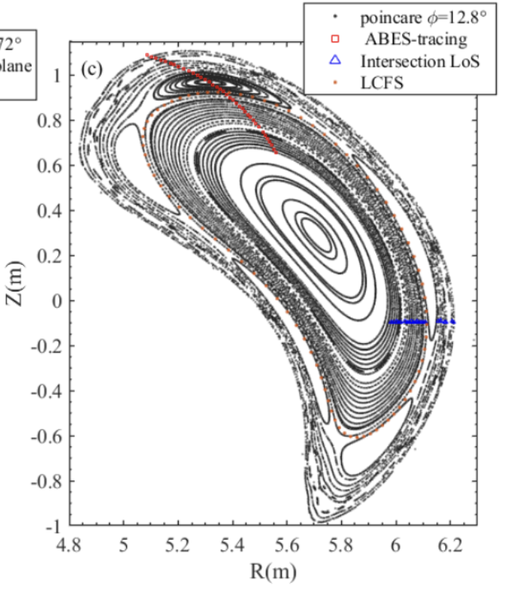
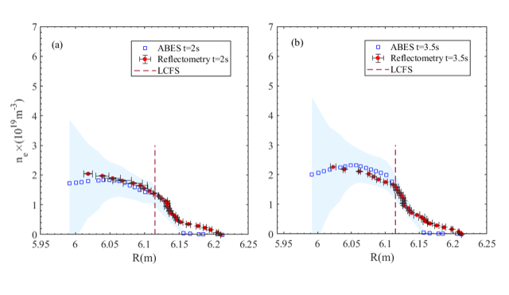
Good agreement between ICRH density profile reflectometer and Alkali Beam Emission Spectroscopy (ABES)
H.M. Xiang et al., Nuclear Science and Techniques (submitted), 2023

Slide 4
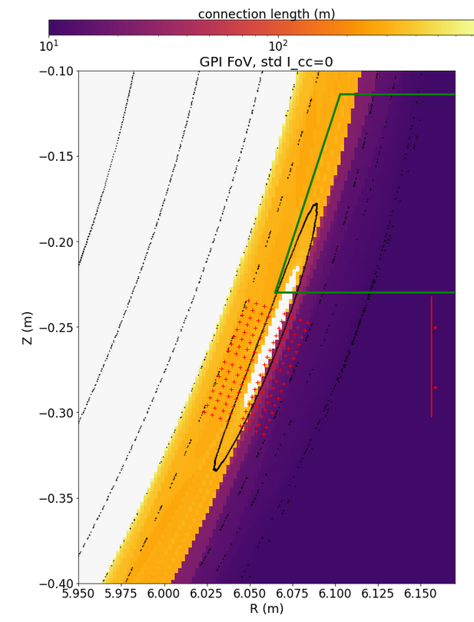
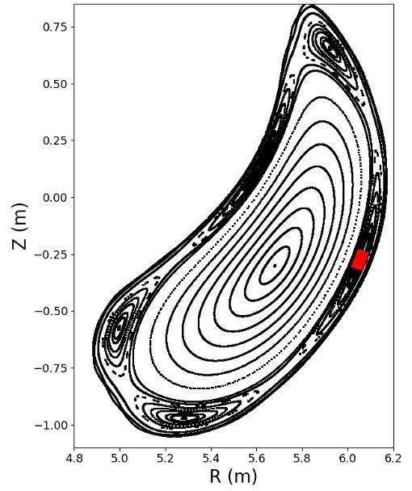
GPI and MPM provide complementary measurements of turbulence in the outboard island region of W7X
Standard magnetic configuration
MPM
sampling area
GPI nozzles
GPI with camera rotated 90º
GPI normal view

Slide 5
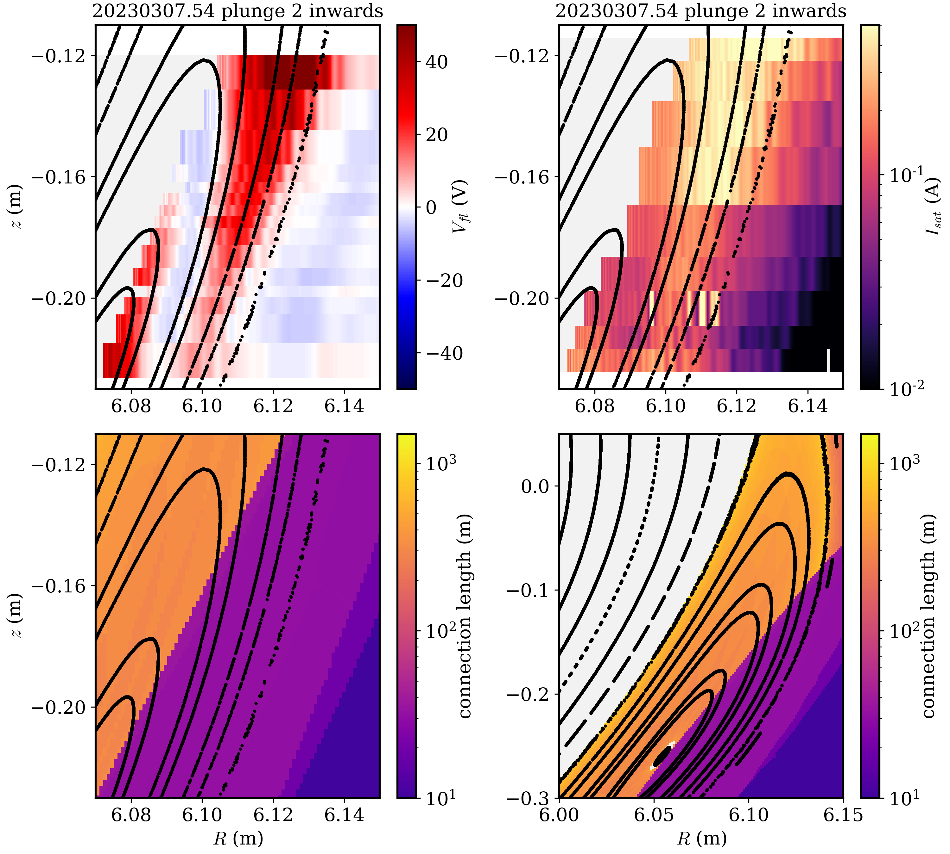
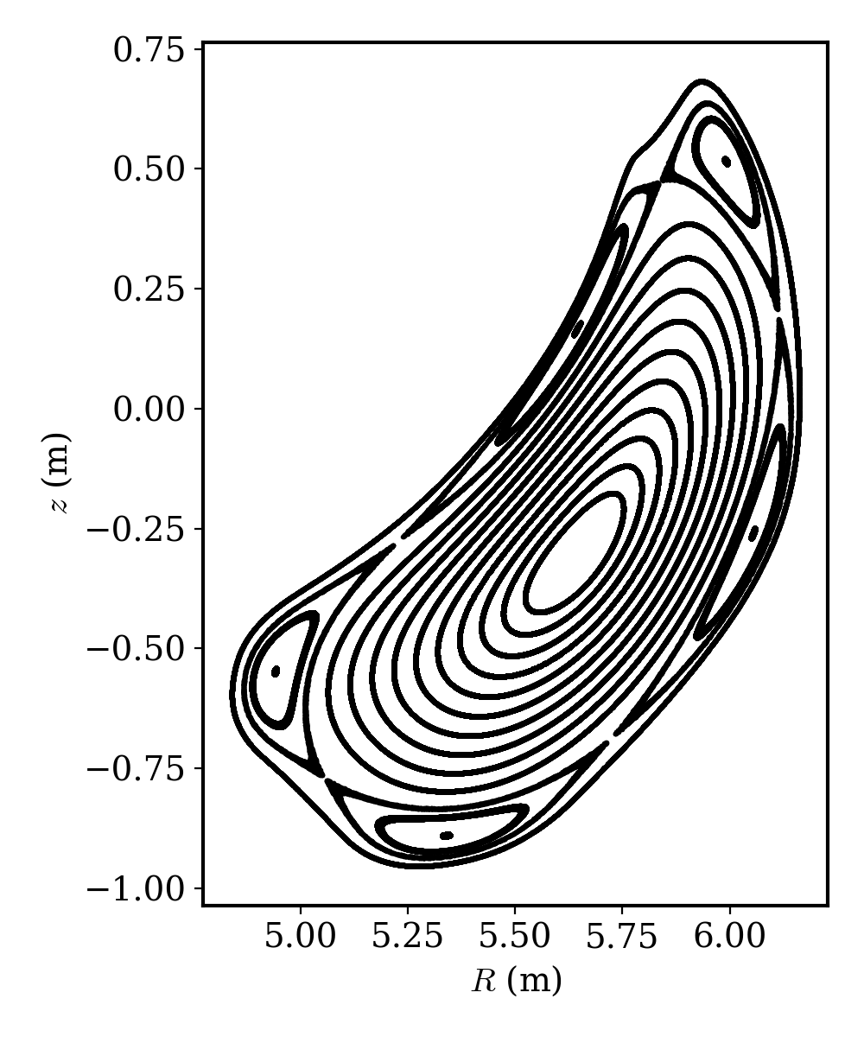
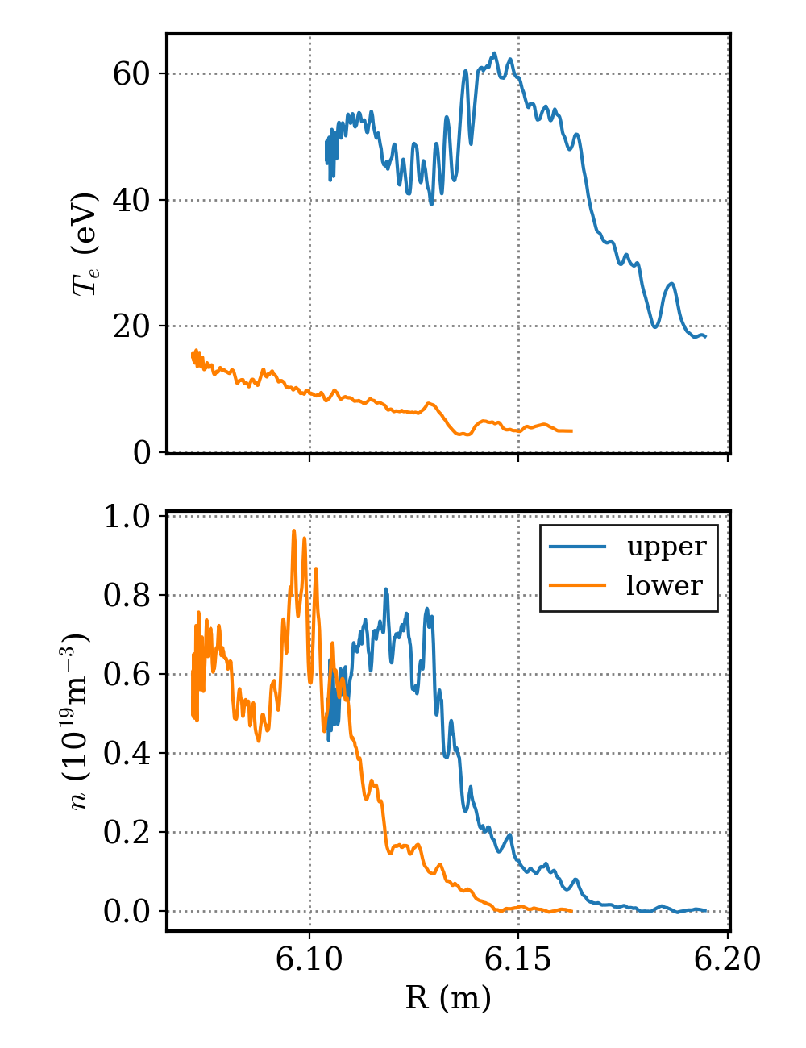
MPM finds that the island potential structure is aligned with flux surfaces
V_{fl} structure follows flux surface (outer island separatrix) rather than connection length transition!
MMG000+2520
I_{cc}=+1500A
Triple probe profiles
island separatrix
poloidal structure:
higher V_{fl} and T_{e} for upper pins (towards X point)
positive V_{fl} around island O point

Slide 6
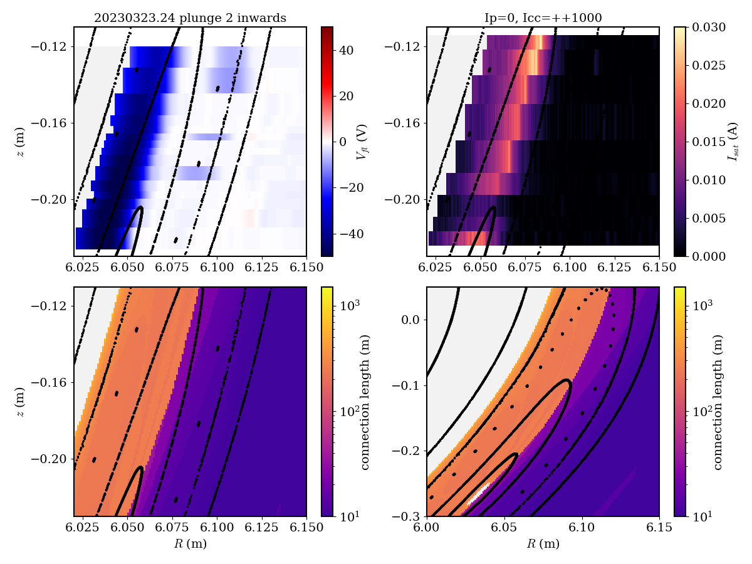
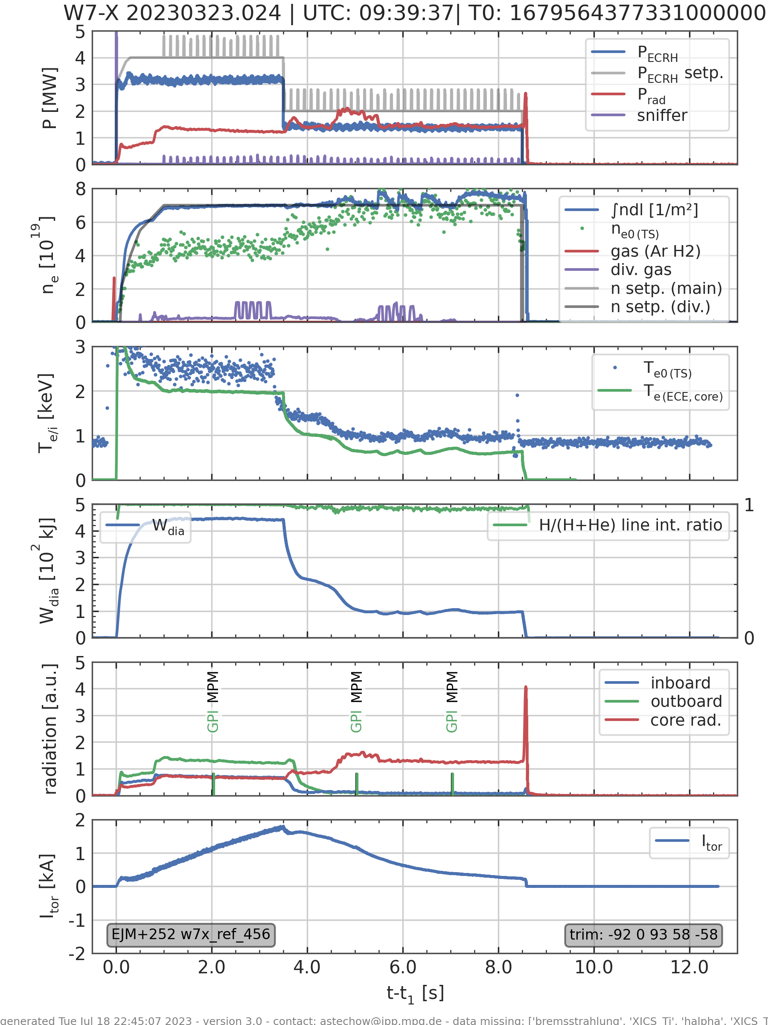
MPM: magnetic structure still important in far SOL of a small plasma
small / detached plasma with almost no SOL density left
still, a small but clearly localized Isat current is measured at the Lc transition

Slide 7
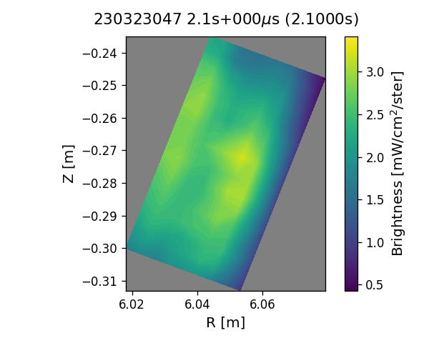
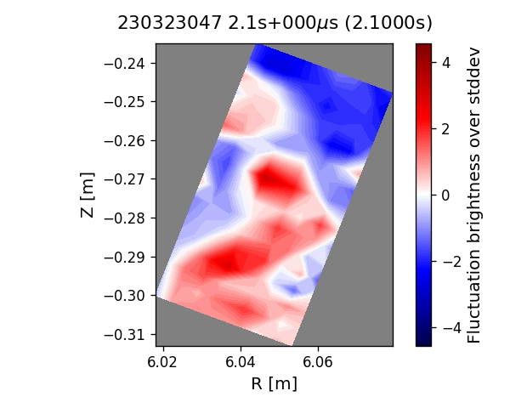

Poloidal motion is seen to dominate in GPI videos
Standard magnetic configuration
Original video
Background-subtracted
$$\frac{I−{\overline{I}}_{±50μs}}{std(I)}$$
LCFS

Slide 8
GPI finds consistent poloidal flow pattern near O-point and trend with toroidal current
Standard configuration
EJM007+2520 (340 puffs)
Island O-point
LCFS
Edge of closed field line region
Edge of closed field line region
LCFS
zig-zagging of blue/red boundary due to detector resolution

Slide 9
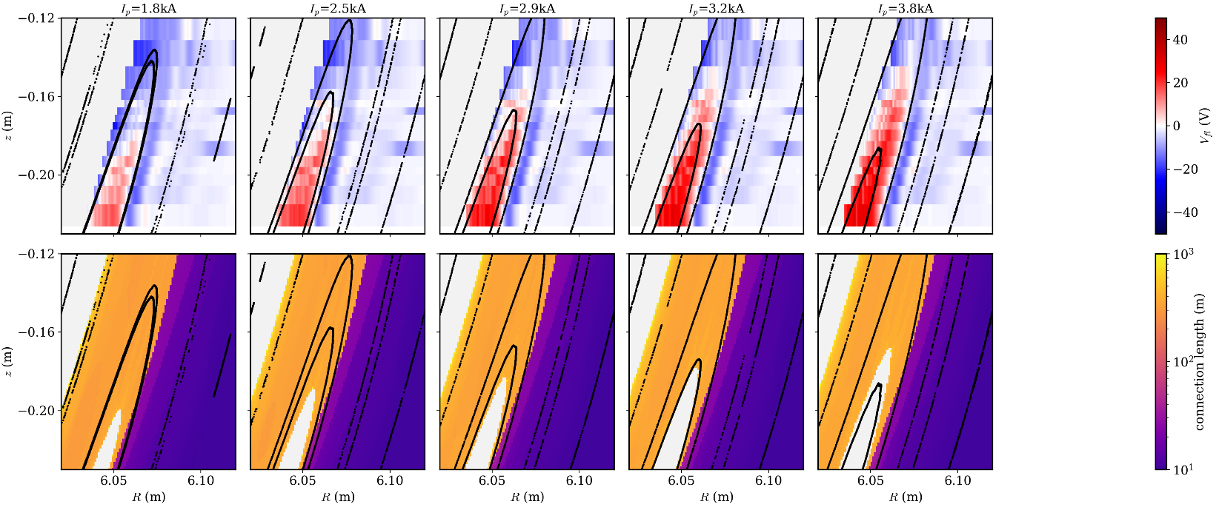
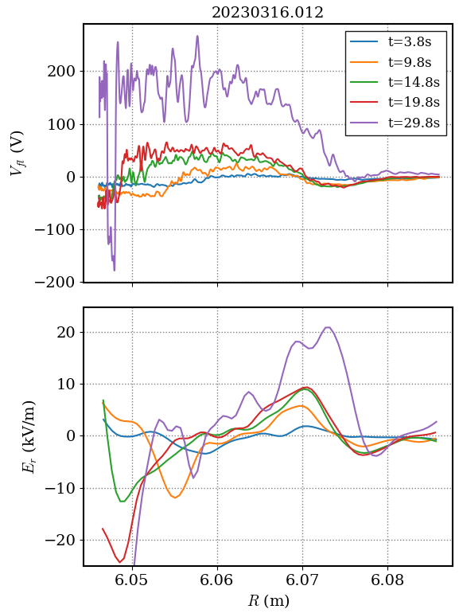
MPM confirms GPI observation of high poloidal velocities at high toroidal current
MPM confirms particularly high v_{pol} (~8km/s) for high I_{p} (10kA)
Size of MPM-measured potential structure and island confined region increase with Ip
size increases with I_{p}
closed field lines around island O point

Slide 10
GPI-observed poloidal velocities are due to ErxB drift: when toroidal field is reversed, poloidal velocities reverse
Standard configuration
EJM001+2520 (57 puffs)
Standard configuration, reversed field
EJM016-2520 (40 puffs)
Island O-point
Edge of closed field line region
Edge of closed field line region

Slide 11
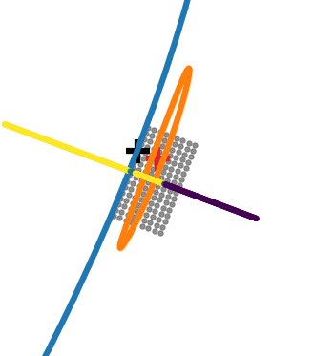
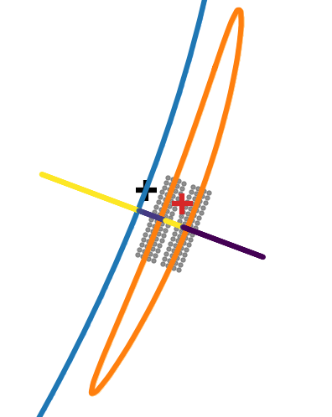
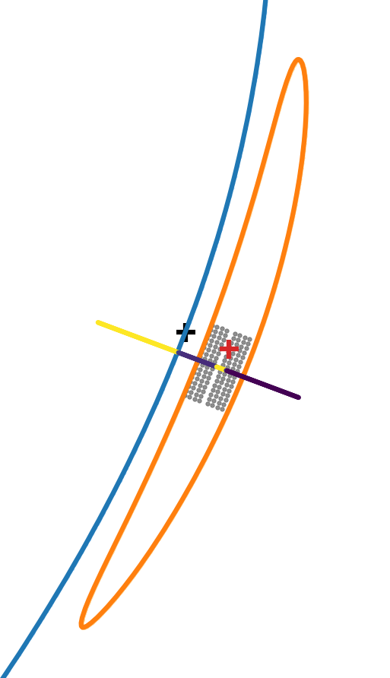
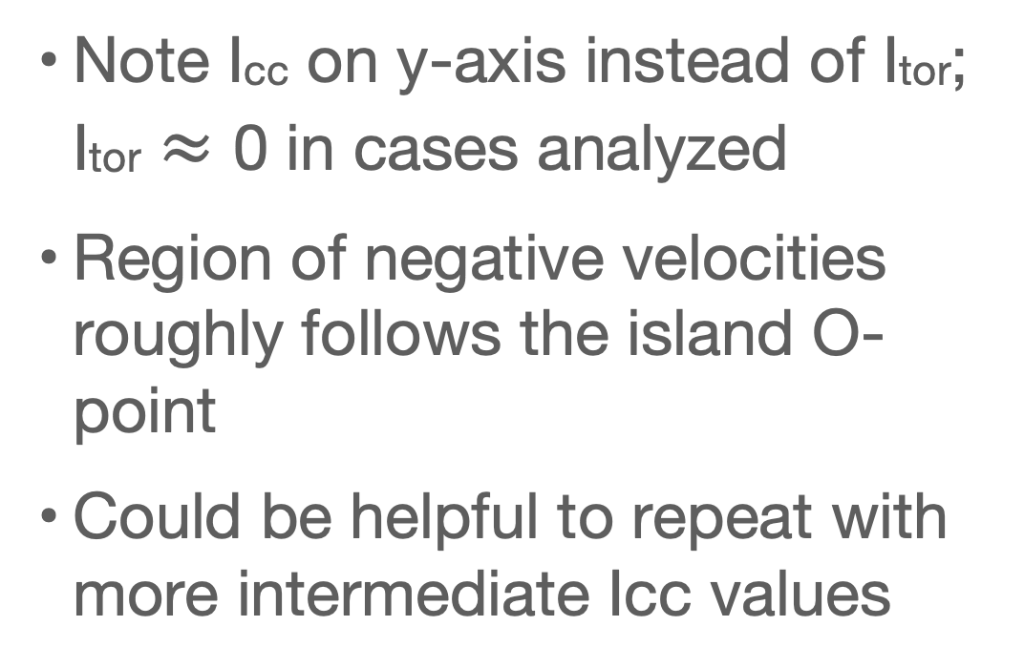
GPI: island size change experiments in standard configuration (reversed field) may indicate that flow directions depend on island O-point location
Icc = 1.5 kA
Note Icc on y-axis instead of Itor; Itor $≈$ 0 in cases analyzed
Region of negative velocities roughly follows the island O-point
Could be helpful to repeat with more intermediate Icc values
Icc = 0 kA
Island O-point
Icc = -1.5 kA
XP_20230118.* (S23, S24)

Slide 12
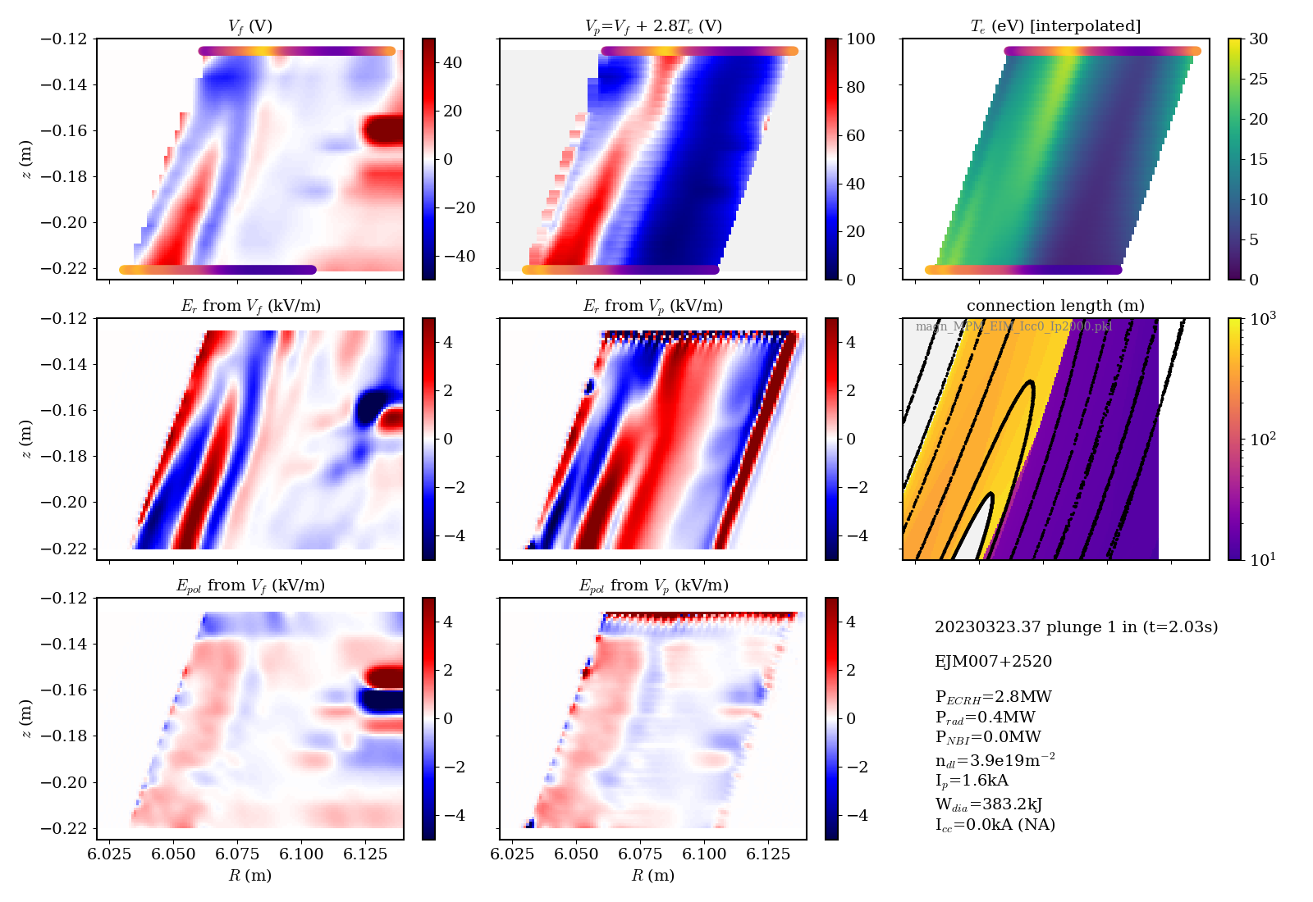
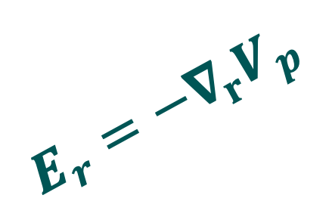

ExB velocities estimated from MPM potential are roughly consistent with GPI velocities
E_{r} structure implies sheared poloidal flows
v_{pol} ~ few km/s (B=2.3T)
flow
$$E_{r}=−∇_{r}V_{p}$$
E_{pol} implies (small) inwards radial flow, ≈100m/s
flow
$$E_{pol}=−∇_{pol}V_{p}$$

Slide 13
Radial velocities extracted from GPI are in the same ballpark as those found by MPM
GPI velocity field
GPI average velocity in each column
MPM E_{pol} (different shot)
flow
A.D. Helgeland, J.M. Losada, O.E. Garcia
Difficult to see radial motion in videos as faster poloidal motion dominates
Difficult to measure radial velocity with standard methods, so using new 3-point time-delay estimation method
E_{pol} implies (small) inwards radial flow, ≈100m/s

Slide 14
Part 1: 3D profiles vs magnetic island details
Part 2: attempt at mapping GPI and MPM data
Part 3: SOL currents and modes/turbulence

Slide 15
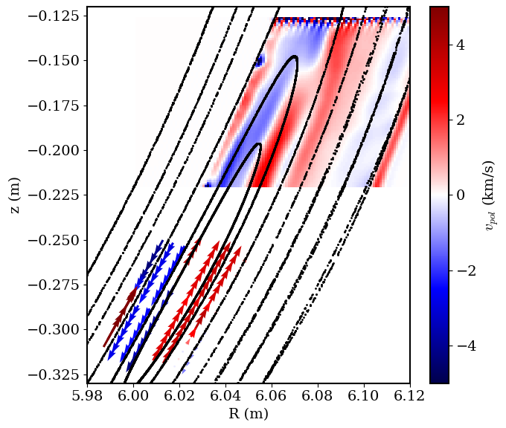

GPI and MPM poloidal velocity patterns can match qualitatively
red = upwards
blue = downwards
probes: $v_{pol}=E_{r}×B$
with E_{r} derived from potential distribution
gas puff imaging: direct imaging of poloidal flows via spatio-temporal dynamics of fluctuations

Slide 16
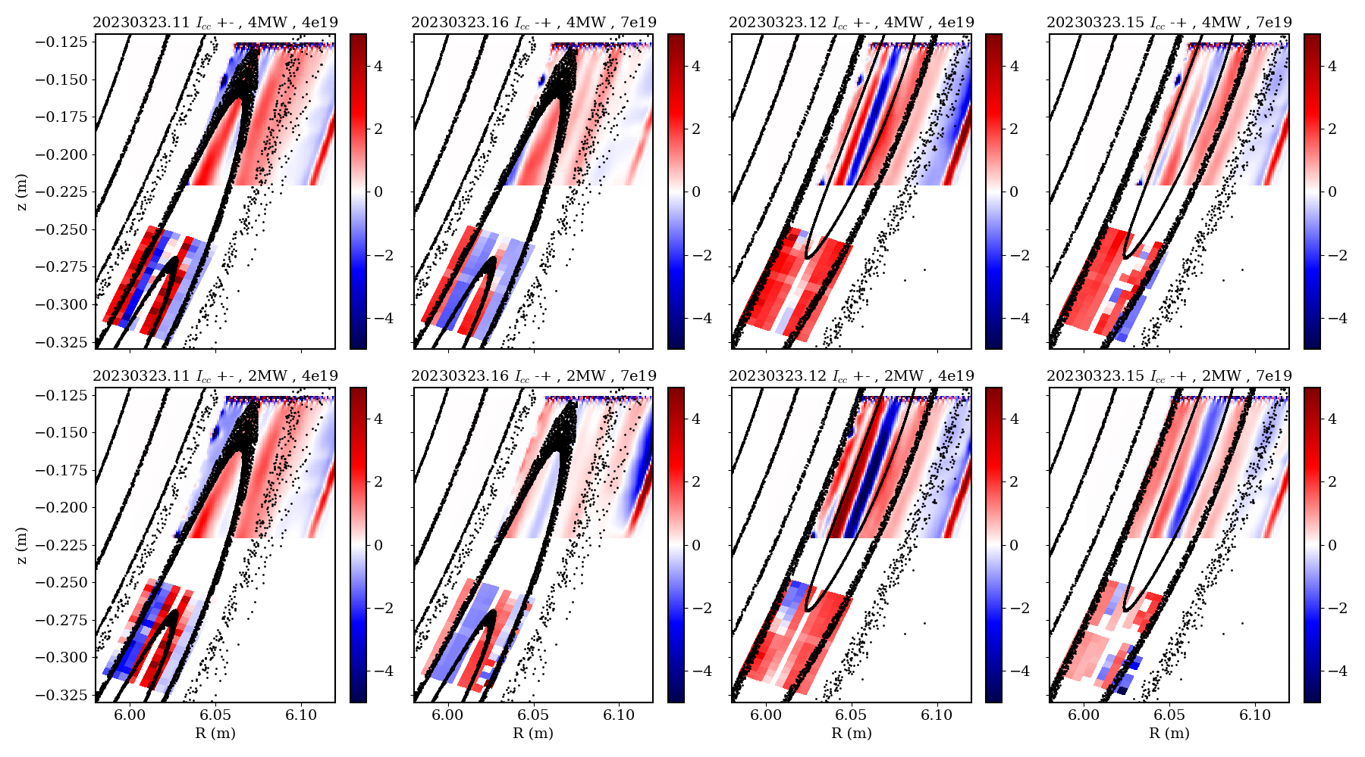
MPM-GPI comparison in standard config island rotation scan was not fully satisfying
unclear results!
pattern of shear layers sometimes, but not consistently agrees
better FoV overlap of diagnostics would help
possible effect of error fields / toroidal asymmetries (MPM and GPI are in different islands, mapping assumes stellarator symmetry)
would benefit from finer steps in Icc

Slide 17
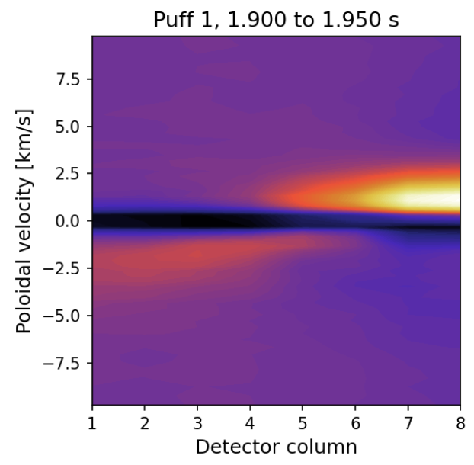
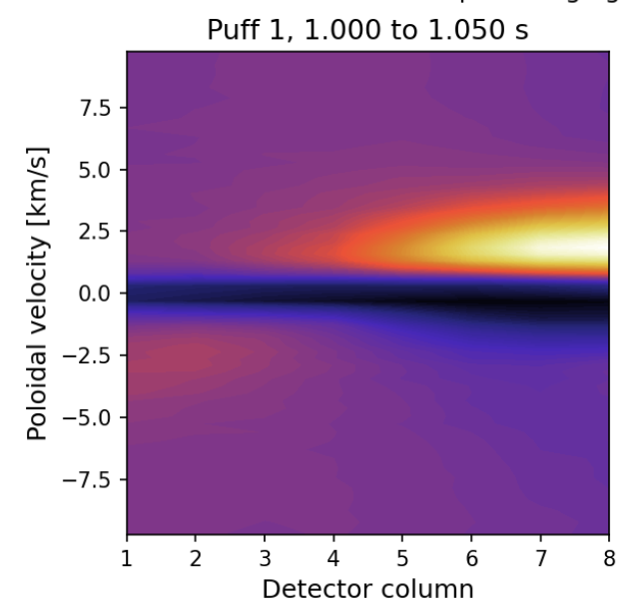
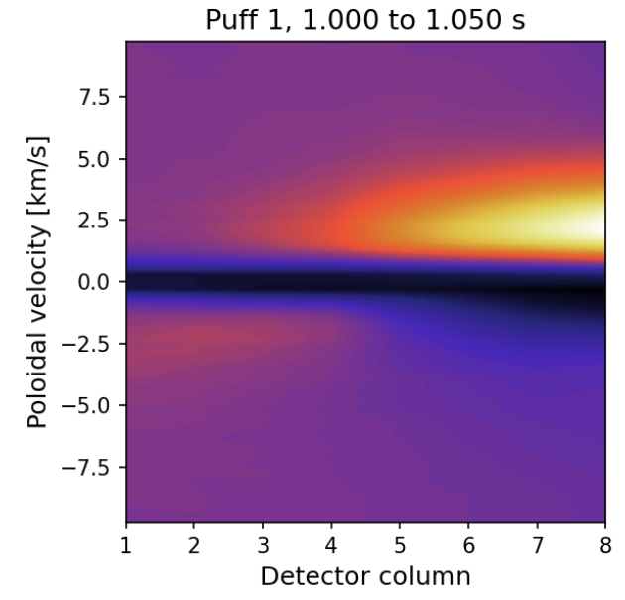
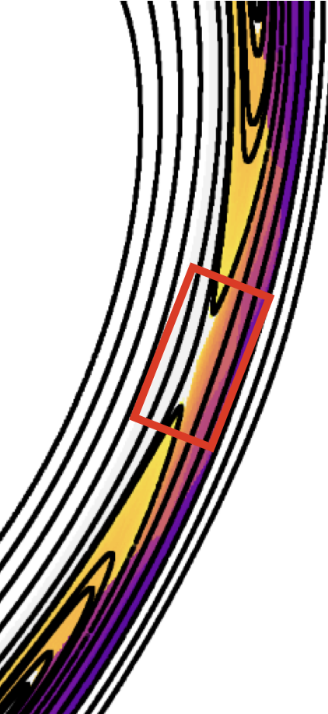
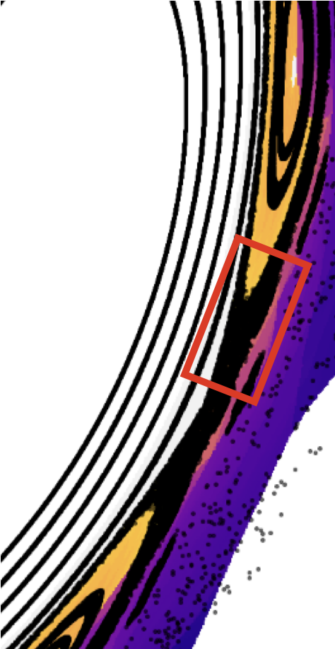
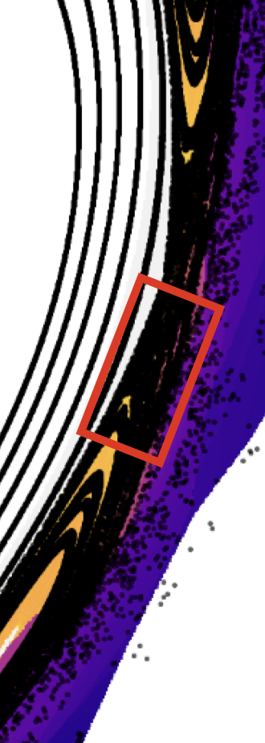
GPI: island rotation had little impact on observations in low iota
I_{cc} = 0 A
I_{cc} = +/- 2.5 kA
I_{cc} = -/+ 2.5 kA
XP_20230126.54
XP_20230131.9
XP_20230131.13
GPI view is approximate

Slide 18
Part 1: 3D profiles vs magnetic island details
Part 2: attempt at mapping GPI and MPM data
Part 3: SOL currents and modes/turbulence

Slide 19
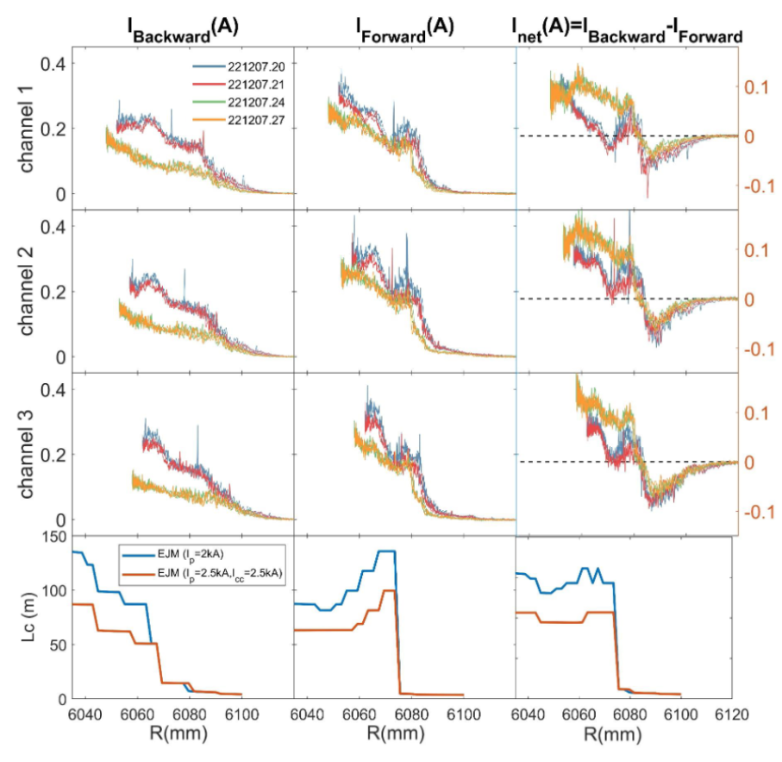
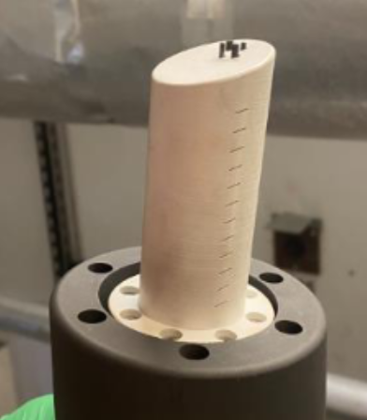
MPM: currents in the SOL can cause significant changes to the island flux surfaces
Directed Electron Probe (DEP) on MPM measures parallel electron currents
First-time operation in OP2.1 shows substantial currents in magnetic islands
current density of 10kA/m² !

Slide 20
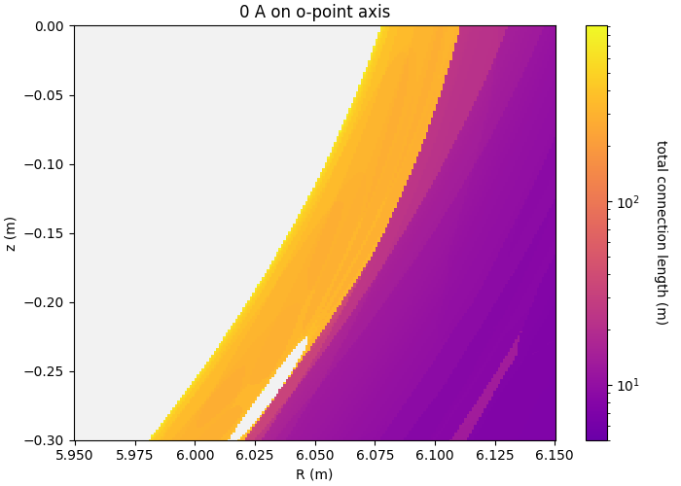
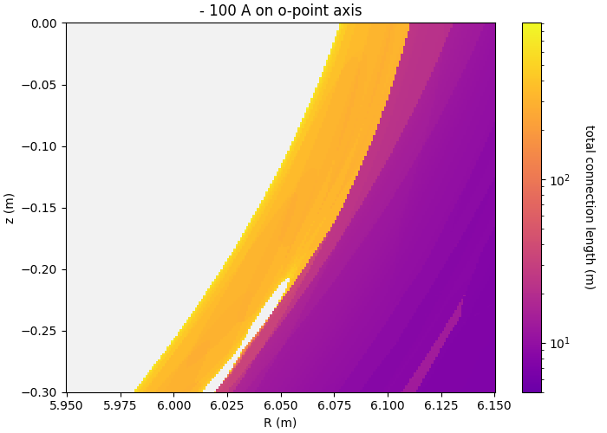
MPM: currents in the SOL can cause significant changes to the island flux surfaces
Directed Electron Probe (DEP) on MPM measures parallel electron currents
First-time operation in OP2.1 shows substantial currents in magnetic islands

Slide 21
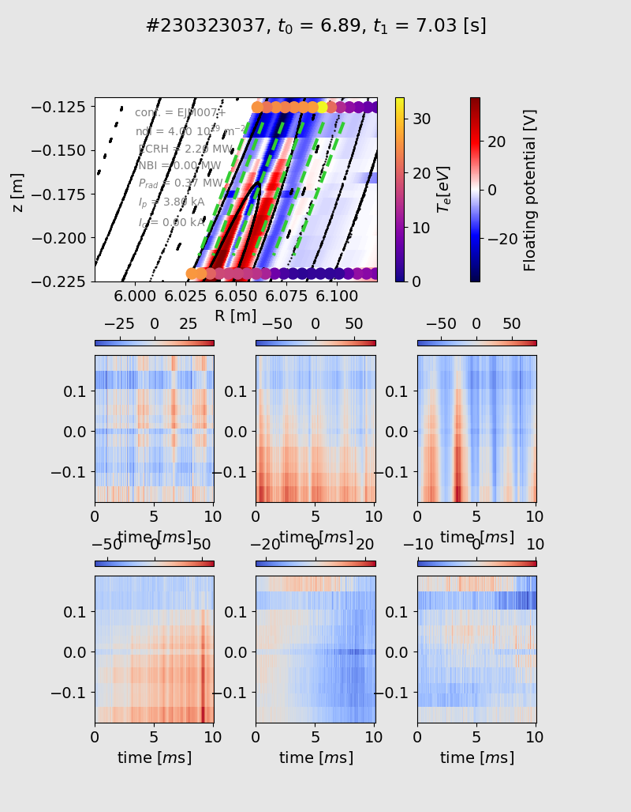
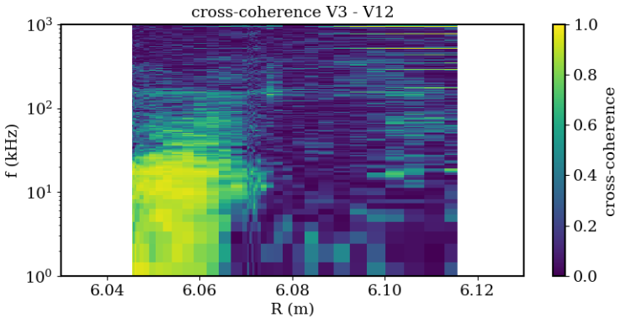
MPM finds different turbulence characteristics in island/center/shadowed regions
technical problems prevent full turbulence analysis (signals only reliable up to 30-50kHz)
high coherence across multiple probe pins inside magnetic islands, low coherence outside
island SOL
target shadow region
island potential structure shows intermittent / quasi-periodic bursts, localized to the island center

Slide 22
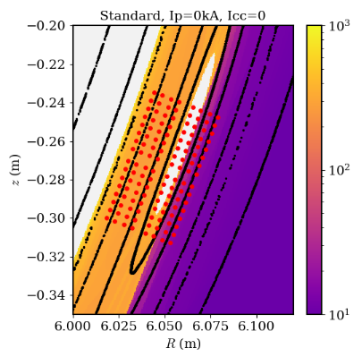
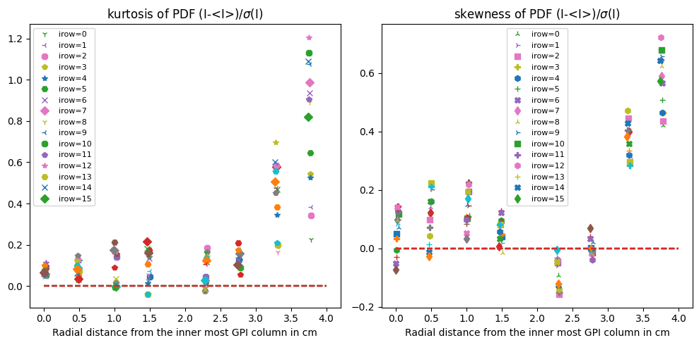
GPI: broadband turbulence with higher kurtosis and skewness is observed in the the target shadow region (230323039)
Two outermost columns are in the region with short connection length
Normal (Gaussian) distributions in the long connection length region, consistent with the past A-BES and MPM measurements

Slide 23
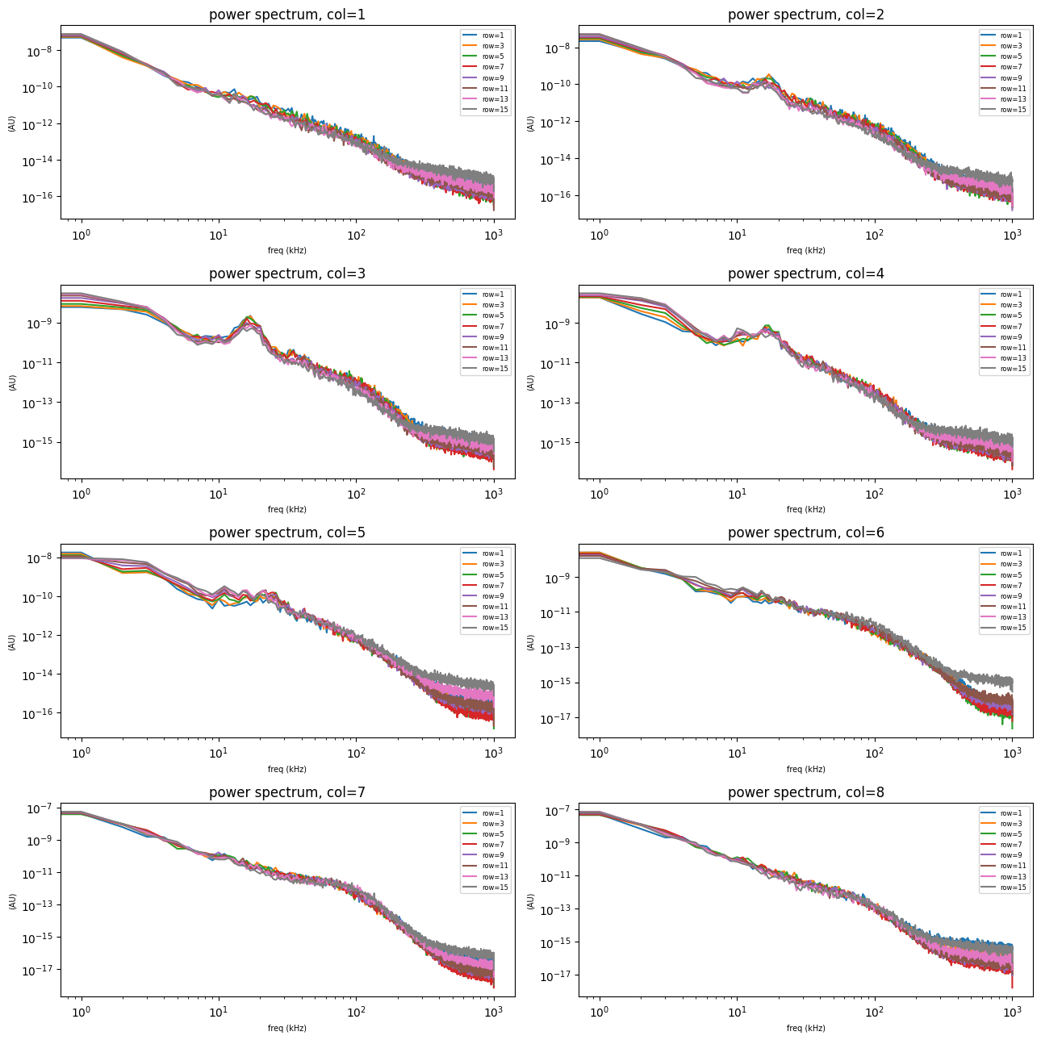
GPI resolves the radial localization of the quasi-coherent mode (QCM)
QCM [Zoletnik, PPCF (2019)] is localized between the LCFS and the O-point.

Slide 24
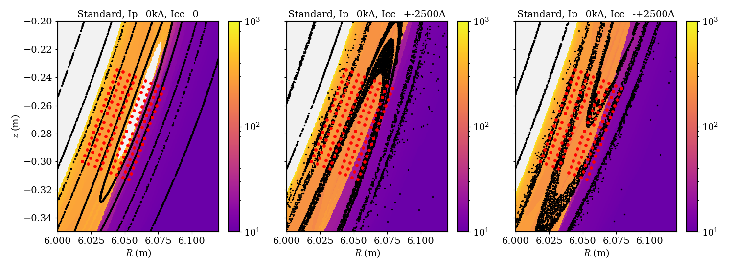
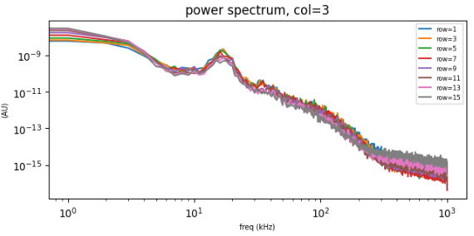
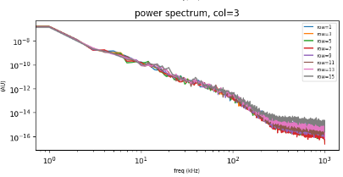
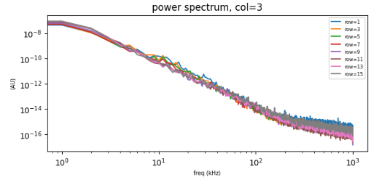
GPI: QCM excitation appears to be sensitive to the poloidal location of the O-point

Slide 25
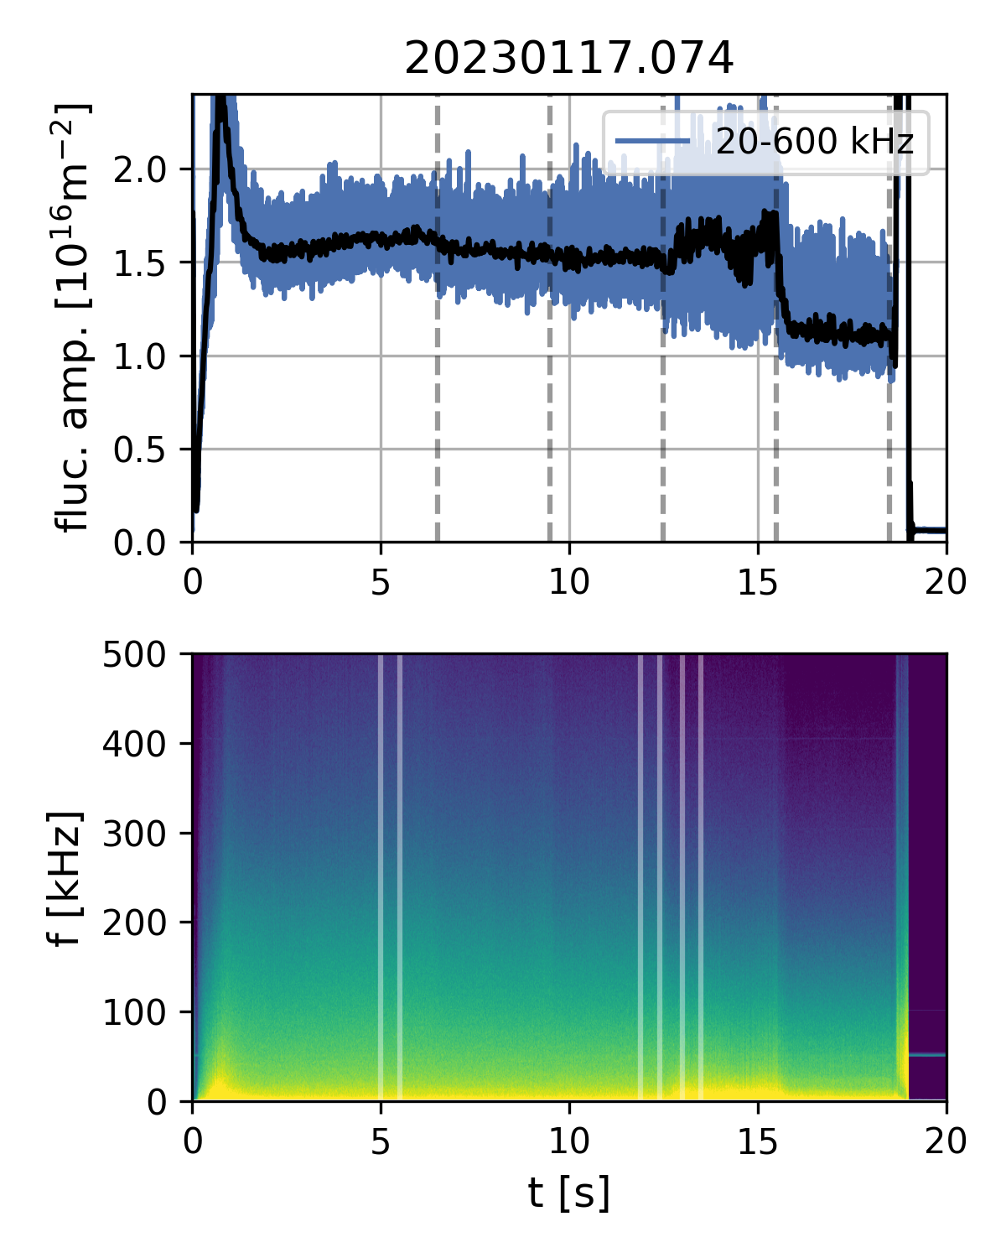
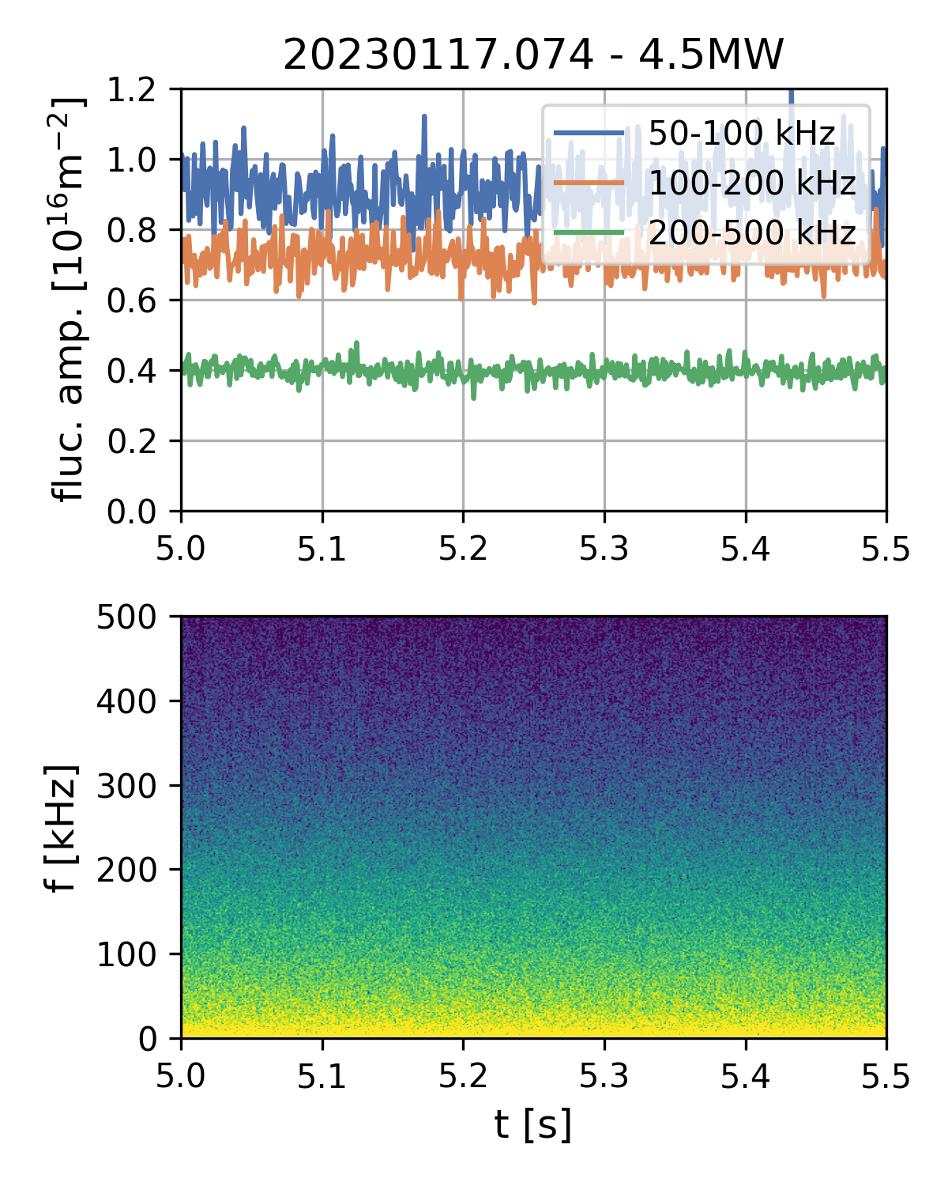
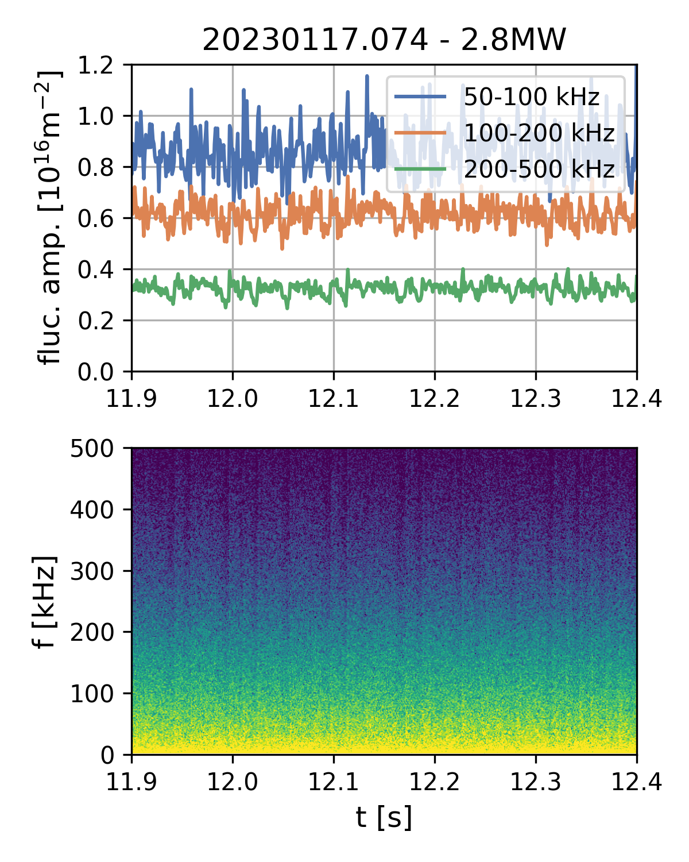
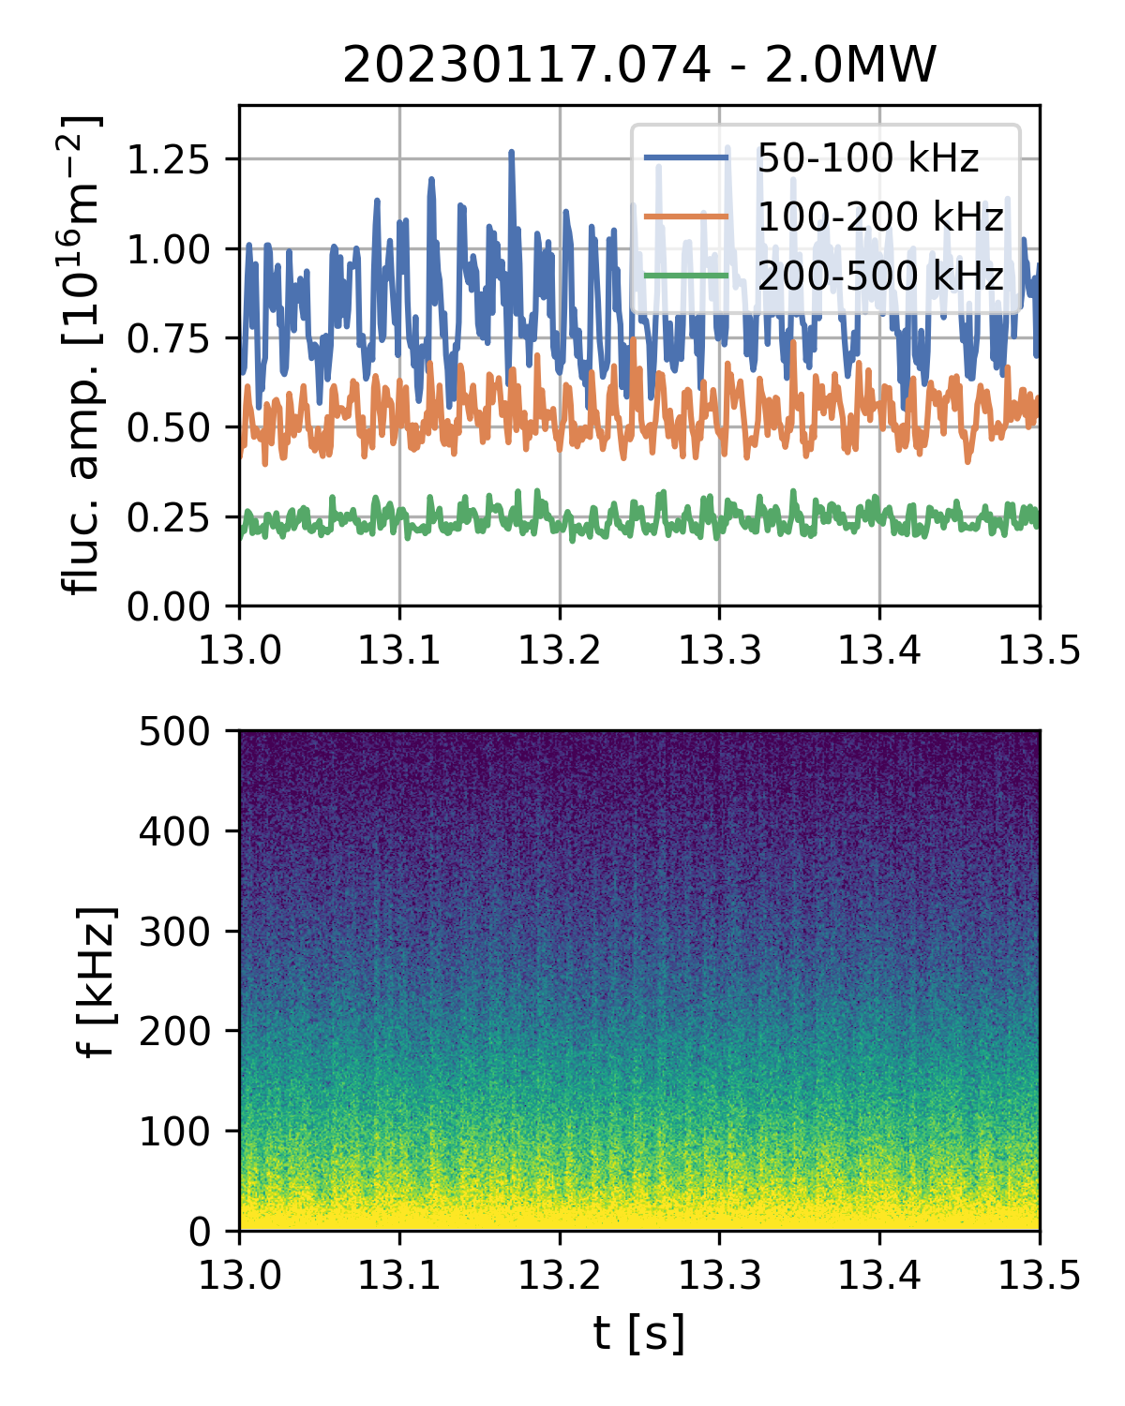
GPI and PCI: bursty fluctuation regime exists at low power
4.5MW
3.6MW
2.8MW
2.0MW
1.3MW
clean
dropouts
spikes
Dropouts (< 25% amplitude) and spikes (<70%) on ms timescale observed by PCI
(line-integrated through core + SOL) in limited heating power range
Events are quasi-periodic with f ~ 50-200Hz, some density and power dependence
Observed at all densities (and radiation fractions) and in all magnetic configurations

Slide 26
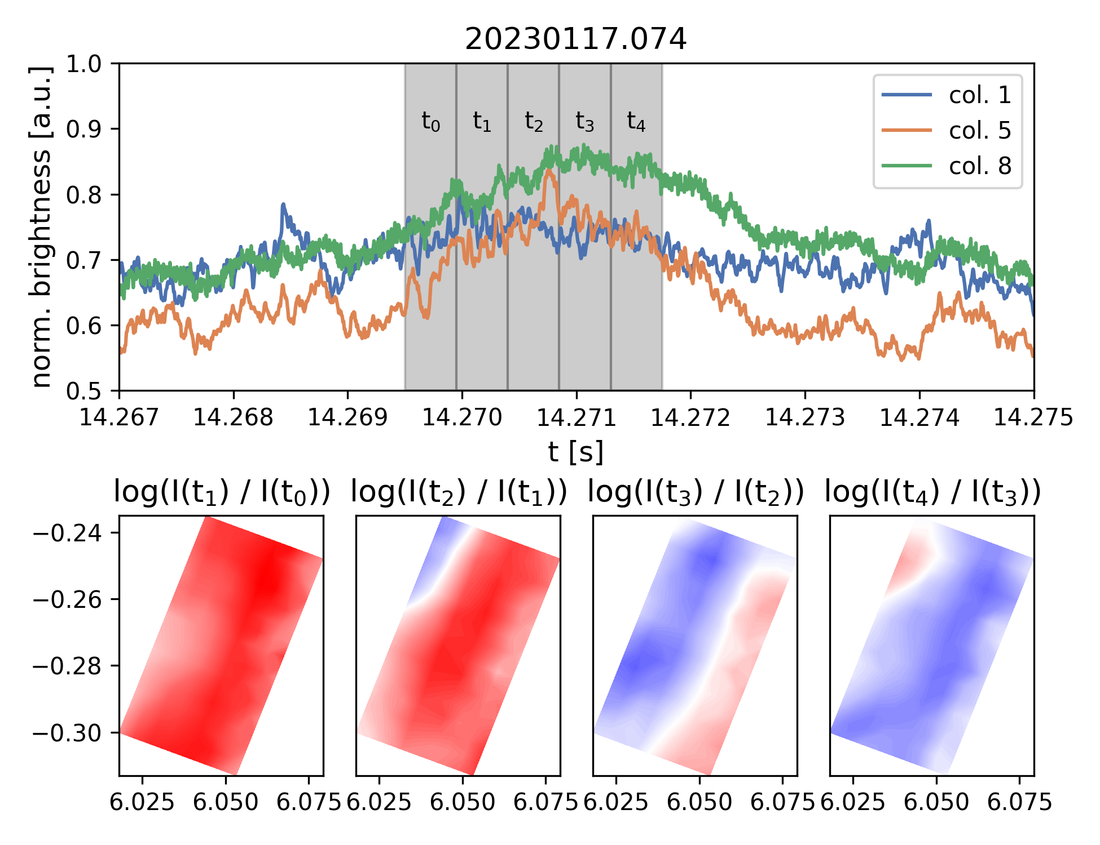
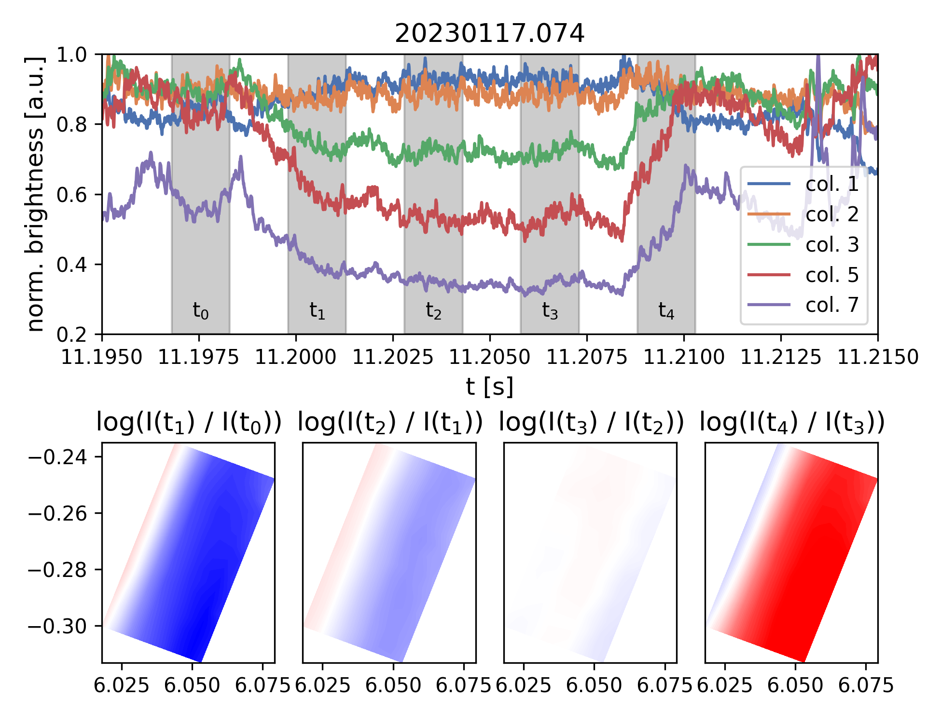
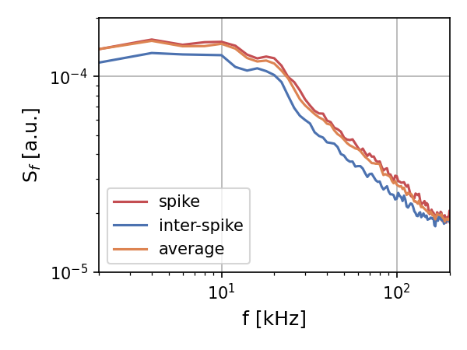
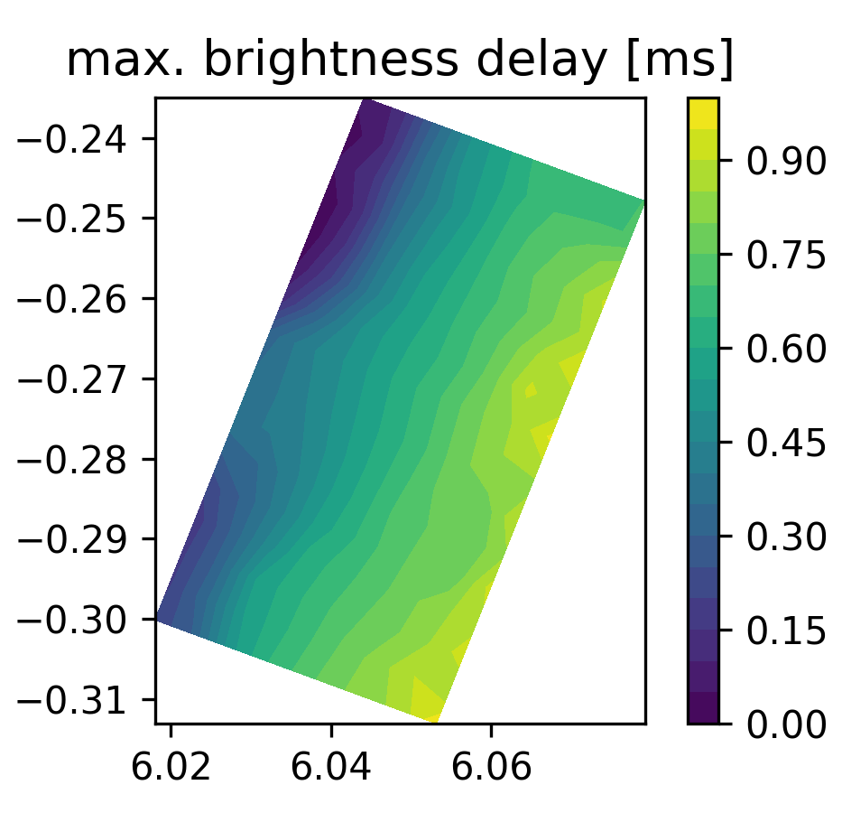
GPI and PCI: bursty fluctuation regime exists at low power
single pixel
col. 4
GPI shows corresponding SOL emissivity changes ~ f(n_{e},T_{e}) and increase/decrease in turbulent fluctuations
Spikes: ~2ms brightness increase, radial propagation
Dropouts: ~10ms brightness loss, largest in confined O-point and far SOL
Events synchronized with ECE and PCI diagnostics
ECE gradient flattening around inversion radius (ρ≈0.8)

Slide 27
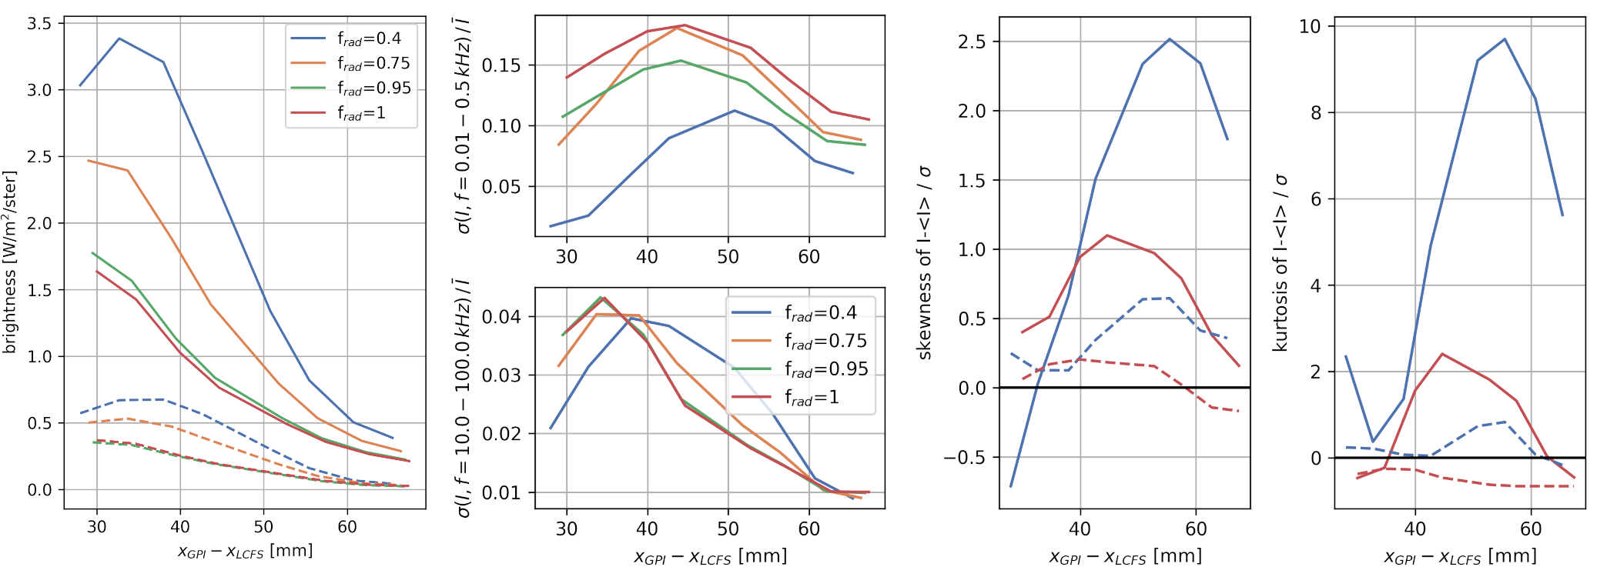
GPI: SOL fluctuations change during seeded detachment
SOL (GPI) average/fluctuating H_{𝛼} brightness profiles
fluctuation skewness + kurtosis
HM conf.
HM conf.
HM conf.
average
brightness
LF fluctuation level
FOV bottom
FOV bottom
FOV top
standard deviation
HF fluctuation level
FOV top
Core density fluctuations measured by PCI unaffected during seeded detachment
GPI field-of-view: H_{𝛼} line emission front moves inward and decreases due to local T_{e} (and n_{e}) drop
Normalized δI/<I> profiles follow inward shift, LF and HF components at different radii
Poloidal phase velocities (not shown) decreased, generally v_{r} ≪ v_{pol}
Skewness + kurtosis strongly reduced in detachment, generally poloidally highly asymmetric
Sean Ballinger | W7-X op2.1 results workshop 28.11.2023 | event.ipp-hgw.mpg.de/event/969/contributions/1509

Slide 28
Summary
ICRH reflectometer and ABES find close agreement in edge density profiles
Profiles and turbulence in island are aligned with flux surfaces but can also depend on connection length profile
GPI and MPM velocity measurements agree qualitatively
  GPI-MPM spatial comparison would benefit from a finer island rotation scan
GPI sees different radial extents of SOL depending on I_{tor} and mirror ratio: modifications to make them more comparable?
Bursty fluctuation regimes could be investigated through further scans
For OP2.2/3 proposal collaboration, contact sballin@mit.edu (GPI), carsten.killer@ipp.mpg.de (MPM)

Slide 29


GPI: a change in the turbulence statistics of the island divertor SOL is observed between the attached and detached states
Attached:
SOL transport is likely to be a spatially dependent process, as seen from the radial and poloidal variations of the moments.
Detached:

