Slide 1
Turbulence (O1.D2)
J.-P. Bähner, D. Carralero, S. K. Hansen, E. Maragkoudakis, A. von Stechow, G. M. Weir, T. Windisch

Slide 2
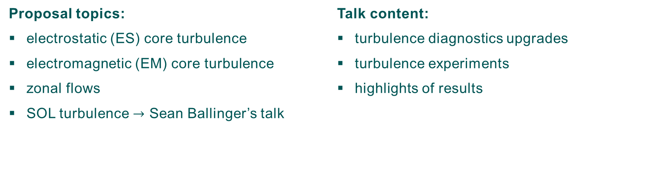
Overview
O1: Complete the core transport and stability physics basis in the extended operational space D2: Assessment of the effects of heating and fueling actuators (profile shaping, fast ions) and magnetic configuration on turbulent transport
Proposal topics:
electrostatic (ES) core turbulence
electromagnetic (EM) core turbulence
zonal flows
SOL turbulence $→$ Sean Ballinger’s talk
Talk content:
turbulence diagnostics upgrades
turbulence experiments
highlights of results

Slide 3
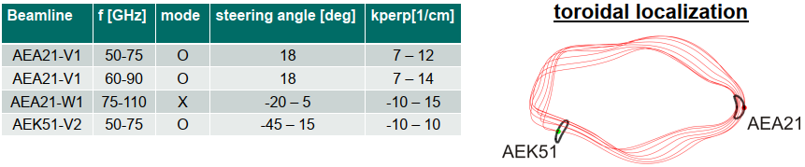
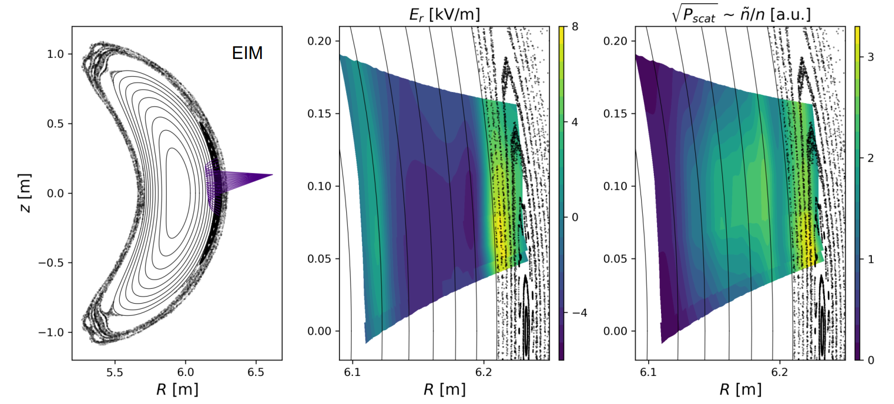
Diagnostic upgrades
Doppler reflectometry
Additional reflectometer systems:
  V-band at different toroidal position (AEK51)
  E-Band (AEA21)
  W-band comb system (ASDEX-Upgrade)
  new capabilities:
  long-range correlation
  radial correlation
  simultaneous radial resolution
Steerable plasma-facing mirrors on AEA21-W1 and AEK51-V2
  2D profiles and wavenumber spectra
  can measure poloidal asymmetries
courtesy of T. Windisch
see T. Windisch et al. EPS 2023

Slide 4
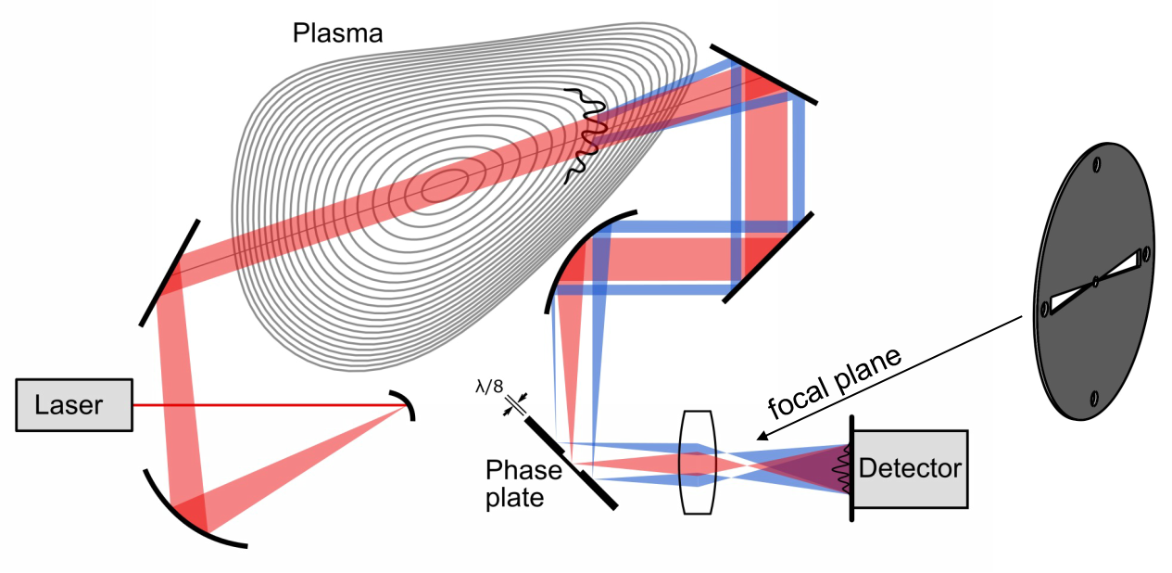
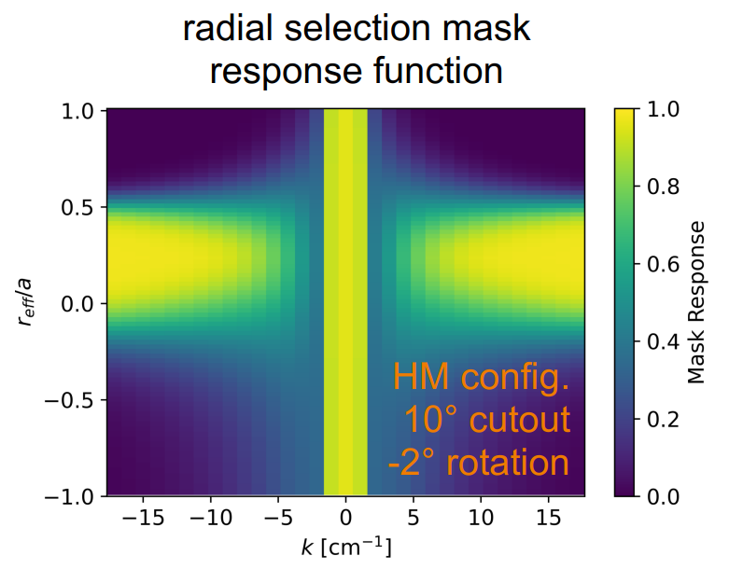
Diagnostic upgrades
Phase Contrast Imaging
Radially selective measurements with mask filters
mask in focal plane blocks part of the scattered signal
diagnostic response restricted to section along the LOS
radial range can be changed with mask opening angle and orientation
modelling with synth. PCI and simplified model and comparison to experimental data
OP 2.1 experiments:
1 detector without mask (fully line-integrated)
1 detector with mask, usually focused on core
could radially localize coherent modes and fluctuation changes during detachment
$∝$ magnetic pitch angle
$$k$$
see S. K. Hansen et al. EPS 2023 and APS 2023 journal article in preparation

Slide 5
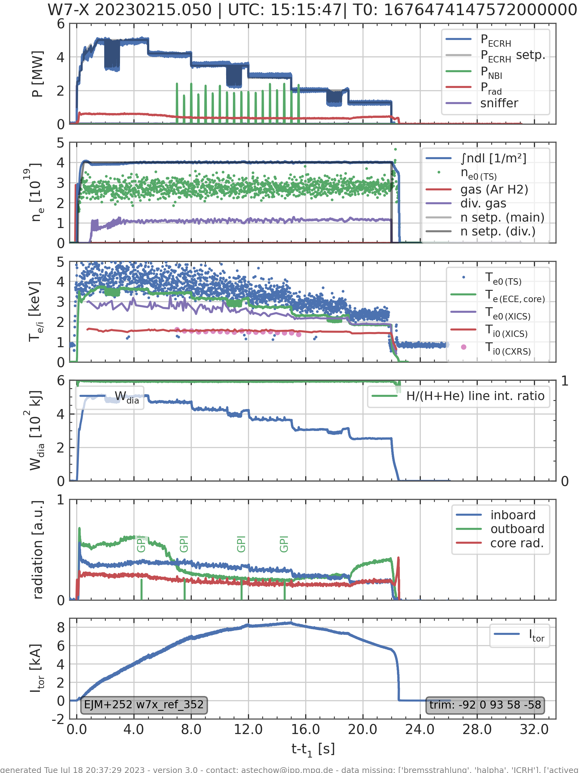
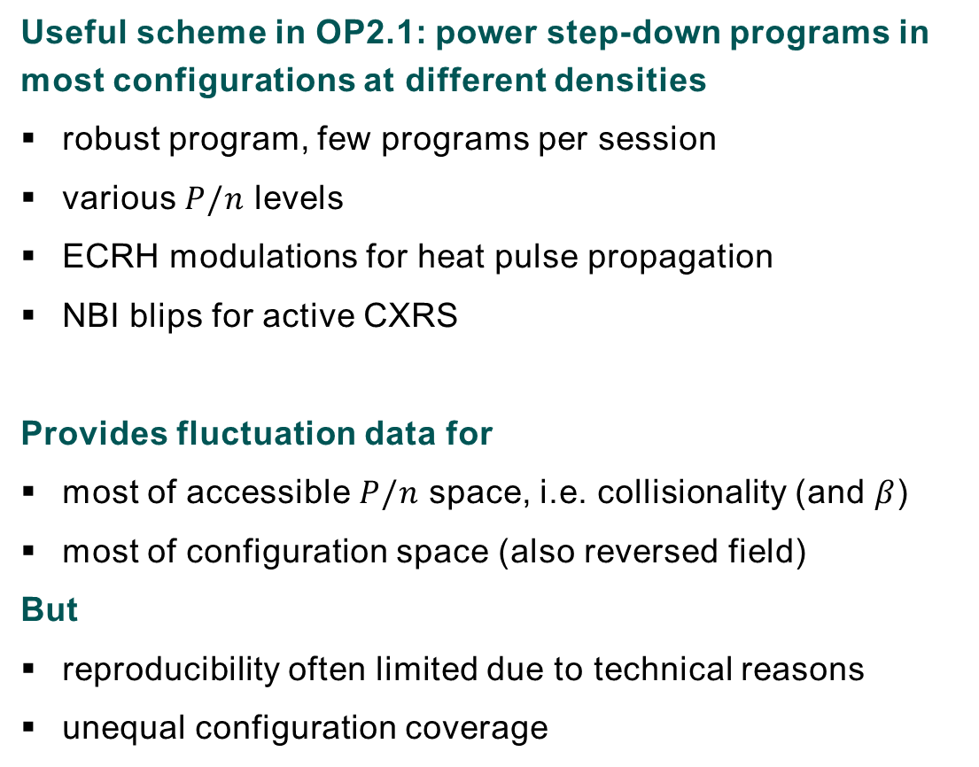
Turbulence experiments
Useful scheme in OP2.1: power step-down programs in most configurations at different densities
robust program, few programs per session
various $P/n$ levels
ECRH modulations for heat pulse propagation
NBI blips for active CXRS
Provides fluctuation data for
  most of accessible $P/n$ space, i.e. collisionality (and $β$)
  most of configuration space (also reversed field)
  But
  reproducibility often limited due to technical reasons
  unequal configuration coverage
courtesy of A. von Stechow

Slide 6
Turbulence experiments
many other successful experiments, often analysis still pending
Major restrictions / problems during experiments:
  limited total ECRH power
  duration + availability of NBI blips
  density control (before divertor gas-inlet feedback system)
  missing pellet injector
  reproducibility due to technical restrictions (heating systems, density control, diagnostic coverage)
  time (number of sessions, proposals/programs per session, contingency for technical issues)
Experiments which did not quite work
  turbulence reduction after massive LBO – technical issues with LBO
  …

Slide 7
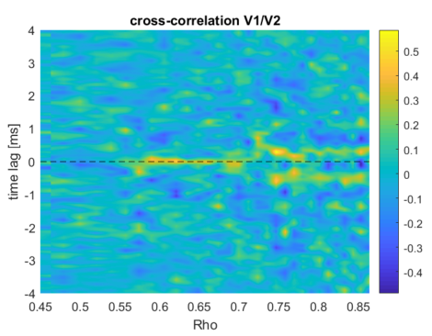

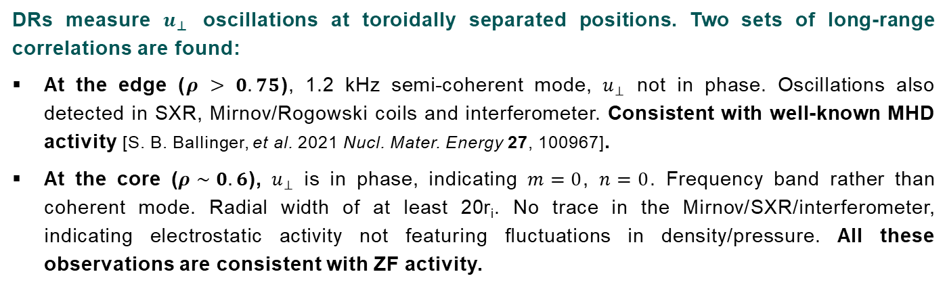
Zonal Flow detection: DR measurements of $u_{⊥}$ oscillations
I
I
II
III
II
DRs measure $u_{⊥}$ oscillations at toroidally separated positions. Two sets of long-range correlations are found:
At the edge ($ρ > 0.75$), 1.2 kHz semi-coherent mode, $u_{⊥}$ not in phase. Oscillations also detected in SXR, Mirnov/Rogowski coils and interferometer. Consistent with well-known MHD activity [S. B. Ballinger, et al. 2021 Nucl. Mater. Energy 27, 100967].
At the core ($ρ \sim 0.6$), $u_{⊥}$ is in phase, indicating $m=0$, $n=0$. Frequency band rather than coherent mode. Radial width of at least 20r_{i}. No trace in the Mirnov/SXR/interferometer, indicating electrostatic activity not featuring fluctuations in density/pressure. All these observations are consistent with ZF activity.
III
courtesy of D. Carralero
see D. Carralero et al. TG turbulence, 26.10.2023
time (ms)

Slide 8
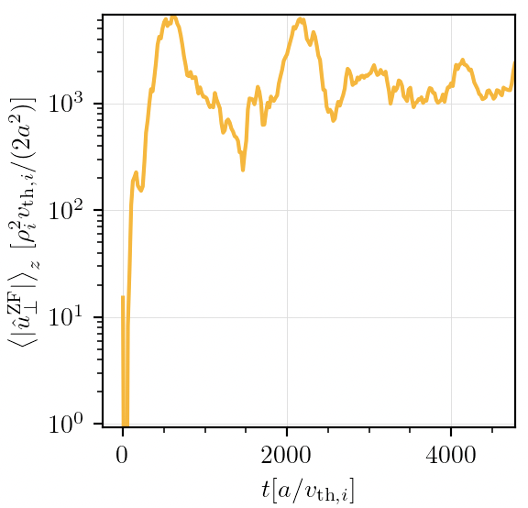
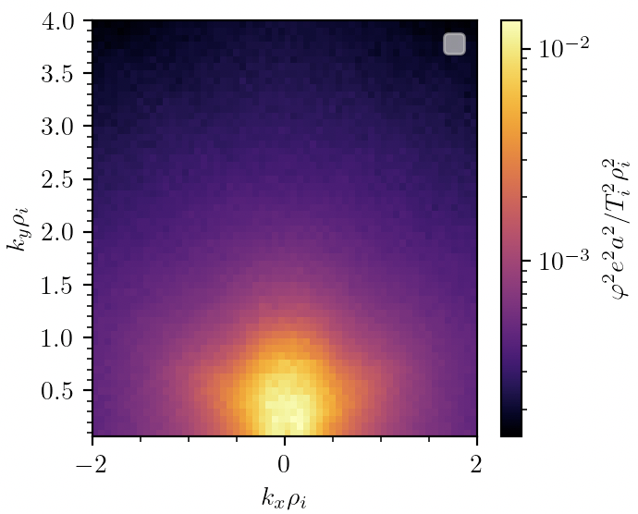
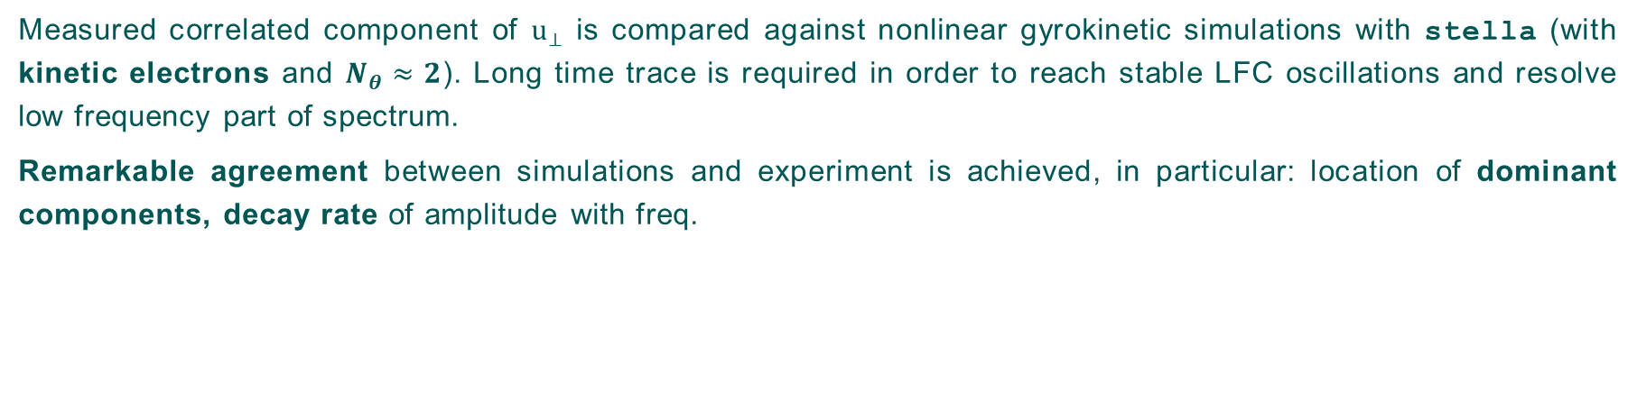
Zonal Flow detection: non-linear GK simulations
Measured correlated component of $u_{⊥}$ is compared against nonlinear gyrokinetic simulations with stella (with kinetic electrons and $N_{θ}≈2$). Long time trace is required in order to reach stable LFC oscillations and resolve low frequency part of spectrum.
Remarkable agreement between simulations and experiment is achieved, in particular: location of dominant components, decay rate of amplitude with freq.
Experimental characteristics are all consistent with ZF activity and in good agreement with ZF component in non-linear GK simulations$⇒$ We have detected ZFs.
courtesy of D. Carralero
see D. Carralero et al. TG turbulence, 26.10.2023

Slide 9
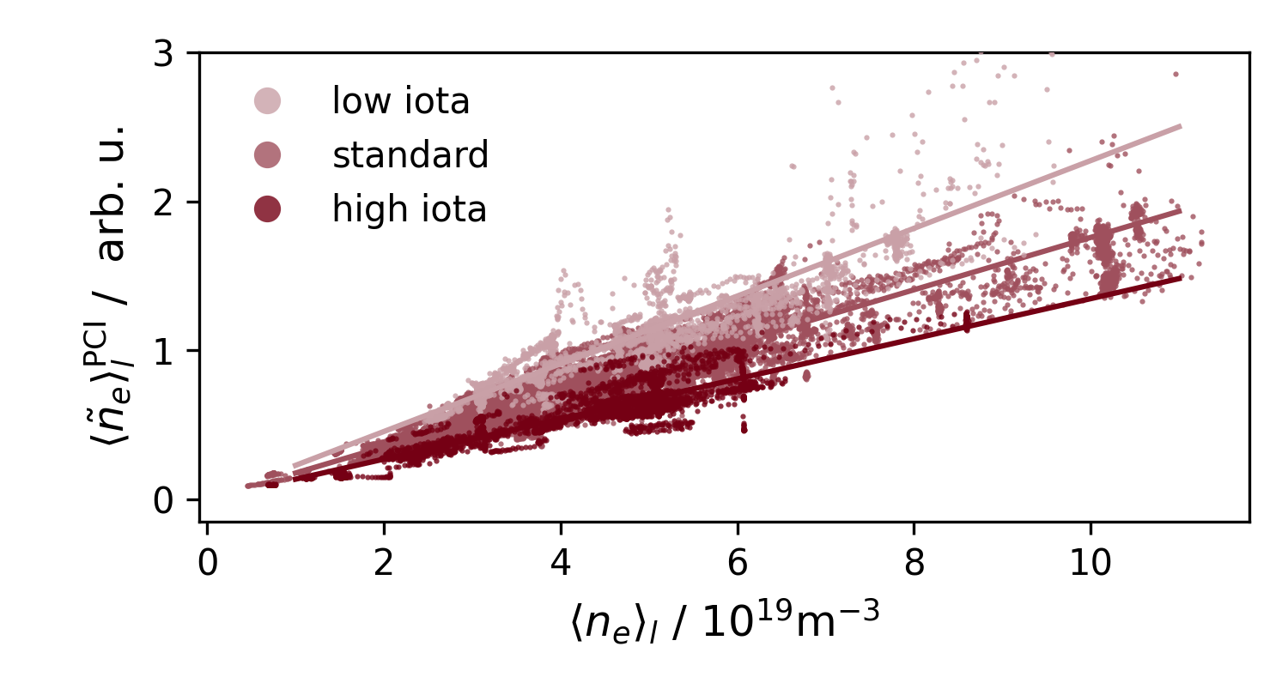
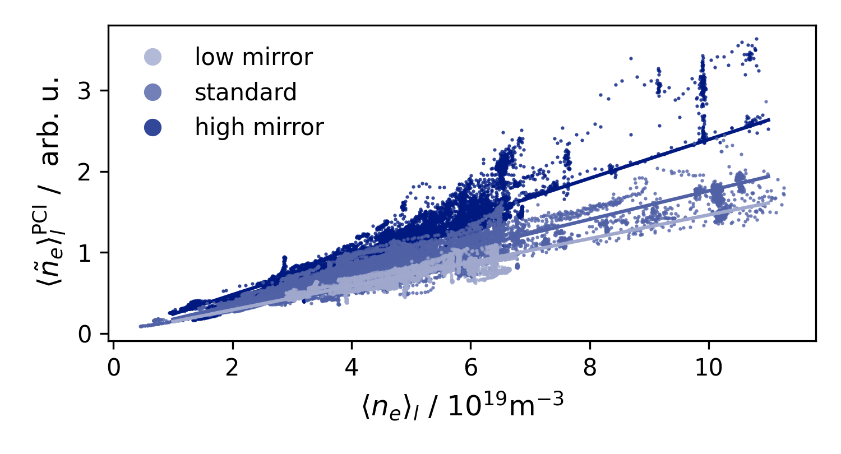
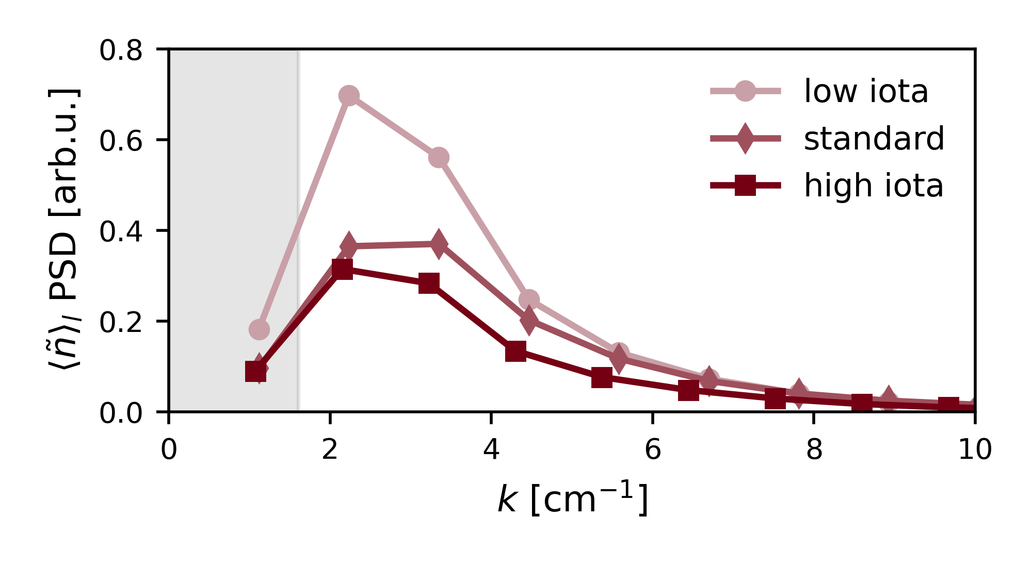
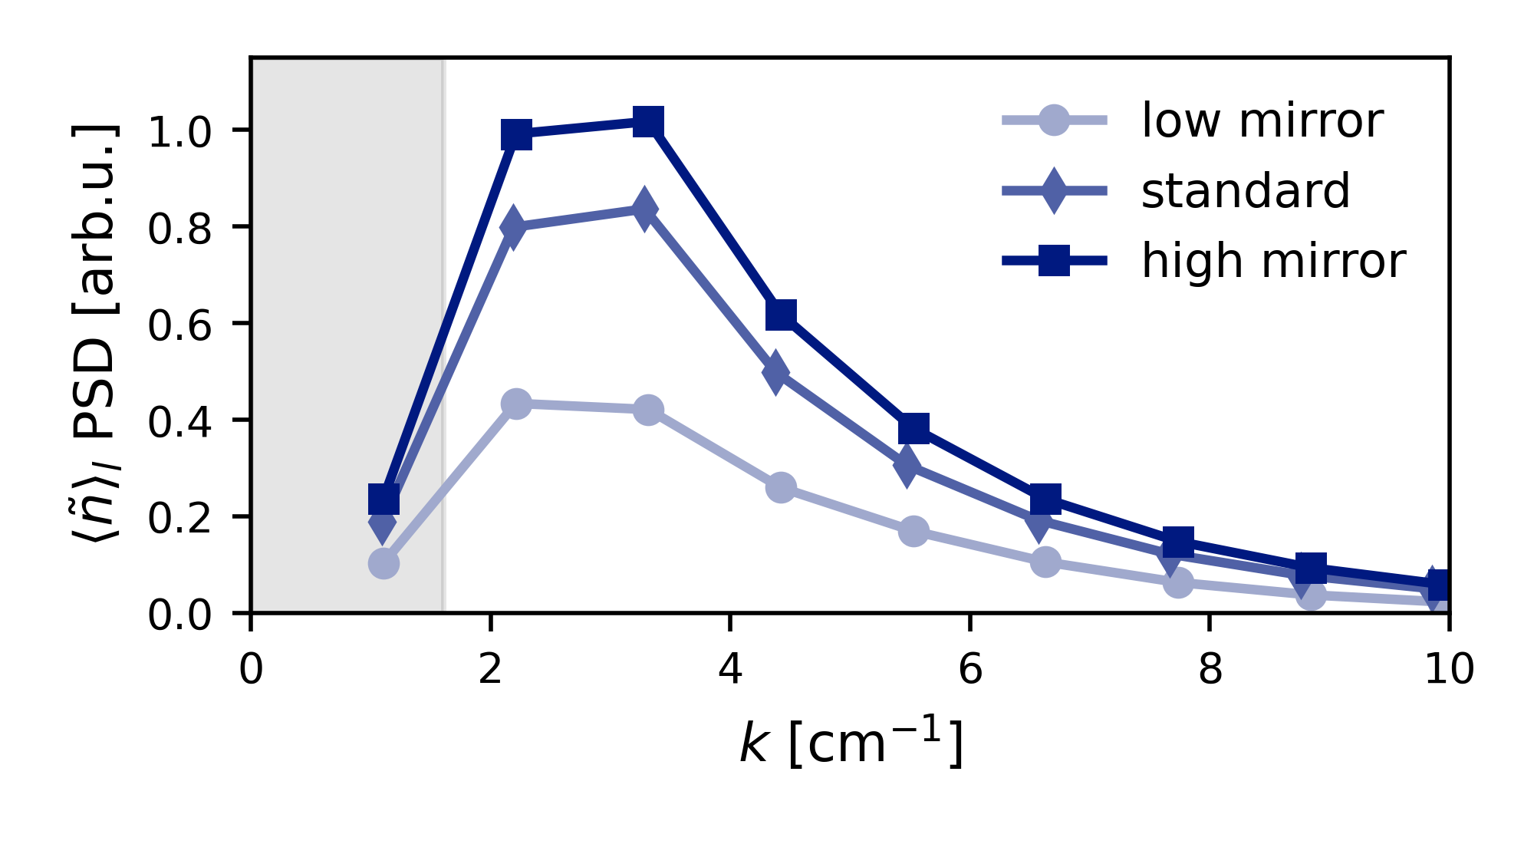
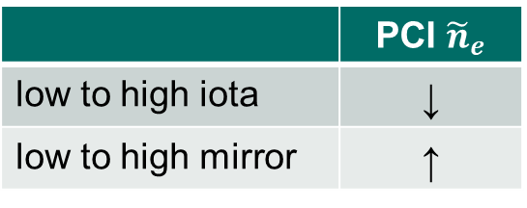
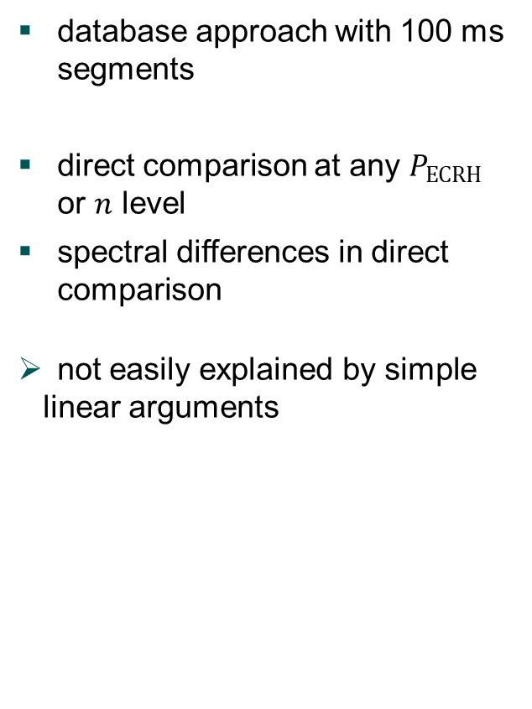
Effect of magnetic configuration on turbulence
PCI fluctuation measurements
low to high iota
low to high mirror
database approach with 100 ms segments
direct comparison at any $P_{ECRH}$ or $n$ level
spectral differences in direct comparison
not easily explained by simple linear arguments
 | PCI ${\tilde{n}}_{e}$
low to high iota | ↓
low to high mirror | ↑
see J.-P. Bähner et al. EPS 2023 and APS 2023
Notes:
non-linear effects, self-consistent changes of profiles, flux-surface- and radially global effects

Slide 10

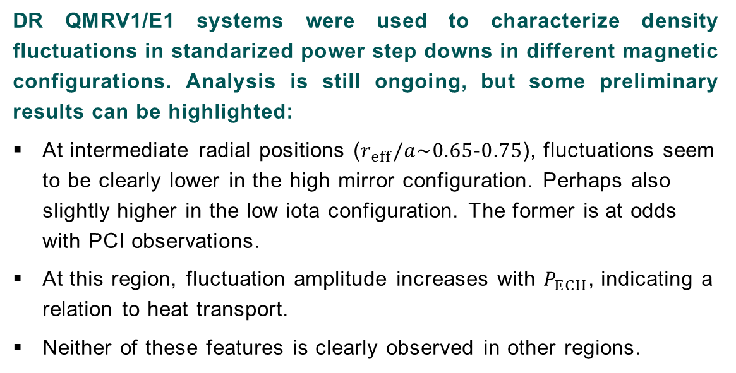

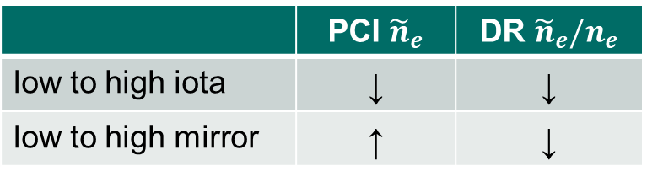
Effect of magnetic configuration on turbulence
DR fluctuation measurements
DR QMRV1/E1 systems were used to characterize density fluctuations in standarized power step downs in different magnetic configurations. Analysis is still ongoing, but some preliminary results can be highlighted:
At intermediate radial positions ($r_{eff}/a\sim 0.65−0.75$), fluctuations seem to be clearly lower in the high mirror configuration. Perhaps also slightly higher in the low iota configuration. The former is at odds with PCI observations.
At this region, fluctuation amplitude increases with $P_{ECH}$, indicating a relation to heat transport.
Neither of these features is clearly observed in other regions.
$$ρ=0.55$$
 | PCI ${\tilde{n}}_{e}$ | DR ${\tilde{n}}_{e}/n_{e}$
low to high iota | ↓ | ↓
low to high mirror | ↑ | ↓
$$ρ=0.75$$
courtesy of E. Maragkoudakis

Slide 11
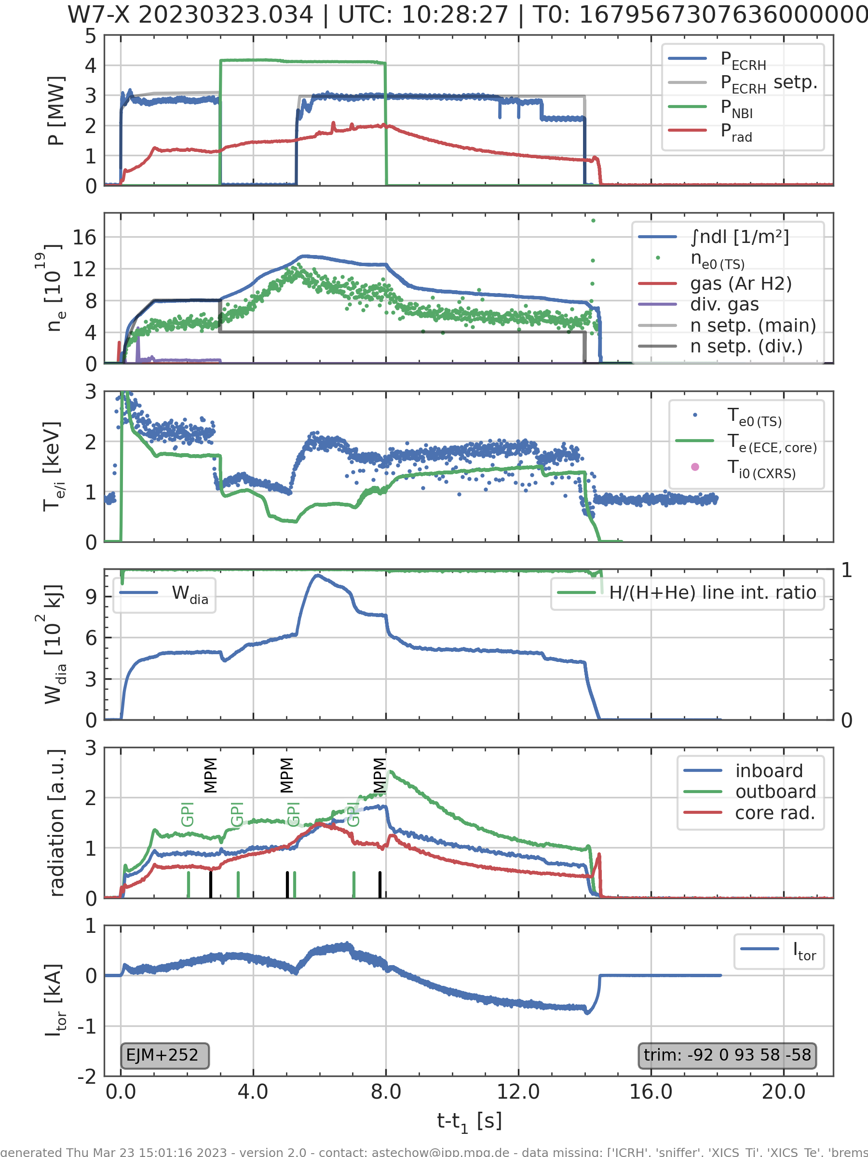
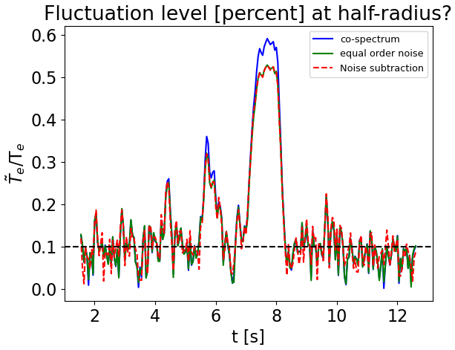

Core temperature fluctuation measurements with Correlation Electron Cyclotron Emission (CECE)
Core fluctuations observed with NBI and/or O2 ECRH
$T_{e}$ fluctuation level usually close to resolution limit for CECE
in some situations a sharp rise in ${\tilde{T}}_{e}/T_{e}$ is observed, e.g. during improved performance in NBI + ECRH phase
$τ_{i}=$100 ms
courtesy of G. M. Weir

Slide 12
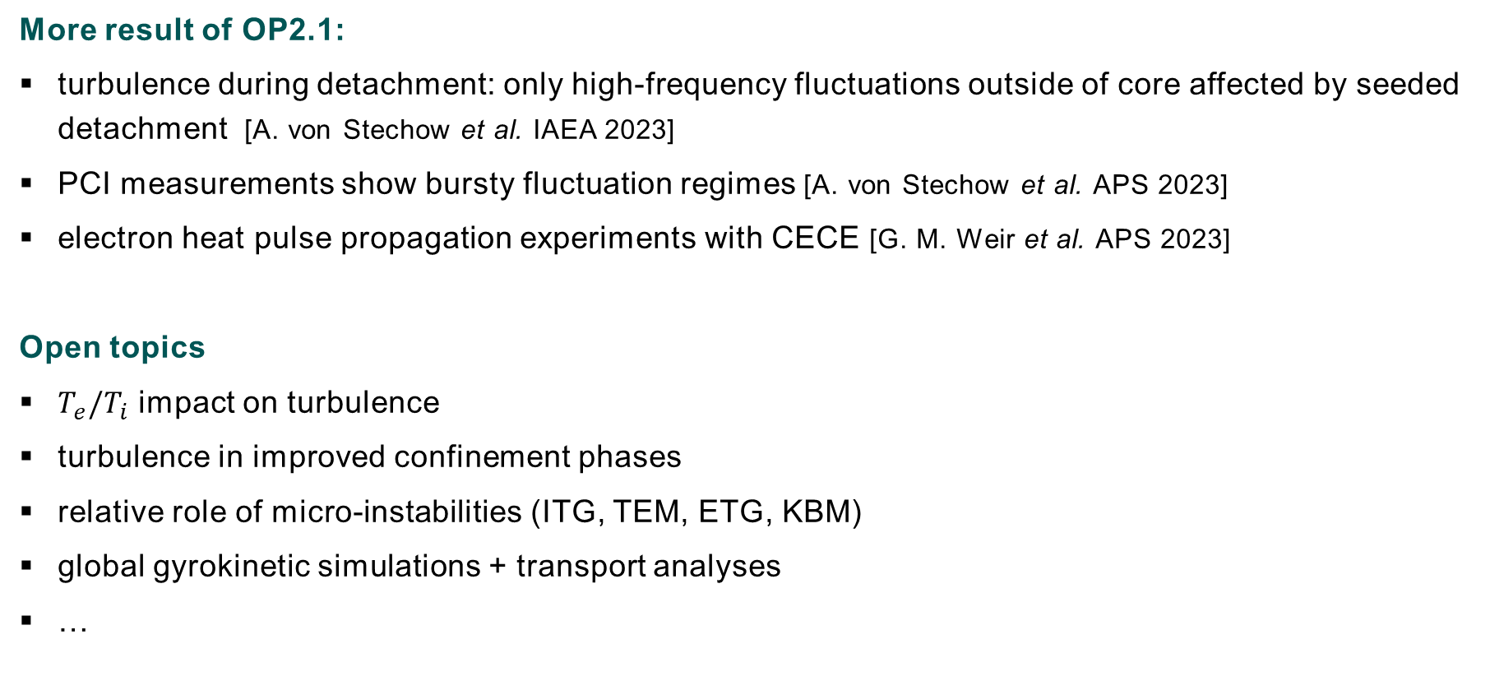
Final remarks
More result of OP2.1:
  turbulence during detachment: only high-frequency fluctuations outside of core affected by seeded detachment [A. von Stechow et al. IAEA 2023]
  PCI measurements show bursty fluctuation regimes [A. von Stechow et al. APS 2023]
  electron heat pulse propagation experiments with CECE [G. M. Weir et al. APS 2023]
Open topics
  $T_{e}/T_{i}$ impact on turbulence
  turbulence in improved confinement phases
  relative role of micro-instabilities (ITG, TEM, ETG, KBM)
  global gyrokinetic simulations + transport analyses
  …
profile availability caused delays

Slide 13
Key take-aways for OP2.2
  barely any failed experiments due to physics constraints
  many proposals require or would greatly benefit from repeat in OP2
  What could improve outcome of turbulence experiments?
  reliability of technical systems (heating and diagnostic coverage)
  fast availability of profiles

Slide 14
Additional material

Slide 15
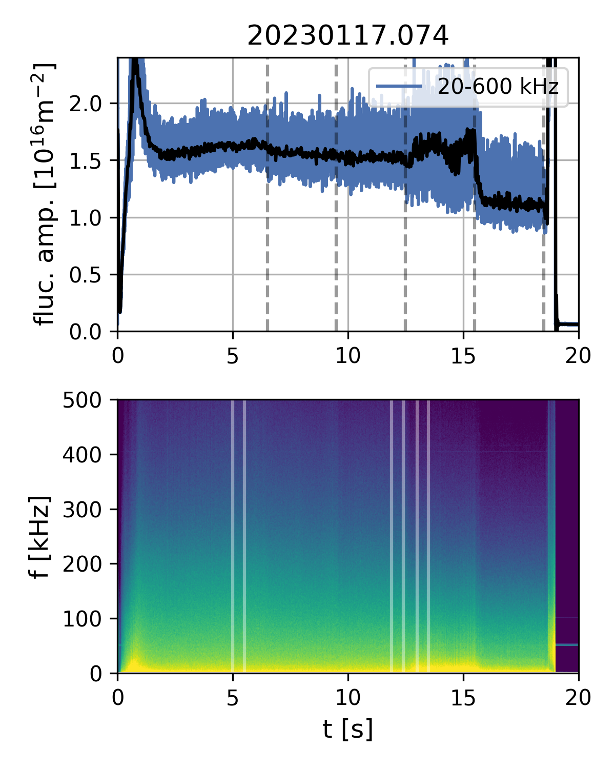
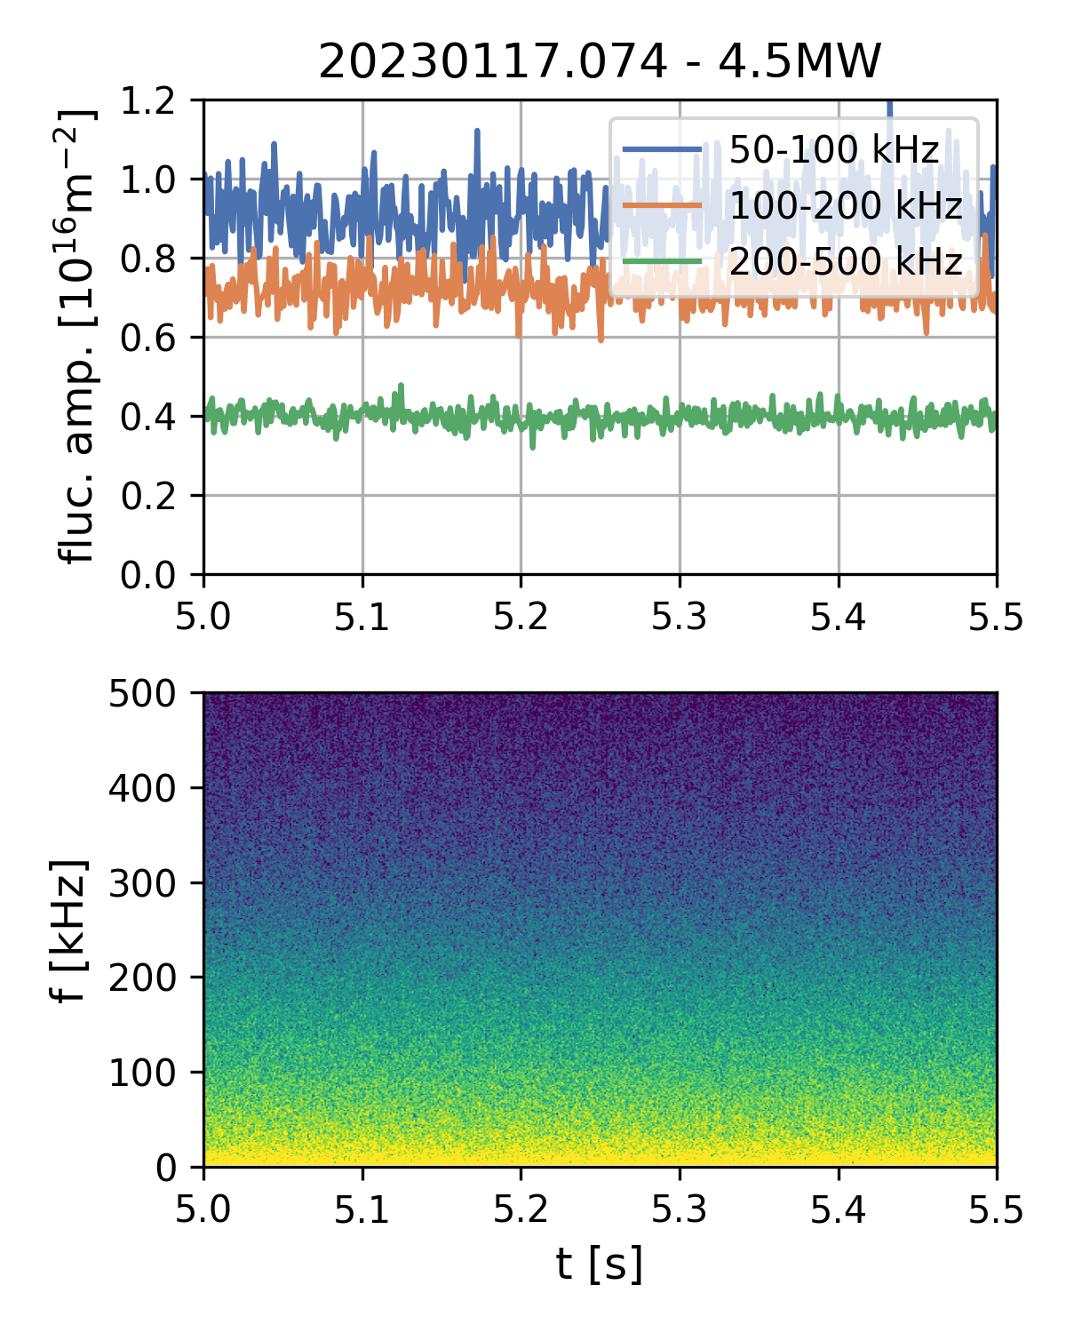
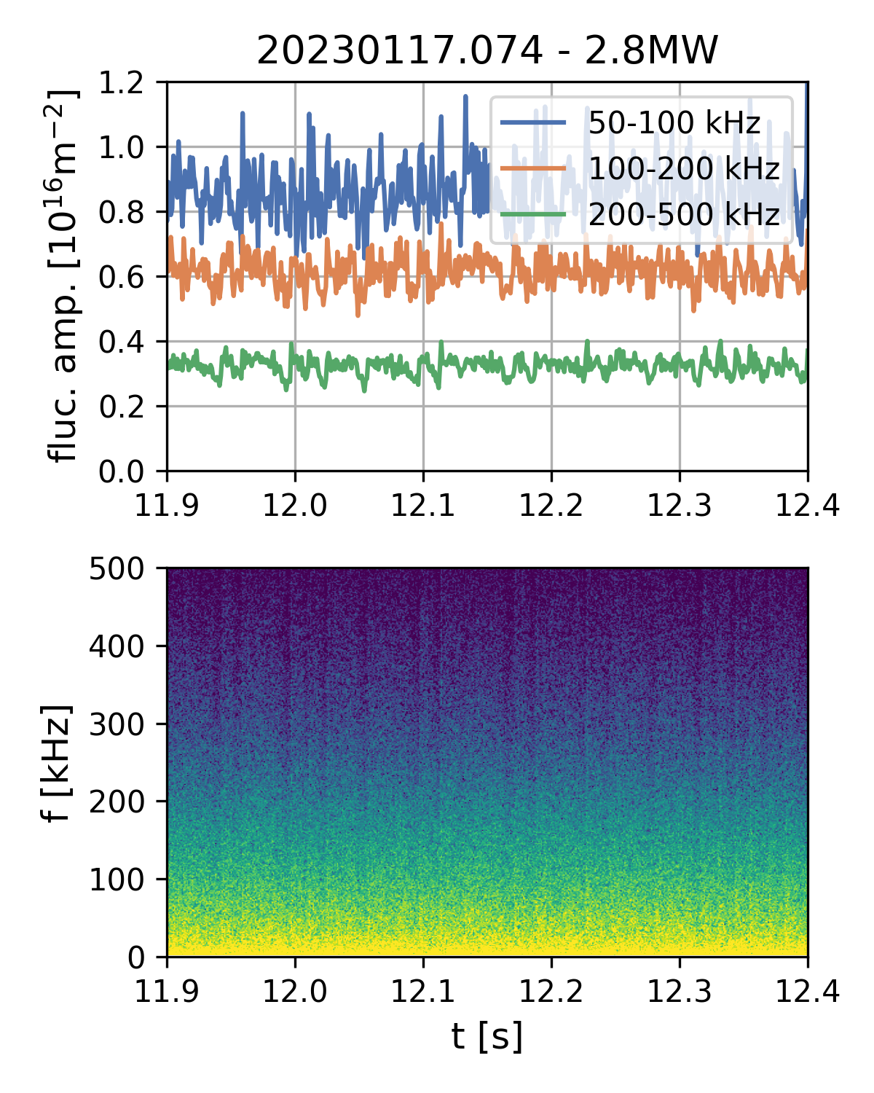
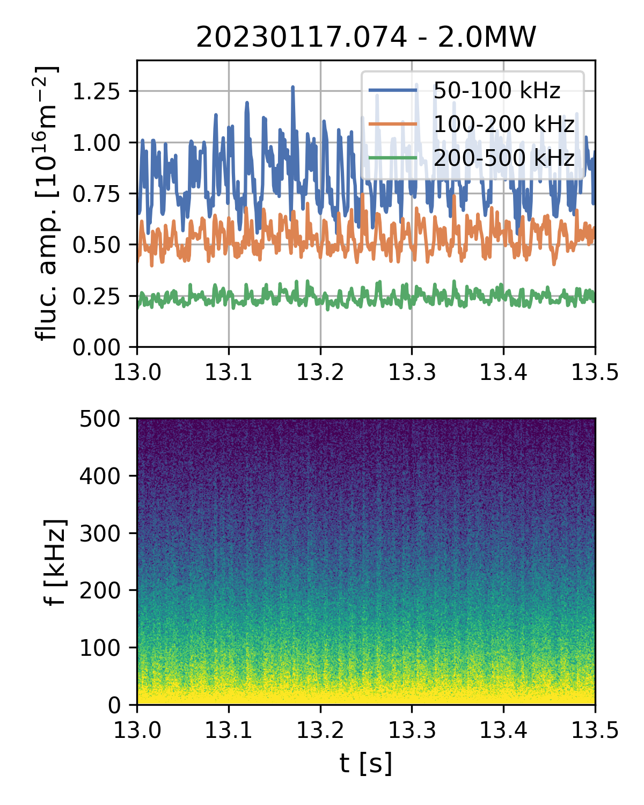
Bursty fluctuation regimes
4.5MW
3.6MW
2.8MW
2.0MW
1.3MW
clean
dropouts
spikes
Dropouts (< 25% amplitude) and spikes (<70%) on ms timescale observed by PCI
(line-integrated through core + SOL) in limited heating power range
Events are quasi-periodic with f ~ 50-200Hz, some density and power dependence
Observed at all densities (and radiation fractions) and in all magnetic configurations

Slide 16
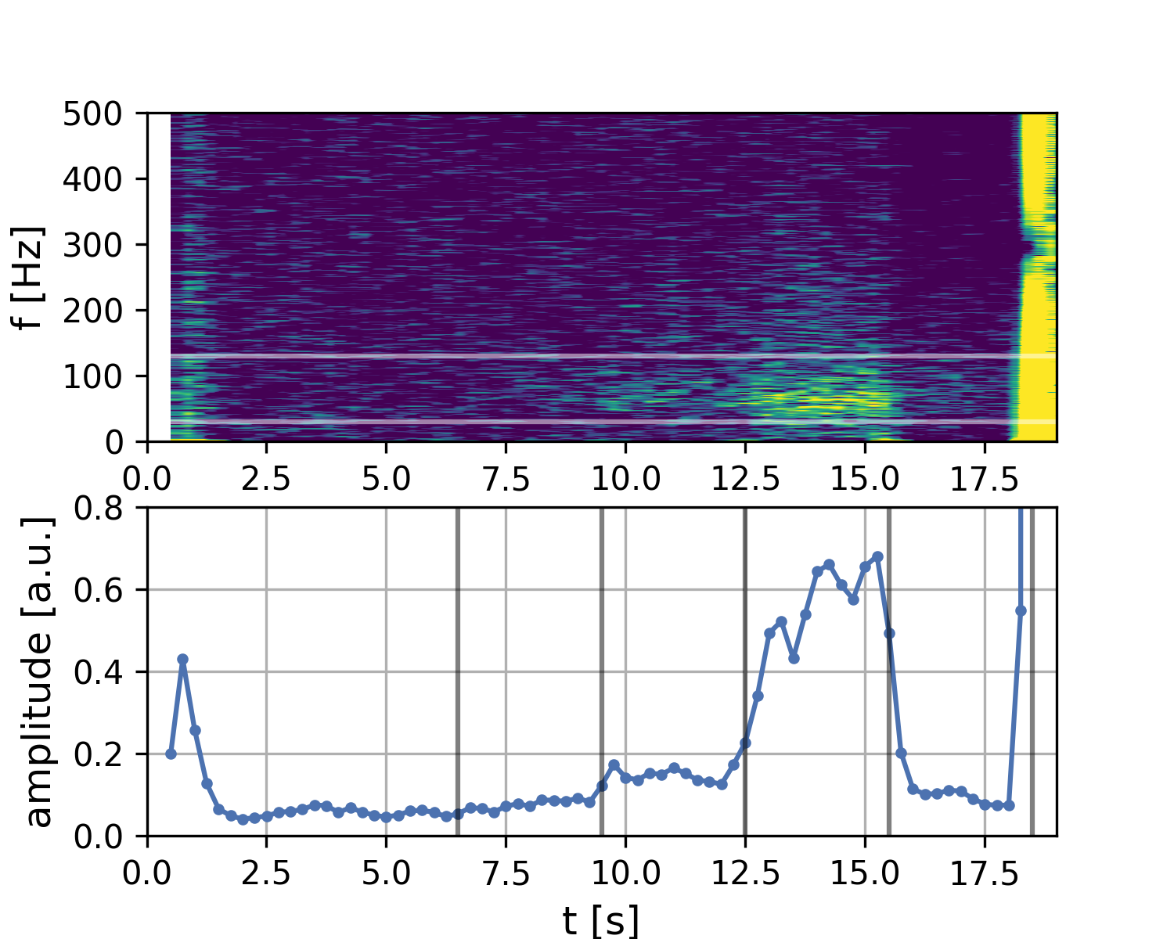
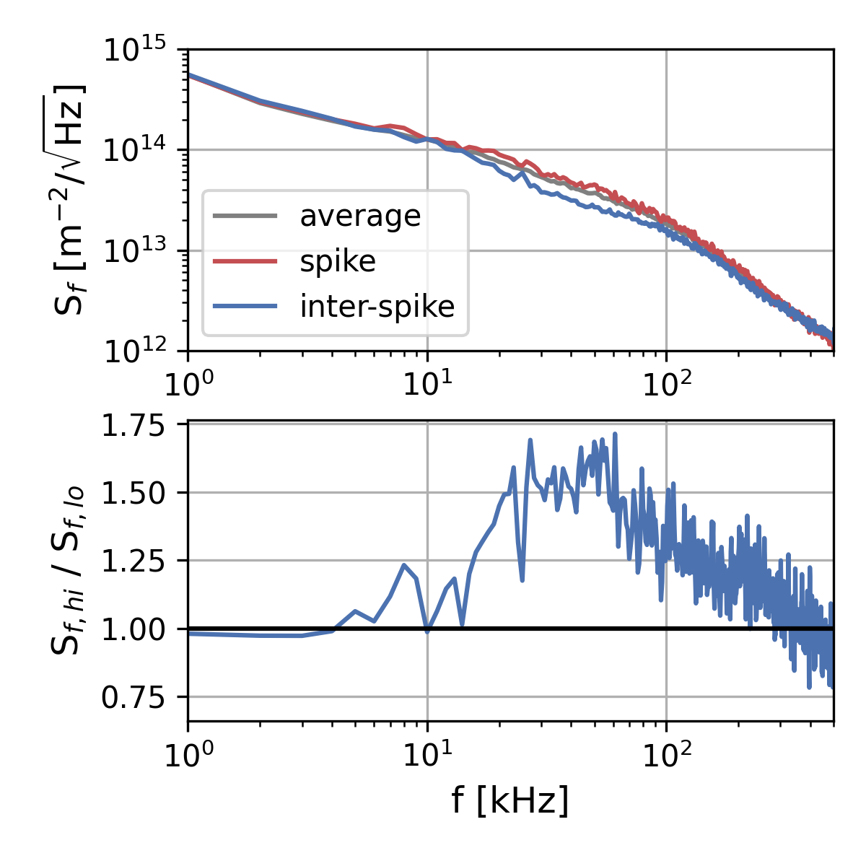
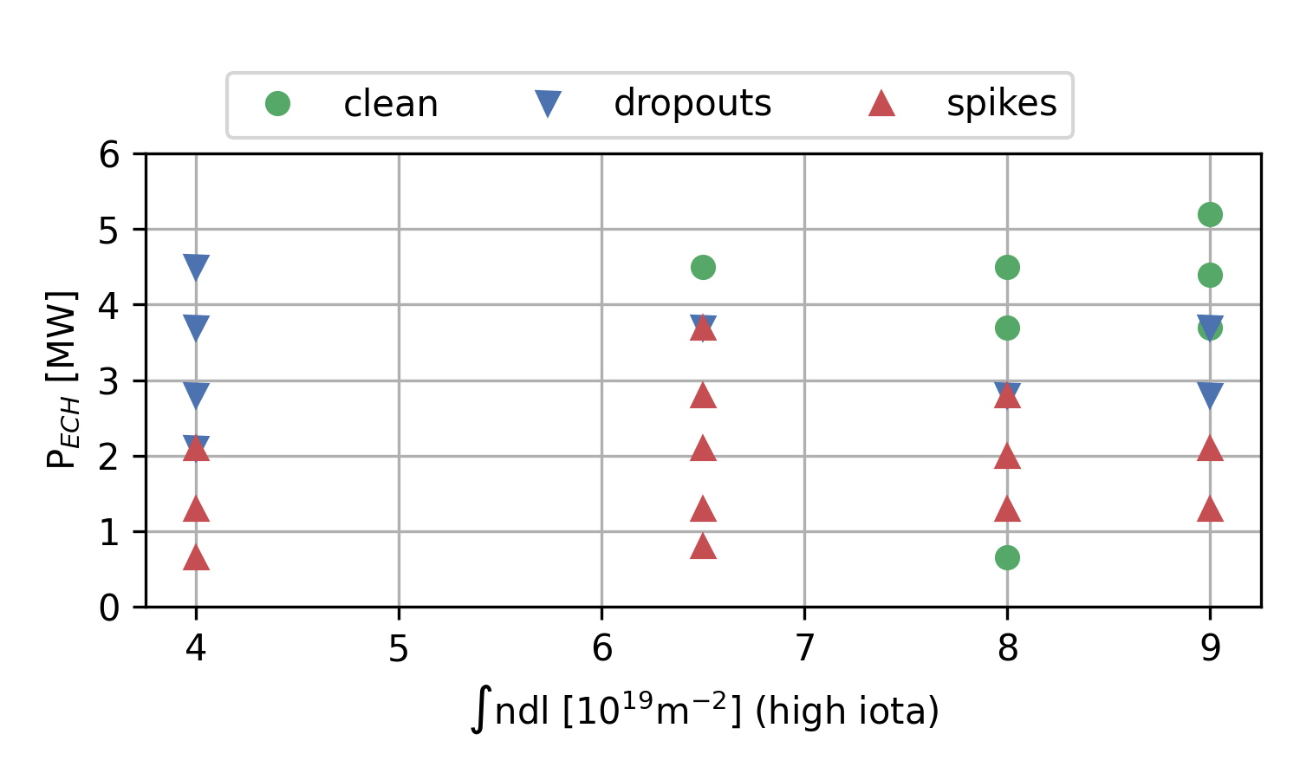
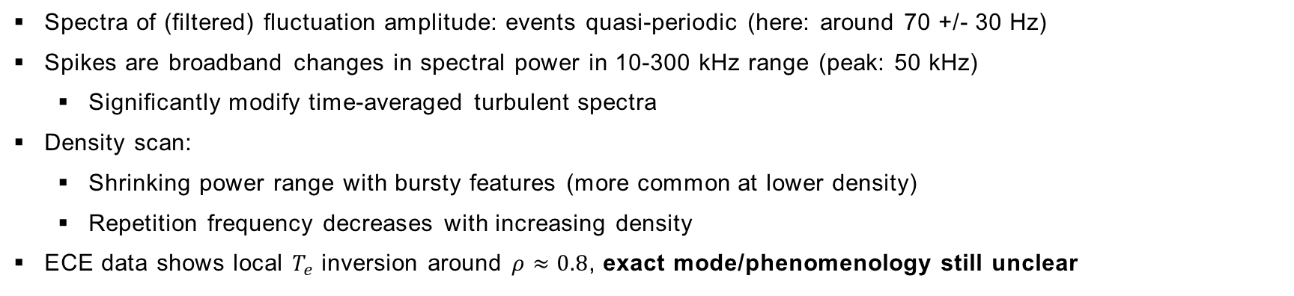
Bursty fluctuation regimes
20230117.074
burst spectrum
integrated spectrum (30-120 Hz)
4.5 MW
3.6 MW
2.8 MW
2.0 MW
1.3 MW
clean
  Spectra of (filtered) fluctuation amplitude: events quasi-periodic (here: around 70 +/- 30 Hz)
  Spikes are broadband changes in spectral power in 10-300 kHz range (peak: 50 kHz)
        Significantly modify time-averaged turbulent spectra
  Density scan:
        Shrinking power range with bursty features (more common at lower density)
        Repetition frequency decreases with increasing density
  ECE data shows local $T_{e}$ inversion around $ρ≈0.8$, exact mode/phenomenology still unclear

Slide 17
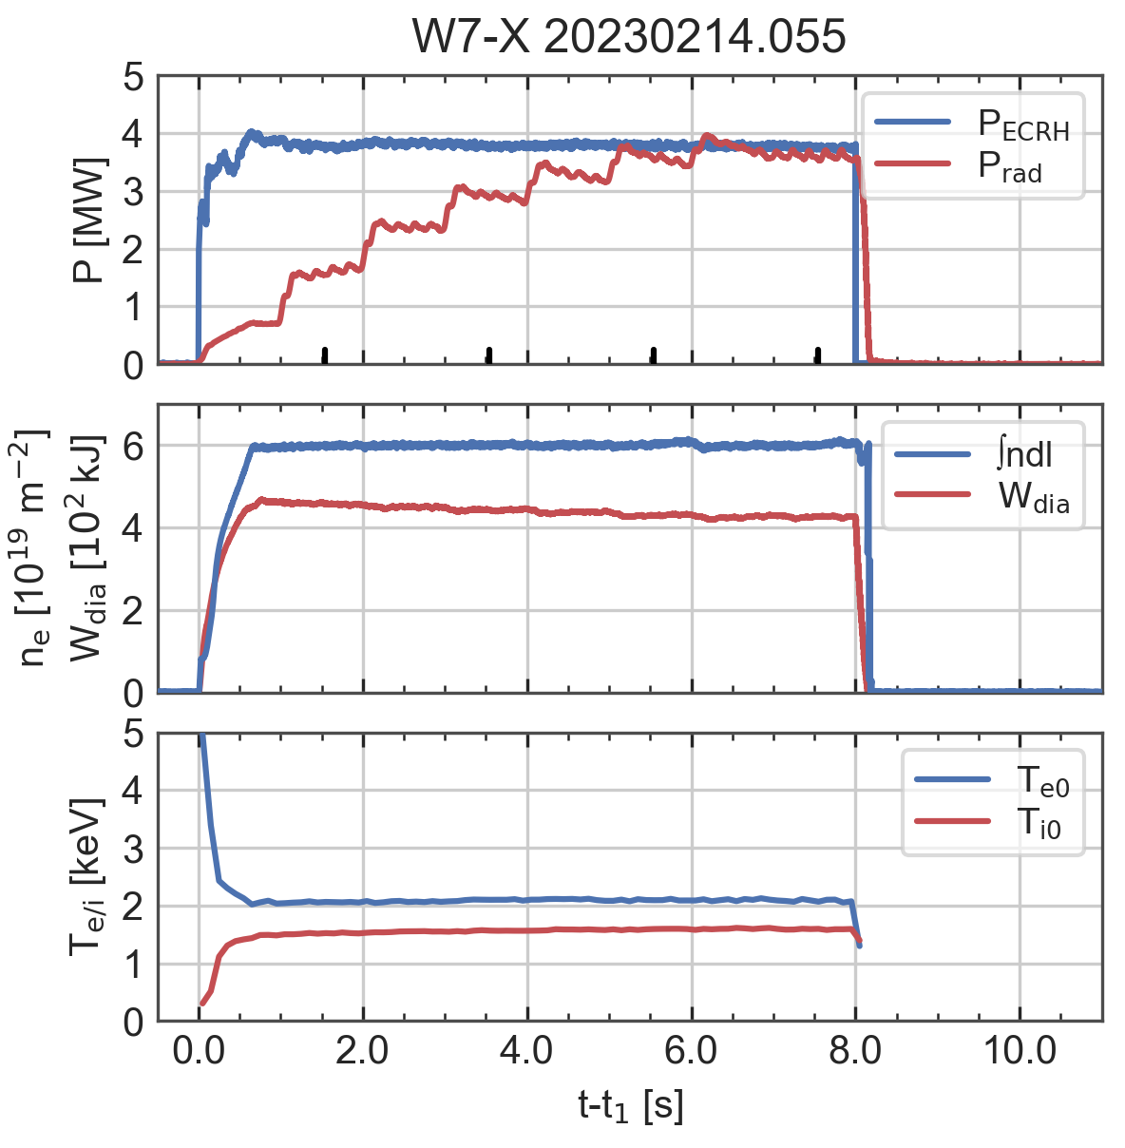
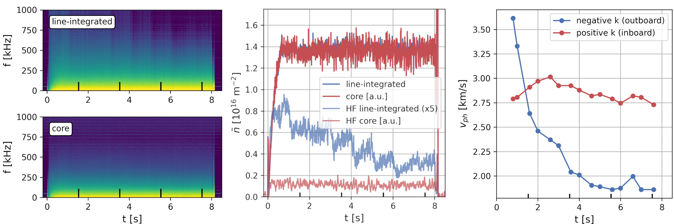
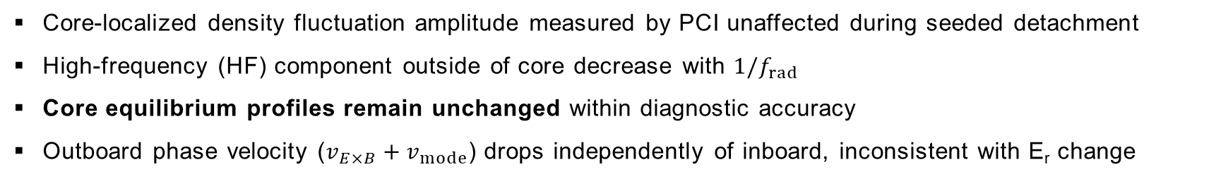
Core fluctuations during seeded detachment
integrated fluctuation
amplitude
fluctuation phase
velocity evolution
PCI fluctuation spectra
  Core-localized density fluctuation amplitude measured by PCI unaffected during seeded detachment
  High-frequency (HF) component outside of core decrease with $1/f_{rad}$
  Core equilibrium profiles remain unchanged within diagnostic accuracy
  Outboard phase velocity ($v_{E×B}+v_{mode}$) drops independently of inboard, inconsistent with E_{r} change

Slide 18
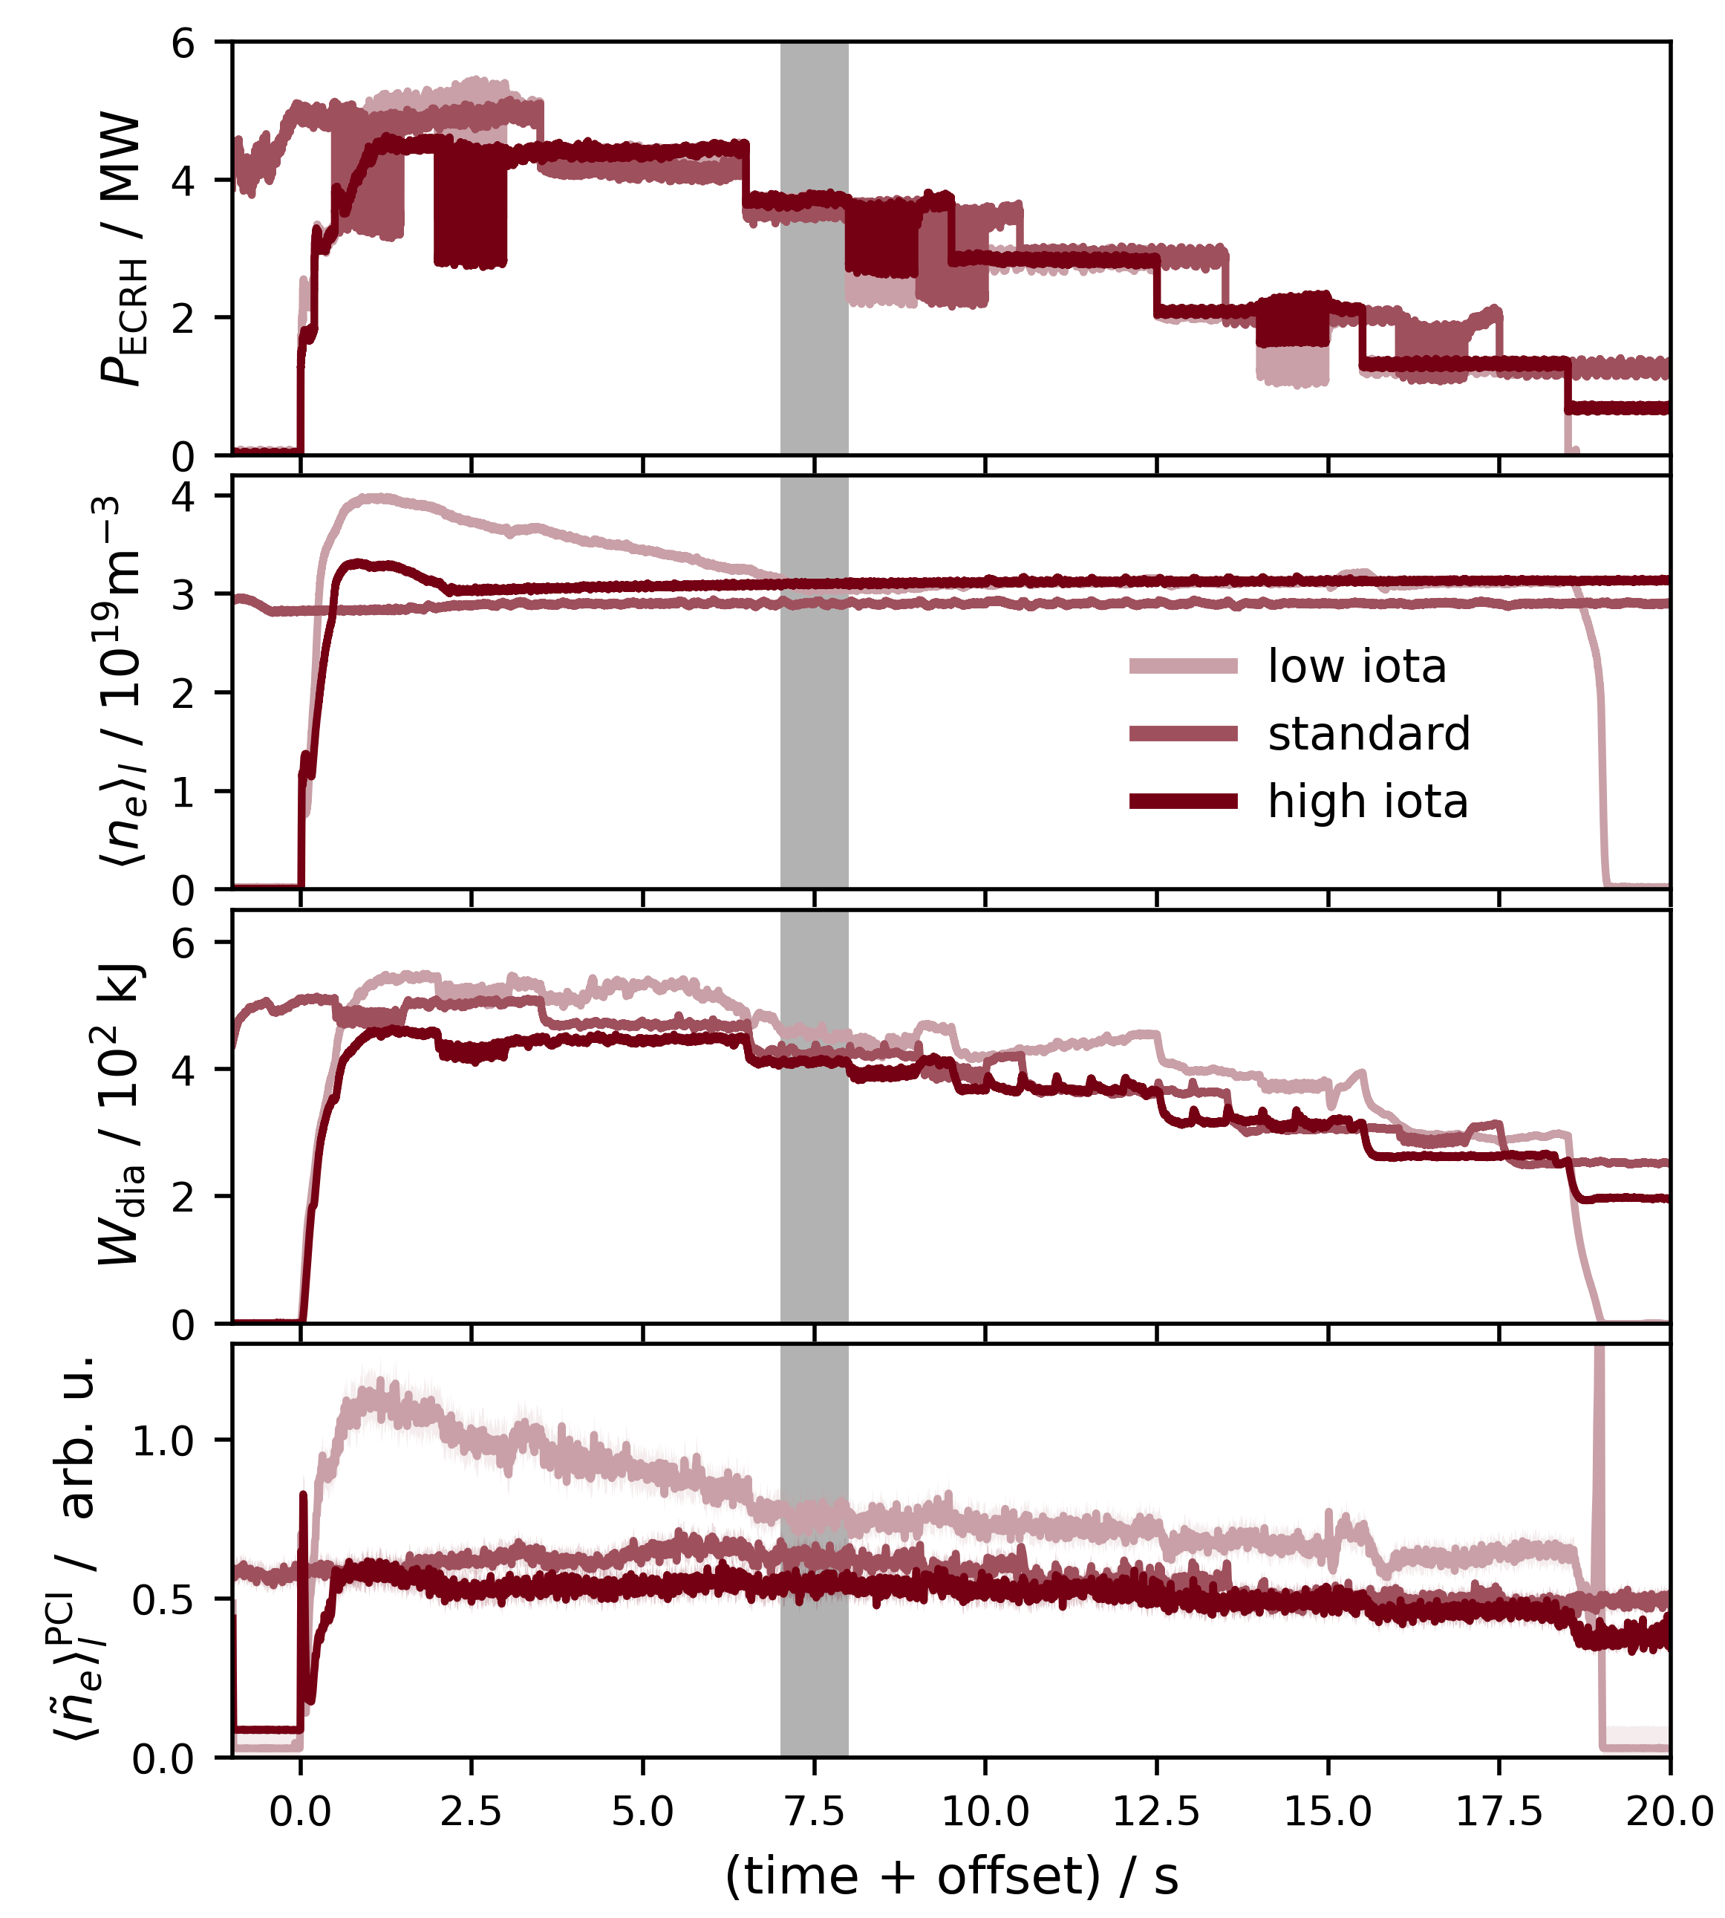
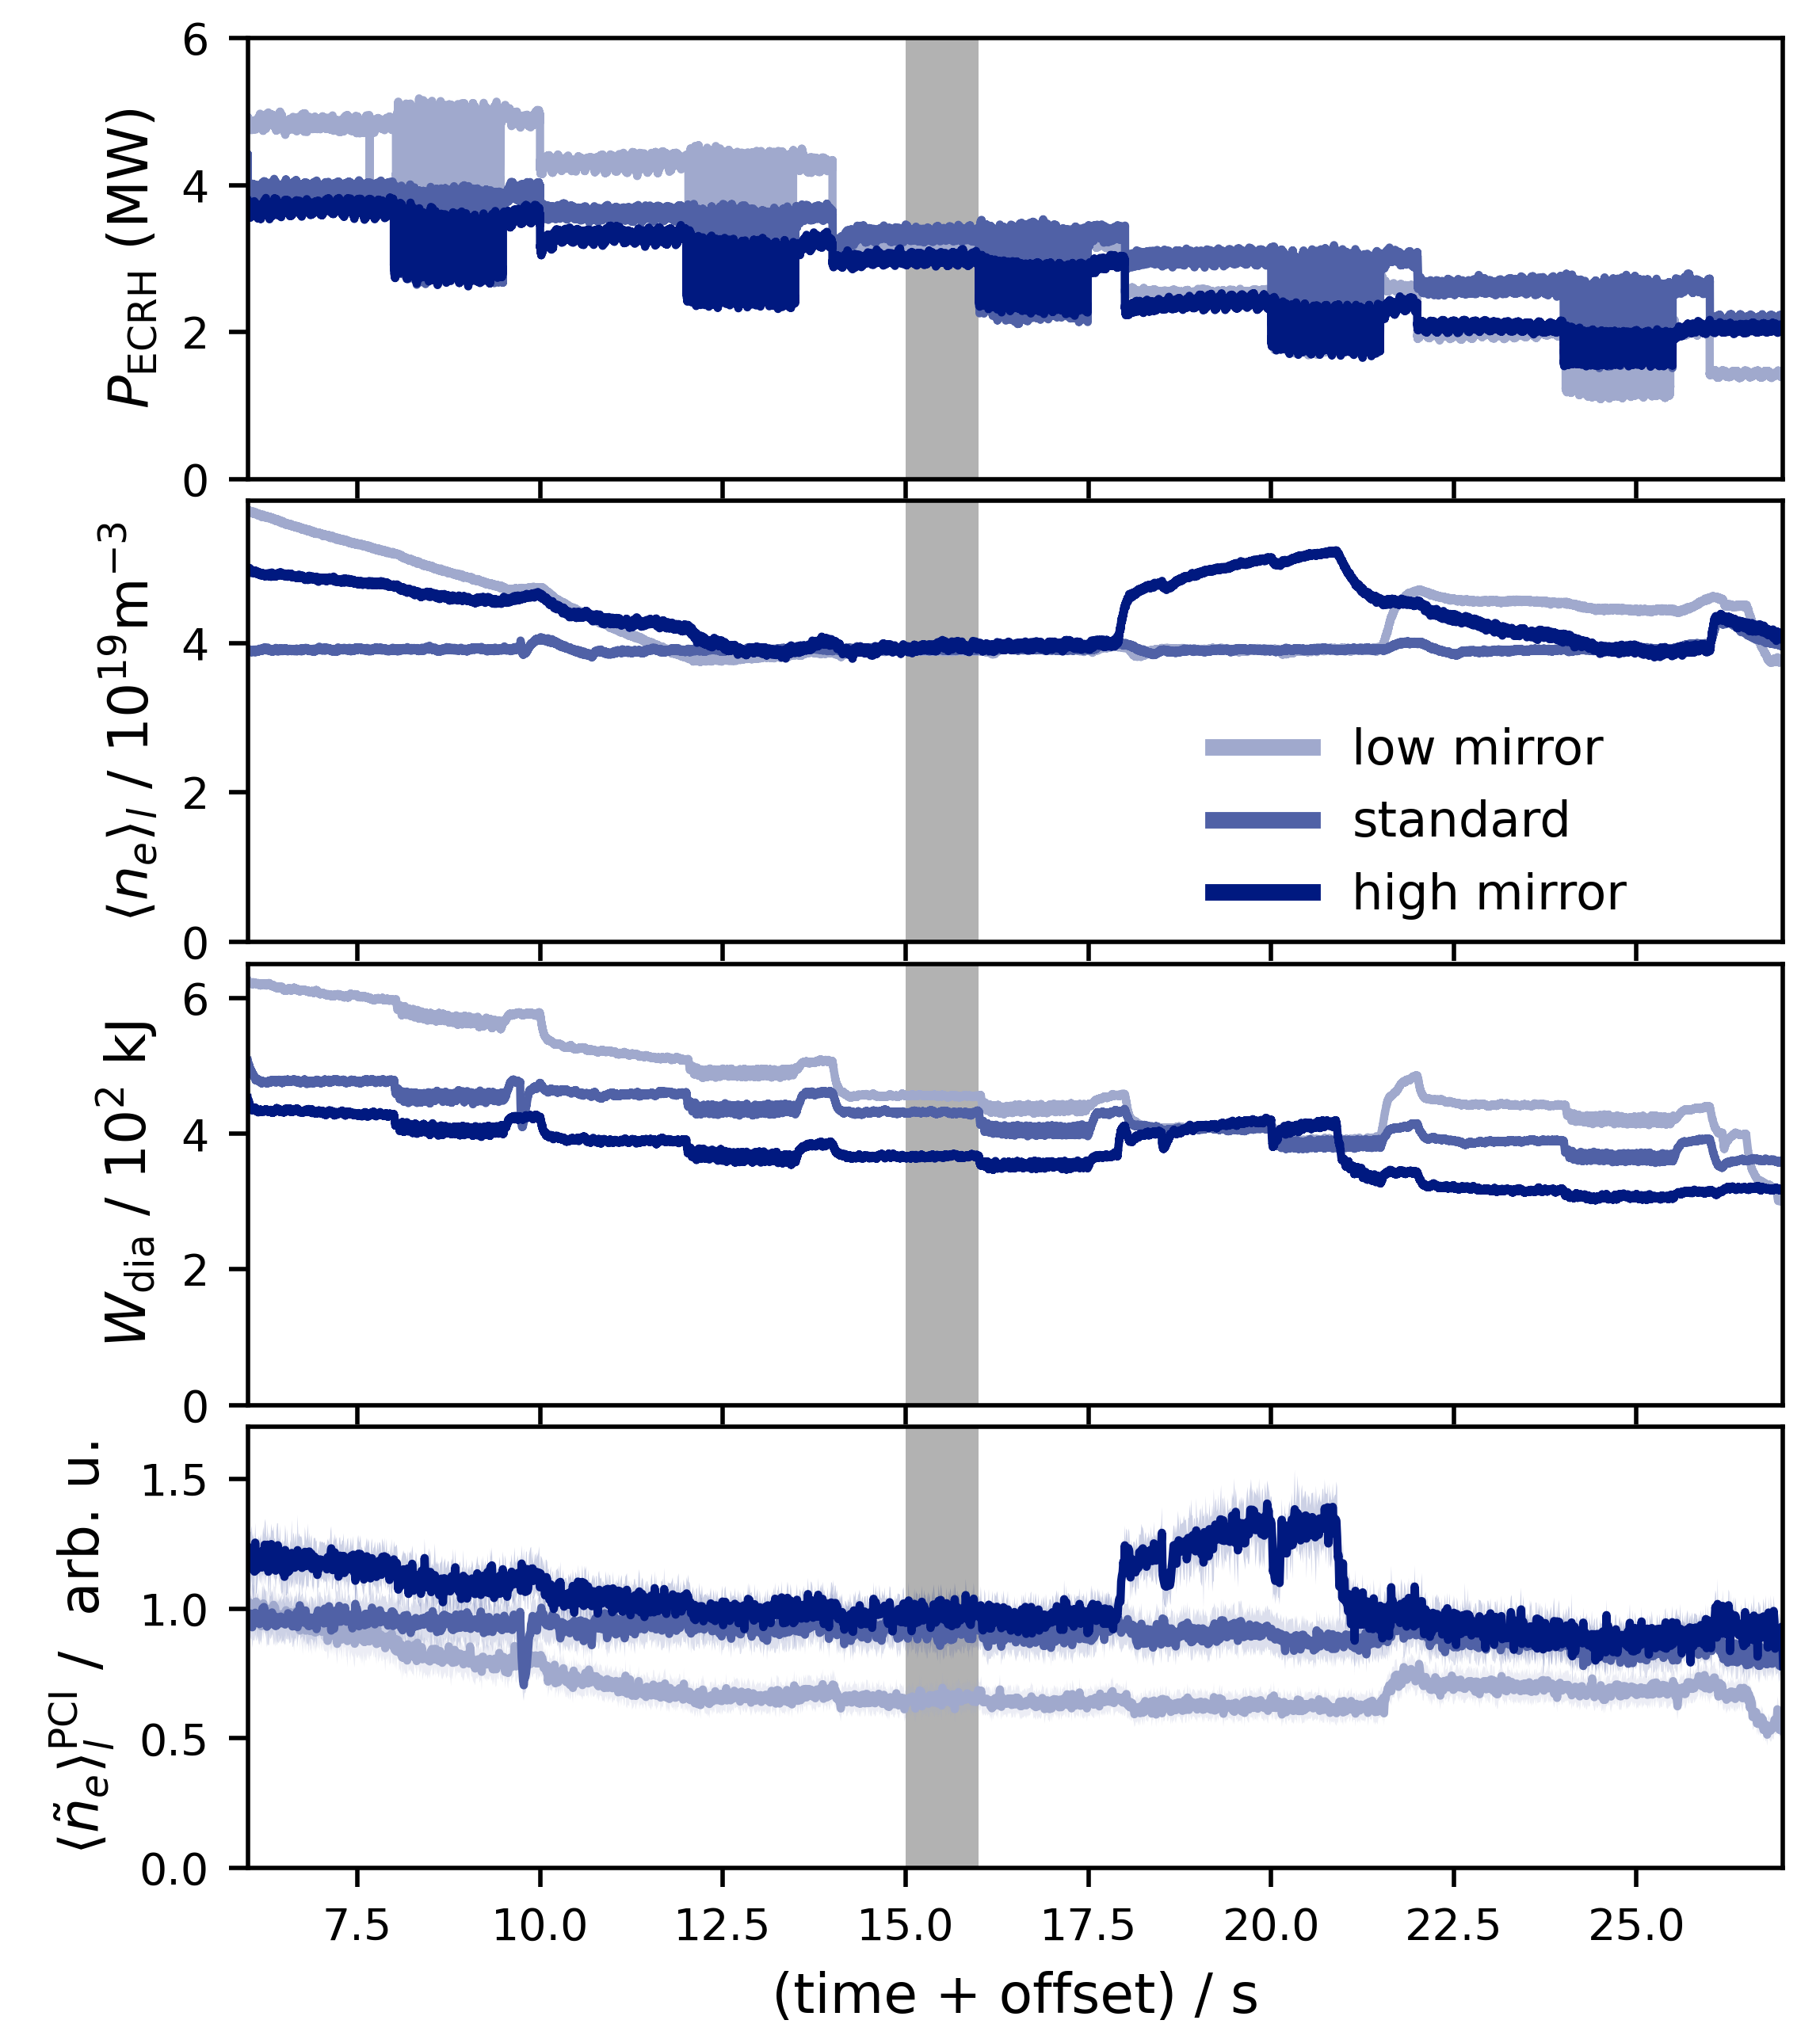
Effect of magnetic configuration on turbulence
PCI fluctuation measurements
low to high iota
low to high mirror

Slide 19
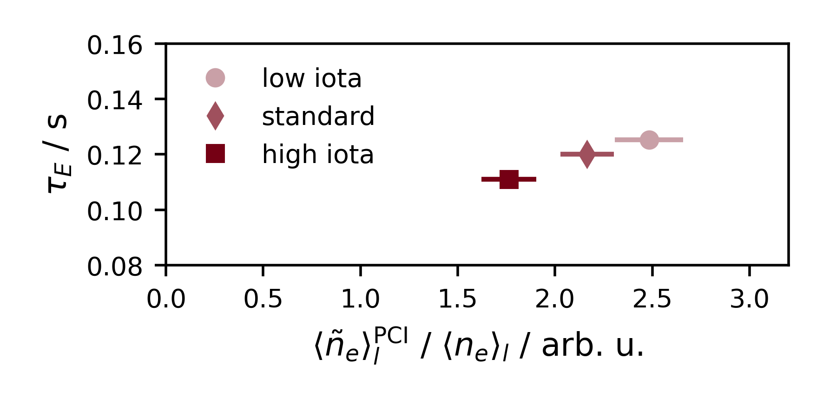
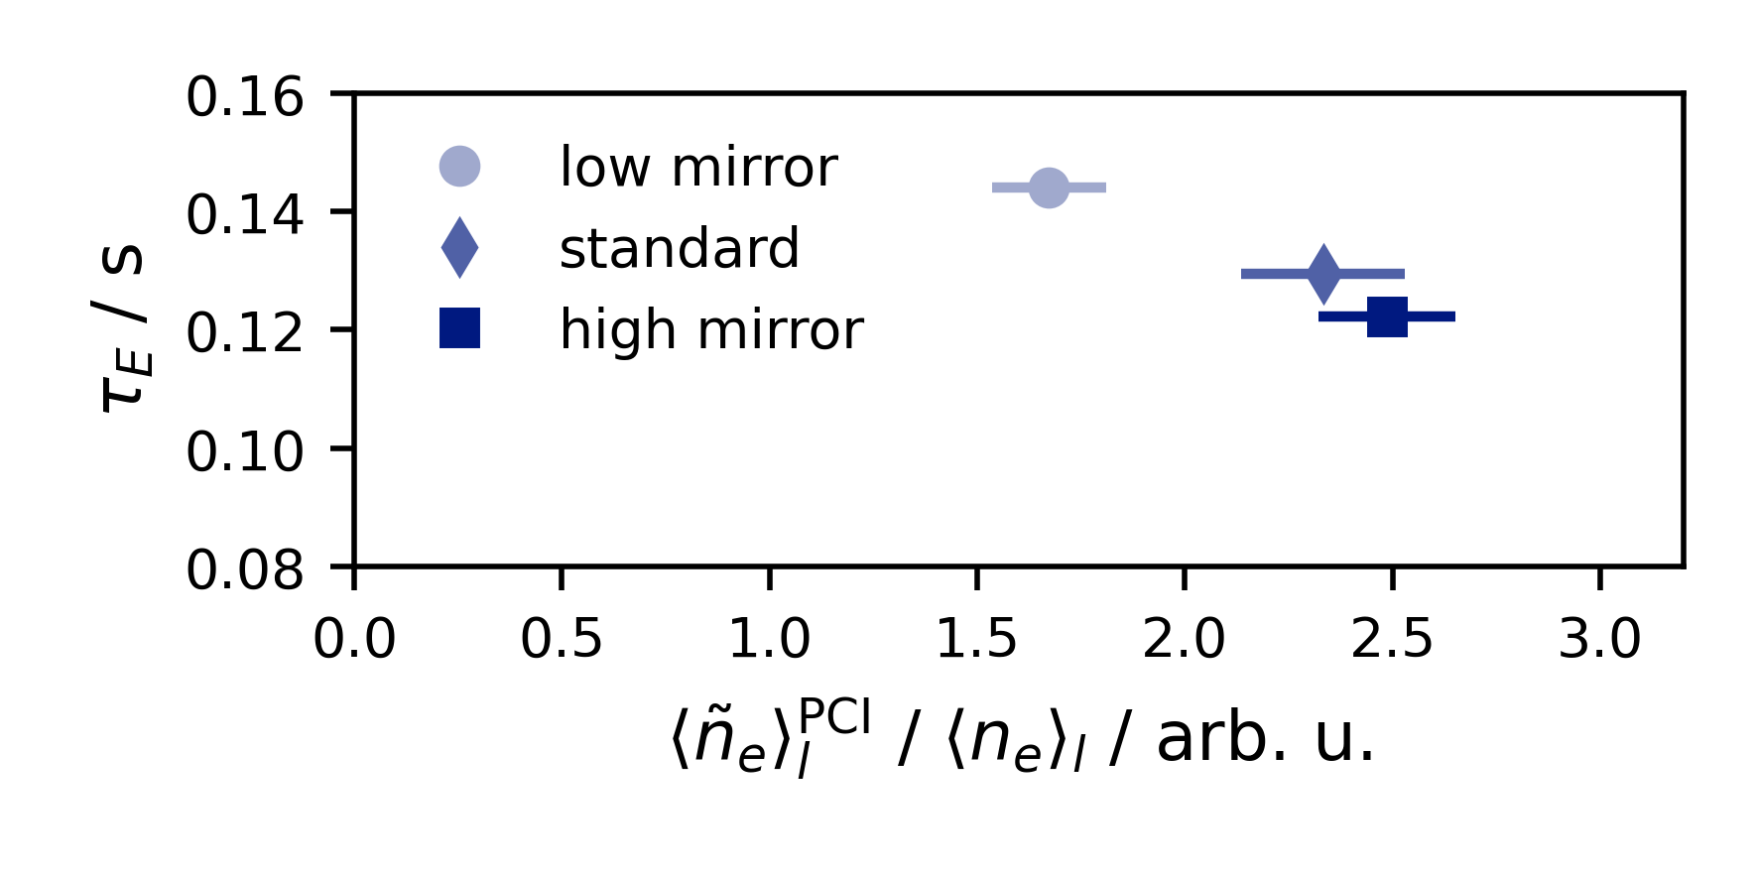
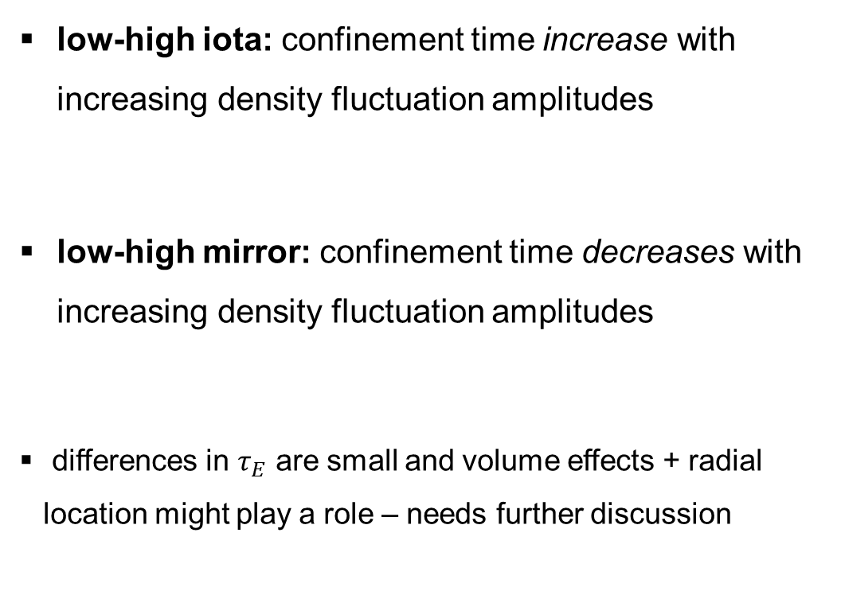
Effect of magnetic configuration on turbulence
PCI fluctuation measurements
low-high iota: confinement time increase with increasing density fluctuation amplitudes
low-high mirror: confinement time decreases with increasing density fluctuation amplitudes
differences in $τ_{E}$ are small and volume effects + radial location might play a role – needs further discussion

