Slide 1
TF III “Optimization” Review of OP2.1 experiments Lessons learned for OP2.2/2.3
Carsten Killer and Daniel Carralero
28.11.2023

Slide 2
TF-III Main Objectives and Deliverables
O1: Core transport and stability
D1: Documentation of profiles for transport analysis and modeling
D2: Turbulence in plasma scenario of magnetic configuration (MC) space
D3: Impurity transport and perturbative experiments
D4: Neoclassic optimization at increased T_{i}
D5: Reduced equilibrium currents at higher beta and in MC space
D6: MHD stability and modes in the MC space
O2: Edge and SOL transport
D1: Transport across LCFS and in island divertor SOL
D2: Validation of edge transport codes
D3: SOL width and target heat flux scalings
D4: Asymmetries and mapping of diagnostics in 3D SOL
O3: Low-field high beta scenarios
D1: Optimization criteria at increased beta
D2: High-beta plasma profiles, magnetic fluctuations
D3: Field stochastization and implications for SOL / divertor
formulation of deliverables in full prosaic beauty: https://event.ipp-hgw.mpg.de/event/161/contributions/217/

Slide 3
TF-III Main Objectives and Deliverables
O1: Core transport and stability
D1: Documentation of profiles for transport analysis and modeling Marc Beurskens
D2: Turbulence in plasma scenario of magnetic configuration (MC) space Jan-Peter Bähner
D3: Impurity transport and perturbative experiments Thilo Romba
D4: Neoclassic optimization at increased T_{i}
D5: Reduced equilibrium currents at higher beta and in MC space Joachim Geiger
D6: MHD stability and modes in the MC space Kian Rahbarnia
O2: Edge and SOL transport
D1: Transport across LCFS and in island divertor SOL
D2: Validation of edge transport codes
D3: SOL width and target heat flux scalings
D4: Asymmetries and mapping of diagnostics in 3D SOL
O3: Low-field high beta scenarios
D1: Optimization criteria at increased beta
D2: High-beta plasma profiles, magnetic fluctuations
D3: Field stochastization and implications for SOL / divertor
increased T_{i} /high beta scenarios not readily available
only investigation on NC optimization: scan of mirror field width at moderate performance

Slide 4
TF-III Main Objectives and Deliverables
O1: Core transport and stability
D1: Documentation of profiles for transport analysis and modeling
D2: Turbulence in plasma scenario of magnetic configuration (MC) space
D3: Impurity transport and perturbative experiments
D4: Neoclassic optimization at increased T_{i}
D5: Reduced equilibrium currents at higher beta and in MC space
D6: MHD stability and modes in the MC space
O2: Edge and SOL transport
D1: Transport across LCFS and in island divertor SOL Matt Kriete / Sean Ballinger
D2: Validation of edge transport codes Victoria Winters (TF-II) / Matt Kriete
D3: SOL width and target heat flux scalings
D4: Asymmetries and mapping of diagnostics in 3D SOL Gabriele Partesotti / Sean Ballinger
O3: Low-field high beta scenarios
D1: Optimization criteria at increased beta
D2: High-beta plasma profiles, magnetic fluctuations
D3: Field stochastization and implications for SOL / divertor
figure of merit missing
low field experiments are integral to O2.D3, were not available in OP2.1

Slide 5
TF-III Main Objectives and Deliverables
O1: Core transport and stability
D1: Documentation of profiles for transport analysis and modeling
D2: Turbulence in plasma scenario of magnetic configuration (MC) space
D3: Impurity transport and perturbative experiments
D4: Neoclassic optimization at increased T_{i}
D5: Reduced equilibrium currents at higher beta and in MC space
D6: MHD stability and modes in the MC space
O2: Edge and SOL transport
D1: Transport across LCFS and in island divertor SOL
D2: Validation of edge transport codes
D3: SOL width and target heat flux scalings
D4: Asymmetries and mapping of diagnostics in 3D SOL
O3: Low-field high beta scenarios
D1: Optimization criteria at increased beta
D2: High-beta plasma profiles, magnetic fluctuations
D3: Field stochastization and implications for SOL / divertor
No low field scenario → O3 mostly unaddressed in OP2.1

Slide 6
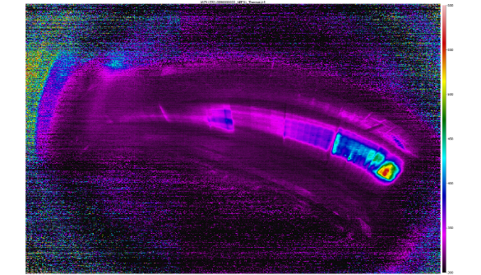
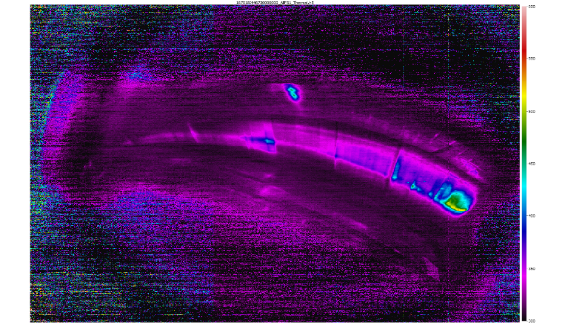
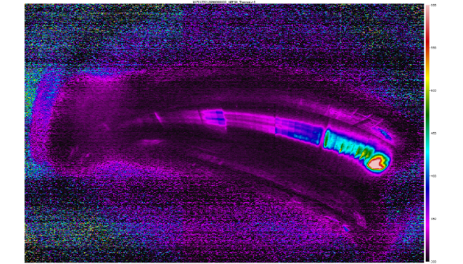
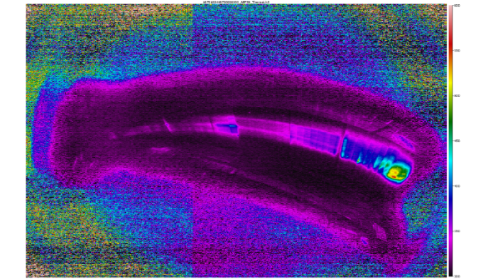
Studies of beta-dependent aspects in OP2.1 for β_{vol}<1%
O3.D1 KBM-prone experiments attempted (Low Mirror) → modes, Kian Rahbarnia
O3.D2 local magnetic fluctuation measurements (MPM) → analysis ongoing, technical validation
O3.D3 Boundary topology change with beta in Low Shear configurations → analysis ongoing
O3.D3 Heat flux studies at intermediate beta in Low Iota → little progress on analysis (workpower limited)
20230131.040
20230131.054 ($β_{vol}≈0.5\%$)
5 upper
5 upper
5 lower
5 lower
[Knieps]

Slide 7
Conclusion on TFIII activities: major missing aspects
reliable high beta / increased T_{i} scenario is essential for future TF III investigations
large parts of O1, entire O3
low field scenario play an essential role for high beta operation (O3) and is relevant for O2.D3
limited machine capabilities, not even regarding high beta
pellet injection unavailable
limited heating power (competition for power supplies, reliability)
not all magnetic configurations attempted in OP2.1
XIM (negative mirror, for turbulence / MHD ): initially planned for OP2.2
UFM (MHD unstable / FI confinement): requires low field (coil forces), initially planned for OP2.2
KTM (highest KBM stability) only run in commissioning, AAM (lowest KBM stability) not planned
planned sessions in FTM (fundamental turbulence / SOL characterization) and FMM (high performance) cancelled due lost experiment days

Slide 8
Conclusion on TFIII activities; thoughts towards OP2.2/2.3
neccessary repeats of OP2.1 experiments
impurity transport studies (limited diagnostic availability)
some core transport (O1) experiments were conducted but might suffer from core profile quality issues → further assessment is required to identified affected proposals
edge/SOL (O2) to be repeated with better diagnostic coverage + coordination
room for improvement: standard scenarios
for reproducibility and comparison of programs across the campaign. Was partly attempted (e.g. power step down program for turbulence survey, reversed field comparisons)
still, in practice sometimes varying power and density levels (e.g. “low” density was 3-5e19m⁻², “medium” density was 6-8e19m⁻²). Different use / timing of diagnostic tools, e.g. NBI blips , LBO → attempt more coherent standardization
edge/SOL plasma is very sensitive to I_{plasma} and f_{rad} →better control / prediction capabilities
design programs for a clearer separation of P,n scans from I_{plasma} evolution (many diagnostics to not operate continuously!). Possible solution: better exploit long pulse lengths

