Slide 1
Spectroscopic analysis of impurities in the edge
D. Gradic on behalf of the W7-X team

Slide 2
Overview of objectives/deliverables (TF II)
D9: Characterize the scrape-off layer retention for tungsten impurities (eroded from baffle and heat shield)
D11: Characterize enrichment/accumulation for low-Z and high-Z impurities
Why are we interested in edge impurity behaviour/enrichment?
Necessary for e.g. power exhaust and burn criterion for later reactor
How many impurities born/seeded in the divertor reach the core?
→ impurity radiation crucial for reaching detachment. What will be the necessary impurity content for higher heating powers in W7-X?

Slide 3
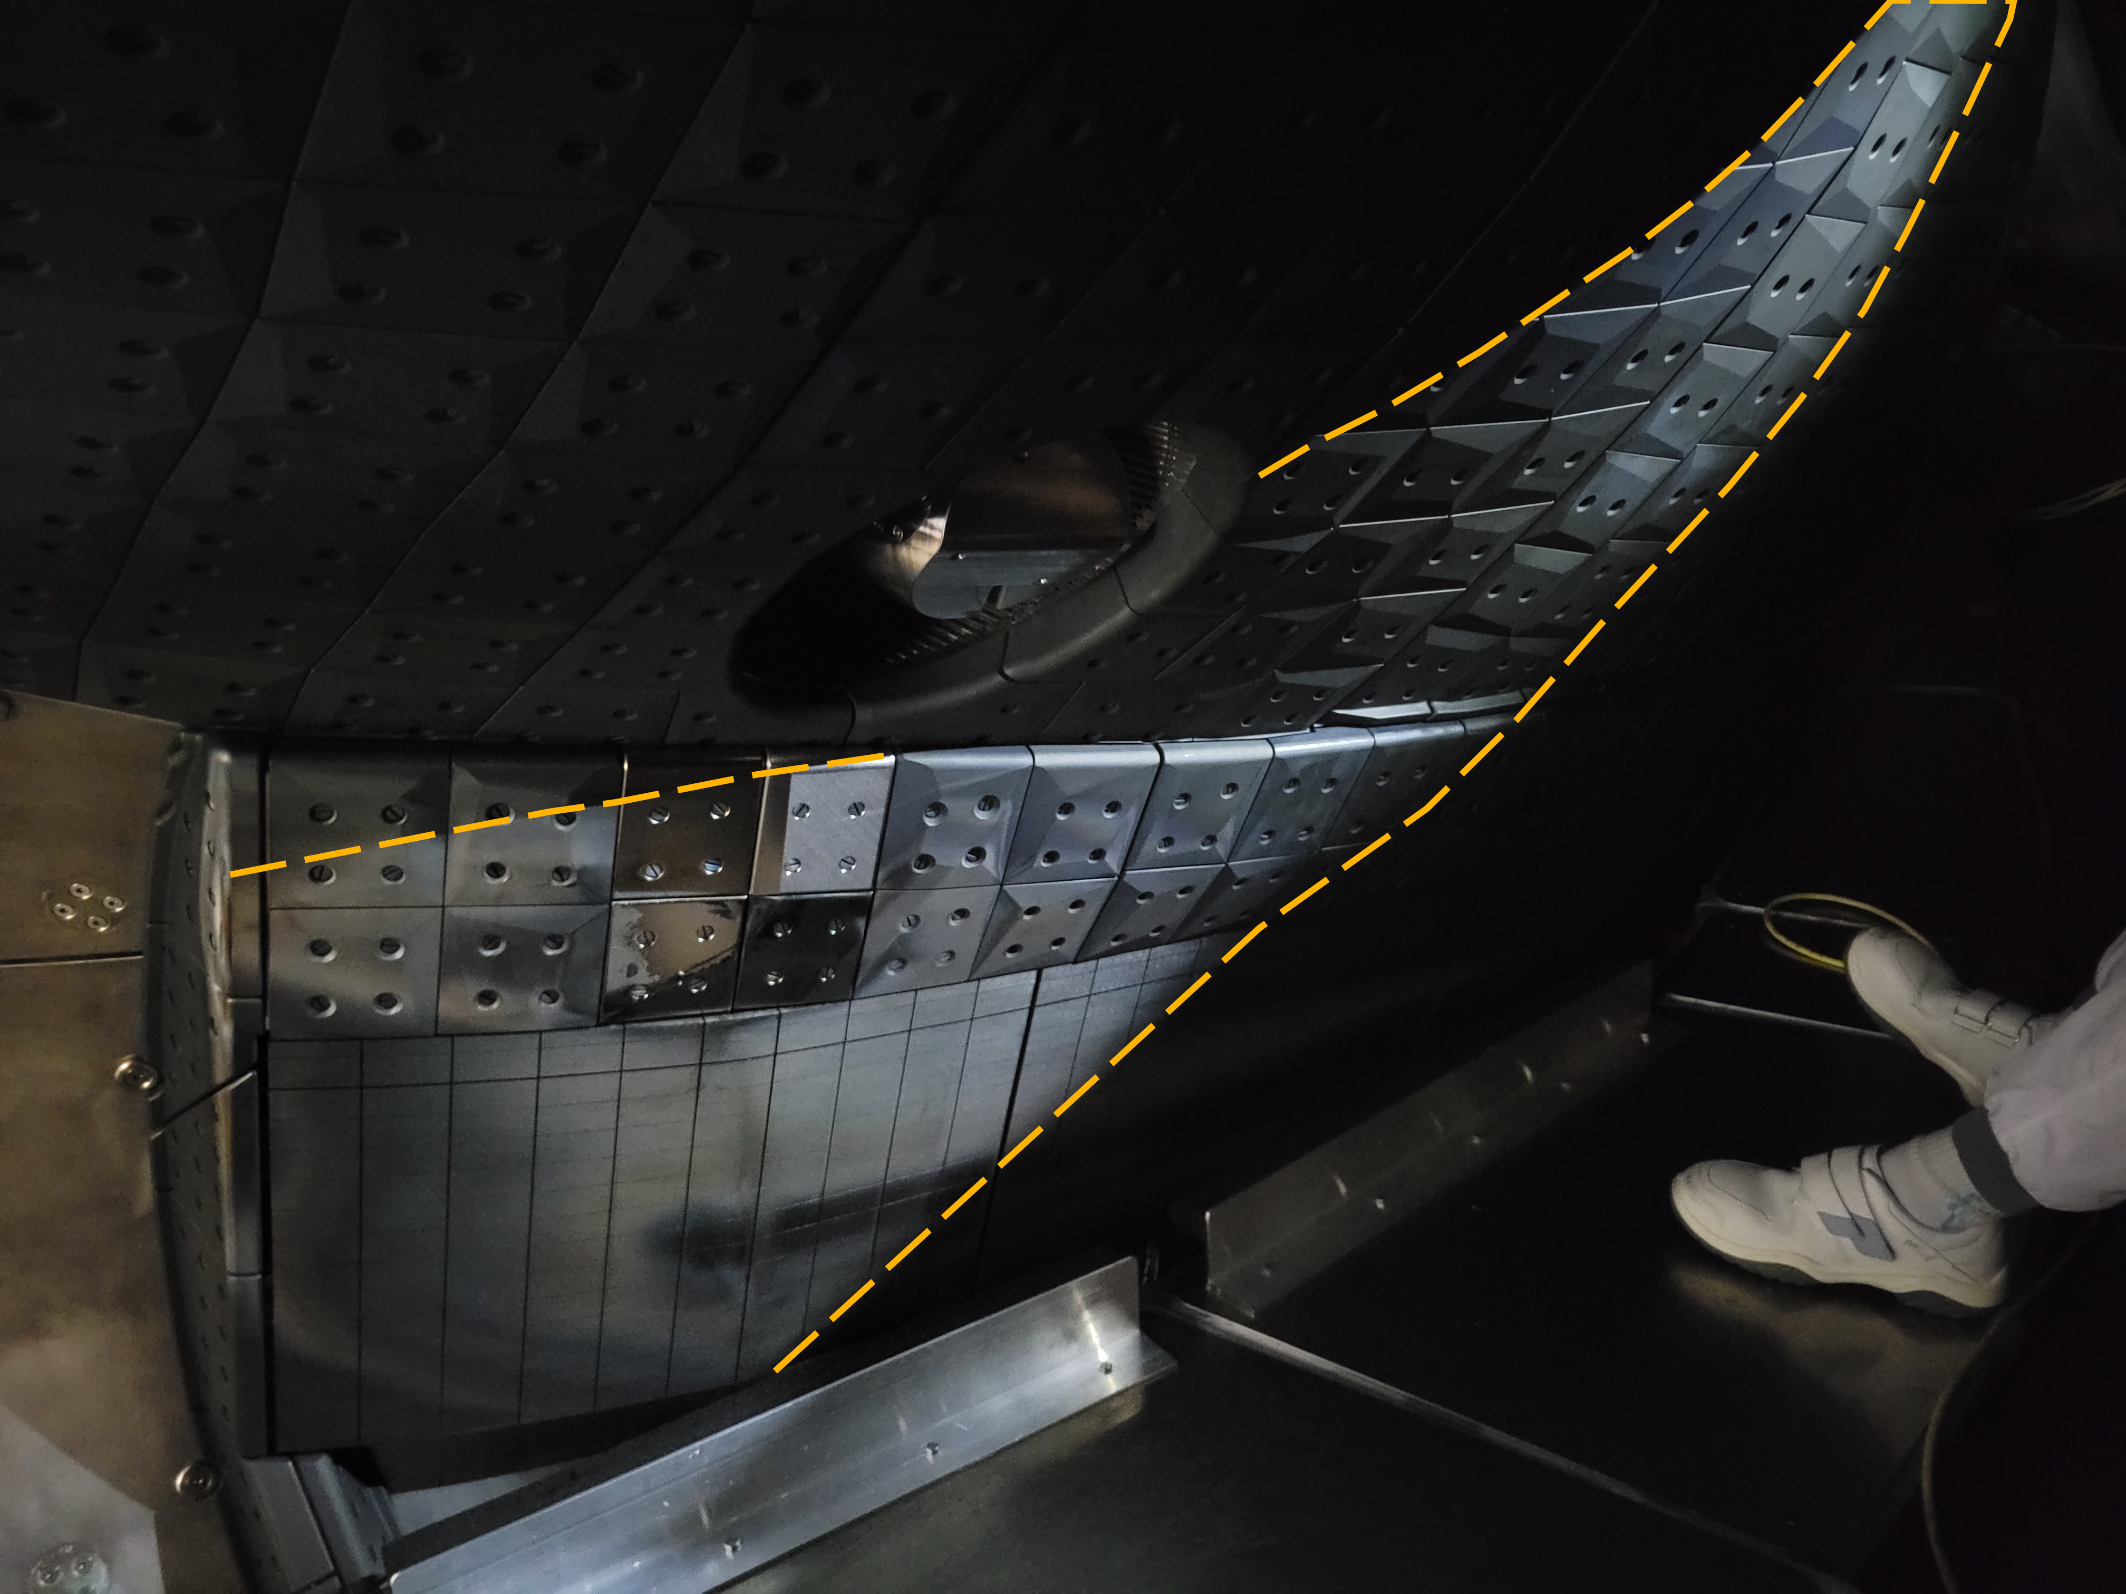
On D9 – tungsten retention in SOL
No Tungsten lines observed by Divertor spectroscopy in SOL during OP2.1
→ New tungsten overview fibre installed for OP2.2
For D9, no SOL data available yet. A repeat (or first-time implementation) of the related proposals/experiments is suggested.

Slide 4
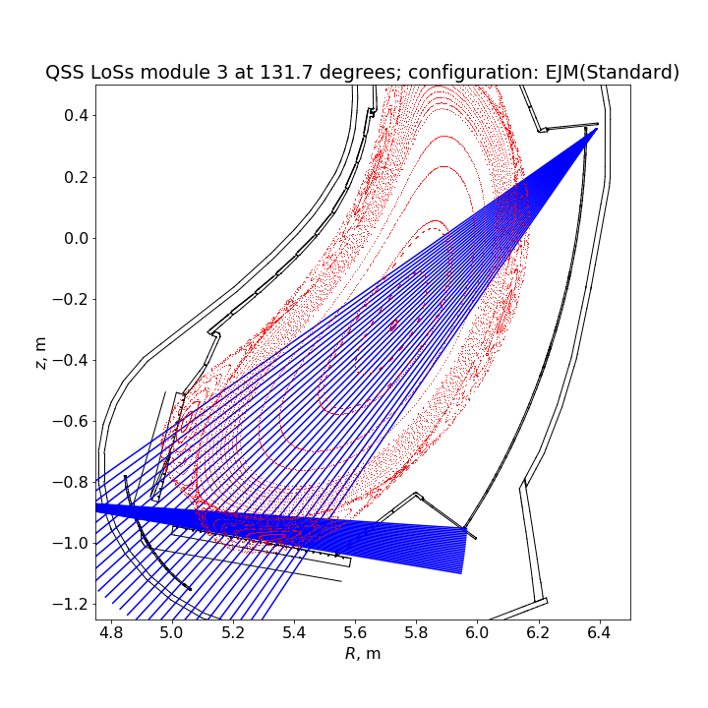
On D11 – SOL impurity enrichment
Divertor spectroscopy QSS70 LOS
Spectroscopic diagnostics available in OP2.1:
Divertor spectroscopy (QSS70)
Tomography of available emission lines
Spectroscopic observation of divertor gas inlet (QSQ) species possible
AEI: (active) He/Ne beam emission for $n_{e}$, $T_{e}$ measurements
Alkali beam CXRS spectroscopy (AEB20) (outer edge)
CXRS spectroscopy (QSK) (mainly core, AEA20)
AEF30/51
AEI30/51
QSQ
[picture provided by F. Henke]

Slide 5
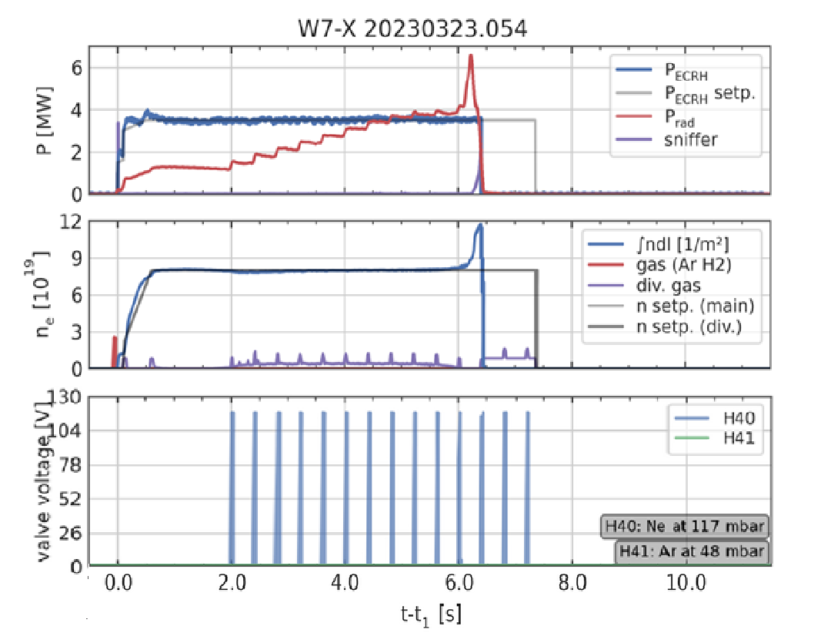
Impurity Tomography over AEI/AEF LOS (OP 2.1)
With after-OP2.1 calibration made in August 2023, tomography now possible for OP2.1 analysis, very first results coming in…
QSQ
[provided by F. Henke & M. Krychowiak]
Most lowly ionized impurity species radiate strongly in vicinity of strikelines on horiz. & vertical target
During detachment, we observe significant upstream transition of most impurity lines

Slide 6
Enrichment: absolute impurity concentrations in Divertor SOL
Absolute impurity concentrations can be deduced from line intensity of an observed emission line:
PEC: Photon emissivity coefficient (dependent on $T_{e}$)
→ When $n_{e}$, $T_{e}$ are known, impurity density $n_{imp}$ (and therefore impurity concentration $c_{imp}=\frac{n_{imp}}{n_{e}}$) straightforward to analyse

Slide 7
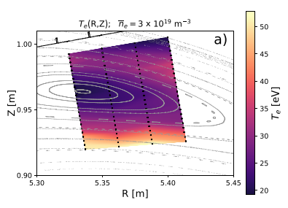
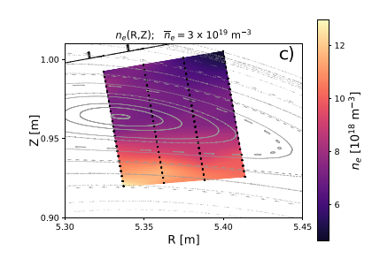
How to get $n_{e}$, $T_{e}$ in the (divertor) SOL?
In OP2.1, only measurements of $n_{e}$, $T_{e}$ in divertor SOL made by He beam analysis (Langmuir probes only operated last 2-3 weeks)
[E. Flom et al., submitted to NF]
Local measurements of $n_{e}$, $T_{e}$ around Divertor gas inlet through O-point of island → however no coverage of crucial areas around X-point or strike-line area (where highest impurity radiation is usually observed) except in low-iota

Slide 8
Enrichment: absolute impurity concentrations in Divertor SOL
Absolute impurity concentrations can be deduced from line intensity of an observed emission line:
If $n_{e}$, $T_{e}$ are NOT known by other diagnostics/means, we need to measure three impurity lines to analyse them as well! → Line ratios of same different emission transitions dependent on $n_{e}$, $T_{e}$!
Example of Neon:
Ratio 371.3 / 371.7 = 0.25
Ratio 357.1 / 371.3 = 0.35
[pictures provided by F. Henke]

Slide 9
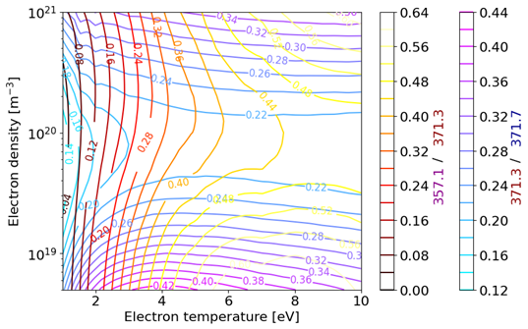
Enrichment: absolute impurity concentrations in Divertor SOL
With passive spectroscopy, analysis of $n_{e}$, $T_{e}$ and $n_{imp}$ in theory possible if 3 spectroscopic lines available in one spectrometer setting!
In OP2.1, our focus was on N & Ne seeded impurity as proof-of-principle:
- N lines (395 to 410 nm) difficult since one of the three lines is covered by He line, only 2 lines nicely visible
- Ne: 3 lines are in area of 350 to 370 nm, at the very edge of our observation capabilities, with non-unique solution

Slide 10
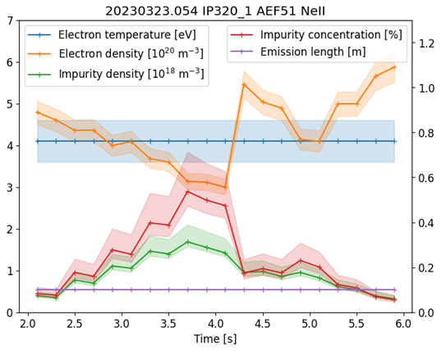
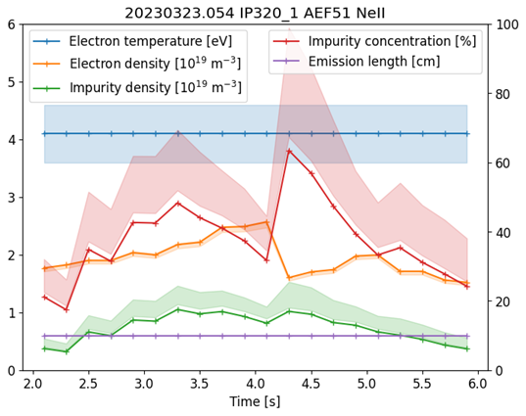
Enrichment: absolute impurity concentrations in Divertor SOL
PRELIMINARY (work in progress)
$$n_{e}$$
$$T_{e}$$
$$T_{e}$$
$$n_{e}$$
$$c_{Ne}$$
$$c_{Ne}$$
High-density solution
Low-density solution
[provided by F. Henke]
Derived Ne concentrations in the Divertor SOL very different for low & high-density solutions during detachment transition in the shown program

Slide 11
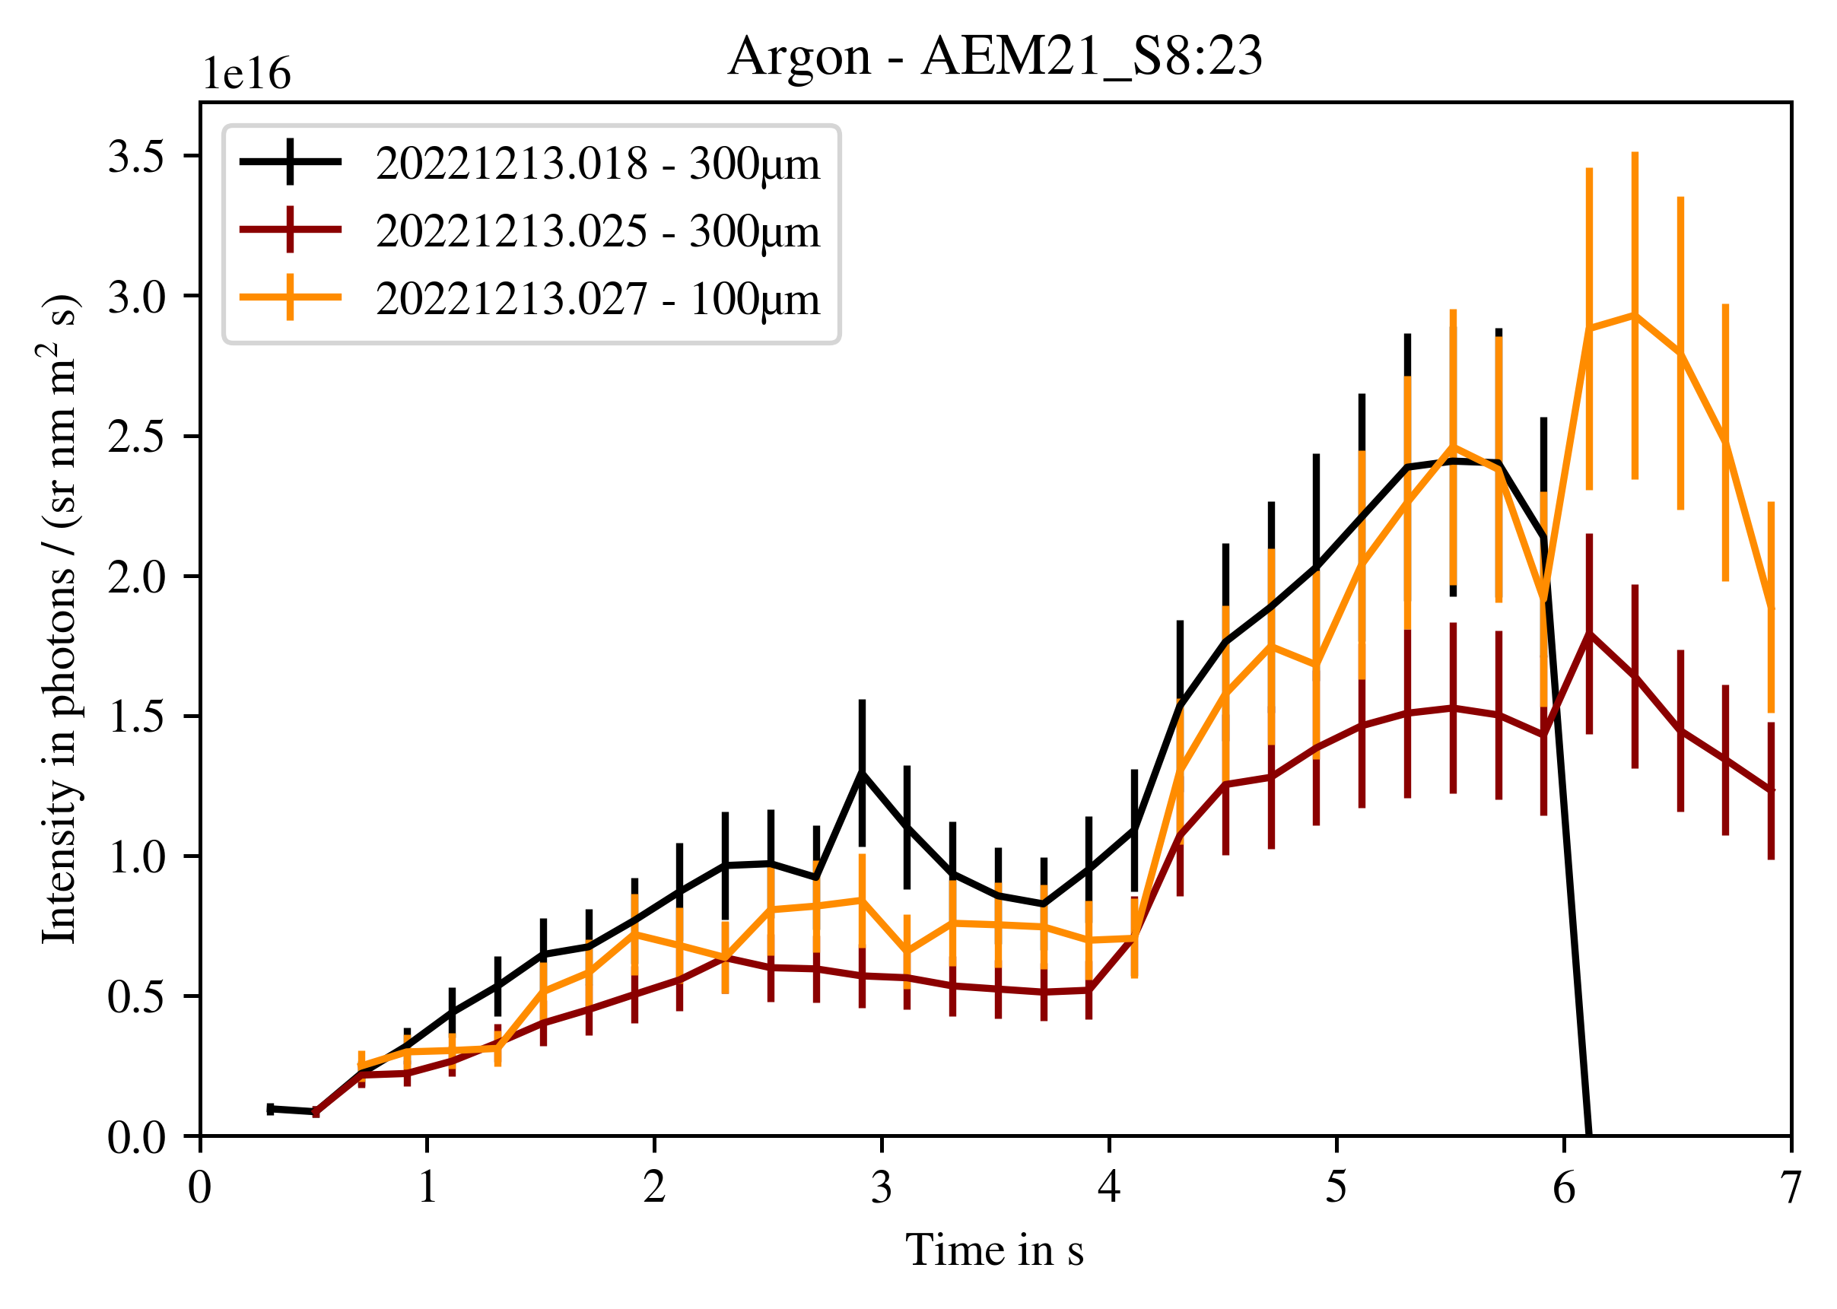
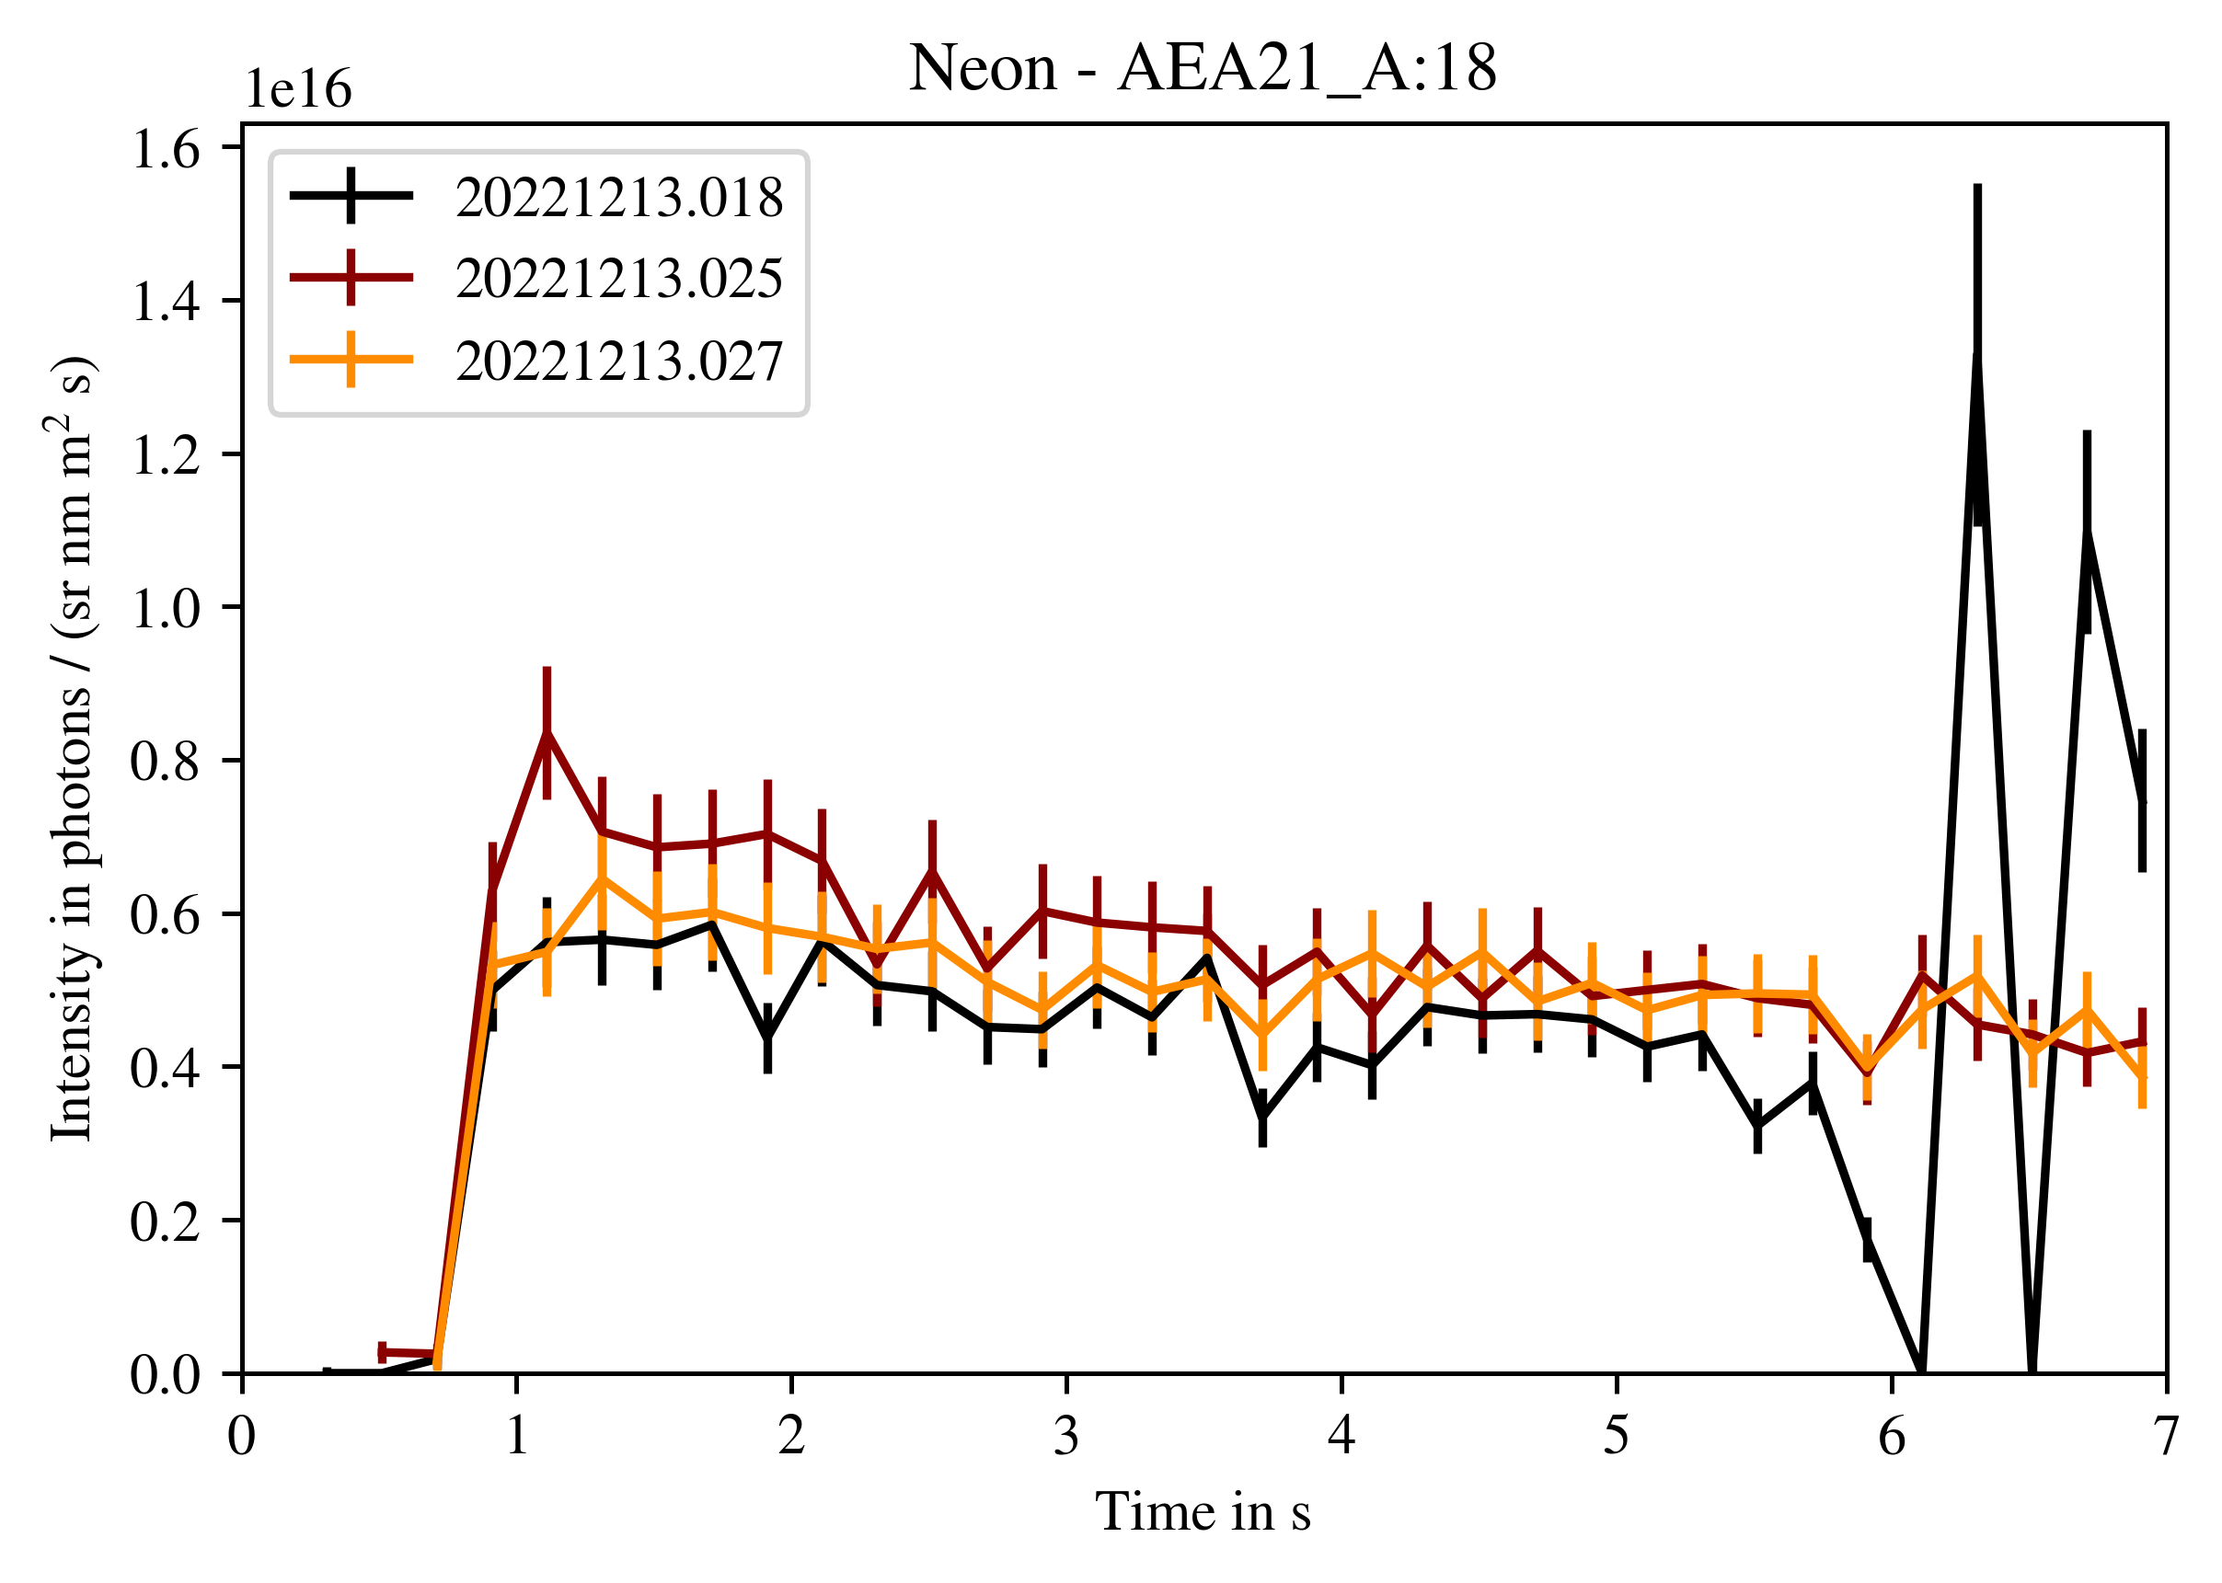
Impurity concentrations from the core
Argon
T. Romba
Upstream/core impurity concentration possible with active beams such as e.g. QSK CRXS
Good coverage from core to edge if NBI (blips) are used
Allows for direct comparison of SOL and core impurity concentrations to study impurity transport
Neon
Next campaign: N, Ne and Ar divertor seeding experiments should be performed with accompanying NBI blips and full diagnostic capabilities for $n_{e}$, $T_{e}$(LP)

Slide 12
Summary
Concerning tungsten (D9), we have not observed any spectroscopic lines in the SOL yet. A repeat of the proposals is suggested for OP2.2, where we have a new W overview fibre available for spec. observation
For SOL impurity enrichment (D11), further analysis of the existing experimental results of OP2.1 is necessary – Not many results yet. Work in progress, proof-of-principles currently underway, spectroscopic calibrations available since August. Also here, a repeat of seeding proposals is suggested (slightly modified) with better diagnostic coverage
comparison of the spectroscopic data with modeling (EMC3/Eirene, ERO2.0) ongoing

Slide 13
attachments

Slide 14
Deliverables/Objectives
Deliverable 9 “SOL tungsten retention”
B. Buttenschön: Quantification of intrinsic (and/or injected) tungsten content in W7-X plasmas (bubi_009)
B. Buttenschön: Collection of tungsten spectral fingerprints to create a data basis for quantitative tungsten analysis (bubi_010)
D. Ennis: Studies of time-resolved tungsten gross erosion and prompt re-deposition rates
E. Wang: Investigation of tungsten transport in SOL (erwa_008)
Deliverable 11 “SOL impurity Enrichment”
T. Dittmar: Impurity transport studies using 15N injections (tid_003) → OP2.2
F. Henke: Impurity concentrations and local plasma parameter measurements (ne, Te) in SOL via line ratio spectroscopy (N2, Ne, Ar) (frhe_001)
P. Kornejew: Effect of tungsten/carbon erosion from inner wall tiles and impact of the target material on the H flux from these tiles (pak_001)
T. Kremeyer: Understanding He recycling flux fueling in ?? Configuration by gas injection proxy (thkr_13 to 15)
V. Perseo: Impurity flow measurements: identification of thermal force regime (vape_001)
V. Winters: Location dependence of impurity retention of partially recycling species (viwi_004)
V. Winters: Ionization energy dependence of impurity retention - transport in the island divertor (viwi_005)
V. Winters: Island size effect on impurity retention in the SOL (viwi_007)

Slide 15
SOL impurity enrichment
Intrinsically present: C, O (E. Wang, Yu Lou, T. Romba (with CXRS)), B. Csillag
Seeded: N, Ne, Ar (Frederik), He (Thierry, Stepan)
Others: W (D. Ennis, Matt, Petra)

Slide 16
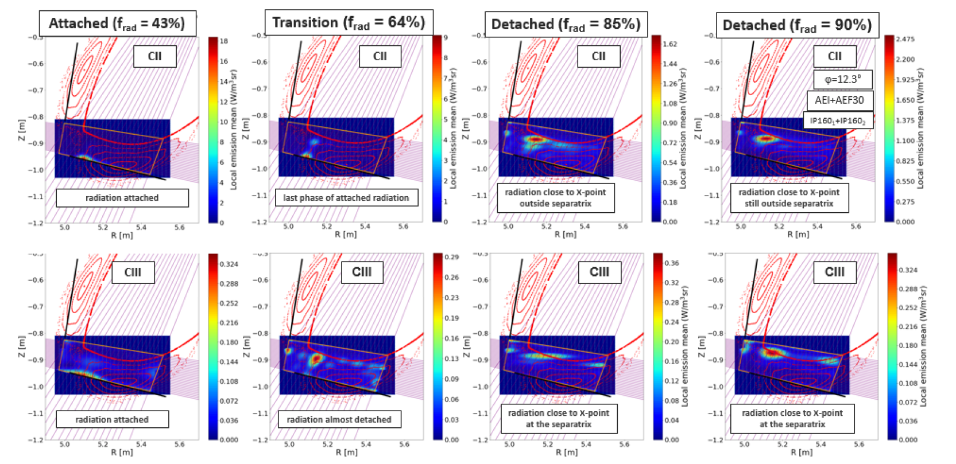
Impurity Tomography over AEI/AEF LOS (OP1.2b, proof-of-principle)
[Krychowiak, EPS 2021 proc., P1.1026]
CII (712 nm) and CIII (674 nm) emission profiles during detachment transition in 20181010.27
Carbon radiation located in vicinity of strikeline, moves towards LCFS during detachment transition

Slide 17
Island size effect on impurity retention in the SOL
Argon
T. Romba
viwi_007
Results from S11
No clear trend of island size on impurity contamination level for either Ar, Ne (CXRS)
Poor density control, uncertainties in impurity source
Unwanted ECCD (wrong launcher settings)
Lack of important edge diagnostics (divertor LPs, etc)
Suggestion for OP2.2 – repeat but do I_{cc} coil ramp within one program (no cryopump)
minimal decay of Ar, Ne and same source for multiple I_{cc} settings
Large | I_{cc}=2kA
Medium | I_{cc}=1kA
Small | I_{cc}=-1.5kA
Neon

Slide 18
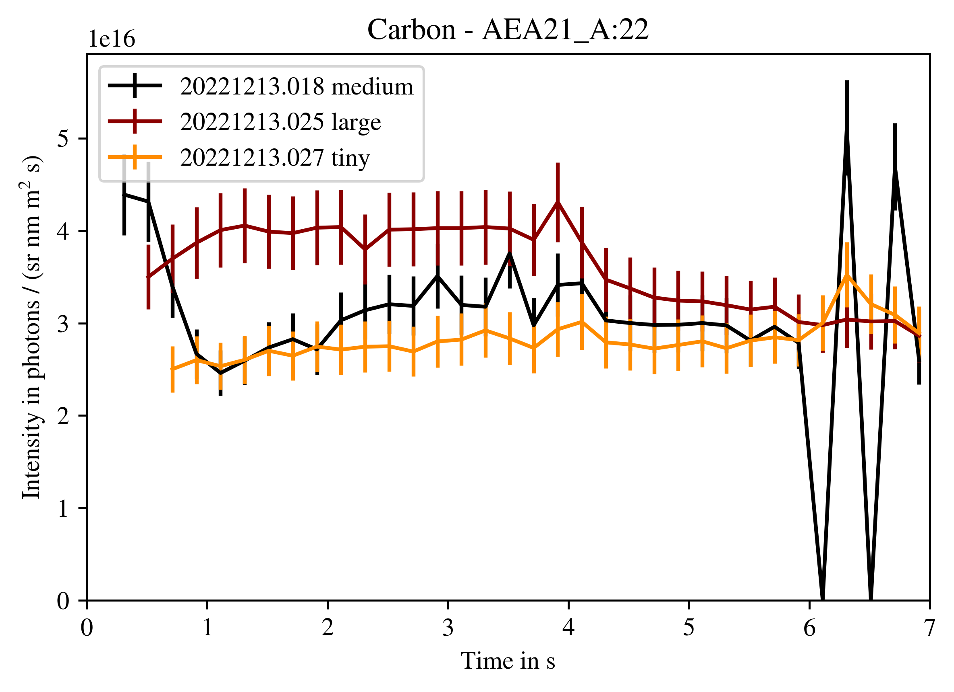
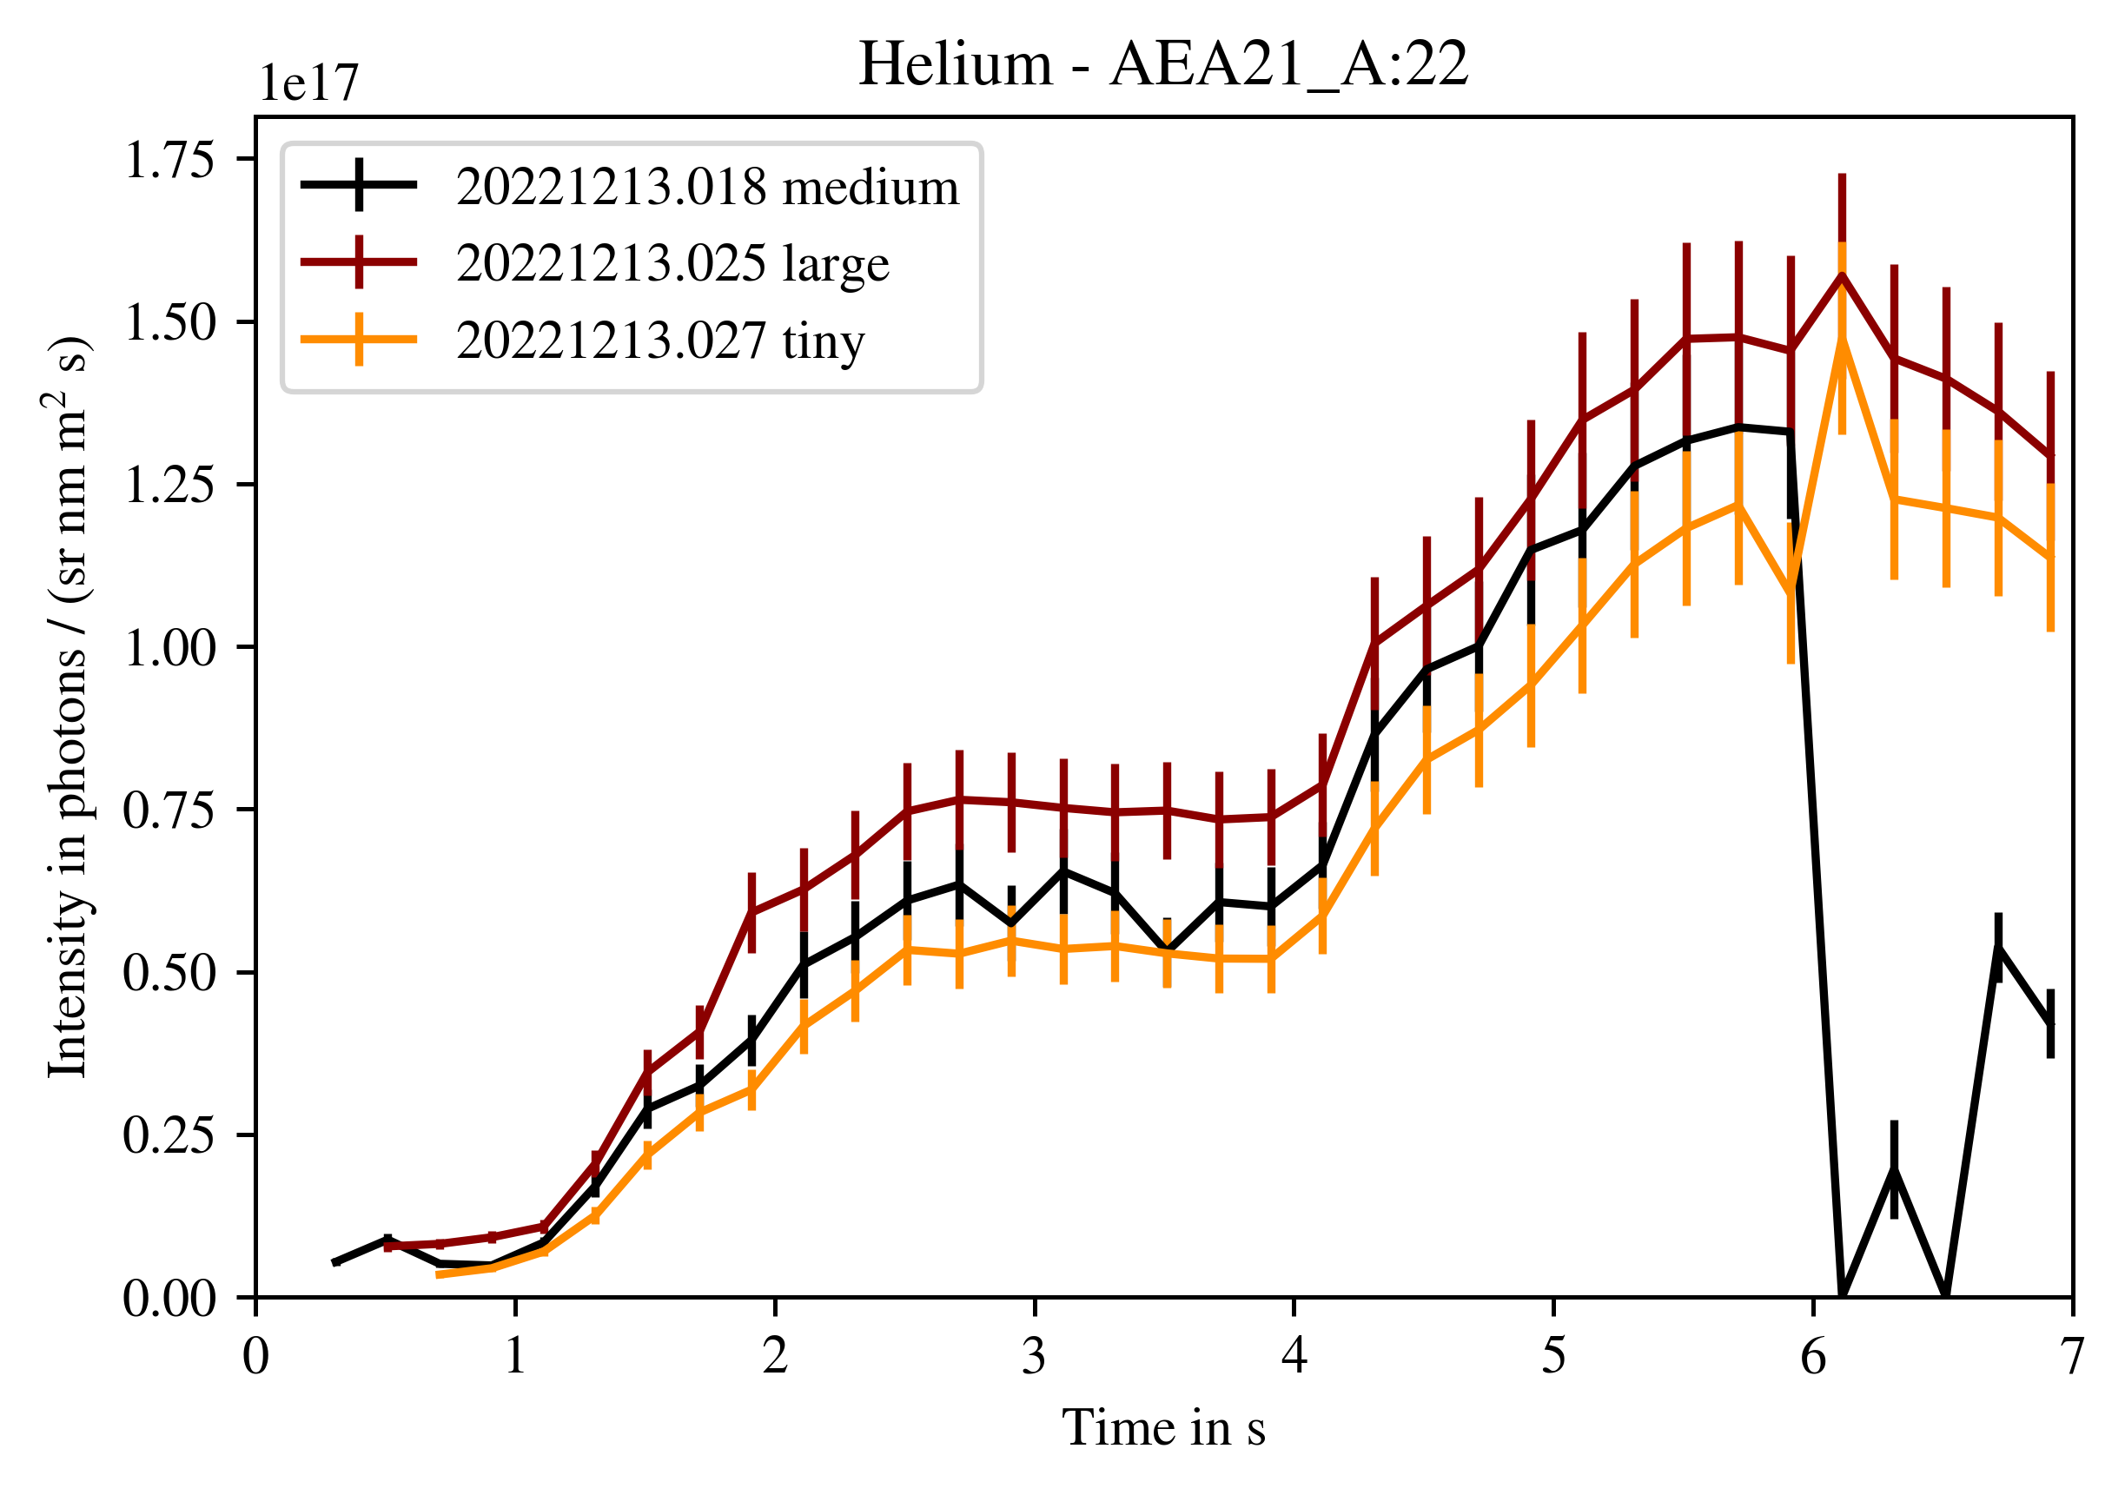
Island size effect on impurity retention in the SOL
Carbon
T. Romba
viwi_007
Results from S11
Clear island size effect on density level of intrinsic species (carbon, helium)
Highest core impurity density – largest island
Lowest core impurity density – smallest island
Likely reason: $Γ_{recyc}$ increases with island size – more erosion source of carbon at larger island sizes
More release of helium with larger $Γ_{recyc}$?
Would need divertor LP and/or H-alpha camera measurements to fully confirm!
Intrinsic measurements can be done piggy-back to dedicated Ne,Ar measurements in OP2.2
Large | I_{cc}=2kA
Medium | I_{cc}=1kA
Small | I_{cc}=-1.5kA
Helium

Slide 19
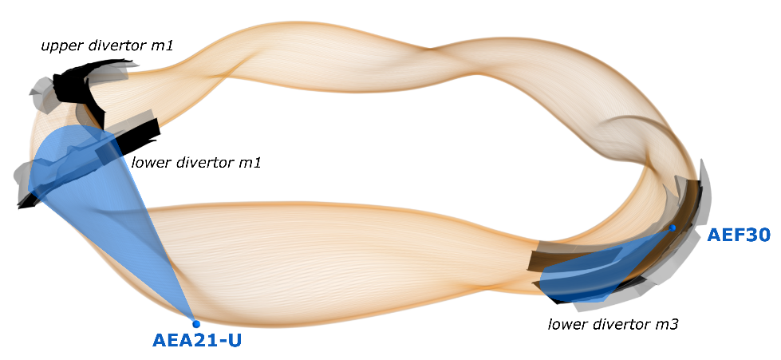
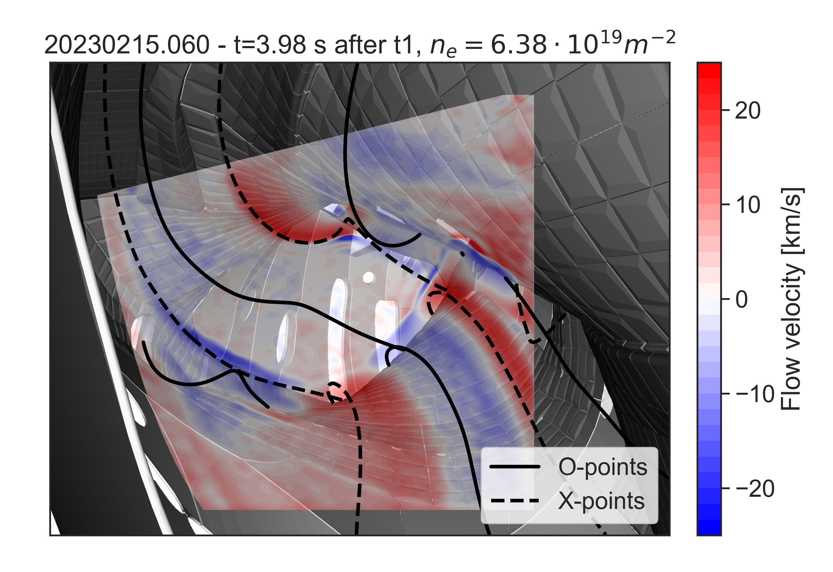
Coherence Imaging Spectroscopy (CIS) in OP2.1
Possible to analyse impurity radiation, velocity and temperature with CIS → focus mostly on C2+ so far
Helpful insights into overall carbon SOL distribution, impurity transport
Future impurity temperature helpful for e.g. sputtering/heat flux estimations?
AEA21
[pictures provided by V. Perseo]

Slide 20
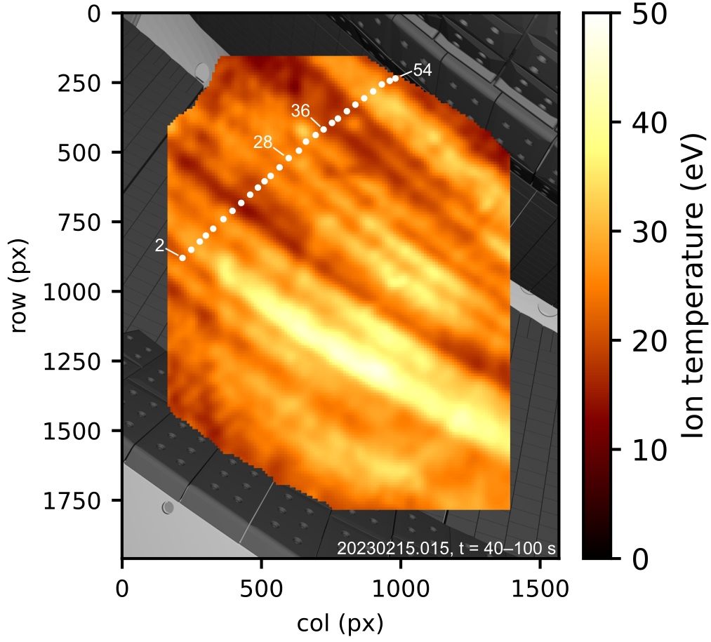
New coherence imaging spectroscopy (CIS) system images carbon radiation and ion temperature near lower divertor
C III intensity during density ramp to detachment
C²⁺ ion temperature in attached plasma
[pictures provided by M. Kriete]
Next campaign: N, Ne and Ar divertor seeding experiments should be performed with accompanying NBI blips and full diagnostic capabilities for $n_{e}$, $T_{e}$(Ne beam, upstream He/Ne beam, LP)

