Slide 1
Overview: particle exhaust and gas balance
V. Haak, T. Bräuer, CP. Dhard, T. Kremeyer, G. Motojima, D. Naujoks, G. Schlisio, H. Viebke, O. Volzke, W7-X Team

Slide 2
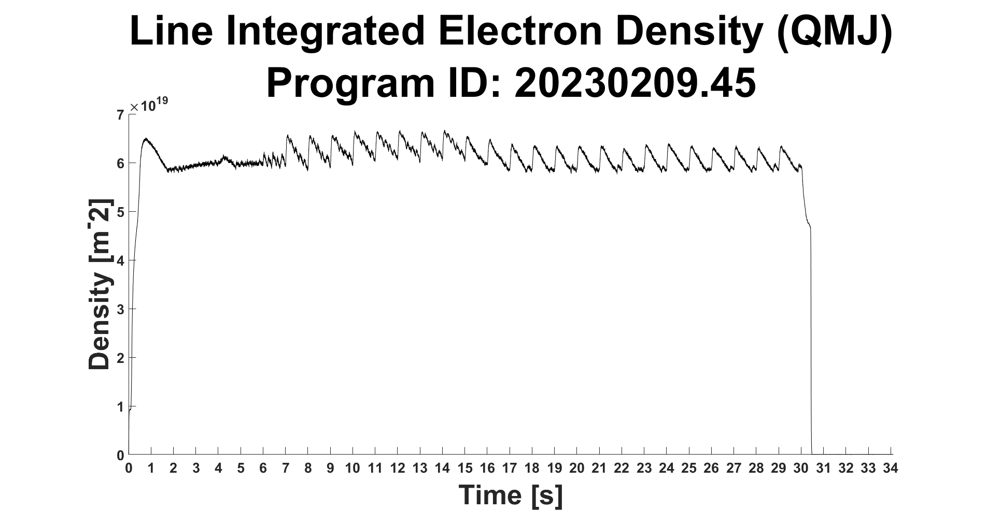
Effective particle confinement time for hydrogen (Thierry Kremeyer)
The effective confinement time τ_{p}* describes how long a particle spends in the machine before being exhausted. It is therefore a key metric for particle exhaust (besides S_{eff}, p_{n}, Γ_{exhaust})
It is measured by fitting an exponential decay to the density signal at n_{e} = 6 E+19 m⁻²
τ_{p}* strongly wall dependent, as the wall can act as additional source or sink
$$τ_{p}^{∗}=\frac{τ_{p}}{1−R}$$
Method: determine decay of line integrated density after gas puffs
Notes:
When talking about particle exhaust, the key metric is the exhaust rate, how many particles/s we exhaust – Γ_{exhaust.} Which is calculated by multiplying the effective pumping speed S_{eff} with the neutral gas presser p_{n.} Experiments for these metrics completed last week.
Another key metric is the effective particle confinement time, τ_{H}*, which describes how long a particle effectively spends in the machine, before being exhausted.
Measured through fitting an exponential decay to density signal. 3 different Experimental set ups:
Gas puff – additionaly to τ_{H}* fueling efficiency $η_{core fueling}$ of fueling system used and S/XB_{eff} - effective photon/particle conversion factors.
*CLICK*
Feedback on/off – only τ_{H}* but better control over starting density, better statistics and therefore lower uncertainty. Also the traditional way to measure τ_{H}*
*CLICK*
Feedback off – gives a density dependance of τ_{H}*

Slide 3
Effective particle confinement time for hydrogen (Thierry Kremeyer)
The effective confinement time τ_{p}* describes how long a particle spends in the machine before being exhausted. It is therefore a key metric for particle exhaust (besides S_{eff}, p_{n}, Γ_{exhaust})
It is measured by fitting an exponential decay to the density signal at n_{e} = 6 E+19 m⁻²
τ_{p}* strongly wall dependent, as the wall can act as additional source or sink
$$τ_{p}^{∗}=\frac{τ_{p}}{1−R}$$
Decay Experiment: | Gas puff
Standard – EJM | With CVP: 11.00 s ± 0.86 s Without CVP: 10.99 s ± 1.82 s
High Iota – FTM | With CVP: 6.63 s ± 1.00 s Without CVP: no data
High Mirror – KKM | With CVP: 5.56 s ± 1.03 s Without CVP: no data
Notes:
When talking about particle exhaust, the key metric is the exhaust rate, how many particles/s we exhaust – Γ_{exhaust.} Which is calculated by multiplying the effective pumping speed S_{eff} with the neutral gas presser p_{n.} Experiments for these metrics completed last week.
Another key metric is the effective particle confinement time, τ_{H}*, which describes how long a particle effectively spends in the machine, before being exhausted.
Measured through fitting an exponential decay to density signal. 3 different Experimental set ups:
Gas puff – additionaly to τ_{H}* fueling efficiency $η_{core fueling}$ of fueling system used and S/XB_{eff} - effective photon/particle conversion factors.
*CLICK*
Feedback on/off – only τ_{H}* but better control over starting density, better statistics and therefore lower uncertainty. Also the traditional way to measure τ_{H}*
*CLICK*
Feedback off – gives a density dependance of τ_{H}*

Slide 4
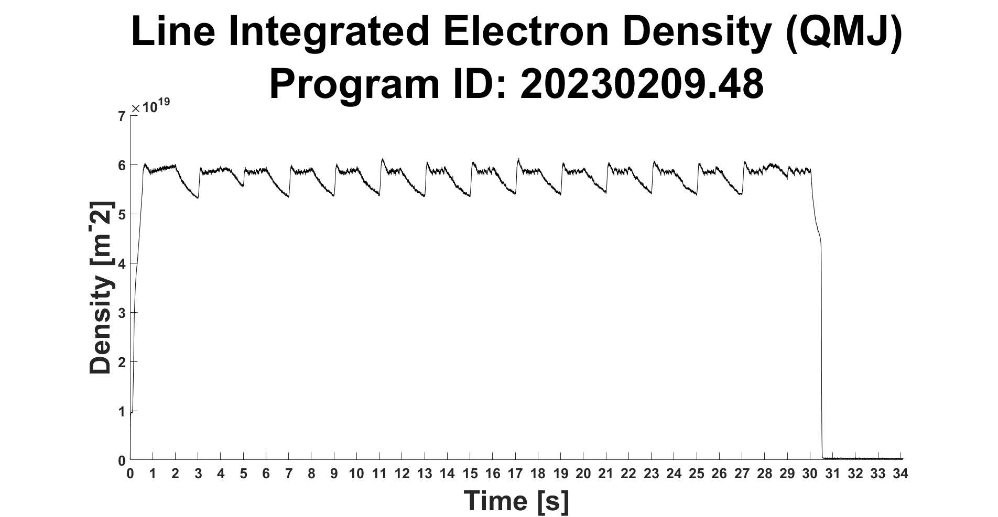
Effective particle confinement time for hydrogen (Thierry Kremeyer)
The effective confinement time τ_{p}* describes how long a particle spends in the machine before being exhausted. It is therefore a key metric for particle exhaust (besides S_{eff}, p_{n}, Γ_{exhaust})
It is measured by fitting an exponential decay to the density signal at n_{e} = 6 E+19 m⁻²
τ_{p}* strongly wall dependent, as the wall can act as additional source or sink
$$τ_{p}^{∗}=\frac{τ_{p}}{1−R}$$
Method: determine decay of line integrated density when switching gas inlet on and off
Notes:
When talking about particle exhaust, the key metric is the exhaust rate, how many particles/s we exhaust – Γ_{exhaust.} Which is calculated by multiplying the effective pumping speed S_{eff} with the neutral gas presser p_{n.} Experiments for these metrics completed last week.
Another key metric is the effective particle confinement time, τ_{H}*, which describes how long a particle effectively spends in the machine, before being exhausted.
Measured through fitting an exponential decay to density signal. 3 different Experimental set ups:
Gas puff – additionaly to τ_{H}* fueling efficiency $η_{core fueling}$ of fueling system used and S/XB_{eff} - effective photon/particle conversion factors.
*CLICK*
Feedback on/off – only τ_{H}* but better control over starting density, better statistics and therefore lower uncertainty. Also the traditional way to measure τ_{H}*
*CLICK*
Feedback off – gives a density dependance of τ_{H}*

Slide 5
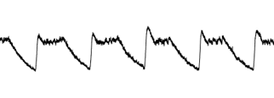
Effective particle confinement time for hydrogen (Thierry Kremeyer)
The effective confinement time τ_{p}* describes how long a particle spends in the machine before being exhausted. It is therefore a key metric for particle exhaust (besides S_{eff}, p_{n}, Γ_{exhaust})
It is measured by fitting an exponential decay to the density signal at n_{e} = 6 E+19 m⁻²
τ_{p}* strongly wall dependent, as the wall can act as additional source or sink
$$τ_{p}^{∗}=\frac{τ_{p}}{1−R}$$
Decay Experiment: | Gas puff | Gas inlet on/off
Standard – EJM | With CVP: 11.00 s ± 0.86 s Without CVP: 10.99 s ± 1.82 s | With CVP: no data Without CVP: 11.30 s ± 1.07 s
High Iota – FTM | With CVP: 6.63 s ± 1.00 s Without CVP: no data | With CVP: 7.59 s ± 0.29 s Without CVP: no data
High Mirror – KKM | With CVP: 5.56 s ± 1.03 s Without CVP: no data | With CVP: 4.99 s ± 1.06 s Without CVP: no data
Notes:
When talking about particle exhaust, the key metric is the exhaust rate, how many particles/s we exhaust – Γ_{exhaust.} Which is calculated by multiplying the effective pumping speed S_{eff} with the neutral gas presser p_{n.} Experiments for these metrics completed last week.
Another key metric is the effective particle confinement time, τ_{H}*, which describes how long a particle effectively spends in the machine, before being exhausted.
Measured through fitting an exponential decay to density signal. 3 different Experimental set ups:
Gas puff – additionaly to τ_{H}* fueling efficiency $η_{core fueling}$ of fueling system used and S/XB_{eff} - effective photon/particle conversion factors.
*CLICK*
Feedback on/off – only τ_{H}* but better control over starting density, better statistics and therefore lower uncertainty. Also the traditional way to measure τ_{H}*
*CLICK*
Feedback off – gives a density dependance of τ_{H}*

Slide 6
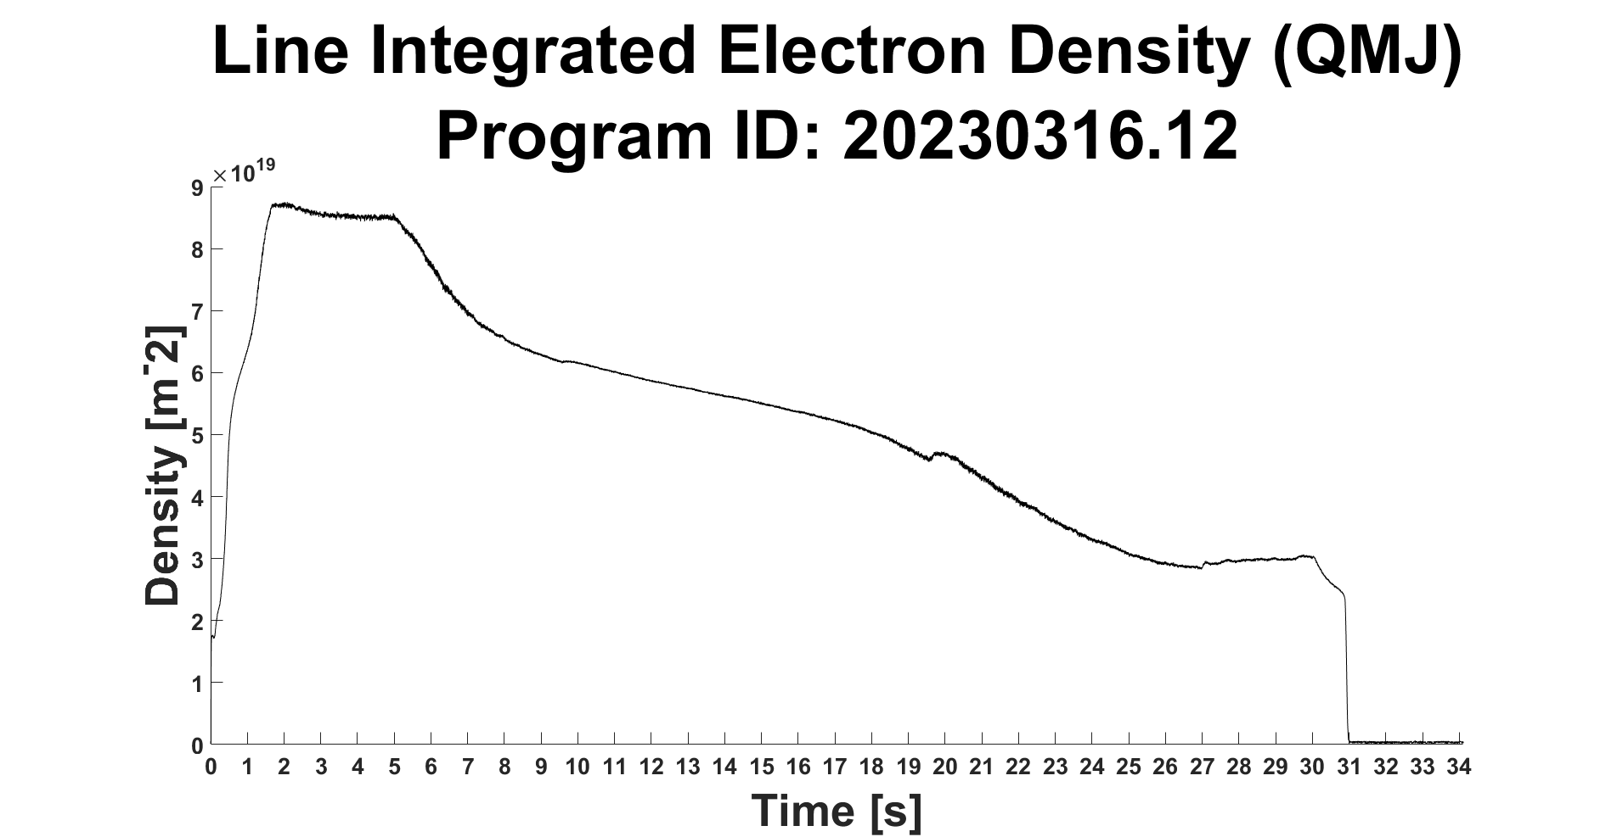
Effective particle confinement time for hydrogen (Thierry Kremeyer)
The effective confinement time τ_{p}* describes how long a particle spends in the machine before being exhausted. It is therefore a key metric for particle exhaust (besides S_{eff}, p_{n}, Γ_{exhaust})
It is measured by fitting an exponential decay to the density signal at n_{e} = 6 E+19 m⁻²
τ_{p}* strongly wall dependent, as the wall can act as additional source or sink
$$τ_{p}^{∗}=\frac{τ_{p}}{1−R}$$
Method: determine decay of line integrated density after switching gas inlet off
Notes:
When talking about particle exhaust, the key metric is the exhaust rate, how many particles/s we exhaust – Γ_{exhaust.} Which is calculated by multiplying the effective pumping speed S_{eff} with the neutral gas presser p_{n.} Experiments for these metrics completed last week.
Another key metric is the effective particle confinement time, τ_{H}*, which describes how long a particle effectively spends in the machine, before being exhausted.
Measured through fitting an exponential decay to density signal. 3 different Experimental set ups:
Gas puff – additionaly to τ_{H}* fueling efficiency $η_{core fueling}$ of fueling system used and S/XB_{eff} - effective photon/particle conversion factors.
*CLICK*
Feedback on/off – only τ_{H}* but better control over starting density, better statistics and therefore lower uncertainty. Also the traditional way to measure τ_{H}*
*CLICK*
Feedback off – gives a density dependance of τ_{H}*

Slide 7
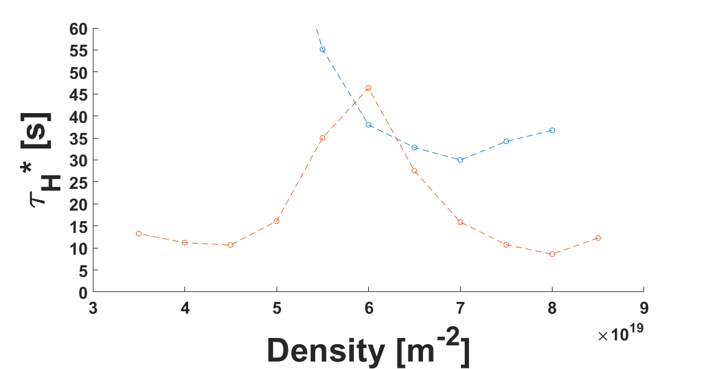
Effective particle confinement time for hydrogen (Thierry Kremeyer)
KKM without CVP
EJM without CVP
Different confinement times during density decay observed
Confinement times determined using this method much higher than for the other methods
Why does τ_{H}* peak?
Notes:
When talking about particle exhaust, the key metric is the exhaust rate, how many particles/s we exhaust – Γ_{exhaust.} Which is calculated by multiplying the effective pumping speed S_{eff} with the neutral gas presser p_{n.} Experiments for these metrics completed last week.
Another key metric is the effective particle confinement time, τ_{H}*, which describes how long a particle effectively spends in the machine, before being exhausted.
Measured through fitting an exponential decay to density signal. 3 different Experimental set ups:
Gas puff – additionaly to τ_{H}* fueling efficiency $η_{core fueling}$ of fueling system used and S/XB_{eff} - effective photon/particle conversion factors.
*CLICK*
Feedback on/off – only τ_{H}* but better control over starting density, better statistics and therefore lower uncertainty. Also the traditional way to measure τ_{H}*
*CLICK*
Feedback off – gives a density dependance of τ_{H}*

Slide 8
Effective particle confinement time for hydrogen (Thierry Kremeyer)
The effective confinement time τ_{p}* describes how long a particle spends in the machine before being exhausted. It is therefore a key metric for particle exhaust (besides S_{eff}, p_{n}, Γ_{exhaust})
It is measured by fitting an exponential decay to the density signal at n_{e} = 6 E+19 m⁻²
τ_{p}* strongly wall dependent, as the wall can act as additional source or sink
$$τ_{p}^{∗}=\frac{τ_{p}}{1−R}$$
Decay Experiment: | Gas puff | Gas inlet on/off | Gas inlett off
Standard – EJM | With CVP: 11.00 s ± 0.86 s Without CVP: 10.99 s ± 1.82 s | With CVP: no data Without CVP: 11.30 s ± 1.07 s
High Iota – FTM | With CVP: 6.63 s ± 1.00 s Without CVP: no data | With CVP: 7.59 s ± 0.29 s Without CVP: no data
High Mirror – KKM | With CVP: 5.56 s ± 1.03 s Without CVP: no data | With CVP: 4.99 s ± 1.06 s Without CVP: no data
KKM without CVP
EJM without CVP
Notes:
When talking about particle exhaust, the key metric is the exhaust rate, how many particles/s we exhaust – Γ_{exhaust.} Which is calculated by multiplying the effective pumping speed S_{eff} with the neutral gas presser p_{n.} Experiments for these metrics completed last week.
Another key metric is the effective particle confinement time, τ_{H}*, which describes how long a particle effectively spends in the machine, before being exhausted.
Measured through fitting an exponential decay to density signal. 3 different Experimental set ups:
Gas puff – additionaly to τ_{H}* fueling efficiency $η_{core fueling}$ of fueling system used and S/XB_{eff} - effective photon/particle conversion factors.
*CLICK*
Feedback on/off – only τ_{H}* but better control over starting density, better statistics and therefore lower uncertainty. Also the traditional way to measure τ_{H}*
*CLICK*
Feedback off – gives a density dependance of τ_{H}*

Slide 9
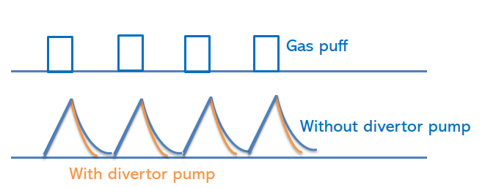
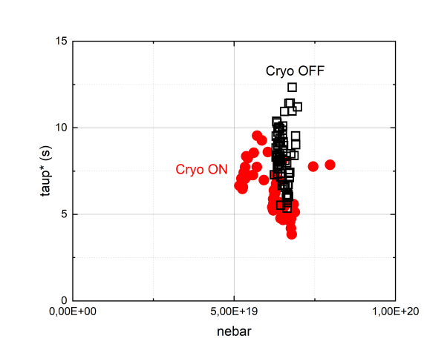
Effective particle confinement time for hydrogen (Gen Motojima)
$$τ_{p}^{∗} \left[s\right]$$
Effective particle confinement time evaluated from density decay after gas puffs in standard configuration with (Session 9, 07.12.2022) and without CVP (Session 17, 09.02.2023)
Effective confinement time appears shorter with CVP on
Evaluated density window is very narrow, especially without CVP. Further data sets are needed to see the density dependence
Differences in τ_{p}* are observed for the same density without CVP, the causes of which need to be investigated in detail for each shot
Effective confinement times overestimated due to contribution of the wall
$${\overline{n}}_{e}$$
$${[m}^{−2}]$$
$$τ_{p}^{∗}=\frac{τ_{p}}{1−R}$$
$$R=1−\frac{τ_{p}}{τ_{p^{∗}}}$$
For $τ_{p}^{∗}$ = 10s and $τ_{p}$= 200ms, R = 0.98

Slide 10
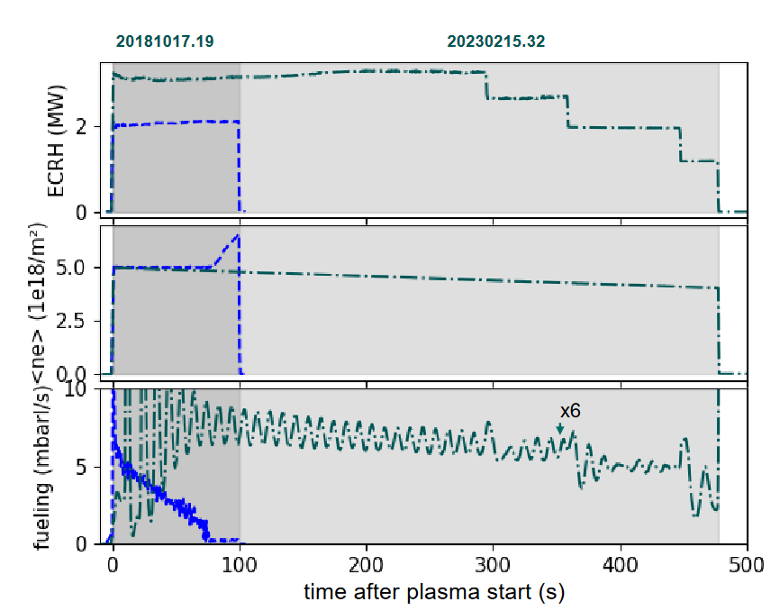
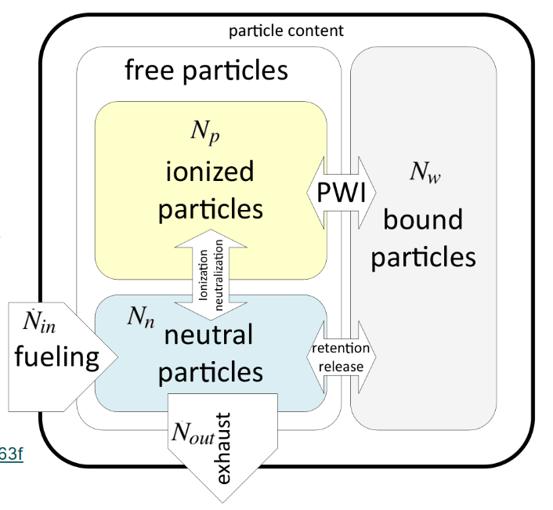
Gas balance with water-cooled divertor (Georg Schlisio)
20181017.19
• 480s plasma duration
• Water-cooled divertor
• Near-constant fueling-density-ratio
• Stable density

Slide 11
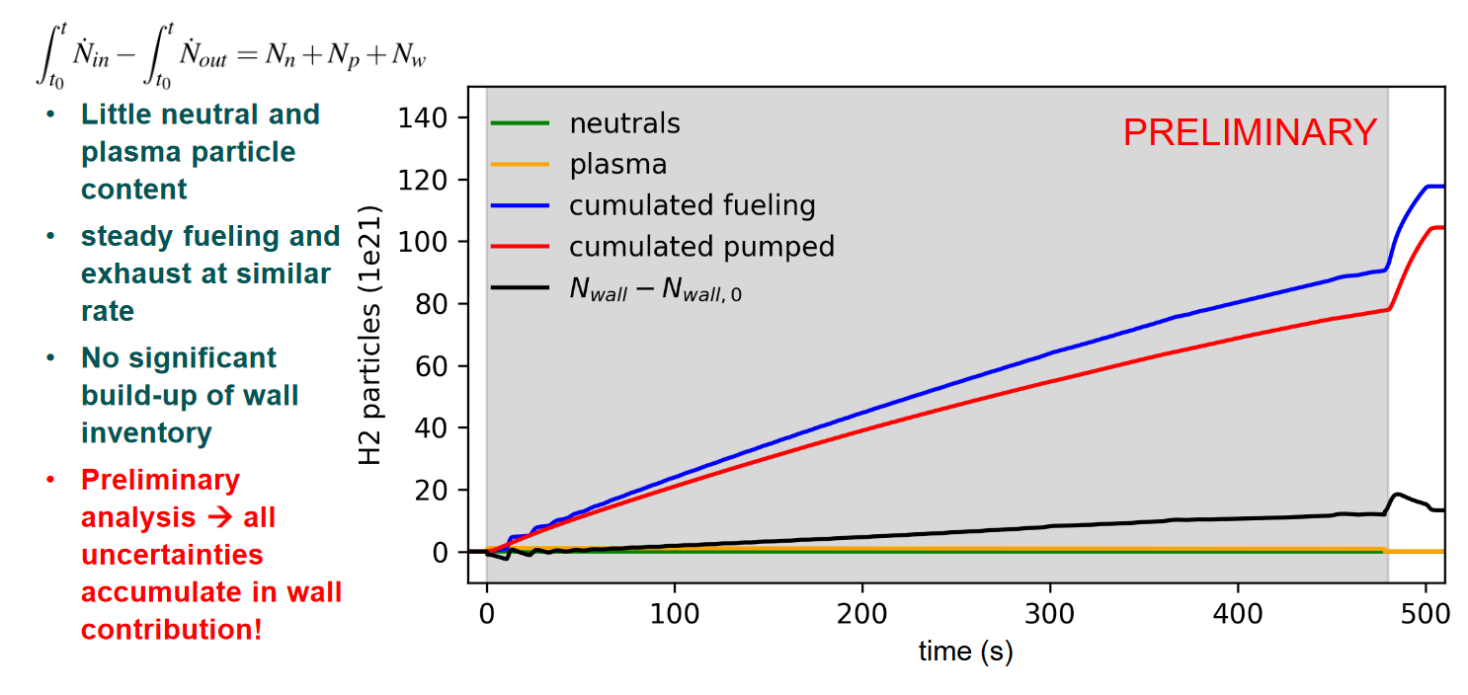
Gas balance with water-cooled divertor (Georg Schlisio)
20230215.32

Slide 12
Calibration of the neutral gas diagnostics – overview (G. Schlisio)
System | Quantities | Status
Plasma vessel | Volume | Successful
Main gas valves (DCH) | Flow rate as function of valve voltage | Successful
Divertor gas inlet (QSQ) | Flow rate | Under evaluation → A. Tsikouras
NBI | Box volume, getter pump speed | Successful
Neutral gas manometers (QRG) | Total pressure calibration | Successful
WISP-gauges (QRF) | Total and partial pressure cal. | Partially successful
TMPs (ADB) | Pumping speed | It‘s complicated
CVPs | Pumping speed | Under evaluation → V. Haak
ICRH valve characterization | Flow rate | Postponed to OP2.2
GPI valve characterization | Flow rate | Successful
IR endoscope flushing rate | H2 flow rate | Successful

Slide 13
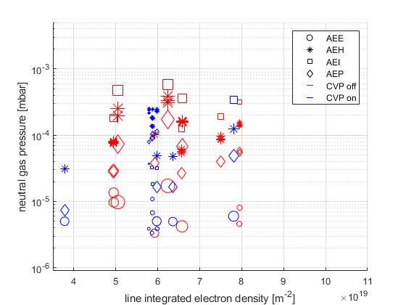
Neutral gas pressures with and without CVP
Standard configuration
Neutral gas pressures in the same range as during OP1.2b
1e-04 mbar – 5e-04 mbar at pumping gap
4e-05 mbar – 3e-04 mbar at AEH pumping port in subdivertor volume
Slightly lower neutral gas pressures in subdivertor during operation of CVP
Overall no significant impact of CVP on neutral gas pressures in current pressure regime

Slide 14
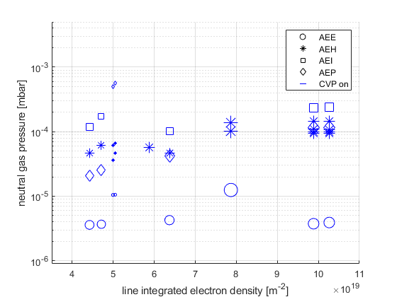
Neutral gas pressures with and without CVP
High iota configuration
Neutral gas pressures in the same range as during OP1.2b
1e-04 mbar – 2.5e-04 mbar at pumping gap
4e-05 mbar – 5e-04 mbar at AEP pumping port in subdivertor volume
No comparison between discharges with and without CVP possible

Slide 15
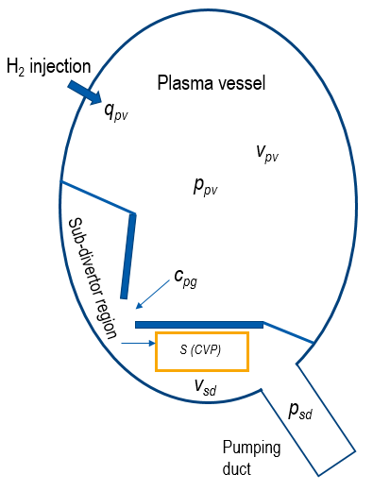
Pumping speed of the Cryo-vacuum pump (V. Haak, CP Dhard)
Pumping speed of the cryopump can be determined using the following equations
$\frac{dp_{sd}}{dt}=\frac{C}{V_{sd}}∗\left({p_{pv} −p}_{sd}\right)−p_{sd}∗\frac{S_{eff}}{V_{sd}}$
$\frac{dp_{pv}}{dt}=\frac{C}{V_{pv}−V_{sd}}∗(p_{sd} −p_{pv})+\frac{q_{pv}}{V_{pv}−V_{sd}}−\frac{q_{loss}}{V_{pv}−V_{sd}}$
with pressure measurements in the divertor, the pumping speed can be determined using the steady-state case of the equations during the gas puff (constant pressure)
0 $=C∗(p_{pv}−p_{sd})$ $−{ p}_{sd}∗S_{eff}$
0 $=C ∗(p_{sd}−p_{pv})+q_{pv}$
$C =A_{pumpinggap}∗\sqrt{\frac{kT}{2πm}}$
$$S_{eff}= \frac{q_{pv}}{p_{sd}}$$

Slide 16
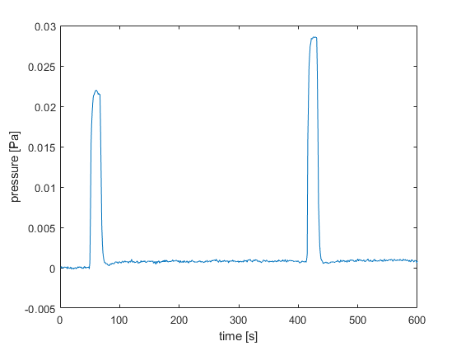
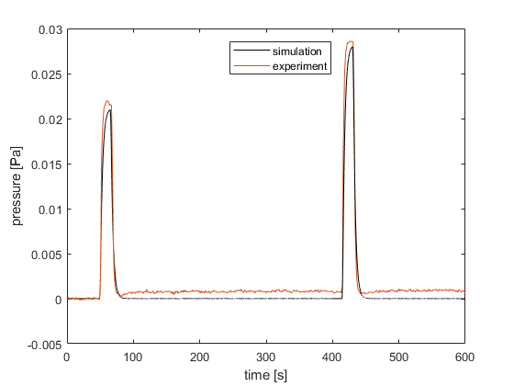
Pumping speed of the Cryo-vacuum pump (V. Haak, CP Dhard)
CVP Pumping speed of 70.97 m³/s and 70.93 m³/s calculated from H2- gas injection
Good agreement between experiments and time-dependent simulation of the neutral gas pressure in the subdivertor during gas injection
$$S_{eff}= \frac{q_{pv}}{p_{sd}}$$
H2 (15mbar l/s & 20mbar l/s)
Gas on
Gas off
$$\frac{dp_{sd}}{dt}=\frac{C}{V_{sd}}∗\left({p_{pv} −p}_{sd}\right)−p_{sd}∗\frac{S}{V_{sd}}$$
$$\frac{dp_{pv}}{dt}=\frac{C}{V_{pv}−V_{sd}}∗(p_{sd} −p_{pv})+\frac{q_{pv}}{V_{pv}−V_{sd}}−\frac{q_{loss}}{V_{pv}−V_{sd}}$$

Slide 17
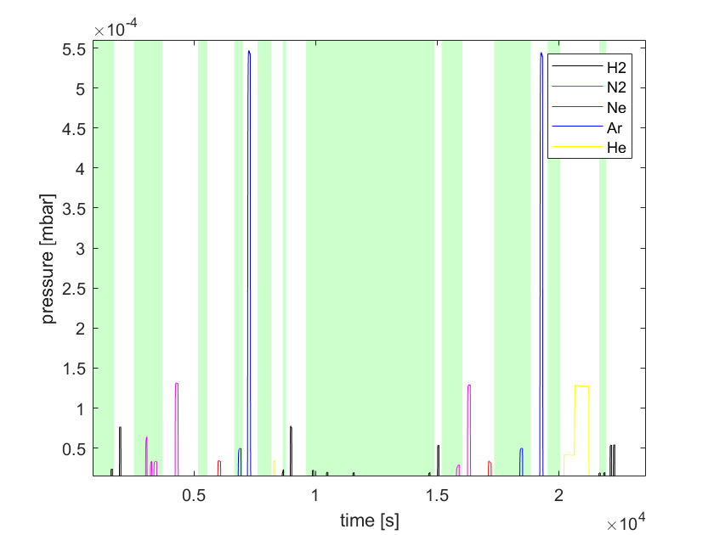
Pumping speed of the Cryo-vacuum pump in different gases
More experiments to determine the pumping speed have been performed with (green background) and without (white background) the turbomolecular pumps and with different gases (H2, N2, Ne, Ar, He)
gas | S without TMP (m³/s)
H2 | 71,0 / 71,0
N2 | 21,9 / 19,9
Ne | 22,2 / 21,6
Ar | 9,4 / 9,4

Slide 18
Summary and planned activities
Particle confinement times for hydrogen ~11s with and without CVP in standard configuration, likely overestimated due to wall
No data for discharges without CVP in high iota and high mirror configuration
Study of He-confinement times using He-NBI during the next campaign
Determination of τ_{p}* based on density decay when gas inlet is switched off
results in much higher confinement times
Preliminary gas balance indicates no significant built-up of wall inventory
with water-cooled divertor
Calibration of divertor gas inlet, ICRH valve and TMPs missing for final gas balance
KKM without CVP
EJM without CVP

Slide 19
Summary and planned activities
No changes in neutral gas pressure in subdivertor despite modifications to subdivertor structures
No significant impact on CVP on neutral gas pressure in the subdivertor in current pressure regime of 4e-05-3e-04mbar in low iota subdivertor volume
No comparison of neutral gas pressure with and without CVP in FTM
How can neutral gas pressure be increased for effective use of the CVP?
Pumping speed of CVP: 71 m³/s for H2
21 m³/s for N2
22 m³/s for Ne
9 m³/s for Ar
Combined pumping speed of CVP and TMPs not easy to determine
Development of numerical conductance models using ANSYS and DIVGAS

