Slide 1
Development of long pulse detached scenario at Wendelstein 7-X
M. Jakubowski, M. Krychowiak, et al.

Slide 2
Main Objectives of TF II in OP2.1 and OP2.2
Main objectives | Scientific goal | Measures of success/Deliverables
Development of long, stationary divertor detachment scenarios with and without impurity seeding | Creating conditions for detachment o Impurity seeding; edge impurity concentration o Edge radiation losses o Optimization of edge topology (control/trim coils) o Dependence on core fueling/heating mechanisms Compatibility with high-performance scenarios o High-mirror and high-iota configurations in comparison with the standard configuration o Pellet-fueled discharges o Exhaust efficiency under detachment | Demonstration of scenarios with long, stationary divertor detachment, in particular, for high-mirror, high-iota and standard configuration Characterize the conditions under which detachment is possible Attain detachment during a high-performance discharge Achieve rapid transition to detachment

Slide 3
Intrinsic detachment

Slide 4
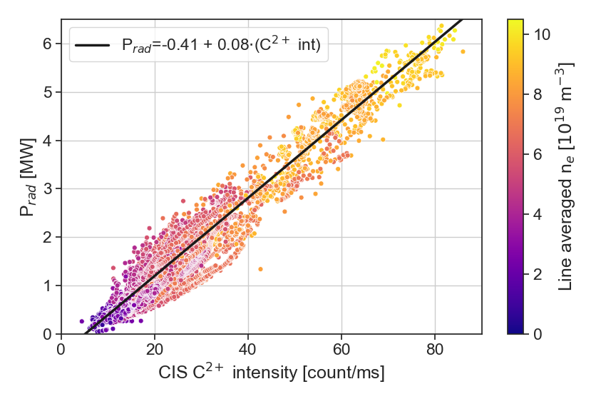
Plasma radiation proportional to C²⁺ intensity and plasma density
Obtaining detachment with help of intrinsic impurities (carbon) is rather straightforward at W7-X.
In order to reach certain level of radiated power we need to increase carbon concentration/radiation at the plasma edge (via plasma density).
V. Perseo et al 2021 Nucl. Fusion 61 116039

Slide 5
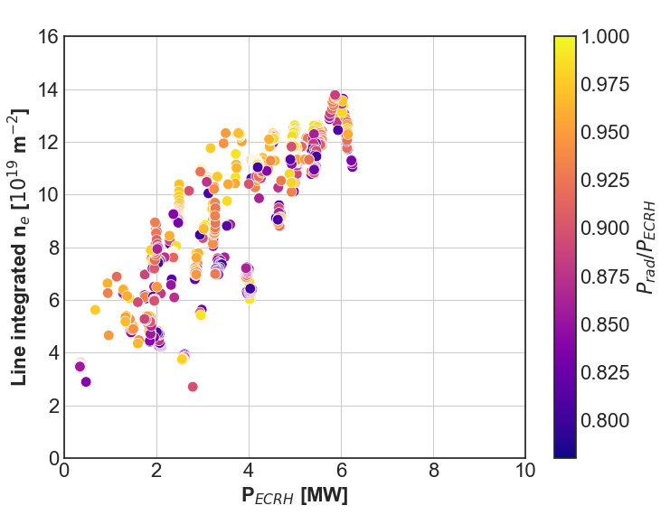
Density required to reach detachment. Limitation at 16×10¹⁹ m⁻²
Absorption of O2 ECRH becomes inefficient
V. Perseo et al 2021 Nucl. Fusion 61 116039

Slide 6
Detachment can be obtained by raising the plasma density
Obtaining detachment with help of intrinsic impurities (carbon) is rather straightforward at W7-X.
In order to reach certain level of radiated power we need to increase carbon concentration at the plasma edge (via plasma density).
In a typical W7-X detachment discharge plasma line integrated density is raised to a level above 1×10²⁰ m⁻², which leads to f_{rad} > 80%.
This leads to strong reduction of peak heat load > 8 and particle fluxes, i.e. plasma detachment.
This state could be easily maintained with feedback for the whole plasma duration thanks to PID controller.
proxies for detachment level
M. Jakubowski et al 2021 Nucl. Fusion 61 106003
[M. Krychowiak, et al., NME, 34 (2023) 101363]
O. Schmitz et al 2021 Nucl. Fusion 61 016026
Notes:
Feedback control system

Slide 7
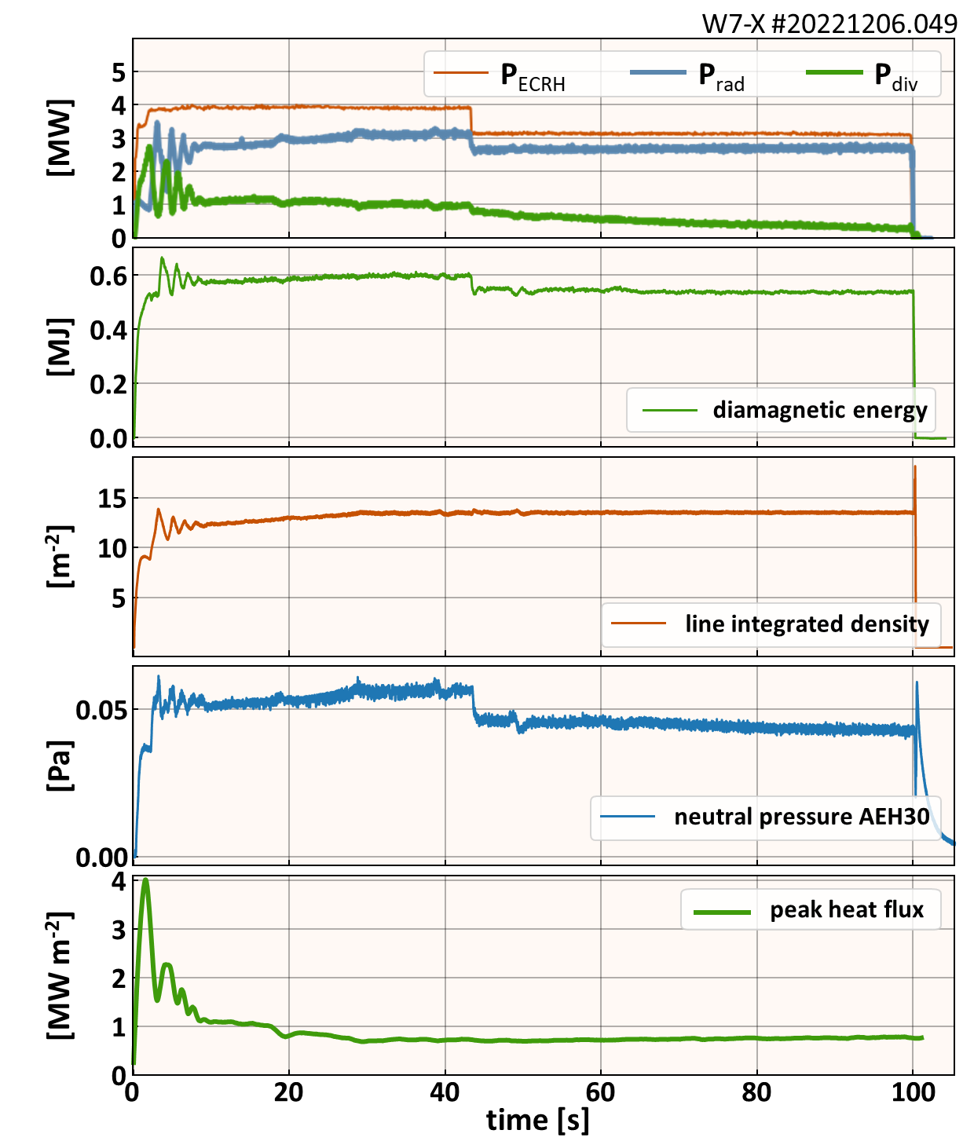
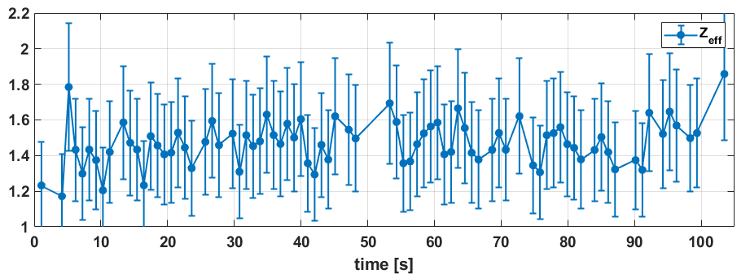
Intrinsic detachment could be prolonged in OP2.1 to 100 s
This scenario could be successfully prolonged in OP2, with 100 s long detached discharge
The feedback system was controlling plasma density and not plasma radiation.
Radiation fraction of ca. 80% required higher plasma density than in OP1.2
No significant increase of core impurities
Feedback control:
  On P_{rad} (constant P_{ECRH} necessary)
  Otherwise on f_{rad}
not stable on longer time scales
Notes:
Feedback control system

Slide 8
Intrinsic detachment could be prolonged in OP2.1 to 100 s
Notes:
Feedback control system

Slide 9
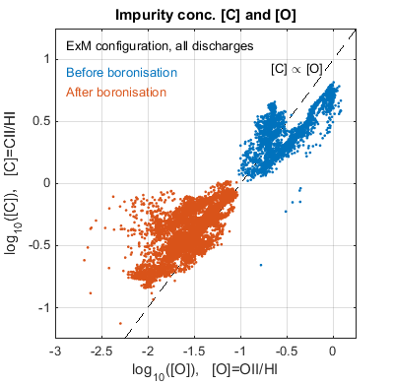
Lower carbon contents at the plasma boundary due to boronizations
After 1 boronization
T. Wauters, et al., Nucl. Mat. Ene. 17 (2018) 235–2
Boronization effects in OP1.2
Boronization produces amorphous boron containing carbon films a-C/B:H on a plasma surface, which has a strong ability to gatter oxygen.
  In OP1.2: Oxygen reduced by a factor of 10 (or a lot more, in some cases)
  Carbon reduced by about a factor of 7, to large degree due to much lower oxygen content at the plasma edge.
Notes:
Feedback control system

Slide 10
Lower carbon contents at the plasma boundary due to boronizations
Inefficient absorption O2 ECRH
After 3 boronizations
T. Wauters, et al., Nucl. Mat. Ene. 17 (2018) 235–2
Boronization effects in OP1.2
Boronization produces amorphous boron containing carbon films a-C/B:H on a plasma surface, which has a strong ability to gatter oxygen.
  In OP1.2: Oxygen reduced by a factor of 10 (or a lot more, in some cases)
  Carbon reduced by about a factor of 7, to large degree due to much lower oxygen content at the plasma edge.
Notes:
Feedback control system

Slide 11
Seeded detachment

Slide 12
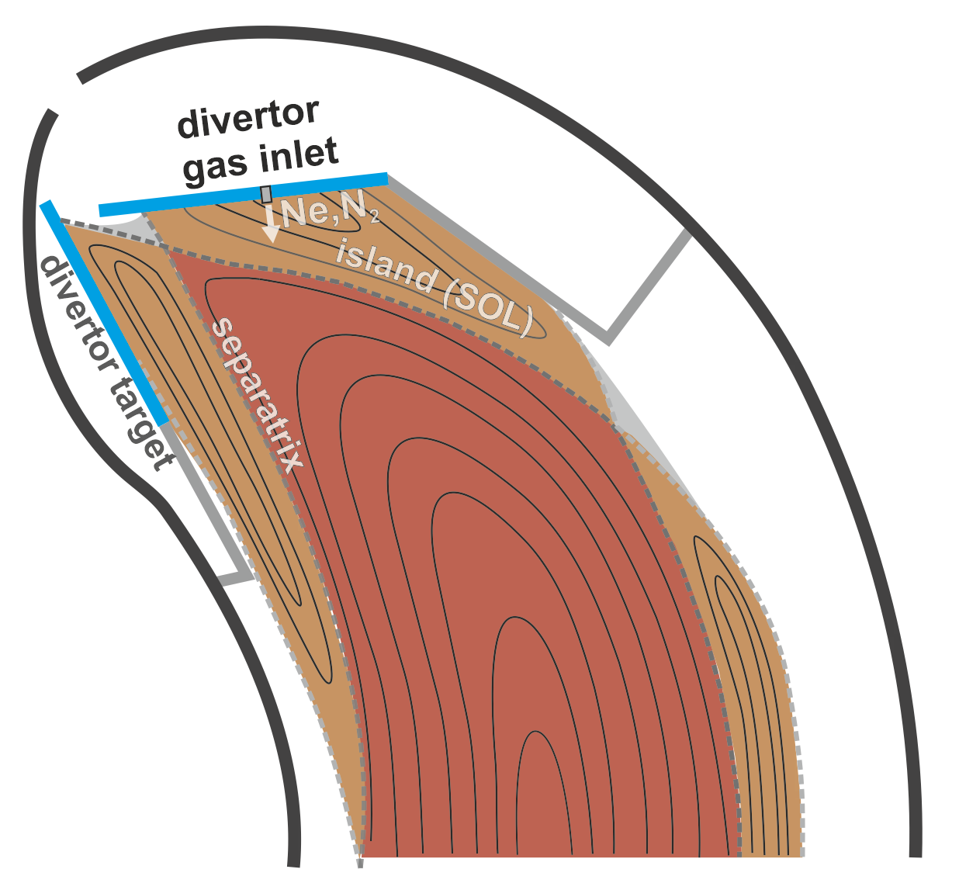
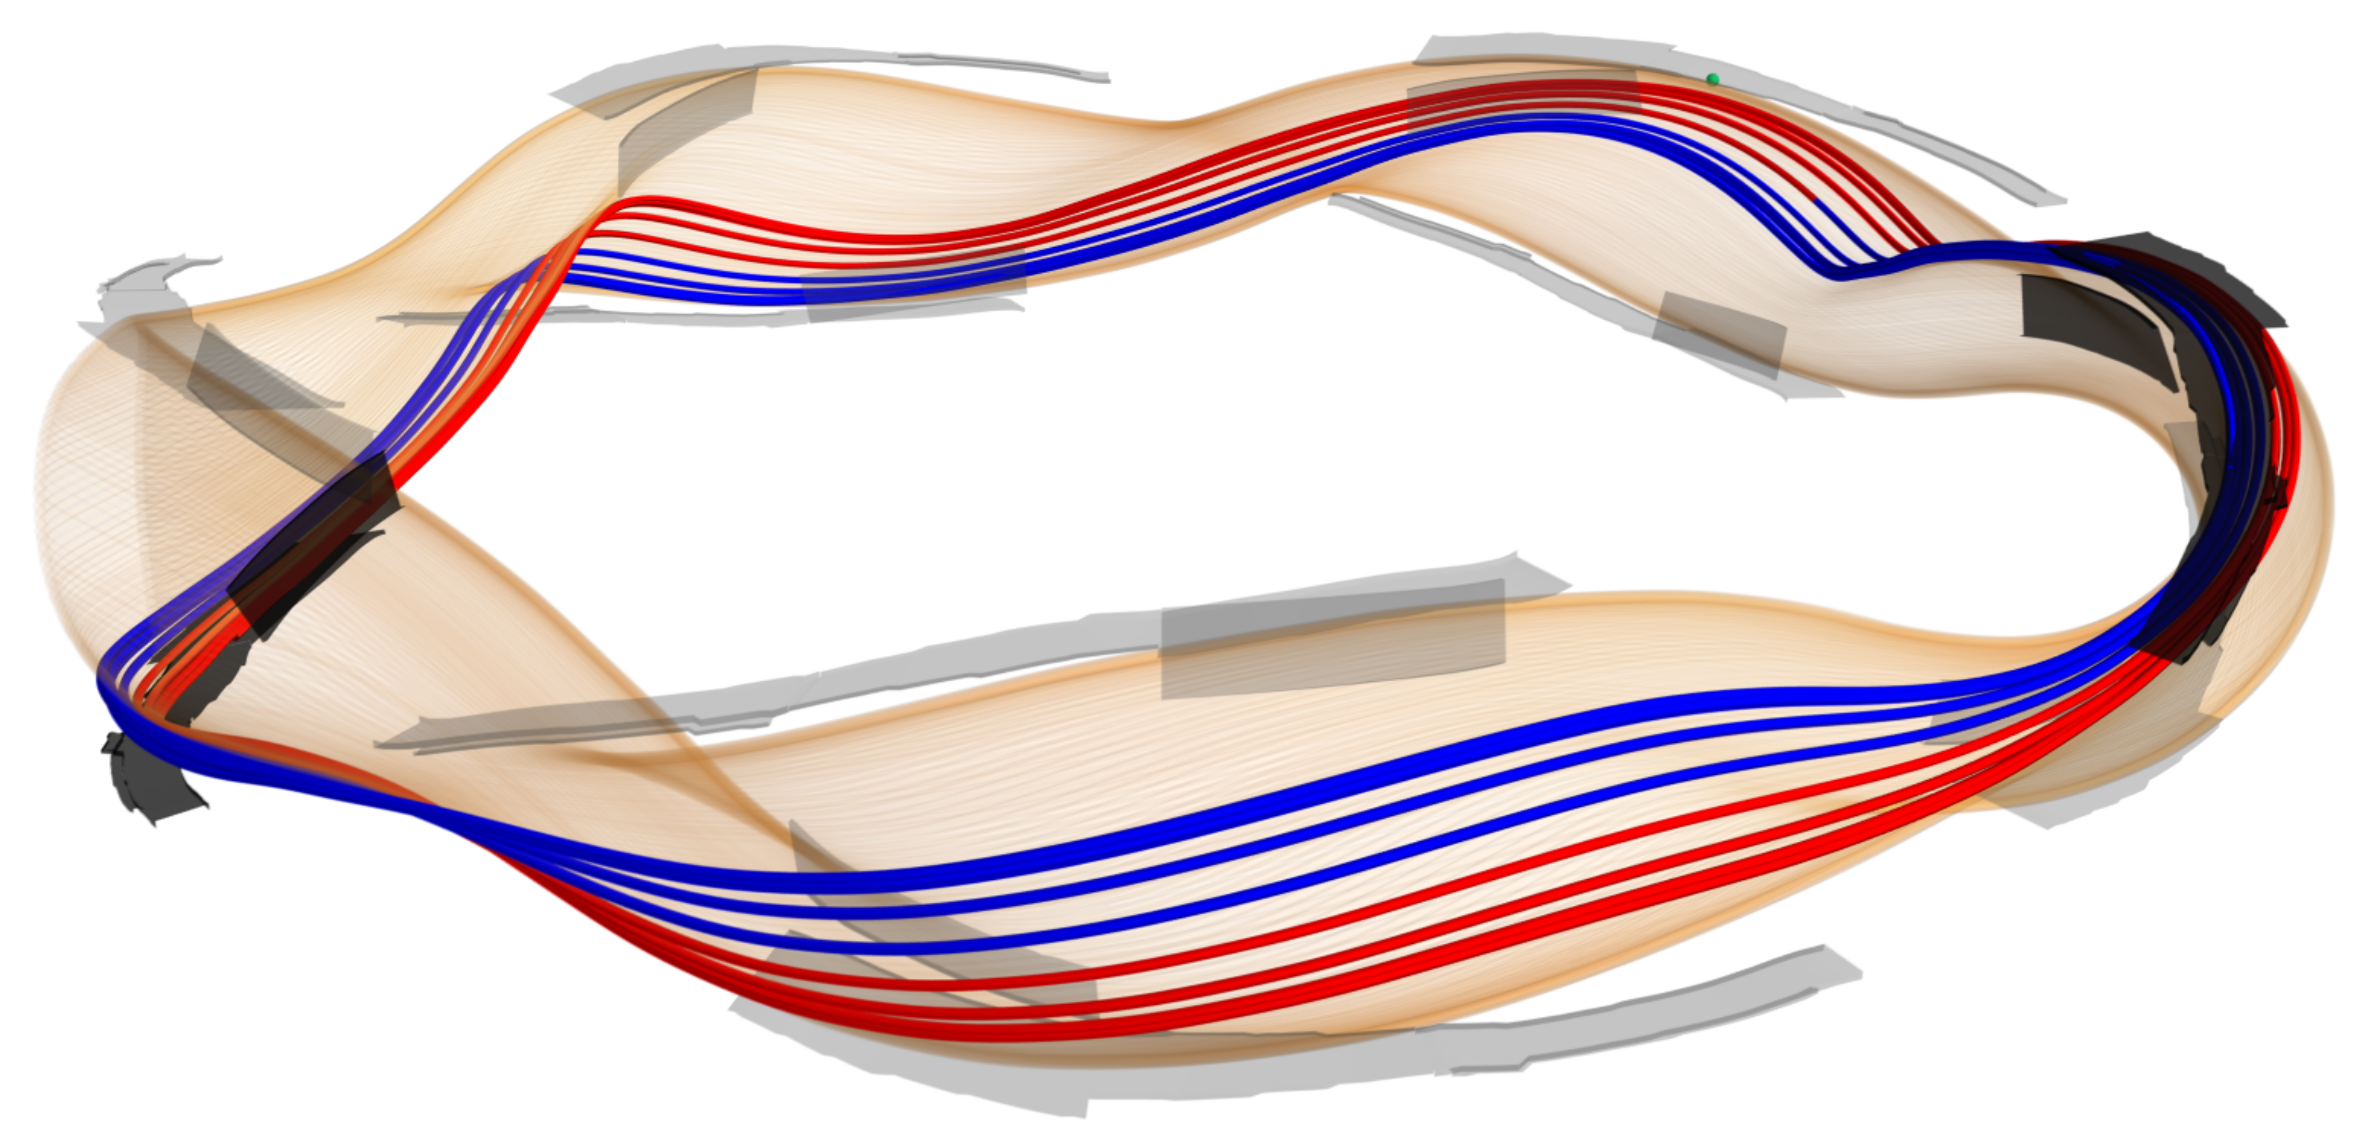
Set-up of seeding detachment experiments
F. Effenberg et al 2019 Nucl. Fusion 59 106020
Krychowiak, M., et al., Rev. Sci. Instrum. 87 (2016) 11D304
Injection of Ne
Injection of N2
Injecting Ne or N2 through a one out of ten divertor injection systems into an island SOL.

Slide 13
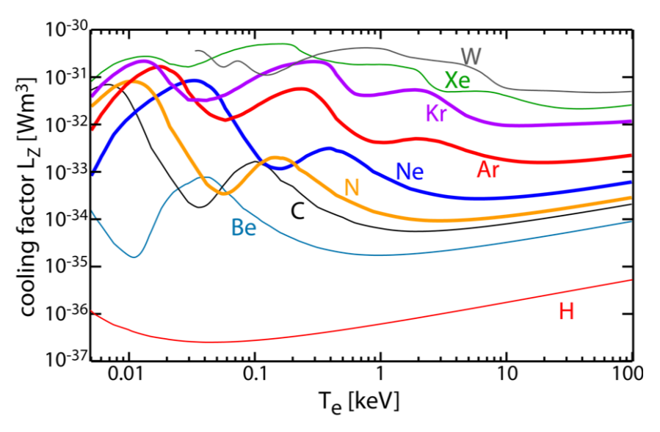

Choice of seeding impurities for heat load control
The choice of impurities or the mix of several impurities will depend on the expected temperature range, the achievable impurity density n_{Z} and ne.
As the SOL at W7-X is supposed to operate at plasma electron temperatures of few to 10 eV the choice of impurities is limited to low- or medium-Z species, e.g. N2 or Ne.
Especially nitrogen seems to be attractive impurity as it L_{Z} characteristics is similar to carbon
L_{z} calculated for coronal equilibrium [1]
$$q_{rad}^{imp}\sim n_{e}n_{Z}L_{Z}(n_{e},T_{e}, τ)$$
SOL of island divertor at Wendelstein 7-X
[1] M. Wischmeier, et al., IAEA-FEC TH/P7-5 (2018)

Slide 14
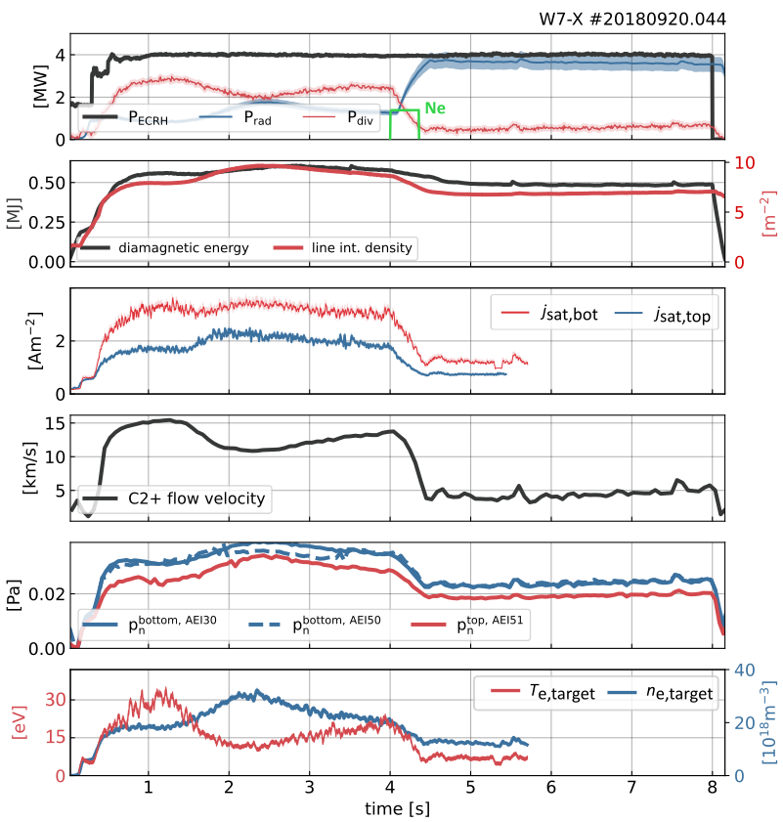
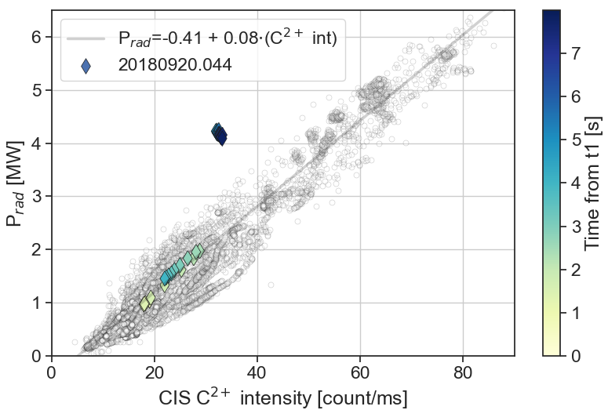
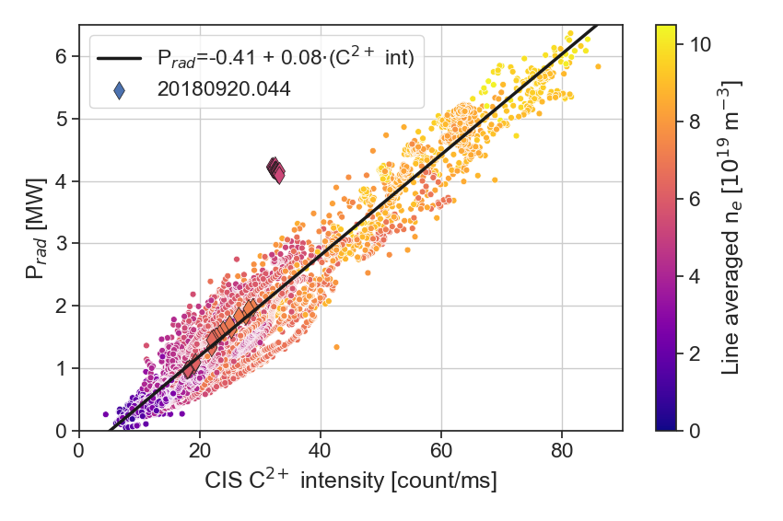
Detachment with neon seeding long living due to high recycling of Ne
C + remaining Ne
C + Ne
C
C + remaining Ne
C + Ne
ΔP_{rad} ≈ 1.5 MW
C

Slide 15
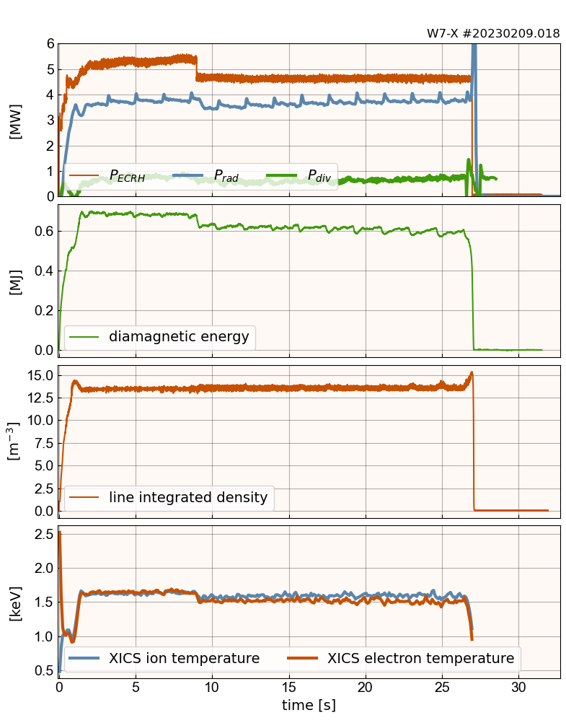
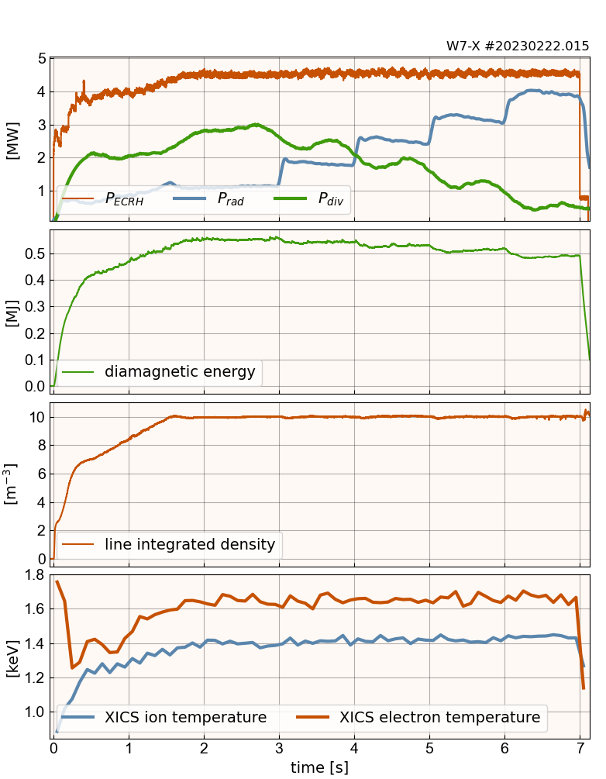
Due to very efficient boronization low carbon contents, detachment aided by impurities seeding.
Due to very efficient boronization low carbon concentration at the plasma edge.
Detachment (f_{rad} > 70%) had to be aided with seeded impurities (Ne, N₂)
This needed careful scenario development (no feedback on plasma radiation yet).
Scenario development allowed to reach f_{rad} > 80% required for steady-state.
seeded with too little Ne
seeded with enough Ne

Slide 16
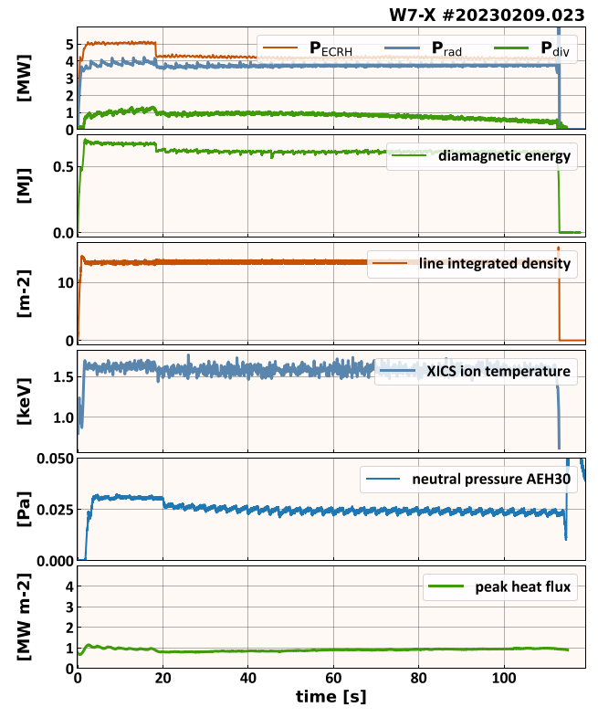
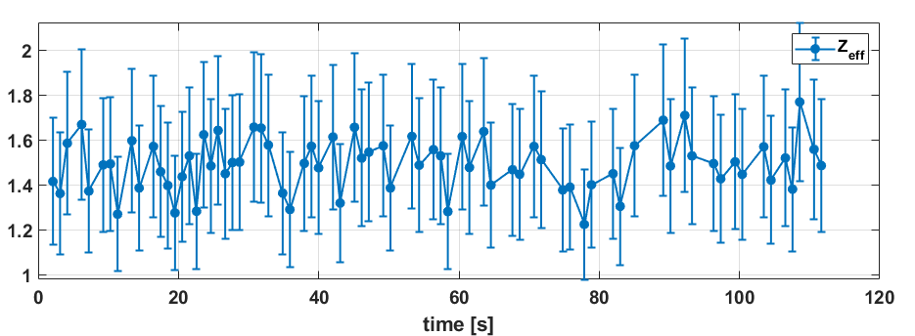
Longest detached scenario with Ne seeding
After several attempts (no feedback on f_{rad} possible before OP2.3), an optimized scenario has been found, which allowed to reach proper P_{SOL}/P_{rad} to keep both vulnerable components in the safe temperature range and aim at 1 GJ.
Puff of ca. 8·10¹⁷ Ne atoms every 2.5 seconds kept P_{rad} baseline constant at f_{rad} = 0.8 in the first 18 seconds. Gyrotrons dropped after t = 18 s

Slide 17
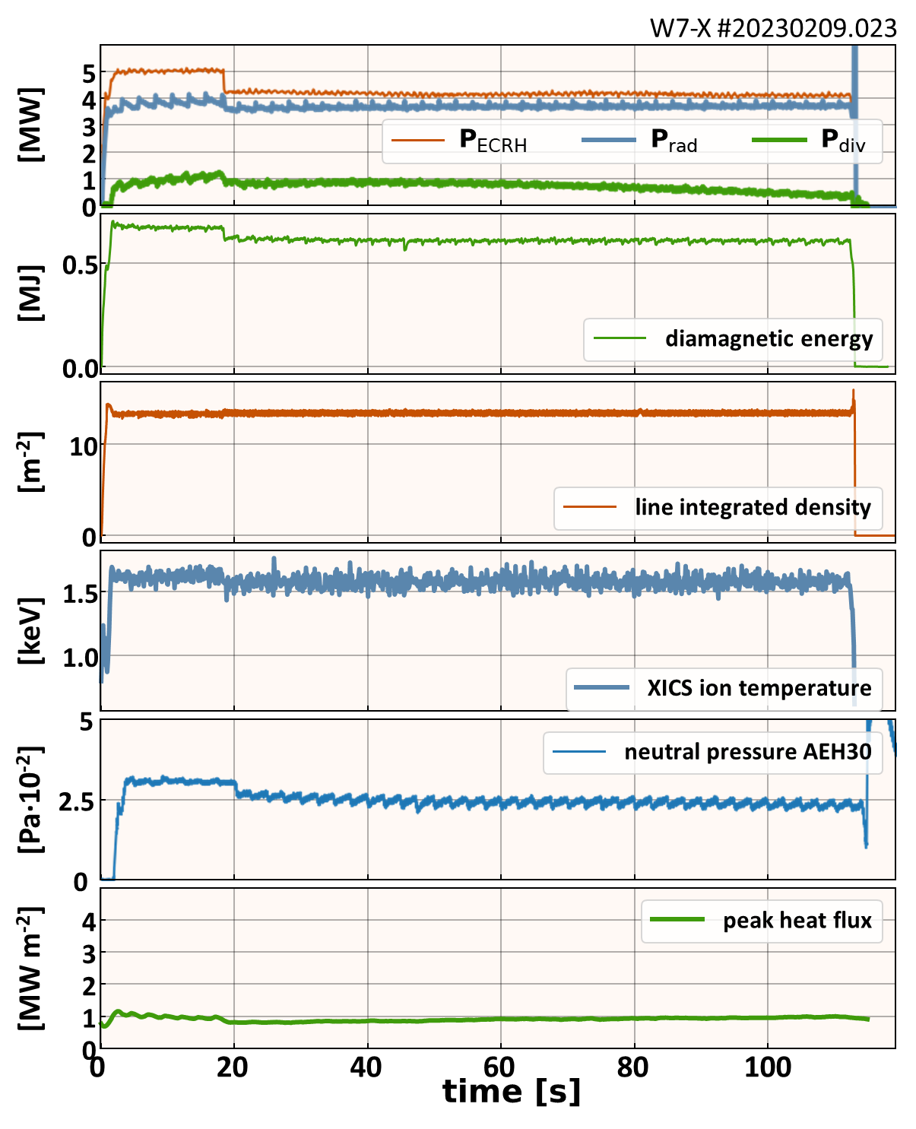
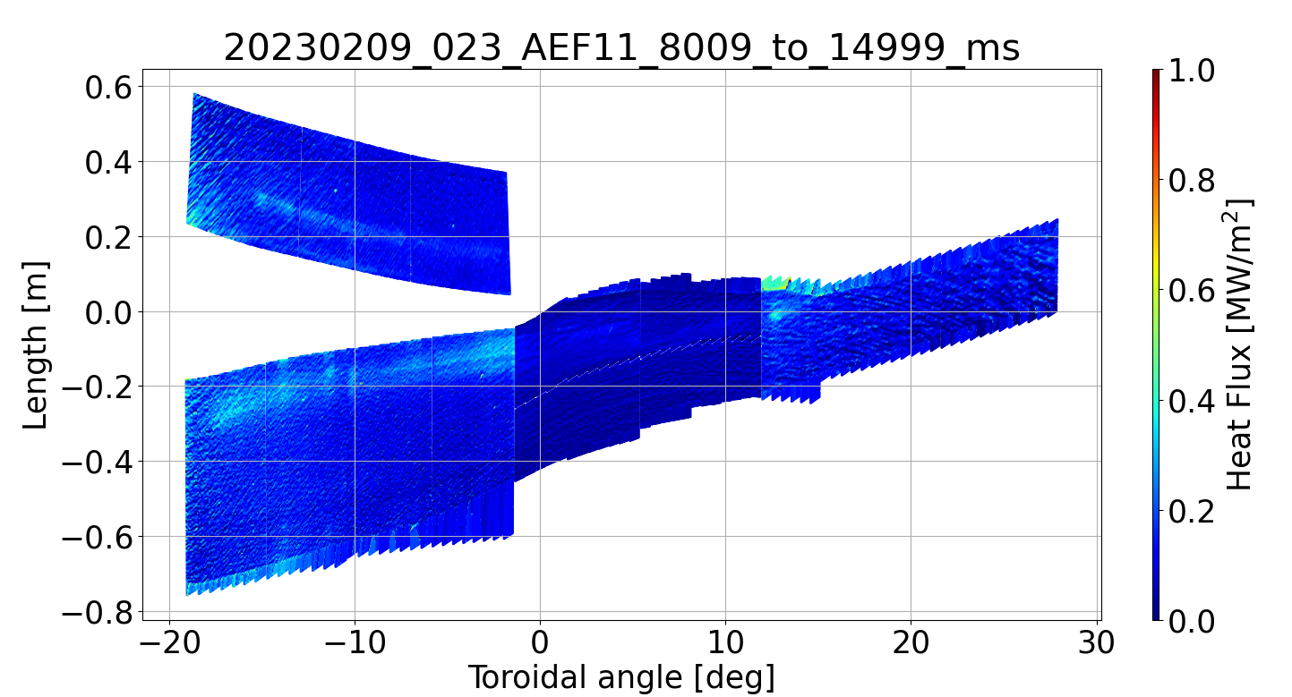
Longest detachment program in OP2.1 (seeding Ne)
After several attempts (no feedback on f_{rad} possible before OP2.3), an optimized scenario has been found, which allowed to reach proper P_{SOL}/P_{rad} to keep both vulnerable components in the safe temperature range and aim at 1 GJ.
Puff of Ne every 2.5 seconds kept P_{rad} baseline constant at f_{rad} = 0.8 in the first 18 seconds. Gyrotrons dropped after t = 18 s

Slide 18
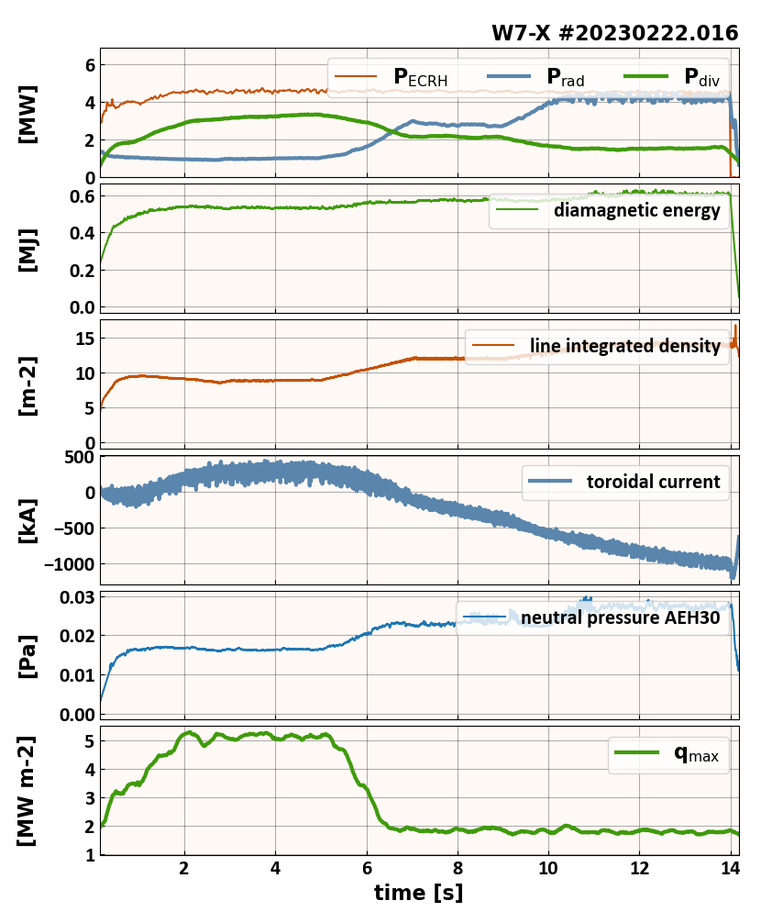
High mirror and high-iota configuration
High mirror, forward B_{tor}
Only a handful of discharges with intrinsic detachment performed (plus one in reversed field).
Operational window not scanned
No seeded detachment proposals performed
AEI pressure guages not available
The results are very promissing and require more thorough investigastion in OP2.2/2.3
High iota programs were not executed in OP2.1
subdivertor pressure remains at the pre-detachment level, no roll over?
M. Jakubowski | W7X Workshop 2023

Slide 19
Feedback control needs for long pulse detachment
OP1.2b
  P_{rad} control used to develop stable detachment scenarios
  n_{e} control sufficient for ~30 sec. programs
OP2.1
  P_{rad} control not available
  Scenario development (~100 sec.) with just n_{e} control time consuming
What we need
  Either: P_{rad} control + stable ECRH power
  Or: f_{rad} control
  Or: Other proxies for detachment level
    CII/CIII radiation in the edge filterscopes (detachment stabilization demonstrated in OP1.2b)
    Neutral gas pressure
    T_{surf}
[M. Krychowiak, et al., NME, 34 (2023) 101363]

Slide 20
Summary
Both intrinsic and seeded detachment experiments were performed in standard configuration.
Inefficient development of seeded detachment scenarios without feedback on P_{rad} (and sometimes even without P_{rad})
Boronization reduces f_{rad} level for a given plasma density such that detachment for P_{ECRH} > 4 MW not possible without additional Ne or N₂.
We were able to extend the duration of the pulse from 30 s to >100 s for intrinsic and seeded detachment, but we could not optimize the performance (f_{rad} > 95%) for most of the pulse.
It will be difficult to extend the seeded detachment beyond 100 s without proper feedback system.
High mirror and high iota are very promising for detachment and higher plasma performance, yet almost no experiments were performed in OP2.1.

