Slide 1
The Wendelstein 7-X stellarator
O. Grulke

Slide 2
Content The Wendelstein 7-X stellarator and its optimization criteria Operation achievements and transport assessment Operation planning

Slide 3
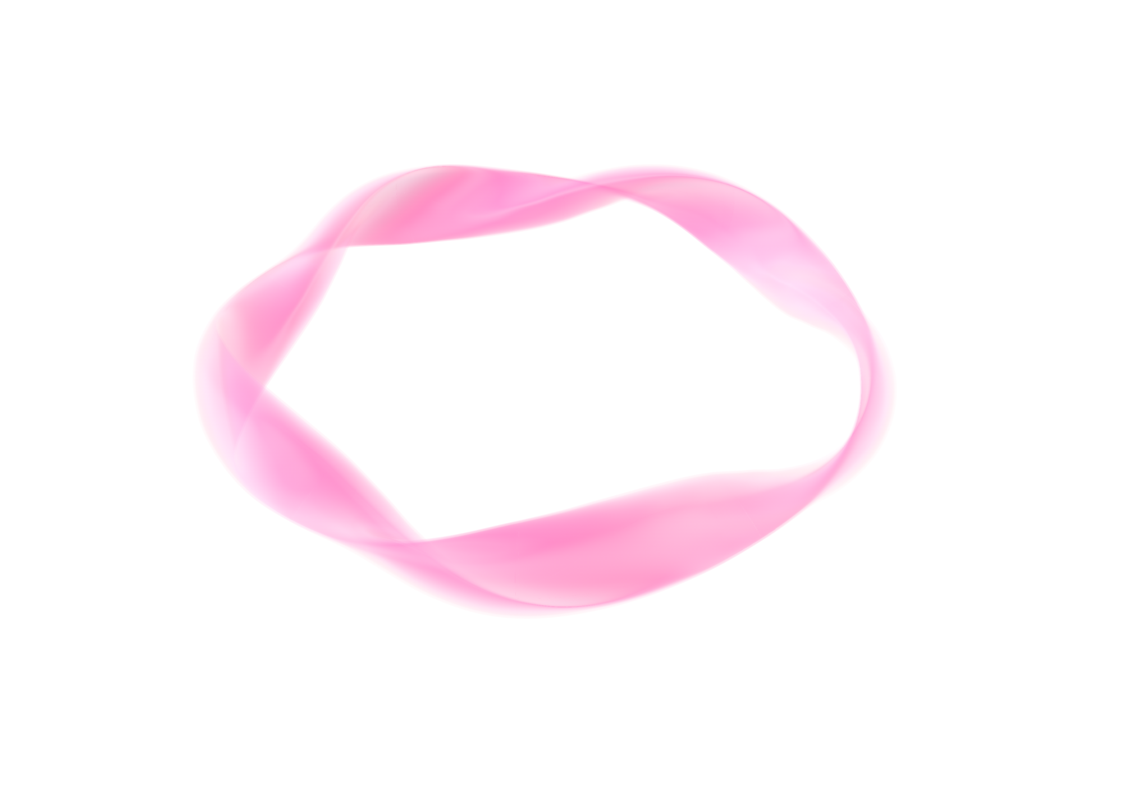
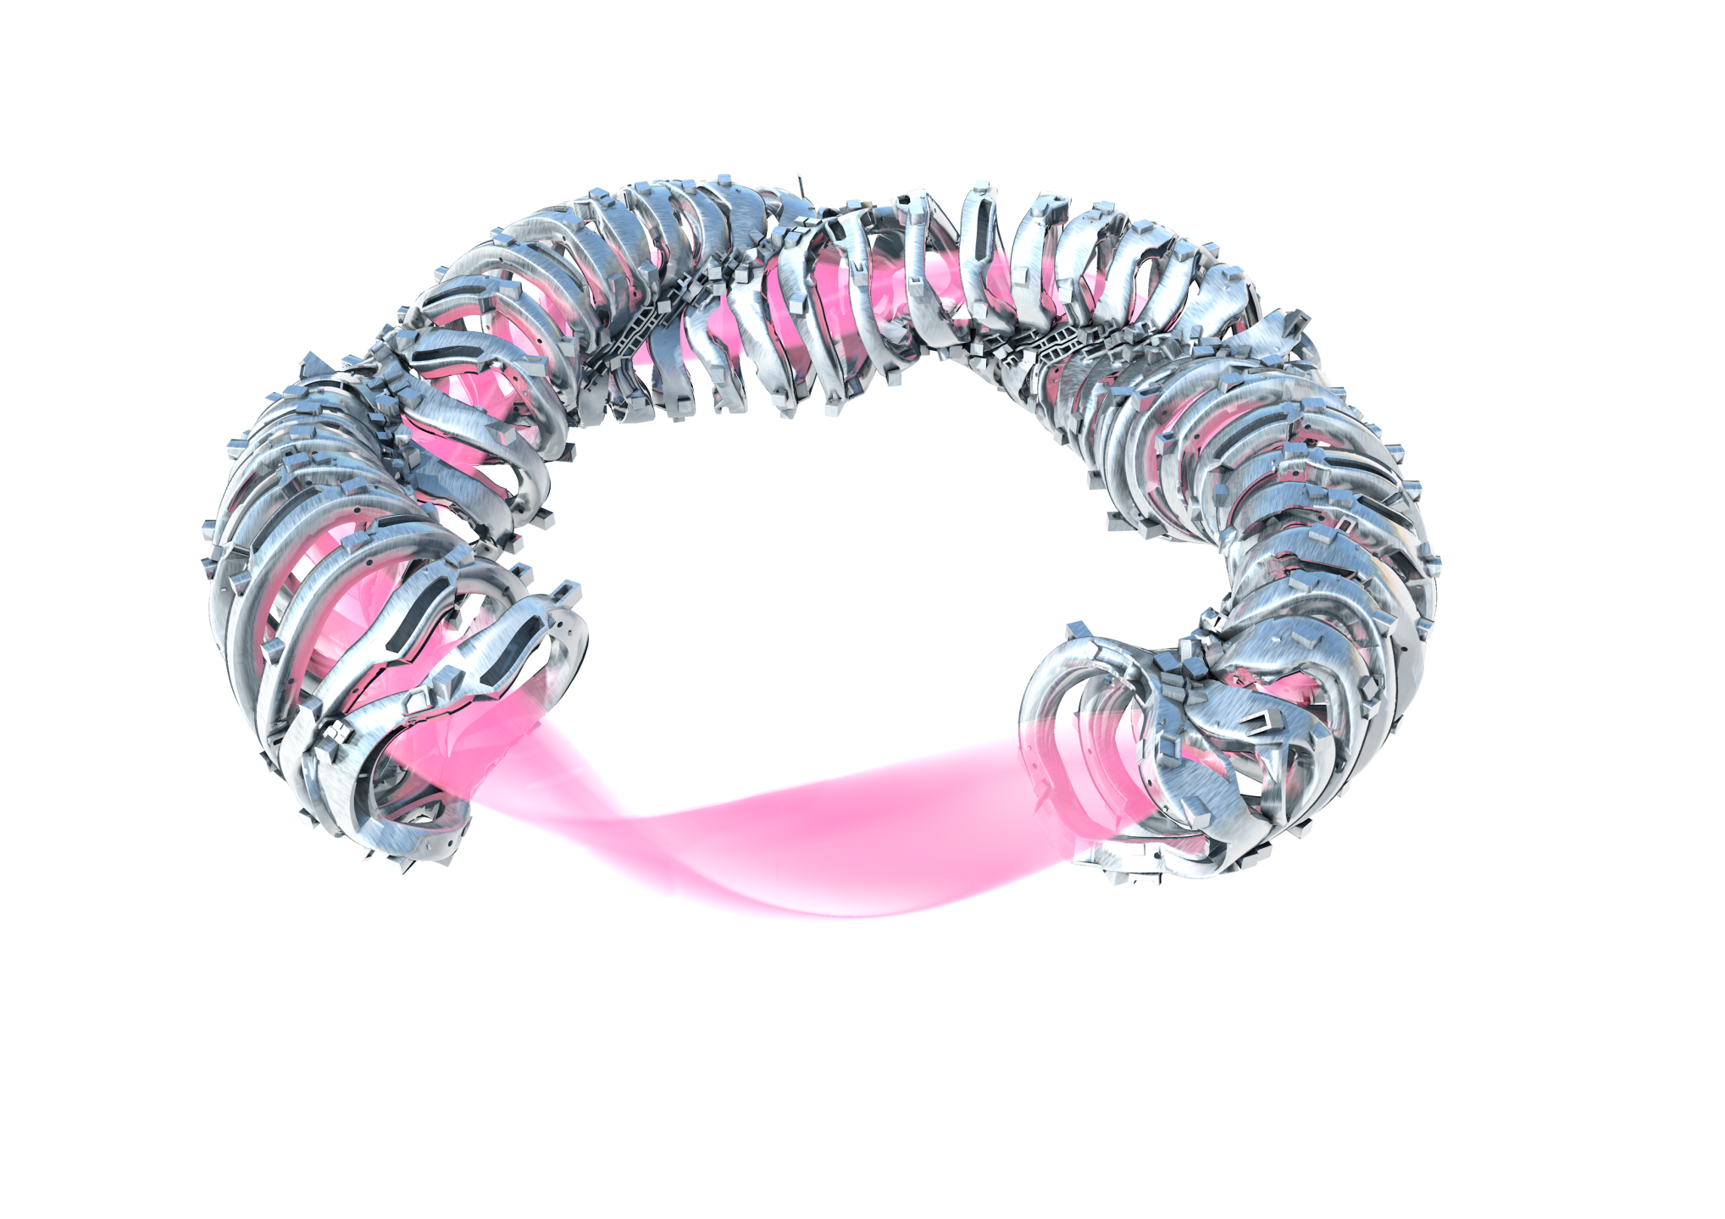
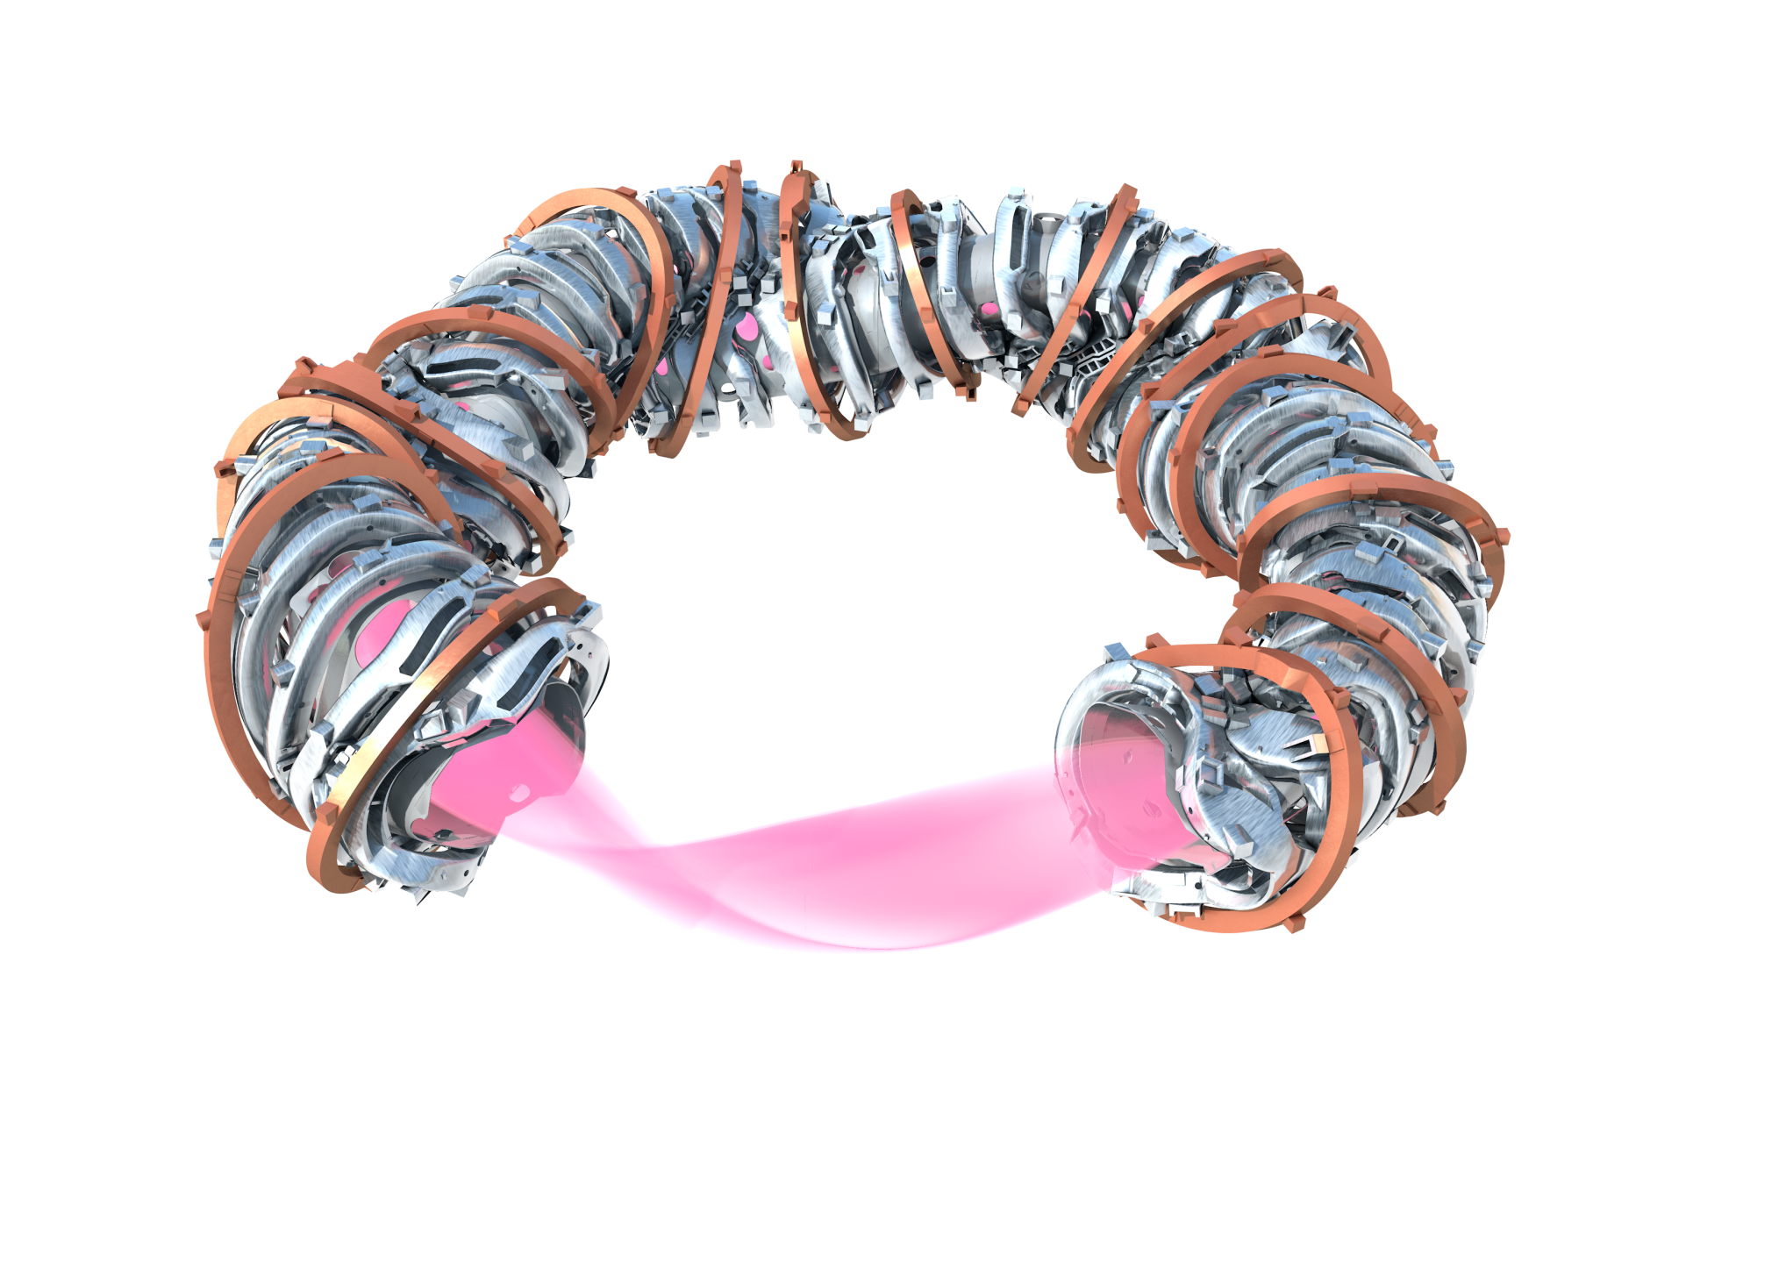
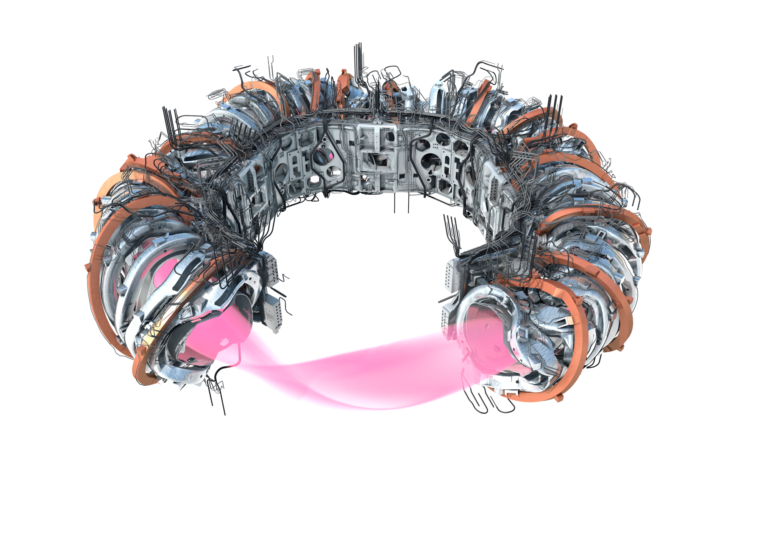
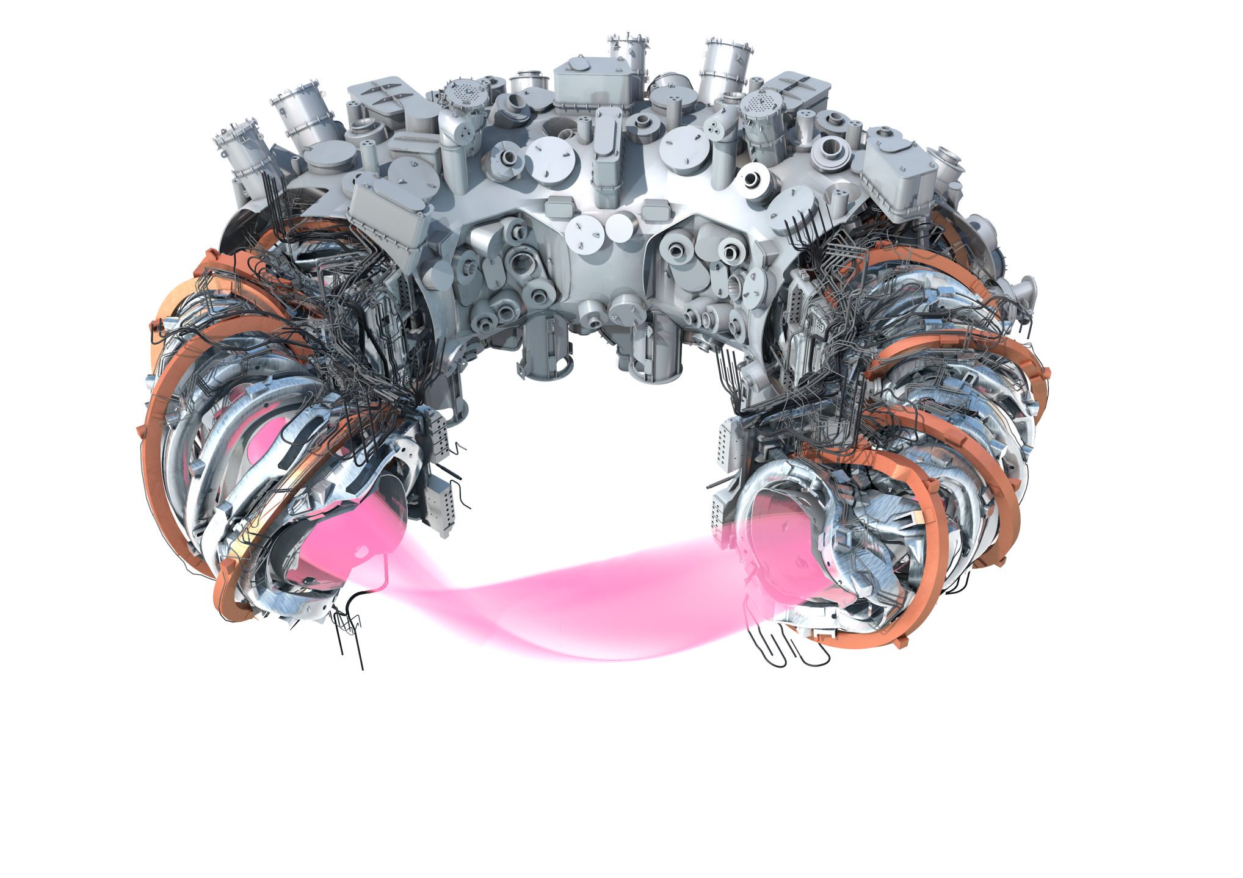
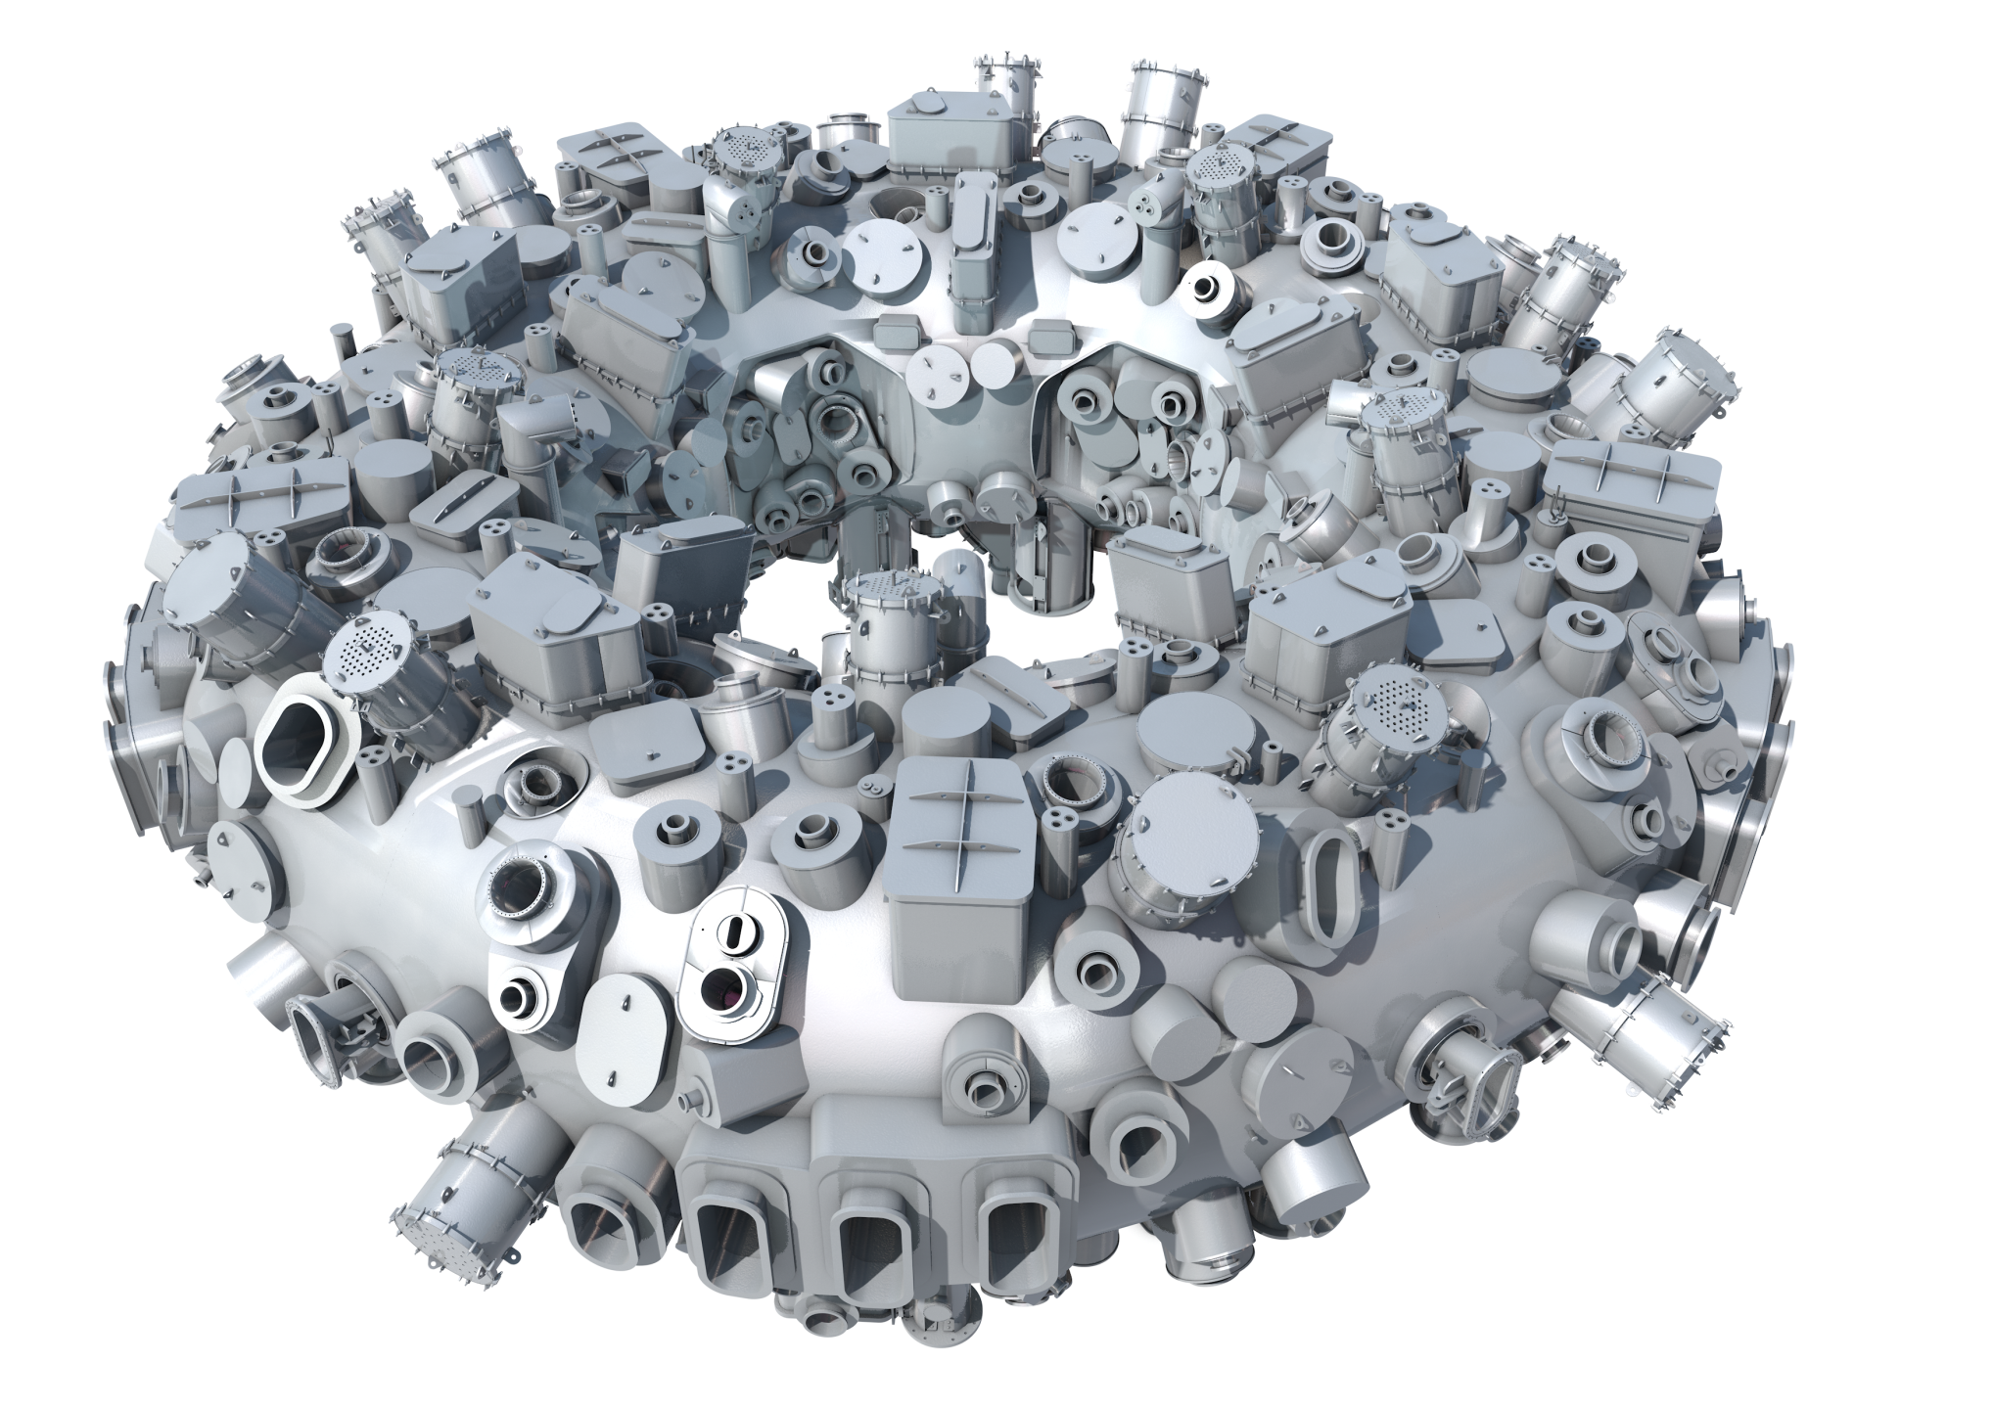
Wendelstein 7-X
plasma shape
50 non-planar superconducting coils
20 planar superconducting coils
3.4 K
support structure, supply
outer cryostat vessel

Slide 4
Wendelstein 7-X – facts and figures
cryogenic 3.4 K device
1000 t total weight
15 m outer diameter
project start 1996
1st large components 2004
12 years of assembly
1.3 mio assembly hours
device final stage 2022
capital investment 400 mio €
total project cost 1.3 bn €

Slide 5
Wendelstein 7-X – operation parameters
quantity | unit | value
magnetic induction | T | 2.5
rotational transform | 2π | 5/6 … 5/4
ECRH power | MW | 8.5 (>10)
NBI power | MW | 8 (>10)
Neutral gas |  | H₂, He (D₂)
PFC |  | mostly carbon
max. heating energy | GJ | 18
steady-state divertor heat flux | MW/m² | 10
typical pulse length (max.) | s | <30 (1800)

Slide 6
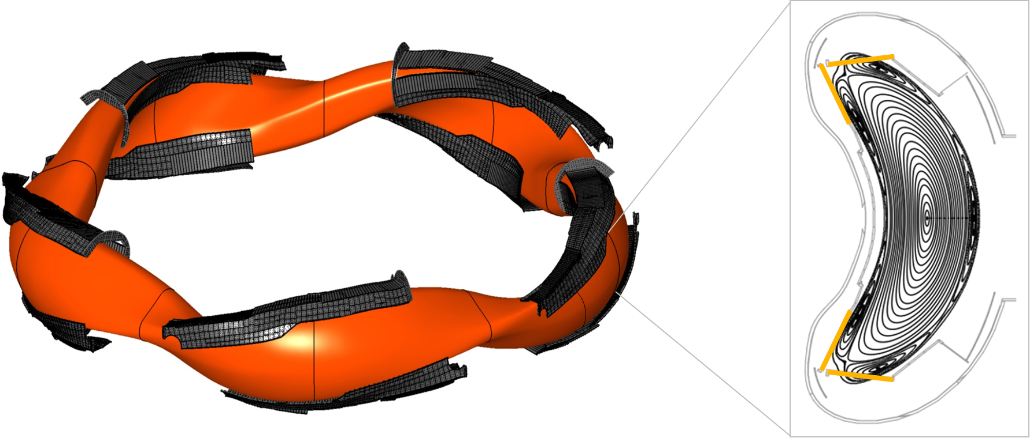
Island divertor concept
novel divertor concept to allow for a controlled heat and particle exhaust
resonant magnetic islands are intersected by divertor plates
magnetic islands

Slide 7
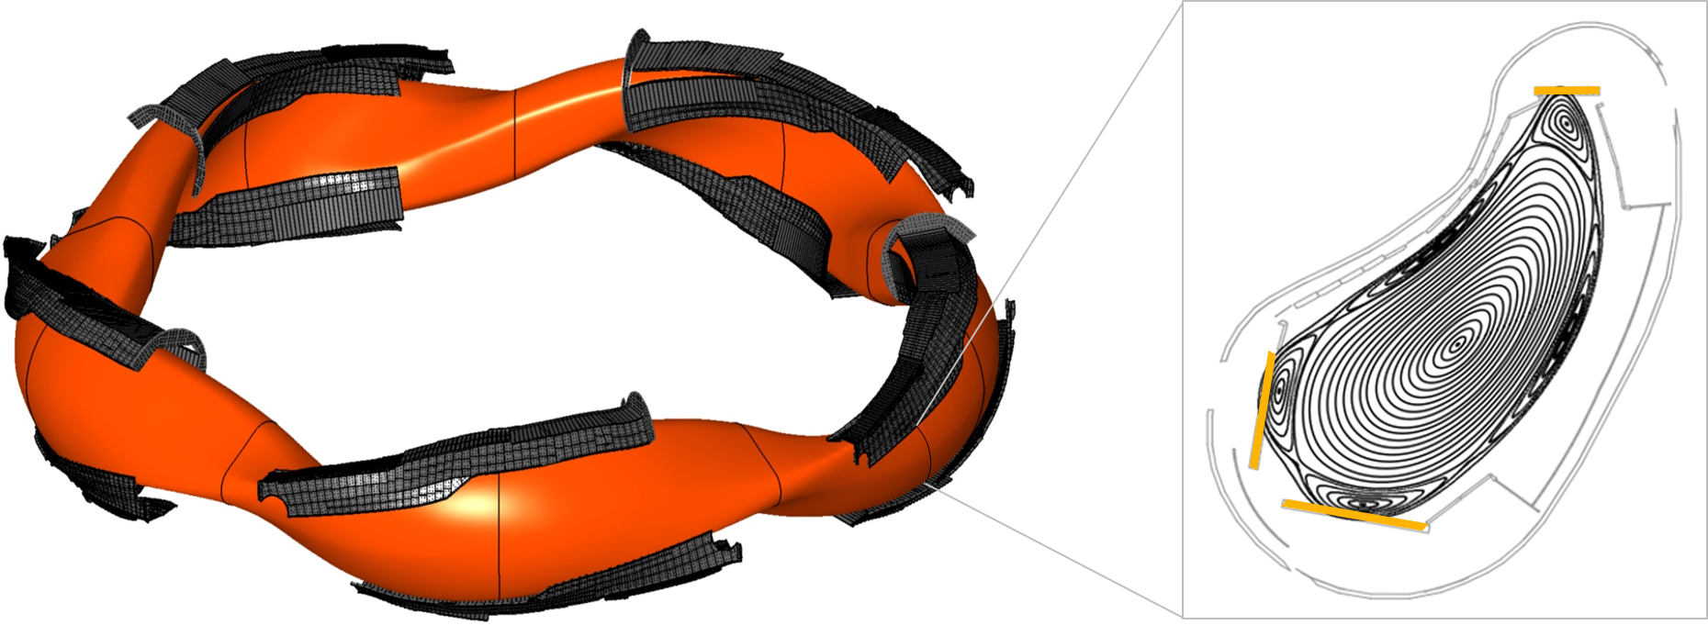
Island divertor concept
novel divertor concept to allow for a controlled heat and particle exhaust
resonant magnetic islands are intersected by divertor plates
three-dimensional magnetic field requires three-dimensional divertor geometry

Slide 8
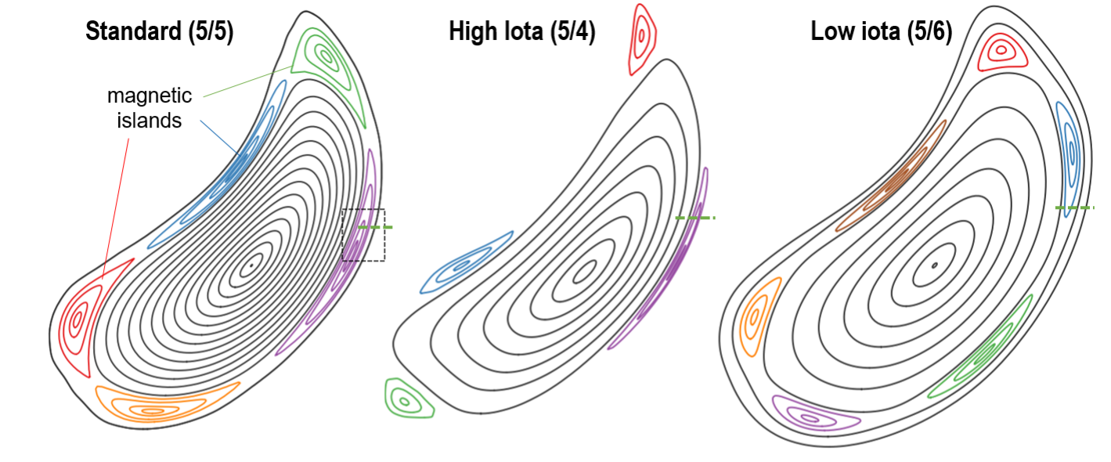
Island divertor concept
novel divertor concept to allow for a controlled heat and particle exhaust
resonant magnetic islands are intersected by divertor plates
three-dimensional magnetic field requires three-dimensional divertor geometry
island geometry is an important operation control parameter

Slide 9
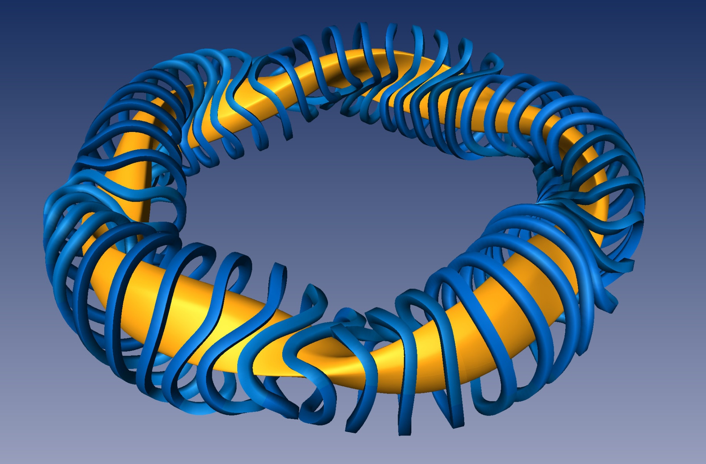
Optimization criteria and operation goals
coupled 3d-codes to achieve:
MHD equilibrium
MHD stability
neoclassical transport
guiding center drifts
island divertor

Slide 10
Optimization criteria and operation goals
coupled 3d-codes to achieve:
MHD equilibrium
MHD stability
neoclassical transport
guiding center drifts
island divertor
The mission of Wendelstein 7-X is to demonstrate the physics basis for a HELIAS reactor concept.
I | long-pulse operation | 30min discharges @ 18GJ energy turnaround
II. | good finite-β equilibrium and MHD stability | high-β operation (β≥3%)
III. | good neoclassical confinement | at reactor relevant collisionalities
IV. | stiff magnetic field geometry | high-β operation
V. | good collisionless α-particle confinement | high-β operation
VI. | compatible core-edge scenarios | divertor operation w/ control of PFC heat fluxes
VII. | reactor-relevant first wall | future operation with all-metallic PFCs

Slide 11
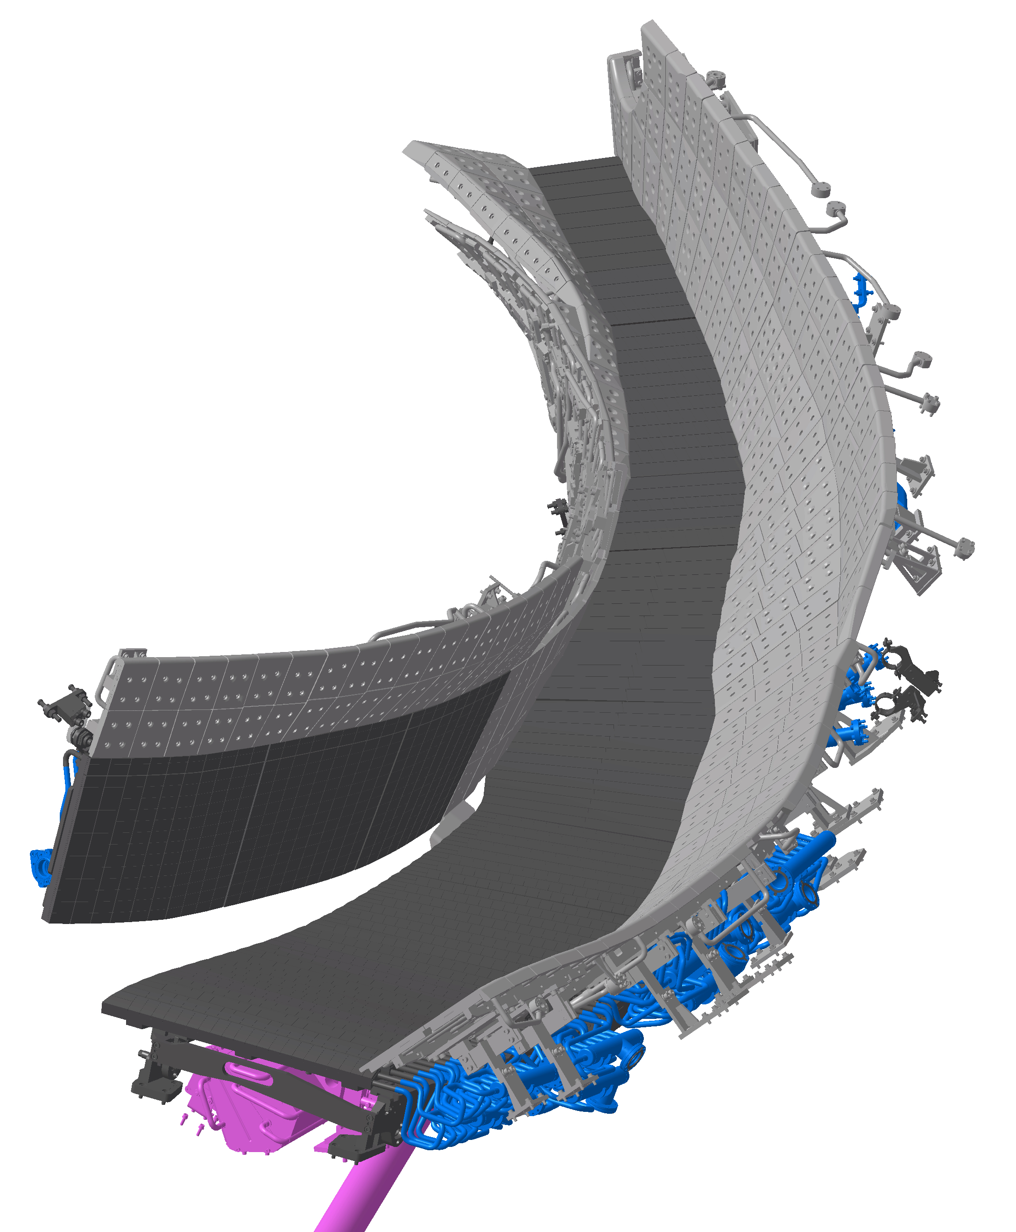
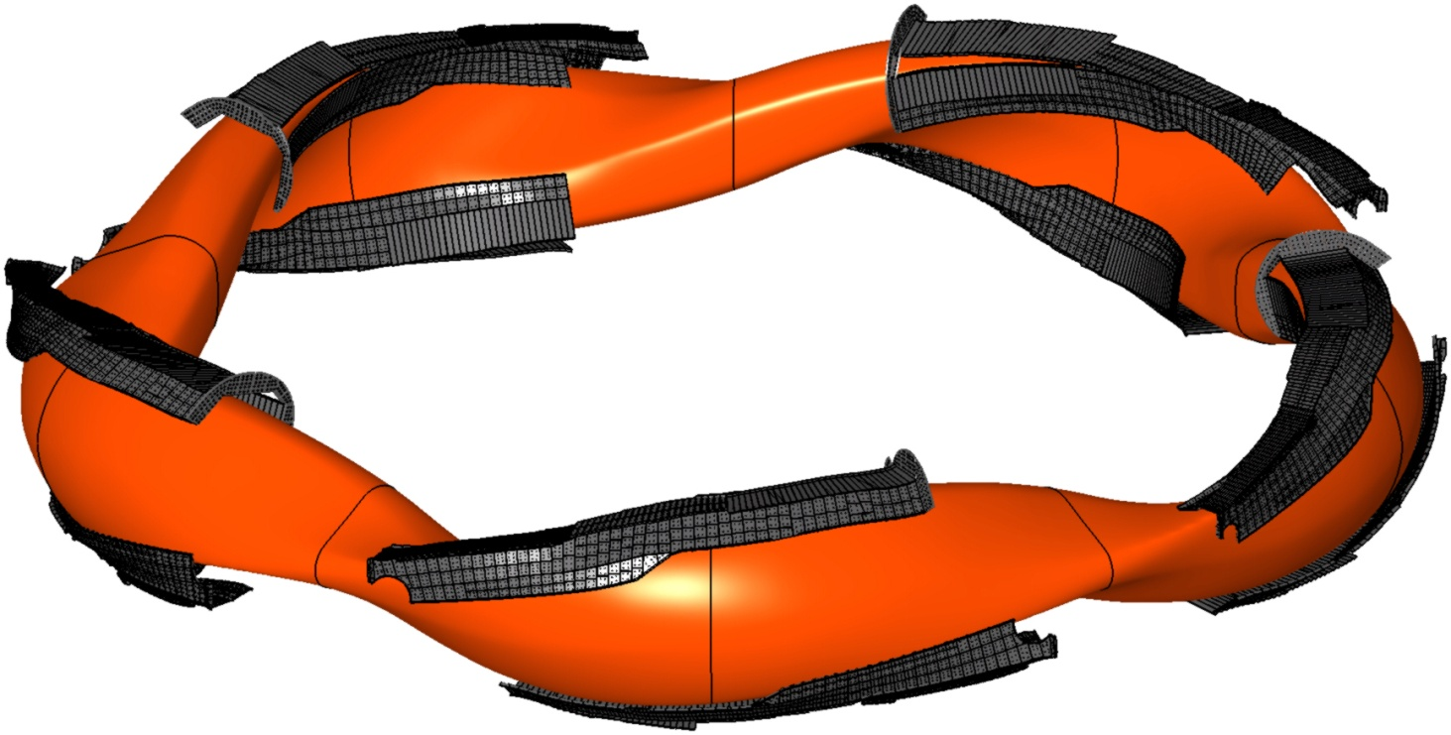
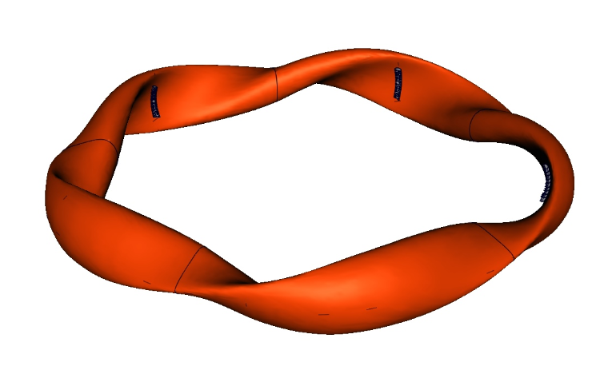
History of operation
operation phase OP 1.1: 2015 / 2016
no divertor
uncovered first wall
technical demonstration
operation phase OP 2.1: 2022/2023
fully water-cooled divertor units with cryo pumps
water-cooled first wall
self limitation to 1GJ energy throughput
discharge lengths up to 8min
achieved energy throughput 1.3GJ
to be increased to 30min@18GJ in upcoming campaigns
operation phase OP 1.2: 2017 / 2018
uncooled divertor units
full wall coverage
discharge lengths up to 100s
achieved energy throughput 200MJ

Slide 12
First milestone: 1.3GJ energy turnaround

Slide 13
Long-pulse detachment
feed-forward Ne seeding to stabilize detachment
 puff of ~8·10¹⁷ Ne atoms every 2.5s to keep radiated power constant at f_{rad}=0.8
 no influence on density control or core plasma parameters (Z_{eff}=1.5 throughout entire discharge)
strongly reduced divertor heat flux at P_{heat}≈1MW/m²
programmed pulse length of 110s achieved
 stability of scenario allows for much longer pulse lengths (will be addressed in upcoming experimental campaign)
 it is foreseen to introduce feedback on radiative power levels to counteract changes in impurity radiation in long pulse scenarios

Slide 14
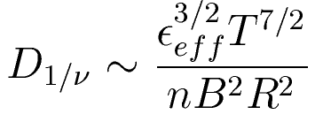
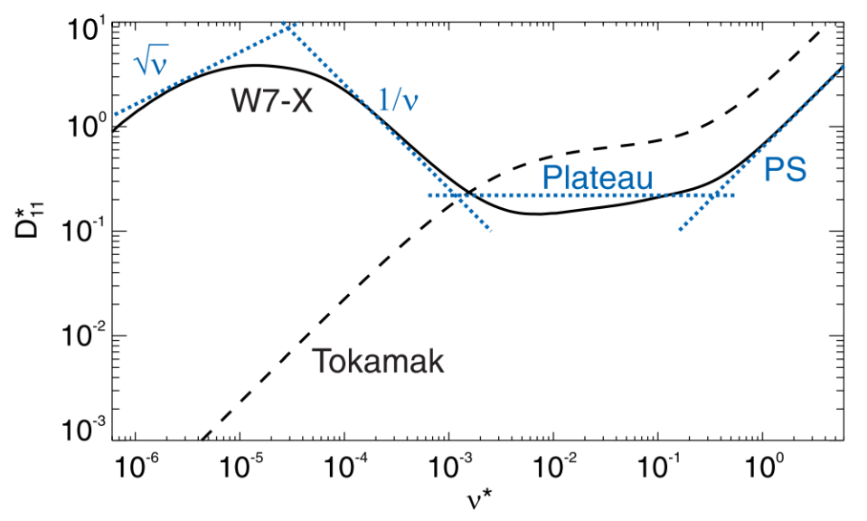
Neoclassical transport
stellarators generally suffer from enhanced neoclassical transport at low plasma collisionality
dependence on magnetic field ripple ε_{eff} allows for geometrical optimization of the magnetic field to reduce neoclassical diffusion to tokamak level
 a major optimization criterion for the
Wendelstein 7-X stellarator
ion transport affected by ambipolar neoclassical radial electric field
Stellarator optimization
reducing ε_{eff}
D_{electrons}
Effect of radial electric field
Helander et al. Plasma Phys. Control. Fusion 54 (2012)
operation at high plasma density is instrumental!

Slide 15
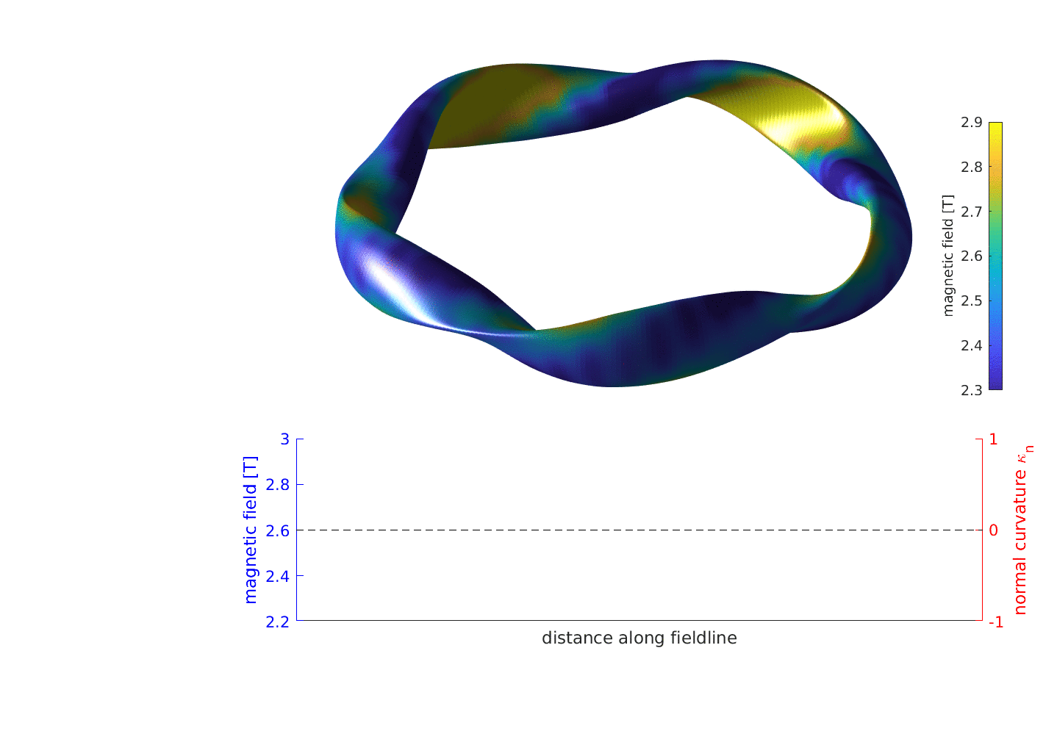
Wendelstein 7-X configuration

Slide 16
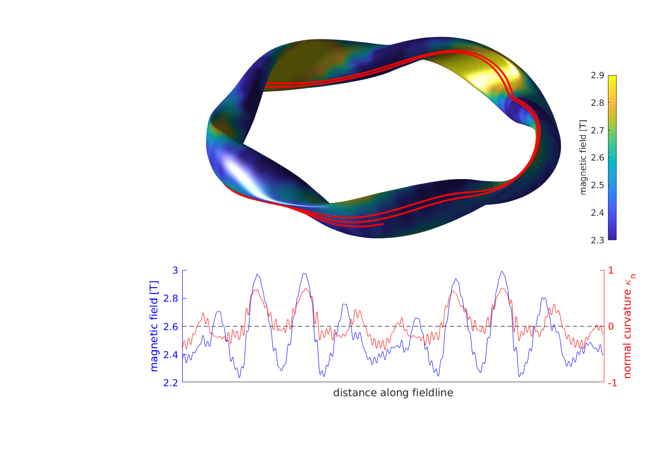
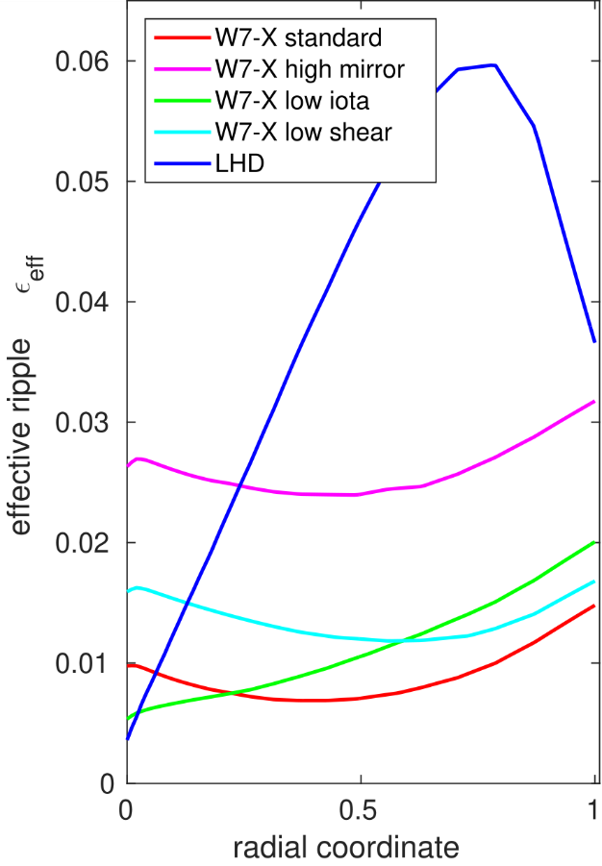
Wendelstein 7-X configuration
neoclassical transport optimization due to strongly reduced effective magnetic ripple ε_{eff}

Slide 17
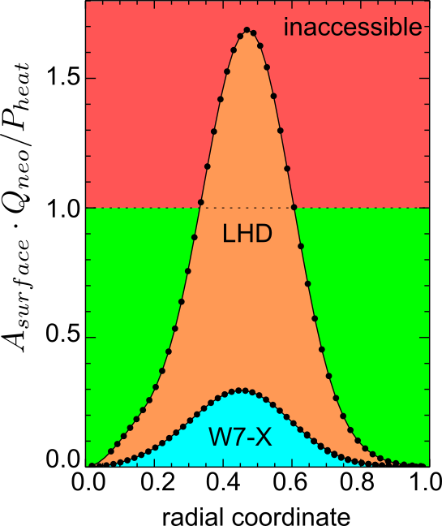
Experimental demonstration of neoclassical transport optimization
actual plasma performance demonstrates that neoclassical transport is strongly reduced
operation scenario dominated by neoclassical transport
balance heating power against neoclassical power losses
observed performance would not be possible without
strongly reduced neoclassical transport
C.D. Beidler et al., Nature 2021

Slide 18
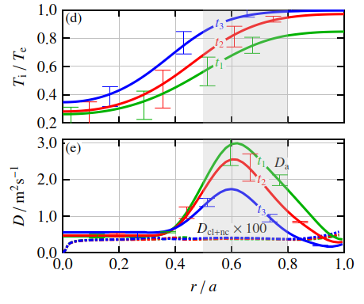
Dominance of turbulent transport
impurity transport a good proxy for plasma energy transport
tracking tracer amounts of injected impurities allow for a detailed quantitative study of turbulent and neoclassical transport
turbulent transport generally orders of magnitude larger than neoclassical transport
dependency on temperature ratio aligns with the hypothesis of dominant ITG transport

Slide 19
Gradient-driven instabilities
ion temperature gradient modes (ITG)
simple fluid instability criterion

Slide 20
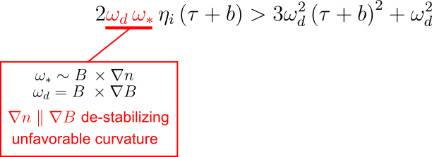
Gradient-driven instabilities
ion temperature gradient modes (ITG)
simple fluid instability criterion
electron temperature gradient modes (ETG)
ETG can contribute considerable to electron heat
transport in tokamaks by the formation of streamers
(small k_{r})
in stellarators with multiple magnetic field periods,
local magnetic shear prevents streamer formation
 ETG turbulent transport small
tokamak
W7-X
G.G. Plunck et al., Phys. Rev. Letters 2019

Slide 21
Gradient-driven instabilities
ion temperature gradient modes (ITG)
simple fluid instability criterion
trapped electron modes (TEM)
results from resonance between trapped electron precession
and drift wave phase velocity
 for centrally-peaked density profiles, no resonance for max(J) configurations (J peaks in center)
possibility to stabilize ITG turbulence via density gradient, but not to the expense of TEM destabilization
P. Helander et al., Phys. Plasmas 2013

Slide 22
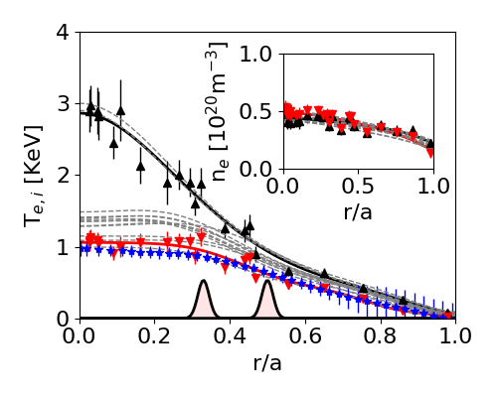
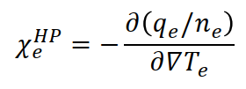
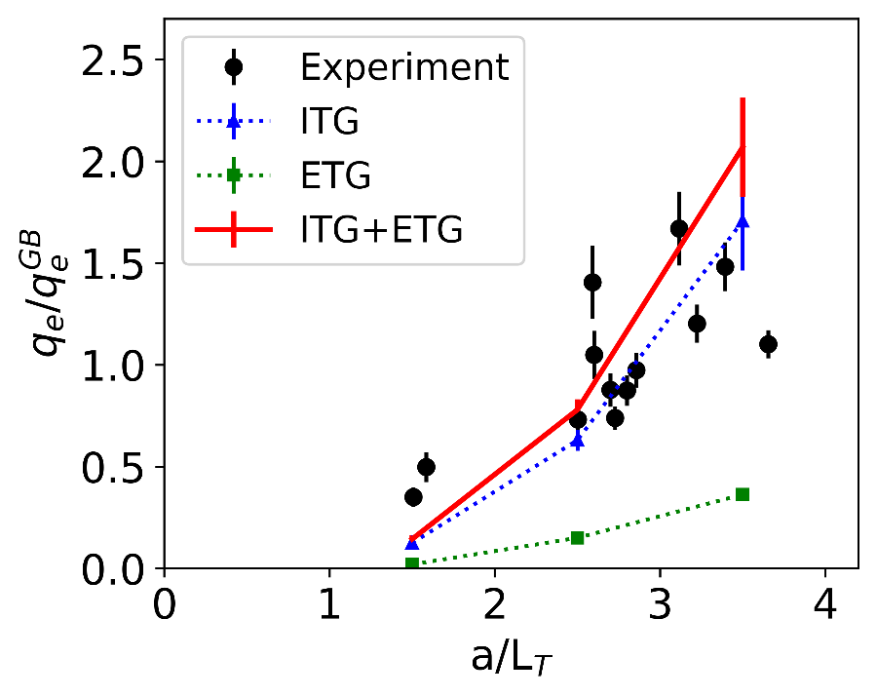
Electron heat flux
ECRH deposition allows for controlled variations of ∇T_{e} (off-axis heating)
tracking of centrally deposited ECRH heat pulses allows for direct measurements of electron heat transport
measured electron heat flux does not show indications of strong stiffness
in agreement with flux-tube simulations of ITG heat transport
$$T_{i}$$
G. M. Weir et al., Nucl. Fusion 2021

Slide 23
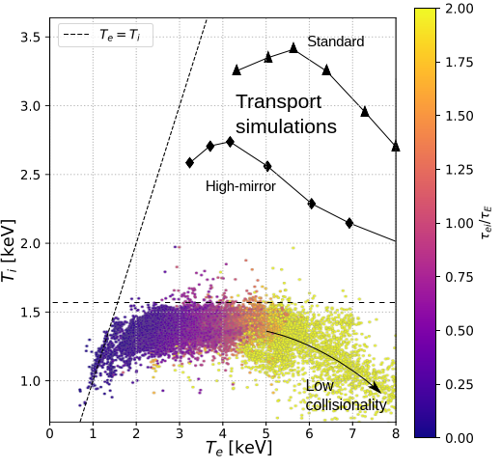
Increased heat transport limits T_{i} operation regime
observed peak ion temperatures consistently smaller than expected from neoclassical transport
for available plasma heating powers, T_{i}≤1.5keV in the ECRH gas-fueled discharges
often denoted as „ion temperature clamping“
However…

Slide 24
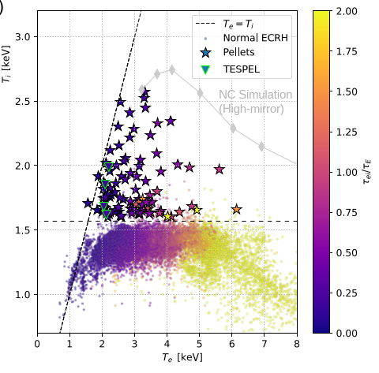
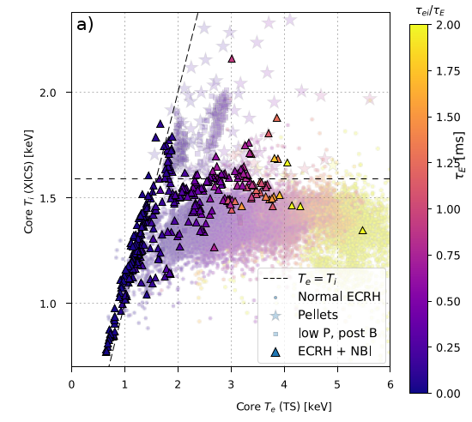
Exceptional confinement scenarios
operation scenarios with small turbulent heat flux
confinement approaching the neoclassical transport limit
 operation with centrally peaked plasma density profiles

Slide 25
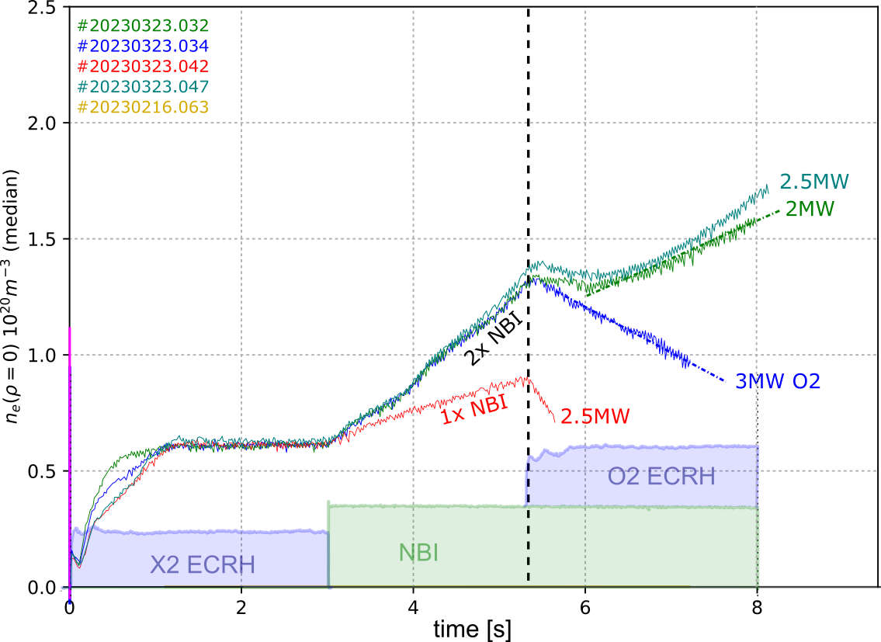
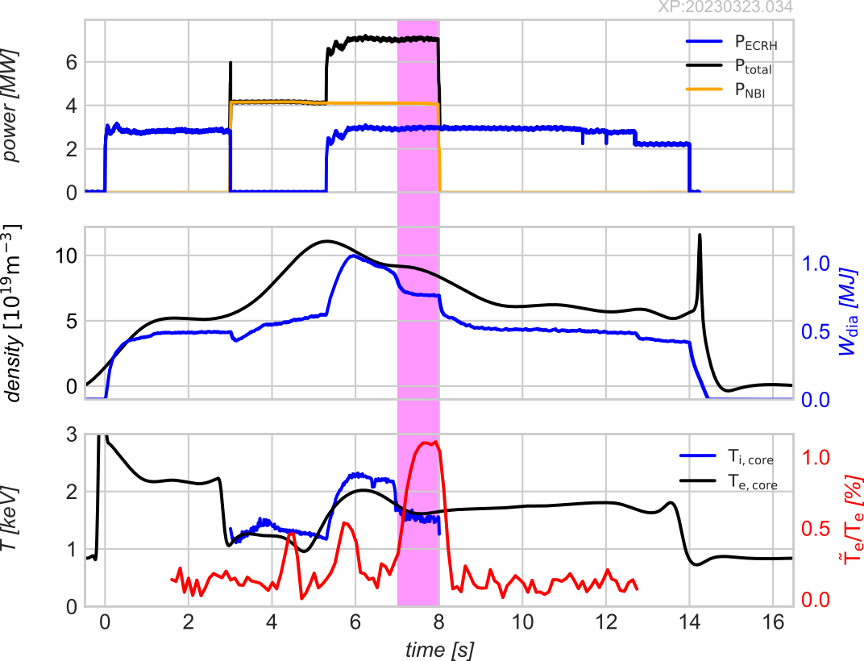
Reduced plasma turbulence with NBI fueling
improved confinement phase is observed as long as central density peaking is maintained
critical dependence on ECRH heating level (density pump-out)
loss of density peaking correlates with increase of turbulence

Slide 26
Not the full story…
little understanding of particle transport

Slide 27
Not the full story…
role of ambipolar neoclassical electric field
little understanding of particle transport

Slide 28
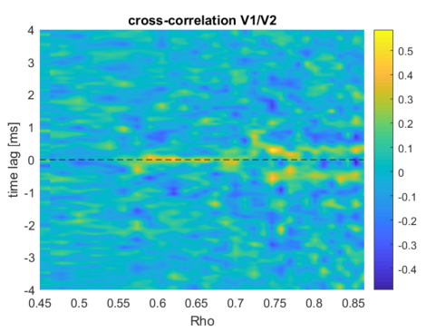
Not the full story…
role of ambipolar neoclassical electric field
little understanding of particle transport
I
II
III
saturation of ITG and role of zonal flows

Slide 29
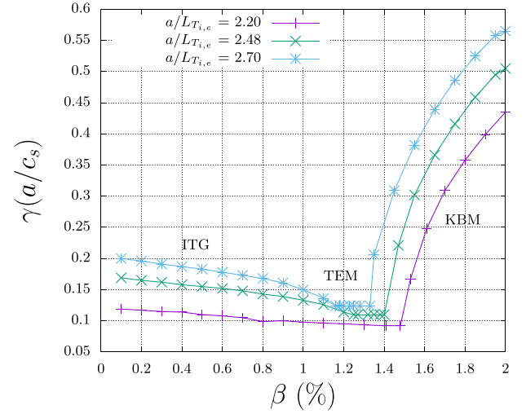
Not the full story…
role of ambipolar neoclassical electric field
little understanding of particle transport
I
II
III
turbulence at increased plasma-β and role of KBM
saturation of ITG and role of zonal flows

Slide 30
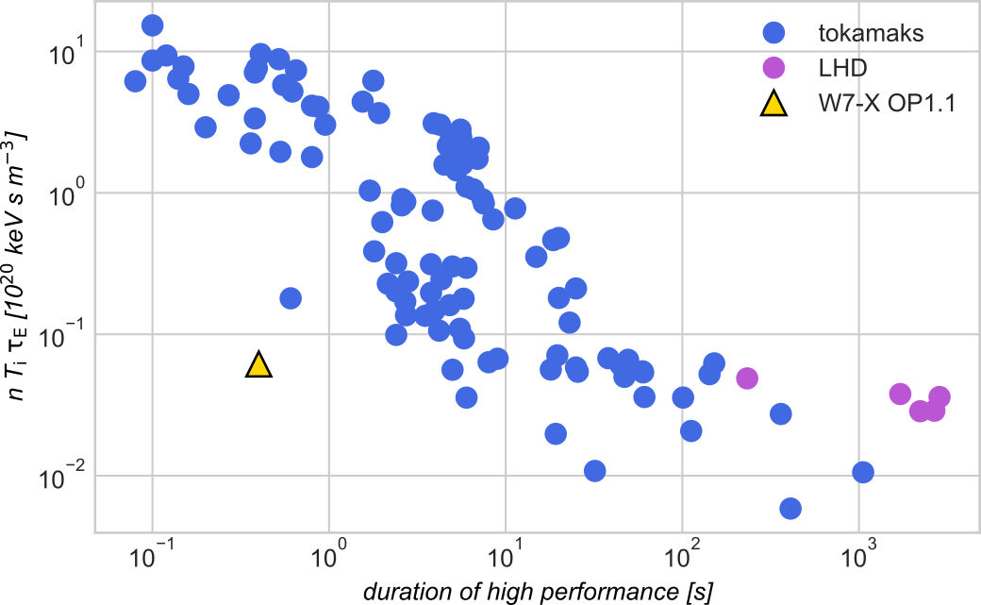
Figure of merit

Slide 31
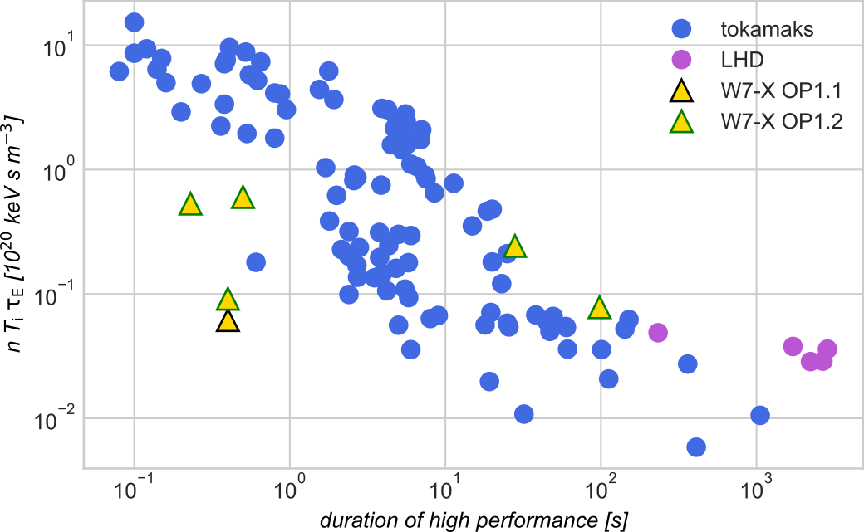
Figure of merit

Slide 32
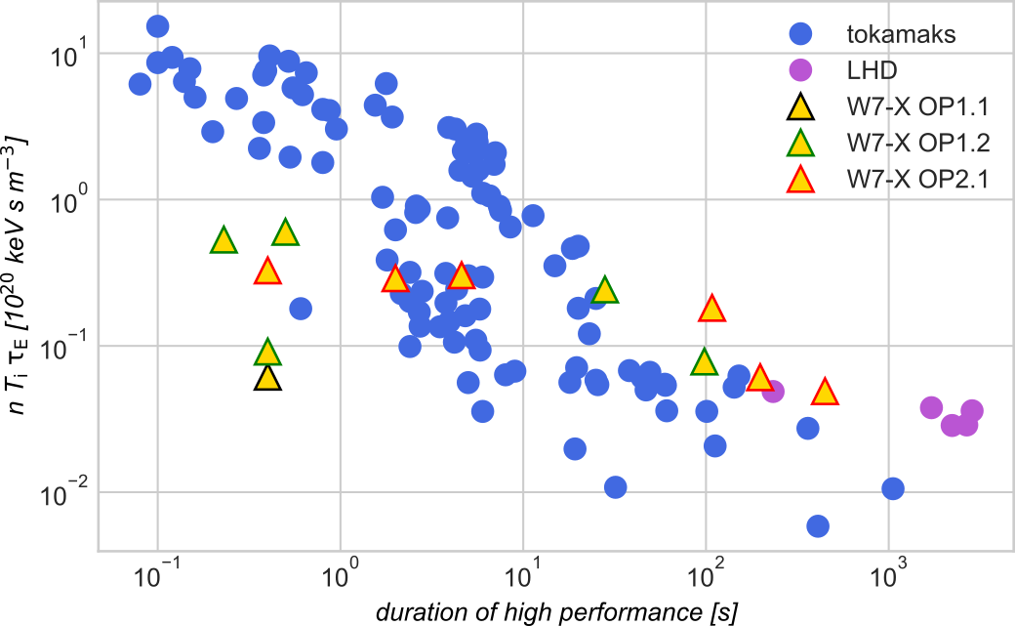
Figure of merit

Slide 33
Operation planning

