Slide 1
Investigation of radiation distribution and scaling for power exhaust in W7-X
HEPP seminar – progress talk
G Partesotti, F Reimold, T Klinger, M Krychowiak and the W7-X team.

Slide 2
Overview
Introduction
New bolometer diagnostics
Radiation distribution
$P_{rad}$ proxy improvement
Summary

Slide 3
Overview
Introduction
New bolometer diagnostics
Radiation distribution
$P_{rad}$ proxy improvement
Summary

Slide 4
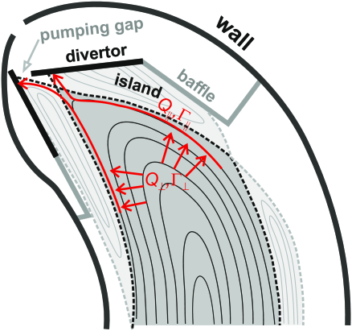
Introduction
Material limits of 10 $MW/m^{2}$ on the PFCs
Radiation emission is a major power dissipation channel
Radiative cooling must be localized in plasma edge
$$P_{rad}$$
[Jakubowski et al. 2020]

Slide 5
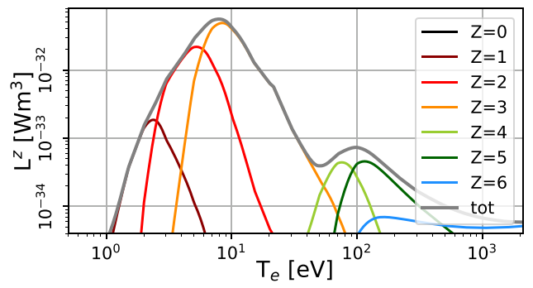
Introduction
Material limits of 10 $MW/m^{2}$ on the PFCs
Radiation emission is a major power dissipation channel
Radiative cooling must be localized in plasma edge
$P_{Z}=n_{e}n_{Z}L_{Z}(n_{e},T_{e})$
C radiation loss function
$$P_{rad}$$
[Geißler 2022]
[Jakubowski et al. 2020]

Slide 6
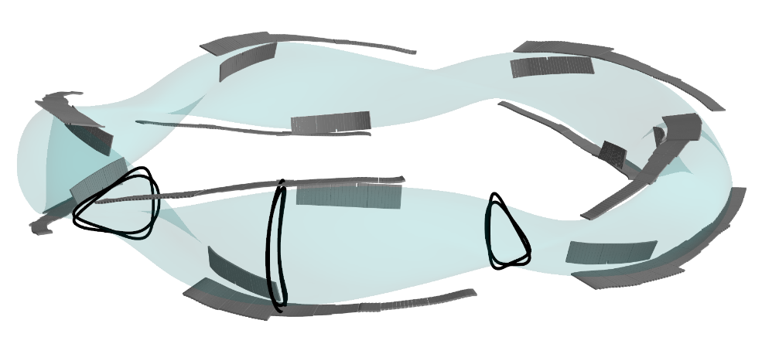
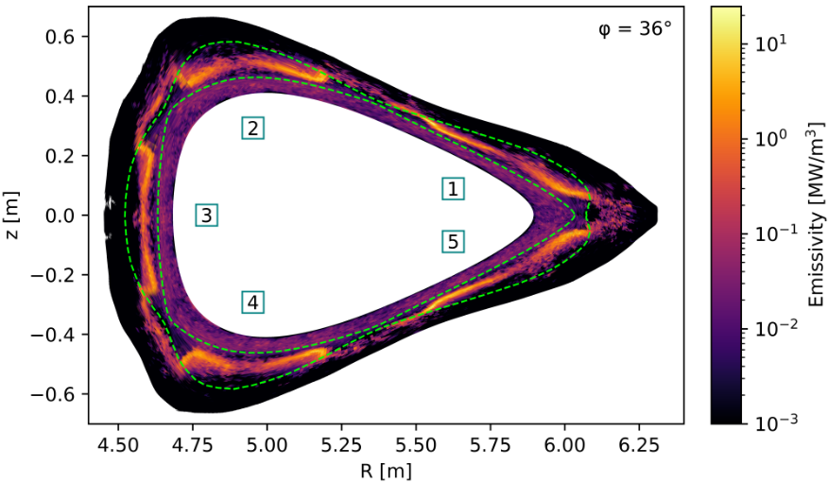
Introduction
Material limits of 10 $MW/m^{2}$ on the PFCs
Radiation emission is a major power dissipation channel
Radiative cooling must be localized in plasma edge
$P_{Z}=n_{e}n_{Z}L_{Z}(n_{e},T_{e})$
Stellarator geometry
4-6 magnetic islands
Island divertor
Discontinuous divertor targets
Particle drifts
Intrinsic radiation asymmetries
divertor targets
EMC3-EIRENE

Slide 7
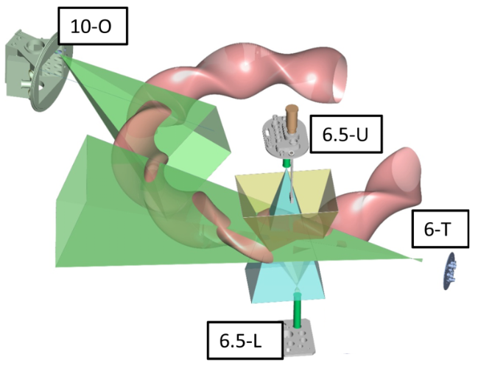
Introduction
Material limits of 10 $MW/m^{2}$ on the PFCs
Radiation emission is a major power dissipation channel
Radiative cooling must be localized in plasma edge
$P_{Z}=n_{e}n_{Z}L_{Z}(n_{e},T_{e})$
Stellarator geometry
4-6 magnetic islands
Island divertor
Discontinuous divertor targets
Particle drifts
Intrinsic radiation asymmetries
Underdiagnosed for tomography
→ Investigation of 3-D
radiated power distribution
divertor targets
EMC3-EIRENE
LHD
[Sano et al. 2020]

Slide 8
Overview
Introduction
New bolometer diagnostics
Radiation distribution
$P_{rad}$ proxy improvement
Summary

Slide 9
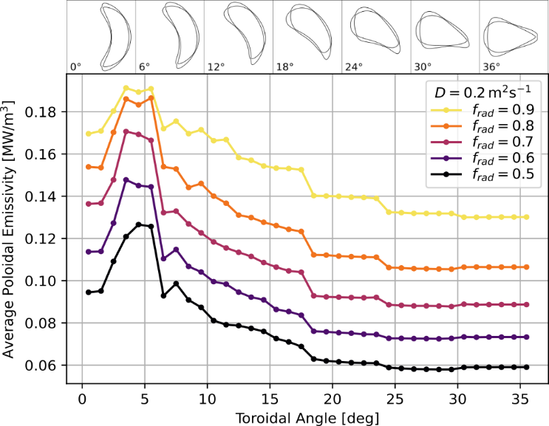
New bolometer diagnostics
Analysis of EMC3-EIRENE radiated power density
Intrinsic toroidal asymmetry of $P_{rad}$

Slide 10
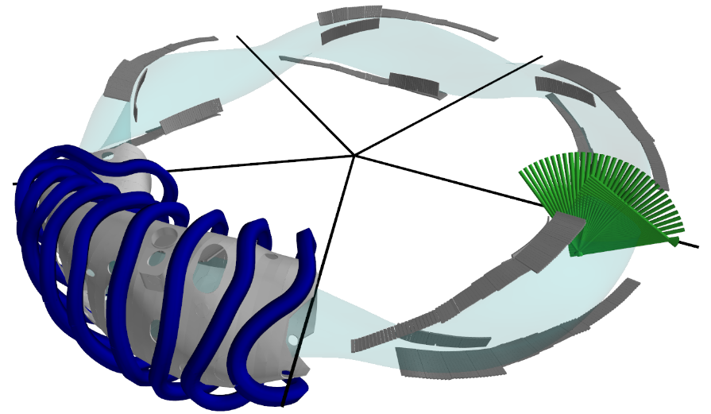
New bolometer diagnostics
Analysis of EMC3-EIRENE radiated power density
Intrinsic toroidal asymmetry of $P_{rad}$
$P_{rad}$ is measured by bolometer cameras
Toroidally localized measurement can lead to $P_{rad}$ errors
Radiated power density peaks in divertor region
More diagnostic coverage is required
Initial bolometer diagnostics:
Core bolometry (3 cameras, 80 ch.)
Core
bolometry

Slide 11
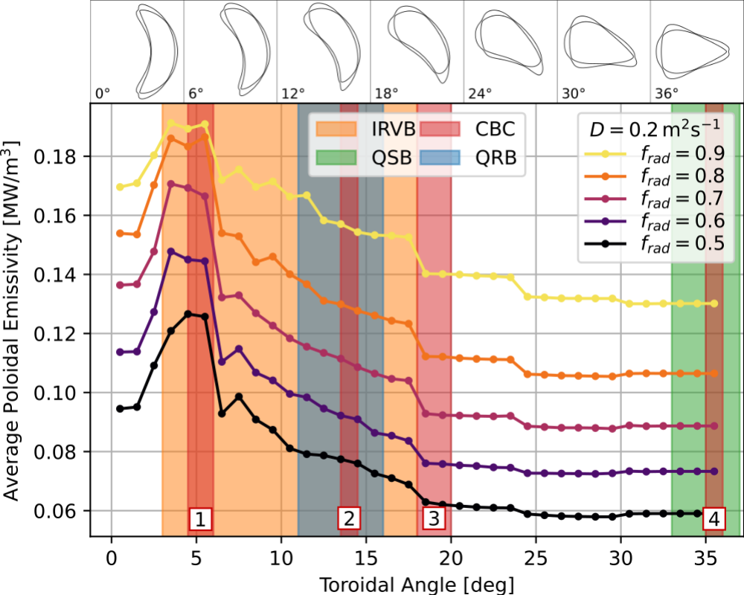
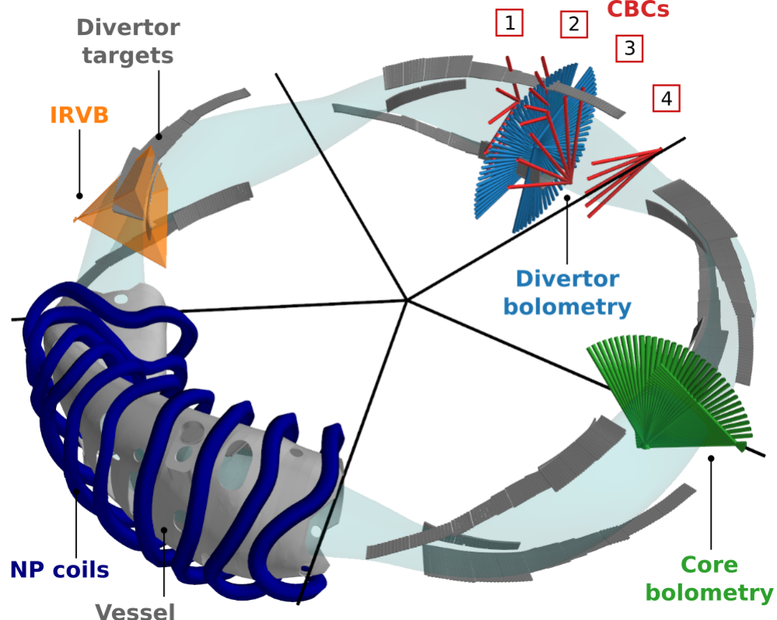
New bolometer diagnostics
Analysis of EMC3-EIRENE radiated power density
Intrinsic toroidal asymmetry of $P_{rad}$
$P_{rad}$ is measured by bolometer cameras
Toroidally localized measurement can lead to $P_{rad}$ errors
Radiated power density peaks in divertor region
More diagnostic coverage is required
New bolometer diagnostics:
Core bolometry (3 cameras, 80 ch.)
Divertor bolometry (4 cameras, 88 ch.)
Compact Bolometer Cameras (CBCs)
InfraRed (imaging) Video Bolometer camera (IRVB, 520 ch.)

Slide 12
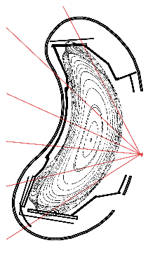
New bolometer diagnostics
CBC (compact resistive bolometers)
Fast ray tracing developed to model diagnostics
Geometry optimized for accuracy of local $P_{rad}$ estimation
4 CBCs designed, 3 installed
Inexpensive and simple design, compact size
Easy to adapt to any diagnostic port (multiple toroidal locations)
CBC geometry

Slide 13
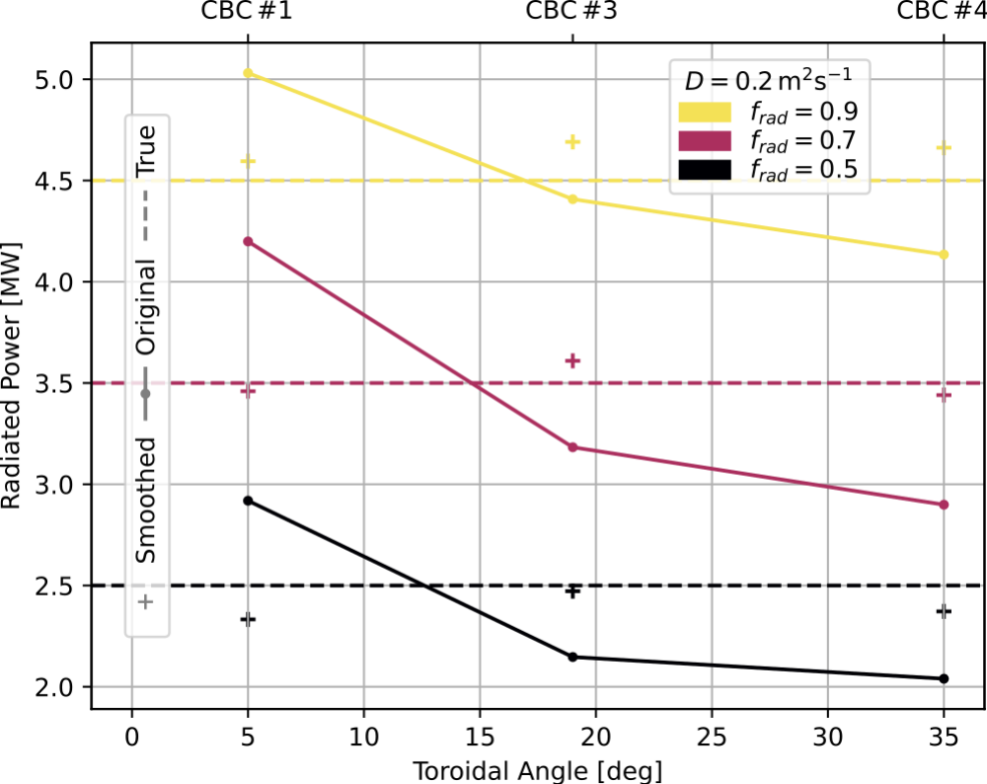
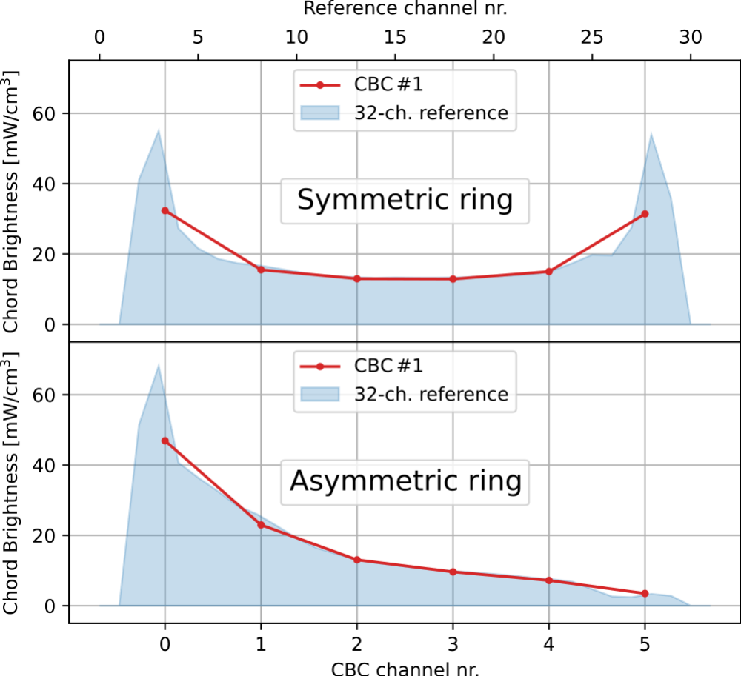
New bolometer diagnostics
CBC (compact resistive bolometers)
Fast ray tracing developed to model diagnostics
Geometry optimized for accuracy of local $P_{rad}$ estimation
4 CBCs designed, 3 installed
Inexpensive and simple design, compact size
Easy to adapt to any diagnostic port (multiple toroidal locations)
Identification of poloidal/toroidal radiation asymmetries
CBC geometry
toroidal asymmetry
poloidal asymmetry

Slide 14
New bolometer diagnostics
IRVB (wide view imaging video bolometer)
First data acquisition last campaign
Diagnostic made operational (ray tracing + foil heat transport)
Very large number of channels
IRVB geometry

Slide 15
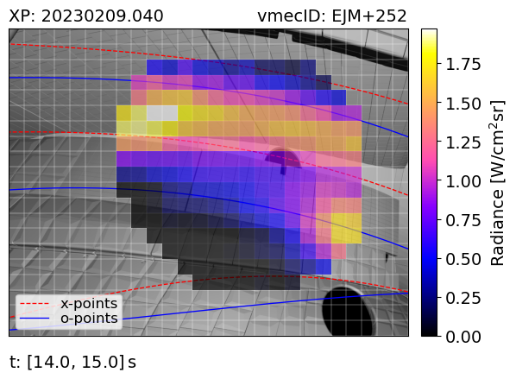
New bolometer diagnostics
IRVB (wide view imaging video bolometer)
First data acquisition last campaign
Diagnostic made operational (ray tracing + foil heat transport)
Very large number of channels
Measure divertor $P_{rad}$
Compare to other divertor system
Directly image 2-D emissivity
IRVB geometry
Divertor radiated power
IRVB measurement

Slide 16
Overview
Introduction
New bolometer diagnostics
Radiation distribution
$P_{rad}$ proxy improvement
Summary

Slide 17
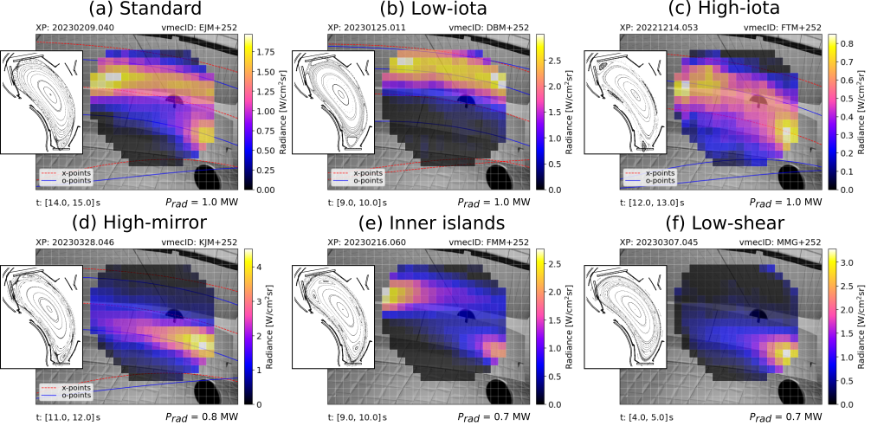
Radiation distribution
Divertor radiation pattern is characterized by stripes
Emission originates close to target plates

Slide 18
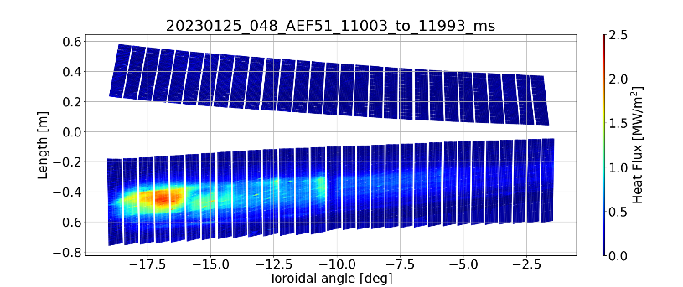
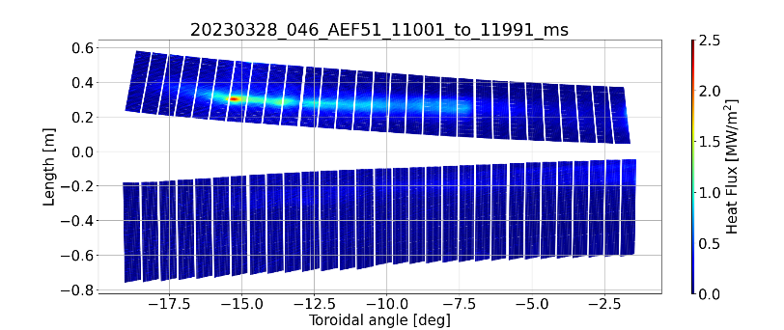
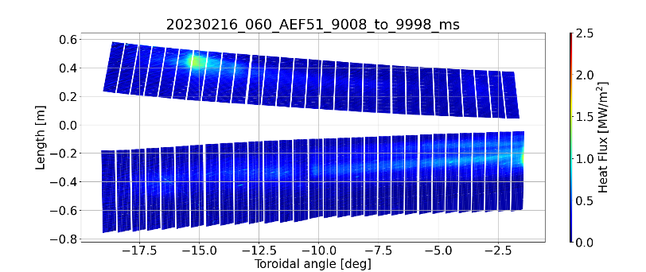
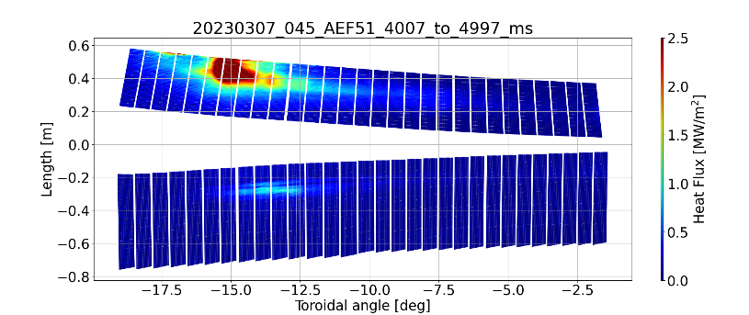
Radiation distribution

Slide 19
Radiation distribution
Divertor radiation pattern is characterized by stripes
Emission originates close to target plates
Radiation features resemble power power deposition pattern
Different magnetic configuration → different strike-line geometry

Slide 20
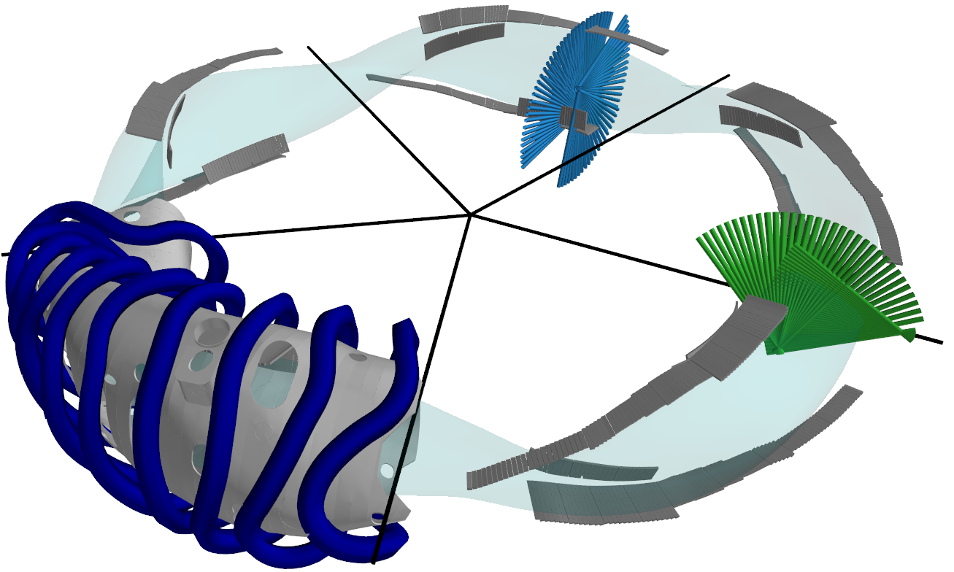
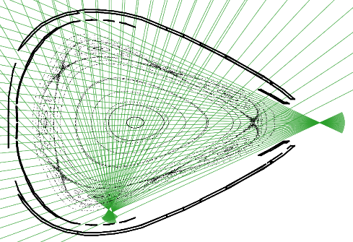
Radiation distribution
Study toroidal variation of radiated power pattern
Gaussian Process Tomography (GPT) [from Moser 2022]

Slide 21
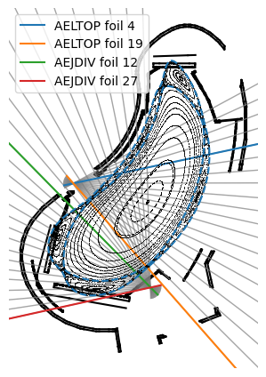
Radiation distribution
Study toroidal variation of radiated power pattern
Gaussian Process Tomography (GPT) [from Moser 2022]
Limited number of channels
No tomography on divertor cross section
Tomographic inversion in the triangular plane (core bolometry)
Mapping of tomogram to divertor bolometry system
(assume constant $ε$ along field lines)

Slide 22
Radiation distribution
Study toroidal variation of radiated power pattern
Gaussian Process Tomography (GPT) [Moser 2022]
Limited number of channels
No tomography on divertor cross section
Tomographic inversion in the triangular plane (core bolometry)
Mapping of tomogram to divertor bolometry system
(assume constant $ε$ along field lines)
Case 1: small plasma
mapped
tomogram

Slide 23
Radiation distribution
Study toroidal variation of radiated power pattern
Gaussian Process Tomography (GPT) [Moser 2022]
Limited number of channels
No tomography on divertor cross section
Tomographic inversion in the triangular plane (core bolometry)
Mapping of tomogram to divertor bolometry system
(assume constant $ε$ along field lines)
Case 1: small plasma
Case 2: attached plasma
mapped
tomogram

Slide 24
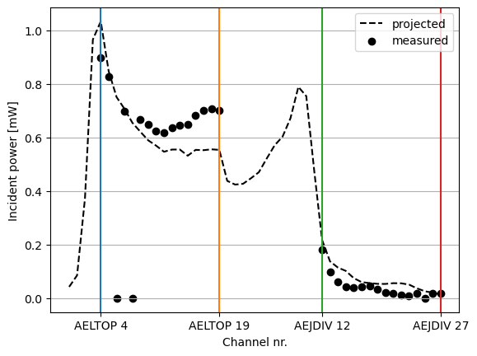
Radiation distribution
Two cameras available: AEJDIV and AELTOP
Bolometer response is directly comparable
Edge and core channels don’t match
Radiated power varies both in intensity and distribution
small plasma

Slide 25
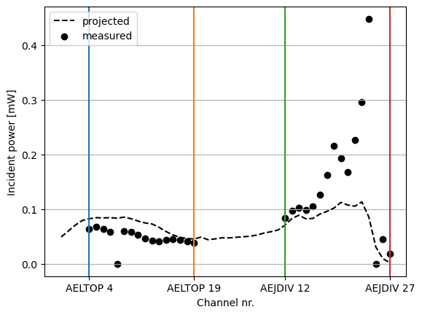
Radiation distribution
Two cameras available: AEJDIV and AELTOP
Bolometer response is directly comparable
Edge and core channels don’t match
Radiated power varies both in intensity and distribution
Very localized divertor signal in attached plasmas
Consistent with IRVB observations
→ Radiated power density distribution is fully 3-D
small plasma
attached plasma

Slide 26
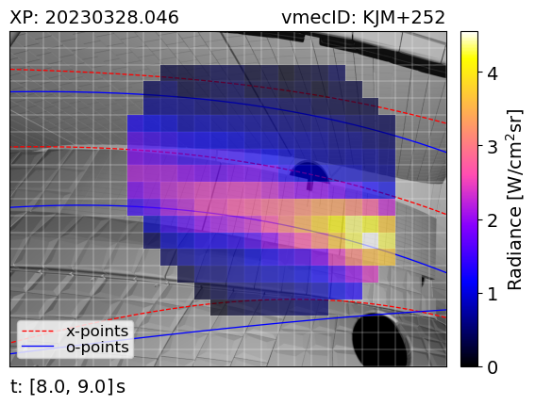
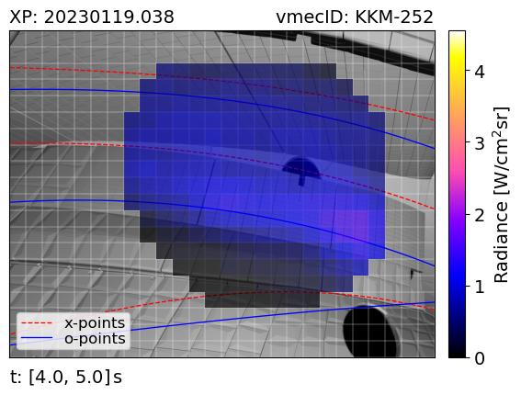
Radiation distribution
Comparable density, heating power, radiated power
Both attached
Field-reversal effects observed with IRVB
Might be caused by poloidal $E×B$ drifts
IRVB measurement
forward B
reversed B

Slide 27
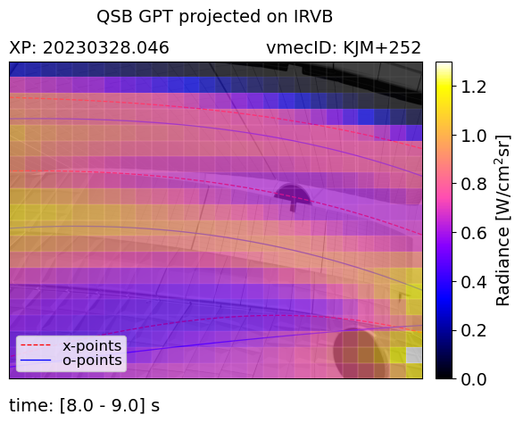
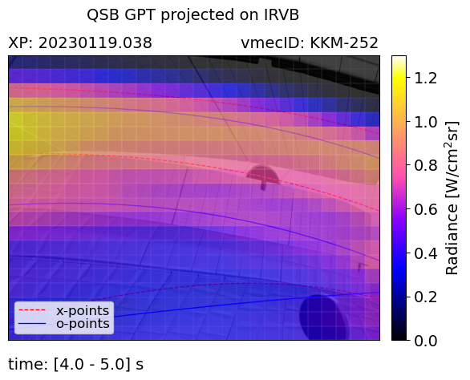
Radiation distribution
Comparable density, heating power, radiated power. Attached
Field-reversal effects observed with IRVB
Might be caused by poloidal $E×B$ drifts
Reversal is consistent with mapping
Up-down asymmetry is conserved at divertor
Localized divertor radiation
Tomography in divertor region is needed
How to calculate total $P_{rad}$?
IRVB measurement
mapped
forward B
reversed B

Slide 28
Overview
Introduction
New bolometer diagnostics
Radiation distribution
$P_{rad}$ proxy improvement
Summary

Slide 29
$P_{rad}$ proxy improvement
Total $P_{rad}$ is calculated from core bolometry system
Local average poloidal emissivity extended to full plasma
Emissivity is not constant along the field lines
Neither distribution nor intensity
Need for more robust $P_{rad}$ proxy method
Core
bolometry

Slide 30
$P_{rad}$ proxy improvement
Total $P_{rad}$ is calculated from core bolometry system
Local average poloidal emissivity extended to full plasma
Emissivity is not constant along the field lines
Neither distribution nor intensity
Need for more robust $P_{rad}$ proxy method
Weighted sum technique:
$P_{rad}=\sum_{i}{c_{i}P_{i}}$
Coefficients $c$ need to be calculated with training
Total radiated power $P_{rad}$ is linear combination of line-integrated measurements $P$ with weights $c$
All bolometer diagnostics are employed
Standard method at LHD [Van de Giessen et al. 2021]

Slide 31
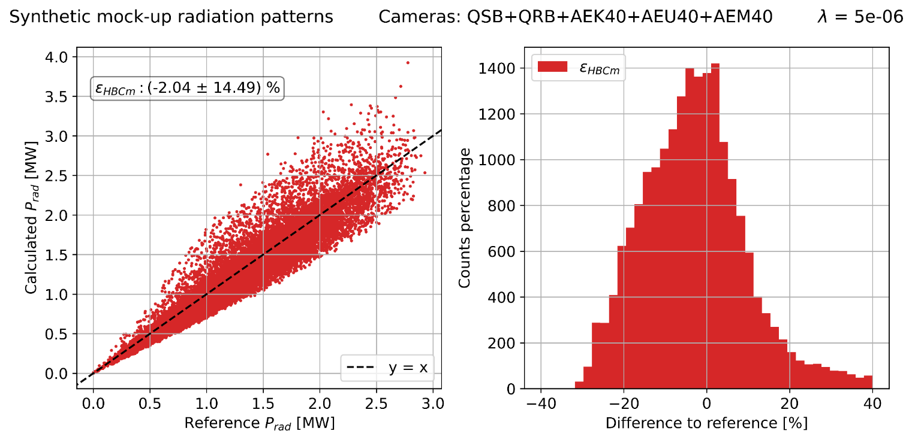
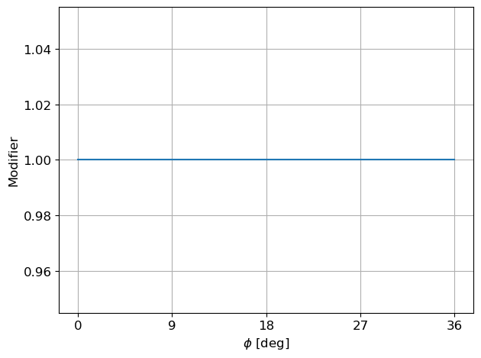
$P_{rad}$ proxy improvement
Test with randomly generated mock-up patterns
Without toroidal asymmetry
Current method tends to underestimate
toroidal asymmetry

Slide 32
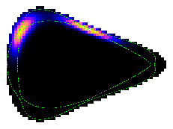
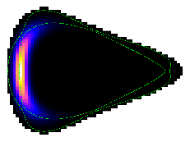
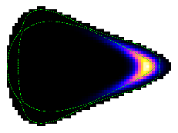
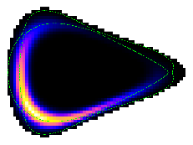
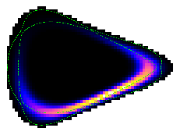
$P_{rad}$ proxy improvement
Inboard
dominant
Outboard
dominant
Test with randomly generated mock-up patterns
Without toroidal asymmetry
Current method tends to underestimate
Pol. asymmetries cause large errors [Maaziz 2021]
Error increases when toroidal asymmetry is included
toroidal asymmetry

Slide 33
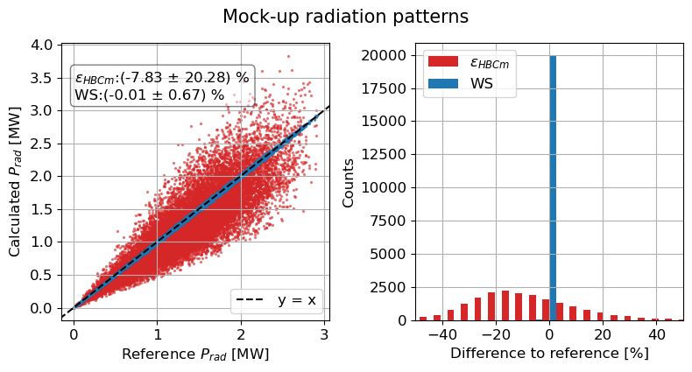
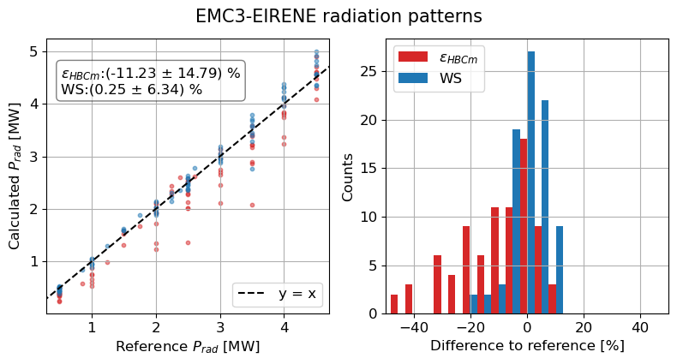
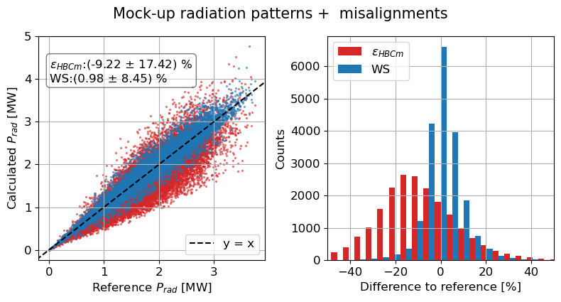
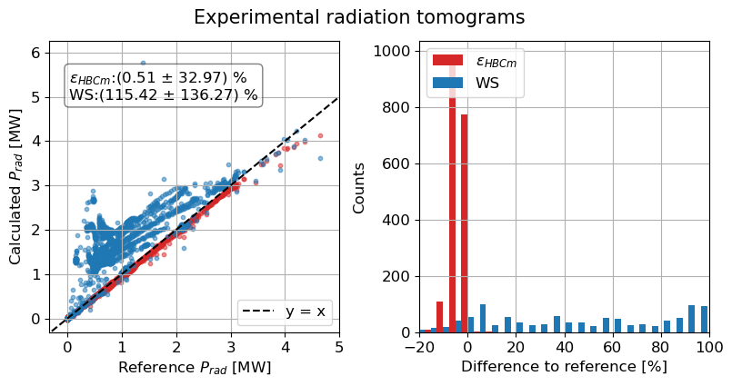
$P_{rad}$ proxy improvement
Trained weighted sum (WS) method using randomly generated mock-up patterns
Toroidal asymmetries included in the training
Tested traditional method and WS method:
Mock-ups
Mock-ups + misalignment
EMC3-EIRENE
Experimental

Slide 34
$P_{rad}$ proxy improvement
Trained weighted sum (WS) method using randomly generated mock-up patterns
Toroidal asymmetries included in the training
Tested traditional method and WS method:
Mock-ups
Mock-ups + misalignment
EMC3-EIRENE
Experimental
WS method has best performance in all cases except experimental
But: limited number of channels
$f_{rad}$ dependence seems consistent with expectations

Slide 35
Overview
Introduction
New bolometer diagnostics
Radiation distribution
$P_{rad}$ proxy improvement
Summary

Slide 36
Summary
Introduction
Analysis of EMC3-EIRENE emissivity patterns
Intrinsic toroidal asymmetry
New bolometer diagnostics
Fast ray tracing of geometry matrix
CBCs – identify poloidal/toroidal asymmetries
IRVB – wide-view image of divertor $P_{rad}$
Radiation distribution
Divertor $P_{rad}$ determined by target interaction
Polarity-dependent up-down divertor asymmetry
Gaussian Process Tomography
Strong toroidal asymmetry
$P_{rad}$ proxy improvement
Current proxy is sensitive to asymmetries
New weighted sum technique

Slide 37
Summary
Introduction
Analysis of EMC3-EIRENE emissivity patterns
Intrinsic toroidal asymmetry
New bolometer diagnostics
Fast ray tracing of geometry matrix
CBCs – identify poloidal/toroidal asymmetries
IRVB – wide-view image of divertor $P_{rad}$
Radiation distribution
Divertor $P_{rad}$ determined by target interaction
Polarity-dependent up-down divertor asymmetry
Gaussian Process Tomography
Strong toroidal asymmetry
$P_{rad}$ proxy improvement
Current proxy is sensitive to asymmetries
New weighted sum technique
Future work
Measure asymmetry with CBCs and ws
Tomography on divertor bolometry
Apply power balance to ws proxy

Slide 38
Thank you for your attention!

Slide 39
Additional slides

Slide 40
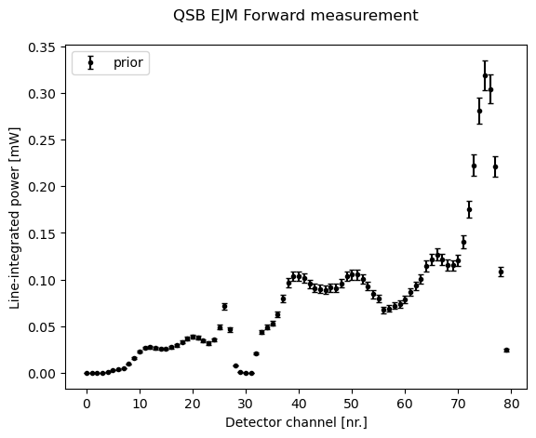
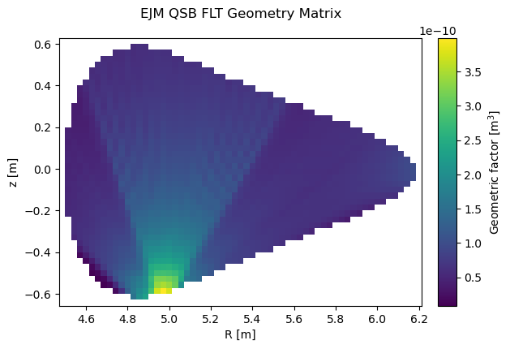
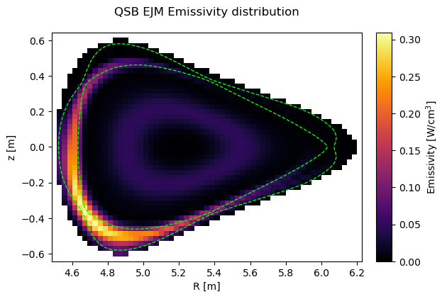
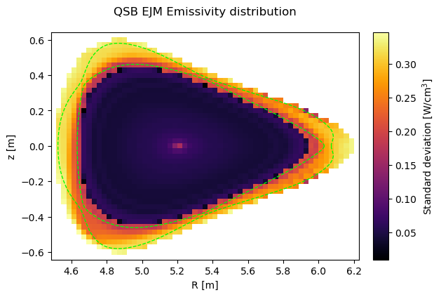
Gaussian Process Tomography
Line-integrated measurements: $d_{m}=G_{m×n}E_{n}±\vec{ε}$
Method based on Bayes probability theory: $P(A|B)=\frac{P\left(B|A\right)P\left(A\right)}{P(B)}$ with $P(A|B)=\frac{P\left(A⋂B\right)}{P(B)}$
Assume normal distribution of input data (emissivity $E_{n}\sim N\left(μ_{E}, Σ_{E}\right)$ and measurement $d_{m}\sim N(μ_{d}, Σ_{d})$)
Using ^{[1]}: $Σ_{E}^{post}={\left(Σ_{E}^{−1}+G^{T}Σ_{d}^{−1}G\right)}^{−1}$ $μ_{E}^{post}=Σ_{E}^{post}G^{T}Σ_{d}^{−1}d_{m}$
GPT input
measurement distribution $μ_{d}, Σ_{d}$
transfer (geometry) matrix $G$
covariance matrix $Σ_{E}$
GPT output
Pattern distribution $μ_{E}^{post}, Σ_{E}^{post}$
[1] K. Moser, Fusion Science and Technology 78 (2022)

Slide 41
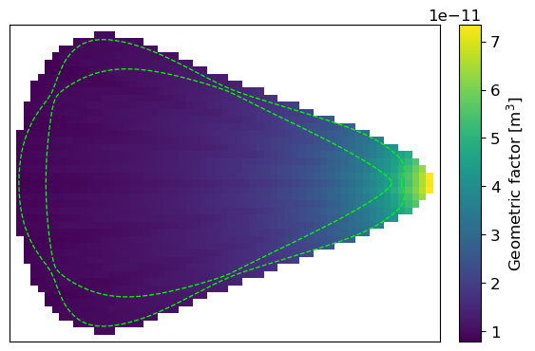
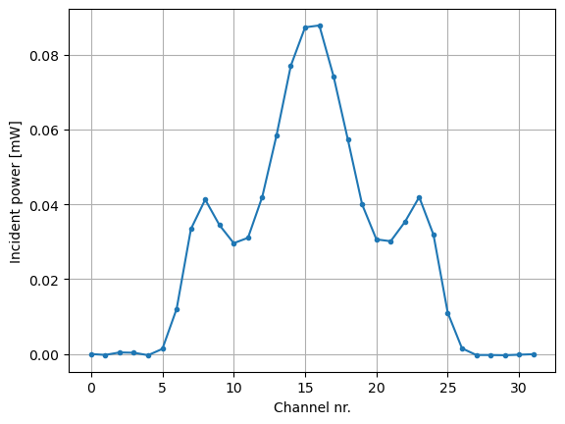
Weighted sum method
Weighted sum solution: $P_{rad}=\sum_{i}{c_{i}}P_{i}$ with $\left[c_{1}, c_{2}, …{,c}_{m}\right]$ LoS coefficients, $m$ number of channels
Line-integrated measurement: $P=G×ε+ε$ ($ε=1μ$W + 2% random noise)
$x^{m}$ coefficients from Thikonov regularization: ${\min\left|\left|Ax −b\right|\right|}^{2}+λ{\left|\left|x\right|\right|}^{2}$
$A^{m×n}=$ dataset $b^{n}=∑εV_{pixel}=$ reference values $λ=$ regularization parameter
Solution: $x={\left(A^{T}A+λI\right)}^{−1}A^{T}b$ $n$ number of samples
Emissivity pattern $ε$
Geometry matrix $G$
$$P_{in}=G×ε$$
$$×$$
$$=$$
$P_{rad}$ = 1.54 MW

Slide 42
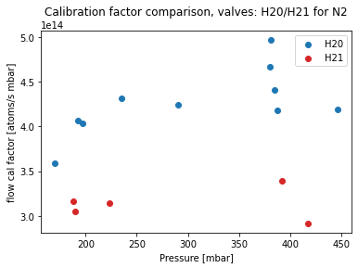
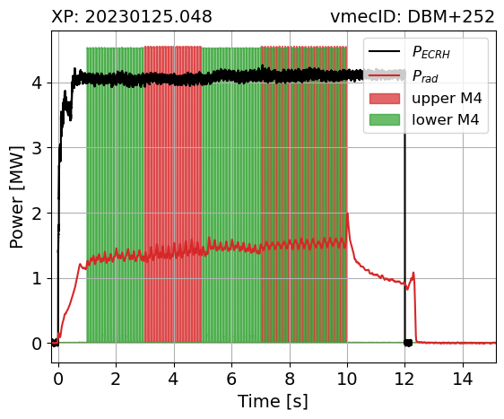
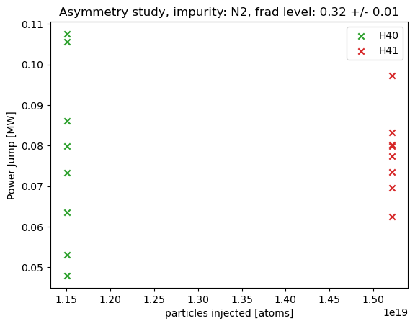
Gas valve calibration
Seeding rate is different for upper M2 and lower M2 valves
→ valve-dependent calibration factor must be used
However: missing calibration data for full comparison
Seeding response asymmetry might be present (in low-iota)
Must avoid: NBI blips, $n_{e}$ ramps, different gas pressures …
Broader analysis is still missing
Valve calibration is ongoing (A. Tsikouras)
lower M2
upper M2
courtesy of A. Tsikouras
lower M4
upper M4

Slide 43
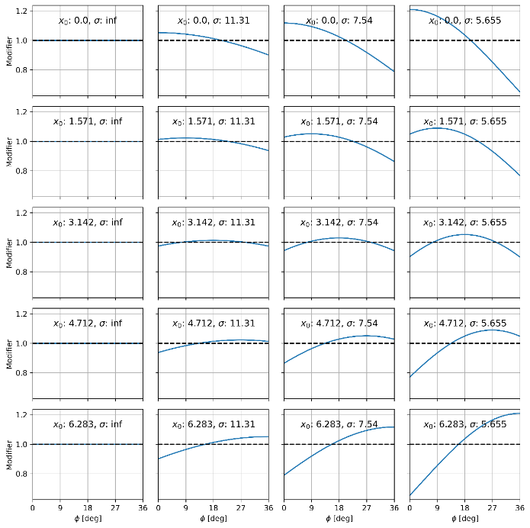
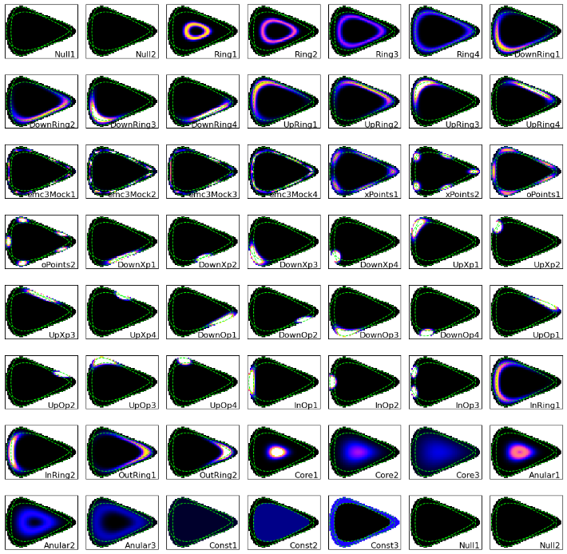
Weighted sum training
56 mock-up radiation patterns: 45 edge patterns + 11 core patterns
Gaussian functions of VMEC $(r_{eff}, θ)$ coordinates
Poloidally symmetric and asymmetric archetypes
20 toroidal asymmetry modifiers
1 000 000 samples = $mod∗\left(x_{1}p_{1}+x_{2}p_{2}+x_{3}p_{3}+x_{4}p_{4}\right)$

Slide 44
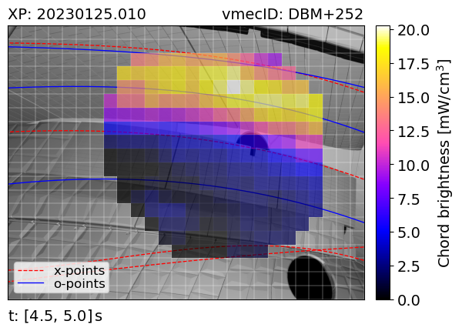
IRVB signal and target interaction
IRVB view:
Horizontal direction: toroidal movement
Vertical direction: poloidal movement
IRVB observations:
Plasma $ε$ peaking towards $φ=4^{∘}$
Plasma $ε$ dominated by target interaction
low-iota
standard
high-iota
IRVB measurement
Divertor temperature

Slide 45
Seeding from upper vs. lower valves
Higher bolo signal in lower divertor region
→ Toroidal asymmetry of plasma $ε$
Larger signal step on lower valve injection
→ Toroidal asymmetry in seeding response
Missing standard+ and high-iota
low-iota +
standard -
Horizontal bolometer camera
Is the $P_{rad}$response to seeding asymmetric?
Different gas pressures used
Valve calibration is necessary
Divertor camera

Slide 46
Asymmetry effects

Slide 47
Radiation scaling
$f_{rad}=\frac{P_{rad}}{P_{heat}}>$ 80% required in DEMO for power exhaust [Asakura et al 2021]
Investigation of $P_{rad}$ dependence on plasma parameters
Old scaling law: $P_{rad}\left(x, β\right)=β_{0}P_{Heat}^{β_{1}}n_{e}^{β_{2}}Z_{eff}^{β_{3}}p_{neutral}^{β_{4}}I_{C^{2+}}^{β_{5}}$
Radiation response to seeding of impurities (A. Tsikouras)
Agerup et al. 2022

Slide 48
EMC3-EIRENE results
Main radiation source: line emission from Carbon
EMC3-EIRENE (impurity transport in the SOL)
Analysis of EMC3-EIRENE radiated power density:
Radiation is localized in the edge
Emission from island X/O-points
Detached radiation moves inwards and towards X-points
Intrinsic toroidal asymmetry
poloidal cross section
toroidal profile
radial profile
poloidal profile
Core
bolometry

Slide 49
Poloidal asymmetry
Poloidal $E×B$ drift inside the island
→ Asymmetric island $n_{e}$ and particle fluxes to targets
→ Asymmetric $n_{e}$ and impurity concentration at the targets
→ Asymmetric radiated power density
M. Kriete et al 2023 Nucl. Fusion 63 026022
K. C. Hammond et al 2019 Plasma Phys. Control. Fusion 61 125001

Slide 50
Geometry matrix
Fast geometry matrix calculation (Cherab)
Modeling of the diagnostics
Including wall effects
Forward measurement of synthetic data
Tomographic inversion
Applicable to other line-integration diagnostics
QRB
IRVB
Emissivity pattern $ε$
Geometry matrix $G$
$$P_{in}=G×ε$$
$$×$$
$$=$$

Slide 51
Total radiated power proxy
Current method: average chord brightness
Only horizontal bolometer camera (HBCm)
Chord brightness: $P_{chord}=\frac{P_{in}}{d_{LoS}E}$
Average emissivity: $\overline{ε}=∑\frac{P_{chord}V_{LoS}}{∑V_{LoS}}$
Total radiated power: $P_{rad}=\overline{ε}V_{plasma}$
$P_{in}$ = line-integrated measurement
$E=\frac{A_{P}cosα}{d^{2}}A_{D}cosβ$ = line-of-sight etendue
$d_{LoS}, V_{LoS}$ = line-of-sight length/volume inside plasma
$V_{plasma}$ = volume of the W7-X plasma
Horizontal Bolometer Camera (HBCm)

Slide 52
Geometry matrix
The geometry matrix is calculated through ray tracing using Cherab, on a 3 cm x 3 cm x 1 deg cylindrical grid.
The values are then interpolated from the regular cylindrical to a field-aligned cartesian grid using a volume overlap weighted sum. This way the emissivity can be summed up in the toroidal direction and the forward measurement is reduced to a 2-D matrix multiplication.
Strong assumption: constant emissivity along the magnetic field lines.

Slide 53
Divertor bolometers OP2.1
Divertor bolometers
[module 40]
[module 51]
Divertor bolometry
IRVB
Divertor camera
Imaged area
Available lines-of-sight: 32/88 (36%)
Available lines-of-sight: 207/520 (40%)

Slide 54
IRVB view
Core Bolometry
Several bolometry systems at W7-X:
Resistive bolometers
Core bolometry (source of $P_{rad}$ signal) ^{[1]}
Divertor bolometry
Compact Bolometer Cameras (CBCs)
InfraRed imaging Video Bolometer (IRVB)
The IRVB diagnostic:
7x9 cm C-coated gold foil (5 μm thick)
High-resolution IR camera
Optical setup (Au-coated parabolic mirrors)
→ cable-free
Large number of channels (26x20 = 520)
No active water cooling
CBCs
Divertor Bolometry
IRVB
camera
mirrors
foil

Slide 55
Radiation asymmetry summary
dominant lower side dominant upper side
courtesy of D. Zhang | standard (EJM) | low-iota (DBM) | high-iota (FTM) | high-mirror (KKM)
Forward B
Reversed B |  | ×
$$f_{rad}$$ | 0.2 | 0.2 | 0.3 | 0.25
20230215.58
20230125.18
20221214.59
20230222.16
20230117.74
20230119.31
20230119.42

Slide 56
IRVB modeling
The temperature data is mapped from the IR camera image to the foil pixels
The incident radiated power, integrated along each channel line-of-sight $P_{lin}$ is calculated by solving the inverted 2-D heat transfer equation ^{[1]}
$$\frac{dT}{dt}=D\left[\frac{d^{2}T}{dx^{2}}+\frac{d^{2}T}{{dy}^{2}}\right]+\frac{d}{dt}\left(\frac{P_{lin}}{c}\right) −\frac{d}{dt}\left(\frac{εσ_{SB}\left[T^{4}−T_{amb}^{4} \right]}{c}\right)$$
The incident power $P_{lin}$ is normalized to the channel geometry (pixel etendue $e$ and line-of-sight length $d_{LoS}$) obtaining the chord brightness $P_{chord}=\frac{P_{lin}}{ed_{LoS}}$
diffusion
incident
power
black-body
emission
$T$ on IR camera
$T$ on foil view
$P_{lin}$ on foil view
$P_{chord}$on foil view
1
2
3

Slide 57
Asymmetries
EMC3-EIRENE
localized X/O-point radiation
Intrinsic toroidal asymmetry
Experiment
Up-down asymmetric at low $f_{rad}$
In-out poloidal asymmetry at high $f_{rad}$ (deeply detached)
(LHD) Seeding response toroidal asymmetry
poloidal
poloidal
$$f_{rad}∼0.2$$
$$f_{rad}∼0.95$$
Zhang et al. 2021
toroidal
toroidal
Peterson et al. 2021

Slide 58
Measure asymmetry with WS method
Use multiple cameras to measure toroidal asymmetry
Measure local $ε$
Apply WS method (van de Giessen 2021)
Train individual cameras (QSB, QRB)
Train without toroidal asymmetry
Compare $W_{QSB}$ and $W_{QRB}$
QRB
QSB
QRB
QSB

Slide 59
Comparison to EMC3-EIRENE
Experimental and synthetic measurements, calculated with EMC3-EIRENE, are compared for two cases at different radiated power fraction $f_{rad}=\frac{P_{rad}}{P_{heat}}$.
Comparison is only qualitative
One island contributes to most of the emission
Radiation peak is aligned on same island X-/O-point
Radiation zone broadens poloidally at high $f_{rad}$
Additional experimental noise (vibrations?)
EMC3-EIRENE doesn’t capture right-hand side emission spots
$f_{rad}$ = 0.5
$f_{rad}$ = 0.9
EMC3-EIRENE
EXPERIMENTAL
EMC3-EIRENE
EXPERIMENTAL
$f_{rad}$ = 0.5
$f_{rad}$ = 0.9

Slide 60
GPT Projections
Projection
Experiment

Slide 61
$k_{bolo}$ factor
The line-integrated power on a given pixel scales with the pixel etendue $E$ ( roughly pinhole-to-foil projectied area) and the length (or volume) of the LoS crossing the plasma volume, $d_{LoS}$.
The raw power load data is usually divided by the so-called $k_{bolo}$ factor, defined as the product of the two, to disentangle the plasma emissivity features from the specific camera geometry. This normalized quantity is named chord brightness $P_{chord}$.
$$P_{chord}=\frac{P_{lin}}{d_{LoS}E}$$

Slide 62
ICRH effect on $P_{rad}$
ICRH power is radiatively dissipated
$W_{dia}$ is unaffected
$P_{rad}$ effect is localized in lower right island
Magnetically connected to injection point
Pattern without antenna is slightly different

Slide 63
IRVB components
camera box (closed)
camera box (open)
parabolic mirrors
foil + frame
endoscope cap
foil (assembled)
endoscope front
torus hall

