Slide 1
Changes to W7-X technical procedures
Handling of several documents types in the IDM-system
(some practical hints)
Change note (CN, ÄA)
Non Conformity Report (NCR, QAB)
Quality Assurance and Assembly Plan (QAAP)
for assembly carried out by E5-Eng
for assembly in labs under responsibity of RO
miscellaneous

Slide 2
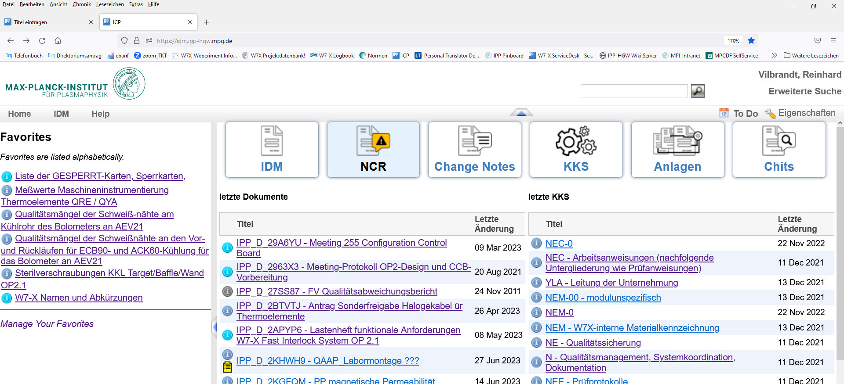
Changes to W7-X technical procedures NCR - QAB
select Non Conformity Report (NCR, QAB)

Slide 3
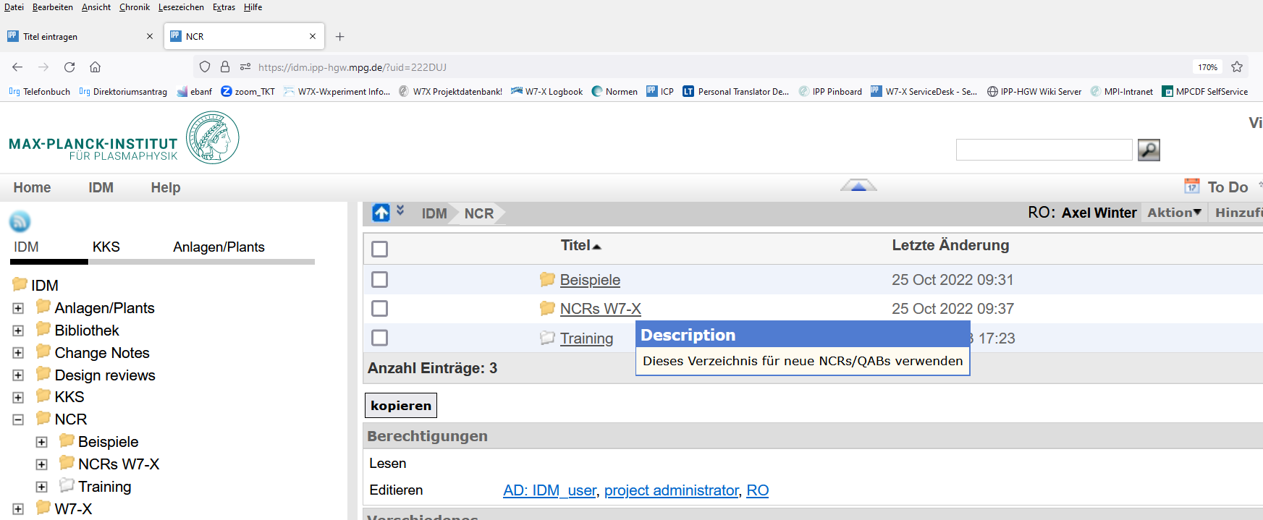
Changes to W7-X technical procedures NCR - QAB
select folder

Slide 4
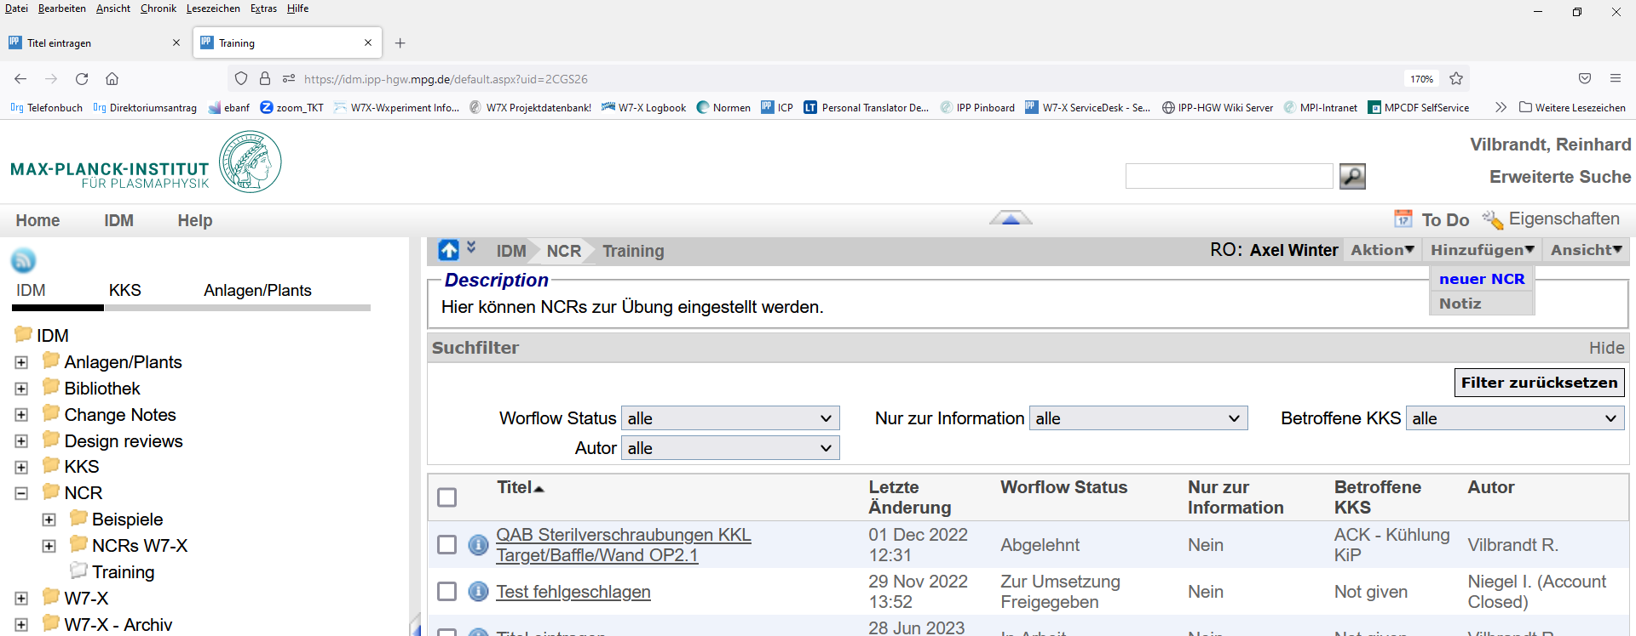
Changes to W7-X technical procedures NCR - QAB
choose „neuer NCR“

Slide 5
Changes to W7-X technical procedures NCR - QAB

Slide 6
Changes to W7-X technical procedures NCR - QAB

Slide 7
Changes to W7-X technical procedures NCR - QAB

Slide 8
Changes to W7-X technical procedures NCR - QAB

Slide 9
Changes to W7-X technical procedures NCR - QAB

Slide 10
Changes to W7-X technical procedures NCR - QAB

Slide 11
Changes to W7-X technical procedures NCR - QAB

Slide 12
Changes to W7-X technical procedures NCR - QAB

Slide 13
Changes to W7-X technical procedures NCR - QAB

Slide 14
Changes to W7-X technical procedures NCR - QAB

Slide 15
Changes to W7-X technical procedures NCR - QAB

Slide 16
Changes to W7-X technical procedures NCR - QAB

Slide 17
Changes to W7-X technical procedures NCR - QAB

Slide 18
Changes to W7-X technical procedures NCR - QAB

Slide 19
Changes to W7-X technical procedures NCR - QAB

Slide 20
Changes to W7-X technical procedures NCR - QAB

Slide 21
Changes to W7-X technical procedures NCR - QAB

Slide 22
Changes to W7-X technical procedures NCR - QAB

Slide 23
Changes to W7-X technical procedures NCR - QAB

