Slide 1
Prediction of current evolution in W7-X Plasmas Coffee Talk L. van Ham, July 12th, 2023
This research investigates the temporal evolution of the toroidal plasma current in the Wendelstein 7-X (W7-X) stellarator for different scenarios. The THRIFT code [Strand and Houlberg, Phys. Plasmas 8, 2782 (2001)] has been implemented and its predictions of the evolution of the toroidal current has been compared against experimentally measured currents in W7-X. For four discharges with varying complexity, varying degrees of agreement in $τ_{L/R}$ between experiment and prediction is observed. For one case simulations indicate $τ_{L/R}=13.2±0.3$ s, while $τ_{L/R}=12.8±0.4$ s is observed in experiment. Total bootstrap currents are under-predicted owing to the applicability of the BOOTSJ model for the plasma collisionalities in question. Edge plasma resistivity is found to play an important role in the asymptotic behaviour of the evolution of the current, indicating a possible limitation of the minimum plasma temperature when applying this model. Simulations of ECCD and heating power steps show THRIFT can capture the dynamical evolution of the current in response to changes in current sources. Future uses of THRIFT include validating and benchmarking other non-inductive current models.

Slide 2
Prediction of Current Evolution in W7-X Plasmas
Lucas van Ham
Supervisors: J.H.E. Proll, S. A. Lazerson

Slide 3
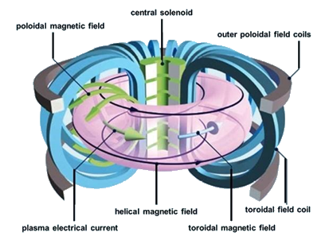
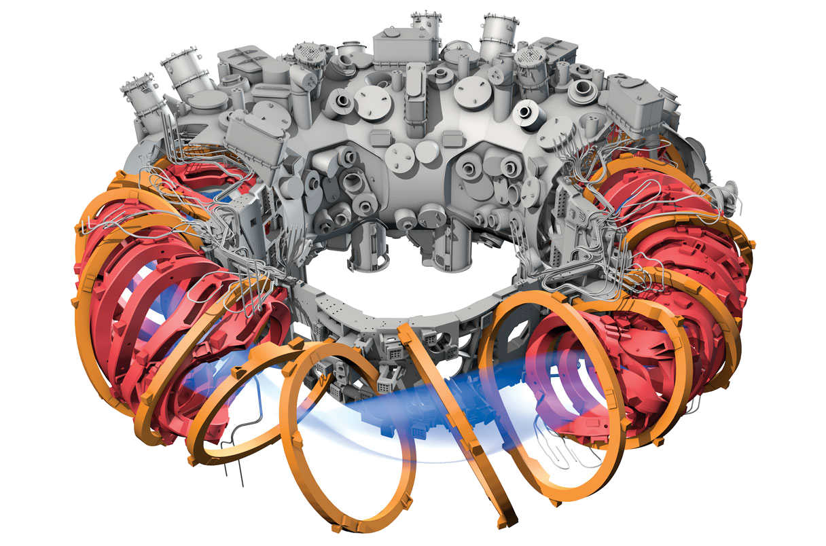
Background: the rotational transform
Proper confinement of fusion plasmas requires a helical magnetic field!
Approach A: Tokamak
Approach B: Stellarator
Safety factor
$$q\left(r\right)≈\frac{rB_{T}}{RB_{p}}$$
Rotational transform
$$ι\left(r\right)≡\frac{1}{q}$$
Figures: Courtesy EUROfusion; Klinger, T. et al. Nucl. Fusion 59 (2019)

Slide 4
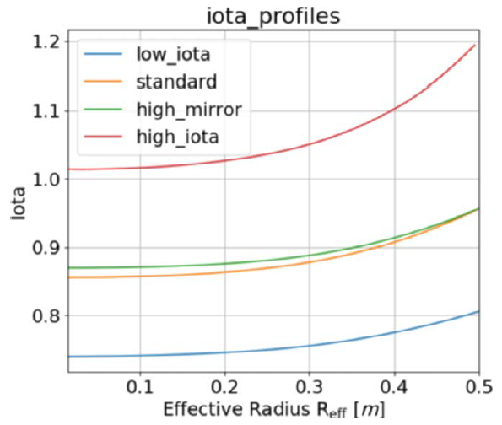
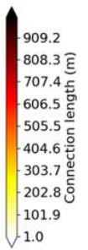
The rotational transform in W7-X
Features:
Low shear $\left(ι^{′}\right)$ $→$ avoid (important) resonances
Edge $ι:$ $ι_{a}=5/m$ $→$ island divertor operation
$$n/m=5/5$$
$$n/m=5/6$$
Figures: Pedersen, T. et al. Plasma Phys. Control Fusion 61 (2019)

Slide 5
The rotational transform is dynamic
Currents affect the rotational transform:
$$ι=\frac{μ_{0}}{S_{11}Φ^{′}}I−\frac{S_{12}}{S_{11}}$$
Current sources:
Bootstrap current
Externally driven currents (ECCD, NBCD)
Effect on island divertor:
Shifting of strike-lines ($\sim 9mm/kA$, standard)
Entering of limited configuration
[Strand, P.I. & Houlberg, W.A. 2001 Phys. Plasmas 8 2782]
$$S_{11}=\left\langle \frac{g_{θθ}}{\sqrt{g}}\right\rangle S_{12}=\left\langle \frac{g_{θζ}}{\sqrt{g}}\right\rangle$$
$$g_{θθ}=\frac{∂x}{∂θ}⋅\frac{∂x}{∂θ} g_{θζ}=\frac{∂x}{∂θ}⋅\frac{∂x}{∂ζ}$$
$\sqrt{g}−$Jacobian
$\left\langle …\right\rangle −$flux surface average
$μ_{0} −$ vacuum permeability
$I−$ toroidal current
$Φ−$toroidal magnetic flux
[Yu Gao et al 2019 Nucl. Fusion 59 106015]
Need for accurate source current models

Slide 6
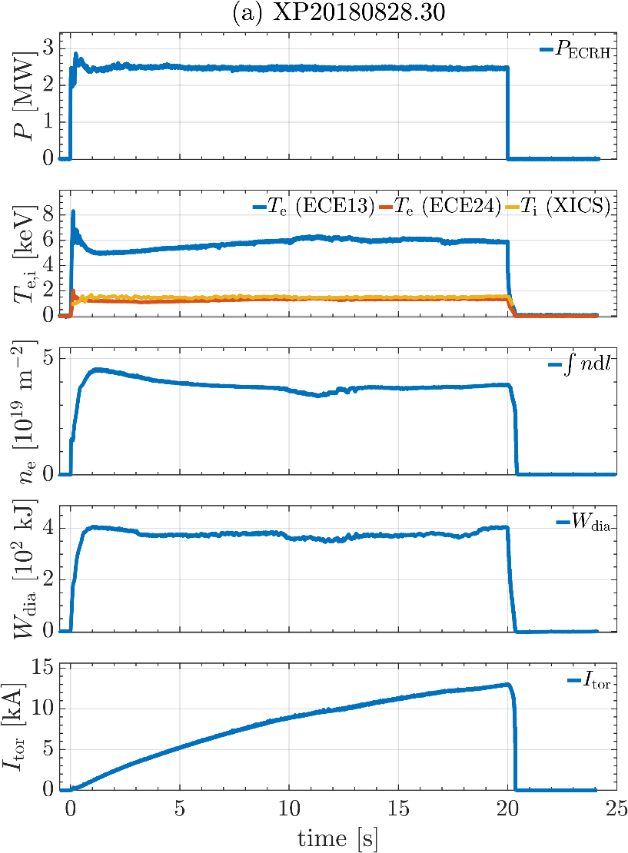
Currents evolve on inductive-resistive timescales
Total current evolves with $L/R$ time (~30s in W7-X):
$∇×B=μ_{0}J→$ toroidal current changes poloidal $B$-component
$∇×E=−∂B/∂t→$ parallel electric field is induced
$J_{shield}=σ_{∥}E_{∥}→$ “shielding” current opposes total current
Fitting does not capture:
Little research into self-consistent short-term evolution of currents.
Research question:
How does the current evolve in W7-X on short-term timescales?
total current
influences…
influences…
magnetic field
bootstrap current
influences…

Slide 7
The THRIFT code (1): System of equations
Diffusion equation for $ι$:
$$\frac{dι}{dt}=\frac{dι}{dΦ}\frac{dΦ}{dt}+\frac{d}{dΦ}\left[\frac{η_{∥}}{μ_{0}}Φ^{′}{\left(S_{11}ι+S_{12}\right)}^{2}\frac{d}{dρ}\left(\frac{S_{11}ι+S_{12}}{S_{21}ι+S_{22}} \right)−η_{∥}\left\langle J_{s}B\right\rangle \frac{dV}{dΦ}\right]$$
$$\frac{du}{dt}=\frac{S_{11}}{Φ_{a}^{2}}\frac{d}{ds}\left[η_{∥}V^{′}\left(\frac{\left\langle B^{2}\right\rangle }{μ_{0}}u^{′}+p^{′}u−\left\langle J_{s}B\right\rangle \right)\right]$$
$$\frac{du}{dt}=α_{1}+α_{2}u+α_{3}u^{′}+α_{4}u′′$$
Discretise radial $s=Φ/Φ_{a}$-grid (ns points) & apply Backwards Time, Centred Space (BTCS) scheme
Boundary conditions:
Magnetic axis $\left(s=0\right)$: No current enclosed $→$ $u=0$
Plasma edge $\left(s=1\right):$ Voltage in inductor $→E=−\frac{L_{ext}}{2πR}\frac{dI}{dt}$
Initial condition: No currents anywhere $→u=0$
[Strand, P.I. & Houlberg, W.A. 2001 Phys. Plasmas 8 2782]
$ρ−$ radial variable
$J_{s}−$net source current
$V−$ plasma volume
Issue: THRIFT not self-consistent
$$u=S_{11}ι+S_{12}=\frac{μ_{0}}{Φ_{a}}I$$
[Schmitt, J.C. PhD thesis (2011)]
$s=Φ/Φ_{a}$
$p−$ pressure
$$α_{1}=−\frac{S_{11}}{Φ_{a}^{2}}\frac{d}{ds}\left[η_{∥}V^{′}\left\langle J_{s}B\right\rangle \right]$$
$$α_{2}=\frac{S_{11}}{Φ_{a}^{2}}\frac{d}{ds}\left[η_{∥}V^{′}p′\right]$$
$$α_{3}=\frac{S_{11}}{Φ_{a}^{2}}\left(\frac{d}{ds}\left[η_{∥}V^{′}\frac{\left\langle B^{2}\right\rangle }{μ_{0}}\right]+η_{∥}V^{′}p\right)$$
$$α_{4}=\frac{S_{11}}{Φ_{a}^{2}}η_{∥}V^{′}\frac{\left\langle B^{2}\right\rangle }{μ_{0}}$$
$L_{ext}−$external inductance
$R−$major radius

Slide 8
The THRIFT code (2): Solving system of equations
Write system of equations in TDM form:
Coefficients depend on:
Densities and temperatures
Resistivity $η_{∥}→$ Sauter resistivity
Magnetic geometry $→$ VMEC
Solved by DGTSV (Linear Algebra PACKage) using Gaussian elimination with partial pivoting
$$\left[\begin{matrix}b_{1} & c_{1} & & & & 0 \\ a_{2} & b_{2} & c_{2} & & & \\ & a_{3} & b_{3} & ⋱ & & \\ & & ⋱ & ⋱ & c_{ns−2} & \\ & & & a_{ns−1} & b_{ns−1} & c_{ns−1} \\ 0 & & & & a_{ns} & b_{ns}\end{matrix}\right]\left[\begin{matrix}u_{1}^{n} \\ u_{2}^{n} \\ u_{3}^{n} \\ ⋮ \\ u_{ns−2}^{n} \\ u_{ns−1}^{n} \\ u_{ns}^{n}\end{matrix}\right]=\left[\begin{matrix}y_{1} \\ y_{2} \\ y_{3} \\ ⋮ \\ y_{ns−2} \\ y_{ns−1} \\ y_{ns}\end{matrix}\right]$$
$$u^{n}=u\left(t^{n}\right)$$
$$I^{n}$$
[Sauter, O. et al, Phys. Plasmas 6, 2834-2839 (1999)]
[Hirshman, S.P. & Whitson, J.C. Phys. Fluids 26, 3553 (1983)]

Slide 9
Flow of THRIFT
Experiment
THRIFT
$$p\left(t^{n}\right)→VMEC$$
$$J\left(t^{n−1}\right)→VMEC$$
update equilibrium
$$VMEC$$
source current codes
update $J_{s}$
Solve system of equations
$$\begin{matrix}u=0 & s=0 \\ \frac{du}{dt}=α_{1}+α_{2}u+α_{3}u′+α_{4}u′′ & 0<s<1 \\ E=−\frac{L_{ext}}{2πR}\frac{dI}{dt} & s=1\end{matrix}$$
false
next time step
true
$$ΔJ<J_{tol}?$$
$$J$$
Picard loop
$${n_{e},T}_{e},n_{i},T_{i}$$
time loop

Slide 10
Verifying the THRIFT implementation
Ideal case:
large aspect ratio, circular cross-section tokamak
spatially uniform in resistivity profile
time-invariant source current
Evolution determined by
$$μ_{0}σ_{∥}\frac{∂E_{∥}}{∂t}=\frac{1}{r}\frac{∂}{∂r} \left(r\frac{∂E_{∥}}{∂r}\right)$$
Exact solution:
$$E^{FB}\left(x,t\right)=\sum_{n=1}^{∞}{f_{n}F_{n}\left(x\right)\exp\left(−\frac{t}{τ_{n}}\right)}$$
[Mikkelsen, D.R. Phys. Fluids B 1 (1989)]
THRIFT recreation:
large aspect ratio ($R/a=1000$), circular cross-section tokamak
$η_{Sauter}$ independent of $T_{i}$ $→$ Spatially uniform $T_{e}$, $n_{e}$, $n_{i}$
Spatially varying $T_{i}$ $→∇T_{i}$-driven bootstrap current
$$J_{bs}(s)=\frac{\sqrt{ε}R}{Φ_{a}} p^{′}s$$
Verification:
Calculate $E^{FB}\left(x,t_{0}\right)$ from $E^{sim}\left(x,t_{0}\right)$
Compare $E^{FB}\left(x,t\right)$ to $E^{sim}\left(x,t\right)$at later times
$F_{n}$ - Bessel function
$f_{n}$ - amplitude
$τ_{n}$- decay time

Slide 11
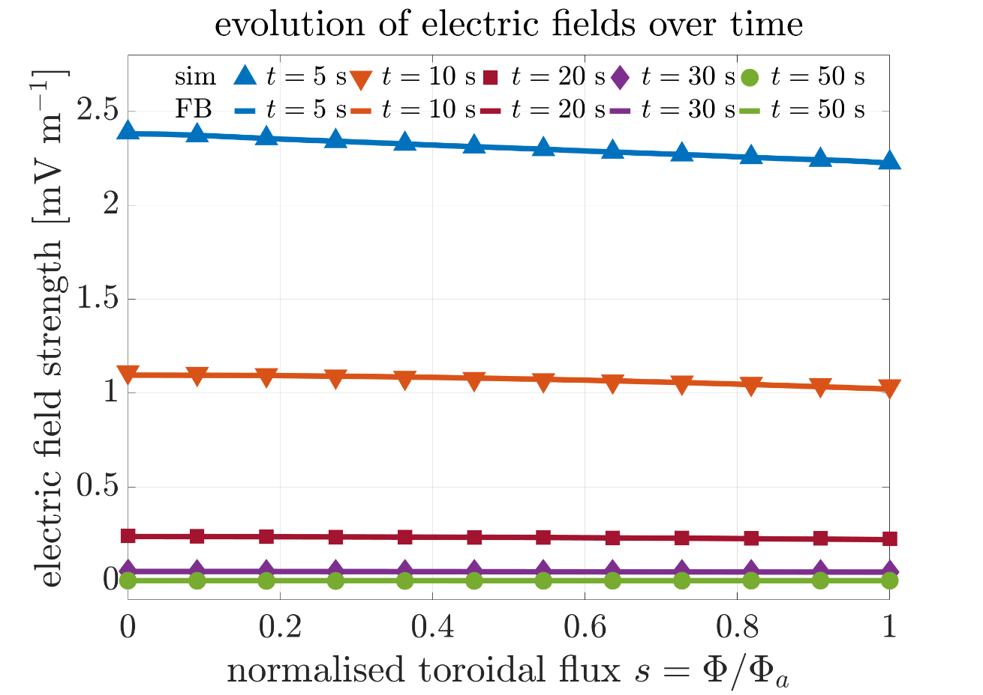
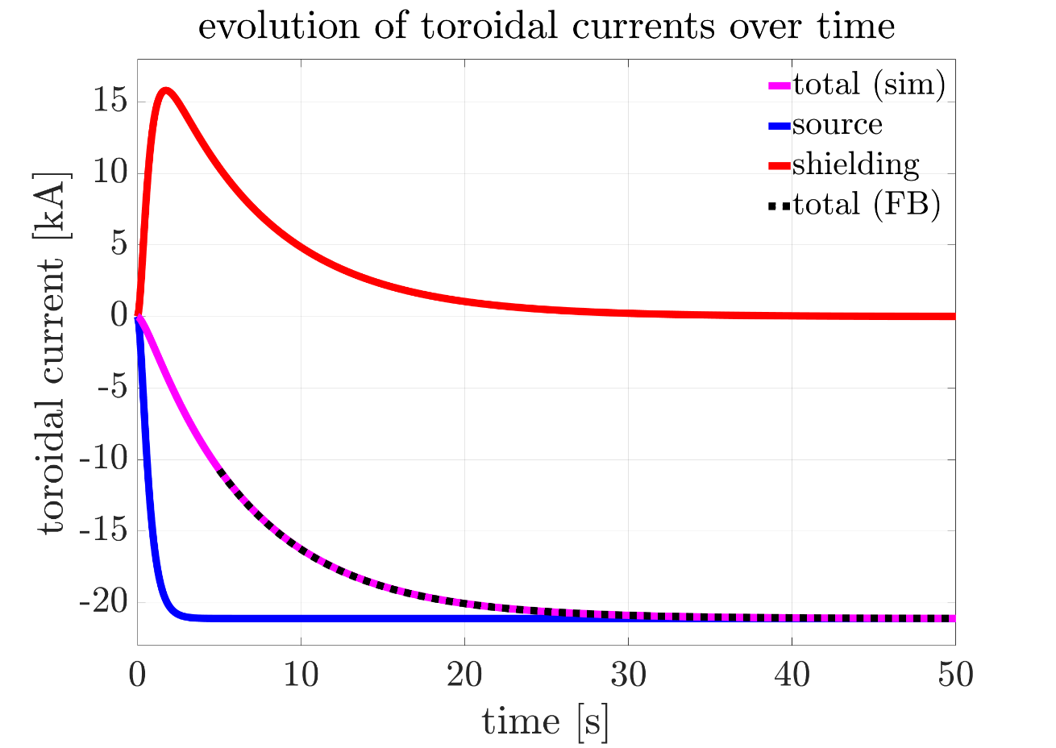
Verification results
$t_{0}=5$ s
Agreement between predicted and simulation results
Verification successful

Slide 12
Applying THRIFT to W7-X
Featured W7-X discharge: $XP20180828.30$ (low-iota)
Constant ECRH power $\left(2.5 MW\right)$
Stable densities and temperature
Clear asymptotic evolution
“Long” discharge
Good quality fits of $I$ expected
Set-up in THRIFT:
$n, T$ profiles produced by WAPID_FIT
Bootstrap current calculated by BOOTSJ

Slide 13
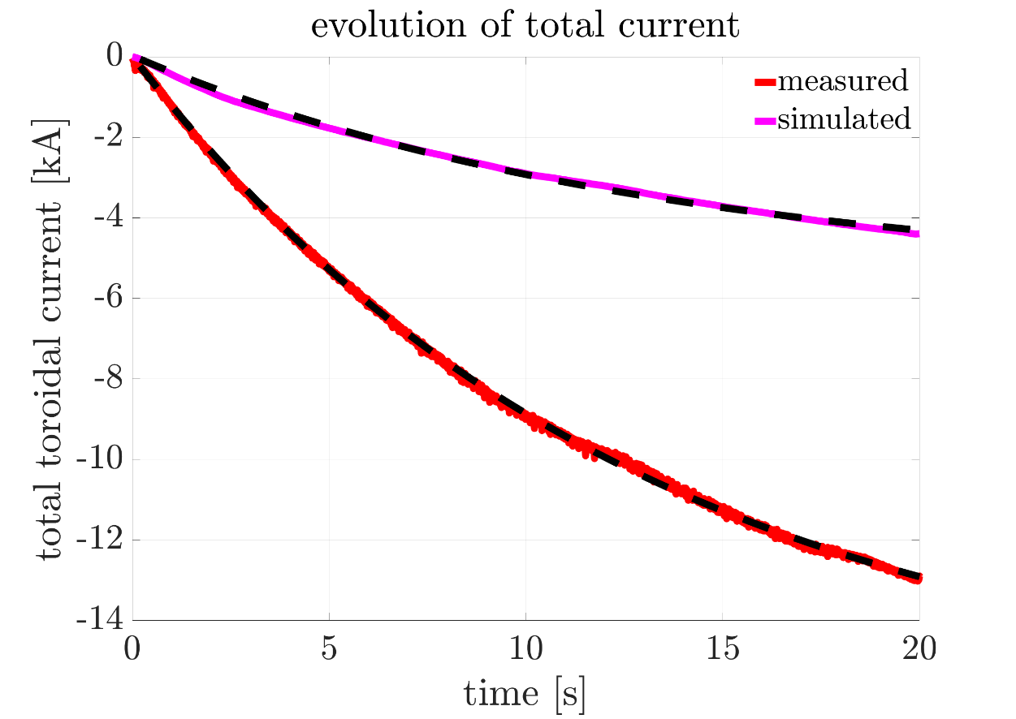
Comparing simulated and measured currents
Curve fits:
$$I\left(t\right)=I_{∞}\left(1−\exp\left(−t/τ_{L/R}\right)\right)$$
experimental uncertainties from fitting;
simulation uncertainties from profile uncertainties
 | $$τ_{L/R} [s]$$ | $$I_{∞} [kA]$$ | $$I_{BS} [kA]$$
experiment | $$12.76±0.36$$ | $$16.32±0.24$$ | $$−$$
simulation | $$13.22±0.33$$ | $$5.53±0.06$$ | $$8.65$$
Quantitative agreement in $τ_{L/R}$ within uncertainties
Bootstrap current $\sim$half the experimental $I_{∞}$
Noticeable difference (few kA) between $I_{∞}$ and $I_{BS}$

Slide 14
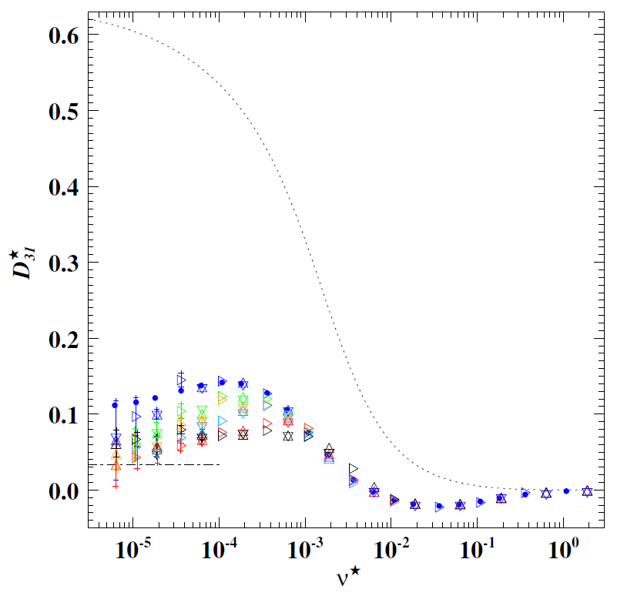
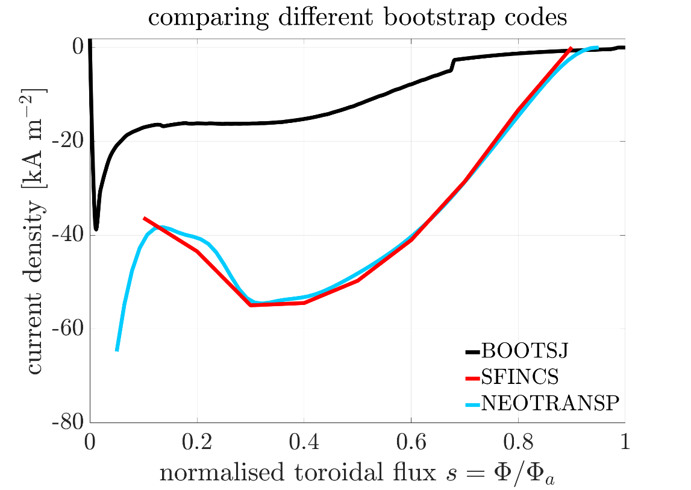
Applicability of BOOTSJ
mono-energetic bootstrap current coefficient (standard-iota)
BOOTSJ model is derived in the collisionless limit
Plasma collisionality for discharge: $ν^{∗}\sim 6⋅{10}^{−3}$
BOOTSJ expected to overpredict instead of underpredict
Low-iota vs standard-iota
Disagreement with other current codes
BOOTSJ inaccurate at finite collisionalities
collisionless limit
Figure: Beidler C.D. et al. Nucl. Fusion 51 (2011) 076001

Slide 15
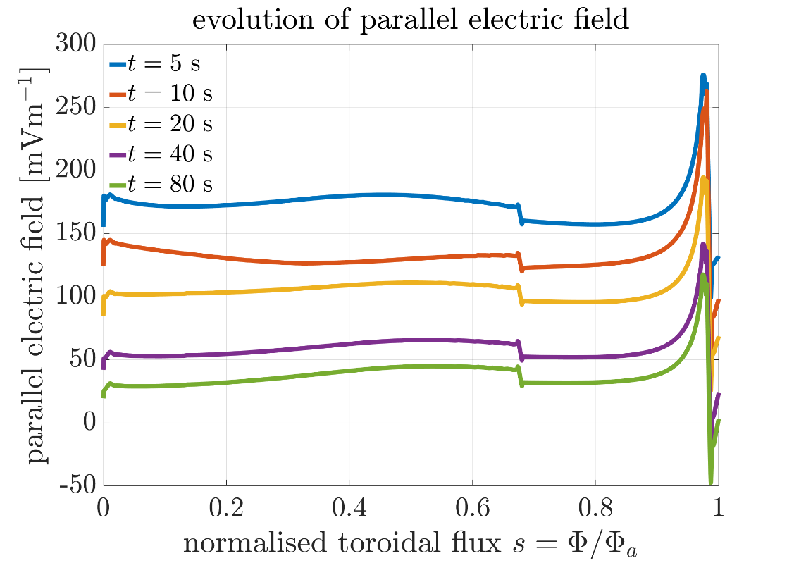
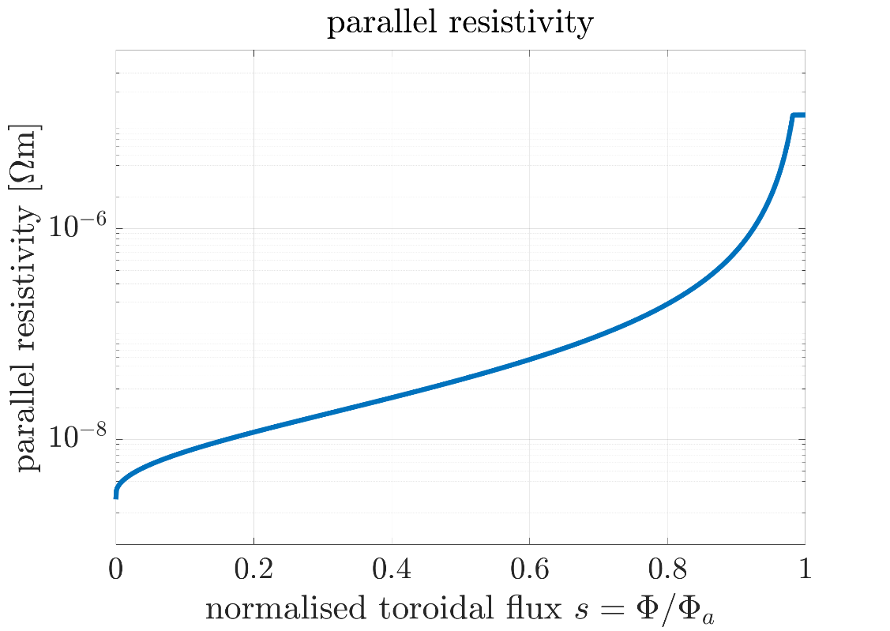
Edge temperature and edge resistivity
Electric field peaked in the plasma edge
At edge, $E_{∞}→0$
Electric field cannot dissipate
Rapid climb in $η_{∥}$ in plasma edge
$η_{∥}$ diverges as $T→0$
Plasma temperature clamped to $14 eV$
Limitation on minimum edge temperature used by THRIFT

Slide 16
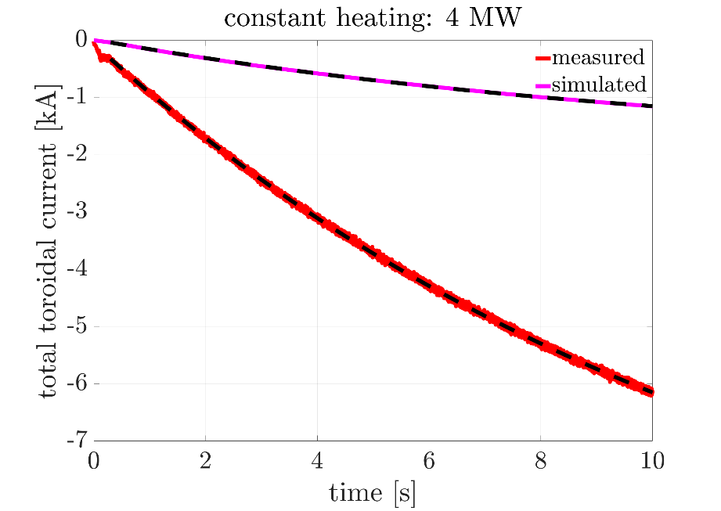
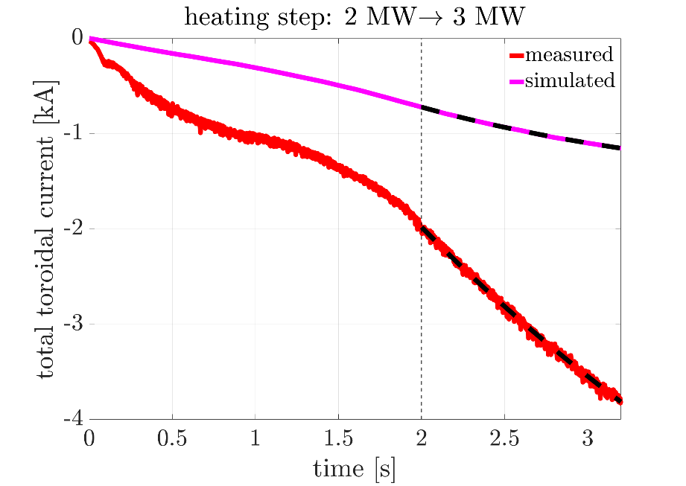
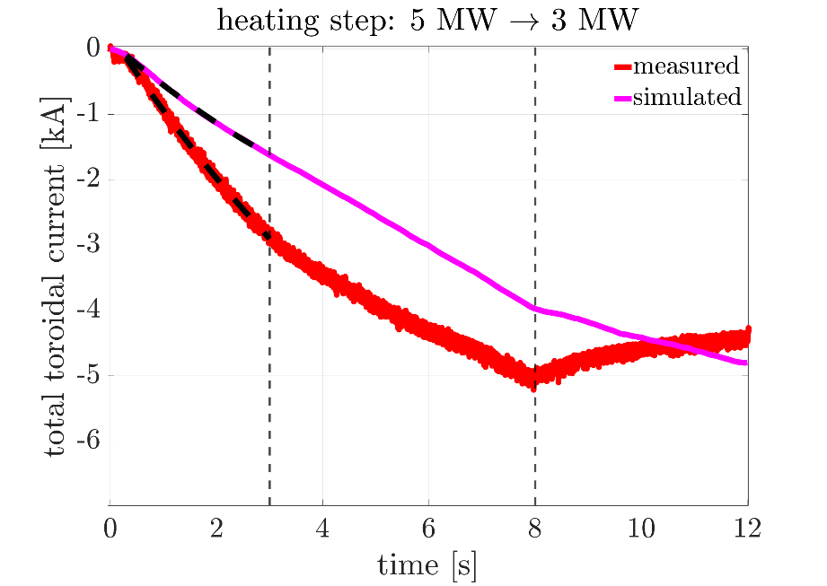
Comparisons for other cases
(A)
(standard-iota)
(B)
(low-iota)
(C)
(low-iota,
reversed
field)
step $→$
C1
step $→$
C2
 | $$τ_{L/R} [s]$$ |  | $I_{∞}$ [kA] |  | $I_{BS}$ [kA] | $$ν^{∗}$$
 | experiment | simulation | experiment | simulation | simulation | simulation
A | $$12.16±0.07$$ | $$11.09±0.003$$ | $$10.59±0.002$$ | $$1.91±0.001$$ | $$3.31$$ | $$5.7⋅{10}^{−3}$$
B (after step) | $$3.93±0.08$$ | $$1.97±0.03$$ | $$8.95±0.04$$ | $$1.67±0.03$$ | $$9.53$$ | $$6.1⋅{10}^{−3}$$
C1 (before step) | $$8.66±0.05$$ | $$6.59±0.47$$ | $$10.31±0.05$$ | $$4.63±0.28$$ | $$11.56$$ | $$1.9⋅{10}^{−2}$$
C2 (after step) | $$1.59±0.004$$ | $$33.60±17.04$$ | $$4.37±0.001$$ | $$11.46±3.63$$ | $$7.98$$ | $$4.2⋅{10}^{−2}$$
experimental and simulation uncertainties from fitting
A: Same general observations
B: $τ_{L/R,sim}\sim 0.5τ_{L/R,exp}$
C1: Agreement in $τ_{L/R}$
C2: Poor simulation fits
, $I_{BS}\sim I_{∞}$
, $I_{BS}\sim I_{∞}$
, $I_{BS}>I_{∞}$
General agreement in $τ_{L/R}$, mixed performance of BOOTSJ

Slide 17
Current “acceleration” with ECCD
Without current drive, current asymptotically evolves towards ${I_{∞}=I}_{BS}$
$$I\left(t\right)=I_{∞}\left(1−\exp\left(−t/τ_{L/R}\right)\right)→\dot{I}\left(t\right)∝I_{∞}$$
Externally driving current increases ${I_{∞}=I_{BS}+I}_{ext}→$ increases $\dot{I}$
If $I_{ext}$ is turned off when $I=I_{BS}$, $\dot{I}\left(t\right)=0$ afterwards
Set-up in THRIFT:
Simple Gaussian model of ECCD:
$$J_{ECCD}\left(ρ\right)=I_{norm}\exp\left(−\frac{{\left(ρ−r_{c}\right)}^{2}}{w^{2}}\right)$$
$r_{c}=0.3$, $w=0.175$
$I_{norm}$ defined such that $I_{ECCD}=20$ kA
ECCD applied for different durations $t^{∗}$: $5$ s, $8$ s, $11$ s, $15$ s
$ρ=\sqrt{s}=\sqrt{Φ/Φ_{a}}$
$r_{c}−$deposition location
$w−$deposition width
[Yu Turkin et al, Fusion Sci. Technol. 50, 387-394 (2006)]

Slide 18
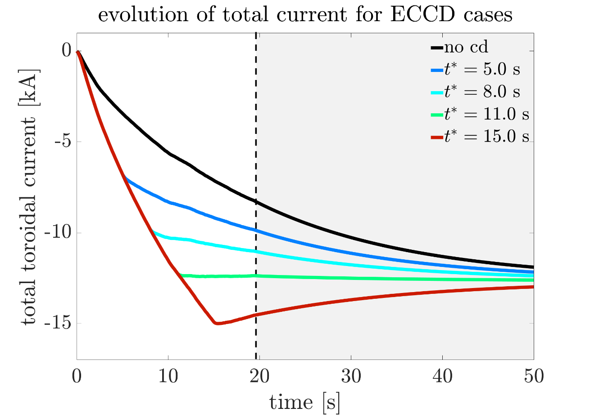
Results for ECCD Scenarios
Early ECCD shut-down (blue) $→$ undershoot of $I_{BS}$
Late ECCD shut-down (red) $→$ overshoot of $I_{BS}$
ECCD shut-down at $t^{∗}=11$ s $→$ stable at $I_{BS}$
Changes in behaviour of current evolution due to changes in source currents captured by THRIFT

Slide 19
Conclusion
Reimplemented and verified the THRIFT code
Decay times of plasma currents in W7-X are recreated by THRIFT
BOOTSJ underpredicts currents $→$ Plasma collisionality
Limitation on minimum edge temperature used by THRIFT
Changes in source currents captured by THRIFT
Future potential uses of THRIFT:
Validating/benchmarking other source current codes
Investigating current drive scenarios
Paper planned on these findings

Slide 20
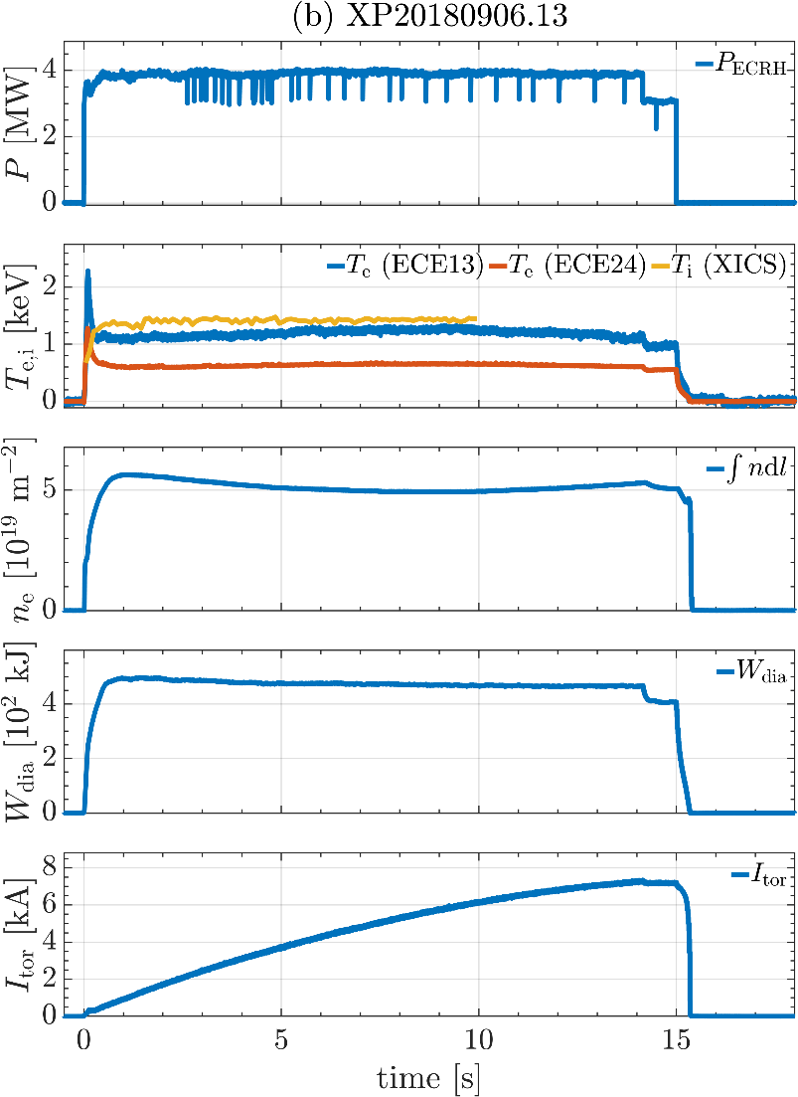
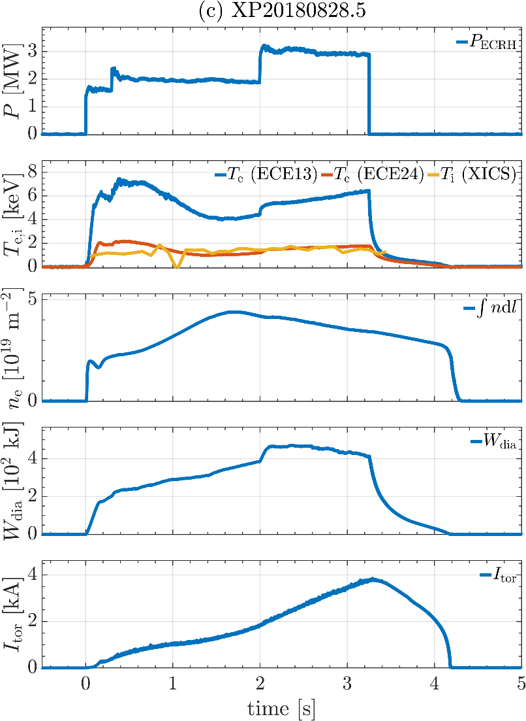
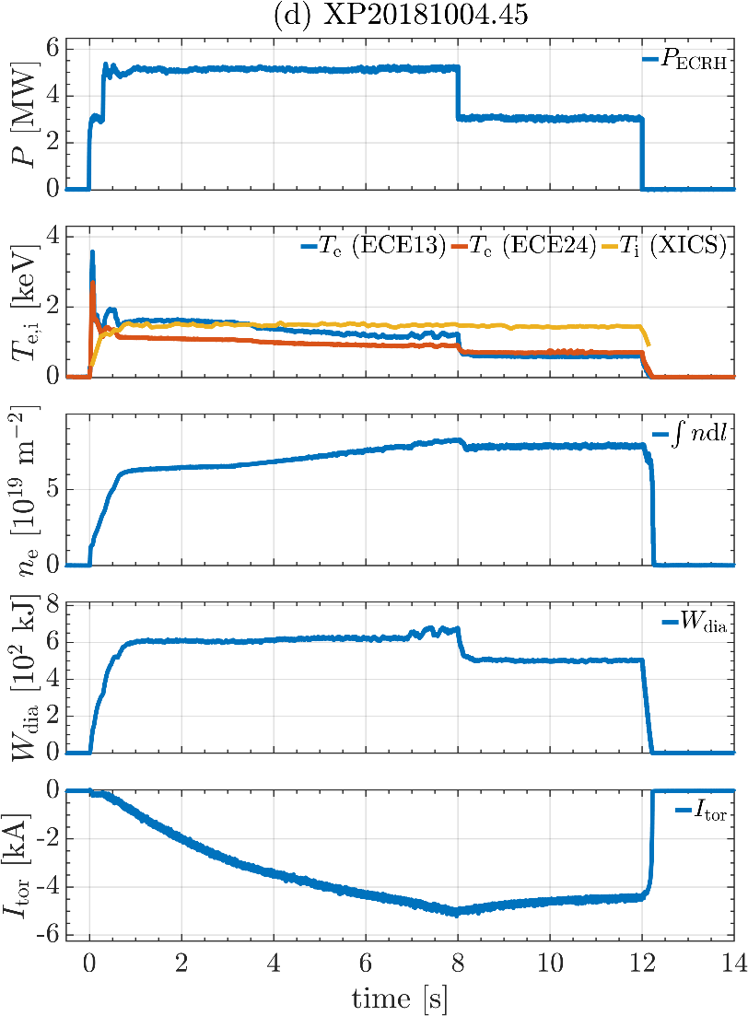
Overviews of other cases
(A)
(B)
(C)
stable
step-up
step-down

Slide 21
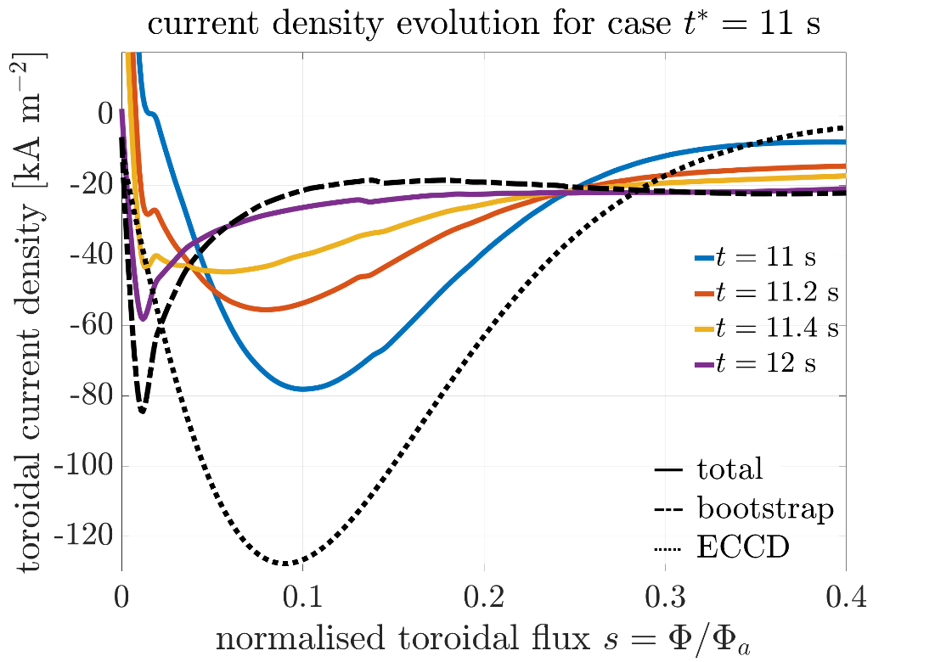
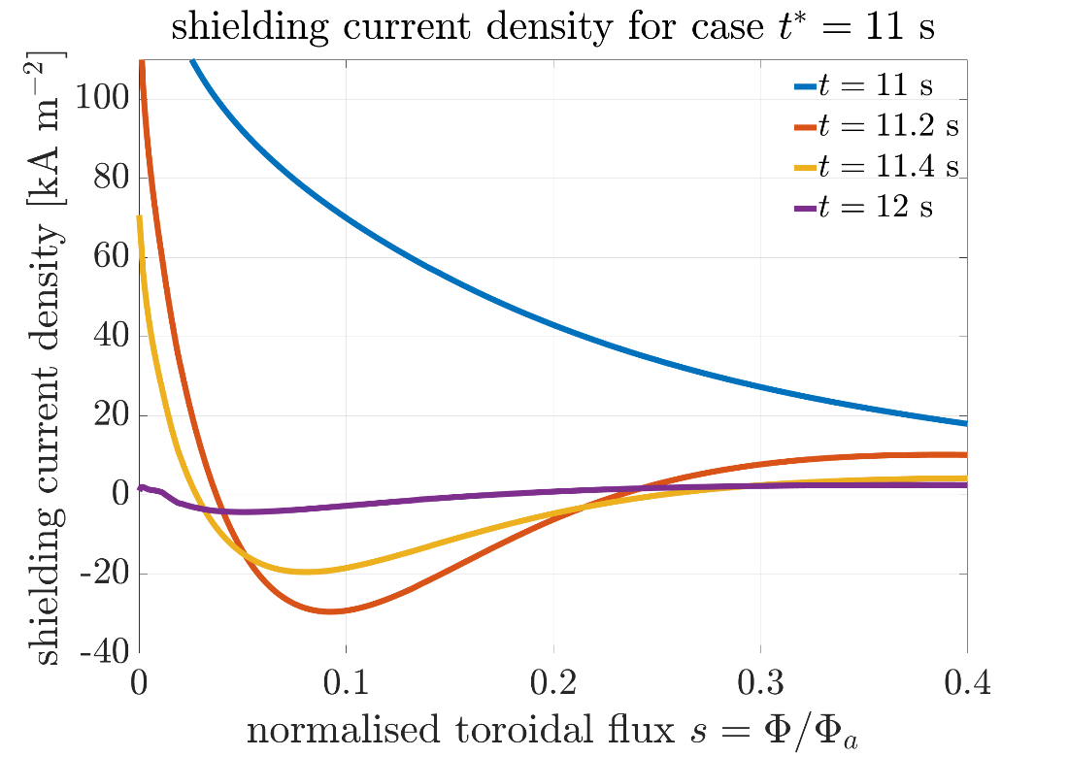
Current density for ECCD $t^{∗}=11$ s
Total current remains unchanged
Total current density redistributes to match bootstrap current
Redistribution occurs on timescale of $\sim 1$s
Shielding current $∝E_{∥}$
$E_{∥}$ becomes locally negative (in direction of total current) $→$ rapid diffusion from “negative” to “positive” locations
$∫E_{∥}ds=0$

