Slide 1
SOFE 2023: Divertor-related contributions

Slide 2
Alan Barth, UKAEA

Slide 3
Alan Barth, UKAEA

Slide 4
Alan Barth, UKAEA

Slide 5
Alan Barth, UKAEA

Slide 6
Particle exhaust in STEP divertor
Divertor pressure of >10 Pa during detached operation expected
Cryo pump and TMPs used for gas exhaust
Effective pumping speed in the range of 20-30 m^3/s expected

Slide 7
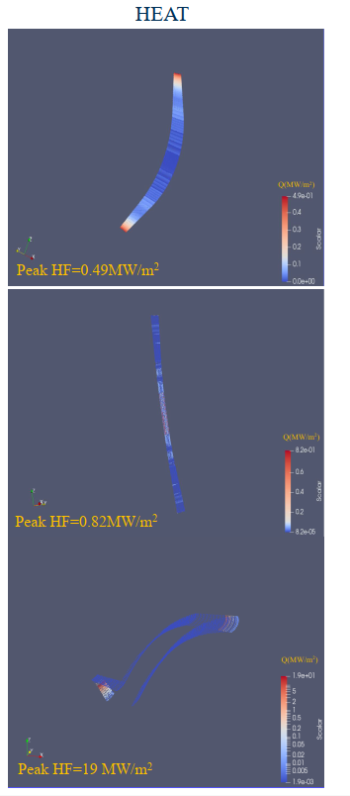
Heat flux on plasma facing components in STEP

Slide 8
Radiation loads on the first wall in STEP

Slide 9
Radiation loads on the first wall in STEP

Slide 10
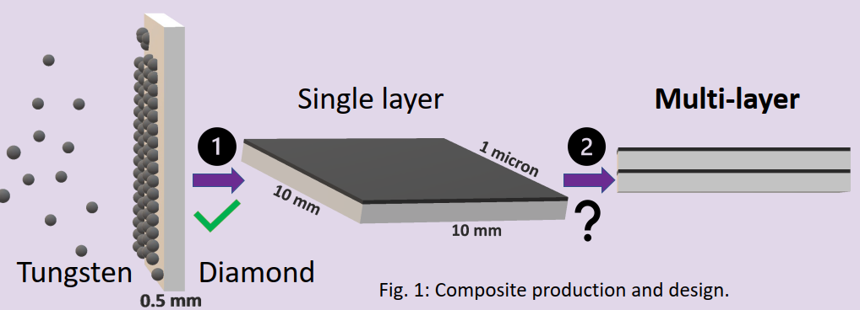
W-diamond composite for plasma facing components
Uniform and adhesive tungsten coating on diamond substrate produced by pulsed laser deposition
Manifacturing of multi layer composite will be investigated
Mechanical and neutron irradiation tests planned

Slide 11
Contributions related to materials for PFCs and first wall
Free-surface liquid Lithium PFC development with real-time Deuterium implantation and extraction
Design and analysis of liquid Lithium PFCs
Compact fusion blanket using plasma-facing Li-LiH walls and Pb pebbles
Helium cooled Lithium blanket concept for STEP
In-situ SEM investigation on W-Cu composites for PFCs
Analysis of CuCrZr H isotope transport properties
H isotope retention and release from fusion relevant steels
Modelling the oxidation of tungsten in fusion reactor first walls
Metallic glasses (Zr60Cu30Al10) as novel materials for application in nuclear fusion

