Slide 1
2D divertor target design based on a priori first principles
Thierry Kremeyer¹
¹ Max Planck Inst. for Plasma Physics, 17491 Greifswald, Germany
Notes:
Thierry Kremeyer, PostDoc at Max Planck Inst für PlasmaPhysik
Work on particle fueling and exhaust
Thank the committee for the oportunity to give this talk, in front of a live audience
Thank all my Co-authors, in particular the Fueling & Exhaust Team, as well as the entire W7-X Team

Slide 2
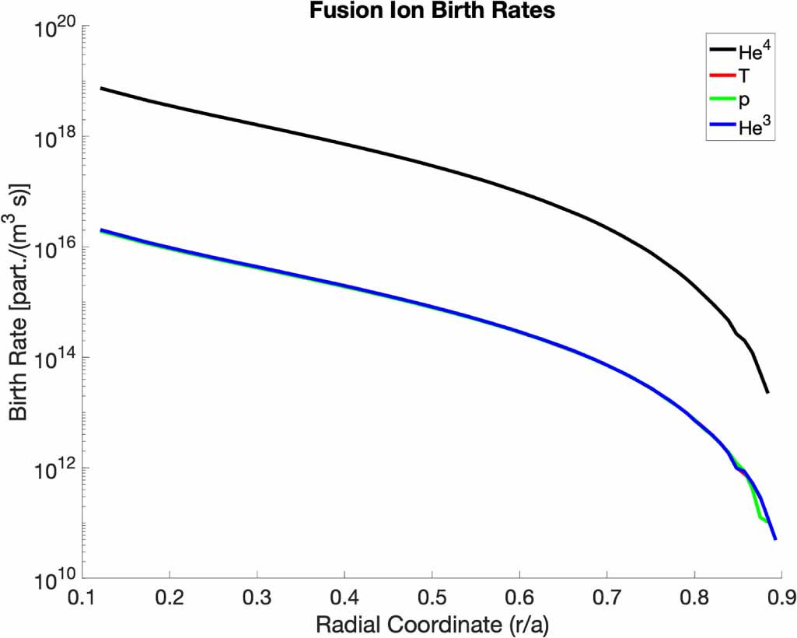
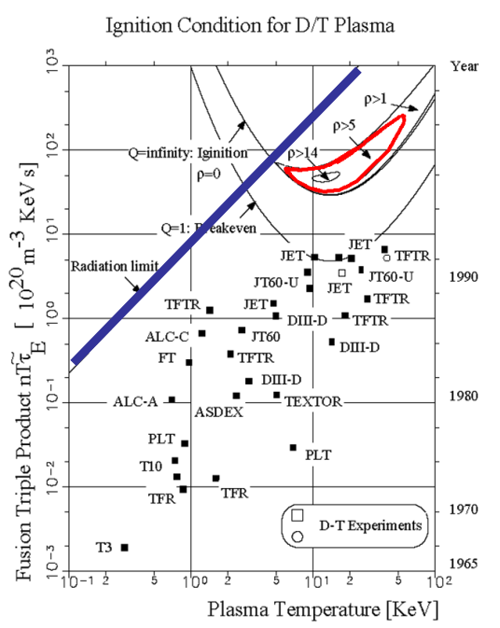
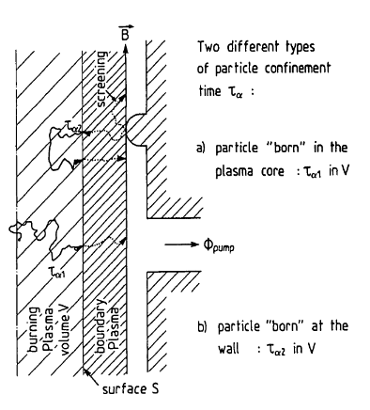
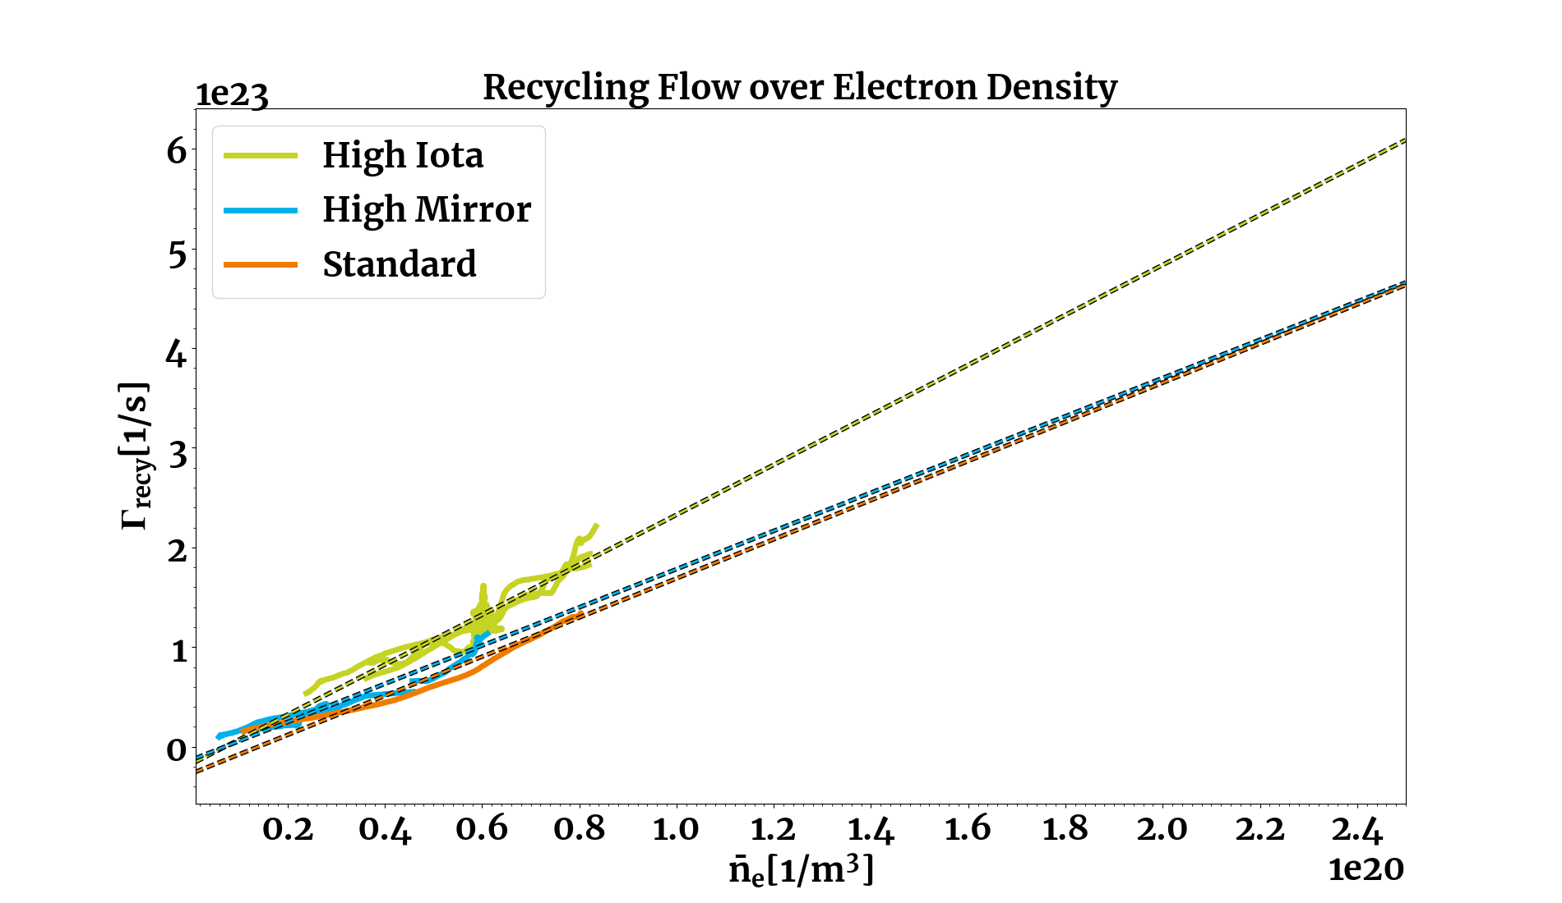
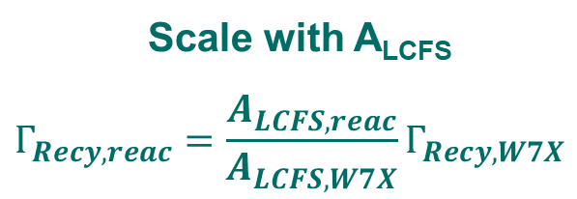


Reactor performance requirements
  Γ_{He,exhaust} = Γ_{α,1}
  Minimize R_{eff} for impurities
n_{e} = 2 E+20 m⁻³
Scale with A_{LCFS}
$$Γ_{Recy, reac}=\frac{A_{LCFS, reac}}{A_{LCFS,W7X}}Γ_{Recy, W7X}$$
$$ρ=\frac{τ_{α}^{∗}}{τ_{E}}$$
[S. Lazerson PPCF 2021]
W7-X
$$τ_{α}^{∗}= τ_{α1}+\frac{R_{eff}}{(1−R_{eff})}τ_{α2}$$
[Reiter NF 1990]
[S. Dräger]

Slide 3
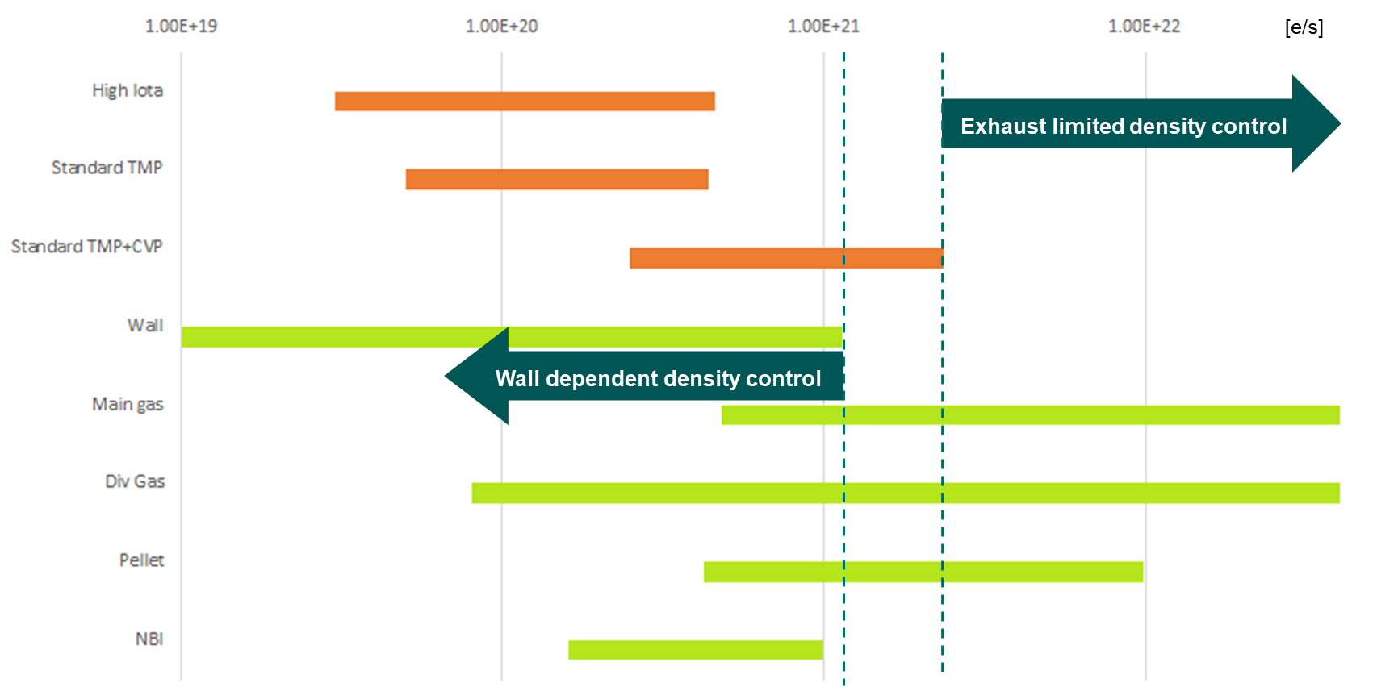
Opertational performance requirements
  Stable density in equilibrium
  Γ_{exhaust} = Γ_{source}
  Wall independent density control
  Γ_{exhaust} > Γ_{wall}
  Γ_{exhaust} > 1.1E+21 e/s
  Exhaust limited density control
  Γ_{exhaust} < Γ_{wall} + Γ_{NBI} + Γ_{pellet} (+Γ_{Gas})
  Γ_{exhaust} < 1.4E+22 e/s (4.1E+23)
  Fueling limited density control
  Γ_{exhaust} > Γ_{wall} + Γ_{NBI} + Γ_{pellet} (+Γ_{Gas})

Slide 4
Guarantee requirements
  Survive P_{div} = P_{rec,surf}(Γ_{ion,div}) + P_{rec,vol,div}(Γ_{ion,div}) + P_{rad,div} + P_{n,div}
  q_{div} ≤ 10 MW/m² (q_{max} ≤ 20 MW/m²)
  Survive neutron dpa (ITER 0.14 - 2.5dpa; DEMO 70 – 80 dpa)
  T_{e,t} < 10 eV (< 5 eV W sputtering; < 1.5 eV volume recomb.)
  Objective: Optimize performance metrics
  Maximize Γ_{exhaust} combined with throttle
  Minimize R_{eff}

Slide 5
Particle exhaust metrics and efficiencies
Unfavorable particles Favorable particles
Γ_{loss, sub-div}
Γ_{recy, edge}
Γ_{recy, div}
Γ_{exhaust}
R_{eff}*Γ_{Neutral}
Γ_{ion,div}
Γ_{pumpgap}
Γ_{ion,core}
Γ_{ion,edge}
Γ_{neutral}
pump gap
Core Edge Divertor Sub-divertor
(Burning plasma) (Plasma) (Plasma + Neutrals) (Neutrals)
Exhaust efficiencies
Particle collection Particle removal
η_{collection} = Γ_{pumpgap} / Γ_{neutral} η_{removal} = Γ_{exhaust} / Γ_{pumpgap}
= 4 % - 10 % = 2 %
Particle plugging Particle exhaust efficiency
η_{plugging} = Γ_{recy, div} / (Γ_{neutral} – Γ_{exhaust}) η_{exhaust} = Γ_{exhaust} / Γ_{neutral} = η_{collection} η_{removal}
= 75 % - 97 % = 0.04% - 0.6 %

Slide 6
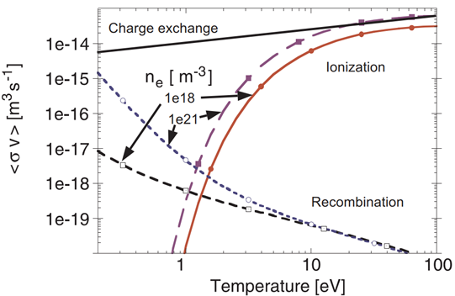
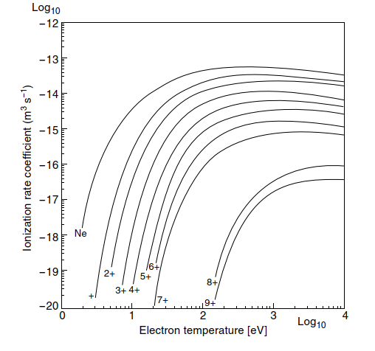

A priori first principles
Limiter
Divert – $grad$ B = 0
    Closed surfaces, meet at x points, rotational transform visualize
    Visualize super x, snowflake, single null, double null,
    3D plot tripple product rho
    Tripple product density temperature confinement
Neutralization Γ_{ion,div} Γ_{Neutral}
– Only neutral particles can be exhausted
      Surface recombination on target, P_{rec,surf} = Γ_{ion,div} ((γT_{e})+(½m_{ion}v_{ion}²)+ε_{i})
      Volume recombination, preferred, T_{e,t} < 1.5 eV, MAR ~n_{e},n₀, EIR ~ n_{e}³
      $q_{div}= \frac{P_{rec, surf}}{A_{wetted}}+P_{rad,div}$
      $q_{div}\left(P_{in}=12.5 MW\right)≤10 \frac{MW}{m²}$ for A_{wetted,max}
Minimize R_{eff} for impurities
– Keep recycling particles outside of core
      Ionize outside of LCFS, minimize λ_{iz,He}, T_{e} ≥ 100 eV, ~ n_{e}
      Minimize inward impurity transport
      Minimize sputtering source, T_{e,t} < 5 eV
      R_{eff,H}(f_{rad}=0.85) = 7 % R_{eff,H}(f_{rad}=0.90) = 30 %
      Helium?
MAR
[Ralf Schneider]
[Stangeby 2000]

Slide 7
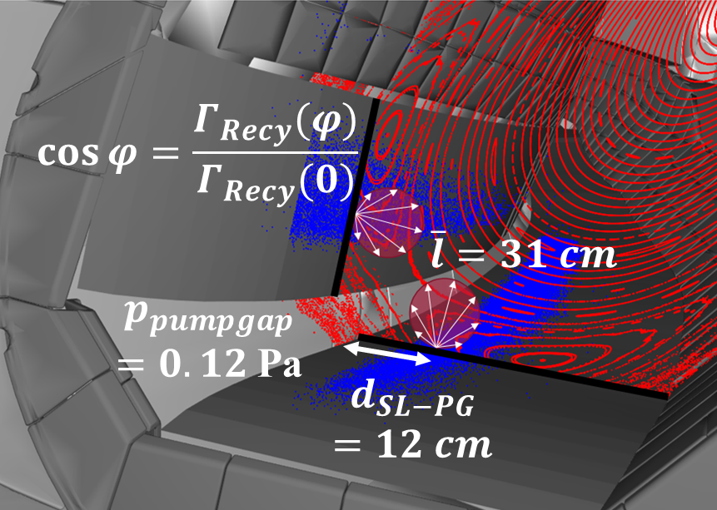
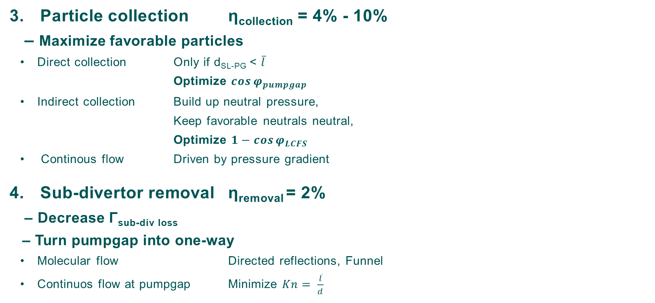
A priori first principles
Particle collection η_{collection} = 4% - 10%
– Maximize favorable particles
      Direct collection Only if d_{SL-PG} < $\overline{l}$
      Optimize $\cos{φ_{pumpgap}}$
      Indirect collection Build up neutral pressure,
      Keep favorable neutrals neutral,
      Optimize $1−cos{φ_{LCFS}}$
      Continous flow Driven by pressure gradient
Sub-divertor removal η_{removal} = 2%
– Decrease Γ_{sub-div} _{loss}
– Turn pumpgap into one-way
      Molecular flow Directed reflections, Funnel
      Continuos flow at pumpgap Minimize $Kn= \frac{\overline{l}}{d}$

Slide 8
A priori first principles
Plugging η_{plugging} = 75 % – 97 %
– Block escaping neutrals
– Relevance decreases as η_{exhaust} increases
      Hardware (Baffles): Thermal loads
      Re-Ionization: Weakend by detachment?
Survive heat loads
– Exhaust heat necessary for particle exhaust
– Radiate rest
    Surface recombination on target
    Volume recombination in front of target
    Radiated power Radiation location and stability:
      X-Point vs homogenous island radiation
      Neutron power

Slide 9
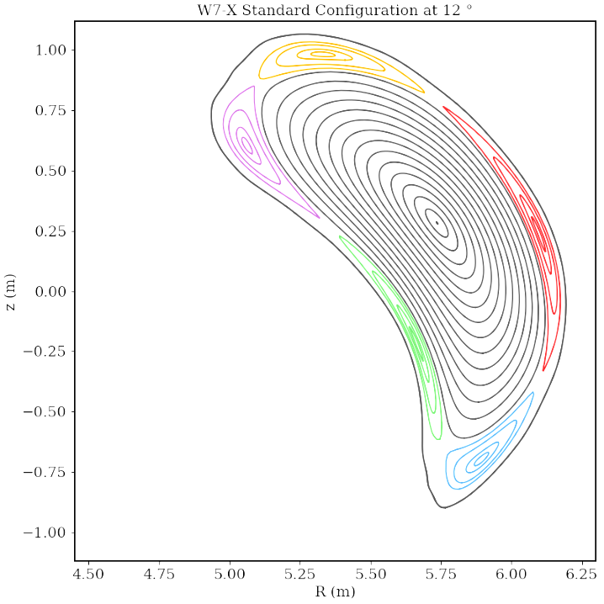
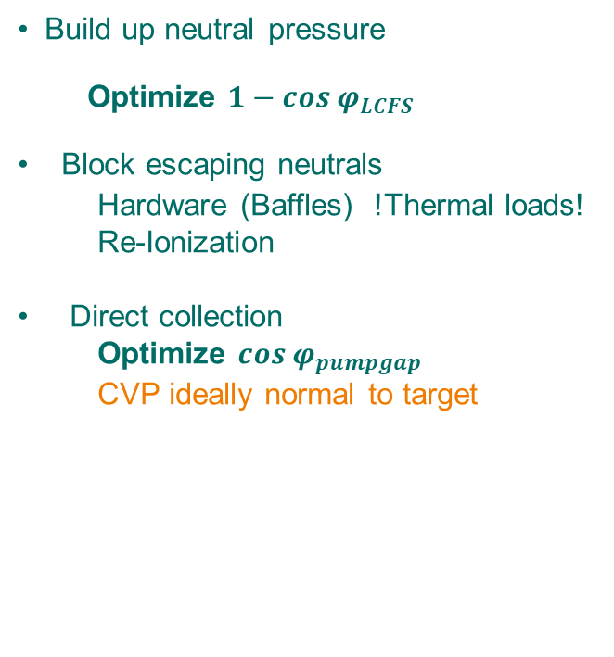
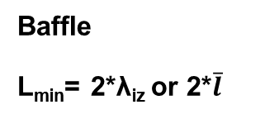
2D Target cross section of „standardized“ sections
Build up neutral pressure
Optimize $1−cos{φ_{LCFS}}$
Block escaping neutrals
      Hardware (Baffles) !Thermal loads!
      Re-Ionization
    Direct collection
      Optimize $\cos{φ_{pumpgap}}$
      CVP ideally normal to target
Baffle
Targets
CVP
Smallest possible angle?
L
Smallest possible radius?
Baffle
L_{min}= 2*λ_{iz} or 2*$\overline{l}$
Dome/ Double Baffle
Targets
Notes:
Only one configuration
Moveable baffle / target

