Slide 1
Divertor Development Meeting
W7-X Divertor Optimization: Status and Ideas
Amit Kharwandikar

Slide 2

Next-Step W7-X Divertor
IDEAL

Slide 3
Background
Aim: Design 3D divertors
Heat Flux Compatibility
Improved Neutral Exhaust
Flexibility in configuration space
Known: Tools (EMC3-lite), Boundary Conditions (HL limits, Configuration Space, Neutrals?)
3D SOL -> Large design space
Roadblock to Formulate an Iterative Optimization problem?
Clever initial design guess -> Design reference
Identify (limited but sufficient) parameter space to scan

Slide 4
High Level Strategy
Initial Guess
2D Idea
3D Island Divertor Design
Fast, Reduced Model
Heat Load Optimized Designs
Complete Physics Model

Slide 5
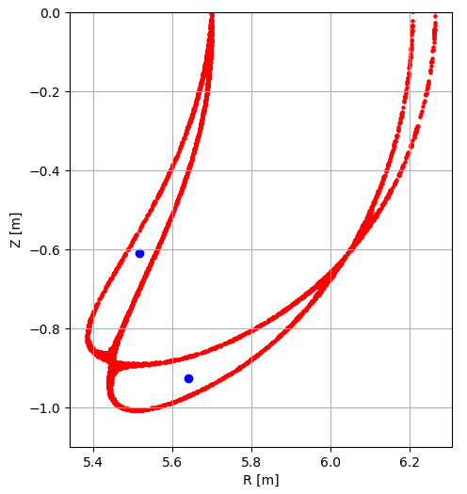
2D Idea

Slide 6
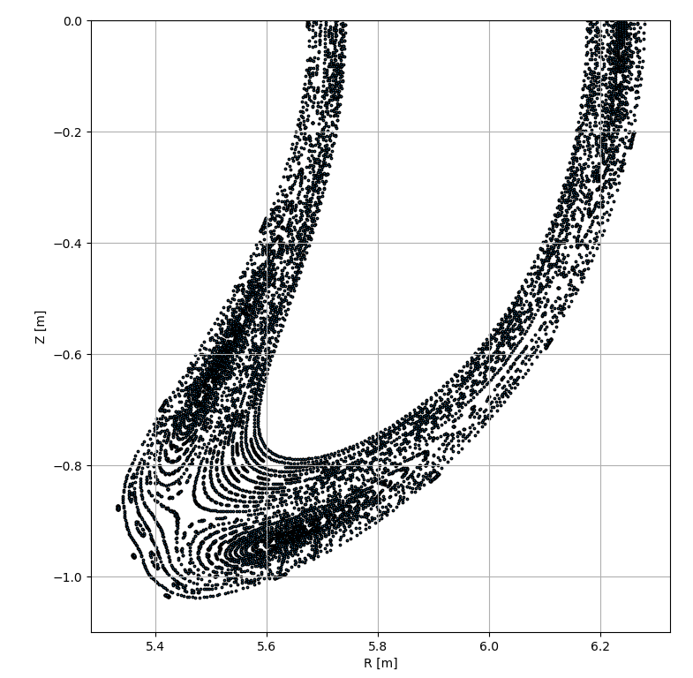
Island Frame for a Given Magnetic Configuration

Slide 7
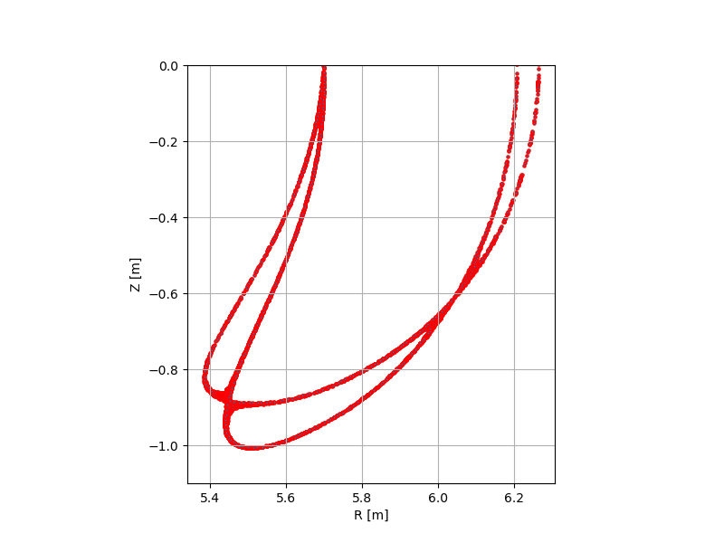
High Qparallel surface

Slide 8

Unique points
O-point and nearest point on the High QII
Has to be traced to make a spline, hence no perturbations
Could be X-point ? (Flux expansion highest there, but how useful for heat flux??)
Can we use the field line pitch?

Slide 9
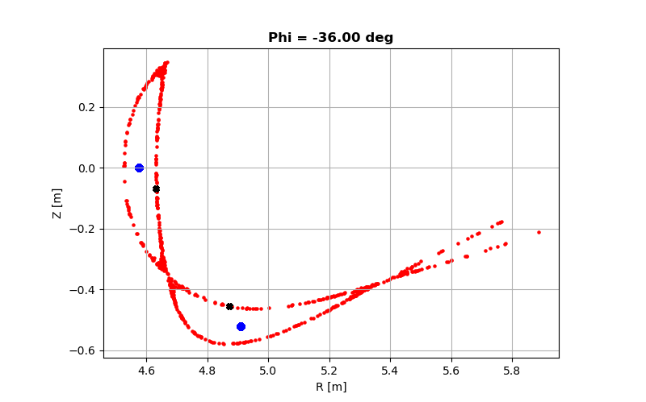
Island frame
Observe both islands:
- Sweet spot (shape of island, width, LCMS) varies for both islands
-> Design for both islands independently => different toroidal location for strikeline
!!!!! Continuous flow
But, having strikelines on both divertors at similar toroidal location contributes to laminar flow??

Slide 10
DEMO

Slide 11
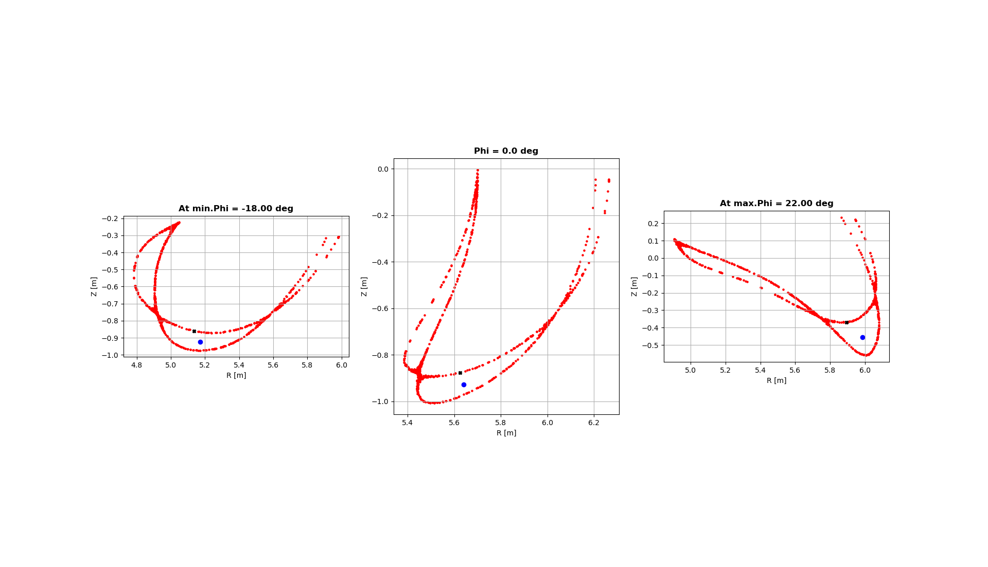
1. Phi Extents – User input

Slide 12
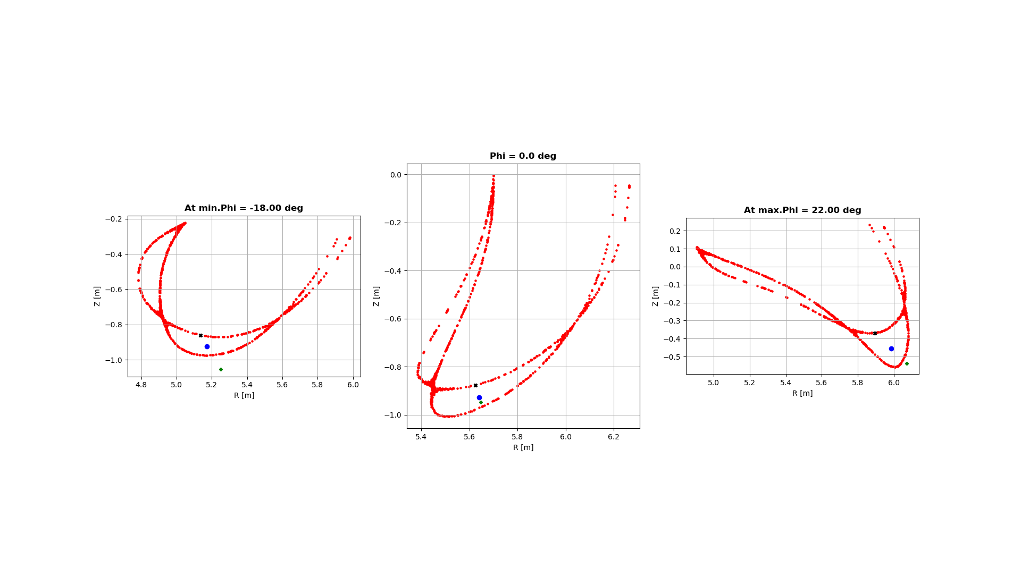
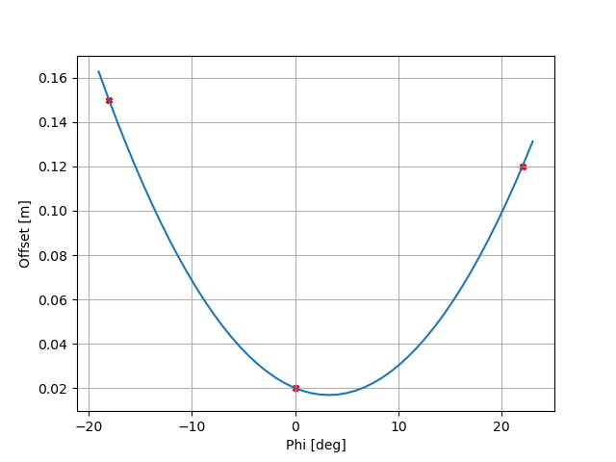
2. Offsets – User input
Interpolate profile of offset

Slide 13
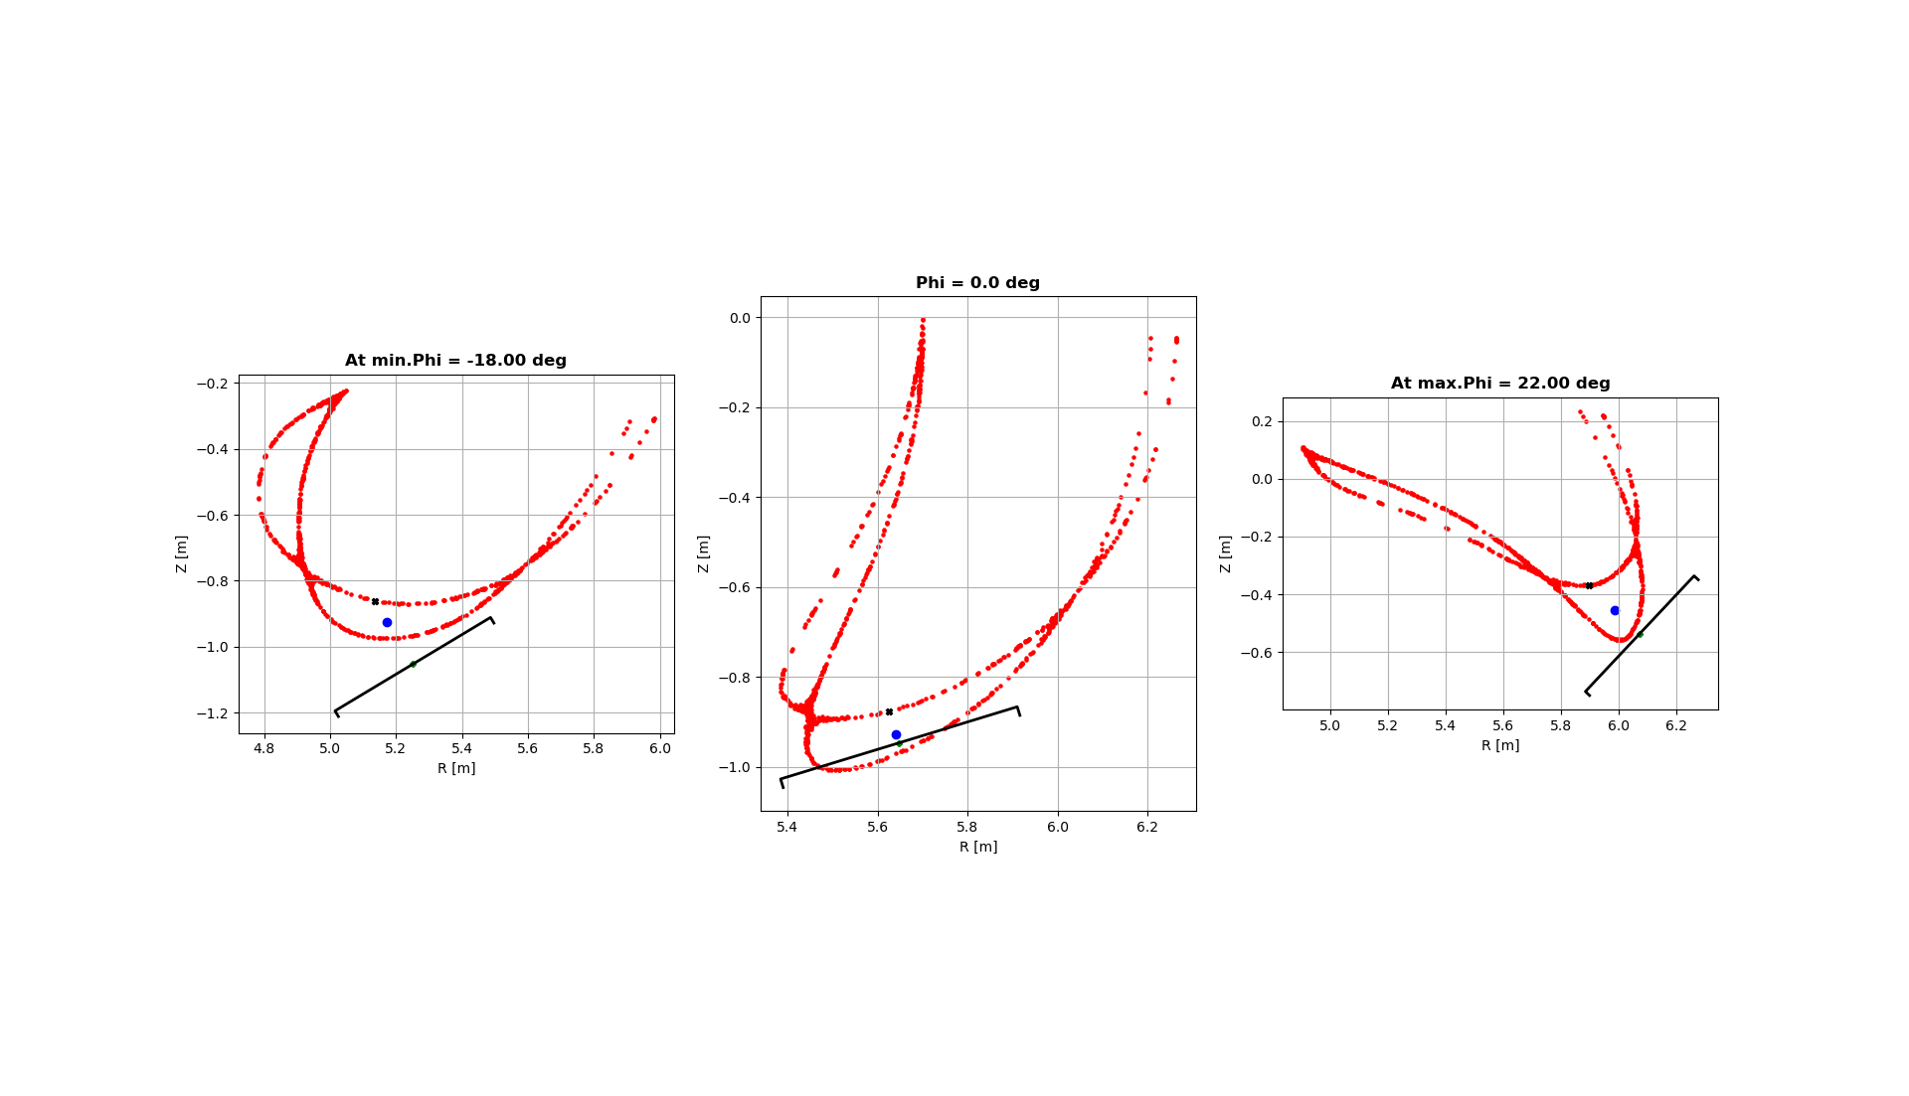
Divertor Dimensions

Slide 14
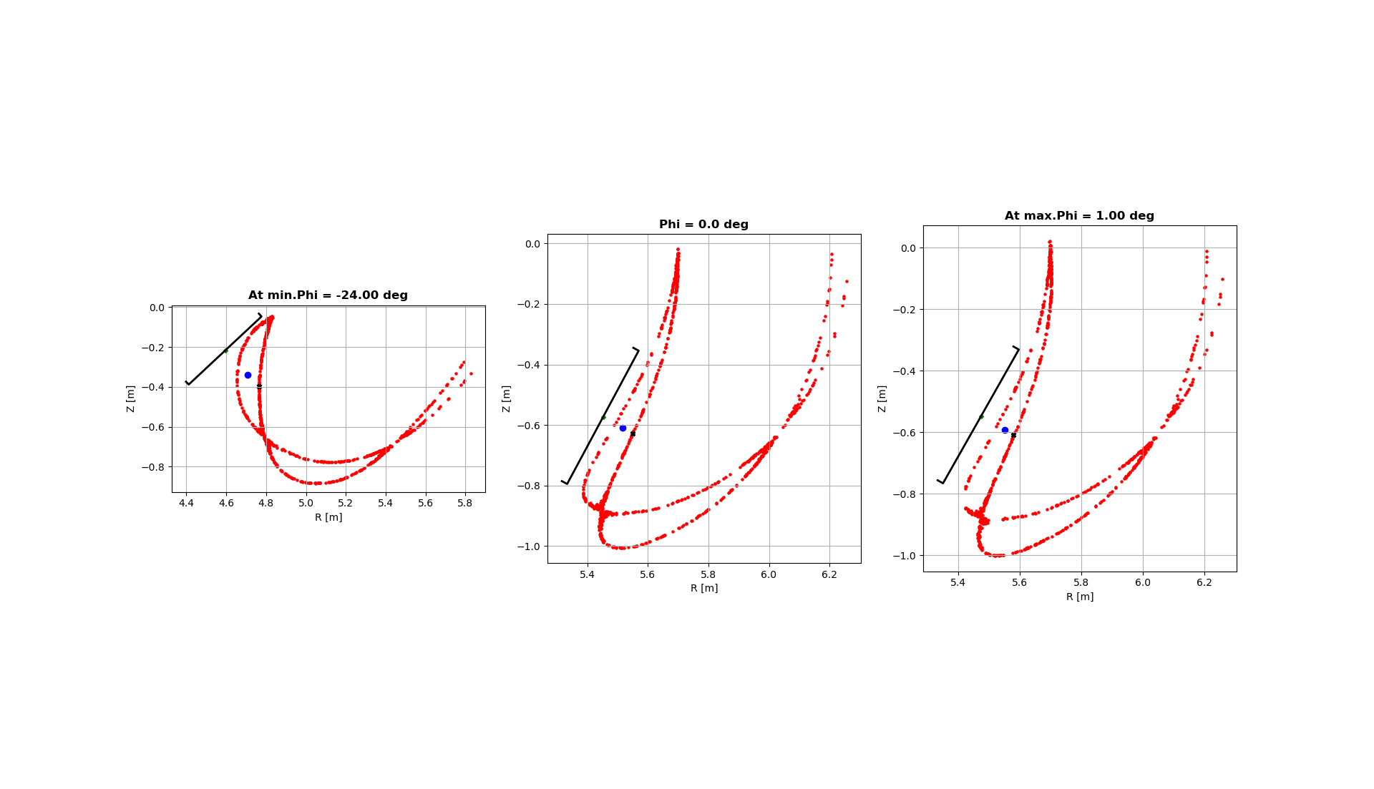
Vertical Divertor

Slide 15
Initial Guess for 3D Island Divertor Design for a 2D Idea

Slide 16
Parameterization Example
Dimension
Offset
Tilt

Slide 17
High Level Strategy
Initial Guess
2D Idea
3D Island Divertor Design
Fast, Reduced Model
Heat Load Optimized Designs
Peak Heat Loads
Wetted Area, etc.
Complete Physics Model

Slide 18
Results

Slide 19
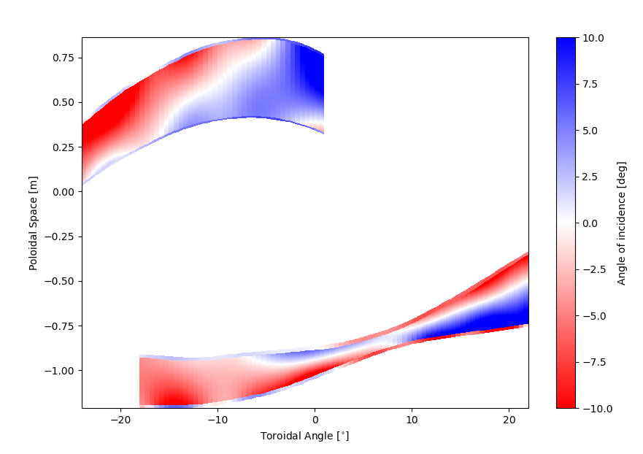
Incidence Angle

Slide 20
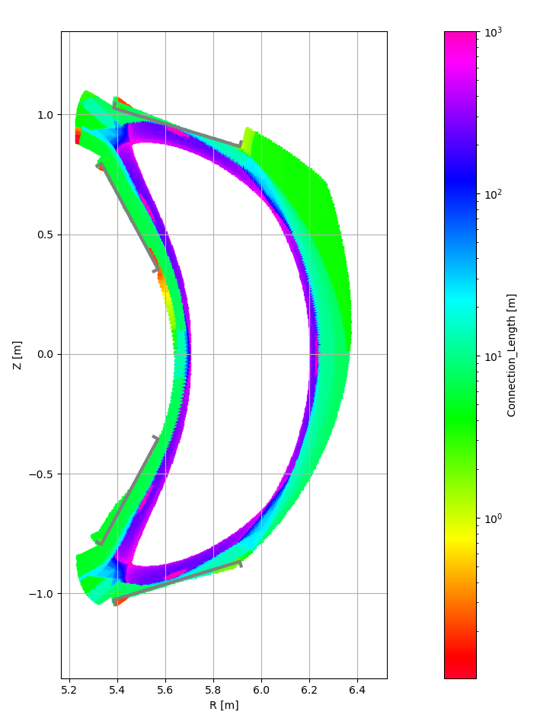
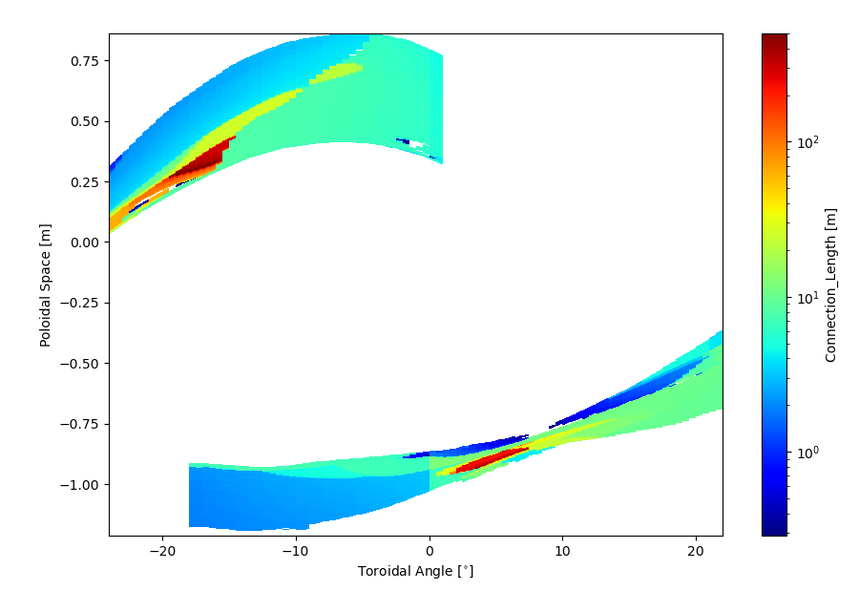
Connection length

Slide 21
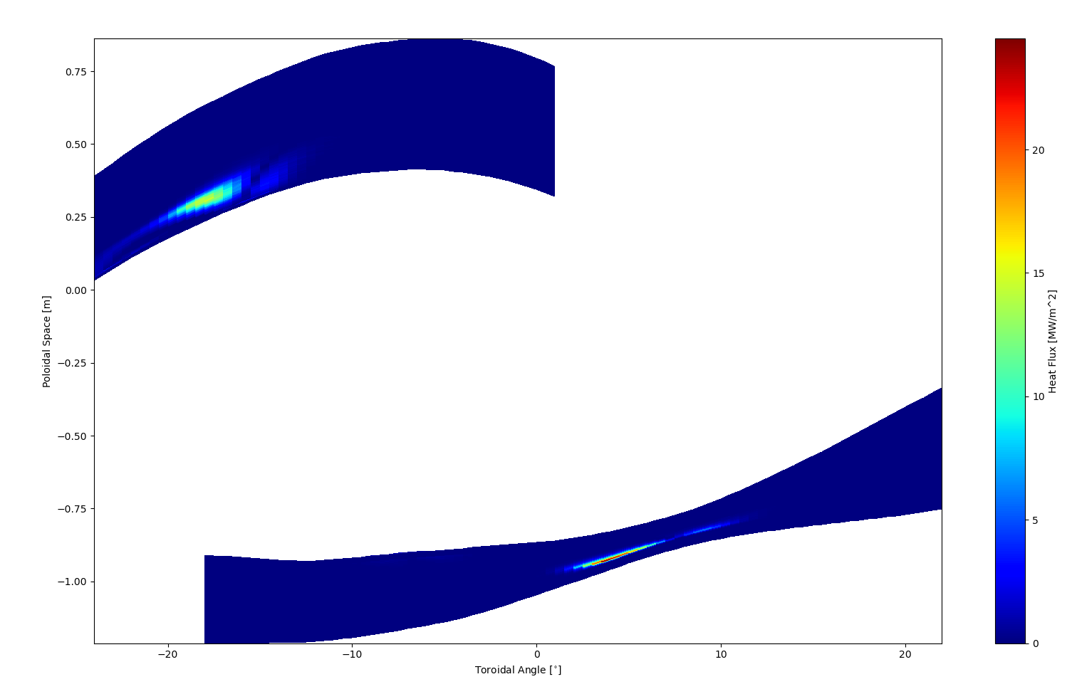
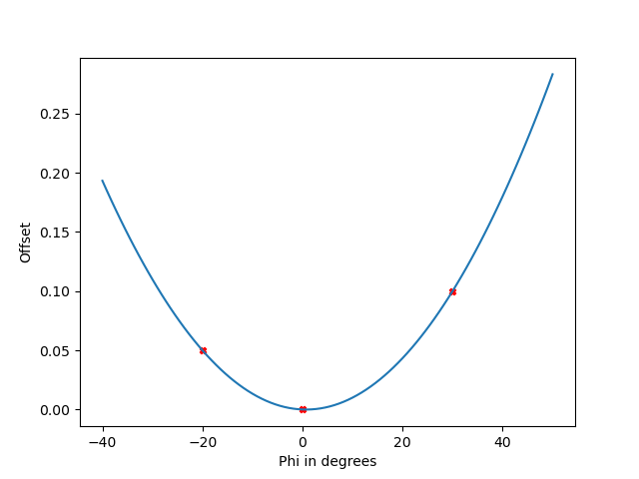
Heat Flux
High LC regions dominant
Flatten offset profile

Slide 23
Idea2: Highest Curvature Point

Slide 24
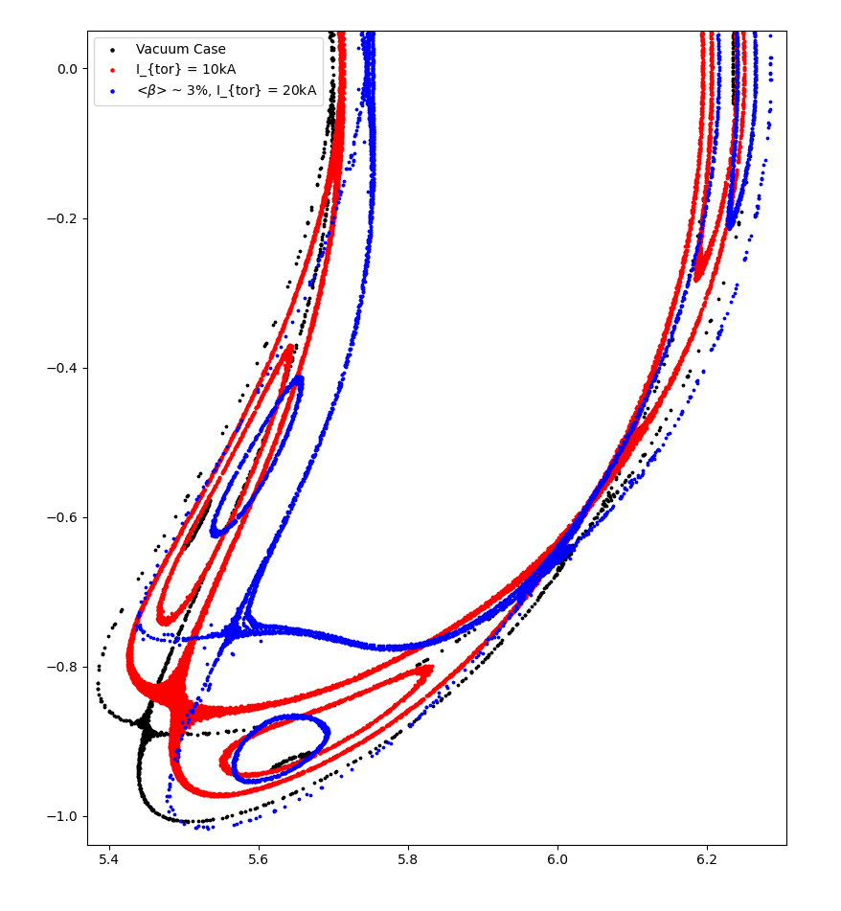
High Poloidal Curvature in Outboard side of Island
Features:
Predictable evolution of high qII flux surface (island blows up in a certain way, owing to the magnetic topology)
Radially farthest from inner island separatrix

Slide 25
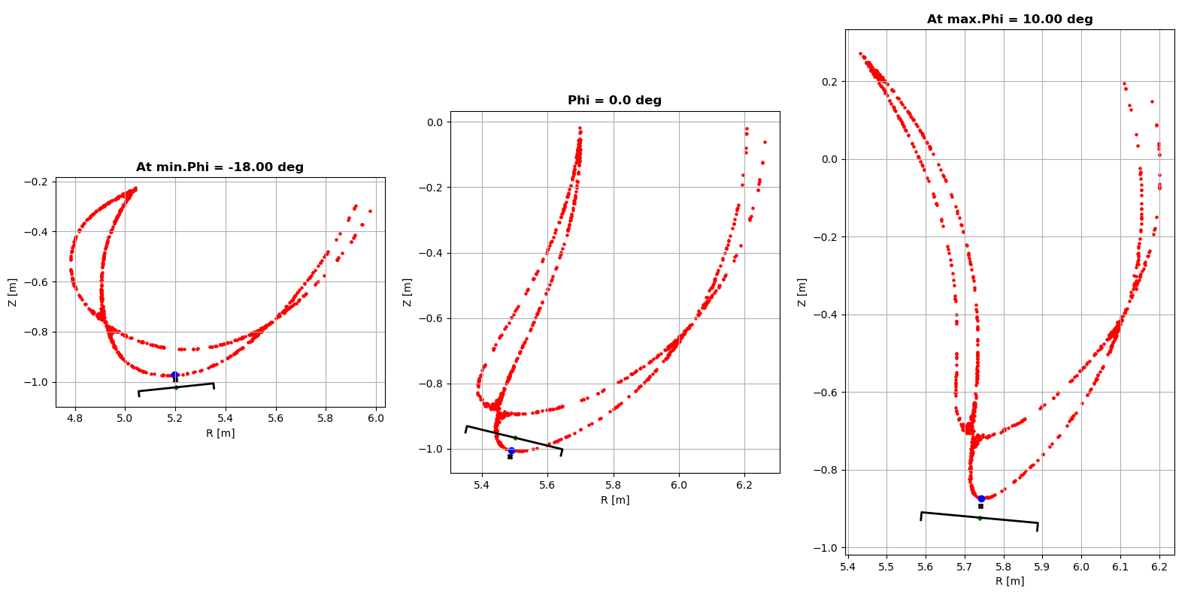
Algorithm – Estimating High K points

Slide 26
Parameterization Example
Dimension
Offset
Tilt

Slide 27
High Poloidal Curvature ~ Island Width
Advantages:
Technically, for a given configuration, can limit the width of the targets
X-point side => leverage flux expansion
Efficiently utilize island geometry
Well defined surface even in Finite beta scenarios => Approach valid for any general ID

Slide 28
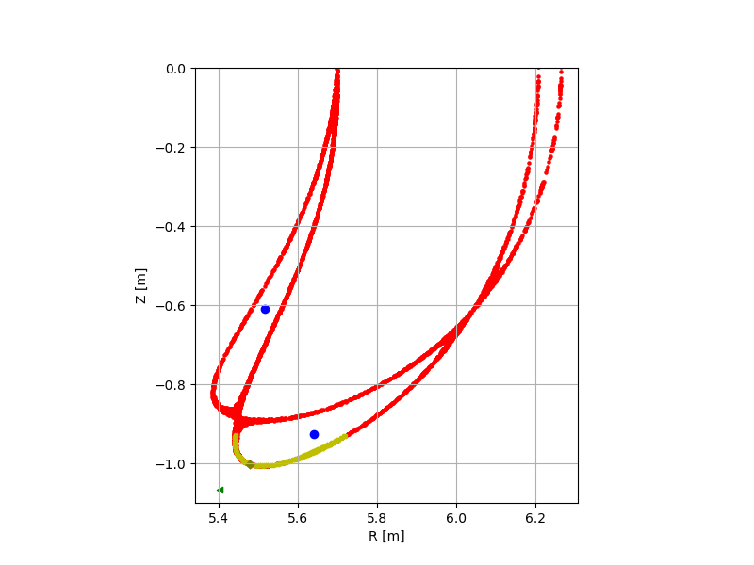
Open Questions
Extent of Benefits of Flux Expansion in Island Divertor SOL?
Technical constraints that affect Phi extent
Iota profile within islands? With Plasma Beta?
Analytical or Semi-analytical approach:
Evolution of Shape of LCMS or Island?
O and X points
Real space to magnetic coordinates (eg. Pitch angle??)

Slide 29
Thank you

