Slide 1
Divertor Development Meeting W7-X Divertor Optimization: Status and Ideas
Amit Kharwandikar

Slide 2
Background
Aim: Design 3D divertors
Heat Flux Compatibility
Improved Neutral Exhaust
Flexibility in configuration space
Known: Tools (EMC3-lite), Boundary Conditions (HL limits, Configuration Space, Neutrals?)
3D SOL -> Large design space
Roadblock to Formulate an Iterative Optimization problem?
Clever initial design guess -> Design reference
Identify (limited but sufficient) parameter space to scan
Options -> Seek motivation from Transport physics/magnetic topology/combination of both

Slide 3
Parameterization of the Divertor Design

Slide 4
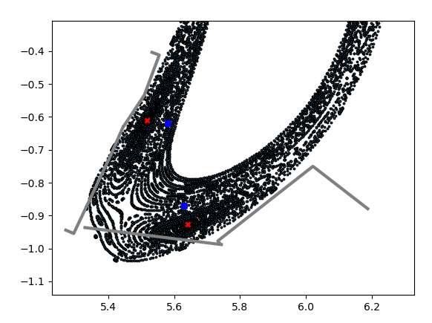
Alternate Divertor Geometries
Example -> Use shape/spline of flux surfaces or stationary points of a given magnetic topology to guide shape of divertor -> general framework for any configuration
O-line divertors:
Spline of O-point
Spline of closest radially inward flux surface
(Instead can use power carrying layer!)
Toroidally consistent with iota
Basis vector->design relevant coordinate system

Slide 5
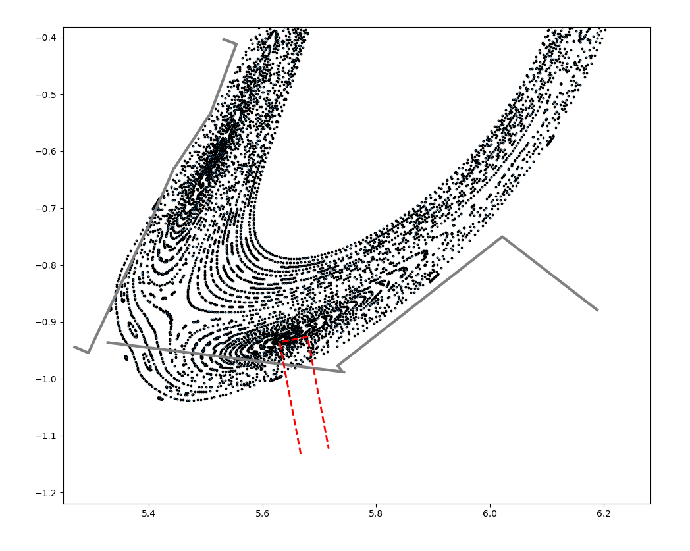
Alternate Divertor Geometries
Parameters:
Phi-extent
Off-set from O-point over toroidal length
Length and width
Inclination with basis vector
Control offset -> shadow potential leading edges

Slide 6
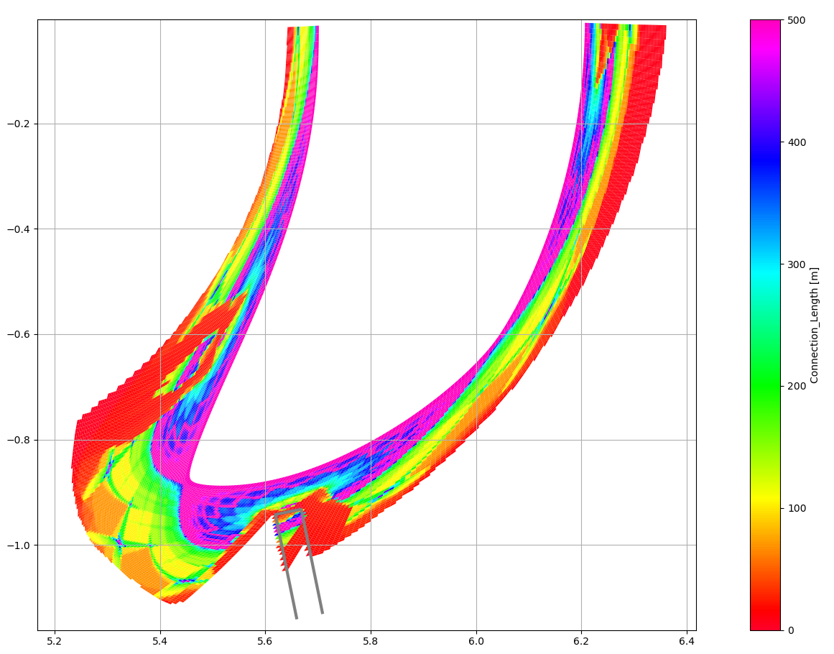
Limitations of Emc3-lite

Slide 7
Better BASIS?

Slide 8
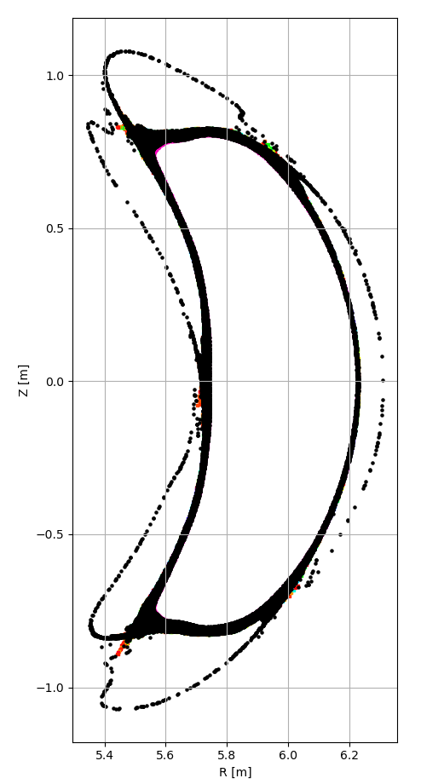
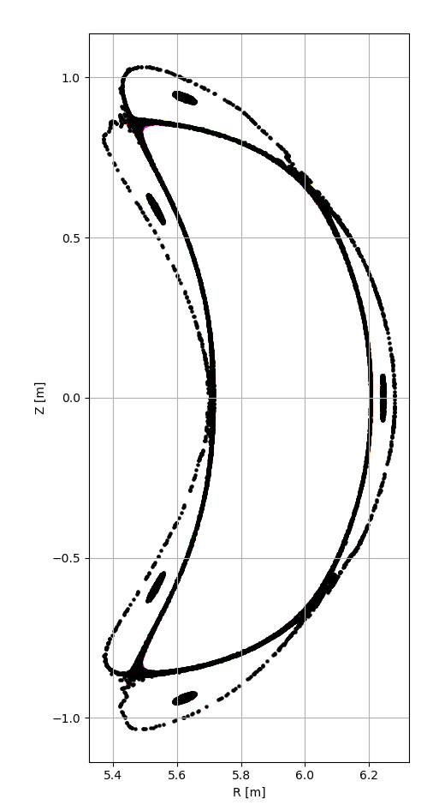
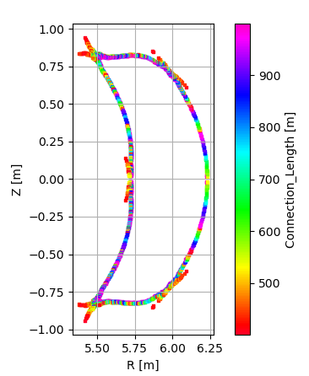
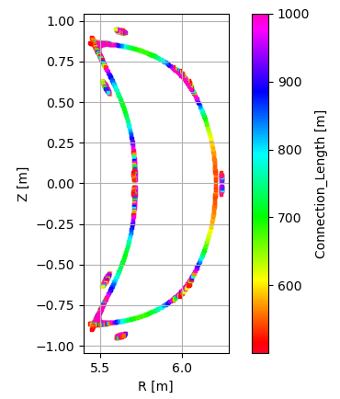
Standard Config. – High QII Surface
3% Beta
1% Beta

Slide 9
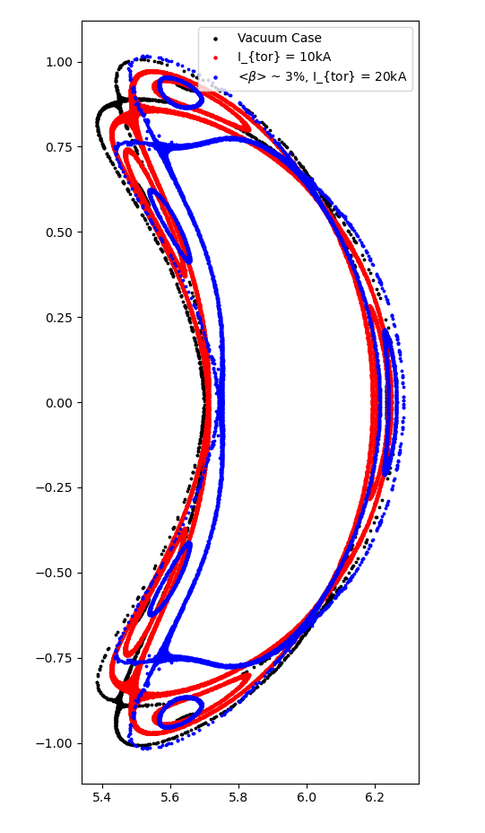
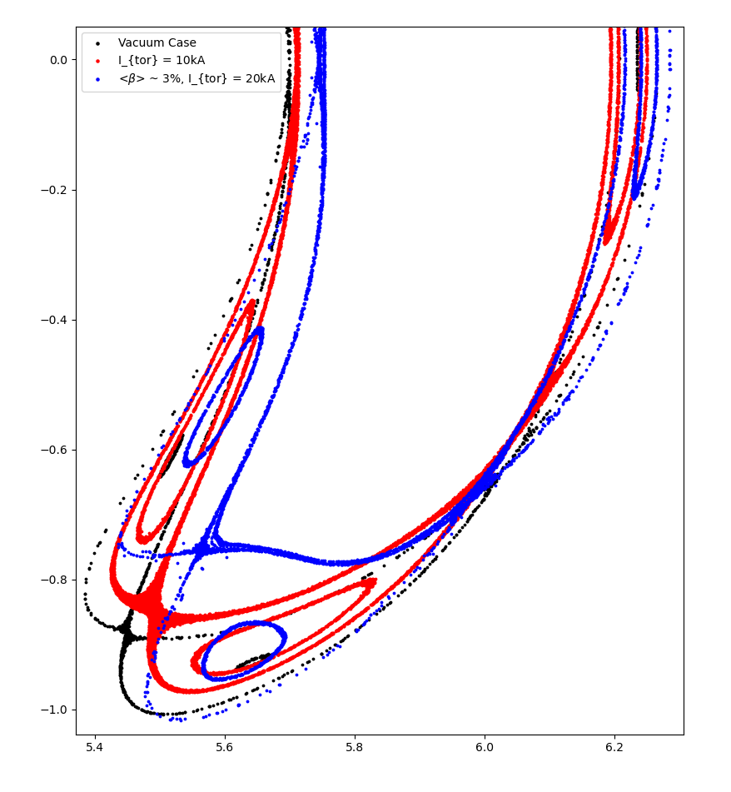
Standard Config. – High QII Surface
Bounding surface for target magnetic configurations

Slide 10
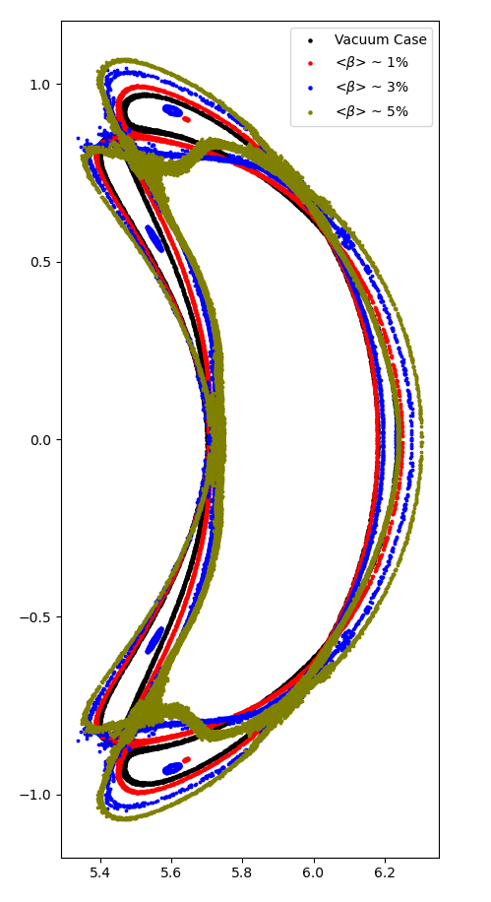
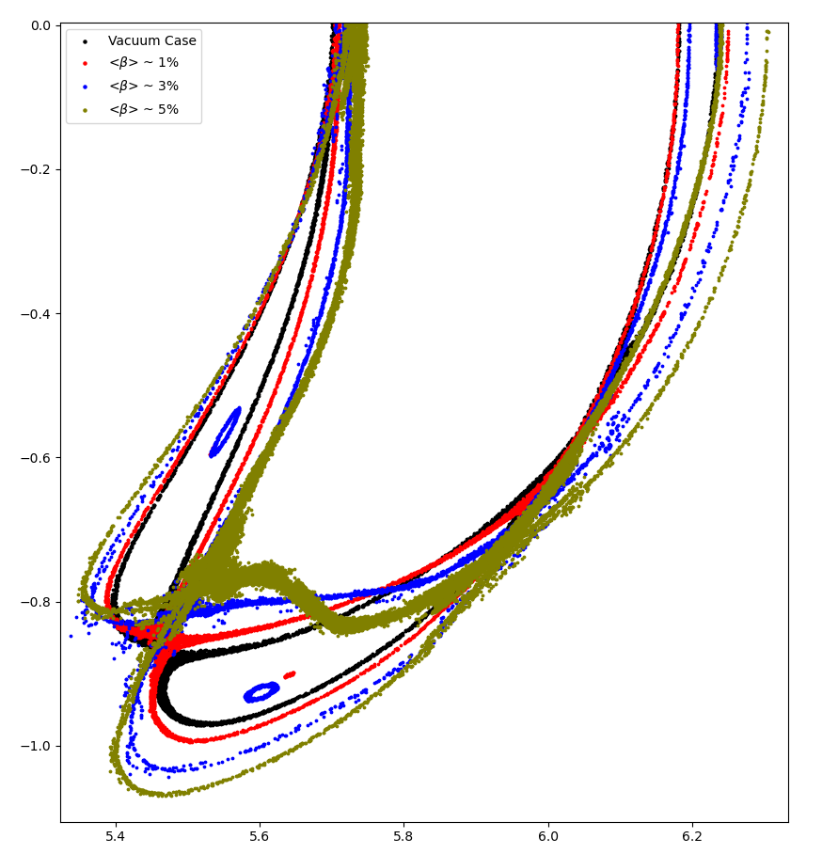
High Mirror. – High QII Surface
Bounding surface for target magnetic configurations

Slide 11
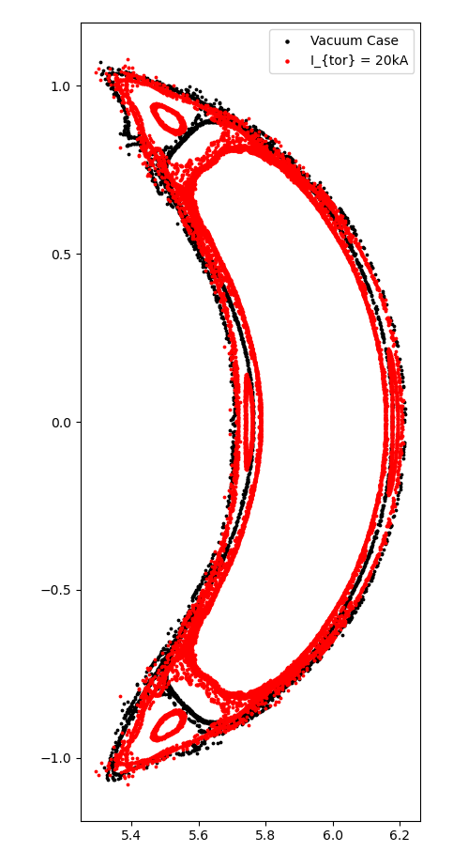
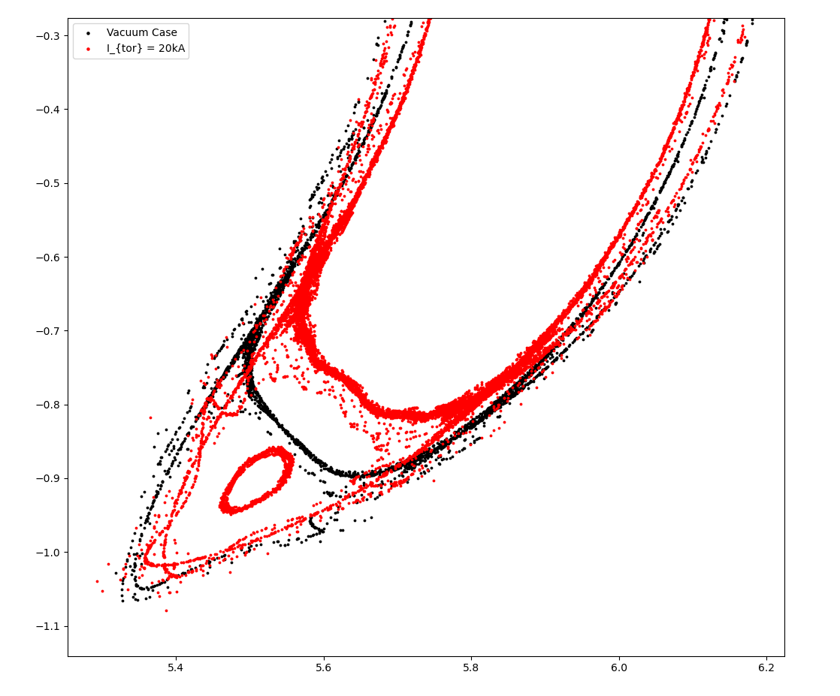
High Iota Config. – High QII Surface
Bounding surface for target magnetic configurations

Slide 12
Thank you

