Slide 1
TM5h1 limits in OP2
Joris Fellinger

Slide 2
Objective
Determination of limit loads of TM5h and TM6h
Keep T_{CuCrZr} below 500 °C
Keep cyclic strain range in cooling pipe below 0.27 %
Approach
Thermal-mechanical FEM Model of TM5h
Iterate steady state limit loads until both acceptance criteria are fulfilled
Determine cyclic strain range by appling multiple cycles until plastic strain range is stable
Verify allowed pulse duration for higher heat loads
Estimate pulse duration as time to reach pipe temperature of steady state limit load
Confirm stabilized strain range fulfills acceptance criterion for this pulse duration

Slide 3
Modelling
Merging pipes to heat sink with extra layer braze to obtain continuous mesh
Mesh refinement towards end of braze, 1 element over pipe thickness

Slide 4
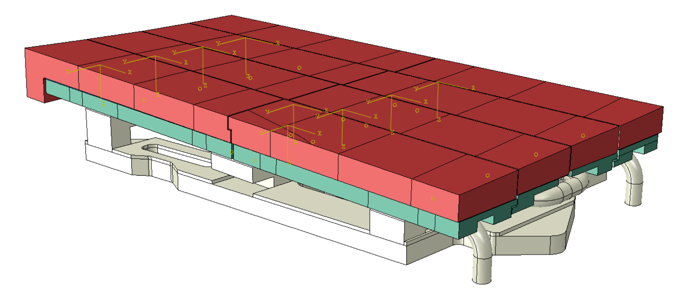
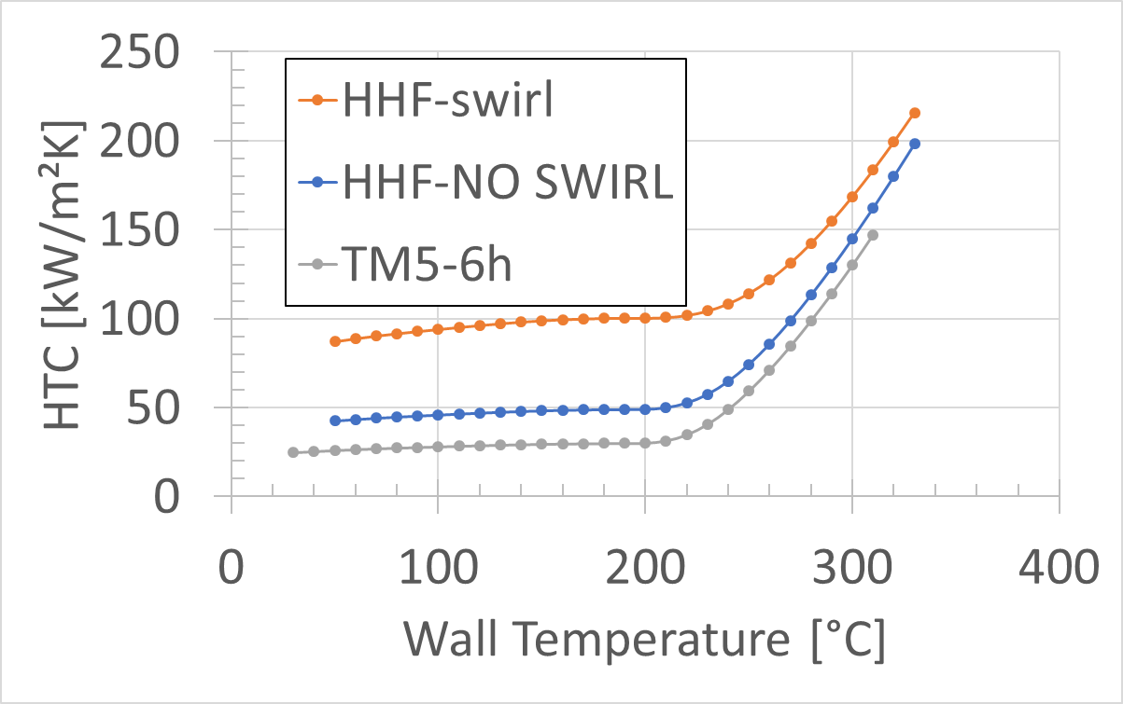
Thermal model
Thermal model (linear elements)
Thermal conductance between heat sink and supports: 1 kW/m²K
Cooling water heat transfer coefficient for TM5-6h to water of 25 °C
25-30 kW/m²K between 20 and 200°C
Radiation from graphite to the environment of 25 °C
Heat load:
100 kW/m² over whole plasma facing surface
+ X MW/m² strike line load in 7 regions

Slide 5
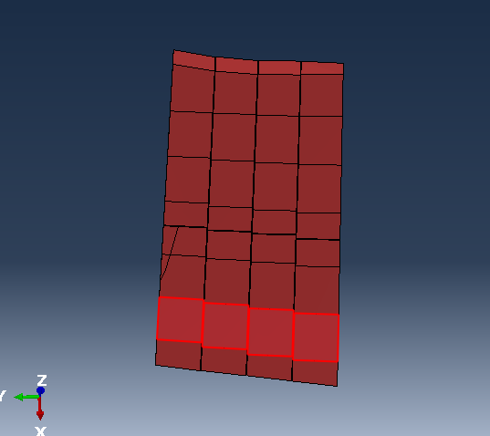
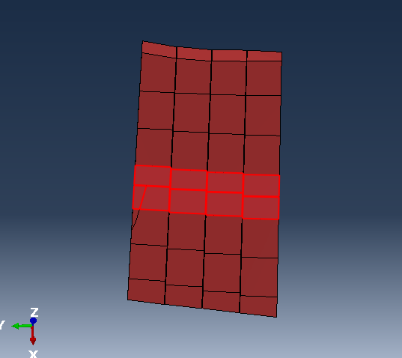
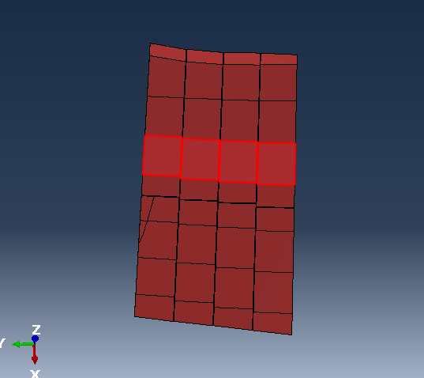
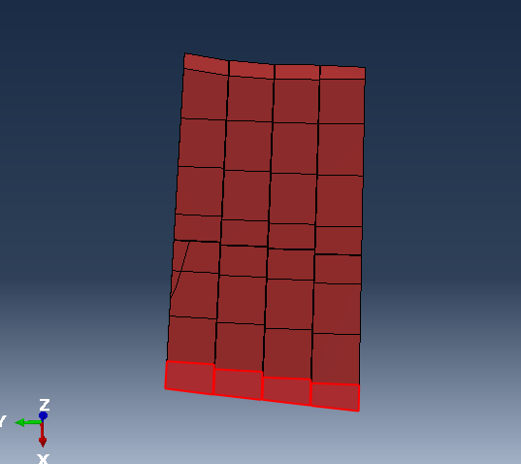
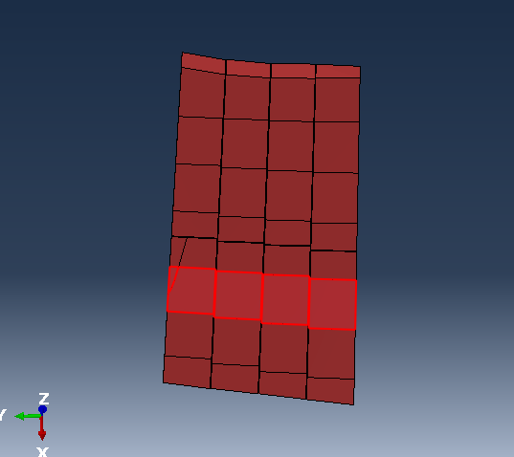
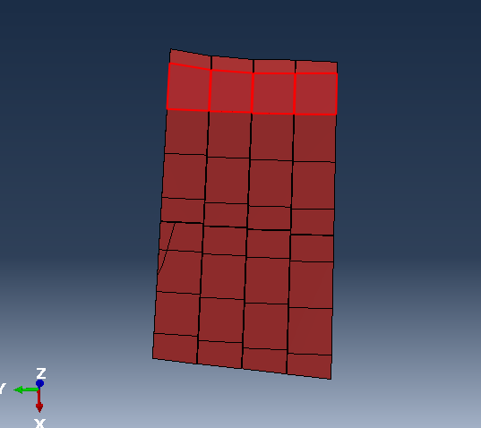
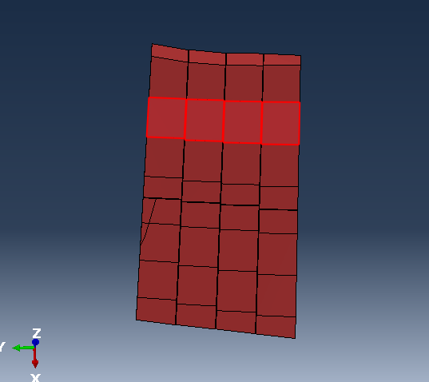
Assumed heat load regions
7 cases: 100 kW/m² radiation on all plasma exposed surfaces + X MW/m² in one of seven strike line regions
Radiation: 100 kW/m²
Strike line region 2a: X MW/m²
Strike line region 3: X MW/m²
Strike line region 4a: X MW/m²
Strike line region 1: X MW/m²
Strike line region 2b: X MW/m²
Strike line region 5: X MW/m²
Strike line region 4b: X MW/m²

Slide 6
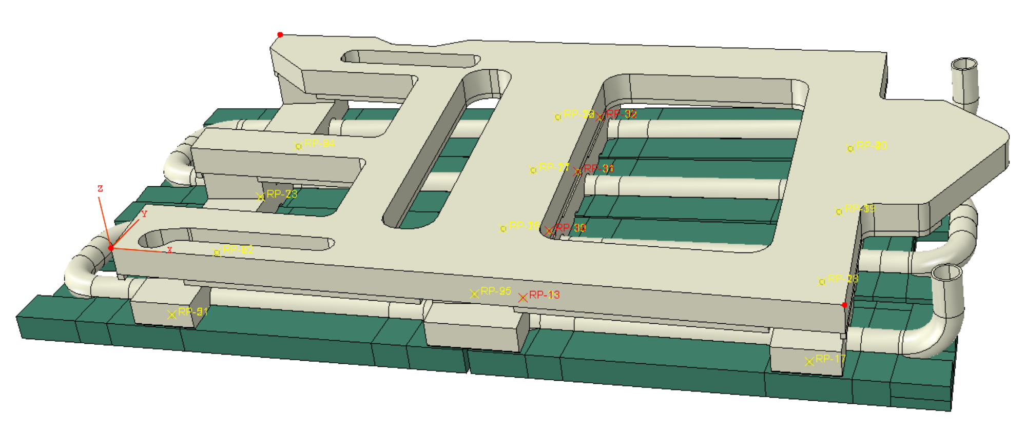
Mechanical model
Mechanical model (quadratic elements, mesh identical to thermal model)
Graphite and sigraflex excluded
Bolt modelling between heat sink and support bars
Removing bolts and holes to reduce number of elements
Adding 2 reference points at intersection of axis bolt with contact surface of heat sink – support
Distributed coupling between point 1 and contact surface of support, influence radius 5 mm
Distributed coupling between point 2 and contact surface of heat sink, influence radius 5 mm
Adding equations between point 1 and 2 to make displacements and rotations equal
Displacement in bolt axis direction (local z) for all bolts
Displacement in support bar direction (local y) for all bolts / Alternatively release in y direction tested once
Displacement in pipe axis direction (local x) at 4 bolts of middle support only (red RPs)
Rotations about local x and y axis for all bolts, rotation about local z axis remains independent
Three point support of base plate (no restraint forces)
ux₁ = uy₁ = uz₁ = 0
uy₂ = uz₂ = 0
uz₃ = 0
3
1
2

Slide 7
Material properties
 | Density [kg/m³] | Thermal conductivity |  |  |  |  |  | Specific heat |  |  |  | Thermal expansion |  | Young‘s modulus
 |  | Temp. [°C] |  |  | [W/mK] |  |  | Temp. [°C] |  | [J/kgK] |  | Temp. [°C] | [µm/mK] | Temp. [°C] | [GPa]
Graphite | 1793 | 30. 100. 200. 300. 400. 500. 600. 700. 800. | 900. 1000. 1100. 1200. 1300. 1400. 1500. 1600. |  | 128. 144. 121. 110. 94. 88.4 81.0 73.9 69.8 |  | 63.3 59.6 54.9 51.8 49.2 46.6 44.7 42.8 | 30. 100. 200. 300. 400. 500. 600. 700. 800. | 900. 1000. 1100. 1200. 1300. 1400. 1500. 1600. | 552. 834. 954. 1140. 1270. 1430. 1510. 1590. 1680. | 1720. 1760. 1790. 1820. 1840. 1870. 1900. 1940.
CuCrZr | 8900 | 20. 50. 100. 150. 200. 250. 300. 350. 400. 450. 500. |  |  | 318 324 333 339 343 345 346 347 347 346 346 |  |  | 20. 100. 200. 300. 400. 500. 600. 700. |  | 390 398 407 417 427 437 447 458 |  | 20. 100. 200. 300. 400. 500. 600. | 16.7 17.3 17.7 18.0 18.1 18.5 18.6 | 20. 100. 200. 300. 400. 500. 600. 700. | 127 127 123 118 113 106 95 86
EN1.4404 | 7960 | 20 400 |  |  | 15 21 |  |  | 20 400 |  | 472. 520. |  | 20. 100. 200. 300. 400. 500. 600. 700. | 15.9 16.3 16.8 17.3 17.8 18.3 18.8 19.4 | 20. 100. 200. 300. 500. | 158.00 152.70 146.15 139.04 133.51
Sigraflex | 1900 | // x |  | // y |  | ┴ z |  |  |  | 500
 |  | 100 |  | 100 |  | 2

Slide 8
Cyclic plastic properties: Chaboche model
 | Datatype | # back-stresses | Temp. [°C] | Yield stress f_{y} [MPa] |  | Kinematic hardening parameter C₁ [GPa] |  | Kinematic hardening parameter γ₁ [MPa] |  | Kinematic hardening parameter C₂ [GPa] |  |  | Kinematic hardening parameter γ₂ [MPa] |  | Kinematic hardening parameter C₃ [GPa] |  | Kinematic hardening parameter γ₃ [MPa]
EN 1.4404 [1] | Parameters | 3 | 20 100 200 300 500 | 208 204 203 94 87 |  | 22.6 5.2 9.6 40.0 18.5 |  | 562 1032 1 4750 1180 |  | 10.7 24.1 17.5 19.0 18.5 |  |  | 45 208 140 192 190 |  | 11.7 13.1 18.0 10.3 10.6 |  | 54 1 695 16 1
 |  |  | Temp. [°C] | Stabilized plastic strain [%]
 |  |  |  | 0 | 0.1 |  | 0.2 |  | 0.3 |  | 0.4 | 0.5 |  | 0.6 |  | 0.7 |  | 0.8
CuCrZr [2] | Stabilized | 1 | 20 350 500 | 261 281 215 | 343 295 225 |  | 381 301 233 |  | 397 305 236 |  | 407 307 241 | 415 309 |  | 422 311 |  | 430 312 |  | 435
[1] Gianella, Procedia Structural Integrity 8 (2018), 318–331
[2] ITER-SDC-IV V3, Appendix A.S31.5.8

Slide 9
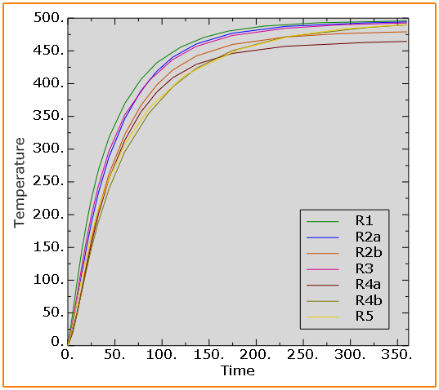
Strike line heat flux limit based on T_{CuCrZr} < 500°C
Assuming 100 kW/m² on all exposed graphite surfaces
Corresponding maximum temperatures in graphite and stainless steel pipe
T_{CuCrZr} = 500 °C | R1 | R2a | R2b | R3 | R4a | R4b | R5
q_{limit} [MW/m²] | 1.5 | 1.9 | 2 | 1.5 | 2 | 1.6 | 0.75
T_{graphite} [°C] | 1294 | 1468 | 1511 | 1383 | 1478 | 1241 | 1152
T_{pipe} [°C] | 337 | 367 | 374 | 337 | 366 | 345 | 289

Slide 10
Graphite temperature
Radiation only
100 kW/m² + 2 MW/m² @2a
100 kW/m² + 2 MW/m² @3
100 kW/m² + 2 MW/m² @4a
100 kW/m² + 2 MW/m² @1
100 kW/m² + 2 MW/m² @2b
100 kW/m² + 2 MW/m² @5
100 kW/m² + 2 MW/m² @4b

Slide 11
Heat loads up to T_{CuCrZr} = 500 °C
Radiation only
100 kW/m² + 1.9 MW/m² @2a
100 kW/m² + 1.5 MW/m² @3
100 kW/m² + 2 MW/m² @4a
100 kW/m² + 1.5 MW/m² @1
100 kW/m² + 2 MW/m² @2b
100 kW/m² + 0.8 MW/m² @5
100 kW/m² + 1.6 MW/m² @4b

Slide 12
Cyclic strain limit for stainless steel pipes
Expected W7-X cycles:
15 years x 40 experimental days x 100 programs = 60000 cycles
Conservative as strike line is not always on same position)
Fatigue curves from RCC-MR (2002)
Based on cyclic tensile tests with uniform strain over the cross section ➔ FEM strains averaged over pipe thickness (1 element)
Δɛ calculated acc. RB3227 from local FEM peak result
4 locations of max: ɛ_{total,principle}, ɛ_{plastc,principle}, ɛ_{tplastic,eq}, ɛ_{plastic,magn}
mechanical strain components ε_{M,ij}= ε_{Total,ij –} ε_{Thermal,ij}
strain component increments t_{n} - t_{n-1}: dε_{M,ij}= ε_{M,ij,n -} ε_{M,ij,n-1}
Equivalent strain range
Criterion:
EN1.4404 ➔ property group 3S (Tech. Annex A3)
Strain range Δɛ < 0.27 % (Fig. A3.S3542)

Slide 13
Example of mechanical strain history of element with max. principle plastic strain
Strain increment stable within 0.02% from 2nd loading step onwards ➔ to be used further on

Slide 14
Comparison strain extraction locations
Example case of 2 MW/m² on R2b for 29s over 2 cycles
Average strain components over pipe element
Strain components extracted at each integration point
Integration point range 0.5-1.7 x centroid value < safety margin on LCF curve
 | Centroid | IP1 | IP2 | IP3 | IP4 | IP5 | IP6 | IP7 | IP8
Δε [%] | 0.20 | 0.23 | 0.15 | 0.33 | 0.18 | 0.28 | 0.13 | 0.34 | 0.10

Slide 15
Strike line heat flux limit based on Δε_{EN1.4404} < 0.27%
Analyses up to steady state |  | R1 | R2a | R2b | R3 | R4a | R4b | R5
q_{limit} [MW/m²] @Δε = 0.27% |  | 0.5 | 0.5 | 0.6 | 0.6 | 1.0 | 0.5 | 0.3
T_{pipe,max} @qlimit |  | 168 | 173 | 192 | 196 | 251 | 197 | 192
Δε @ q = 0.5 MW/m² |  | 0.23 | 0.27 | 0.23 | 0.21 | 0.13 | 0.27 | 0.31
Δε @ q = 1.0 MW/m² | Y fixed |  | 0.45 | 0.44 |  | 0.23
 | Y released |  | 0.26
Δε @ q = 1.5 MW/m² |  |  | 0.60 | 0.63 | 0.64
Allowed heat loads limited rather by strains in the pipe than by temperature of CuCrZr
As for baffles, allowing sliding in y-direction of the bolts would reduced significantly pipe strains

Slide 16
Pulse duration limit for q > q_{limit} based onT_{pipe} = T_{max} @q_{limit}
Time [s] | R1 |  |  | R2a |  |  | R2b |  |  | R3 |  |  | R4a |  |  | R4b |  |  | R5
T_{limit} [°C] | 168 |  |  | 173 |  |  | 192 |  |  | 196 |  |  | 251 |  |  | 197 |  |  | 192
 | t₁ | T_{1max} | t₂ | t₁ | T_{1max} | t₂ | t₁ | T_{1max} | t₂ | t₁ | T_{1max} | t₂ | t₁ | T_{1max} | t₂ | t₁ | T_{1max} | t₂ | t₁ | T_{1max} | t₂
0.5 MW/m² |  |  |  |  |  |  |  |  |  |  |  |  |  |  |  |  |  |  | 110 | 240 | 89
1.0 MW/m² | 48 | 170 | 40 | 56 | 176 | 47 | 74 | 196 | 63 | 67 | 199 | 57 |  |  |  | 79 | 200 | 68 | 75 | 241 | 46
1.5 MW/m² | 32 | 176 | 26 | 38 | 185 | 30 | 47 | 202 | 38 | 41 | 204 | 34 | 84 | 254 | 75 | 52 | 205 | 43 | 50 | 251 | 28
2 MW/m² | 25 | 180 | 20 | 31 | 195 | 23 | 37 | 211 | 29 | 31 | 206 | 25 | 58 | 259 | 50 | 41 | 212 | 33 | 39 | 256 | 21
3 MW/m² | 19 | 196 | 13 | 24 | 210 | 15 | 28 | 205 | 22 | 23 | 223 | 17 | 40 | 274 | 32 | 31 | 226 | 22 | 30 | 279 | 13
5 MW/m² | 14 | 211 | 8 | 19 | 222 | 11 | 21 | 236 | 13 | 17 | 244 | 11 | 29 | 262 | 23 | 23 | 239 | 15 | 22 | 320 | 5
1st iteration: t₁ = intersection of T-t curve at T_{limit} for pulse duration of 360 s (excludes overshoot)
2nd iteration: t₂ = t₁ - (T_{1max}-T_{limit})/((T_{limit}-T₀)/t₁)

Slide 17
Confirmation of temperature and strain ranges for short pulses
Load | R1 |  |  |  | R2a |  |  |  | R2b |  |  |  | R3 |  |  |  | R4a |  |  |  | R4b |  |  |  | R5
T_{limit} [°C] | 168 |  |  |  | 173 |  |  |  | 192 |  |  |  | 196 |  |  |  | 251 |  |  |  | 197 |  |  |  | 192
MW/m² | t_{pulse} | T_{pipe} | T_{sink} | Δε | t_{pulse} | T_{pipe} | T_{sink} | Δε | t_{pulse} | T_{pipe} | T_{sink} | Δε | t_{pulse} | T_{pipe} | T_{sink} | Δε | t_{pulse} | T_{pipe} | T_{sink} | Δε | t_{pulse} | T_{pipe} | T_{sink} | Δε | t_{pulse} | T_{pipe} | T_{sink} | Δε
0.5 |  |  |  |  |  |  |  |  |  |  |  |  |  |  |  |  |  |  |  |  |  |  |  |  | 89 | 183 | 299 | 0.21
1 | 40 | 161 | 240 | 0.19 | 47 | 167 | 220 | 0.22 | 63 | 187 | 233 | 0.19 | 57 | 190 | 269 | 0.20 | 68 |  |  | 0.24 | 68 | 192 | 261 | 0.24 | 46 | 197 | 329 | 0.22
1.5 | 26 | 164 | 250 | 0.19 | 30 | 168 | 220 | 0.22 | 38 | 186 | 230 | 0.19 | 34 | 191 | 272 | 0.20 | 75 48* | 248 | 308 | 0.42 0.29 | 43 | 191 | 253 | 0.24 | 28 | 185 | 316 | 0.20
2 | 20 | 167 | 260 | 0.19 | 23 | 170 | 223 | 0.23 | 29 | 189 | 213 | 0.20 | 25 | 190 | 274 | 0.20 | 50 32 | 249 | 307 | 0.42 0.28 | 33 | 194 | 252 | 0.25 | 21 | 184 | 313 | 0.20
3 | 13 | 158 | 255 | 0.19 | 15 | 148 | 214 | 0.22 | 22 | 185 | 231 | 0.22 | 17 | 193 | 280 | 0.21 | 32 20 | 252 | 287 | 0.42 0.26 | 22 | 181 | 224 | 0.25 | 13 | 170 | 293 | 0.18
5 | 8 | 155 | 253 | 0.17 | 11 | 162 | 204 | 0.25 | 13 | 182 | 225 | 0.21 | 11 | 198 | 287 | 0.21 | 23 13 | 261 | 321 | 0.47 0.26 | 15 | 194 | 239 | 0.26 | 5 | 118 | 196 | 0.11
* Pulse duration of 1.5 MW/m² needs further reduction to 43 s as for R4b

Slide 18
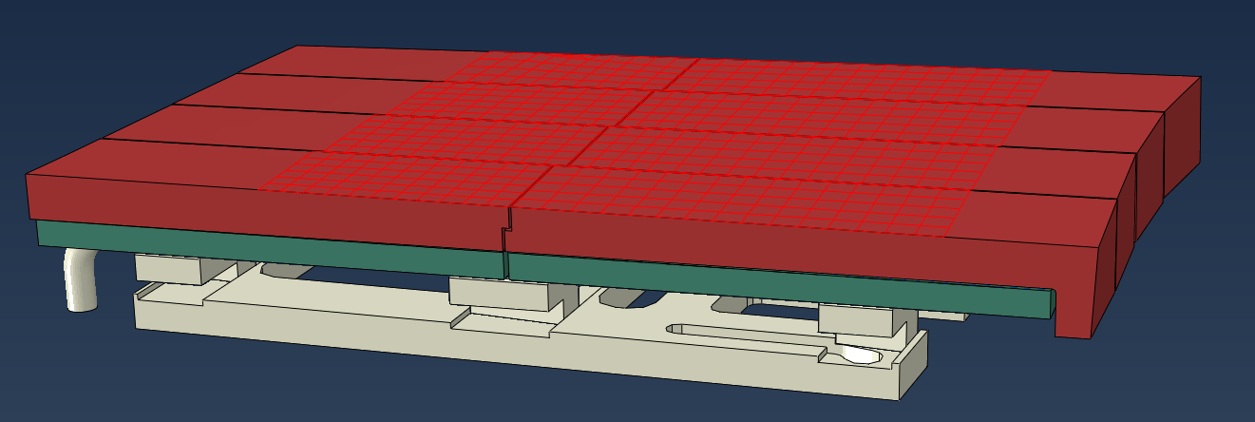
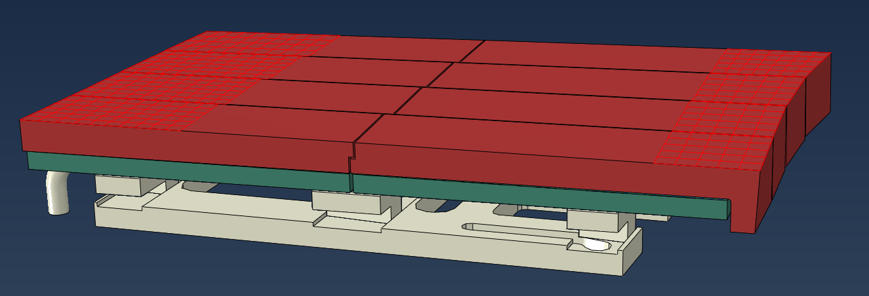
Final recommendations
 |  | R1 | R2a | R2b | R3 | R4a | R4b | R5
Steady state heat load [MW/m²] |  | 0.5 | 0.5 | 0.6 | 0.6 | 0.6 | 0.6 | 0.3
Allowed pulse duration [s] | 0.5 [MW/m²] |  |  |  |  |  |  | 90
 | 1.0 [MW/m²] | 47 | 47 | 68 | 68 | 68 | 68 | 47
 | 1.5 [MW/m²] | 30 | 30 | 43 | 43 | 43 | 43 | 30
 | 2.0 [MW/m²] | 23 | 23 | 30 | 30 | 30 | 30 | 23
 | 3.0 [MW/m²] | 15 | 15 | 22 | 22 | 22 | 22 | 15
 | 5.0 [MW/m²] | 11 | 11 | 15 | 15 | 15 | 15 | 11
Regions grouped into 2 groups
100 mm
60 mm

