Slide 1
Thermal results of TE 1S
Z. Wang for the WPDIV W7-X Team
DIV-W7X and JT60SA Final monitoring meeting - 28th of November 2022

Slide 2
Contents
Introduction
Typical temperature distribution – 10MW/m2
Parametric study summary
Allowable heat flux
Influence of the U-turn HTC
Conclusions

Slide 3
Introduction
According to existing analyses, the target element 1S can’t withstand a steady state 10MW/m² on both top and front surfaces. Therefore, a parametric study is performed to find the operational heat flux space.
Input parameters:
Heat flux on the top tile (close to the pumping gap), from 0.1MW/m² to 10MW/m²;
Heat flux on the front tile, from 0.1MW/m² to 10MW/m².
Output parameters:
Steady state temperature of W, Cu, CuCrZr and cooling pipe surface.
The HTC of the U-turn is 100k W/m²K. The water temperature is 25°C.
A uniform 10MW/m² heat flux is applied on other tiles.
Top tile
Front tile
L-tile
Two-tile

Slide 4
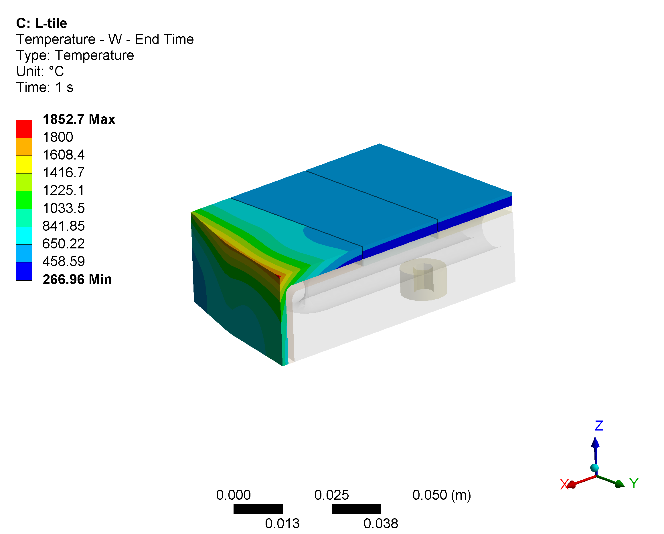
Temperature distribution – W tiles – 10MW/m²
Two-tile
L-tile
Red zone temperature exceeds allowable

Slide 5
Temperature distribution – Cu interlayer – 10MW/m²
Two-tile
L-tile
Red zone temperature exceeds allowable

Slide 6
Temperature distribution – CuCrZr sink – 10MW/m²
Two-tile
L-tile
Red zone temperature exceeds allowable

Slide 7
Temperature distribution – pipe surface – 10MW/m²
Two-tile
L-tile
Red zone temperature exceeds boiling point

Slide 8
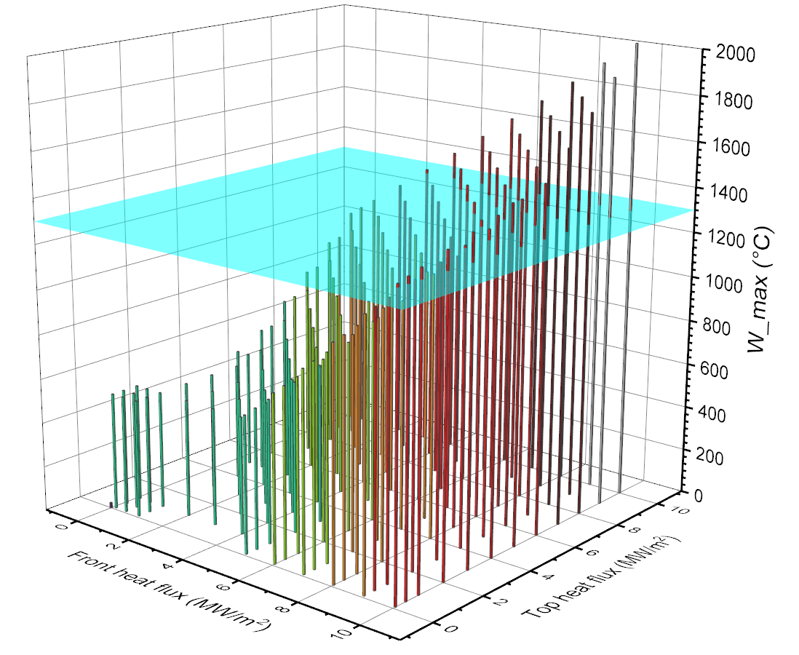
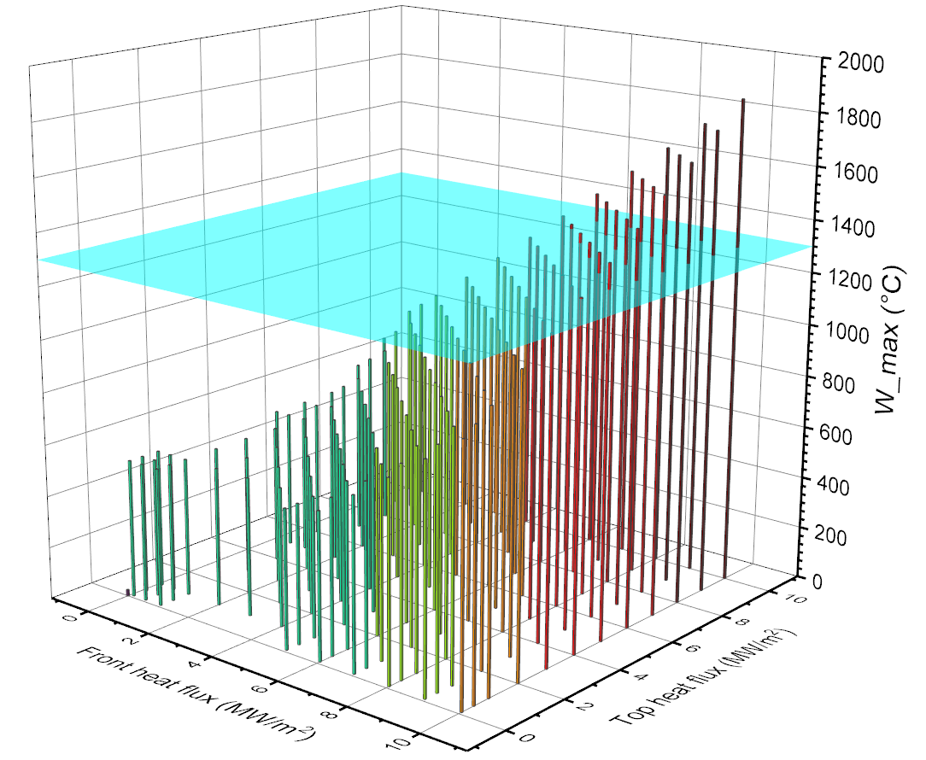
Parametric study summary – W tiles
Two-tile
L-tile
Blue surface indicates the allowable temperature of W (1300°C)

Slide 9
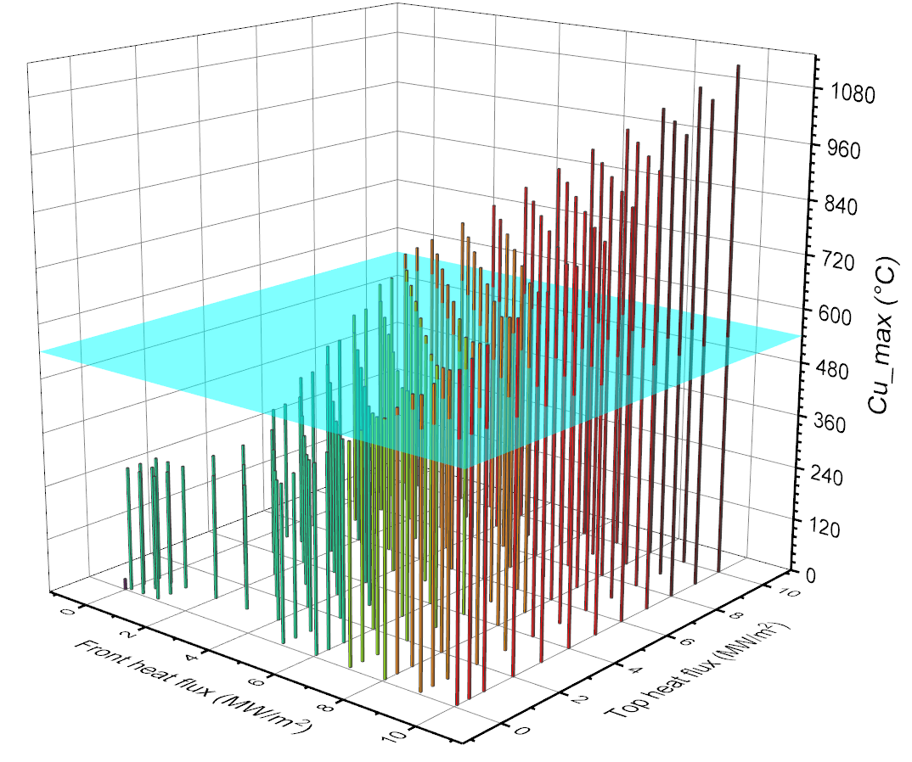
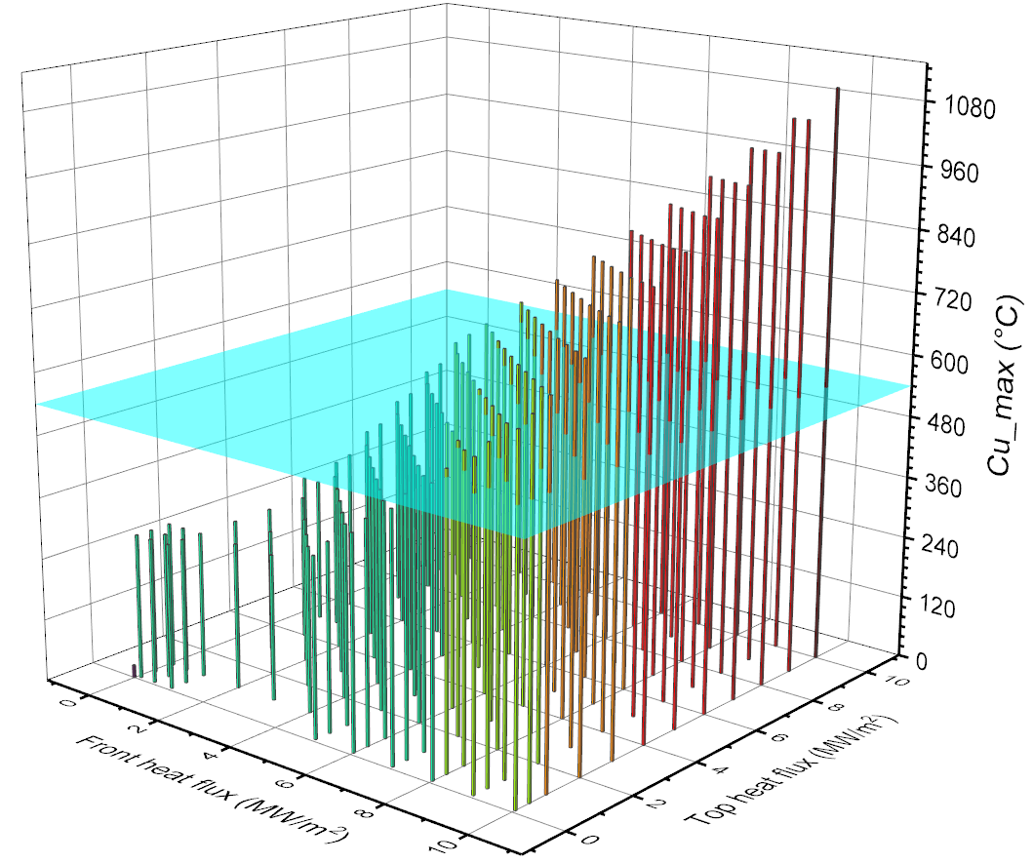
Parametric study summary – Cu interlayer
Two-tile
L-tile
Blue surface indicates the allowable temperature of Cu (540°C)

Slide 10
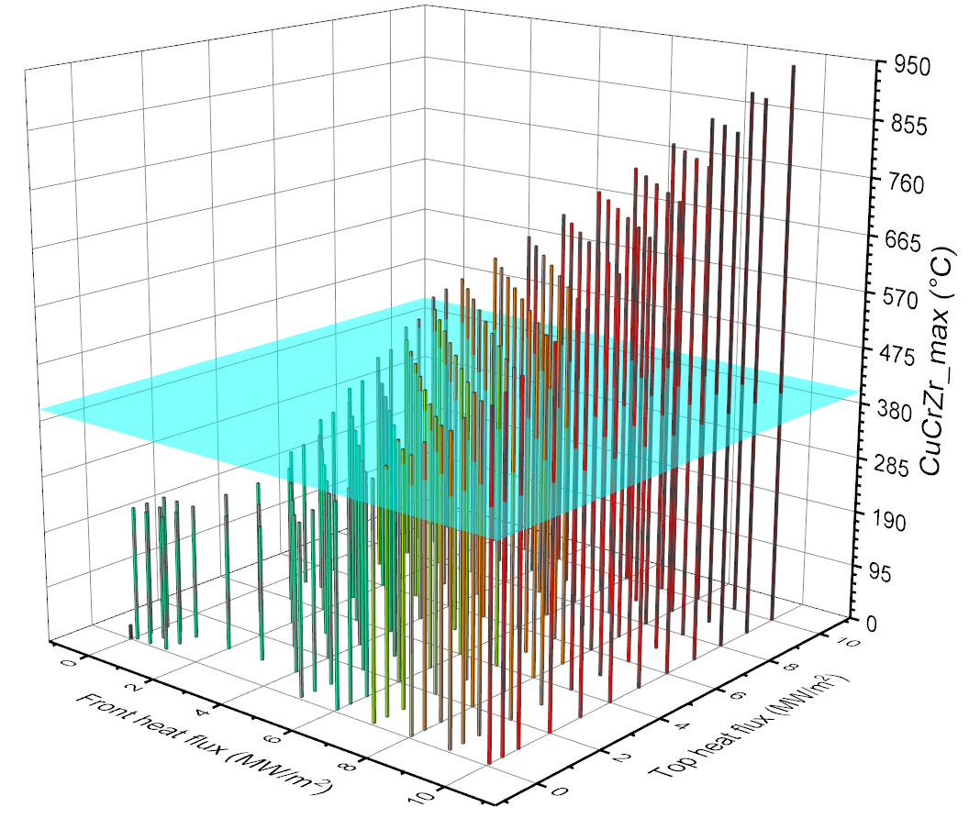
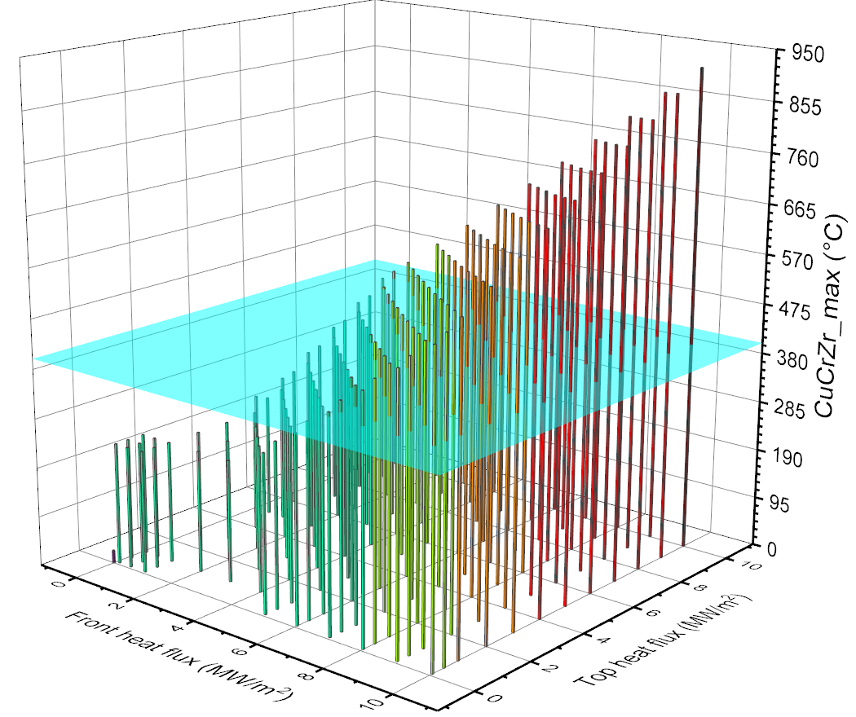
Parametric study summary – CuCrZr sink
Two-tile
L-tile
Blue surface indicates the allowable temperature of CuCrZr (400°C)

Slide 11
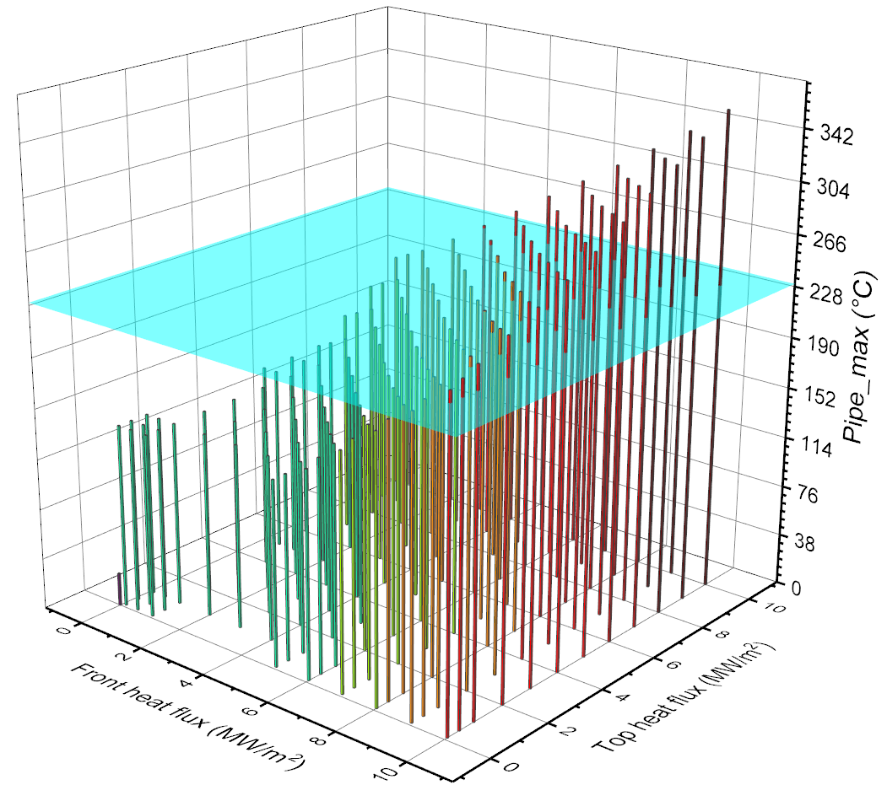
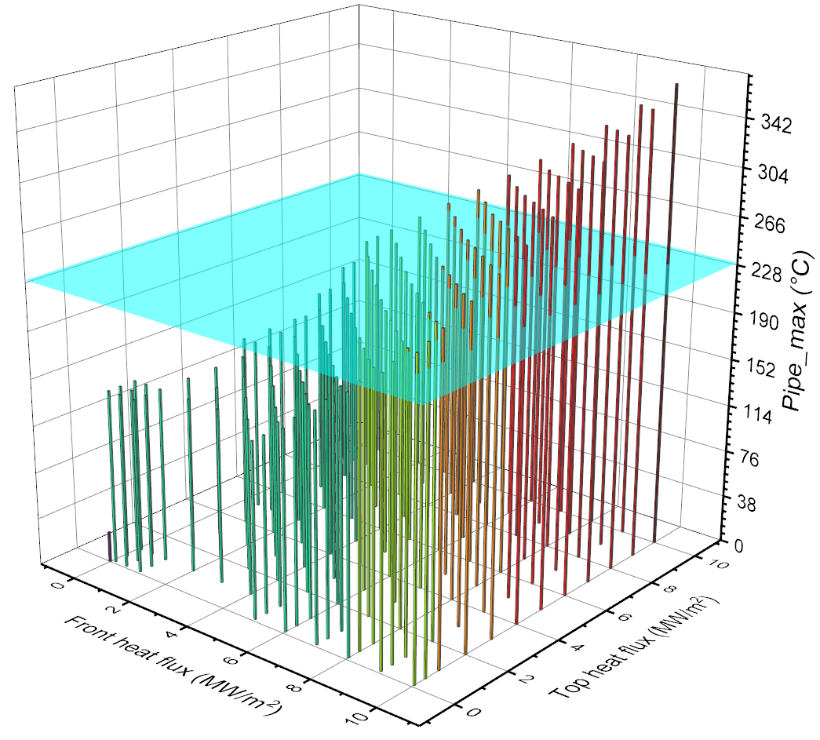
Parametric study summary – pipe surface
Two-tile
L-tile
Blue surface indicates the water boiling point (230°C)

Slide 12
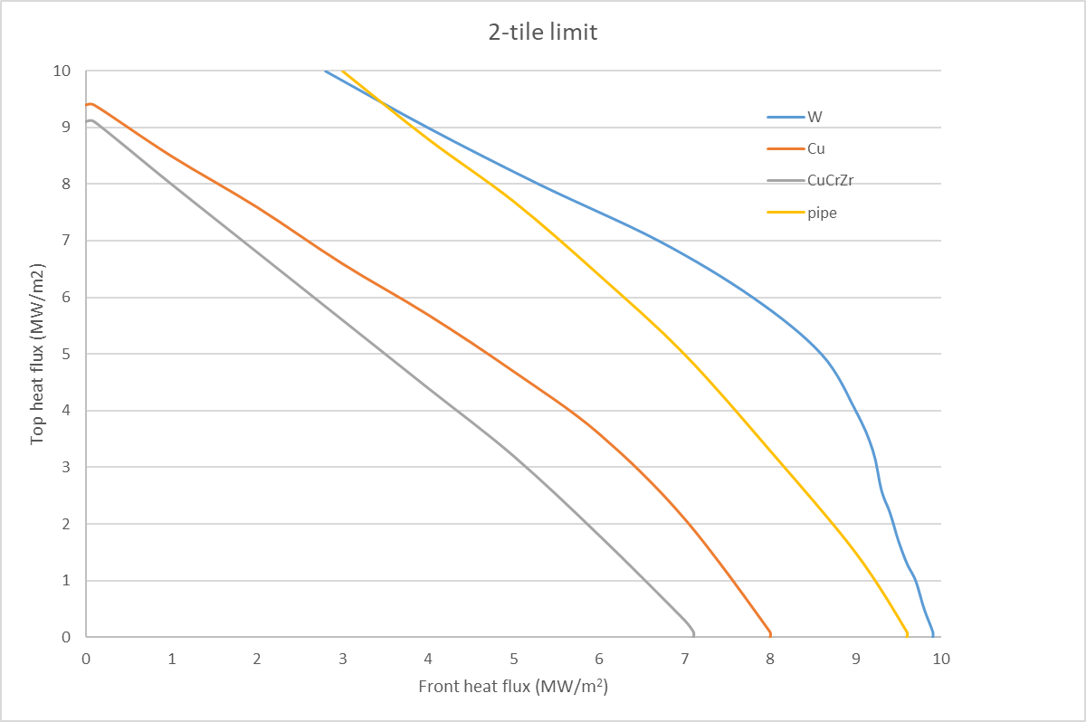
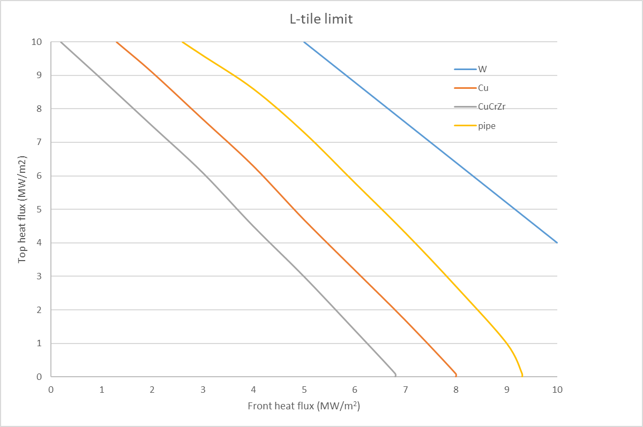
Allowable heat flux summary

Slide 13
Influence of the U-turn HTC
The convective heat transfer coefficient (HTC) in the cooling channel is important for the plasma facing component design. In present target element design, swirl tapes are employed in the straight section, however, the U-turn has no inserts and keeps a smooth circular surface.
The HTC with the swirl tapes is implemented according to the experiment data, but the literature formula for the U-turn could underestimate the HTC, because of the influence of the upstream swirl tapes. Therefore, a uniform HTC is applied on the U-turn surface.
Two U-turn HTCs (20k W/m²K and 100k W/m²K) are compared on the Two-tile model.
The U-turn has a big influence on the hot edge

Slide 14
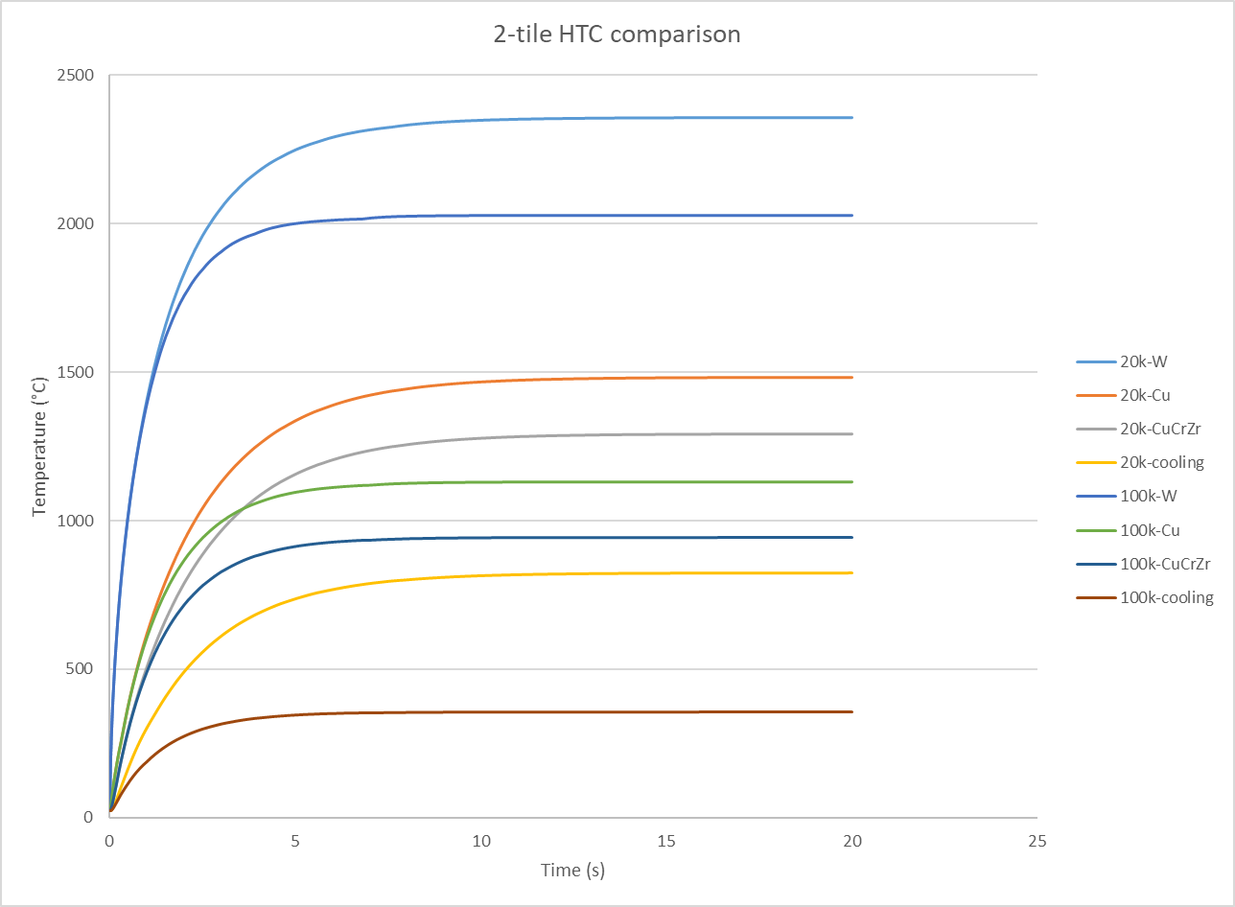
Steady state temperature comparison
Lower HTC = higher temperature, and the temperature difference under 10MW/m² is listed below.
W tiles: ∆T=330°C
Cu interlayer: ∆T=353°C
CuCrZr sink: ∆T=348°C
Cooling surface: ∆T=469°C
With a higher HTC, it takes shorter time to reach steady state.

Slide 15
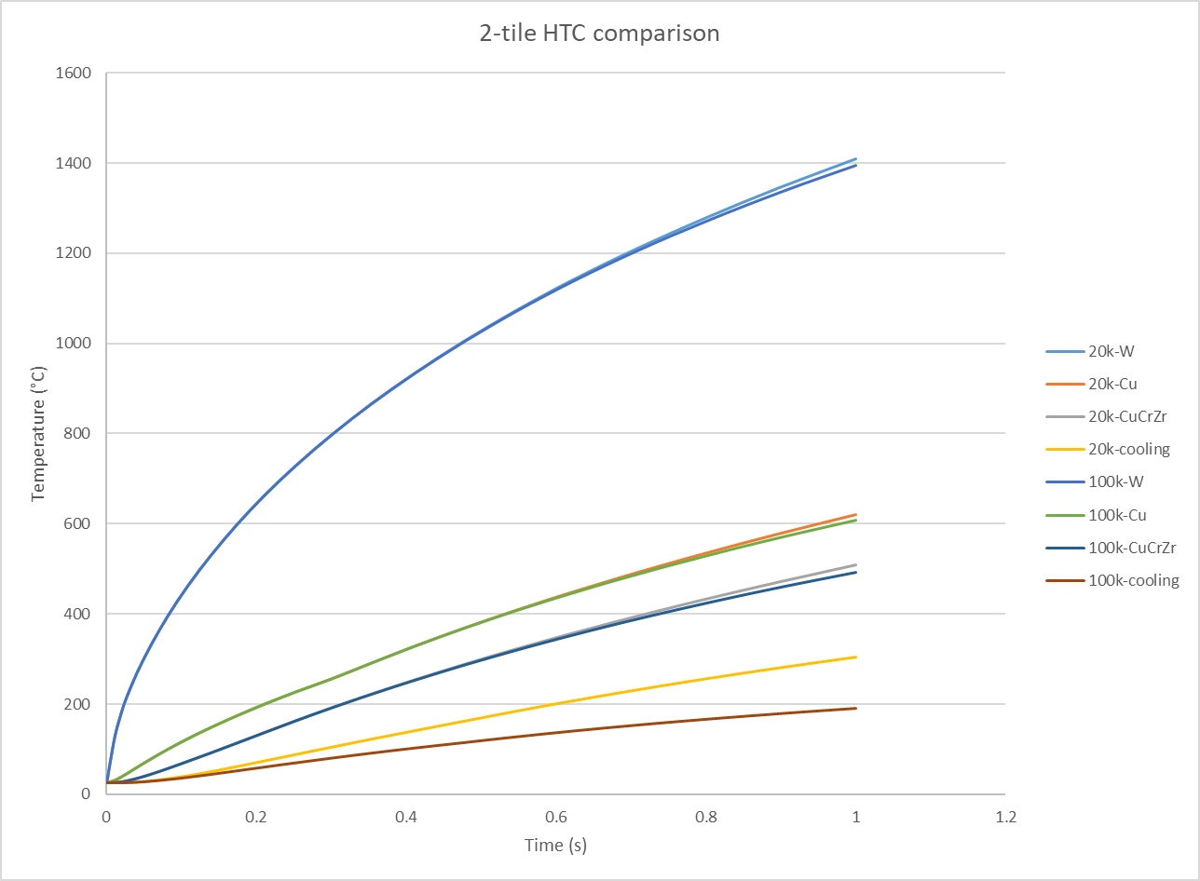
Heating up speed comparison
Due to the temperature limit of the CuCrZr (450°C), the heating time is set at 1s, and the temperature profile of the element is not affected by the HTC, except the cooling surface (∆T=114°C).

Slide 16
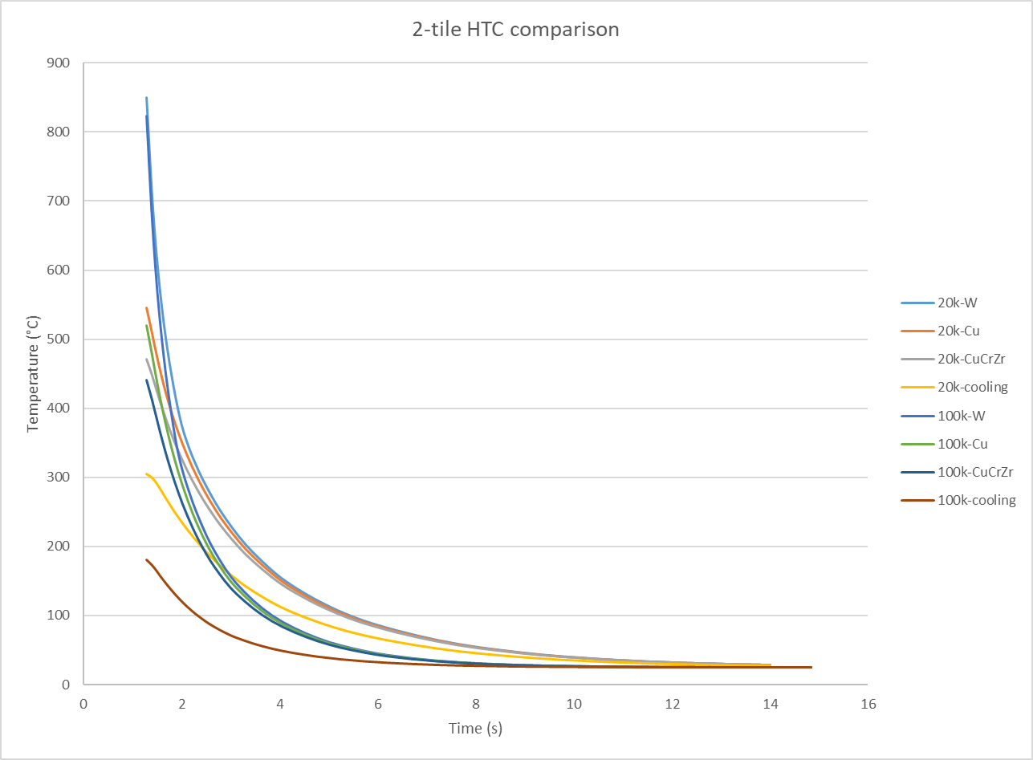
Cooling down speed comparison
Similar to the heating up process, the cooling down time of the solids is consistent, only the difference of the cooling surface temperature can be noticed.

Slide 17
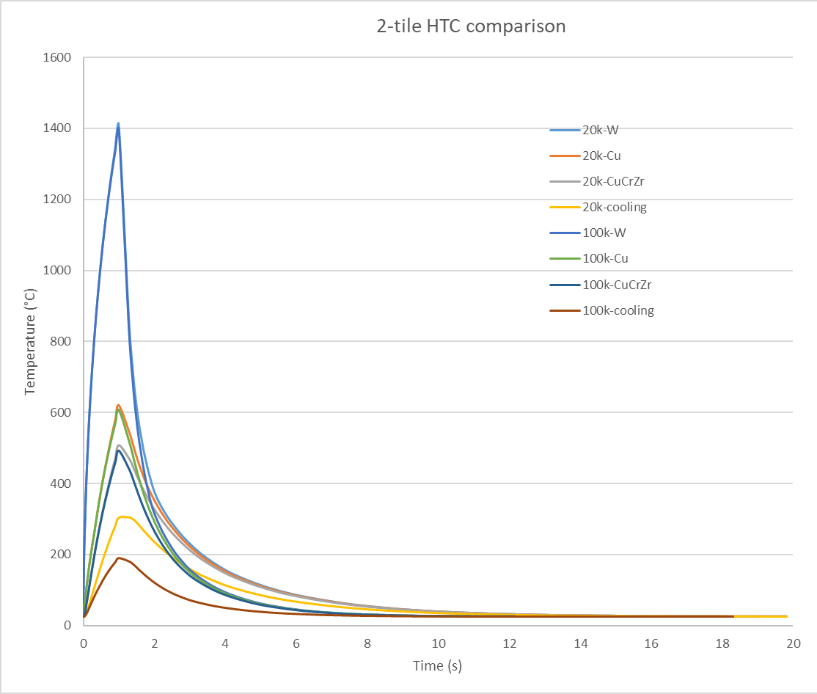
Thermal analysis results summary – Two-tile
Component | Case | Max. T (°C) – 20k W/m²K | Max. T (°C) – 100k W/m²K
W tile | Static | 2357 | 2027
 | Heating for 1s | 1409 | 1395
Cu interlayer | Static | 1482 | 1129
 | Heating for 1s | 621 | 608
CuCrZr sink | Static | 1292 | 944
 | Heating for 1s | 509 | 493
Cooling surface | Static | 825 | 356
 | Heating for 1s | 305 | 190
Temperature profile with 1s heating

Slide 18
Conclusions
A parametric study is performed to find the operational heat flux in the two-tile and L-tile design.
In both designs, the limiting issue is the CuCrZr temperature.
However, the allowable heat flux is calculated with a U-turn HTC assumption, which has a big influence because of the shortest distance to the hot edge.
Two HTCs are compared (20k W/m²K and 100k W/m²K) , the static temperature of all materials is lower with the higher HTC, the difference under 10MW/m² is ~350°C.
When limiting the heating time to 1s, the heating up and cooling down speed is not sensitive to the HTC, however, the cooling surface temperature has a bigger difference, which decides the hydraulic heat transfer status.
Therefore, the U-turn HTC requires more attention to decide the operation heat flux space.

