Slide 1
TM05h Thermo-Mechanical Analysis
Zhongwei Wang, May 2023

Slide 2
Location
TM5h-1

Slide 3
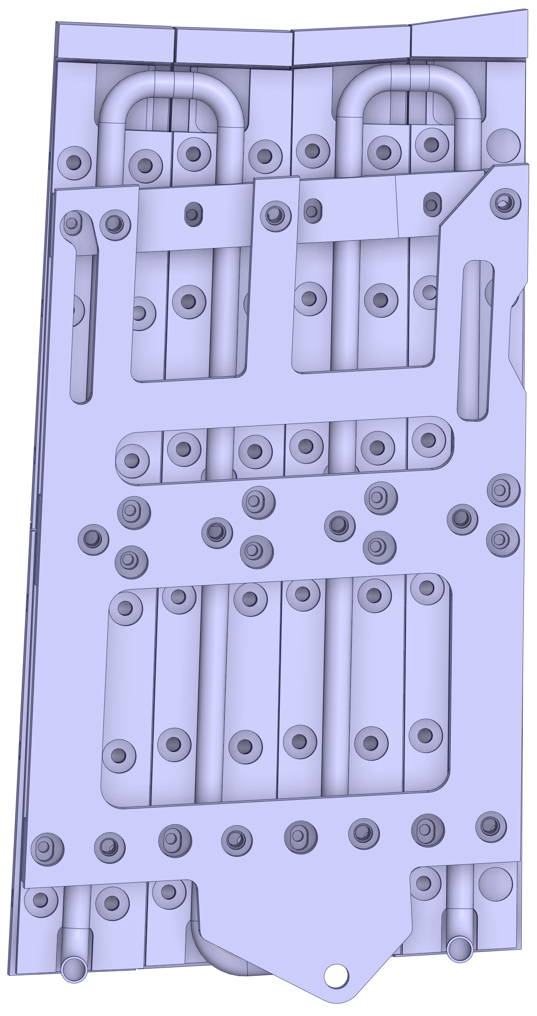
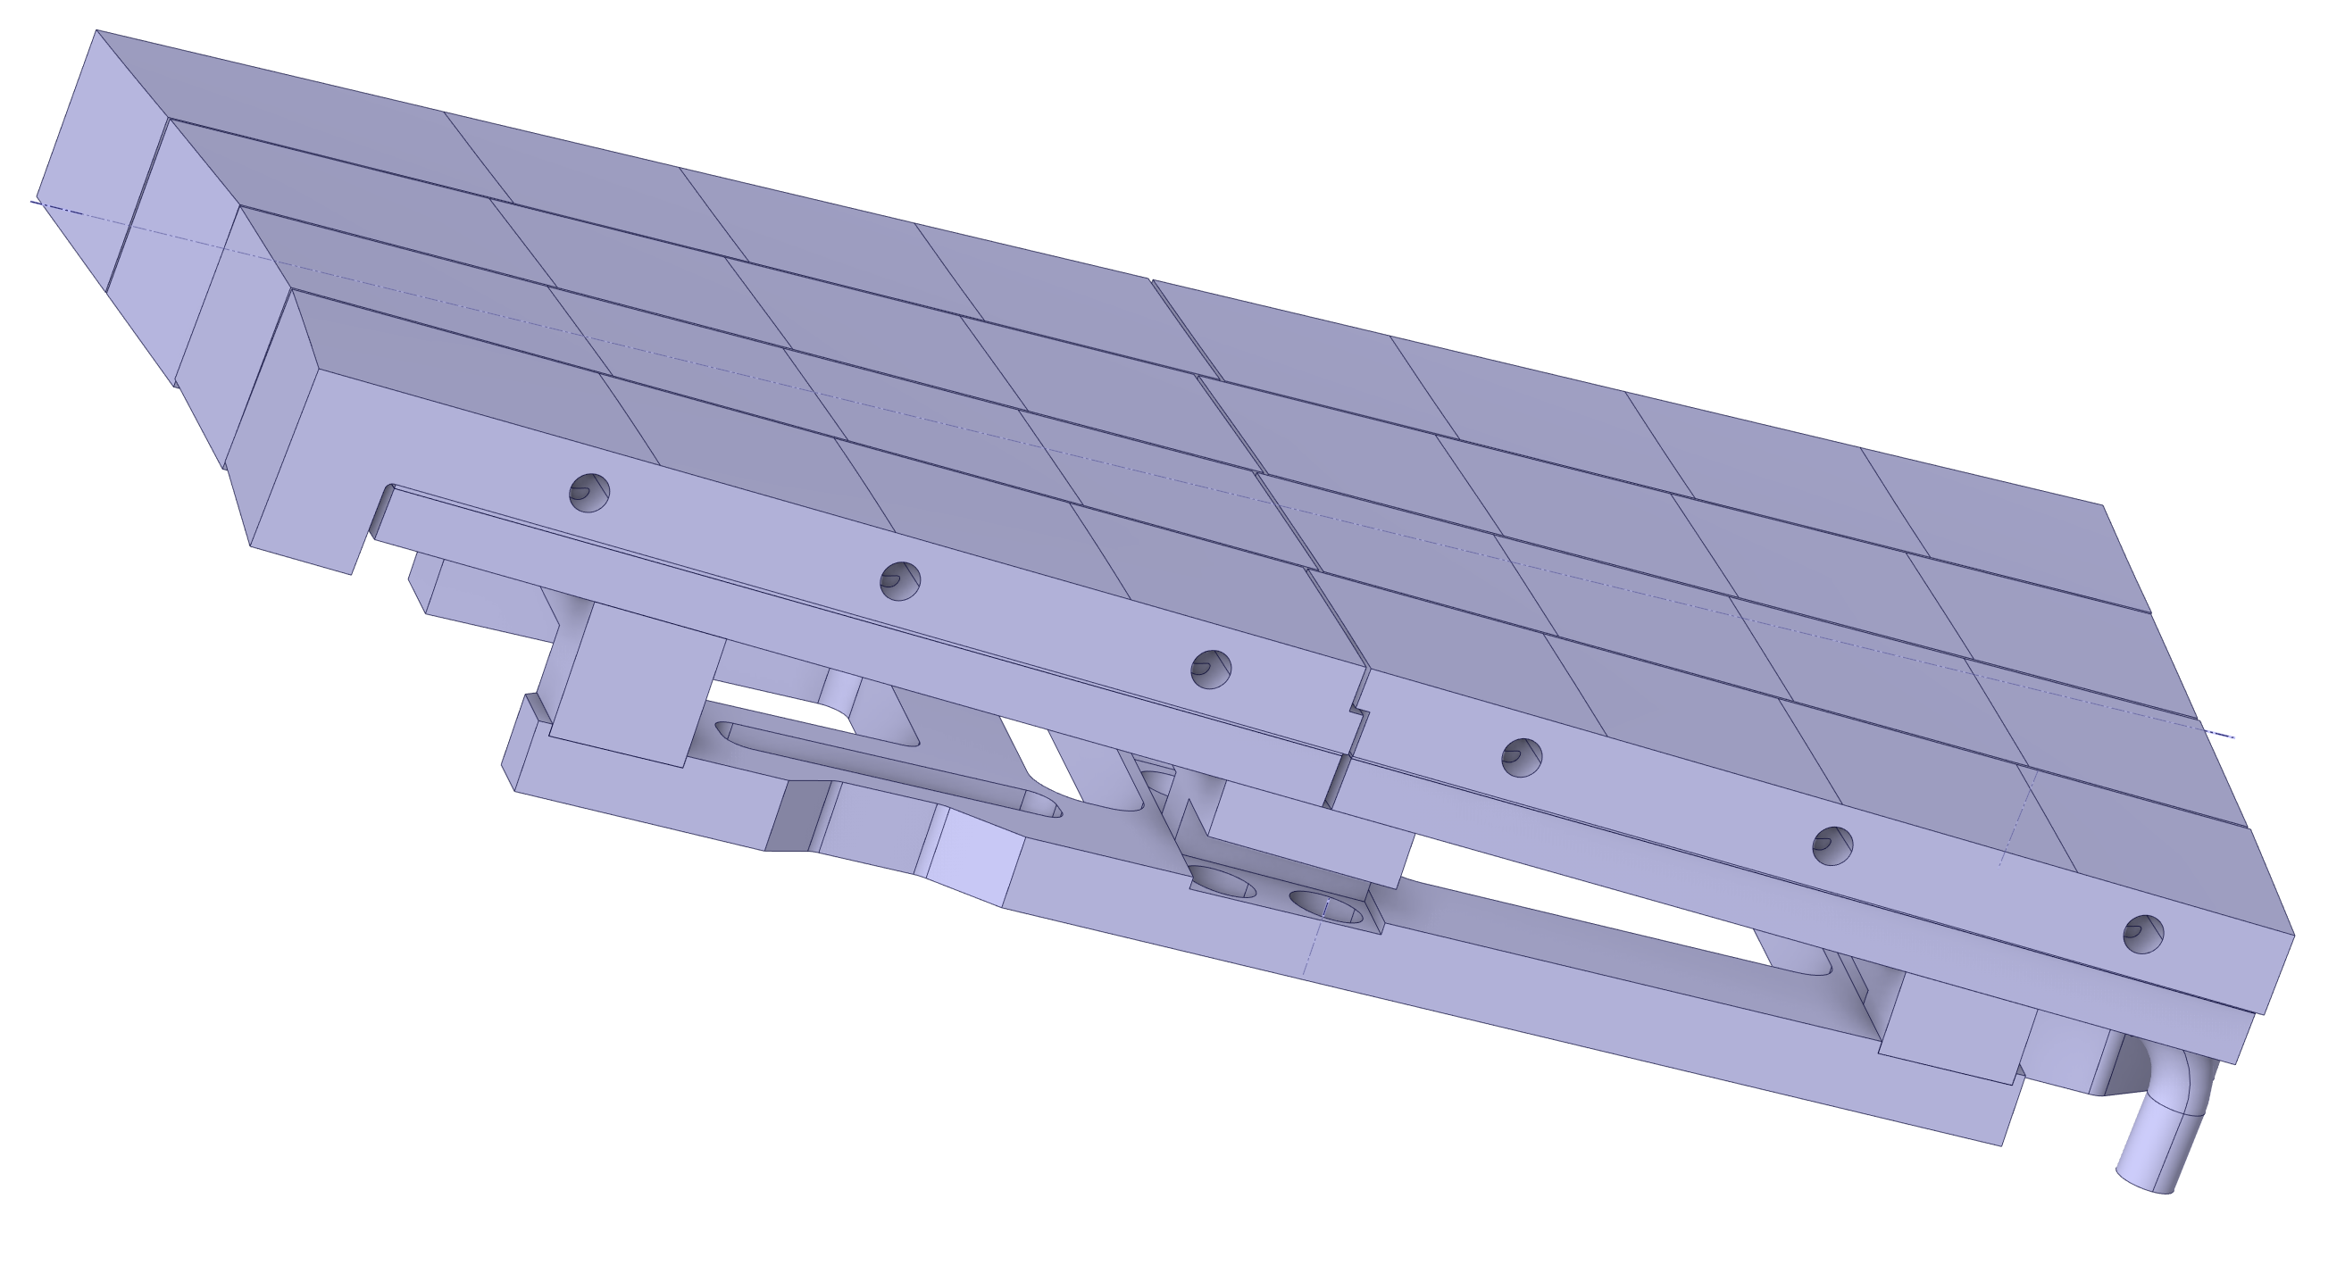
setup
TM05h has been identified as a region of interest as it is subjected to high fluxes from the plasma.
TM05h has similar traits to the baffle modules in its design, despite being a target module. As such it is also constrained by the same limitations imposed on the baffle modules, namely:
Maximum allowable temperatures of the heat sinks must not exceed 500°C
Maximum cyclic mechanical equivalent strain increment amplitude in the steel pipe < 0.2%
The graphite surface has been divided into 5 different regions where each region is loaded until a temperature of 500°C is reached in the Heat Sinks.
Region 5
Region 4
Region 3
Region 2
Region 1

Slide 4
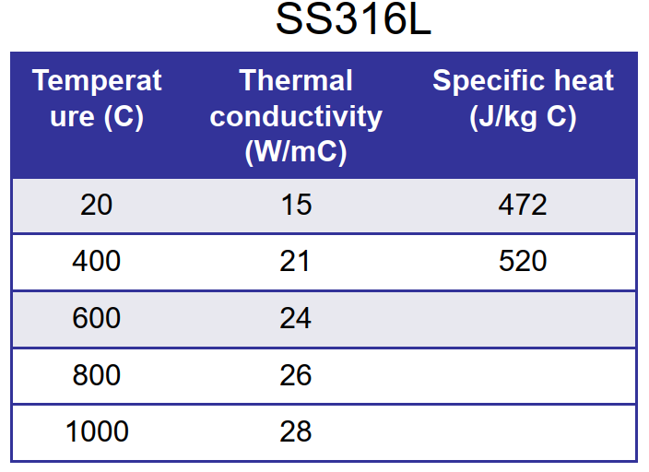
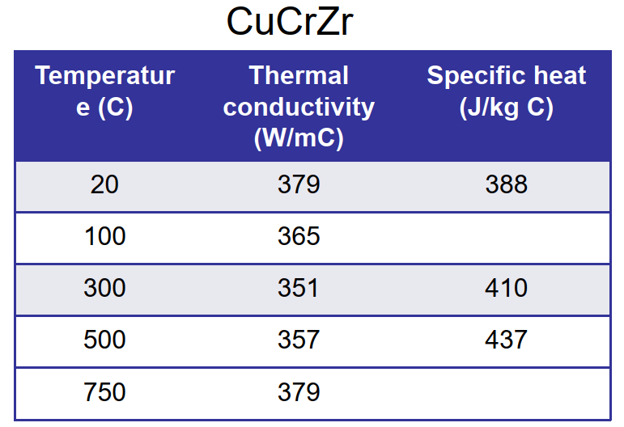
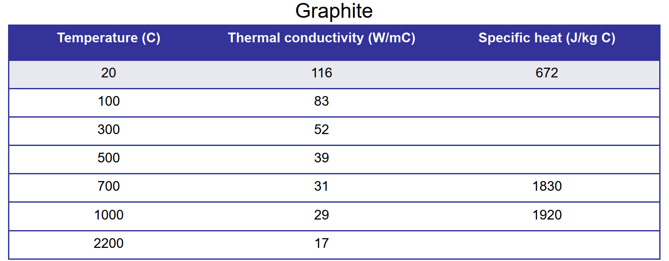
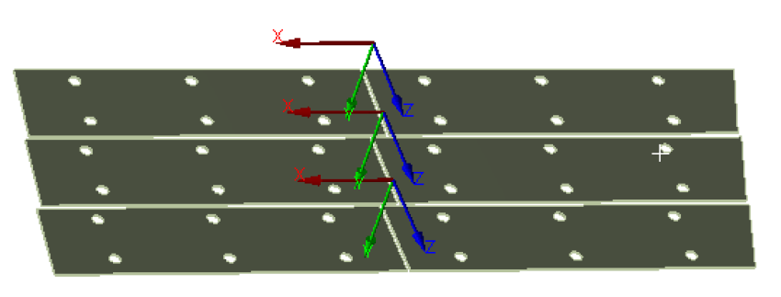
Material Thermal properties
Sigraflex has orthotropic thermal conductivity. Each finger has been oriented accordingly.

Slide 5
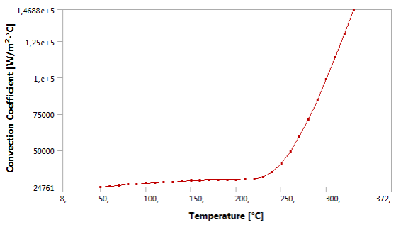
Steady State Thermal Boundary conditions and loads
Heat flux applied as per the relevant case.
Radiation from tiles to ambient. Emissivity = 0.82 (1-AC-S0014). Ambient set to 200°C.
Radiation from heat sinks to ambient. Emissivity = 0.2. Ambient set to 80°C.
Radiation from supports to ambient. Emissivity = 0.255 (1-AC-S0014). Ambient set to 80°C.
Forced convective cooling. The heat transfer coefficient is temperature dependent and was experimentally determined for cooling pipes without twisted tapes.

Slide 6
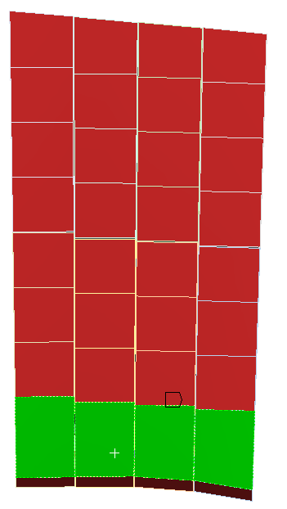
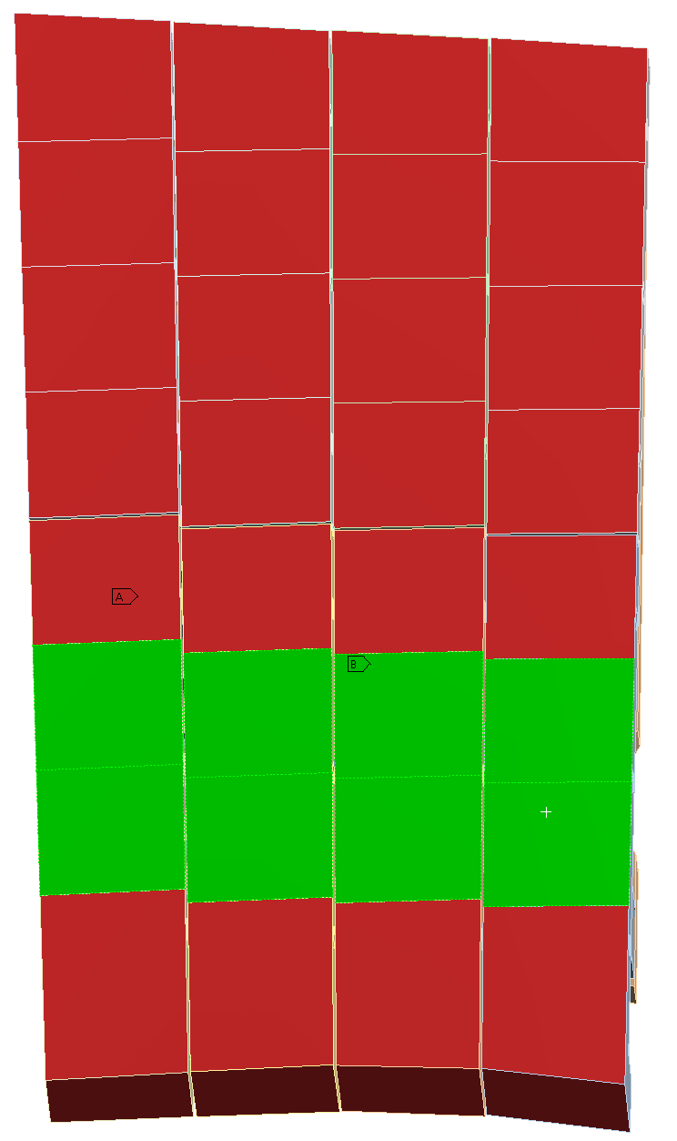
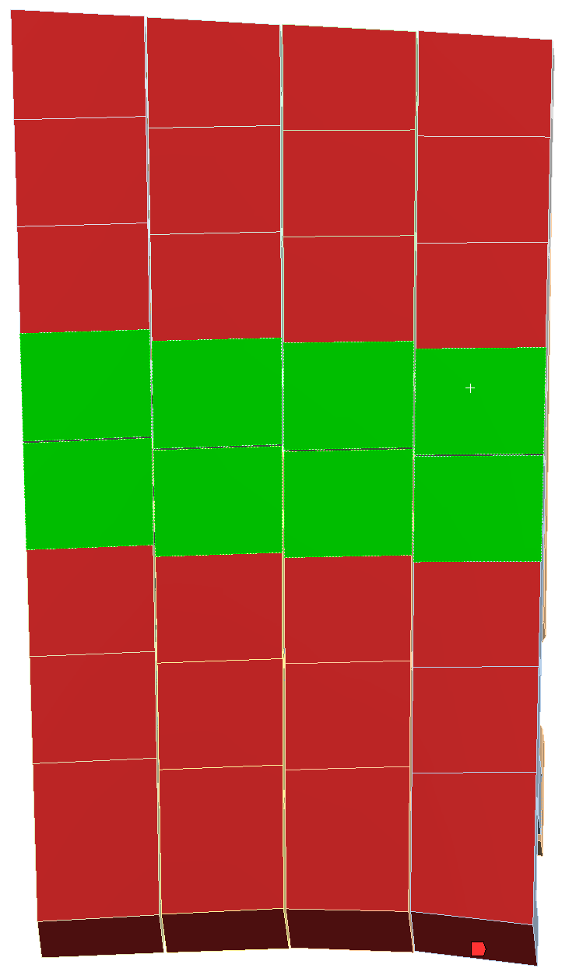
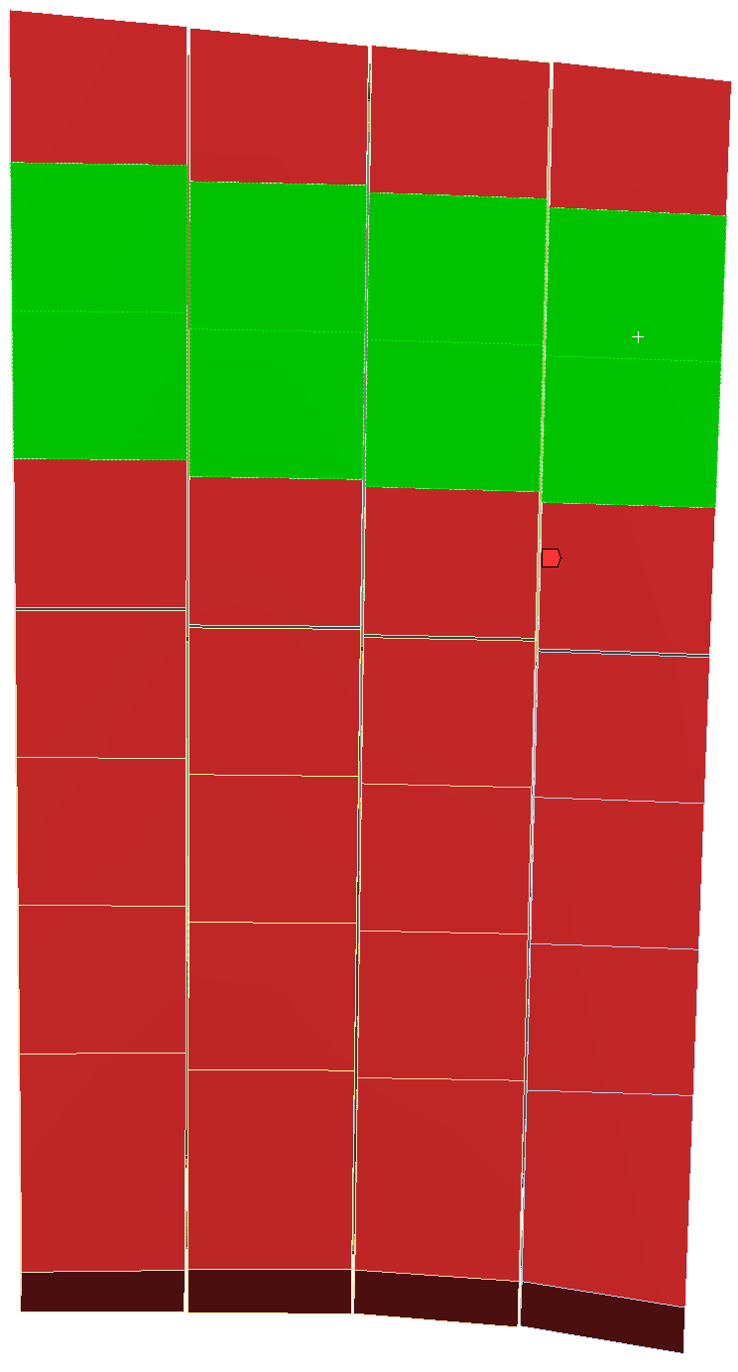
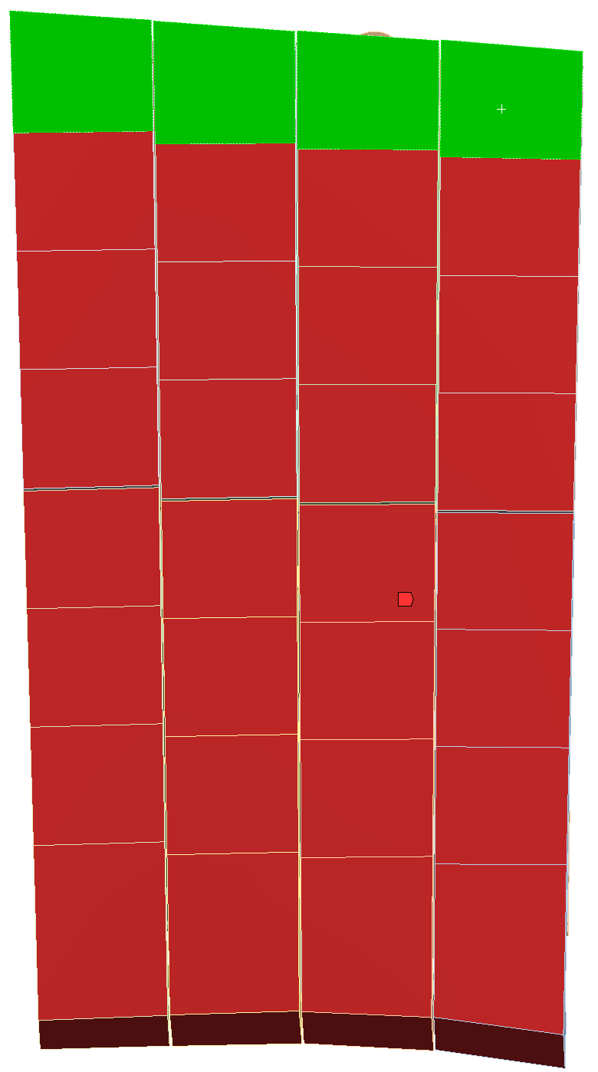
3rd Paramertic study - Results summary
Region 1 – homogeneous (100 kW/m^2) and local convective loading |  | Region 2 – homogeneous (100 kW/m^2) and local convective loading |  | Region 3 – homogeneous (100 kW/m^2) and local loading |  | Region 4 – homogeneous (100kW/m^2) and local loading |  | Region 5 – homogenous (100 kW/m^2) and local loading
Local Conv Heat Flux (kW/m^2) | Max Heat Sink Temp (°C) | Local Conv Heat Flux (kW/m^2) | Max Heat Sink Temp (°C) | Local Conv Heat Flux (kW/m^2) | Max Heat Sink Temp (°C) | Local Conv Heat Flux (kW/m^2) | Max Heat Sink Temp (°C) | Local Conv Heat Flux (kW/m^2) | Max Heat Sink Temp (°C)
600 | 505
Local Heat Flux
Homogenoues Heat Flux

Slide 7
Mechanical ANALYSIS – as build
x
Connection allows for translation in the x-direction
Connection allows for translation in the x-direction
Fixed connection
Connection allows for translation in the x-direction

Slide 8
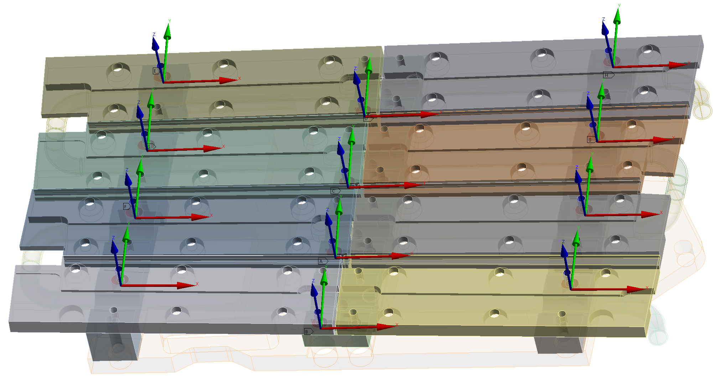
Mechanical analysis – ansys translational joints
All joints represented here, have a dgree of freedom in the x-direction.

Slide 9
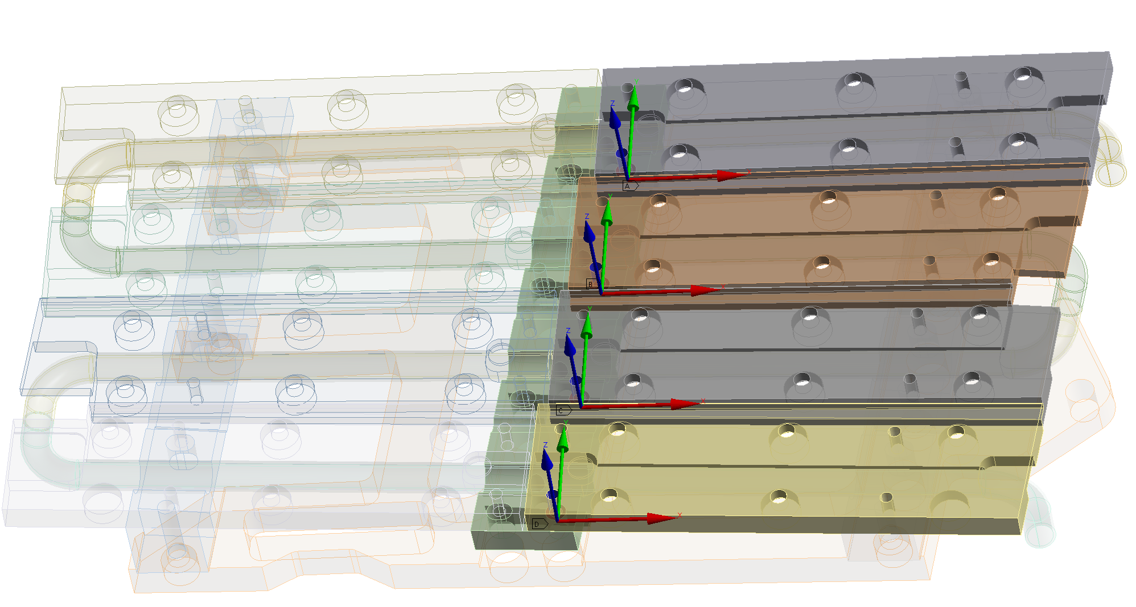
Mechanical analysis – ansys fixed joints
All joints represented here, are fixed in all degrees of freedom.

Slide 10
Mechanical analysis – support connections
Bonded surfaces.

Slide 11
mesh
Structural model
Thermal model
Pipe mesh in structural model

Slide 12
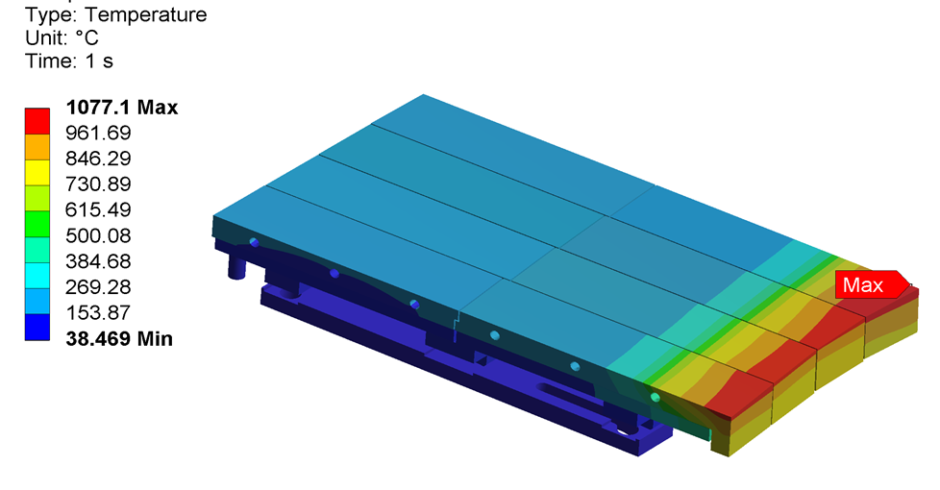
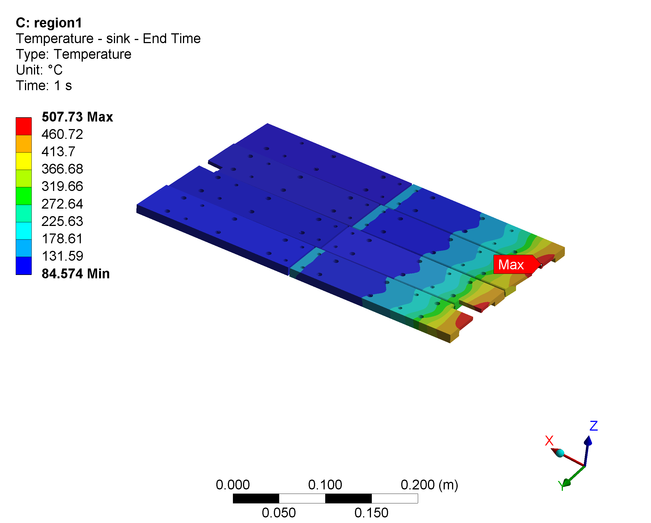
Thermal analysis – region 1
Global temperature
CuCrZr sink temperature

Slide 13
structural analysis – general results
A single load step is finished to check the model.
Total deformation
SS pipe total strain (averaged)

Slide 14
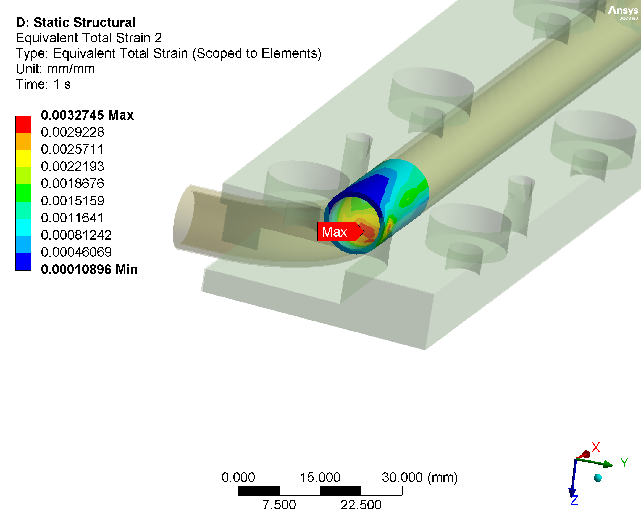
structural analysis – pipe strain postprocessing
SS pipe total strain (averaged)
SS pipe total strain (unaveraged)
The unaveraged strain is 9% higher than the averaged one at the dangerous position.

Slide 15
structural analysis – strain calculation for assessment
Due to the singularity, the maximum strain may be mesh sensitive.
Several elements around the peak position are selected, and the average strain of these elements will be used for assessment.
The increment of the six strain components will be accumulated by cycle, then the equivalent strain is calculated.
The cyclic calculation is ongoing.

