Slide 1





Tungsten based divertor development for Wendelstein 7-X
PFMC-19
Joris Fellinger et al.
WPDIV partners: IPP, CEA, VR, JSI, ENEA, FZJ
Notes:
Logos !

Slide 2
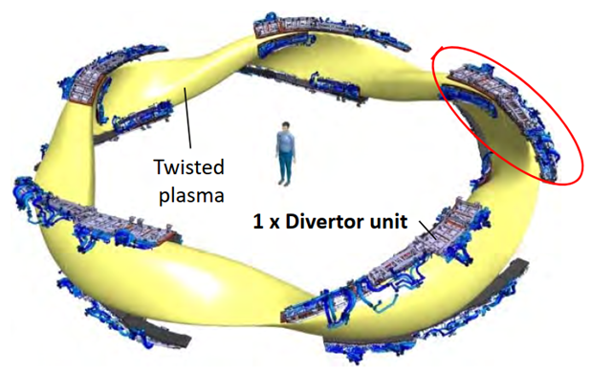
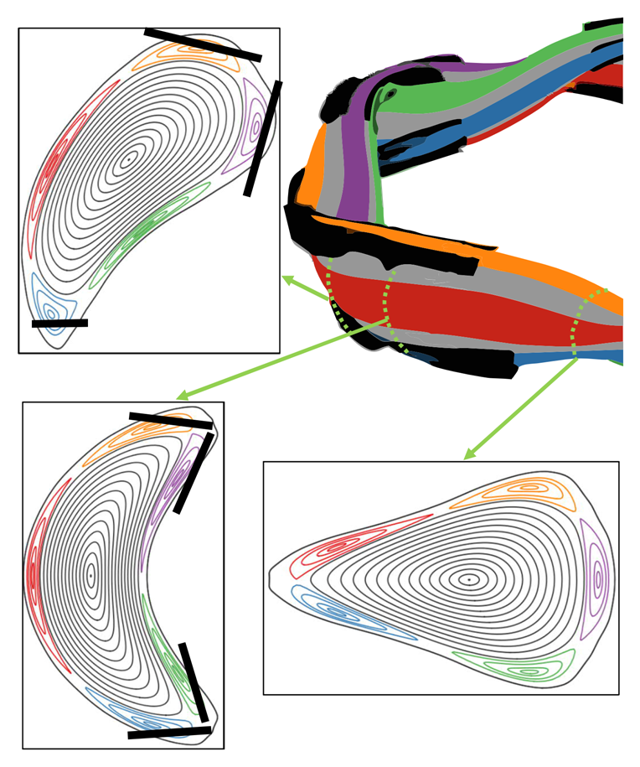
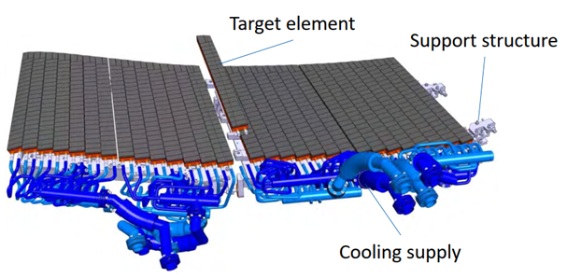
Island divertor in W7-X
CFC Divertor
in operation since 2022
Notes:
Define what is a target module, target element, what is CFC

Slide 3
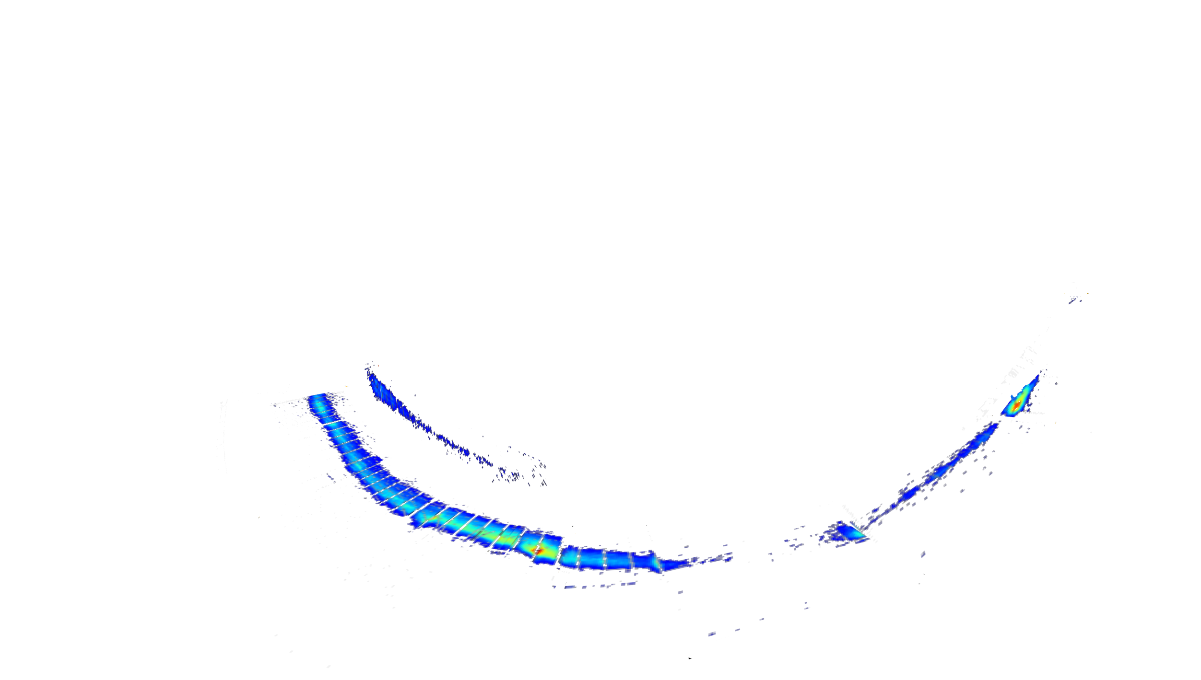
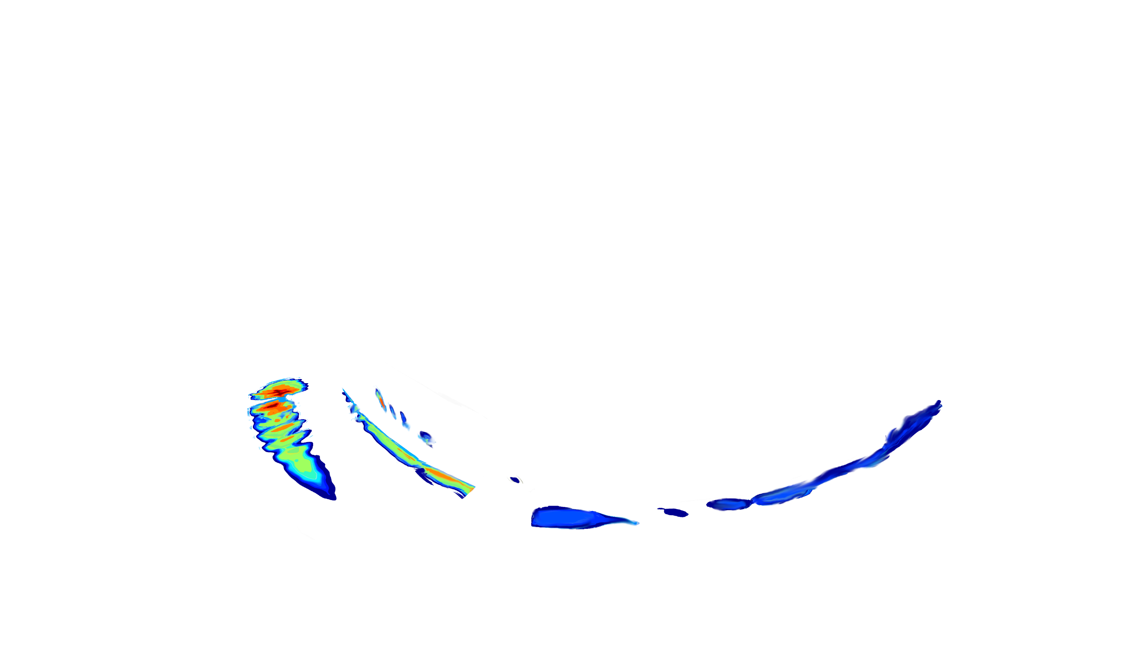
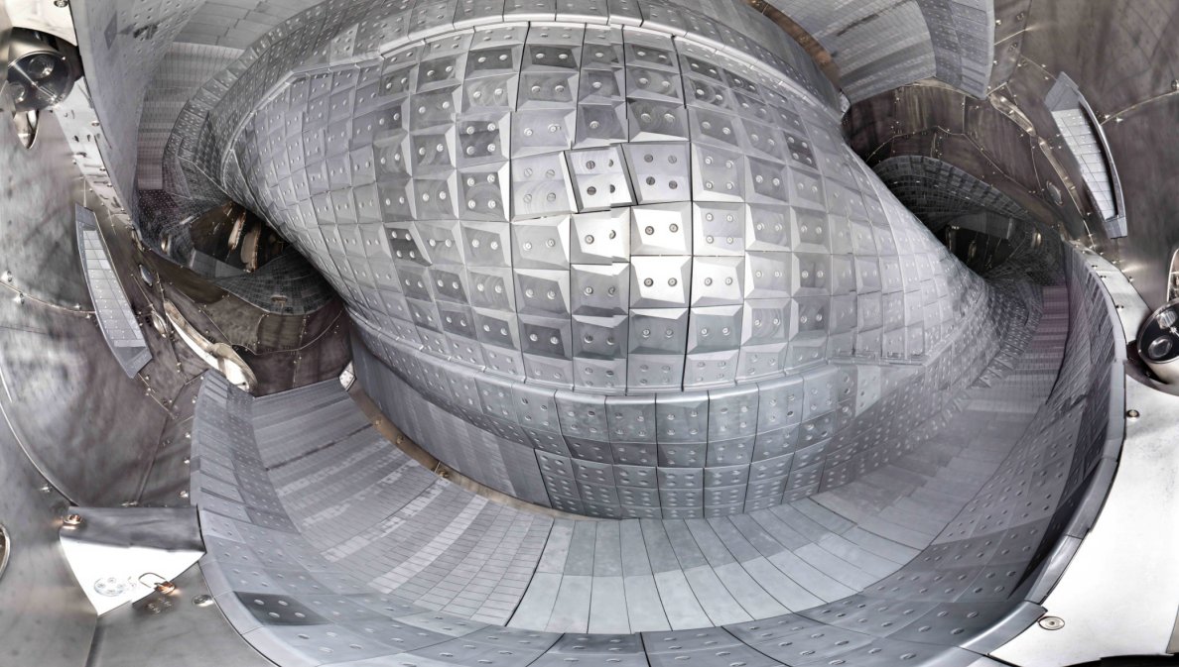
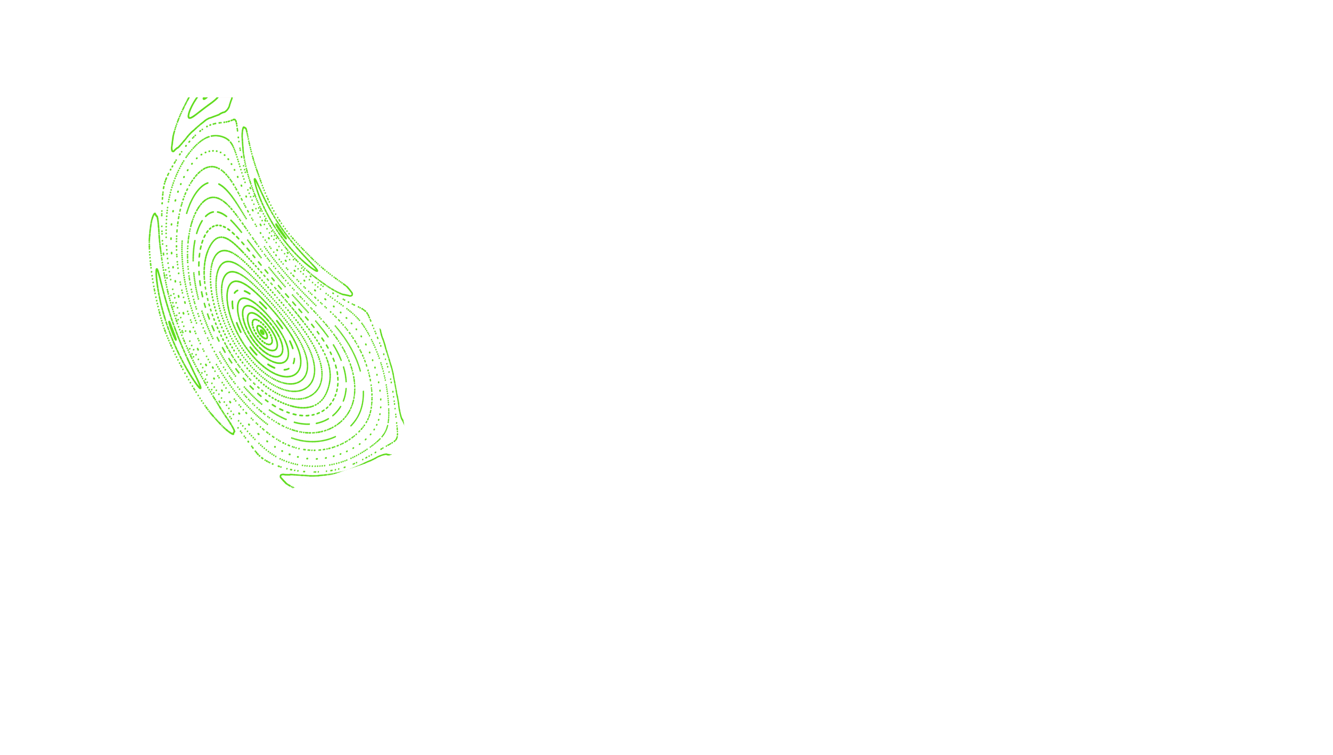
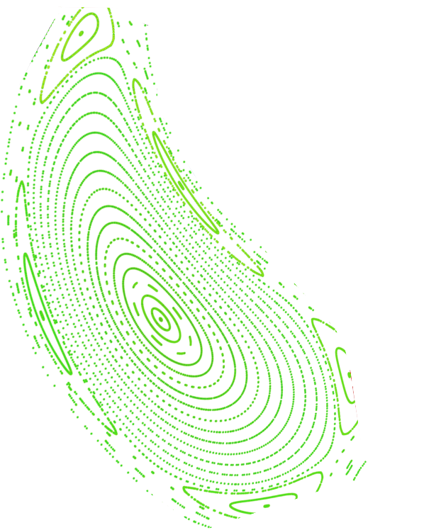

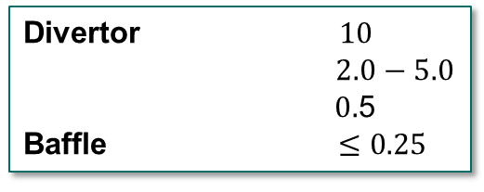

Current divertor layout Wendelstein 7-X
Heat load limit $q_{max }$in MW/m²
Divertor $10$
$2.0−5.0$
$0.$5
Baffle $≤0.25$
CFC
Edge (CFC)
Baffle like
Graphite
Strike line position affected by
Broad magnetic configuration flexibility
Plasma currents
Pumping gap
Divertor heat load (a.u.)
Divertor)
Courtesy
D. Boeckenhoff
Notes:
A showstopper problem for fusion is the heat exhaust problem: how to obtain a safe scenario for the divertor while having high-performance operations in the core? This is also one of the W7-X scientific goals.
Why we need a divertor?
Limit heat loads on the first wall to acceptable levels
Neutral pressure for pumping out the ashes
Prevent the influx of impurities into the main plasma
The basic idea of a divertor concept in any confinement scheme is to move the region where the hot plasma interacts with the solid vessel away from the last closed flux surface.
Auslass -> abfüha

Slide 4
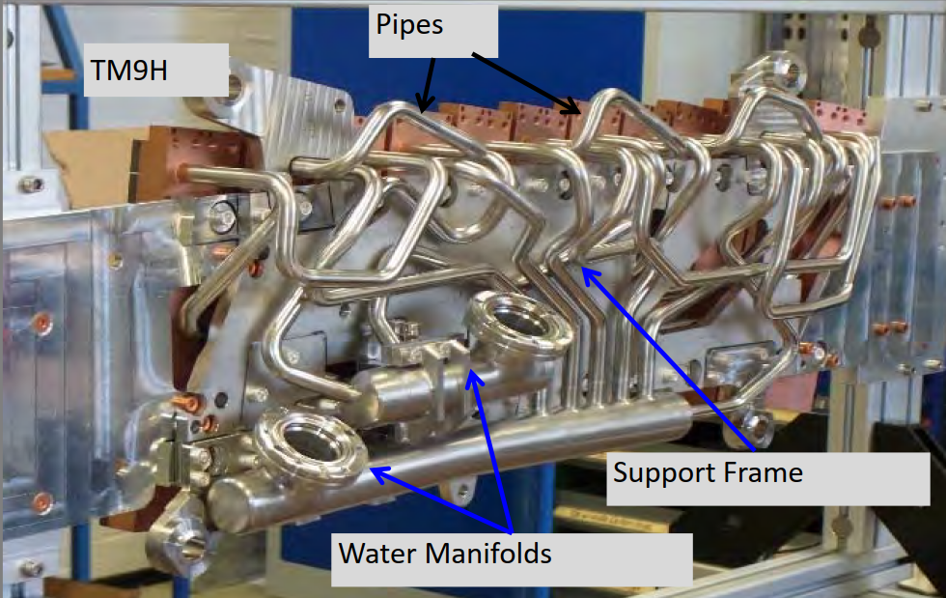
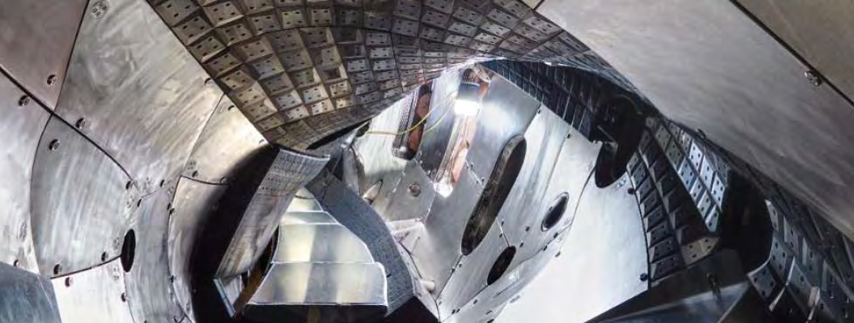
W based divertor project
Goal
  Demonstrate stellarator performance with reactor relevant (carbon free) plasma facing materials
    to reduce tritium retention
    despite higher impurity accumulation challenge
    Include lessons learnt from manufacturing, installation and operation
Outline
  Physics based optimization of plasma facing geometry using EMC3-Lite and EMC3-Eirene
    Impurity control
    Maximize input power while avoiding power overload
    Improve exhaust
  Manufacturing and installation technology qualification
    Targets (EUROfusion WPDIV-W7X)
    Baffles
100
Notes:
Add a scale

Slide 5
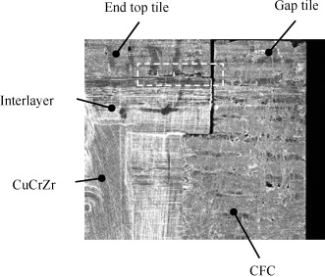
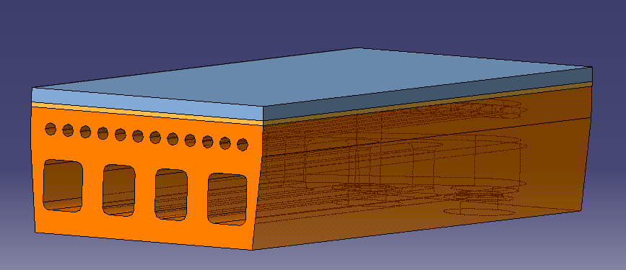
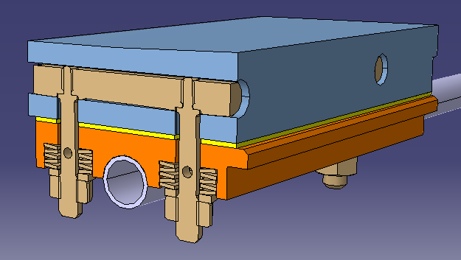
Fundamental differences divertor ⬄ baffle
 | Divertor | Baffle
Plasma facing material | W or W₉₅NiFe ➔ improved machinability and ductility
Heat sink material | Cu or CuCrZr
Heat load requirement | 5-10 MW/m² | < 1-2 MW/m²
W-Cu Interface | Perfect thermal bond required | Cold contact sufficient
Connection type | continuous | Loose bolted connection allowed
Interlayer | 1 mm OFE-Cu ΔT @ 10 MW/m² = ~25 K | Graphite foil ΔT @ 1 MW/m² = 500 K
Key design concern | Thermal expansion mismatch Interface stress singularity | Maximum W temperature Bolt design

Slide 6
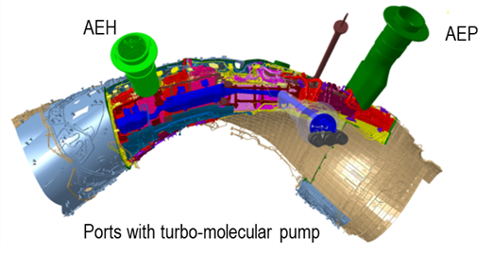
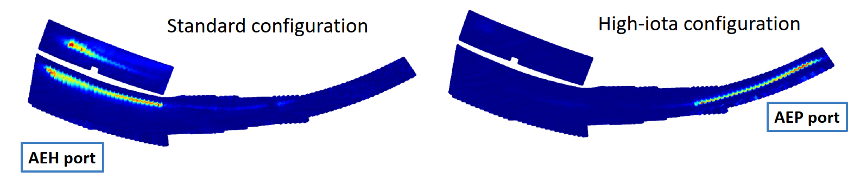
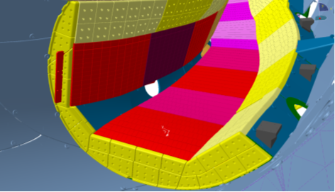
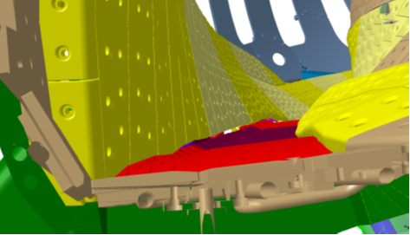
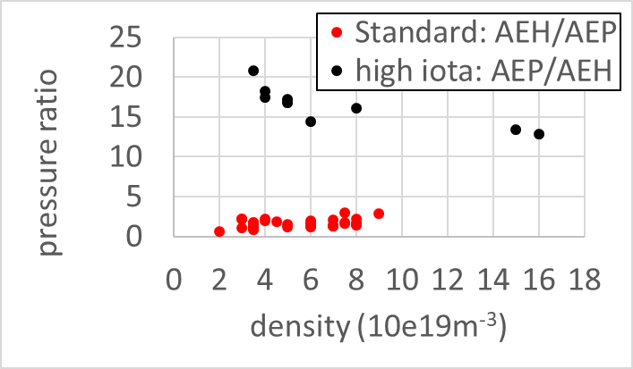
Exhaust issues
Large pumping gap (Standard) less effective than small gap (High iota)
  Standard configuration: p_{AEH} = 0.4∙10⁻³ mbar. Ratio p_{AEH}/p_{AEP} = 1-3
  High iota configuration: p_{AEP} = 1.0∙10⁻³ mbar. Ratio p_{AEP}/p_{AEH} = 13-20
Need to change geometry of large pumping gap and orientation of pumping gap panels
Demand to improve heat load capacity of edge tiles to allow strike line (recycling zone) close to pumping gap
Courtesy V. Haak
Notes:
Particles in low iota pumping gap are reflected back from pumping gap panels into plasma again

Slide 7
Tools for plasma facing surface shaping
Smooth magnetic island geometry
by Fourier transformation of traced particles along edge field lines
β = 0 %
β = 1 %
β = 2 %
β = 5.6 %
Parametric surface model
baffle
divertor
Actual baffle overloads
cryopumpe

Slide 8
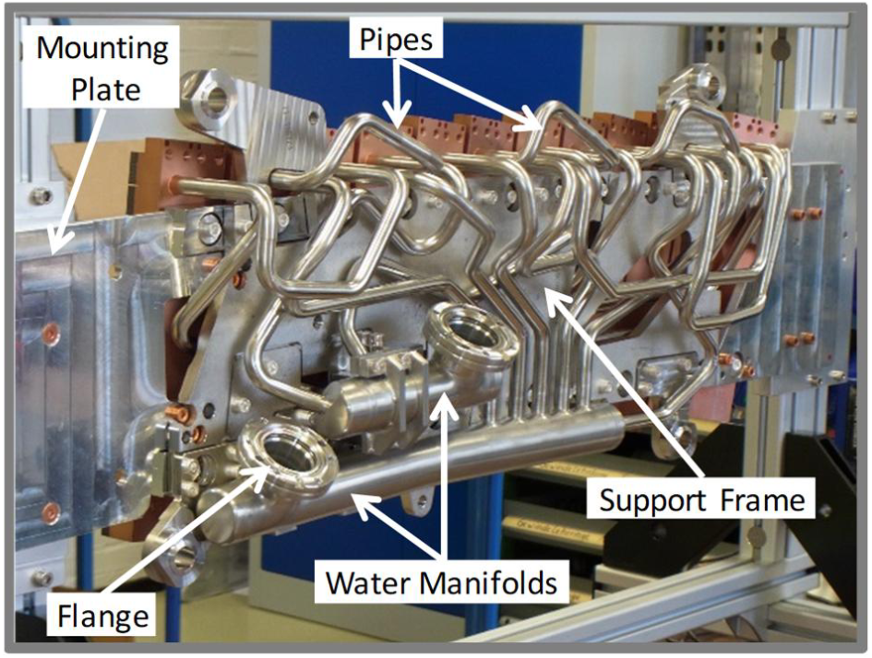
Technology qualification for target modules
Assumptions
  Similar plasma facing geometry as CFC divertor: 10 MW/m² design heat load
    15 MW/m² in cyclic HHF test
  Using existing cooling water infrastructure: 5 l/s per target module, 13 modules per unit
    Current critical heat flux of CFC divertor > 30 MW/m², water remains in single phase flow at 10 MW/m²
  Limiting target module weight ~50 kg:
    3 mm W instead of 7 mm CFC increases weight by 40 kg/m²
  Preferably increased design heat load for edge tile near pumping gap from 2-5 to 10 MW/m²
Objectives
  Simplify manufacturing and inspection and installation
    Minimize pipe work and number of weld seams
    Minimize number of target elements per module (aim = 1)
    Minimize number of manufacturing and inspection steps
    Relax tolerance requirements
Design rules
    Hydraulic loss ⬄ heat removal: high velocity only where heat is removed
    Heat sink deforms as result of competition between hot and cold side
      Make cold side far more rigid than hot side
    W-Cu interface closest to water to minimize temperature & stress
    Statically determined support system, free of thermal restraint forces

Slide 9
Simplifying target module geometry
Size ~0.4x0.6 m x 50 mm

Slide 10
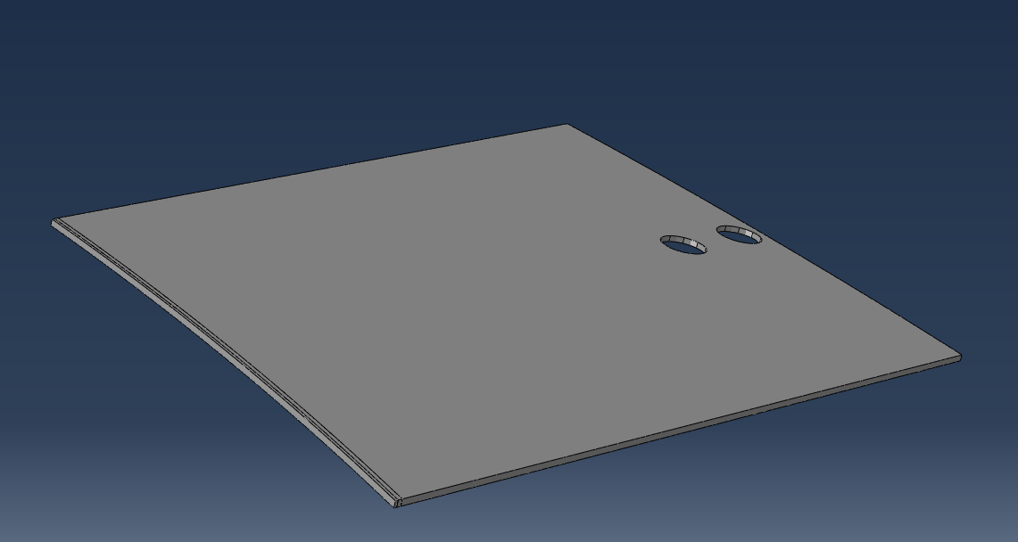
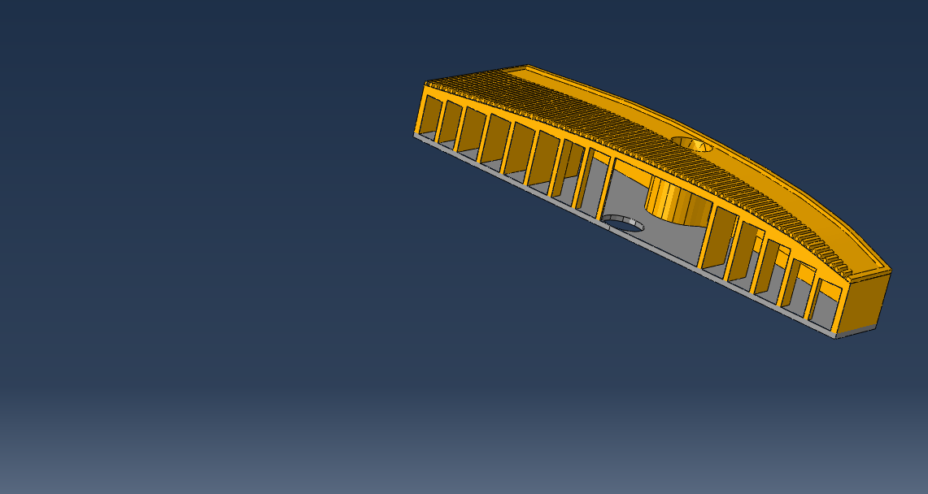
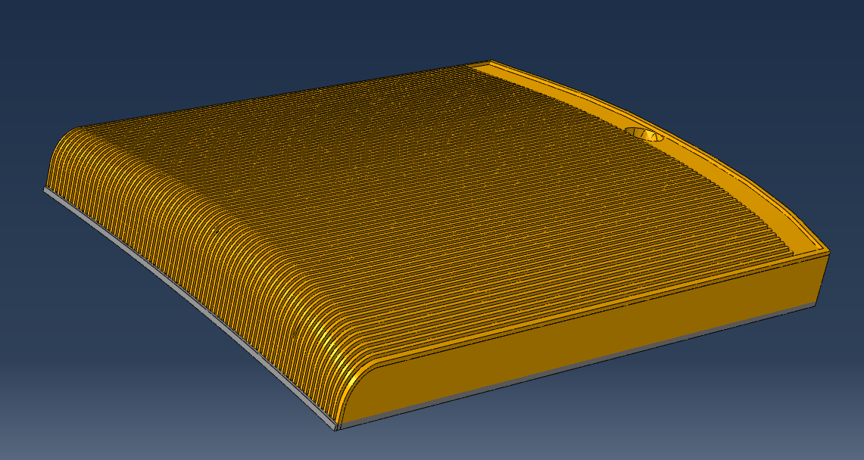
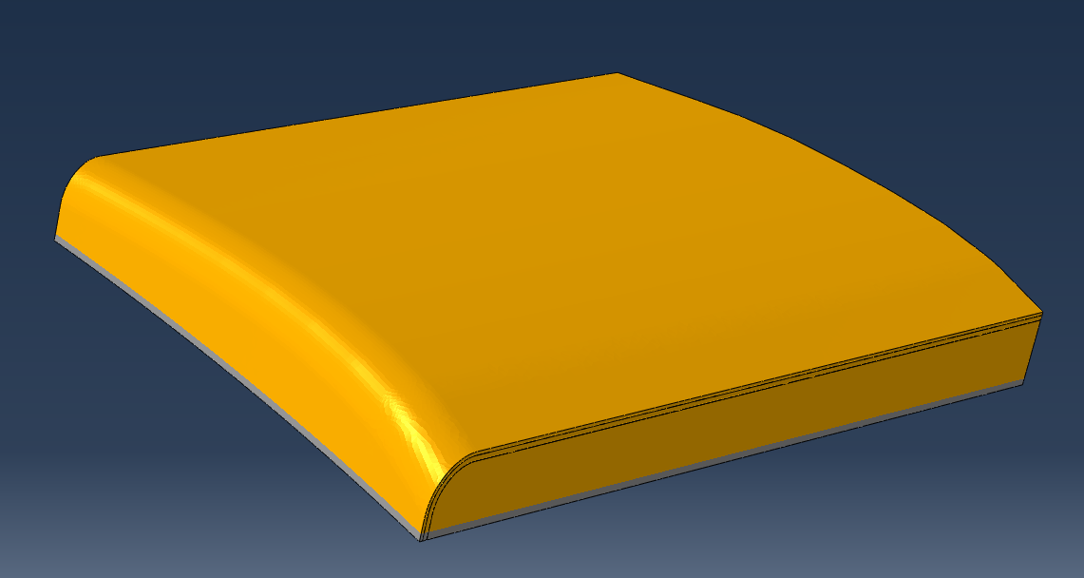
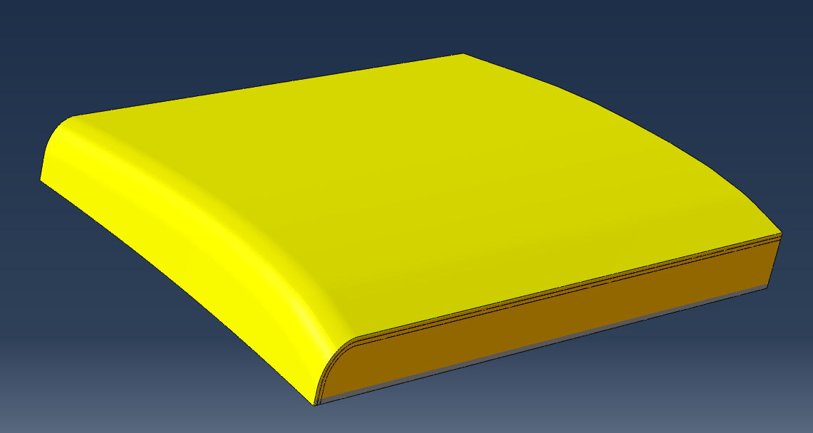
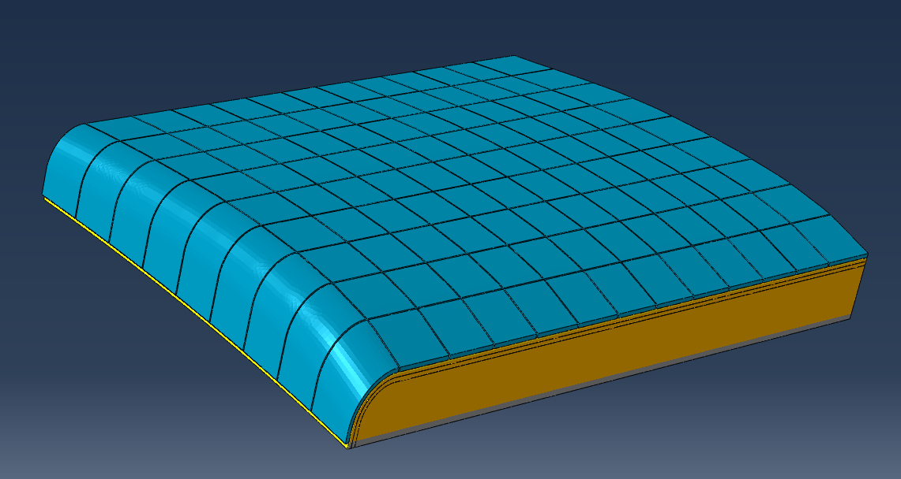

Conceptual layout of target module
Heat sink with integrated manifold
  Diffusion welded flat plates
    Machining of plasma facing side after welding
  Or additive manufactured CuCrZr (LPBF)
Soft OFE-Cu interlayer
  Galvanized, cast, diffusion welded or HIP to W
W or WNiFe plasma facing surface
  Coating
    Thickness > 0.1 mm
      To survive erosion over W7-X life (~300h)
  Or mosaic of tiles bonded by HIP
    Surface machining after HIP process
    Curved edge tile
    Size < 40x40 mm
      To limit manufacturing deformation
    Thickness > 2-3 mm
      to avoid Cu sputtering in slits
FEM results show temperatures < 800 °C and displacements < 3 mm

Slide 11
Qualification tasks target element
Measurement of properties of W, W heavy alloys, SLM CuCrZr, cast and galvanized copper
  Stress-strain, magnetization, ductility, machinability
Cooking recipes for manufacturing processes For diffusion welding, AM, HIP and coating
Demonstration of robust and reliable performance
  Cyclic He leak tightness of heat sinks
  Cyclic HHF resistance
Notes:
recipes
in preparation of call for tender of series production
even for existing technologies
Incoming inspections, pre-treatment, process parameters, post-treatment, required tests, handling, …
HHF
No fatigue crack growth due to strain singularity at free end of W-Cu interface
Confirmation of FEM predictions of deformation and temperature
Demonstration of critical heat flux

Slide 12
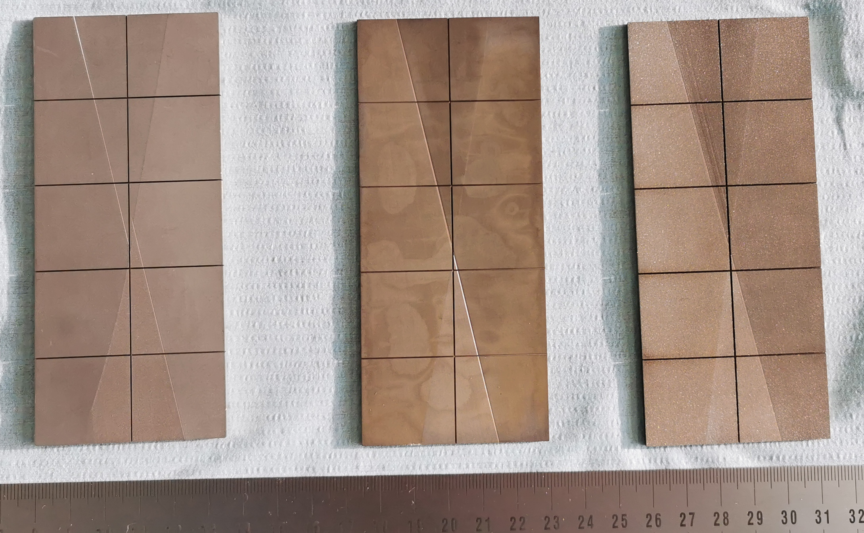
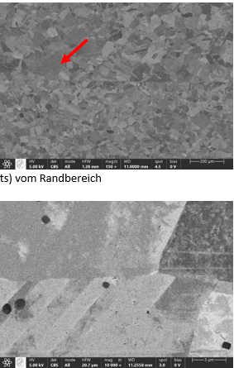
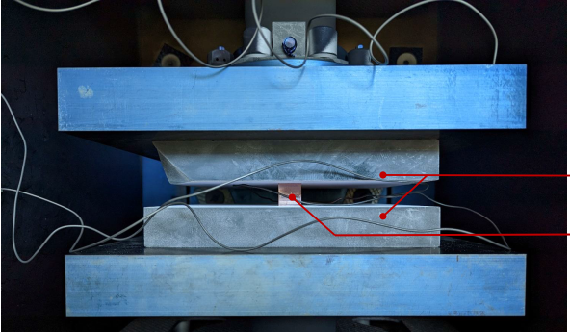
First technical results
Diffusion welding of CuCrZr
  Rationale: No added constituents, no liquid phase transformations
  800-950°C @ 4-17 N/mm² for 30-60 minutes
  100% bonding
  residual deformation ⬄ initial tolerance requirements
    Initial flatness < 15 µm, R_{z} < 15 µm, no scratches
    < 5% reduction of height feasible
Machining by wire erosion and milling
  Accurate machining possible
  WNiFe easier to mill than pure W
  Machined surface gets contaminated by wire constituents: requires cleaning
200 µm
316 LN
W95NiFe
W100
5 µm
Notes:
How accurate Gunnar ?

Slide 13
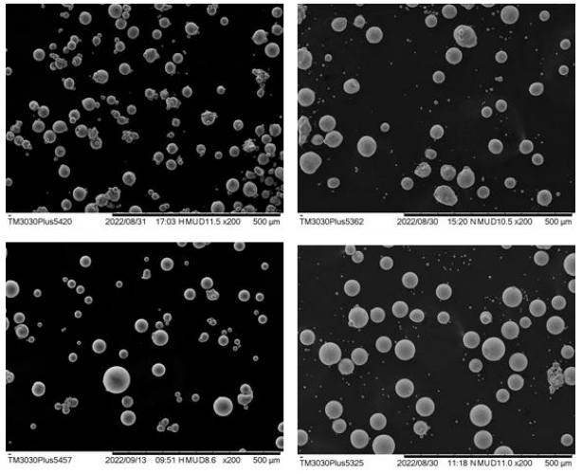
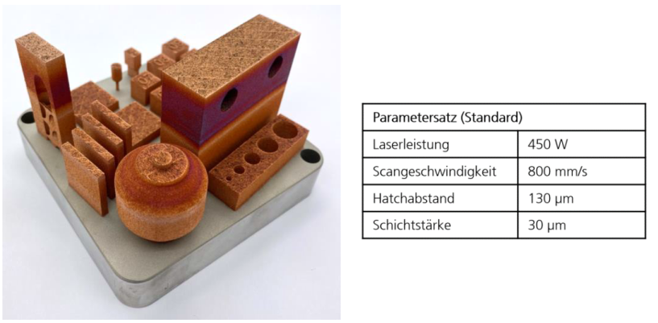
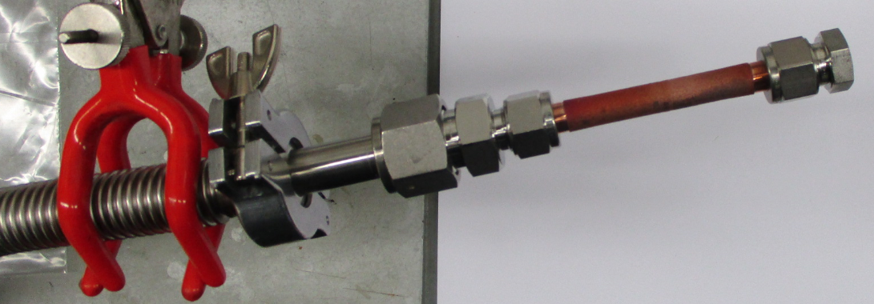
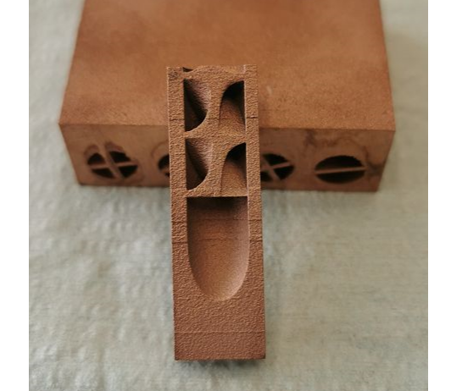
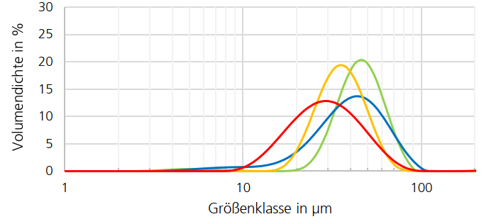
Additive manufactured CuCrZr
Additive manufacturing CuCrZr
  Rationale: Increased geometric design space, single manufacturing process
  4 commonly available powders compared ➔ all four applicable
  Integrated swirl tape feasible
  Density 99.7 %
  He leak tightness 10⁻⁹ mbar∙l/s for wall thickness of 1-3 mm
    First 7/7 samples successful
Process parameters
Laser power | 450 W
Head speed | 800 mm/s
Hatch distance | 130 µm
Layer thickness | 30 µm
Volume fraction [%]
Particle size [µm]
Notes:
Modify to english
Add scale

Slide 14
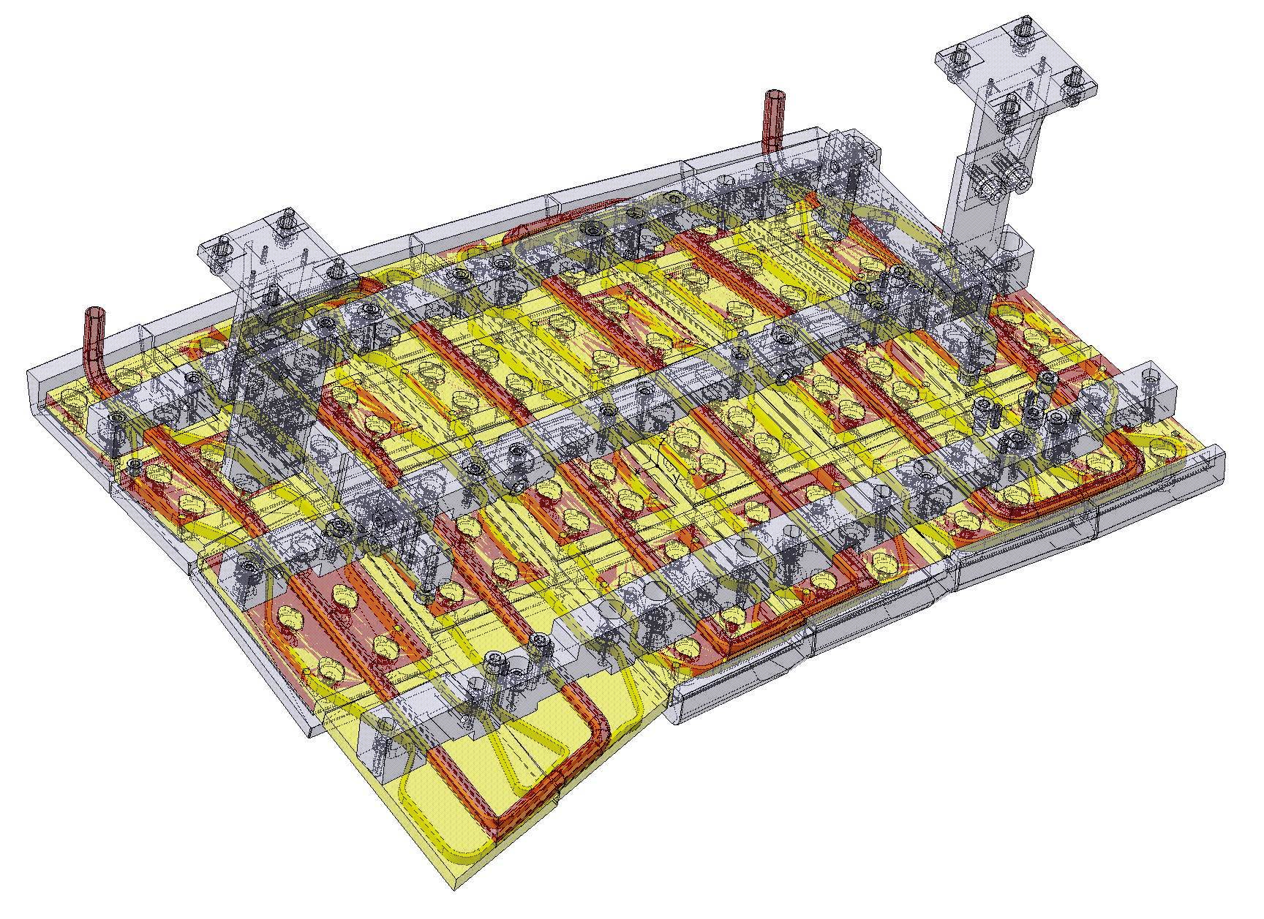
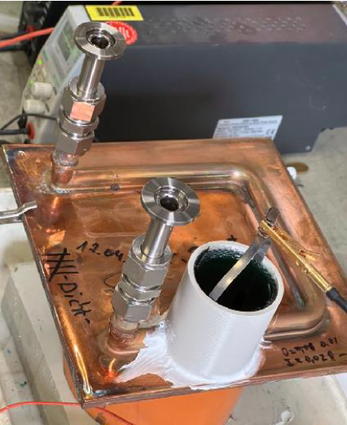
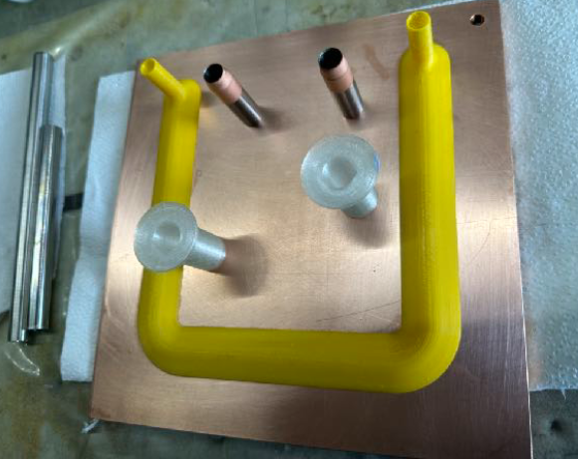
Baffle hardening and simplification
Stainless steel meander with partially brazed CuCrZr heat sinks replaced by single CuCrZr block
  Water channels machined and sealed by galvanisation
  First 3 samples He leak tight
6x larger cooling area than in current design
  No need for steel support structure
  Braze with high thermal stress avoided
Size ~0.4 x 0.8 m
Courtesy F. Kunkel
Notes:
Alternatively, plastic water channel counterform is galvanised are dissolved afterwards
Stainless steel transition part leak tight integrated in galvanisation process

Slide 15
Resume and Outlook
Tools for physics based modification of geometry
  Improved exhaust
  Maximized allowable input power
  Avoiding leading edges
Technology qualification for divertor and baffles
  Focus on simplifying and minimizing manufacturing and inspection steps
  First qualification results very promising
  Pursued heat load on divertor edge tile and baffles seems feasible
Outlook
  2023: manufacturing and testing of samples
  2024: manufacturing and testing of small scale prototypes
  2025-2026: optimization and manufacturing and testing of mockups
  After qualification and definition of geometry
    Go/no-go decision on full exchange of CFC divertor
    Or possibly gradual exchange of components that are limiting operation

Slide 16
Backup slides
Exhaust need

Slide 17
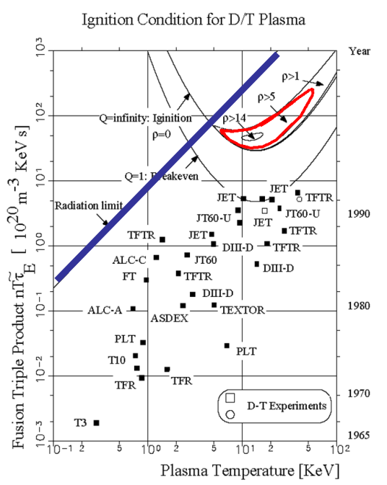
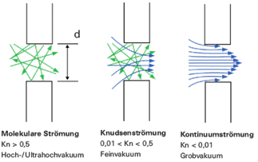
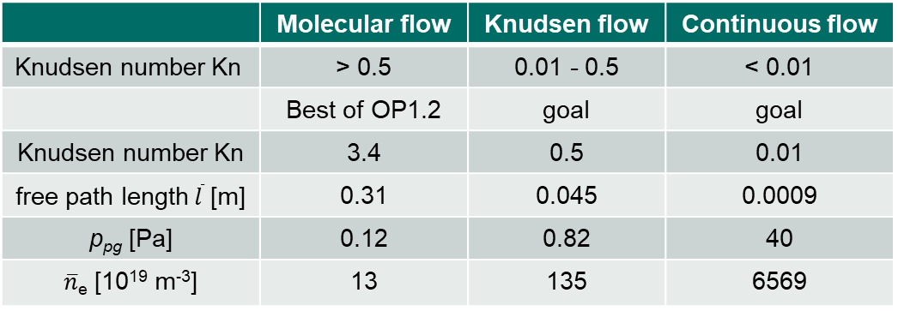

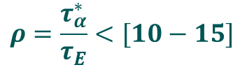


Exhaust challenge
Reactor perspective – He concentration shrinks operational space
The global He particle confinement time $τ_{α}^{∗}$ must be small relative to the energy confinement time $τ_{E}$
Operational perspective – Density control
  Only neutrals can be removed
  Role of target is to intercept, neutralize and exhaust particles
    Large exhaust relative to wall source/sink improves control
$$ρ=\frac{τ_{α}^{∗}}{τ_{E}}<[10−15]$$
$$ρ=\frac{τ_{α}^{∗}}{τ_{E}}$$
$Kn= \frac{\overline{l}}{d}$ $d_{PG}=\sim 90 mm$
 | Molecular flow | Knudsen flow | Continuous flow
Knudsen number Kn | > 0.5 | 0.01 - 0.5 | < 0.01
 | Best of OP1.2 | goal | goal
Knudsen number Kn | 3.4 | 0.5 | 0.01
free path length$\overline{l}$ [m] | 0.31 | 0.045 | 0.0009
p_{pg} [Pa] | 0.12 | 0.82 | 40
$\overline{n}$_{e} [10¹⁹ m⁻³] | 13 | 135 | 6569
Asdex upgrade 0.5-1.5 Pa
Density must be improved by at least an order of magnitude
[R. Schneider, Fusion Lectures]
Notes:
Why do we need a divertor?
Yesterday a lot about Power exhaust,
Necessary: In a reactor, the produced He has to be removed, as an increasing He concentration shrinks our operational space up to the point where no operation is possible.
Rho central metric, effective He core confinement time over energy confinement time.
Also be translated into He concentration. To much He radiates power away
Recent research suggests that we have to be more on the lower side, the lower, the better
BUT also operational important for density control.
Ideal world: No source, nor sink, purely fueled by recycling (not too far from W7-X)
But Wall source and sink. Sink no issue, just fuel more, outgasing source has to be exhausted.
Equilibrium: what goes in, must come out.
We need to exhaust particles, and we can only remove neutral particles.

Slide 18
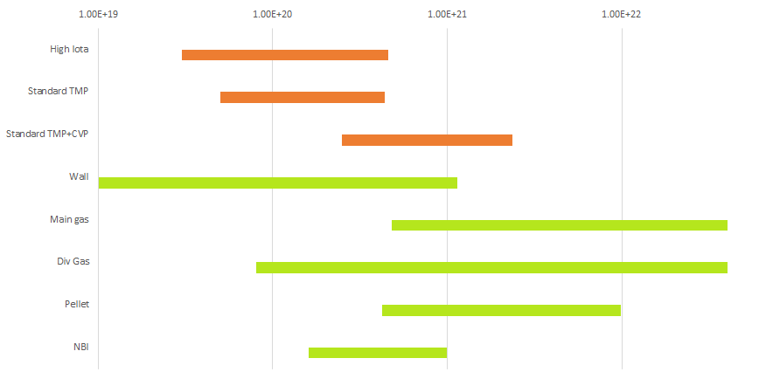
Exhausts limits profile shaping
    Flat profiles ➔ Particle exhaust = Wall source
    Peaked profiles ➔ Particle exhaust = Core + Wall source
[n/s]
sinks
Transient peaked profiles
sources
Courtesy
Th. Kremeyer
Notes:
Depending on density, exhaust rates
CVP at higher densities will grant us wall independent density control.
If wall source is low, we can even pump all 4 NBI sources
Without CVP we can only exhaust the smallest Pellet at 1 Hz.
Above only transient peaked profiles possible
Peaked profiles in equilibrium source=sink, what goes in, must come out.

Slide 19
Design approach
Flat tile following curvatures of magnetic field at plasma facing side
CuCrZr heat sink with integrated manifold
  Flat plates with machined half sides of water channels
  Stiffeners at cold side to minimize thermal curvature
  Threaded channel surface to mimic swirl
  Diffusion welded with flat weld interface (alternatively brazed)
  Plasma facing side machined after welding to match optimized plasma facing geometry
  Alternatively 3D SLM printed heat sink
3 mm W or W alloy tiles with 1 mm soft copper interlayer
  Galvanized copper (stress free at room temperature, delamination stress is compressive in heating up)
  Cast copper (stress free at molten copper temperature of 1080°C, delamination stress is tensile in cooling down)
HIP process to join heat sink to copper interlayer
  Allowing for wavy plasma facing surface shape and L-shaped edge tile L-shaped edge tile
    L-tile avoids strain singularity at free end of interface where peak temperature occurs
  Alternatively no HIP with modified plasma facing surface to avoid need for edge tile
  Alternatively no HIP with separate edge tile (e-beam welding) but lower design load
Final W machining after HIP

Slide 20
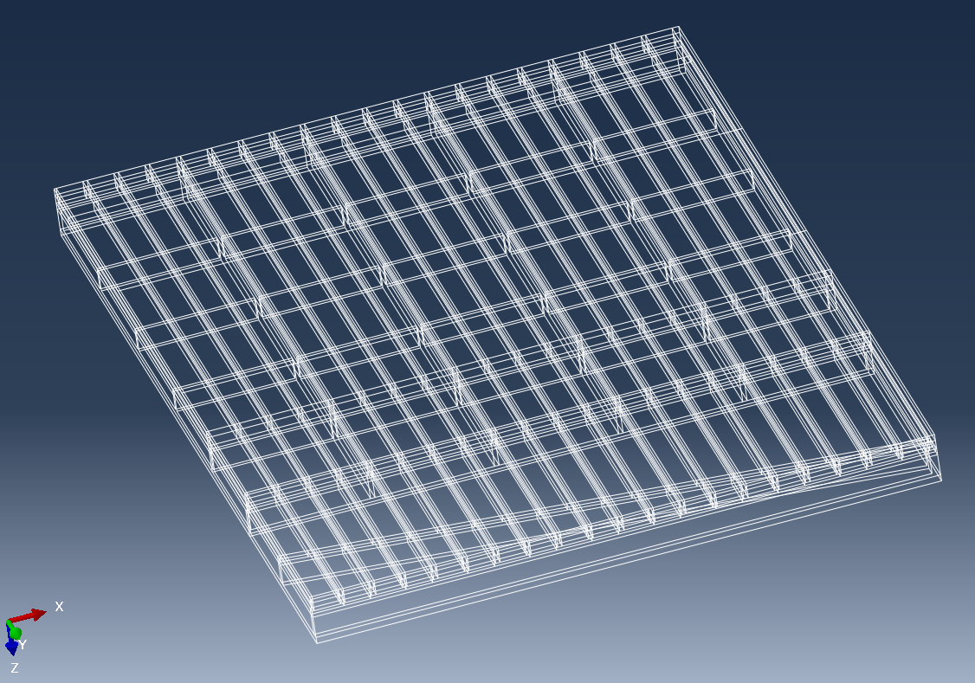
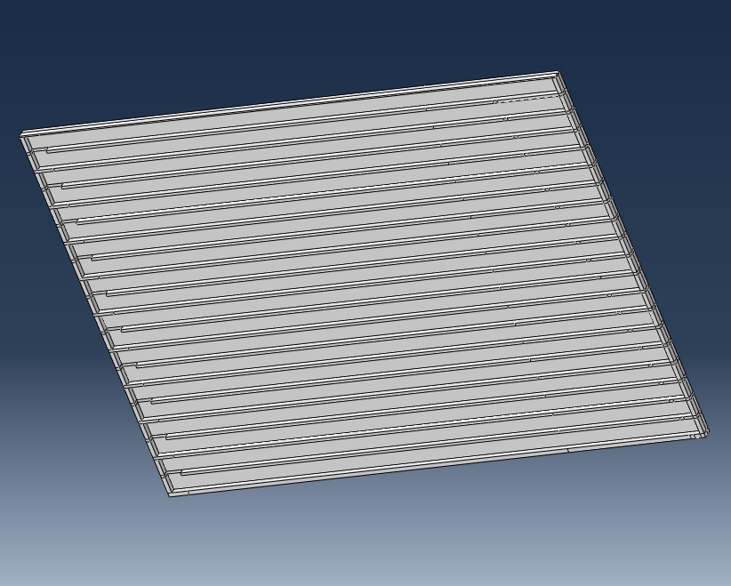
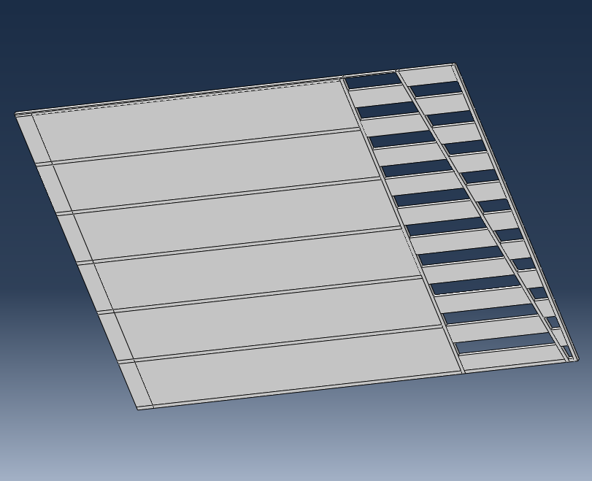
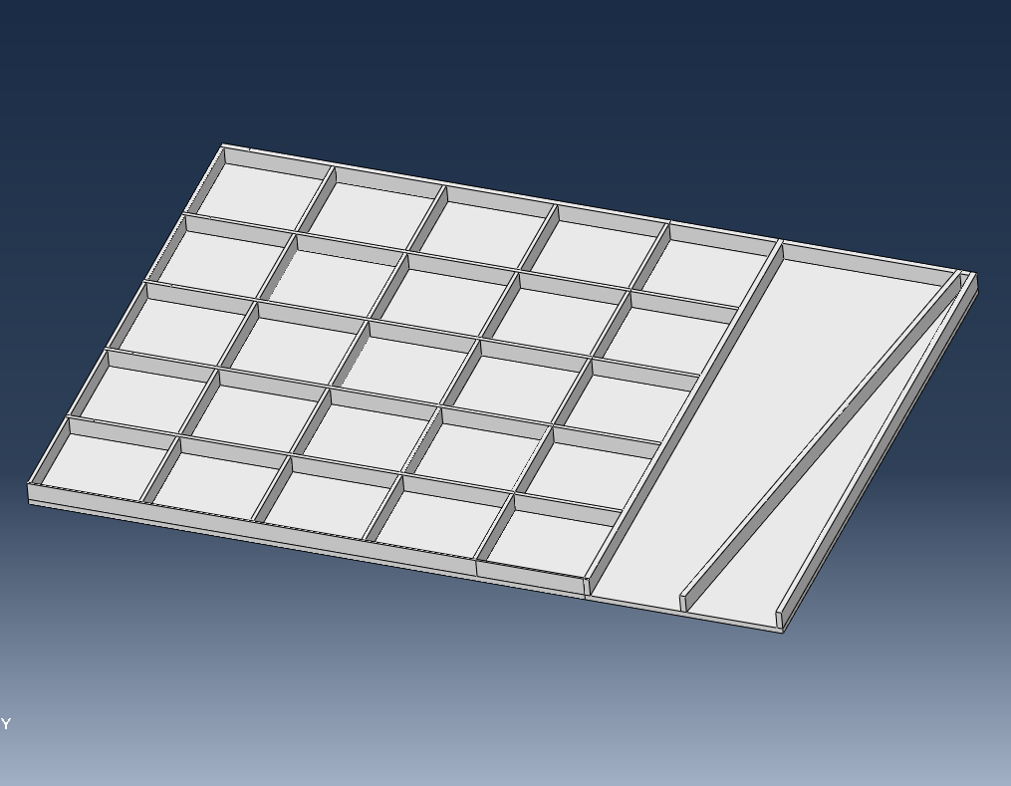
Alternative design
Target element completely out of W heavy alloy
  No W-Cu interface ➔ no thermal stress singularity
  Qualification tasks
    Sintering of pre-machined plates
    He leak tightness
    Corrosion resistance against DI water
    Crack stabilization after thermal shocks

Slide 21
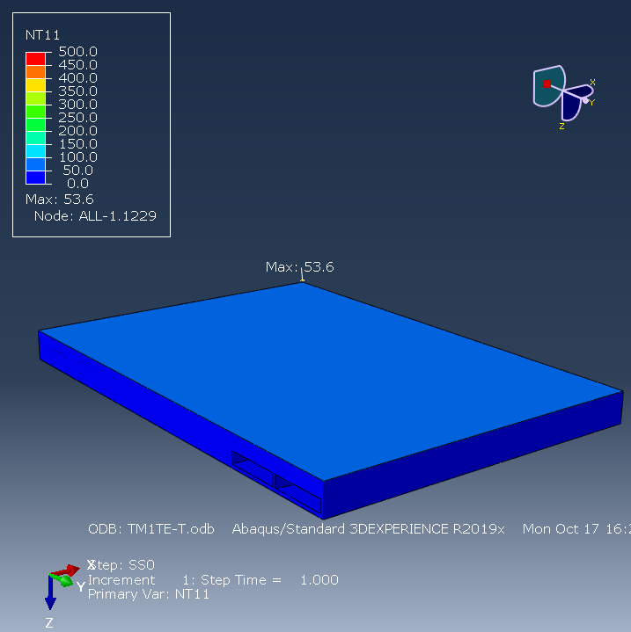
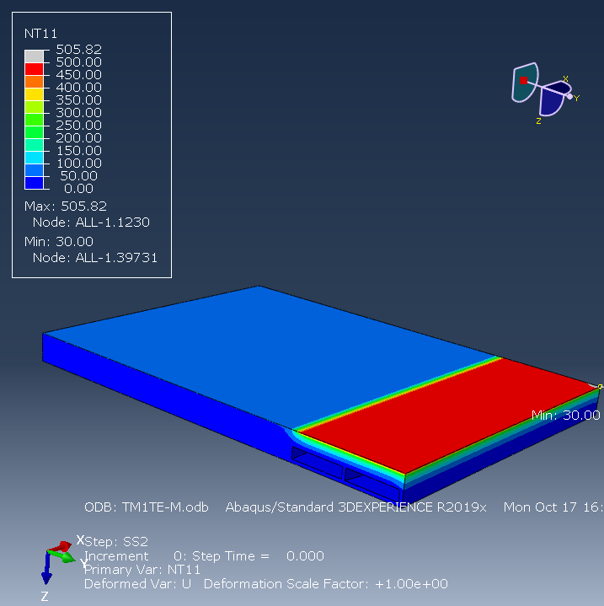
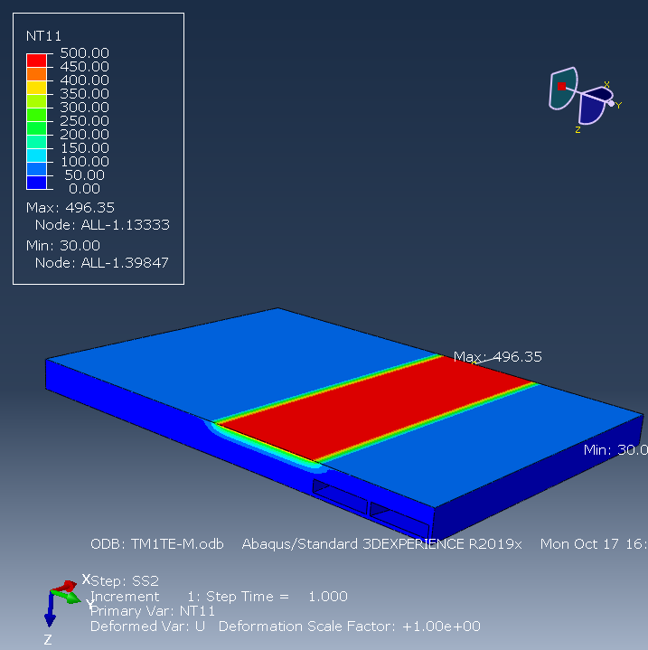


Thermal results
500 kW/m² radiation
+ 10 MW/m² @100 mm
500 kW/m² uniform radiation
10 MW/m² @ 100 mm case 1
10 MW/m² @ 100 mm case 2
10 MW/m² @ 100 mm case 3
10 MW/m² @ 100 mm case 4

Slide 22





Plasma exposure ⬄ HIP process
500 kW/m² uniform radiation
10 MW/m² @ region 1
Uniform cool down 500➔ 20 °C
10 MW/m² @ region 2
10 MW/m² @ region 3
10 MW/m² @ region 4

Slide 23

Need to use tessellated W surface
Normal displacement during manufacturing cool down from 500 ➔ 20°C
Tessellation strongly reduces normal displacement, allowing for final machining HIP process
Notes:
Or castellated

Slide 24
10 MW/m² ➔ need for thermal bond W-Cu
Perfect thermal bond implies perfect mechanical bond W-Cu
  In steady state @ 10 MW/m²: ΔT_{channel} = ~150 K, ΔT_{Cu} = ~30 K/mm, ΔT_{W} = ~100 K/mm
  Bending stress in W and Cu
    Maximum based expansion mismatch Δε_{T} = ε_{W,int} + ε_{Cu,int}
    Δα_{T} = 17-5 = 12 µm/mK ➔ Δε_{T} = 0.2% @ ΔT_{int} = 170 K
    Gradual increase from zero at free end, gradient defined by yielding of soft copper interlayer
  Strain singularity at free end of W-Cu interface
    FEM results are mesh dependent
    All strains are proportional to ΔT
  Delamination stress peak at free end of interface
    Tensile stress at ΔT < 0 for W-Cu combination
    Limited by yielding of soft copper interlayer
  Shear stress along interface
    Limited by yielding of soft copper interlayer
ε_{W}
Thermal strain
M_{W}
Bending stress
Mechanical strain causing a force:
F_{w} + F_{cu} = 0
t_{W}
W
F_{W}
W
Delamination stress
Shear stress
CuCrZr
M_{Cu}
CuCrZr
t_{Cu}
F_{Cu}
Mechanical strain causing a moment:
M_{cu} + M_{W} + F_{W}(t_{w}+t_{Cu})/2 = 0
Δε_{T}
κ
ε_{Cu}
Total strain

Slide 25

Temperature during plasma operation
10 MW/m² @ 2 toroidal strike lines of 100 mm + 500 kW/m² radiation
Conductance of 50 kW/m²K along cooling channels (no swirl tape assumed)
Peak temperature < 800°C at curved edge tile despite 10 MW/m² load

Slide 26

Displacements during plasma operation
Only cantilever support at inlet/outlet tube
Normal displacement < 3 mm, compare to 5 mm for current CFC divertor
  Sliding supports at pumping gap could further reduce normal displacement

Slide 27










FE model including water channels
W95NiFe
OFE Cu Interlayer
CUCrZr top plate
CuCrZr bottom plate
CuCrZr manifold
CuCrZr Stiffener
symmetry fixed in X
Fixation in Y
Fixation in Z
HTC with swirl tape
W95NiFe: 2 mm
OFE Cu: 1 mm
CuCrZr: 23 mm
3 mm plate
4 mm water channel
3 mm plate
10 mm manifold/stiffener
3 mm plate

Slide 28
Summary of FEM results
Deformation during cool down of HIP process far too large
Possible counter measures
  Softer copper interlayer ➔ material will harden over time
  Thicker copper interlayer
  Stiffer cold side compared to W based side
  Tessellation of W based surface ➔ only realistic option: Normal deformation < 1 mm
Heat sink | Interlayer | OFE Cu | Slits | u_{z} | σ WNiFe | σ OFECu
25 mm | 1 mm | ITER SDC-IC | no | 14.1 | -1491 | 154
25 mm | 1 mm | R_{0.2} = 3 MPa | no | 2.5 | -393 | 3
50 mm | 1 mm | ITER SDC-IC | no | 4.5 | -2301** | 160
48 mm | 3 mm | ITER SDC-IC | no | 4.3 | -1939** | 158
80 mm | 1 mm | ITER SDC-IC | no | 3.2 | -2297** | 162
50 mm | 1 mm | ITER SDC-IC | 40x40 mm | 0.8 | -659 | 151
** in case of yielding: plastic strain < 0.3%

Slide 29
Target element concept
Heat sink with integrated manifold
  Diffusion welded flat plates
    Stainless steel cold side
    CuCrZr hot side
    Machining of plasma facing side after welding
  Or additive manufactured CuCrZr (LPBF)
    CuCrZr-stainless steel transition part required
Soft OFE-Cu interlayer
  Reduce stress at W-Cu singularity
  Galvanized, cast, diffusion welded or HIP to W
W or WNiFe plasma facing surface
  Mosaic of tiles bonded by HIP
    Surface machining after HIP process
    Size < 40x40 mm
      To limit manufacturing deformation
    Curved edge tile
      To avoid singularity at hottest edge
      To minimize distance to water
    Thickness > 2-3 mm
      to avoid Cu sputtering in slits
  Or coating
    Thickness > 0.1 mm
      To survive erosion over W7-X life (~300h)

Slide 30



Divertor / baffle overload issues
Delamination at CFC-Cu interface limiting allowed load onto edge tiles
Boscary 2012
Local peak loads due to leading edges

Slide 31


Tools to optimize plasma facing geometry
Plasma modeling
  EMC3-lite (heat loads)
  EMC3-Eirene (heat loads + particle balance in the edge)
Modelling of neutral gas transport from strike line to pump in sub-divertor space
Leading edge tool to determine allowable steps between tiles and modules
Incident angles
Allowable step size T_{WNiFe} < 1300 °C
Aggregate over 9 mag. configurations
No shielding by neighouring tiles
Standard
Low Mirror
Areas of opposite
incident angle
Courtesy A. Menzel
Notes:
EMC3-Lite: Diffusion based heat unit tracing using Monte Carlo approach
Reversal of particles included ➔ allows for loads in shaded areas
Can be called from CATIA for any divertor geometry
Very fast: < 1 min
Eirene: (extension of heat balance with neutral gas balance)
Considers opposite incident angles from different magnetic configurations
Calculates allowable step based on FEM database with temperatures W, Cu, CuCrZr and cooling channel for parameter set of heat loads, incident angles and leading edges

Slide 32







Assessment of W and W₉₅NiFe
Comparison of 2 suppliers
Rolling direction visible in W but not in W₉₅NiFe
W95NiFe
W
Courtesy K. Hunger
200µm
Rolling direction
20µm
200µm
ε_{u} = 7±1%
20µm

