Slide 1
Divertor concept development for the W7-X stellarator experiment
D. Naujoks¹, A. Kharwandikar¹, V. Haak¹, T. Sieber¹, M. Banduch¹, J. Boscary², Chr. Day³, C.P. Dhard¹, G. Ehrke¹, J. Fellinger¹, Y. Feng¹, Y. Gao¹, J. Geiger¹, Yu. Igitkhanov³, M. Jakubowski¹, R. König¹, T. Kremeyer¹, R. Neu², G. Schlisio¹, H. Strobel³, T. Sunn Pedersen¹, Chr. Tantos³, J. Tretter¹, S. Varoutis³ and the W7-X Team*
¹Max-Planck-Institut für Plasmaphysik, D-17491 Greifswald, Germany
²Max-Planck-Institut für Plasmaphysik, D-85748 Garching, Germany
³Karlsruhe Institute of Technology (KIT), Institute of Technical Physics, Vacuum Department, Karlsruhe, Germany
*The full list of W7-X team members is given in T. Sunn Pedersen et al 2022 Nucl. Fusion 62 042022

Slide 2
W7-X divertor setup OP3
physics
optimization objectives
optimization criteria
optimization tools
technology

Slide 3
W7-X divertor setup OP3 – physical optimization objectives
heat loads on PFCs should not exceed their specific, defined limits
acceptable peak loads,
tolerable input energies to individual components,
by broadening of heat load distribution (larger wetted areas),
avoid localized excess heat loads (leading edges, fast particles).
power
exhaust
particle removal
impurity control
to pump helium, the fuel gases are pumped at almost the same rate!
high neutral gas pressure in the sub-divertor region (TMPs, cryopumps)
by ensuring a high neutral gas pressure above the targets
(high ion influx into divertor plasma, efficient plugging/baffling, reduced leakages
into main chamber, optimum pumping gap area, improved guidance of the
neutrals towards the pumping positions).
acceptable net erosion
screening/retention of impurities in divertor plasma
increase power dissipation in the divertor plasma/SOL (by seeding),
prevent core radiation losses -> exhaust of impurities
by friction, electric thermal forces, drift effects; reduce sputtering.
⬄

Slide 4
W7-X divertor setup OP3 – technical optimization objectives
heat loads on PFCs should not exceed their specific, defined limits
avoid localized excess heat loads (leading edges, fast particles).
e.g. cost reduction, limitation of the magnetic field configuration space ...
power
exhaust
particle removal
impurity control
high neutral gas pressure in the sub-divertor region (TMPs, cryopumps)
acceptable net erosion
screening/retention of impurities in divertor plasma
⬄

Slide 5
W7-X divertor setup OP3 – optimization criteria
heat loads on PFCs should not exceed their specific, defined limits
avoid localized excess heat loads (leading edges, fast particles).
p < 10 MW/m² steady state -> GLADIS tests with 15 MW/m²
p_{max} = ?? MW/m² for ?? s,
T_{max} (WNiFe) < 1300 °C,
wetted areas > 1 m², incidence angles < 5°
power
exhaust
particle removal
impurity control
high neutral gas pressure in the sub-divertor region (TMPs, cryopumps)
p_{neutrals} ~ 10⁻² mbar (1 Pa); AUG: 0.5-1.5 Pa
acceptable net erosion
net erosion rate < 0.2 nm/s
screening/retention of impurities in divertor plasma
W core concentration < 2e-05

Slide 6
W7-X divertor setup OP3 – optimization tools
heat loads on PFCs should not exceed their specific, defined limits
fast tools: EMC3-Lite, SHFP model (-> Amit Kharwandikar / Thierry Kremeyer)
state-of-the-art: EMC3/Eirene (-> Dieter Boeyaert / Amit Kharwandikar)
avoid localized excess heat loads (leading edges, fast particles).
fast tools: EMC3-Lite, ANSYS (-> Antara Menzel-Barbara)
power
exhaust
particle removal
impurity control
high neutral gas pressure in the sub-divertor region (TMPs, cryopumps)
fast tools: multi-chamber models, ANSYS (-> Victoria Haak)
fast tools: 2D-analytical model (-> Thierry Kremeyer)
fast tools: COMSOL (molecular flow module) (-> Thierry Kremeyer)
fast tools: Direct Simulation Monte Carlo (DSMC) (-> Amit Kharwandikar ?)
state-of-the-art: EMC3/Eirene (-> D. Boeyaert / A.Kharwandikar)
state-of-the-art: DIVGAS (-> Stylianos Varoutis, Christos Tantos (KIT))
but only in the sub-divertor region
acceptable net erosion
state-of-the-art: ERO2.0 (-> FZ Jülich (A. Kirschner, J. Romazanov))
screening/retention of impurities in divertor plasma
state-of-the-art: EMC3/Eirene, ERO2.0 (-> Victoria Winters)
design tools -> next slide

Slide 7
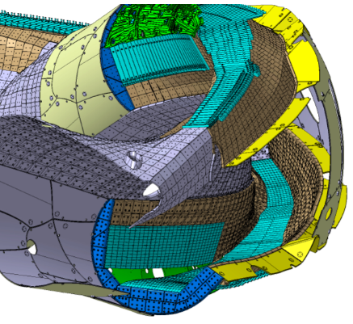
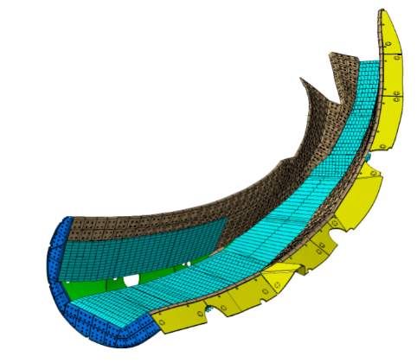
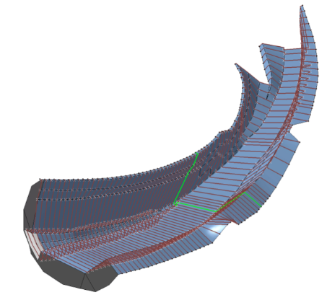
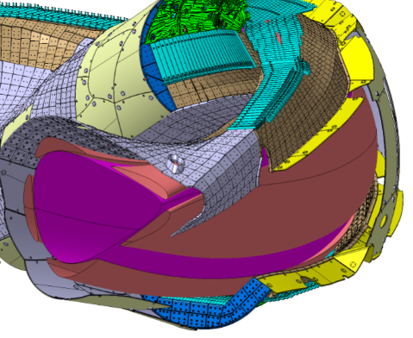
W7-X design tools with CATIA – for modified geometries
the grid model [T. Sieber]
detailed CAD geometry of one divertor unit
reduced grid model with limited number of grid points
the modeling activities are supported by the development of efficient engineering tools in a CATIA environment that process the complex 3D W7-X design data at different levels of sophistication to promote an efficient interchange with the physics-based codes

