Slide 1
Divertor Optimization Activities
Amit Kharwandikar

Slide 2
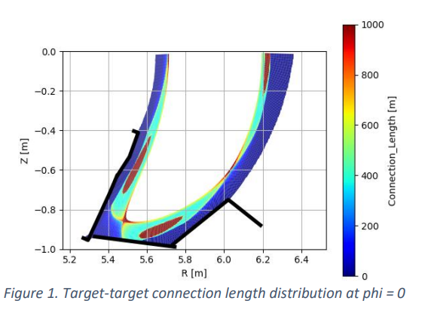
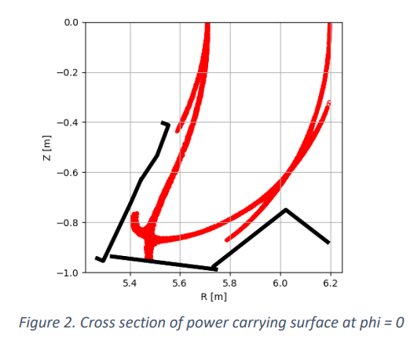
Simplified Heat Flux Prediction Tool
Most of the power flows along the long field lines that come close to the LCMS
Confined Core Plasma

Slide 3
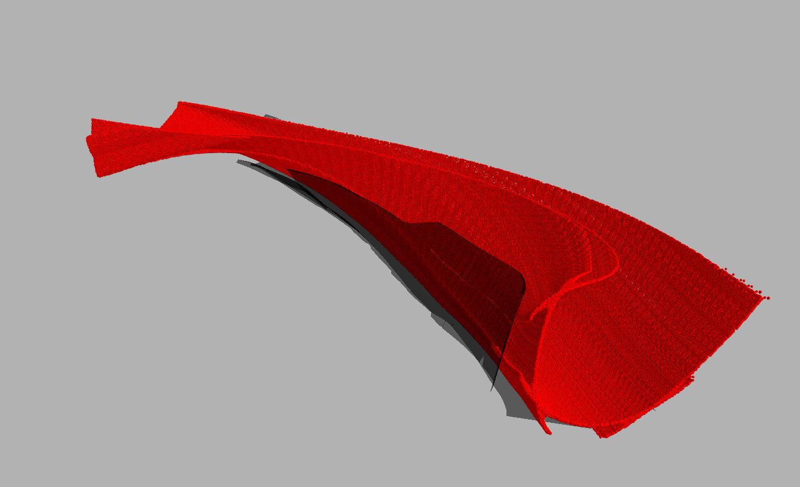
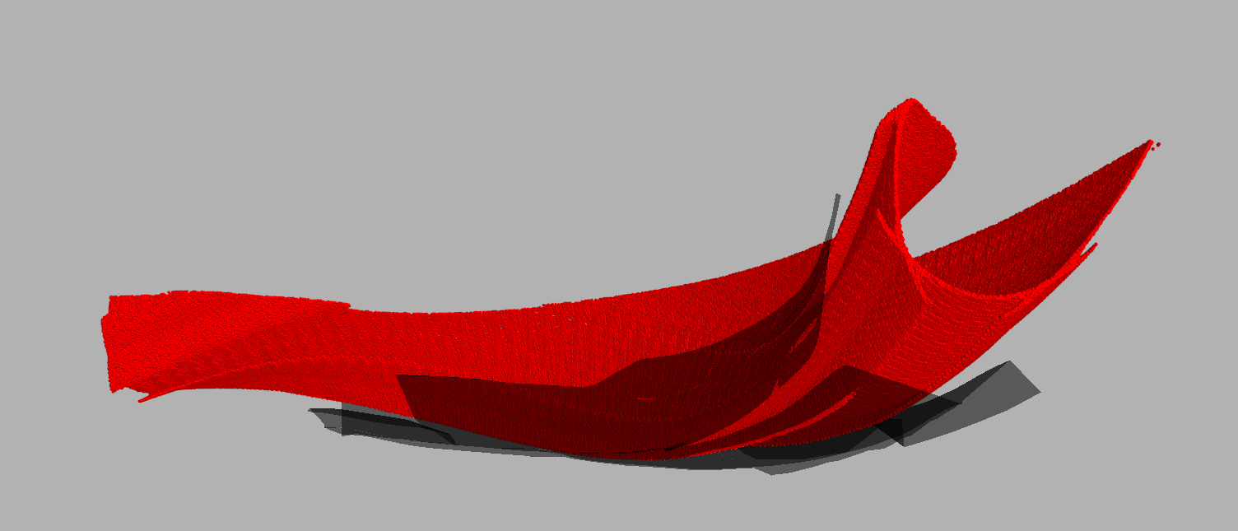
3D Power Carrying Surface

Slide 4
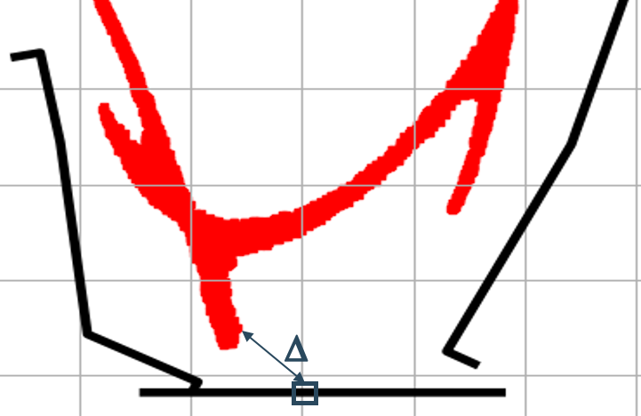
Ansatz

Slide 5
Ansatz
qs∥ -> constant parallel heat flux flowing in the surface = Psol/Ator -> Scaling factor
λ⊥ -> parametric Scale length -> Perp vs Parallel transport
sin(α) -> perp component of power incident on PFC
2 simple dependencies on magnetic topology: ∆ and α
Fixed parallel transport, only play with perp. transport

Slide 6
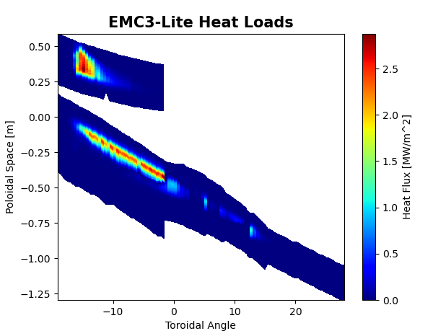
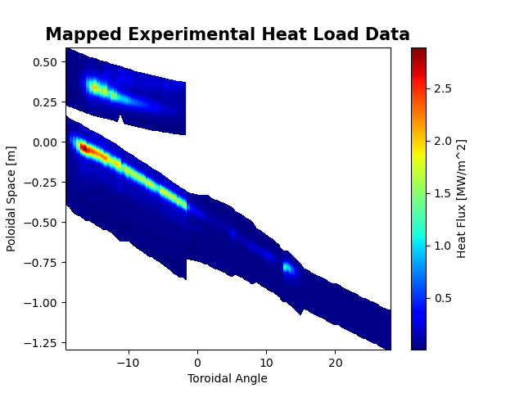
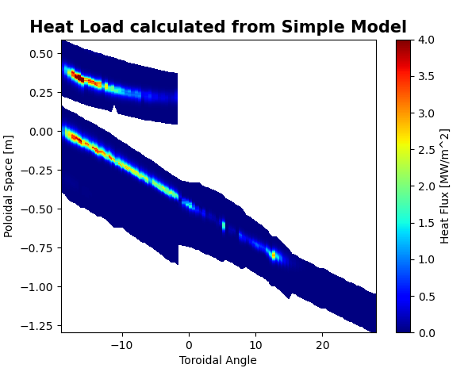
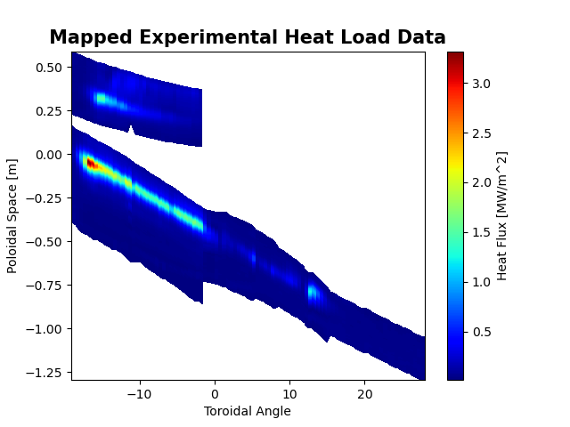
Results
Upper Divs
Avgd
Lower Divs
Avgd

Slide 7
Results

Slide 8
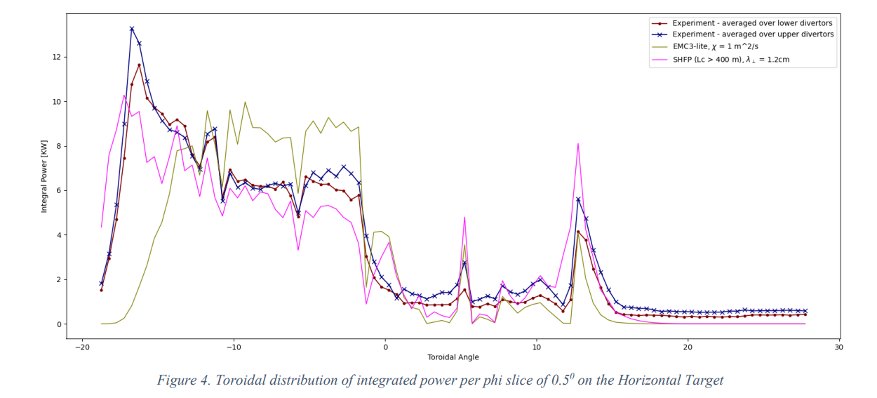
Results

Slide 9
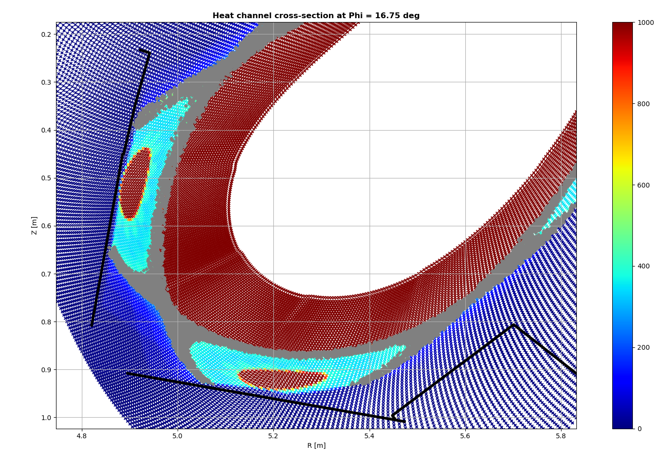
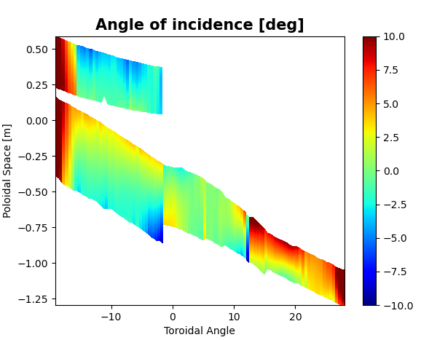
Main Features and Assumptions
Anisotropic Transport
-> Perp. To Flux surfaces vs Binormal
-> isotropic assumption
- perp. transport missing

Slide 10
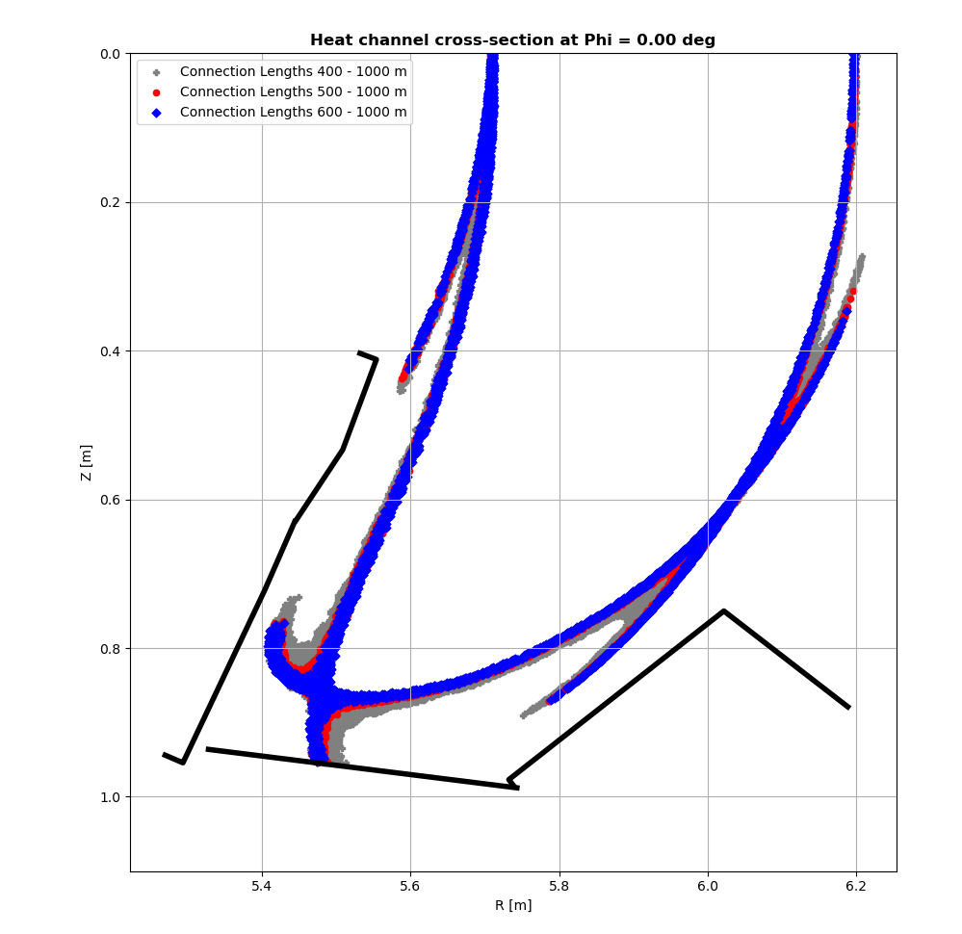
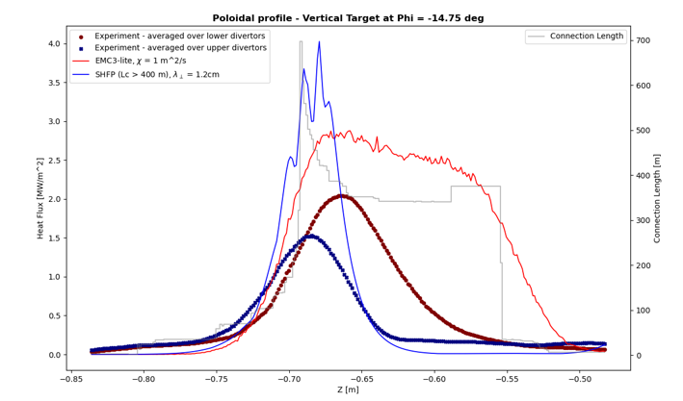
Main Features and Assumptions
Effect of Flux tube selection
-> dictates qs∥
-> dictates perp. To flux surface transport

Slide 11
Advantages and Limitations
Need a fast tool to scan the vast parameter space of PFC geometry
Advantages:
-> Given magnetic topology: faster (x10), simpler, captures main trends of HF and depo. Power
-> Can scan effect of plasma parameters on transport w/o retracing
-> 1 Global parameter sufficient, no MC -> statistics not important
-> No shadowing information explicitly included -> Low LC heat loads captured
Limitations
-> Only apt for target heat loads as of now, i.e. no baffles
-> Incomplete physics description
-> Dependence on resolution of FLT, prep. phase time-consuming right now
-> Overestimation of HL at various locations

Slide 12
Proposed Tool Utility
SHFP predicts potentially unsafe regions on PFCs for given magnetic topology
-> 3D power carrying layer plays important role
Not essentially a HF prediction tool for optimization
-> Keep the Power carrying 3D surface away from regions of high incidence angle
The actual drivers of perpendicular transport not important
-> From P.O.V of divertor optimization, only a proxy for acceptable heat load distribution and peak heat load important
-> SHFP promising capabilities to act as a fast tool for divertor optimization

