Slide 1
EEG23_P06 Integral component design for W divertor in Wendelstein 7-X using novel technologies
Thierry Kremeyer¹ et al
¹ Max Planck Inst. for Plasma Physics, 17491 Greifswald, Germany

Slide 2
Exhaust optimized, reactor relevant divertor target geometry for W7-X based on a first principles, design science research approach
Why do we need a divertor?
Exhaust with current W7-X island divertor
Project objectives
Divertor first principles
Design Science Research
Milestones
Notes:
Talk about H fuel cycle at W7-X, with a focus on particle exhaust, in particular on the role of the target geometry after neutralization.
First I will briefly summarize why we need a divertor and which metrics we use to qualify exhaust
Present the magnetic field of W7-X and how we use the edge island structure as an interface for a divertor.
Introduce the processes of the H fuel cycle and walk you through each one at W7-X
What changes with detachment
Conclusion
Finish by extrapolating design criteria for a reactor divertor that are applicable to Tokamak and Stellarator and ask you some questions for the discussion
*Click* To keep things simple:
Standard configuration
ECRH only, no NBI or ICRH
Gas fueling only, no NBI or pellet
Boronized wall
Engineering approach:
Simple as possible, accurate as necessary
Uncertainties: When in doubt, take the conservative estimate to achieve a valid conclusion

Slide 3
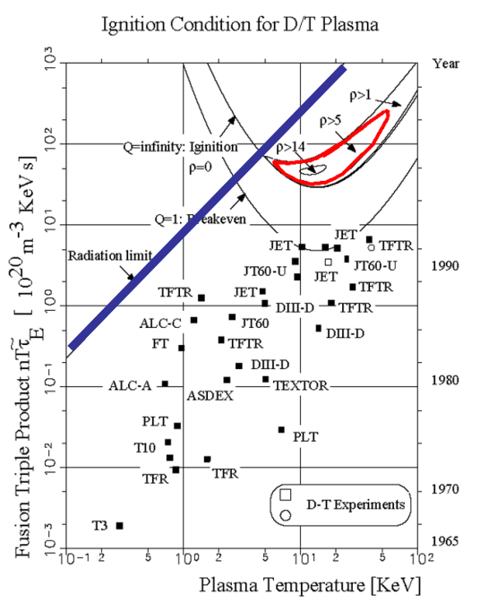
Why do we need a divertor? Particle control!
Reactor perspective – He concentration shrinks operational space
He produced in a reactor, has to be removed
Depending on assumed concentration of additional impurities ρ must be less than 10-15, the lower the better
Operational perspective – Density control
Particle exhaust > wall source wall independent density
Particle exhaust = Particle source stable density in equilibrium
Flat profiles Particle exhaust = Wall source
Peaked profiles Particle exhaust = Core + Wall source
Only neutral particles can be removed
Target to intercept,neutralize and exhaust particleflux Divertor
$$ρ=\frac{τ_{α}^{∗}}{τ_{E}}$$
[R. Schneider, Fusion Lectures]
Notes:
Why do we need a divertor?
Yesterday a lot about Power exhaust,
Necessary: In a reactor, the produced He has to be removed, as an increasing He concentration shrinks our operational space up to the point where no operation is possible.
Rho central metric, effective He core confinement time over energy confinement time.
Also be translated into He concentration. To much He radiates power away
Recent research suggests that we have to be more on the lower side, the lower, the better
BUT also operational important for density control.
Ideal world: No source, nor sink, purely fueled by recycling (not too far from W7-X)
But Wall source and sink. Sink no issue, just fuel more, outgasing source has to be exhausted.
Equilibrium: what goes in, must come out.
We need to exhaust particles, and we can only remove neutral particles.

Slide 4
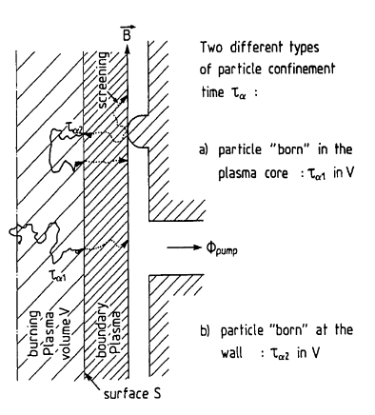
Divertor requirements and metrics
Reactor requirements: Exhaust enough particles to keep ρ < 10-15 $ρ=\frac{τ_{α}^{∗}}{τ_{E}}$ Γ_{He-Exhaust} = Γ_{He-Fusion}
Particle exhaust - Γ_{Exhaust} / Γ_{Ion Divertor} = η_{exhaust}
Particle collection - Γ_{Pumpgap} / Γ_{Ion Divertor} = η_{collection}
Particle removal - Γ_{Exhaust} / Γ_{Pumpgap} = η_{removal}
Particle plugging - Γ_{Divertor} _{Recycling} / Γ_{Recycling} = η_{plugging}
Impurity control - Keep confined plasma clean
Minimize erosion - T_{e} < 5 eV
Minimize R_{eff} - Divertor > Limiter
Subsequent requirements:
Heat load control/exhaust
< 10 MW/m² - Detachment?
Shallow incidence angles; Avoid leading edges
Material science
Low activation
Tolerance to high displacements per atom
$$τ_{α}^{∗}= τ_{α1}+\frac{R_{eff}}{(1−R_{eff})}τ_{α2}$$
[Reiter et al 1990 Nucl. Fusion 30]
Notes:
Particle exhaust after neutralisation – hard boundary condition is to keep rho below 10, and for a steady state reaction we need to exhaust as much He as is formed in the fusion reaction.
Divertor exhaust metric, how many of the neutralized particles are exhausted
Seperate into collection, what fraction of particles from the strike line make it into the sub-divertor
Removal, what fraction of the particles in the sub-divertor is removed
Additionally plugging: Keep particles that aren‘t exhausted in the divertor. Another chance for exhaust, minimize CX
Neutralize on targets – plasma wall interaction - Impurities out of confined plasma
Minimize erosion, T_{e}
Can‘t fully avoid it, keep erosion away from LCFS, so that impurities can ionize in SOL
*Click* These targets have to be engineered
Handle the heat loads
Materials that survive nuclear conditions
*Click* This talk has the goal to extrapolate design metrics for particle exhaust, based on the fuel cycle at W7-X

Slide 5
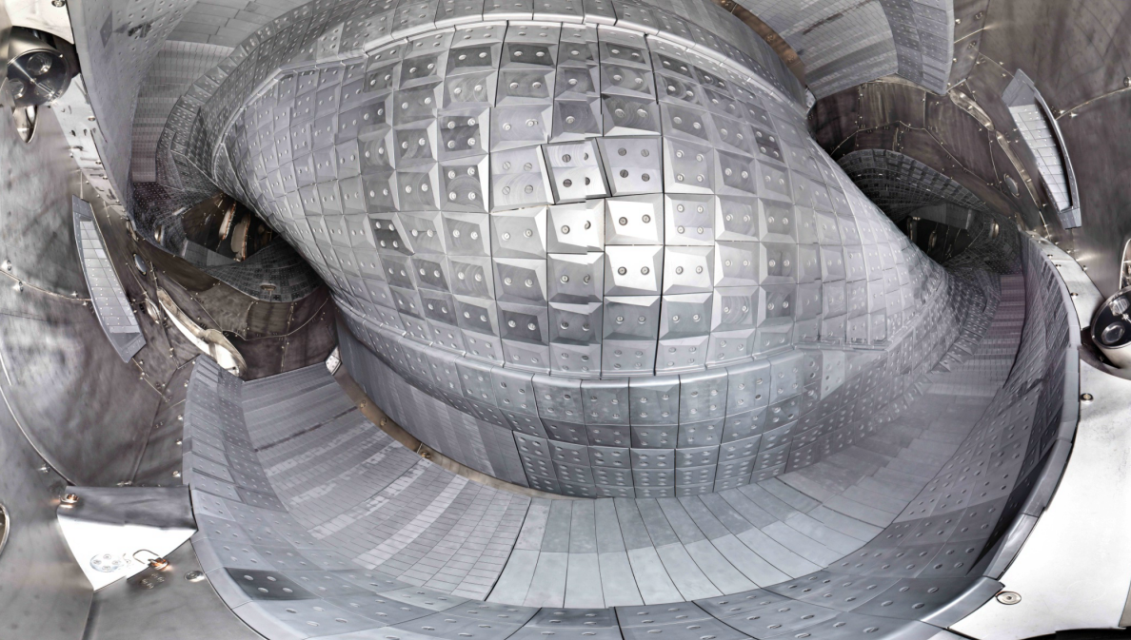
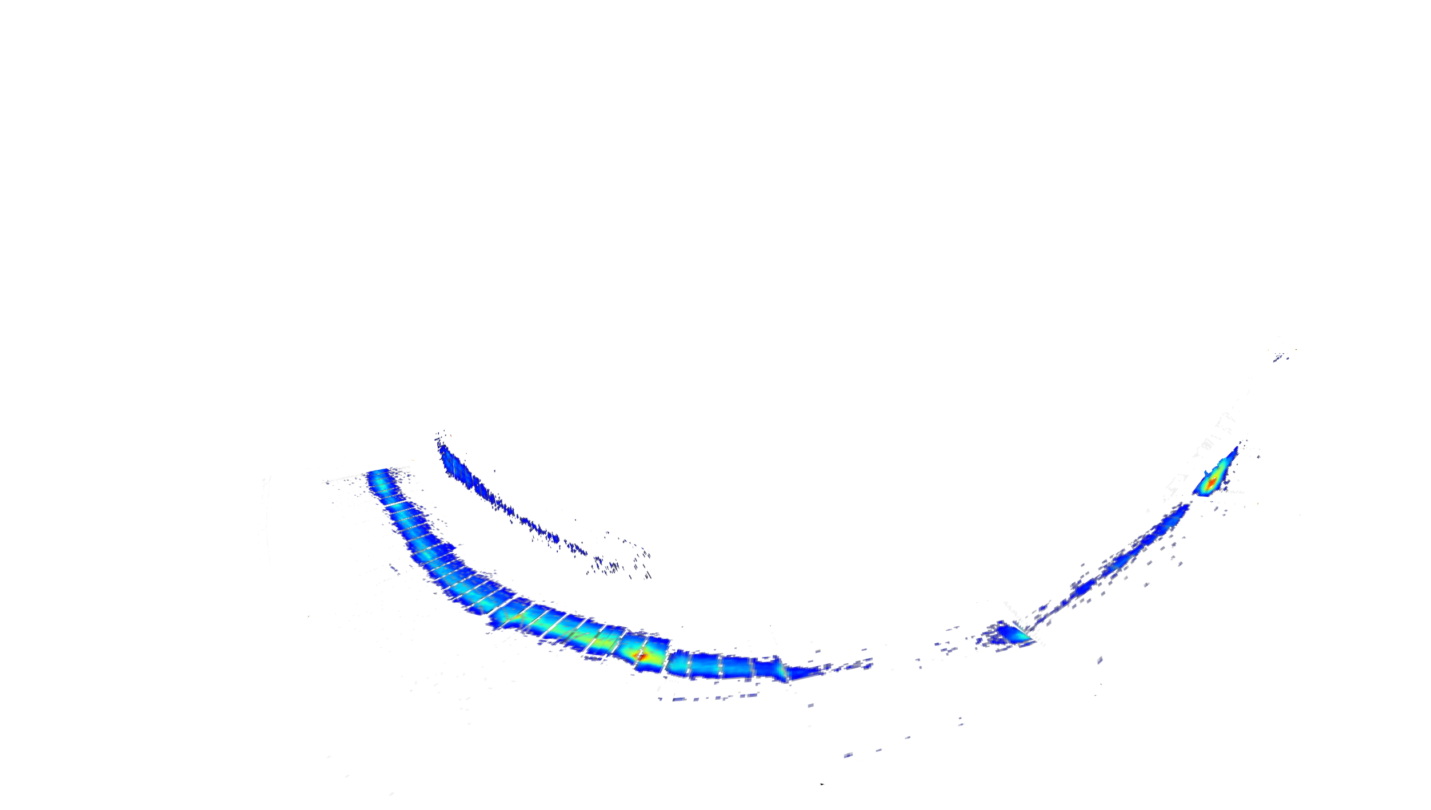
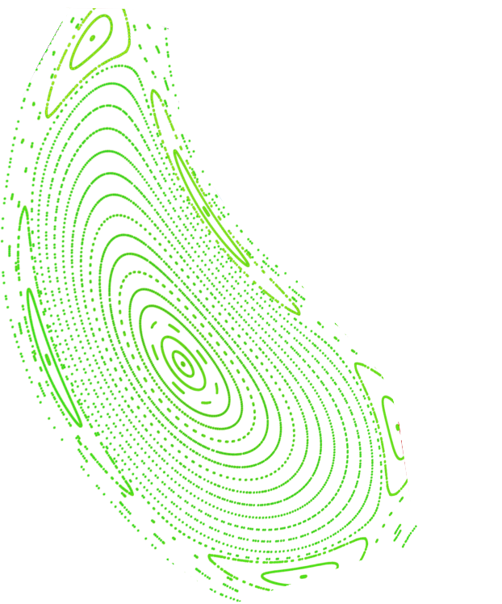
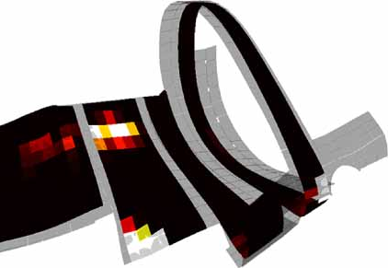
~99% of particles neutralize on divertor target
1 % of $Γ_{Recycling}$ arrives at the heat shield
[V. Winters, PPCF 2021]
$$Γ_{Ion target}=99 \% Γ_{Recycling}$$
$$Γ_{Ion target}=5.2×{10}^{22} 1/s$$
[D. Böckenhoff]
Notes:
Anomalous/Turbulent transport perpendicular across the LCFS
Undergo SOL transport in our island structure
*Click* As introduced earlier, these islands are intersected by our divertor target plates, Pump gap!
*Click* Modeling shows that these are our dominant recycling surfaces, as only 1% of particles are neutralized at other surfaces.
*Click* 99% of particles, mid 10^22 particles/s, arrive at the strike lines, shown here in an infra red image, on the vertical and horizontal target
Neutralisation – Collection – Removal - Plugging

Slide 6
Particle collection with an open carbon divertor
Ion
Neutral
Source
$$\cos{Θ}=\frac{Γ_{Recy}(Θ)}{Γ_{Recy}(0)}$$
(Re-) Ionization
Core confinement
$$\overline{l}=31 cm$$
$p_{PG}=0.12$Pa
SOL Transport
Neutralization
$$d_{SL−PG}=12 cm$$
Particle collection
Wall pumping
Particle collection:
Pumpgap opening ~ 68°- 90° ~7.3 % of $Γ_{Target}$ Only particles that dont
EMC3-EIRENE 4.0 % of $Γ_{Target}$ ionize on the way, make it to pump gap
Exhaust
Notes:
Targets in grey, poincaré plot in red, strike line through open field lines in blue.
Based on our temperatures, particles are released as 90% molecules, 10% atoms
After neutralization, assume particles leave in a cosine function along strike line
Most particles straight out of surface, following the cosine law, to no particles along the surface.
If ignore CX, particles can only reach pump gap, if they don‘t ionize
With our present pressures, neutrals travel 31cm before they collide with another neutral particle, far exceeding our distance from strike line to pump gap of 12 cm.
Obviously they will often ionize beforehand, in particular if flying towards the plasma, ionisation length much shorter.
*Click* Based on this we can estimate what maximum fraction of particles can make it into the pumpgap based on the initial flight path and opening angle of the pump gap to the strike line – maximum of ~7%, only if particles don‘t ionize on the way.
EMC3-EIRENE modeling that does take these processes into account arrives at 4% of particles.
Since the collected fraction is so low, plasma plugging is important. Keep particles in the divertor
*Click* Plugging traps neutrals by physical objects, or ionized by plasma and transported back to strike line.
Particles can leave poloidally as seen here in H density in modeling.
But unlike in a tokamak our divertor is not toroidaly closed

Slide 7
Particle removal and sub-divertor leakage
DIVGAS modeling
Ion
Neutral
$$Γ_{Leakage}$$
$$Γ_{Ion target}$$
Source
$$Γ_{Pump gap}$$
(Re-) Ionization
Core confinement
$$Γ_{Exhaust}$$
Neutralization
SOL Transport
$$Γ_{Ion target}=5.2×{10}^{22} 1/s$$
$Γ_{Pump gap}=4 \% Γ_{Ion target}$
$$Γ_{Exhaust} =p_{n}×S_{eff}$$
$$Γ_{Exhaust} =6\%Γ_{Pump gap}$$
$$Γ_{Leakage}=Γ_{Pump gap}−Γ_{Exhaust}$$
$$Γ_{Leakage} =94\% Γ_{Pump gap}$$
Particle collection
Wall pumping
75% leak through Pumpgap
Exhaust
Notes:
Lets take a look at our sub-divertor space. Red plasma, grey is the divertor, blue is the pump duct with our TMP‘s at the end.
Particles arrive at the target as ions and are neutralized.
Modeling 4% make it through the pump gap
Mean free paths so long, just wall collisions, almost random probability how they leave the sub-divertor: they end up in the pump duct, pump gap, or another gap.
Sub-divertor particle balance, rest leaks back into main chamber.
Biggest opening is pump gap, but other leaks as well.
*Click* DIVGAS modeling one step further simplified divertor geometry with 15 largest gaps, identified pump gap leakage with 75% of Gamma_pumpgap

Slide 8
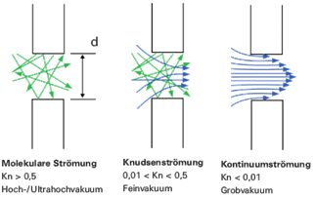
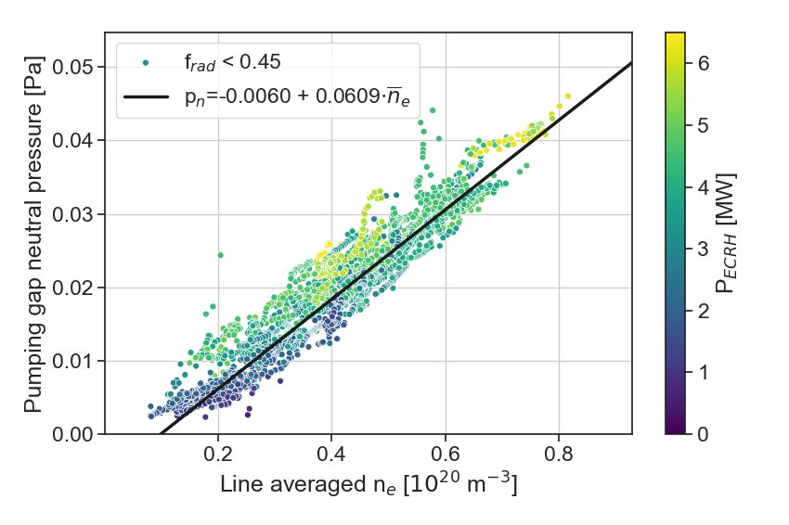
Continous flow minimizes leakage
How to access continous flow regime?
Increase pump gap opening
Increase pump gap pressure
Shifting strike line closer to pump gap
Increasing density
Change the target geometry
I_{cc} = 0kA $d_{SL−PG}=12.1 cm$
I_{cc} = 2kA $d_{SL−PG}=6.2 cm$
Increase of p_{PG} by 25%
Shifting SL as close as possible to PG
Increase of p_{PG} ~50%?
[www.pfeiffer-vacuum.com]
$Kn= \frac{\overline{l}}{d}$ $d_{PG}=90 mm$
 | Best OP1.2 | Knudsen | Continuos
Kn | 3.4 | < 0.5 | < 0.01
$\overline{l}$ [m] | 0.31 | 0.045 | 0.0009
p_{pg} [Pa] | 0.12 | 0.82 | 40
$\overline{n}$_{e} [10¹⁹ m⁻³] | 13 | 135 | 6569
[V. Perseo]
Notes:
How can we stop particles from escaping the sub-divertor? Continuous flow!
Molecular – only collisions with wall
Knudsen – some collisions with particles, flow is starting to evolve
Continuous – particles can‘t go against the flow anymore, too many collisions
We can look at the best OP1.2 case, you hear a lot about divertor compression, but in the end we only compress from an ultra high vacuum to a high vacuum. Particles still just bounce from wall to wall.
See what pressure we need for other flow regimes:
Increase pump gap opening – can‘t easily do that.
Pump gap pressure, transport more particles to the pump gap
Shift strike line, one main experiment, increase collected fraction
Increase density, increase absolute number available
End up with densities that are absurdly high, where we don‘t have power, nor even the technology to couple to these high densities with ECRH

Slide 9
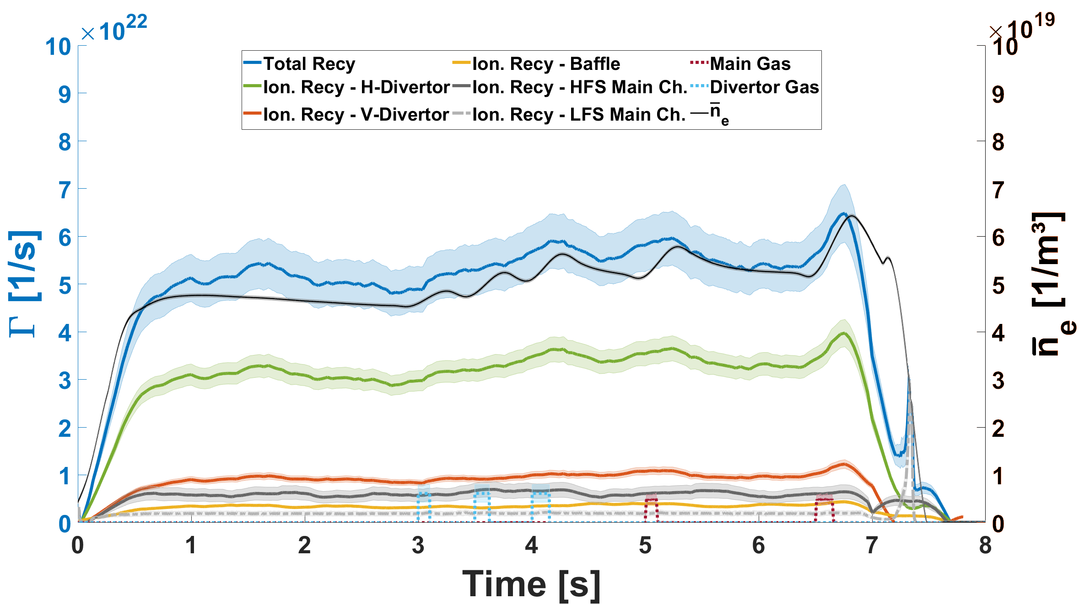
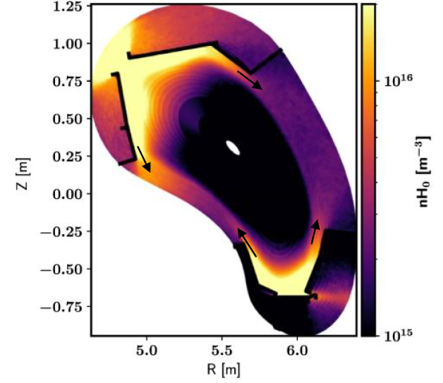
Re-ionisation shows good plugging
EMC3-EIRENE
modeling
Ion
Neutral
Source
(Re-) Ionization
Core confinement
H- Divertor 60%
HFS-MC 11%
[V. Winters, PPCF 2021]
V- Divertor 18%
Baffle 7%
LFS-MC 4%
Neutralization
SOL Transport
Neutral particles escape poloidally and toroidally from divertor
ID 20181010.010
[T. Kremeyer, NF 2022]
Particle collection
Wall pumping
Experimental | EMC3-EIRENE
η_{Plugging} = 85 % | η_{Plugging} = 96 %
HFS-ionization = 11 % | Poloidal losses = 2.5 %
LFS-ionization = 4 % | Toroidal losses = 1.5 %
Exhaust
Notes:
Particles that aren‘t absorbed, or pumped will eventually re-ionize.
The ionization process main source for H_a radiation. Particle fluxes can be inferred from the photon flux and effective S/XB coefficients. Due to different plasma parameters these are different for the divertor and main chamber components.
Cameras observe the divertor modules and large fractions of the main chamber, which are then scaled to the full surface.
Between neutralization and ionization significant neutral transport can happen, i.e. insufficient divertor plugging.
*Click* Cameras used to measure total recycling flux, but can also localize above which surfaces the ionization takes place. Measurement at the point of ionization.
Most particles above H and V target, some above baffle
But neutrals can escape poloidaly and toroidaly and ionize in the main chamber.
Not due to sub-divertor leakage, but imperfect plugging lets 15% of particles escape

Slide 10
Full magnetic flexibility at effective, but in-efficient exhaust
Particle collection dominated by pump gap opening angle to strike line
Sub-divertor leakage dominated by pump gap
Exhaust and Wall source at same order
Good plugging, despite toroidally open divertor
Stable detachment opens up neutral channels
W7-X detachment decreases particle flux towards divertor
$$Γ_{Leakage}$$
$$Γ_{Ion target}$$
$$Γ_{Pump gap}$$
$$Γ_{Exhaust}$$
Attached Detached
$$Γ_{Ion divertor}=99 \% Γ_{ion}$$
$$η_{Collection}=4 \% Γ_{Ion target}$$
$$η_{Removal} =6\% Γ_{Pump gap}$$
$$η_{Exhaust} =<1\% Γ_{Ion divertor}$$
$$η_{Plugging} =85 \% Γ_{Ion divertor}$$
$Γ_{Ion divertor}$ decreases 60 %
$$η_{Collection}=12 \% Γ_{Ion target}$$
$$η_{Plugged}$$
Notes:
First:
Island divertor works effectively in all magnetic field configurations. R close to 1, equilibrium with stable densities.
Flexibility was bought with low exhaust efficiency, drastically limiting our fueling. T_i clamping with pellets.
However enough to compensate wall source in most cases.
Particle collection – opening angle, or really high density to get into continous flow but lack power and technology
Sub-divertor leakage – not enough collisions, molecular flow, pump gap is
detachmend will always decrease plugging, plugging less relevant at higher exhaust efficiency
1% less efficient and we wouldn‘t even be effective
Active control on exhaust is limited, strike line shift doesn‘t have a large effect, rest depends primarily on density

Slide 11
Exhaust optimized, reactor relevant divertor target geometry for W7-X based on a first principles, design science research approach
Maximize particle exhaust
Throttle makes exhaust an active control parameter
Reactor relevance
Evaluate design at higher power densities (30MW?)
Feasibility of remote handling in future
Decrease design cycle time
Decrease cost
Utilize standardized target module, developed in parallel
Smaller?
Uncooled? (Allow for 30s, 1 min, 5 minute,? minutes operation)
Retain magnetic flexibility
Moveable targets?

Slide 12
Divertor first principles
Neutralization – Only neutral particles can be exhausted
Subsequent requirements: Power handling: 10 MW/m²; T_{e} < 5 eV;
Detachment likely necessary: Stability, Controlability Conflict with 2.
Minimize (optimize) R_{eff} – Keep recycling particles outside of LCFS
Direct particle collection – Initial flight path directed to pumpgap
Build up neutral pressure - Keep neutrals, neutral. Initial flight path away from plasma
Sub-divertor removal - Continuos flow at pumpgap, minimize $Kn= \frac{\overline{l}}{d}$
Plugging - Less relevant as η_{exhaust} increases , Block escaping neutrals by
Baffles: - Thermal loads
Ionization: - Weakend by detachment
High density in divertor, but not in main chamber

Slide 13
Design Science Research
Environment Design Knowledge Base
Reactor
$ρ=\frac{τ_{α}^{∗}}{τ_{E}}$ < 10-15
Power density
Remote handling
Material science
Wendelstein 7-X
Density control
Spatial boundaries
Magnetic flexibility
Technology
Cost reduction by
Standardized TM
Uncooled TM
Moveable target
Decrease V_{plasma} , increase V_{Div}
People
Roles
Capabilities
Characteristics
Develop/Build
First principles
Theories
Evaluate/Justify
Analytical
Simulation
Experimental
Foundations
First principles
Theories
Models
Methodologies
Data analysis
Key metrics, $η_{Exhaust}$, $η_{Collection}$, $η_{Removal}$, $η_{Plugging}$,…
Validation criteria
Relevance Cycle
Needs
Requirements
Application
Rigor Cycle
Additions to KB
Applicable Knowledge
Refine
Assess
Notes:
Action research is problem centered, seeks to develop scientific knowledge while simultaneously acting to solve real problems.
Design Science Research is problem-solving oriented

Slide 14
Accelerated Design cycle - Reduced complexity by de-coupling problems
Analytical cycle (hours) Accelerated modeling cycle (days) Intensive modeling cycle (w/m)
Scope of this project
2D Target surface
Direct collection
$$\cos{φ_{Pumpgap}}$$
Direct collection
cos⁡〖φ_𝑃𝑢𝑚𝑝𝑔𝑎𝑝 〗
Neutral buildup
1-$\cos{φ_{Plasma}}$
Neutral buildup
1-cos⁡〖φ_𝑃𝑙𝑎𝑠𝑚𝑎 〗
Sub-divertor removall
$$Kn= \frac{\overline{l}}{d}$$
Sub-divertor removall
𝐾𝑛= 𝑙 ̅/𝑑
Refine
3D CATIA
EMC3 light
Amits simple model
COMSOL
Review addition:
Heat loads and flow regime
Refine
3D CATIA
EMC3-EIRENE
DIVGAS
Review addition:
Plasma/Neutral interaction
Detailed sub-divertor leakage
Plugging
Refine
Modeling Tools
Amits simple model - Strike line & heat loads
EMC3 lite - Strike line & heat loads
COMSOL - Multiphysics, capable of cross flow regime neutral modeling
ANSYS - Molecular neutral flow, by thermal calculation proxy
EMC3-EIRENE - Plasma + Neutral interaction; BGK Approximation for self collisions
DIVGAS - Only neutrals, no BGK approximation, needs EMC3-EIRENE input
Complexity
Speed
Notes:
Bhatnagar-Gross-Krook, uncertainty in continuous flow

Slide 15
Milestones
M1: Analytical cycle
D1.1: Comparison of existing 2D divertor target geometries in analytical cycle (W7-X, ITER, LHD, ASDEX, JET, JT60-SA, DIII-D,…
D1.2: Comparison of 20 new 2D island divertor target geometries
M2: Accelerated modeling cycle
D2.1: Apply accelerated modeling cycle to current target geometry as benchmark
D2.2: Comparison of 10 most promising 2D geometries in 3D
M3: Hand over of 5 target geometries utilizing standardized target module to Intensive modeling cycle
D3.1: 4 exhaust optimized target geometries for Standard, High Iota, High Mirror, and Low iota configuration
D3.2: 1 exhaust optimized target geometry with magnetic flexibility for 2+ configurations
M4: Recommendations for new target geometry for W7-X
D4.1 Final report with recommendation for exhaust optimized island divertor in W7-X

Slide 16
Training
Schule für Vakuum – 1 week training, 1590€
https://schule-fuer-vakuumtechnik.de/programm/
COMSOL training – CFD modules, 595$
https://www.comsol.de/events/training-course/cfd-modeling-with-comsol-107582
2 month mission to ITER:
Improve relevance cycle in respect to reactor relevance, nuclear, and remote handling requirements
2 month mission to ENEA:
Improve relevance cycle in respect to technology development, extend knowledge base regarding exhaust metrics used for DTT design

Slide 17
Appendix

Slide 18
Design criteria for a reactor divertor
Particle collection
Maximize pump gap opening angle – Cosine law initial flight path
How does initial flight path of neutrals change with W?
Particle removal
Minimize Knudsen number
Increase pressure
Particle collection
Particle plugging
Close poloidal and toroidal neutral channels
Block neutrals by baffles where thermal loads allow
Ionize neutrals
Weakend by detachment
BUT less relevant as η_{exhaust} increases
New target angle
Average initial flight direction
Dome necessary?
$$Kn= \frac{\overline{l}}{d}$$
[V. Winters, PPCF 2021]
How much exhaust do we need?
ρ < 10 SOL ? η_{exhaust}
Target geometry should provide more, throttle pumps
Notes:
New target angle where particles intrinsically move to the pumpgap
How much do we need to exhaust?
Target geometry should provide a bit more, throttle vacuum pumps
Generally don‘t want to exhaust more than necessary, filter out tritium.
You only need to plug, what you don‘t exhaust. Plugging becomes less relevant as exhaust efficiency increases.
Toroidal plugging only stellarator
2. What are the practical distinctions between your work for stellarator divertor design and those for tokamaks? How much of your work is applicable for tokamak divertor design also?
3. What are the uncertainties in projecting your work to reactor scale divertor design? In particular relate this uncertainty to the background divertor and SOL plasma. What aspects, or parameters, of the plasma solution are most critical for divertor design from the perspective of your work? This will help in the following discussion of identifying the most critical work for Div/SOL physics going forward.

Slide 19
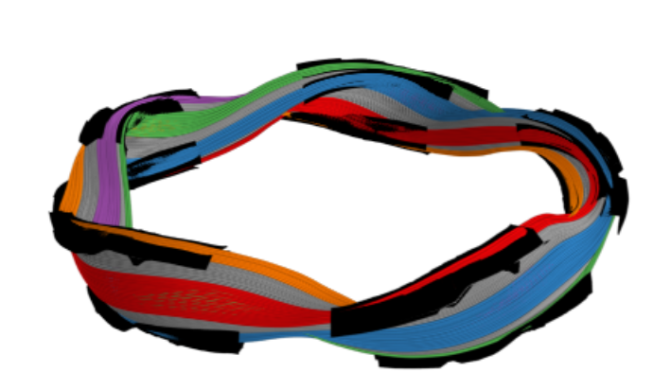
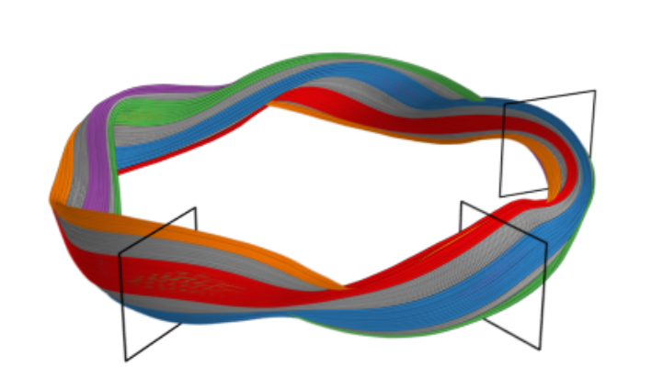
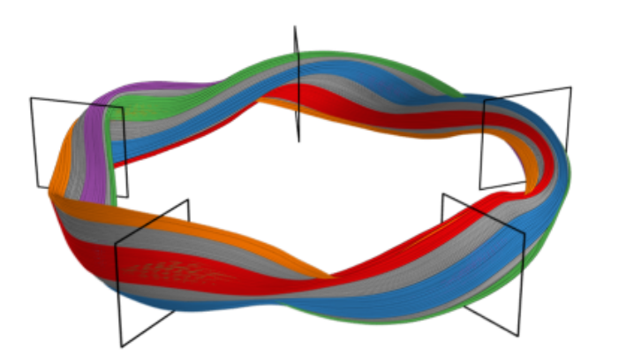
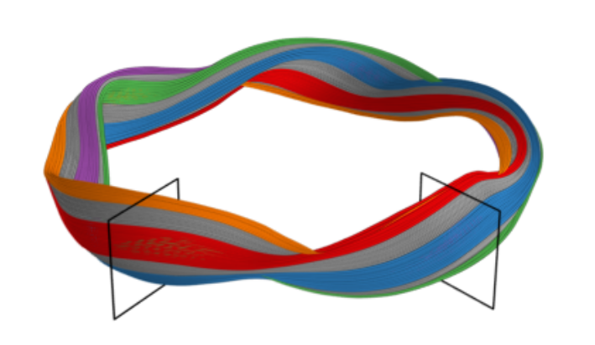
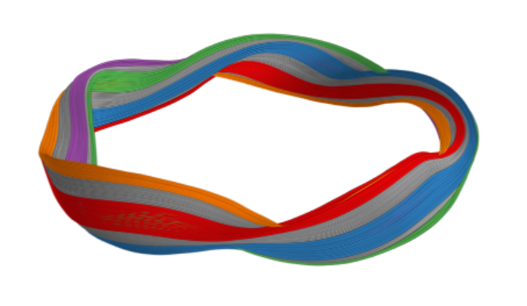
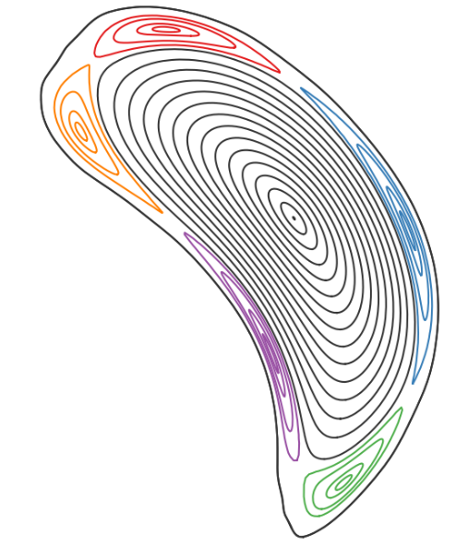
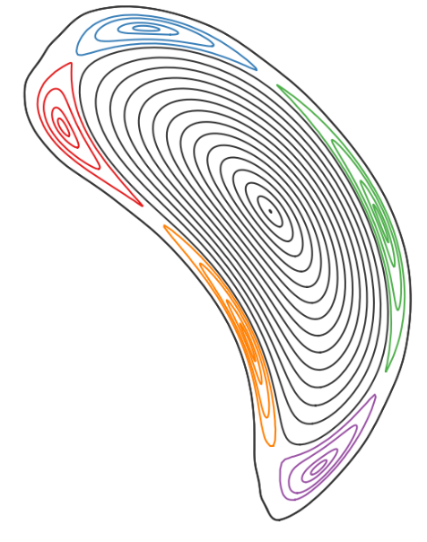
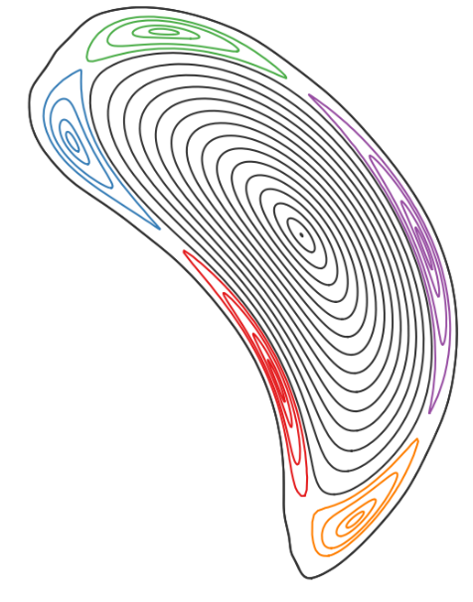
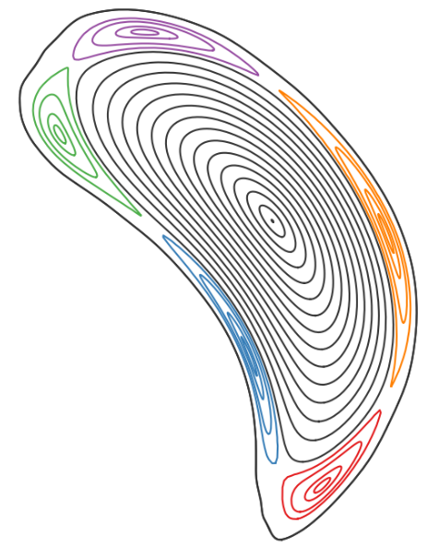
Magnetic islands form interface for the divertor
Magnetic islands twist around the central plasma and connect the different divertor modules
[V. Perseo]
Example of
standard configuration
SOL with 5
independent islands
W7-X divertor:
island divertor
10 units
made of fine graphite
Notes:
Standard configuration, 5 independent island bands wrap around the central plasma
Poincaré plot, LCFS in black defining the core, individual islands color coded.
As we go around the device toroidally, we see how the islands rotate, with an iota of 1 where islands complete one poloidal turn per toroidal turn.
Islands are intersected by target plates and form an interface with the plasma.
10 divertor units, unlike Tokamak divertors toroidally open.

Slide 20
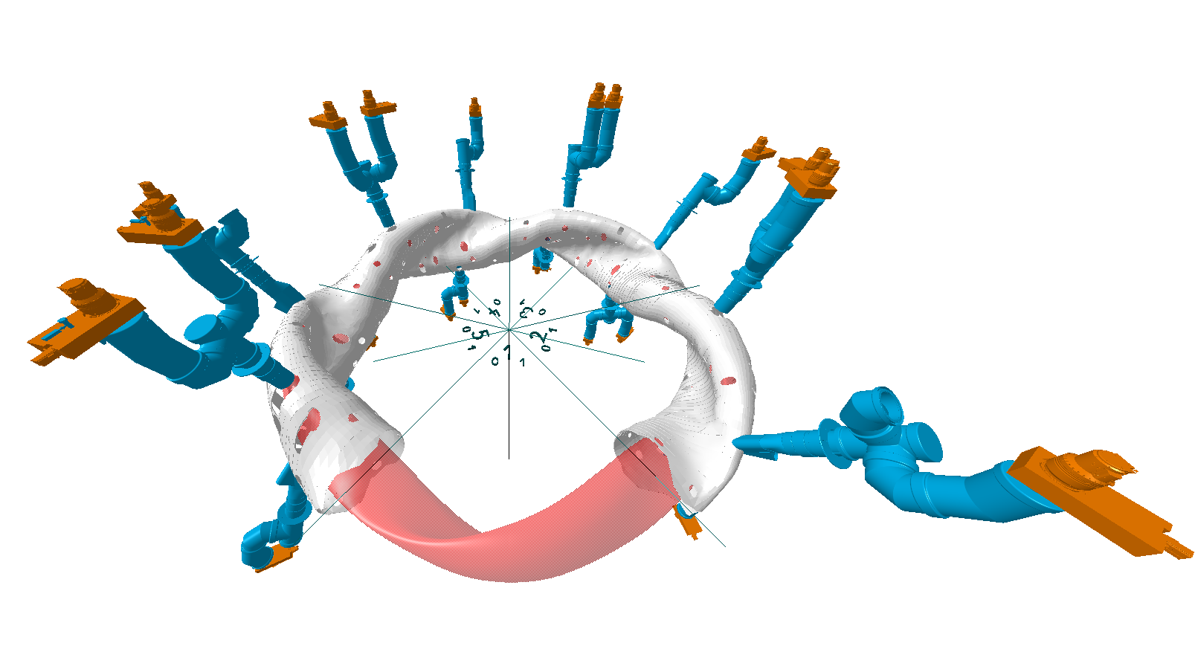
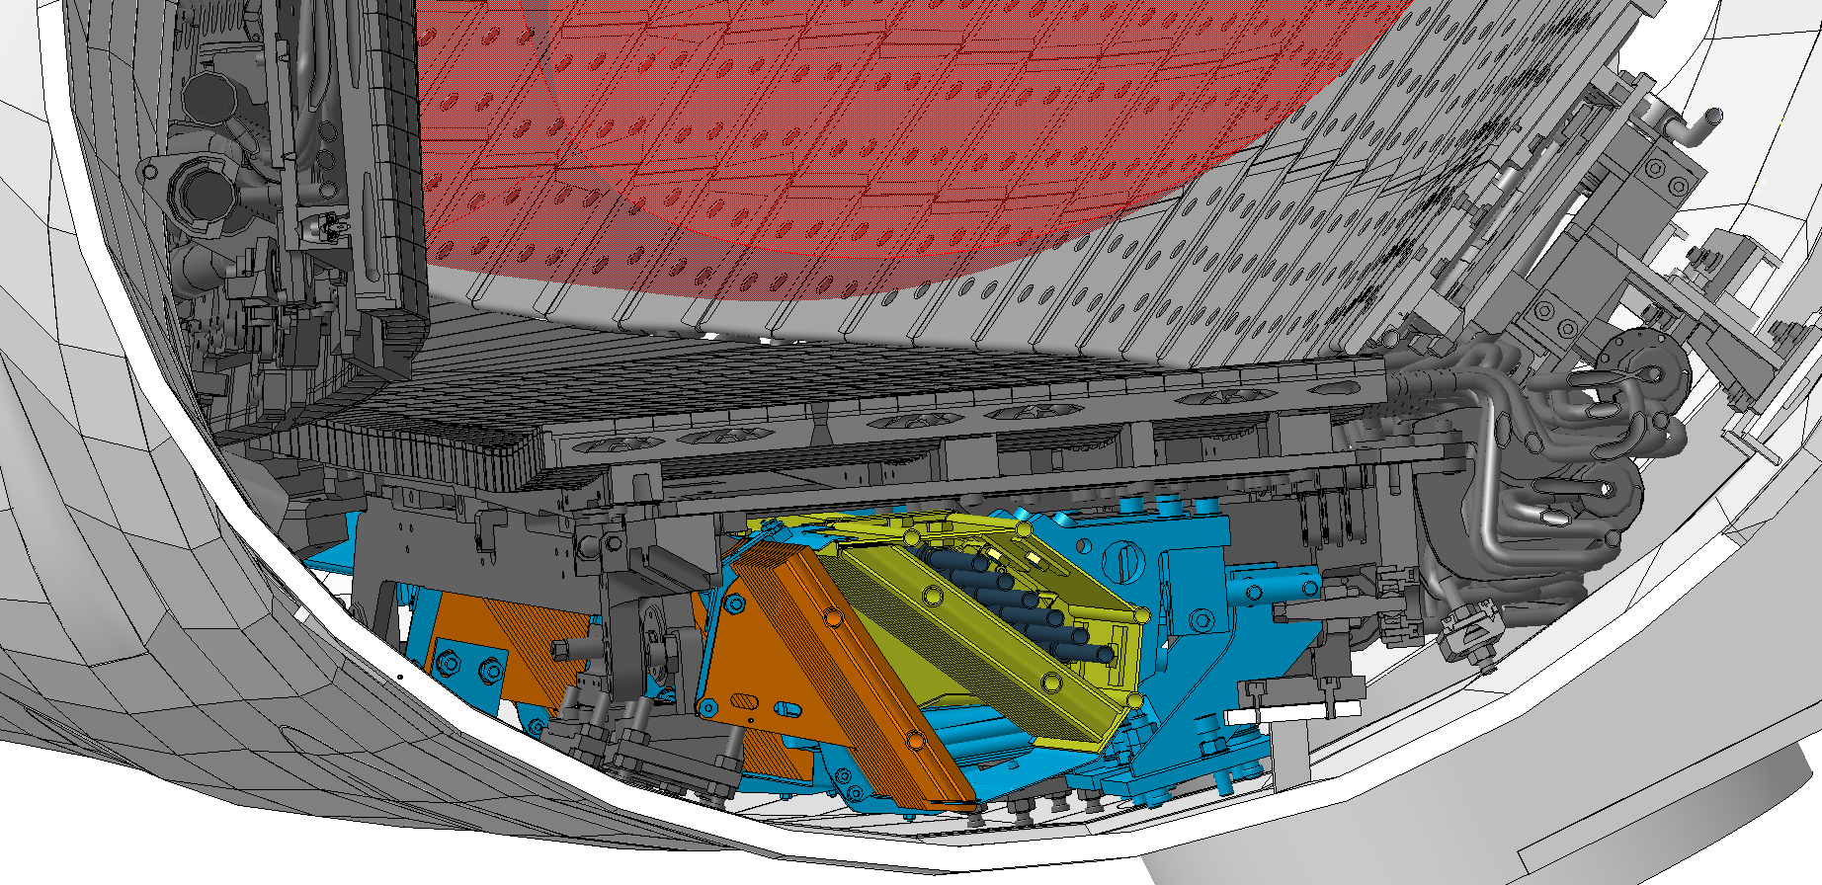
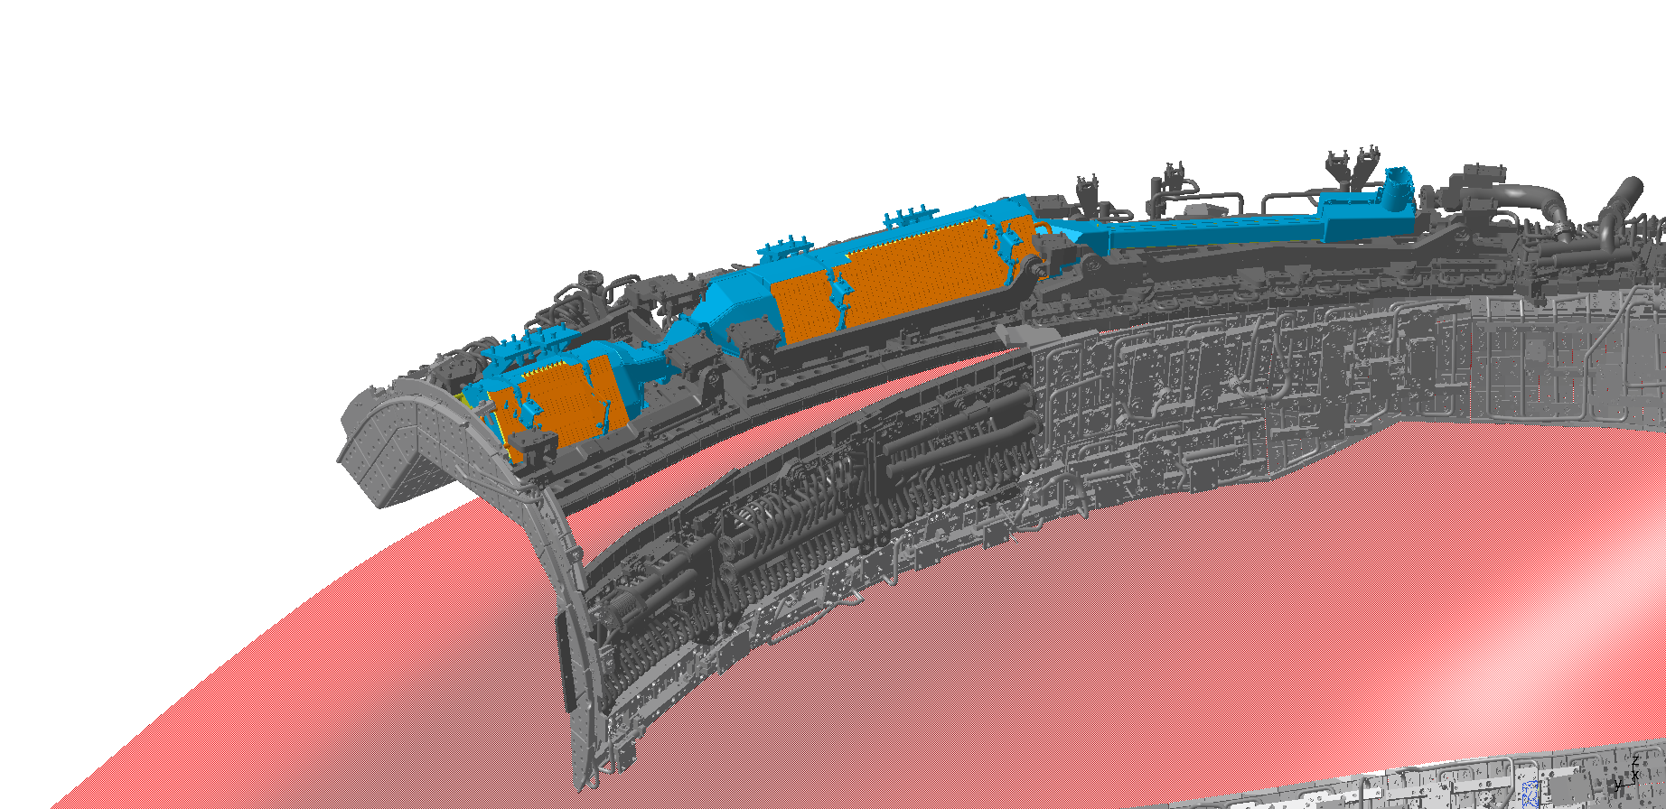
Two active main particles sinks
3 Turbo molecular pumps (TMP) for each divertor module
Cryo vacuum pump (CVP) in each low iota sub-divertor
TMP + Gate Valve
Pump duct
Plasma
Baffle
Divertor
Ion
Neutral
Source
(Re-) Ionization
Core confinement
Neutralization
SOL Transport
Pumping system | Sub-divertor pumping speed
Turbo molecular pumps | 29 760 l/s
Cryo vacuum pumps | 106 100 l/s
Particle collection
Wall pumping
Exhaust
290 K Chevron 80 K Chevron 4 K Sink
CVP Structure Plasma Baffle Divertor
Notes:
Picture, red plasma, white plasma vessel, blue pump duct, and orange the TMP‘s and gate valves.
3 TMP‘s for each divertor. 30 pumps in total acchieve roughly 30000 l/s
*Click* OP2 Cryo pump, sub-divertor in the low-iota section. Particles are gradually cooled until frozen to sink.
Particles can enter through orange surfaces
More than 3 times pumping speed than TMP, in addition to the exisiting TMP

Slide 21
H fuel cycle Ion Neutral
Core confinement
SOL Transport
Wall absorbtion/release
Source
(Re-) Ionization
Neutralization
Particle collection
Exhaust
Notes:
Go through processes
Particles introduced are ionized.
Ionized particles are confined either in the core or in the SOL. Inside LCFS is core!
Particles leave the SOL into Core, or strike divertor surface.
Implanted or neutralized
Neutral particles can also be absorbed or released from the wall.
Neutral particles in the divertor can be collected into sub divertor -> exhaust or go back
Or reionize and start another round in the H fuel cycle

Slide 22
Turbo molecular pumps create vacuum
TMP + Gate Valve
Pump duct
Plasma
Baffle
Divertor
Ion
Neutral
3 TMP in 10 Divertor modules
Total pumping speed: S_{eff} = 29760 l/s
Particles inside LCFS: $N_{tot}=\frac{p V_{LCFS}}{R T}$
Source
(Re-) Ionization
Core confinement
Neutralization
SOL Transport
$$V_{LCFS}=28.60 m3 ±0.85 m3$$
 | Pressure | N_{tot} inside LCFS
Base pressure | 5 E-8 mbar | 3.5 E+16 Molecules
In between discharges | 3 E-7 mbar | 2.1 E+17 Molecules
Particle collection
Wall pumping
Exhaust
Notes:
Flow chart on the right hand side as orientation, current step highligted in organe.
But before we can start with the fuel cycle, we start with close to nothing, our vacuum.
Picture, red plasma, white plasma vessel, blue pump duct, and orange the TMP‘s and gate valves.
3 TMP‘s for each divertor. 30 pumps in total acchieve roughly 30000 l/s
*Click* Base pressure mid E-8 mbar range, but in between discharges an order of magnitude higher.
Base on pressure we can calculate the number of gas molecules inside LCFS

Slide 23
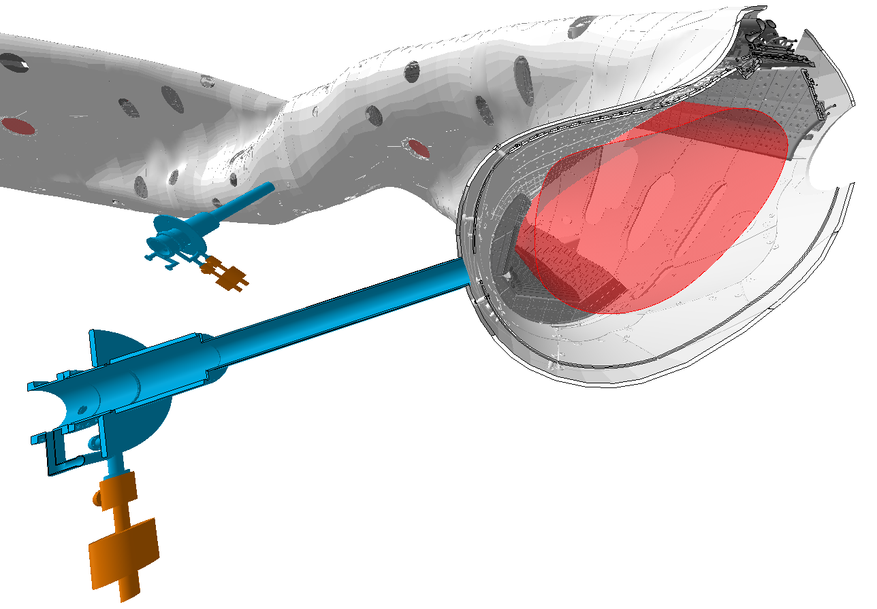
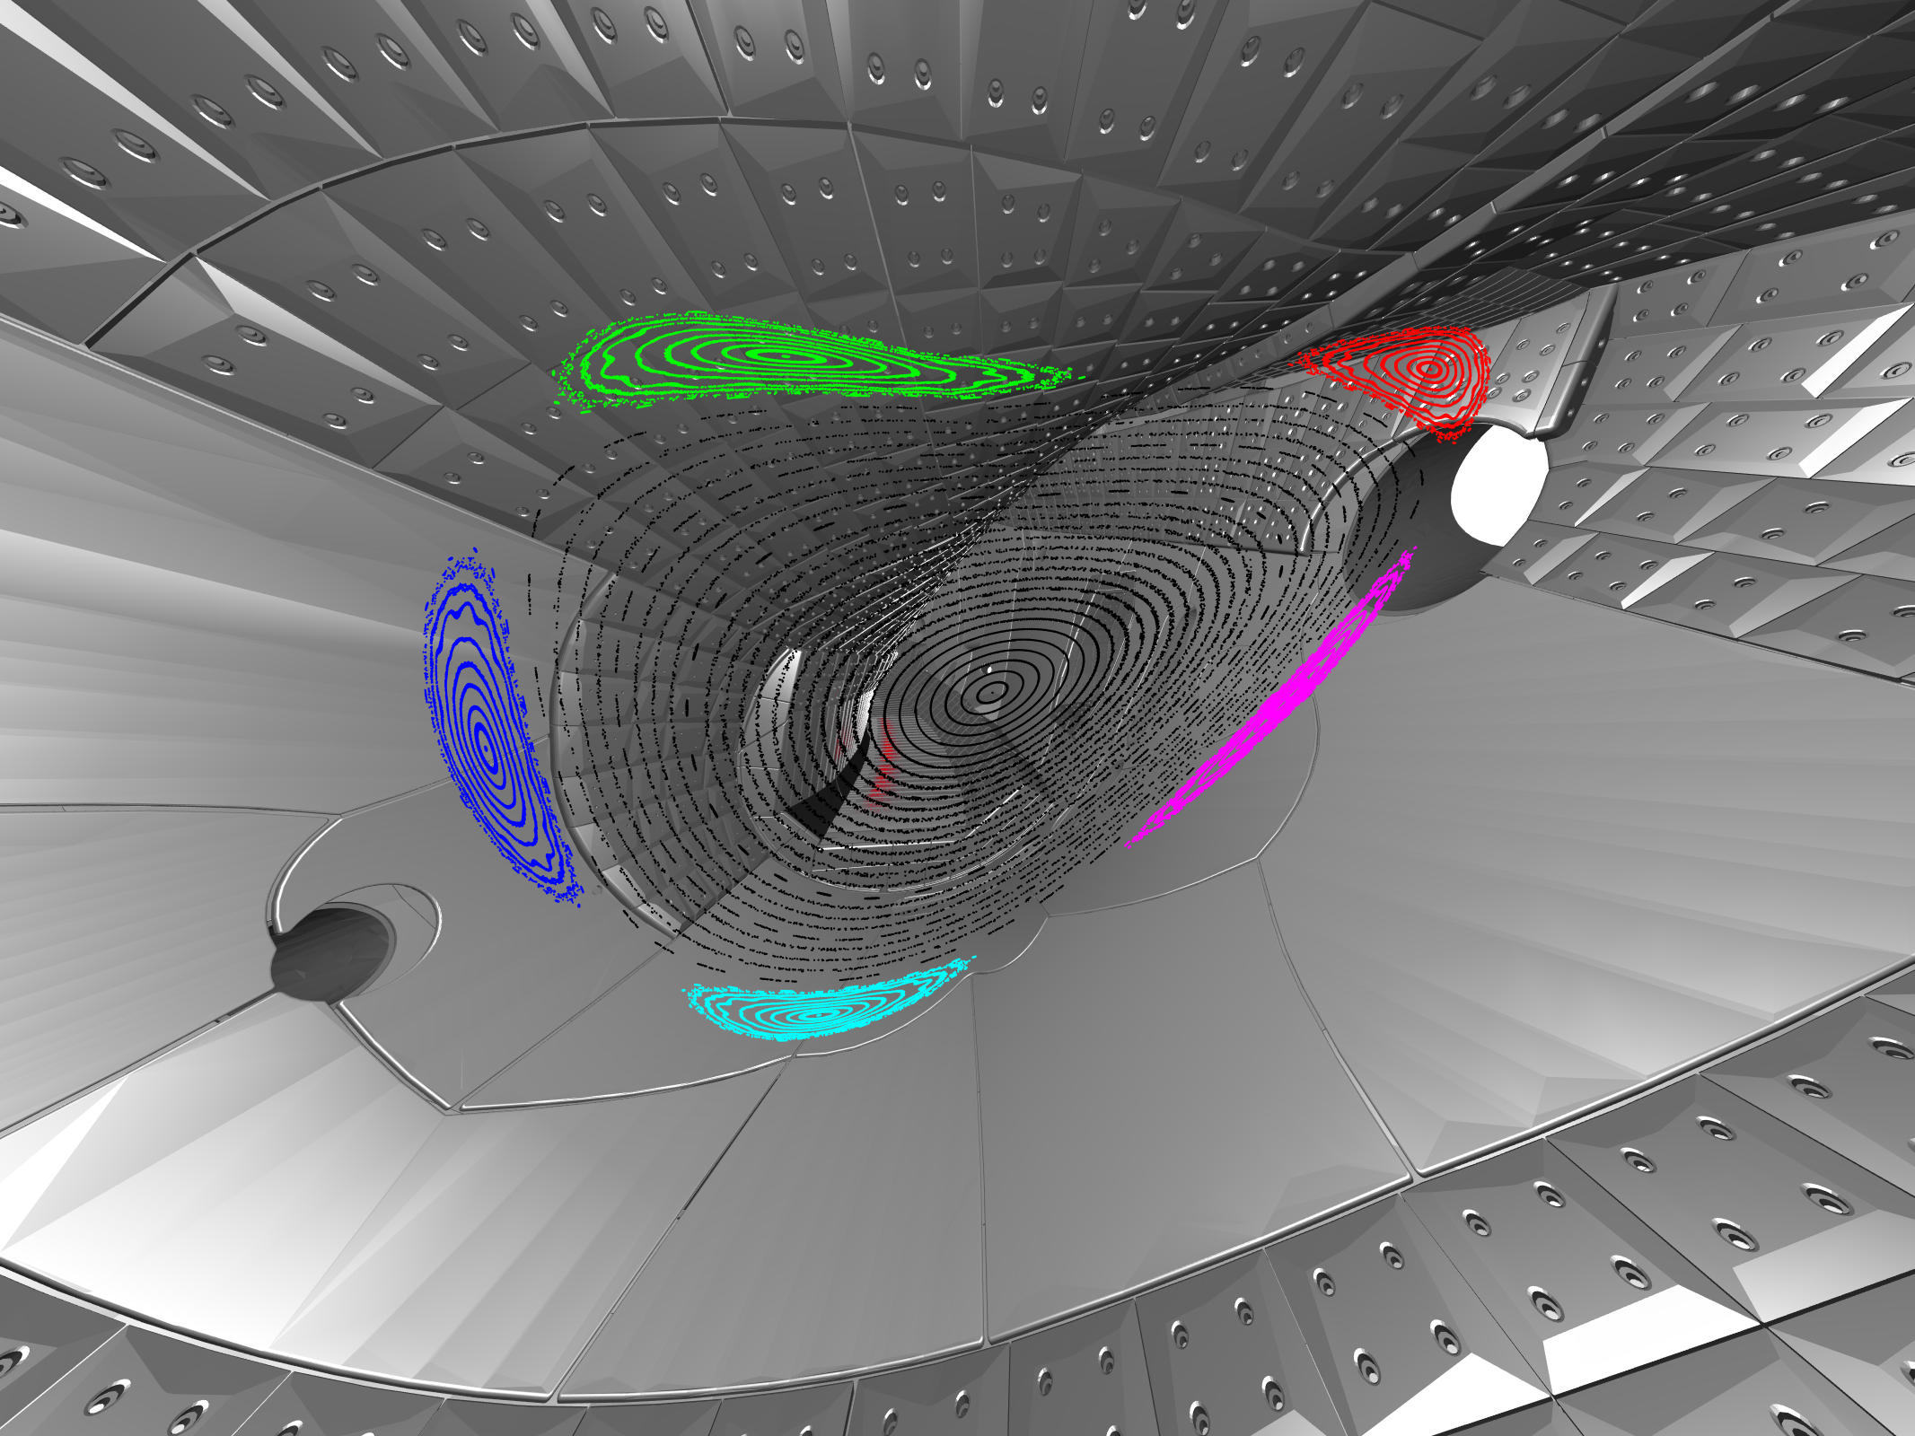
Main gas system pre fills particles
Ion
Neutral
Fueling rate 10x 4.8 E+20 – 4.8 E+21 e/s
Source
(Re-) Ionization
Core confinement
Valve Nozzle Plasma Baffle Divertor
Poincaré plot with
nozzle extension to LCFS in white
Neutralization
SOL Transport
 | Pressure | N_{tot} inside LCFS
Base pressure | 5 E-8 mbar | 3.5 E+16 Molecules
In between discharges | 3 E-7 mbar | 2.1 E+17 Molecules
Prefill | 5 E-5 mbar | 6.9 E+19 e⁻ (as H²)
Particle collection
Wall pumping
Exhaust
Only ~0.5 % not H
Notes:
Before we start a plasma, we need to introduce the particles that we want to turn into a plasma, in this case H.
Main gas system, the port as nozzle in blue, valve in orange.
Poincaré plot shows the location on lower inboard in respect to the island structure.
After the prefill, only ~0.5% not H

Slide 24
ECRH turns neutral gas into plasma
Ion
Neutral
10 Gyrotrons inject power at 4 ports
Maximum 7.5 MW at 140 GHz
Source
(Re-) Ionization
Core confinement
f_{rad}=17%
Neutralization
SOL Transport
$$N_{tot}= V_{LCFS}∗n_{e}$$
$$V_{LCFS}=28.60 m3 ±0.85 m3$$
 | Pressure | N_{tot} inside LCFS
Base pressure | 5 E-8 mbar | 3.5 E+16 Molecules
In between discharges | 3 E-7 mbar | 2.1 E+17 Molecules
Prefill | 5 E-5 mbar | 6.9 E+19 e⁻ (as H²)
Plasma |  | 1.5 E+21 e⁻
Particle collection
Wall pumping
Exhaust
Notes:
To turn neutral H into plasma we have the worlds largest micro wave system
The power of 10 gyrotrons is coupled into the machine through 4 launcher systems in orange.
*Click*Input power in blue, radiated power fraction in orange.
For our case 4.5 MW heat the plasma, of which 17% was radiated away with the rest of the heat load arriving at the divertor target.
*Click* Line averaged density in blue, particle source in red.
After pre-fill, ECRH turns on at 0s. Density builds up within half a second to 5E+19 1/m³. Sits in equilibrium without any external fueling. Later gas injections for fueling and confinement time studies.
With the plasma density we can calculate our total number of particles inside the LCFS.
Initial prefill is ionized and confined, remaining neutral gas outside of LCFS is also ionized, increasing the number of particles inside LCFS

Slide 25
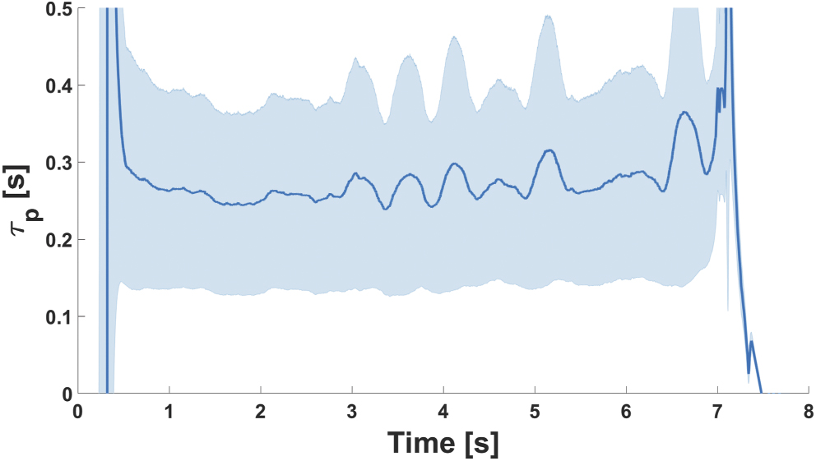
Core confinement with a finite particle confinement time
Neo-classical Transport
Orbits Collisions
Calculable
Applicable for fast particles
Anomalous Transport
Turbulence
Dominant at LCFS
Ion
Neutral
Source
Collisionality
“Experimental study of the fast-ion confinement in W7-X based on FIDA spectroscopy”
Peter Poloskei – ID [551]
“Radial electric fields, turbulence and transport studies in W7-X and TJ-II”
Teresa Estrada – ID [192]
(Re-) Ionization
Core confinement
[S.A. Bozhenkov, NF 2020]
$\frac{dN_{tot}(t)}{dt}= Γ_{Source}−\frac{N_{tot}(t)}{τ_{p}(t)}$
Neutralization
SOL Transport
Particle collection
Wall pumping
ID 20181010.010
Exhaust
[T. Kremeyer, NF 2022]
Notes:
Particles can be confined in the core or SOL
Core – anything within the LCFS
W7-X is optimized for neo classical transport. Orbits, and with increasing collisionality, dominated by collisions. Reality is a mix.
*Click* Calculable Fast particles -> large orbits, low collisions
We see the full orbit motion of a particle as generated by NBI system of W7-X and becoming ripple trapped, quickly drifting radially outward and hitting a divertor baffle. The particle was simulated using the ASCOT5 code, developed at Aalto University, Finland. Animation done in Blender.
*Click* Based on our profiles our core particle transport is significantly 'anomalous.' One anomalous transport mechnism that we know is turbulence. Anomalous transport is dominant at LCFS and is responsible for particles crossing the LCFS
*Click*We can set up a particle balance around the LCFS, where the change in confined particles is desrcribed by the source rate and the particles leaving by the average particle confinement time tau_p. Solving for tau_p results in a value arround 250 ms.
*Click* For more info on neo classical – peters talk
Machine comparison on anomalous transport – teresas talk

Slide 26
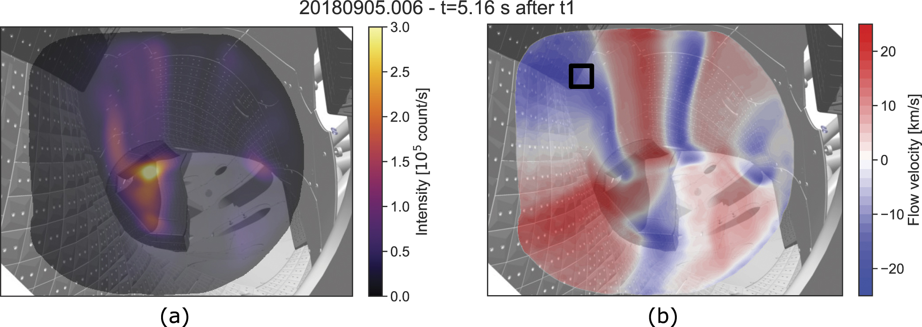
SOL Transport
Perpendicular transport
Anomalous
Can not be ignored due to longer connection lengths
Driven by density gradient
Leads to wider strike line
Parallel transport
Driven by pressure gradient along field line
Creates strike line
Form counter streaming flows
Ion
Neutral
Source
“Impurity flow measurements with Coherence Imaging Spectroscopy at Wendelstein 7-X”
Valeria Perseo – ID [569]
(Re-) Ionization
Core confinement
Neutralization
SOL Transport
Particle collection
Wall pumping
“Inter-machine comparison of SOL particle dynamics in ASDEX Upgrade and Wendelstein 7-X”
Dorothea Gradic – ID [42]
Exhaust
[V. Perseo, NF 2019]
28.06.2022
Notes:
When particles cross the LCFS after that time, they are in the SOL.
Due to our long connection lengths in SOL this anomolous transport across field lines can not be ignored in SOL.
Driven by density gradient
One effect is wider strike line
Fact that we do have a strike line is due to parallel transport along the field lines.
This transport is driven by a pressure gradient along the field line and creates counter streaming flows.
CIS can use carbon radiation on the left and make these flows in the island structure visible.
Flow pattern with flows going into and coming out of the image plane in red and blue colors.
Interested in how these flows were measured experimentaly - Valerias talk
If you want to know how our SOL transport compares with a Tokamak – Dorotheas talk

Slide 27
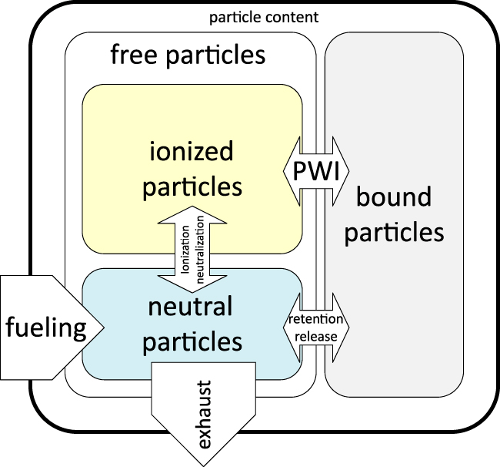
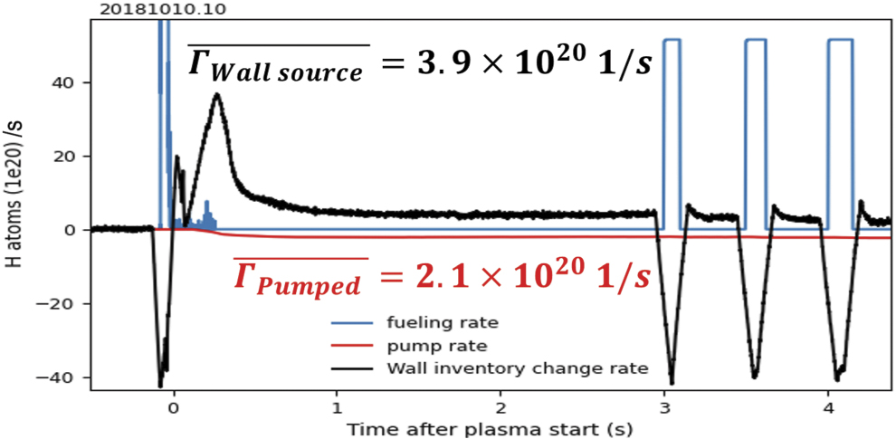
Wall pumping is highly dynamic
Ion
Neutral
Significant wall heating is key to mobilize retained gas
Auxiliary fueling on low-heated walls leads to strong H absorption
OP1.2b max $Γ_{Wall pumped}≤6.67×{10}^{20} 1/s$
OP1.2b max $Γ_{Wall source} ≤1.14×{10}^{21} 1/s$
A strong $Γ_{Wall}≈±1×{10}^{21} 1/s ≤2\text{\% }Γ_{Recycling}$
Transient wall source/sink can be higher
Source
(Re-) Ionization
Core confinement
[G. Schlisio, NF 2021]
Neutralization
SOL Transport
Particle collection
Wall pumping
Exhaust
Notes:
Another source or sink can be the wall interaction.
Ionized particles that impact on a plasma facing component can be implanted into the material.
Additionally the wall can also absorb or release neutral particles.
Can‘t seperate the two, but a gas balance can resolve the change in the bound particles
*Click* Blue fueling, red pumping, black wall inventory.
Prefill, absorbtion; plasma heat up, release; equilibrium pumped, wall slightly higher, gas pulses absorbtion.
Strong wall effects below 2% of recycling, but highly dynamic

Slide 28
Detachment at W7-X

Slide 29
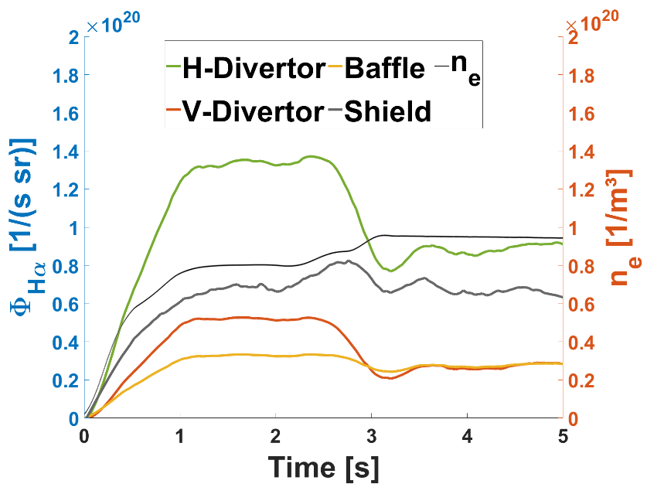
Detachment definition and power balance
Observations of detachment in Tokamak are:
‘roll-over’ and decrease of the ion saturation current, j+sat, of Langmuir probes built into the divertor targets
H_{α} radiation from the target regions does not roll over/decrease, but continues to increase with n_{e}
A further feature of detachment is that it occurs when the target Langmuir probes indicate low temperatures, T_{e} ≈ a few eV or less “
- Stangeby, Plasma Boundary Book IoP 2001
Detachment easily accesible with stable radiation front
But H_{α} decreases
Particle and Power detachment achieved by radiating power in the SOL through seeded and/or intrinsic impurities
Power balance
Recyling flux reduced at high f_{rad}
$$P_{in}=Γ_{rec}\left(γT_{t}+ϵ_{i}\right)+f_{rad}P_{in}$$
ID 20181010.036
[M. Jakubowski, NF2021]
[Y. Feng, NF2021]
Notes:
Stangeby defines detachment by three features:
Roll over of Jsat – less particles arriving at the target
H_a radiation does not decrease but continues to increase – same ionization, ionization increases with n_e
Same amount of particles is transported to the divertor, but instead of neutralizing on the target, they neutralize in a recombination layer above
Low temperatures
Not true at W7-X, H_a decreases as seen in video arround 3s.
For a reactor <10 MW/m² and below 5eV for sputtering.
Achieved at W7-X by starving the SOL of power, through seeded and or intrinsic impurities.
Described by power balance, power is either transported to the target by the recyling flux or radiated away.
Black is density, ramp up density, increase the intrinsic carbon radiation.
H_a on H and V target drops, baffle and shield stay more or less same.

Slide 30
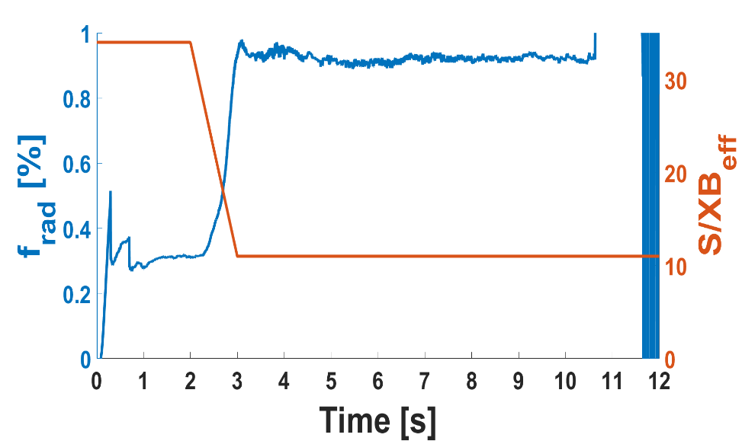
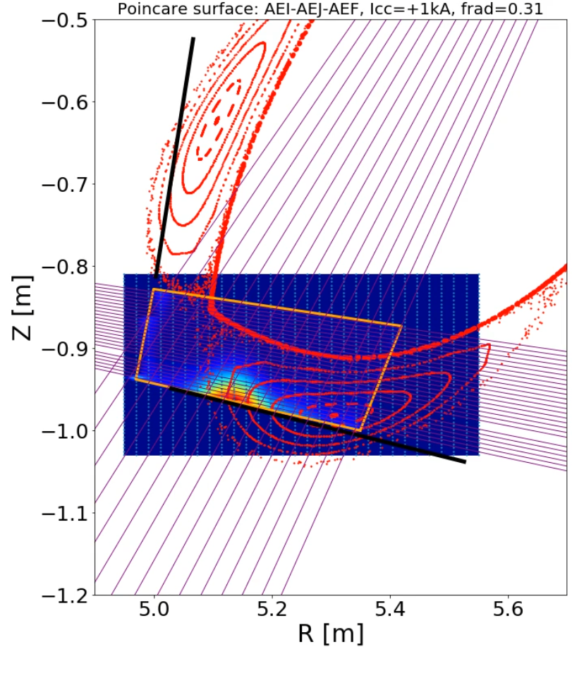
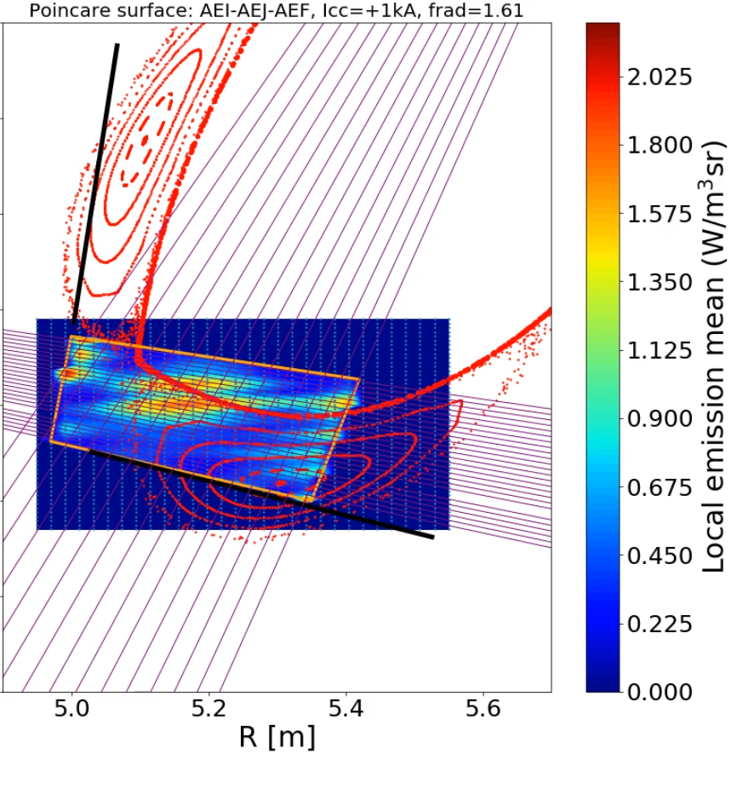
Detachment particle drop, fueling efficiency increase
Core fueling rate from the divertor
$Γ_{Core}^{Div} \left(t\right)=Φ_{Hα}\left(t\right)∗{S/XB}_{eff} ∗f_{Recy}^{Div}$
f_{rad} = 0.3
f_{rad} > 0.9
Photon flow in divertor decreases
by 35 %
$Φ_{Hα}^{Div}=$2.3E+21 1/s $Φ_{Hα}^{Div}=$1.5E+21 1/s
Plasma parameters change,
decreasing S/XB_{eff} by 67%
${S/XB}_{eff}^{Div}=$ 34 ${S/XB}_{eff}^{Div}=$ 11
Ionization front moves partly inside LCFS
$f_{Recy}^{Div}=$7% $f_{Recy}^{Div}=$30%
[O. Schmitz NF 2020]
[Y. Feng NF2021]
Notes:
What else changes in detachment?
H_a drops, Plasma parameters change, colder, S/XB_eff drops -> overall recycling flux drops
Tomography of H_g shows where particles ionize, attached at strikel ine.
Plasma gets smaller, at high f_rad ionization front moves partly inside LCFS. H_g tomography, attached at strike line, detached cross LCFS. Recycling particles have it easier to cross LCFS
Fueling efficiency increases, fraction of recycling particles that can cross the LCFS

Slide 31
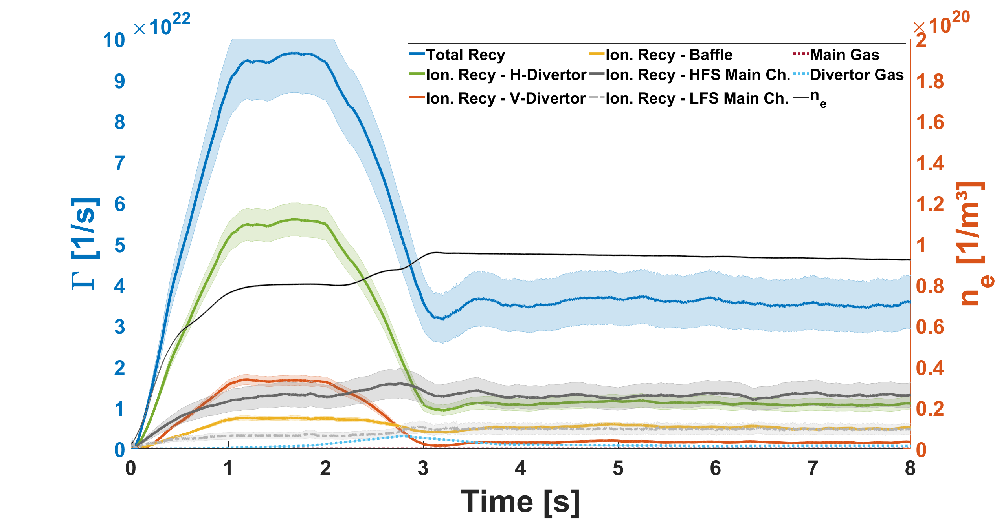
Detachment reduces particle flux, brings higher collection, but weaker plugging
$$η_{Collection}=4\%$$
ID 20181010.036
[Y. Feng NF2021]
Attached:
MC ionisation 15%
Detached:
MC ionisation 50%
$$η_{Collection}=12\%$$
$Γ_{Ion divertor}$ 60 %
$$η_{Plugged}≈50 \%$$
 | Pump gap [mbar] | Midplane [mbar]
Attached | 6.2 E-4 ± 6.0 E-5 | 3.0 E-6 ± 6.7 E-7
Detached | 7.0 E-4 ± 5.2 E-5 | 1.2 E-5 ± 1.6 E-6
Notes:
Blue total recycling flux, color coded the ionization location. Ramp up in density
H_a goes down, S/XB goes down, total recycling drops by 60%
Modeling ionization lengths are short, 4% make it into pump gap.
*Click* Detach neutrals can travel further before ionizing, 12% make it into target. But plasma plugging decreases
While total ionization in MC doesn‘t change, now half of particles can leave the divertor space
*Click*Also seen in neutral pressure. Pressure increase due to density, midplane pressure due to weaker plugging.
Source drops, but no additional fueling needed. Lets look at the core fueling:
*Click* Transition into detachment rate drops, but as we go into deeper detachment, fueling eff goes up.
Well balanced that core fueling rate doesn‘t change, only true for detachment with f_rad~90%

Slide 32
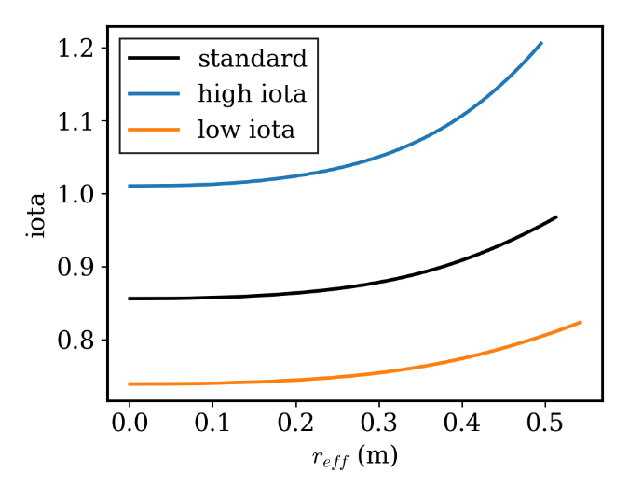
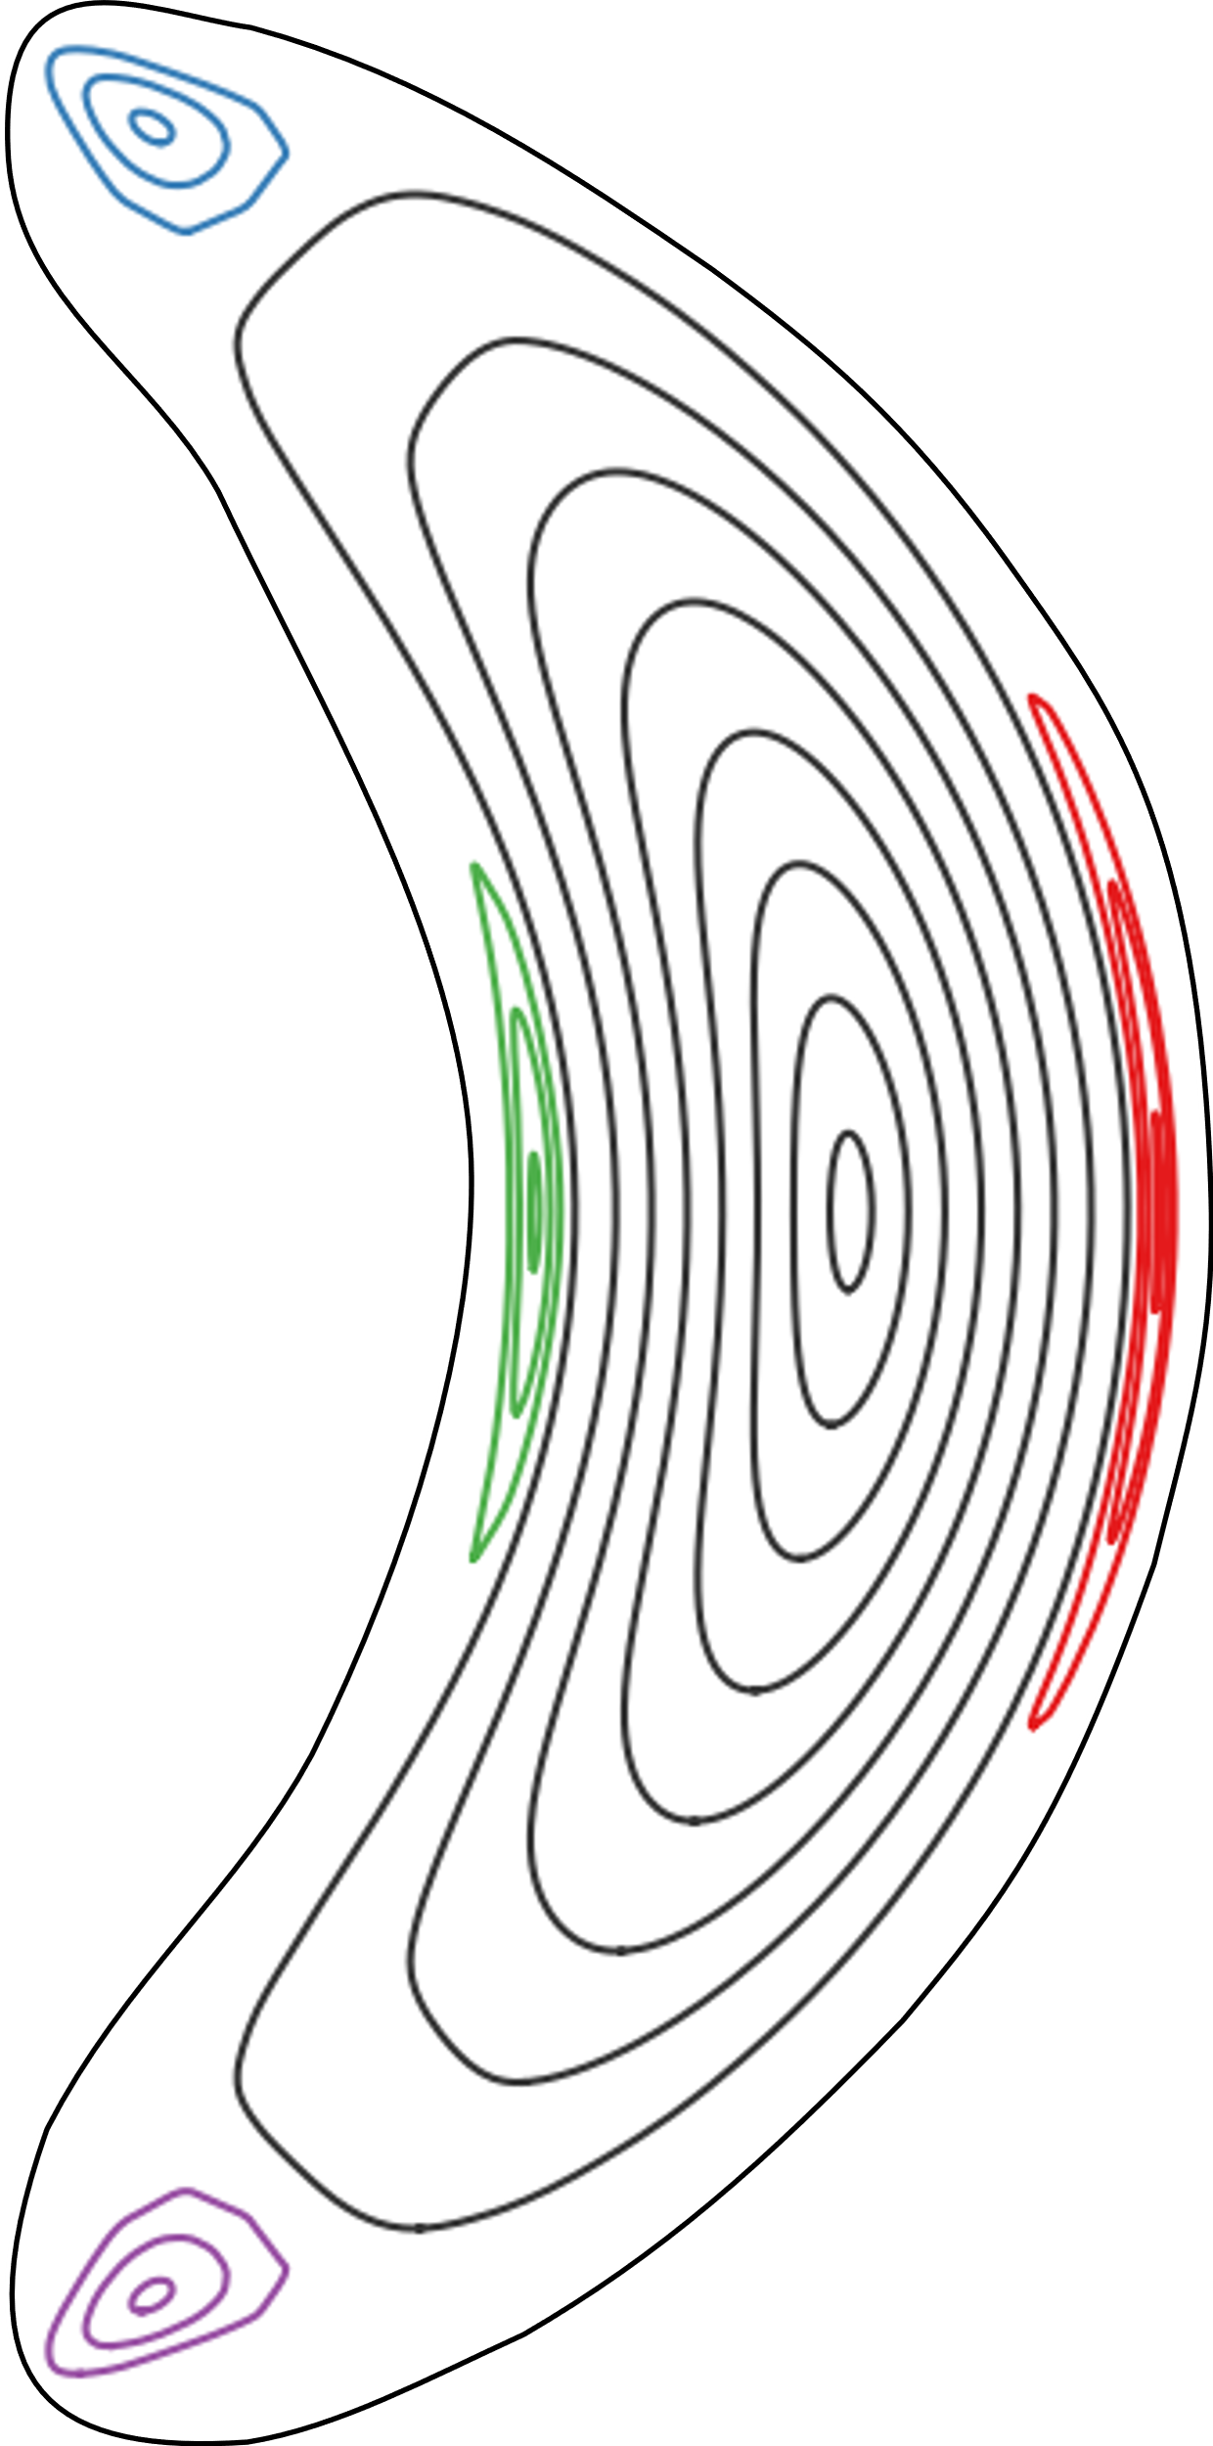
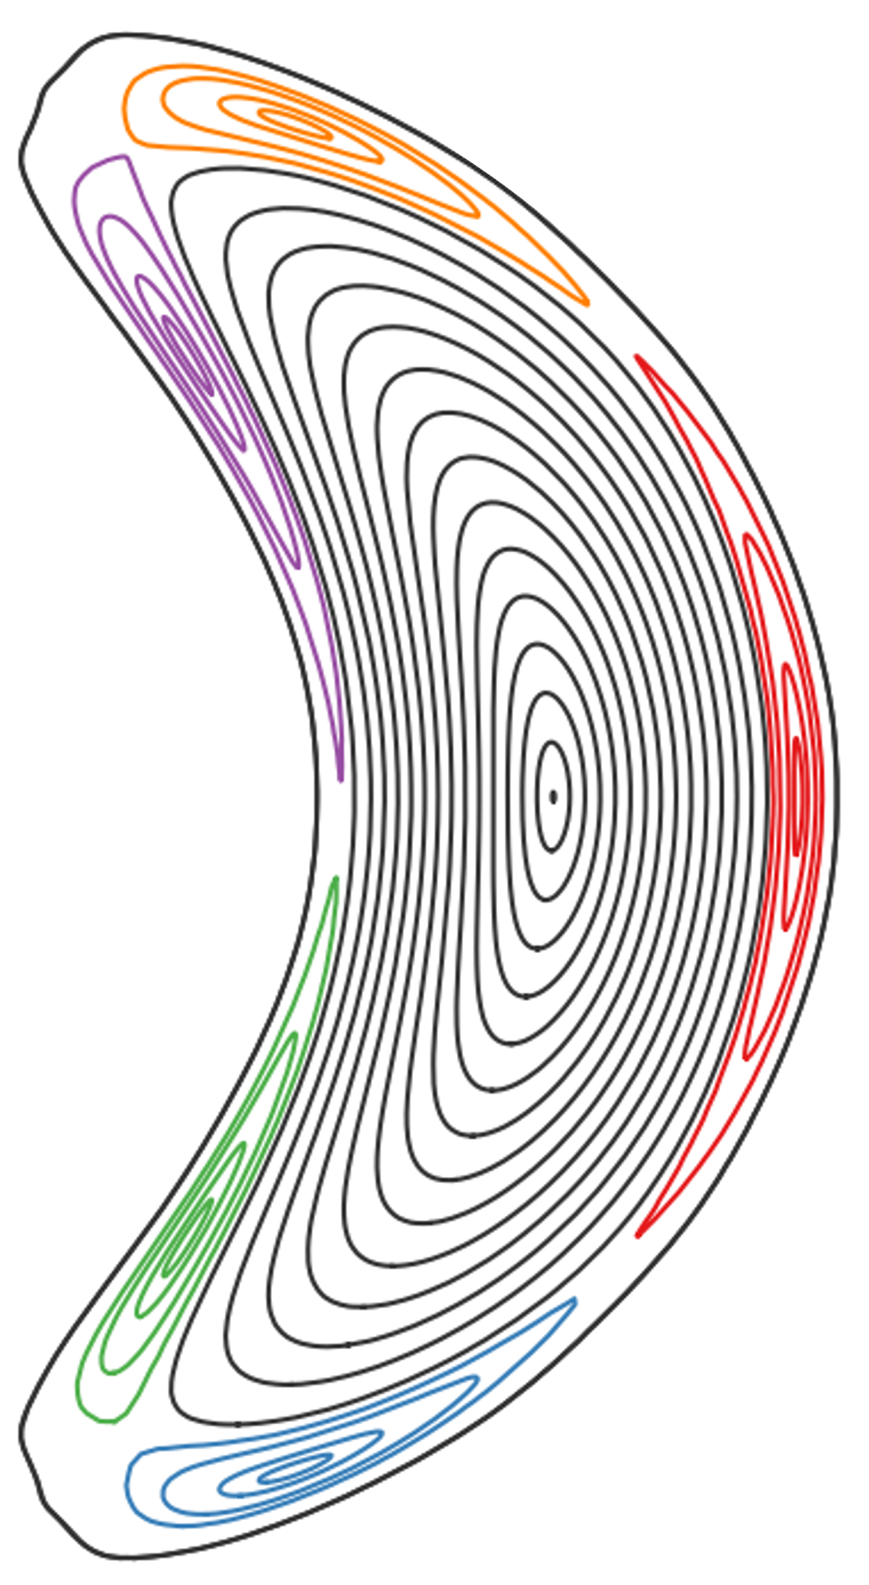
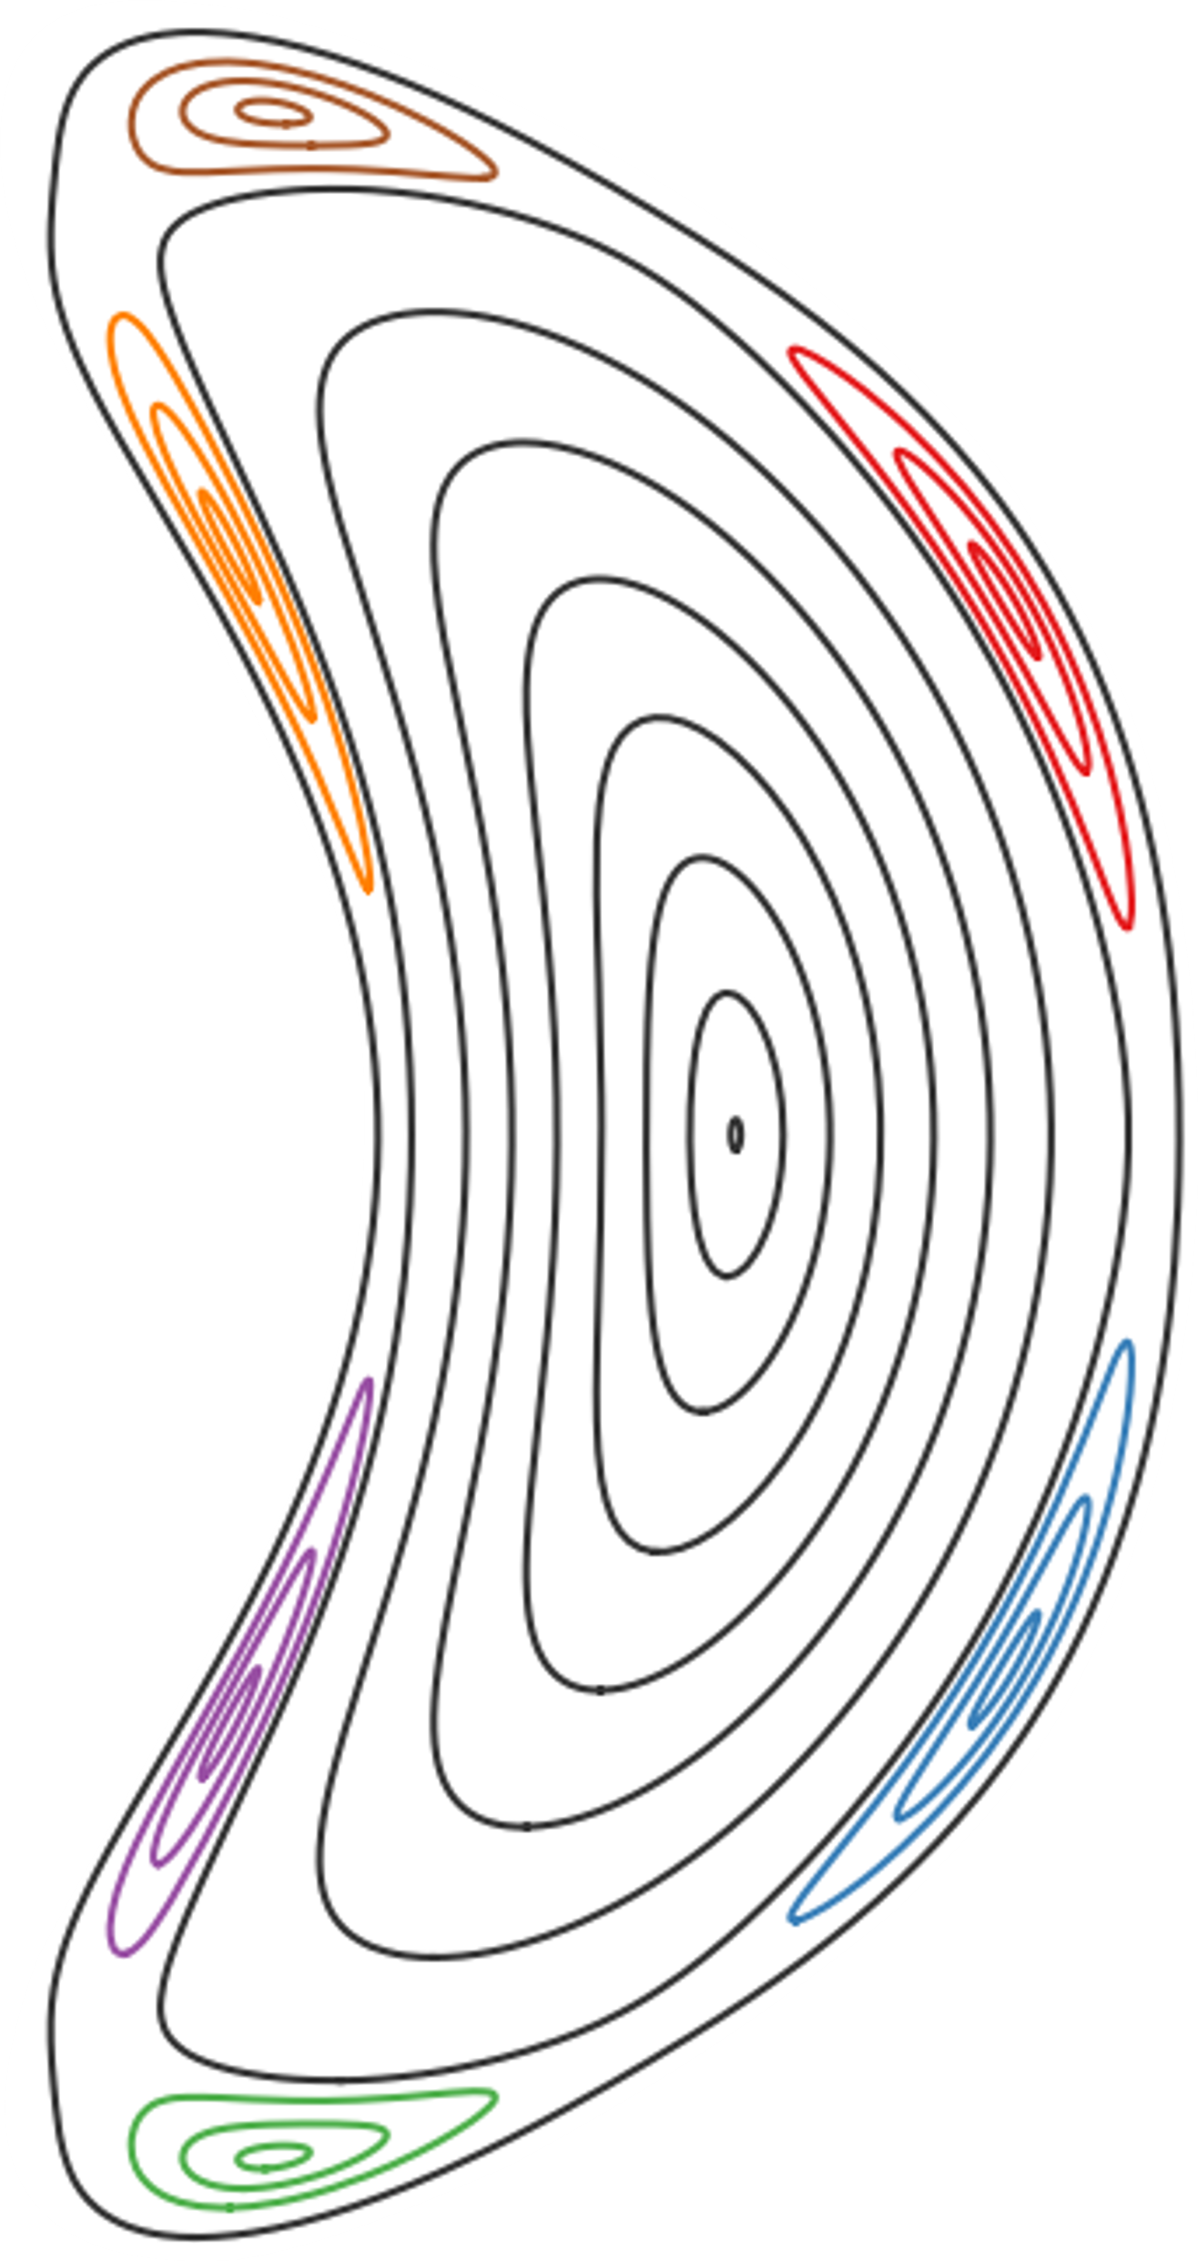
Different coils allow flexibility in magnetic field configurations
Wendelstein 7-X (W7-X): advanced stellarator with flexible coil system
$ι$= = $\frac{n}{m}$ close to 1, in which
$n=5$ designed to be fixed
4 ≤ 𝑚 ≤ 6 depending on planar coils
→ in fixed cross-section different number of islands
$$ι$$
Notes:
Core – anything within the LCFS

Slide 33
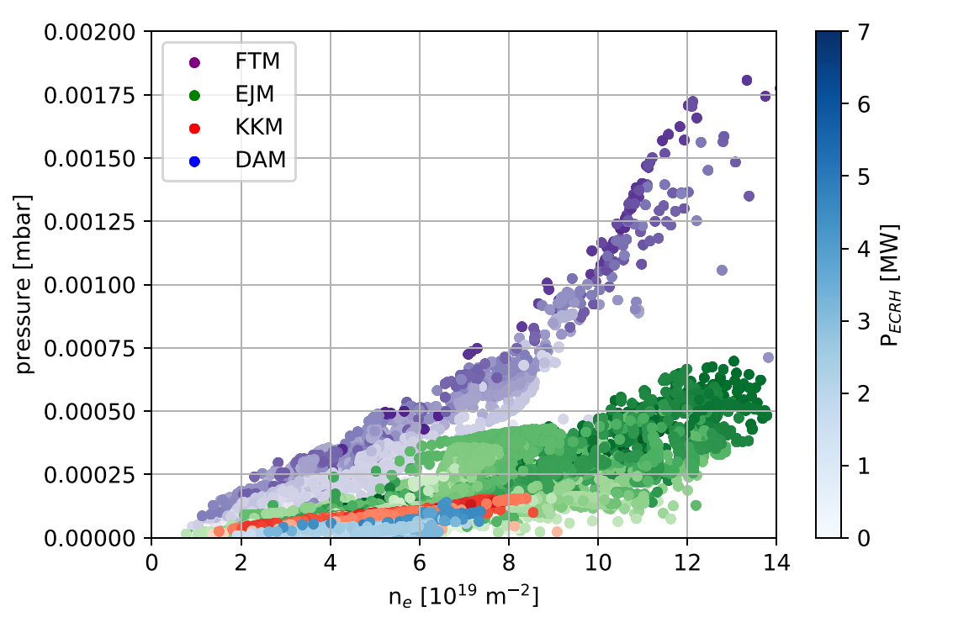
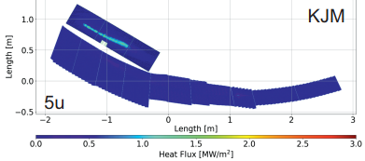
Particle source and sink overview
[M. Jakubowski, NF 2021]
Div gas: 10x 8.0 E+19 e/s – 3.6E+22 e/s f_{eff} = 12% - 44%
Main gas: 10x 4.8 E+20 e/s – 4.8 E+21 e/s f_{eff} = 28%
NBI: 4x 1.6 E+2.7E+20 e/s (throttle to 60%) f_{eff} = 70% - 90%
Pellet: 4.25E+20 – 9.9E+20 @ max 10 Hz f_{eff} = 40% - 85% (OP1.2)
Strong wall: +- 1.14E+21
High iota [e/s]
5.2 E+20
4.6
3.9
3.3
2.6
2.0
1.3
0.7
0.0
TMP [e/s]
11.7 E+20
10.2
8.8
7.3
5.8
4.4
2.9
1.5
0.0
TMP+CVP [e/s]
6.3 E+21
5.5
4.7
3.9
3.1
2.3
1.6
0.8
0.0
High iota
Standard
High mirror
Low iota
high mirror
[V. Haak, soon on pinboard]
Notes:
Now that we completed the H fuel cycle, lets look at how our sources and sinks compare.

Slide 34
Particle Exhaust and compression in other configurations
high mirror
Exhaust is determined by divertor pressure, not by compression
Low main chamber pressure desirable to minimize main chamber erosion due to CX
[M. Jakubowski, NF 2021]
Configuration | Pump gap [mbar] | Midplane [mbar]
Low-iota | 4.2 E-5 ± 5.5 E-6 | 3.5 E-6 ± 6.5 E-7
Standard (attached) | 3.4 E-4 ± 6.0 E-5 | 3.0 E-6 ± 6.7 E-7
Standard (detached) | 7.0 E-4 ± 5.2 E-5 | 1.2 E-5 ± 1.6 E-6
High-iota | 7.7 E-4 ± 3.5 E-4 | 1.3 E-5 ± 6.9 E-6
High-mirror | 4.0 E-4 ± 5.0 E-6 | 4.7 E-6 ± 1.0 E-6
Notes:
Now that we completed the fuel cycle from neutralization to re-ionization, lets look at the other magnetic field configurations W7-X can operate under
Low iota, strike line further away
Standard, closer and vertical
High iota, strike line moves further back
High mirror with the load predominantly on the vertical target.
Exhaust only dependant on sub-divertor pressure, many neutrals in the main chamber not an issue from a naive exhaust perspective
However low main chamber pressure desirable to minimize main chamber erosion due to CX
Low iota, not many neutrals make it through the pump gap
Standard in detachment double exhaust, but cut compression in half due to 4x higher midplane
Similar to high iota, despite different strike line position
High mirror in between.
Thick SOL might shield us from strong CX and therefore we might be able to life with a lower compression as long as we have higher exhaust

Slide 35
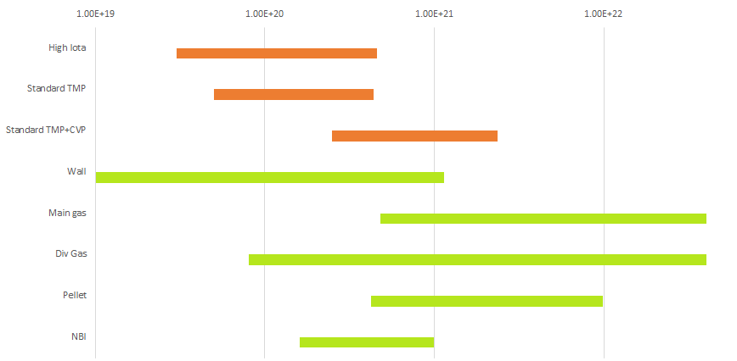
Profile shaping capabilities are exhaust limited
[e/s]
Transient peaked profiles
Flat profiles Particle exhaust = Wall source
Peaked profiles Particle exhaust = Core + Wall source
Notes:
Depending on density, exhaust rates
CVP at higher densities will grant us wall independent density control.
If wall source is low, we can even pump all 4 NBI sources
Without CVP we can only exhaust the smallest Pellet at 1 Hz.
Above only transient peaked profiles possible
Peaked profiles in equilibrium source=sink, what goes in, must come out.

Slide 36
Current island divertor geometry is not reactor relevant
Increasing pump gap opening angle to strikeline will increase collection and p_{pg}
Increased p_{pg} necessary for continous flow which will minimize sub-divertor leakage
We need 10x more p_{pg} for Knudsen flow or 350x more p_{pg} for continuous flow, only accessible with new target geometry
Demo Tokamak/Stellarator decision time schedule allows for ~ 2 prototype cycles at W7-X
Demo will not be a stellarator, without a proven exhaust concept
Beginning of this year: E4+E5-ENG-DE tool development, just starting to implement
Currently nobody else in the world is working on a stellarator divertor target geometry
If we don‘t work on a stellarator target design, and prove a reactor relevant exhaust, DEMO will be a Tokamak
Dome necessary?
New target angle where particles intrinsically move to the pumpgap
Average initial flight direction
Actively cooled targets necessary?
Notes:
You only need to plug, what you don‘t exhaust. Plugging becomes less relevant as exhaust efficiency increases
Does the next divertor have to be water cooled steady state?
Hybrid: Leave high iota water cooled, redesigning low iota section without active cooling would allow faster prototype cycles and open up a path to movable targets, drastically reducing prototype cycles.
Reduce complexity – decouple problems – more iterations

Slide 37
Outlook: Cryo Vacuum Pump
New Hardware:
Cryo pumps add significant pumping speed in the sub-divertor
Optimized sub-divertor closure
Fully water-cooled first wall will reach equilibrium wall conditions easier
Pumping system | Sub-divertor pumping speed
Turbo molecular pumps | 29 760 l/s
Cryo vacuum pumps | 106 100 l/s
290 K Chevron 80 K Chevron 4 K Sink
CVP Structure Plasma Baffle Divertor
Notes:
Estimated pumped particles ≈ $1×{10}^{21} 1/s$
Strong enough to balance large wall source - Wall source will be less dynamic
4 NBI sources at a total of $1.1×{10}^{21} 1/s$

