Slide 1
Update on Non-Resonant Divertor Activities
Aaron Bader for the CWGM-NRD group
CWGM June 4, 2025

Slide 2
Papers and invited talks on Non-resonant Divertors
D. Boeyaert et al "Towards improved neutral exhaust in the HSX stellarator" NME, 2025
K. Garcia et al "Resilient stellarator divertor characteristics in the helically symmetric eXperiment" PPCF, 2025
R. Davies et al "The Topology of non-resonant divertors" sub. NF
F. Cai "Impact of multifold magnetic structure on spectroscopy analysis in Heliotron J based on EMC3‐EIRENE simulation" CPP, 2024
C. Smiet "Turnstile area as a measure for chaotic transport in magnetic confinement fusion devices" sub. J. of Chaos
H. Frerichs "Magnetic mesh generation and field line reconstruction for scrape-off layer and divertor modeling in stellarators" PPCF 2025
A. Boozer "Efficient Analysis of Magnetic Field Behavior in Toroidal Plasmas" PoP, 2025
Invited talks
K. Garcia "Chaos in the magnetic field structure governs the plasma edge and divertor fluxes in resilient stellarator divertors" ISHW 2024
C. Smiet "Turnstiles and topological index in fusion reactor divertors" SIMONS Hidden Symmetries, 2025

Slide 3
NRD work (2024-2025)
Work on HSX
D. Boeyaert (Improving neutral exhaust)
K. Garcia (Comparisons of HSX edge structures)
Work on W7-X
R. Davies, D. Boeyaert (CYM NRD experiment)
Work on Heliotron J
F. Cai - Multifold structure in Heliotron J
Work on other machines
CTH
Star-lite
Theoretical work
R. Davies - non resonant divertor topologies
C. Smiet - Paired and unpaired x-points
Future tasks and needs

Slide 4
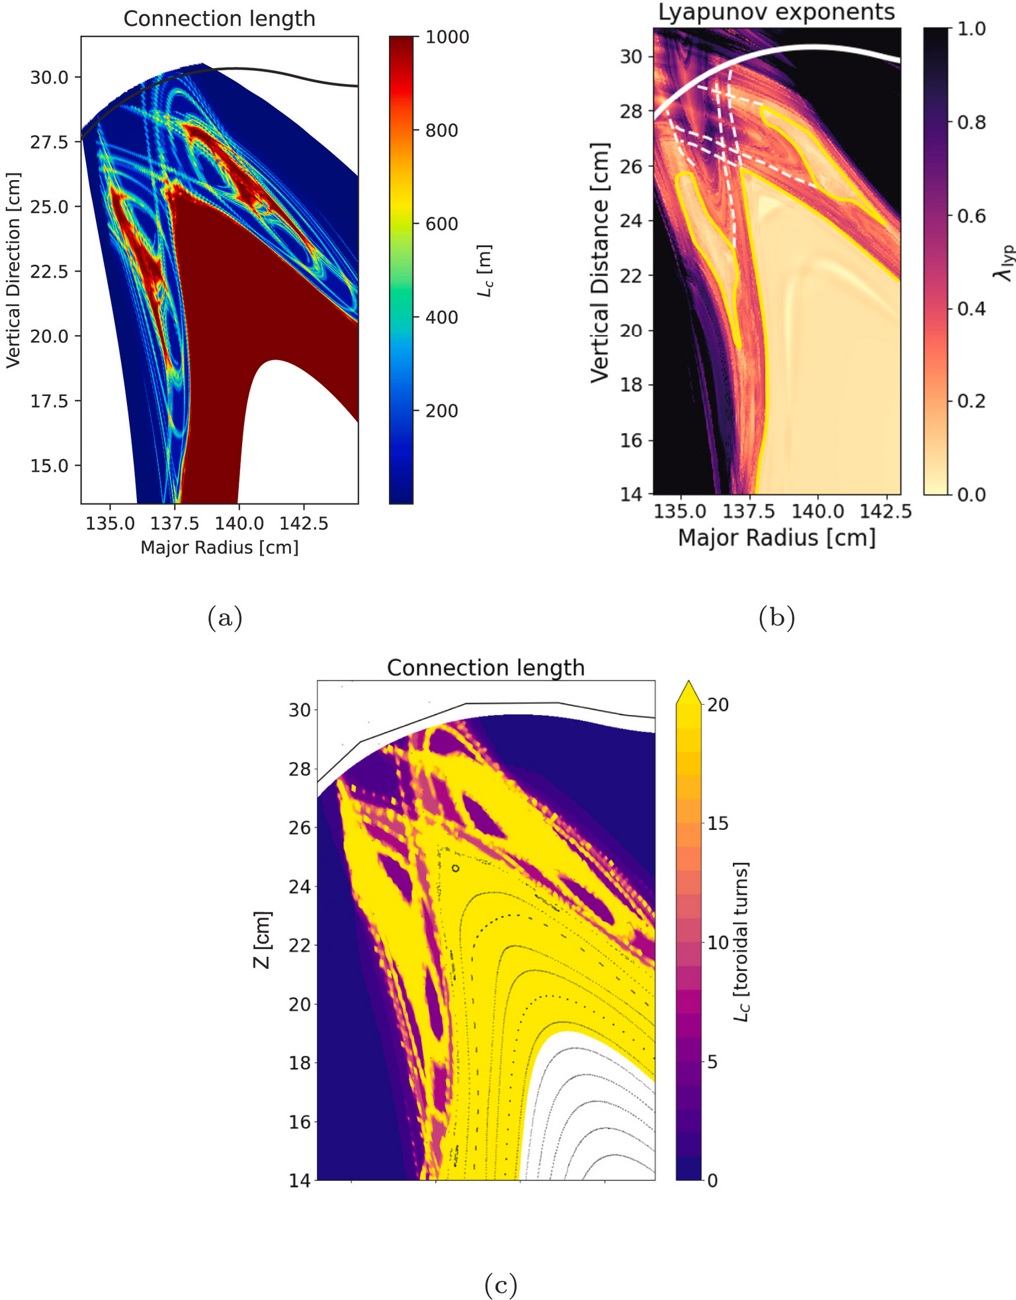
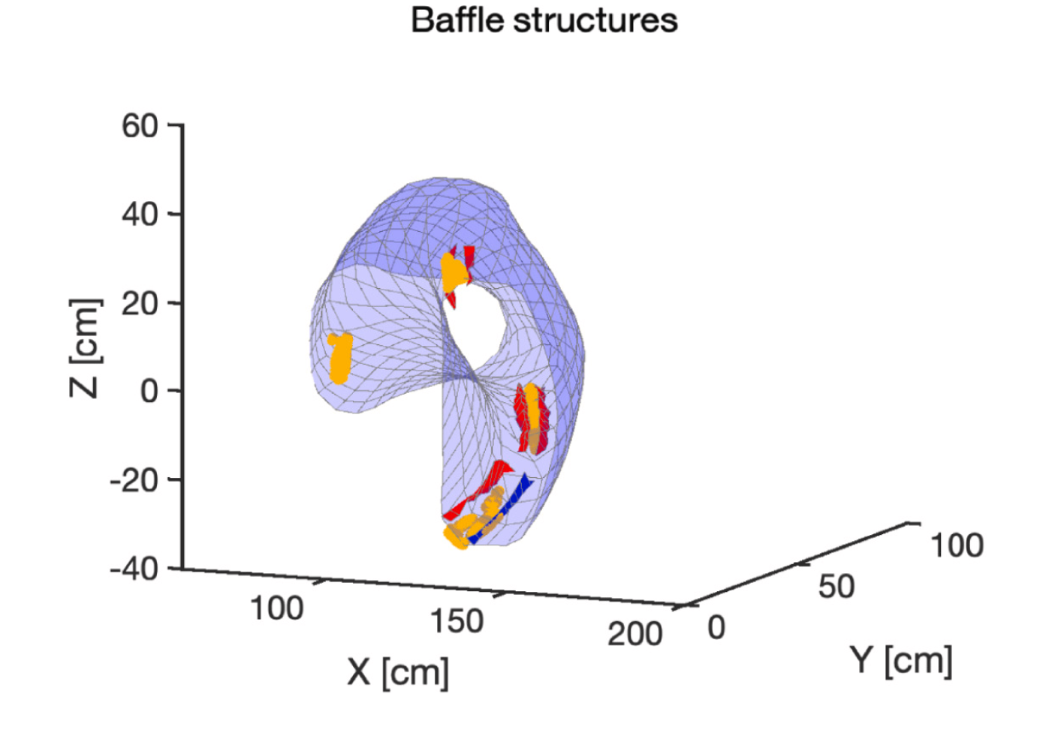
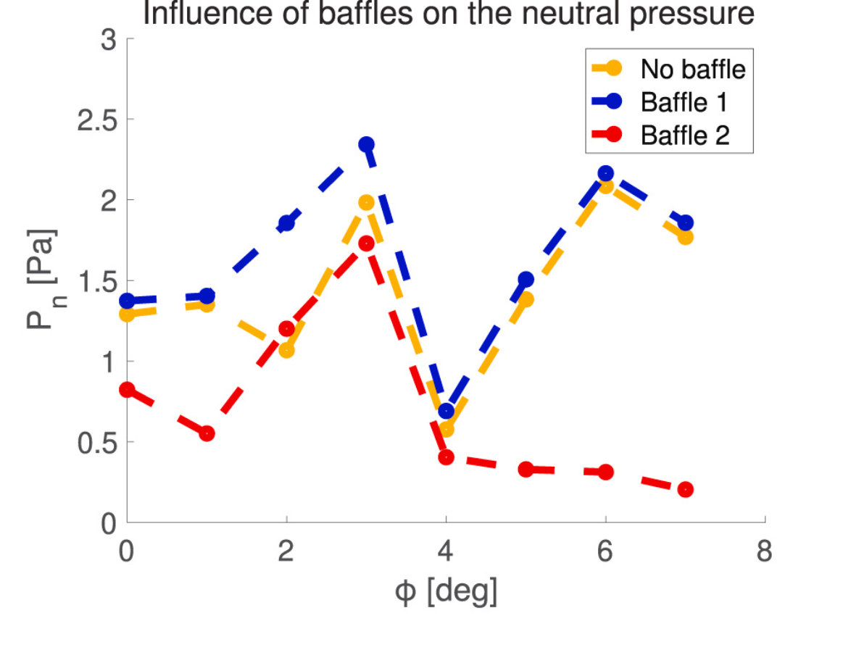
Improving neutral exhaust on HSX
Boeyaert NME (2025)
Standard HSX configuration has an 8/7 island
Open divertors tend to have poor pumping
Slight increase in neutral pressure found
Decrease in pressure for Baffle 2 is because it intercepts some field lines

Slide 5
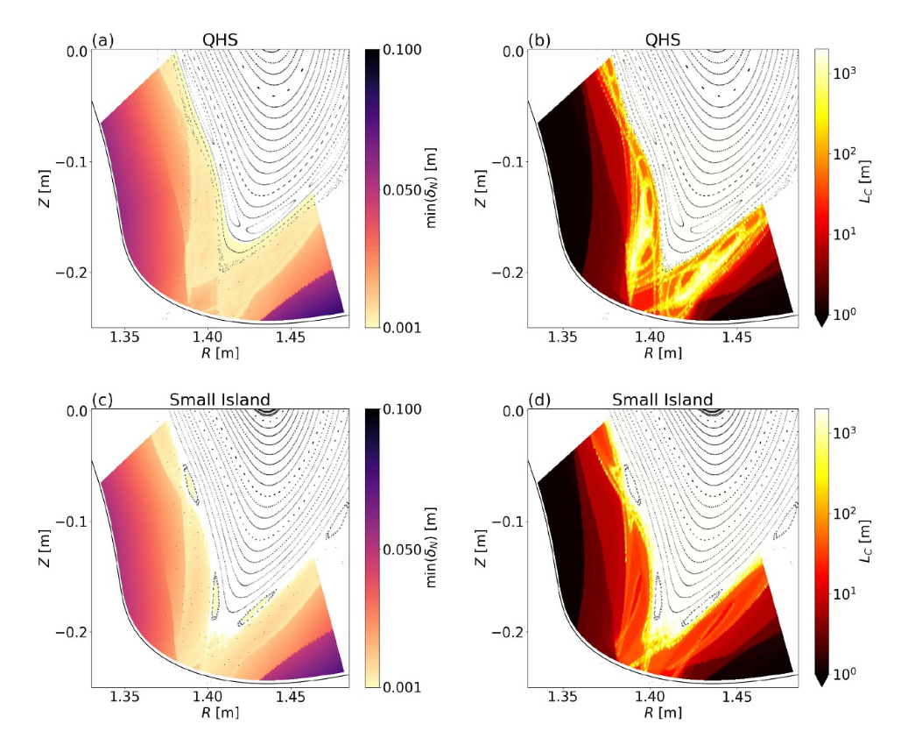
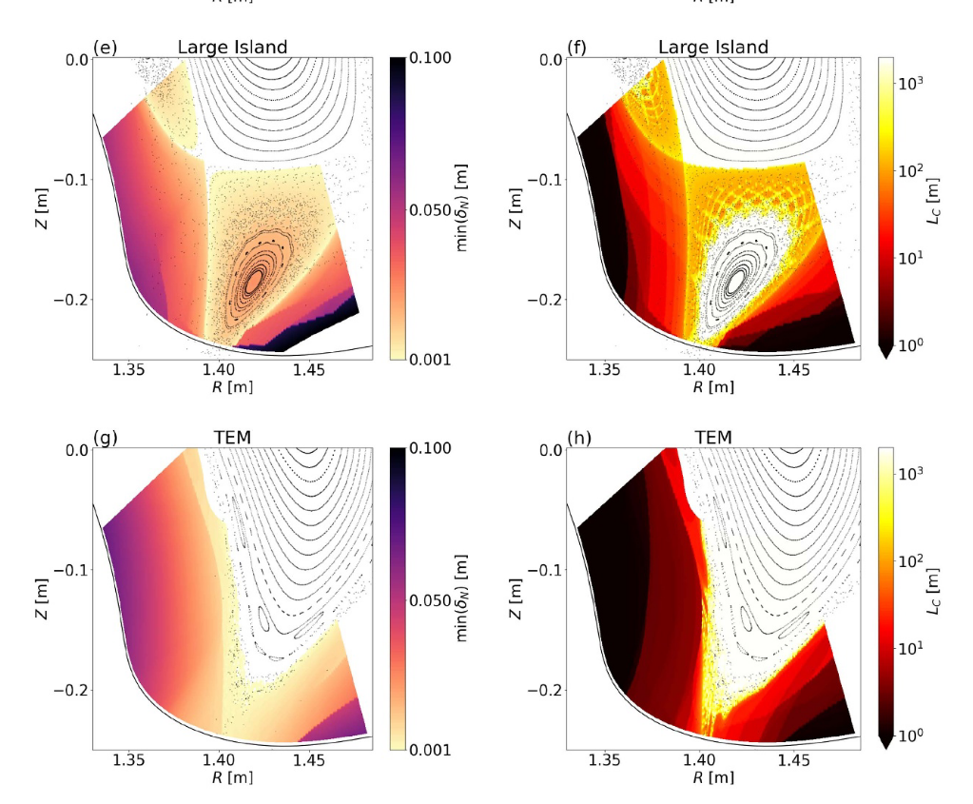
HSX topology studies
K. Garcia (2024)
Analysis of 4 HSX configurations, noting the transition between non-resonant and island dominated
Includes radial penetration calculation with comparison to connection length

Slide 6
W7-X experiment
Initial results from the CYM configuration were obtained at W7-X
The CYM configuration is an ultra-high iota configuration, in which the 5/4 resonance is present but chaotic (i.e. there is a large volume where good flux surfaces do not exist)
EMC3-Lite predicts that the heat is transported along the manifolds of the 5/4 X-points, which have interesting fine structure and correlate with long connection lengths. A consequence of this is a predicted splitting of the strike line
Successfully ran 5 shots (low field with only NBI heating), and in all cases observed (via IR camera data) this splitting, so qualitative agreement with simulation (quantitative comparison ongoing)
The strike location did not show sensitivity to toroidal current, although toroidal current was low in all shots.
Additional work on the transition between a stochastic island divertor and an NRD by Amit Kharwandikar
Includes optimization of possible divertor targets that are shape independent
Calculation of heat fluxes in "closed" divertors

Slide 7
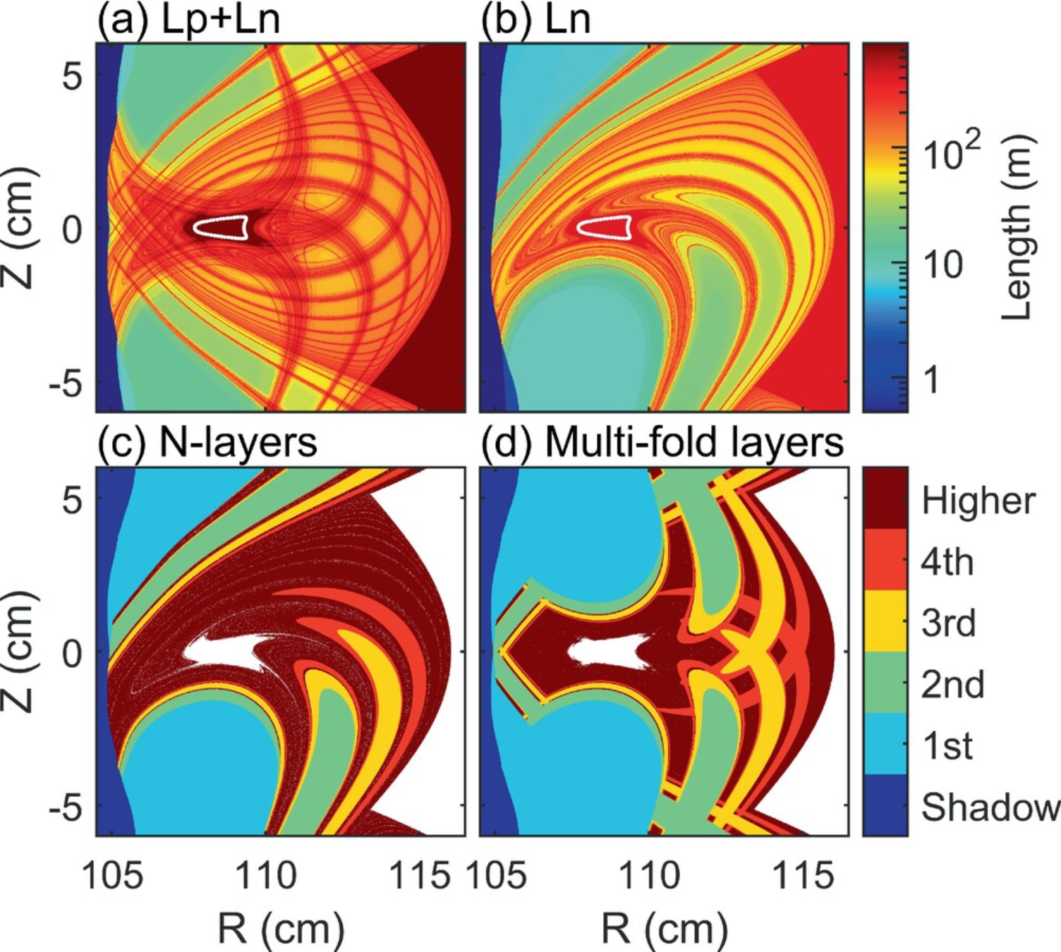
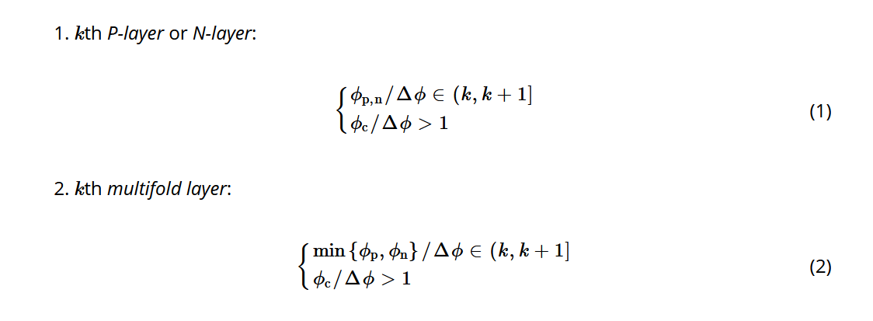
Heliotron J edge structure
F. Cai CPP (2024)
Studied the topology if the distance to the vacuum vessel was increased
Ergodic-like structures appeared
Defined "multifold-layers" to help categorize the edge structures

Slide 8
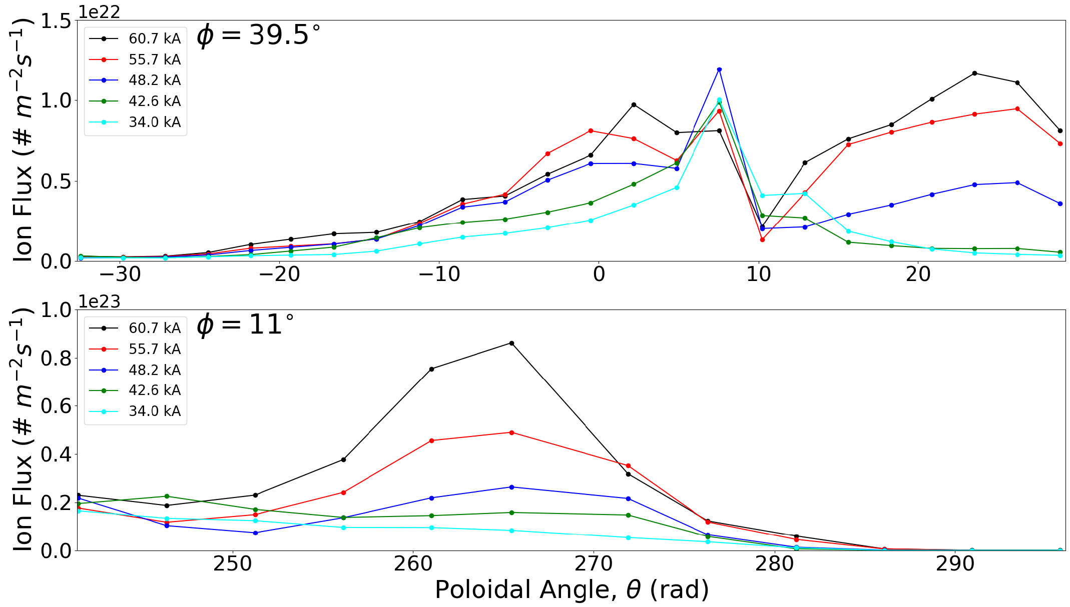
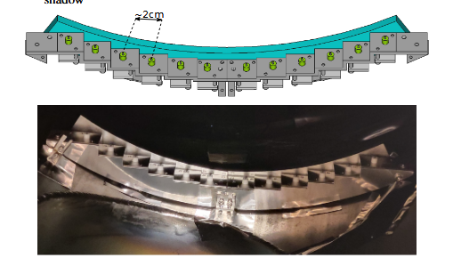
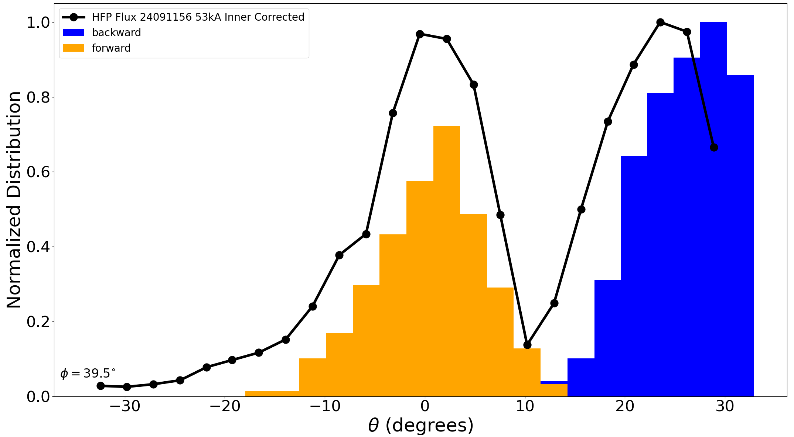
Measuring strike line resiliency on CTH
N. Allen APS-DPP 2024
Radially translatable probe array installed in CTH
Resiliency seen with varying current and magnetic shear
Comparisons with FLARE field-line following calculations

Slide 9
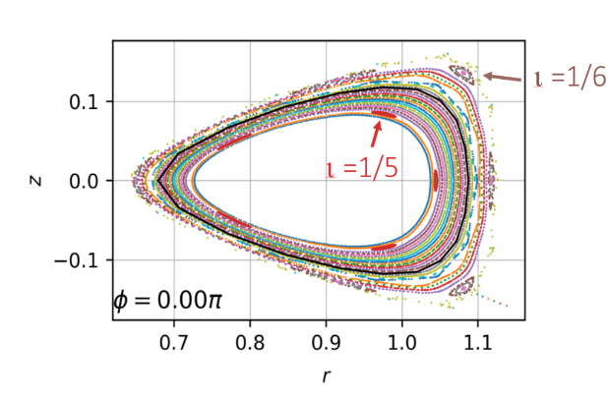
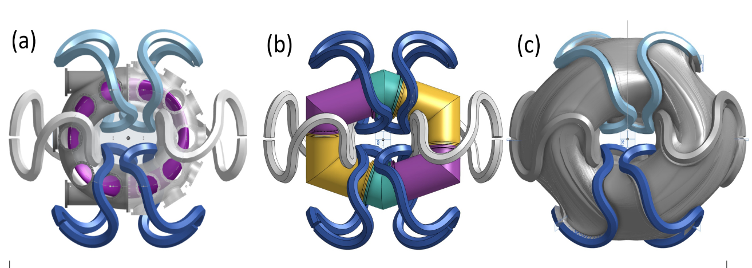
Star-lite
Star-Lite is a new stellarator in construction at Hampton University
Plans to explore geometrical qualities of non-resonant divertors

Slide 10
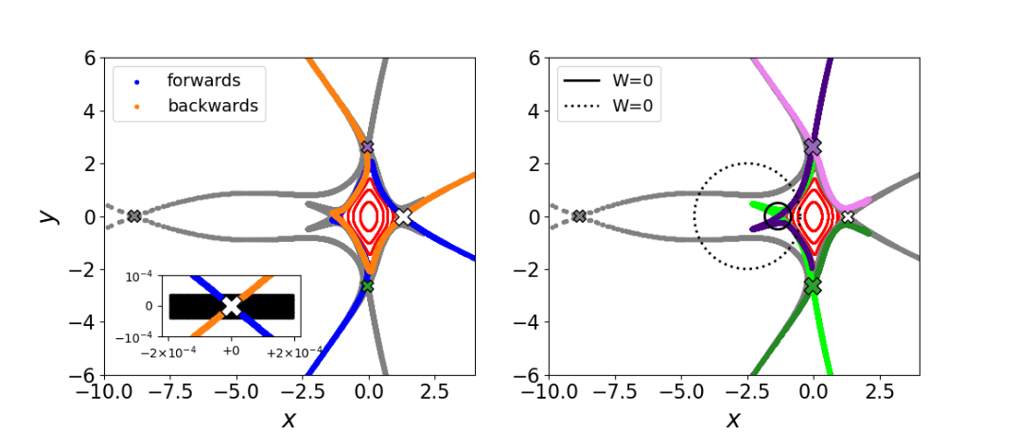
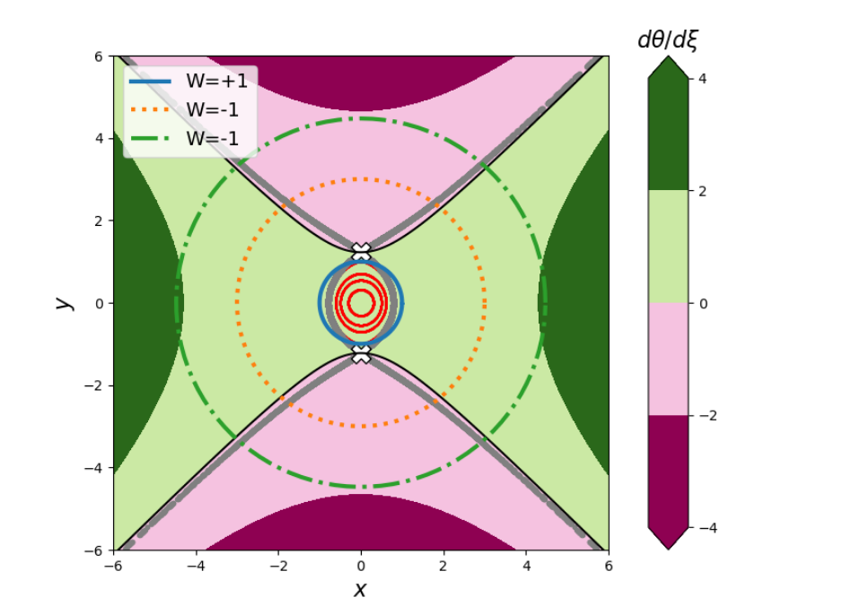
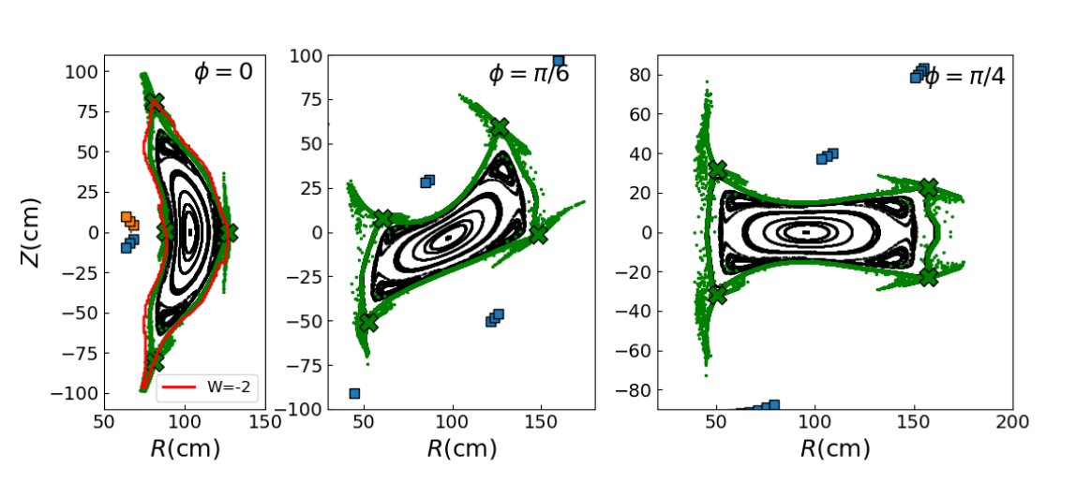
Topology of Non-Resonant divertors
R. Davies (2025)
Calculation of winding number of closed contours
Shows that unpaired x-points can divert field lines away from confined regions
Comparison with axisymmetric Hamiltonian
Results from the QUASR database

Slide 11
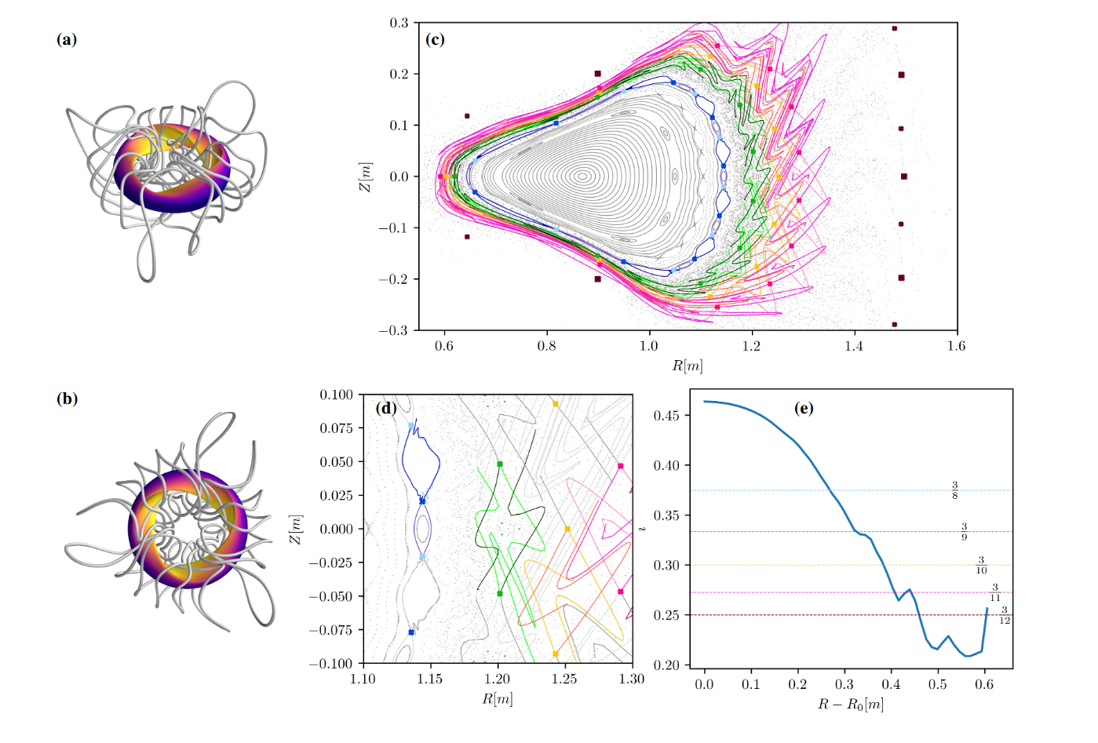
Turnstile areas to measure chaotic transport
C. Smiet (2025)
Methods of using the action principle to measure the areas of turnstile regions
Uses QUASR database to find interesting configurations

Slide 12
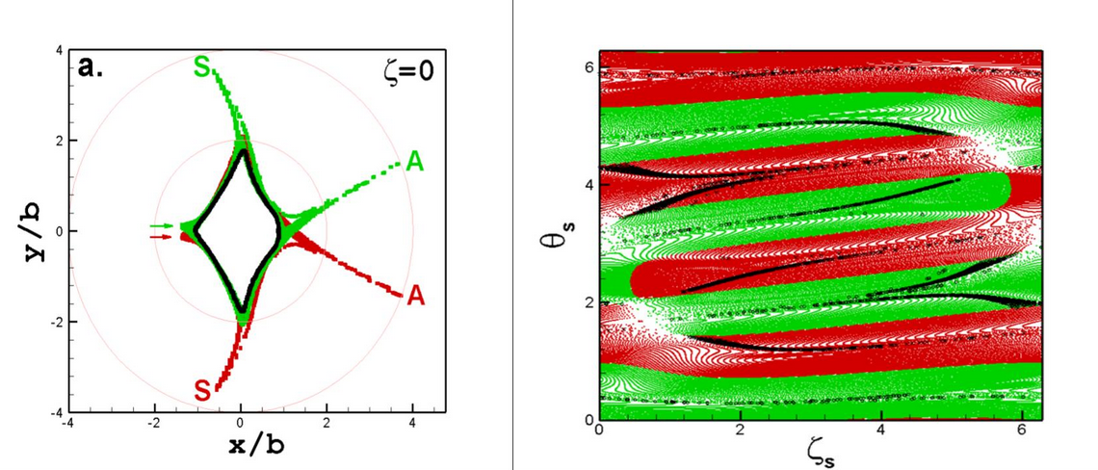
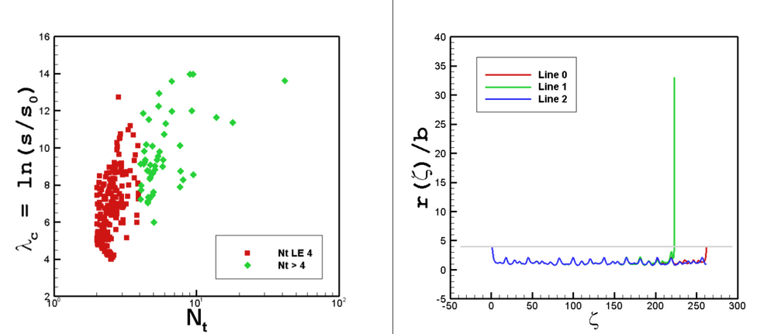
Field lines intercepting wall
A. Punjabi (presented to HiFiStell)
Compares locations of entry and exit of field lines on wall
Calculates the level of chaos for field lines based on how many transits they make
More transits = more chaos

Slide 13
Areas that need additional research
Neutral exhaust studies of NRDs
Initial steps taken by D. Boeyaert, but further calculations necessary here
Question: can NRDs provide better neutral pumping than open (baffled) island divertors?
Power plant relevant plasmas
Many calculations use vacuum fields and focus on mathematical properties
NRD property changes with finite beta
collaboration with MHD team to get a configuration test-case
Perhaps a Goodman SQuID config? QS?
Use EMC3-EIRENE (or other edge codes?) to calculate impurity transport and radiation stability
Experimental measurements at multiple devices to empirically constrain edge transport parameters
Using mathematical techniques to optimize NRDs
Can we determine whether any configurations (unpaired x-points, turnstile volume, hybrid etc) are beneficial for designs?
Can we then target some of these parameters in an optimization framework?
How sensitive are the results?

Slide 14
Open discussion: Future of NRD research

