Slide 1
Overview of the impurity injection studies and remaining work for LHD Federico Nespoli
PPPL: R. Lunsford, A. Nagy, N.A. Pablant
LHD (Japan): N. Tamura, M. Nunami, K. Tanaka, S. Masuzaki, M. Shoji
W7-X (Germany): T. Wegner, C. Killer, D. Cipciar, B. Buttenschon
CIEMAT (Spain): I. Garcia Cortes, A. De Castro Calles, D. Medina Roque, K. Maccarthy
CWGM, PPPL, June 4th 2025

Slide 2
Outline
Background: low Z powder injection improved stellarator performance
LHD:
Turbulence reduction and improved confinement
W7-X:
Confinement improvement with pulsed powder injection
JE to directly compare effect of impurity powder across machines
LHD results
W7X results
TJ-II results
Comparison with B LBO
Next steps

Slide 3
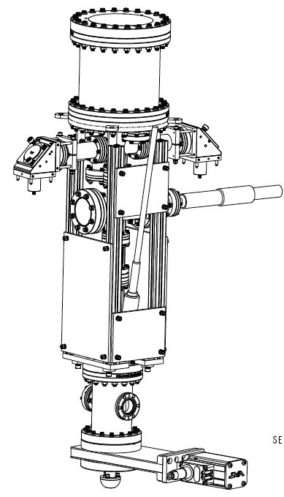
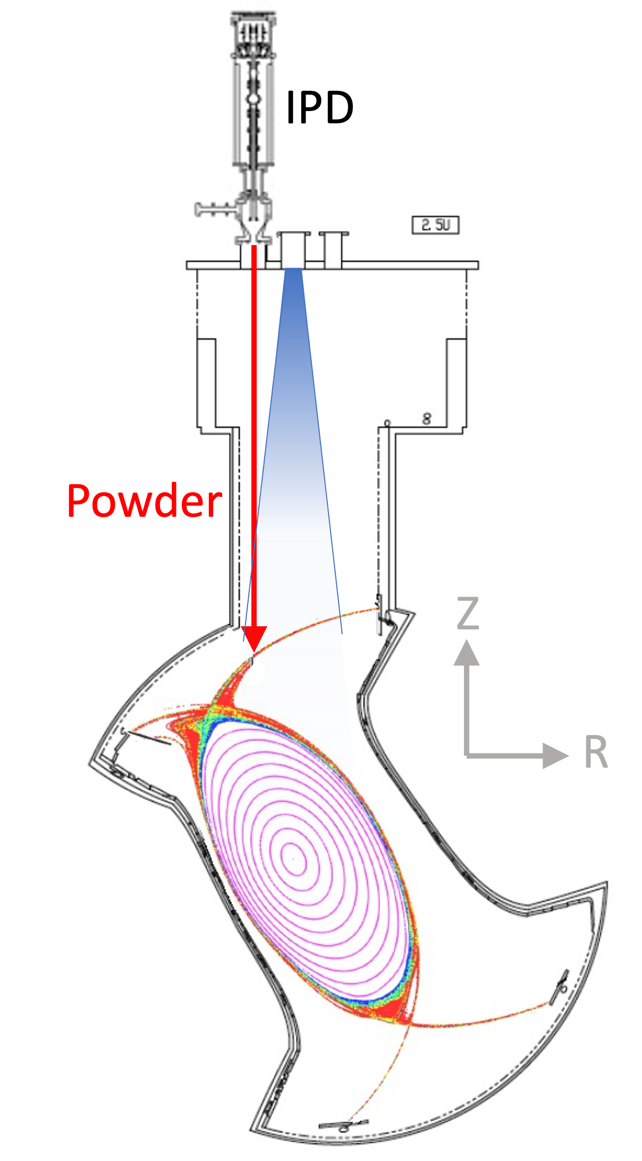
Developing real time boronization in steady state operation
Maintaining good wall conditions is a challenge for metal walls, steady-state reactors
Real time boronization by injecting boron powder into the plasma with the Impurity Powder Dropper:
no toxic gas
no interruption of operation
more mass-efficient
Already been tested in tokamaks (DIIID, ASDEX-U, EAST, WEST, KSTAR)
Improved plasma performances accessing lower collisionalities through lower wall recycling and impurity content
LHD capable of 1 hour long discharges: assess the viability of real time boronization in steady state operation with IPD
outboard
toroidal

Slide 4
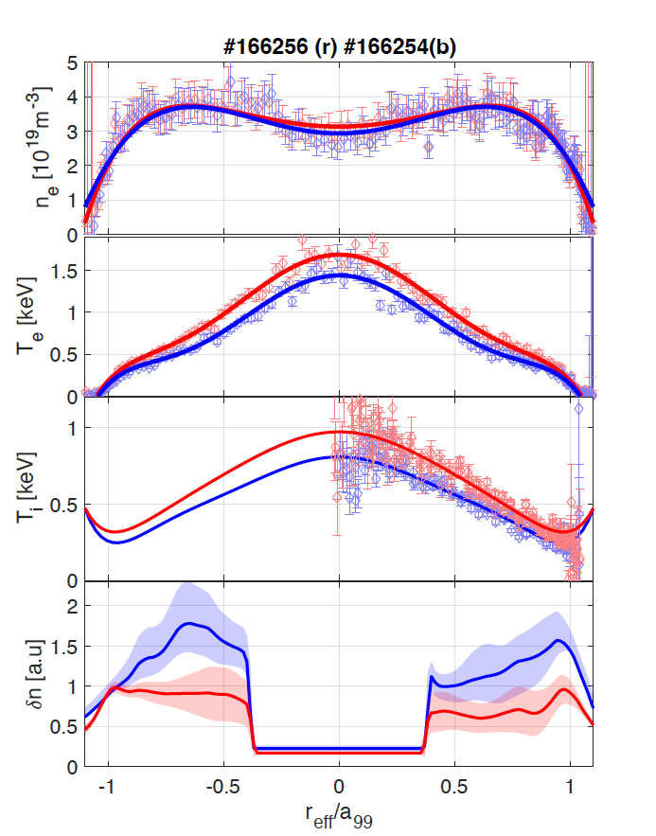
Access to a reduced turbulence improved confinement regime
Reference
B powder
Increase of T_{e} and T_{i} sometimes observed during B powder injection
Matched discharges with same density and power
T_{i} can increase up to ~ 50%
At the same time, turbulent density fluctuations decreased up to a factor 2 across plasma volume
Observed with
various heating schemes
both D and H plasmas
both directions of magnetic field
[Nespoli Nat Phys 2022]
Extensive experiments scanning plasma parameters, powder materials [Nespoli NF 2023]
T_{e} ~ +25%
T_{i} ~ +25%
No data

Slide 5
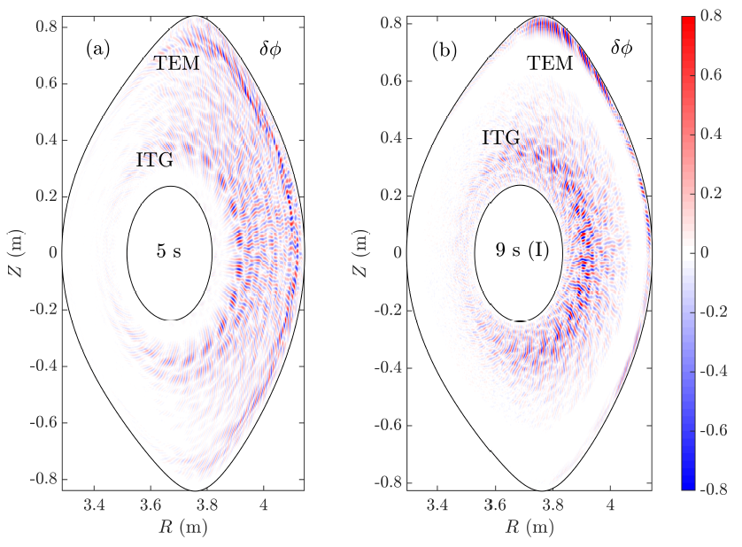
Suppression of ion scale turbulence possible cause of improvement
ITG-like lower frequency turbulence damped, TEM-like higher frequency excited.
Presence of both ITG and TEM confirmed by gyrokinetic simulations [Singh NF 2023]
ITG reduction can be due to
Profile modification
Increase in Z_{eff}
Reference
B powder
Reference
B powder

Slide 6
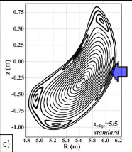
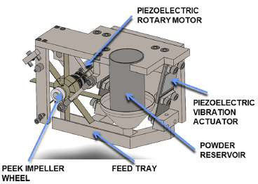
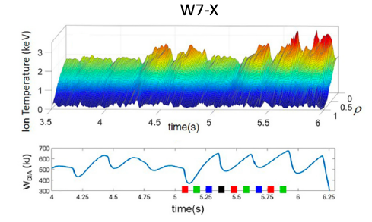
Powder injection in W7-X with the PMPI
Probe Mounted Powder Injector: A reduced version of IPD that fits on a reciprocating probe [Nagy FED 2019]
B₄C powder injected horizontally in pulses by a paddle wheel
First set of experiments showed an increase of T_{i} above the T_{i}-clamping level and reduction of turbulence [Lunsford PoP 2021]
Effect on T_{e} and W_{p} remain transitory
Possibly same mechanism at play as in LHD, could be steady-state with continuous powder flow

Slide 7
Joint experiment on effect of impurity on stellarator performance
Objectives:
Directly compare effect of boron powder impurities on stellarator performance across different machines
temperature increase
turbulence reduction
Inject powder in “identical” plasmas [Warmer PRL 2021]
Compare different injection techniques
Continuous –pulsed (LHD)
Powder – B LBO (W7-X)
T_{e}
powder
LHD
W7-X
TJ-II/HSX
LBO
n_{e}

Slide 8
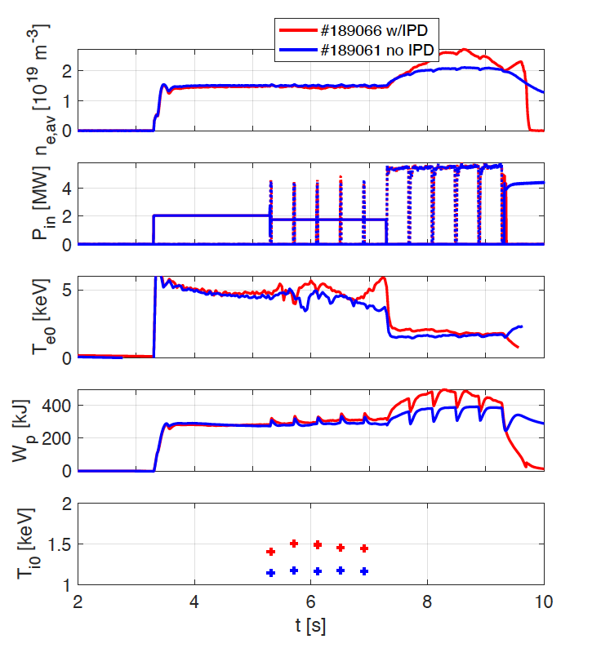
LHD experiments
B powder injected in plasmas
3 scenarios:
TJ-II n_{e}=0.5e19 P_{ECH} =0.7MW
W7-X Warmer PRL n_{e}=1.5e19 P_{ECH}=2MW
W7-X Lunsford PoP n_{e}=5.2e19 P_{ECH} =4MW
1) T_{i} increases but T_{e} decreases. n_{e} increases (no density control)
2) T_{e} and T_{i} increase
3) T_{e} increases, T_{i} not clear more analysis needed
Additional heating phases require more analysis (pNB only to mimic W7-X)
POWDER

Slide 9
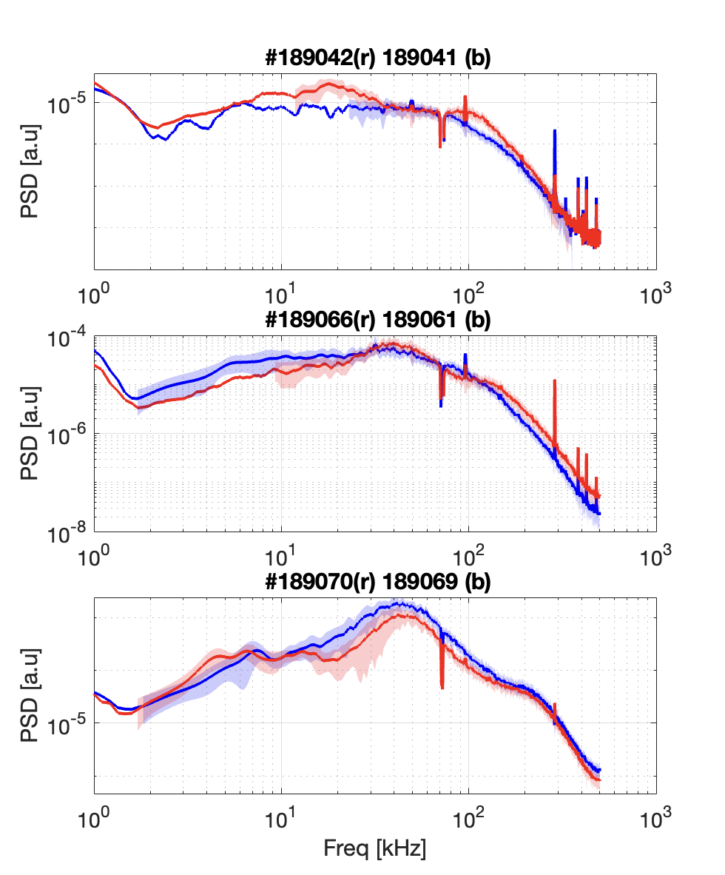
LHD experiments
B powder
B powder injected in plasmas
3 scenarios:
TJ-II n_{e}=0.5e19 P_{ECH} =0.7MW
W7-X Warmer PRL n_{e}=1.5e19 P_{ECH}=2MW
W7-X Lunsford PoP n_{e}=5.2e19 P_{ECH} =4MW
Effect on turbulence:
1) turbulence increased
2) turbulence spectrum changed
3) turbulence reduced
Somewhat in line with previous experiments in LHD
reference
Low density (TJ-II -like)
Mid density (W7-X Warmer -like)
High density (W7-X Lunsford -like)

Slide 10
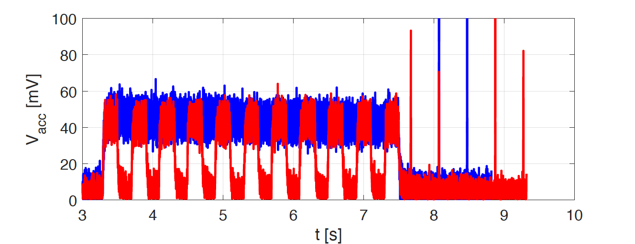
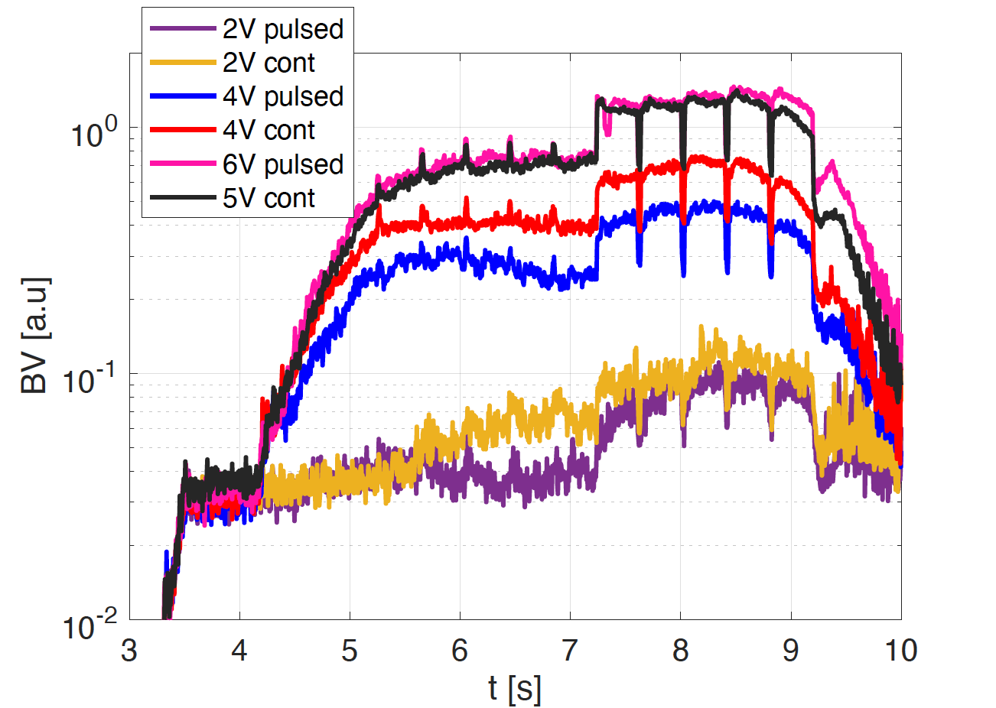
LHD experiments
Comparison continuous- pulsed
Attempted pulsed powder injection 0.2s on/off to mimic PMPI on W7X
Each pulse spreads in time during powder free fall, superimposing
Gives almost continuous flow but with lower mass rate

Slide 11
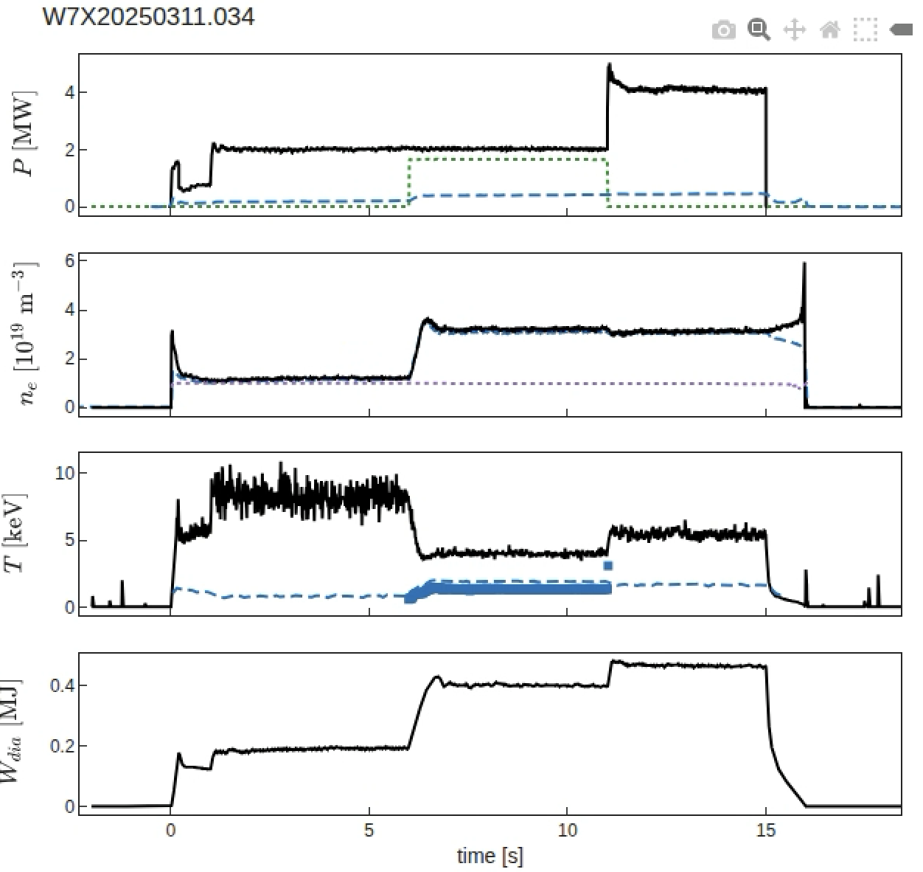
W7-X experiments
New set of experiments in March 2025
3 scenarios:
Warmer PRL n_{e}=1.5e19 P_{ECH}=2MW
n_{e}=3e19 P_{ECH} =2MW +P_{NBI}=1.6 MW
n_{e}=3e19 P_{ECH} =4MW
[Courtesy of C.Killer]

Slide 12
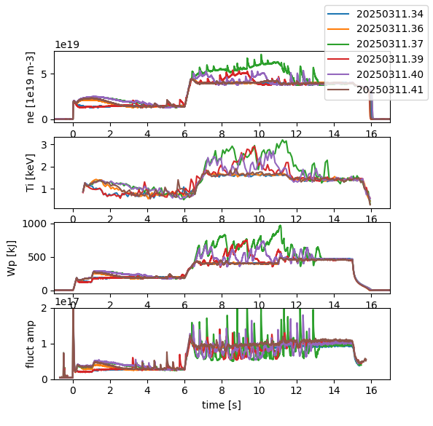
W7-X experiments
New set of experiments in March 2025
3 scenarios:
Warmer PRL n_{e}=1.5e19 P_{ECH}=2MW
n_{e}=3e19 P_{ECH} =2MW +P_{NBI}=1.6 MW
n_{e}=3e19 P_{ECH} =4MW
Clearer improvement of performances(T_{i}, W_{p}) during ECH +NBI heating
Turbulence reduced in between pulses (PCI)

Slide 13
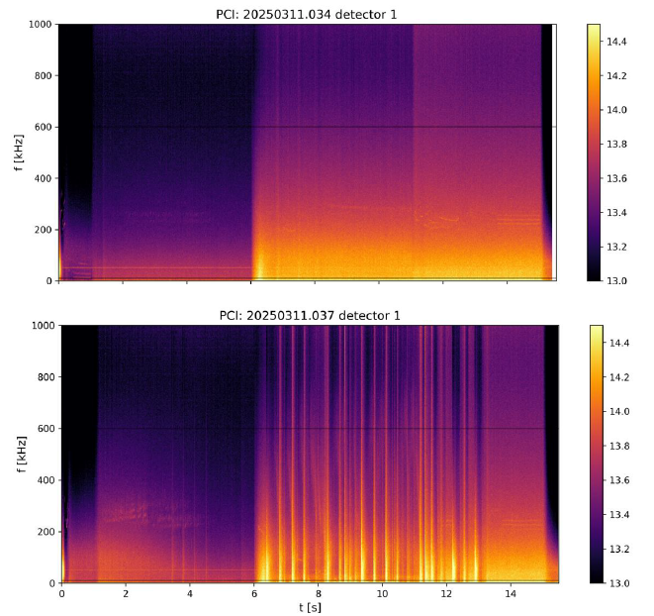
W7-X experiments
New set of experiments in March 2025
3 scenarios:
Warmer PRL n_{e}=1.5e19 P_{ECH}=2MW
n_{e}=3e19 P_{ECH} =2MW +P_{NBI}=1.6 MW
n_{e}=3e19 P_{ECH} =4MW
Clearer improvement of performances(T_{i}, W_{p}) during ECH +NBI heating
Turbulence reduced in between pulses (PCI)
[Courtesy of A. von Stechow]

Slide 14
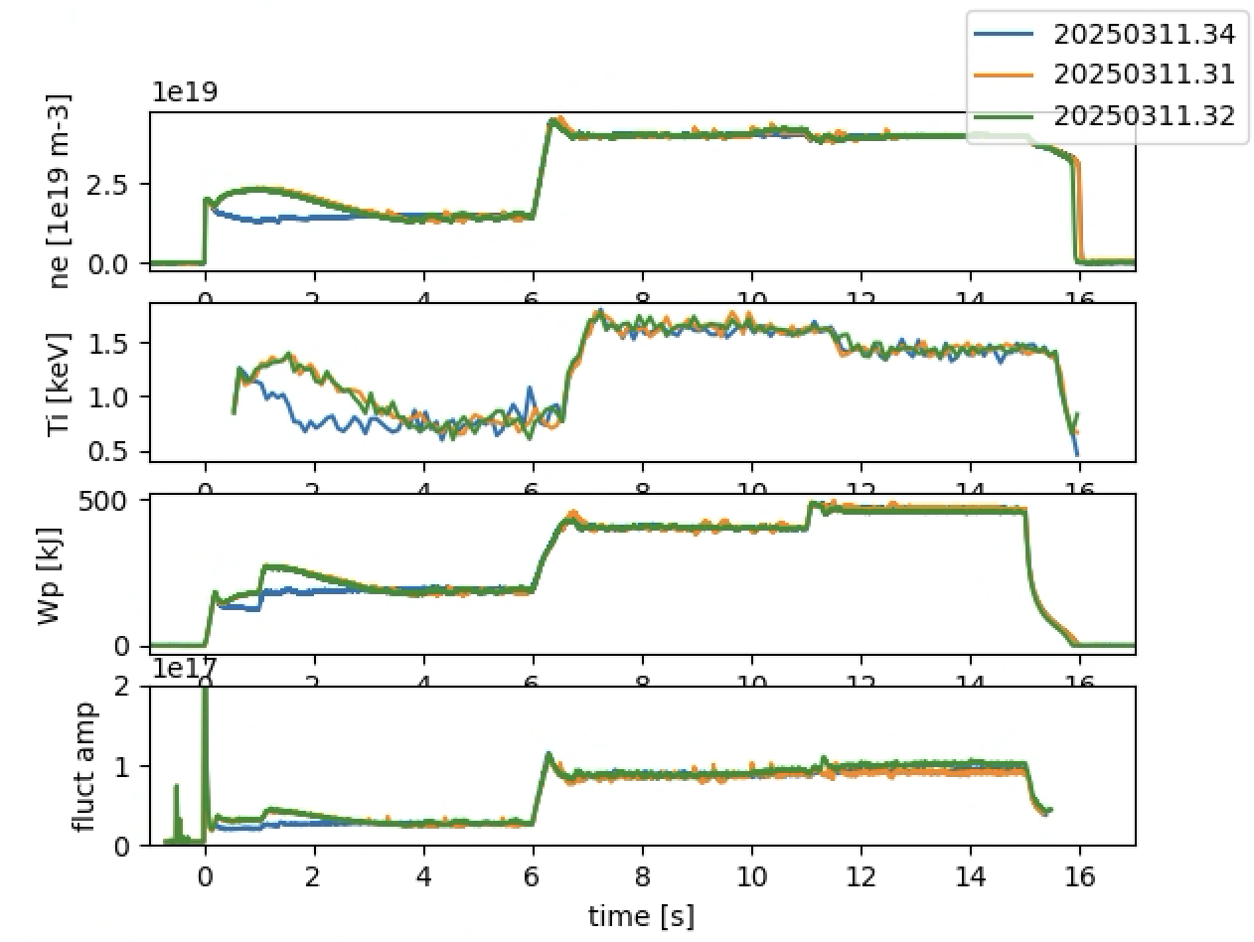
W7-X experiments
Comparison PMPI/ B LBO
B LBO injected in same plasma conditions, first at ~3Hz
Increasing intensity of the laser
Increase to max frequency 20 Hz
Even in that case, no clear effect on the plasma
Possibly quantity of injected B still too little O(e17)/pulse
More analysis needed

Slide 15
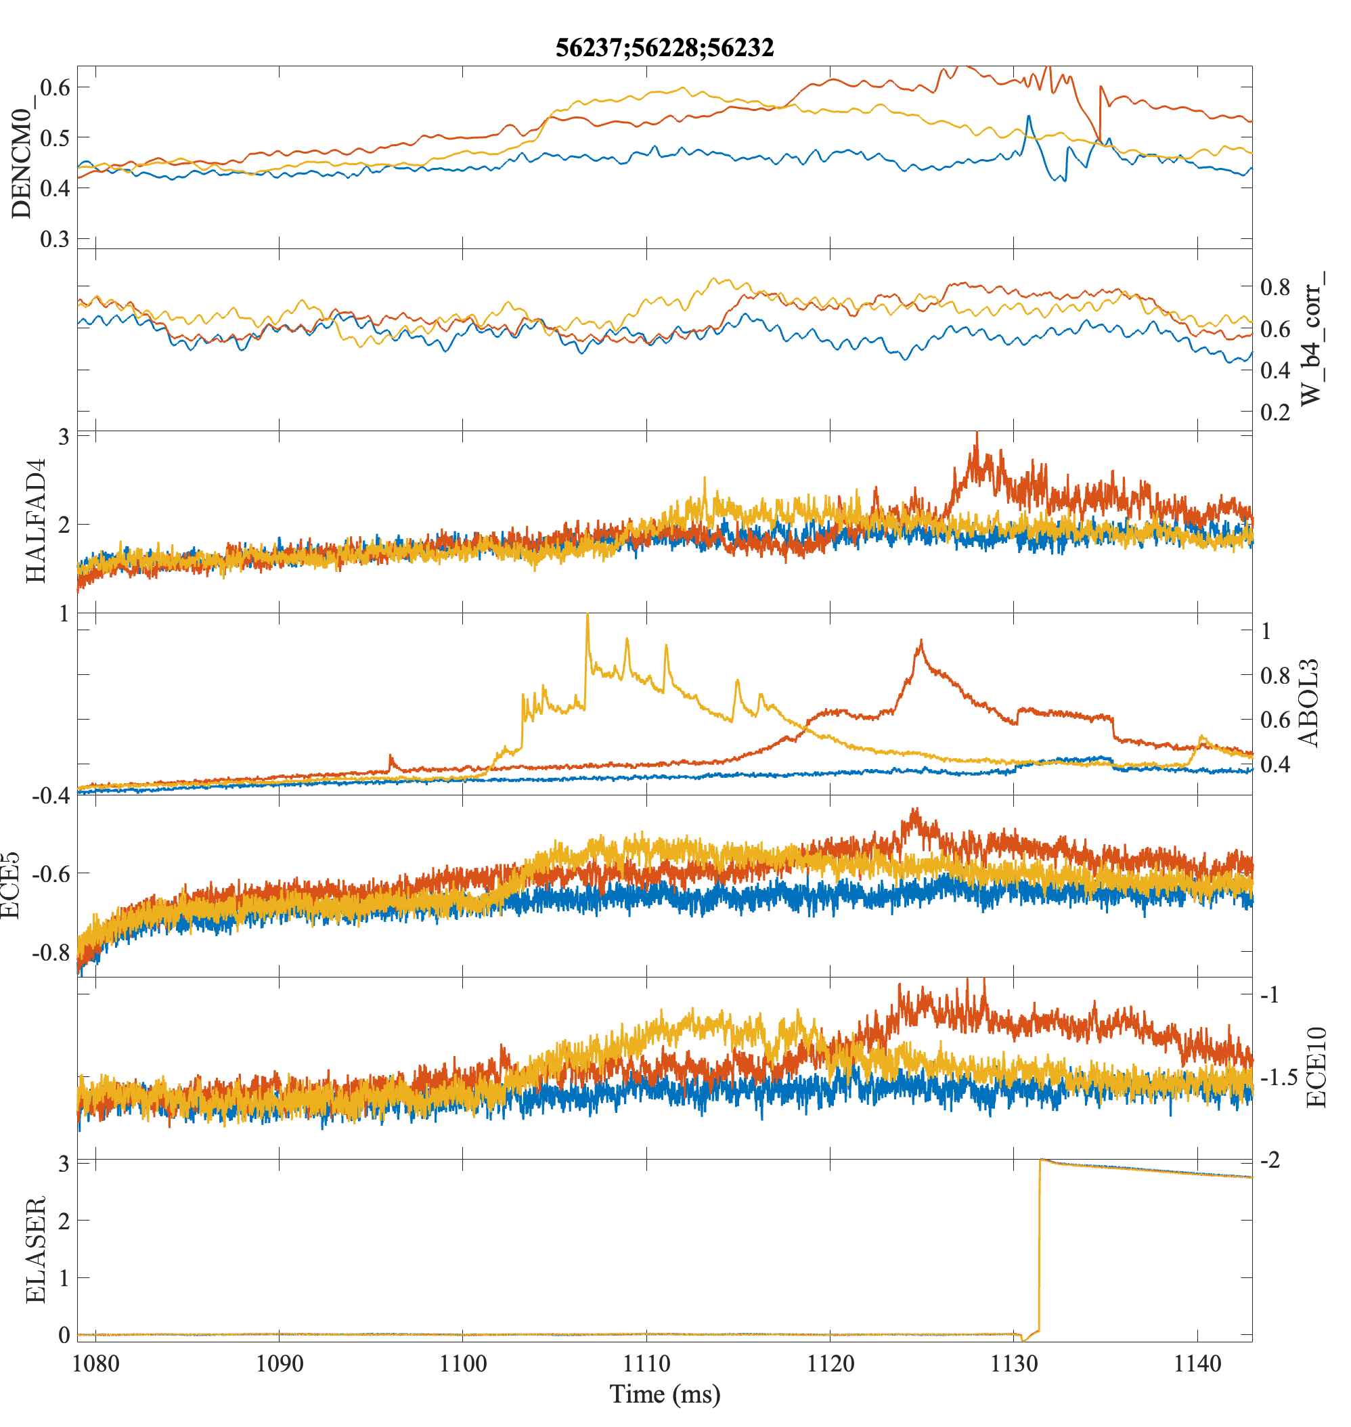
TJ-II experiments
B₄C powder injection attempted using TESPEL mechanism without encapsulation
Only one shot successful, then powder got stuck in revolving mechanism
Compared with B LBO
In both cases no clear effect on T_{i}, Te drop, n_{e} increase
B₄C pow
B LBO
ref

Slide 16
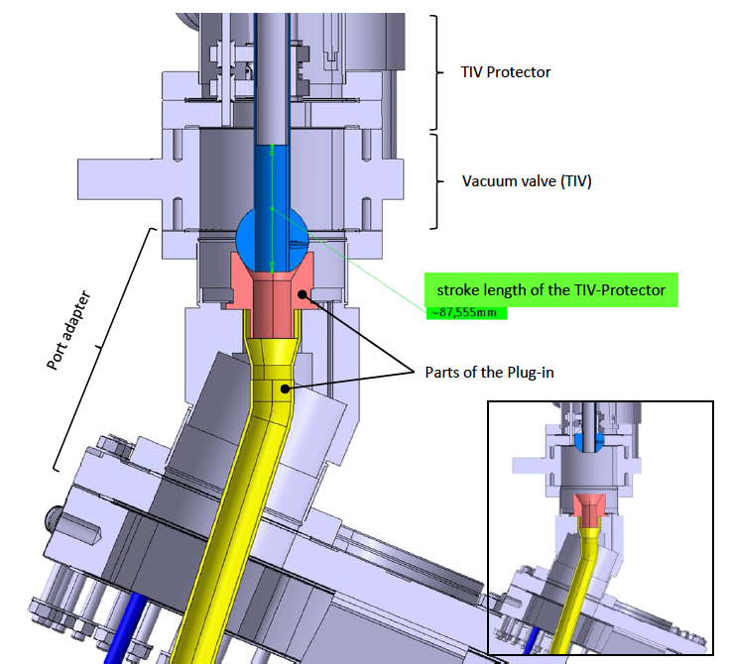
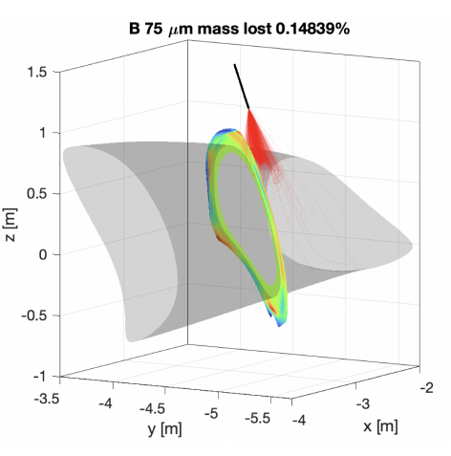
Next steps
LHD: in last campaign, repeat scenarios used in latest W7-X experiments
W7-X: nothing to be done until OP2.4. A full IPD will be operative by then, more in dept comparison will be possible
TJ-II, HSX: possibility to install a small powder dropper under consideration. Perform more B LBO experiments

Slide 17
Backup slides
B
BN
Li

Slide 18
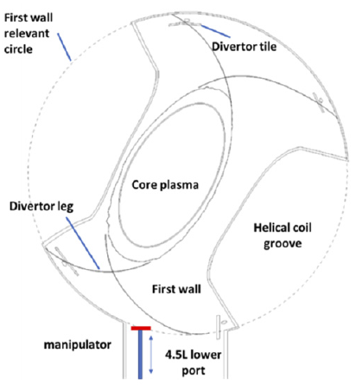
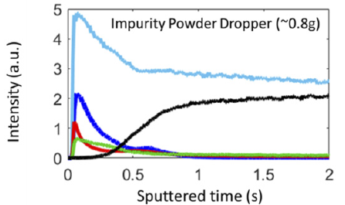
Boron deposited on first wall and divertor
Material sample located at first wall exposed to IPD experiments
deposition of B thin film confirmed by the post mortem optical emission spectroscopy analysis [Lunsford NF 2022]
Emission from BH molecules and B+ ions measured with spatially resolved spectroscopy
BH and B+ are concentrated in the divertor region during powder injection
B ions are deposited on the divertor as well [Kawate NF 2022]
H
B
Fe
C
O (10X)

Slide 19
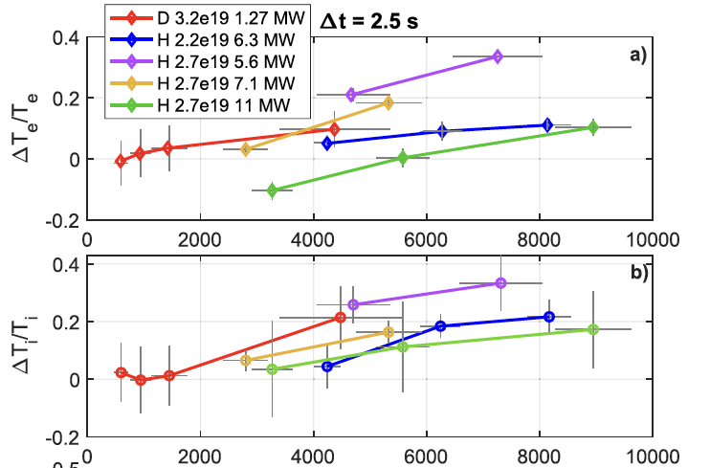
Improvement scales with amount of injected powder
Relative improvement of ion and electron temperature increases with amount of injected powder
Increase in confinement time in general positive
Above a mass injection threshold, density control is lost and/or plasma collapses
Turbulence response more complicated, varies with different scenarios
[Nespoli NF 2023]

Slide 20
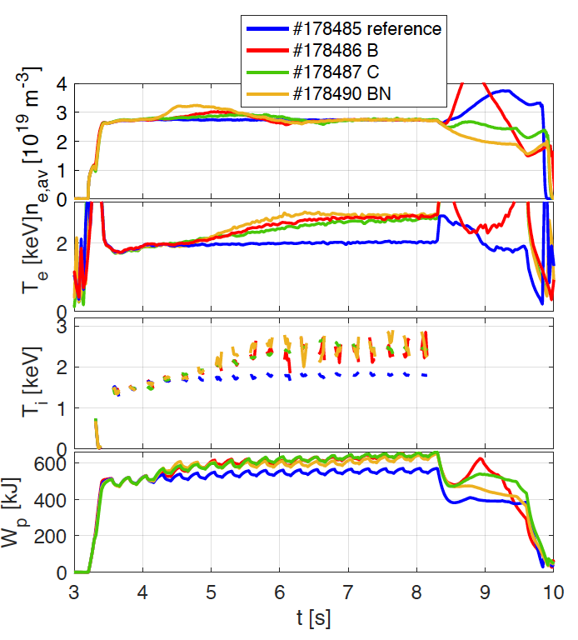
Improvement observed with different powder materials
Access to reduced turbulence observed with B, C, BN powders
Similar response for the three materials:
~30% increase of T_{i} and T_{e}
turbulence decrease inside LCFS and for lower frequencies, increase for higher frequencies and close to LFCS
Reduction of χ_{i} and χ_{e} for 0.4< r_{eff}/a₉₉<0.9 (DYTRANS)
Reduction of intrinsic impurities
Reduction of recycling (even for C)

Slide 21
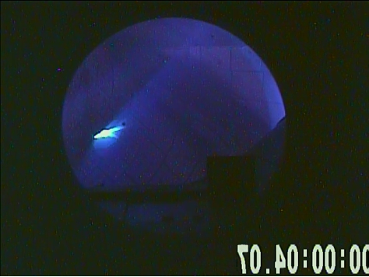
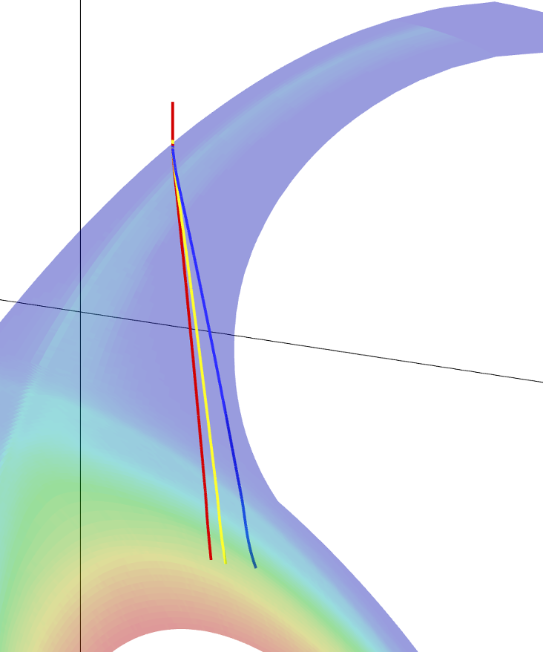
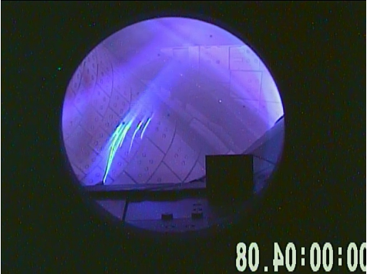
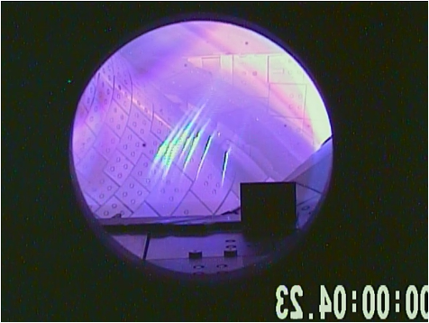
Simulations help understanding powder injection
Outboard side
B 150 μm
Coupled simulations of EMC3-EIRENE (plasma background) with DUSTT (powder grains dynamics)
Dedicated experiments for model validation
Increasing plasma density, powder ablation point observed to move outwards
Result recovered in simulations, due to increased ion drag in the divertor leg [Shoji, NME 2025]
1.5×10¹⁹ m⁻³
increasing n_{e}
3×10¹⁹ m⁻³
5×10¹⁹ m⁻³

