Slide 1
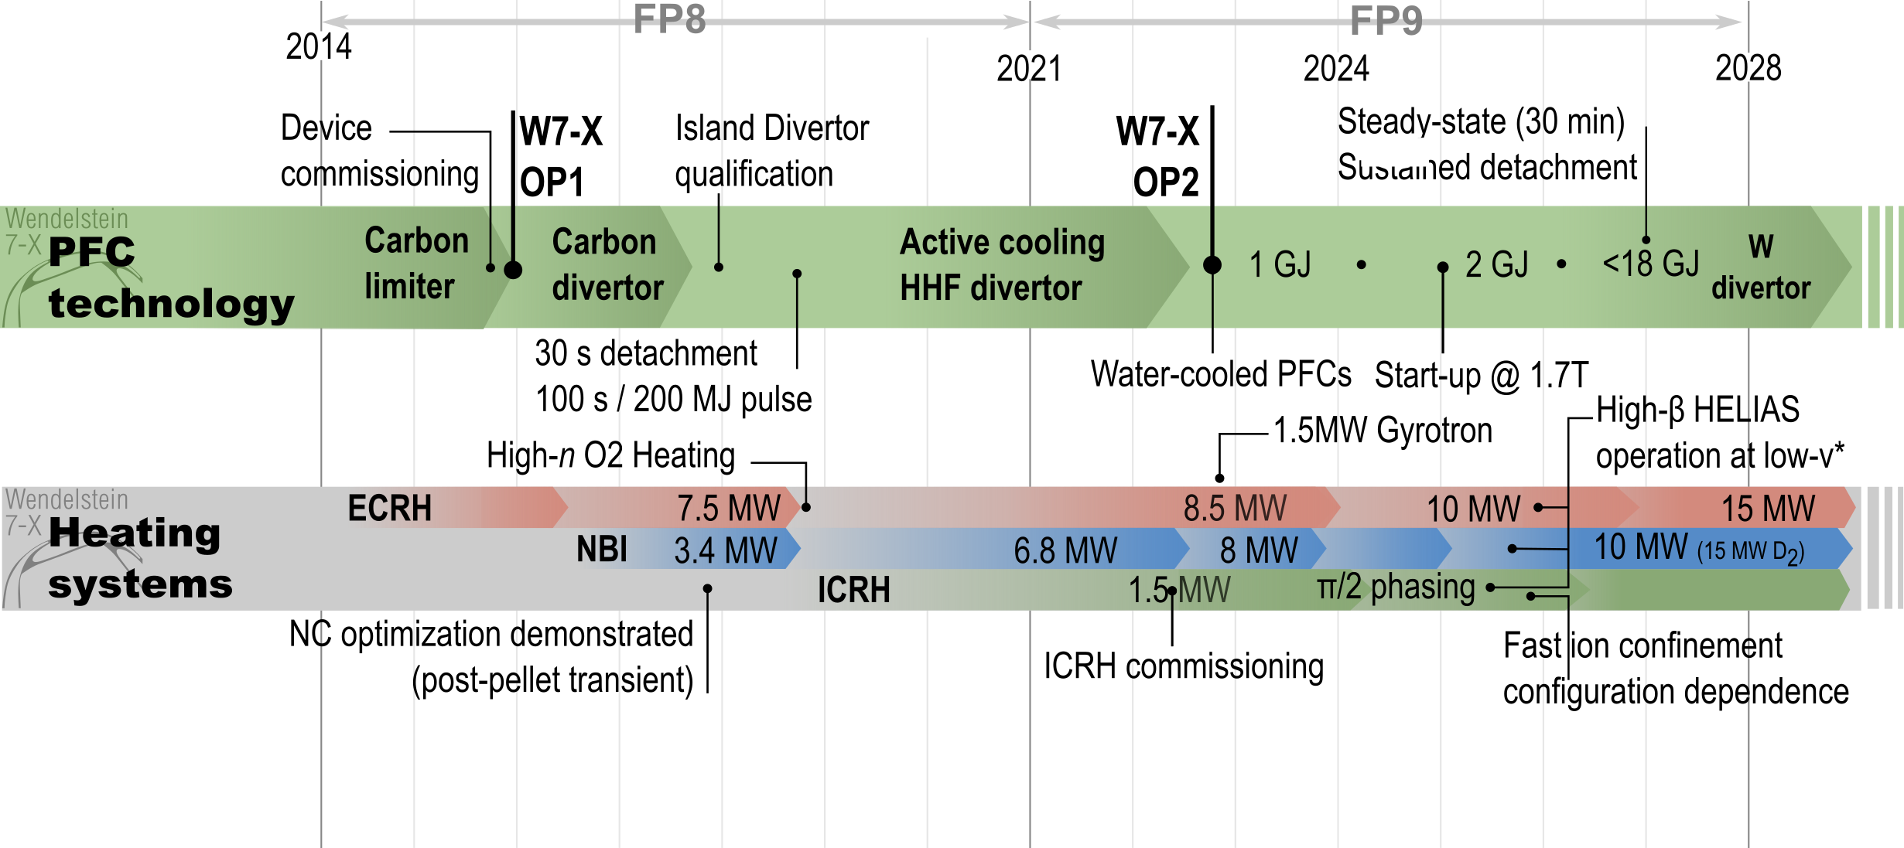
Reaching goals of W7-X within FP9

Slide 2
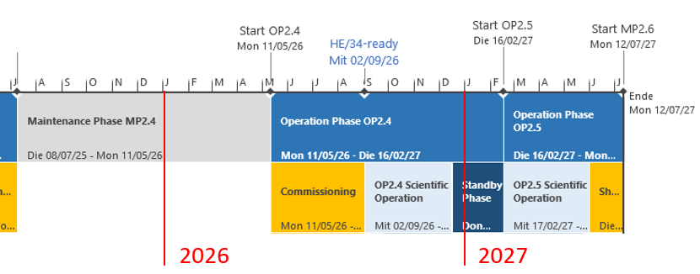
Plans for W7-X for the following years
In 2026/2027 two experimental campaigns (OP2.4/OP2.5) scheduled back to back like OP2.2/OP2.3
No major upgrades planned for MP2.4
Preparation of deuterium operation (planned for OP2.6)

Slide 3
Minor upgrades before OP2.4
Manufacturing and installation of additional 1.5 MW gyrotrons (12 in total). Development of 2 MW gyrotron, manufacturing should start 2027. With more heating power: → operation at the W7-X design point of 1.5x10²⁰ m⁻³ → operation at higher beta: up to <4%> at low field?
First elements of heavy-ion beam: OP2.4 detector, OP2.6 accelerator
4-channel interferometer, which may allow to create a feedback system on density peaking.
Improvements to pellet injector: smaller pellets, better software,…
Feedback system on f_{rad} instead of P_{rad} for better detachment control

Slide 4
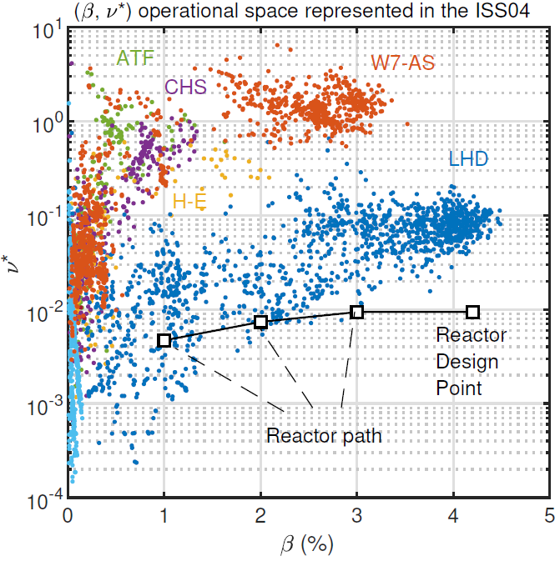
Importance of developing low-B scenarios at W7-X
The development of low-B scenarios at W7-X (namely, 1.7 T for X3-ECH heating) is programatically important beacause:
Plasma start-up not based on X2-ECH will be required in a reactor. At W7-X, also the combination of ICH and NBI is being pursued.
Low-B operation at W7-X allows an easier access to high-β, low-ν* operation, potentially close to reactor design values (see next slide).
Investigate B transport dependencies for reactor projections. Notably, there is no stellarator scaling of the SOL e-folding length.
W7-X
<OP2.2
W7-X
OP2.3
W7-X
OP2.4?

