Slide 1



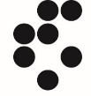



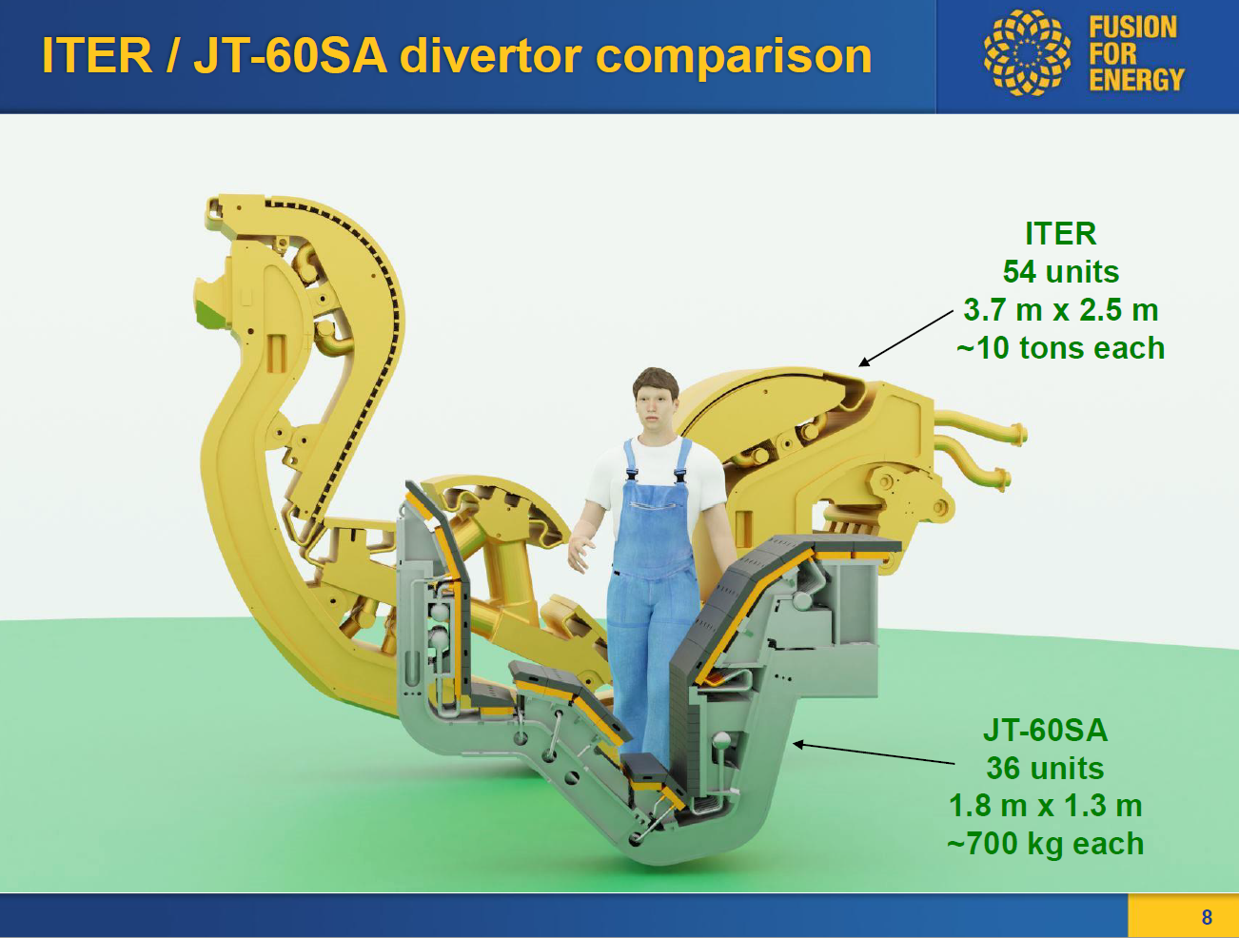
Rounding edge calculation
Z. Wang for the WPDIV W7-X Team
MPG

Slide 2
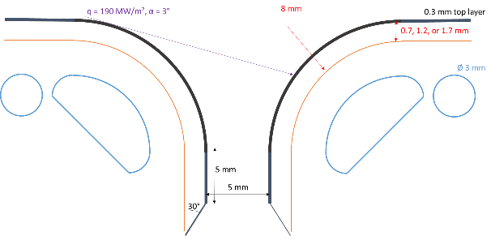
Scope, objectives, deliverables
Assessment of the effect of rounding of the poloidally oriented edges of the heat sink on the thermal stress for a 10 MW/m² uniform load.
The thickness of the graded layer and the radius of the rounding of the coating along the unexposed sides of the heat sink must be parametrized to determine their effect on the normal thermal stress in the coating. The top layer equals 0.3 mm. The depth of the coating around the rounded corner equals 5 mm to avoid any load near the stress singularity. The graded layer is varied at 0.7, 1.2 and 1.7 mm. The rounding radius outer surface of the heat sink is varied at 4, 6 and 8 mm. The outer cooling channel in the heat sink will be adapted to the rounding to maintain a wall thickness of 2.5 mm

Slide 3
Material properties
The CuCrZr (heat sink) and the Tungsten (coating) have plastic properties.
The graded layer has elastic properties from the average value of the W/Cu mixture, according to their percentage, which is a linear function of the layer thickness (from 100% W to 100% Cu linearly).
Temperature (°C) | Thermal conductivity (W/K-m) |  | Young’s Modulus (GPa) |  | Poisson’s Ratio |  | Thermal expansion coefficient (10⁻⁶/K)
 | W | Cu | W | Cu | W | Cu | W | Cu
20 | 173 | 401 | 398 | 116.54 | 0.29 | 0.33 | 4.5 | 16.83
100 | 165 | 395 | 397 | 114.2 |  |  | 4.5 | 17.2
200 | 155 | 388 | 396 | 110.14 |  |  | 4.53 | 17.59
300 | 145 | 381 | 395 | 104.83 |  |  | 4.58 | 17.92
400 | 140 | 374 | 393 | 98.256 |  |  | 4.63 | 18.22
500 | 132 | 367 | 390 | 90.425 |  |  | 4.68 | 18.5
600 | 128 | 360 | 387 | 81.336 |  |  | 4.72 | 18.8
700 | 122 | 354 | 383 | 70.989 |  |  | 4.76 | 19.14
800 | 118 | 347 | 379 | 59.384 |  |  | 4.81 | 19.55
900 | 113 | 340 | 374 | 46.521 |  |  | 4.85 | 20.05

Slide 4
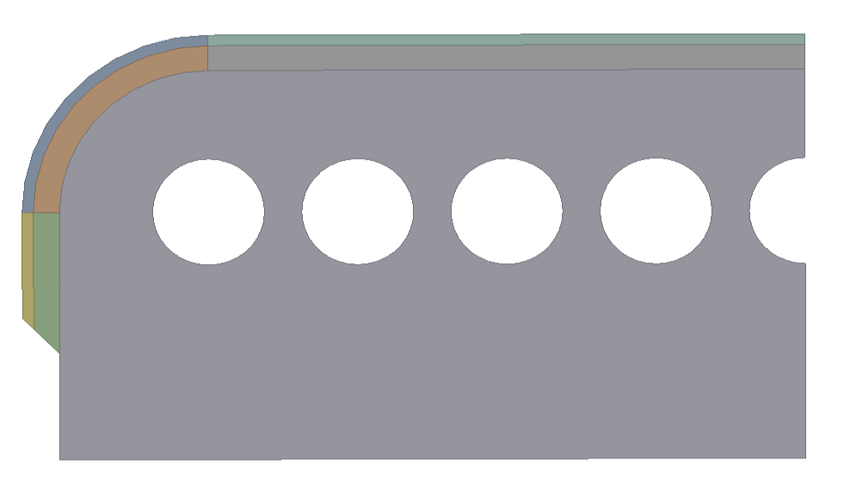
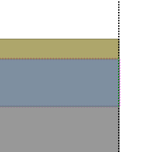
Analysis model
A symmetric 2D model is taken from the cross section of the target module, here is the case with rounding radius=4 mm and the graded layer thickness=0.7 mm.
The return flow channel is represented by a convection boundary condition.
R 4 mm
1 mm
W
0.3 mm
2.5 mm
12 mm
Graded layer
0.7 mm
Ø 3 mm
CuCrZr
Cu
W
20mm
Linear Interpolation

Slide 5
Loads and boundary conditions
Uniform 10 MW/m² on the straight edge
Symmetric
Thermal: 20 °C, 40 kW/m²-K cooling water
Structural: 25 bar water pressure
Reference temperature=250°C
Thermal: 20 °C, 5 kW/m²-K cooling water
Structural: frictionless support

Slide 6
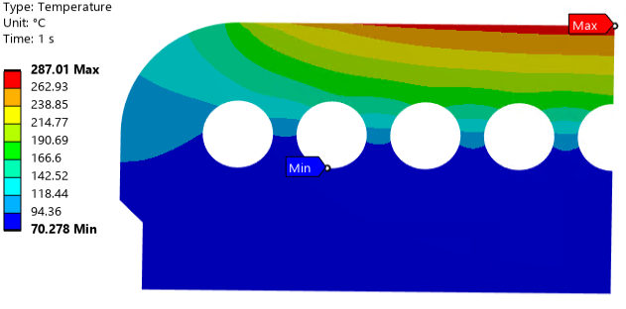
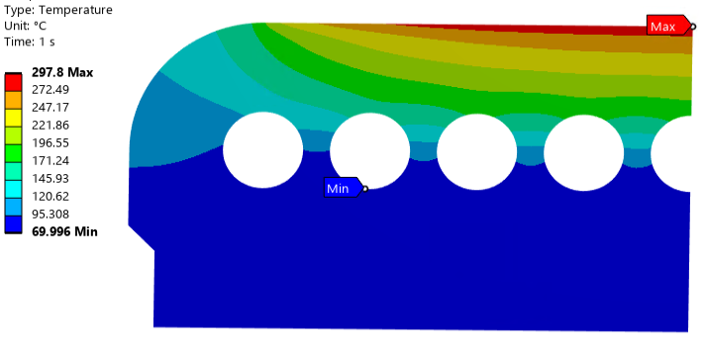
Results – thermal – Cu/graded interlayer comparison
Cu interlayer
Graded interlayer
The peak temperature of the graded interlayer is 10 °C higher than the Cu one.

Slide 7
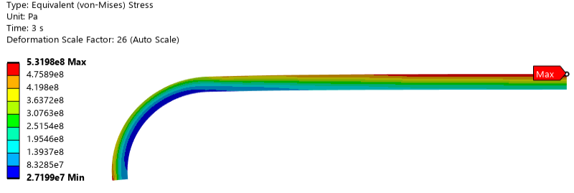
Results – structural – plastic calculation problem
The manufacturing is finished at 250 °C, so it’s considered a stress-free condition, then the water pressure and the plasma exposure are applied.
Because the graded layer is elastic, so it has a stress higher than the Cu yield strength, which is not realistic.
Therefore, all materials are elastic in the following slides.
Cu yields at 3 MPa.

Slide 8
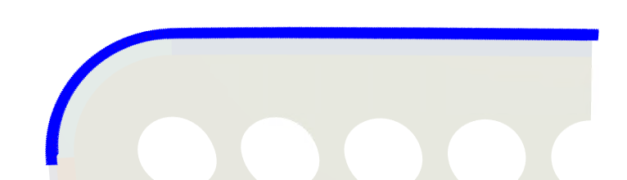

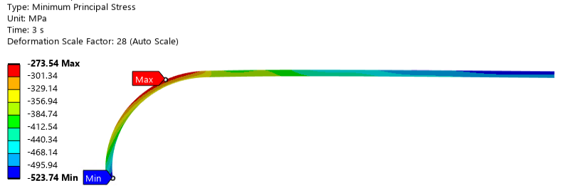
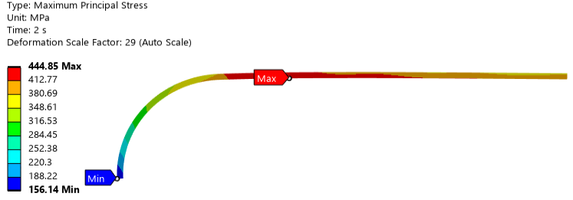
Results – structural – different stress-free status
When the target element cools down from 250 °C to 20 °C, compressive stresses appear, which compensates the thermal expansion in the plasma exposure.
If the stress-free status is at 20 °C, the temperature gradient will generate high tensile stresses.
The W tile stress is shown.
Compressive stress due to the 250 °C stress-free temperature
Tensile stress due to the 20 °C stress-free temperature
Minimum principle stress in the plasma exposure
Maximum principle stress in the plasma exposure

Slide 9
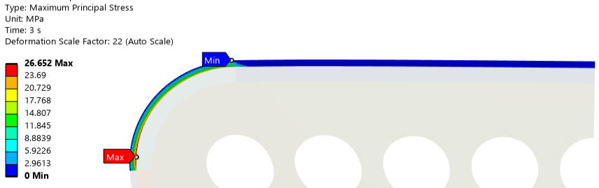
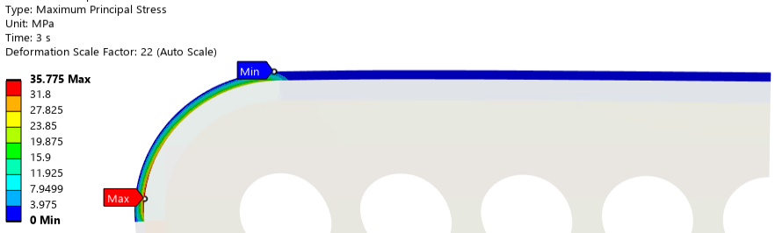
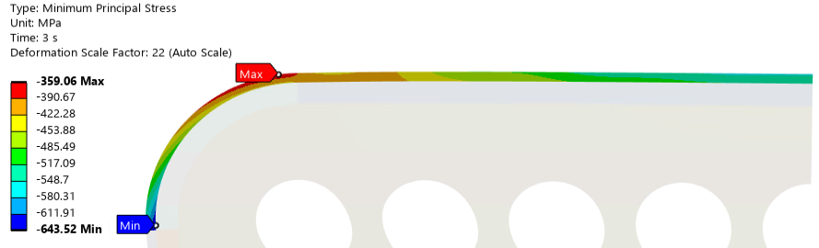
Results – structural – different interlayer material
A Cu interlayer and a graded layer are compared in the plasma exposure.
The W tile stress is shown, in both cases it takes compressive stresses.
Both calculations have a stress-free temperature of 250 °C.
Maximum principle stress with graded layer: 27MPa.
Maximum principle stress with Cu interlayer: 36 MPa.
Minimum principle stress with graded layer: -524 MPa.
Minimum principle stress with Cu interlayer: -644 MPa.

Slide 10
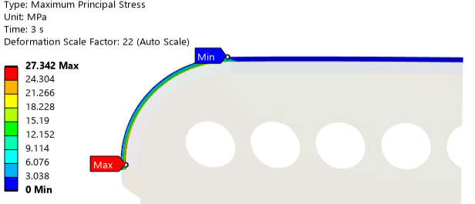
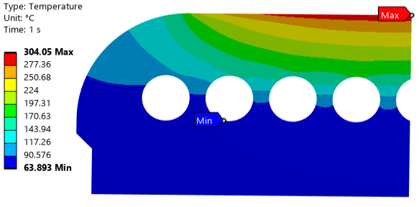
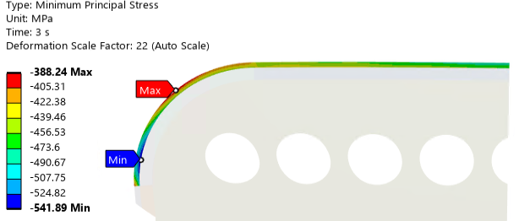
Results – radius=6 mm
The target element radius is changed to 6 mm, and the thermal/structural results are shown.
Only the graded layer and the 250 °C stress-free conditions are considered.
Maximum principle stress: 27 MPa.
Temperature in the plasma exposure
Minimum principle stress: -542 MPa.

Slide 11
Conclusions
The thermomechanical analysis of the target module with a rounded edge is performed, which consists of a steady state thermal analysis and a static structural analysis with a 2D symmetric model.
A graded layer made of W and Cu is modeled with a linear profile through the thickness, only elastic properties are used for all materials.
A uniform 10 MW/m² heat flux and a convection boundary (40k W/m²-K HTC in the micro channel and 5k W/m²-K in the return channel) are applied in the thermal analysis.
The structural analysis includes the thermal load and a coolant pressure of 25 bar, a symmetric and a frictionless support boundary conditions.
The graded layer has a higher peak temperature than the Cu interlayer (~10 °C).
The 250 °C stress-free condition could compensate the thermal expansion in the plasma exposure and keeps compressive stresses in the W tiles.
Compared to the Cu interlayer, the graded layer could reduce the stresses in the W tiles.
A radius of 6 mm doesn’t make significant change compared to a 4 mm radius.

