Slide 1
HEPP Introductory Talk
(And Two Brief Intros to Fast ICRH Modeling at ASDEX Upgrade and Extended MHD for Pedestal Stability)
Michael Sieben

Slide 2
About me

Slide 3

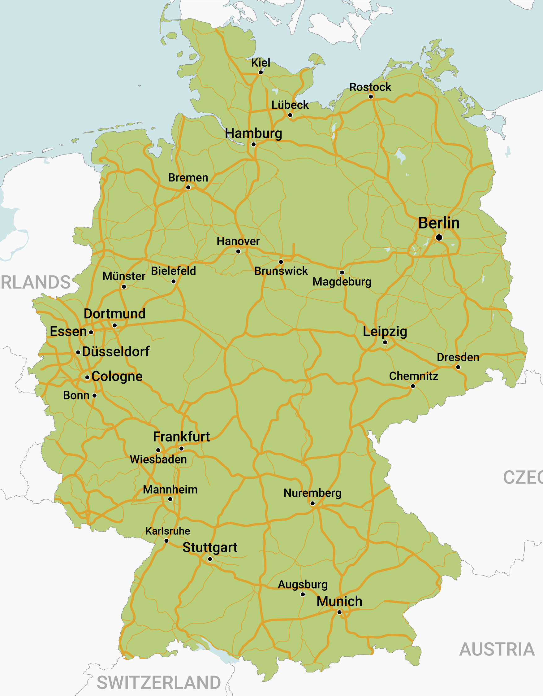




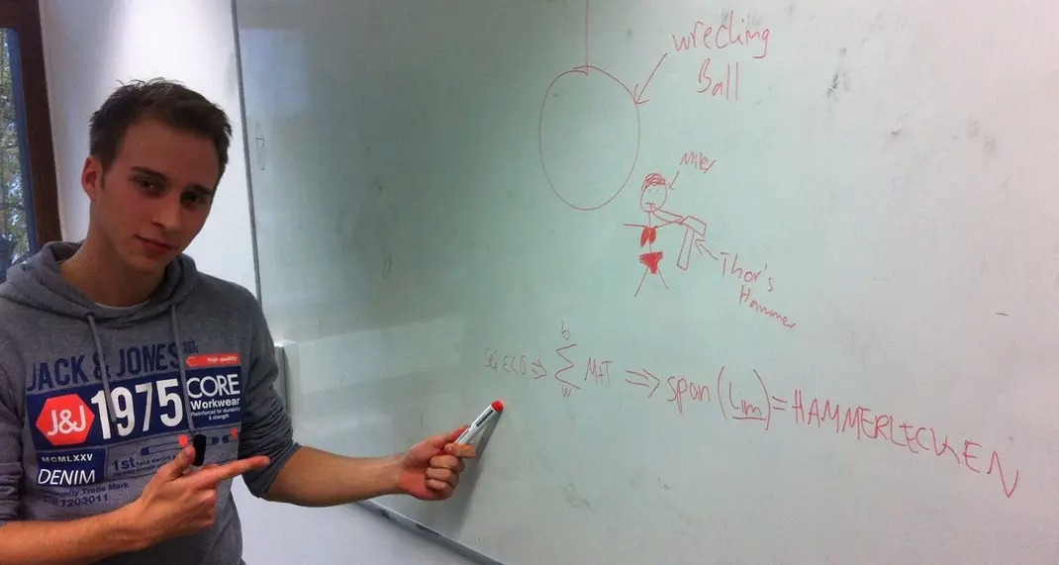


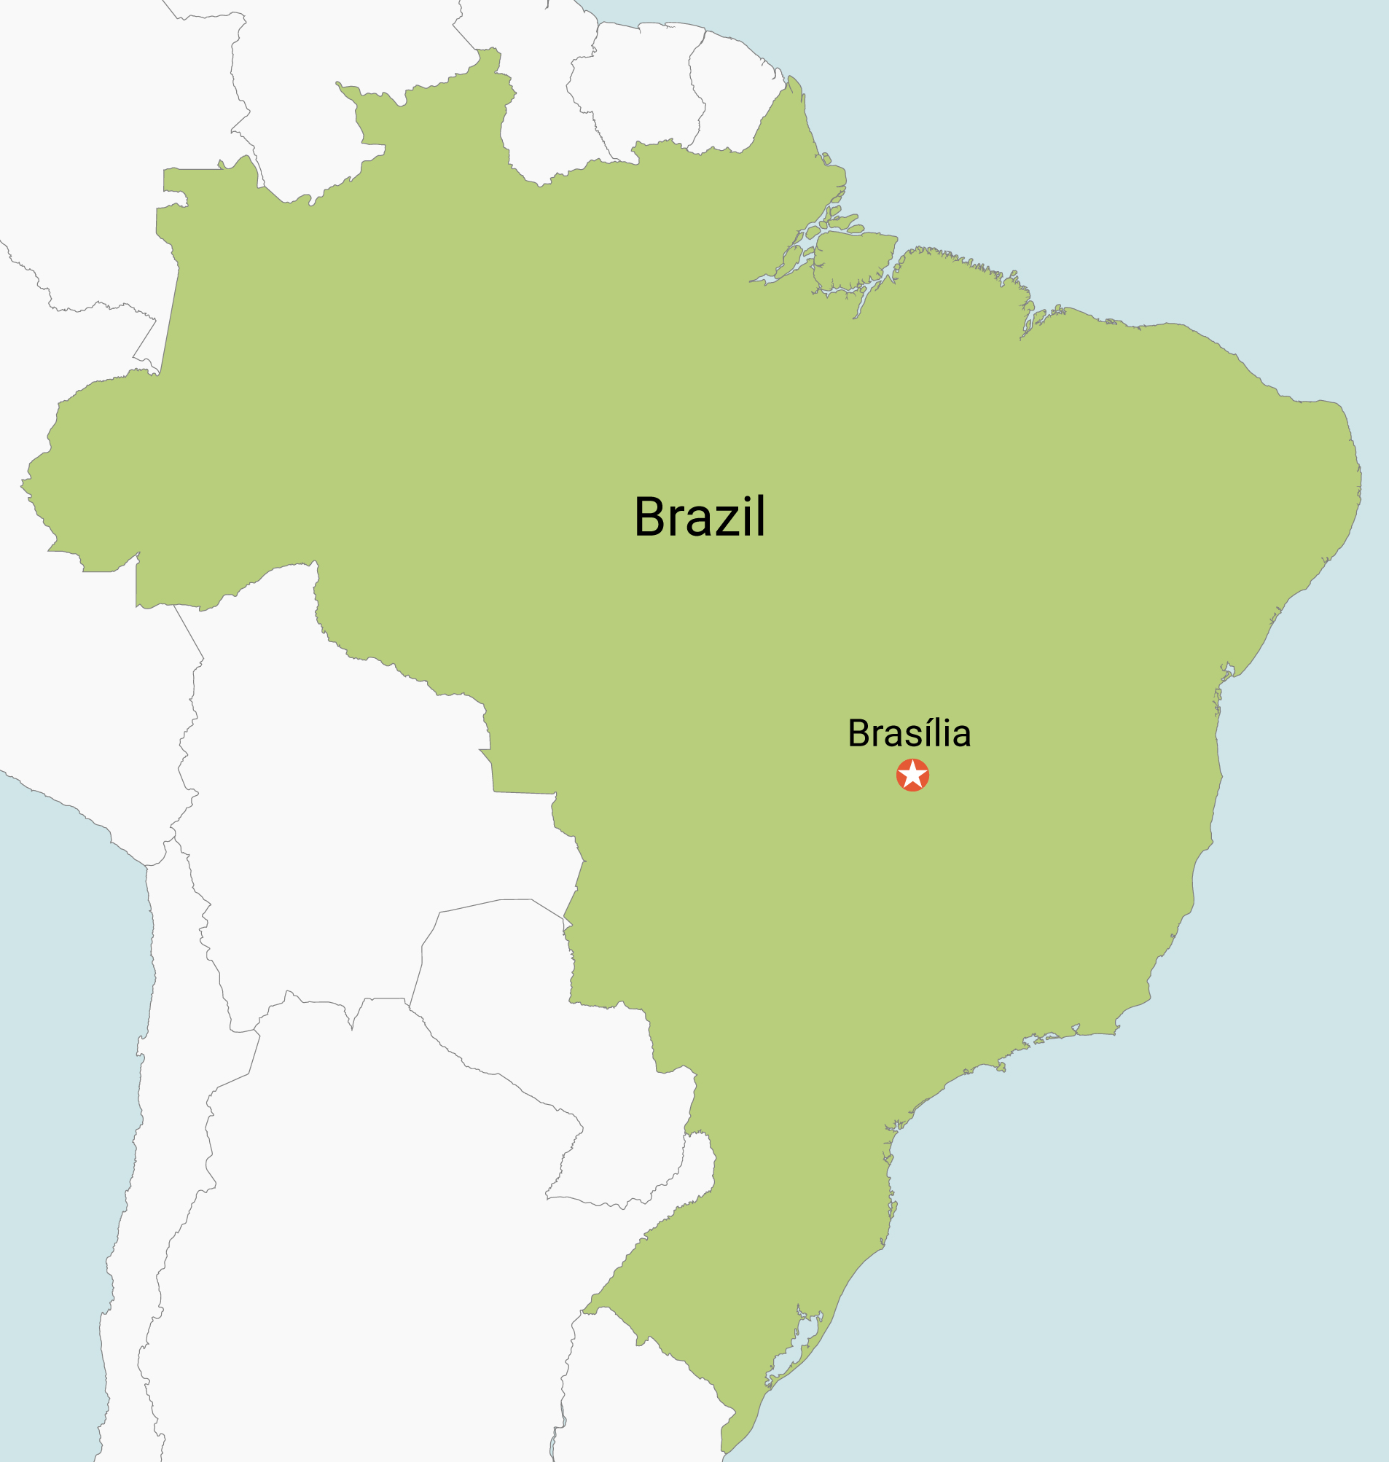
Backstory Time
*1993
Ulm
2017
São Paulo

Slide 4
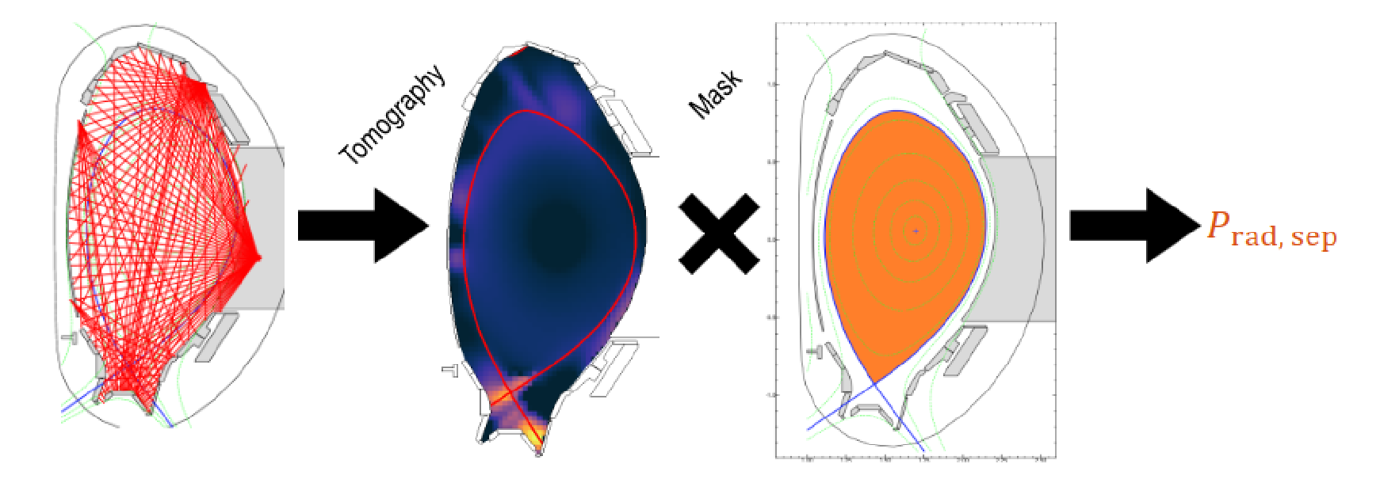
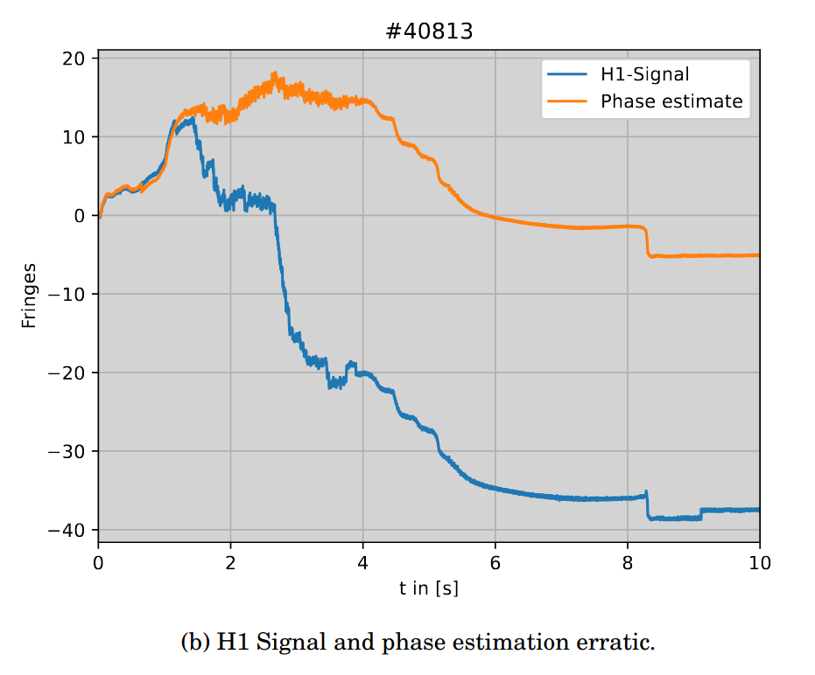
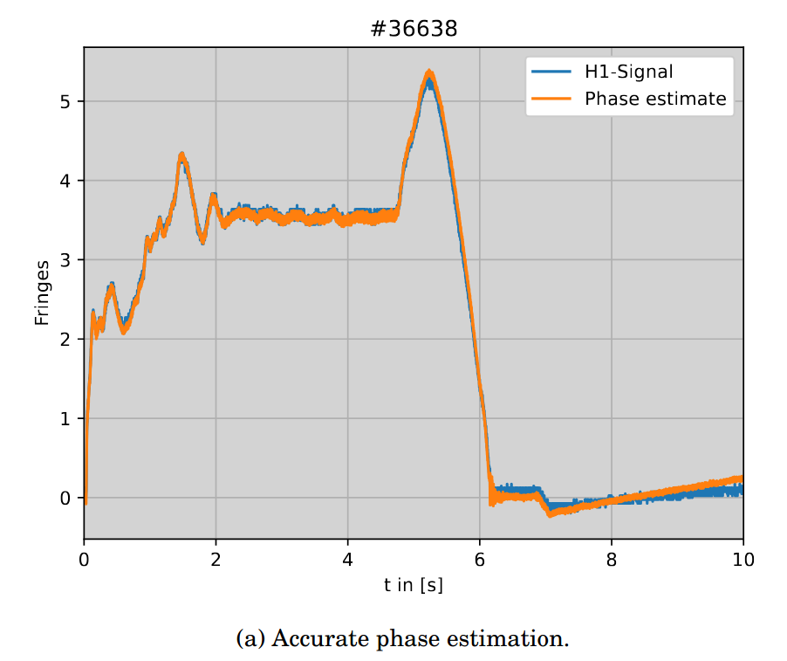
Backstory Time
2021 — 2024: Physics Bachelor + Master
2022: First time at IPP as working student, developing a CICLOP database framework with Alex Bock
2022/23: Second working student job with Pierre David on implementing real-time capable Gaussian Process Tomography, used for P_{rad} controller [P. David, 2025]
2023: Internship with Alex Bock to implement Kalman Filter to enhance DCN measurements

Slide 5
Master Thesis

Slide 6
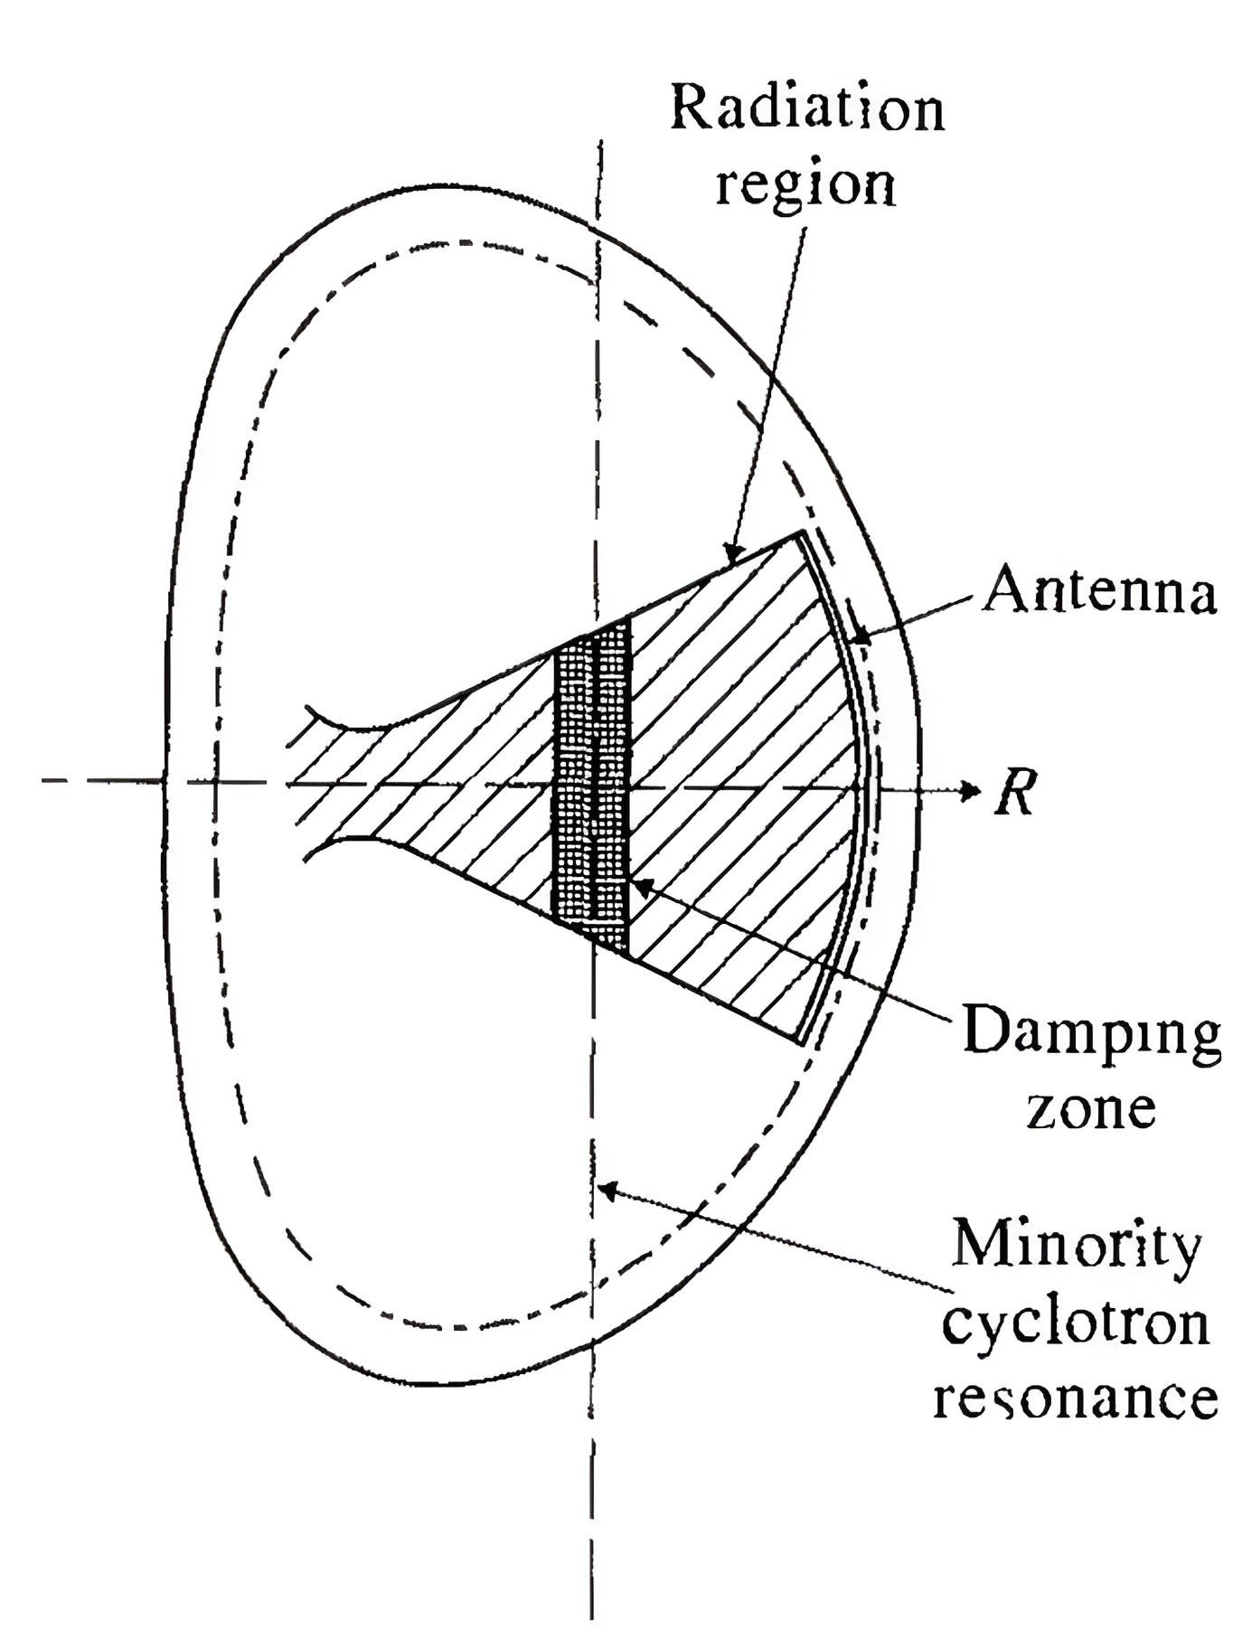
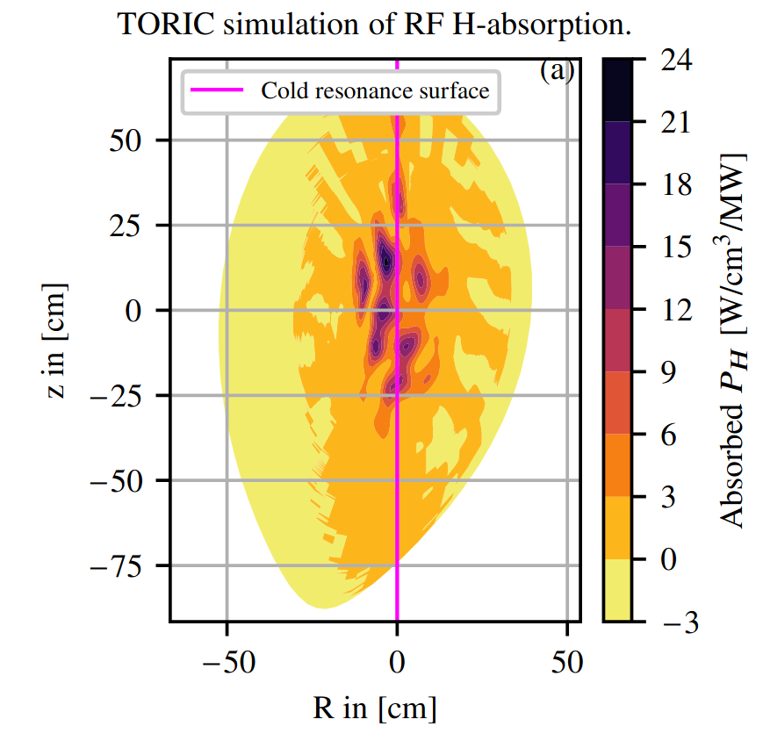
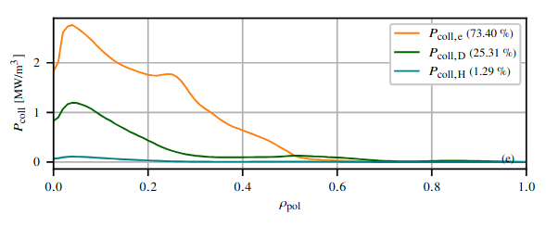
Fast ICRH Surrogate Model for AUG
Motivation: Fast transport modelling (e.g. ASTRA or Raptor) and real-time control require fast modelling of ICRH minority heating
At AUG, high fidelity simulations are performed by
2D wave equation solver TORIC and Fokker-Planck
solver SSFPQL (TS), run times of the orders of minutes
  Implement fast neural network surrogate model with
  calculation times < 1 ms.
[Tokamaks, Wesson, 2004]

Slide 7
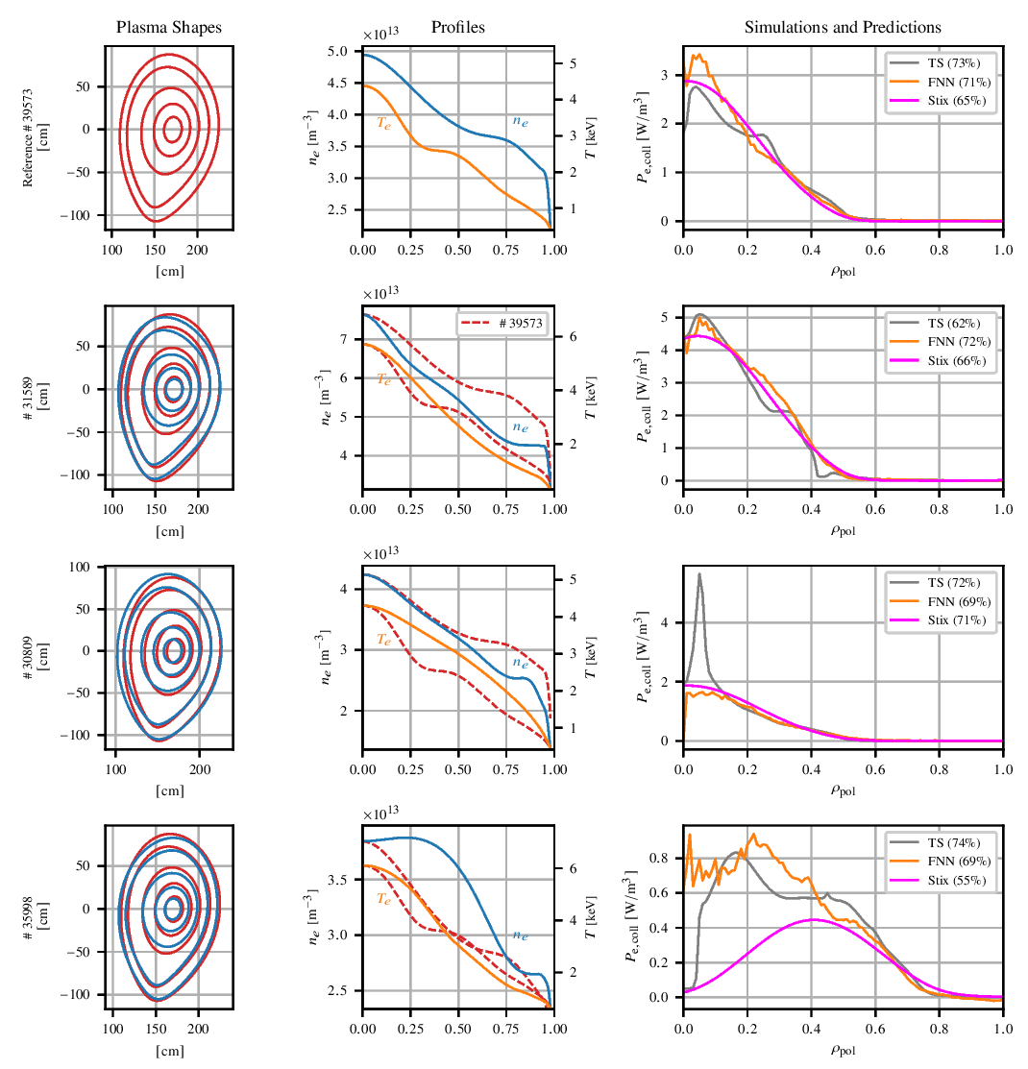
Fast ICRH Surrogate Model for AUG
NN inference is at 0.04 ms!
Model performs good on test set (R²>0.85)
Outperforms benchmarking model
Applied to different discharges than the one trained on
Network is exported into ONNX framework and testcases to interface with C++ and Fortran exist!
  Paper now on pinboard!

Slide 8
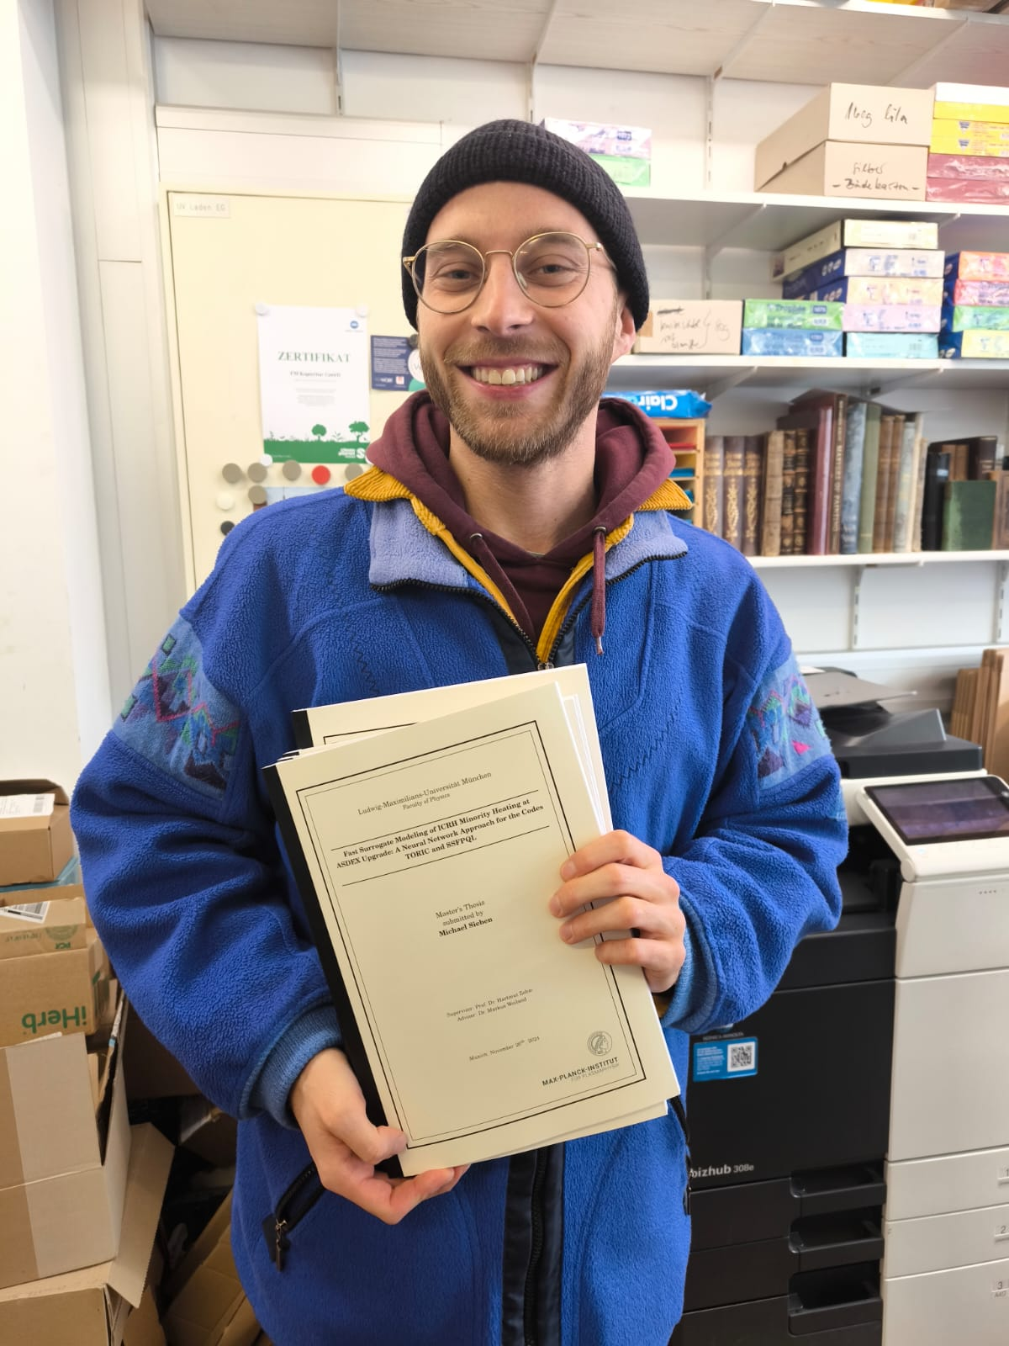


Slide 9
PhD Project:
Enhancing Predictive Frameworks for Peeling-Ballooning Stability: Integrating Extended MHD with CASTOR3D

Slide 10
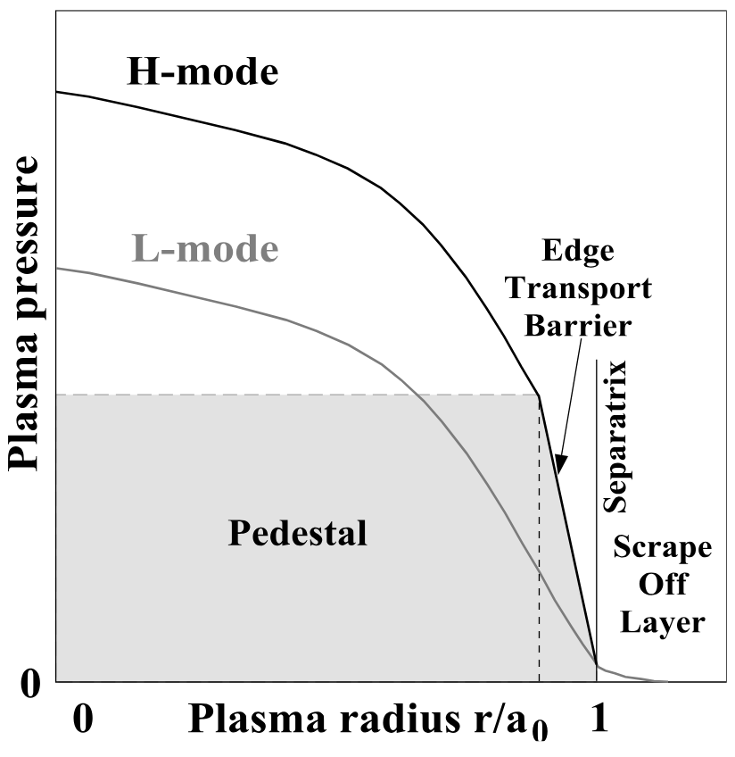
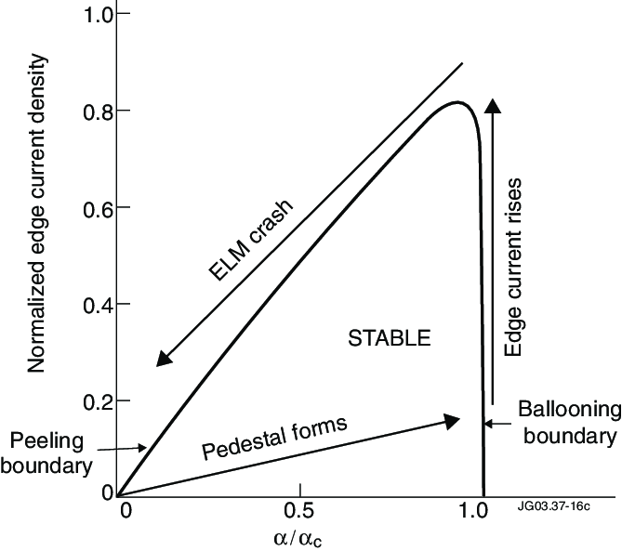
Motivation
[Lang et al, 2013]
p_{ped}
High confinement mode (H-mode) performance scales with pedestal pressure
Type I Edge Localized Modes (ELMs) onset is determined by pedestal pressure
Goal: maximize pedestal pressure while staying just below the instability threshold
Required: prediction of maximal pedestal pressure
before ELM onset
Δ_{ped}
[Perez et al, 2004]

Slide 11
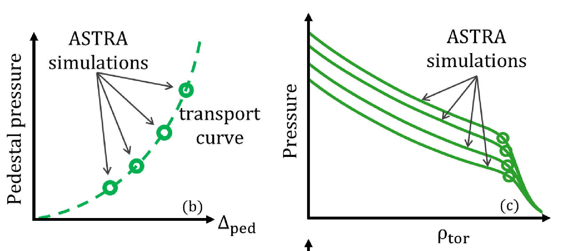
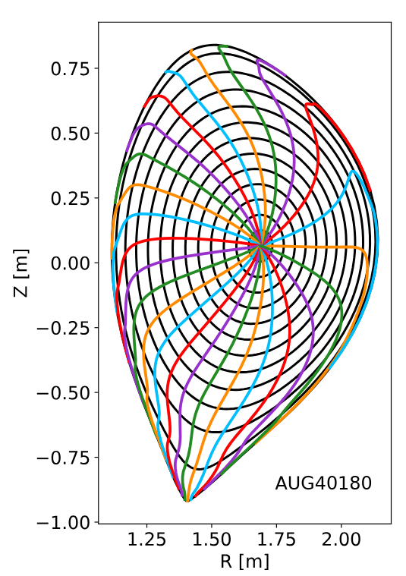
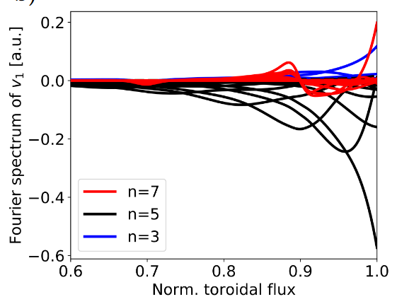
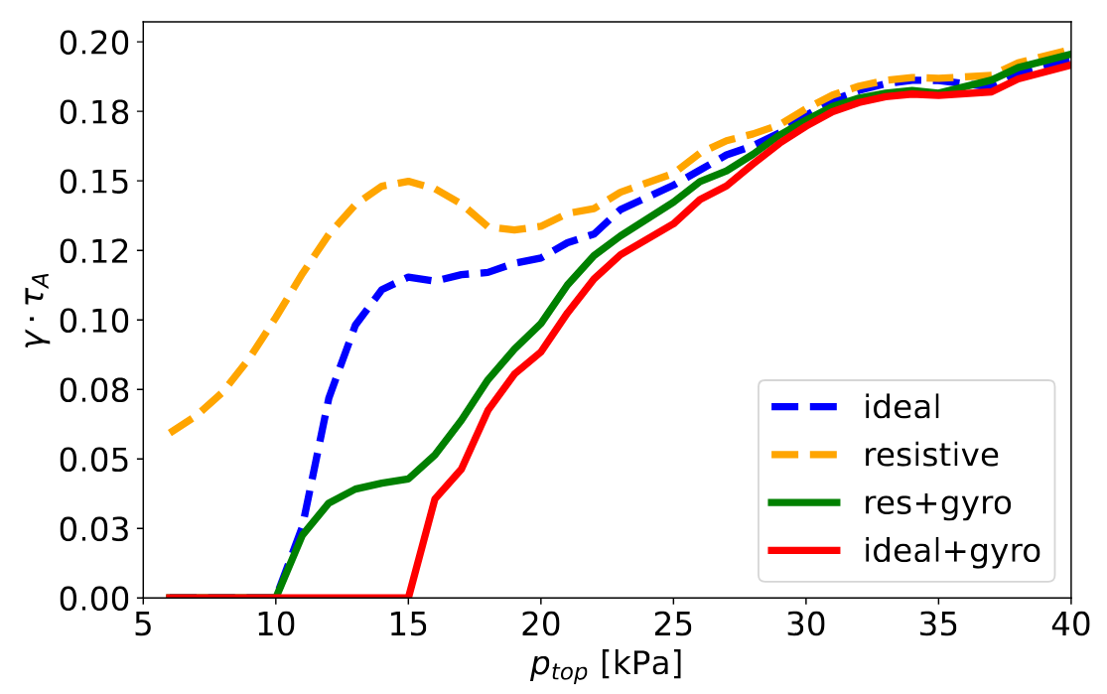
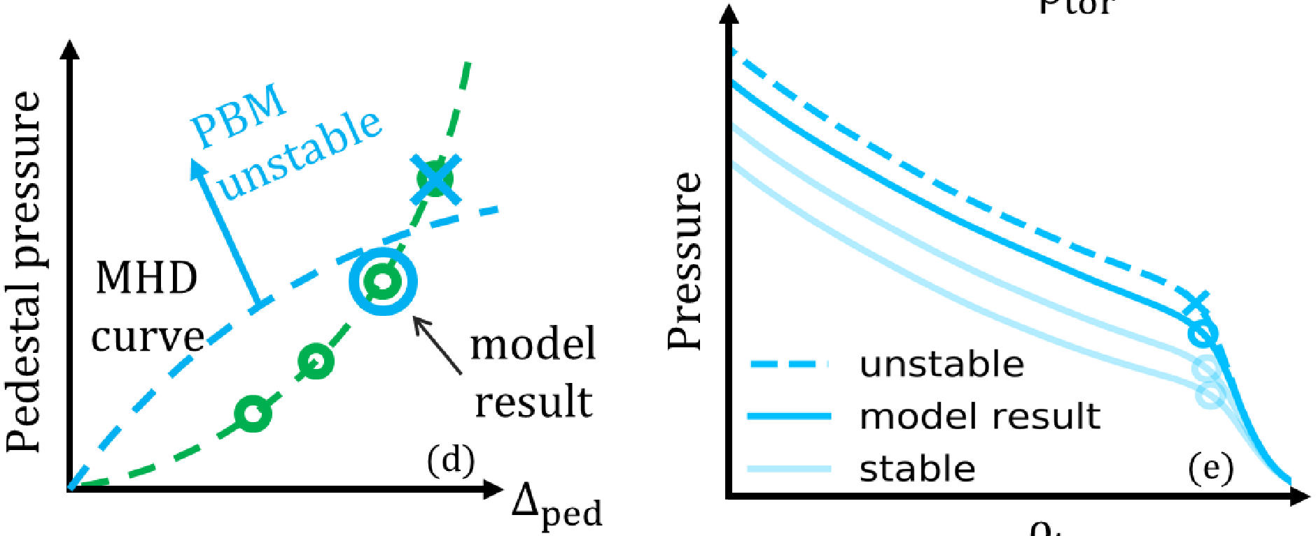
Workflow
(a)
Δ_{EPED} =
c₁ $${β_{θ,ped}}^{1/2}$$
[Luda, 2020]
Pedestal model, e.g. KBM
Pedestal
scan
Experiment, or pedestal model:
EPED [Snyder, 2009], IPED [Dunne, 2017], IMEP [Luda, 2020]
Pressure
Top pedestal pressure
Δ_{PED}
ρ_{tor}
(b)
[Puchmayr, 2023]
(c)
(b) Equilibrium solver:
HELENA, VMEC, GVEC
[Puchmayr, 2023]
[Stefanelli, 2025]
[Luda, 2020]
(c) MHD Stability Code:
MISHKA, ELITE, GASTOR3D
Δ_{PED}
ρ_{tor}

Slide 12
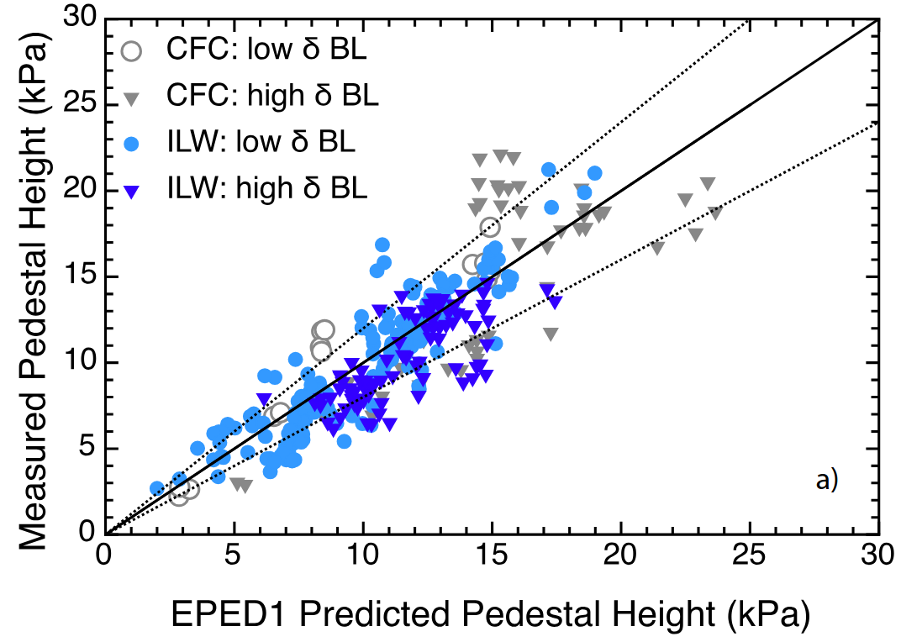
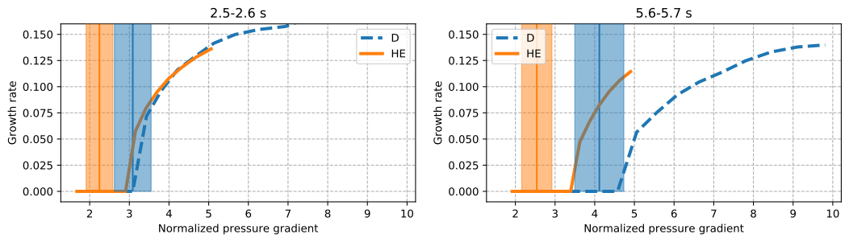
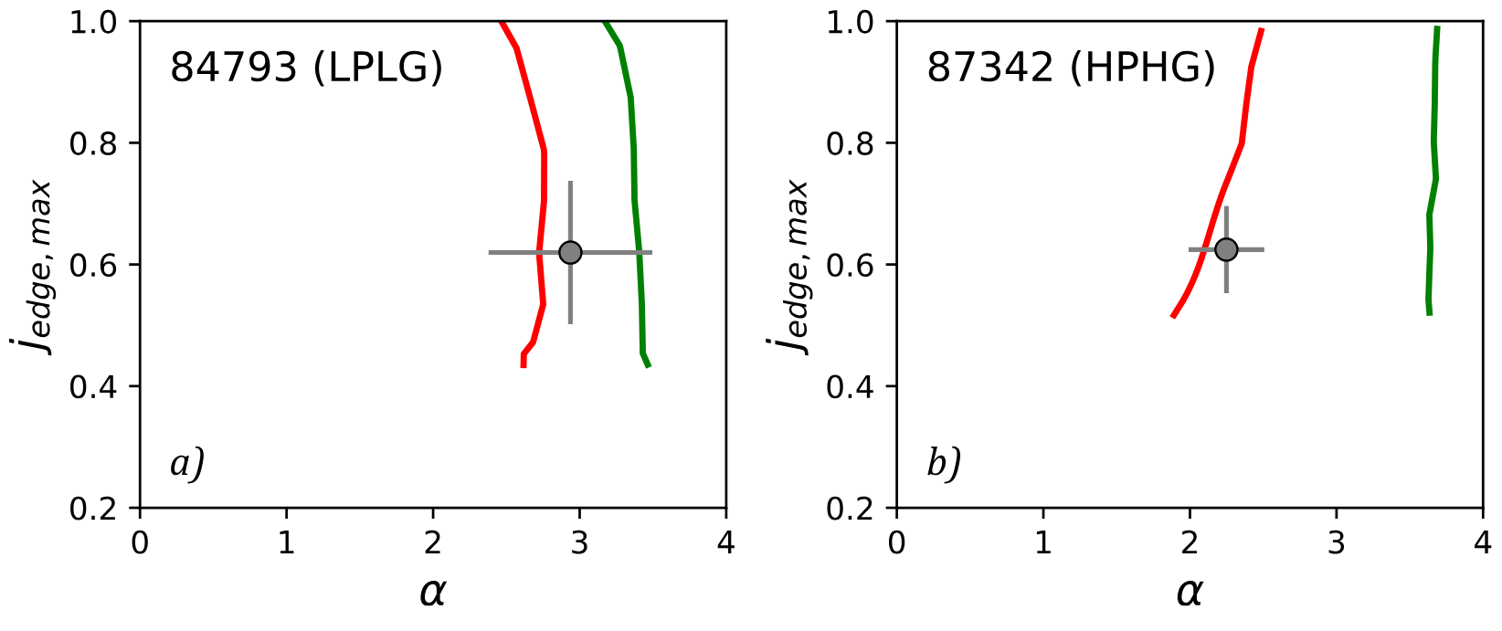
Challenges of Current Frameworks
[Beurskens et al, 2014]
Large deviations of ± 20-30% typical for studies with EPED model. E.g. JET-ILW plasmas with high gas rate [Beurskens et al, 2014]
Charge/mass ratio dependency, see work of Roxana Takacs
[Nyström et al, 2022]
Jet-C
[Roxana Takacs - HEPP Introductory Talk]
Jet-ILW
Improve predictive framework (IPED) by including extended MHD physics (resistivity and flows) with CASTOR3D
— ideal — resistive

Slide 13

Thanks for Your Attention!

Slide 14
Backup Slides

Slide 15
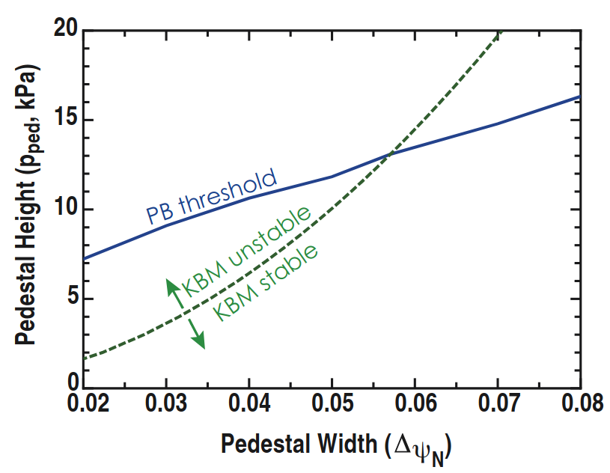
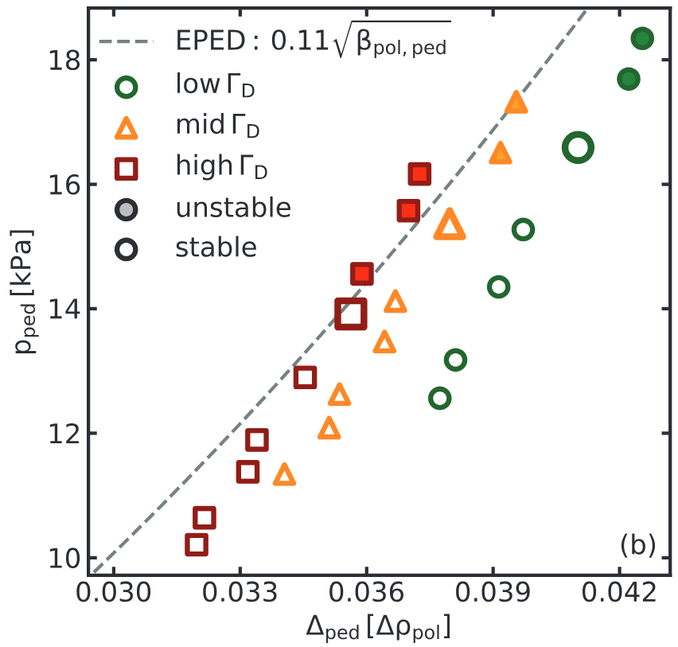
Predictive Frameworks
[Groebner, 2012]
EPED [Snyder et al, 2009] combines
  the PB stability threshold of the pedestal top pressure, calculated by the ideal MHD stability code ELITE [Wilson et al, 2002] (roughly of the form p_{ped}$$∝$$Δ^{3/4}), with
  a transport constraint linked to kinetic ballooning mode (KBM):
Δ = c₁ $${β_{θ,ped}}^{1/2}$$
IPED [Dunne, 2017], developed at AUG, based on EPED scaling model with ideal MHD stability code MISHKA (allows for more flexible profiles)
IMEP [Luda et al, 2020] integrates full transport model with ASTRA (therefore including diffusion and sources). It uses different empirical pedestal constraint associated with electron temperature gradient modes (ETG) or micro tearing modes (MTM):
R <ΔT_{e}>/T_{e,top}= - 82.5
[Luda et al, 2020]

Slide 16
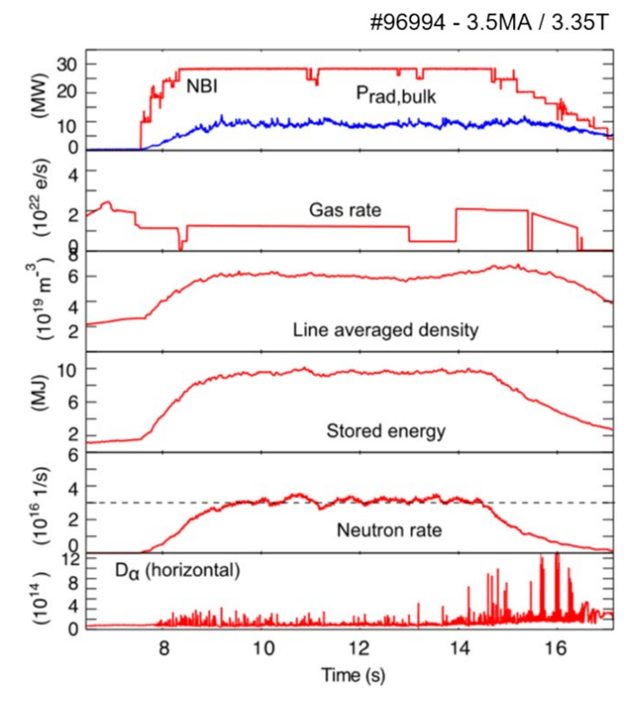
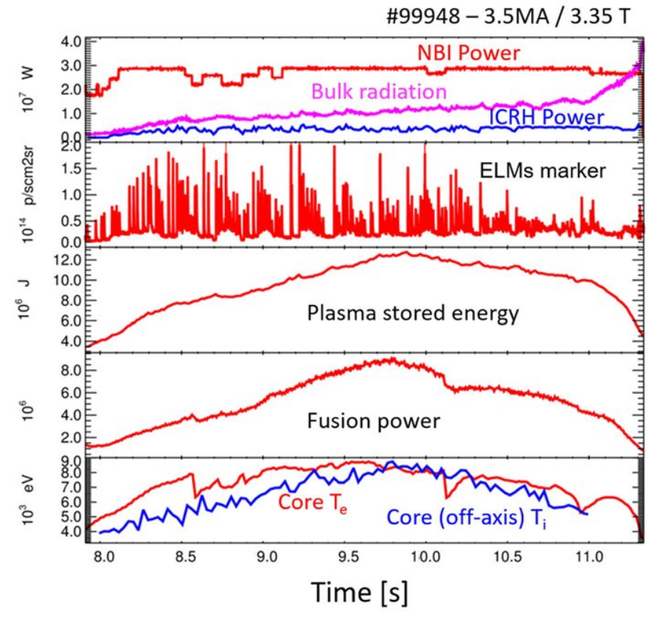
Example case for JET
[Garcia, 2025]

Slide 17
Including Resistive MHD with CASTOR
Agreement with JET-ILW experiments improved
[Nyström et al, 2022] when employing the resistive MHD code
CASTOR [Kerner, 1998]
Explanation: higher gas puff leads to higher resistivity
at separatrix
However: CASTOR slightly under-predicts critical pressure
gradient systematically
Using the extended (including resistive + flow physcis) MHD code
CASTOR3D [Strumberger, 2017], [Stefanelli, 2025] shows that diamagnetic
stabilization has to be included to obtain meaningful instability growth rates
[Nyström et al, 2022]
— ideal — resistive
Jet-C
Jet-ILW
Also shown by Jonas Puchmayrs
EPS rehearsal talk on 4.6.2025
Predictive frameworks improve by including extended MHD physics (resistivity and flows)

Slide 18
PhD Project
Research Gaps and Considerations:
No unified framework exists that includes extended (resistive + flow) MHD stability code like CASTOR3D
No comprehensive study quantifying the impact of extended MHD models on PB stability boundary predictions across various devices
CASTOR3D stability calculations often produce unreliable results (noise/numerical artifacts) that can be identified by detecting unphysical outputs
Key Elements of PhD Project:
Upgrade IPED 2.0 to include CASTOR3D as extended MHD stability code
Perform study on how pedestal prediction is influenced by inclusion of extended MHD across various devices
Increase robustness of CASTOR3D predictions by developing a framework to identify unphysical outputs (noise/numerical artifacts)
Jet-C
Jet-ILW

Slide 19
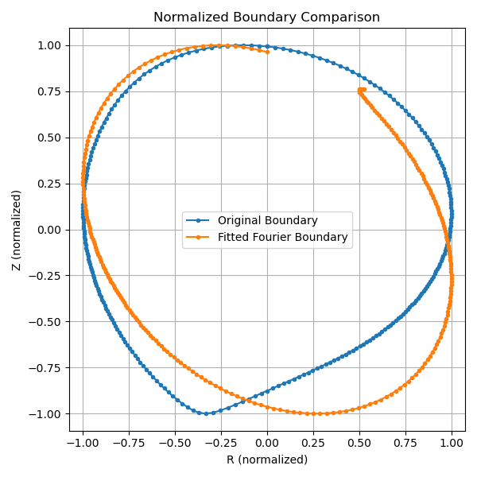
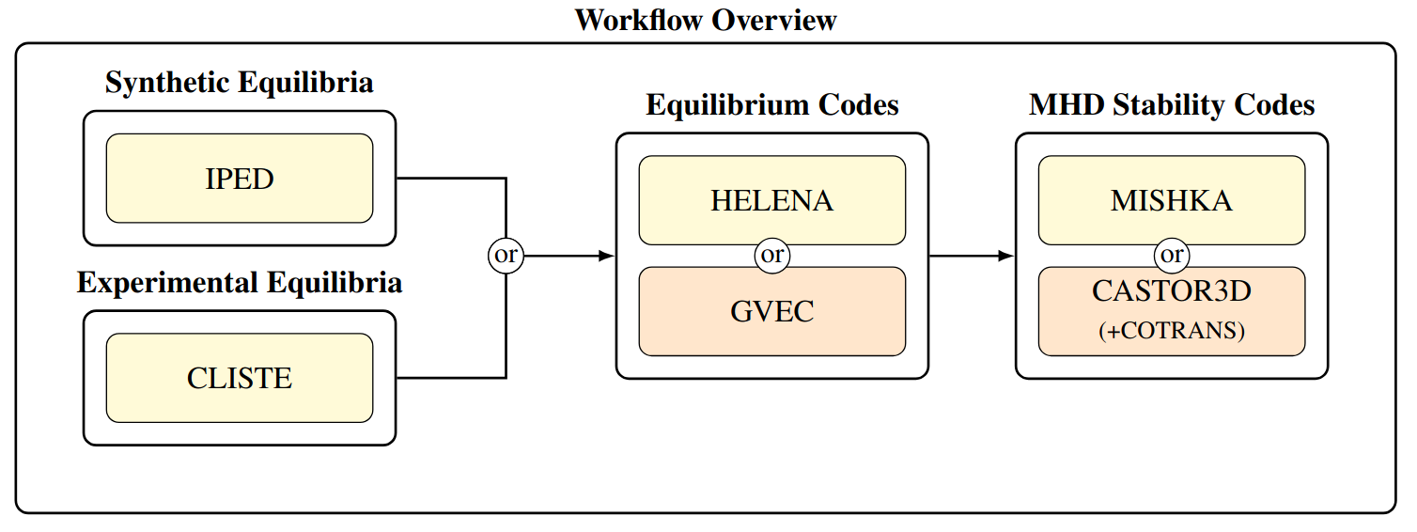
PhD Project
Jet-C
Jet-ILW

Slide 20
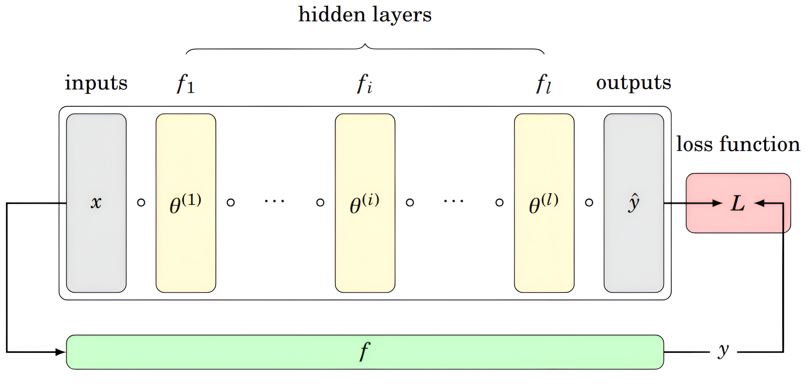
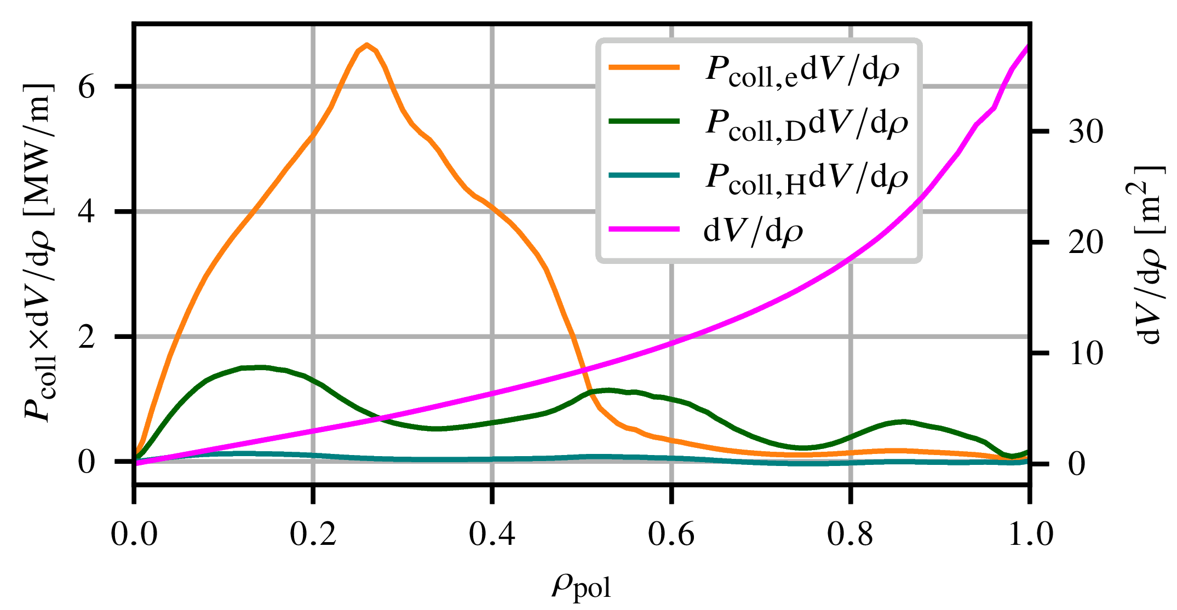
Fast ICRH Surrogate Model for AUG
Creating machine learning pipeline to create TS database and train neural network, with volumetric loss function
Train feed-forward neural network on synthetic database
Implement reduced semi-analytic model by Stix [Stix, 1975] for benchmarking
$$f$$$$∝ exp\left[\int{d}v\left(\frac{G_{1}}{G_{2}+G_{3}v^{2}}\right)\right]$$

