Slide 1
Investigating the physics behind the different performance of negative ion sources for fusion in hydrogen and deuterium
J. Rubin, D. Wünderlich, U. Fantz

Slide 2
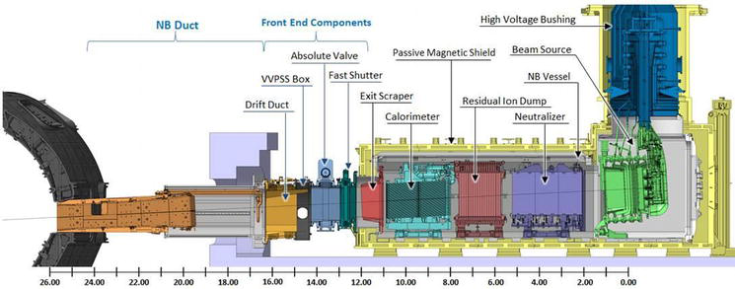
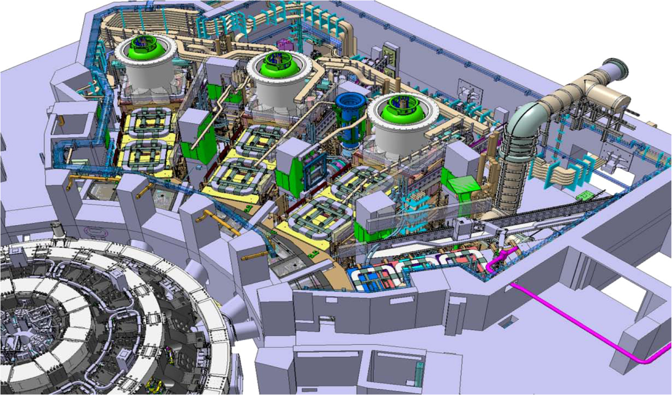
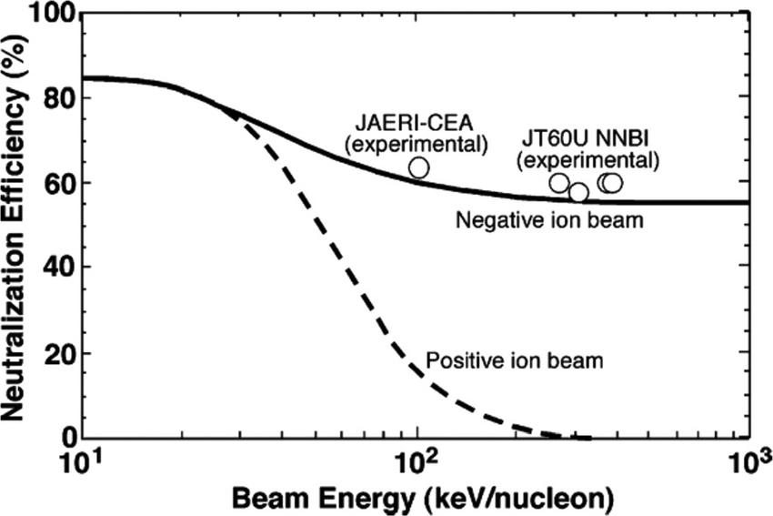
Neutral Beam Injectors for ITER
HNB 3
HNB 2
HNB 1
DNB
R. S. Hemsworth and D. Boilson, Fusion Energy. IntechOpen, 2020.doi:10.5772/intechopen.88724.
Hemsworth et al, New Journal of Physics, 2017, doi: https://doi.org/10.1088/1367-2630/19/2/025005
16.7 MW / HNB, in the form of … 870 keV H⁰ beam for 1000 s 1 MeV D⁰ beam for 3600 s
R. S. Hemsworth and T. Inoue, IEEE Trans. Plasma Sci. 33(6), 1799 (2005). doi:10.1109/TPS.2005.860090

Slide 3
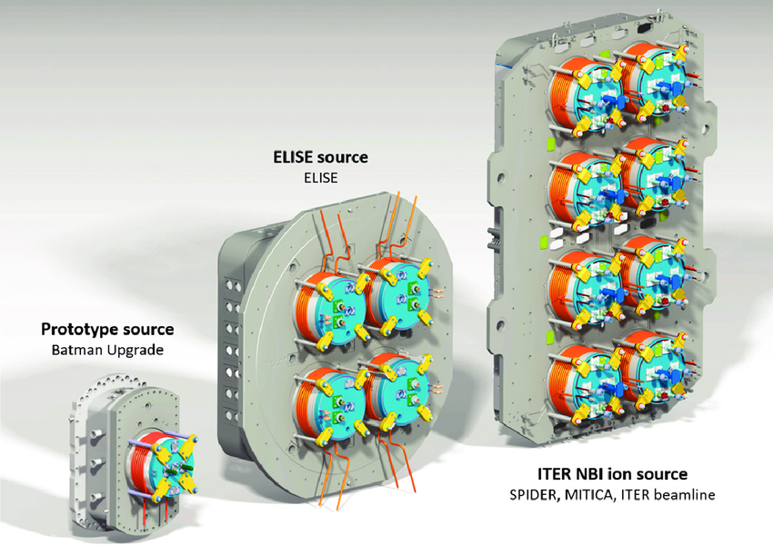
Negative ion sources for ITER
x2
x4

Slide 4
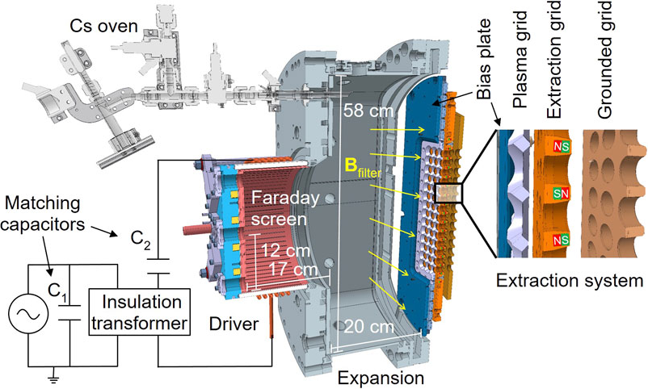
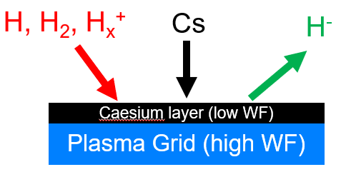
Negative ion sources for ITER
U_{ext}
U_{acc}
ITER requirements | H | D
Pulse length | 1000 s | 3600 s
Extracted current density | 329 A/m² | 286 A/m²
Electron to ion current density ratio | < 1
Source performance strongly limited by co-extracted electrons → Worse in Deuterium
The aim of the thesis is to deepen the understanding of this isotope effect.
Surface production : H + e^{surface} → H⁻, H_{x}⁺+2e^{surface} → H⁻ + H_{x-1}

Slide 5
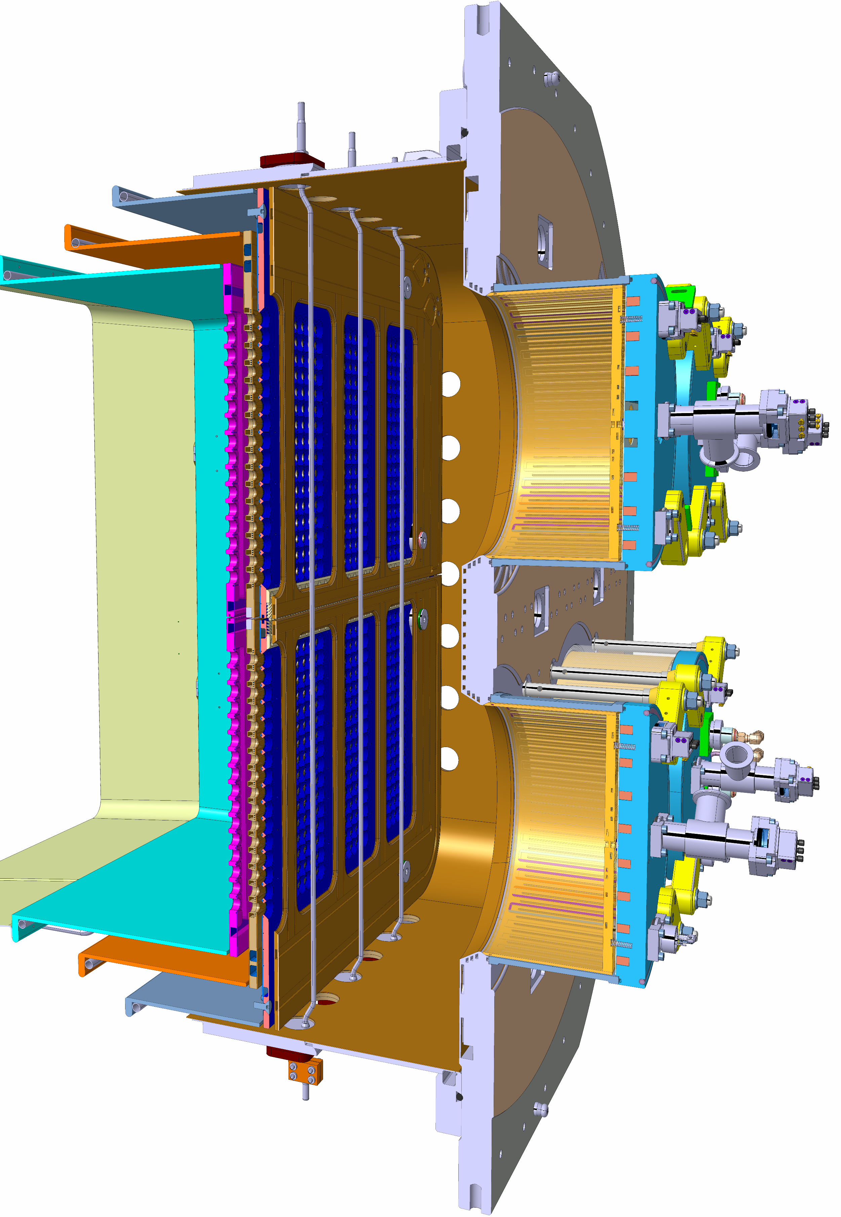
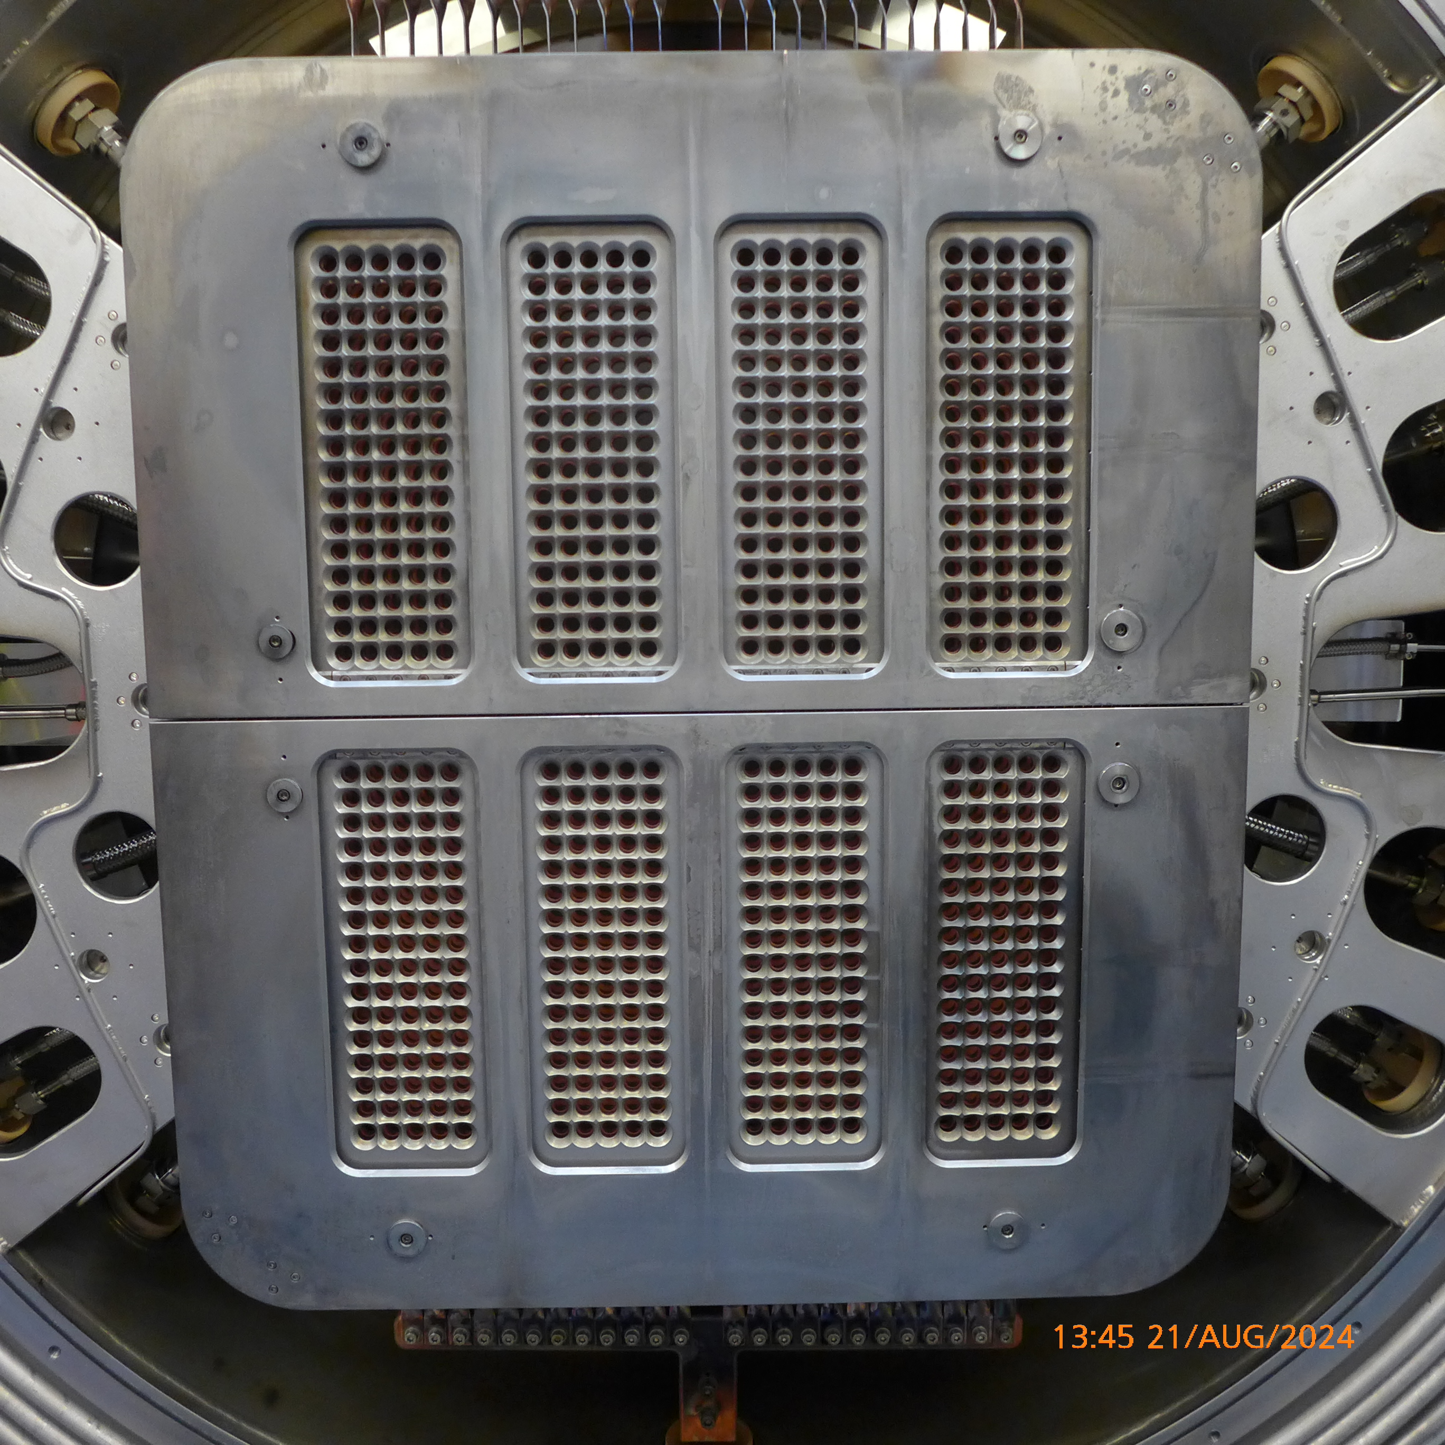
(Some) Diagnostics in ELISE
Bias plate
Plasma grid
Grid system
Drivers
Expansion

Slide 6
(Some) Diagnostics in ELISE
TOP
Current Measurements → extracted negative ion current I_{ext}, co-extracted electron current I_{e}
Langmuir Probes → plasma potential V_{pl}, positive ion density n_{i}, electron density n_{e}, electron temperature T_{e}
Tunable Diode Laser Absorption Spectroscopy (TDLAS) → neutral caesium density n_{Cs}
Cavity Ring-Down Spectroscopy (CRDS) → negative ion density n_{H-}
BOTTOM

Slide 7
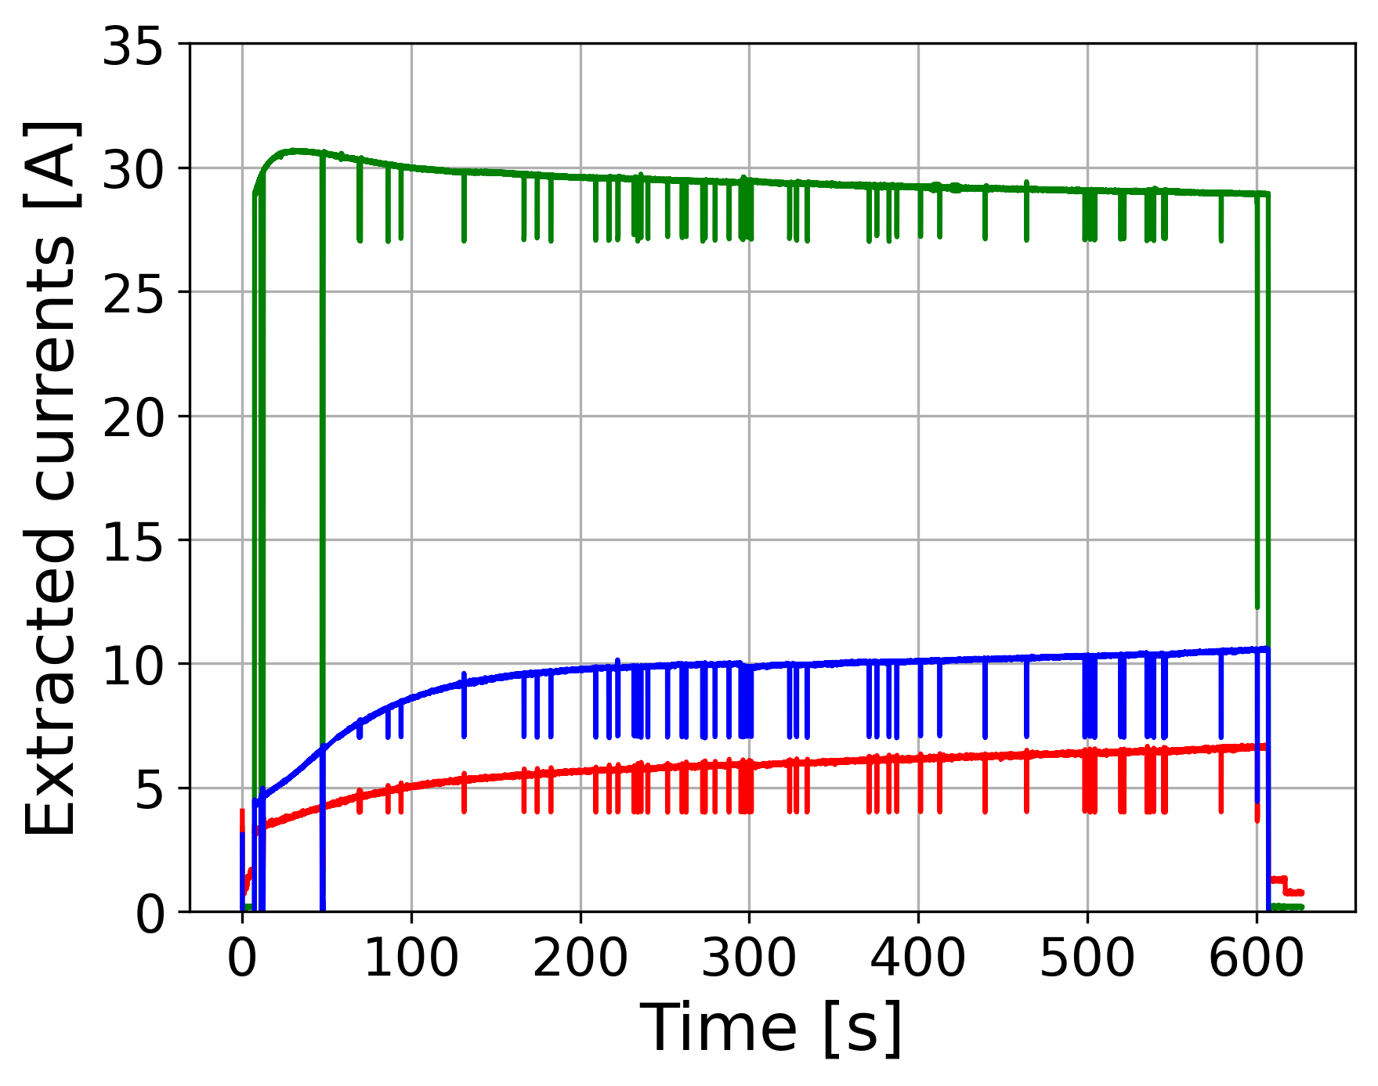
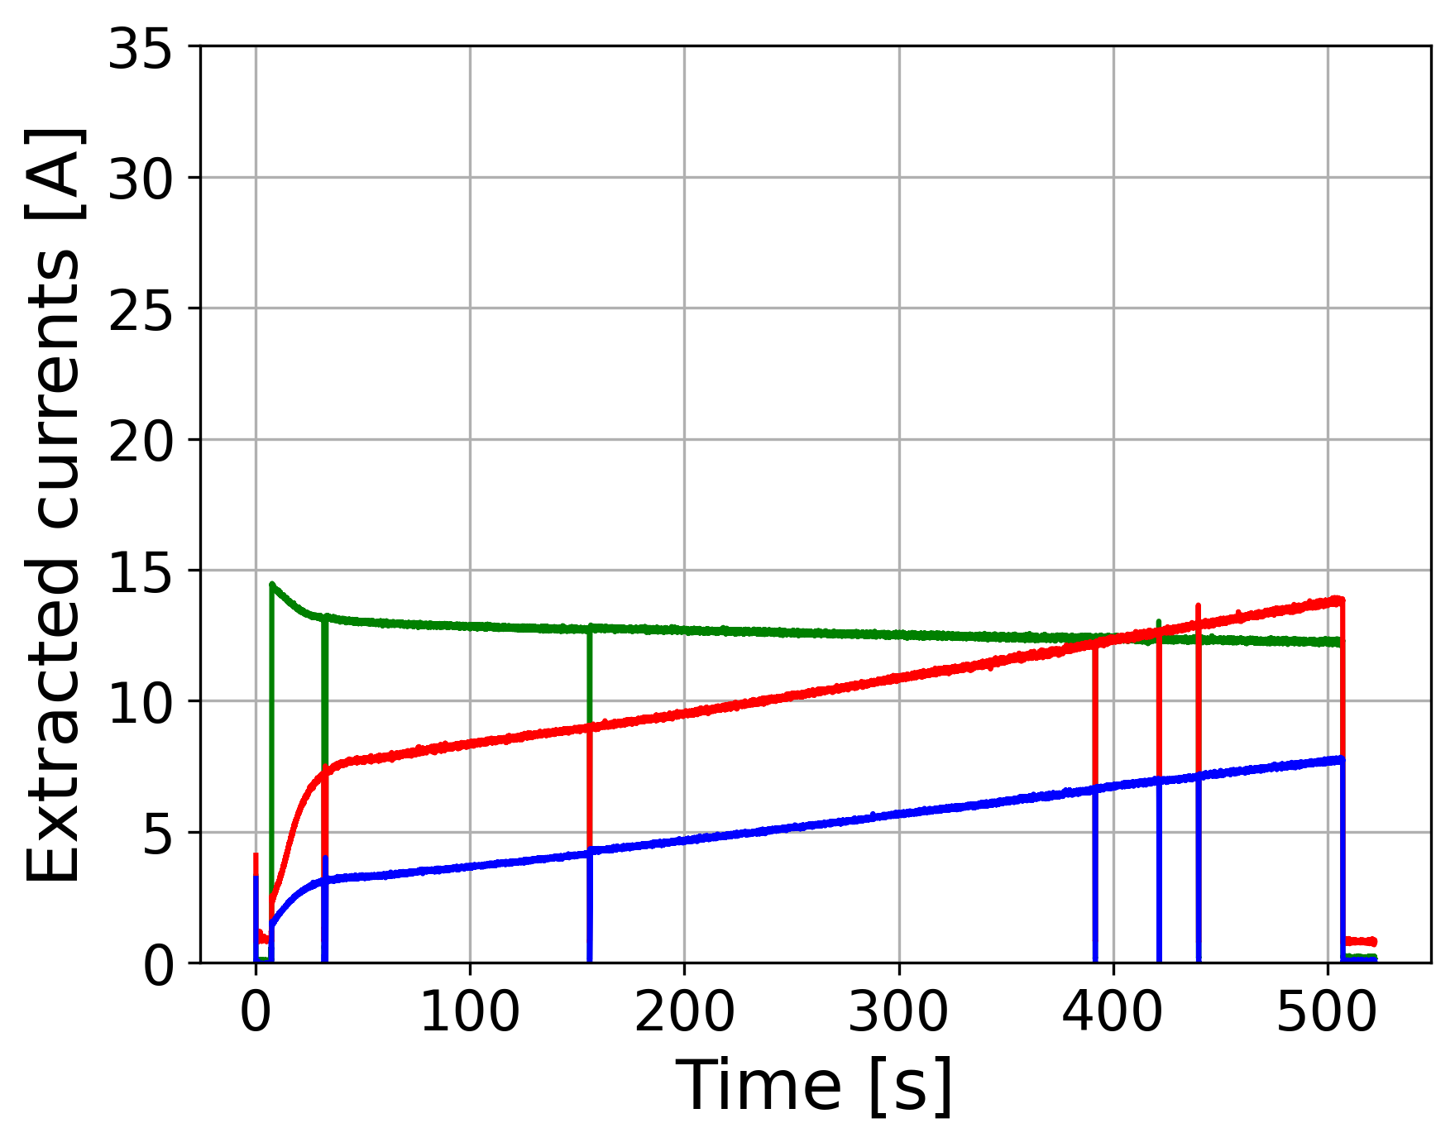
Long pulses with continuous extraction at ELISE : I_{ext}, I_{e}
HYDROGEN
DEUTERIUM
I_{ext}
P_{RF} = 45 kW/driver
P_{RF} = 75 kW/driver
I_{ext}
I_{e}^{bottom}
I_{e}^{top}
I_{e}^{bottom}
I_{e}^{top}
ITER current requirements : proven in H*, lot of improvement necessary in D

Slide 8
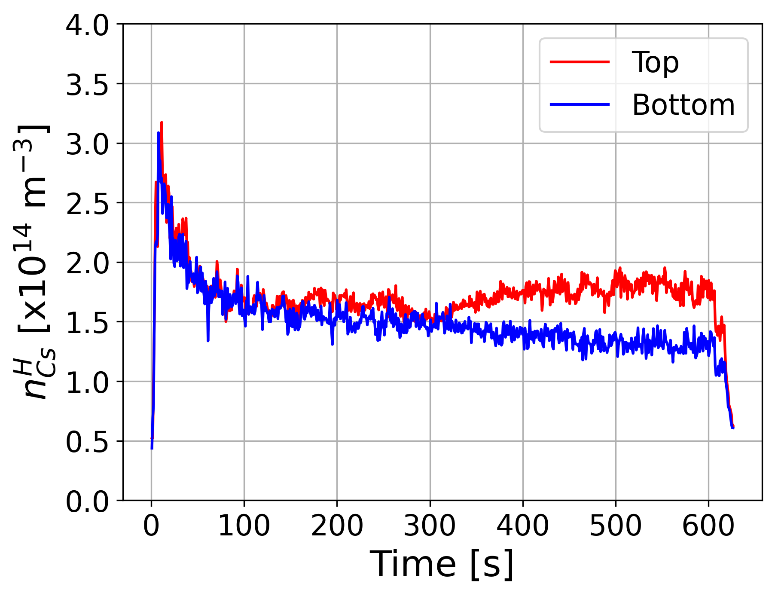
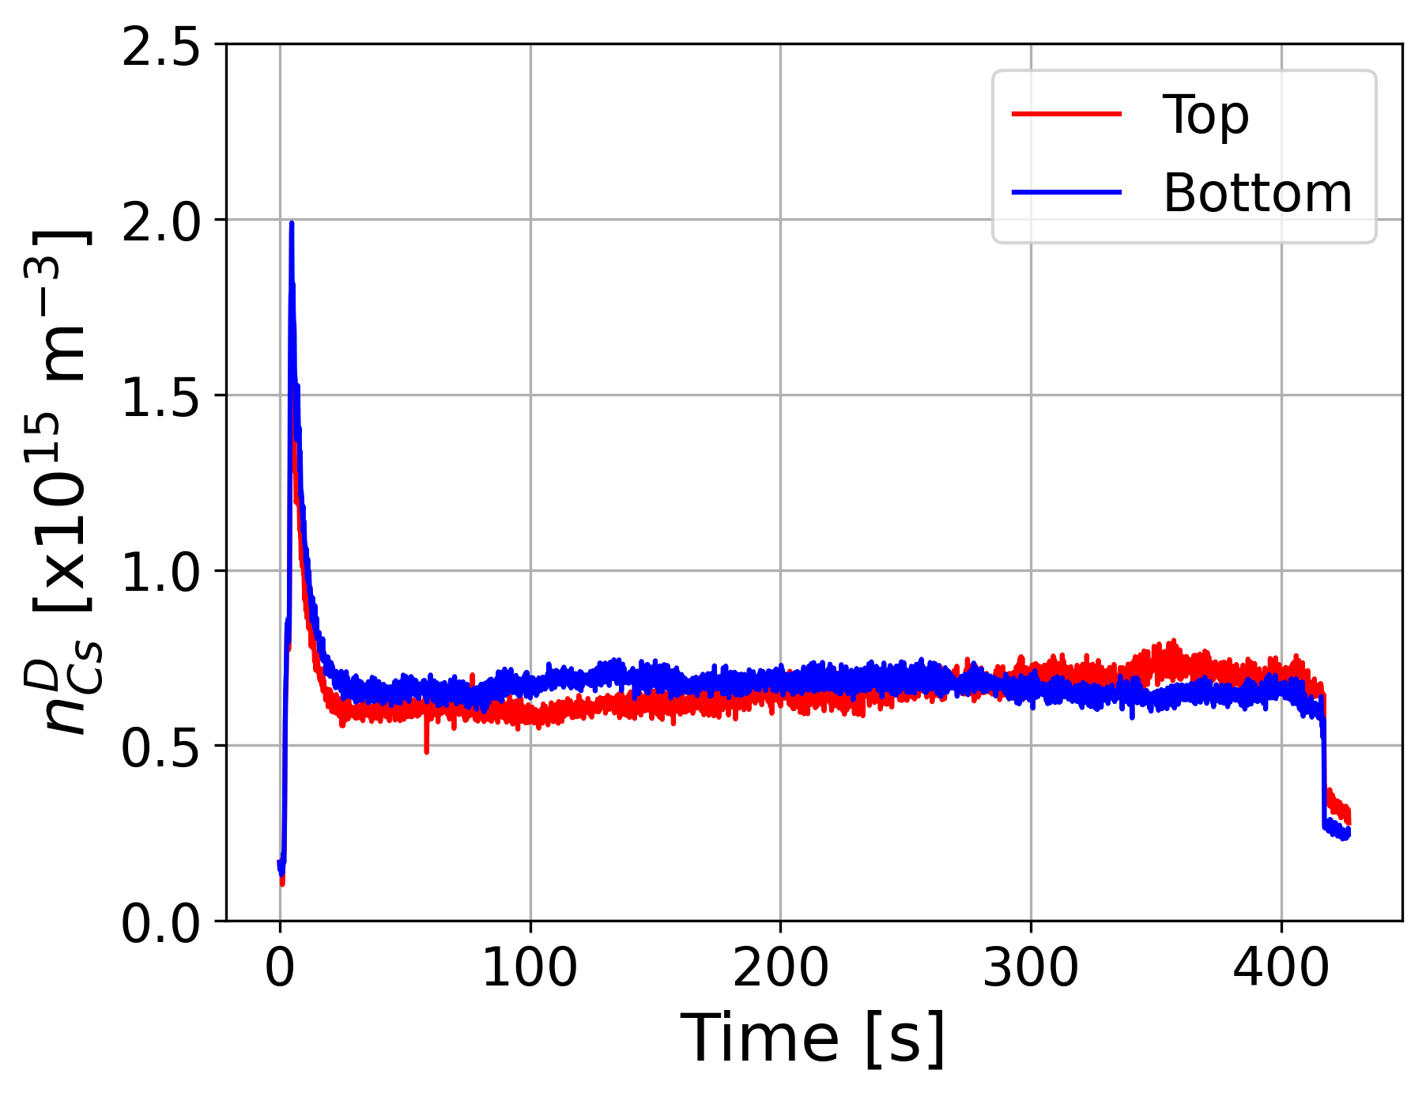
Long pulses with continuous extraction at ELISE : n_{Cs}
HYDROGEN
DEUTERIUM
n_{Cs} decreases over time : 2 steps, more pronounced in D. n_{Cs}^{D} >> n_{Cs}^{H} and is more top/bottom uniform

Slide 9
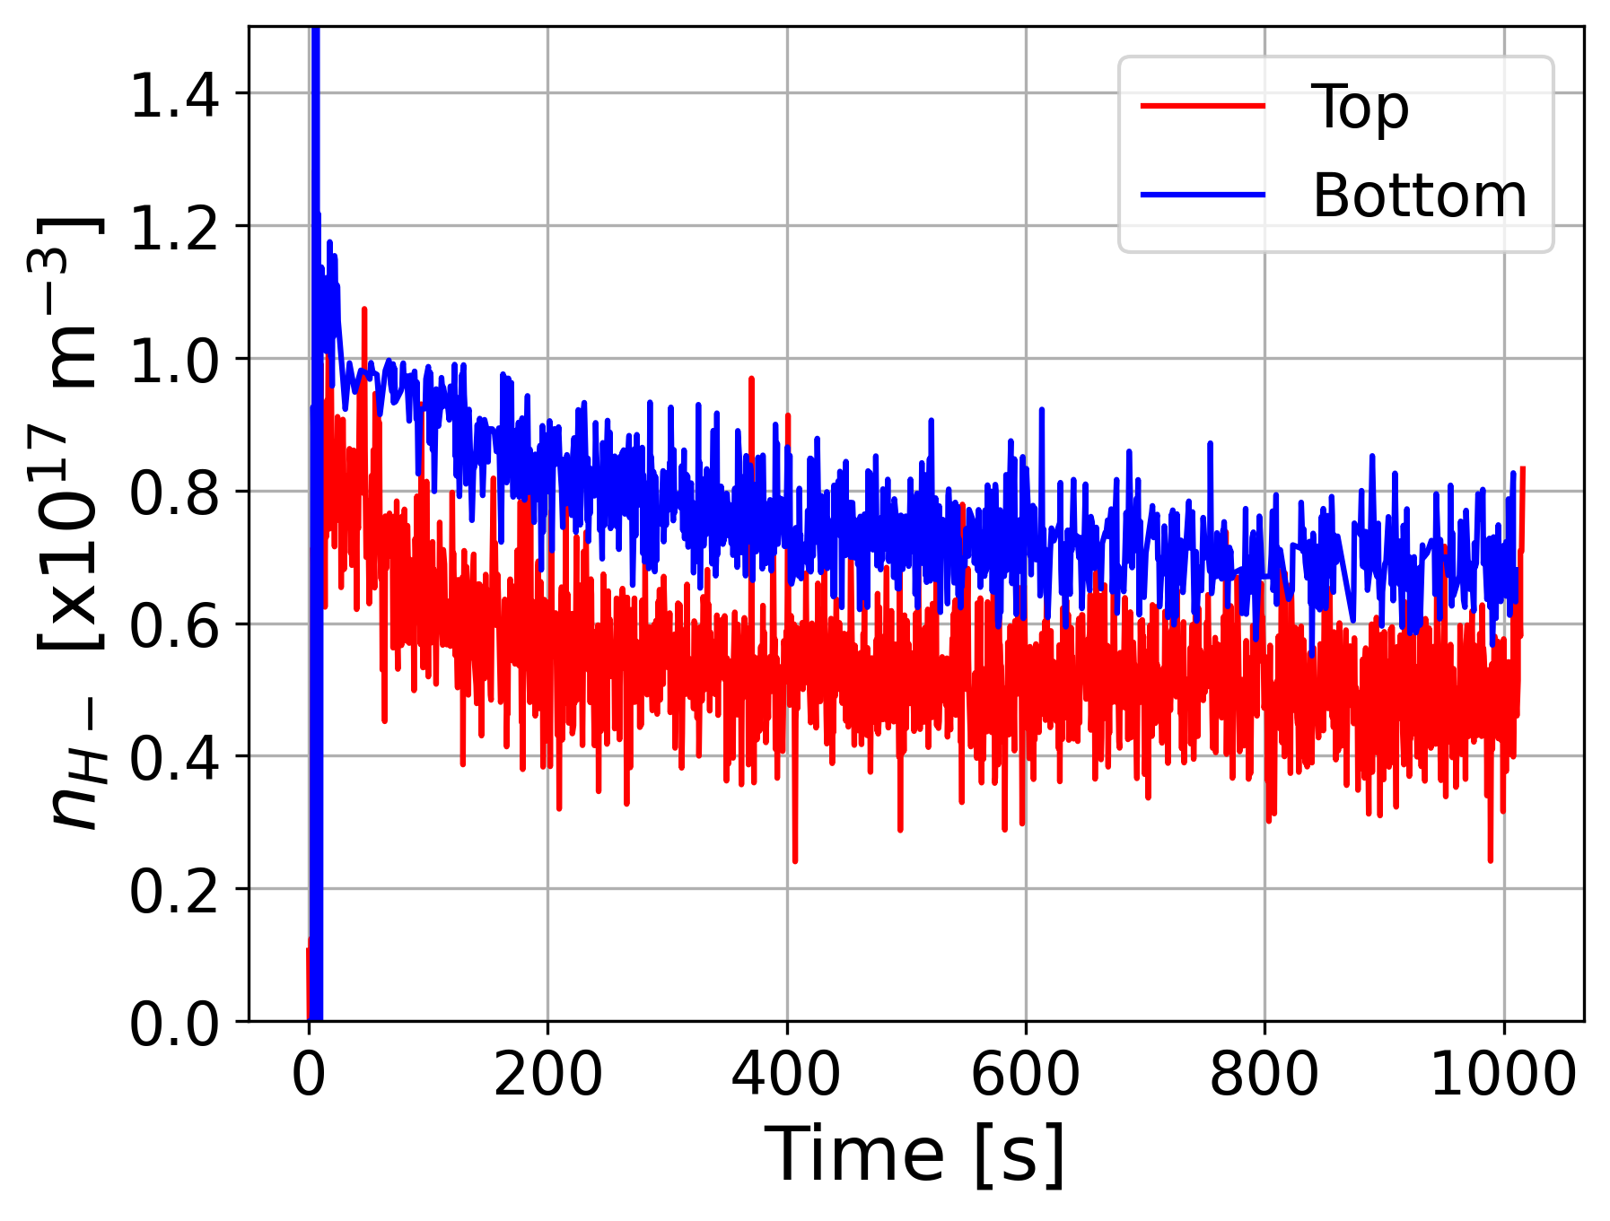
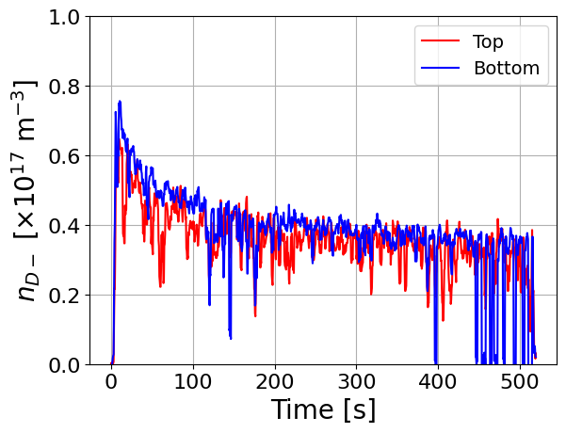
Long pulses with continuous extraction at ELISE : n_{H-}
HYDROGEN
DEUTERIUM
n_{H-} decreases over time : 2 steps, more pronounced in D. n_{D-} ≥ n_{H-} and is more top/bottom uniform

Slide 10
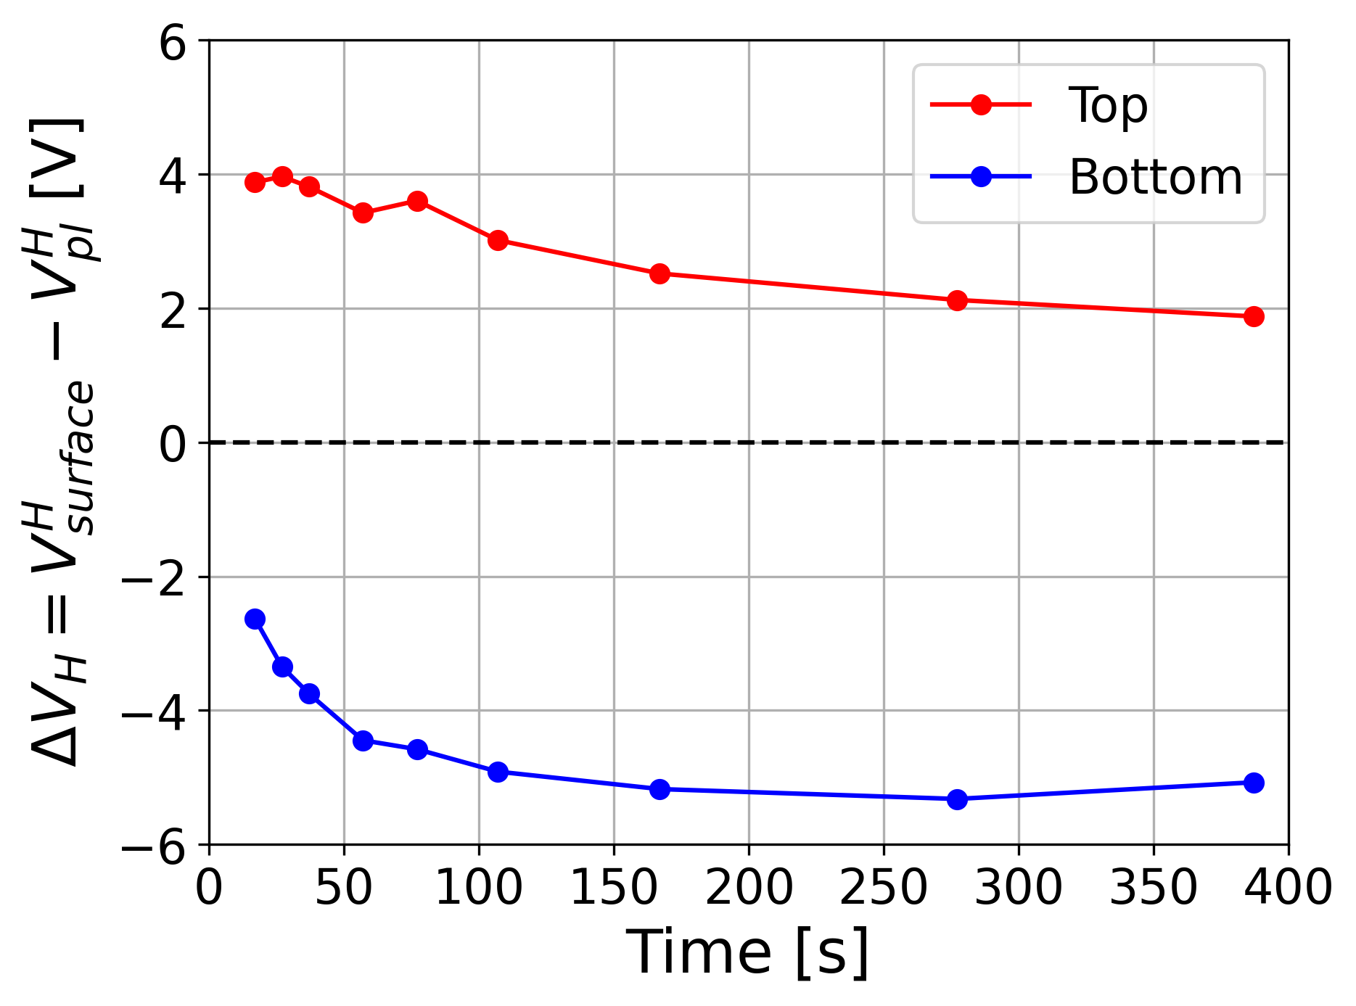
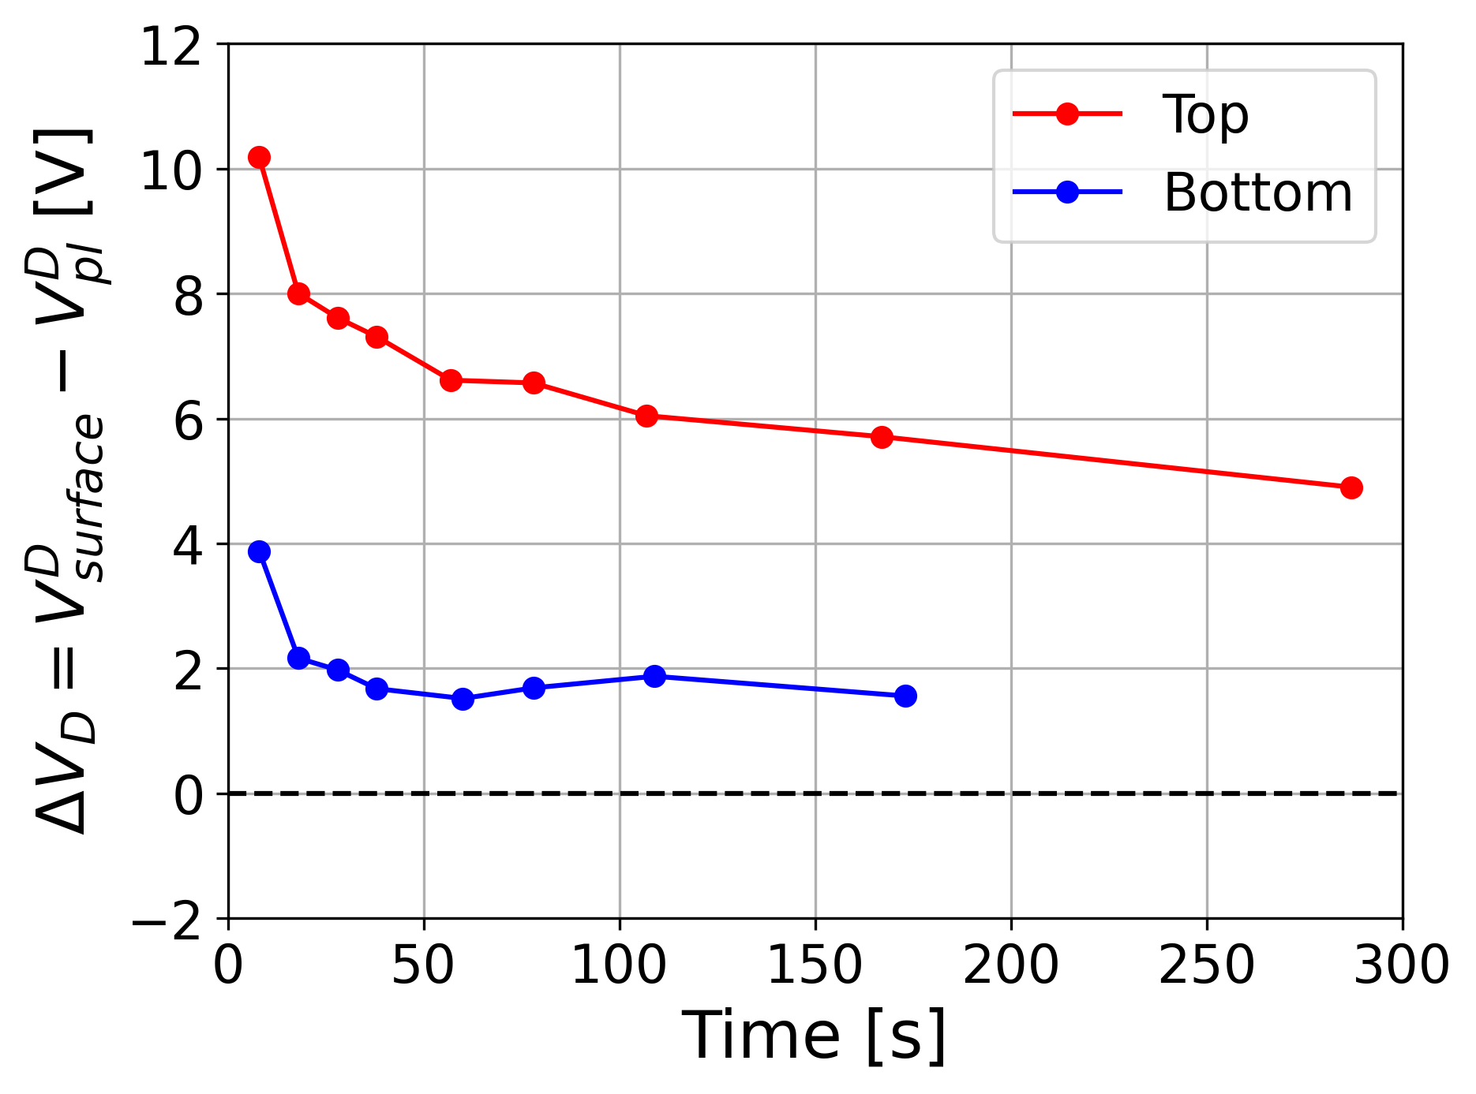
Long pulses with continuous extraction at ELISE : V_{pl}, Δϕ
HYDROGEN
DEUTERIUM
ΔV decreases over time : 2 steps, more pronounced in D. ΔV^{D} >> ΔV^{H} and is more top/bottom uniform

Slide 11
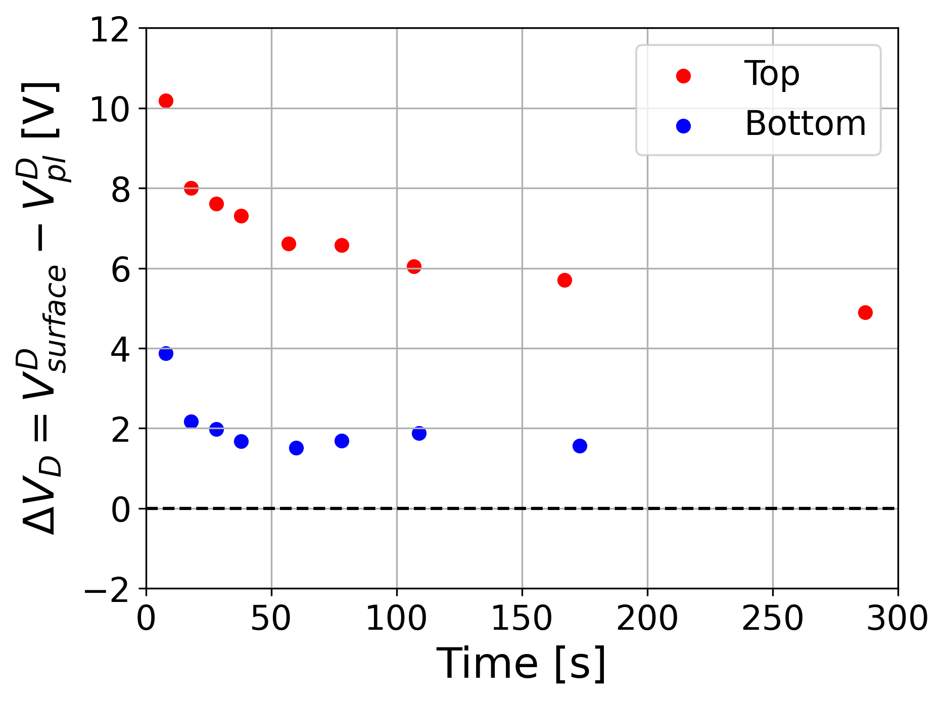
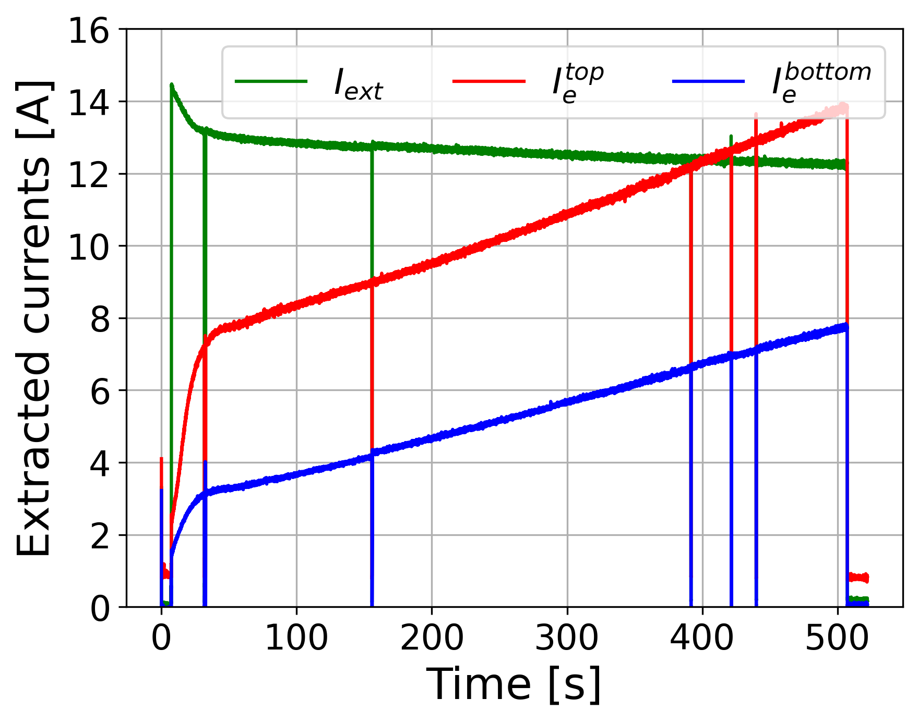
Understanding the increase of I_{e}
↓ n_{Cs}
↓ Г_{Cs}
↑ WF
↓ Г_{H-}
↑ n_{e}/n_{H-}
↑V_{pl}, ↓ΔV
↑ I_{e}
Measured during the pulse @ BUG and ELISE
Measured after the pulse @ BUG
Not accessible (also n_{Cs}⁺, meniscus, virtual cathode), hopefully results from codes such as CsFlow3D and ONIX
Experimentally one can try to influence 2 parameters within a pulse … → caesiation → sheath potential structure Next : some examples of what could be achieved !

Slide 12
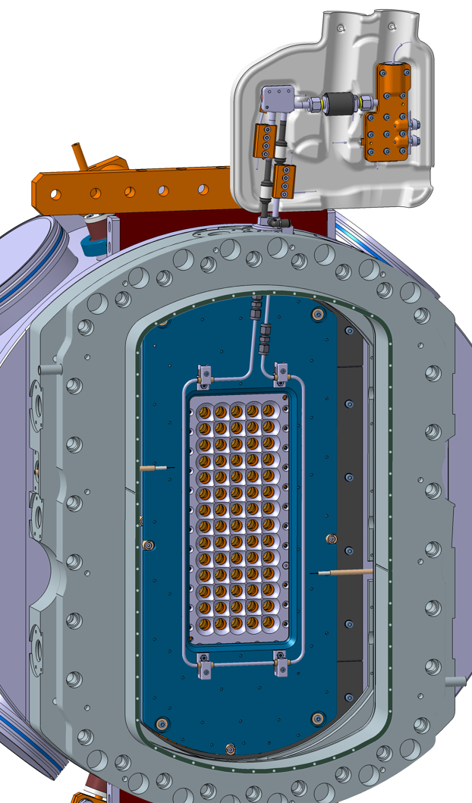
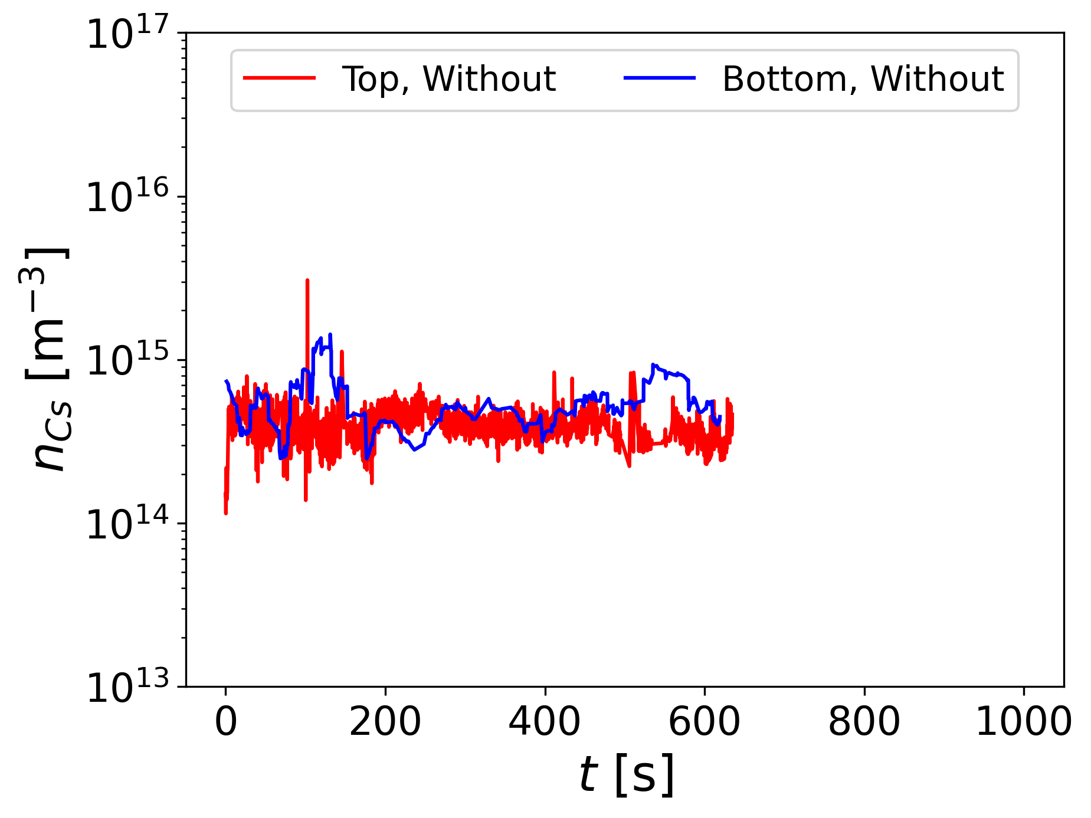
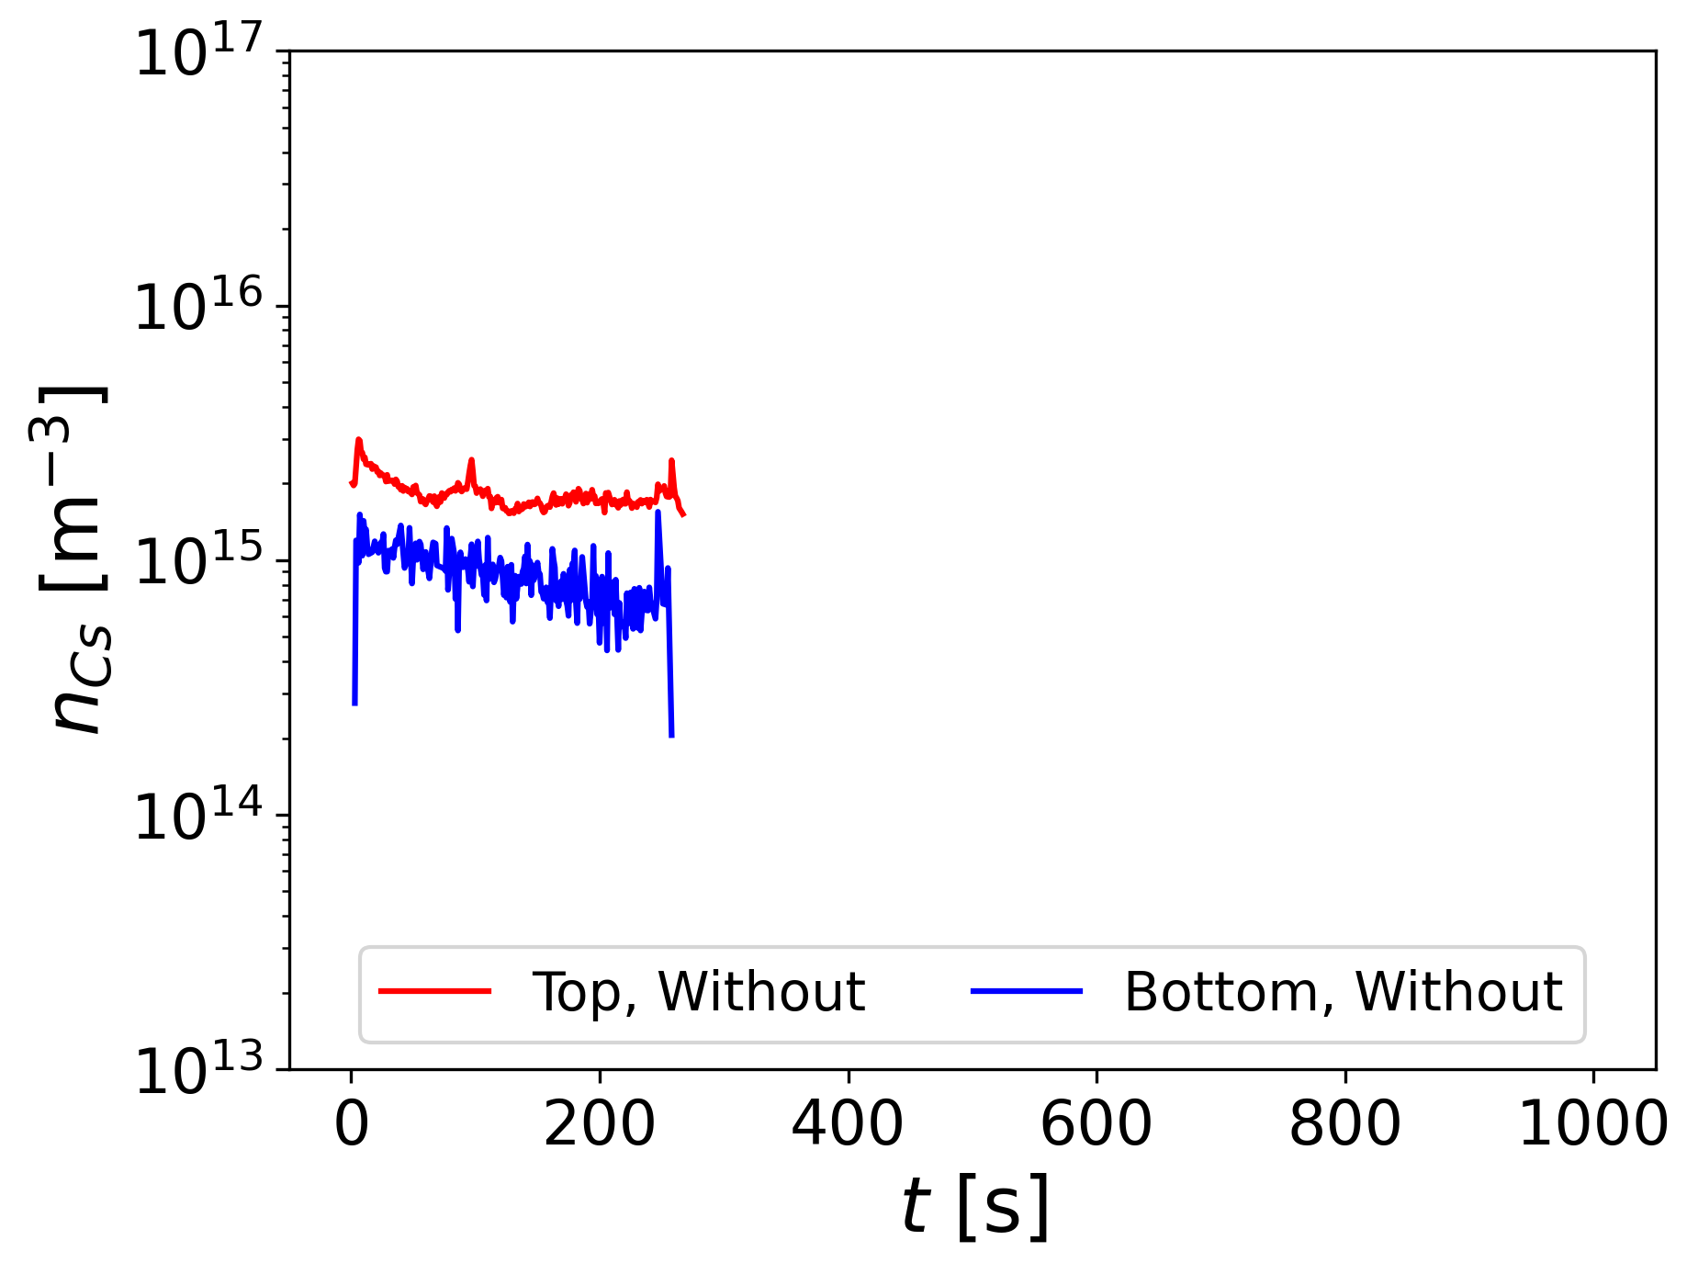
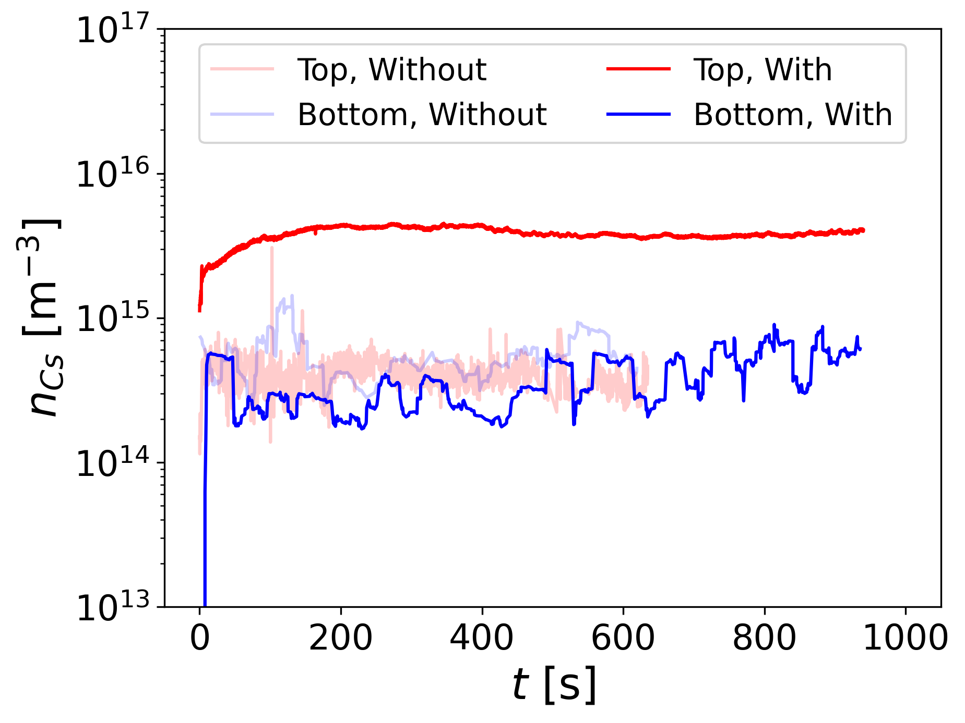
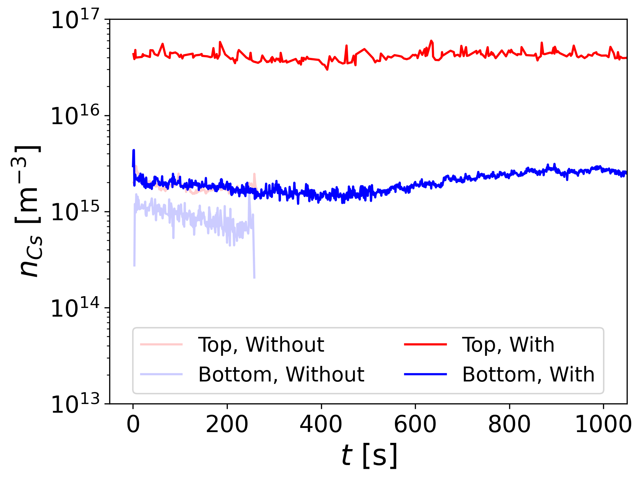
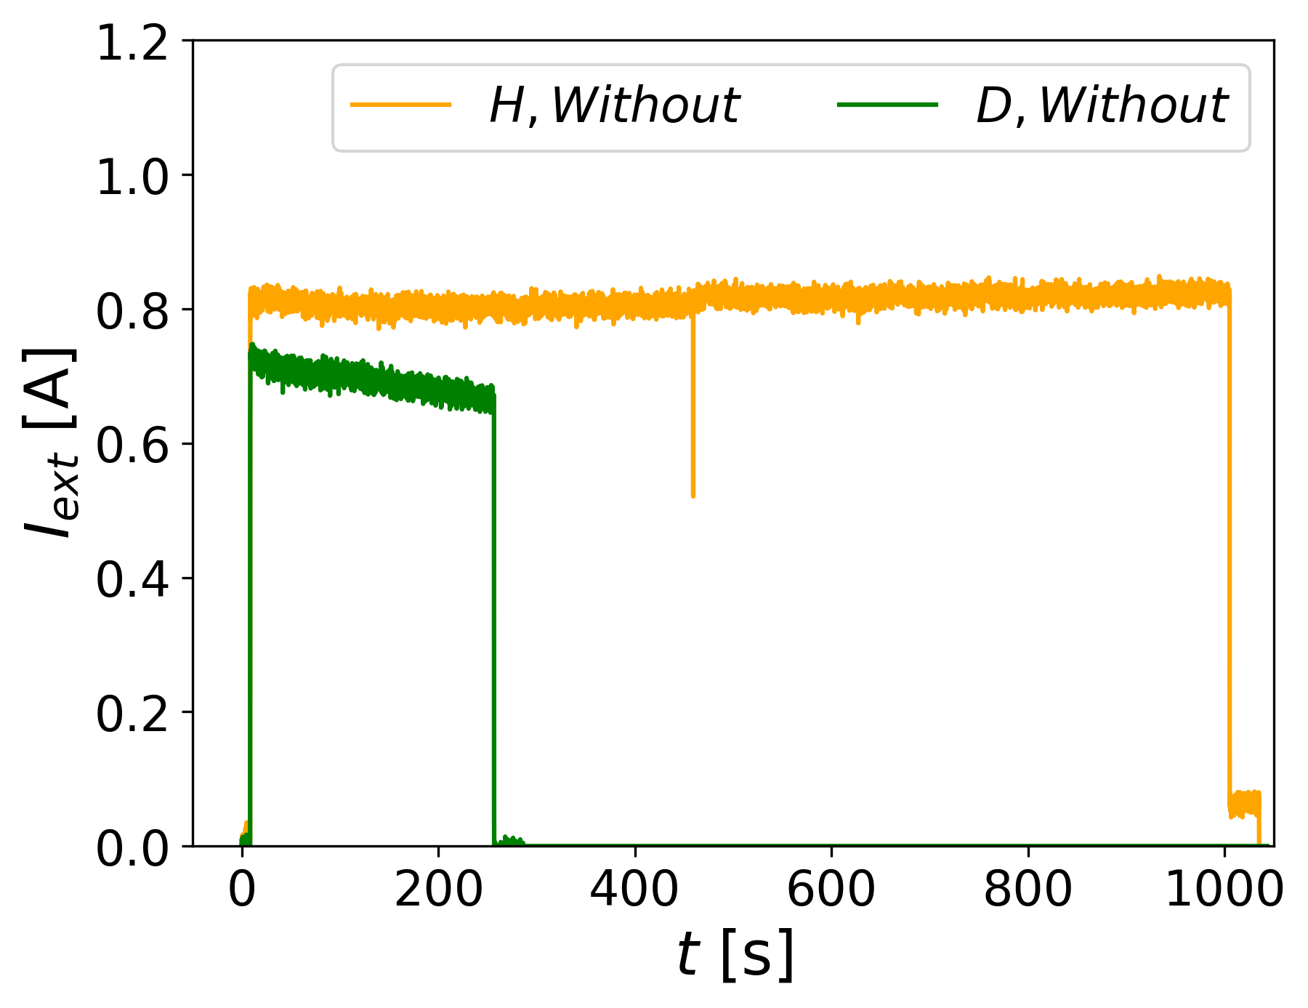
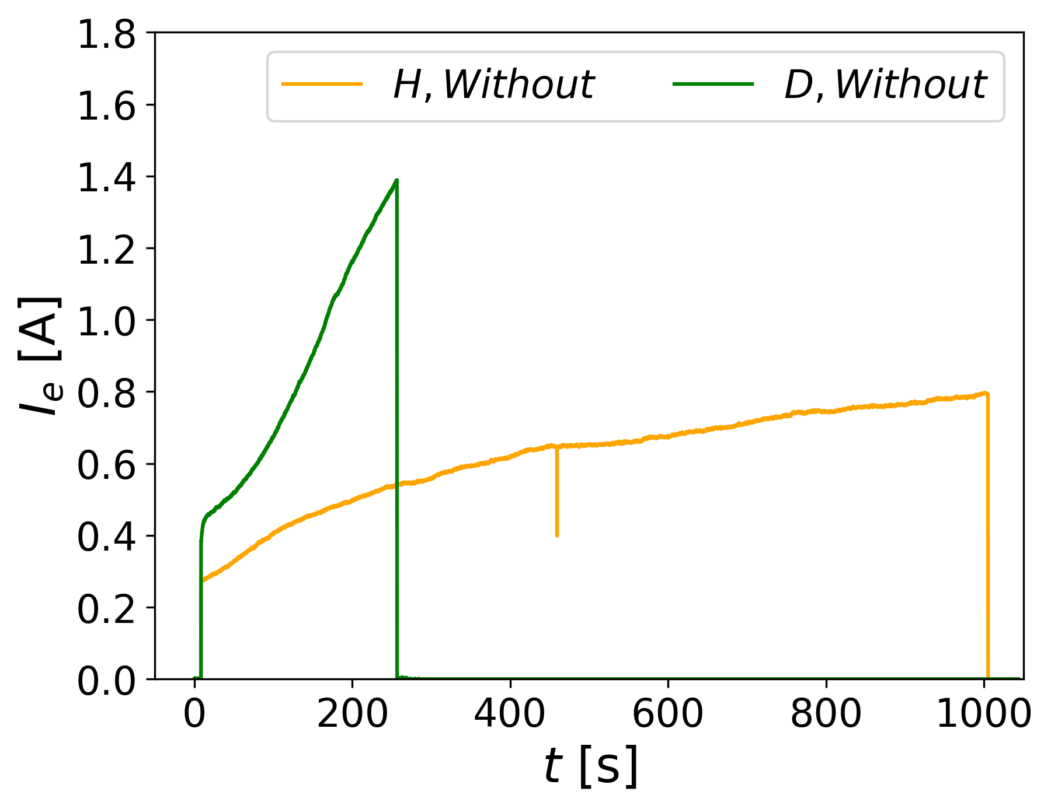
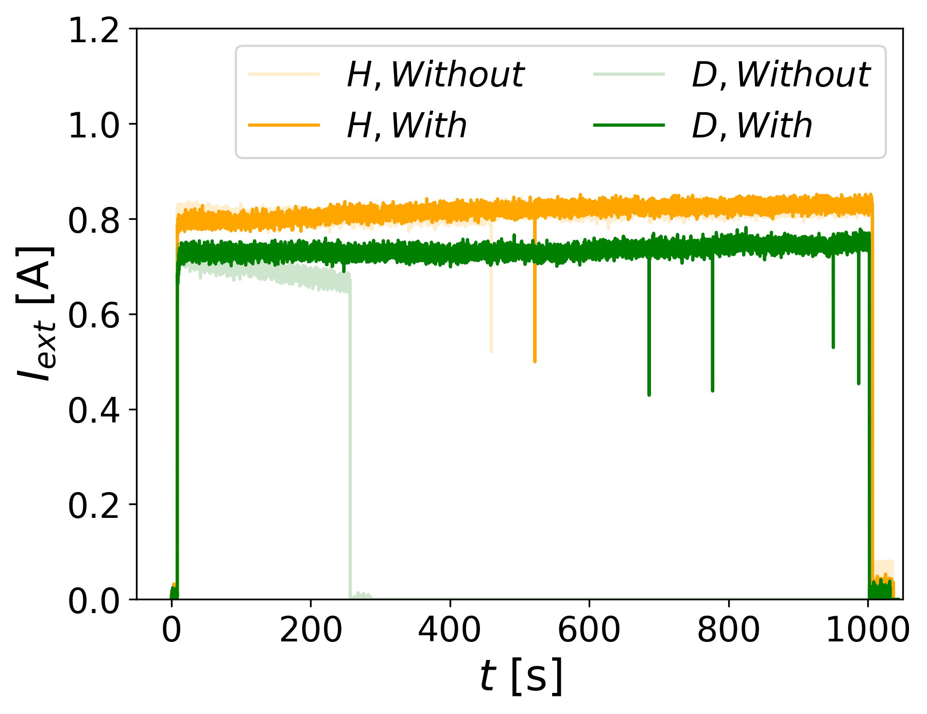
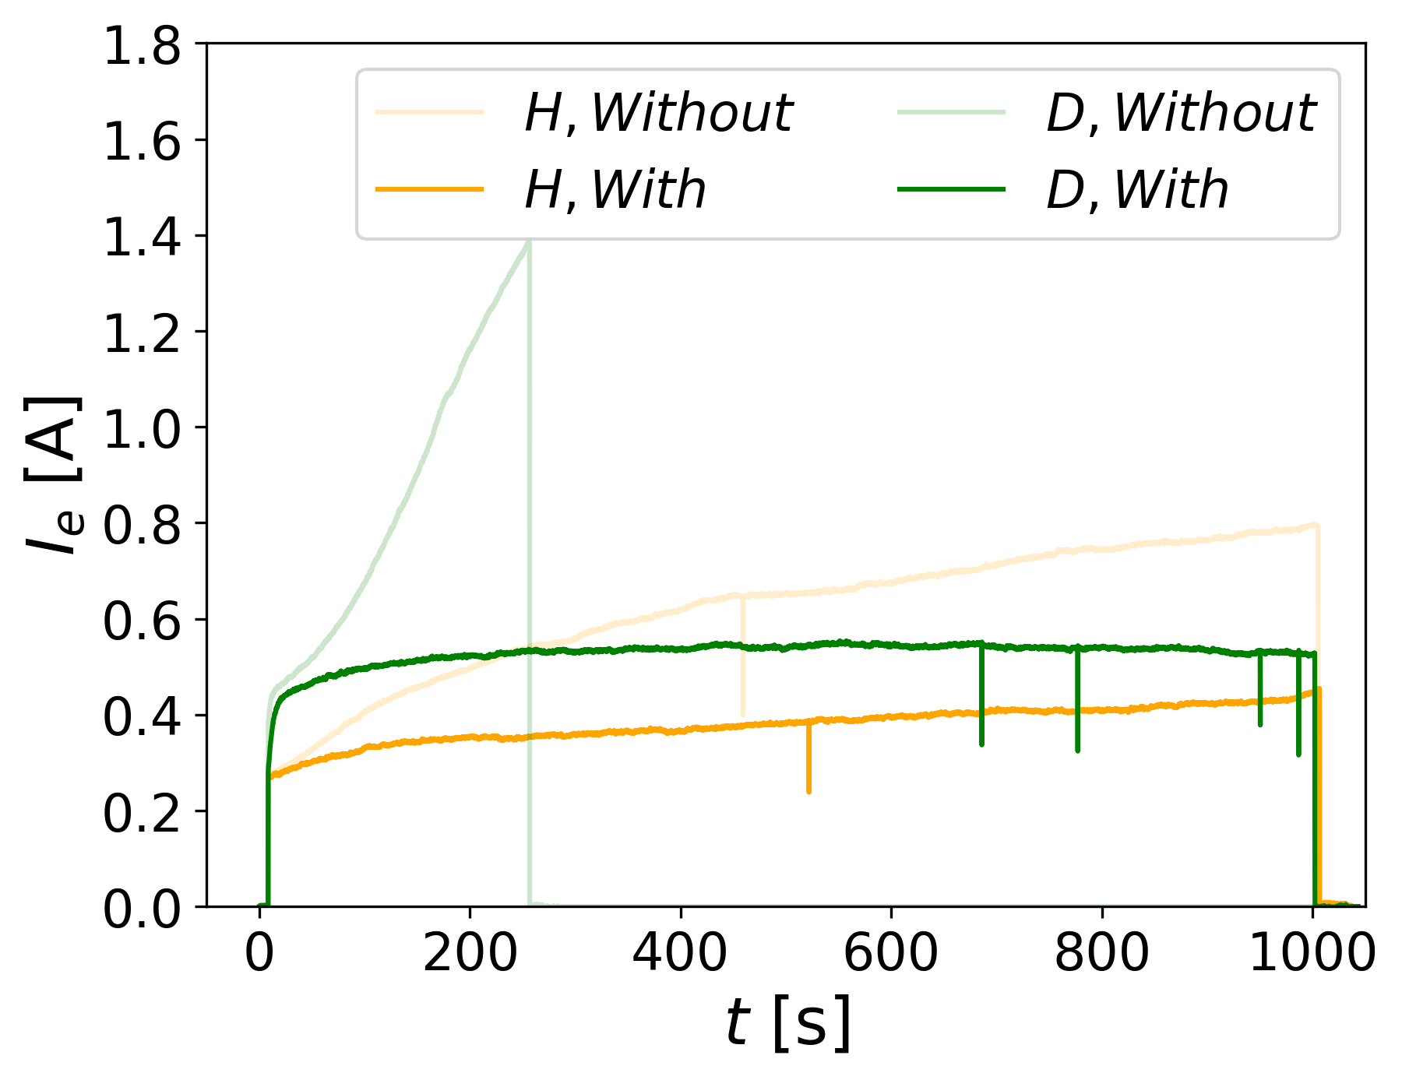
Mitigating the increase of I_{e} : improved Cs distribution at BUG
Cs oven
Large asymmetry
D
D
Bias plate
H
H
Shower
Plasma grid
Stable amount of Cs → stable co-extracted electron current

Slide 13
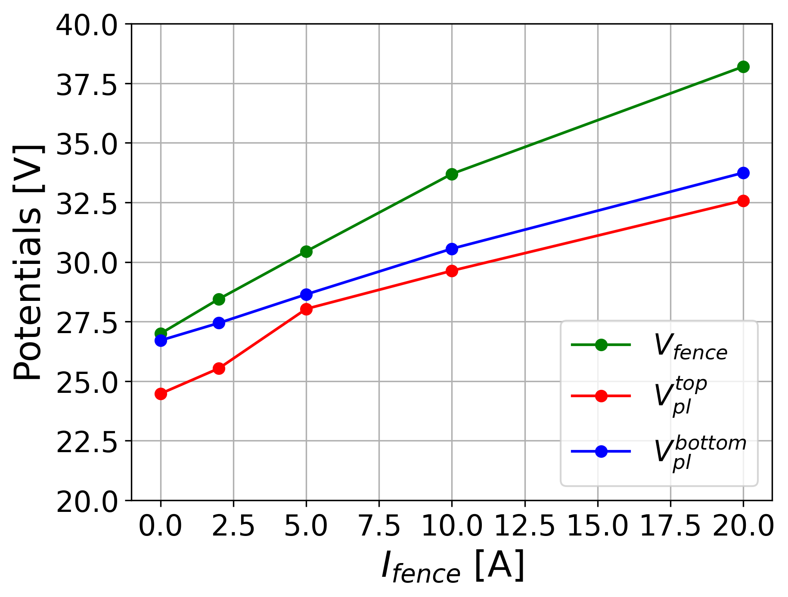
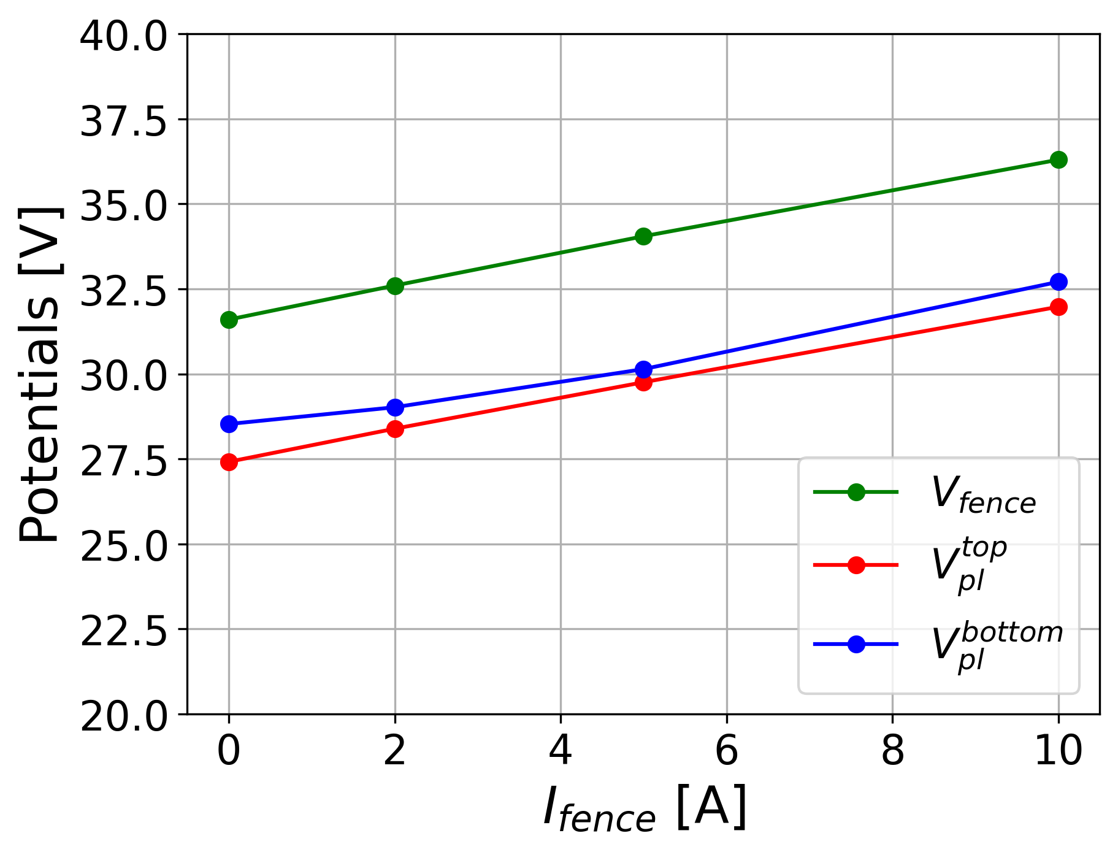
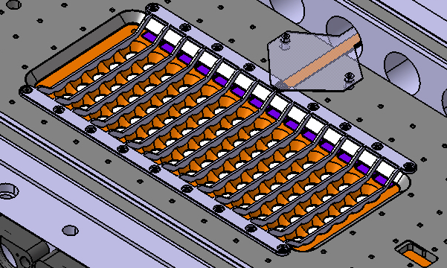
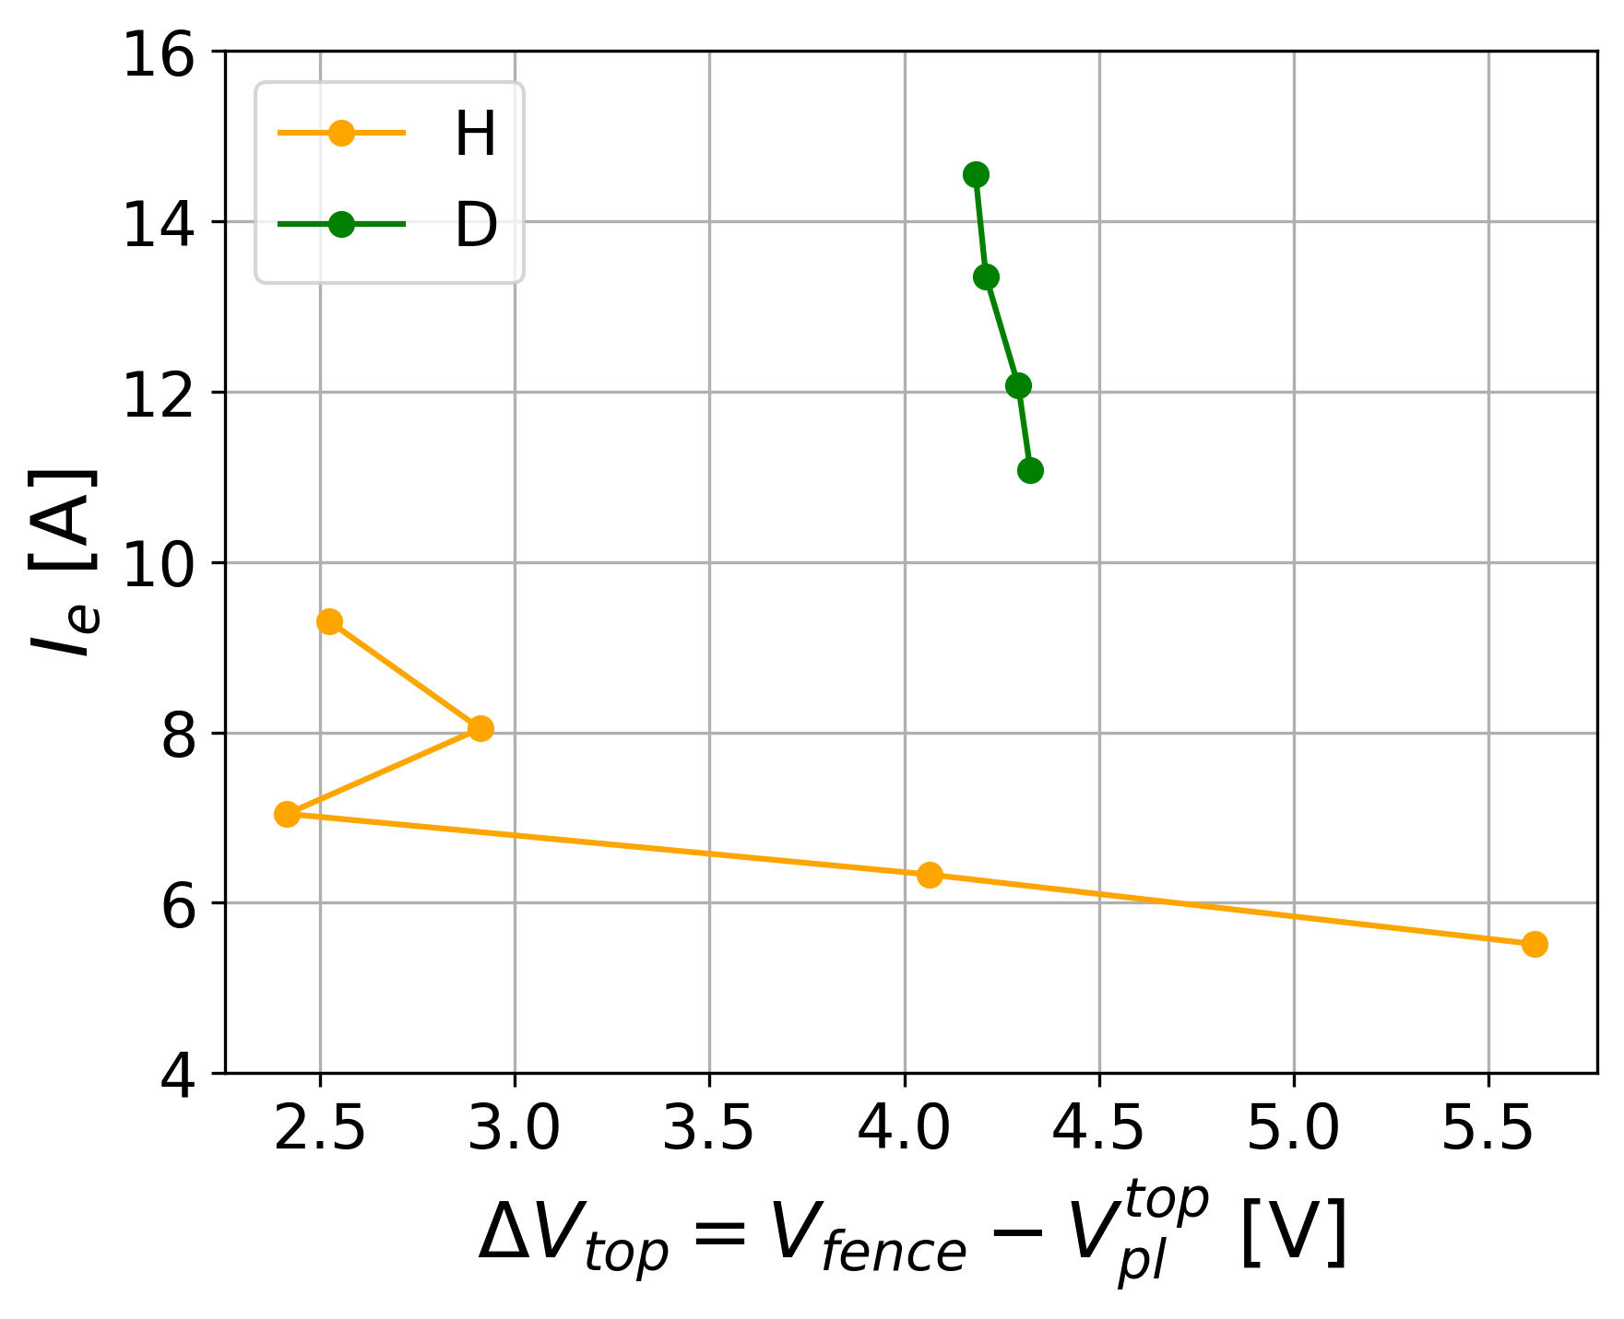
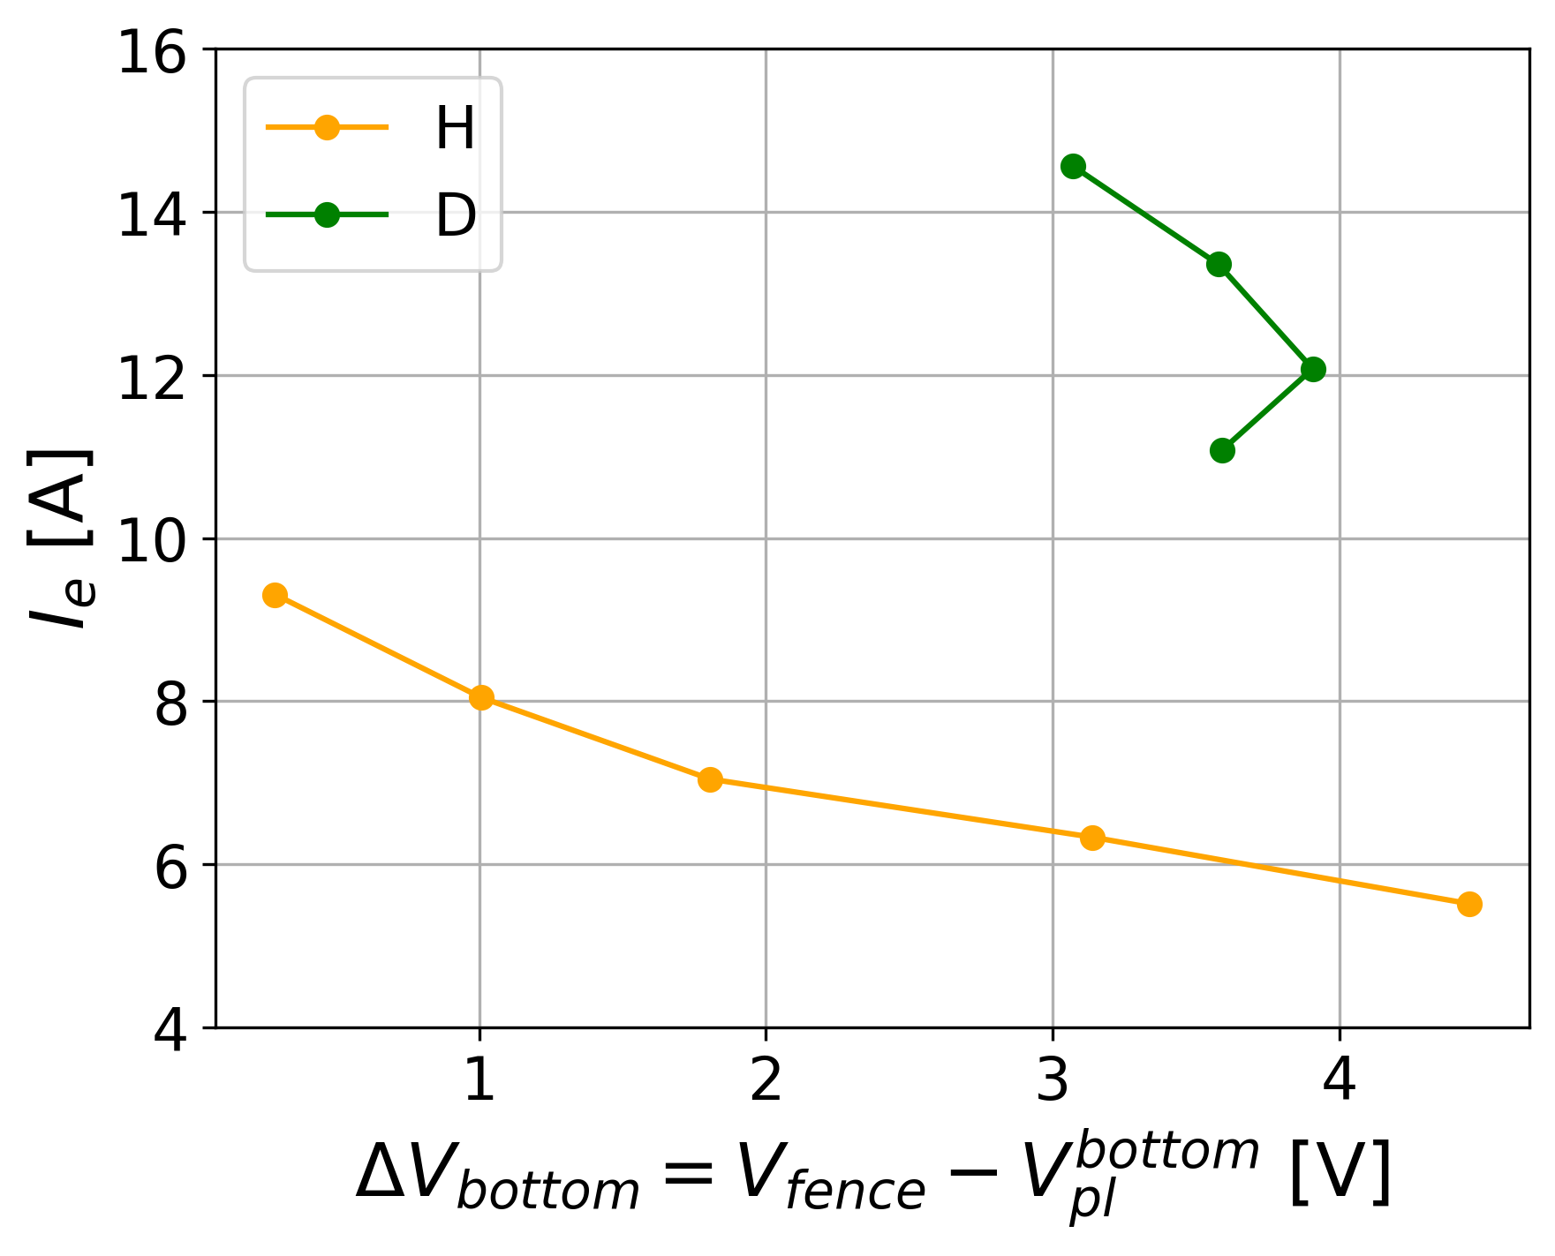
Mitigating the increase of I_{e} : surface biasing
Bias plate
Plasma grid
H
D
Fence
Electron fence → highlight connection ΔV – I_{e} but can not conclude (yet) it is a suitable solution

Slide 14
Summary
Outlook
Compiled a detailed list of similarities/differences between H and D operation by gathering extensive diagnostics data across different machines and campaigns (shown here for long pulses with CW extraction @ ELISE)
Formulation of a working hypothesis explaining the increase of I_{e}
Dedicated campaigns have been conducted to test the hypothesis, to try to stabilize and minimize I_{e} (Cs shower, electron fence, various biasing configurations, …)
Deploy work function measurements at ELISE.
Explore new biasing strategies (flexibility with rods, BP, PG, fence)
Work on Cs (re-)distribution (shower, one driver operation)
Focus on plasma – beam correlations
Integrate modelling results
→ Systematic investigations in H and D

Slide 15
Investigating the physics behind the different performance of negative ion sources for fusion in hydrogen and deuterium

Slide 16
Back-up slides

Slide 17
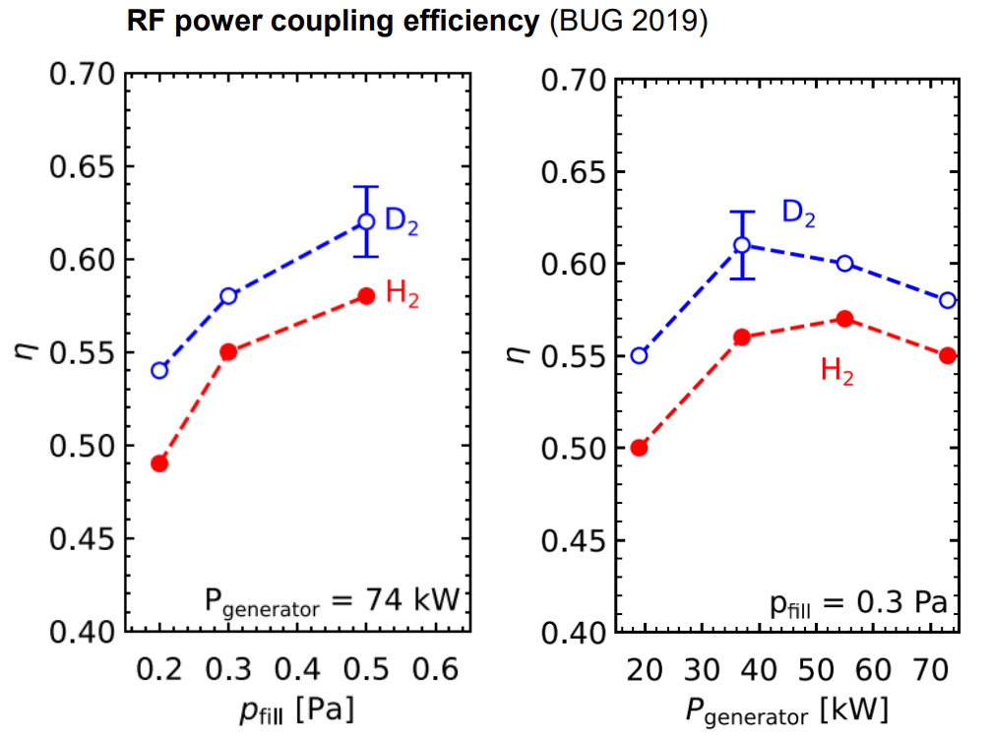
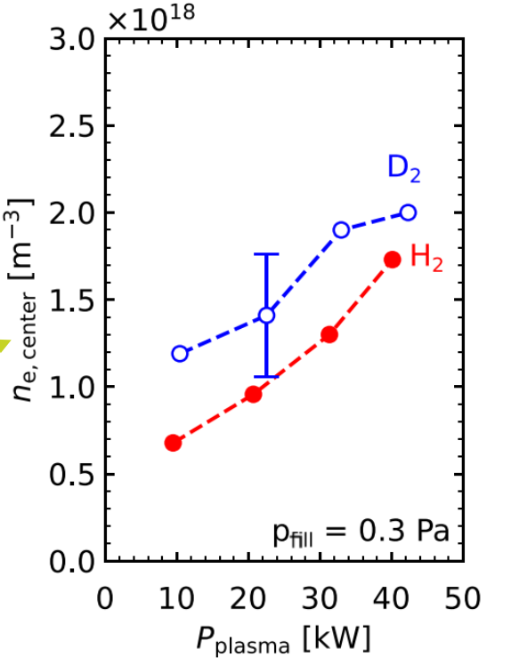
Static effect due to higher mass of Deuterium : lower diffusion

Slide 18
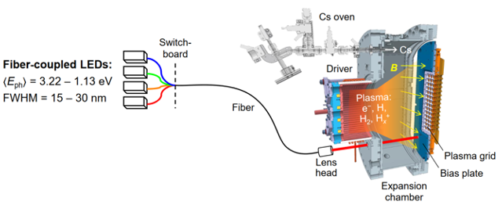
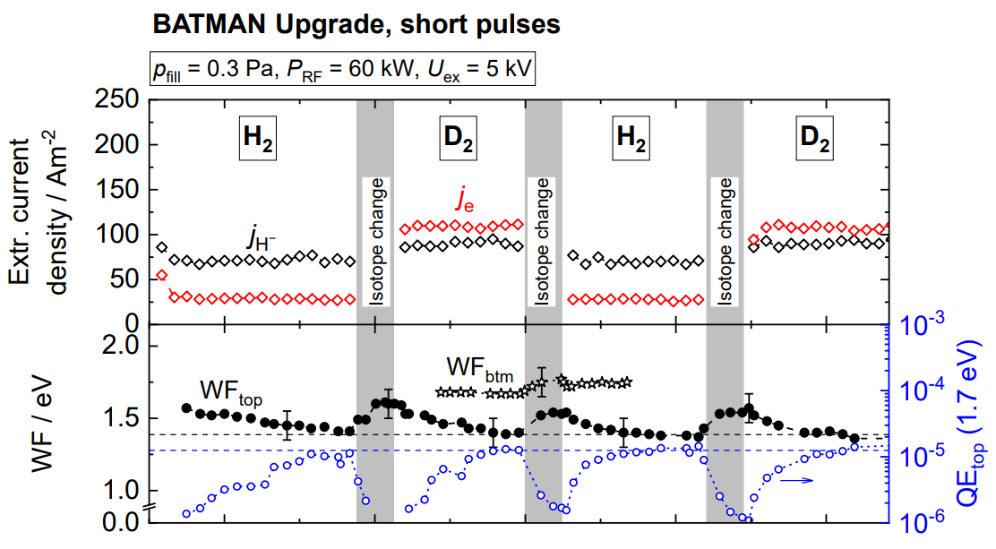
WF measurements at BUG
A
50 V
Ring electrode collects photoelectrons
Pico-ammeter measures photocurrent
Measurements only possible during plasma-off phases
A. Heiler et al, SOFT 2024
Similar low work function reachable in both H and D → To be brought @ ELISE

Slide 19
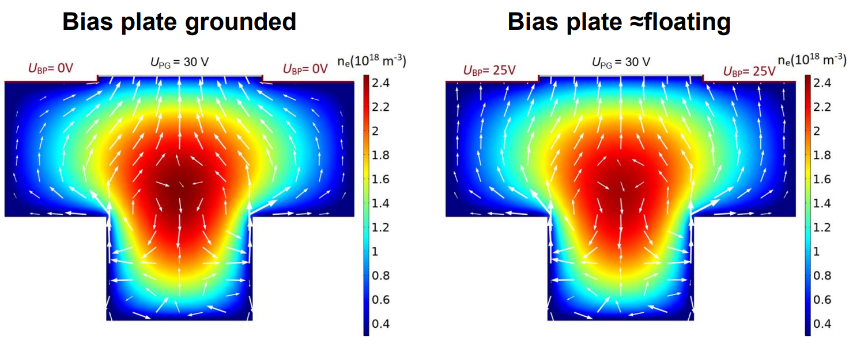
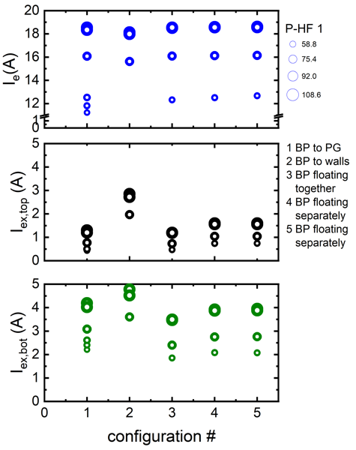
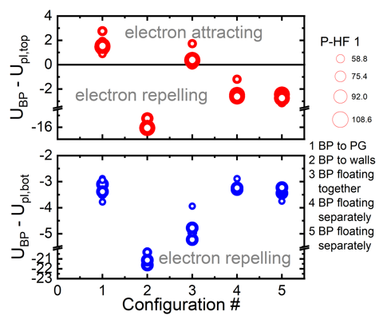
Mitigating the increase of I_{e} : surface biasing
Courtesy of D. Yordanov
Bias plate configuration has limited influence on I_{e} in H. Similar in D ?

Slide 20
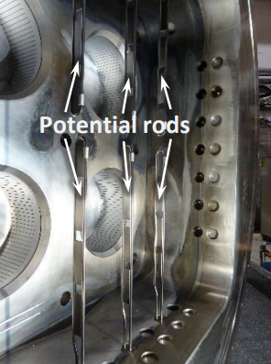
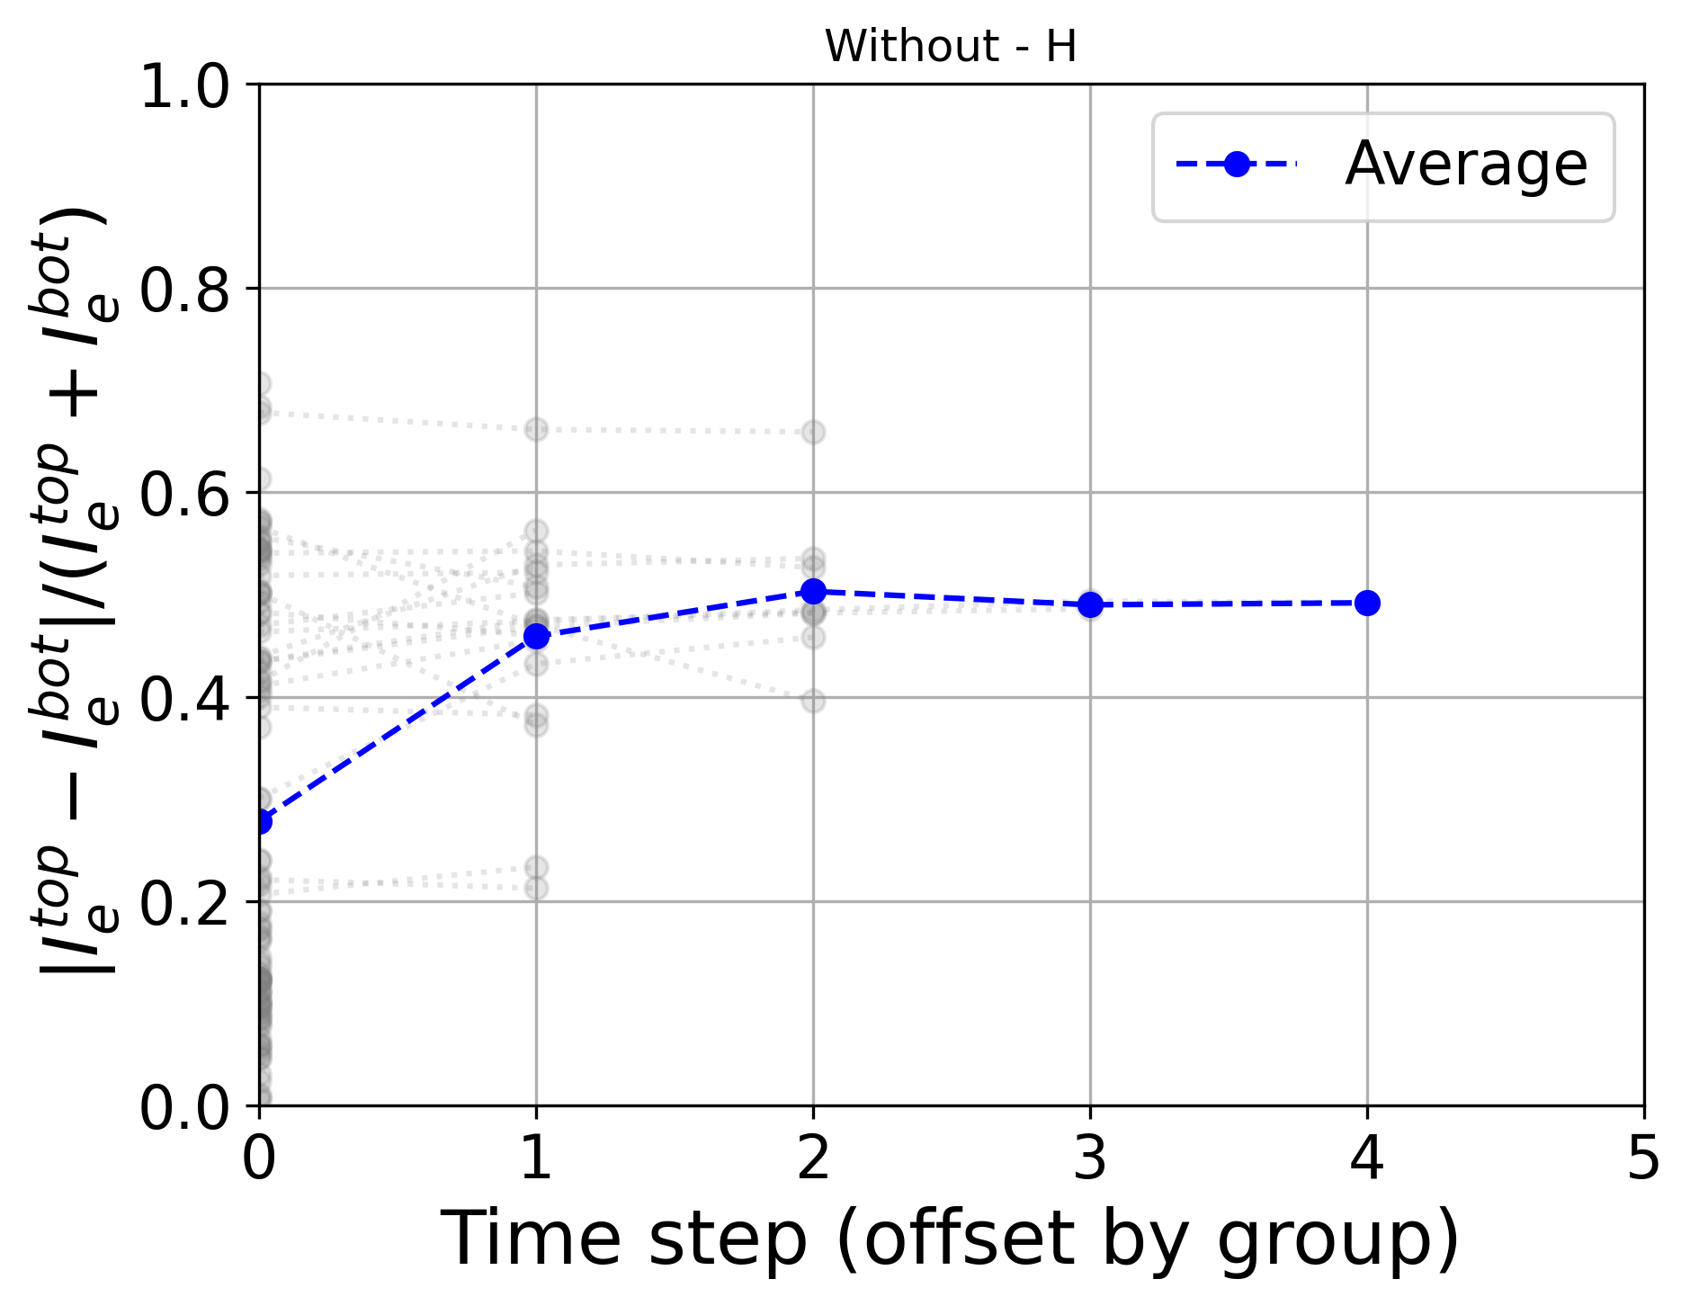
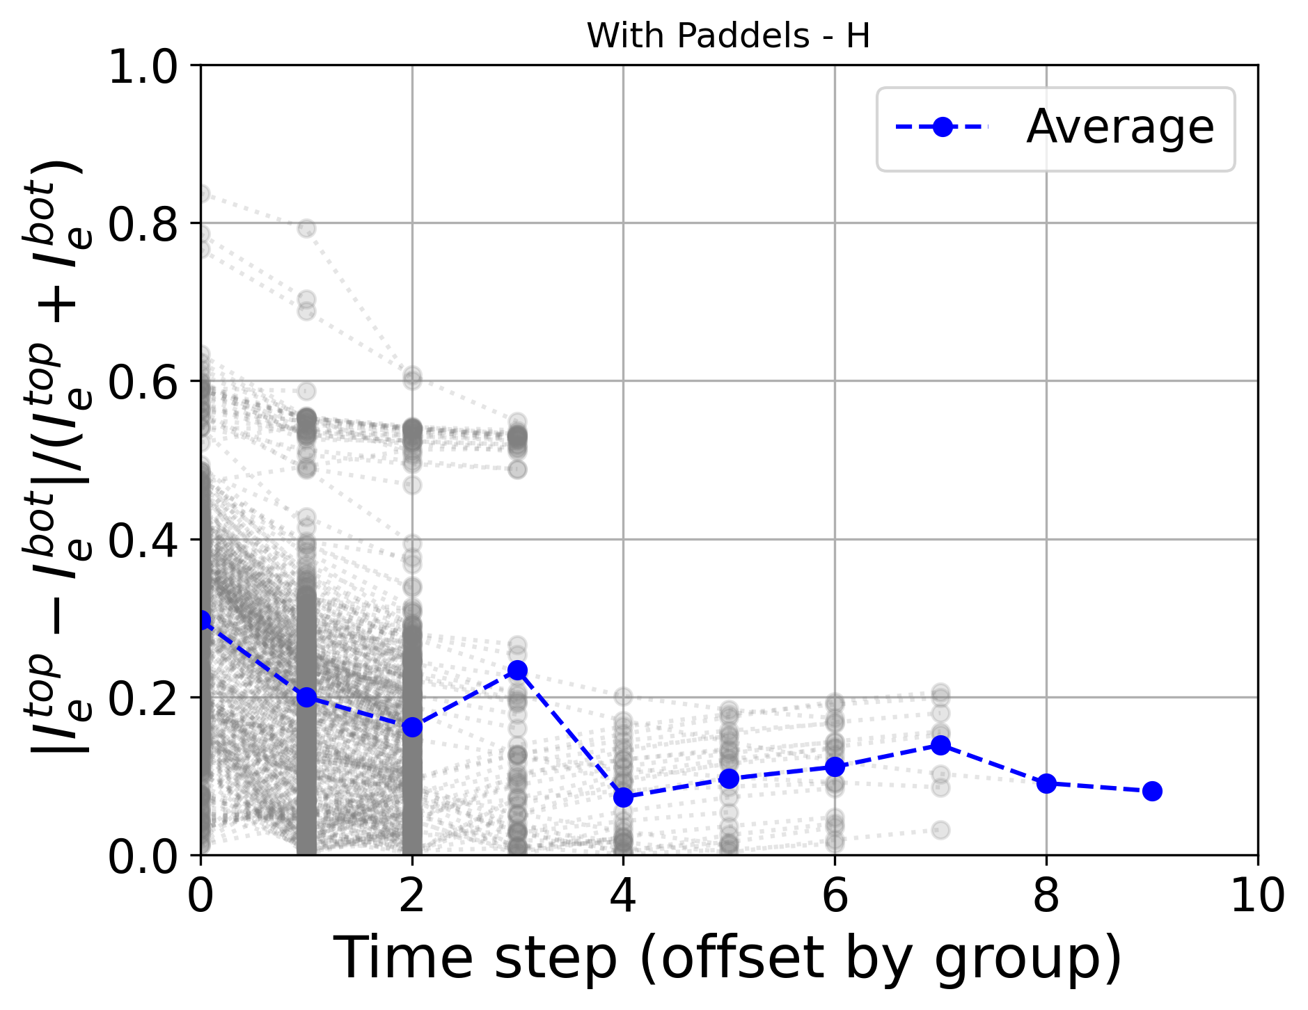
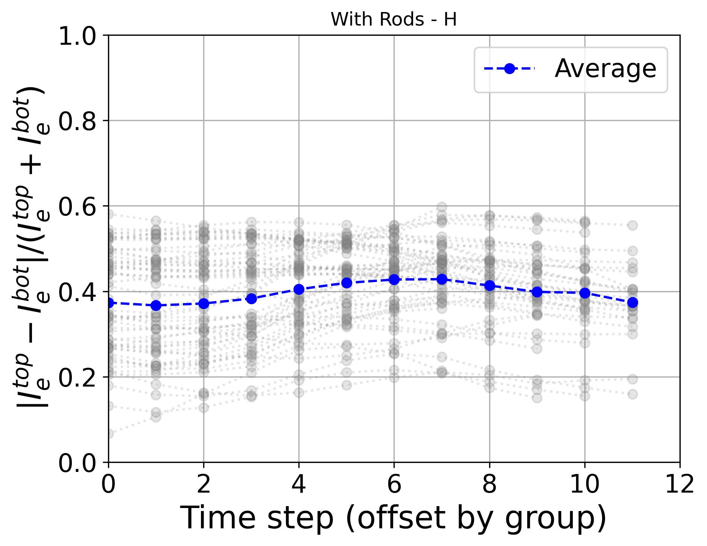
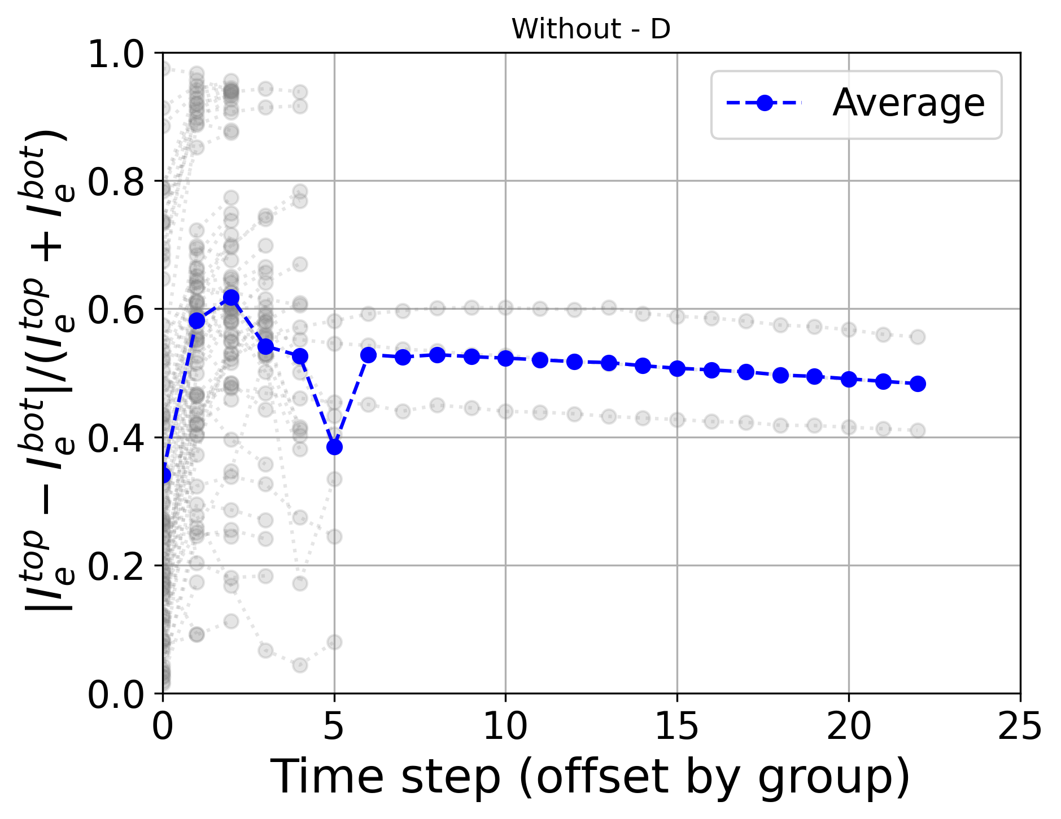
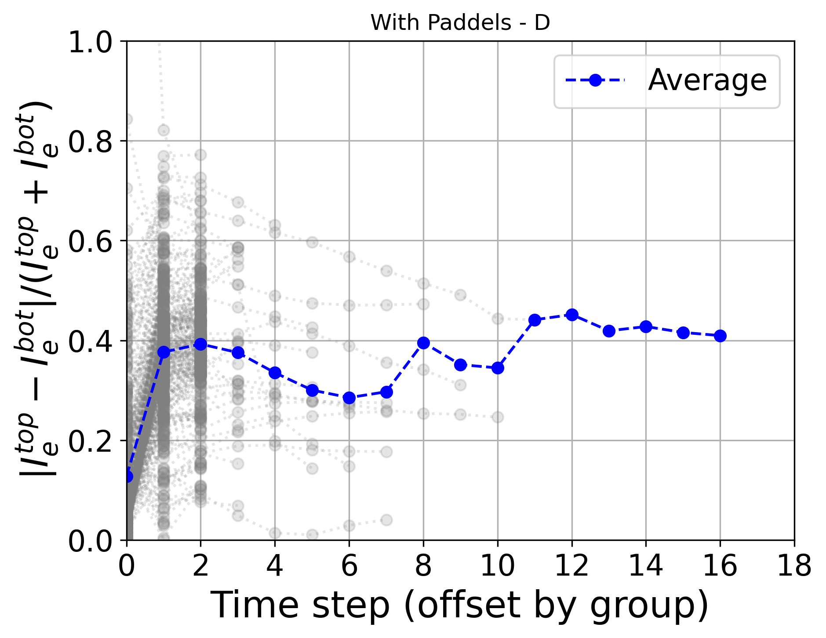
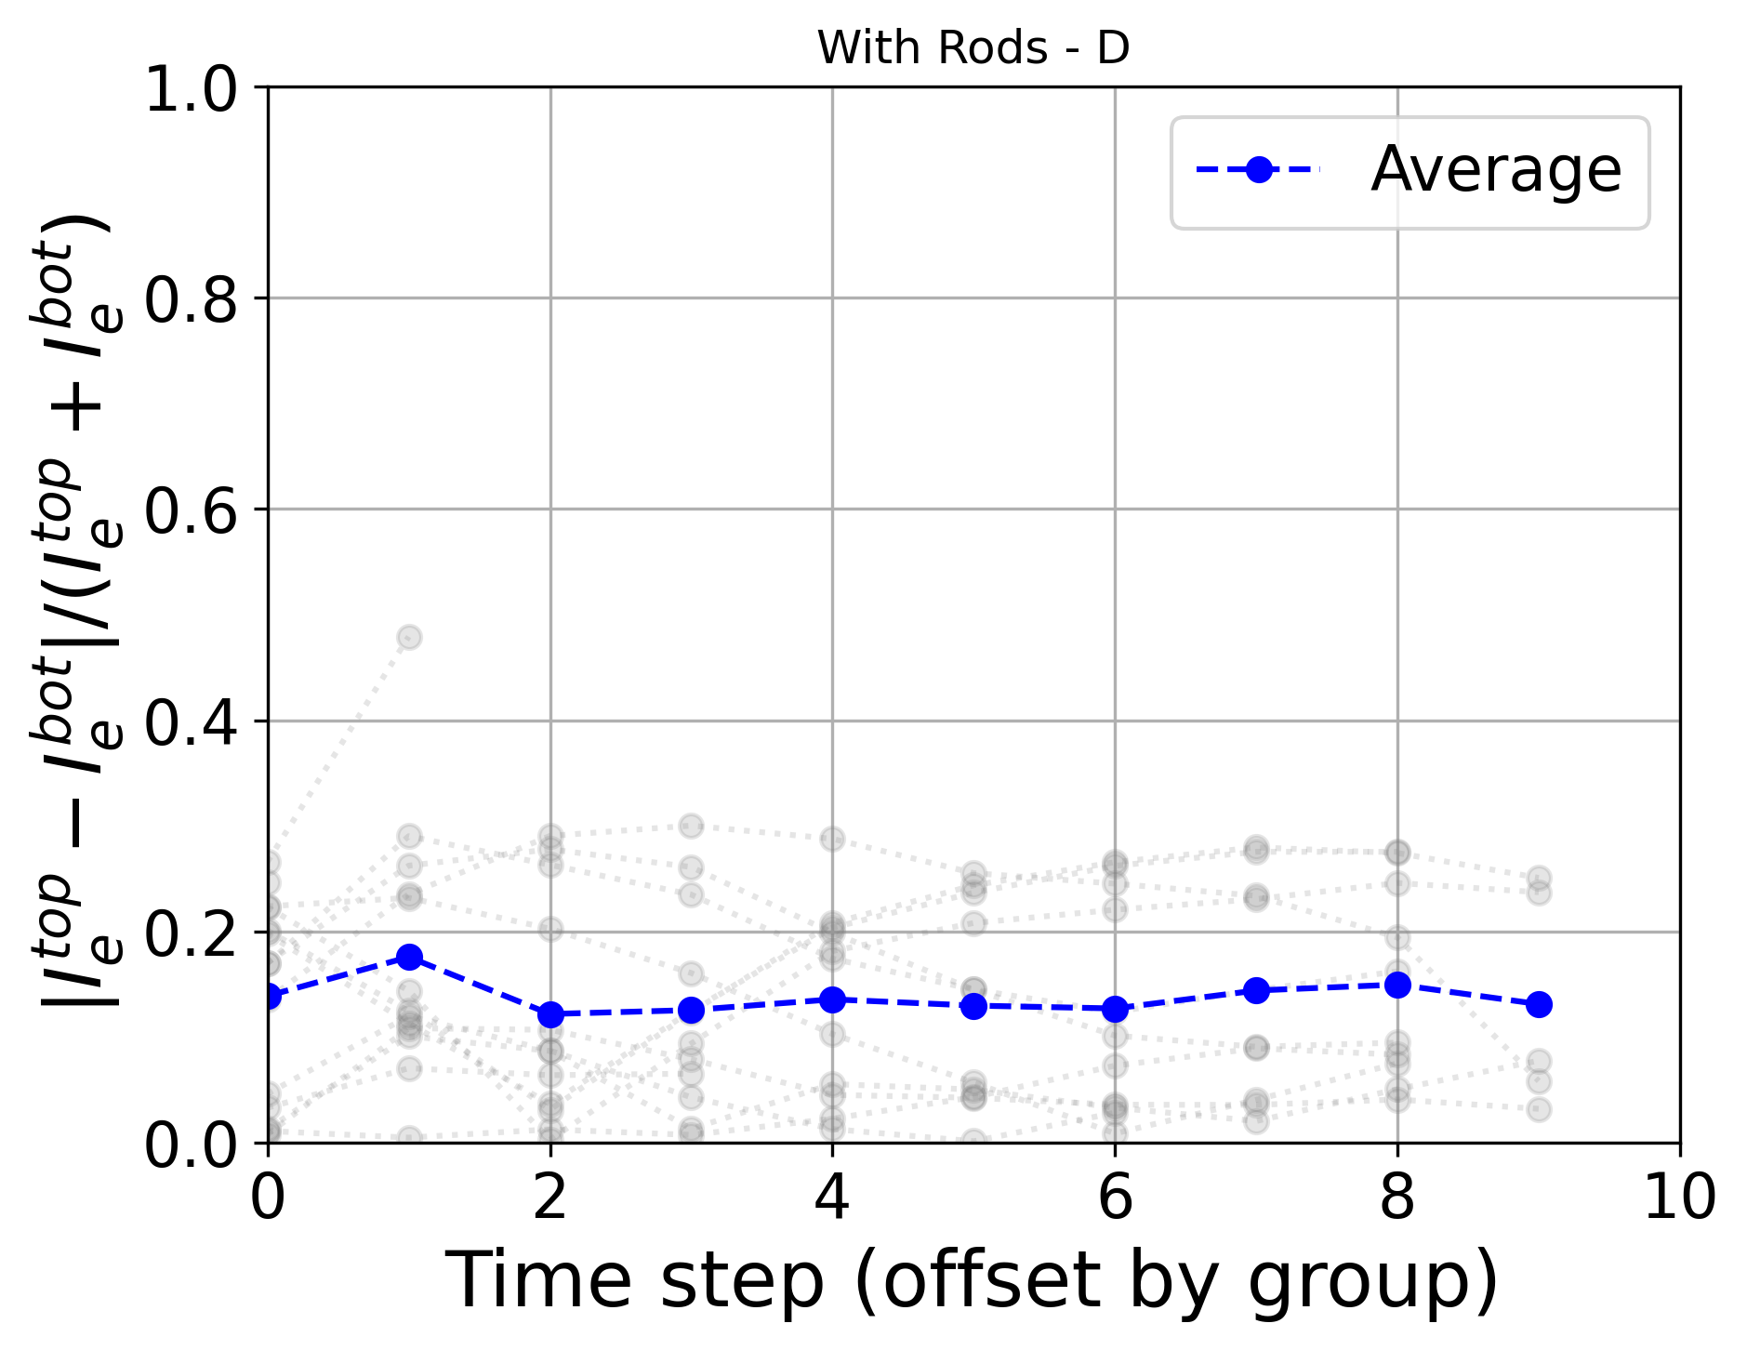
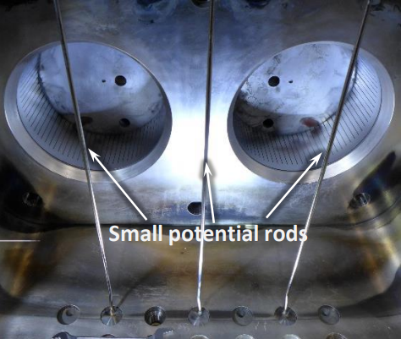
Mitigating the non-uniformity of I_{e} : surface biasing
HYDROGEN
Time
Time
Time
2017 – 2020
DEUTERIUM
2023 - present
Time
Time
Time
Metallic rods in ELISE help symmetrizing the plasma both in H and D

Slide 21
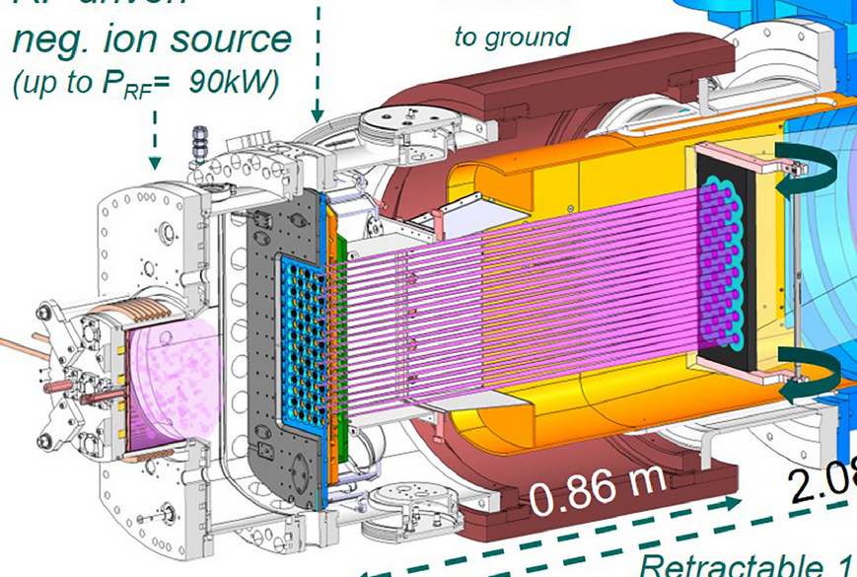
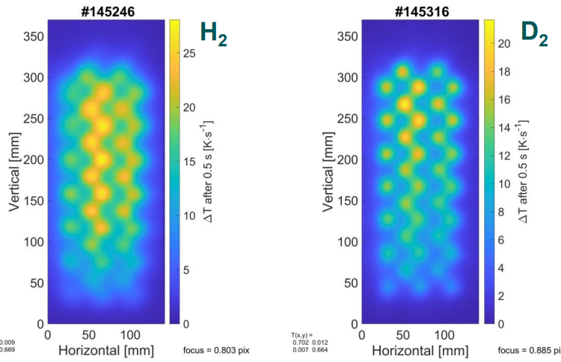
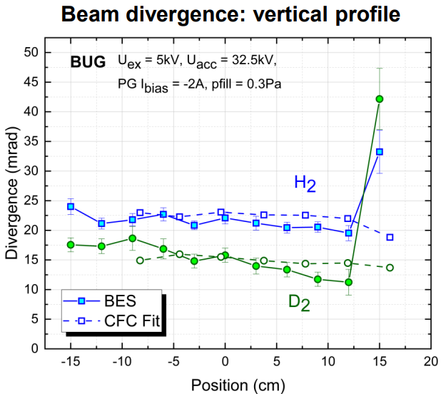
Beam divergence and uniformity
Divergence is lower in D – Uniformity/Homogeneity may differ

