Slide 1
Experimental characterization of detachment in Alternative Divertor Configurations in ASDEX Upgrade
Felix Albrecht, Dominik Brida, Gregor Birkenmeier
Max-Planck-Institut für Plasmaphysik | Felix Albrecht | 26.05.2025
HEPP intro talk - Detachment in ADCs in Asdex upgrade

Slide 2
About me
Munich
Born in '97
Constance
B.Sc. Physics
„Nanostructuring Silicon and Indium Tin Dioxide
via Laser Interference Lithography“
Vienna
B.A. Jazz trumpet
Munich
Vienna
Constance
Max-Planck-Institut für Plasmaphysik | Felix Albrecht | 26.05.2025
HEPP intro talk - Detachment in ADCs in Asdex upgrade

Slide 3
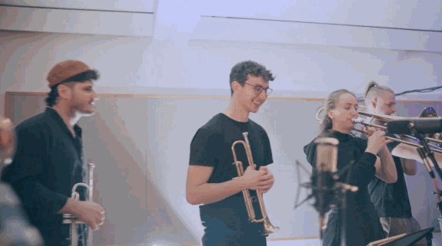
About me
Munich
Born in '97
Constance
B.Sc. Physics
„Nanostructuring Silicon and Indium Tin Dioxide
via Laser Interference Lithography“
Vienna
B.A. Jazz trumpet
Munich
Vienna
Constance
M.Sc. Physics
„Measurement of ion residence times in the ILIAMS
cooler at VERA with a new multi-beam switcher“
Max-Planck-Institut für Plasmaphysik | Felix Albrecht | 26.05.2025
HEPP intro talk - Detachment in ADCs in Asdex upgrade

Slide 4
Master thesis: Accelerator Mass Spectrometry at VERA
Ion Sources
Magnets
Magnet
Accelerator
Detectors
Max-Planck-Institut für Plasmaphysik | Felix Albrecht | 26.05.2025
HEPP intro talk - Detachment in ADCs in Asdex upgrade

Slide 5
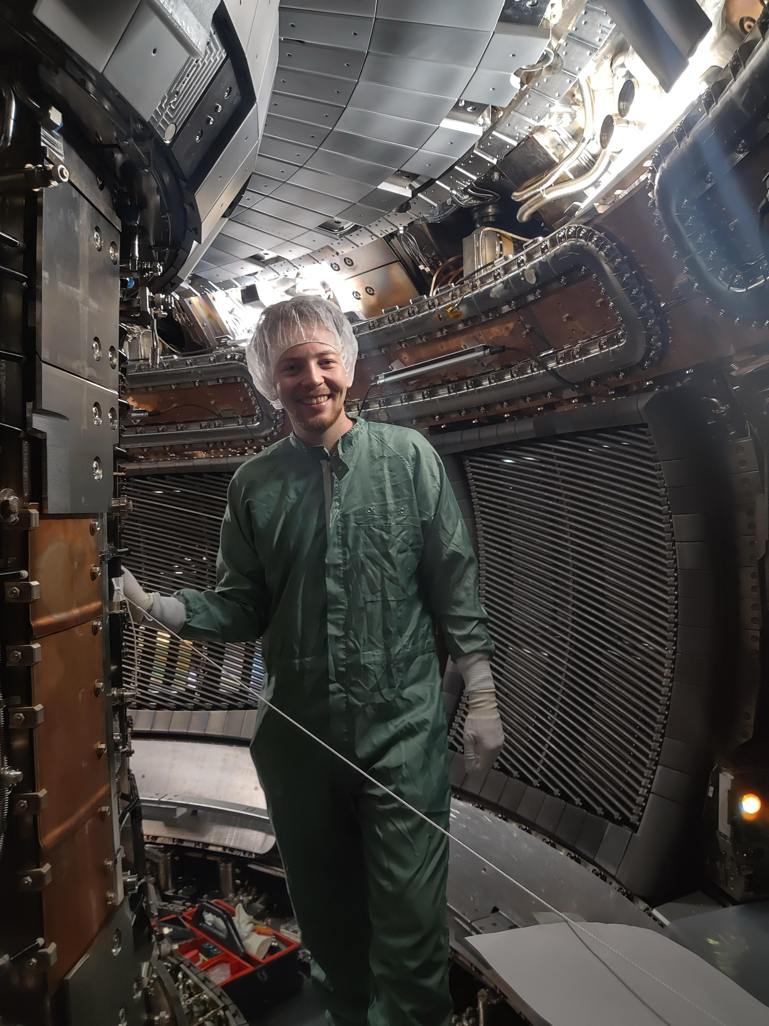
Internship: Calibration of MSE diagnostic
Motional Stark Effect (MSE) diagnostic
Constraints for reconstruction of q-profile, i.e. $1/ι$
Polarisation angle of D$α$ emission of injected neutrals (NBI)
Tasks/Challenges
Calibration of fibre transmission, PMT & PC sensitivity
Exact position of NBI not known -> align MSE LsOS with „best guess“ -> forward model by Ralph Dux
D. Silvagni
Max-Planck-Institut für Plasmaphysik | Felix Albrecht | 26.05.2025
HEPP intro talk - Detachment in ADCs in Asdex upgrade
Notes:
MBS will be used for AMS measurement
-> I will use it for „fast switching“
B = 4334G
Magnet is impulse filter! p = √2mE ~ √m -> longer radius for higher masses and higher Energies

Slide 6
PhD thesis - Experimental characterisation of detachment in Alternative Divertor Configurations at ASDEX Upgrade
Max-Planck-Institut für Plasmaphysik | Felix Albrecht | 26.05.2025
HEPP intro talk - Detachment in ADCs in Asdex upgrade
Notes:
MBS will be used for AMS measurement
-> I will use it for „fast switching“
B = 4334G
Magnet is impulse filter! p = √2mE ~ √m -> longer radius for higher masses and higher Energies

Slide 7
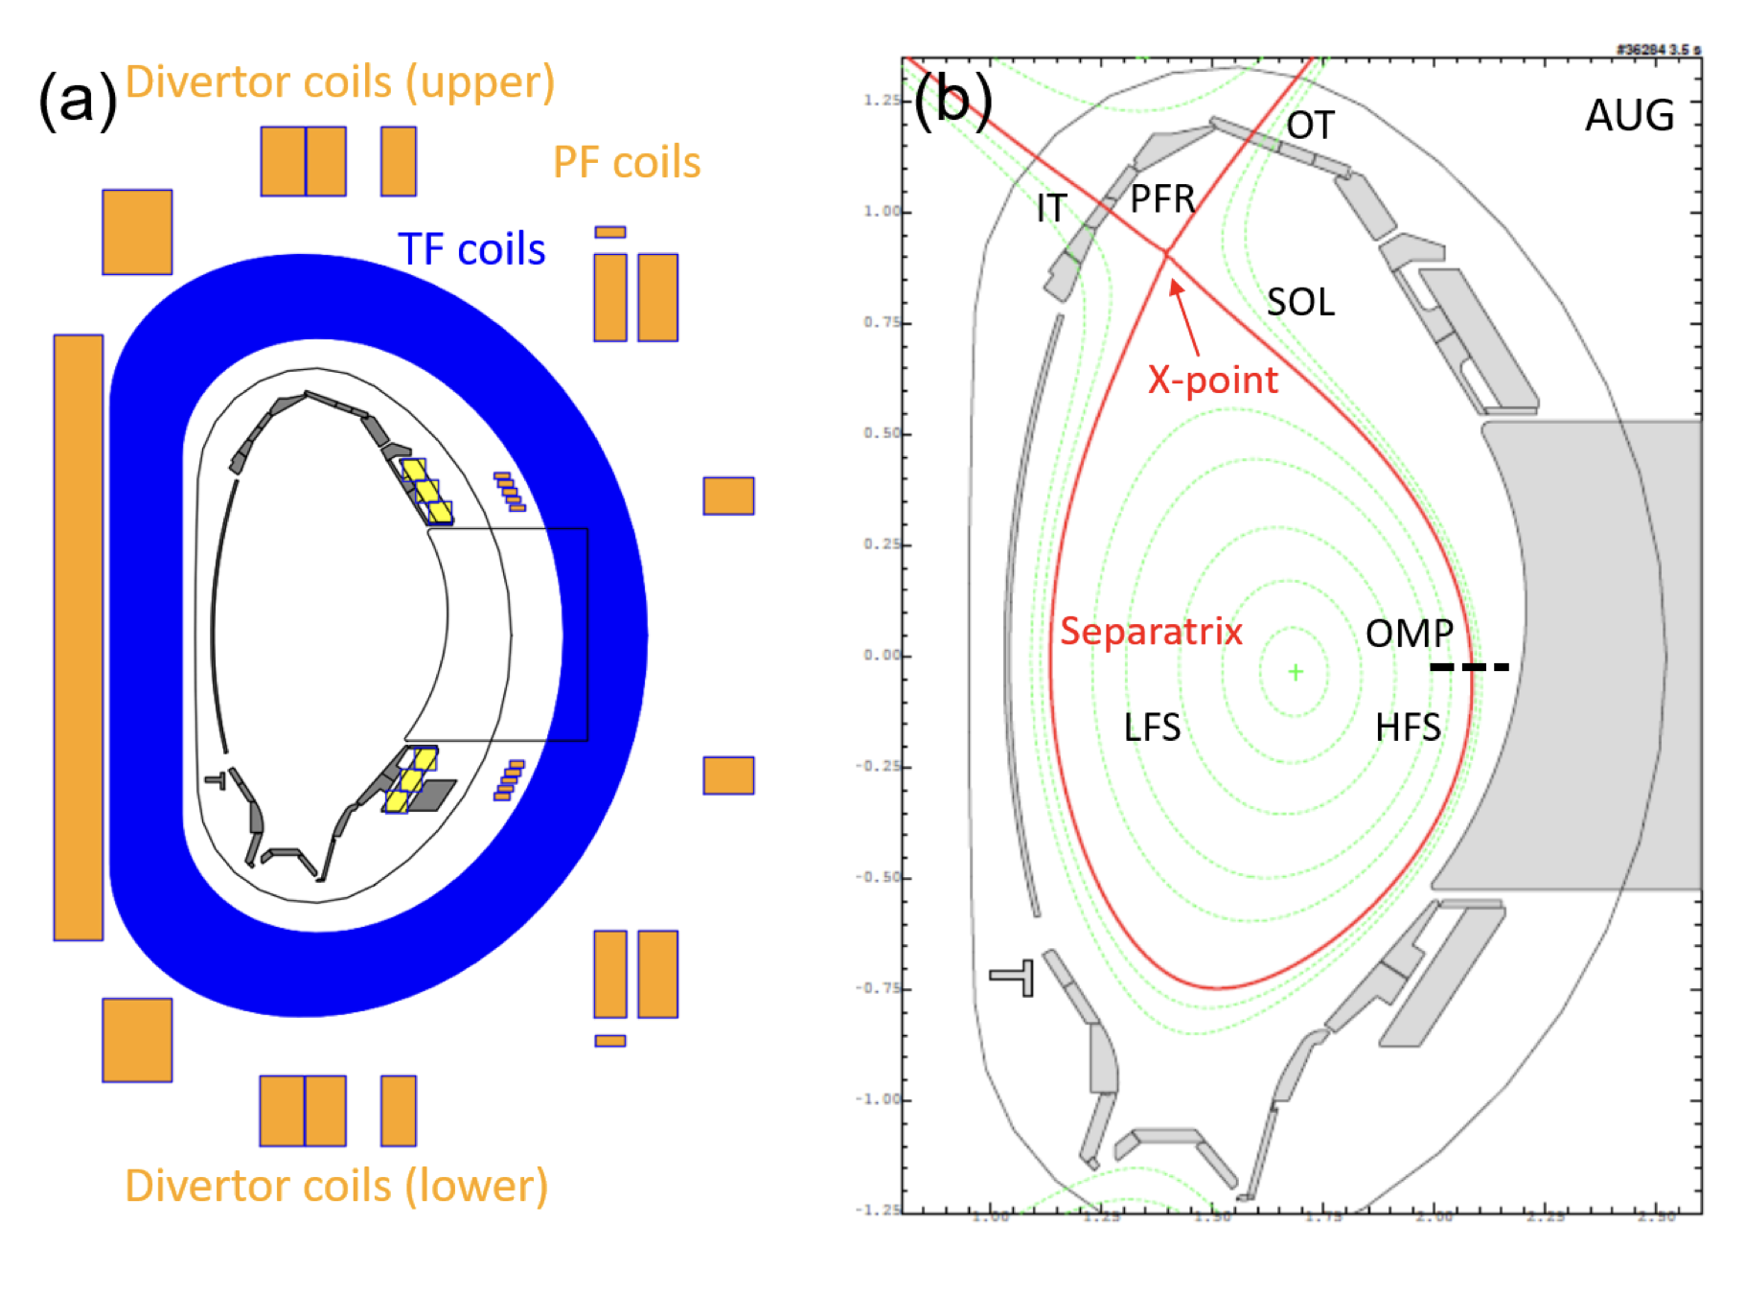
PhD thesis - Experimental characterisation of detachment in Alternative Divertor Configurations at ASDEX Upgrade
Limiting of plasma through divertor
Creation of X-point through poloidal coils
Separatrix intersects wall components
In SOL: mainly parallel heat conduction
Spitzer conductivity: $σ_{Sp}∝T^{3/2}$
Connection lengths 50-100m
O. Pan 2020 PhD Thesis
Max-Planck-Institut für Plasmaphysik | Felix Albrecht | 26.05.2025
HEPP intro talk - Detachment in ADCs in Asdex upgrade
Notes:
MBS will be used for AMS measurement
-> I will use it for „fast switching“
B = 4334G
Magnet is impulse filter! p = √2mE ~ √m -> longer radius for higher masses and higher Energies

Slide 8
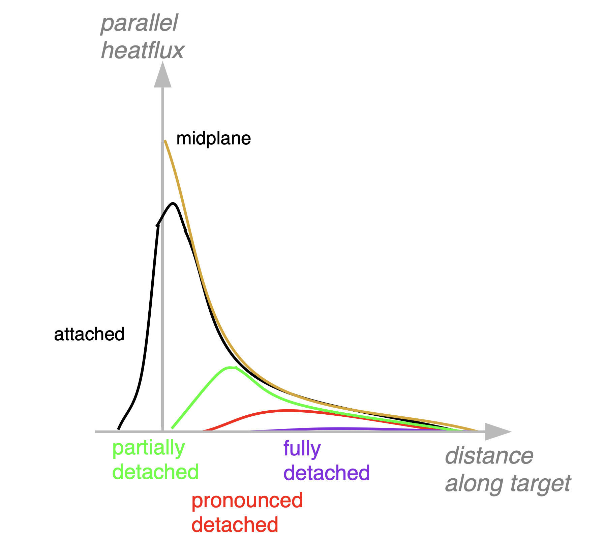
PhD thesis - Experimental characterisation of detachment in Alternative Divertor Configurations at ASDEX Upgrade
Heat flux to target, attached
Exponential decay
Power fall-off length λq (SOL width)
Detachment of divertor plasma from target plasma
Power loss through radiation, ionization, charge ex-change, recombination
Impurity seeding
High divertor neutral pressure
High upstream density
Characterised by:
Peak reduction in ne, Te, jsat and q⟂
midplane
A. Kallenbach et al 2015 Nucl. Fusion 55 053026
Max-Planck-Institut für Plasmaphysik | Felix Albrecht | 26.05.2025
HEPP intro talk - Detachment in ADCs in Asdex upgrade
Notes:
MBS will be used for AMS measurement
-> I will use it for „fast switching“
B = 4334G
Magnet is impulse filter! p = √2mE ~ √m -> longer radius for higher masses and higher Energies

Slide 9
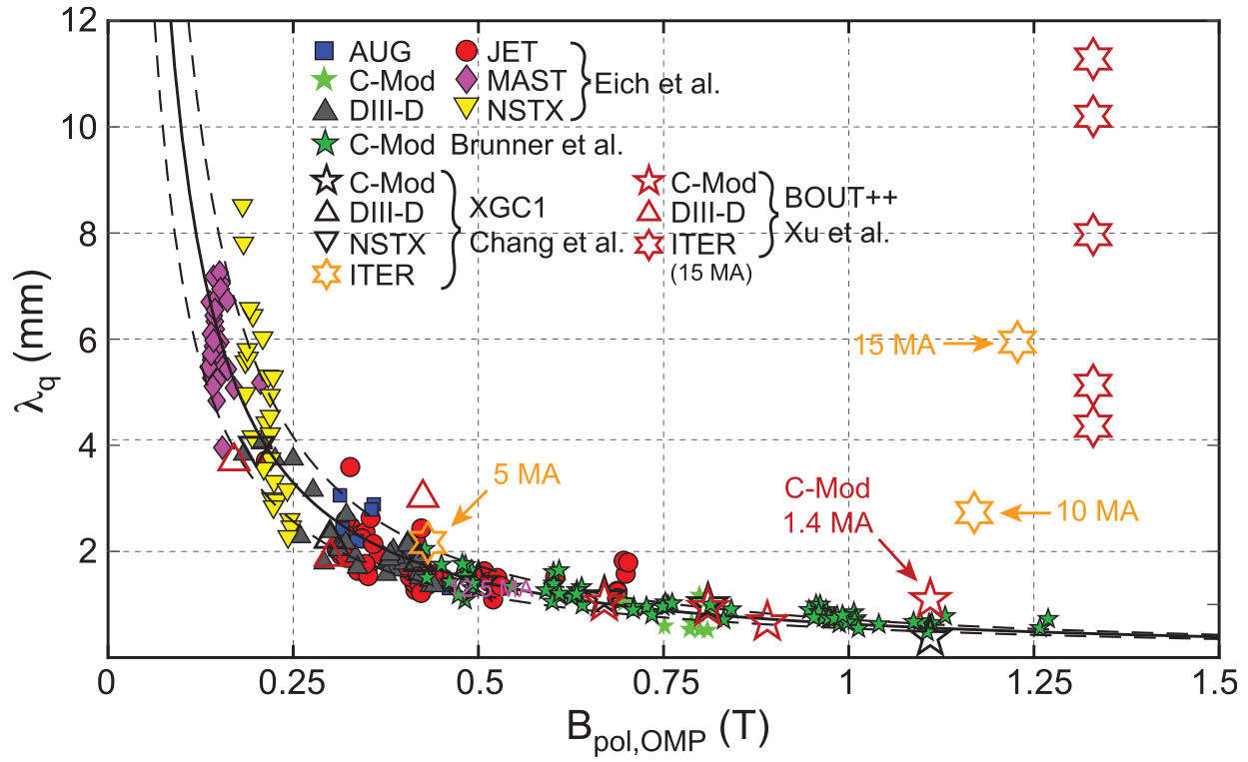
PhD thesis - Experimental characterisation of detachment in Alternative Divertor Configurations at ASDEX Upgrade
λq scaling
Attached inter-ELM SOL width
Unfavourable for high Bpol
Experimental scaling: λq,ITER ~ 1 mm
Simulations: λq,ITER ~ 6 mm
> ITER operates partially detached
Risk mitigation for DEMO
Alternative Divertor Configurations
Experiments at TCV, MAST-U, AUG
K. Krieger et al 2025 Nucl. Fusion 65 043001
Max-Planck-Institut für Plasmaphysik | Felix Albrecht | 26.05.2025
HEPP intro talk - Detachment in ADCs in Asdex upgrade
Notes:
MBS will be used for AMS measurement
-> I will use it for „fast switching“
B = 4334G
Magnet is impulse filter! p = √2mE ~ √m -> longer radius for higher masses and higher Energies

Slide 10
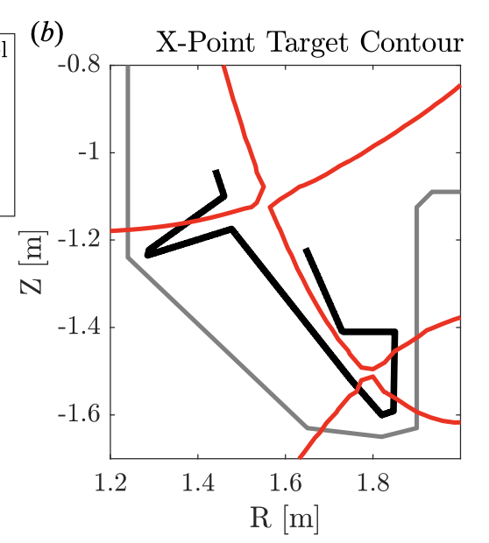
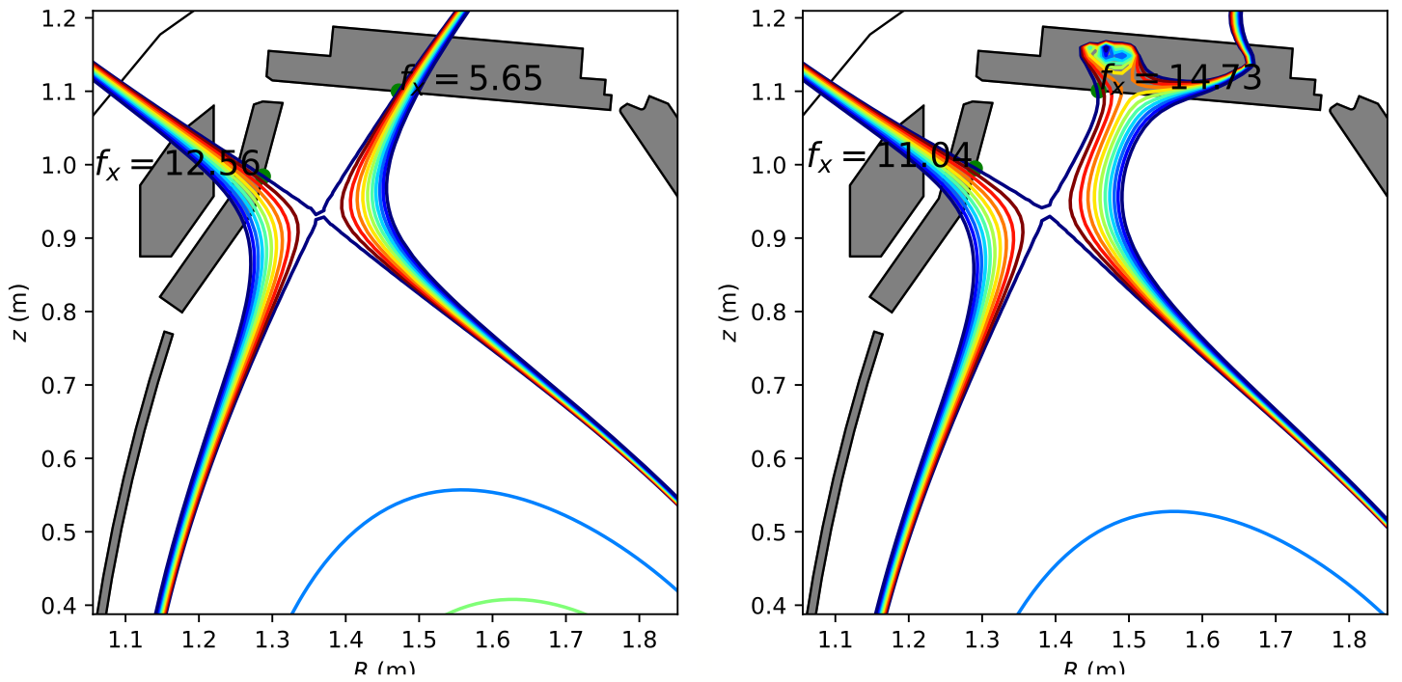
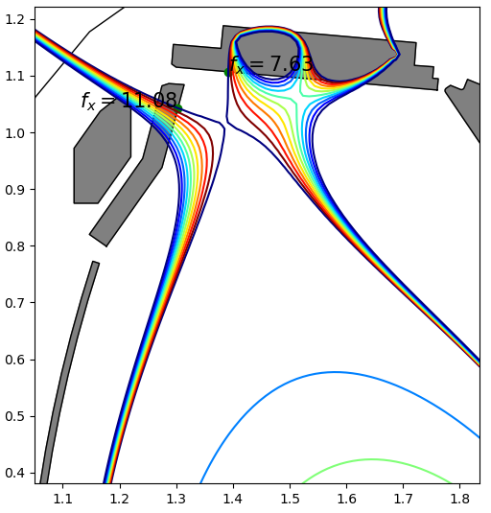
PhD thesis - Experimental characterisation of detachment in Alternative Divertor Configurations at ASDEX Upgrade
Increase poloidal flux expansion fx
fx: spacing between flux surfaces
Increase λint ~ λq / fx
Second X-point by in-vessel coil
A. Q. Kuang et al 2020 J. Plasma Phys. 86 865860505
Single Null
X-Divertor
Snowflake
R (m)
R (m)
R (m)
Max-Planck-Institut für Plasmaphysik | Felix Albrecht | 26.05.2025
HEPP intro talk - Detachment in ADCs in Asdex upgrade
Notes:
MBS will be used for AMS measurement
-> I will use it for „fast switching“
B = 4334G
Magnet is impulse filter! p = √2mE ~ √m -> longer radius for higher masses and higher Energies

Slide 11
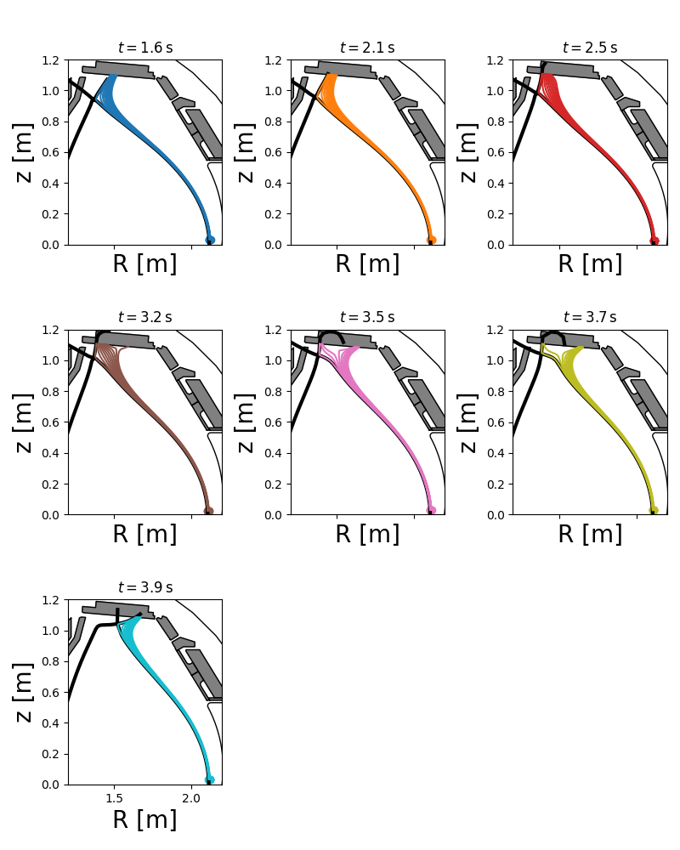
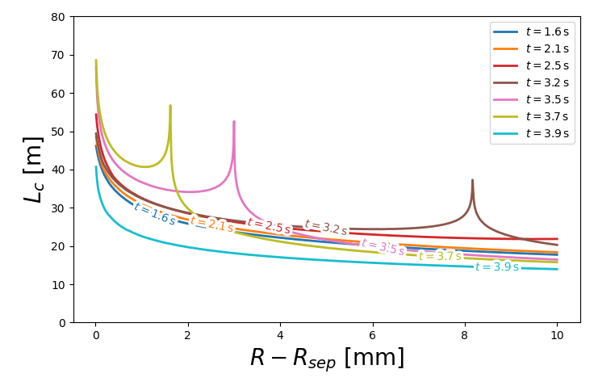
PhD thesis - Experimental characterisation of detachment in Alternative Divertor Configurations at ASDEX Upgrade
Connection length
Measure of radiative cooling
Mapped to upstream radial position
Max-Planck-Institut für Plasmaphysik | Felix Albrecht | 26.05.2025
HEPP intro talk - Detachment in ADCs in Asdex upgrade
Notes:
MBS will be used for AMS measurement
-> I will use it for „fast switching“
B = 4334G
Magnet is impulse filter! p = √2mE ~ √m -> longer radius for higher masses and higher Energies

Slide 12
PhD thesis - Experimental characterisation of detachment in Alternative Divertor Configurations at ASDEX Upgrade
Langmuir probes
Infrared thermography
Thomson scattering
Many diagnostics available
Compare data in reference discharges
Goals
Easier detachment in ADCs?
Dependence on fx?
What is power fall-off length?
Spectroscopy
Bolometry
Gas puff imaging
Max-Planck-Institut für Plasmaphysik | Felix Albrecht | 26.05.2025
HEPP intro talk - Detachment in ADCs in Asdex upgrade
Notes:
MBS will be used for AMS measurement
-> I will use it for „fast switching“
B = 4334G
Magnet is impulse filter! p = √2mE ~ √m -> longer radius for higher masses and higher Energies

Slide 13
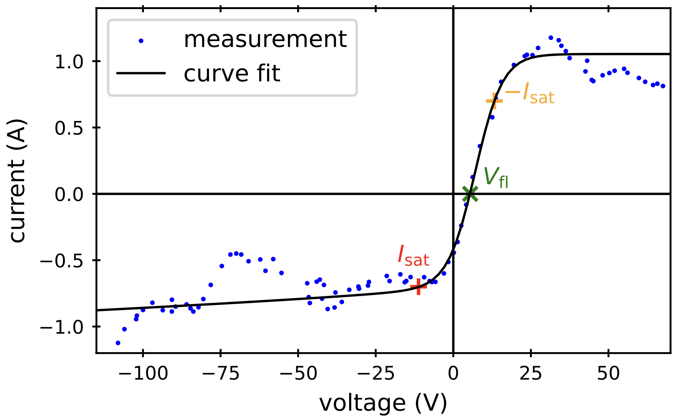
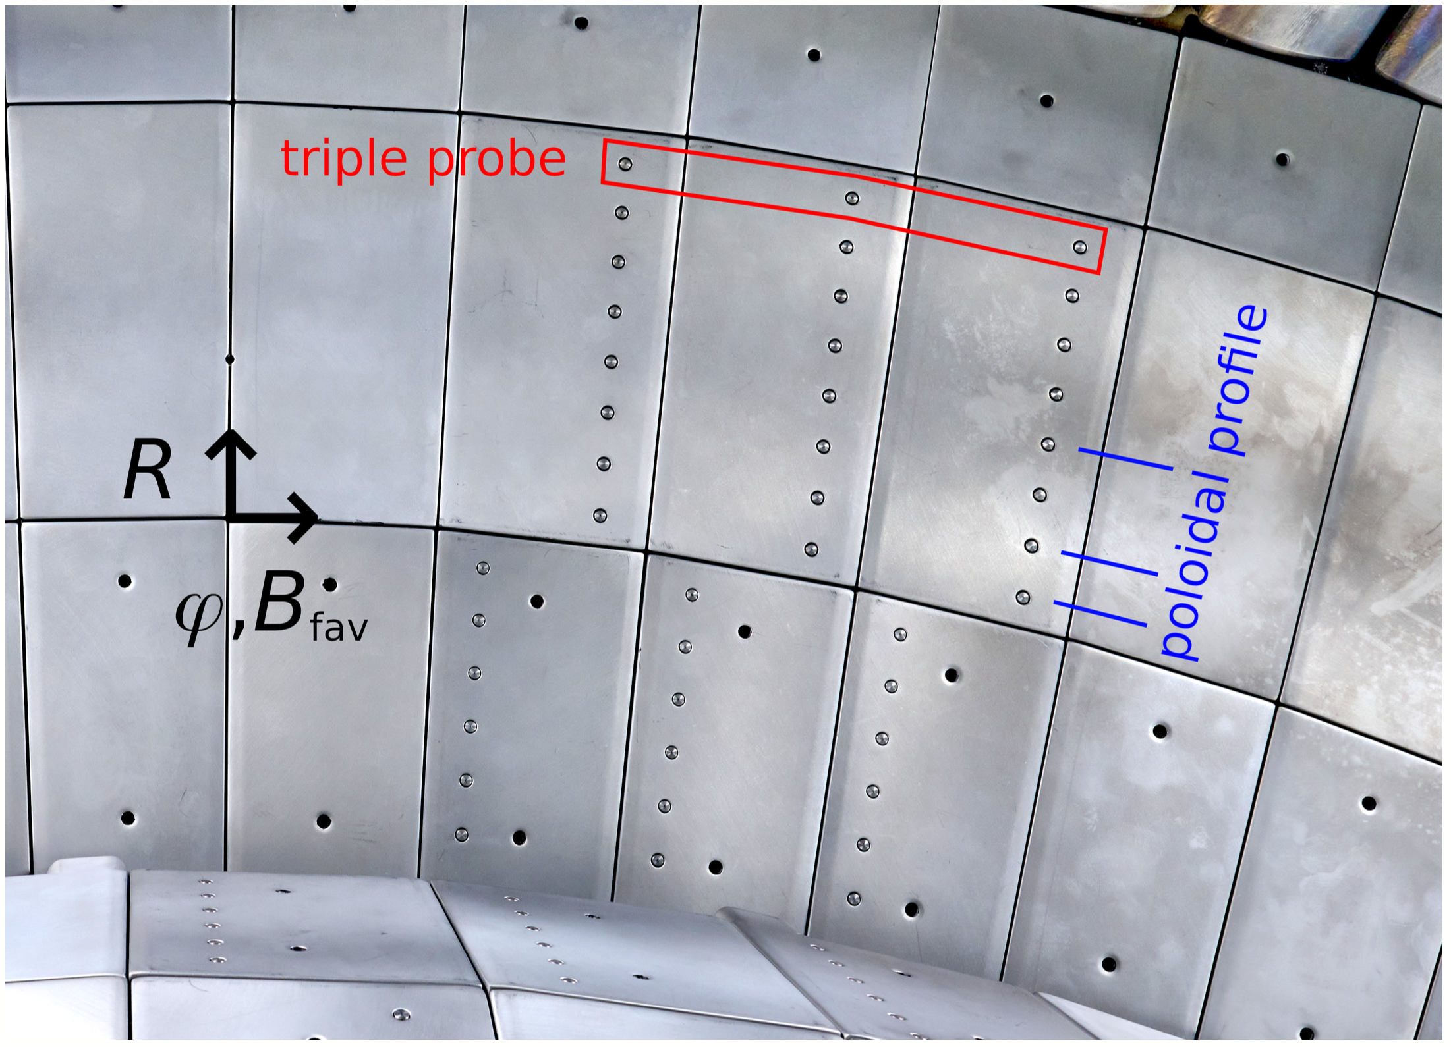
Langmuir probes
measure IV curve
→ jsat, ne, Te → q⟂
Poloidal view
$$ϑ={3.68}^{∘}$$
Dome profile
→ collect current at angles < 0.5°
Triple probes
$$\overset{⃗}{B}$$
$$⋅$$
$$A_{eff}=1.34{mm}^{2}$$
Max-Planck-Institut für Plasmaphysik | Felix Albrecht | 26.05.2025
HEPP intro talk - Detachment in ADCs in Asdex upgrade
HEPP intro talk - Detachment in ADCs in Asdex upgrade
Notes:
MBS will be used for AMS measurement
-> I will use it for „fast switching“
B = 4334G
Magnet is impulse filter! p = √2mE ~ √m -> longer radius for higher masses and higher Energies

Slide 14
First data - Upper single null
decrease D2 puff & N2 seeding
Max-Planck-Institut für Plasmaphysik | Felix Albrecht | 26.05.2025
HEPP intro talk - Detachment in ADCs in Asdex upgrade
Notes:
MBS will be used for AMS measurement
-> I will use it for „fast switching“
B = 4334G
Magnet is impulse filter! p = √2mE ~ √m -> longer radius for higher masses and higher Energies

Slide 15
Conclusions
Status so far
First ADCs in AUG!
Langmuir probes operational
Next steps
Improve diagnostic coverage
D2 and N2 puff ramps for detachment onset
Compare diagnostics
Upstream profiles
SOLPS-ITER simulations
Triple probes: High time resolution, ELM distribution study?
Thanks for your attention!
HEPP intro talk - Detachment in ADCs in Asdex upgrade

Slide 16
Back-up slides
HEPP intro talk - Detachment in ADCs in Asdex upgrade

Slide 17
First data - X-Divertor
decrease D2 puff & N2 seeding
Max-Planck-Institut für Plasmaphysik | Felix Albrecht | 26.05.2025
HEPP intro talk - Detachment in ADCs in Asdex upgrade
Notes:
MBS will be used for AMS measurement
-> I will use it for „fast switching“
B = 4334G
Magnet is impulse filter! p = √2mE ~ √m -> longer radius for higher masses and higher Energies

Slide 18
First data - Snowflake
Max-Planck-Institut für Plasmaphysik | Felix Albrecht | 26.05.2025
HEPP intro talk - Detachment in ADCs in Asdex upgrade
Notes:
MBS will be used for AMS measurement
-> I will use it for „fast switching“
B = 4334G
Magnet is impulse filter! p = √2mE ~ √m -> longer radius for higher masses and higher Energies

Slide 19
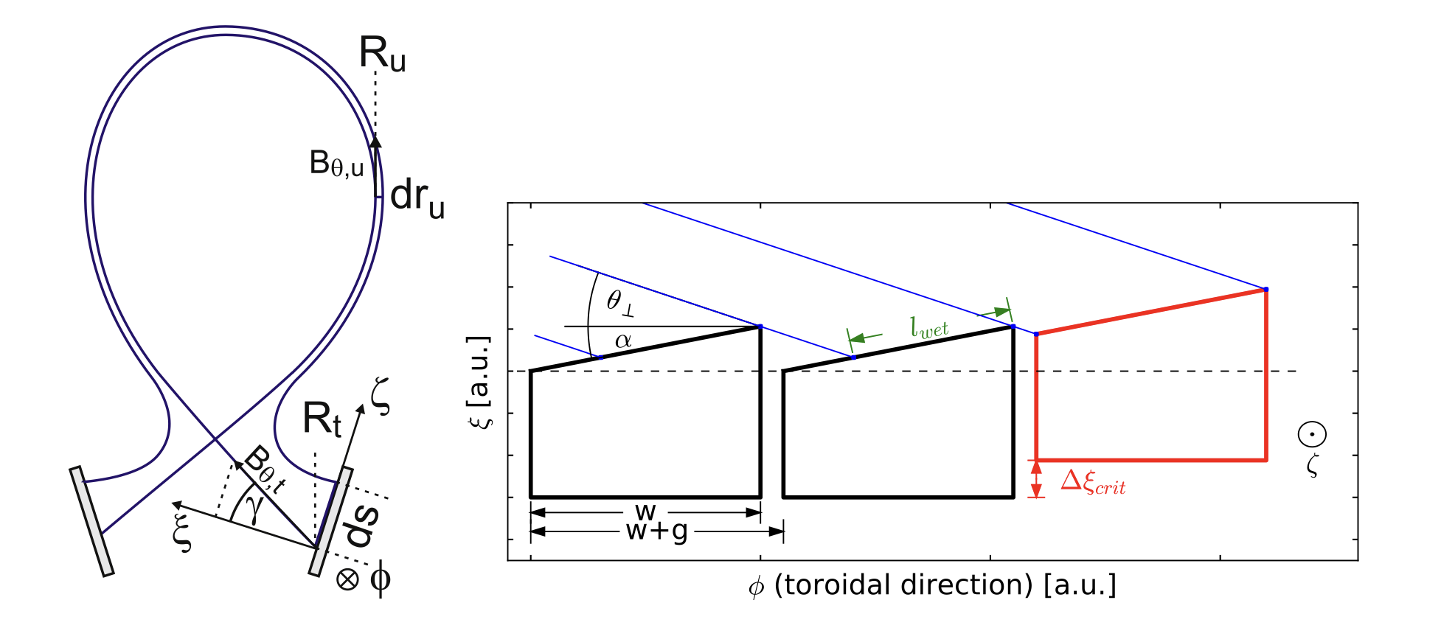
Divertor langmuir probes
Toroidal rotation for off-center probes
Fishscale target structure (lower divertor)
$$ϑ_{tor}$$
$$ϑ={3.68}^{∘}$$
Sheath effects
→ probe shadowing → Aeff reduction
Triple probe shadowing
$$\overset{⃗}{B}$$
$$ϑ_{Bpol}$$
$$A_{eff}=<1.34{mm}^{2}$$
$$⋅$$
Max-Planck-Institut für Plasmaphysik | Felix Albrecht | 26.05.2025
HEPP intro talk - Detachment in ADCs in Asdex upgrade
HEPP intro talk - Detachment in ADCs in Asdex upgrade
HEPP intro talk - Detachment in ADCs in Asdex upgrade
Notes:
MBS will be used for AMS measurement
-> I will use it for „fast switching“
B = 4334G
Magnet is impulse filter! p = √2mE ~ √m -> longer radius for higher masses and higher Energies

Slide 20
Master thesis: Accelerator Mass Spectrometry at VERA
?
³⁶Cl
³⁶S
17x p⁺
19x n
16x p⁺
20x n
Max-Planck-Institut für Plasmaphysik | Felix Albrecht | 26.05.2025
HEPP intro talk - Detachment in ADCs in Asdex upgrade

Slide 21
Isobar separation by Laser photodetachment
Laser
Ions
–
–
Laser
Laser
Isobar neutral
Isobar ion
Desired
Ion
D. Baumgartner, 2024
Max-Planck-Institut für Plasmaphysik | Felix Albrecht | 26.05.2025
HEPP intro talk - Detachment in ADCs in Asdex upgrade
Notes:
Ion source, in which an ion beam is created from a sample by Caesium sputtering. The target is consumed in the process.
TIMS
Thermal ionisation
Heated filament, on which sample is
Small amounts, evaporate -> very sensitive
Have to completely empty sample
RF ion source
e.g. H_2 gas is inside RF coil
> electrons act as secondary coil, plasma is created
Extraction with electrostatic lens
ICP-MS
Argon is used as gas, and a sample gas is injected into ICP torch
Also solids possible by laser ablation, with positional information
SIMS
Secondary ions
Similar to SNICS, but no accelerator
Only positive ions used

Slide 22
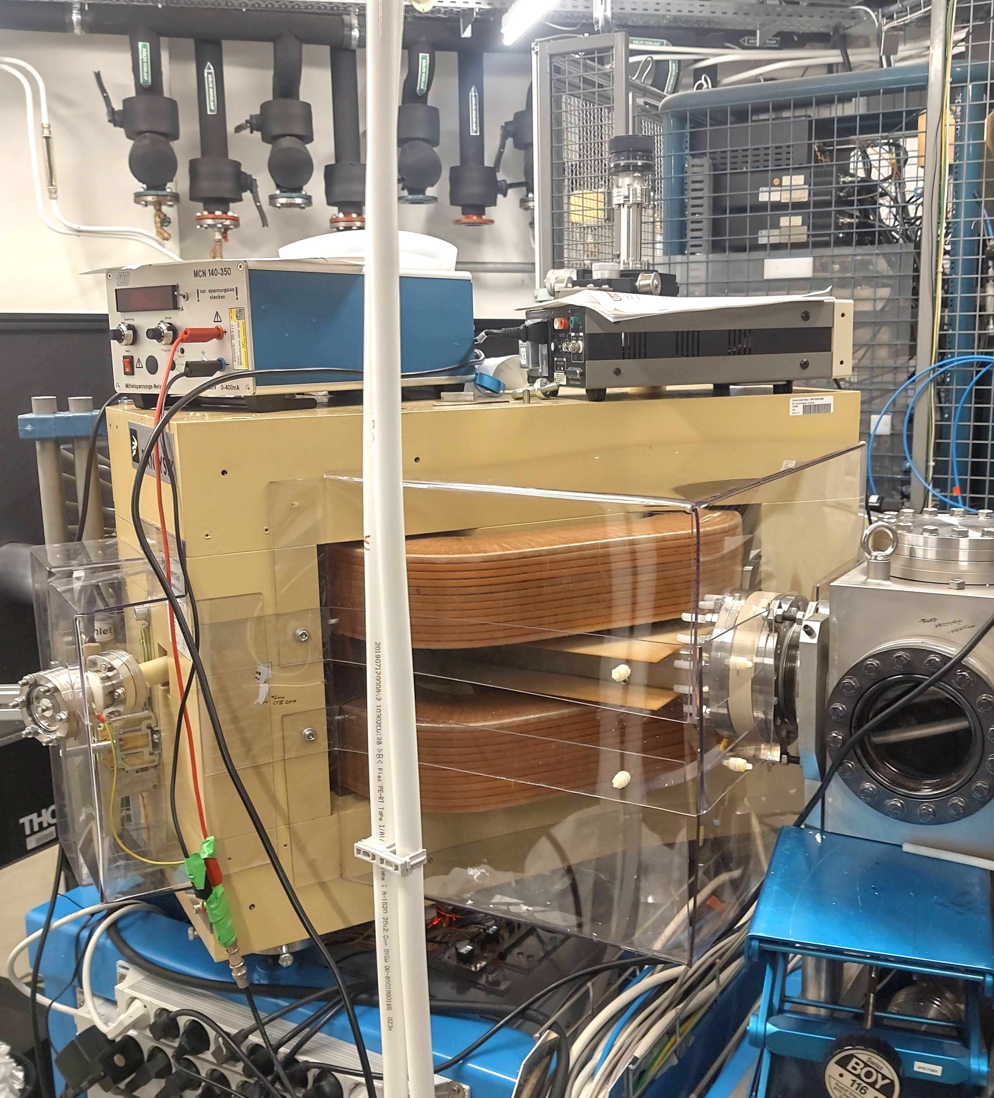
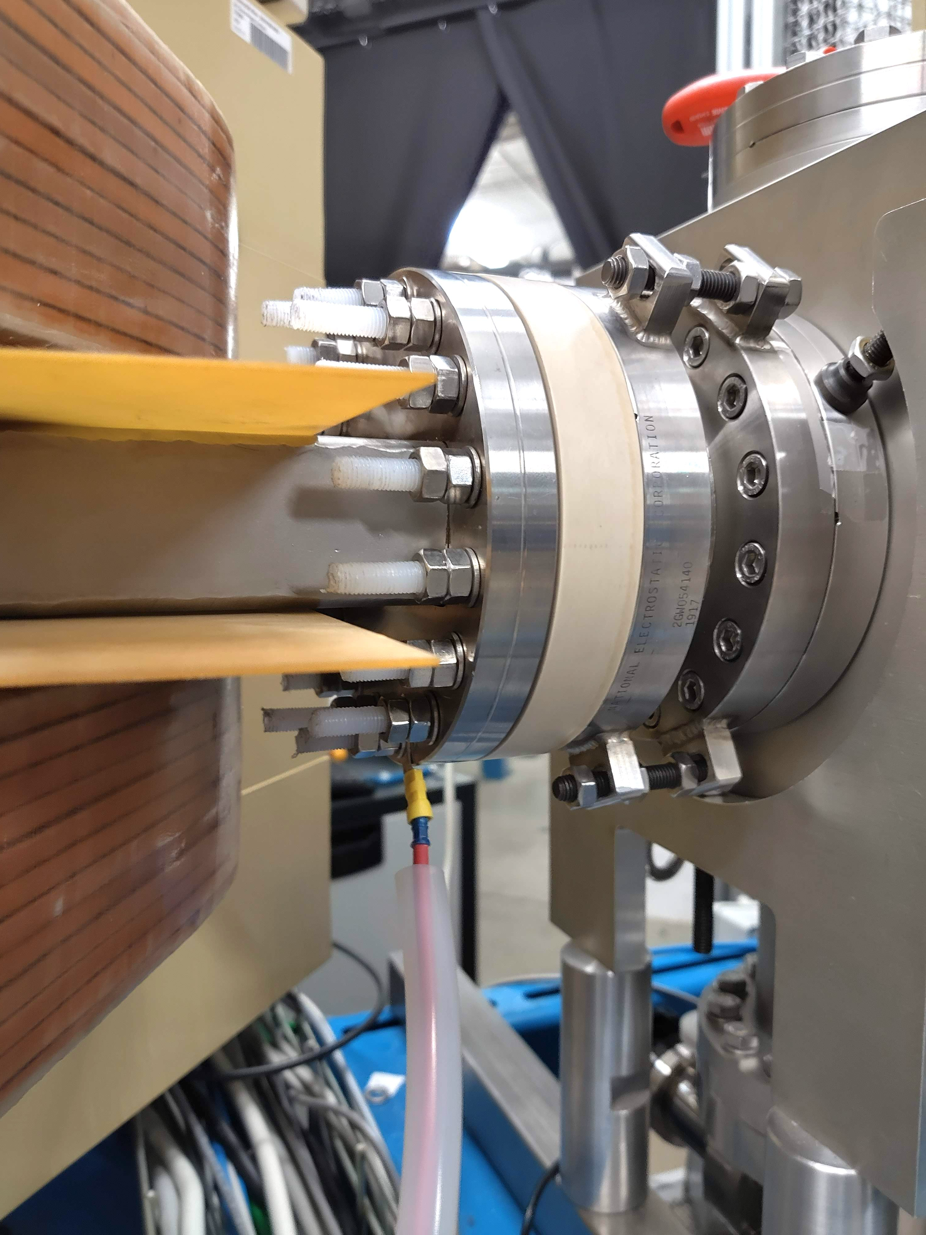
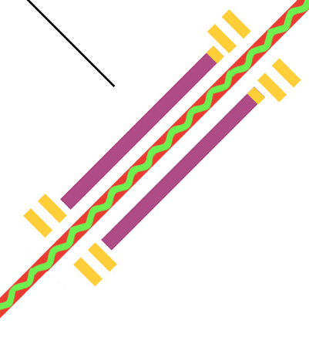
A new multi-beam switcher for the ILIAMS cooler
Ion Source
PEEK Ring
80 cm
85 mm
Magnet
Cooler
To Cooler →
Max-Planck-Institut für Plasmaphysik | Felix Albrecht | 26.05.2025
HEPP intro talk - Detachment in ADCs in Asdex upgrade
Notes:
MBS will be used for AMS measurement
-> I will use it for „fast switching“
B = 4334G
Magnet is impulse filter! p = √2mE ~ √m -> longer radius for higher masses and higher Energies

