Slide 1

Study of XPR stability and its links to edge turbulence and transport
HEPP introductory talk by Yu-Chih Liang
26.05.2025
Academic supervisor: (currently) prof. Dr. Ulrich Stroth, (later) prof. Dr. Tim Happel
Scientific supervisor: Dr. Ou Pan

Slide 2


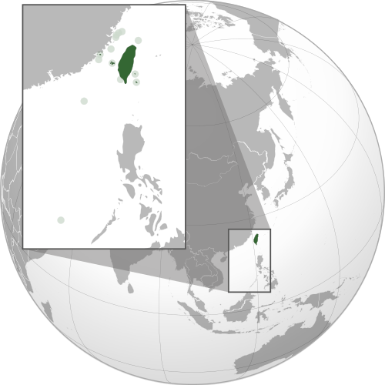
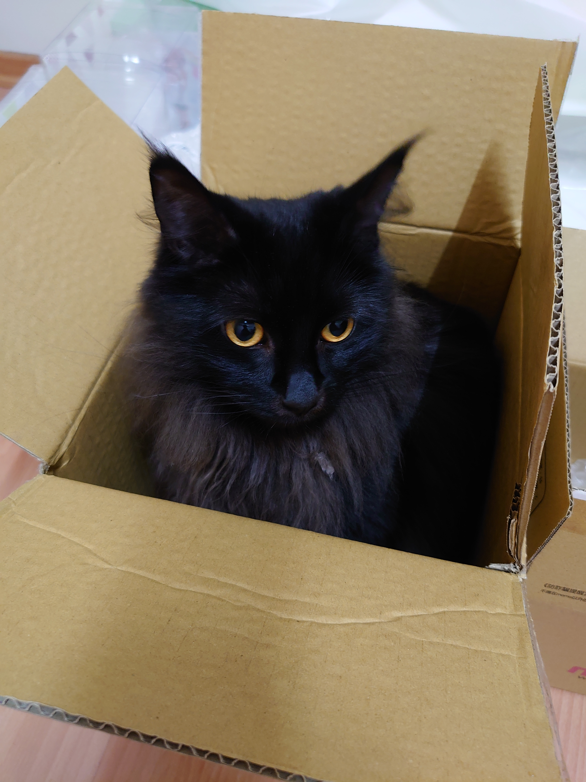

Who am I? Where am I from?
Was born and grew up in Changhua, Taiwan
Extreme love for cats (more than fusion, yes)
https://makeameme.org/meme/who-am-i-ba2siz
By KOKUYO - Own work。參考禁止、限制水域地圖。, CC BY-SA 4.0, https://commons.wikimedia.org/w/index.php?curid=135707508

Slide 3


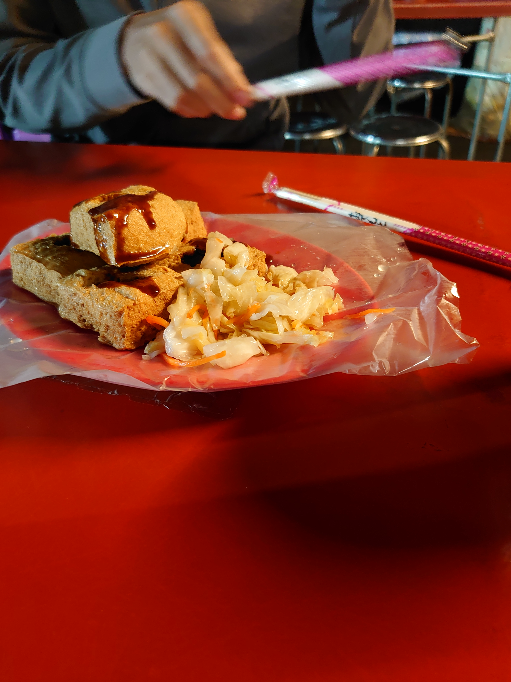
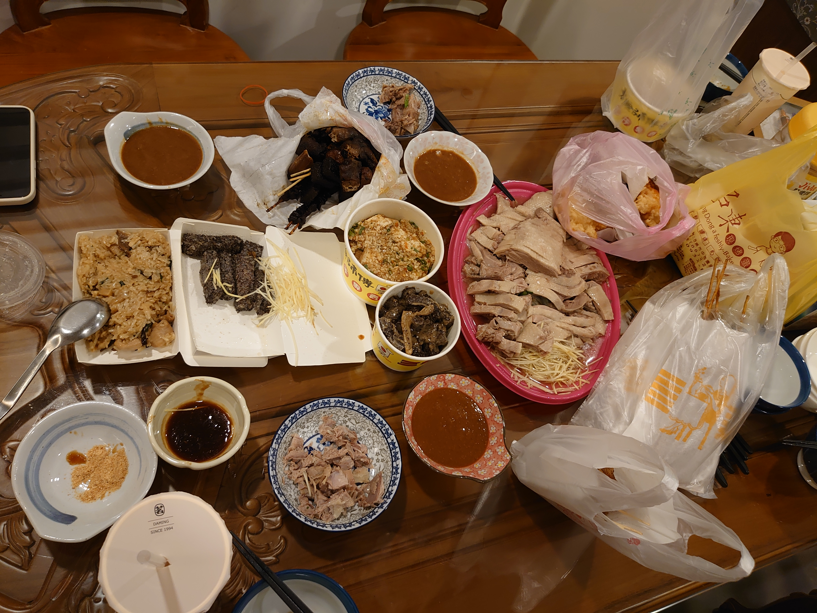
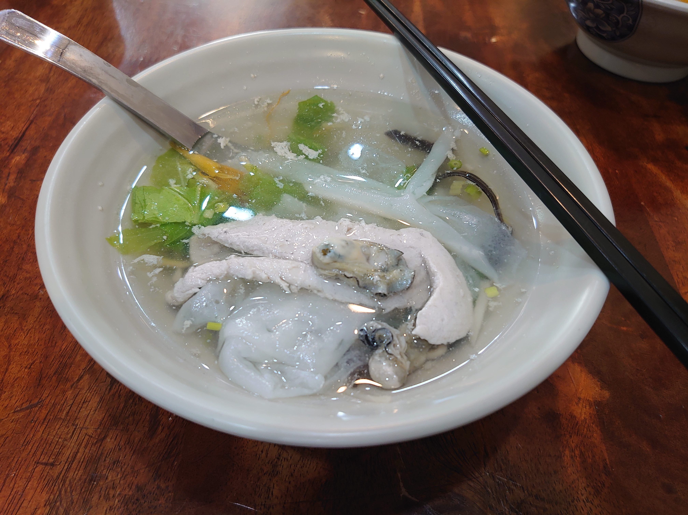


Fun facts about Taiwan and its people
Fun facts about Taiwan:
Very nice weather, usually very warm & humid
Short distance between nice beaches and mountains
Large variety of great food, night markets everywhere
Every receipt is a lottery!
Garbage truck plays music!
Fun facts about Taiwanese people:
CRAZY over food (eg. the 2021 salmon chaos)
High hospitality, especially when providing food
(grandma-ness: tendency to feed people lethal dose of food)

Slide 4
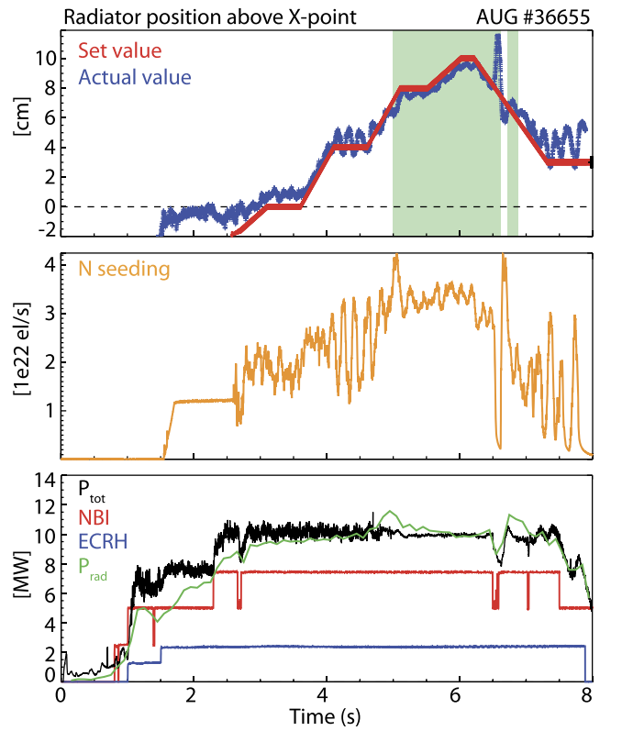
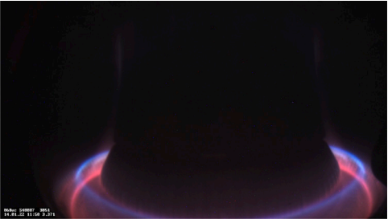
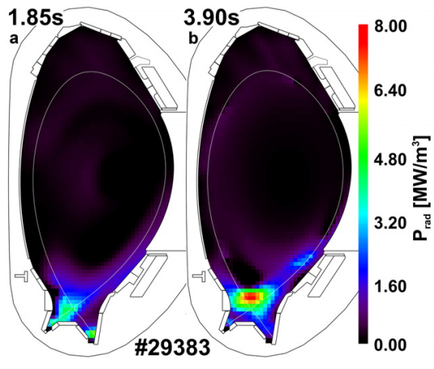
Master thesis at TUM & IPP
Master’s thesis at IPP Garching : JOREK simulations of the X-point radiator (XPR)
Master’s thesis at IPP Garching : JOREK simulations of the X-point radiator (XPR)
Master’s thesis at IPP Garching : JOREK simulations of the X-point radiator (XPR)
3D non-linear MHD code
Coupled with its fully kinetic particle extension
Cold, dense & highly radiative region above the X-point
Potential solution to power exhaust problem in DEMO
Accessibility from neutral density & flux expansion (U. Stroth et al, NF, 2022)
ELM suppression at certain XPR height (M. Bernert et al, NF, 2021)
Figure 5 from M. Bernert et al 2021 Nucl. Fusion 61 024001
Figure 1 from M. Bernert et al 2023 Nuclear Materials and Energy Volume 34, 101376
Figure 6 from F. Reimold et al 2015 Nucl. Fusion 55 033004

Slide 5
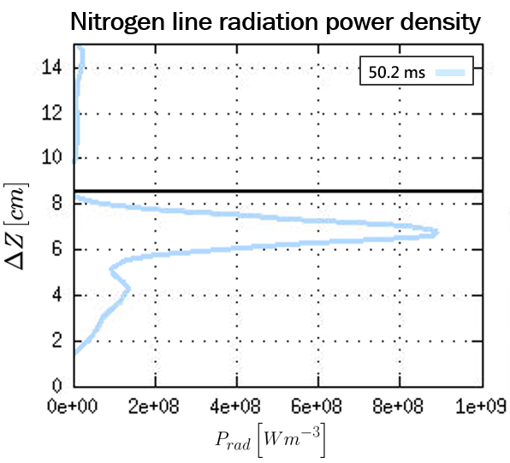
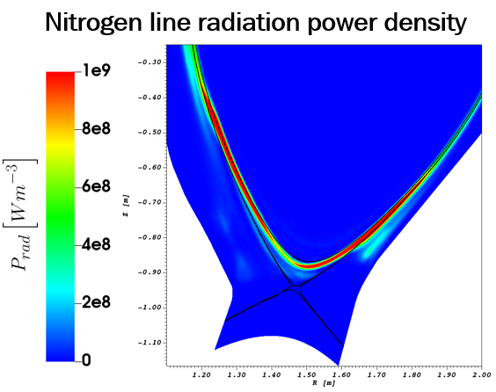
Master thesis: XPR simulations
Reference simulation: Quasi-stationary XPR
Y-C. Liang et al 2025 DPG Göttingen poster

Slide 6
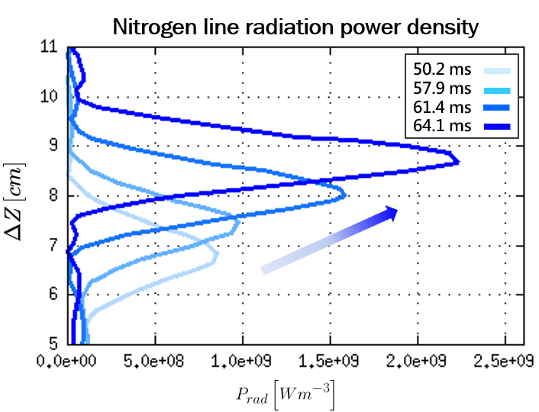
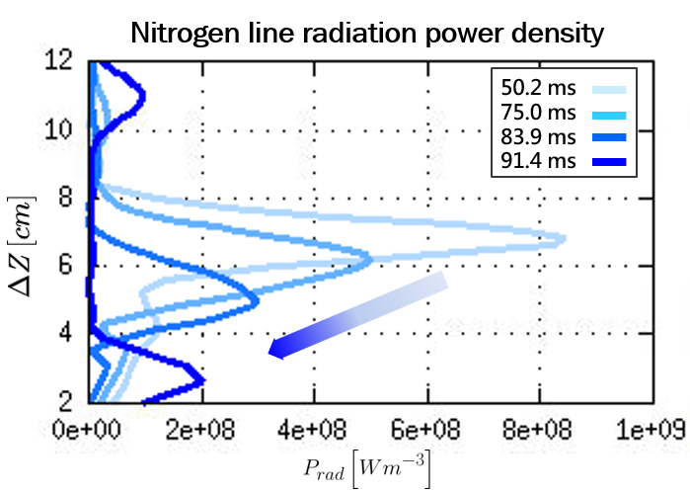
Master thesis: XPR simulations
Reference simulation: Quasi-stationary XPR
Increase N seeding: Growing XPR (MARFE)
Decrease N seeding: Retreating XPR
Y-C. Liang et al 2025 DPG Göttingen poster

Slide 7
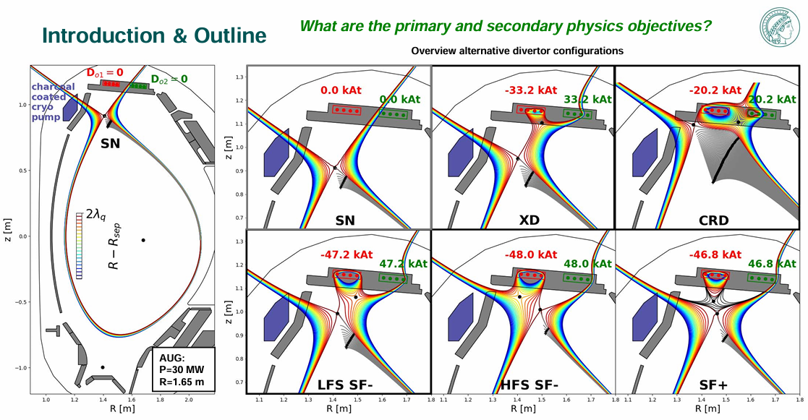
PhD topic: XPR stability & turbulence
Turbulence transport around the XPR (downstream) & at the outer midplane (upstream)
Upper divertor: Bolometry, gas puff imaging (alternative divertor configurations!)
Outer midplane: He beam, doppler reflectometry
Lower divertor: Bolometry, X-point manipulator, He beam
Magnetics: Magnetic probes
T. Lunt, E2(M) Programme Seminar Fraunchiemsee, April 17th-21st 2023

Slide 8
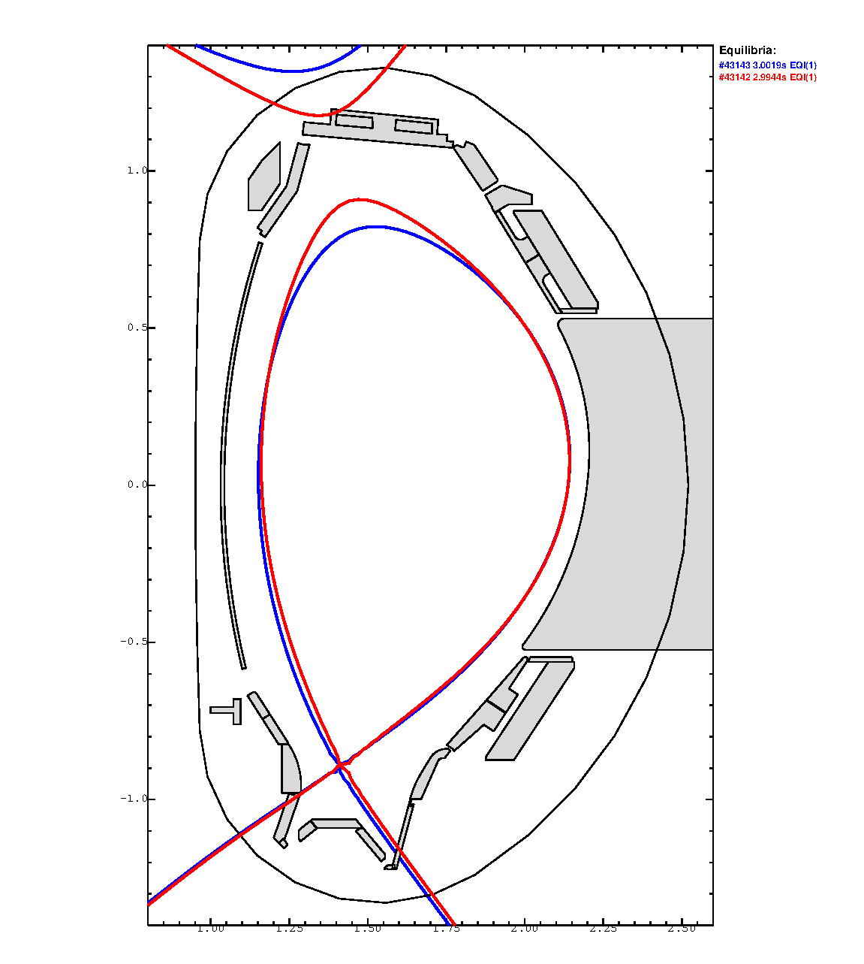
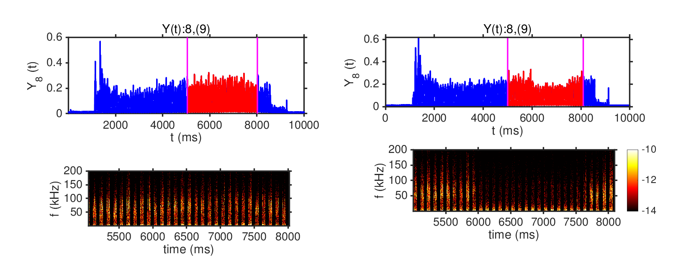
PhD topic: XPR stability & turbulence
Ex. Discharge #43142/43143 (Lower SN XPR with different triangularity)
Quasi-coherent mode (QCM) observed with the He beam diagnostics
With lower triangularity, QCM seems to disappear (?) when XPR is at certain height (ELM suppression phase)
The different flux expansion & magnetic shear can influence the filaments transport
Start by checking the He beam data for filaments transport at the OMP
#43142
#43143

Slide 9


References
F. Reimold et al 2015 Nucl. Fusion 55 033004
M. Bernert et al 2023 Nuclear Materials and Energy Volume 34, 101376
U. Stroth et al 2022 Nucl. Fusion 62 076008
M. Bernert et al 2021 Nucl. Fusion 61 024001
T. Lunt, E2(M) Programme Seminar Fraunchiemsee, April 17th-21st 2023
Y-C. Liang et al 2025 DPG Göttingen poster
https://youtube.com/shorts/xyQT0bvOINY?si=SdWqiu2xHXYSUrvs

Slide 10

What is an X-point Radiator?
Total radiative power fraction
Highly radiative region above the x-point
Created via impurity (nitrogen) seeding
Very cold (~1eV) and dense XPR core
Total radiative power fraction increases to around 100 %.
Figure 6 from F. Reimold et al 2015 Nucl. Fusion 55 033004
Figure 1 from M. Bernert et al 2023 Nuclear Materials and Energy Volume 34, 101376

Slide 11
What is an X-point Radiator?
Highly radiative region above the x-point
Created via impurity (nitrogen) seeding
Very cold (~1eV) and dense XPR core
Total radiative power fraction increases to around 100 %.
Inherently a detached regime
Experimentally, the XPR vertical position can be controlled by the impurity seeding rate.
At ~7 cm, an ELM suppressed regime is observed.
Figure 5 from M. Bernert et al 2021 Nucl. Fusion 61 024001

Slide 12

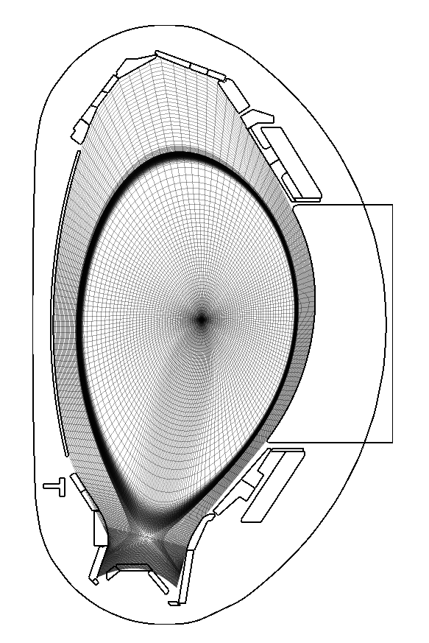
JOREK & Its Kinetic Particle Framework
The background D plasma is simulated by
the reduced MHD model of JOREK with:
Single temperature ( )
Perfectly conducting wall
Plasma drifts included
Computational grid extended to the first wall
Two-way coupling to the kinetic particle framework
Species | Treated as
D ions | Background plasma
D neutrals | Kinetic particles
N particles | Kinetic particles (all charge states)

Slide 13
JOREK & Its Kinetic Particle Framework
The background D plasma is simulated by
the reduced MHD model of JOREK with:
Single temperature ( )
Perfectly conducting wall
Plasma drifts included
Computational grid extended to the first wall
Two-way coupling to the kinetic particle framework
Species | Treated as
D ions | Background plasma
D neutrals | Kinetic particles
N particles | Kinetic particles (all charge states)

Slide 14
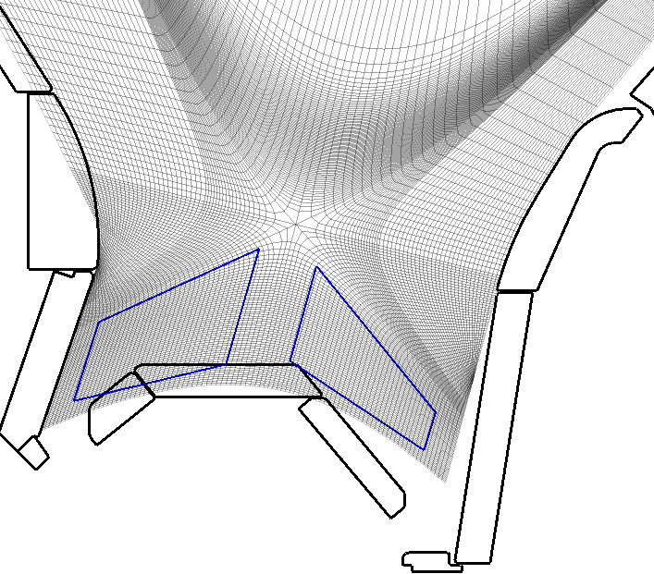
JOREK & Its Kinetic Particle Framework
Neutrals and impurities are modelled kinetically.
And the following physics for particles are included:
Electron impact ionization
Charge exchange
Line radiation
Effective radiative recombination
Neutral gas puffing
Recycling and reflection
Species | Treated as
D ions | Background plasma
D neutrals | Kinetic particles
N particles | Kinetic particles (all charge states)

Slide 15
JOREK & Its Kinetic Particle Framework
Neutrals and impurities are modelled kinetically with:
And the following physics for particles are included:
Electron impact ionization
Line radiation
Charge exchange
Effective radiative recombination
Neutral gas puffing
Recycling and reflection
Species | Treated as
D ions | Background plasma
D neutrals | Kinetic particles
N particles | Kinetic particles (all charge states)

Slide 16
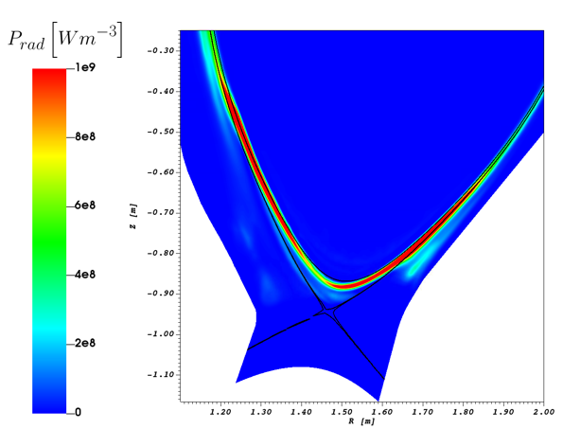

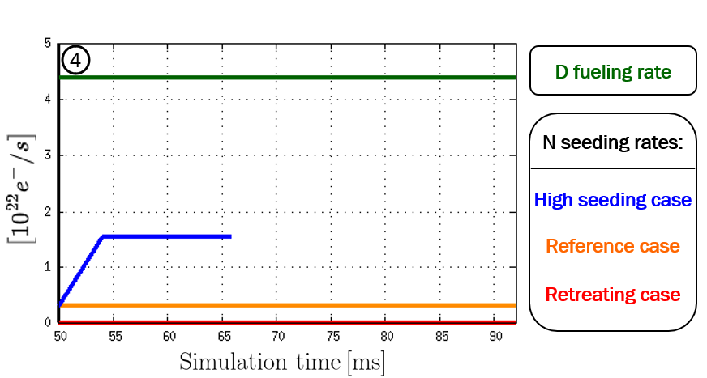
Quasi-stationary XPR (Reference Case)
≈ 52 %
Poloidally elongated XPR
Radiation peak at 6.8 cm
Upper bound at 8.5 cm
( = 20 eV )
N line radiation power density

Slide 17
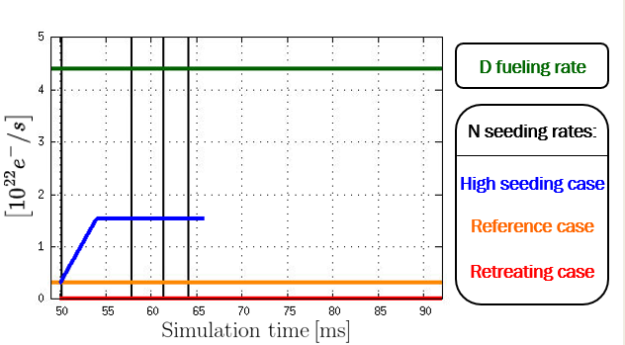
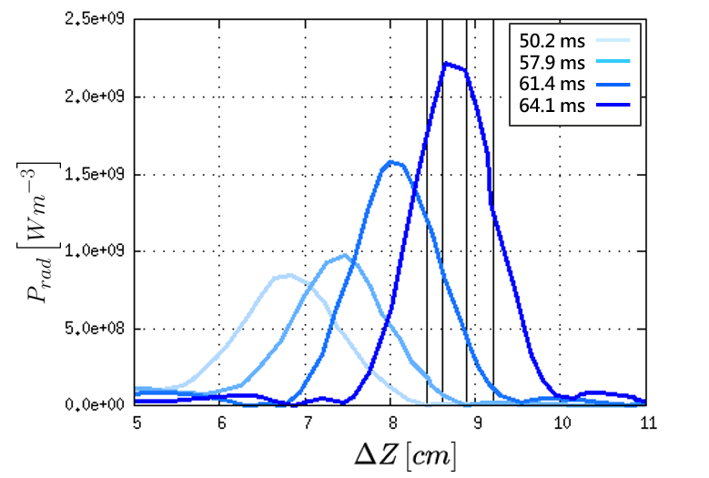
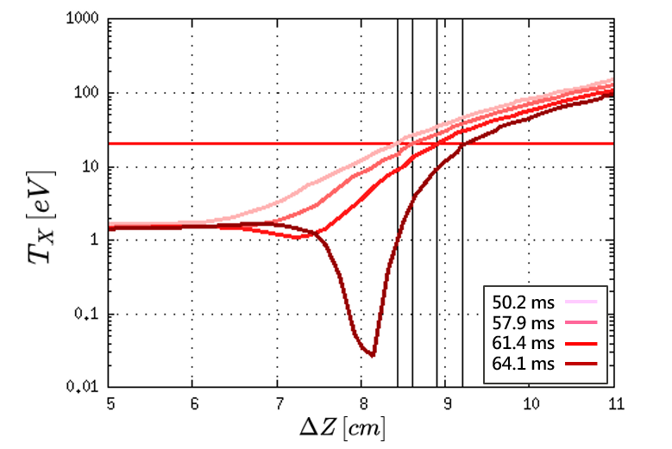
XPR Moves Up (High Seeding Case)
Vertical profiles above the x-points are studied:
Radiation peak: 6.8 cm → 8.4 cm
XPR core cools down drastically to ≈ 0.03 eV.
N line radiation power density
Electron temperature
TX = 20 eV

Slide 18
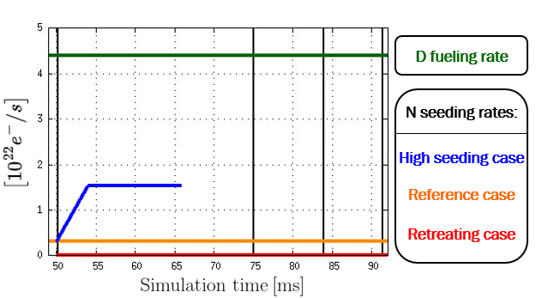
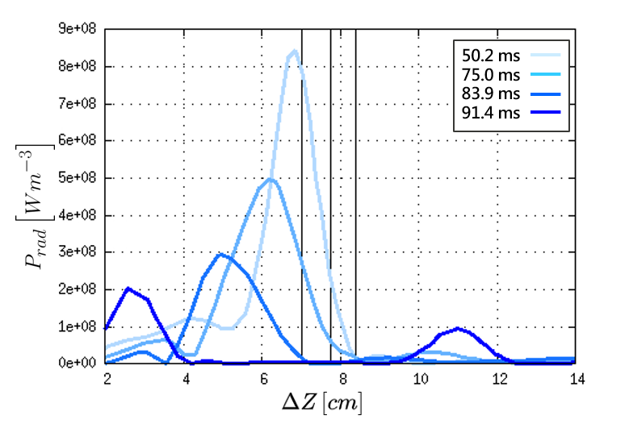
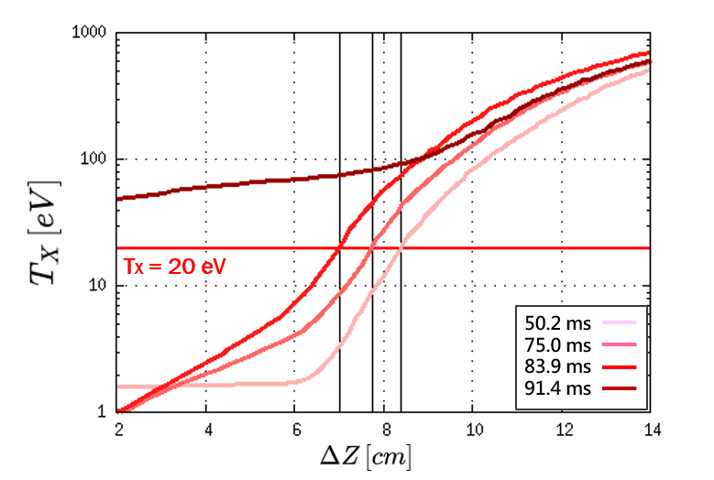
Loss of the XPR (Retreating Case)
Vertical profiles above the x-points are studied:
Radiation peak: 6.8 cm → 2.6 cm
The XPR is lost as exceed 20 eV above the x-point.
N line radiation power density
Electron temperature

Slide 19
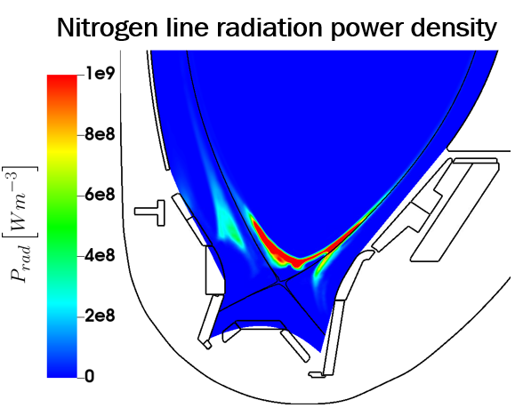
Master thesis: XPR simulations
Reference simulation: Quasi-stationary XPR
Include collisions for the impurity particles
Y-C. Liang et al 2025 DPG Göttingen poster

