Slide 1
Investigation of methane pyrolysis and dry reforming of methane in microwave plasma
Clemens Kranig
Scientific Supervisor: Dr. Ante Hecimovic
Academic Supervisor: Prof. Dr. Ursel Fantz

Slide 2
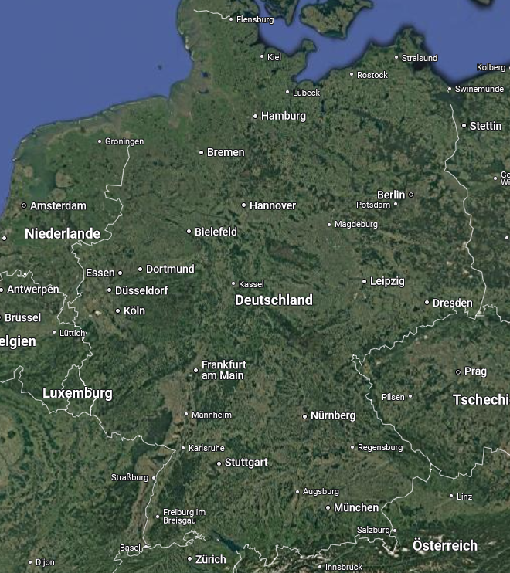
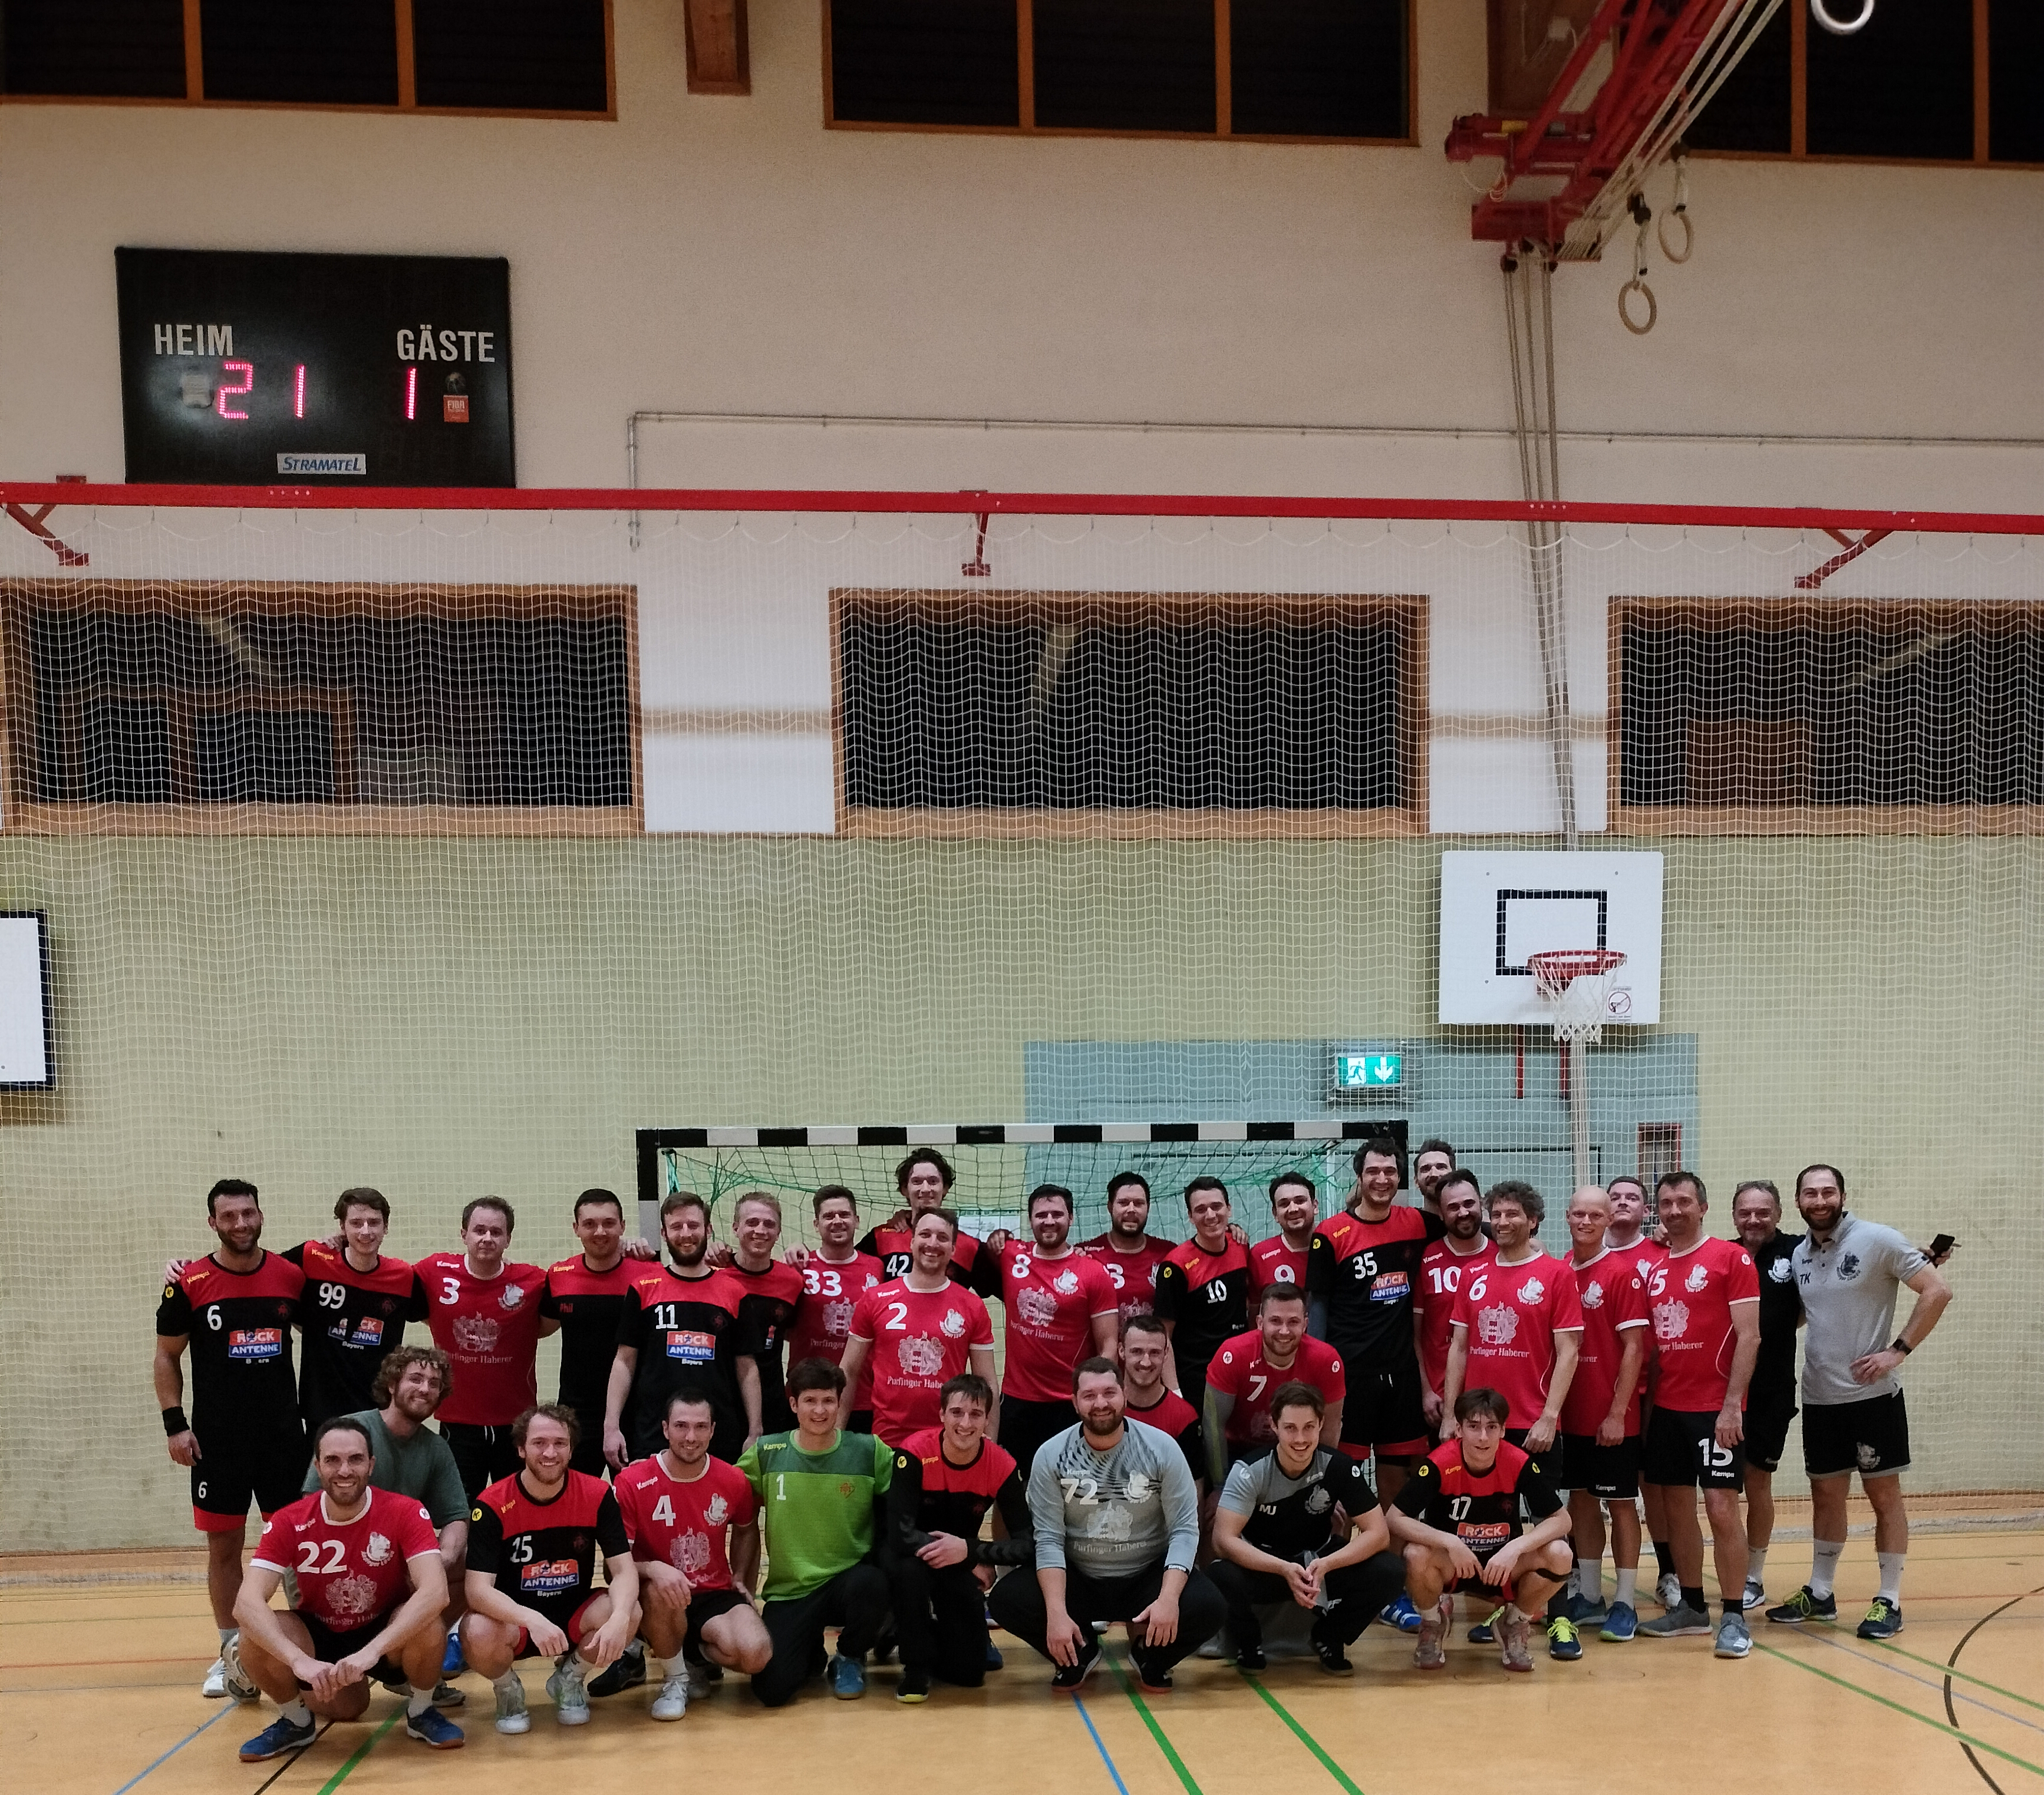
A little bit about myself

Slide 3
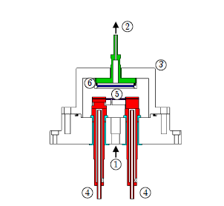
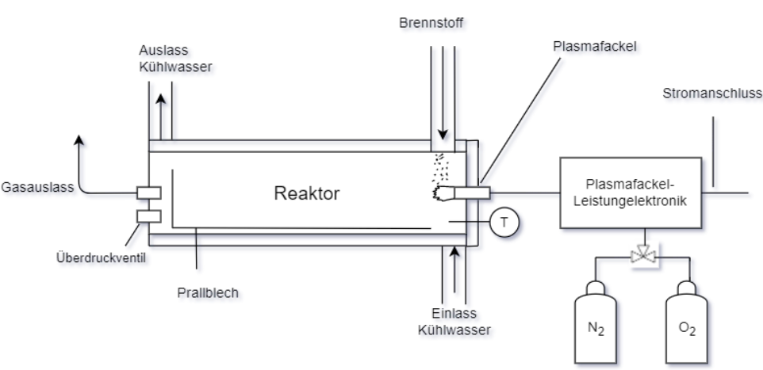
Research history I
B.Sc. Mechanical Engineering @ TUM -> Modeling of pyrolysis in a wire mesh reactor
M.Sc. Energy and Process Engineering @ TUM
Semester Thesis: Conceptual Design of Pyrolysis reactor using a plasma cutter as source
T [°C] | p [bar] | t [s] | H [K/s]
400-1600 | 1 – 40 | 1 – 10 | 10 - 1000
Pyrolysis is an important step within the gasification process
Pyrolysis reaction kinetics used as an input for a larger CFD - simulation
Investigation of direct contact of different fuel particles (biomass, coal, plastic) with the plasma
Replacing larger fossil fuel powered burners in gasification reactors with plasma torches

Slide 4
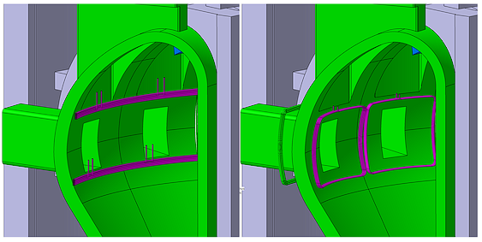
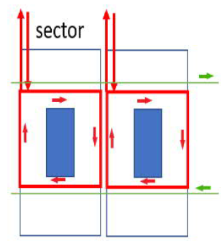
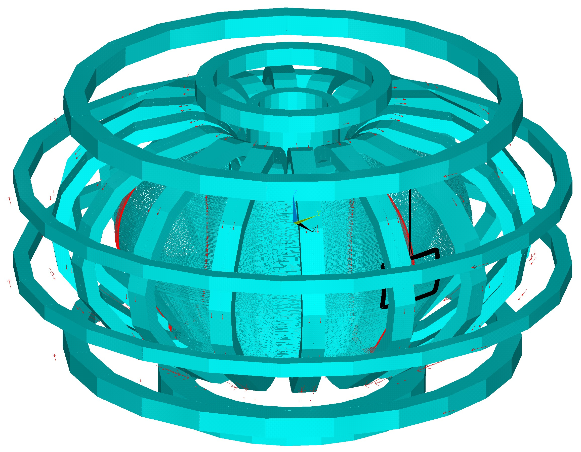
Research history II
Master Thesis at TUM and IPP:
Design of the in-vessel stabilization coils in saddle configuration for DEMO
Left: continuous toroidal configuration
Right: saddle configuration
Saddle configuration of in-vessel coils makes them easier to access

Slide 5
PhD at IPP - Plasma for gas conversion (P4G)
Conversion of different molecules within the framework of Power-to-X and electrification of chemical processes
Electrical energy from renewable energy sources
Plasma
Synthesis gas for Fischer-Tropsch processes or MeOH synthesis
Hydrogen production
CH₄ + CO₂
CO + H₂
CH₄
C_{s} + H₂
CO₂
CO + O₂
Alternative to energy intense Haber – Bosch process
Ammonia as energy carrier or for fertilizer production
NH₃
N₂ + H₂
N₂ + H₂
NH₃
Stabilization of different plasma conditions
Determination of dominant conversion mechanisms
Improvement of plasma processes towards higher conversion and higher energy efficiency based on the dominant conversion mechanism

Slide 6
Dry reforming of methane (DRM) and CH₄-pyrolysis
CH₄-Pyrolysis: $CH_{4}→2H_{2}+C_{s} ∆H^{0}= +75 kJ mol^{−1}$
DRM: $CH_{4}+{CO}_{2} →2CO+2H_{2} ∆H^{0}= +247 kJ mol^{−1}$
Endothermic reactions → much energy required to enable forward reaction
On an industrial scale processes involving these reactions are realized by thermo-catalytic methods, high temperatures provided by burning of fossil fuels
Plasma creates alternative paths for the conversion process apart from thermodynamic equilibrium
Thermodynamic Equilibrium

Slide 7
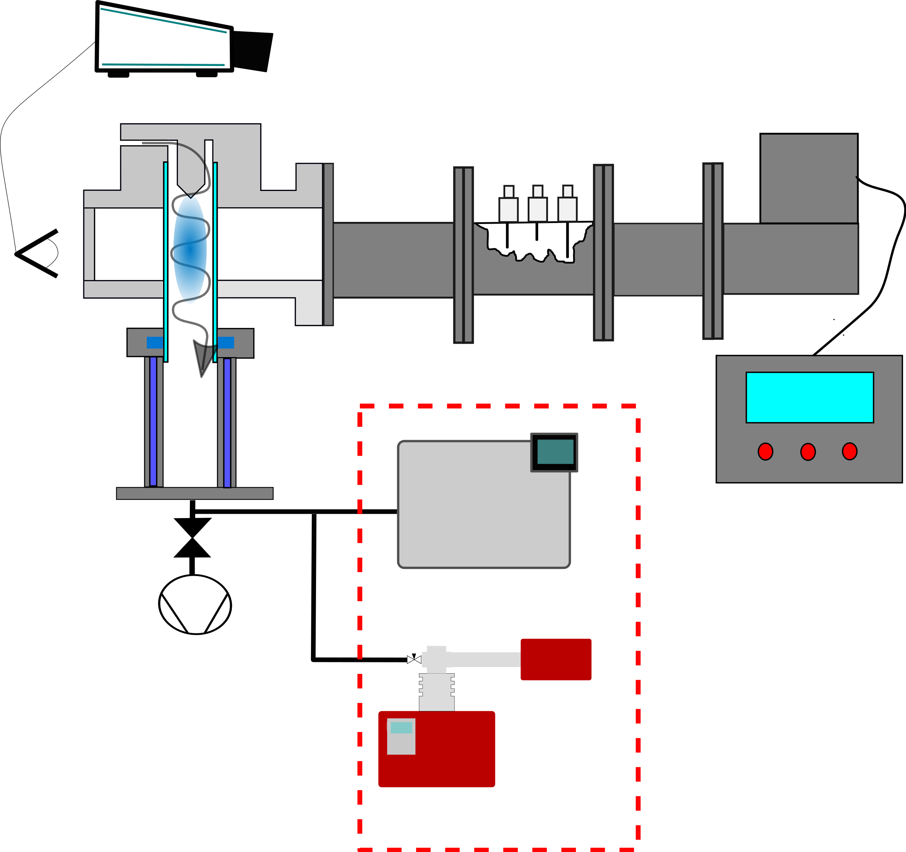
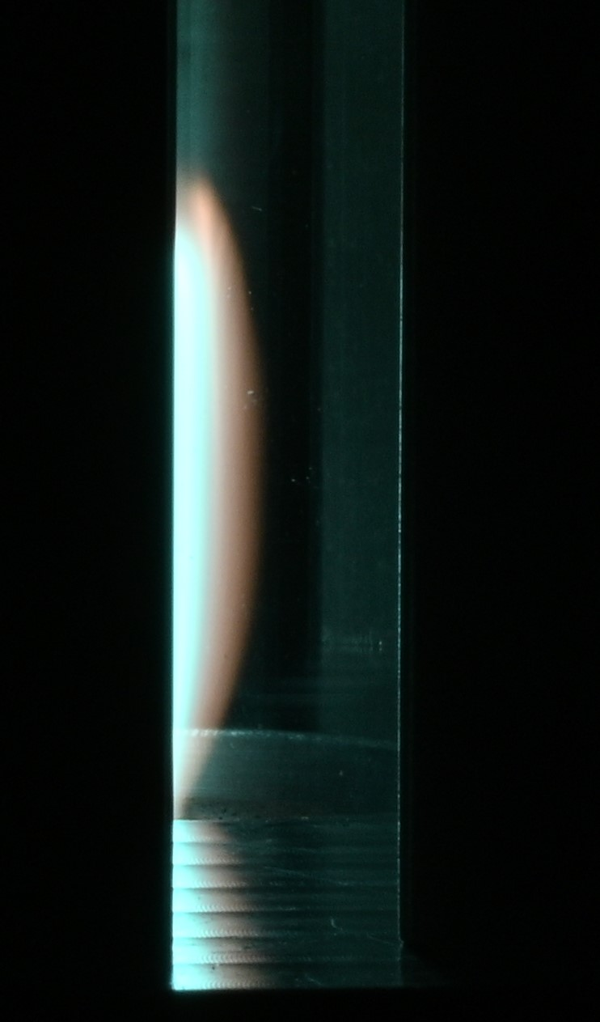
Experimental setup of a microwave plasma torch
Temperature in the center of the plasma
Echelle spectrometer
up to ≈ 6000K
up to ≈ 4000K
Coaxial resonator
2.45 GHz microwave
Three-stub-tuner
Circulator
≈3cm
Power supply
Gas chromatograph
CO₂ Plasma
DRM Plasma [CH₄]/[CO₂]= 1
After experiment cold gas analysis
Mass spectrometer
7

Slide 8
First results on DRM experiments I
For equilibrium condition with T ≥ 1000K: no CO₂ or CH₄ in equilibrium compositions
Equilibrium composition not directly applicable, however together with temperature measurements of the plasma leads to better understanding of the conversion process
Γ_{tot} =20slm
P_{in} = 1.8kW
[H₂]/[CO] ratio effectively changed, high remaining [CH₄] & [CO₂] after the plasma

Slide 9
Next steps and outlook
Further experiments with Biogas compositions ([CH₄]/[CO₂] ≈ 60/40), biogas impurity test
Extended parameter studies for higher CH₄ concentrations ([CH₄] > 60%) in the feed
Improvement of diagnostic/measurement procedure for more accurate determination of gas compositions
Understanding the conversion process of CH₄ with microwave plasma to compare microwave plasma for CH₄ conversion
to other plasma sources
to other thermal processes
Thank you very much for your attention!

Slide 10
First results on DRM experiments II
Experimental results for different specific energy inputs at 1bar
$$CH_{4}+{CO}_{2} →2CO+2H_{2}$$
$$SEI=\frac{P}{Flow}$$
[CO₂]/[CH₄] = 7/3
Γ_{tot} = 6-40slm
P_{in} = 1.2 – 2.64 kW
Increased CO₂ and CH₄ conversion without significantly changing the H₂/CO ratio

