Slide 1
Study of astrophysical perpendicular shocks for intermediate Mach numbers
Valentine Devos, Dr. Artem Bohdan, Dr. Frank Jenko

Slide 2
Contents
Main objective
Shock structure and instabilities
Theoretical expectations
PIC simulations and setup
First simulations and results
Future steps

Slide 3
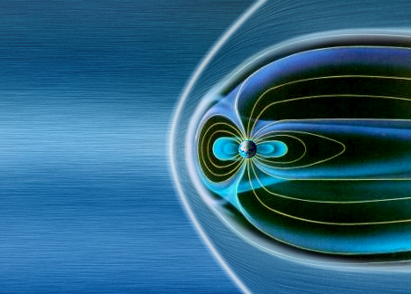
Main Objective
Study of perpendicular collisionless shock and electron acceleration processes
Earth’s bow shock and magnetosphere
Supernovae remnants
Whistler Instability
Weibel Instability
Credit: ESA/AOES Medialab
Credit: NASA, ESA, CSA, STSCI
M_{A}
Notes:
Low Mach number shocks (e.g., in the solar wind) often result in comparable electron and ion heating, as wave-particle interactions distribute energy more evenly.High Mach number shocks (e.g., in supernova remnants, galaxy clusters) preferentially heat ions due to ion reflection, gyro-motion, and wave generation.Electrons, being lighter, couple differently to the shock potential and are often heated via lower-amplitude waves, adiabatic compression, or lower hybrid wave interactions.

Slide 4
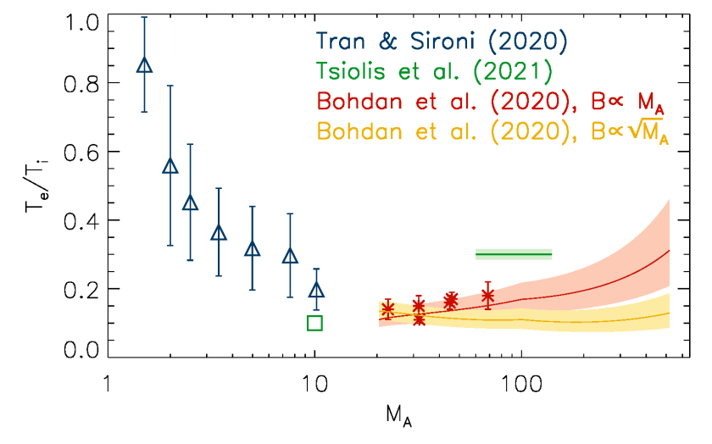
Main Objective
Study of perpendicular collisionless shock and electron acceleration processes
Depending on M_{A}, different kind of instabilities can arise
Intermediate Mach numbers
Transition between Whistler and Weibel instabilities
How does it affect electron heating and acceleration processes ?
Notes:
For low MA, quasi-adiabatic compression dominates, meaning electrons and ions heat similarly. For high MA​, kinetic processes such as ion reflection, Weibel instabilities, and shock surfing acceleration start playing a dominant role.
Te​/Ti​ is a key parameter in modeling shock acceleration mechanisms, including cosmic ray production, as electron injection into Fermi acceleration depends on how efficiently they are preheated.

Slide 5
Shock structure
Shock front
Downstream
Upstream
ϱ_{d}, P_{d}, T_{d}
ϱ_{u}, P_{u}, T_{u}
Flow
Sonic Mach number:
$$Ms=\frac{u}{a}={\left(\frac{ρu^{2}}{γP}\right)}^{1/2}$$
Alfvénic Mach number:
$$MA=\frac{u}{u_{A}}={\left(\frac{μ_{0}ρu^{2}}{B}\right)}^{1/2}$$
Notes:
A shock is a significant discontinuity in the flow of a fluid. Such a discontinuity must be large enough not to be considered as a small perturbation in the flow. The discontinuity separates two main regions, the downstream (post-shock) and the upstream (pre-shock) regions . Both regions are characterized by usual physical quantities such as density (ρ), pressure (P) and temperature (T). The shock front is very narrow. The thickness of the shock front is in particular much smaller than the typical length scale of the system. The sudden change in physical properties generates a jump.
Shocks considered are collisionless shocks. This means than the gas densities are low enough to allow the collisional mean free path of particles to be significantly greater than the length scale of the shocks. Collisions between particles are thus quite rare.
Mach number: This is a dimensionless number characterizing the strength of a shock. It is defined as the flow velocity normalized by the local sound speed. γ is the adiabatic index or ratio of specific heats. P is the pressure of the fluid. ρ is the density of the fluid.
Alfvénic Mach number: flow velocity over Alfvén speed, which is the speed at which disturbances propagate along a magnetic field line in a plasma. B is the magnetic field strength and μ0​ is the permeability of free space.

Slide 6
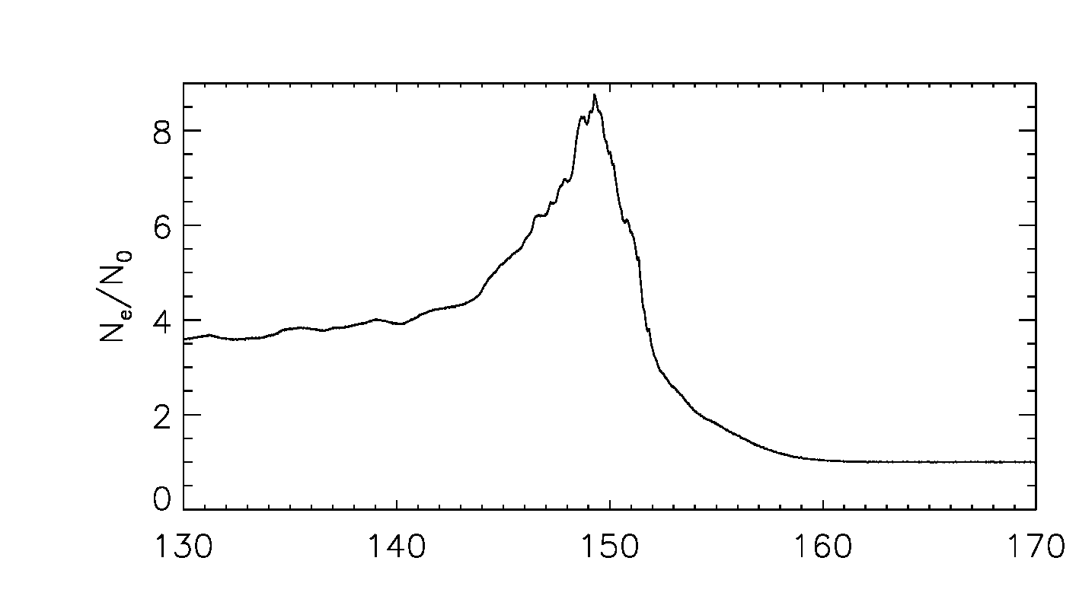
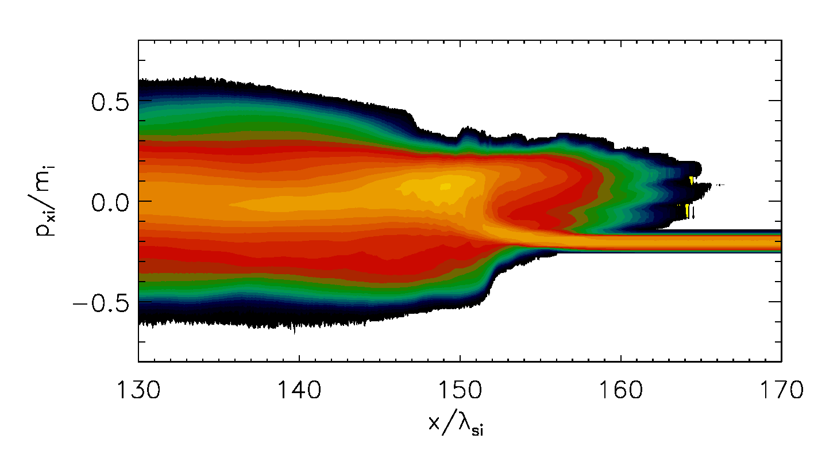
Shock structure
Perpendicular shock Magnetic field perpendicular to the shock normal
Overshoot
Ramp
Downstream
Weibel and Whistler instabilities;
Driven by 2-streams, depending on the Mach number
Can be treated both like T° anisotropies or 2-beams.
Foot
Upstream
Notes:
The structure of perpendicular shocks in the supercritical regime is known to some extent: a fraction of the incoming ions are reflected at the shock front (called the “ramp”) and the reflected ions form a slightly dense region, referred to as the “foot,” in front of the ramp. The ions also accumulate immediately behind the ramp and generate a strong magnetic field there, which is called the (magnetic) “overshoot.”
Main idea: instabilities are driven by 2 streams and depending on Ma, can be treated both like temperature anisotropies or 2 beams ->
Whistler modes can also arise from counter-streaming electrons (e.g., those reflected by a shock) or an anisotropic electron temperature. The Mach number influences how steep the shock ramp is and, in turn, the anisotropy drives the instability.
Weibel instability is often driven by counter-streaming particle populations or temperature anisotropies. In a plasma shock, reflected ions and incoming particles create counter-streams that drive this instability. Higher Mach numbers can enhance ion reflection and increase the free energy available for the instability.
Both instabilities can also be treated as interactions between two particle populations moving in opposite directions (a two-stream model). These streams exchange energy via growing waves, leading to instability.

Slide 7
Instabilities – Whistler anisotropy instability
Whistler Instability
Shock Front
M_{A} < 10
B
Occurs in magnetized plasmas due to anisotropy in the particle distribution
Generates Whistler waves, with typical frequency around the electron cyclotron frequency Ω_{e}, that propagates along the B lines
Wave-particle interaction: acceleration and heating particles in the plasma
If M_{A} is too high, the interaction between the whistler wave and the electrons will be weakened so that the intability’s growth rate decreases. The Mach number influences how steep the shock ramp is and, in turn, the anisotropy or beams driving the instability
Whistler Waves
Electron anisotropy
Notes:
Whistler waves:
Basically, due to the shock compression of the upstream magnetic field, we will have a large-scale magnetic field amplification that will lead to electron anisotropy. When this electron anisotropy is sufficiently high, electrons with higher perpendicular velocities than parallel velocities emit more energy into the wave than they absorb, leading to wave amplification. WAI reduces electron anisotropy by scattering electrons in velocity space. Convert part of the electron energy into magnetic fluctuations, regulating further growth.
WP interaction; SDA

Slide 8
Instabilities – Weibel 2-stream instability
Weibel Instability
Shock Front
M_{A} > 25
Occurs in magnetized plasmas due to anisotropy in the particle distribution + counter-streaming particles population
Ions
The shock induces ions to move at different velocities creation of currents J. By Ampère’s law, J creates B. Feedback loop; B couple back to the motion of particles such that the instability grows. Establishement of current filaments.
Current
Wave-particle interaction: acceleration and heating particles in the plasma
Electrons
Need a sufficient domination of the flow motion compare to the magnetic forces (i.e. high M_{A}). Higher Mach numbers can enhance ion reflection and increase the free energy available for the instability
B
Notes:
By Lorentz Force, it deflects electrons into circular or spiral trajectories around the filaments.
WP interaction; SSA or Magnetic reconnection

Slide 9
Theoretical expectations
Whistler Condition
Weibel Condition
Condition on the electron temperature anisotropy
Needs a sufficient number of exponential growth cycles:
$$N_{w}= M_{A}\frac{c}{v_{sh}}\frac{Γ}{ω_{pi}}ξ,$$
$$\frac{T_{eꓕ}}{T_{e‖}}−1≈\frac{0.21}{β_{e‖}^{0.6}}$$
T_{eꓕ} and T_{e‖} are respectively the perpendicular and parallel temperature of electrons
With ξ ≈ 1/3, Γ the growth rate, and ω_{pi} the ion plasma frequency
β_{e‖} is the beta of electrons parallel to the magnetic field
c = light speed, v_{sh} = shock velocity
With ξ ≈ 1/3, Γ the growth rate, and ω_{pi} the ion plasma frequency
In our case, N_{w} ∝ M_{A} /6
Notes:
Parallel propag bc shown that max growth rate for whistler is at parallel propag
β_{∥p} ≡ 8πn_{p}T_{∥p}/B_{o}², the fitting parameter S_{p} is of order unity but varies as a function of threshold growth rate, and the fitting parameter α_{p} ≃ 0.4 independent of growth rate.
The resonance terms (ωr±Ωj)(\omega_r \pm \Omega_j)(ωr​±Ωj​) determine which particles (via their velocities) contribute most strongly to the wave-particle interaction.
Instability (γ>0\gamma > 0γ>0) occurs when the energy transfer from particles to the wave becomes positive. This depends on a balance between the anisotropy and the resonant effects.
This term peaks when the wave frequency ωr\omega_rωr​ is near the cyclotron frequency Ωe\Omega_eΩe​, meaning the interaction is most efficient at this resonance.

Slide 10
PIC simulation
Vlasov equation
Lorentz force
Maxwell equations
THATMPI code (Two-and-a-Half-Dimensional Advanced Stanford code with Message Passing Interface).
This code is a 2D3V-adapted and modified version of the relativistic electromagnetic PIC code TRISTAN (Three-Dimensional Stanford) [1] with Message Passing Interface-based (MPI) parallelization [2]
[1] Buneman, 1993
[2] Niemiec et al., 2008
Notes:
Particle-In-Cell (PIC) simulation is a computational technique to model highly nonlinear plasma systems. It tracks individual particles moving in a self-generated electromagnetic field. In PIC simulations, both ions and electrons are treated as particles, making it a method for solving the Vlasov equation. The behavior of charged particles is determined by the Lorentz force equation, while fields evolve based on Maxwell's equations.

Slide 11
PIC simulation - setup
Injection method; box with a reflective wall and a plasma beam. Perpendicular magnetic field.
Shock
B0
Reflective wall
Open boundary
y
Beam: v_bulk, v_th
x
Downstream
Upstream
Periodic boundaries
Notes:
The injection method for plasma shock simulations is a technique used in kinetic plasma simulations (e.g., Particle-In-Cell (PIC) codes) to create and maintain a shockwave in the simulation domain. Here's a brief overview:
Injection of Plasma Particles:
Plasma particles (electrons and ions) are continuously injected from one side of the simulation domain. These particles represent the upstream plasma, which moves with a specific bulk velocity toward the shock.
Reflection and Shock Formation:
A reflecting boundary or a counter-streaming flow is used to create a collisionless shock. The interaction between the injected plasma and the reflected plasma generates the shock structure.
Boundary Conditions:
Special boundary conditions, such as open or reflecting boundaries, are applied to prevent unphysical reflections of waves or particles that could disrupt the simulation.
Shock Evolution:
The method allows for the development of a steady-state shock in the simulation domain. Parameters such as Mach number, magnetic field orientation, and plasma composition determine the shock's properties.
REFAIRE ?

Slide 12
First Simulations – Parameters
Goal : define limit cases surrounding the transition region
Plasma beta β_{p} | 1
Mass ratio | 100
Angle with the magnetic field | 90° in x-y plane
Density | 20 Particles per cell
Electron skin depth | 20.0
For Whistler
M_{A} | 10
M | 11
Ve,up | 0.2694 c
Ve,th | 0.1714 c
For Weibel
M_{A} | 23
M | 25
Ve,up | 0.1315 c
Ve,th | 0.08231 c

Slide 13
First Simulations – Parameters
Goal : define limit cases surrounding the transition region
Plasma beta β_{p} | 1
Mass ratio | 100
Angle with the magnetic field | 90° in x-y plane
Density | 20 Particles per cell
Electron skin depth | 20.0
For Whistler
M_{A} | 10
M_{s} | 11
Ve,up | 0.2694 c
Ve,th | 0.1714 c
For Weibel
M_{A} | 23
M_{s} | 25
Ve,up | 0.1315 c
Ve,th | 0.08231 c

Slide 14
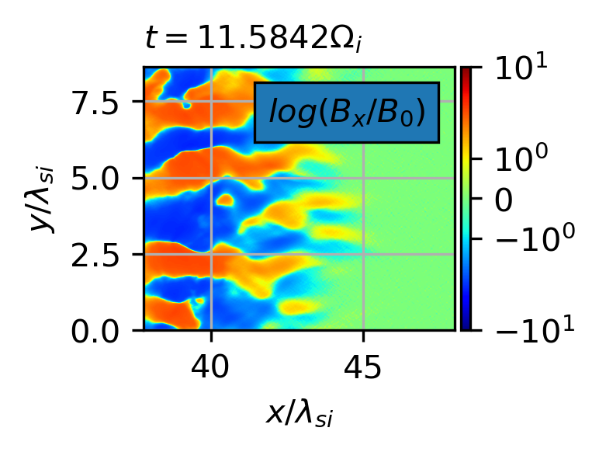
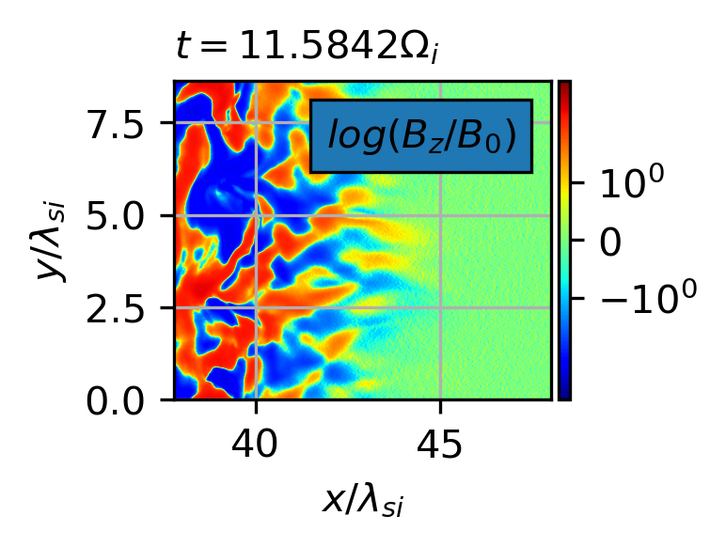
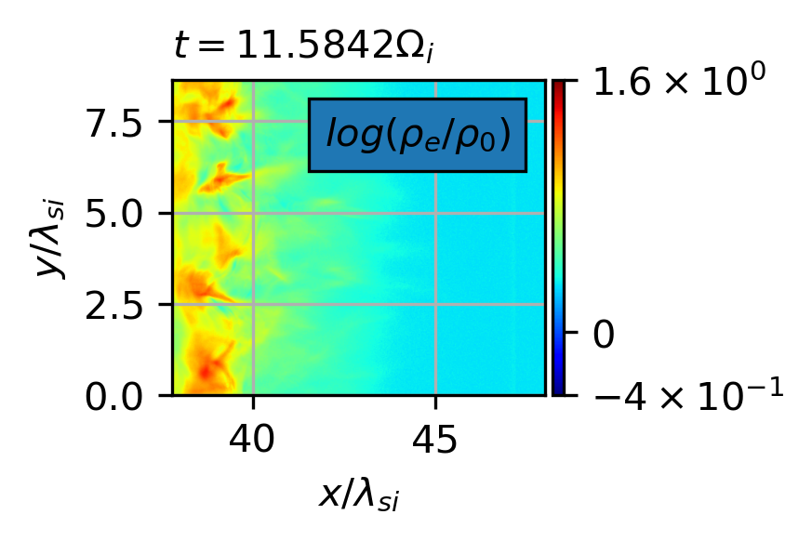
First Simulations – Whistler instability
Notes:
1. Particle Distribution and Bulk Flows:
Shape and Spread:
The spread of particles in the phase space indicates the temperature of the plasma. A broader spread corresponds to higher temperatures.
Bulk Flow:
If the center of the distribution shifts in phase space, it indicates a net flow of particles in that momentum or velocity direction.
2. Anisotropies:
By comparing the distributions in pxp_xpx​, pyp_ypy​, and pzp_zpz​, you can detect temperature anisotropies, such as T⊥>T∥T_\perp > T_\parallelT⊥​>T∥​, which could drive instabilities like the Whistler or mirror instability.
Anisotropy can also indicate preferential acceleration along or across magnetic field lines.
Analyzing Shock Structure:Examine how ion and electron phase spaces evolve across the foot, ramp, and downstream.
Detecting Instabilities:Look for anisotropies or counter-streaming features that indicate active instabilities.
Energy Partitioning:Observe how energy is distributed between species and among the three directions to infer the dominant acceleration mechanisms.

Slide 15
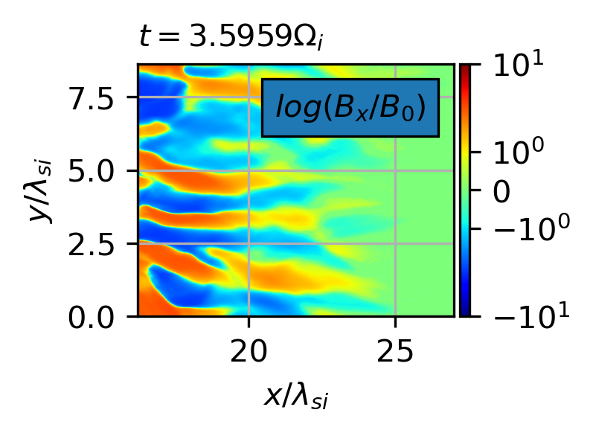
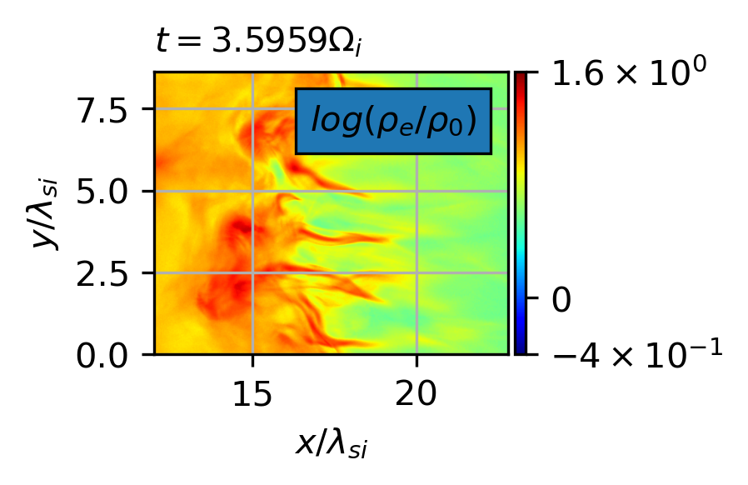
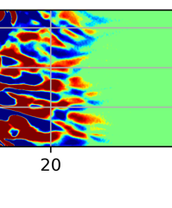
First Simulations – Weibel instability

Slide 16
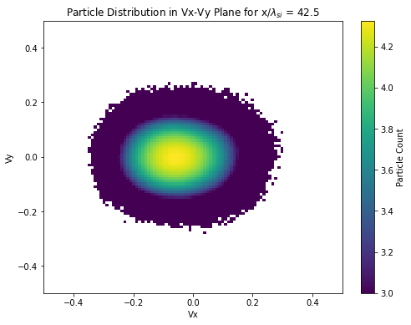
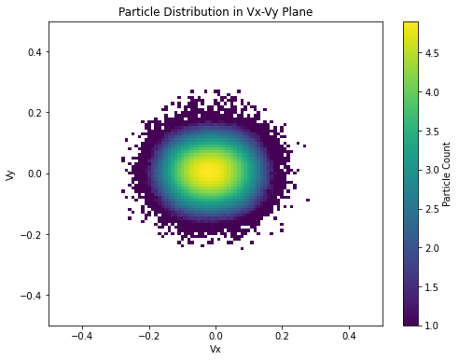
First Simulations – Comparison
Electron and ion velocity particles distribution
Whistler
Weibel
Notes:
The increase in perpendicular temperature at the shock, while the parallel temperature stays the same as in the upstream, leads to a strong electron anisotropy. This excites the electron whistler instability. The electron whistler instability provides a mechanism for electron pitch-angle scattering and thus reduces the electron temperature anisotropy

Slide 17
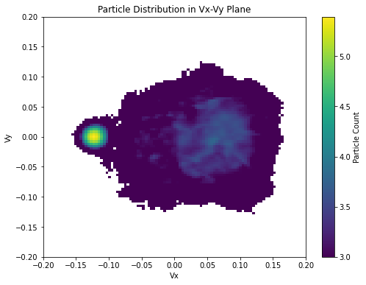
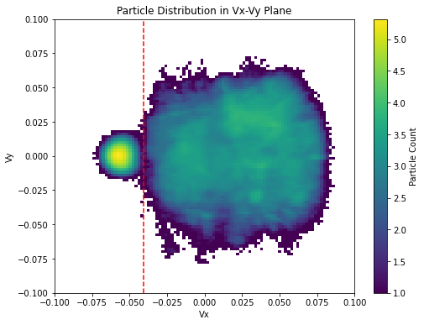
First Simulations – Comparison
Electron and ion velocity particles distribution
Whistler
Weibel
Notes:
The increase in perpendicular temperature at the shock, while the parallel temperature stays the same as in the upstream, leads to a strong electron anisotropy. This excites the electron whistler instability. The electron whistler instability provides a mechanism for electron pitch-angle scattering and thus reduces the electron temperature anisotropy

Slide 18
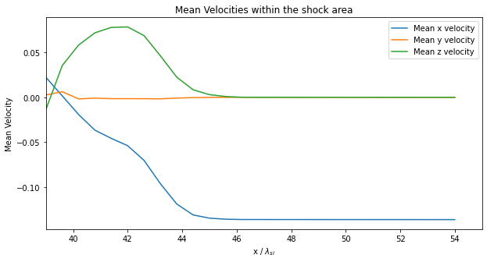
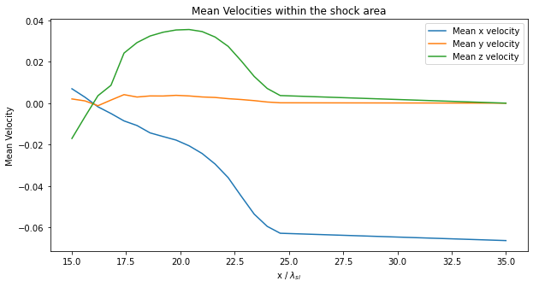
First Simulations – Comparison
Velocities within the shock area
Whistler
Weibel
Notes:
The increase in perpendicular temperature at the shock, while the parallel temperature stays the same as in the upstream, leads to a strong electron anisotropy. This excites the electron whistler instability. The electron whistler instability provides a mechanism for electron pitch-angle scattering and thus reduces the electron temperature anisotropy

Slide 19
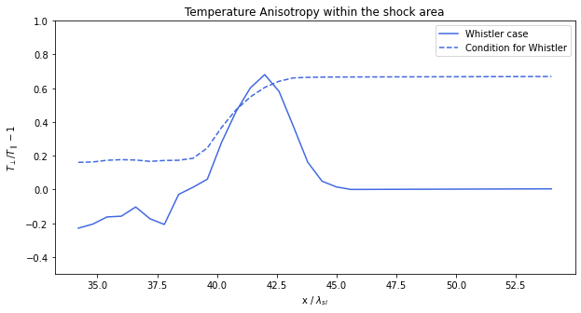
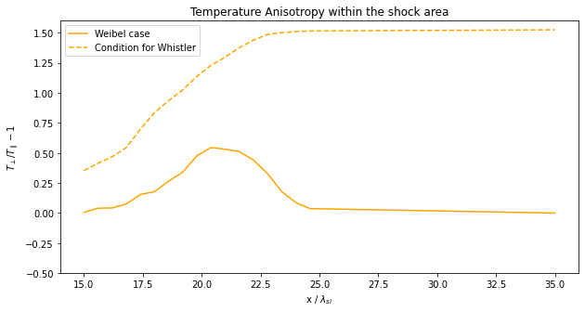
First Simulations – Comparison
Whistler instability condition
Whistler
Weibel
Treshold
Treshold
Notes:
The increase in perpendicular temperature at the shock, while the parallel temperature stays the same as in the upstream, leads to a strong electron anisotropy. This excites the electron whistler instability. The electron whistler instability provides a mechanism for electron pitch-angle scattering and thus reduces the electron temperature anisotropy

Slide 20
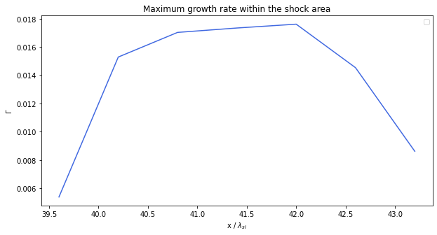
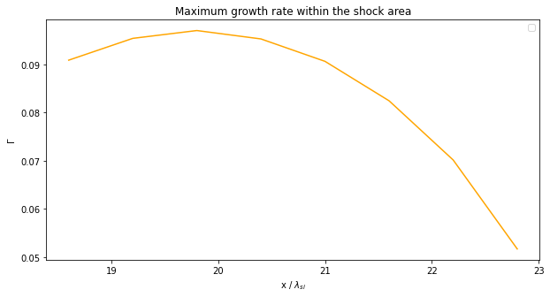
First Simulations – Comparison
Weibel growth rate
Whistler
Weibel
Max ~ 0.02
Max ~ 0.1
Notes:
The increase in perpendicular temperature at the shock, while the parallel temperature stays the same as in the upstream, leads to a strong electron anisotropy. This excites the electron whistler instability. The electron whistler instability provides a mechanism for electron pitch-angle scattering and thus reduces the electron temperature anisotropy

Slide 21
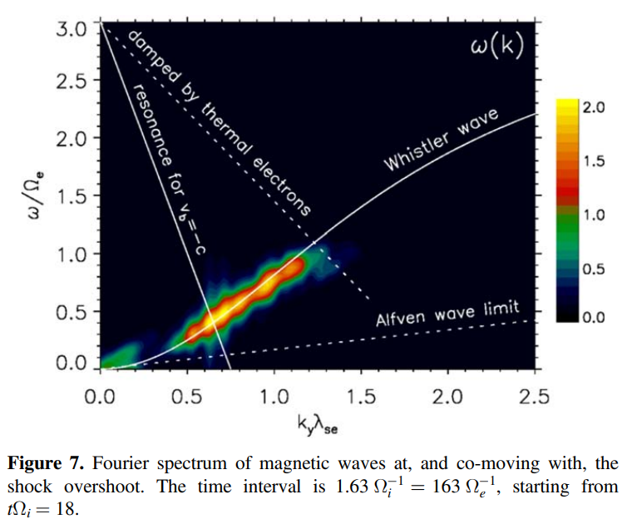
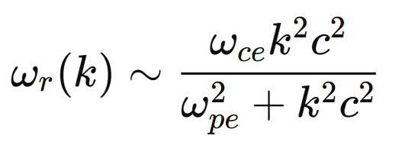
Further steps
Fourier Spectrum
More simulations in the intermediate M_{A} region
For a set of parameters (β = 1, mass ratio = 100)
Distinction between instabilities
Plot from Kobzar et al. (2021)
Notes:
Weibel
Non résonante, donc ωr≈0\omega_r \approx 0ωr​≈0 (fréquence réelle nulle ou très faible).
Croissance purement imaginaire, donc instabilité croissante avec γ=ℑ(ω)\gamma = \Im(\omega)γ=ℑ(ω).

Slide 22
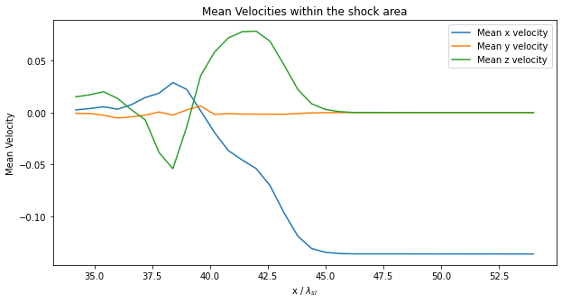
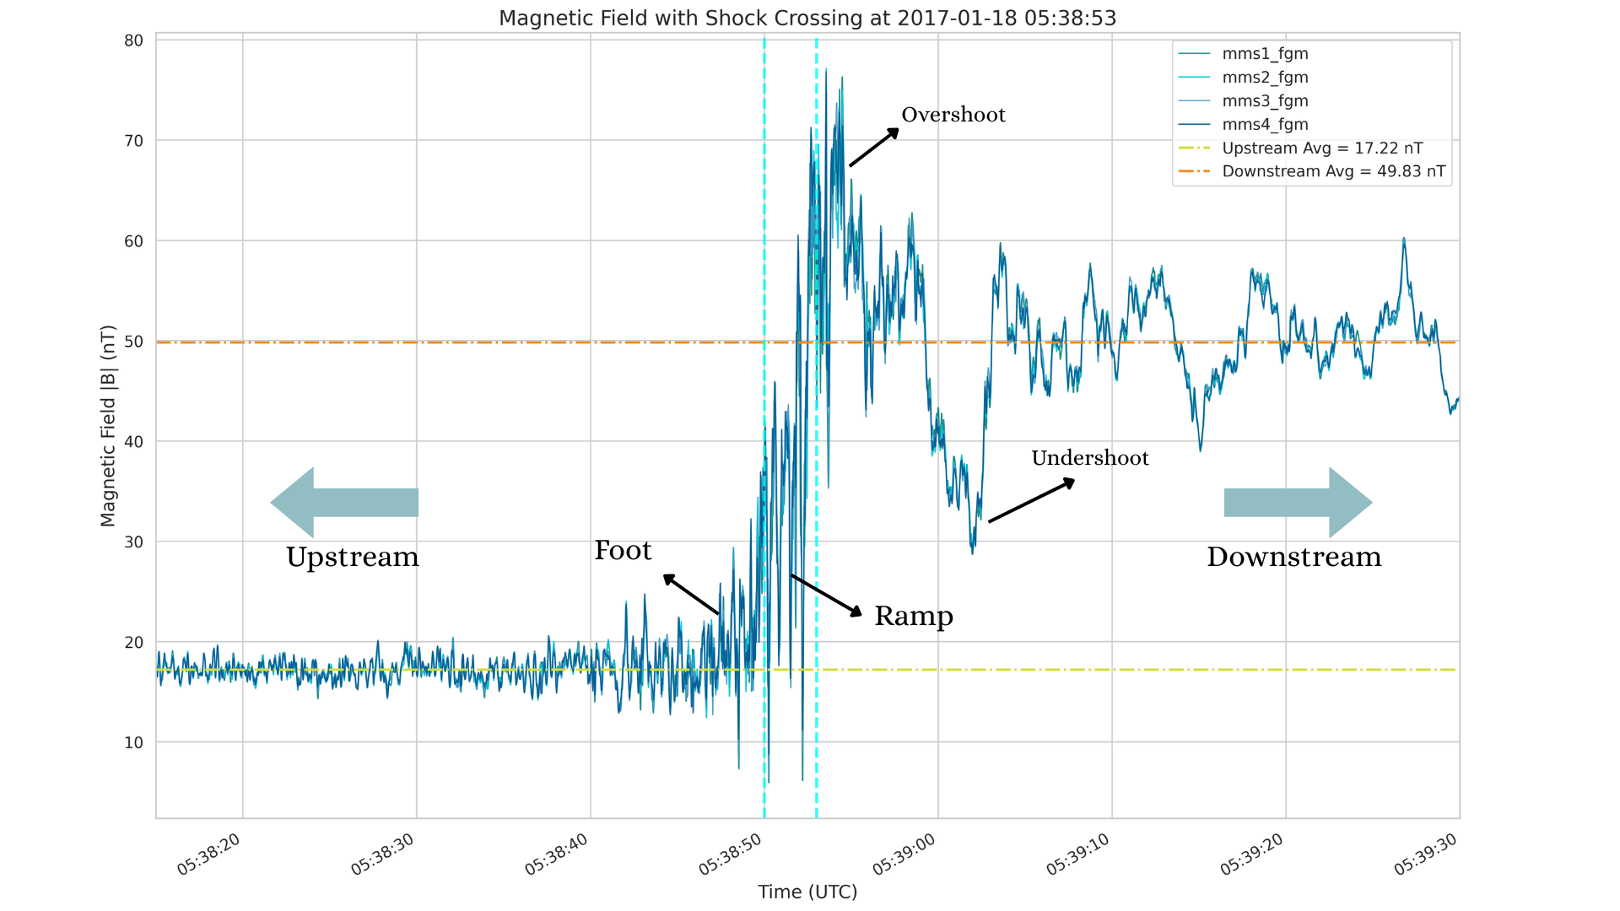
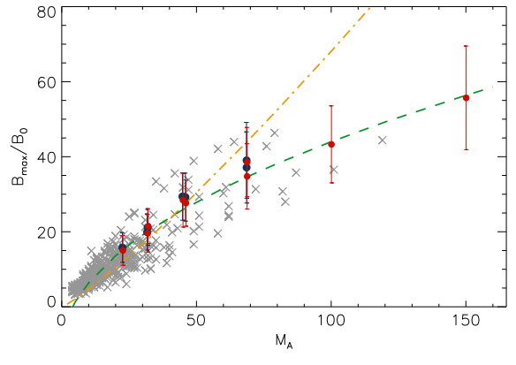
Further steps
More simulations in the intermediate M_{A} region
Varying parameters (β, mass ratio, see Guo2017b)
Comparison with In-situ data
Particle tracing
Accelerations processes
From Bohdan (2021)
From V. Villaflor

Slide 23
Conclusion
Distinction between instabilities
Simulations in the intermediate Mach numbers region

Slide 24
BACK-UP

Slide 25
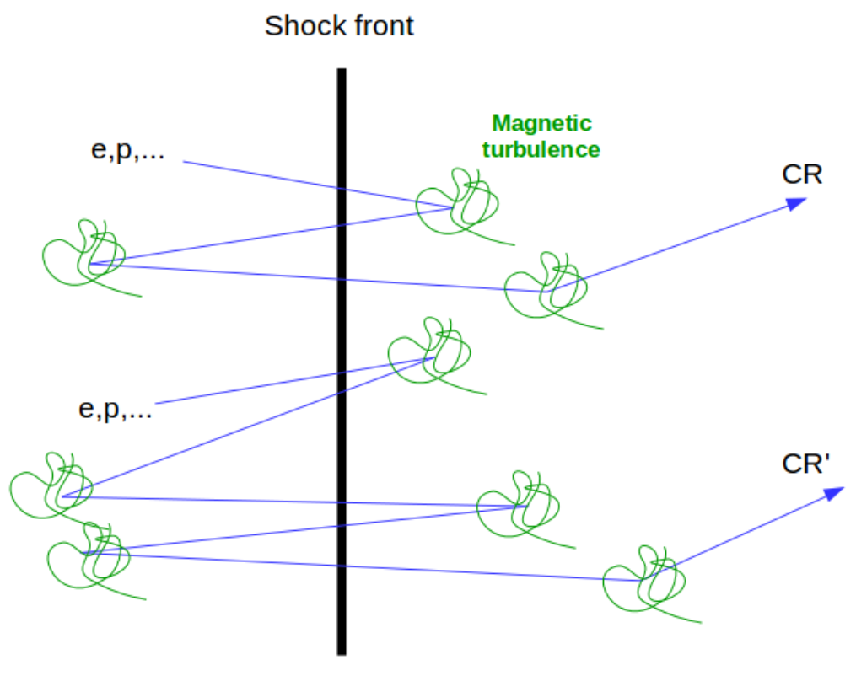
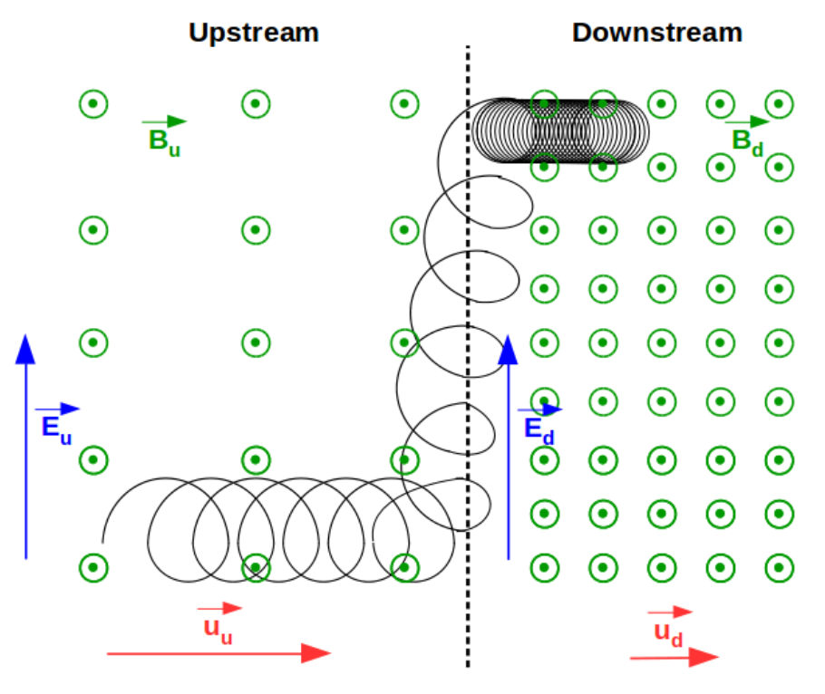
Acceleration processes
Diffusive shock acceleration (DSA)
Stochastic Shock Drifting Acceleration (SSDA)
Multiple scatterings between upstream and downstream regions, gaining energy which each crossing
Injection mechanism required!!
Particles undergo random scatterings and drifts in the shock’s B and E, resulting in their gradual acceleration.
Within the shock’s transition region.
Notes:
Diffusive shock acceleration (DSA) is a mechanism that increases the energies of charged particles. In the DSA process, charged particles are initially scattered back and forth across the shock front due to its turbulent nature. Each time a particle crosses the shock front, it gains energy from the converging flow of plasma. However, the particle also experiences scattering events, which randomize its direction of motion. Over time, this repeated process of acceleration and scattering results in the gradual increase of the particle's energy. The more times a particle crosses the shock front, the more energy it gains, leading to the formation of a power-law distribution of particle energies. Diffusive shock acceleration is considered one of the most efficient mechanisms for accelerating particles to ultra-high energies in astrophysical environments. However, to be efficient enough, it requires the particles to have initial relativistic energies such that an injection mechanism is required.
SSDA: The gyration radius is shorter when the magnetic field is stronger. Consequently, if the gyration is overlapping the shock front, there will be a longer drift in the upstream compared to the downstream region. It results in a net drift of those particles along the shock front. However, the bulk motion of charged particles will induce, because of the presence of the magnetic field, the generation of an electric field, that is able to accelerate those charged particles that are drifted along the shock front. Very efficient acceleration process (few gyration already give a factor of a few energy gain).

Slide 26
Theoretical expectation – Whistler Instability
Vlasov equation Small perturbations
First velocity moment, introducing the dimensionless conductivity of the jth species
Dispersion tensor, depending on S_{j} (k,ω)
Notes:
From diff velocity moment integrals, defining what is called the dimensionless conductivity of the jth species and evaluate it using the Vlasov equation,
Conductivity tensor
Dispersion tensor relates first order electric field to first order current density
Dispersion tensor orthogonal to magnetic field in wave propagating in plasma

Slide 27
Theoretical expectation – Whistler Instability
Linear Vlasov equation for ELM waves in magnetized plasma
First-order distribution function, using unperturbed orbit method
where
Notes:
Transform in Fourier space, relate first order magnetic field and electric field through Faraday’s law
by integrating over the velocity space, considering the boundary conditions and the contributionfrom the initial distribution f (0)j

Slide 28
Theoretical expectation – Whistler Instability
k x B₀ = 0 ELM dispersion relation
Bi-Maxwellian zeroth-order distribution function
Re-evaluation of the first-order distribution function
Notes:
Wave Propagation Along the Field
Maxwellian Distribution: This describes a statistical distribution of velocities for particles in a gas or plasma where the distribution is determined by a single temperature.
Bi-Maxwellian: In the case of a bi-Maxwellian distribution, you have two Maxwellians, typically used to describe the velocity distributions in two directions (say, perpendicular and parallel to a magnetic field):
This form models situations where there are two distinct temperatures along different axes, often seen in plasmas with anisotropic heating or cooling.
In practical applications, such a distribution can be used to model ion or electron populations in magnetized plasmas where temperature anisotropies exist (i.e., the temperature in one direction, typically parallel to the magnetic field, differs from that in the perpendicular directions). The bi-Maxwellian distribution plays a crucial role in the study of plasma instabilities, wave propagation, and other phenomena where particle velocity distributions significantly affect the behavior of the plasma.
We also use here a bi-Maxwellian distribution to be able to detect the different dynamics due to the magnetic field along and across its lines of force.

Slide 29
Theoretical expectation – Whistler Instability
Dimensionless conductivity, for k x B₀ = 0
Assuming weak instability, ignoring protons and assuming electrons are nonresonant [1,2]
References: P. Gary 1993 [1],
Kennel & Petschek 1966 [2]
Notes:
Weak instability; the real and imaginary parts of the linear dispersion relation areestimation of ωr and γ respectively
Using the Landau contour prescription, the imaginary part is obtained via the Landau rule
The Landau contour prescription is a method used in plasma physics to properly handle the integration of singularities in the complex plane when solving the Vlasov equation for wave dispersion relations.
Key idea:
In the presence of wave-particle resonances (ω−kv=0\omega - k v = 0ω−kv=0), the distribution function in the plasma response can lead to singularities in integrals.
To account for Landau damping, the velocity integral is deformed into the complex plane, avoiding the singularity by following a contour that passes below poles for a stable plasma and above them for an unstable one (following causality).
This is done using the Plemelj identity, leading to a principal value integral plus an imaginary term related to wave damping or growth.
This contour shift is crucial for computing the dielectric response function and determining wave damping (Landau damping) or instability growth rates in kinetic theory.

Slide 30
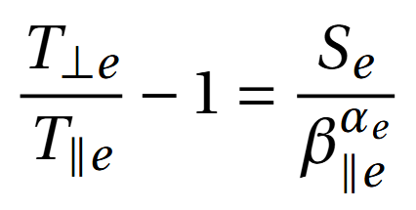
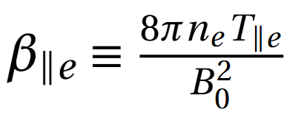
Theoretical expectation – Whistler Instability
Necessary condition [2]:
By definition of the cyclotron
resonance factor:
Linear theory threshold [3,4]:
Numerical values [4,5]:
with
References: Kennel & Petschek 1966 [2],
P. Gary 1997 [3], P. Gary 2005 [4],
X. Guo 2017 [5].
Notes:
This is exactly the necessary condition for instability to grow. It shows that temperature anisotropy(T⊥,e > T∥,e ) must be sufficiently large for the whistler anisotropy instability to develop.Interpretation;• The instability occurs when the anisotropy exceeds a threshold.• The denominator |Ωe |/ωr − 1 represents how much the electron cyclotron frequency dominates over the wave frequency.• If Ωe >> ωr the threshold becomes small, meaning even a small anisotropy can drive instability
If we use values for ωr and kz , which corresponds to solutions of linear dispersion equation at maximum growth, then, the right-hand side only depends on β∥e alone. One can then use least-squares fits to solutions of the linear Vlasov equation. The right-hand side can be then expressed as 3
charged particle can exchange energy with a wave if its motion matches the wave's phase velocity,
Parallel propag bc shown that max growth rate for whistler is at parallel propag
β_{∥p} ≡ 8πn_{p}T_{∥p}/B_{o}², the fitting parameter S_{p} is of order unity but varies as a function of threshold growth rate, and the fitting parameter α_{p} ≃ 0.4 independent of growth rate.
The resonance terms (ωr±Ωj)(\omega_r \pm \Omega_j)(ωr​±Ωj​) determine which particles (via their velocities) contribute most strongly to the wave-particle interaction.
Instability (γ>0\gamma > 0γ>0) occurs when the energy transfer from particles to the wave becomes positive. This depends on a balance between the anisotropy and the resonant effects.
This term peaks when the wave frequency ωr\omega_rωr​ is near the cyclotron frequency Ωe\Omega_eΩe​, meaning the interaction is most efficient at this resonance.
Numerical values = statistical upper boundary

