Slide 1
The interplay of 3D MHD with SOL/divertor physics in EDA H-mode and XPR regimes Máté Szűcs
Matthias Hölzl, Andrés Cathey, Yu-Chih Liang, George Su, Sven Korving, Daniel Maris

Slide 2
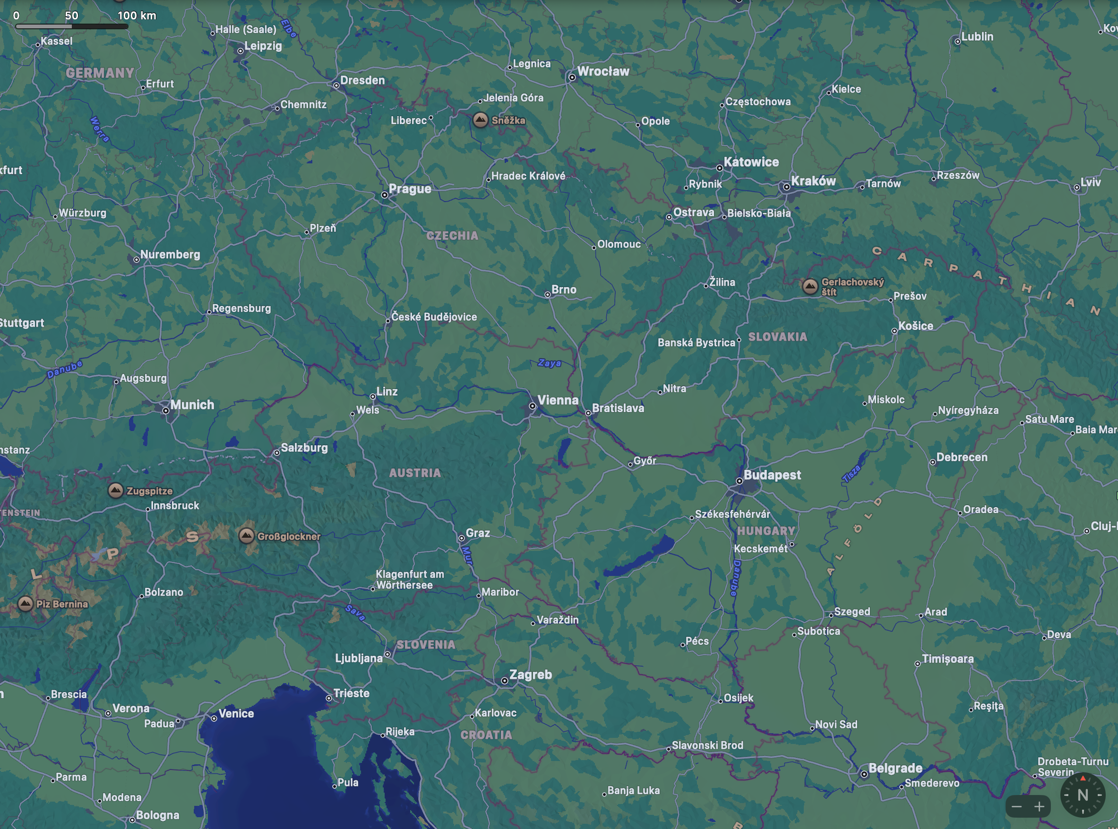
About me

Slide 3
About me

Slide 4
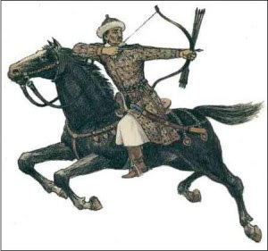
About me

Slide 5
About me

Slide 6
About me – BSc in Budapest

Slide 7
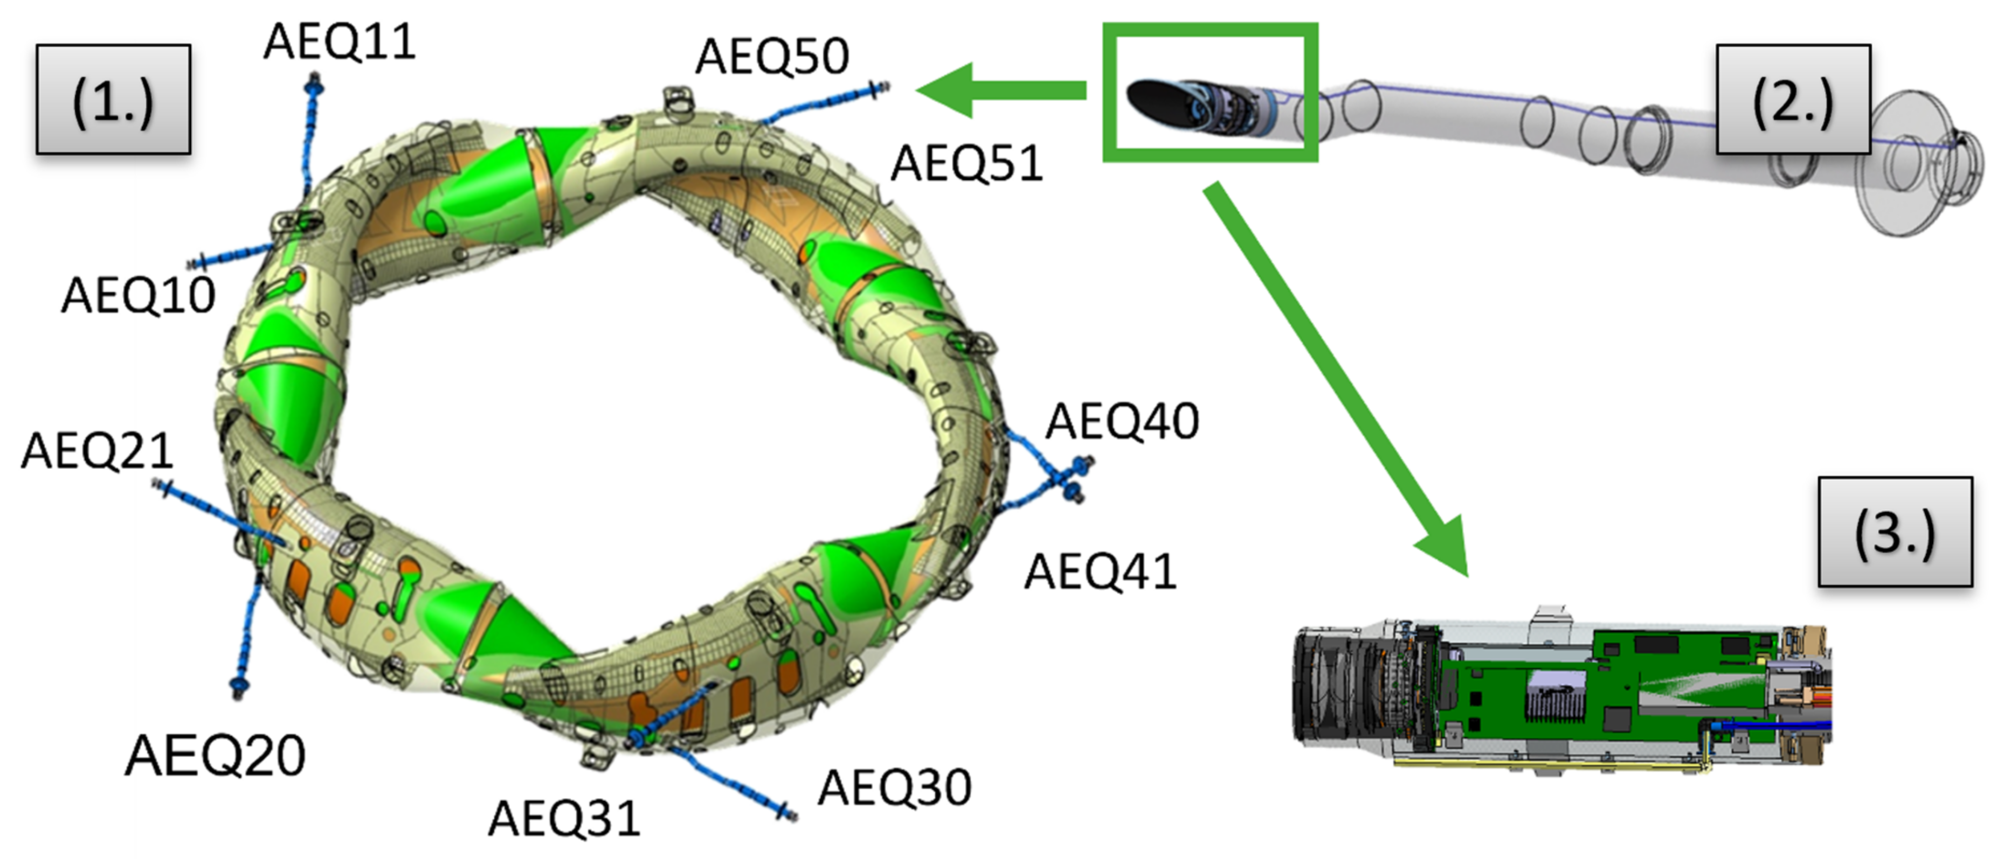
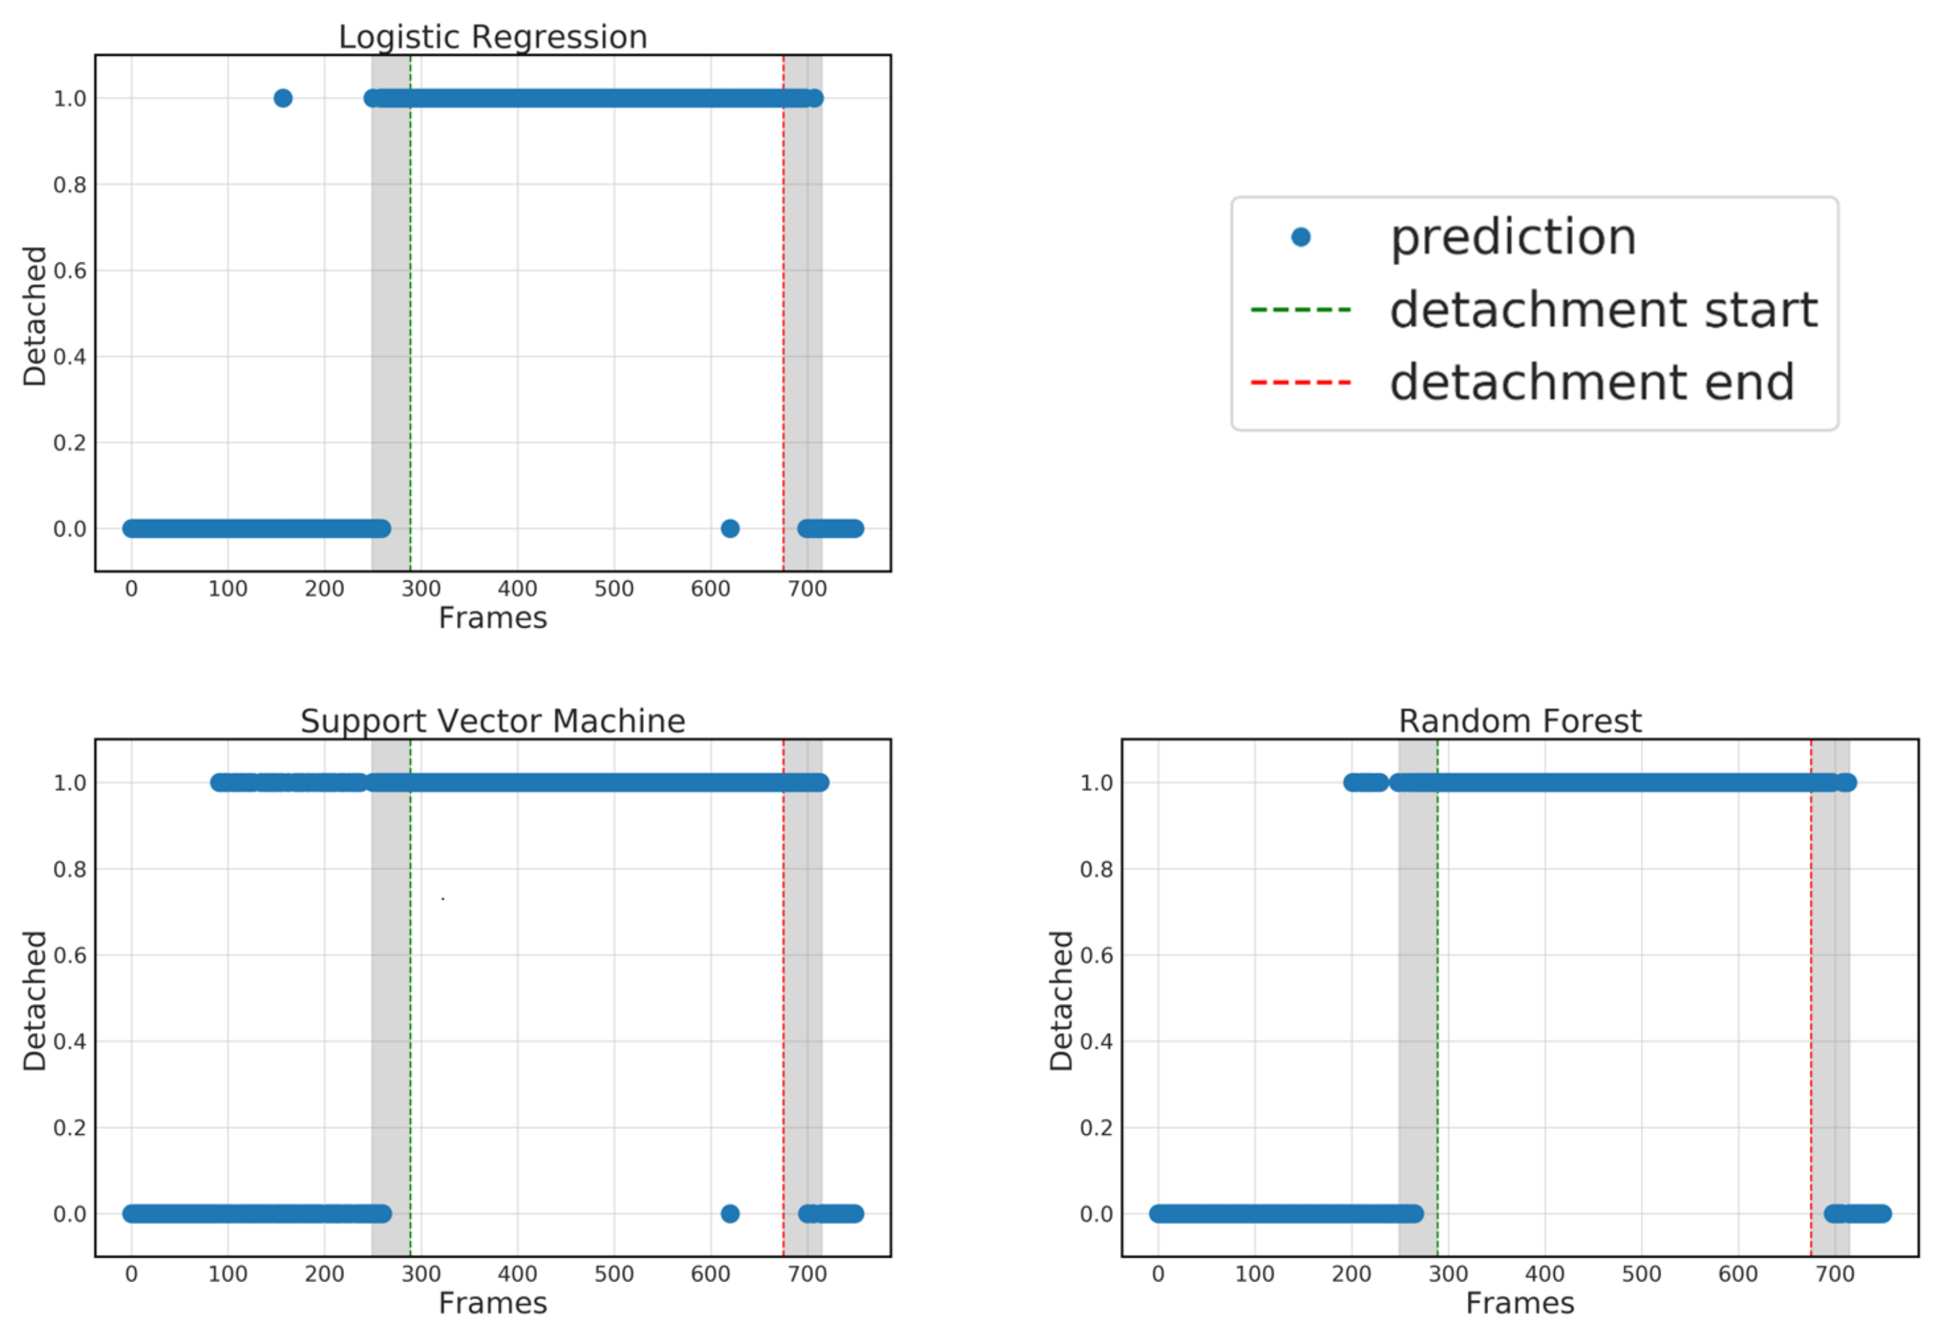
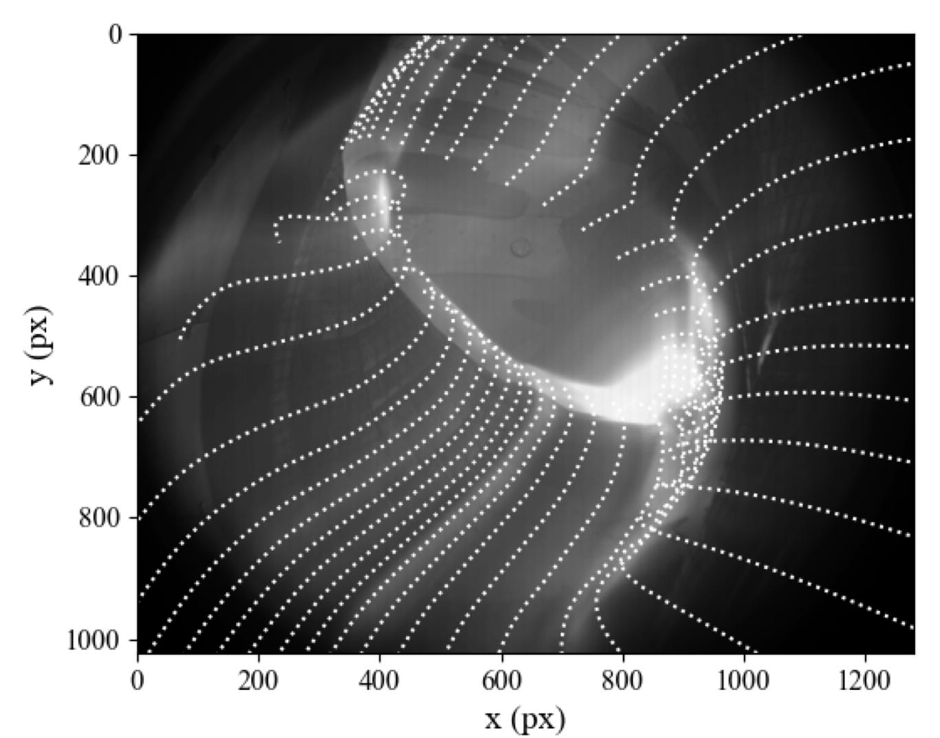
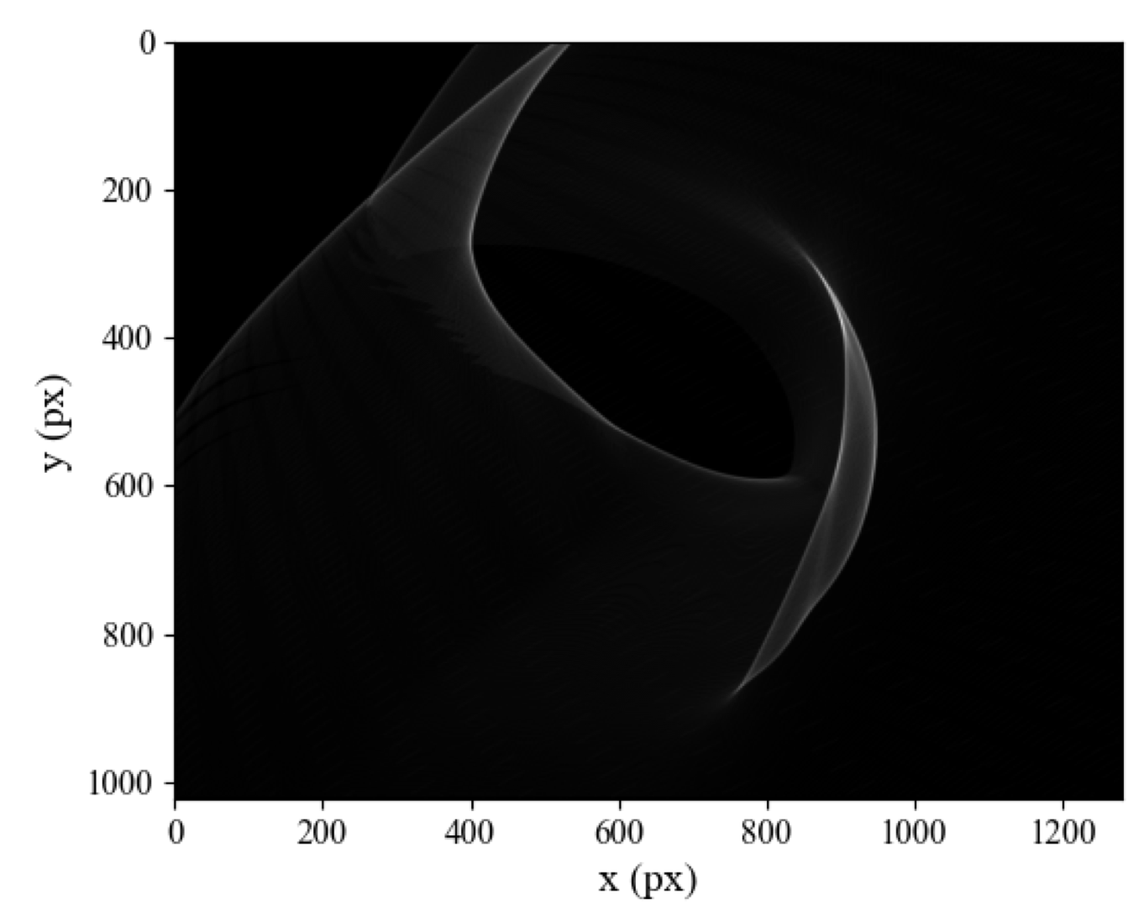
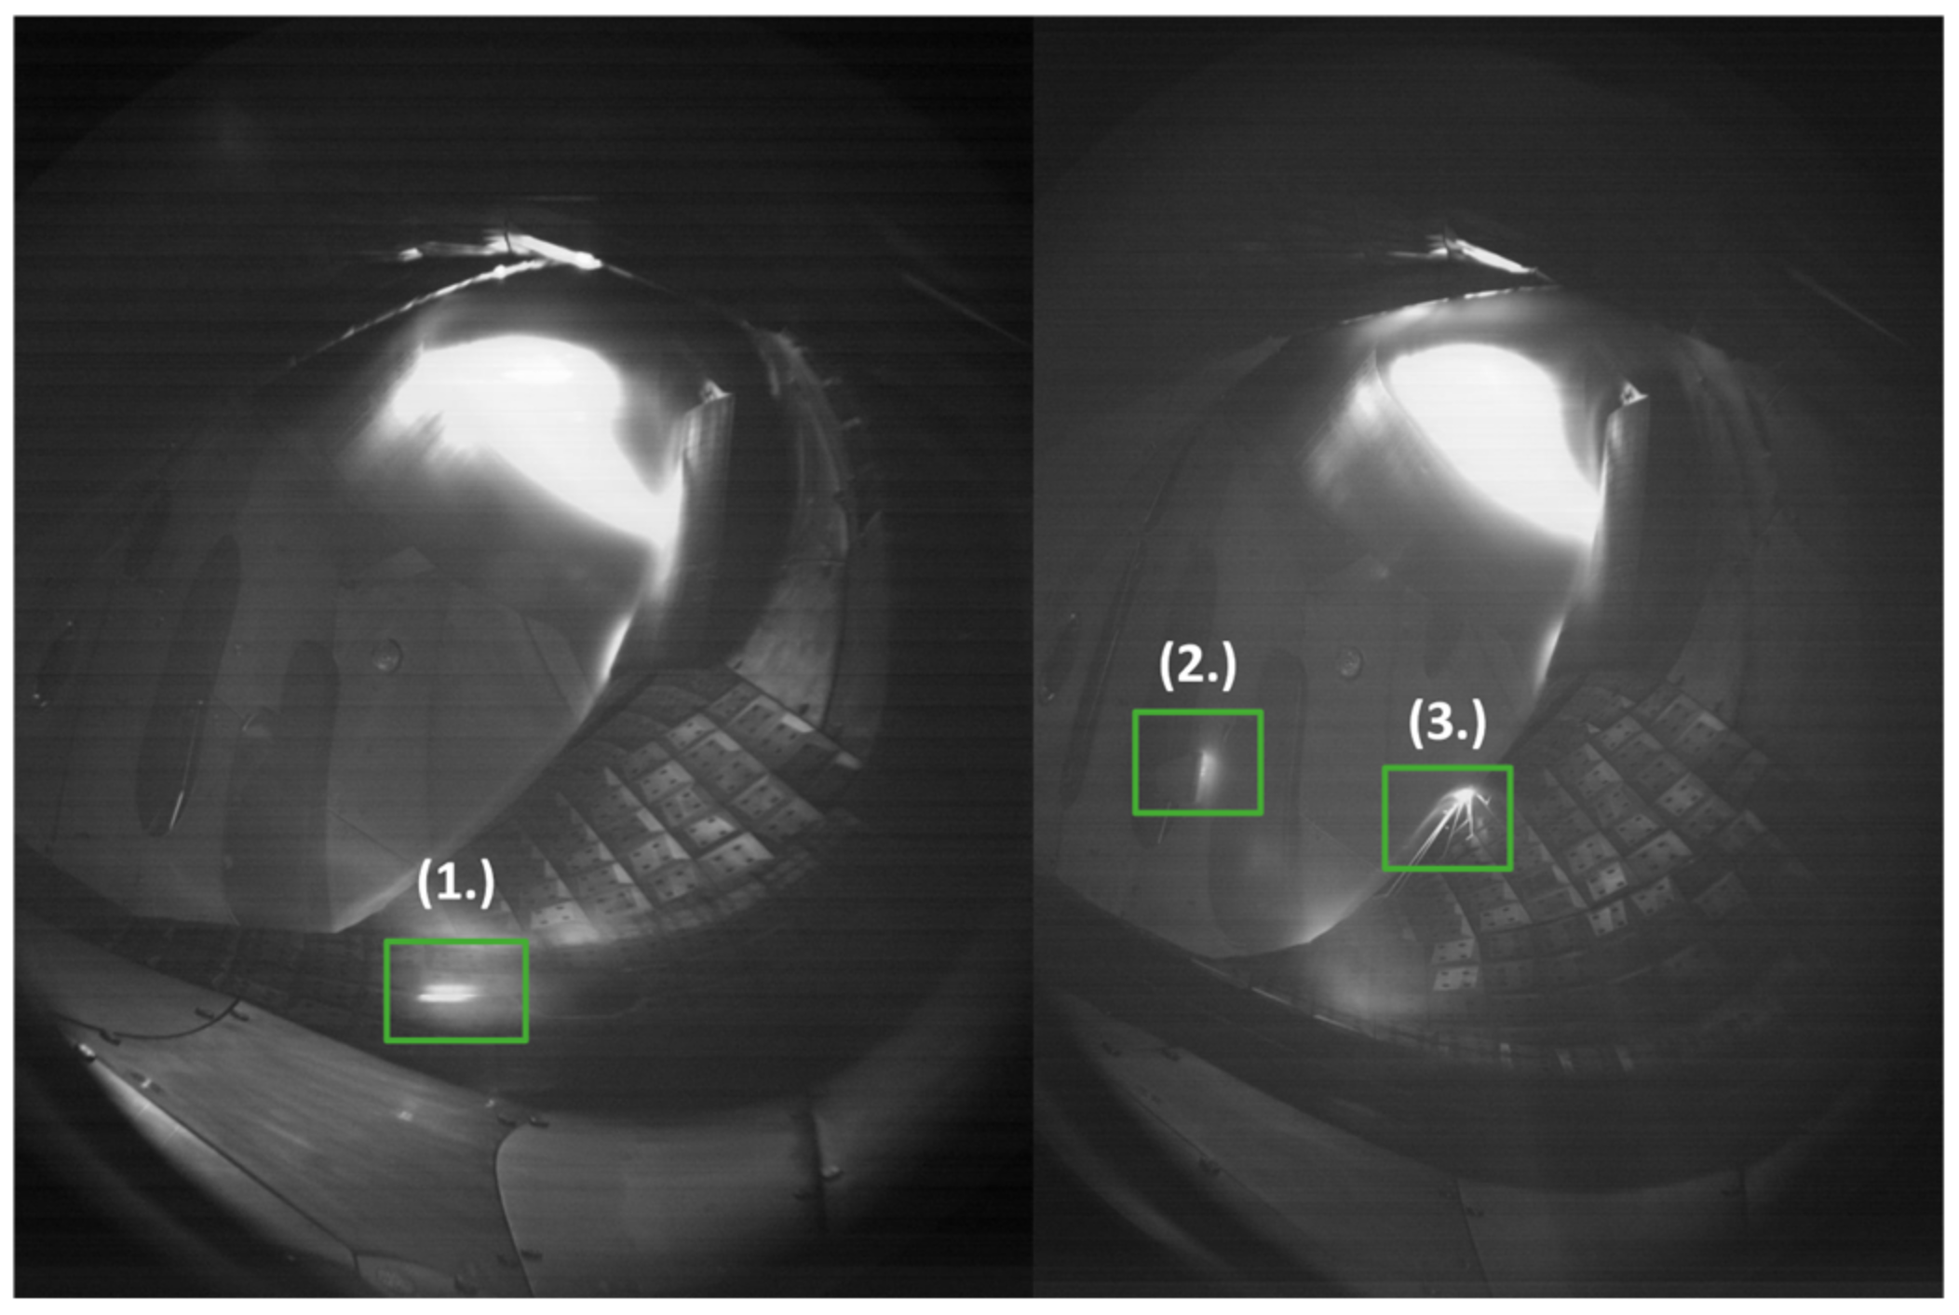
About me – BSc in Budapest
Internship and BSc thesis on the visible video diagnostics on W7-X
Detecting detachment using ML
Szucs M. et al, Appl. Sci. 2022, 12(1), 269
Szucs M. et al, J. Nucl. Eng. 2022, 3(4), 473-479
Plasma size estimation
Detecting “hotspots” with NNs

Slide 8
About me – MSc in Munich
Applied and Engineering Physics
MSc thesis

Slide 9
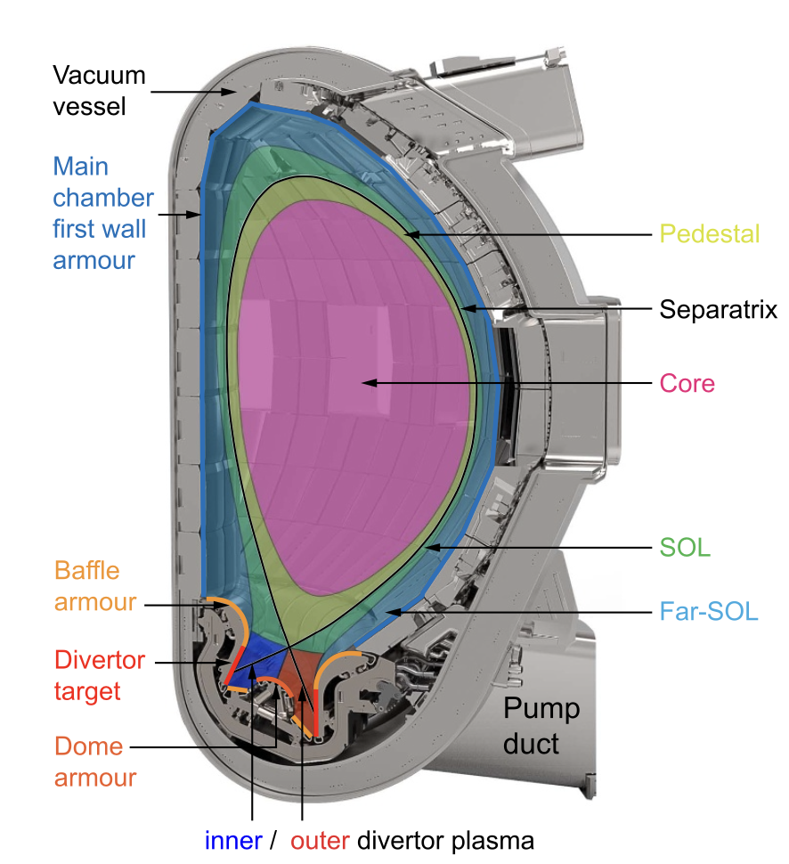
Okay, what am I still doing here? Continuing MSc work and PhD plans
The exhaust problem:
TLDR: high heat- and particle fluxes bad, mitigate them in ITER and large machines
Stationary
Transient: type-I Edge Localized Modes (ELMs)

Slide 10
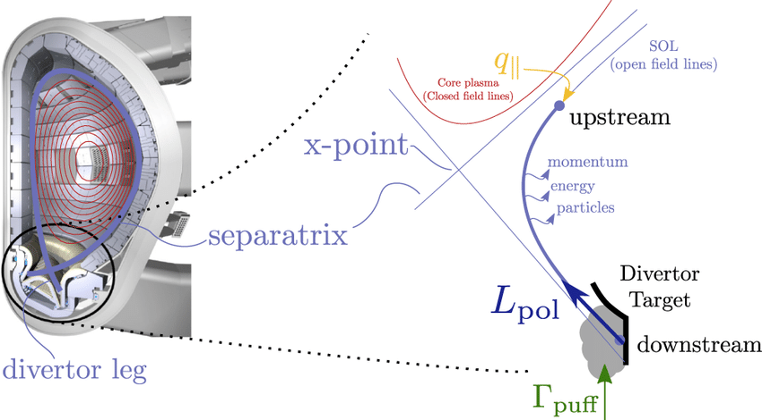
Okay, what am I still doing here? Continuing MSc work and PhD plans
Detachment to shield from stationary fluxes
Introduce neutral atoms (deuterium, nitrogen, etc)
Local radiation cools divertor region
Incoming ions recombine into neutrals

Slide 11
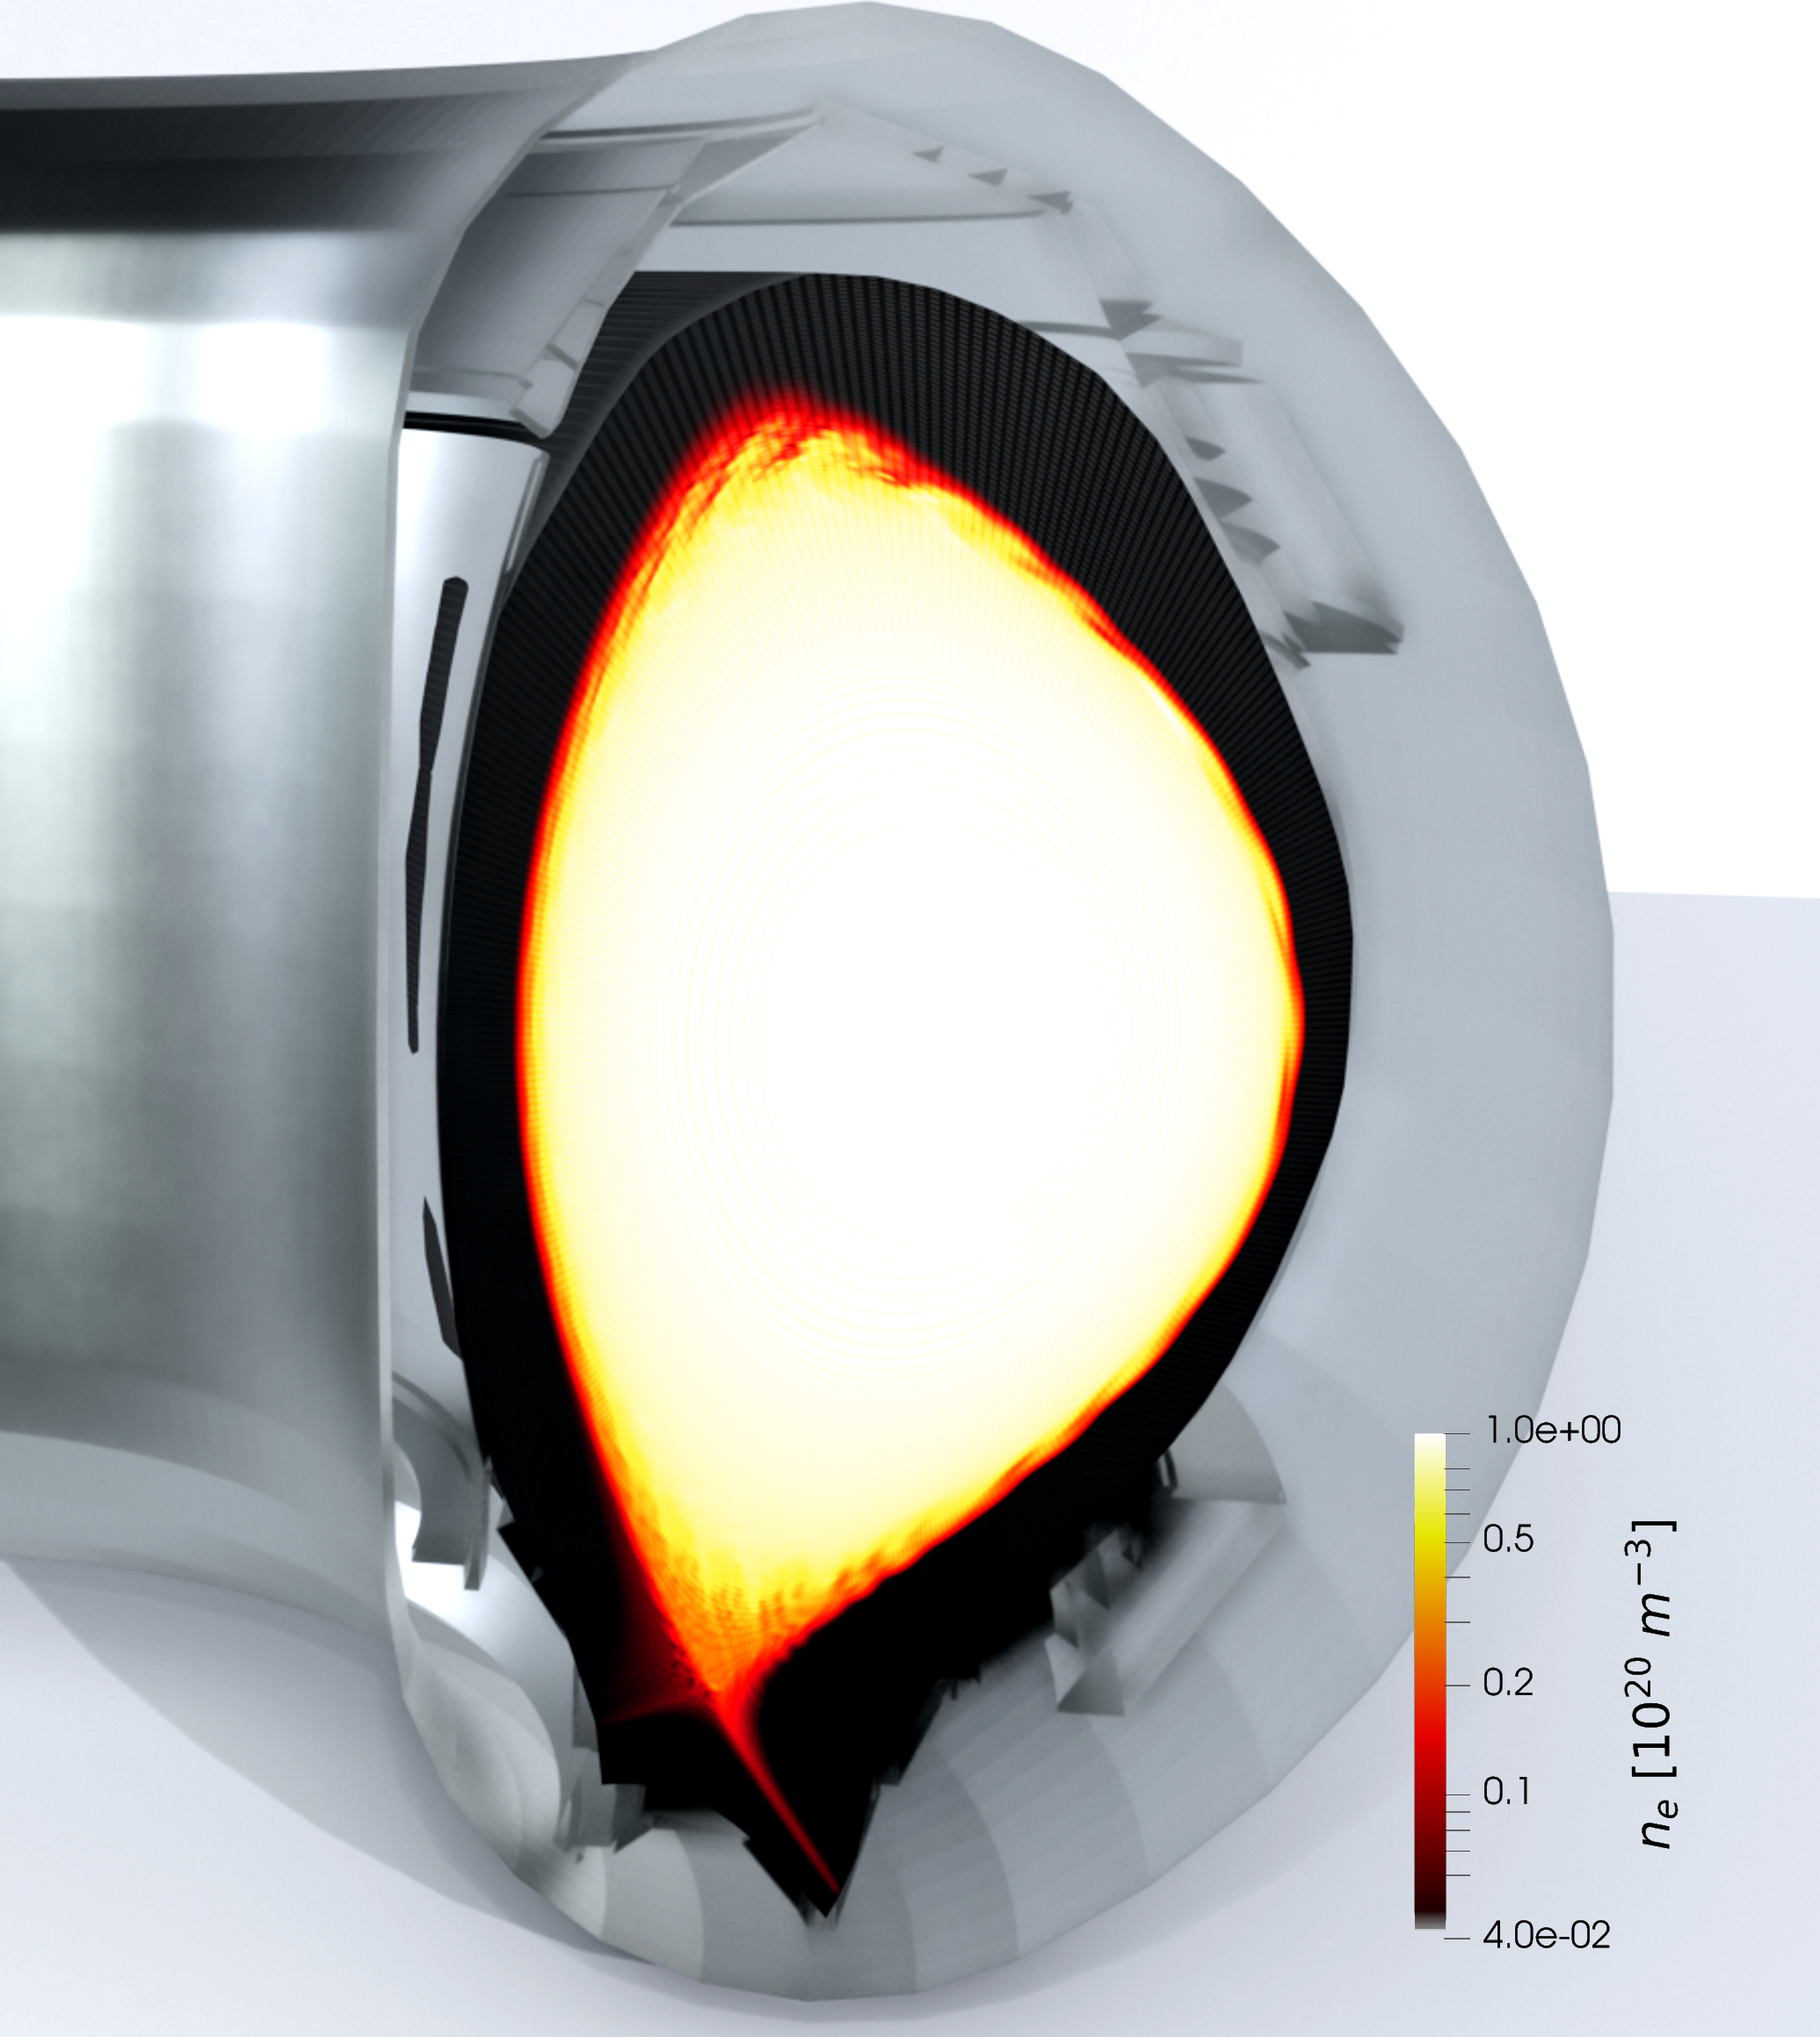
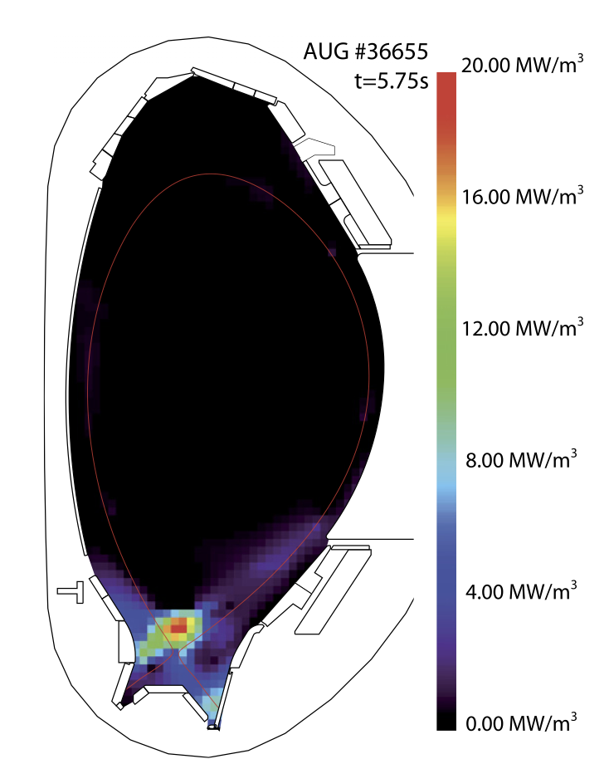
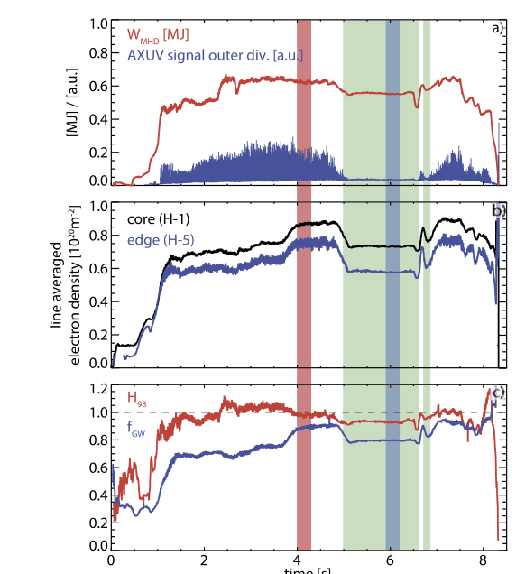
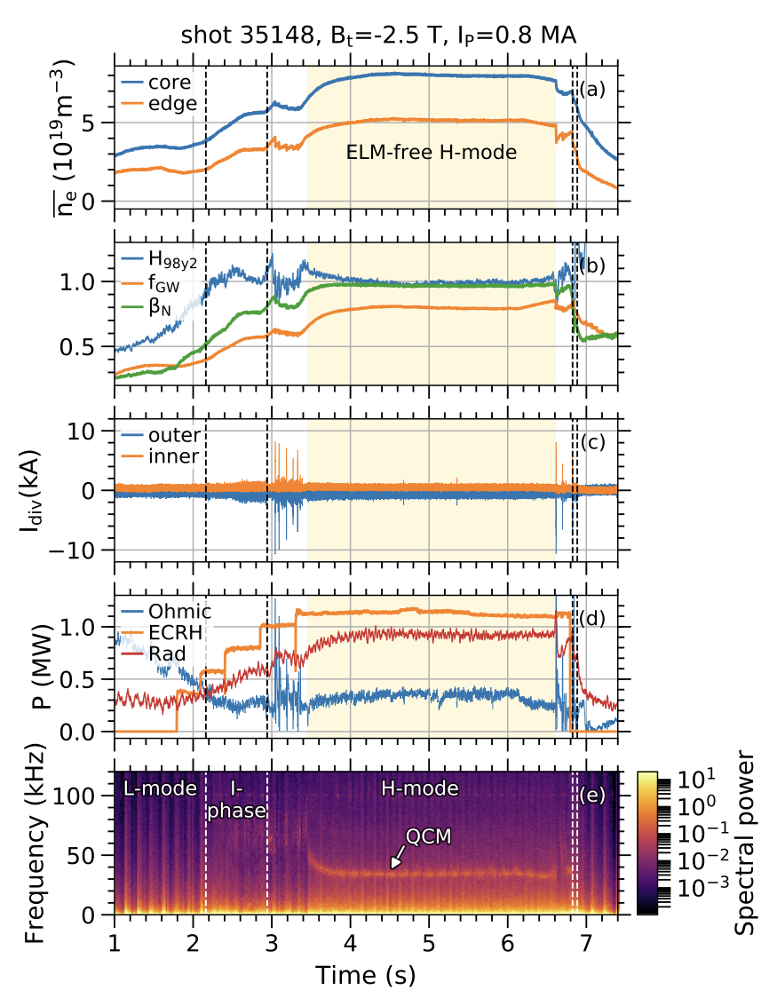
Okay, what am I still doing here? Continuing MSc work and PhD plans
Access regimes without large ELMs. To avoid transient fluxes.
EDA H-mode
X-point radiator (XPR)

Slide 12
Simulations with
For high fidelity predictions we need:
MHD for edge instabilities
Kinetic particles for realistic detachment and XPR
Visco-resisitive nonlinear MHD code in realistic X-point geometries (also for stellarators).
Kinetic extensions available:
Runaway electrons
Energetic ions
Neutrals and impurities
Instabilities in 3D.

Slide 13
Open questions

Slide 14
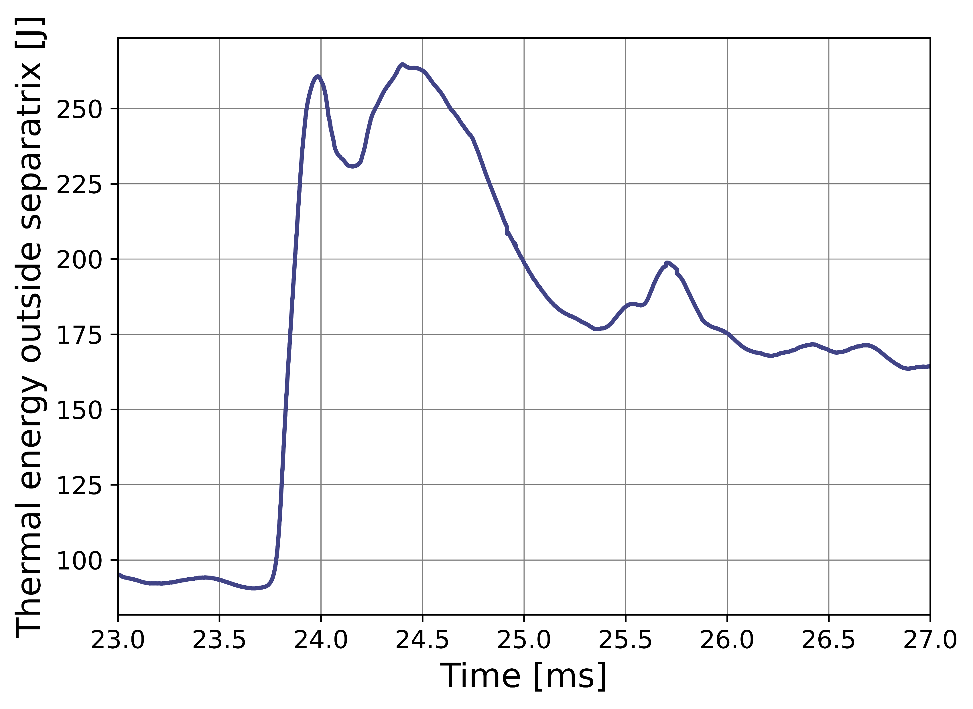
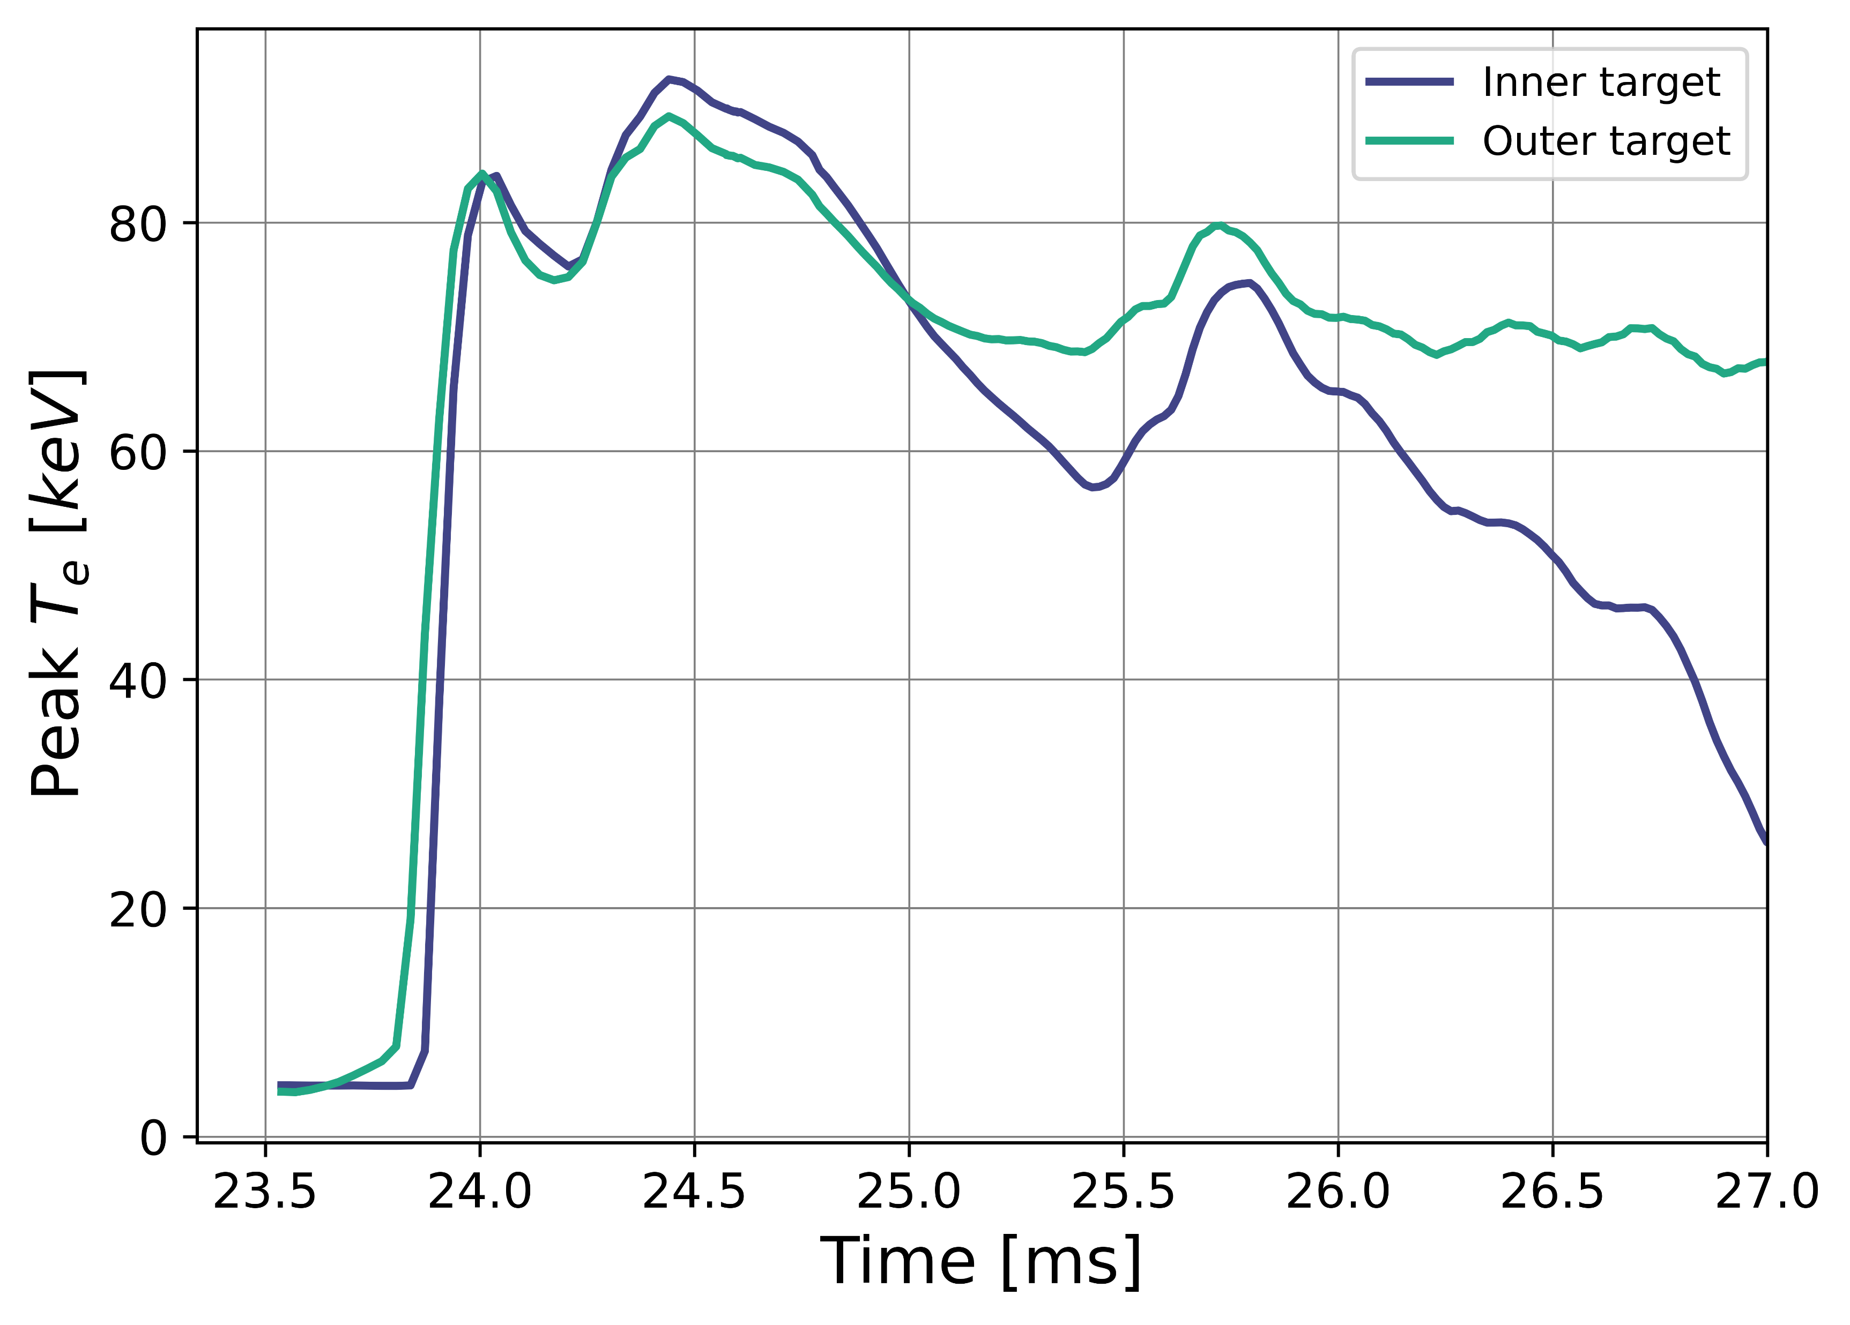
Open questions – EDA H-mode
Does plasma from edge instabilities ”burn through” the detachment front?
(Approx.) thermal energy from edge instability
Peak divertor temperatures

Slide 15
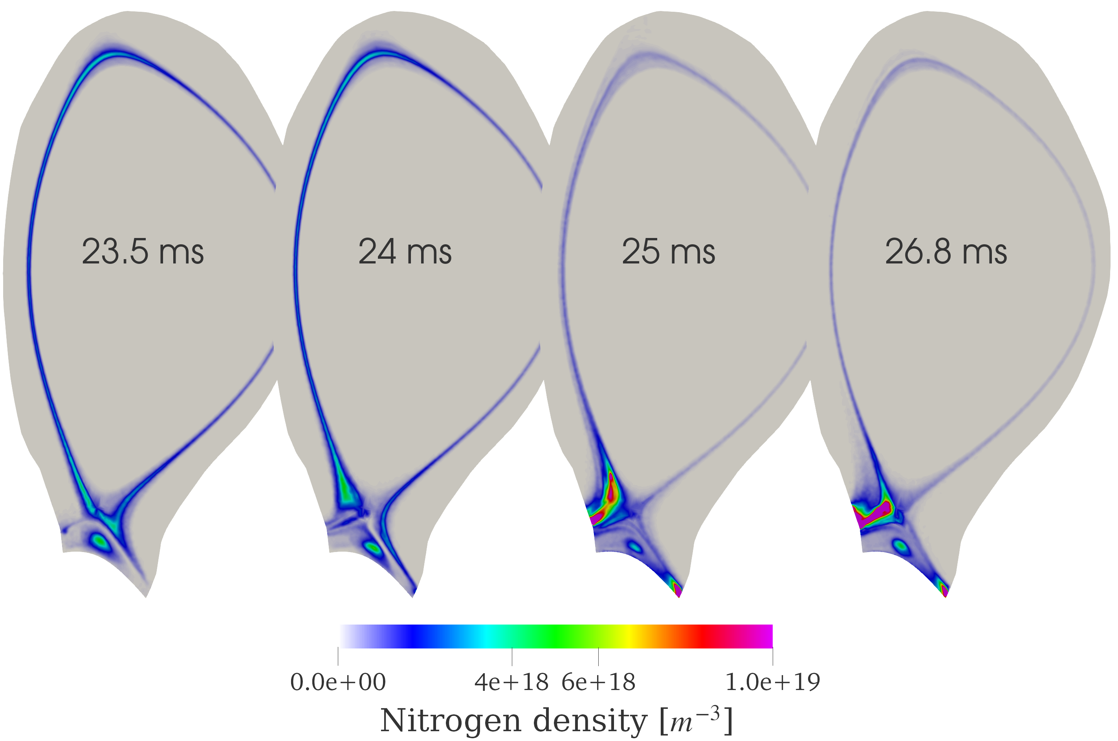
Open questions – EDA H-mode
How are the impurities transported due to the edge instability?
Why is it important?
Cooling of divertors
Core impurity content

Slide 16
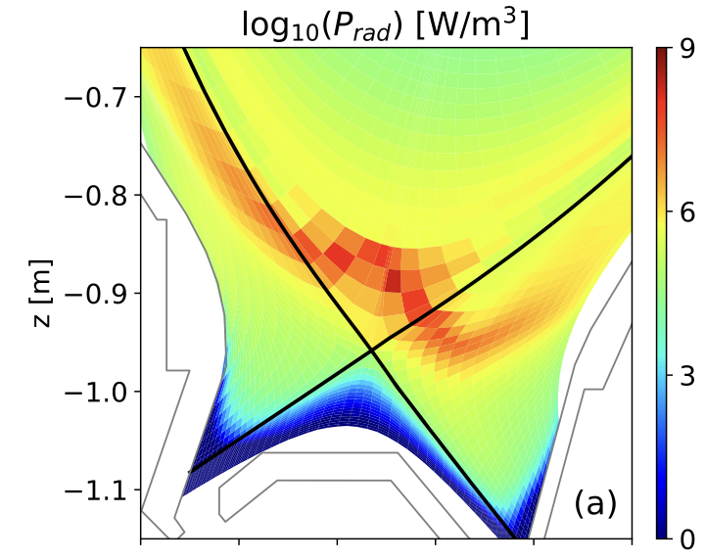
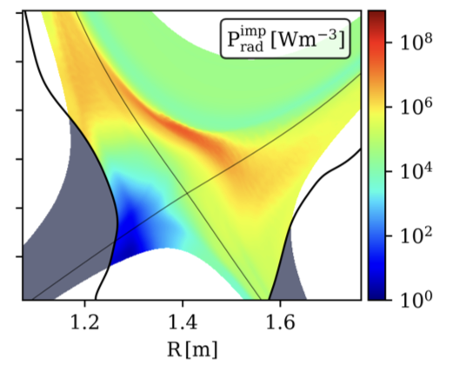
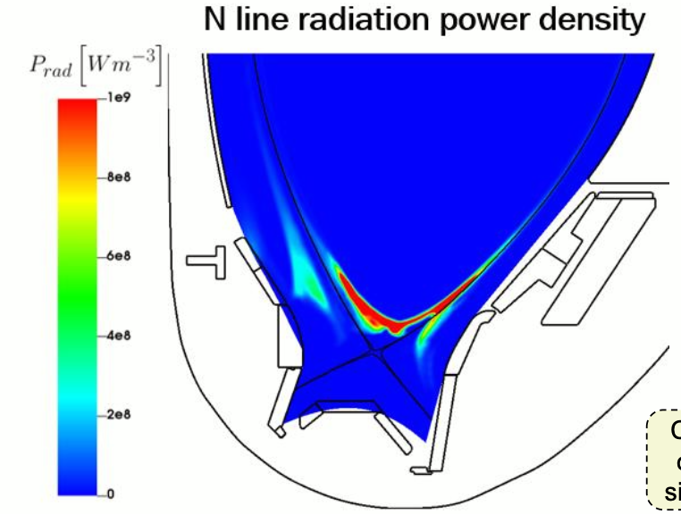
Open questions – XPR
Can we push the JOREK simulations to match the experiments and make predictions for ITER?
AUG H-mode
O. Pan SOLPS-ITER
AUG L-mode
K. Eder GRILLIX
AUG H-mode
Y.-C. Liang JOREK

Slide 17
Open questions – XPR
What is the mechanism behind ELM suppression? What happens if we lose the XPR?
ELMs suppressed at some XPR height
Why does it happen?
Why is it a fast transition?
Can It happen in ITER?

Slide 18
Summary
We need high fidelity simulations to make predictions for future tokamaks.
Nonlinear MHD with kinetic atoms allows for accurate SOL and heat exhaust modeling.
Ongoing/planned phenomena to model:
Loss of detachment (bunt-through) in EDA H-mode in AUG.
Validation of XPR simulations on AUG.
ELM suppression in XPR.
ITER XPR predictions.

