Slide 1
A Machine Learning approach to compensate for alignment fluctuations in Thomson scattering measurements of density profiles
Jule Frank
Technische Universität Berlin jule.m.frank@campus.tu-berlin.de

Slide 2
Outline
The background
The idea
The method
Results
Density profiles show unphysical effects
Laser alignment fluctuations as cause
correct these effects afterwards
step-by-step use of Machine Learning and Neural Networks
Summary and Outlook
corrected profiles

Slide 3
The background

Slide 4
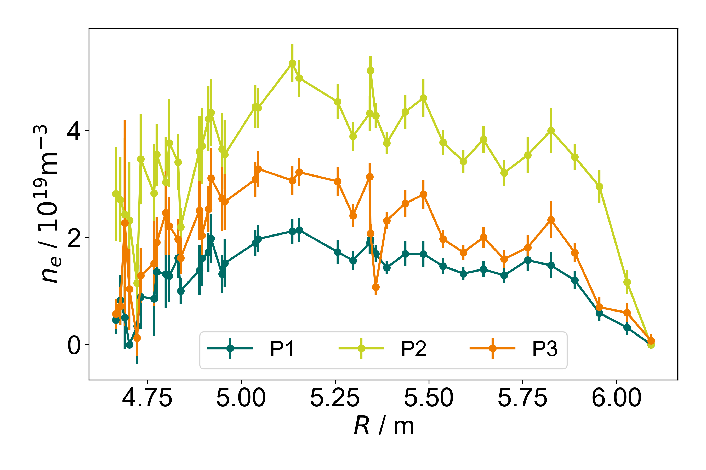
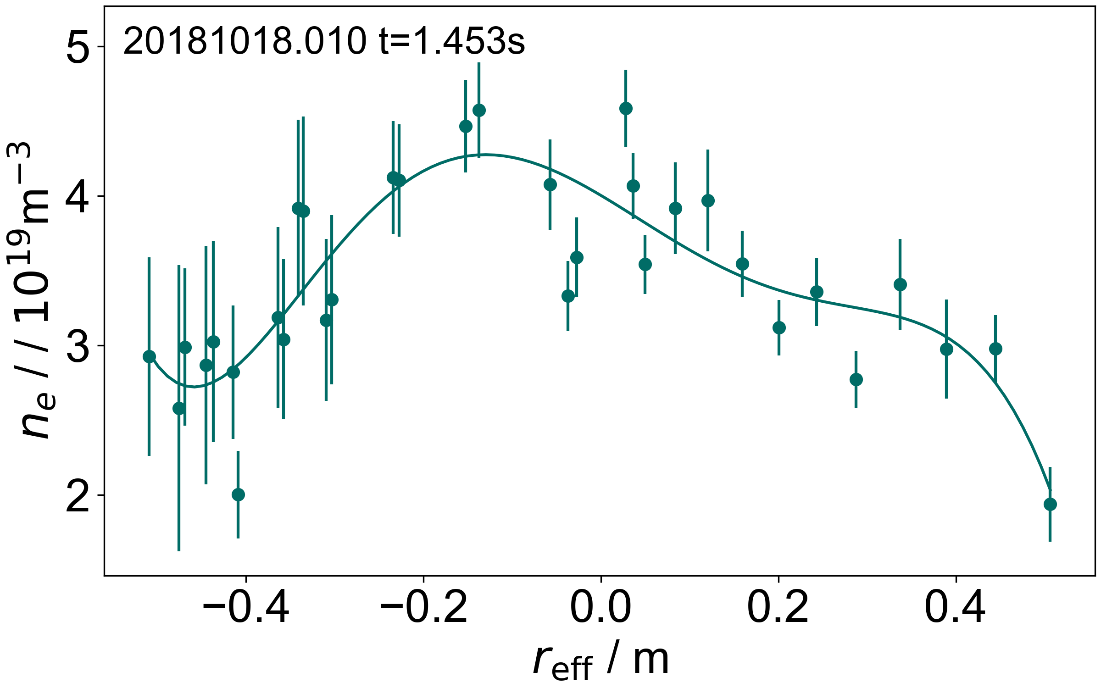
The background: the issue with the density profiles
Profiles are not smooth or symmetric in magnetic coordinates
Measured profiles for similar plasma parameters are very different
P1-20181018.004, t=0.55s P2-20181018.013, t=0.55s P3-20181018.025, t=0.55s
Notes:
Smooth because: scale were are looking at density doesn’t change the much
And jumpy bigger than statistical uncertainty (error bars) as indicated with the arrows (neighbouring data points)
Symmetric because magnetic coordinates(effective radius) and constant plasma pressure → equal density distribution
Profile fitted with polynom over reff (magnetic coodinates → should be symmetric

Slide 5
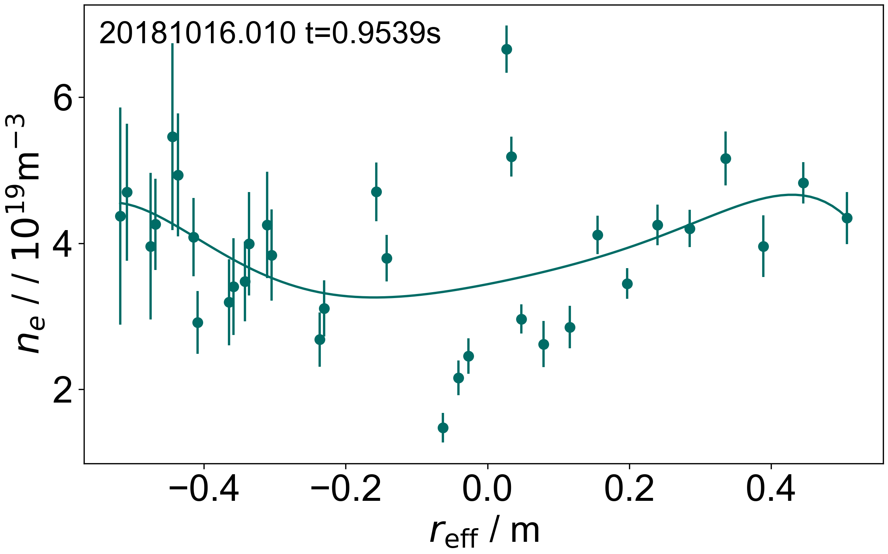
The background: the issue with the density profiles
Profiles are not smooth or symmetric in magnetic coordinates
Measured profiles for similar plasma parameters are very different
P1-20181018.004, t=0.55s P2-20181018.013, t=0.55s P3-20181018.025, t=0.55s
Notes:
Sometime look as bad as this: scattered, no smoothness, no symmetry, huge jumps
Plasmas of the same day, same parameters (heating, plasma energy) but Different absolute values
Difference seen especially in the middle

Slide 6
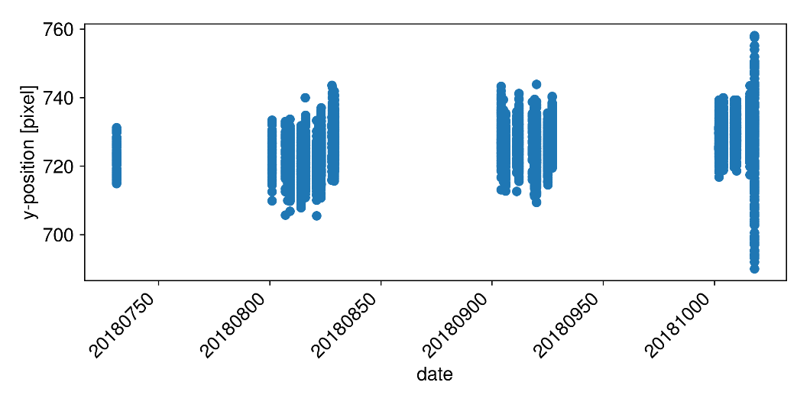
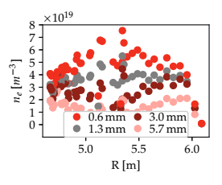
The background: biggest error source of TS density profiles
example laser 2
[image courtesy G. Fuchert]
Master‘s thesis of P. Nelde:
biggest error source: unstable laser alignment.
Two parts:
        Drift
        Vibration
Results in a variety of different profile shapes
Even small drifts can reduce the measured density by 90 %
[P. Nelde, IPP (2021)]
Notes:
how was this evaluated?
- biggest source: laser is unstable in its alignment
- laser was monitored by camera
- movement is categorizable in 2 parts
- intentional shifting allows observing the impact

Slide 7
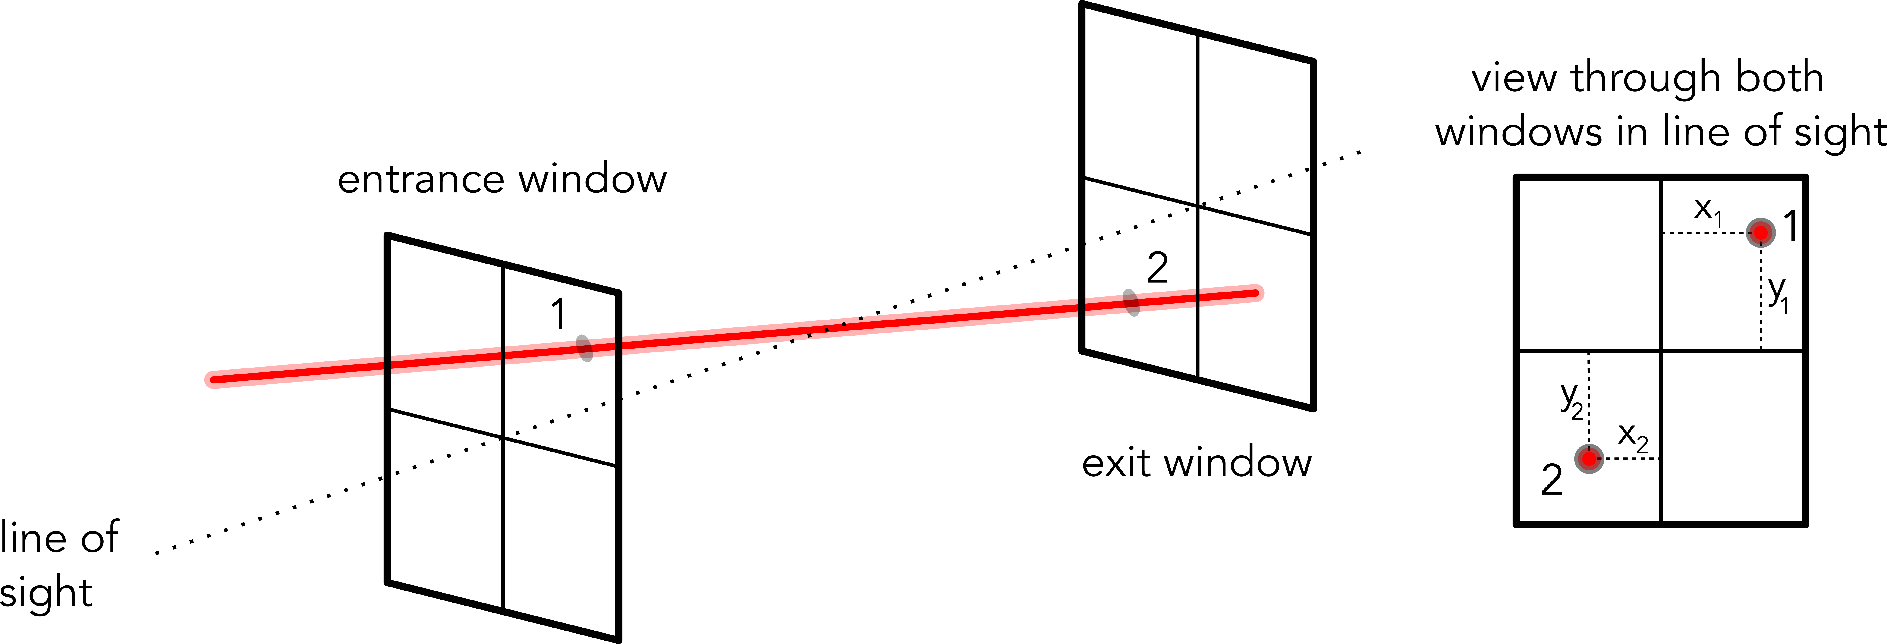
The background: degrees of freedom
Describing the laser path/orientation:
    2 coordinates on each window
    2 coordinates on one window and two angles
Not necessarily all of them have an influence on profile shape → less than 4 dimensions possible
4 coordinates/degrees of freedom
Notes:
to give an idea of the dimensions of this issue
- figure on the bottom
- two coordinates each window
- movement in line of sight shouldn't have influence
- results in 4 degrees of freedom
- keep in mind: masters thesis: only one camera

Slide 8
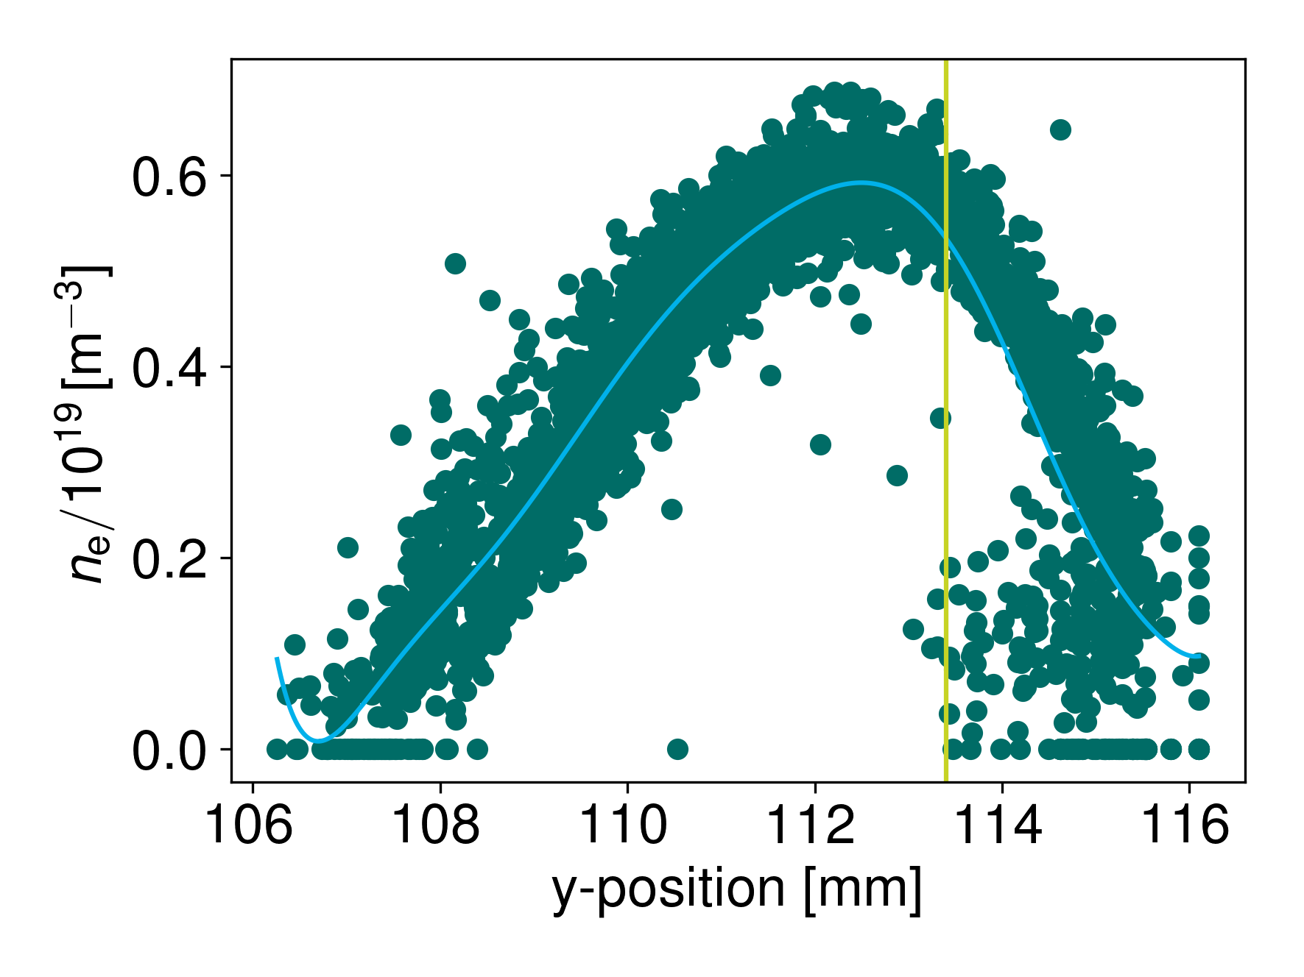
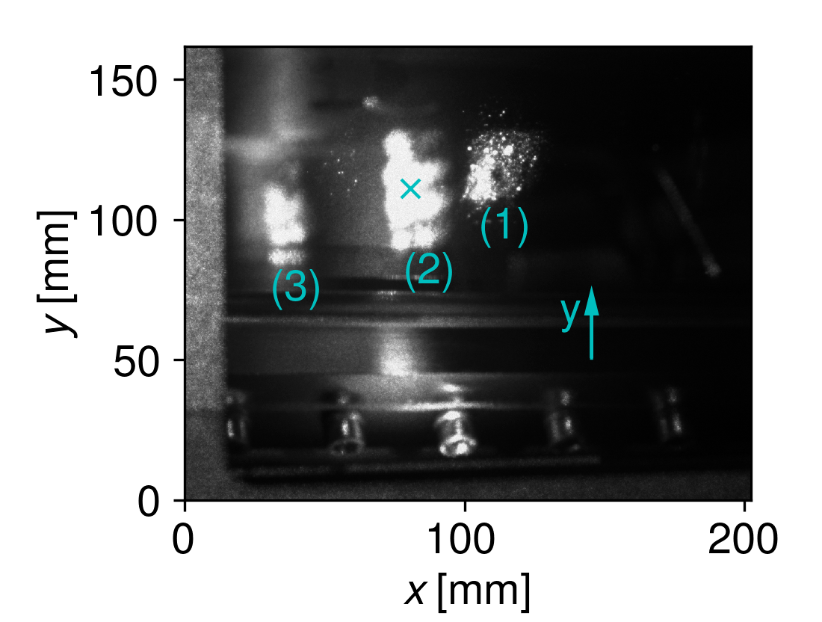
The background: correction by camera
Proof of concept:
Monitoring of entrance laser position with a camera
Position dependence from alignment scans
        each volume has now a relation between position on camera and density (2D)
[G. Fuchert, JINST 17, C03012 (2022)]
Monitored position of the laser spot on the entrance window (1) and two reflections (2 and 3)
Notes:
Monitoring
Position dependence 2D
Relation 2D

Slide 9
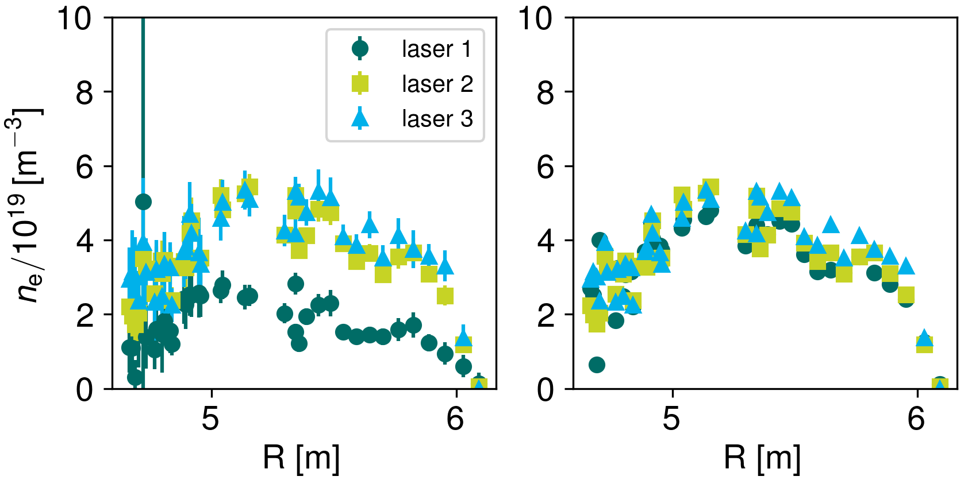
The background: correction by camera
    Correction of profiles influenced by intentional laser misalignment successful
Current OP:
2 cameras monitoring the laser entrance and exit → all degrees of freedom should be sufficiently covered
4D position dependence scans on Sa, 08.10.22
… but correction of OP 1.2b data is not possible since there was no camera observation of laser exit
Notes:
using the information about relation and calibration position allowed for correction of profiles influenced by intentional laser misalignment
Successful
currently this is used again
now 2 cameras allow 4D scans
happened on saturday two weeks ago
this seems to be perfect so where is the issue:
old data of OP 1.2b only covered 2 degrees of freedom
very likely that this is missing information especially if angle movements are important

Slide 10
The idea

Slide 11
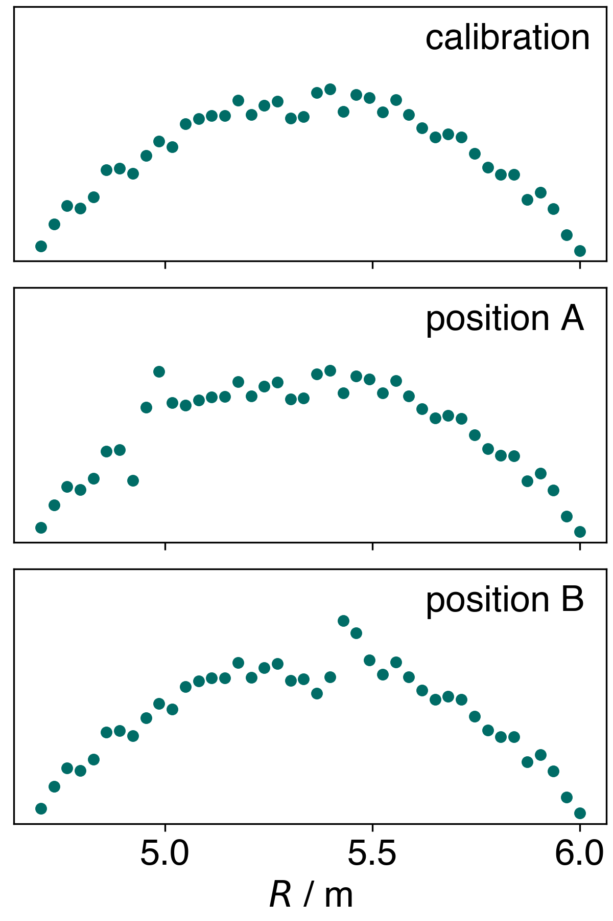
The idea: where to find the laser position
basic illustration of the laser influence
How to get the position afterwards?
Laser influences profile shape in a specific way
→ Information about the laser position is part of the data
Method that can extract this information from the data itself
  → Neural networks (Autoencoder)
Notes:
first: answer the question: what do we know?
influence in specific way: info part of data
every position comes with its unique distortion
here shown in simple way
in reality this is way more complex and not understandable for us
new method needed
As shown later

Slide 12
The idea: procedure in order to correct the profiles
extract laser position with neural networks
infer laser position from profile shape
identify calibration position
perform profile correction
Notes:
1. extract
2. infer
3. identify because by using neural networks we move into an abstract space and we need to find the connections to the actual configuration in the Laboratory
4. after this perfom

Slide 13
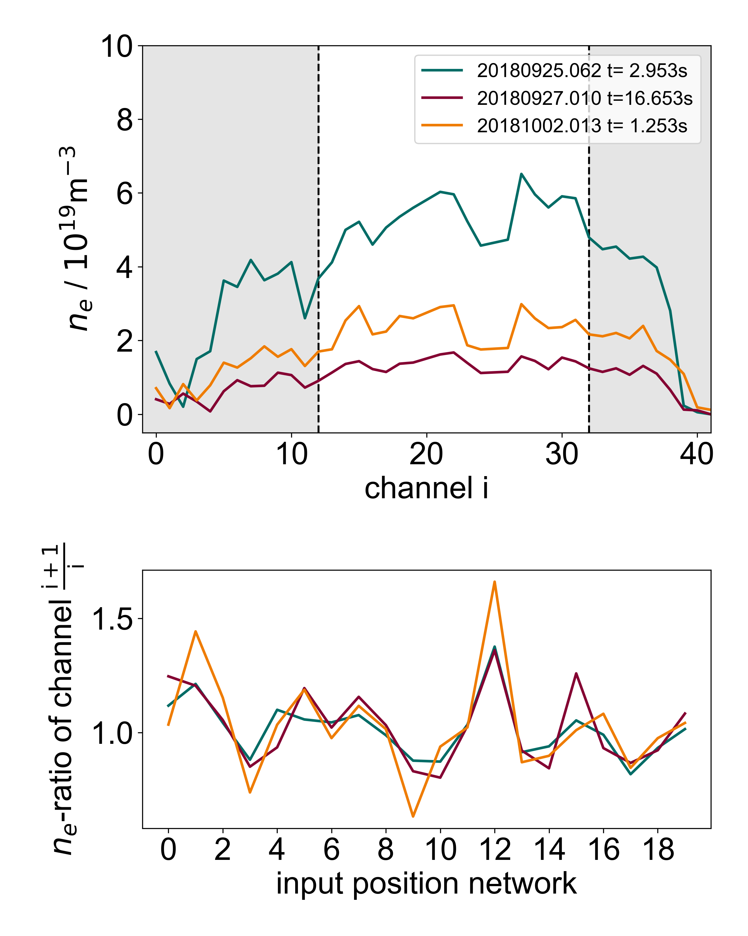
The idea: reduce influence of profile shape
Data preparation
    Ignoring profile edges → better stability (statistical uncertainties)
    Density ratios → remove impact of actual shape
Data representation encodes an abstract laser position
information reduction with neural networks
Notes:
On the edges low signal-to-noise ratio → statistical uncertainties which don't have any pattern so there is nothing to gain from
on first sight: profiles on the right appear to be different, absolute values overall
closer look: are from different shots but look very similar in shape (peaks), same course
Could be possible that this is a result from the same laser position → should be treated equally
Ratios representation an abstract laser position which allows us to "label"
as mentioned degrees of freedom should be at 4 but here more than 18
information reduction to fitting amount of dimensions

Slide 14
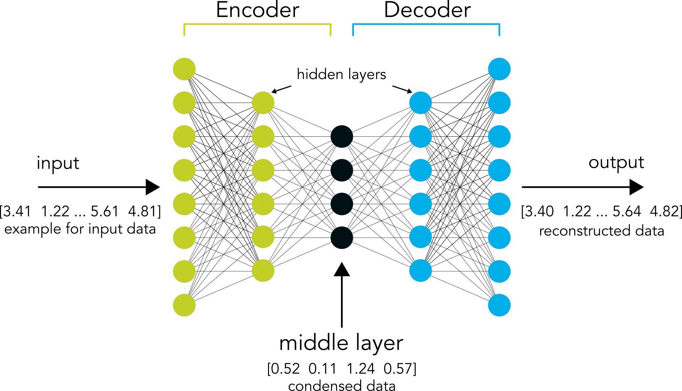
The idea: using a autoencoder network
Autoencoder network
Resemble the process of learning from experience and than predicting the outcome of new input
Unsupervised learning – not knowing about the outcome → Used to find hidden structures in data
Extracting the essential characteristics while losing information about noise
How do they work?
3 main parts: encoder, decoder and middle layer
Middle layer represents abstract laser position
Notes:
Look like this:
neural networks resemble the process of learning from experience and predicting the outcome of new input based on that experience
3 type of network in order to do so: reinforcement, supervised and unsupervised learning – here last one
Hidden structures
How do they work?
Information is passed on from layer to layer (here left to right)
Each layer consists of neurons that contain some sort of information value
Network finds a connection between the information and therefore searches for patterns -process called training
Autoencoder 3 parts
Encoder is where the ratios are put into – passed on while condensing the information until middle layer
Middle layer represents the ratios in its least dimensional form
From there decoder reconstructs the ratios step by step only using the middle layer information
How does the network know what to train for? Same output as input
Middle layer represents fingerprint

Slide 15
Reminder: degrees of freedom
Expecting 4 degrees of freedom
Not necessarily all of them have an influence on profile shape → less than 4 dimensions possible
Why not using more than 4 Dimensions to make sure that all the degrees are covered?
More dimensions would be used to reconstruct statistical effects → makes correction worse
Notes:
Reminder:
Expectation 4 degrees → 4 dimensions in middle layer
Not all of them might be necessary
But a reasonable question would be: Why don’t we use more?
The network can use 4 of them in order to categorize the abstract laser position (what we want) and the rest of them to store random information
This is a problem because network does not need to throw away noise
Correction using this abstract laser position as a base now correcting to statistical effects → worse
→ Need to find the sweet spot

Slide 16
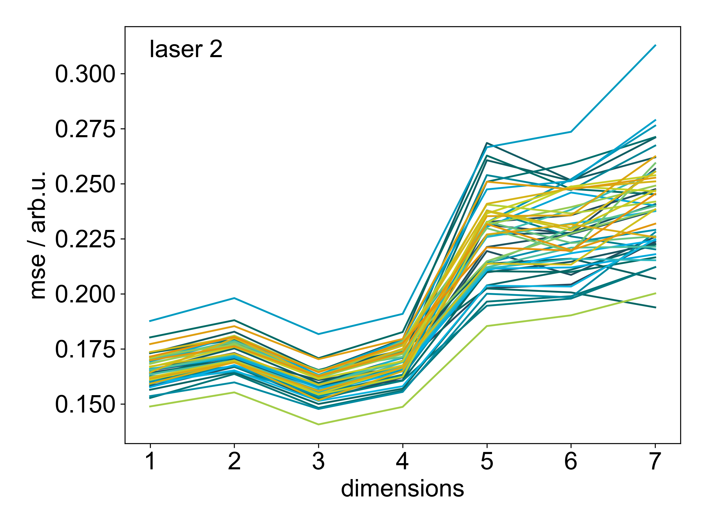
The idea: degrees of freedom – fitting dimension
Comparing corrections of the same profiles with 1-7 dimensions in the middle layer
More than 4 dimensions seem to make the correction worse
1-4 dimensions are rather similar
Minimum seems to be at 3 dimensions
→ Agrees with expectation from geometric configurations
Notes:
We trained 7 different networks with 1 to 7 neurons/dimensions in the middle layer
Comparing corrections…

Slide 17
The idea: assumptions that are made
Laser returns to every position (especially to the calibration position) often enough → sufficient amount of training data and information on “correct” profile shape
Raman calibration successful → profiles at calibration position are “correct” → Each laser and calibration needs its own evaluation because the effects are relative to the respective position during calibration
→ After all this the laser positions are known and the correction can take place

Slide 18
The method

Slide 19
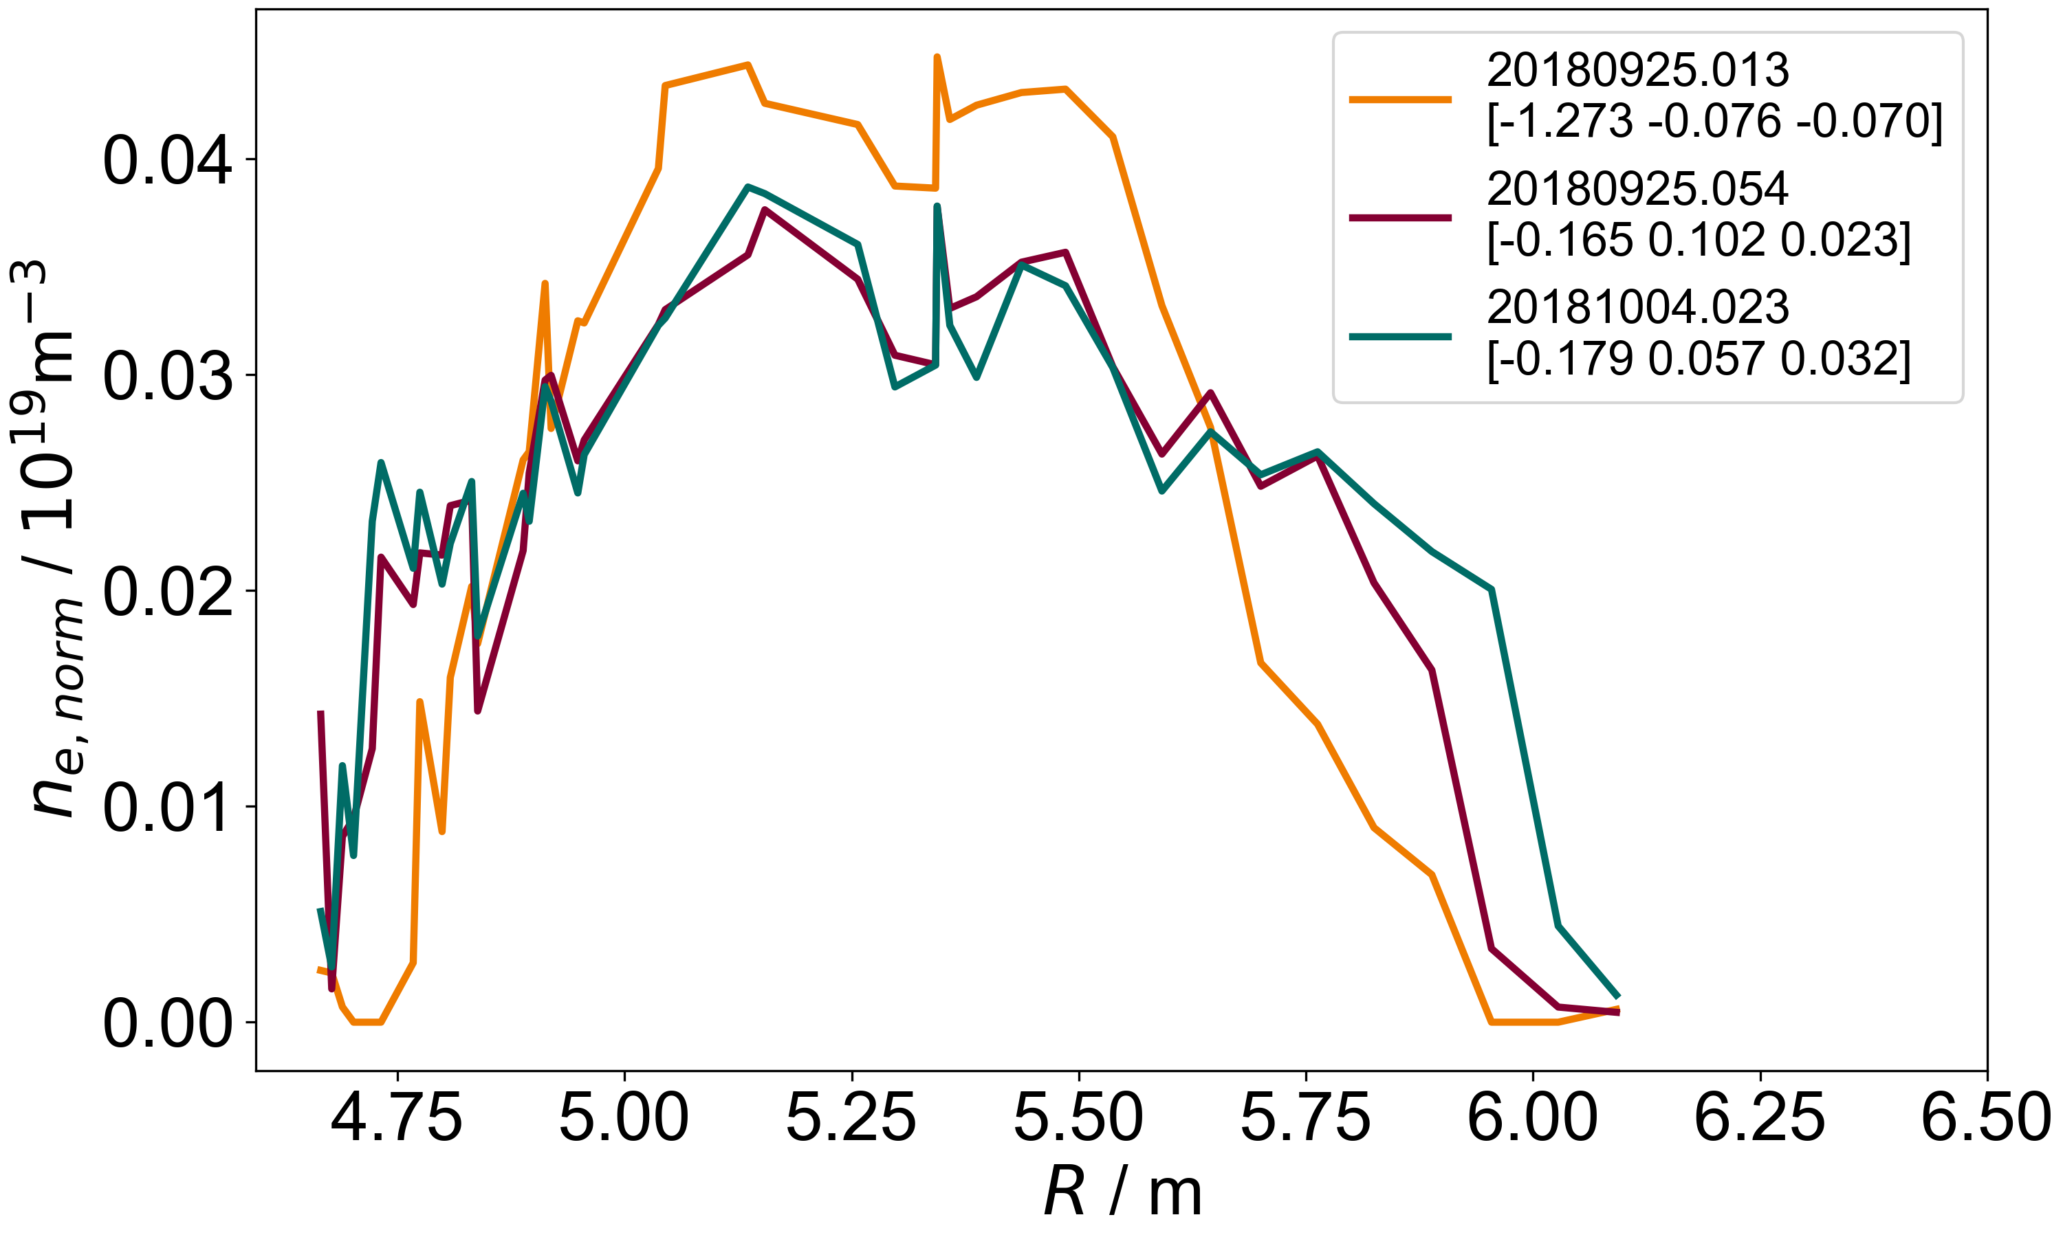
The method: assignment of laser position to profile
Profiles with similar shapes should correspond to similar laser positions → should have similar abstract laser coordinates
Profiles with a different shape should therefore have a different abstract laser position
→ categorizable by abstract laser position
→ creating a grid of abstract laser positions
Notes:
we managed to get abstract laser positions
on the right side: 3 normed profiles
in order to make sure that they are comparable

Slide 20
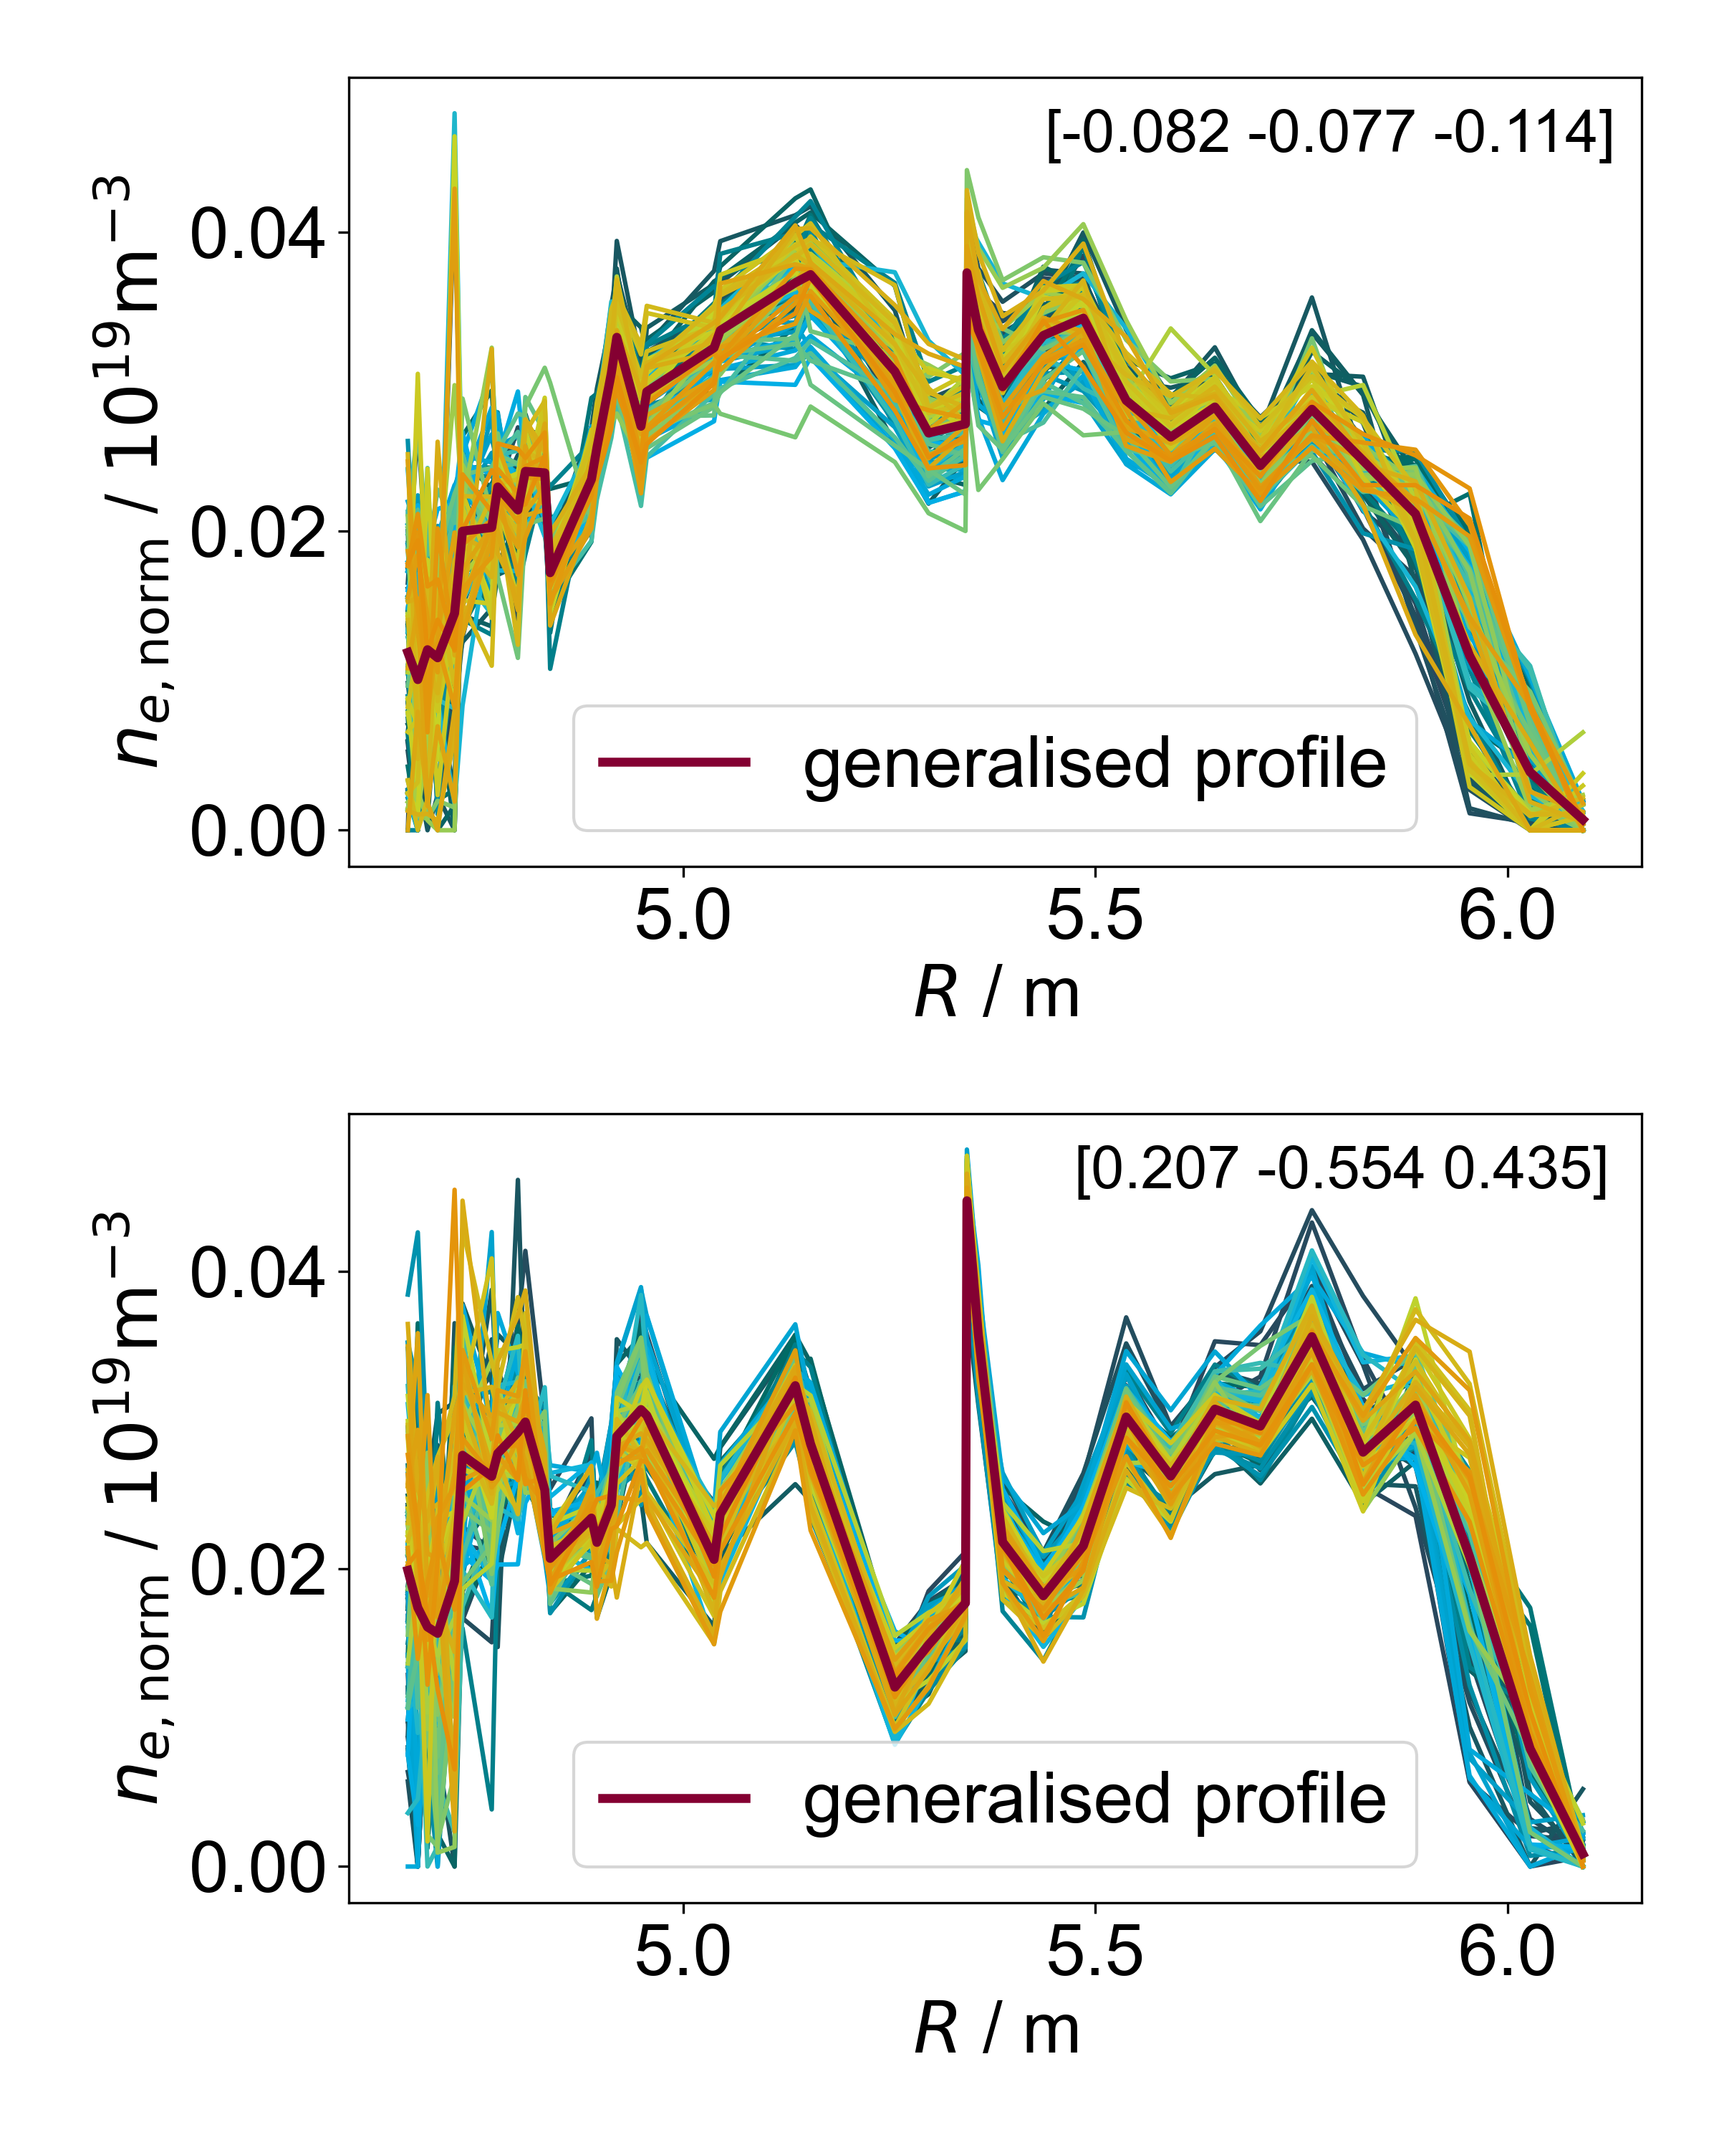
The method: sorting by position with the help of a grid
Grid with one cell for every profile in training data which represents the corresponding position
Assignment of the 100 nearest profiles
All of them are normalized in order to minimize influence of plasma parameters
Calculating the mean as a generalised profile for each cell
assignment successful
→ Each position has a unique generalised profile
need to find the calibration cell
Notes:
Now the positions can be extracted → sorting by laser position

Slide 21
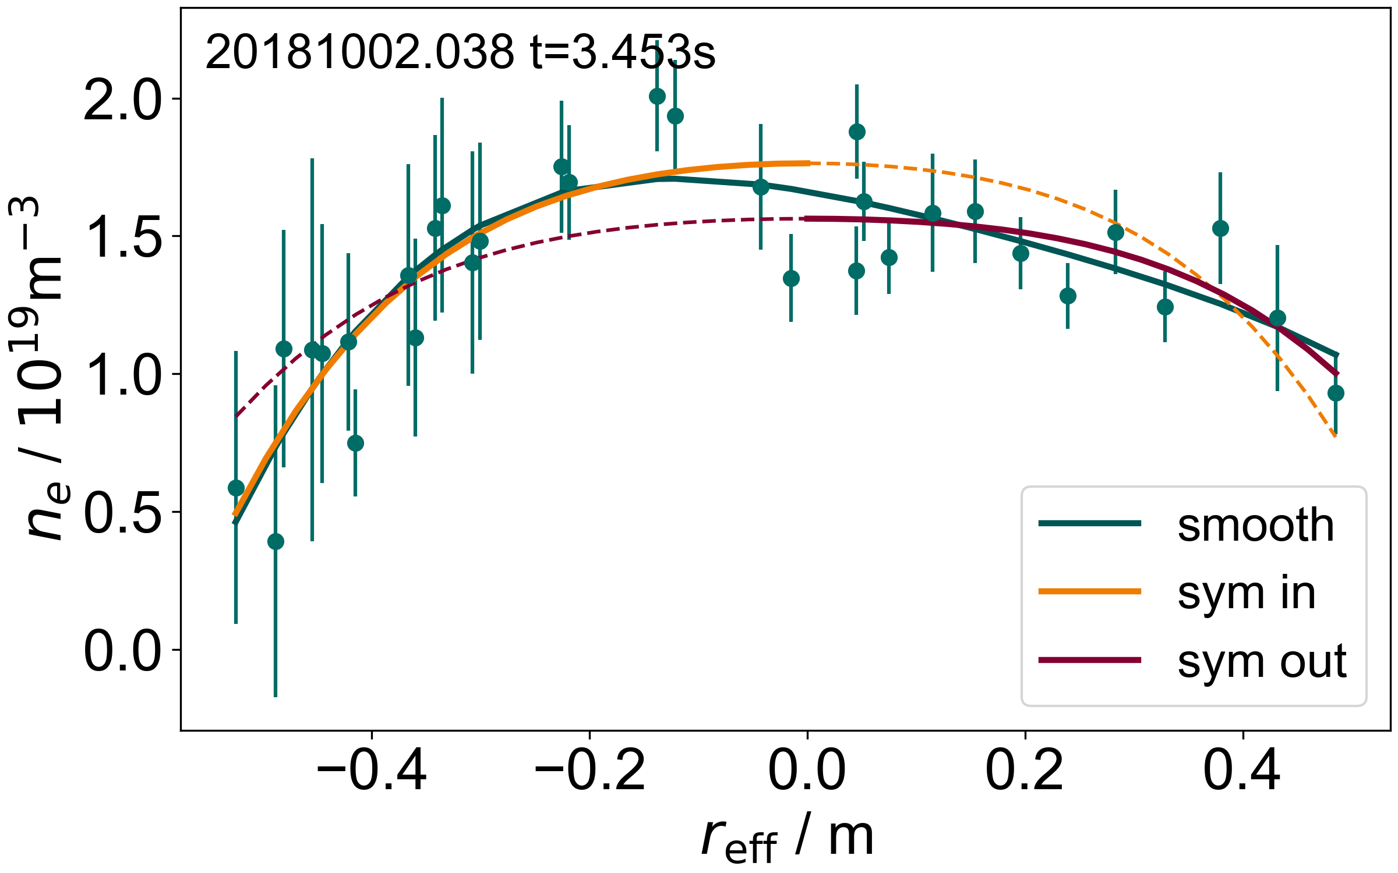
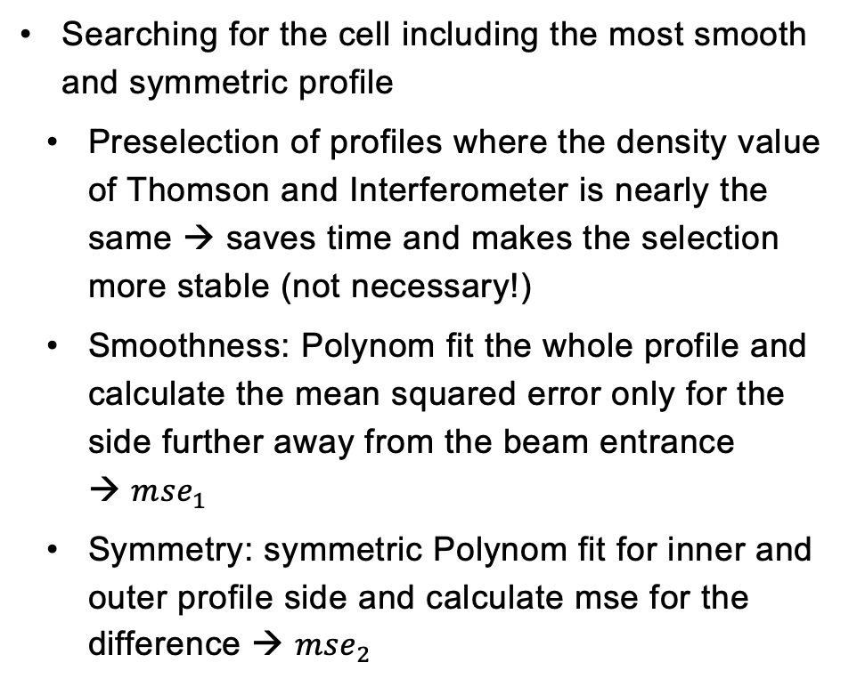

The method: finding the calibration cell/position
Searching for the cell including the most smooth and symmetric profile
    Preselection of profiles where the density value of Thomson and Interferometer is nearly the same → saves time and makes the selection more stable (not necessary!)
    Smoothness: Polynom fit the whole profile and calculate the mean squared error only for the side further away from the beam entrance → ${mse}_{1}$
    Symmetry: symmetric Polynom fit for inner and outer profile side and calculate mse for the difference → ${mse}_{2}$
$$⇒ E= \frac{{mse}_{1}+{mse}_{2}}{2}$$
→ Lowest error $E$ corresponds to the cell with the “best” shape and therefore the calibration cell/position

Slide 22
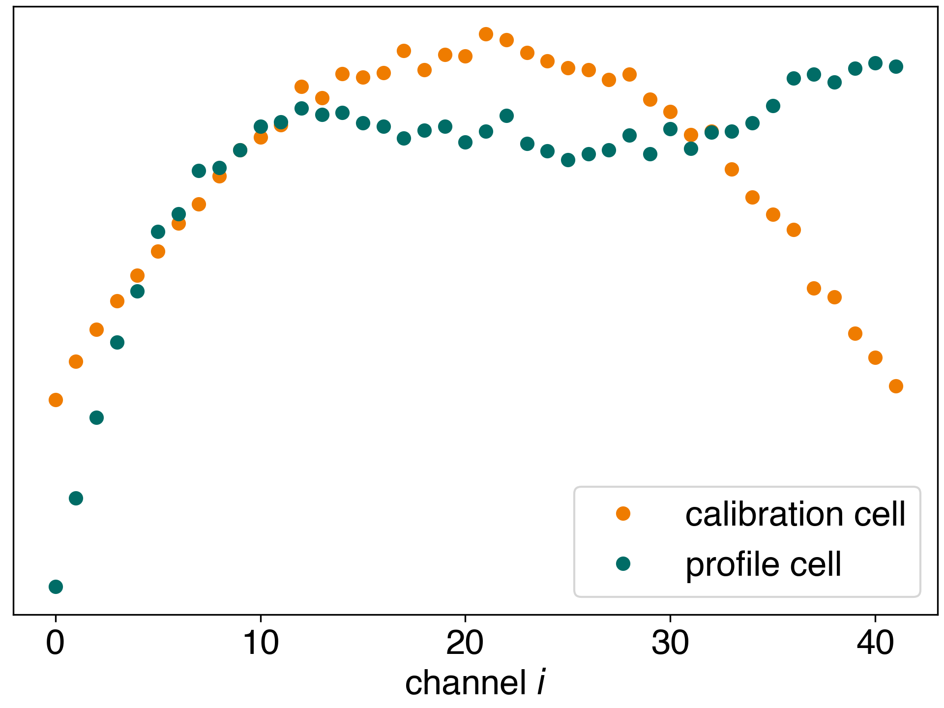
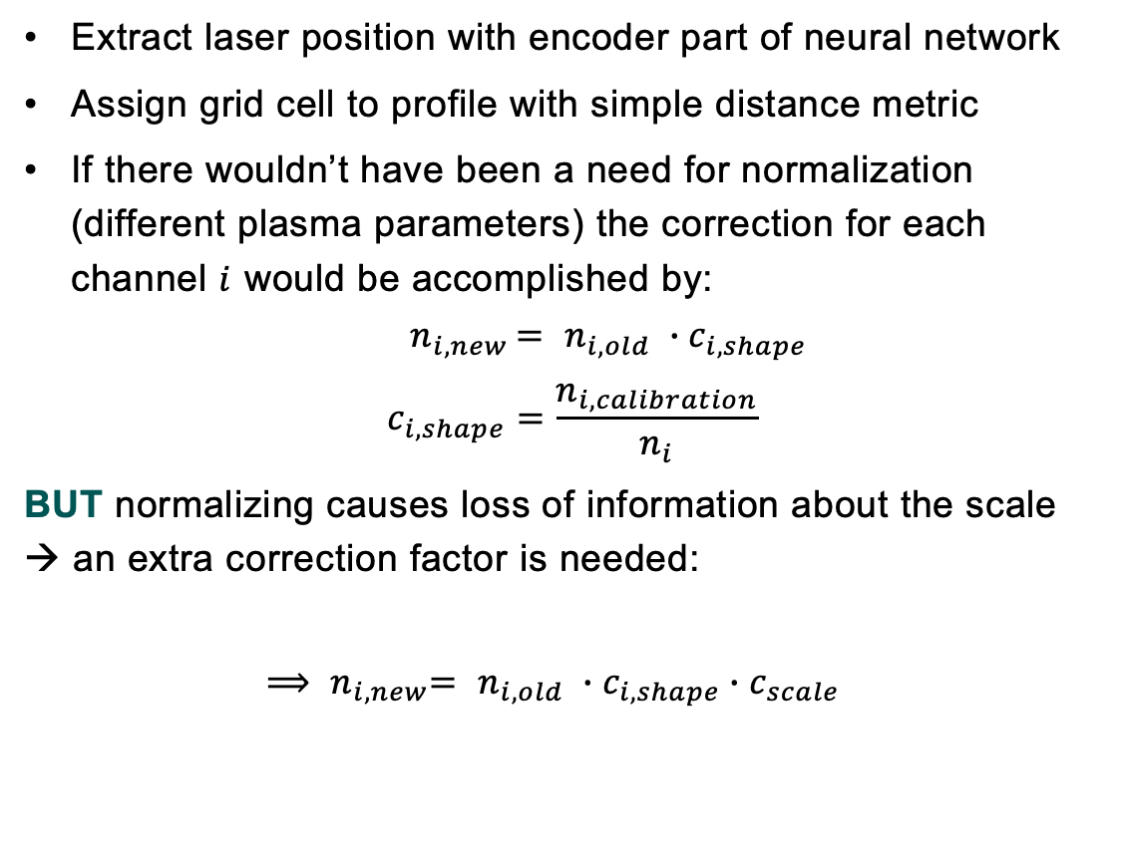
The method: actual correction
Extract laser position with encoder part of neural network
Assign grid cell to profile with simple distance metric
If there wouldn’t have been a need for normalization (different plasma parameters) the correction for each channel $i$ would be accomplished by:
$${ n}_{i,new }= n_{i,old} ∙c_{i,shape}$$
$$c_{i,shape}=\frac{n_{i,calibration}}{n_{i}}$$
BUT normalizing causes loss of information about the scale → an extra correction factor is needed:
      $${⟹ n}_{i,new}= n_{i,old} ∙c_{i,shape}∙c_{scale}$$
Illustration of generalised (normalized) profiles used for correction

Slide 23
The method: scale correction
1.
2.
x
x
x
x
x
4.
3.

Slide 24
The method: correction error
Error: correcting all 100 profiles to all 100 profiles in calibration cell (10000 correction factors) → 95% confidence interval
  Includes the original error → no further error propagation required
  Represents the cell of corrected profile → the closer the shapes of the profiles in the cell the smaller the error

Slide 25
Results

Slide 26
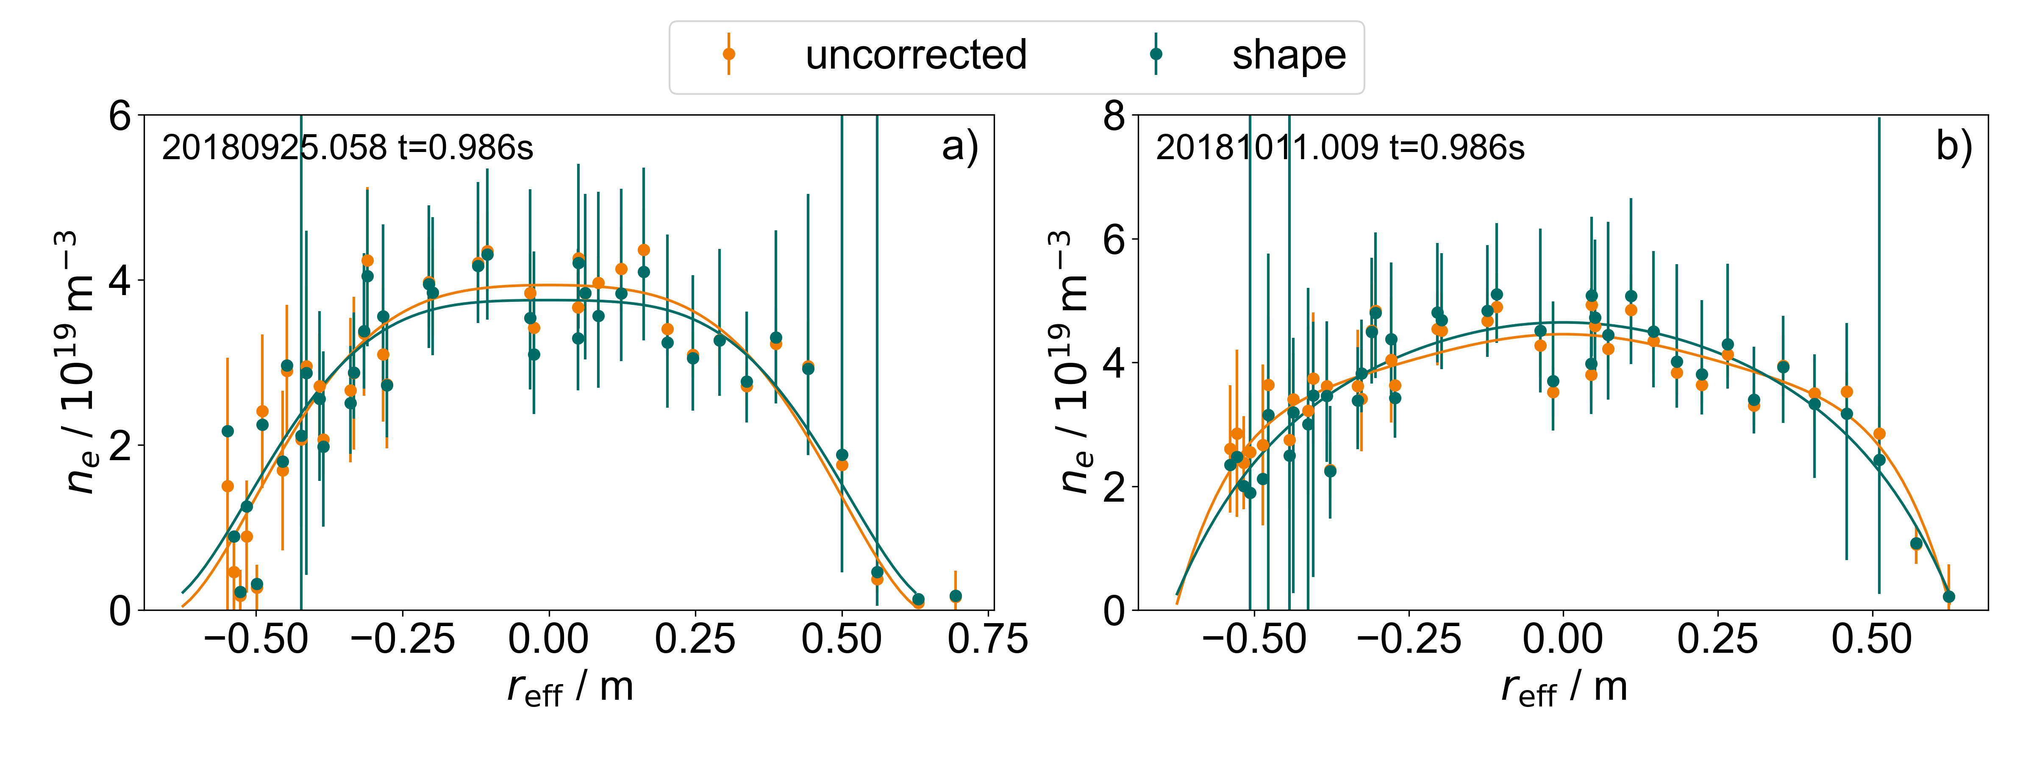
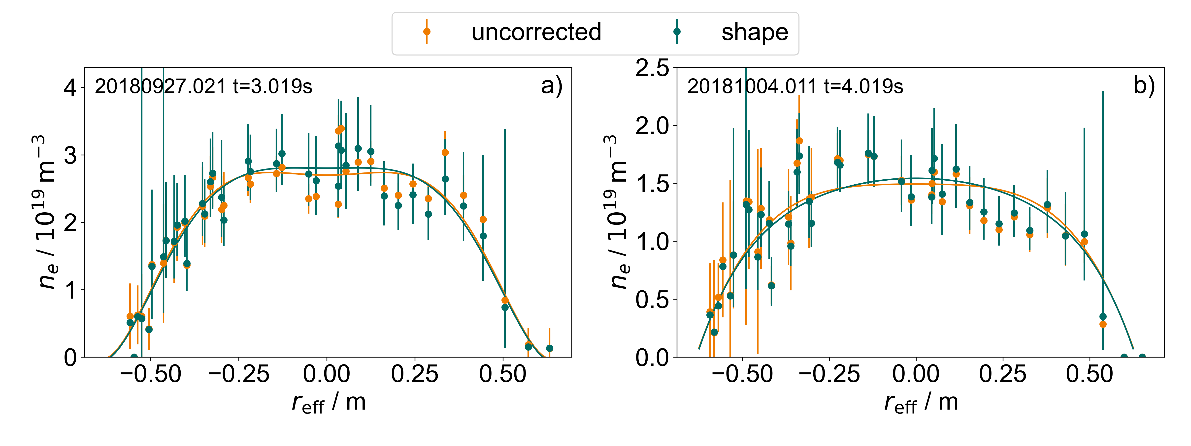
Results: good profiles remain unchanged
Laser 3 V10
Laser 1 V10
Profiles that have a high quality (symmetry and smoothness) already are almost unchanged after the correction
big jump in the middle gets smaller
Increase of smoothness (and therefore symmetry)

Slide 27
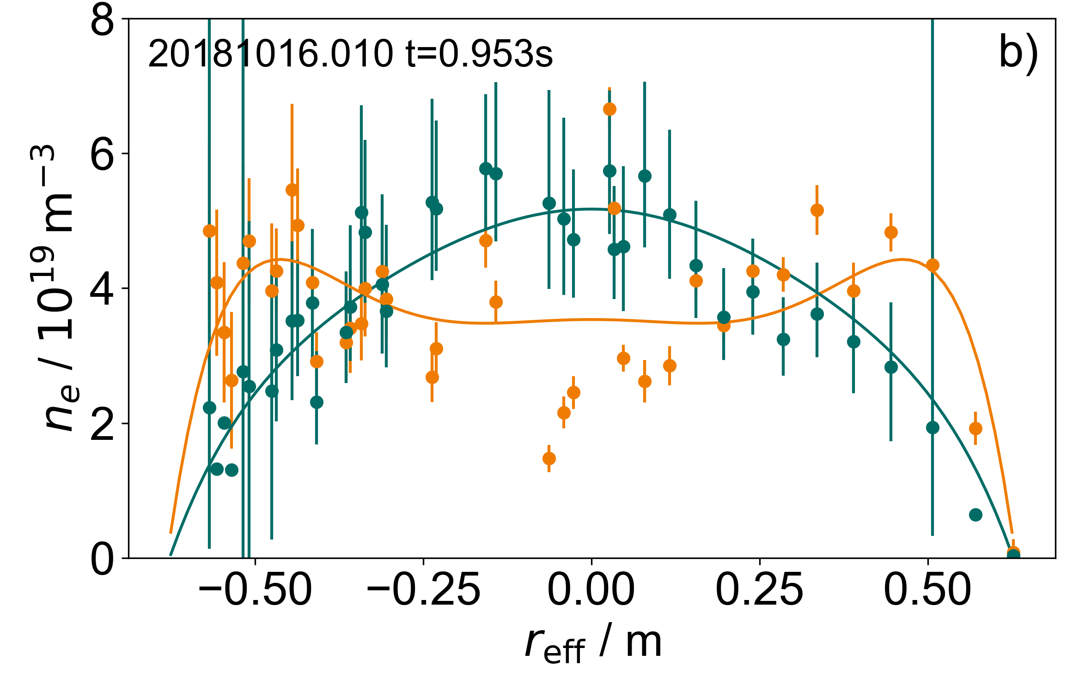
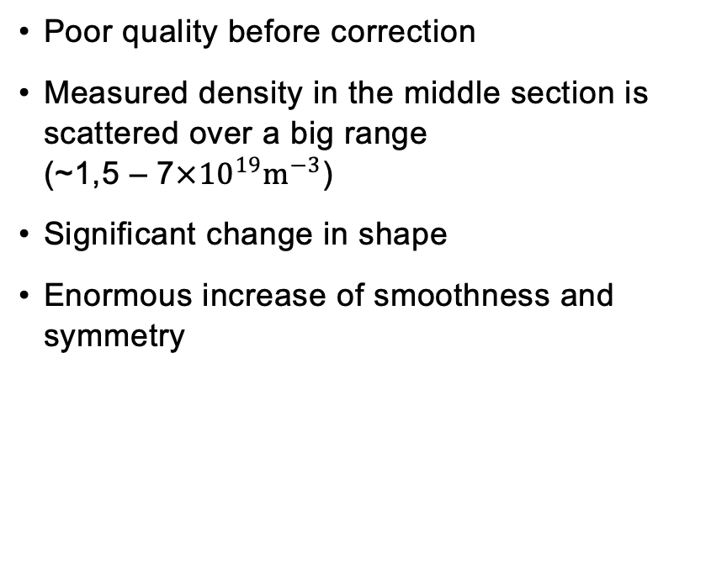
Results: example of drastic correction
Laser 2 V10
Poor quality before correction
Measured density in the middle section is scattered over a big range (~1,5 – 7${×10}^{19}m^{−3}$)
Significant change in shape
Enormous increase of smoothness and symmetry

Slide 28

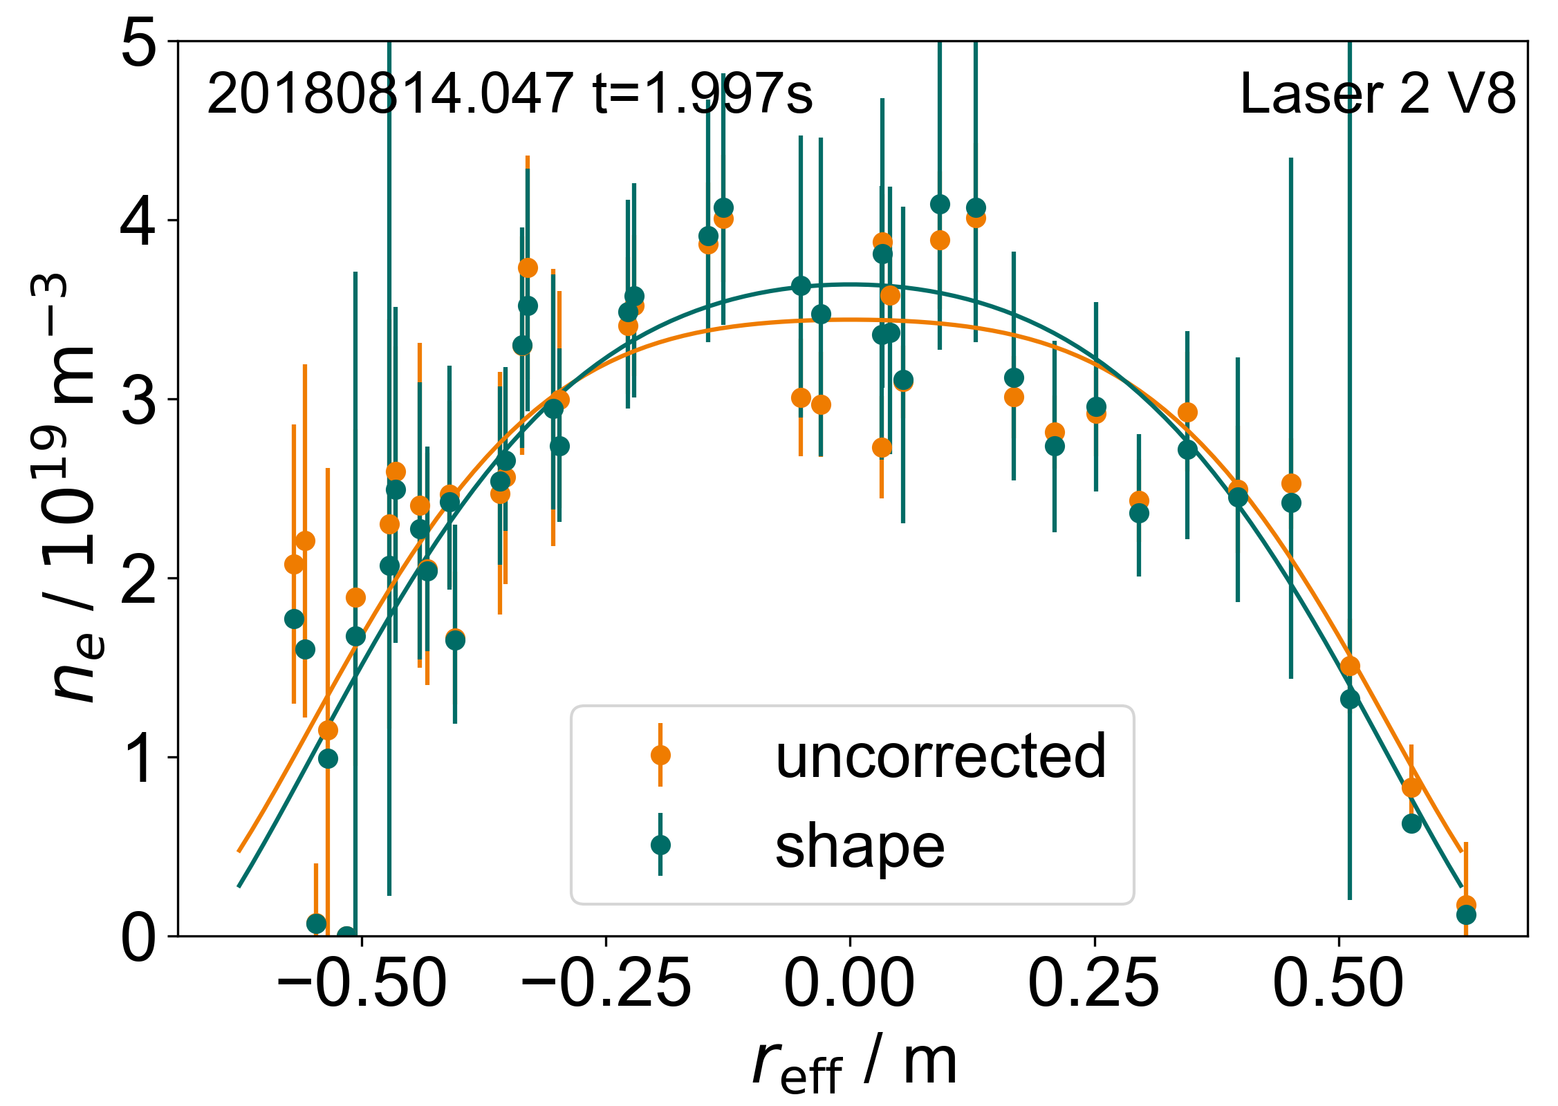
Results: OP 1.2b calibration
Two subcampanges: V8, V10
Method developed on V10 → works well for V10 but not as good for V8
Hypothesis: less positional scatter, laser did not return to calibration position → assumption is not satisfied
BUT calibrations are similar → using V10 version in order to correct V8 profiles
Notes:
V8 27.07.18 – 21.09.18
V10 22.09.18 – 18.10.18

Slide 29
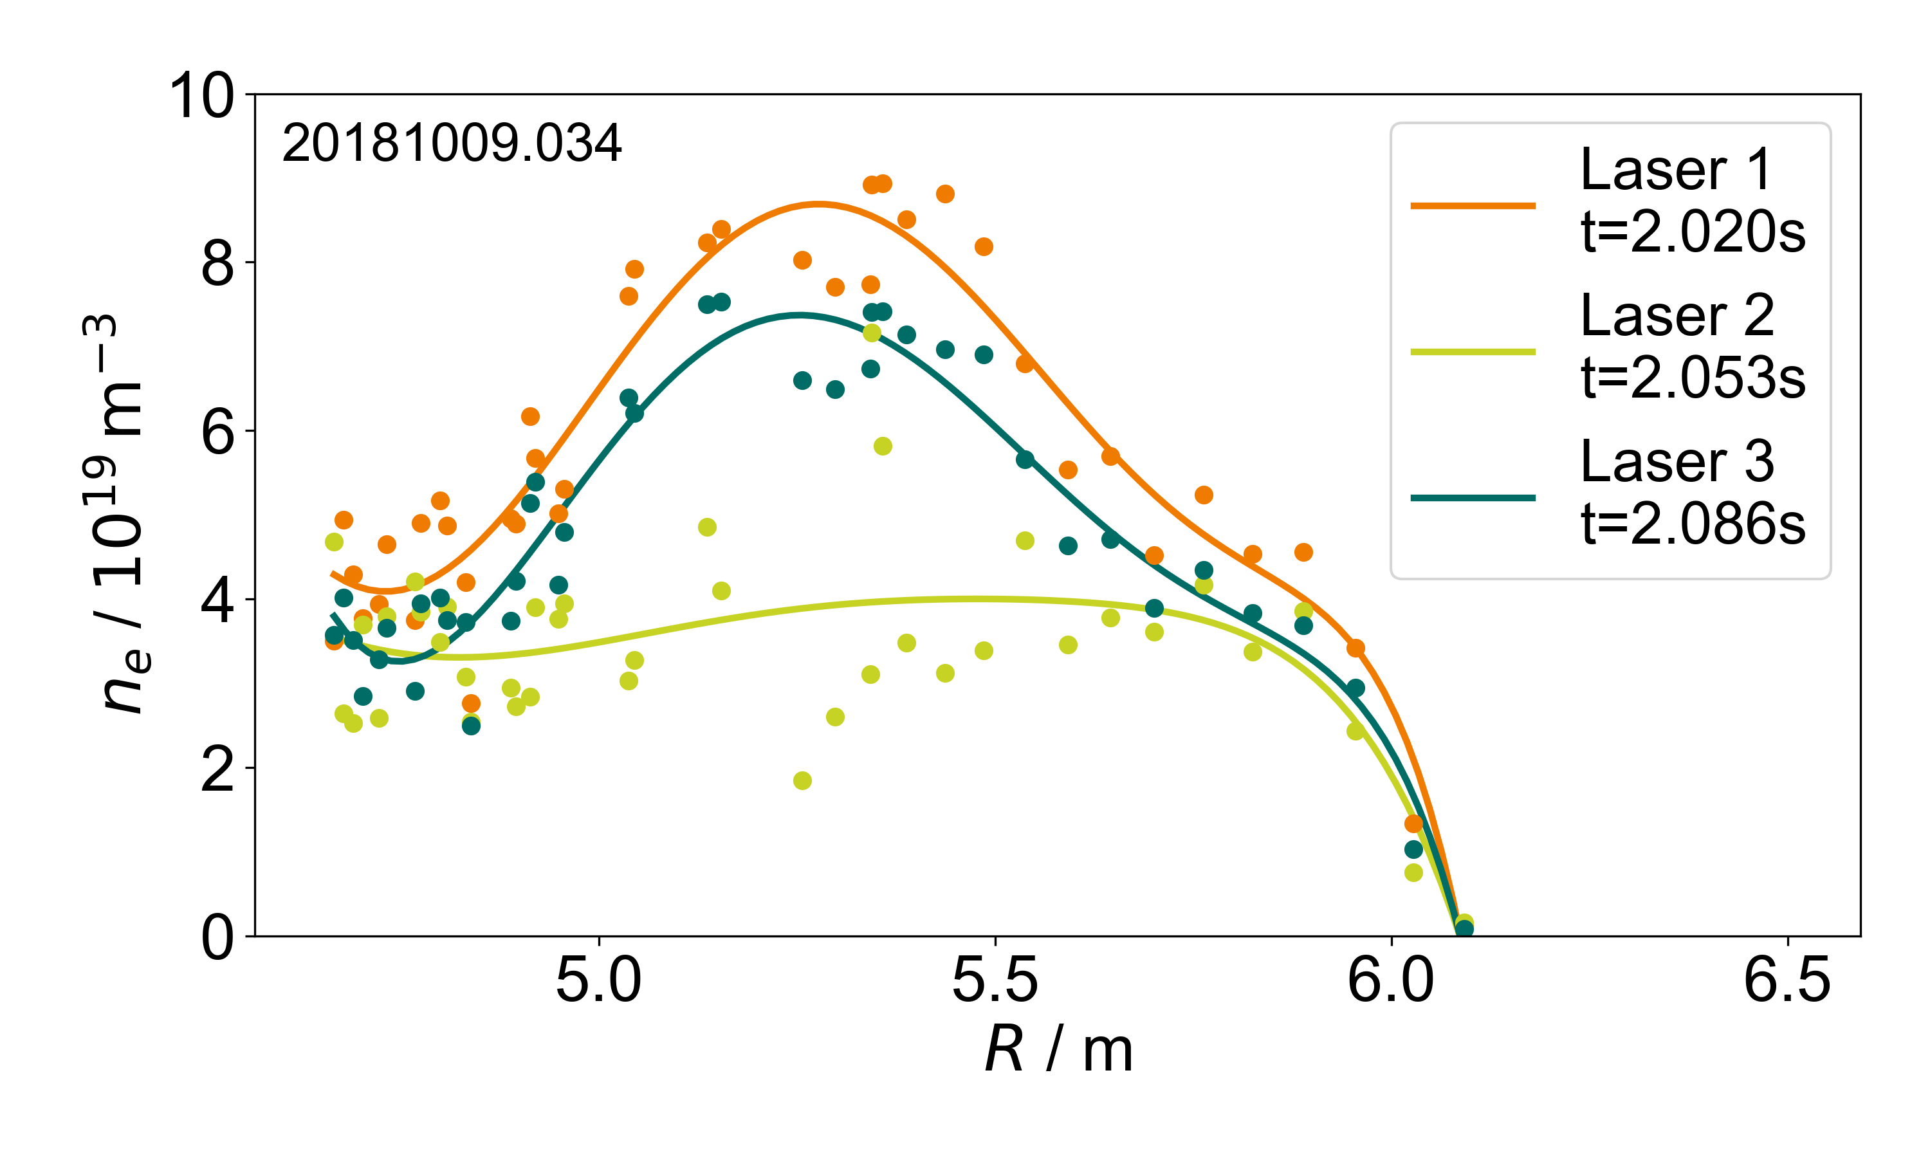
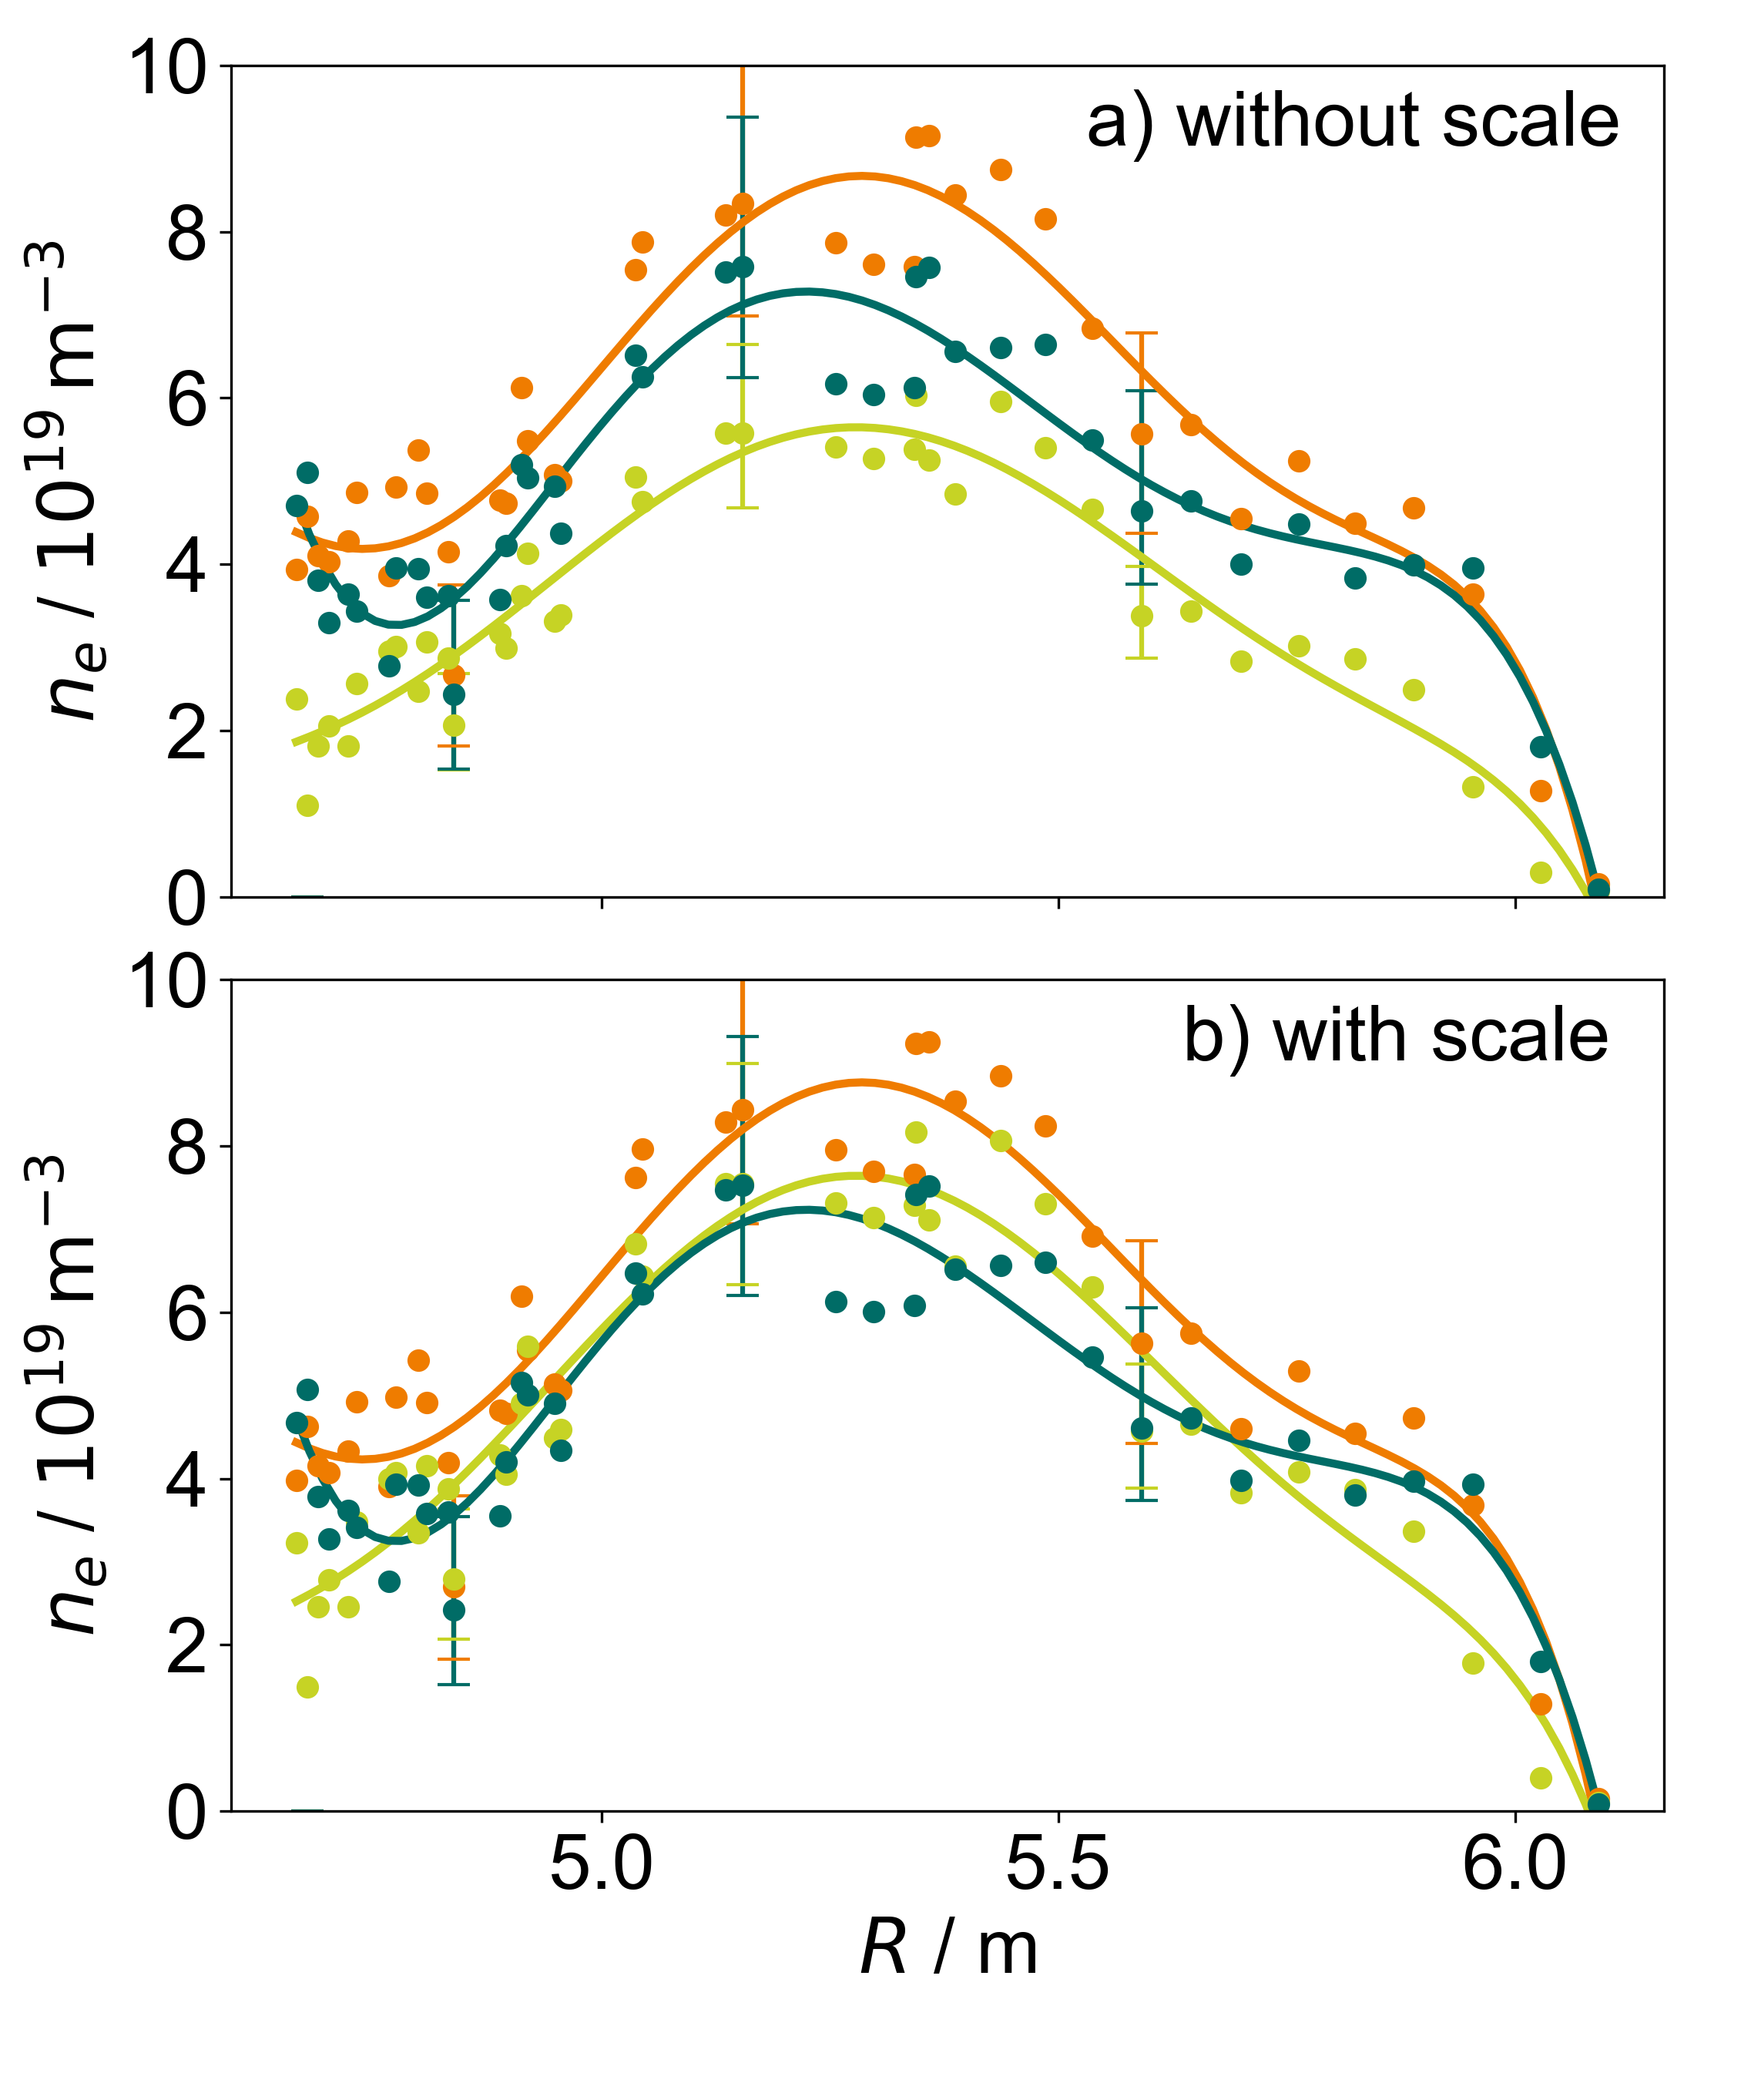
Results: scale discussion
3 consecutive profiles → should look similar
Laser 2 unreasonable → scale important
Correction does not depend on profile shape
→ scale works well in this case

Slide 30
Summary and Outlook
Notes:
results and outlook trennen
hier results
summary and outlook

Slide 31
Summary
Main focus: Extraction of abstract laser position was successful
Proof of concept: correction of profiles influenced by laser misalignment → individual tasks may be improved
V8 needs further investigation but OP 1.2b data can be corrected
        → performing correction with V10 due to similarities in calibration improves quality of profiles

Slide 32
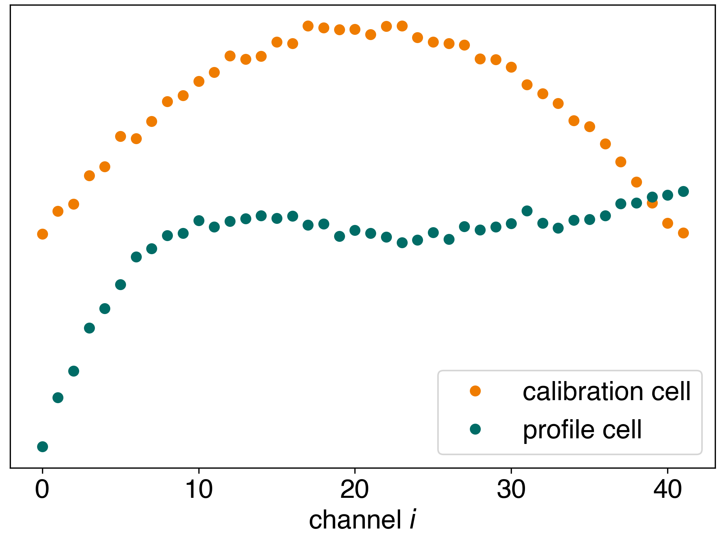
Outlook: correction from reference plasmas
Issue
Scale information lost during normalization, training profiles from different plasma states
A better way
Determine shape correction from sufficiently large training data set from identical reference plasma
→ scale is preserved and automatically included in the correction
Illustration of generalised profiles used for correction while preserving the scale

Slide 33
Outlook: usage in the future
Application for Thomson Scattering
In current OP: lasers are monitored by two cameras
Laser positions can be extracted from these images and calibration depends now on the location
      Machine learning method is not needed anymore
BUT helpful in profile control applications
      Big data from image processing can take a long time to transfer and evaluate → might not be fast enough
      Neural network approach is fast enough for real time applications
Generalization
This is a deterministic issue - more data points than degrees of freedom → overdetermined and necessary information is part of data
There may be more applications at W7-X than just TS

Slide 34
Notes:
Thank you for listening
Happy to answer some questions?

Slide 35
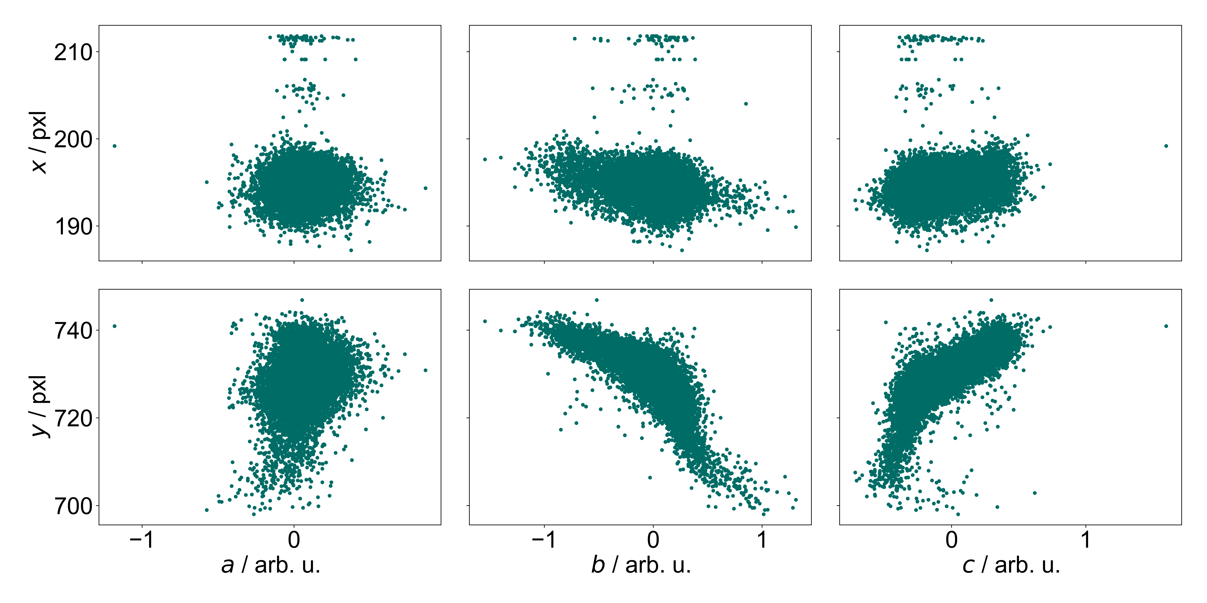
The method: correlation between real and abstract laser coordinates

Slide 36
The method: correlation between real and abstract laser coordinates
abstract laser positions actually mimic the real movement in this case → reduction in middle layer successful in terms of position
→ Profiles can be identified by abstract laser position

Slide 37
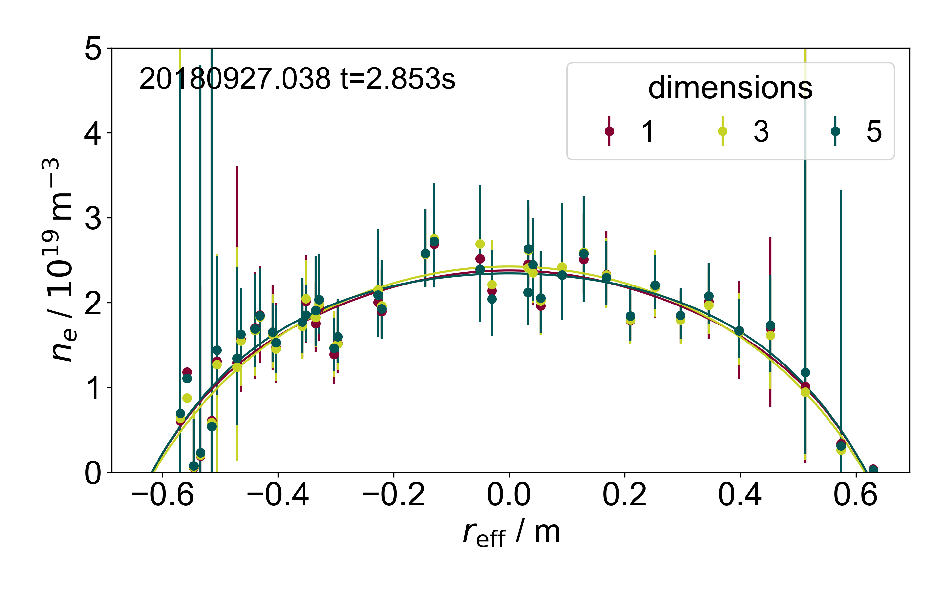
The method: choosing the fitting dimension
Correction of 1000 random profiles and checking for smoothness and symmetry (error E)
Building mean of E for each dimension
Repeating the process above 49 times → result more stable
→ How big is the difference?
example profile laser 2
→ 3 dimensions for all lasers in V10 as an agreement between precision and time management

