Slide 1
Extension of the operational capabilities of the Martin-Puplett Michelson Interferometer at W7-X
Hugo Isaac Cu Castillo

Slide 2
Motivation
Electron temperature is one of the most important plasma parameters
Continuous monitoring necessary for:
Electron heat transport, heat-pulse propagation, power balance studies, MHD phenomena, etc.
Why the Michelson?
Broadband instrument -> probe several harmonics at the same time->X3 ECE available
Radiometer has potential DC signal drifts
Absolute calibration is possible
Calibration problem: huge front-end losses

Slide 3
Outline
Electron Cyclotron Emission
Martin-Puplett Michelson Interferometer
Interferogram
Hot/cold-source calibration
Data acquisition
Characterization of Hot Source
Absolute calibration
Experiment worth looking at

Slide 4
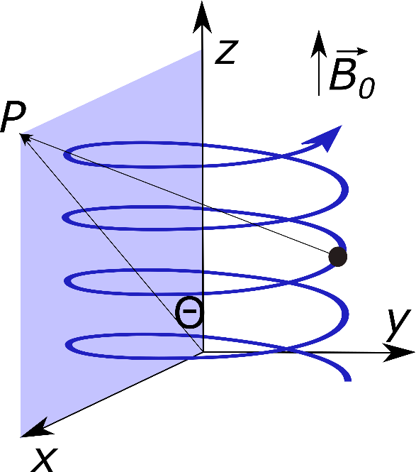
Electron Cyclotron Emission
Physical origin
Charged particle gyrates around B-field
Change of velocity = acceleration = radiation emission
modulated time retardation +dipole antenna +movement along $\vec{B}$
modulated time retardation +dipole antenna +movement along 𝑩 ⃗
Birth of harmonics
$$f_{c}=\frac{e\left|\vec{B}\right|}{m_{e0}}$$
$$f\left(R_{LOS}\right)=mf_{c}$$
O- and X- ECE modes appear
P=observer

Slide 5
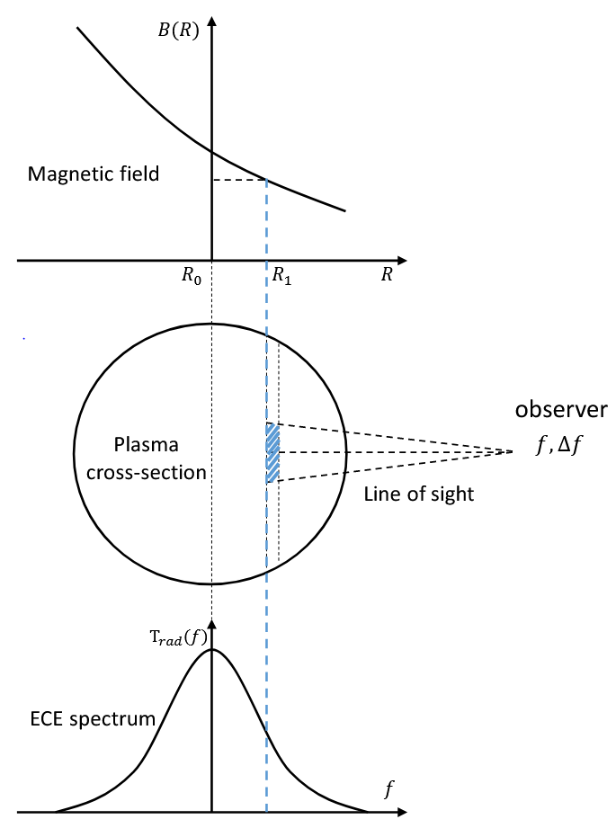
Electron Cyclotron Emission
Optical thickness: measure of how much the radiation is absorbed along a path$τ=\int_{0}^{s_{t}}{αds }$
Cold resonance method:
Rayleigh-Jeans approximation of black body:
$$T_{rad}=\frac{8π^{3}c^{2}}{k_{B}ω^{2}}\frac{I}{N^{2}}$$ -Infinite optical thickness: $T_{e}=T^{rad}$ -Connection intensity at a frequency $f$ to the electron temperature Optical thick modes at W7-X: O1, X2 Optically thin modes e.g. X3 also examinable (but cold resonance not valid)
Images: N. Chaudhary, “Investigation of optically grey electron cyclotron harmonics in Wendelstein 7-X”, 2020, PhD Thesis

Slide 6
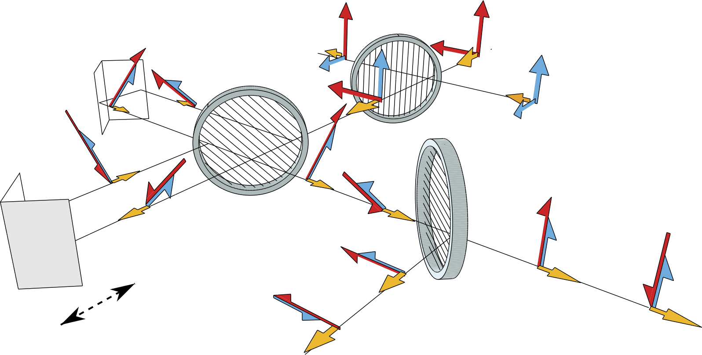
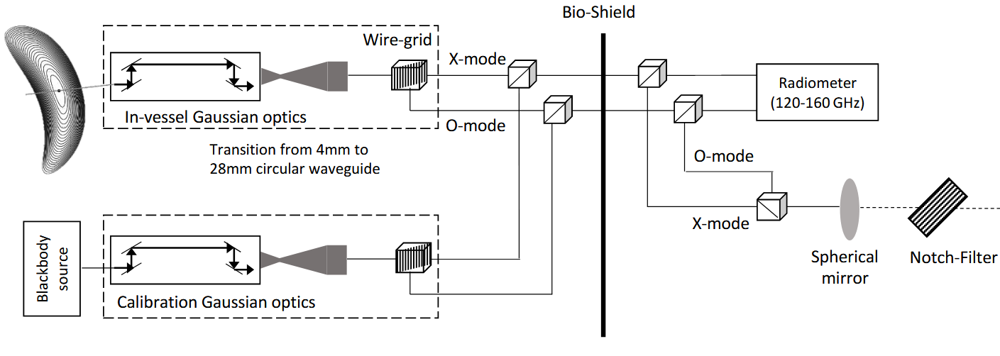
Martin-Puplett Michelson Interferometer
2 input – 2 output device
Beam splitter = wire grid polarizer
Rooftop mirrors $→$ rotate polarization 90°
$Δf=\frac{c}{2x_{max}}$
At W7-X:
$x_{max}≈16$mm
$Δx_{opt}≈40$ um
44 interferograms/s = samp rate: 22 ms
$Δf≈3.6 GHz$
lid
Michelson
Motor
x
Front end-loses $≈$20 dB
Left: S. Schmuck et al, “Electron cyclotron emission spectra in X- and O-mode polarisation at JET: Martin-Puplett interferometer, absolute calibration, revised uncertainties, inboard/outboard temperature profile and wall properties,” Rev. Sci Instrum, vol. 87, 2016.
Right: N. Chaudhary, “Investigation of optically grey electron cyclotron harmonics in Wendelstein 7-X”, 2020, PhD Thesis

Slide 7
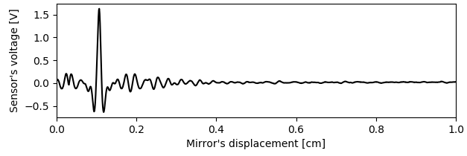
Ideal interferogram
1. Monochromatic source: 2. Polychromatic source minus I:
$$P(x)=I+\frac{I}{2}\cos\left(2π\frac{f}{c}x\right)$$
$$P\left(x\right)=\frac{1}{2}\int_{0}^{∞}{I\left(f\right)\cos\left(2π\frac{f}{c}x\right)df}$$
3. Ideal interferogram
4. Fourier Spectrum
$$V\left(x\right)=\frac{A}{2}\int_{0}^{∞}{I\left(f\right)C\left(f\right)\cos\left(2π\frac{f}{c}x\right)df}$$
$$I\left(f\right)C\left(f\right)=\frac{2}{A}FFT[V\left(x\right)]$$
$A$: amplification$, C\left(f\right)$: calibration factors
Solve for I or C to find:
$I\left(f\right)$ -> $T_{rad}$
$C\left(f\right)$ -> absolute calibration
… but one of them must be known before If I(f) from plasma is to be known, calibration is needed But S/N is low for calibration

Slide 8
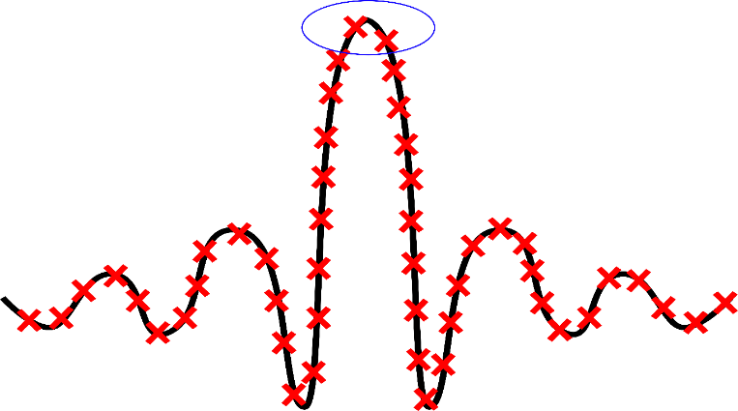
Real Interferogram
$$V\left(x\right)=\frac{A}{2} \int_{0}^{∞}{I\left(f\right)C\left(f\right)cos\left(2π\frac{f}{c}x+α(f)\right)}df+V_{BG}\left(I,x\right)+V^{′}\left(x\right)+N\left(0,σ\right)$$
Additional terms:
$α(f)$: phase error
$V_{BG}(I,x)$: source-dependent background rad.
$V′(x)$: intensity-independent terms
$N\left(0,σ\right)$: Gaussian noise
Zero path difference (zpd) not sampled
Varying power coupling of moving mirror at detector e.g.:
Beam fixed mirror
Beam moving mirror
x$≈$0
x$≈$16 mm

Slide 9
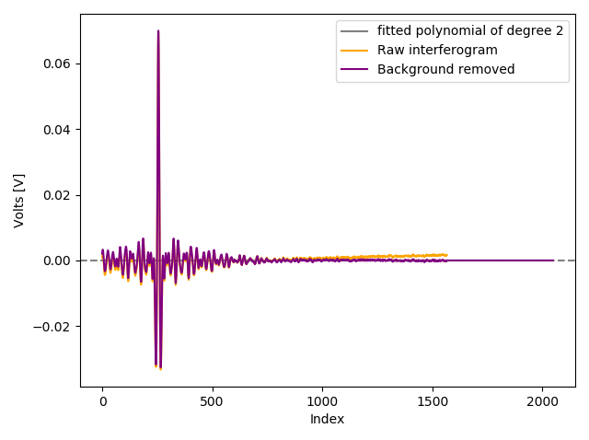
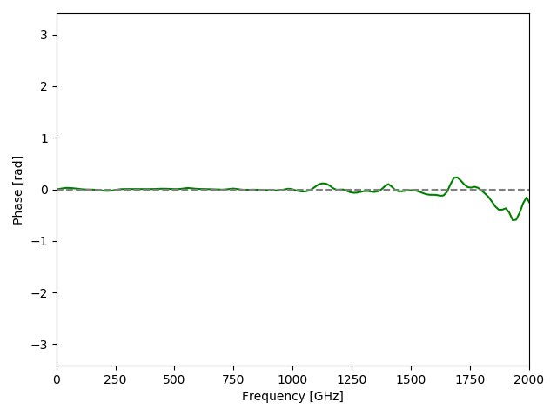
Real Interferogram
$$V\left(x\right)=\frac{A}{2} \int_{0}^{∞}{I\left(f\right)C\left(f\right)cos\left(2π\frac{f}{c}x+α(f)\right)}df+V_{BG}\left(I,x\right)+V^{′}\left(x\right)+N\left(0,σ\right)$$
If plasma discharge : $I\left(f\right)$ is unknown, $V′(x)$ negligeable
$V_{BG}(I,x)$: power coupling scales as
${\left(\frac{x}{L+x}\right)}^{2}≈a+bx+cx^{2}$ ->polynomial fit
$α(f)$: 1) Estimate zpd
2) Apply FFT on (symmetric window function centered on estimated zpd)*($V_{DS}$(x) )
3) $α\left(f\right)=\tan^{−1}\left(\frac{Img\left\{FFT\left[V_{DS}\left(x\right)\right]\right\}}{Re\left\{FFT\left[V_{DS}\left(x\right)\right]\right\}}\right)$

Slide 10
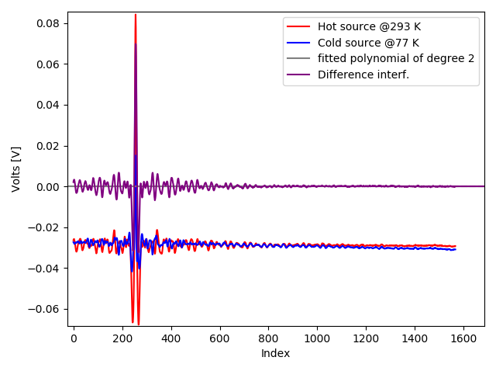
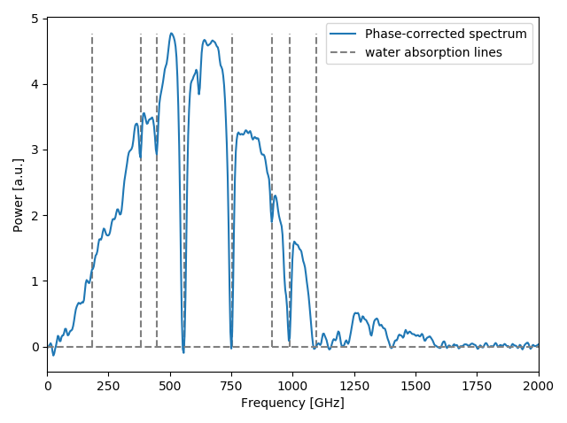
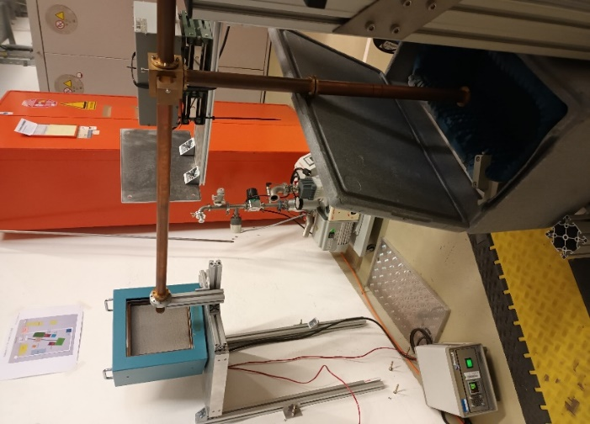
Real Interferogram
$$V\left(x\right)=\frac{A}{2} \int_{0}^{∞}{I\left(f\right)C\left(f\right)cos\left(2π\frac{f}{c}x+α(f)\right)}df+V_{BG}\left(I,x\right)+V^{′}\left(x\right)+N\left(0,σ\right)$$
If calibration: $C\left(f\right)$ is unknown, $V′(x)$ is not negligeable
Hot/cold source technique$: ∆V\left(x\right)=V_{HS}\left(x\right)−V_{CS}(x)$
$$∆V\left(x\right)=\frac{A}{2} \int_{0}^{∞}{\left[I_{HS}\left(f\right)−I_{CS}\left(f\right)\right]C\left(f\right)cos\left(2π\frac{f}{c}x+α(f)\right)}df+V_{BG}\left(I,x\right)+V^{′}\left(x\right)+N\left(0,σ\right)$$
Hot source
@873 K
Switch
Cold source
@77 K
1st, 2nd, 3rd harmonics

Slide 11
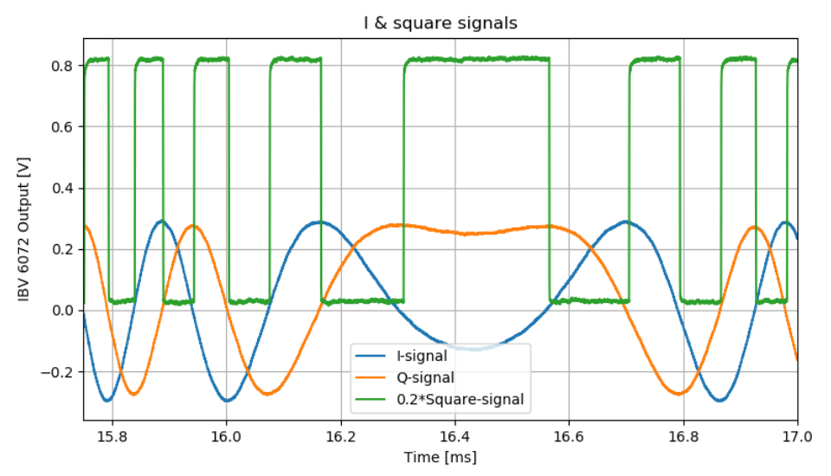
Data acquisition
Mirror position and direction is encoded in I (blue) and Q (orange) signals, $Δφ=90°$
Current acquisition scheme:
Use output of interface electronics (green) to clock sampling ($Δx_{opt}≈20$ um)
One reference marker (purple) for determining mirror direction and for coherent averaging
Ref marker

Slide 12
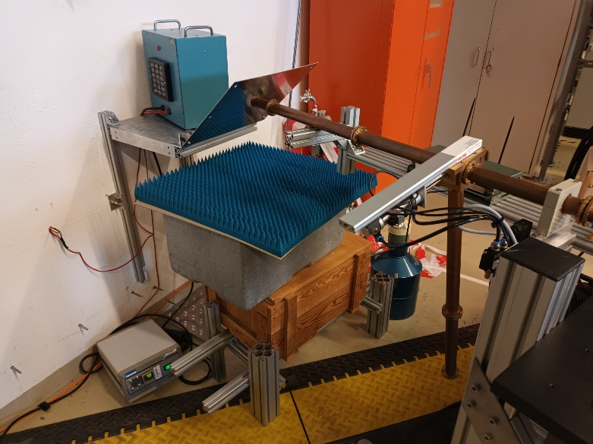
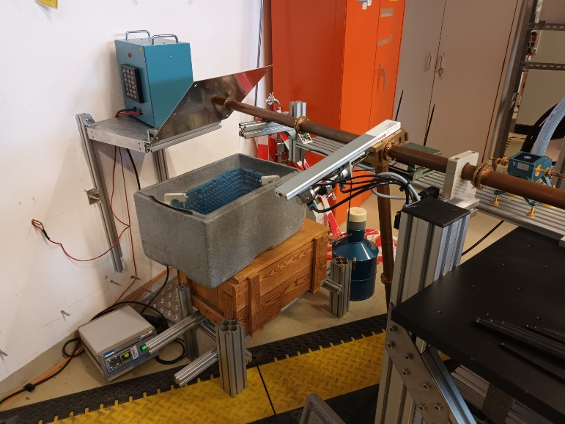
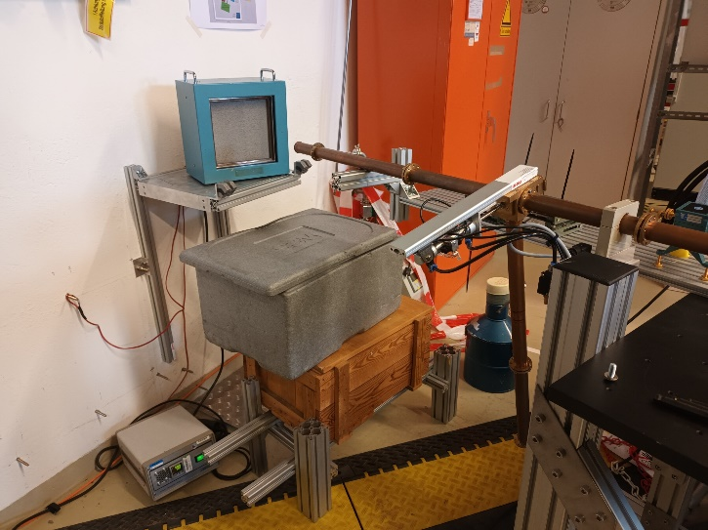
What has been done till now:
Obtention of calib. factors C(f) locally
$I_{CS}(f)$ and $I_{IS}(f)$ are known: Eccosorb as black body emitter for low frequencies
Characterization of Hot Source i.e. $I_{HS}(f)$
C(f) is known for the local diagnostic
Mirror
Towards Michelson
Hot Source @873 K
Eccosorb @297K
Eccosorb @77K (LN2)

Slide 13
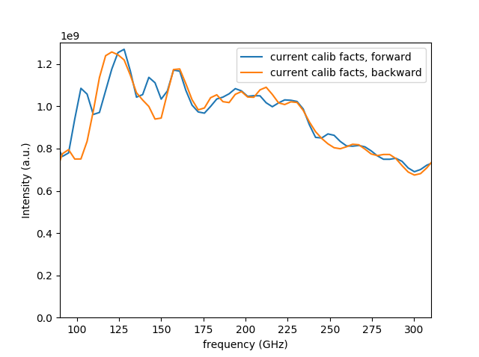
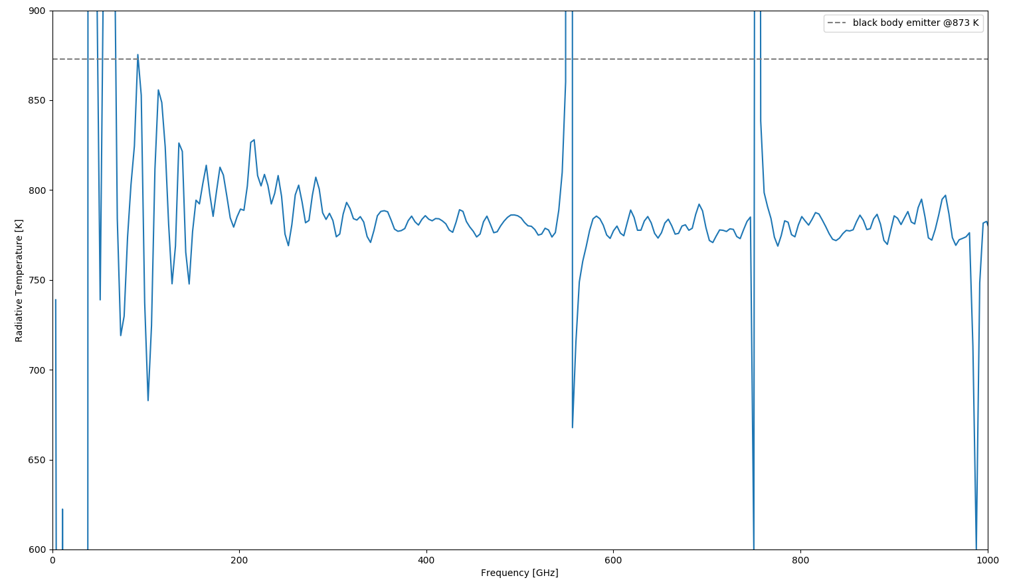
What has been done till now:
Obtention of calib. factors locally
I(f) is known: Eccosorb as black body emitter for low frequencies
Characterization of Hot Source
C(f) is known for the local diagnostic
Eccosorb no longer black body
Insensitivity range for detector
Water absorption lines

Slide 14
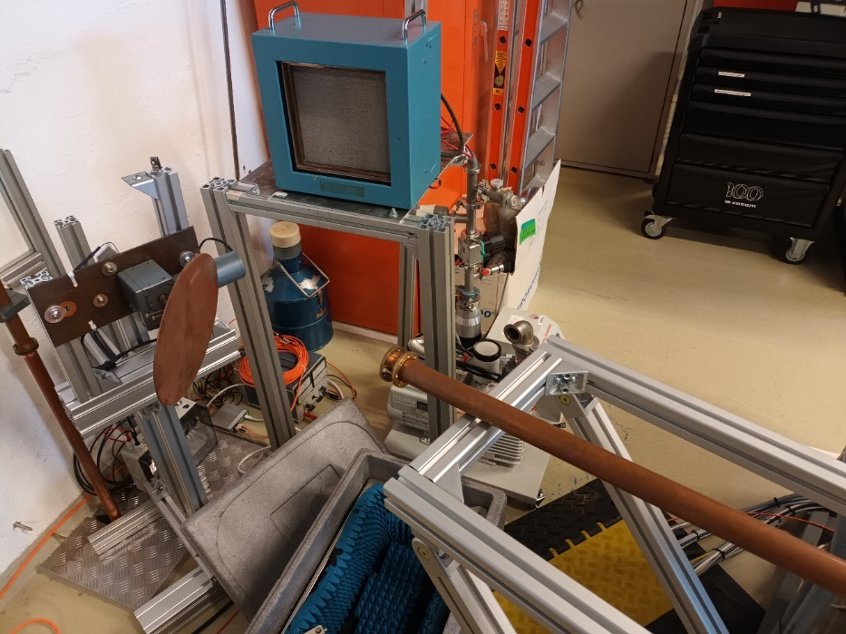
What must be done: Absolute calibration
Experiment:
Save interferograms of Hot Source for 20 min
Move blade (algorithm takes care of it)
Save interferograms of Cold Source for 20 min
Repeat for time required (hours/days)
Repeat steps 1-4 for longer sections/more components
Data analysis:
Filter electromagnetic noise
Average coherently using data of ref. Marker
Obtain FFT
Work on statistics (std. dev)
Towards Michelson
Do this locally and at TH
Hot Source
@873
Uncertainty decreases as $\sqrt{\frac{2}{N}}$ N= number of interferograms
If front-end losses $≈$ 20 dB = 100
-> factor 20 000 nr. of interferograms will be needed to achieve same S/N locally
Controllable moving blade
Cold Source
@293 K?
@77 K?

Slide 15
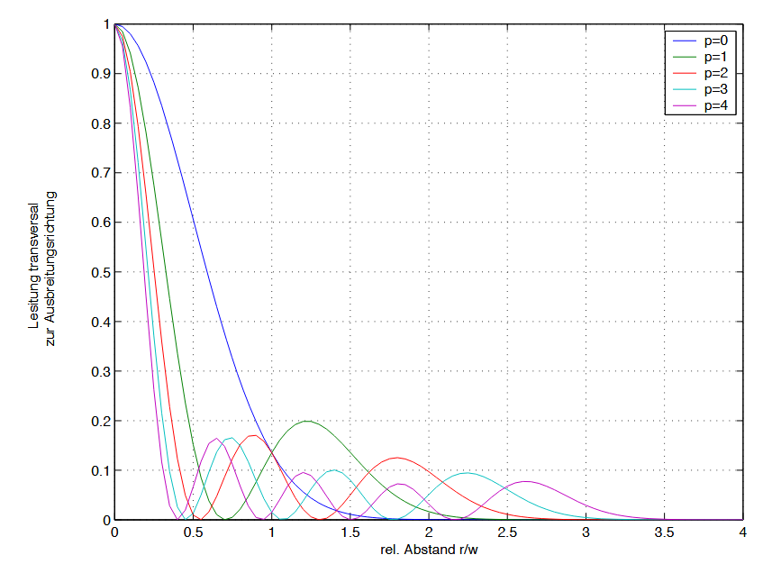
What is worth examining:
Radiation moves in waveguides in modes
And in the Michelson, only 10 Modes can reach detector (free space propagation)*
What if we only work with only fundamental mode?
Higher modes have anyways greater losses
Advantages:
Commercial notch filter useable
Stellartor: 1 Mode=better directivity of antenna
Possible compensation of signal loss: quasioptical sections of transmission line
reduction of mitre bends
*Assesment of Walter Kasparek
Free space propagation, p= mode number
Notes:
Include measurements

Slide 16
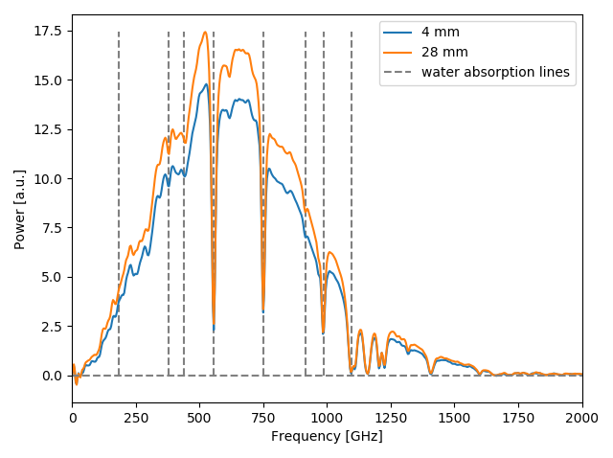
What is worth examining:
Radiation moves in waveguides in modes
And in the Michelson, only 10 Modes can reach detector (free space propagation)*
What if we only work with only fundamental mode?
Higher modes have anyways greater losses
Advantages:
Commercial notch filter useable
Stellartor: 1 Mode=better directivity of antenna
Possible compensation of signal loss: quasioptical sections of transmission line
reduction of mitre bends
*Assesment of Walter Kasparek
Notes:
Include measurements

Slide 17
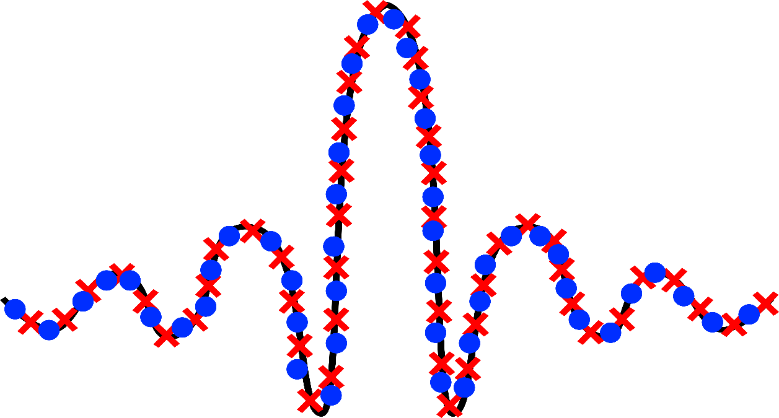
Conclusions
Increase of S/N of calibration is now possible because:
Longer integration times possible because of automatization
Quality checks of obtained data
Improvement of instrument response
Improvement of position of polarizer of spare port
Data augmentation (to investigate)

Slide 18
Phase correction in detail

Slide 19
Phase correction (0): Why necessary?*
Not sampling exactly the zpd introduces a phase error $α\left(σ\right); σ=\frac{f}{c}$
If the interferogram would be sampled in $−∞<x<∞$:
$$V\left(x\right)= \int_{0}^{∞}{S(σ)cos\left(2πσx+α\right)}dσ; S\left(σ\right)=I\left(σ\right)C(σ)$$
$$V\left(x\right)= \int_{−∞}^{∞}{S(σ)e^{2πiσx}e^{iα}}dσ$$
But sampling is finite; Apodization function A(x) exists: $A\left(x\right)=\left\{\begin{matrix}0 & x<{−L}_{1} \\ 1 & −L_{1}<x<L_{2} \\ 0 & x>L_{2}\end{matrix}\right.$
$$V\left(x\right)A(x)=\int_{−∞}^{∞}{S{\left(f\right)}_{A}e^{2πiσx}e^{iα}}dσ$$
$$\int_{−∞}^{∞}{V\left(x\right)A\left(x\right)e^{−2πiσx}dx}=S{\left(f\right)}_{A} e^{iα}$$
*More details: Porter, Tanner (1983): „Correction of phase errors in Fourier Spectroscopy“, International Journal of Infrared and Millimeter Waves, Vol. 4, No. 2

Slide 20
Phase correction (0): Why necessary?
$$\int_{−∞}^{∞}{V\left(x\right)A\left(x\right)e^{−2πiσx}dx}=S(f) e^{iα}$$
Convolution theorem: FFT of a product equals the convolution of the individual FFTs:
$$FFT\left[V\left(x\right)\right]=S\left(σ\right); FFT\left[A\left(x\right)\right]=b\left(σ\right)$$
$$S{\left(f\right)}_{A} e^{iα}=\left[S\left(σ\right)e^{iα}\right]∗b(σ)$$
$$S{\left(f\right)}_{A} e^{iα}=\int_{−∞}^{∞}{S\left(σ^{′}\right)e^{iα}b}\left(σ−σ^{′}\right)dσ$$
If $A(x)$ is not symmetric, $b\left(σ\right)$ is complex: $b\left(σ\right)=b_{r}(σ)+ib_{i}\left(σ\right)$
Product $e^{iα}b(σ)$ results in mixing of real and imaginary parts (but it shouldn‘t!):
$$e^{iα}b=(cos\left(α\right)+i sin\left(α\right))(b_{r}+ib_{i})$$
$$e^{iα}b=[cos\left(α\right)b_{r}−sin\left(α\right)b_{i}] +i[cos\left(α\right)b_{r}+b_{i}\left(σ\right)sin\left(α\right)]$$
Solution: shift theorem: A(x) is translated by the right amount, resulting in:
$$FFT\left[A\left(x−α\right)\right]=e^{−iα}b(σ)$$
Compensation possible

Slide 21
Phase correction (1)
$x_{i}=iΔx+x_{ZPD}$
Information of zero path difference necessary:
Nr. of points for FFT =$2^{n}$ -> zero padding
m=index of maximum peak
<-zpd can be estimated from a parabola at max. 3 points

Slide 22
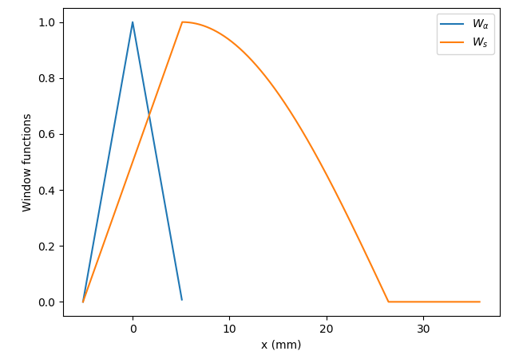
Phase correction (2)
Window functions:
For phase correction For FFT analysis
(centereted around zpd)

Slide 23
Phase correction (3) and FFT
Dispersion term at coarse grid $f_{j}=jΔ^{′}f, Δ^{′}f=\frac{c}{2N_{DS}Δx}≈14.64 GHz$
Finer grid: $f_{k}=kΔf, Δf=\frac{Δ^{′}fN_{DS}}{N_{T}}≈3.66 GHz$
Map $α^{′}\left(f_{j}\right)→α\left(f_{k}\right)$ via linear interpolation
FFT to find spectrum:

