Slide 1
In-situ calibration of charge exchange spectroscopy for spatially resolved measurements of helium-hydrogen density ratio in Wendelstein 7-X
M.Yoshinuma^{𝑎} K.Ida^{𝑎} O.P. Ford ^{𝑏} P.Poloskei ^{𝑏} T.Romba ^{𝑏} M.Zanini^{𝑏} W7-X Team ^{𝑏}
^{𝑎}National Institute for Fusion Science, National Institutes of Natural Sciences, Toki, Gifu 509-5292, Japan
^{𝑏}Max-Planck Institut für Plasmaphysik, 17491 Greifswald, Germany
Paper rehearsal in TG core transport and profiles meeting
February 11, 2025 Zoom
2025_02_11 20min

Slide 2
abstract
In-situ calibration of charge exchange spectroscopy for spatially resolved measurements of helium-hydrogen density ratio is described in this paper.
The helium-hydrogen density ratio in the core plasma is derived from the intensity ratio of the active helium line HeII (468.6nm) and hydrogen line HI (656.3nm) due to the charge exchange recombination process between fully ionized ions and neutral beam.
This system is calibrated by the helium-hydrogen density ratio evaluated from HeII (656.0nm) and HI (656.3nm) in the recombining phase at the end of the discharge.
The helium-hydrogen density ratio at the plasma center derived from the calibrated charge exchange spectroscopy is compared with the influx ratio estimated from the passive spectroscopy.
Charge exchange spectroscopy system are calibrated by the passive emission of HeII (656.0nm) and HI (656.3nm) at recombining phase using the same system and same discharge.

Slide 3
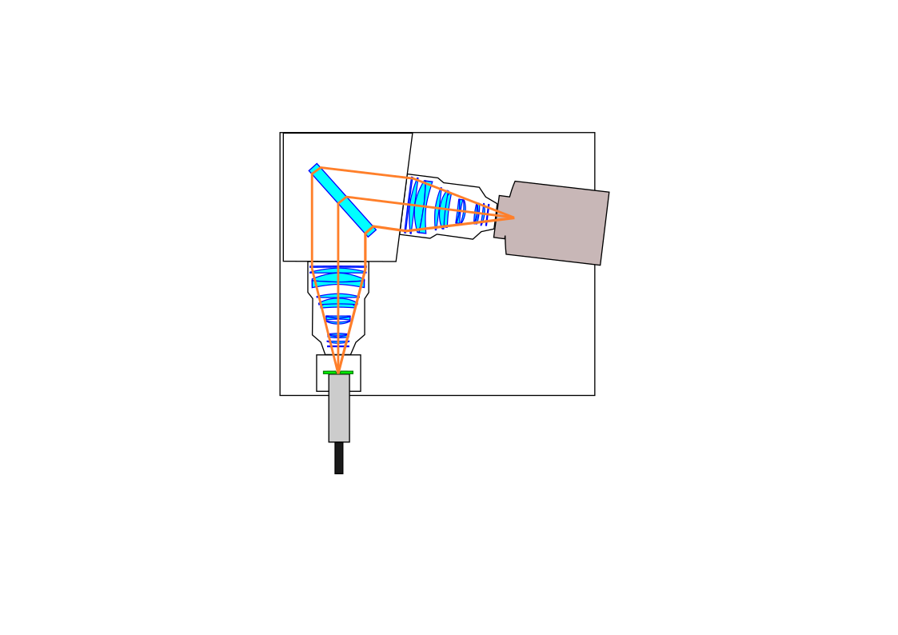
Charge exchange spectroscopy for Hydrogen, Helium and Carbon
Dichroic mirror box divide the light to three spectrometer for
Helium : λ < 490 nm
Carbon : 499nm < λ < 546 nm
Hydrogen : λ > 556 nm
Each spectrometer consists of volume phase grating (3200/mm, 3000/mm, 2000/mm) and
EM-CCD cameras (iXon 888)
VPH
2000/mm
Andor iXon Ultra 888
Hα 656.3 nm
Carbon spectrometer
Hydrogen spectrometer
SLIT
Andor iXon Ultra 888
λ > 556 nm
CVI 529.2 nm
IRIS
Helium spectrometer
499 nm < λ < 546 nm
Dichroic mirror
Light intensity can be adjusted by IRIS in the dichroic mirror box
Wavelength resolution (FWHM) can be controlled by the slit in the spectrometer
SLIT
IRIS
VPH
3200/mm
VPH
3000.mm
Dichroic mirror
λ < 490 nm
IRIS
SLIT
30 Optical fibers
from W-7X
HeII 468.6 nm
Andor iXon Ultra 888

Slide 4
IRIS and slit calibration
OP 1.2b (2018) camera IRIS (manual control) F2 – F22 dynamic range ~ 70
OP 2.1~ (2022~) aperture IRIS (computer control) 0.05mm – 25mm dynamic range ~ 500
Slit width typical value 20μ (Hydrogen) 100μ (Helium) 400μ (carbon)
Narrow slit is selected to distinguish residual cold and hot component for helium and hydrogen
residual : after the subtraction using beam modulation

Slide 5
EM gain calibration
When the light intensity is weak, the intensity can be multiplied by ~ 200 by applying EM gain (2 – 300) of the CCD camera.
Factor is normalized by the intensity with EM-gain off.

Slide 6
Discharge for in-situ calibration
Neutral beam is modulated with 50 Hz (10ms-on 10ms-off) to subtract the cold component.
Steady state phase with NBI for two seconds to accumulate the weak charge exchange emission
The recombining phase should be after the NBI is turned off to avoid the excitation by the beam.
Relatively high Helium fraction H/(H+He) monitor of < 0.3 to obtain the enough HeII (656.0nm) emission during the recombining phase.
Parameters
Hydrogen cxs IRIS F8 slit 20μ Δt=5ms
Helium cxs IRIS F1.4. slit 100μ Δt=5ms

Slide 7
HeII (656.0nm) and HI (656.3nm) Spectrum at recombination phase
Early phase Both HeII (656.0nm) and HI (656.3nm) appears with the similar magnitude
Middle phase HI (656.3nm) increases
Late phase HI (656.3nm) increases and HeII (656.0nm) disappears
Narrow slit (20μ) is required to separate HeII (656.0nm) and HI (656.3nm) emission

Slide 8
HeII (656.0nm) and HI (656.3nm) emissions are integrated in time
Both HeII (656.0nm) and HI (656.3nm) emissions are integrated in time
Radial profiles of HeII (656.0nm) and HI (656.3nm) emission is measured.
The ratio HeII / HI is almost constant in space.
The intensity ratio is converted to density ratio using the coefficient described in the following paper
M. Goto, S. Moria, K. Sawada, T. Fujimoto, S. Yamamoto, J. Miyazawa, H.Yamada, K. Toi,
Determination of the hydrogen and helium ion densities in the initial and final stages of a plasma in the Large Helical Device by optical spectroscopy, Phys. Plasma 5 (2003) 1402.

Slide 9
HeII (656.0nm) and HI (656.3nm) emissions are integrated in time
CCD count of H cxs emission is much lower than the He CXS emission due to the attenuation with IRIS and narrow slit width
Emission intensities are calculated using the slit, IRIS, and EM-gain factor calibrated.
The intensity ratio is 4.6 and almost constat in space, which corresponds to the density ratio of 1.7 derived from the recombination phase

Slide 10
Core helium/hydrogen density ratio is evaluated from CXS
Core helium/hydrogen density ratio is evaluated from CXS for the two discharge with high helium (He/H ~ 1) and low helium (He/H ~ 0.1) concentration
These density ratios are consistent with the influx ratio evaluated from the passive H/(H+He) monitor before the step down of ECH pulse.

Slide 11
Core helium/hydrogen density ratio is evaluated for the pellet shot
Three pellets are injected during the discharge.
The helium/hydrogen ratio decreases from 1 to 0.83 and to 0.71, which is consistent with the 10% increases of electron density.

Slide 12
Summary
The charge exchange spectrometers for spatially resolved measurements of helium-hydrogen density ratio are calibrated by the density ratio of helium to hydrogen estimated from the line ratio of HeII (656.0nm) to HI (656.3nm) observed in the recombining phase after the heating power is switched off.
This is in-situ calibration using the helium and hydrogen mixture plasma, which differs from the conventional calibration based on the charge exchange spectroscopy system’s absolute calibration, consisting of collecting optics, spectrometers, detectors, and emission cross-sections.
The density ratio of helium to hydrogen measured with charge exchange spectrometers calibrated with this method is compared with the influx ratio evaluated from the passive spectroscopy.
These two ratios agree in the discharge with higher ECH power but not with lower ECH power by step down, which suggests that the estimation of the influx ratio is sensitive to the edge plasma condition.
The core density ratio of helium to hydrogen measured with this charge exchange spectrometer drops at the timing of hydrogen pellet injections, while the influx ratio evaluated from passive spectroscopy does not show these drops.
The core density ratio of helium to hydrogen evaluated by these charge exchange spectrometers will provide essential information to optimize the helium concentration in the helium-hydrogen mixture plasma’s ion cyclotron resonance heating (ICRH).

