Slide 1
Progress talk: Tungsten induced plasma termination in large stellarators
Hjördis Bouvain

Slide 2
Motivation Plasma-terminating events due to impurity accumulation
Courtesy of Carsten Killer
What are the physical mechanisms of the plasma termination?
What are the dependencies of the plasma termination?
What are possible mitigation measures?

Slide 3
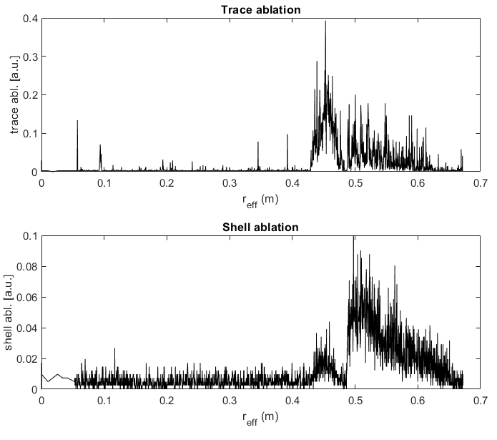
Experimental methods
[1]
Well-defined termination experiments at W7-X and LHD: Injection of TESPEL (Tracer Encapsulated Solid Pellets) loaded with various amounts of tungsten into plasma
TESPEL allow for a precise deposition of known amount of impurities
[1] Rev. Sci. Instrum. 83, 023503 (2012)

Slide 4
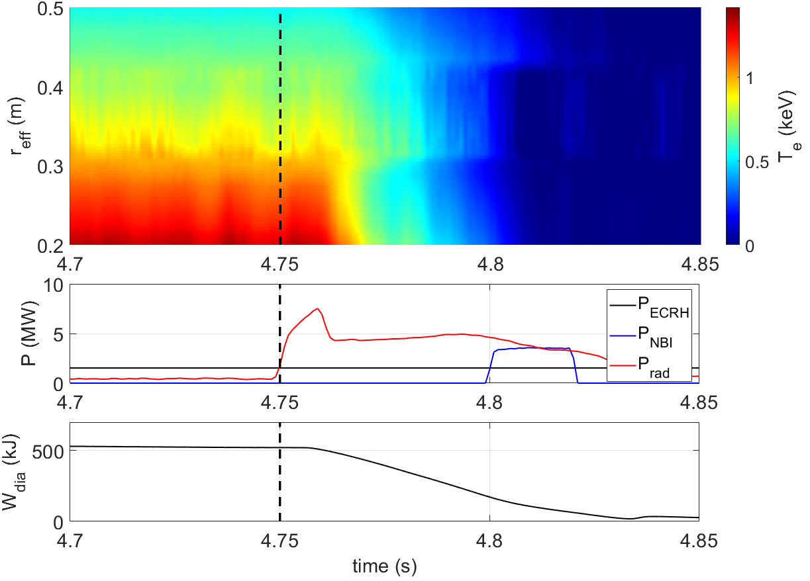
Investigation of termination mechanism: Plasma response to injected tungsten
In LHD:
Impurity injection leads to increase in $P_{rad}$: $P_{rad}>P_{heat}$ → plasma termination
Plasma termination: cold fronts
10 m/s
$3×{10}^{17}$ tungsten atoms leads to plasma termination after $\sim 80$ms

Slide 5
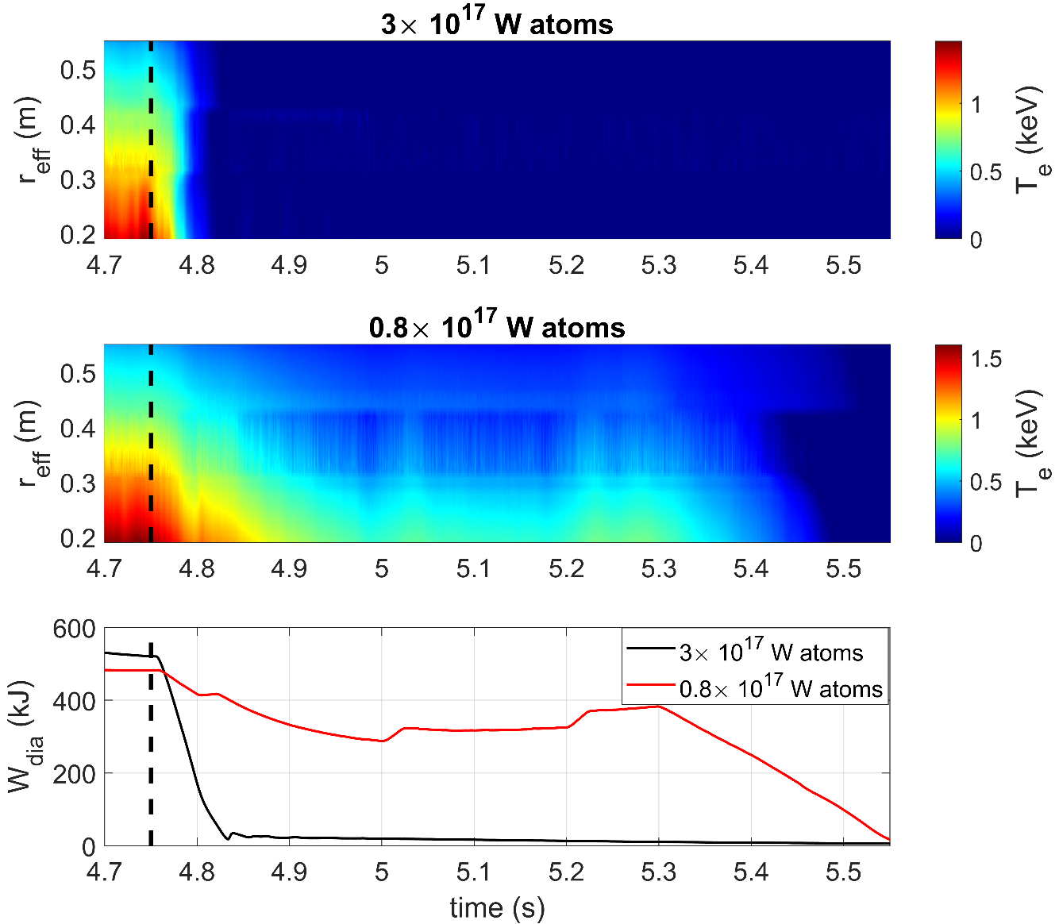
Investigation of termination dependencies: Amount of injected tungsten impurities
In LHD:
Comparison: injection $0.8×{10}^{17}$ vs $3×{10}^{17}$ tungsten atoms
Injection of more tungsten → faster cold fronts
No termination: no full recovery of plasma
Threshold of injected tungsten for plasma termination: $0.8×{10}^{17}<N_{W}<3×{10}^{17}$

Slide 6
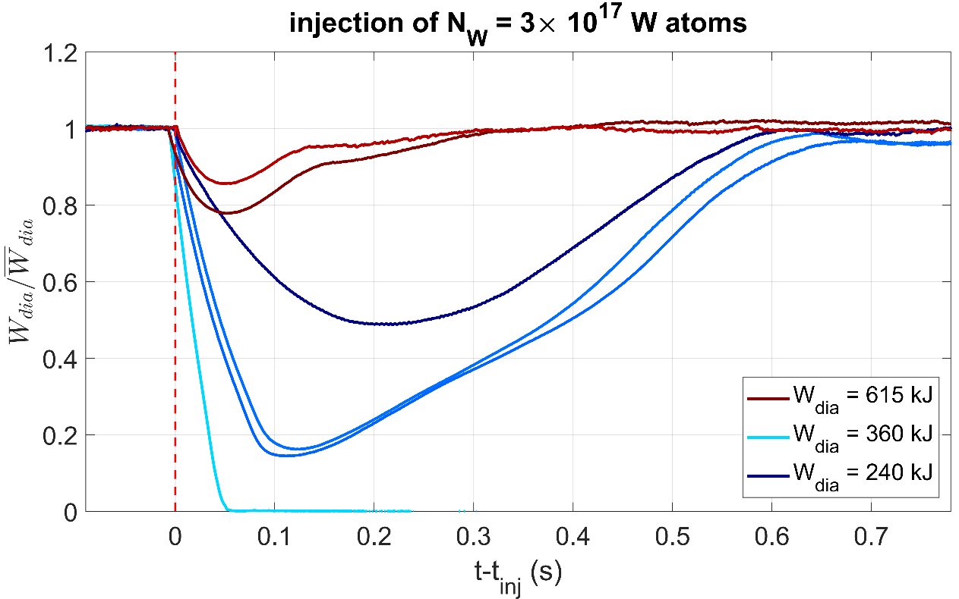
Investigation of termination dependencies: Effect of plasma energy variation
In W7-X:
after disturbance: plasma recovers on confinement time scale
The higher plasma energy, the less is plasma affected
Complete recovery after perturbation shows higher resilience of W7-X plasmas

Slide 7
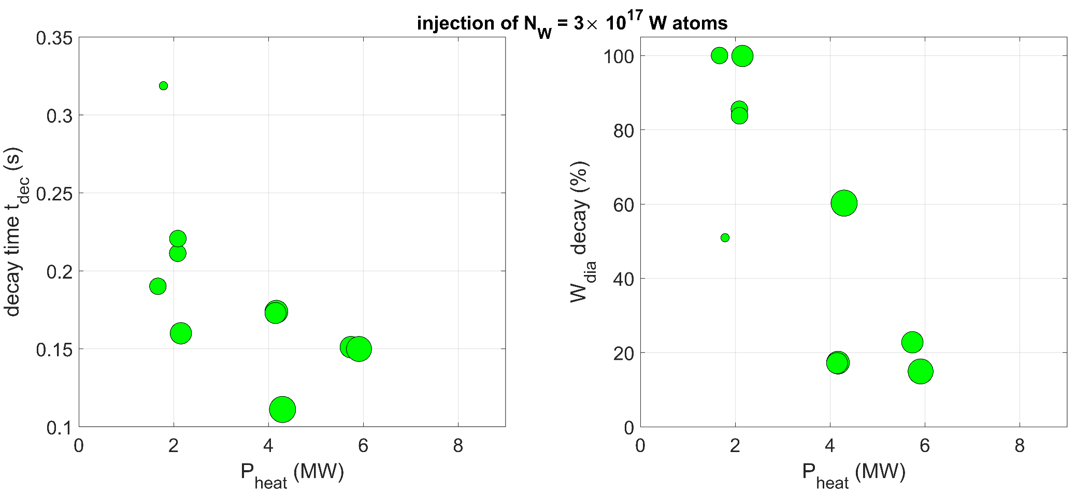
Investigation of termination dependencies: Effect of heating power and density variation
$$t_{dec}$$
Higher heating power leads to a faster but less intense energy decay

Slide 8
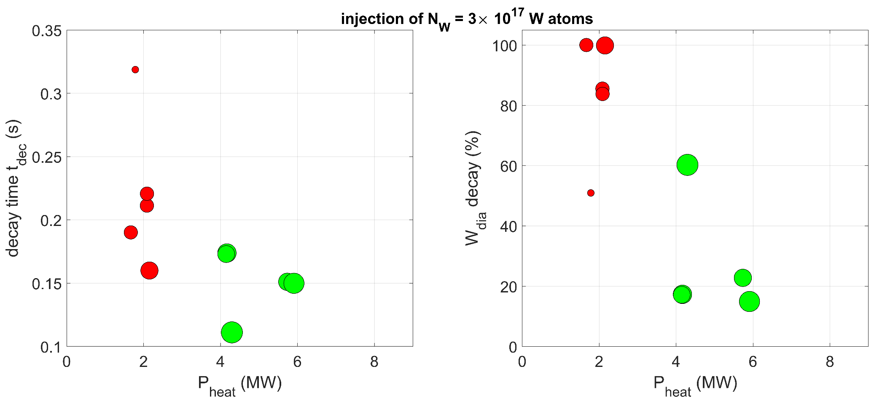
Investigation of termination dependencies: Effect of heating power and density variation
$$t_{dec}$$
Higher densities lead to a stronger and faster plasma cooling

Slide 9
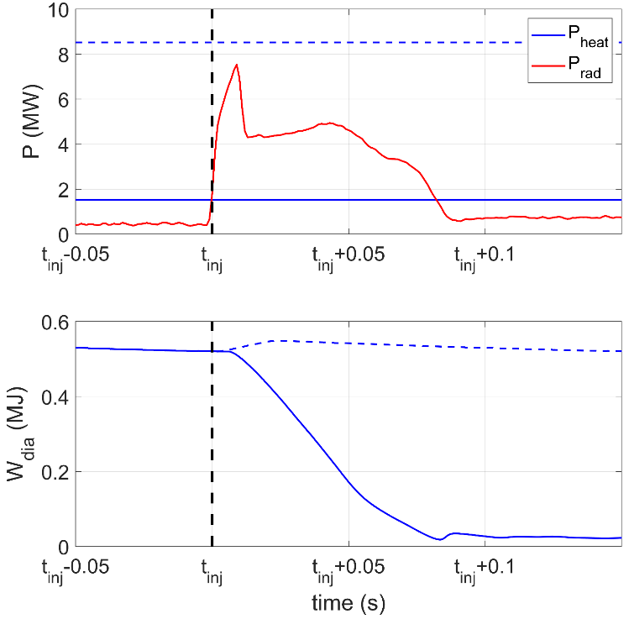
Investigation of mitigation measures: ECRH as rescue heating
Idea:
no termination if $P_{heat}>P_{rad}$
Increase of ECRH to offset lost energy
Previous studies found positive effect of ECRH on impurity accumulation [2]
[2] C. Angioni et al 2017 Nucl. Fusion 57 056015

Slide 10
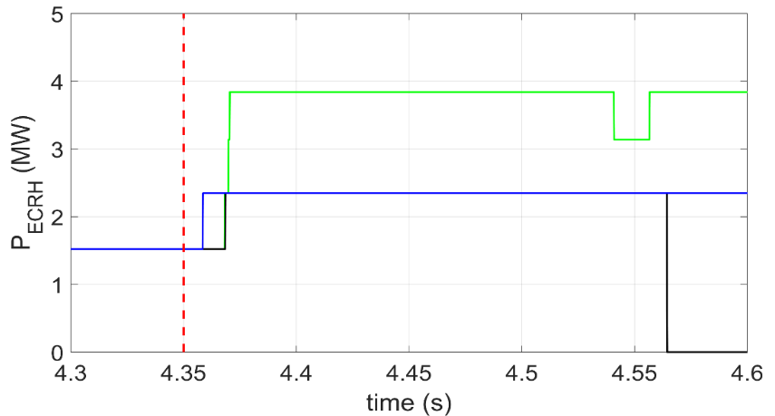
Investigation of mitigation measures: ECRH as rescue heating
Idea:
no termination if $P_{heat}>P_{rad}$
Increase of ECRH to offset lost energy
Previous studies found positive effect of ECRH on impurity accumulation [2]
Method:
Application of additional ECRH after TESPEL injection
Variation of power levels: P_{add} = 0.8 MW, 2.3 MW
Variation of delay times: $Δt=\left[5,10,20,40,80\right]$ms
$$Δt$$
[2] C. Angioni et al 2017 Nucl. Fusion 57 056015

Slide 11
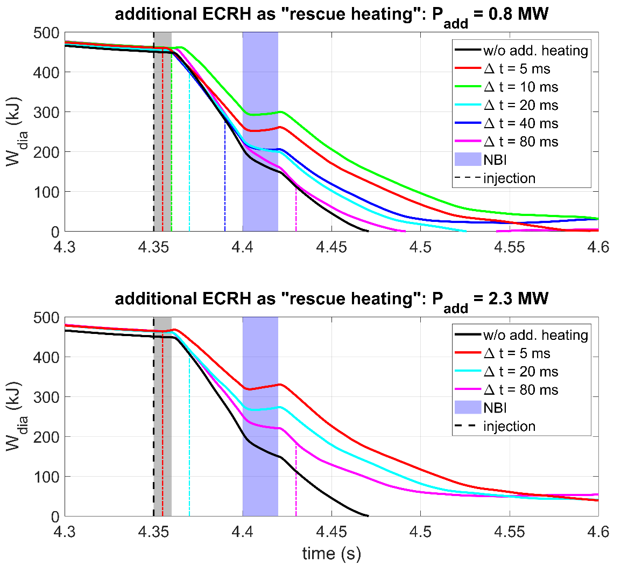
Investigation of mitigation measures: ECRH as rescue heating
In LHD:
Additional ECRH prolongs plasma cooling
Stronger mitigation effect for higher heating power
Time of application of ECRH after injection effects efficiency: optimal delay time $Δt<10$ ms
Additional ECRH can mitigate plasma termination induced by tungsten impurities in the plasma centre up to ~ 300 ms.

Slide 12
Summary
Characterisation: What are the physical mechanisms of the plasma termination?
Impurity radiation leads to inward-propagating cold fronts: velocity sets termination time Resilience of stellarators against certain impurity accumulation shown
Quantification: What are the dependencies of the plasma termination?
More impurity injected leads to faster plasma decay Higher heating power and density accelerate plasma decay Mitigation: What are potential approaches for stabilization of strongly perturbed plasmas?
ECRH as rescue heating prolongs plasma termination Optimal mitigation: short reaction time and high heating power

Slide 13
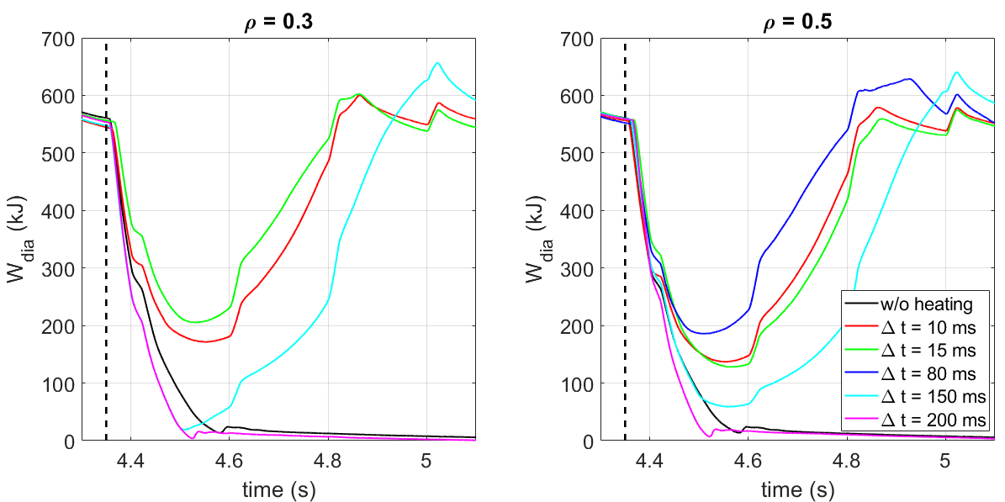
Outlook
What are the physical mechanisms of the plasma termination?
Analysis of spatio-temporal dynamics with Gaussian processing
What are the dependencies of the plasma termination?
Development of scaling law for dependencies on P_{heat} and n_{e}
Further analysis of machine dependency
Investigation of impurity dependency on cooling mechanism
What are potential approaches for stabilization of strongly perturbed plasmas?
Investigation of ICRH and NBI as mitigation measure
Further study on dependency of the ECRH deposition on the mitigation effect

Slide 14
QR code to survey
Thank you for your attention!

