Slide 1
Research and Development of Cherenkov Vacuum Electron Devices in the MM and THz Frequency Range
Sergiy Ponomarenko
O. Ya. Usikov Institute for Radiophysics and Electronics of NAS of Ukraine

Slide 2
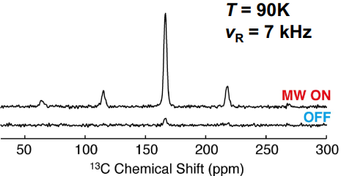
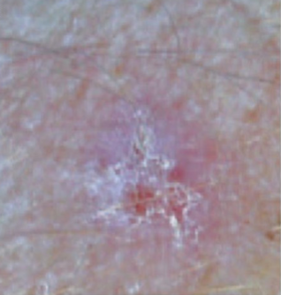
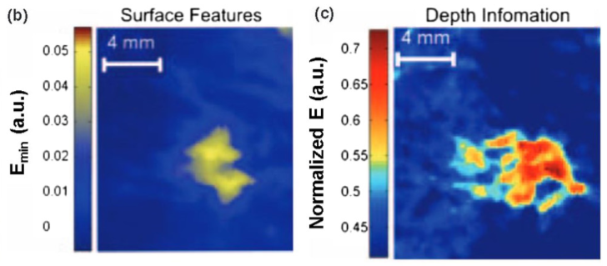
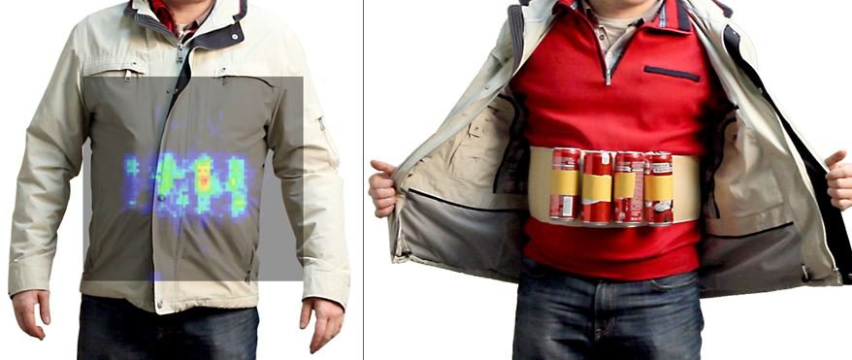
Applications of sub-THz and THz Radiation
Radars and Communication
Plasma applications
Spectroscopy
Non-invasive medical diagnostics
Security
and many others
Barnes et al. JMR 224, 1-7 (2012)
Wallace et al., Br.J.Dermatol. 151, 424 (2004)
terasense.com

Slide 3
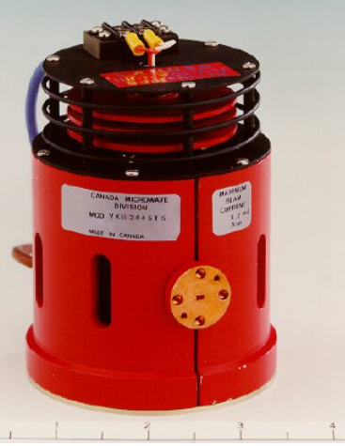
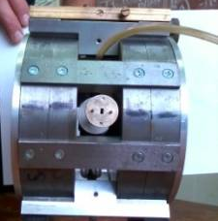
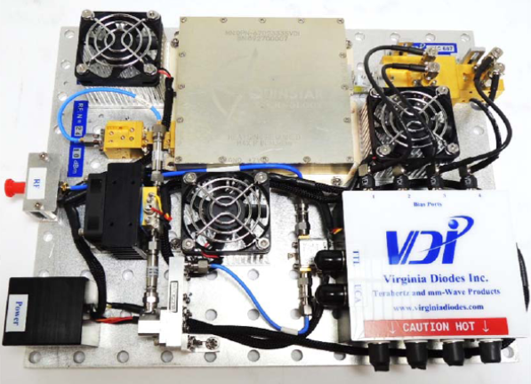
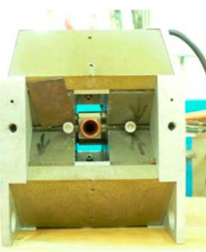
State-of-Art of the Radiation Sources
100
Gyrotron sources
10
Conventional vacuum electron devices
Output Power (W)
1
Klystrons (EIOs)
0.1
TWTs
BWOs
Clinotrons
Solid-state
sources
0.01
100
200
400
600
800
1000
100
Frequency (GHz)
M. Blank & K. L. Felch, Millimeter-wave Sources for DNP-NMR. eMagRes 7, 155-166 (2018)
Notes:
Application of THz radiation and its importance.
Requirements to the sources (power, operating frequency range, ease of use, compact design).
Main problem of development of such devices in the THz frequency range.
Current stage and activity of our lab.
The main task is the research and development of the beam-wave interaction mechanisms in Cherenkov-like vacuum electron devices for efficient generation in the THz frequency range.

Slide 4
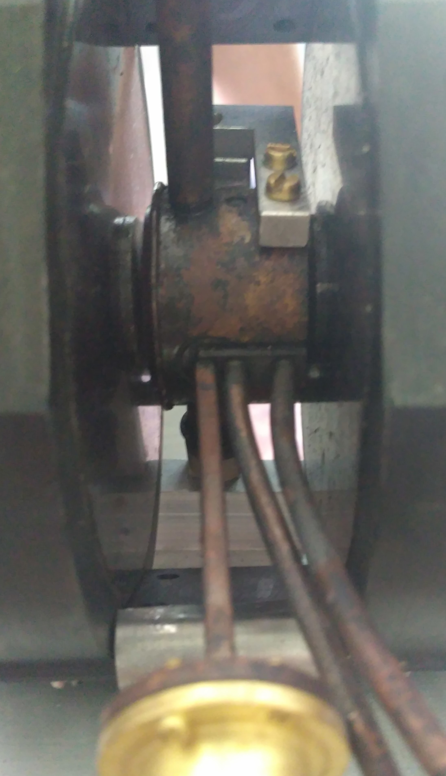
Our Laboratory Activity
Research and Development of sub-THz and THz Clinotrons
Research and Development of Low Voltage Cyclotron Resonance Masers
Clinotrons for 100 – 400 GHz frequency range
8 GHz CRM

Slide 5
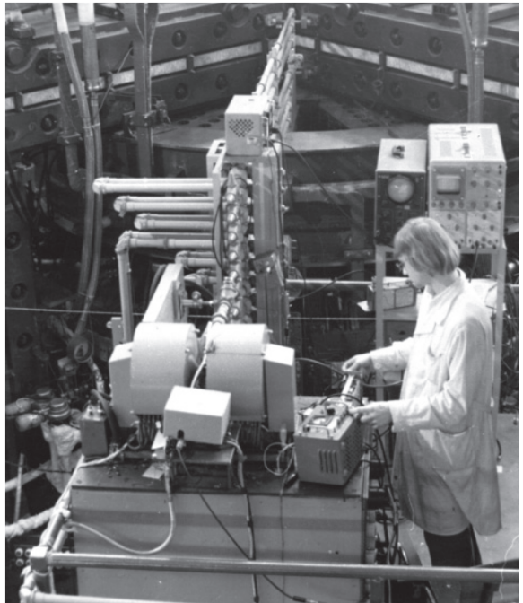
Clinotrons for Plasma Diagnostics
9-channel quasioptic interferometer based on 545 GHz Clinotron at the T-10 tokamak
Ponomarenko S.S., Likhachev A.A., Stoyanova V.V., Kovshov Y.S., Vlasenko S.A., Kishko S.A., Khutoryan E.M., Kuleshov A.N. Spectral Characteristics of THz CW Clinotrons. IEEE Transactions on Electron Devices 67 (12), 5766-5770 (2020)
36 mm
Notes:
Application of THz radiation and its importance.
Requirements to the sources (power, operating frequency range, ease of use, compact design).
Main problem of development of such devices in the THz frequency range.
Current stage and activity of our lab.
The main task is the research and development of the beam-wave interaction mechanisms in Cherenkov-like vacuum electron devices for efficient generation in the THz frequency range.

Slide 6
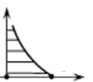
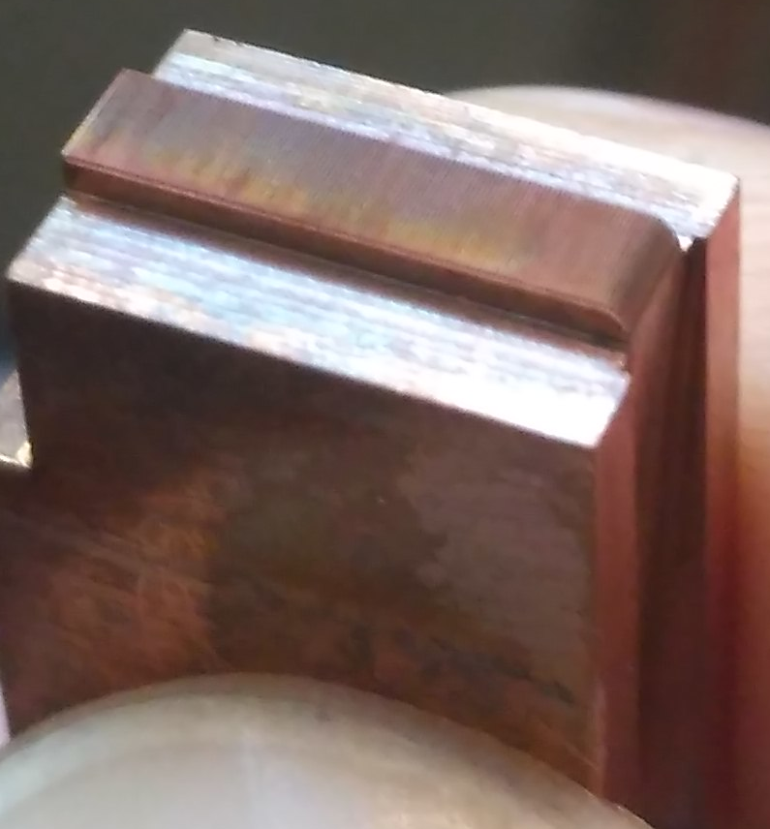
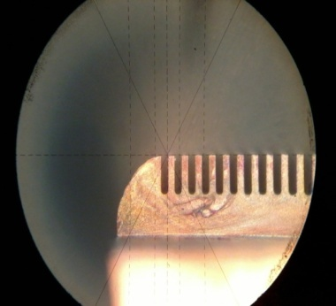
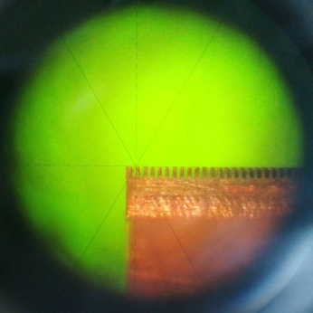
Cherenkov Vacuum Electron Devices
$$υ_{ph}≅υ_{e}$$
y
Electron beam
E_{z}
$$υ_{e}$$
h
z
130 GHz
Metal
Grating Circuit
p
$$E_{z} =\sum_{n=−∞}^{∞}{A_{n}}e^{−α_{n}y}e^{i\left(k_{zn}z−ωt\right)}$$
x 45
$$α_{n}=\sqrt{{k_{zn}}^{2}−{\left(\frac{ω}{c}\right)}^{2}}$$
$$k_{zn} =k+\frac{2πn}{p}$$
$$υ_{ph}=\frac{ω}{k_{zn}}$$
263 GHz
$υ_{ph}<c$
$α_{n}$is real number → the RF field exponentially decays vertically from the circuit
x 45
Notes:
If charged particles move through an isolator of index of refraction 𝑛, the latter is polarized by the electromagnetic field of the flying particle. Usually these polarization superpose destructively and the perturbation can relax while the particle moves on. But if the speed of the particle Ve is higher than the phase velocity of light in the medium C𝑛 the perturbation can no longer decay since the reaction time of the medium is not high enough and the perturbation remains behind the particle. Due to the Huygens principle there occurs a wave front at Ve > Cn but only single spherical waves at Ve < Cn.

Slide 7
Dispersion of a Grating Structure
n = 0
n = -1
n = 1
$$υ_{ph}≅υ_{e}$$
$$υ_{ph}>c$$
$$υ_{ph}<c$$
$$υ_{ph}=\frac{ω}{k_{zn}}$$
TWT
BWO
$$ω_{0}$$
DRO
$$υ_{gr}=\frac{dω}{{dk}_{zn}}$$
$$ω=ck$$
Forward wave
Backward wave
Beam lines
$$ω=υ_{e}k_{z}$$
Notes:
If charged particles move through an isolator of index of refraction 𝑛, the latter is polarized by the electromagnetic field of the flying particle. Usually these polarization superpose destructively and the perturbation can relax while the particle moves on. But if the speed of the particle Ve is higher than the phase velocity of light in the medium C𝑛 the perturbation can no longer decay since the reaction time of the medium is not high enough and the perturbation remains behind the particle. Due to the Huygens principle there occurs a wave front at Ve > Cn but only single spherical waves at Ve < Cn.

Slide 8
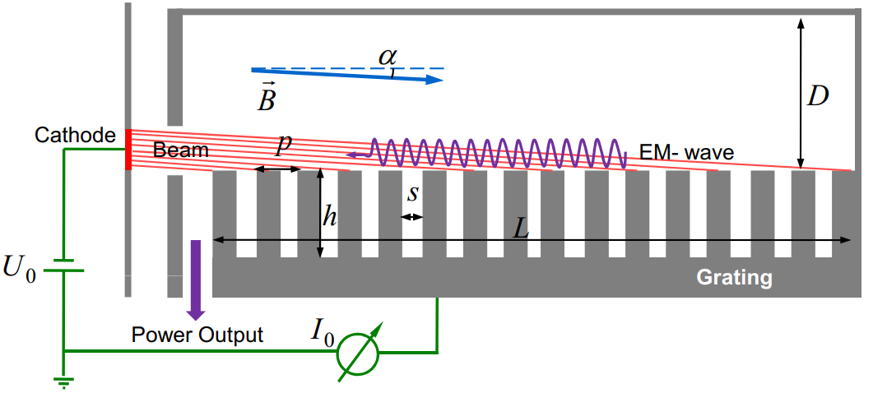
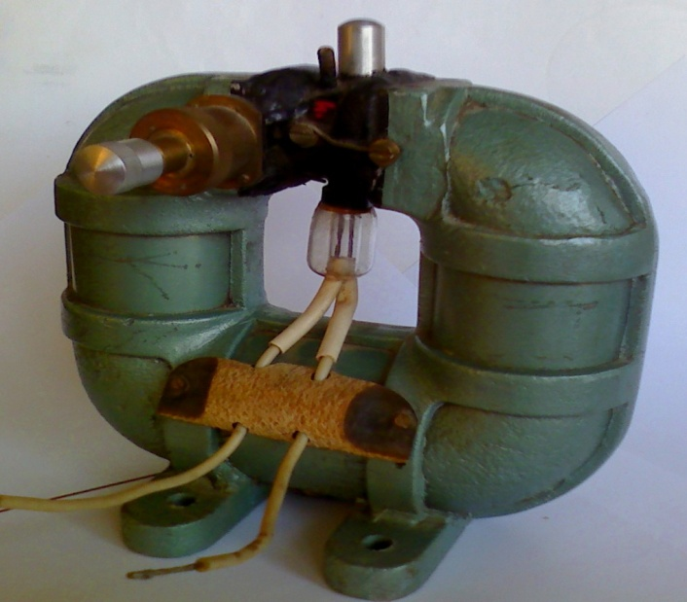
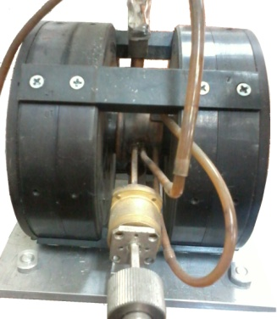
Physics of Clinotron
$$θ$$
$$d={α_{n}}^{−1}$$
B
B
L_{i}
L_{i}
d
d
$$I_{st}≅{L_{i}}^{−3}$$
$$P_{out}≅U_{0}\left(I_{0}−I_{st}\right)$$
G. Ya. Levin, A. Ya. Kirichenko, A. I. Borodkin, S. A. Churilova, A. Ya. Usikov, The Clinotron, Naukova Dumka, Kiev (1992)
Ponomarenko, S.S., Kishko, S.A., Zavertanniy, V.V., Khutoryan, E.M., Lopatin, I.V., Yefimov, B.P., Kuleshov, A.N. 400-GHz continuous-wave clinotron oscillator. IEEE Transactions on Plasma Science 41 (1), 82-86 (2013)
100 GHz
400 GHz
Notes:
Resonant bwo
Inclined thick beam (bunching in a high-amplitude RF field)
Wide oversized structure = sheet beam
знаходження профілю магнітного поля, що фукусує, та геометрії еос методом траєкторного аналізу руху електронних потоків, та на снові отриманих результатів створення компактних мфс та електронних гармат
Software packages
Tech. mfs>1T

Slide 9
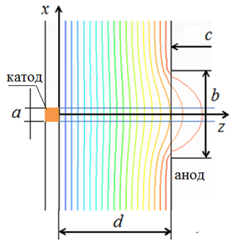
The Effects in Clinotron
Electron beam velocity distribution
Mode transformation in an oversized cavity of THz Clinotron
RF ohmic losses
Y
Likhachev, A.A., Danik, A.A., Kovshov, Y.S., Kishko, S.A., Ponomarenko, S.S., Zheltov, V.N., Khutoryan, E.M., Kuleshov, A.N. Effect of electron beam velocity spread in a clinotron. IEEE Transactions on Electron Devices 66 (3), 1540-1544 (2019)
Kovshov, Y.S., Ponomarenko, S.S., Kishko, S.S., Likhachev, A., Danik, A., Mospan, L., Steshenko, S., Khutoryan, E.M., Kuleshov, A.N. Effect of Mode Transformation in THz Clinotron. Journal of Infrared, Millimeter, and Terahertz Waves 39 (11), 1055-1064 (2018)
Ponomarenko, S.S., Likhachev, A.A., Stoyanova, V.V., Kovshov, Y.S., Vlasenko, S.A., Kishko, S.A., Khutoryan, E.M., Kuleshov, A.N. Spectral Characteristics of THz CW Clinotrons. IEEE Transactions on Electron Devices 67 (12), 5766-5770 (2020)
cathode
Z
ΔY
anode
Notes:
Resonant bwo
Inclined thick beam (bunching in a high-amplitude RF field)
Wide oversized structure = sheet beam
знаходження профілю магнітного поля, що фукусує, та геометрії еос методом траєкторного аналізу руху електронних потоків, та на снові отриманих результатів створення компактних мфс та електронних гармат
Software packages
Tech. mfs>1T

Slide 10
Reasons for RF Ohmic Losses
$$5.7×{10}^{7} Sm/m$$
Simulated Power (W)
$$2×{10}^{7} Sm/m$$
EDM
EDM + polishing
R_{a} = 2.63 µм
T (K)
420
Frequency (GHz)
412
398
Kovshov, Y.S., Ponomarenko, S.S., Kishko, S.A., Khutoryan, E.M., Kuleshov, A.N. Numerical Simulation and Experimental Study of Sub-THz and THz CW Clinotron Oscillators. IEEE Transactions on Electron Devices 65 (6), 2177-2182 (2018)
Ponomarenko, S., Kovshov, Y., Kishko, S., Kuleshov, A. Numerical simulation and experimental study of 130 GHz CW clinotron oscillator. IEEE International Vacuum Electronics Conference (2016)
Likhachev, A., Kovshov, Yu., Ponomarenko, S., Kishko, S., Stoyanova, V., Khutoryan, E., Kuleshov, A. Effect of Grating Thermal Expansion on the THz Clinotron Operation. International Conference on Infrared, Millimeter, and Terahertz Waves (2021)
Y (мм)
385
372
369
346
333
Z (мм)
Notes:
дослідження ефективності електроно-хвильової взаємодії у клинотронах мм та субмм діапазонів з урахуванням впливу омічних втрат, що викликані шорсткістю поверхонь та осіданням електронів пучка на електродинамічну систему;

Slide 11
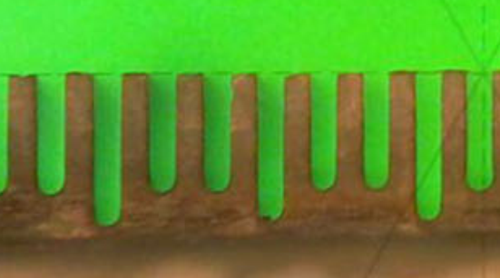
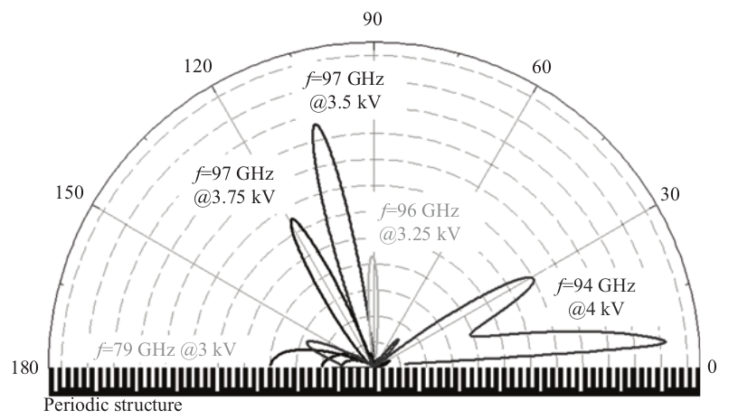
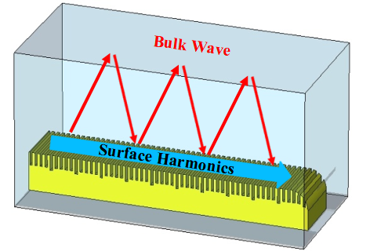
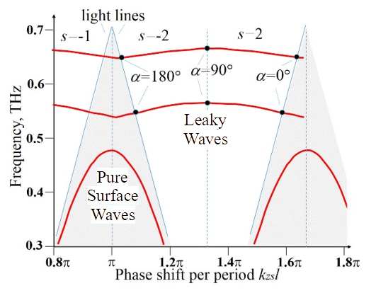
Properties of Bi-Periodic Circuits
p
pN N = 2, 3, ...
Radiation pattern of open W-band circuit
N = 3
Frequency (THz)
Khutoryan, E.M., Kovshov, Y.S., Likhachev, A.S., Ponomarenko, S.S., Kishko, S.A., Lukin, K.A., Zavertanniy, V.V., Kudinova, T.V., Vlasenko, S.A., Kuleshov, A.N., Idehara, T. Excitation of Hybrid Space-Surface Waves in Clinotrons with Non-uniform Grating Journal of Infrared, Millimeter, and Terahertz Waves 39 (3), 236-249 (2018)
Ponomarenko, S.S., Kishko, S.A., Khutoryan, E.M., Kuleshov, A.N., Yefimov, B.P. On ohmic losses decrease in THz BWO-clinotron oscillators. International Conference on Infrared, Millimeter, and Terahertz Waves (2013)
Phase shift per period p
Notes:
Sub-THz Clinotron with Multistage Grating The grating with multiple stages was proposed and investigated in order to decrease the ohmic losses of subTHz Clinotron. Application of multistage grating allows us to provide the feedback using hybrid surface-volume modes as it is shown in fig. 2. Simulation results show that the application of 3-stage grating in 100 GHz Clinotron tube increases the efficiency of the interaction of the ribbon electron beam with electromagnetic wave and, hence, increases the tube output power. Simulation of dispersion characteristics of the 100 GHz Clinotron with the 3-stage grating was done in 2-D assumption using mode matching technique and also using 2-D simulations in Poisson Superfish RF Solver [5]. The electric field distribution of eigen modes of sub-THz Clinotron resonator with 3-stage grating shows the existence of three types of modes: surface (BWO-like) modes when the electric field energy exponentially decays with the distance from the grating surface; volume (orotron-like) modes when electric field energy is distributed in the resonator volume; and hybrid surfacevolume mode when the oscillation energy is accumulated in both surface and volume harmonics as it is shown in fig. 2. Clinotron operation on hybrid surface-volume mode allows choosing the optimal conditions for ohmic losses and coupling impedance.
чисельне моделювання та експериментальне дослідження збудження електронними потоками гібридних поверхнево-обємних хвиль в резонаторах клинотронів з багатоступеневими гребінками проведено обчислювальні експерименти

Slide 12
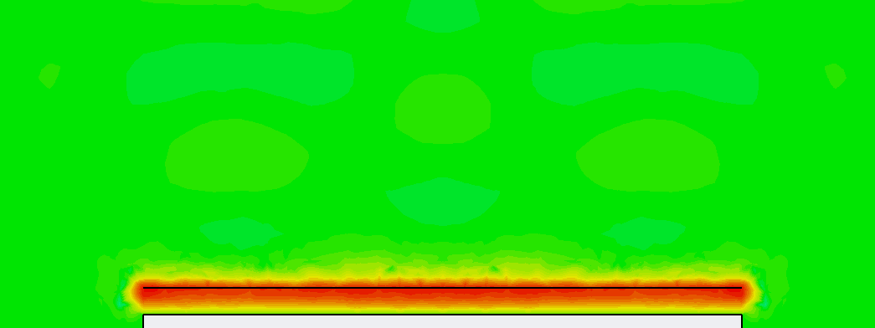
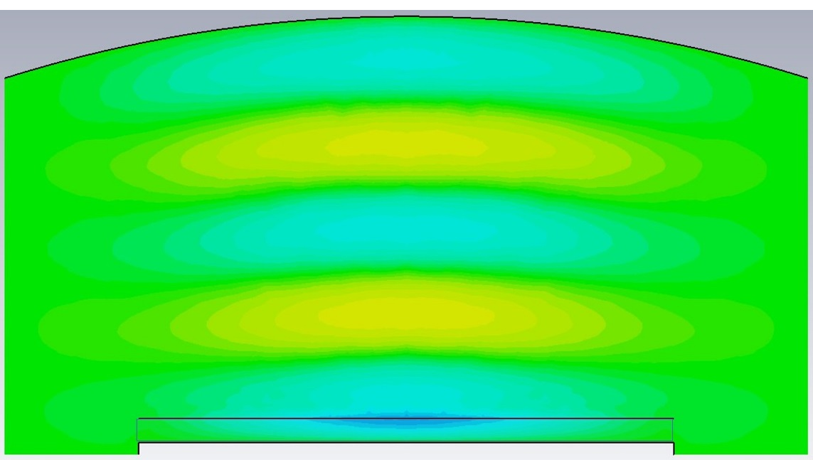
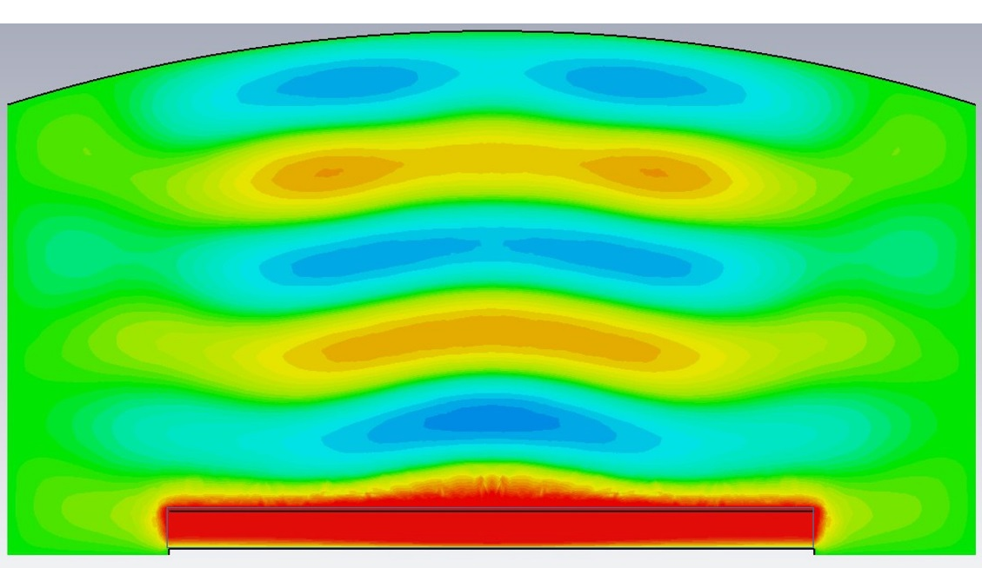
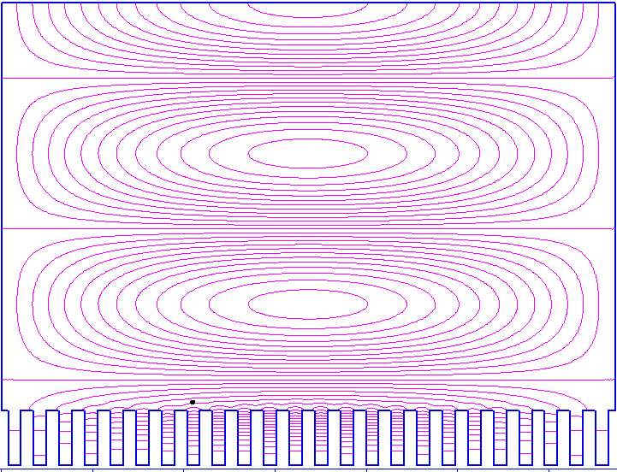
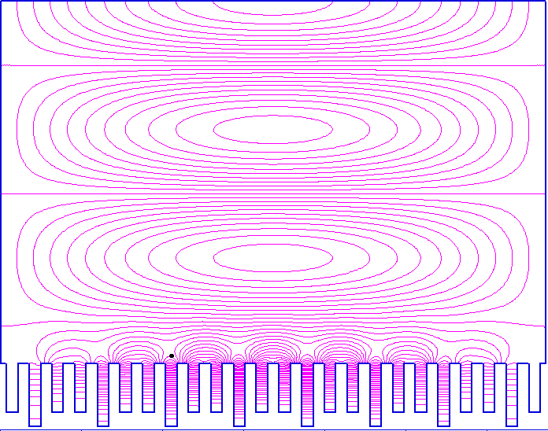
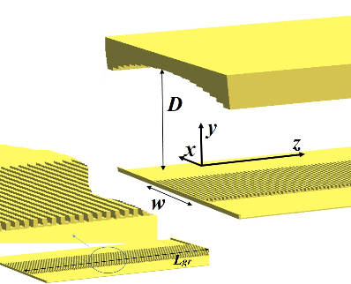
Development of 650 GHz Cherenkov Oscillator
Pure surface wave (BWO, TWT)
Pure bulk wave (DRO, Orotron)
Hybrid bulk-surface wave
y
x
y
y
x
x
y
z
y
y
z
z
Khutoryan E.M., Kuleshov A.N., Ponomarenko S.S., Lukin K.A., Tatematsu Y., Tani M., Hybrid Bulk-Surface Modes Excited by a Sheet Electron Beam in THz Cherenkov Oscillator IEEE Transactions on Electron Devices 69 (6), 3407-3412 (2022)
Khutoryan E., Kuleshov A., Ponomarenko S., Lukin K., Tatematsu Y., Tani M. Efficient Excitation of Hybrid Modes in a THz Clinotron Journal of Infrared, Millimeter, and Terahertz Waves 42 (6), 671-683 (2021)
Notes:
Specific feedback providing efficient beam-wave interaction which is less sensitive to ohmic losses comparably with traditional Cherenkov devices
Efficient oversized radiation output in the cavity with slow-wave circuit
Uniform RF field distribution across a grating allowing efficient interaction with wide sheet electron beams
High mode selectivity because of diffraction losses of higher transverse modes

Slide 13
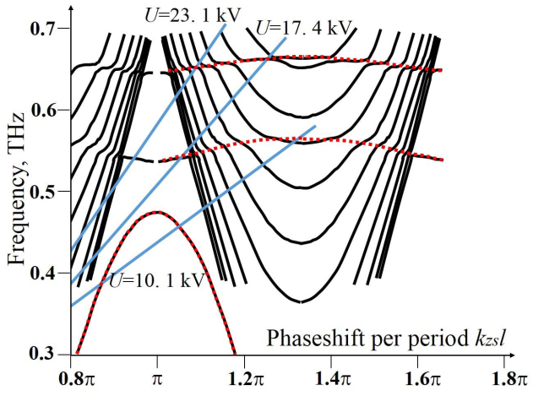
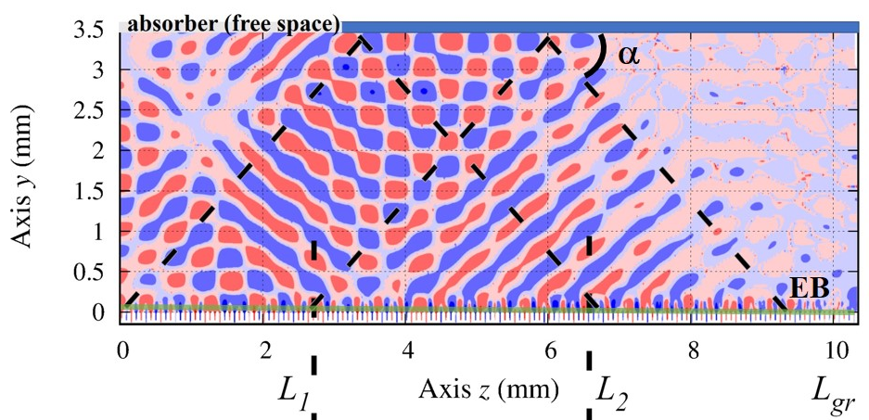
Simulation of the Beam-Wave Interaction
Power output
Frequency (THz)
Phase shift per period p
Phase shift per period p
Khutoryan E.M., Kuleshov A.N., Ponomarenko S.S., Lukin K.A., Tatematsu Y., Tani M., Hybrid Bulk-Surface Modes Excited by a Sheet Electron Beam in THz Cherenkov Oscillator IEEE Transactions on Electron Devices 69 (6), 3407-3412 (2022)
Khutoryan E., Kuleshov A., Ponomarenko S., Lukin K., Tatematsu Y., Tani M. Efficient Excitation of Hybrid Modes in a THz Clinotron Journal of Infrared, Millimeter, and Terahertz Waves 42 (6), 671-683 (2021)
Notes:
Specific feedback providing efficient beam-wave interaction which is less sensitive to ohmic losses comparably with traditional Cherenkov devices
Efficient oversized radiation output in the cavity with slow-wave circuit
Uniform RF field distribution across a grating allowing efficient interaction with wide sheet electron beams
High mode selectivity because of diffraction losses of higher transverse modes

Slide 14
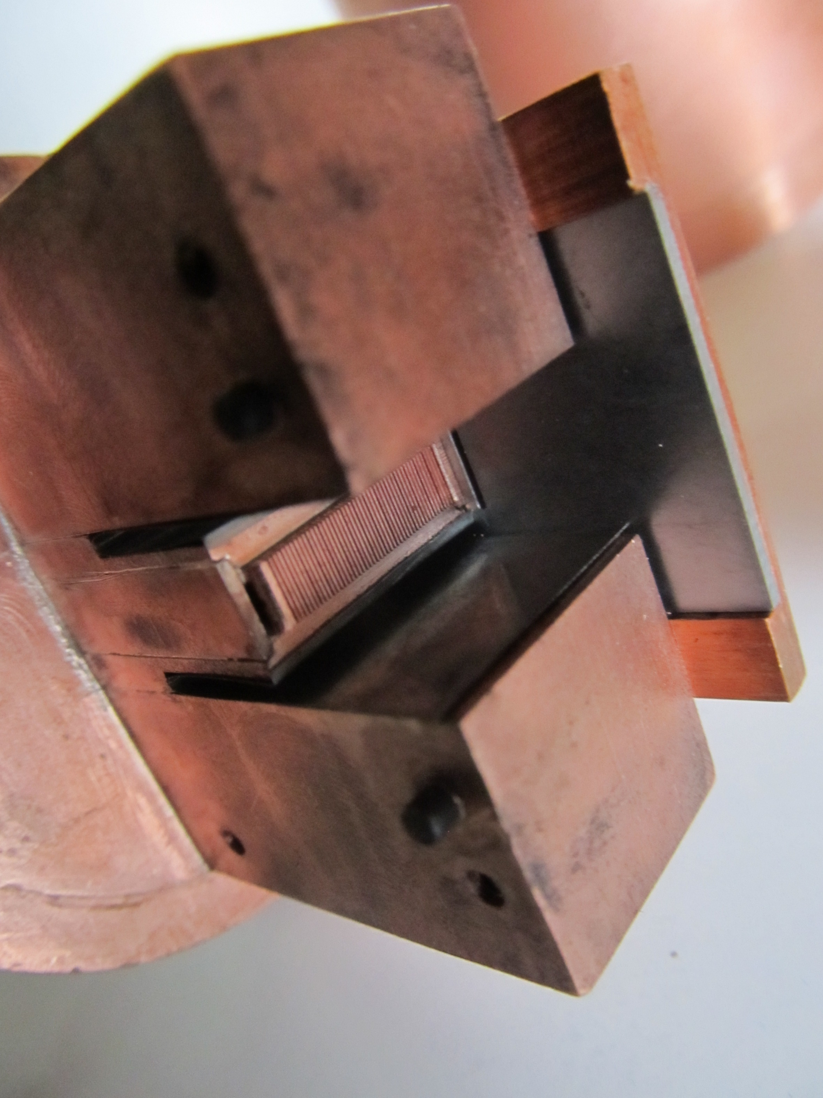
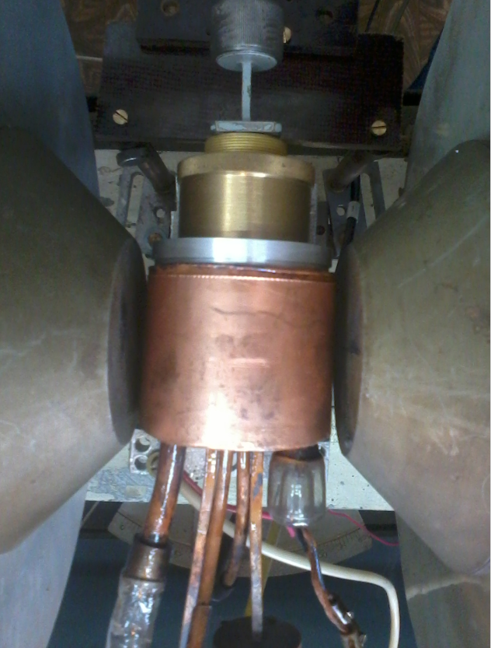
Experimental Test at 100 GHz
Simulation Experiment
1.0
1.0
Simulated Output Power
Observed Output Power
0.5
0.5
0.0
0.0
1.5 2.0 2.5 3.0 3.5 4.0
Beam Voltage (kV)
Khutoryan, E.M., Kovshov, Y.S., Likhachev, A.S., Ponomarenko, S.S., Kishko, S.A., Lukin, K.A., Zavertanniy, V.V., Kudinova, T.V., Vlasenko, S.A., Kuleshov, A.N., Idehara, T. Excitation of Hybrid Space-Surface Waves in Clinotrons with Non-uniform Grating Journal of Infrared, Millimeter, and Terahertz Waves 39 (3), 236-249 (2018)

Slide 15
Traveling-Wave Amplification
Input Power
Absorbing Load
Output Power
1st Section
2st Section
Gain
Cathode
Collector
3.8 kV
60 mA
96.34 GHz
Input Power OFF
Input Power ON
Power x3
Efficiency
sweeping of a beam voltage
2.0
3.3
4.3
2.0
3.3
4.3
Ponomarenko, S.S., Likhachev, A.A., Vlasenko, S.A., Kovshov, Y.S., Stoyanova, V.V., Kishko, S.A., Khutoryan, E.M., Kuleshov, A.N., Lukin, K.A., Tatematsu, Y., Tani, M. Traveling-Wave Amplification in a Circuit with Nonuniform Grating IEEE Transactions on Electron Devices 68 (10), 5232-5237 (2021)
Ponomarenko S.S., Likhachev A.A., Kovshov Yu.S., Stoyanova V.V., Kishko S.A., Khutoryan E.M., Lukin K.A., Kuleshov A.N., Tatematsu Y., Tani M. Mode Interaction in Clinotron with Periodically Modified Grating International Conference on Infrared, Millimeter, and Terahertz Waves, IRMMW-THz (2021)
Notes:
the last problem that i have worked on was

Slide 16
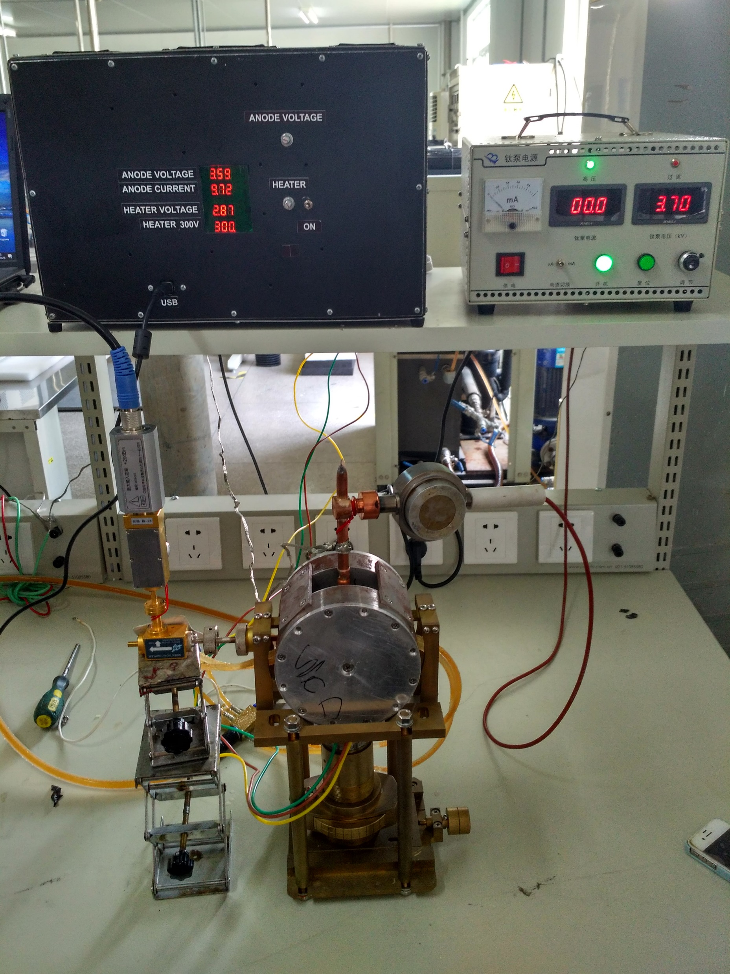
Conclusions
The comprehensive studies of physical effects have been carried out and their results was implemented in the CW THz Clinotrons for optimization of the beam-wave interaction efficiency and frequency characteristics.
Both the theoretical study and 3-D simulations of the excitation of hybrid bulk-surface modes in the THz Cherenkov devices have demonstrated their high potential for a generation of the Watt level THz radiation.
The compact radiation modules based on CW Clinotron oscillators with improved operation parameters have been developed for the frequency range from 25 to 400 GHz in our laboratory.
340 GHz
300 GHz
175 GHz
Notes:
дослідження нестабільності параметрів випромінювання електронно-вакуумних приладів та розроблення системи стабілізації за допомогою під контролю напруг, що живлять еос, у зовнішних контурах зворотнього звязку......

Slide 17
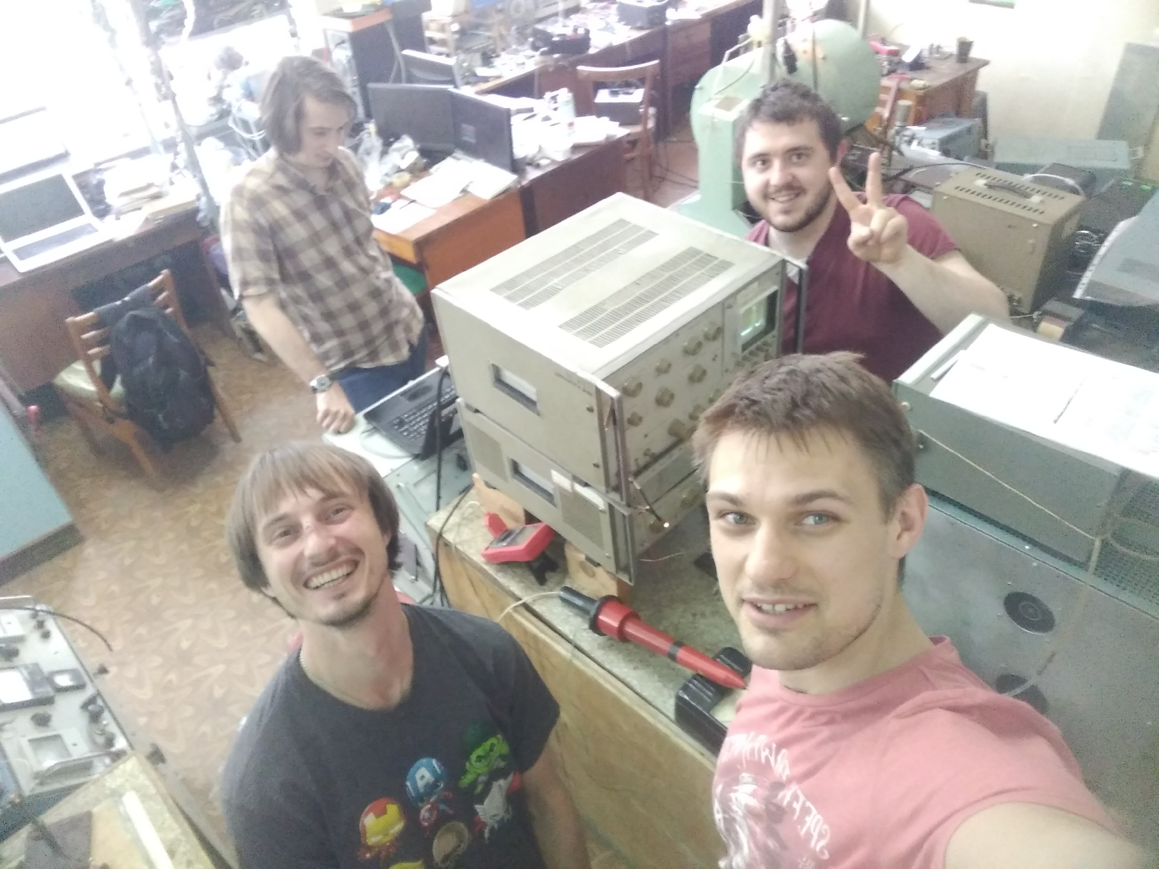
Thank You for Your Attention
The youngest part of the Lab in 2020

Slide 18
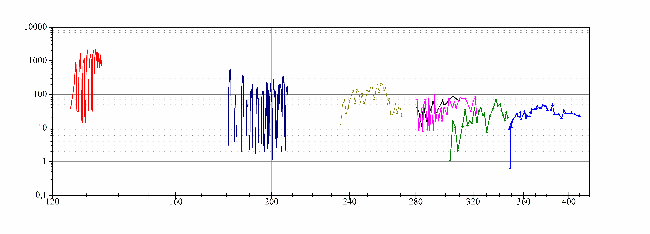
Sub-THz and THz Clinotrons
Power (mW)
Frequency (GHz)
Notes:
Resonant bwo
Inclined thick beam (bunching in a high-amplitude RF field)
Wide oversized structure = sheet beam
знаходження профілю магнітного поля, що фукусує, та геометрії еос методом траєкторного аналізу руху електронних потоків, та на снові отриманих результатів створення компактних мфс та електронних гармат
Software packages
Tech. mfs>1T

Slide 19
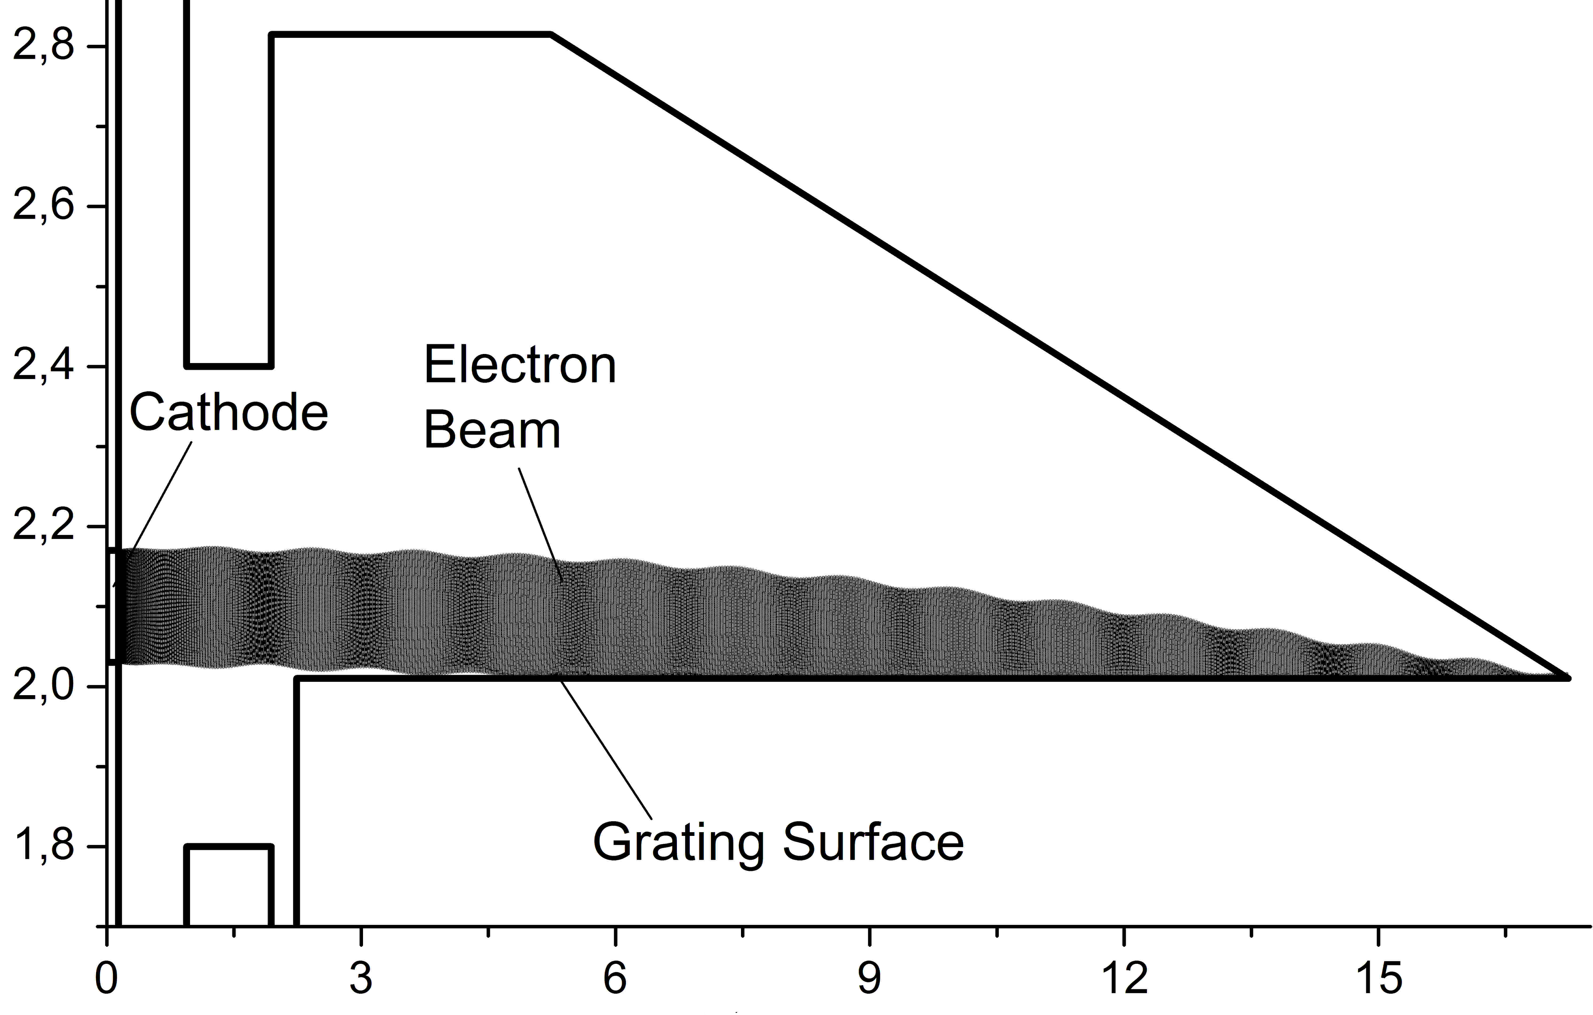
Magnetic Focusing of Electron Beam
Axis Z
Dimension Y (mm)
B_{z} (T)
--, – Simulated
◦ Measured
Dimension Z (mm)
Z (mm)
Kovshov, Y.S., Ponomarenko, S.S., Kishko, S.A., Khutoryan, E.M., Kuleshov, A.N. Numerical Simulation and Experimental Study of Sub-THz and THz CW Clinotron Oscillators (2018) IEEE Transactions on Electron Devices, 65 (6), pp. 2177-2182. DOI: 10.1109/TED.2018.2792258
Zavertanniy, V.V., Kishko, S.A., Ponomarenko, S.S., Yefimov, B.P., Zabrodskiy, A.F., Kirichenko, L.A., Kudinova, T.V., Kuleshov, A.N. Magnetic Focusing System For Intense Electron Beams Of Submillimeter Clinotrons (2012) Izvestiya Vysshikh Uchebnykh Zavedeniy. PND, 20 (5), pp. 112-120. DOI: 10.18500/0869-6632-2012-20-5-112-120

Slide 20
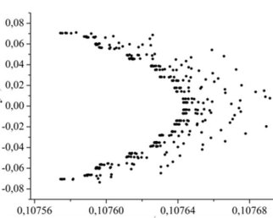
Sheet Electron Beam for a Clinotron
Y
Y (mm)
cathode
Z
$$υ_{e}/c$$
$$υ_{e}/υ_{0}$$
$$υ_{e}/υ_{0}$$
ΔY
anode
fast central layer
fast low layer
fast high layer
$${β_{z}=υ}_{e}/c$$
$$β_{z}$$
$$β_{z}$$
$$β_{z}$$
Kovshov, Y., Ponomarenko, S., Kishko, S., Likhachev, A., Danik, A., Zheltov, V., Khutoryan, E., Zahrevskyi, D., Kuleshov, A. Electron Beam Velocity Spread Effect on a Clinotron Operation (2018) International Conference on Mathematical Methods in Electromagnetic Theory, MMET, 2018-July, art. no. 8460245, pp. 326-329. DOI: 10.1109/MMET.2018.8460245
Kovshov, Y., Ponomarenko, S., Kishko, S., Likhachev, A., Danik, A., Khutoryan, E., Zahrevskyi, D., Kuleshov, A. Tracking Analysis of a Sheet Electron Beam for Clinotron Tube (2018) International Conference on Mathematical Methods in Electromagnetic Theory, MMET, 2018-July, art. no. 8460387, pp. 330-333. DOI: 10.1109/MMET.2018.8460387

Slide 21
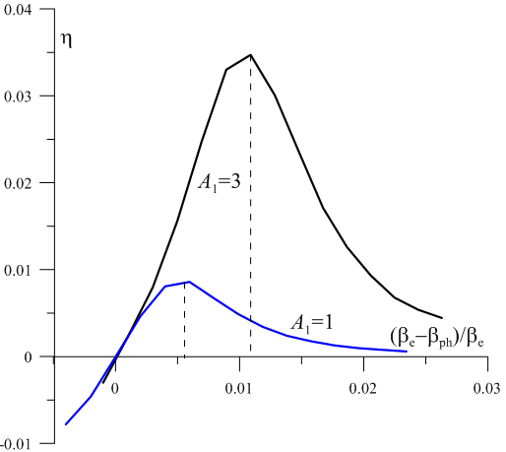
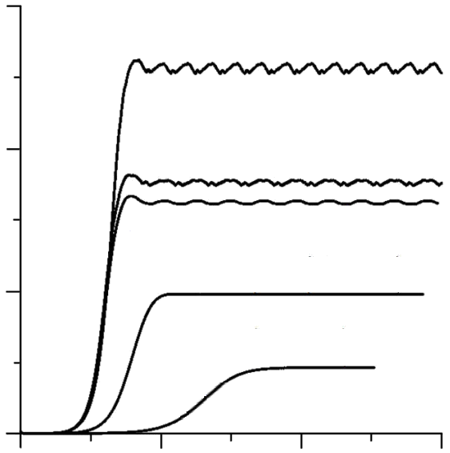
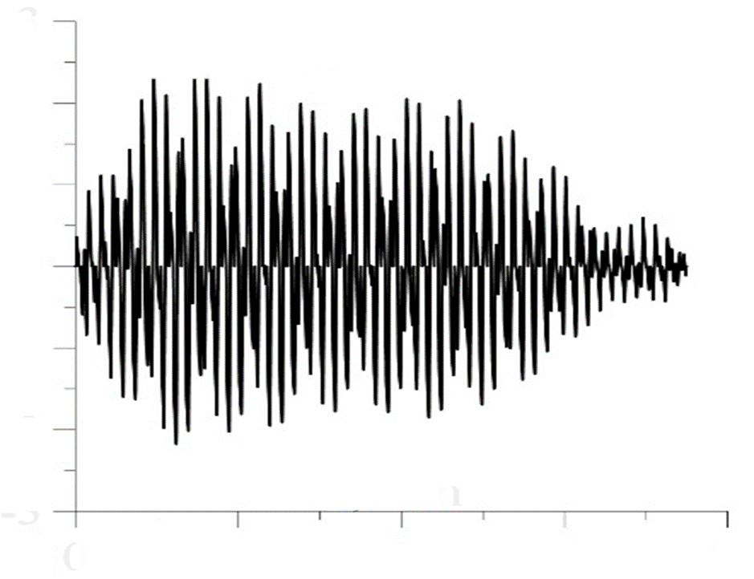
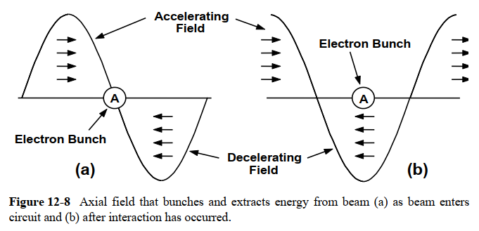
Velocity Distributions in Electron Beam
0.3
fast low layer
Electronic efficiency
0.2
uniform distribution
Output power (W)
fast central layer
3
2
0.1
1
Velocity mismatch
fast high layer
E_{z} (kV/mm)
0
-1
-2
0
-3
0
2
4
6
0
4
8
12
16
Time (ns)
Axis Z (mm)
Likhachev, A.A., Danik, A.A., Kovshov, Y.S., Kishko, S.A., Ponomarenko, S.S., Zheltov, V.N., Khutoryan, E.M., Kuleshov, A.N. Effect of electron beam velocity spread in a clinotron (2019) IEEE Transactions on Electron Devices, 66 (3), art. no. 8624399, pp. 1540-1544. DOI: 10.1109/TED.2019.2891547

Slide 22
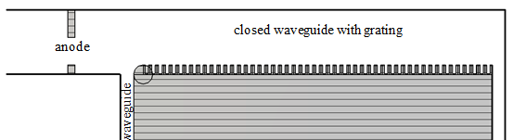
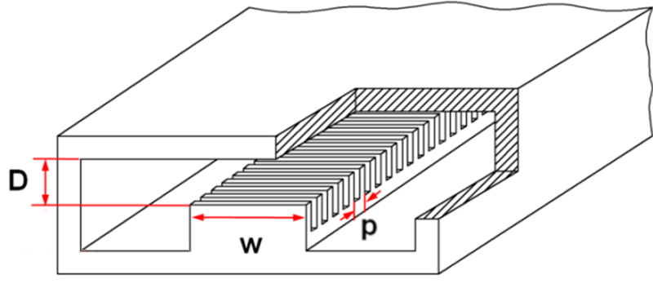
Mode Transformation in a Clinotron
Anode
port
T₁
R₁
R₂
T₀
Grating
Output waveguide
Plunger
Frequency (GHz)
Beam Voltage (V)
Kovshov, Y.S., Ponomarenko, S.S., Kishko, S.S., Likhachev, A., Danik, A., Mospan, L., Steshenko, S., Khutoryan, E.M., Kuleshov, A.N. Effect of Mode Transformation in THz Clinotron (2018) Journal of Infrared, Millimeter, and Terahertz Waves, 39 (11), pp. 1055-1064. DOI: 10.1007/s10762-018-0534-y
Kovshov, Y., Ponomarenko, S., Kishko, S., Likhachev, A., Danik, A., Mospan, L., Steshenko, S., Khutoryan, E., Kuleshov, A. Demonstration of a Mode Transformation Effect in 300-GHz CW Clinotron (2018) International Conference on Mathematical Methods in Electromagnetic Theory, MMET, 2018-July, art. no. 8460346, pp. 254-257. DOI: 10.1109/MMET.2018.8460346
Notes:
проведення чисельного моделювання електронно-хвильової взаємодії з урахуванням відбиття та трансформації хвиль у надрозмірних резонаторах клинотронів мм та субмм діапазонів

Slide 23
Spectral Characteristics
Calculated operating zone
Calculated spectrum
Observed spectrum
High RF losses
Low RF losses
Ponomarenko, S.S., Likhachev, A.A., Stoyanova, V.V., Kovshov, Y.S., Vlasenko, S.A., Kishko, S.A., Khutoryan, E.M., Kuleshov, A.N. Spectral Characteristics of THz CW Clinotrons (2020) IEEE Transactions on Electron Devices, 67 (12), art. no. 9248643, pp. 5766-5770. DOI: 10.1109/TED.2020.3032940

Slide 24
Developed Compact Radiation Modules
340 GHz Module
300 GHz Module
175 GHz Module
Likhachev, A., Kovshov, Y., Kishko, S., Ponomarenko, S., Vlasenko, S., Ivanov, A., Kuleshov, A. Supply voltage control for guaranteed performance of compact terahertz vacuum electron devices (2021) Review of Scientific Instruments, 92 (12), art. no. 124704, DOI: 10.1063/5.0070533
Likhachev, A., Danik, A., Kovshov, Y., Kishko, S., Ponomarenko, S., Martseniak, O., Khutoryan, E., Ogawa, I., Idehara, T., Kuleshov, A. Compact radiation module for THz spectroscopy using 300 GHz continuous-wave clinotron (2019) Review of Scientific Instruments, 90 (3), art. no. 034703, . DOI: 10.1063/1.5064796
Likhachev, A., Ponomarenko, S., Kishko, S., Kovshov, Y., Zheltov, V., Khutoryan, E., Moseev, D., Stange, T., Kuleshov, A. Development and Test of 175 GHz Clinotron Tube (2021) 2021 22nd International Vacuum Electronics Conference, IVEC 2021. DOI: 10.1109/IVEC51707.2021.9722552
Danik, A.A., Likhachev, A.A., Ponomarenko, S.S., Kishko, S.A., Kovshov, K.Y., Zavertanniy, V.V., Vlasenko, S.A., Khutoryan, E.M., Kuleshov, A.N. Compact THz continuous-wave clinotron oscillators (2019) International Conference on Infrared, Millimeter, and Terahertz Waves, IRMMW-THz, 2019-September, art. no. 8874578. DOI: 10.1109/IRMMW-THz.2019.8874578
Notes:
стабілізації та контроль вихідних характеристик електронно-вакуумних приладів з використанням зовнішніх багатоконтурних під регуляторів
(+стабілізації та контроль вихідних характеристик електронно-вакуумних приладів з використанням зовнішніх багатоконтурних під регуляторів)

Slide 25
Traveling-Wave Amplification
MW in
Absorbing Load
MW out
1st Section
2st Section
Cathode
Collector
Input MW OFF
Input MW ON
Gain
3.8 kV
60 mA
96.34 GHz
Power x3
Efficiency
2.0
3.3
4.3
2.0
3.3
4.3
sweeping of a beam voltage
Ponomarenko, S.S., Likhachev, A.A., Vlasenko, S.A., Kovshov, Y.S., Stoyanova, V.V., Kishko, S.A., Khutoryan, E.M., Kuleshov, A.N., Lukin, K.A., Tatematsu, Y., Tani, M. Traveling-Wave Amplification in a Circuit with Nonuniform Grating (2021) IEEE Transactions on Electron Devices, 68 (10), pp. 5232-5237, 10.1109/TED.2021.3105951
Ponomarenko S.S., Likhachev A.A., Kovshov Yu.S., Stoyanova V.V., Kishko S.A., Khutoryan E.M., Lukin K.A., Kuleshov A.N., Tatematsu Y., Tani M. Mode Interaction in Clinotron with Periodically Modified Grating (2021) International Conference on Infrared, Millimeter, and Terahertz Waves, IRMMW-THz, 2021-August, 10.1109/IRMMW-THz50926.2021.9567573
Danik, A.A., Likhachev, A.A., Ponomarenko, S.S., Kishko, S.A., Kovshov, Y.S., Khutoryan, E.M., Kuleshov, A.N. Application of Clinotron Scheme for THz Traveling-Wave-Tubes (2019) International Conference on Infrared, Millimeter, and Terahertz Waves, IRMMW-THz, 2019-September, 10.1109/IRMMW-THz.2019.8873690
Notes:
the last problem that i have worked on was

Slide 26
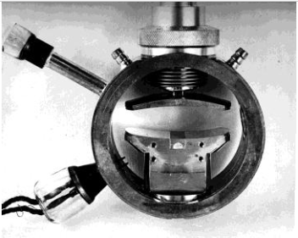
Diffraction Radiation Oscillator
Output waveguide
Vacuum bellows for mechanical tuning of frequency
Upper mirror with a diffractional output
Bottom mirror with a grating

