Slide 1
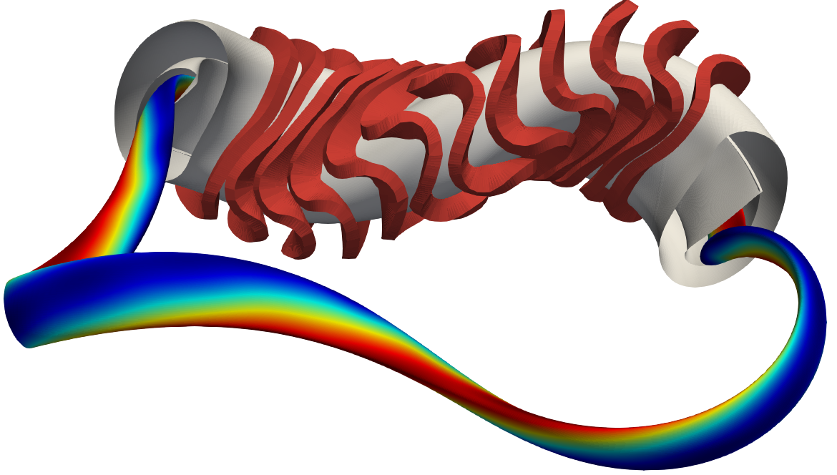
Extend/validate the database towards fusion reactor operation
Wishlist:
Revisit the Sudo-Density limit in all stellarators, as done previously by G. Fuchert in W7-X
Operation at high density is very beneficial for burning plasma operation (increased confinement, reduced alpha particle slowing down, reduced temperatures)
→ Better explore the density limit
Perform experiments with different aspect ratios:
Laspect ratio operation could be one possibility towards a burning stellarator fusion power plant, as this eases coil shaping and the constructability.
Perform “small plasma” experiments in similar to those at W7-X
Build database for high confinement scenarios – “what would be an optimistic ISS04 scaling?” or “Is there hope reaching renormalization factors of two?”

