Slide 1
Multi-Species Impurity Transport Studies in Stellarators: Status and Prospects A. Langenberg¹, M.J. García-Regana², A. Dinklage¹, M. Kubkowska³, Th. Wegner¹, B. Buttenschön¹, N. Pablant⁴, F. Reimold¹ ¹ Max-Planck Institute for Plasma Physics, Greifswald, Germany ² Laboratorio Nacional de Fusión Ciemat, Madrid, Spain ³ Institute of Plasma Physics and Laser Microfusion, Warsaw, Poland ⁴ Princeton Plasma Physics Laboratory, Princeton, USA

Slide 2
Motivation / Status
Theoretic predictions for impurity transport
Neoclassical theory:
Significant variation of transport times τ _{I} for Si¹²⁺→ W⁴⁴⁺ impurities
Absolute values of τ _{I} in the order of several seconds
Turbulent transport simulations:
No Z or M dependence for impurity transport predicted ^{[1]}
Experimental Observations in W7-X ^{[2,3]} and LHD ^{[4]}
No / weak Z or M dependence
Absolute τ _{I} ~ 100 – 500 ms
Turbulence reduced scenarios of W7-X:
Significantly higher τ _{I} in the order of seconds (initial results available, to be verified)
Z dependence in turbulence reduced scenarios unexplored
[1] P. Helander and A. Zocco Plasma Phys. Control. Fusion (2018)
[2] A. Langenberg, Th. Wegner, N. Pablant et al. Phys. Plasmas (2020)
[3] M. Kubkowska, A. Czarnecka, T. Fornal et al. Rev. Scien. Instrum. (2018)
[4] N. Tamura, M. Yoshinuma, K. Ida et al. Plasma and Fusion Research (2021)

Slide 3
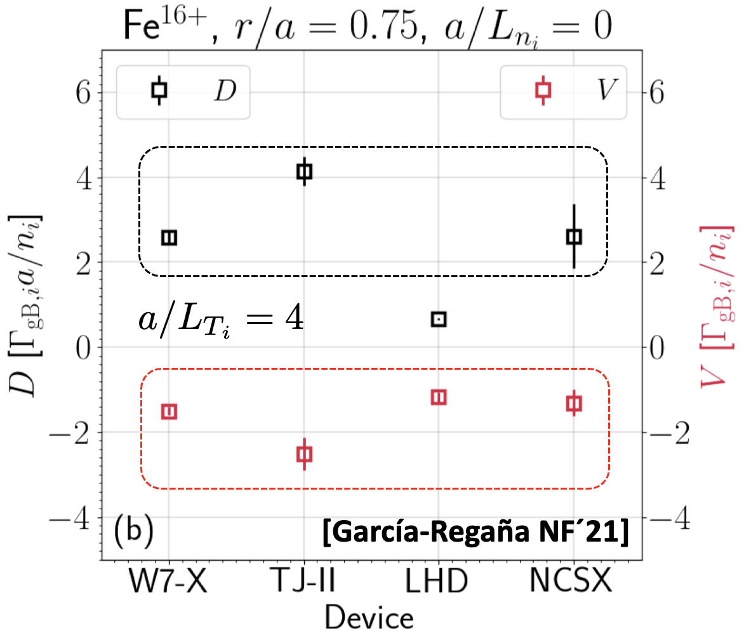
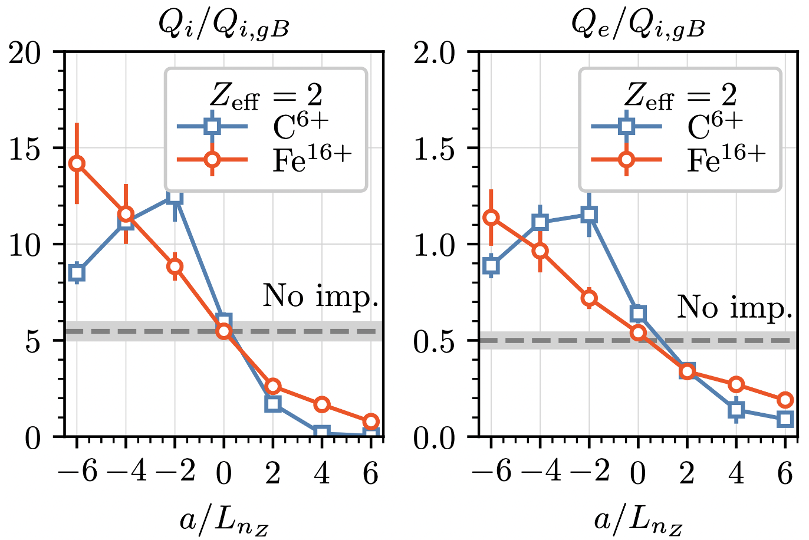
Motivation / Status
Recent theoretical findings with the GK code stella ^{[4]}
Except for LHD, ITG-driven transport of impurities in W7-X is not particularly higher w.r.t. other machines.
Increasing main ion density gradient ➔ turbulent transport coefficients in W7-X drop up to factor of ~8.
Including non-trace impurities can strongly impact turbulent heat fluxes in W7-X
Non-trace impurities with same sign of density gradient as main ions ➔ turbulence suppresion.
Non-trace impurities with opposite sign of density gradient as main ions ➔ turbulence enhancement.
[4] J.M. García-Regana, M. Barnes, I. Calvo et al. Nuclear Fusion (2021)
[García-Regaña EPS´22]

Slide 4
Ideas for Cross Machine Experiments
Z dependence cross comparison:
measure τ _{I} for Si¹²⁺→ W⁴⁴⁺ impurities in W7-X, LHD, …? medium density plasmas
status W7-X:
turbulence dominated ECRH plasmas τ _{I} data available
no data for high performance NBI plasmas (experiments for OP2.1 planned)
status LHD:
signs of weak Z dependence in med n_{e} LHD plasmas
to be repeated with wider variation of impurities incl. W?
Matching experiments in NBI plasmas:
match T_{e}, n_{e} profiles of W7-X and LHD in medium density NBI plasmas for a direct τ _{I} comparison
varying Z if possible
Questions:
observable impurity species in LHD, W?
matching T_{e}, n_{e} profiles in W7-X and LHD NBI plasmas traight forward?
other machines to be included (TJ-II)?

Slide 5
Impurity Diagnostics / Transport Parameter Access
LHD | W7-X | TJ-II | H-J | HSX | AUG/TE | other
τ _{I} (Z) | τ _{I} (Z)
∫ n_{Z} dl, n_{Z} (ρ) ^{B,C, Si, W} | ∫ n_{Z} dl, n_{Z} (ρ) ^{C, Ar, Fe}
D+v (ρ) ^{C} | D+v (ρ) ^{C, Ar, Fe}
 | Γ (ρ) ^{Ar, Fe}
2xTESPEL, IPD | LBO, TESPEL, IPD
E/VUV-Spec, CXS, Tomography? | XICS, PHA, CXRS, VUV-Spec, Tomography

