Slide 1
META Stellarator
Yasuhiro Suzuki¹ and Shigeru Inagaki²
1 Graduate School of Advanced Science and Engineering,
Hiroshima University
2 Institute for Advanced Energy, Kyoto University

Slide 2
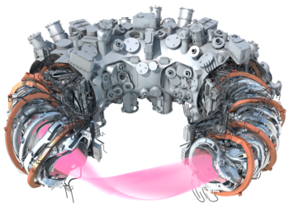
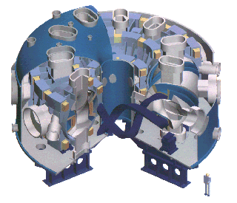
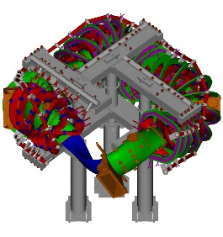
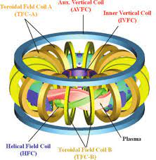
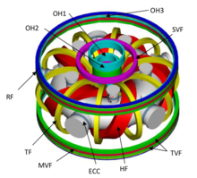
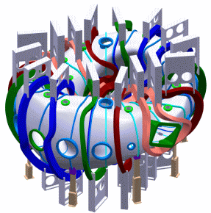
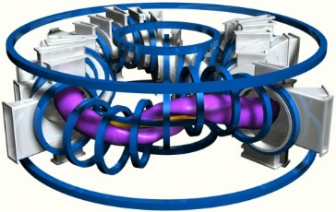
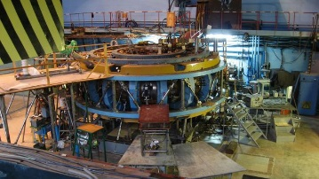
Vehicles to go forward (© A. Dinklage)
Diversity of 3D magnetic configurations
World‘s leading experimental 3D-confinement facilities
  demonstration of plasma performance and specific aspects of 3D magnetic confinement fusion
  Not finding hidden symmetry
How to examine inter-machine comparison of plasma performance and specific aspects with ‘diversity’ of 3D magnetic configuration?
  META Stellarator! (=Virtual Stellarator)

Slide 3
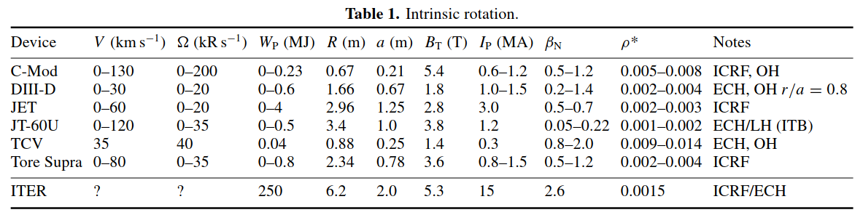
Inter-machine comparison for tokamak
EX: Inter-machine comparison of intrinsic toroidal rotation
J.E. Rice et al 2007 Nucl. Fusion 47 1618
Inter-machine comparison to predict ITER plasma was conducted.
For tokamaks, ITER similar shape can be demonstrated (excluding JT-60U and Tore Supra).
Is it possible for stellarators?
  No! 3D magnetic configurations are too different!
  Configuration of Stellarator Reactor cannot be fixed! (→diversity of 3D fields)

Slide 4
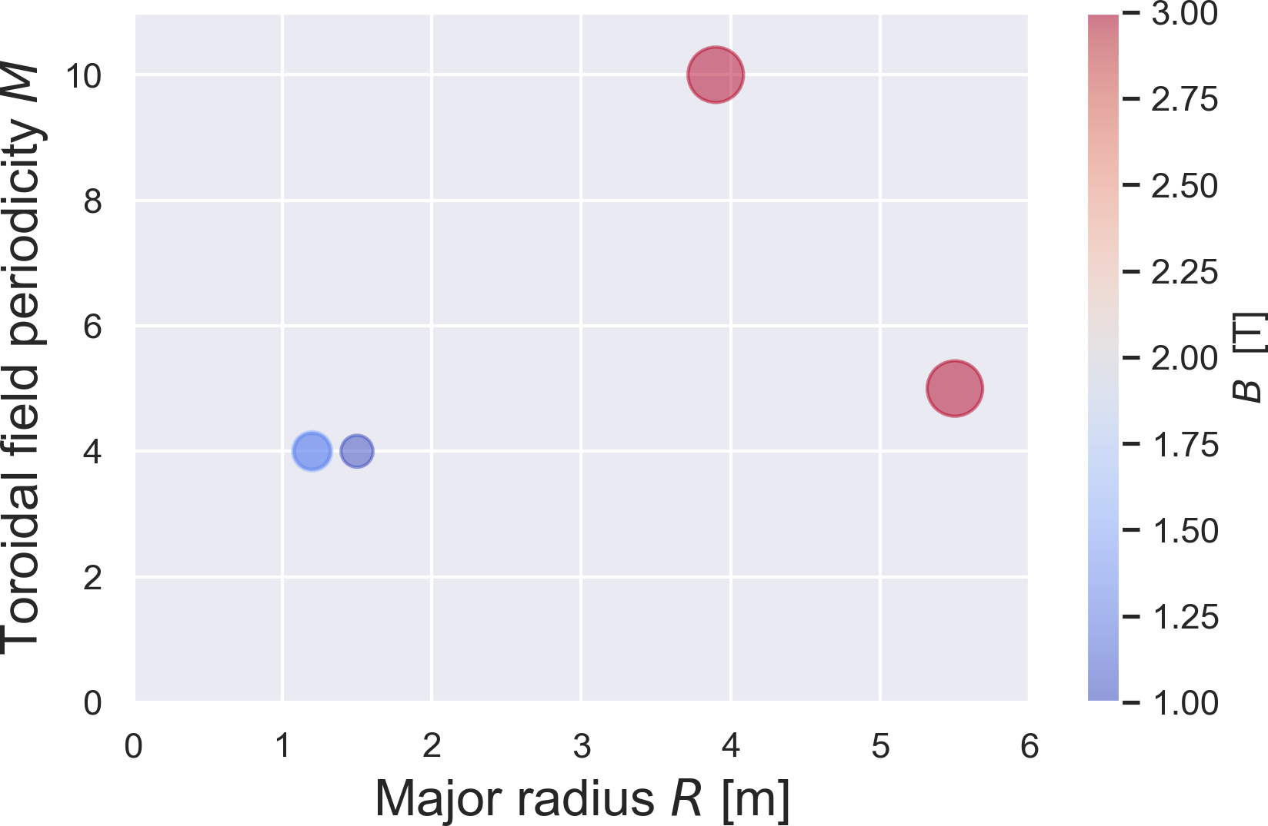
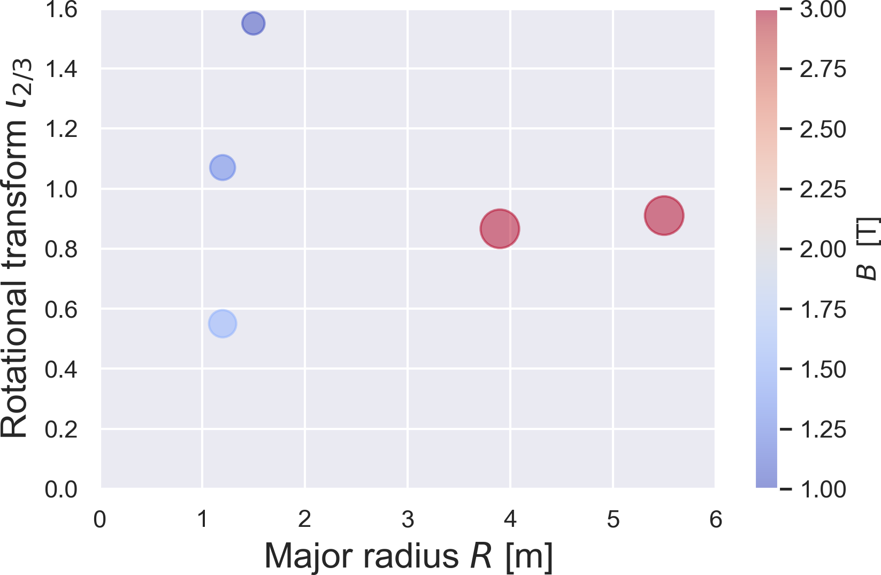
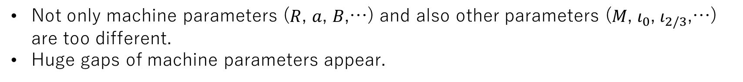
Clustering of 3D magnetic configurations
Clustering of 3D magnetic configurations (LHD, W7-X, H-J, HSX, TJ-II)
Huge gap!
Huge gap!
Not only machine parameters ($R$, $a$, $B$,…) and also other parameters ($M$, $ι_{0}$, $ι_{2/3}$,…) are too different.
Huge gaps of machine parameters appear.

Slide 5
Proposal: META-Stellarator experiments
Creating a completely scalable virtual helical device (Meta-Stellarator) for thermonuclear fusion reactor
Scaling here is not the ISS scaling
Method of extracting the properties of the infinite world from information obtained on finite-scale-phenomena
e.g. Core turbulence, MHD activity, SOL/Div transport,…
What they look like when scaled differently.

Slide 6
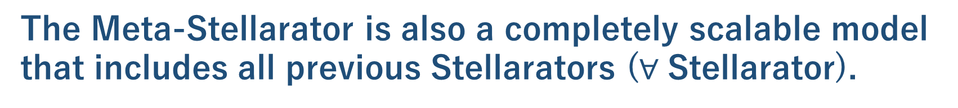
Meta-Stellarator
The Meta-Stellarator is a consortium of stellarators.
The Meta-Stellarator is a complex of several helical devices (Meta-Device/Facility) that act as if they were a single helical device.
The Meta-Stellarator is also a completely scalable model that includes all previous Stellarators ($∀$ Stellarator).
Notes:
Finally, I would like to explain a little about the meta-stellarator concept.

Slide 7
Case study: Produce scale similar plasmas for H-J and LHD
Courtesy to S. Inagaki
H-J
LHD
Model
Geometric Scaling
Dimensionless number
Comparison
Virtual
Scale-down LHD
Interpolation
Virtual
Scale-up H-J
Extrapolation
Meta-Stellarator

Slide 8
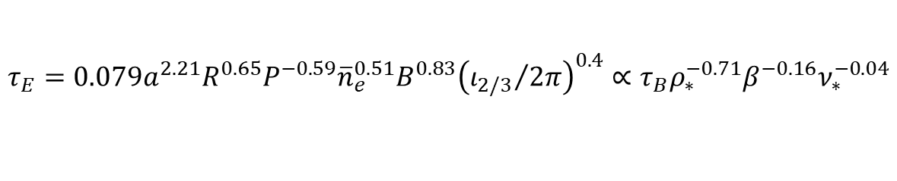
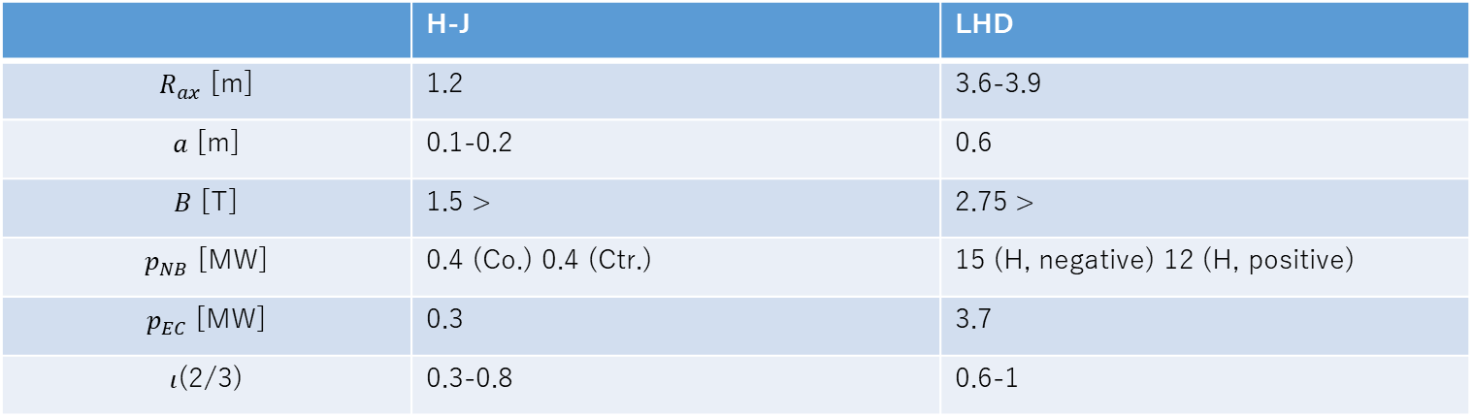
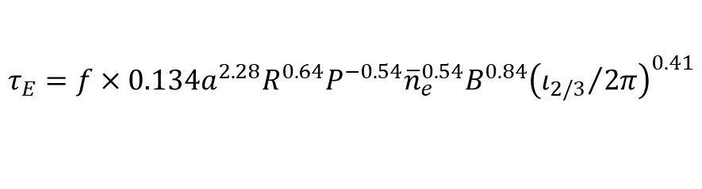
How to scale down?
Courtesy to S. Inagaki
 | H-J | LHD
$R_{ax}$ [m] | 1.2 | 3.6-3.9
$a$ [m] | 0.1-0.2 | 0.6
$B$ [T] | 1.5 > | 2.75 >
$p_{NB}$ [MW] | 0.4 (Co.) 0.4 (Ctr.) | 15 (H, negative) 12 (H, positive)
$p_{EC}$ [MW] | 0.3 | 3.7
$ι$(2/3) | 0.3-0.8 | 0.6-1
ISS95
$$τ_{E}=0.079a^{2.21}R^{0.65}P^{−0.59}{\overline{n}}_{e}^{0.51}B^{0.83}{\left({ι_{2/3}}/{2π}\right)}^{0.4}∝τ_{B}ρ_{∗}^{−0.71}β^{−0.16}ν_{∗}^{−0.04}$$
ISS04
$$τ_{E}=f×0.134a^{2.28}R^{0.64}P^{−0.54}{\overline{n}}_{e}^{0.54}B^{0.84}{\left({ι_{2/3}}/{2π}\right)}^{0.41}$$
What data should be obtained?

Slide 9

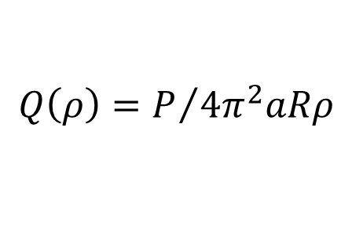



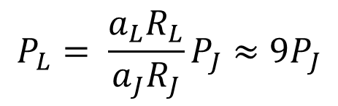

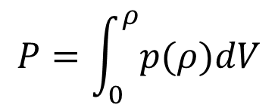

Core Transport
Core Transport
Gradient should be related to flux
Compare gradients with same flux
Courtesy to S. Inagaki
$$P=\int_{0}^{ρ}{p(ρ)dV}$$
$${Q\left(ρ\right)=P}/{4π^{2}aRρ}$$
$$P_{L}= \frac{a_{L}R_{L}}{a_{J}R_{J}}P_{J}≈9P_{J}$$
Metric will be considered for more precise evaluation
ECH
$P_{J}=0.3−0.5$MW
$P_{L}\sim 3−5$MW
Co/Ctr respectively
NBI
$P_{J}=0.4−0.6$MW
$P_{L}=4−6$MW
Target plasma
$$T_{e}=T_{i}$$
$$n_{L}=n_{J}$$
from simplification
Would the collisionality need to be matched?
Discuss differences in configuration
Notes:
The simplest principle is that
For this reason, we first consider making the flux the same.

Slide 10

SOL Transport
Cross-field heat transport is important
Courtesy to S. Inagaki
Assessment
Probability distribution function (PDF) of footprint heat flux on wall
Most probable flux
Mean flux
EMC3-EIRENE
Maximum flux
Skewness
Matoike
$V_{∥}, λ_{div}$, would be important too.
Discuss dependence of the PDF on configuration
Notes:
It is difficult to evaluate SOL.
Here I would like to discuss an example of an assessment in the SOL function
The key is cross-field heat transport..
So, I would like to propose the following heat PDF-based assessment.
Several heat fluxes can be defined. I think any heat flux is important.

Slide 11
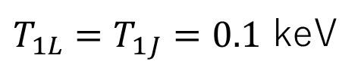
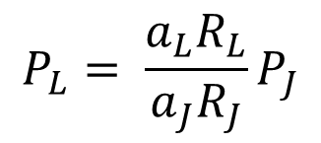
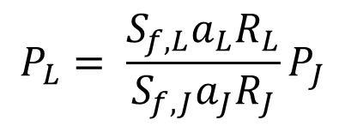
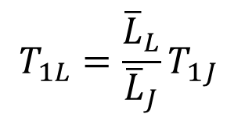
Target of SOL Transport Experiment
Compare PDF with same
Courtesy to S. Inagaki
$$P_{L}= \frac{a_{L}R_{L}}{a_{J}R_{J}}P_{J}$$
Heat flux at the LCFS
Edge T
$T_{1L}=T_{1J}=0.1$ keV
$$T_{1L}=\frac{{\overline{L}}_{L}}{{\overline{L}}_{J}}T_{1J}$$
Parallel gradient T/L
$$P_{L}= \frac{{S_{f,L}a}_{L}R_{L}}{S_{f,J}a_{J}R_{J}}P_{J}$$
Total footprint heat flux

Slide 12
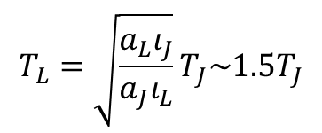

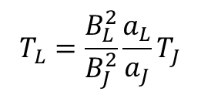

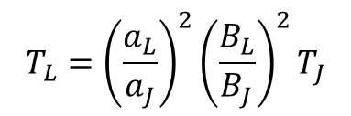

Dimensionless Parameters
Compare dimensionless parameters with the same values of $ρ_{∗}, β, ν_{∗}$
H-J
LHD
$$T_{L}={\left(\frac{a_{L}}{a_{J}}\right)}^{2}{\left(\frac{B_{L}}{B_{J}}\right)}^{2}T_{J}$$
1.25 T, 0.22 keV
1.5 T, 3 keV
same
$$ρ_{∗}$$
0.85 T, 0.1 keV
2.75 T, 10 keV
$$T_{L}=\frac{B_{L}^{2}}{B_{J}^{2}}\frac{a_{L}}{a_{J}}T_{J}$$
same
$$β$$
1.25 T, 0.22 keV
1.5 T, 0.95 keV
$$T_{L}=\sqrt{\frac{a_{L}ι_{J}}{a_{J}ι_{L}}}T_{J}\sim 1.5T_{J}$$
same
$$ν_{∗}$$
Target dimensionless parameters
Magnetic Reynolds Num.
Prandtl num.
Mach num.
Courtesy to S. Inagaki
Lewis num.
Schmidt num.
Péclet num.
Nusselt num.
Show how transport channels are competing
Notes:
Next, we turn our attention to the dimensionless parameters that appear in the ISS scaling.
We compare these dimensionless parameters under the condition that rho_star, beta, neu_star are identical.
These dimensionless parameters are related to competing energy loss channels
Is it heat conduction or convection or flow generation?

Slide 13
Cross-Learning (reinforcement + transfer)
Courtesy to S. Inagaki
H-J Data
LHD Data
Machine Learning
Machine Learning
H-J Model
LHD Model
Feedback
Feedback
Comparison
Comparison
Define reward
H-J Transferred Model
LHD Transferred Model
Maximize reward
Meta-Stellarator Model
Notes:
Our approach may be highly friendly to data science.

Slide 14
Summary
Construct scaling models at LHD that covers the parameter region of the H-J
Compare (interpolated) virtual LHD plasma with real H-J plasma
Predicts H-J scaled up to the same size as LHD by the scaling models (virtual H-J plasma)
Compare (extrapolated) virtual H-J plasma with real LHD plasma
Scaling models with predictive capability
Notes:
Suggesting machine time could be a huge amount of time, so please help someone if you can.

