Slide 1
TKT MP2.4 resource requirements – update September 2024
D. Behrendt, R. Darm, H. Lentz, A. Lorenz,

Slide 3
Resource requirement increase from 04th July to 23rd August
Current status (as yet unbalanced resource load)
Considering TH-team of 1head+7workers resource procurement of 15 ANÜ seems unrealistic
AT /TH are working on resource reduction proposals

Slide 4
Scenarios for reduced but manageable MP2.4 workload
Basis: formation of an internal IPP team of 1 head+12 workers
Scenario A: IPP team feasible + 4 ANÜ, would function efficiently, requires workload reduction of appr. 10.000h
Scenario B: IPP team feasible, +8-10 ANÜ would increase manageable limit, efficiency reduction
Scenario C: IPP team not possible, 5 team members replaced by ANÜ, (stark) decrease of manageable volume and efficiency

Slide 5
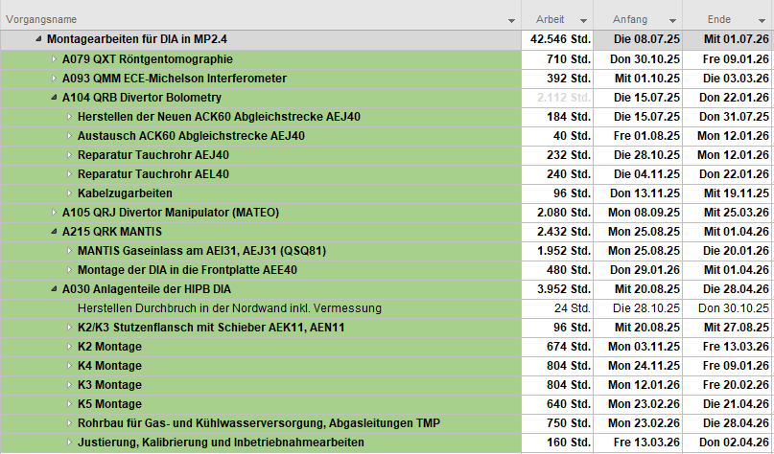
Reduction method 1: strategic postponement of projects / parts
Rationale / results
Criteria of postponements:
    size,
      development progress,
      scientific priority,
      impact on next MP
TH-Resource saving:
    6400 h without considering A030
    >10.000h if A030 would not be prepared and installed

Slide 6
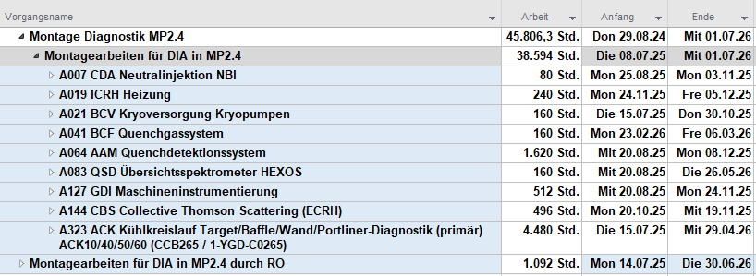
Reduction method 2: RO „can do“ and saves TH resource
Rationale / results
RO work feasible because of past experience, no risk to W7-X
Resource saving in TH of 4600 h
Not yet checked with RO and their heads

Slide 7
Other topic: Geometric surveys in the plasma vessel
E5-ENG requires demand for referenced measurements in plasma vessel during MP2.4
Preparation and implementation requires relatively large technology project

