Slide 1


Kisslingers design maxims and considerations for the current divertor design
E-Mail and phone call exchange in July 2024
Thierry Kremeyer¹ and Johann Kißlinger¹
¹ Max Planck Inst. for Plasma Physics, 17491 Greifswald, Germany

Slide 2
Design at W7-AS and W7-X
Design considerations identical for W7-AS and W7-X
Development in parallel, motivated by W7-X, concept tested for W7-AS
Differences: Less total heating power
Different resonance

Slide 3
W7-X Design constraints and goals
Design constraints:
Magnetic configuration space - Resonances and island width – Control (sweeping) coils added
Started with 3 configurations: standard, low iota, high mirror, extended to 11 configurations
No beta effects considered, all at ß≈3%
No suppression of lower harmonics foreseen: 1/1, 2/2, 3/3, 4/4 islands
Vacuum vessel geometry was set. Coils were designed first, then casing, cryostat and ultimately vacuum vessel and pumping ports without divertor considerations taken into account
Design goals:
Mandatory requirement of heat load survival
- Peak load < 10 MW/m²
- Achieve homogenous power deposition, avoid hot spots and leading edges
Island divertor located at widest island close to pumping ports
Divertor performance requirements of particle exhaust and impurity retention were explicitly not part of the design considerations!

Slide 4
Island divertor - Kißlingers design approach
Design goals:
Mandatory requirement of heat load survival
- Peak load < 10 MW/m²
- Achieve homogenous power deposition
Approach:
Maintain stellarator symmetry – Not necessary but „felt“ right
Shallow incidence angle and maximize wetted area to stay below 10 MW/m²
Homogenous power deposition, by homogenous incidence angle
Design tool: Fieldline diffusion
Design baffles without plasma contact
Design validation: 2D toroidal average in B2-EIRENE
Desired changes:
Distance from target to core, design divertor space before designing vacuum vessel
Reduce magnetic configuration space
Notes:
Beginning of 3D CAD design, so worked in 2D cross-sections: Kißlinger Format

Slide 5
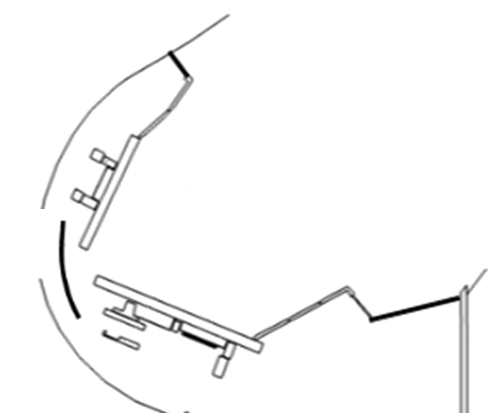
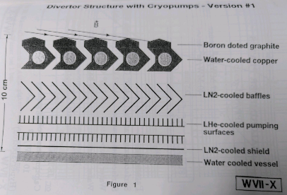
Island divertor - abolished ideas
Bend in target to direct neutrals: Slitted targets:
No documentation found, drawn based on Kißlingers description
Reason: Technical complexity was seen as too large, not justifiable as particle exhaust was not a goal
Design proposal W7-X preferential support phase I, abolished for phase II
Reason: Worry about leading edges, solution would have increased size significantly for same surface load
Notes:
Kißlinger was not foreseen as project lead, as his applied sciences were not recognized at IPP, which led to him eventually leaving IPP

Slide 6
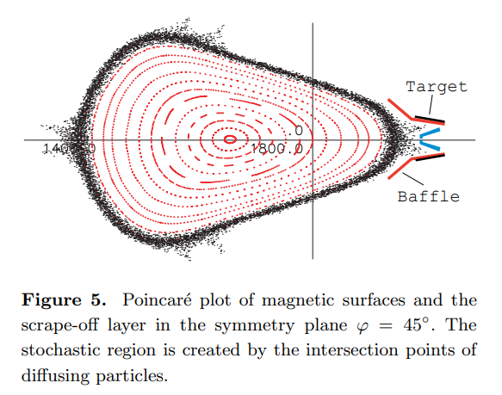
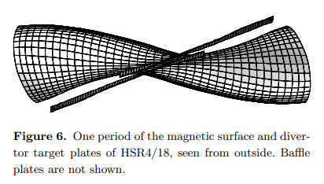
Chaotic approach by Erika Strumberger
Erika Strumberger started with a choatic divertor design at a later stage
Due to later start, concept underdeveloped at decision point
Focus on tool development, no buildable hardware taken into accound
Validation with MFBE, now known as VMEC Extender
Erika Strumberger was put in charge to validated Kißlingers Design
According to Kißlinger, no hard feelings. Strumbergers abandoning of Wendelstein divertor due to prefered location in Munich (confirmation by Strumberger pending)
Source: C.D. Beidler et al 2001 Nucl. Fusion 41 1759 [https://iopscience.iop.org/article/10.1088/0029-5515/41/12/303/meta]

