Slide 1








TKT
PART I: Definition of the plasma facing surface
PART II: Technology development & qualification
Joris Fellinger¹, G. Ehrke¹, F. Kunkel¹, D. Naujoks¹, Th. Kremeyer¹, A. Kharwandikar¹, A. Menzel¹, F. Reimold¹, Th. Sieber¹, M. Endler¹, C.P. Dhard¹, R. Neu¹, J. Tretter¹, Z. Wang¹, J-H. You¹, K. Hunger¹, M. Richou², A. Knieps³, A. Houben³, O. Widlund⁵, B. Končar⁶, M. Tekavčič⁶, E. Tijado⁷, J. Klecka⁸ , Th. Fornal⁹ and the W7-X Team
Max Planck Institut für Plasmaphysik Commissariat à l’énergie atomique, France Forschungszentrum Jülich ENEA - Centro Ricerche Frascati, Italy Research Institutes of Sweden, Sweden | The Jožef Stefan Institute, Slovenia Universidad Politecnica de Madrid, Spain Czech Academy of Science, Czech Institute of Plasma Physics and Laser Microfusion, Poland
Notes:
Logos !

Slide 2
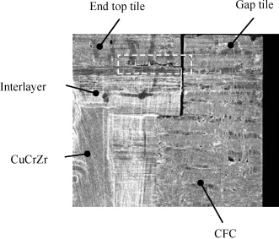
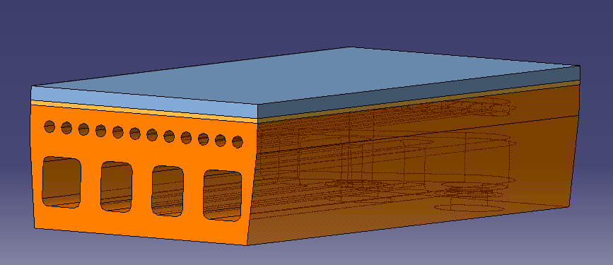
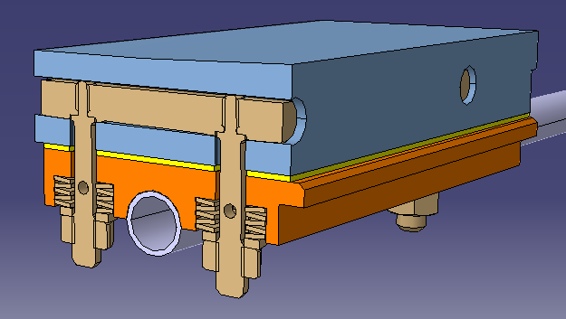
Fundamental differences divertor ⬄ baffle
 | Divertor | Baffle
Plasma facing material | W or W₉₅NiFe
Heat sink material | Cu or CuCrZr
Heat load requirement | 10 MW/m² | < 1-2 MW/m²
W-Cu Interface | Perfect thermal bond required | Cold contact sufficient
Connection type | continuous | Loose bolted connection allowed
Interlayer | 1 mm OFE-Cu ΔT @ 10 MW/m² = ~25 K | Graphite foil ΔT @ 1 MW/m² = 500 K
Key design concern | Thermal expansion mismatch Interface stress singularity | Maximum W temperature Bolt design
CFC – OFE Cu crack example
Notes:
WNiFe ➔ improved machinability and ductility

Slide 3
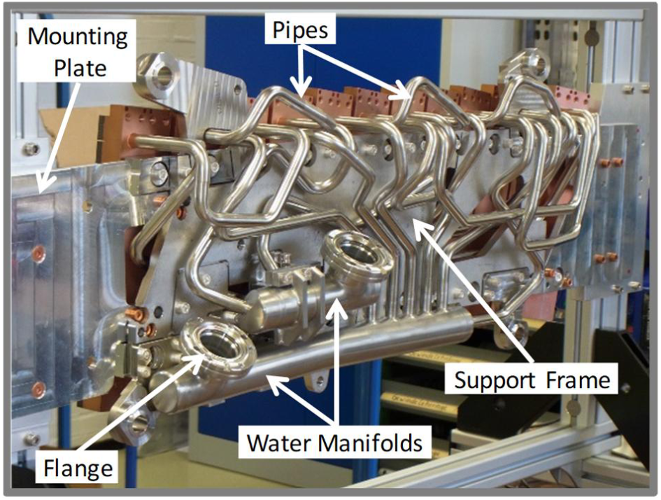
Technology qualification for target modules
Assumptions
  Similar plasma facing geometry as CFC divertor: 10 MW/m² design heat load
  Use existing cooling water infrastructure: 5 l/s per target module, Δp < 15 bar, max 13 modules per unit
  Limiting target module weight ~50 kg
  Preferably increased design heat load for edge tile near pumping gap from 2-5 to 10 MW/m²
  Accessible filter required in supply line outside UHV to prevent flow obstruction in cooling channels
Objectives
  Simplify manufacturing and inspection and installation
    Minimize pipe work and number of weld seams
    Minimize number of target elements per module (aim = 1)
    Minimize number of manufacturing and inspection steps
    Relax tolerance requirements
Design rules
    Hydraulic loss ⬄ heat removal: high velocity only where heat is removed
    Heat sink deforms as result of competition between hot and cold side
      Make cold side far more rigid than hot side
    W-Cu interface closest to water to minimize temperature & stress
      Including soft Cu interlayer to accommodate thermal expansion mismatch
    Statically determined support system, free of thermal restraint forces
Notes:
15 MW/m² in cyclic HHF test
Current critical heat flux of CFC divertor > 30 MW/m², water remains in single phase flow at 10 MW/m²
3 mm W instead of 7 mm CFC increases weight by ~10 kg per module

Slide 4
Simplifying target module geometry
Since the new plasma facing geometry is unknown, the largest and most curved CFC target module TM1h was selected as reference
The edge tile problem is resolved by adding a smooth curvature, allowing cooling channels to closely follow the plasma facing surface
Size ~0.4x0.6 m x 50 mm

Slide 5
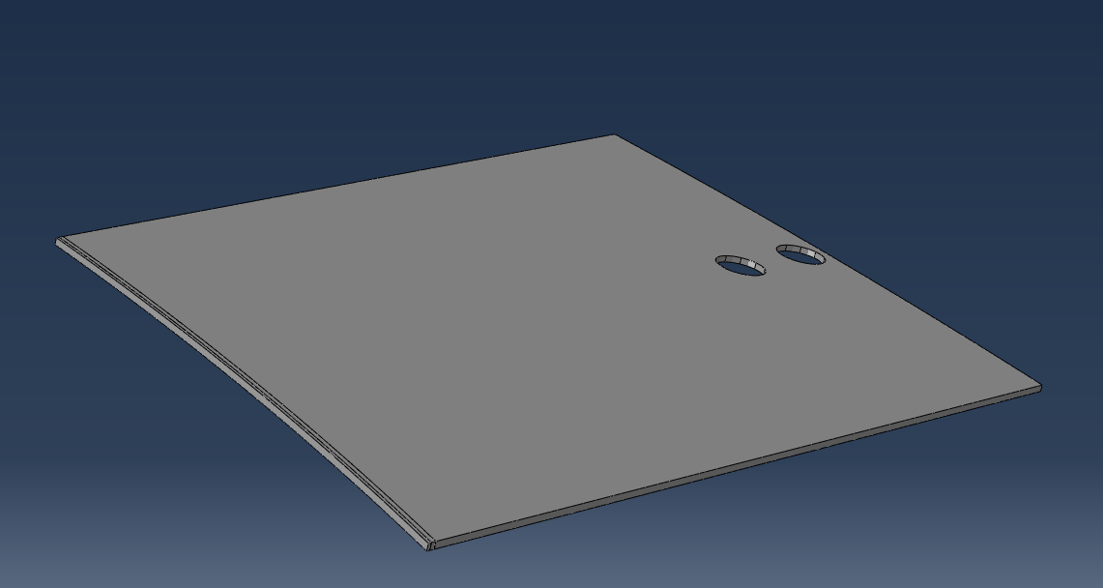
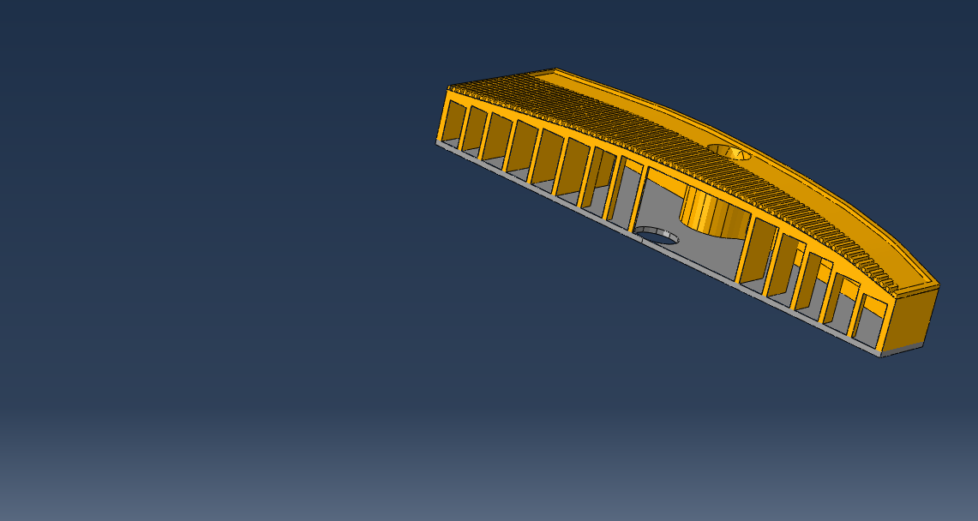
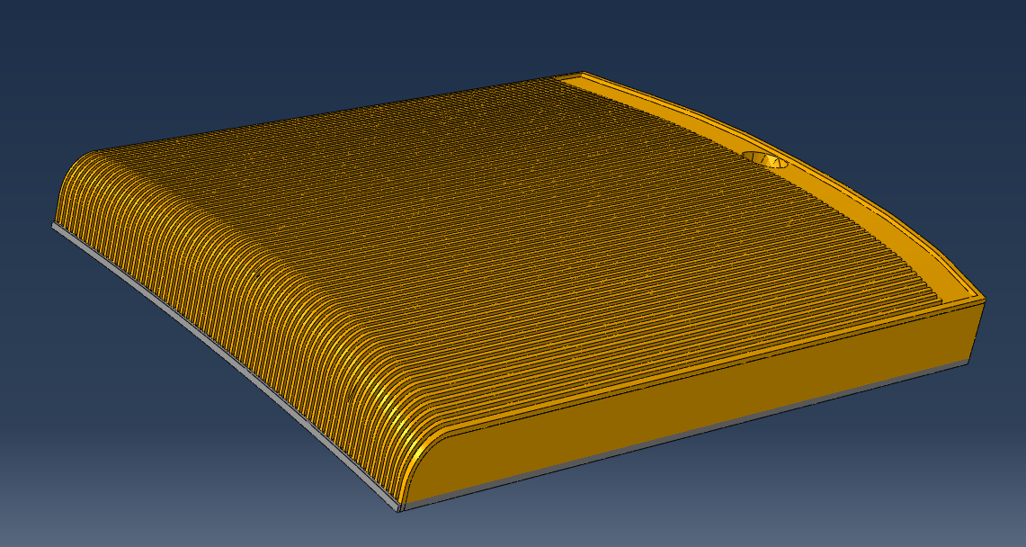
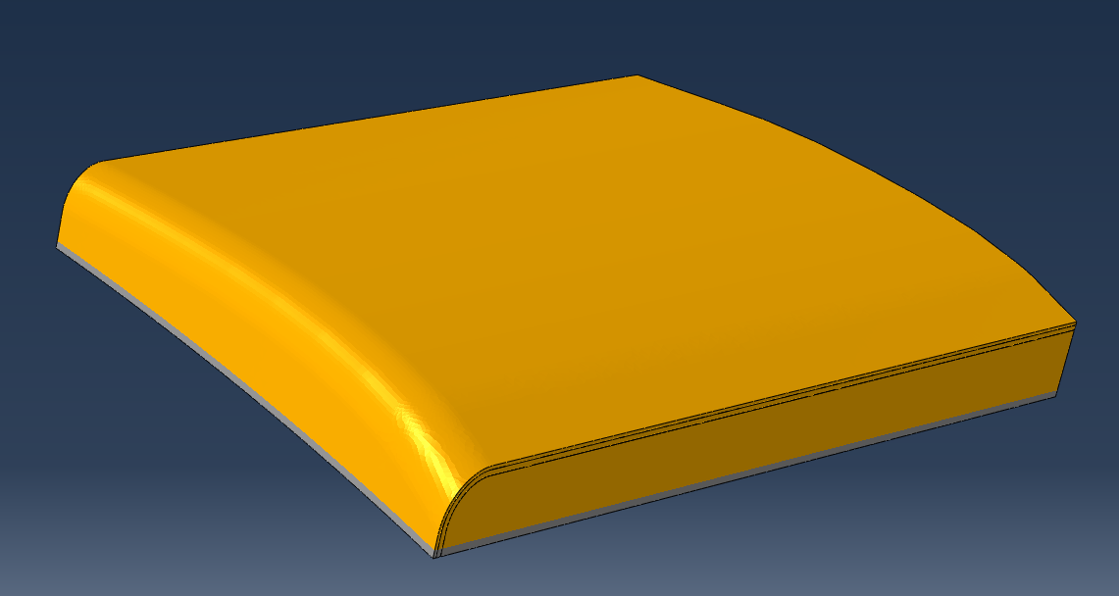
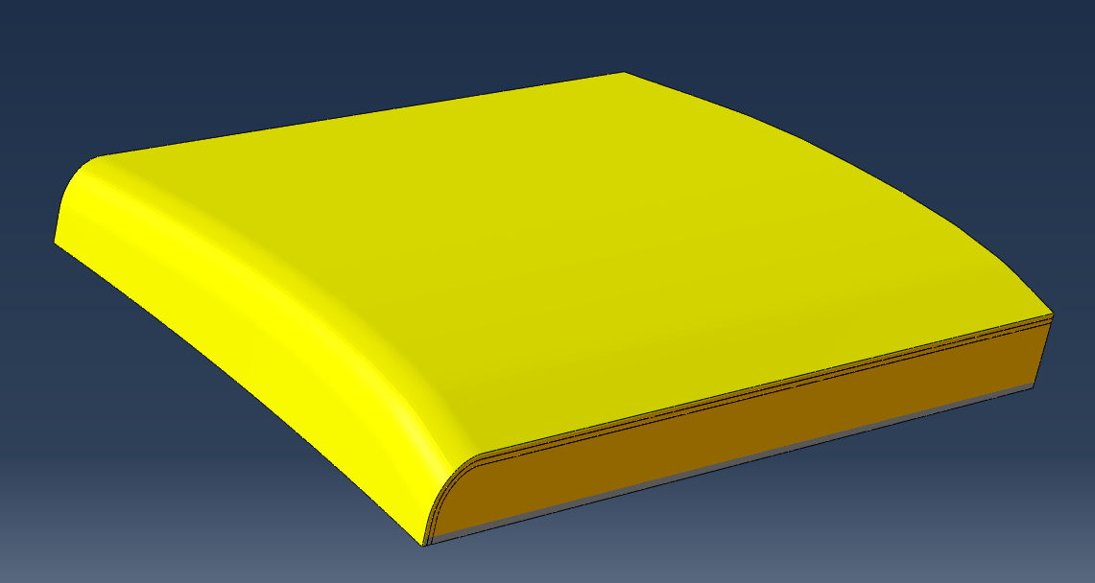
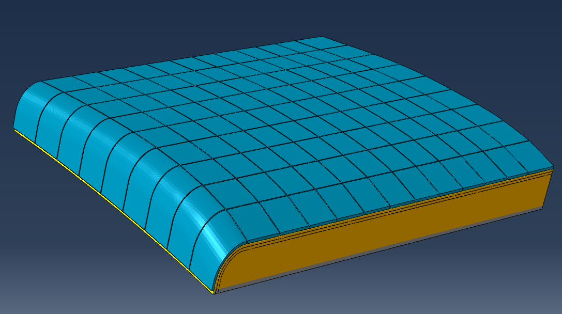

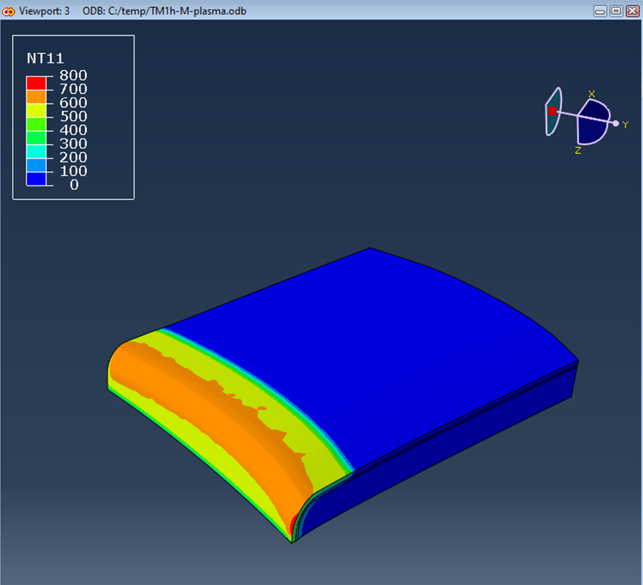
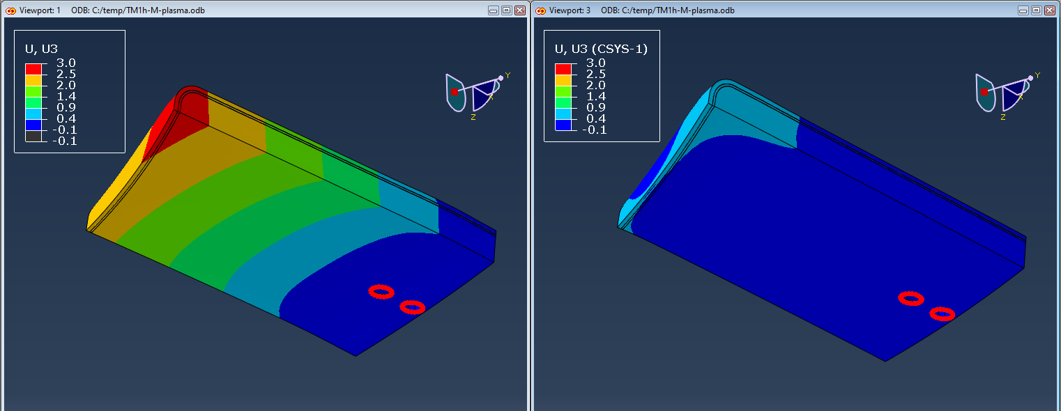
Conceptual layout of target module
Additive manufactured (LPBF) CuCrZr heat sink with integrated manifold
  Heat removal channels closely follow exposed side
  Machining of plasma facing side after printing
Need for soft OFE-Cu interlayer
W or WNiFe plasma facing surface
  WNiCu dissuaded since T_{limit} < 900 °C [Neu: 2017]
  Coating (low pressure plasma spray or cold spray)
    Thickness > 0.2 mm ➔ 0.3 mm targeted
      To survive erosion over W7-X life (~300h)
    Either on soft Cu interlayer or FGM on CuCrZr directly
  Or mosaic of W/Cu sandwich tiles bonded by brazing
    Sandwich tiles by galvanizing, casting or diffusion welding
    Final machining after brazing process
    Size < 30x30 mm
      To limit manufacturing deformation
    Thickness > 2-3 mm
      to avoid Cu sputtering in slits
FEM show temperatures < 800 °C and displacements < 3 mm

Slide 6
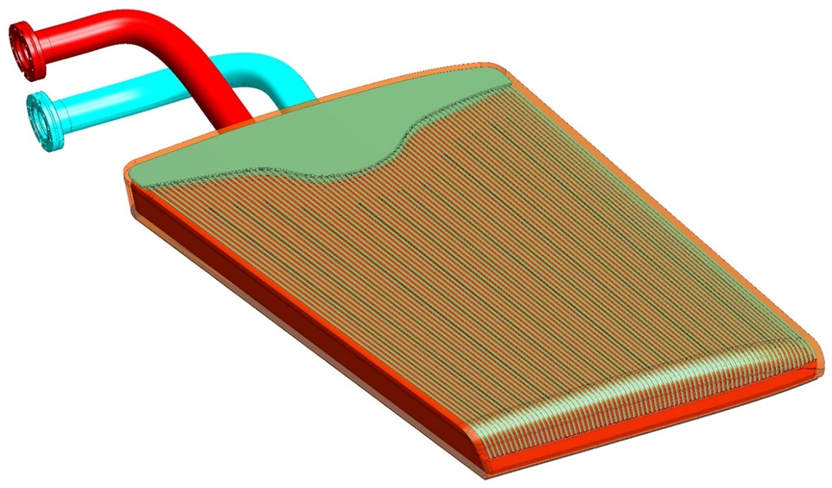
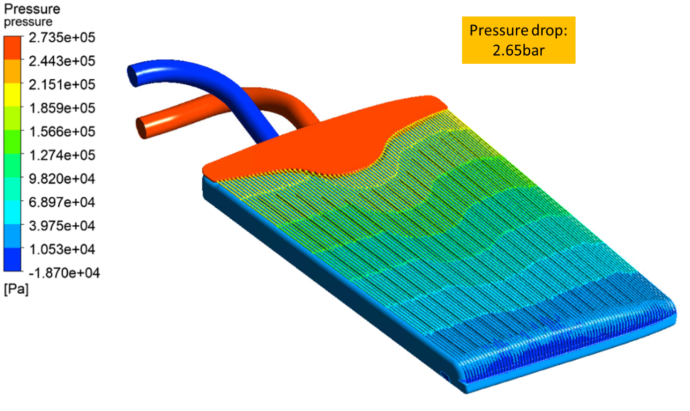
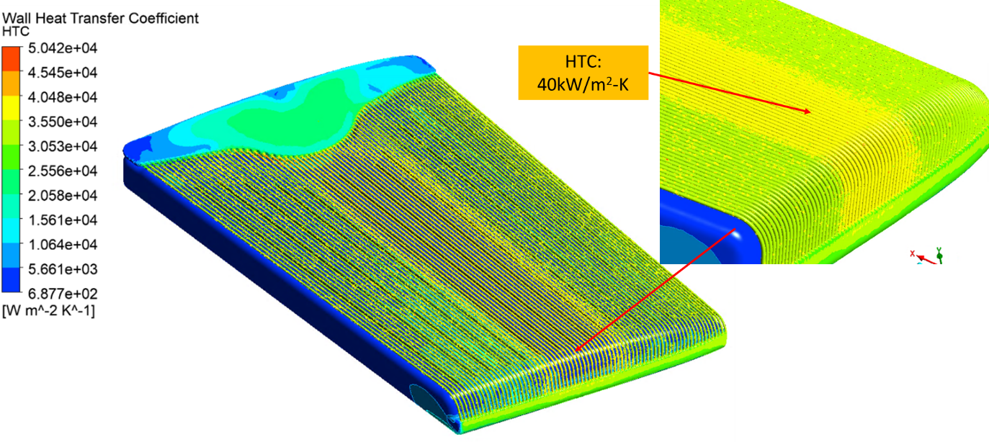
Cooling channel concept
HTC of ~40 kW/m²K at 10 m/s
Δp 2.65 bar over entire target module at 4 l/s(compare to ~7 bar in CFC divertor)
Optimisation of cooling channel geometry ongoing
  Maximum heat removal capability vs manufacturability and removal of powder remains
  Possibly with turbulence enhacing swirl or swirl like features
Tretter: 2023
Wang: 2023

Slide 7
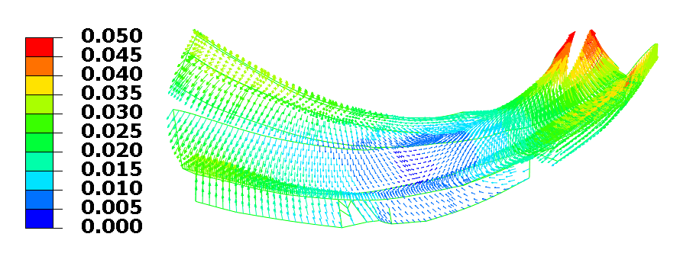
Large components ➔ large Lorentz forces
Decay of plasma in 1 ms
  Pfirsch-Schlüter currents
  Toroidal current (50 kA)
  Diamagnetic current:
    Field exclusively inside LCFS suddenly distributed inside vessel (ΔB_{tor} = ~20 mT)
    Decay of superconducting coil system of 3T in 3 s is less critical: 3/3 < 20∙10⁻³/1∙10⁻³
Change of magnetic field perpendicular to modules B_{perp} causes eddy currents
  Induced currents limited by inductance and resistance of module
    ΔB_{perp} < 22 mT ➔ I_{ind} < 6 kA ➔ F_{support} < 6 kN
    Δσ < 72 MPa for M12 bolt
    Slits can further reduce eddy currents
Avoid current sharing with vessel
    Supports must be electrically isolated
VMEC ➔ Extender ➔ FLT: plasma induced field change on divertor
Fellinger et al.: NME 37, 2023
Notes:
recipes
in preparation of call for tender of series production
even for existing technologies
Incoming inspections, pre-treatment, process parameters, post-treatment, required tests, handling, …
HHF
No fatigue crack growth due to strain singularity at free end of W-Cu interface
Confirmation of FEM predictions of deformation and temperature
Demonstration of critical heat flux

Slide 8
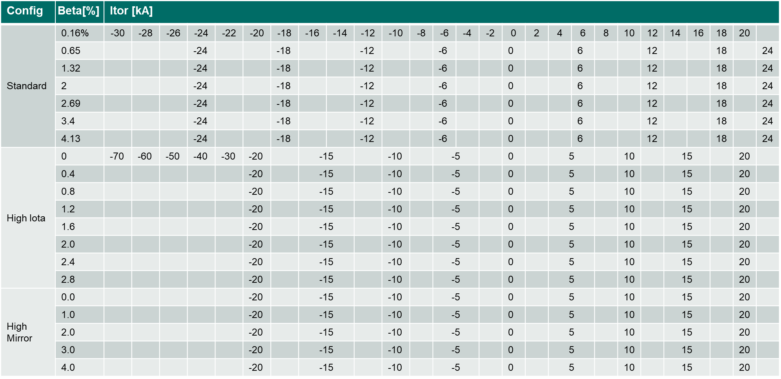
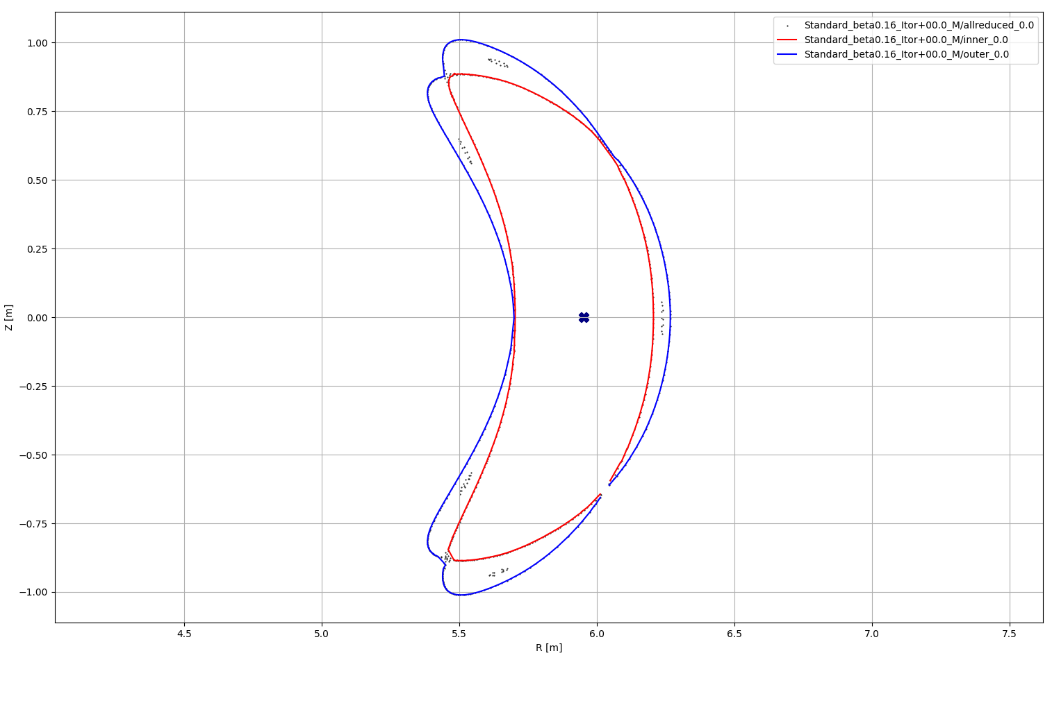
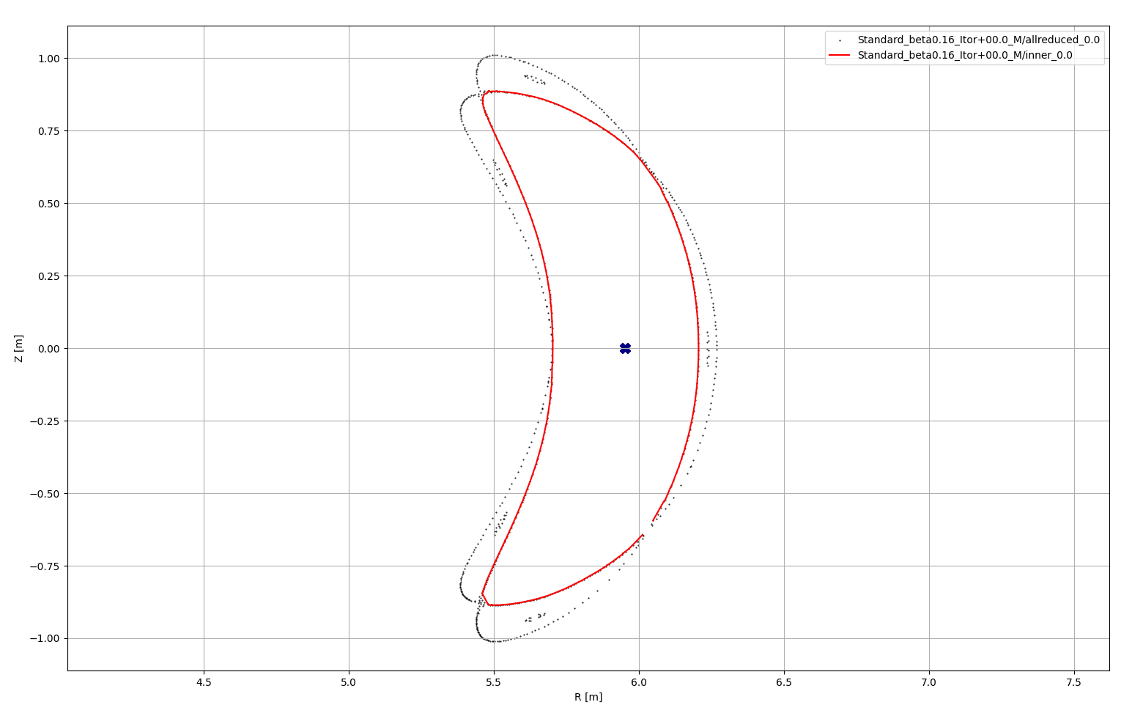
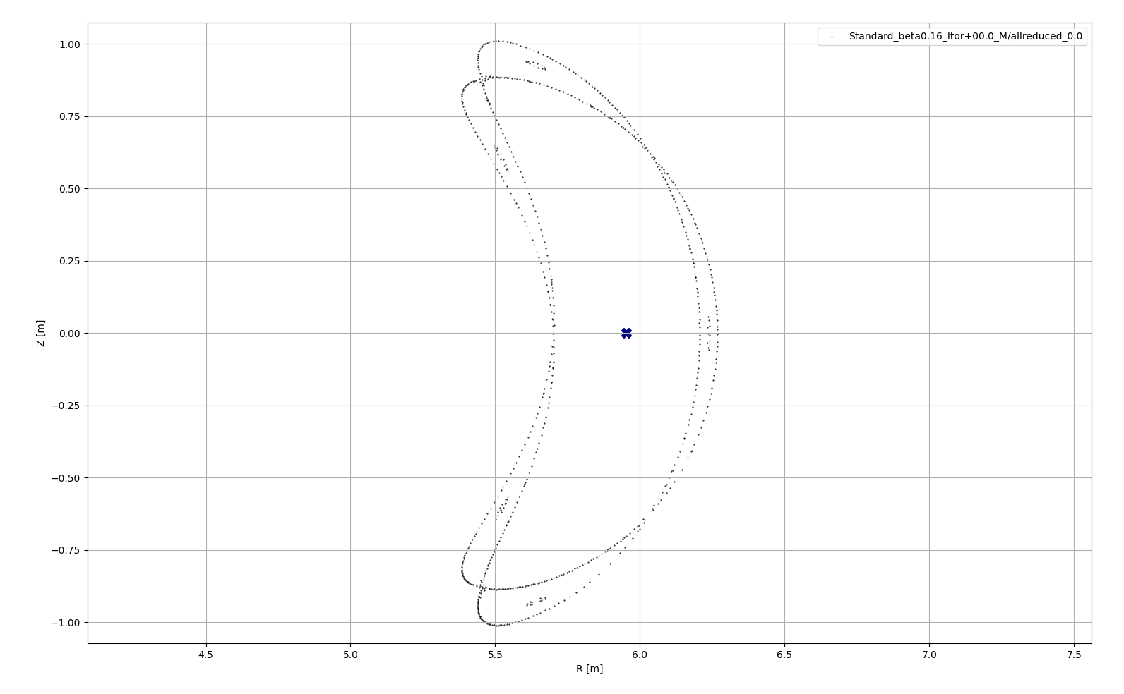
Engineering the plasma facing surface
Calculate separatrix
    Start points with intermediate connection length traced without target geometry [Kharwandikar: 2023]
    More than 200 finite beta cases run with VMEC/extender/EMC-lite [Geiger/Fellinger: 2024]
Divertor does not intersect core plasma
    Safe distance to inner envelop of separatrix
Divertor intersects power shell of SOL
    Intersection of outer envelope of separatrix
Baffle does not intersect power shell of SOL
    No intersection of outer envelope of separatrix
    Only after optimisation of divertor position,
    baffles could be repositioned into shadowed area
  Use control/planar coils to compensate plasma
    to limit separatrix geometry variation
  Engineering tool development
    Magnetic topology toolkit (Davis / Kharwandikar)
  High mirror – beta = 4 % – toroidal current variation -±20 kA
  DE: Fast transfer of CATIA geometry into EMC-lite input data
  Fast creation of divertor geometry [Menzel]

Slide 9
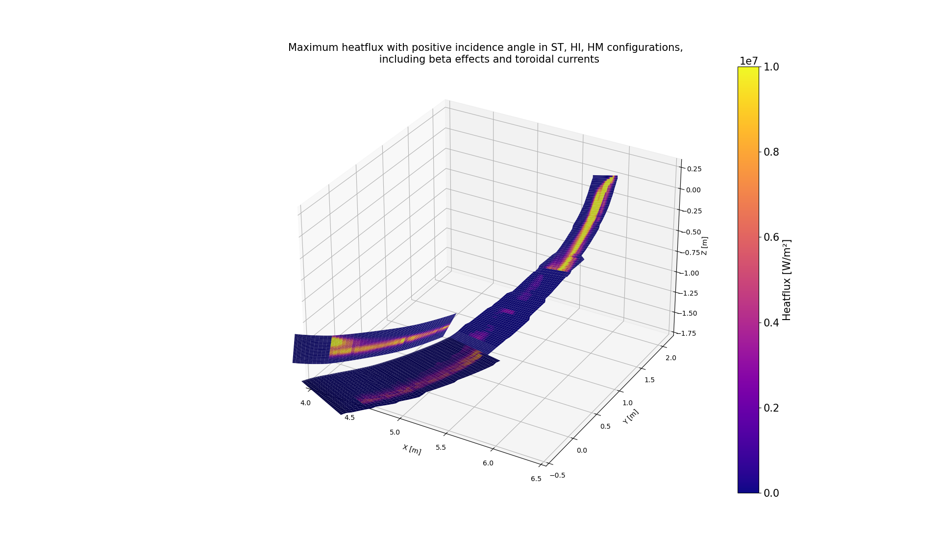
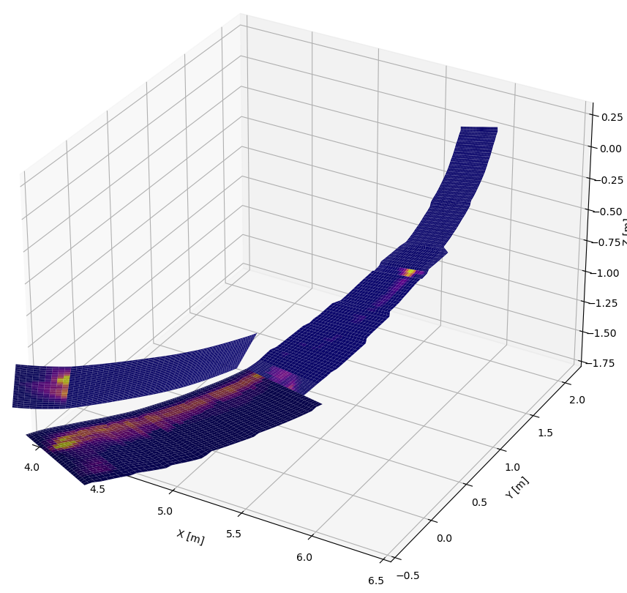
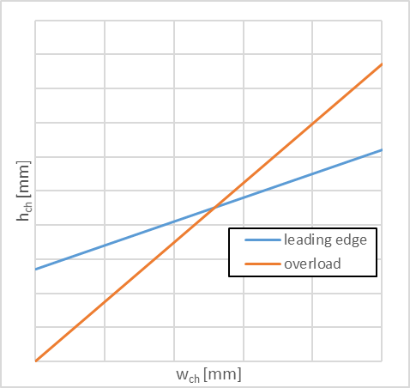
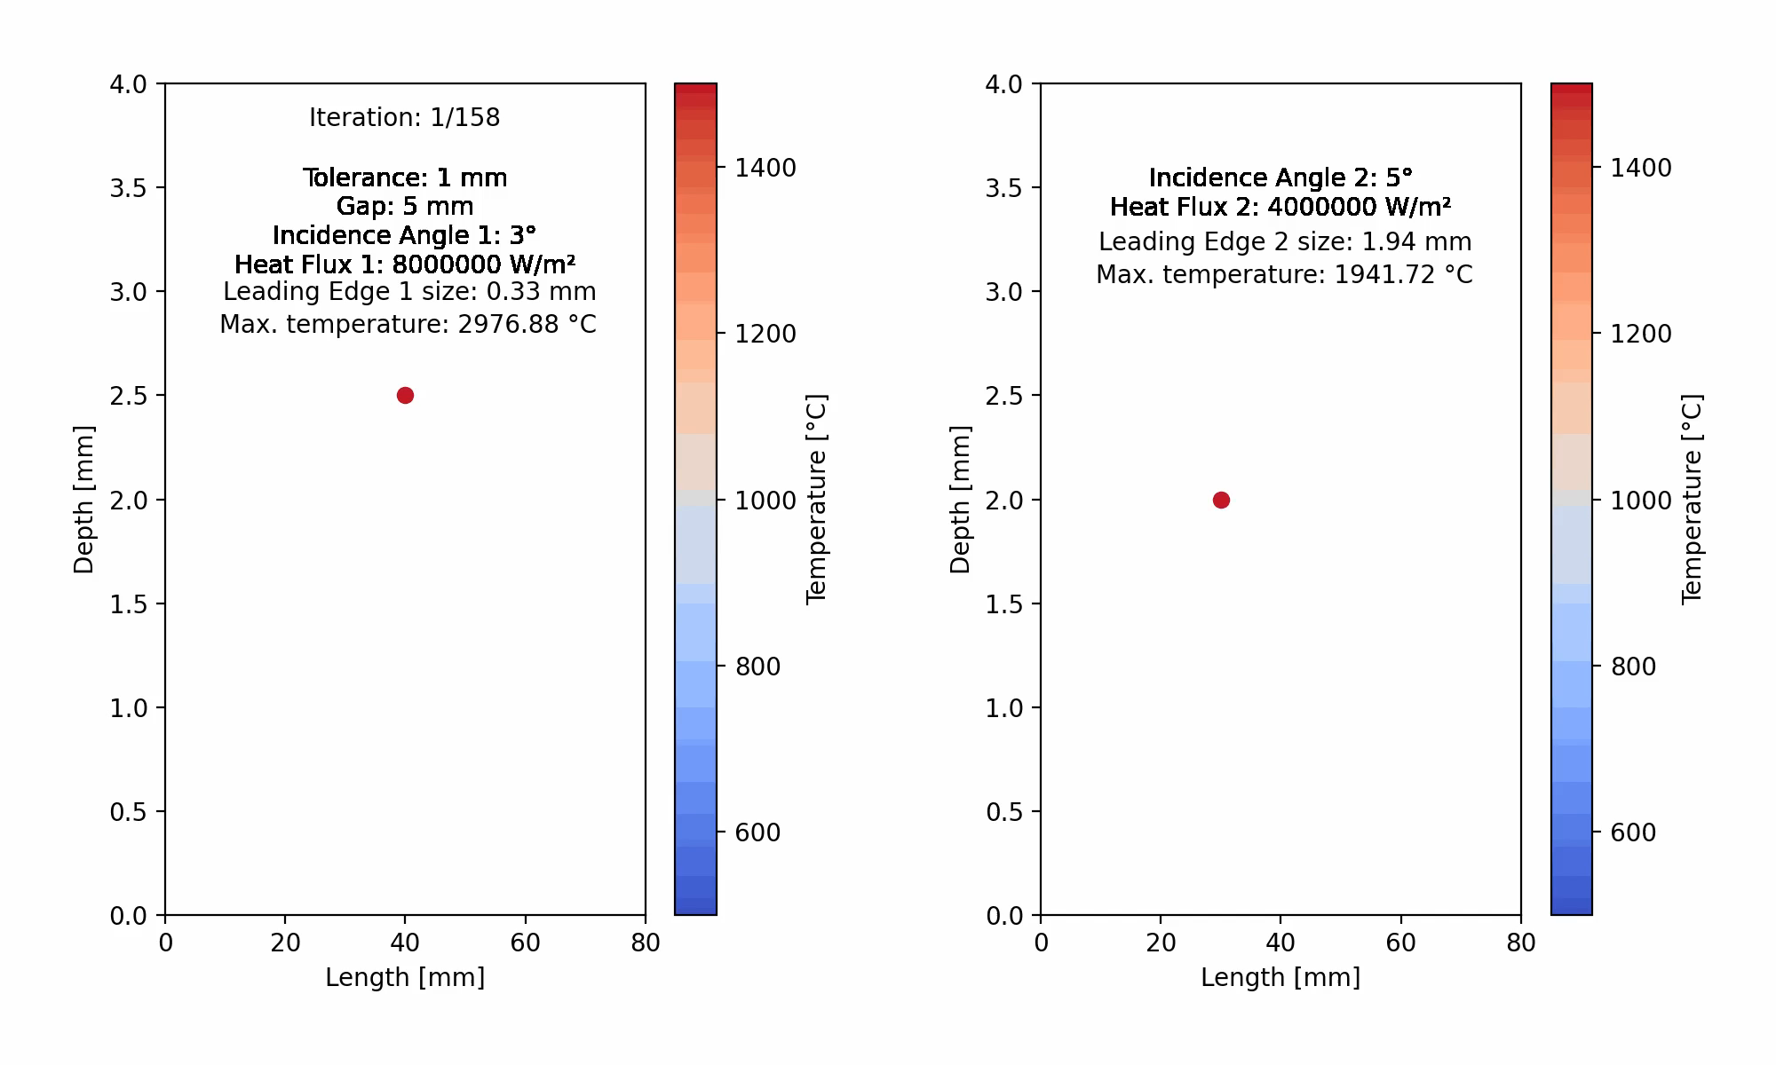
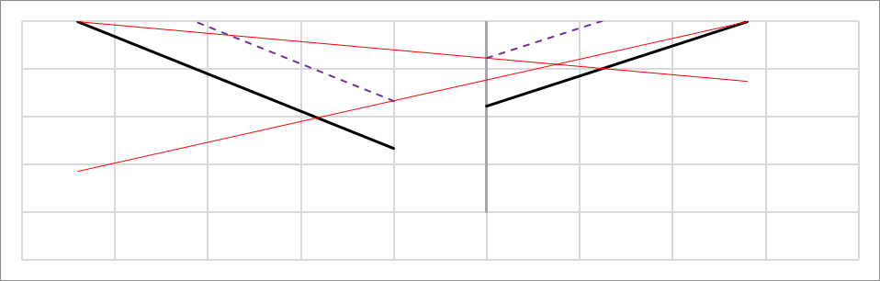
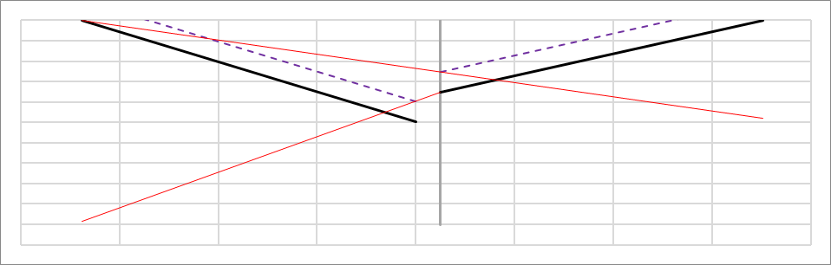
Leading edges [Antara Menzel]
W-based plasma facing surface is less forgiving as CFC with regard to leading edges
  Need for final machining of mosaic of sandwich tiles after brazing
  Large module size allows for shallow chamfering between modules
Tool developed to identify plasma facing area with high loads at incident angles of opposite sides
Tool developed to optimize chamfer geometry to mitigate edge loads
  Simple solution for symmetric case avoiding leading edge
  Simple excel tool for asymmetric case avoiding leading edge and assuming no 3D effects
  Advanced optimization algorithm allowing steep chamfers (3D effect) and small leading edges
q_{max} over ST, HI and HM, 0%/ 1%, 3%, 5% beta/ 10 kA, 20 kA current
Clockwise incident flux
Counter clockwise incident flux
Overload
Feasible domain
w_{ch,min}
No leading edge
leading edge
α_{inc}
No overload
α_{lim} - α_{inc}

Slide 10

Robust leading edge free design [Menzel]
Unfold power shell of one island with global toroidal and local poloidal procession
Choose a starting section of divertor in toroidal section φ₀
Trace section for dφ
Trace section for 2π to find local poloidal procession dθ∗
Create new divertor section in φ₀+dφ
  using shift in opposite direction s∙dθ∗
  s is chosen to tune incident angle and heat load
All heat load can be designed to arrive from one side only
Front edge is in shade
Closed divertor for standard configuration
Measure of toroidal procession φ
dθ∗
dφ
Measure of poloidal procession θ*

Slide 11
Qualification tasks target element
Measurement of properties of W, W heavy alloys, AM CuCrZr, and OFE Cu (cast/galvanic/plate)
  Porosity, stress-strain relation, magnetization, machinability
  Cast Cu is very soft, galvanic copper needs annealing
  LPBF CuCrZr needs age hardening to increase thermal conductivity – overaging must be avoided
Cooking recipes for manufacturing processes
  Additive manufacturing of CuCrZr heat sinks (LPBF)
  Coating W or WNiFe onto heat sink
    Low pressure plasma spraying or cold gas spraying
    Pure W(NiFe) onto soft copper interlayer or functionally graded W(NiFe) + Cu coating directly onto heat sink
  Manufacturing of sandwich tiles of W or WNiFe with soft OFE Cu interlayer
    Bonding W and WNiFe to OFE Cu by diffusion welding (DW), cast Cu or galvanic Cu
  Bonding sandwich tiles onto heat sink
  Galvanic connection of stainless steel connectors to CuCrZr heat sink
Demonstration of robust and reliable performance
  He leak tightness of heat sinks
  Cyclic HHF resistance
Notes:
recipes
in preparation of call for tender of series production
even for existing technologies
Incoming inspections, pre-treatment, process parameters, post-treatment, required tests, handling, …
HHF
No fatigue crack growth due to strain singularity at free end of W-Cu interface
Confirmation of FEM predictions of deformation and temperature
Demonstration of critical heat flux

Slide 12
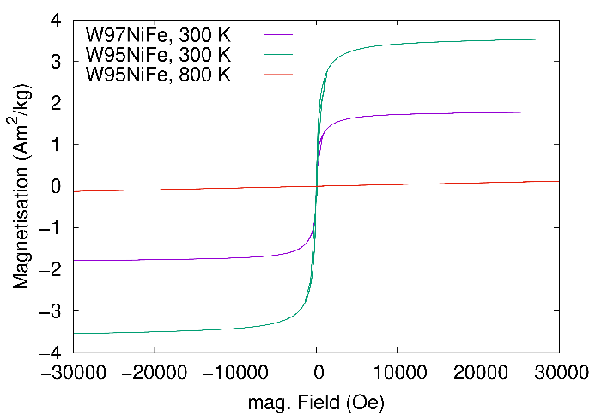
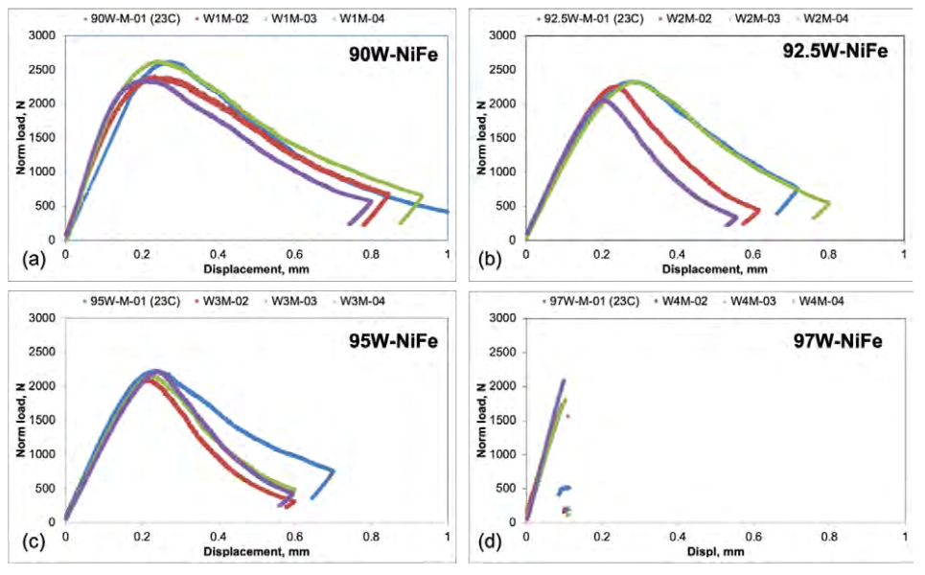
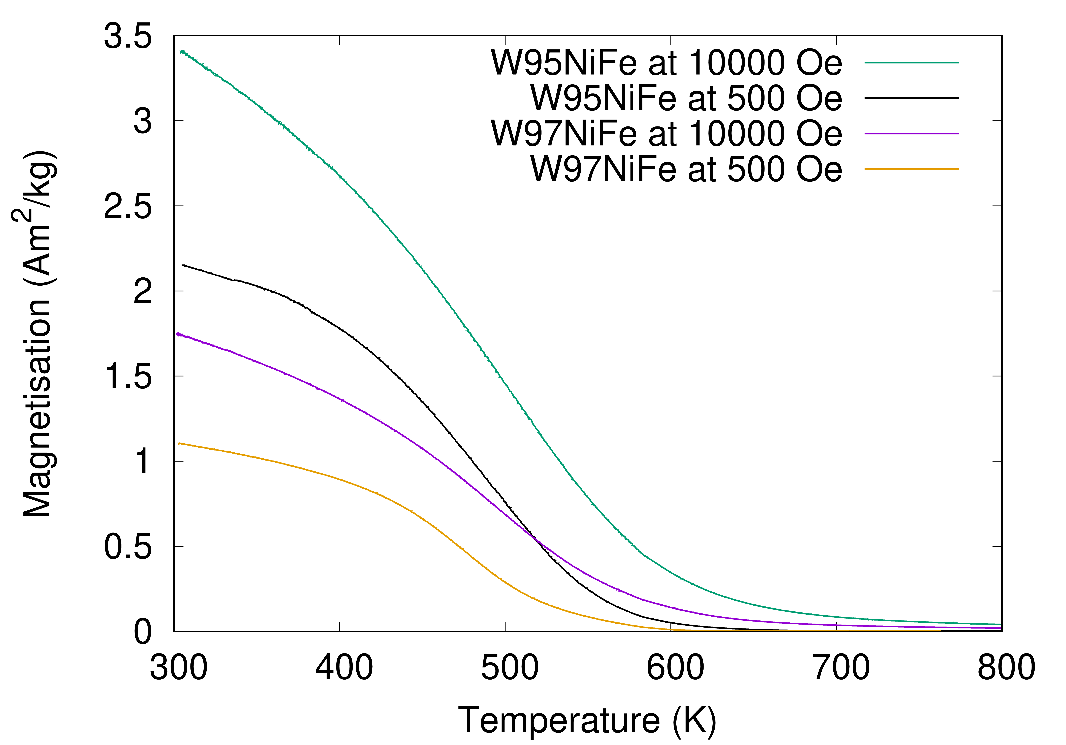
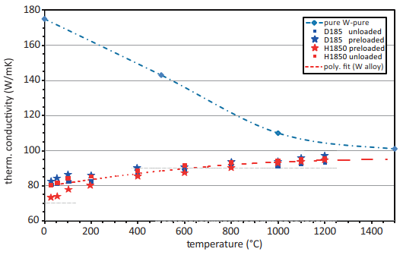
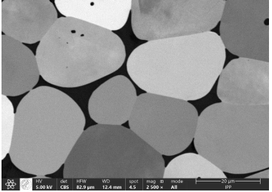

W₉₅Ni_{3.5}Fe_{1.5} properties
Magnetic permeability: $µ=1+\frac{J∗rho}{H}=1+\frac{J∗rho∗4π}{B∗1000}$
Saturation at elevated temperature ➔ µ_{R} = 1 at 500°C
  Risk of amplification of initial asymmetric heat loads
Magnetisation
Houben: 2023
Crack test
ε_{u} = 7±1%
Thermal conductivity
W
W₉₇NiFe
Two-phase: W-grains in WNiFe matrix

Slide 13

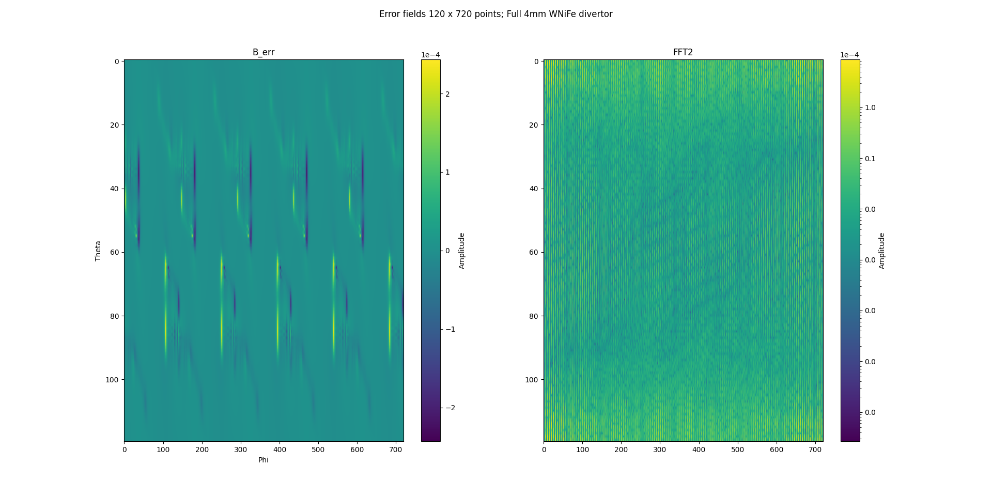
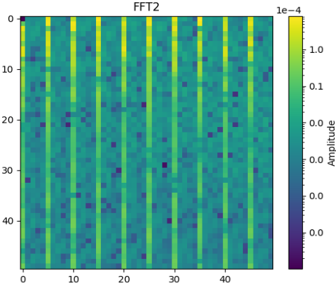
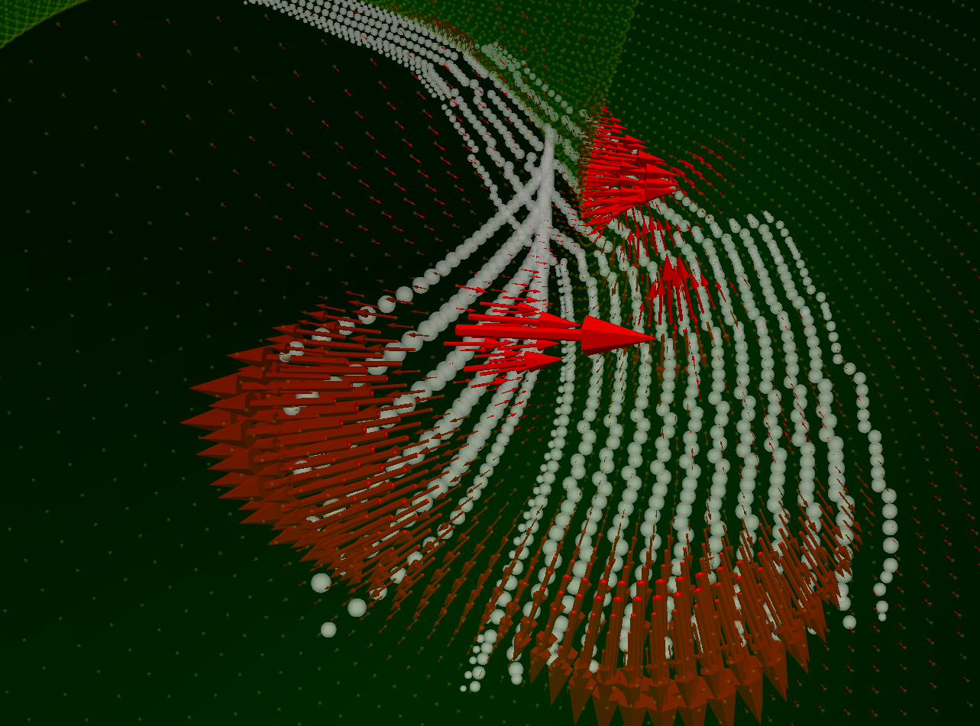

Error field calculations [Thomas Fornal]
µ_{R} > 1.01 ➔ MATLAB tool of M. Köppen
  4 mm thick WNiFe surface modelled with spheres with same volume and same µ_{R}
  Calculation of LCFS with VMEC
    720 x120 points as function of toroidal and poloidal angle
  Calculation of disturbed and undisturbed error field at LCFS
  Calculation of relative error projected onto normal of LCFS
  Calculation Fourier components: B_{err} = $\sqrt{\text{B}\text{11}\text{²+}\text{B}\text{22}\text{²+}\text{B}\text{33}\text{²+}\text{B}\text{44}\text{²}}$ = 1.1∙10⁻⁶ $≪$ 2∙10⁻⁴
Rel. field error
B₁₁ | 4.0∙10⁻⁷
B₂₂ | 5.7∙10⁻⁷
B₃₃ | 7.2∙10⁻⁷
B₄₄ | 4.0∙10⁻⁷
B₅₅ | 3.6∙10⁻⁴

Slide 14
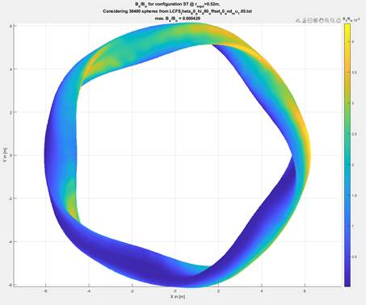
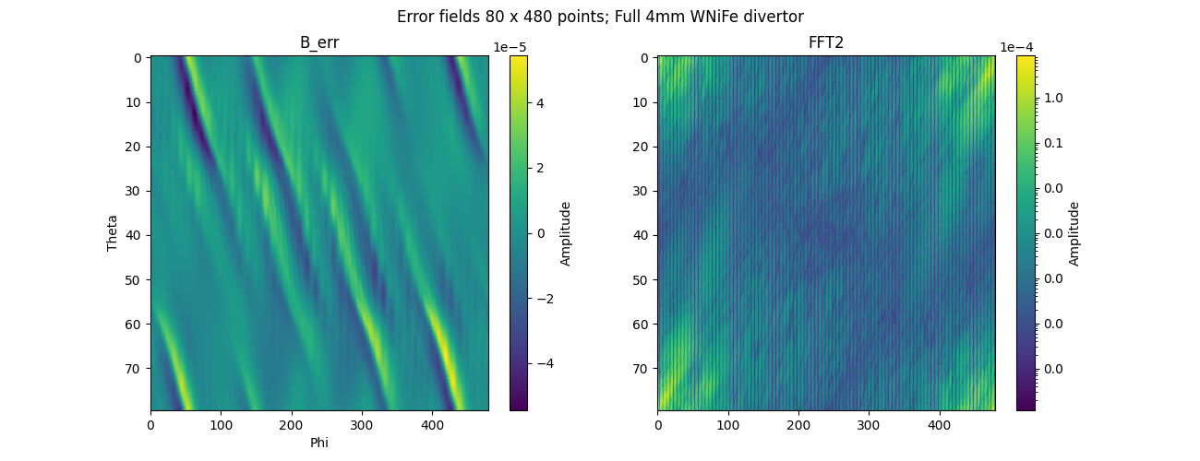

Validation for arbitrary divertor geometry
Background: saturation of WNiFe at elevated temperature may increase asymmetry
Virtual plasma facing surface of WNiFe at 50 mm from LCFS with 4 mm WNiFe
Apply 1-1 variation of µ_{R} over the plasma facing surface: µ_{R} = 1.025 + 0.25∙cos(α_{tor} – α_{pol})
B_{err} = $\sqrt{\text{B}\text{11}\text{²+}\text{B}\text{22}\text{²+}\text{B}\text{33}\text{²+}\text{B}\text{44}\text{²}}$ = 1.7∙10⁻⁴ < 2∙10⁻⁴ ➔ OK even for extreme unfavourable µ_{R} distribution
Conservative approach: In reality saturation at elevated temperature will reduce attraction of field by surface material and thus reduce heat load
Rel. field error
B₁₁ | 1.7∙10⁻⁴
B₂₂ | 1.7∙10⁻⁷
B₃₃ | 8.5∙10⁻⁸
B₄₄ | 2.0∙10⁻⁵
B₅₅ | 1.3∙10⁻⁵
B₆₆ | 1.1∙10⁻⁶
B_{err,max} = 4∙10⁻⁴

Slide 15
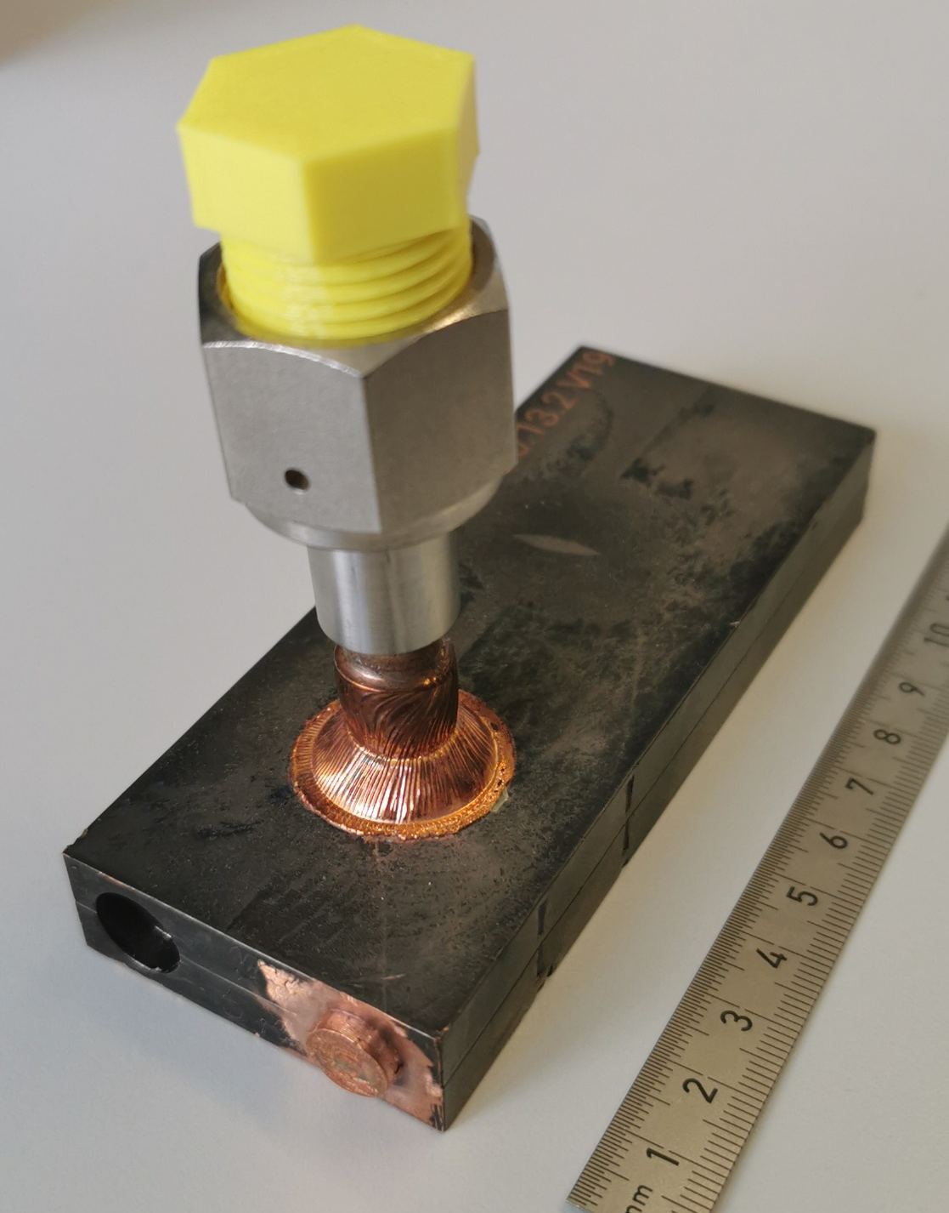
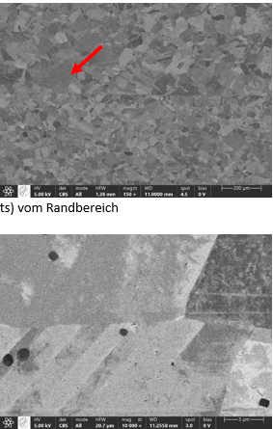
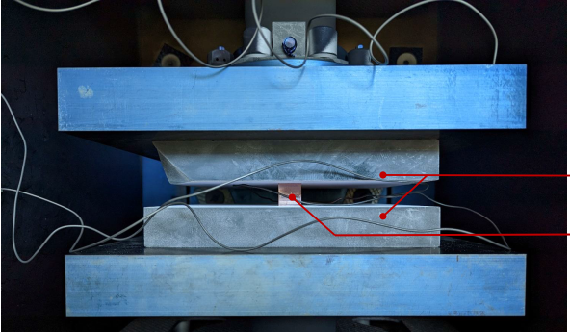
Diffusion welding
Diffusion welding of CuCrZr
  Rationale: No added constituents, no liquid phase transformations
  800-950°C @ 4-17 N/mm² for 30-60 minutes
  100% bonding
  residual deformation ⬄ initial tolerance requirements
    Initial flatness < 15 µm, R_{z} < 15 µm, no scratches
    < 5% reduction of height feasible
  He tightness achieved at 160°C / 30 bar
    for diffusion welded flat plates with half-pipe cut out channels at both sides
    8/10 samples OK at residual deformation of >= 0.1 mm
    2/10 samples not ok at residual deformation 0.05 mm
200 µm
5 µm
Notes:
How accurate Gunnar ?

Slide 16
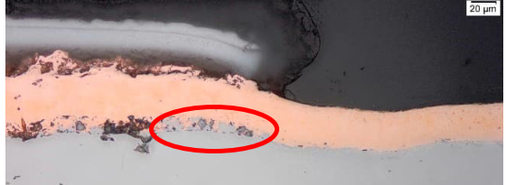
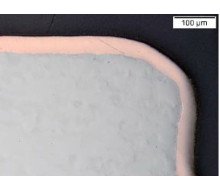
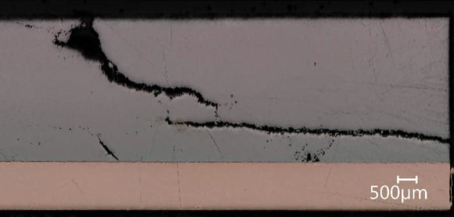
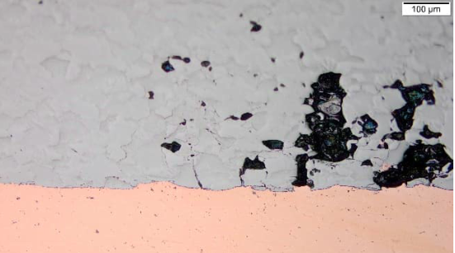
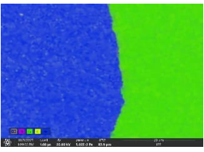
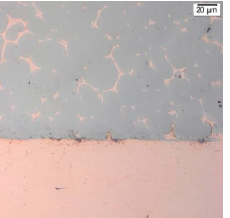
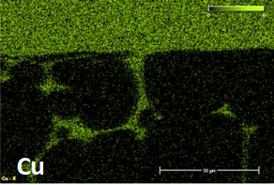
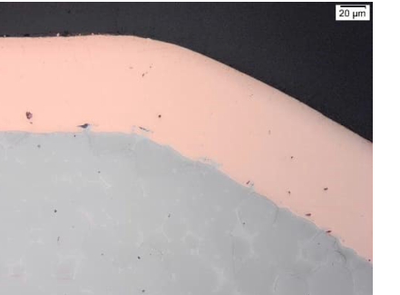

Bonding Cu to W and WNiFe
Courtesy Katja Hunger – IPP Garching
 | Galvanised copper | Cast copper
W100 | Initial issue Local lack of bonding Resolved for series | Cracking of W limits tile size to 40 mm
WNiFe | No diffusion of Cu in WNiFe matrix | Diffusion of Cu in WNiFe matrix
W
Cu
Cu
W97NiFe
WNiFe
NiFe/W-Matrix
Ni-layer
W
Cu
16

Slide 17





Additive manufactured CuCrZr
Additive manufacturing CuCrZr
  Rationale: Increased geometric design space, single manufacturing process
  4 commonly available powders compared ➔ all four applicable
  Integrated swirl tape feasible
  Density 99.8 %
  He leak tightness 10⁻⁹ mbar∙l/s for wall thickness of 1-3 mm
    First 28/28 samples successful with and without heat treatment
Process parameters
Laser power | 450 W
Head speed | 800 mm/s
Hatch distance | 130 µm
Layer thickness | 30 µm
Volume fraction [%]
Particle size [µm]
Notes:
Modify to english
Add scale

Slide 18


Small scale heat sinks with cooling channels
Issues with de-powdering
  Mechanical shaking / Cyclic nucleation
  Pressurized liquid flow through channels
    Measuring powder rests in the liquid
    First 2 heat sinks of interrupted print job fully blocked
      Hirtisation not applicable if flow is fully obstructed
    Next 2 heat sinks cleaned without issues
CT-scan mandatory
He leak test mandatory
  1 leak found near base plate ➔ design & process improvements
  1 heat sink leak tight
Fraunhofer IGCV: Job no. 4

Slide 19


CT scan of heat sinks
General
80 µm resolution
Max size: ~900 x Ø600 mm
Boundaries suffer from reflections
  Line scan with higher contrast at boundaries possible
Cost depends on resolution
Objective
Detection of remaining powder
Interrupted print job
Powder remains clearly visible
Smoothly run print job
No powder remaining

Slide 20



Coating
Low pressure plasma spraying
  Small scale: substrate of 73x20x10 mm
  W or WNiFe on OFE Cu
    Very low porosity
  FGM W/Cu or WNiFe/Cu on CuCrZr
    Cu particles too small: Cu vapor
Cold gas spray trials ordered
Material | Spraying process | Porosity [%]
 |  | Single pass | Multipass 400 µm
W on Cu | "standard" | 7.2
 | Lower pressure + lower feed rate |  | 3.5
WHA on Cu | "standard" | 12.8
 | Lower pressure | 9.1
 | Double feedrate | 10.7
 | Lower power | 30.3
 | Lower pressure + lower feedrate | 2.4 | 5.7
substrate

Slide 21




Brazing sandwich tiles onto heat sink
Aim
  Bond OFE Cu to CuCrZr with reduced diffusion welding parameters:
    low pressure (~ 0.5 MPa) to avoid need for external contact pressure
    low temperature (< 580 °C) for short time (< 30 min.) to ensure CuCrZr properties
  Moderate tolerances: 50 µm planarity / parallelism / Rz5
  High thermal conductance
  Sufficient strength to survive thermal stress from nearby W-Cu interface
3 types of paste with µm or nm Cu particles under investigation
  1x µm particles
    2 MPa, 650°C, 100 µm thickness shows promising result
    No compression or 450°C or 250 µm thickness not satisfactory
    including Ag ➔ not compatible with W7X
  1x µm particles but poor viscosity ➔ only feasible with preprint process
  1x nm particles with better viscosity and no Ag ➔ next test
Wallis et al.: 2019
2 MPa, 450°C, 100 µm
2 MPa, 650°C, 100 µm

Slide 22

Machining the plasma facing surface
Machining by wire erosion and milling
  Trials with same surface shape as most complex CFC target elements successful
  WNiFe easier to machine than pure W
  Machined surface gets contaminated by wire constituents: requires cleaning
Straight wire used for wire erosion limits surface shape
  Toroidal curvature will be both convex and concave
  Poloidal curvature must be flat or convex
concave
wire
Toroidal direction➔
convex
wire
Poloidal direction➔
convex
316 LN
W95NiFe
W100

Slide 23
Resume
Technology qualification for divertor
  Focus on simplifying and minimizing manufacturing and inspection steps
    Additive manufactured CuCrZr heat sink
    Plasma facing surface
      W-based coating or
      Mosaic of W-based sandwich tiles brazed onto CuCrZr
  First qualification results very promising
    Leak tightness of heat sink / low porosity of coating / high quality bond W/Cu and WNiFe/Cu
    HHF tests pending
  Pursued heat load on divertor edge tile and baffles seems feasible

Slide 24
Outlook
2024
    Manufacturing sandwich tiles 40x20x(4+10) mm
      W/Cu and WNiFe/Cu: galvanic, cast, diffusion welded
      Cyclic HHF tests to determine best bond between W/Cu and WNiFe/Cu
    Triple product HHF samples 40x20x(4+1+10) mm
      Brazing trials Cu on CuCrZr
      Best sandwich tiles brazed on CuCrZr
    Additive manufacturing small series of A4 size CuCrZr heat sinks by 3 loan manufacturers
      Optimization of cooling channel geometry (by CFD)
      Improvement of technology of galvanic connection to stainless steel pipe
      He leak tests, hydraulic test, critical HHF test
    Coated HHF samples 40x20 mm
      Low pressure plasma coating 0.3 mm W or WNiFe on 10 mm Cu
      Low pressure plasma coating 0.3 mm W or WNiFe + 1.2 mm FGM on 10 mm CuCrZr
      Cold gas coating 0.3 mm W or WNiFe + 1.2 mm FGM on 10 mm CuCrZr

Slide 25
Outlook
2025
  Brazing mosaic of sandwich tiles onto heat sinks
  Coating of heat sinks
  HHF testing of brazed and coated heat sinks
2026
  Upscaling qualification to full size (A2 format)

Slide 26



Baffle reinforcement and simplification
Stainless steel meander with partially brazed CuCrZr heat sinks replaced by single CuCrZr block
  Water channels machined and sealed by galvanisation
  First 3 samples He leak tight
6x larger cooling area than in current design
  No need for steel support structure
  Braze with high thermal stress avoided
Size ~0.4 x 0.8 m
Courtesy F. Kunkel
Notes:
Alternatively, plastic water channel counterform is galvanised are dissolved afterwards
Stainless steel transition part leak tight integrated in galvanisation process

Slide 27



Thermal results new baffle design
T_{max,CuCrZr} < 350°C @ 1 MW/m²
dT_{max,wall-water} < 110°C @ 1 MW/m²

Slide 28




Manufacturing of 1/3 module
Leak tightness shown
160°C /30 bar test pending
Hydraulic test pending
HHF test pending

Slide 29
Resume and outlook baffle technology
Resume
1 MW/m² over entire plasma facing surface feasible
  Locally (2 tiles) 2MW/m² acceptable, limited by water temperature rise
  Also suitable to improve heat load capacity of TM56h
Cost of 14 k€ for manufacturing and material
Robust cooling plate allows for in vessel mounting onto support structure
Outlook
Technology for galvanic connection to stainless steel to be improved
Hydraulic and thermal test
Improvement of bolting technology of tiles open to avoid galling (“fressen”)
  W-coated graphite tiles
  W-coated heat sink if coating process for divertor will be successfully qualified
    W-coated Cu plates could also be used to replace graphite tiles of heat shields
Further channel geometry enhancement possible if bolt pattern is changed

Slide 30
Back up slides navigator
Main slides
  Divertor concept W7-X
  Outline
  Divertor ⬄ baffle
  Particle exhaust issues
  Tools
  Technology qualification
  Target module concept
  Diffusion welding / machining
  Additive manufacturing
  Baffle concept
  Outlook
Backup slides
  Particle exhaust need
  Wall source and sink vs pumping
  Thermal stress
  Thermal and deformation FEM results TM1h
  Parametric FEM thermo-mechanical results
  Current thermal overload issues
  Leading edges
  W and WNiFe
Galvanic heat sink

Slide 31
Divertor type strategy
Current divertor: CFC-based – cooled – open – well diagnosed
W-based – cooled – open – well diagnosed
Reactor relevant divertor: W-based – cooled – closed – well diagnosed
C- or W-based – (un)cooled – closed – limited diagnosed

Slide 32
Background
2020 TWG W7-X strategy 2030 identified need for transition to all metallic PFC in W7X
  New design of W-based cooled divertor required
    Keep current cooling water supply
    Respect weight and space restriction
  Option of uncooled divertor was rejected
  Option of in-situ coating of CFC divertor was shifted as parallel research program to FZJ
2021 EUROfusion funded project was awarded for W-based target element development
2022 W-Based divertor project was approved in RSR

Slide 33


W based divertor project
Goal
  Transition of W7-X to reactor relevant plasma facing materials
    To prove that the stellarator concept can meet the requirements of a future carbon-free fusion reactor
    By demonstrating high-performance, steady-state HELIAS operation
  Include lessons learnt from manufacturing, installation and operation
Outline
  Physics based optimization of plasma facing geometry using EMC3-Lite and EMC3-EIRENE
    Impurity control
    Maximize input power while avoiding power overload
    Improve particle exhaust
    Naujoks: 2022 https://conferences.iaea.org/event/286/contributions/25129/
  Manufacturing and installation technology qualification
    Targets (EUROfusion WPDIV-W7X)
    Baffles
  Gradual transition to W-based tiles on WSZ and baffles
    W coating on graphite tiles ECRH beam dump
    W tiles in NBI beam dump
    Thin WNiCu tiles in baffle module to reduce convective load
    Naujoks 2023: https://users.euro-fusion.org/repository/pinboard/EFDA-JET/
    conference/106863_naujoks_pfmc_2023_tungsten_pfcs_in_w7-x.pdf
100

Slide 34








Current divertor layout Wendelstein 7-X
Heat load limit $q_{max }$in MW/m²
Divertor $10$
$2.0−5.0$
$0.$5
Baffle $≤0.25$
CFC
Edge (CFC)
Baffle like
Graphite
Strike line position affected by
Broad magnetic configuration flexibility
Plasma currents
Pumping gap
Divertor heat load (a.u.)
Divertor)
Courtesy
D. Boeckenhoff
Notes:
Heat and energetic particles jump from over the separatrix from the core into the outermost flux surface of the island and hit the divertor under shallow incident angles between 1-5°. Neutrals are generated on the strike line and we try to guide them to the pumping gap and pump them out them by the pumps underneath the divertor.
Magnetic flexibility and plasma currents enables us to steer the strike line as close as possible to the pumping gap to maximize the pumped fraction.
However, the heat load resistance of the divertor is limited, especially the edge tile at the pumping gap is limited design due to the U-turn of the water channel. Moreover, the baffles and middle part of the divertor use a simpler technology significantly reducing their heat load resistance.
Limit heat loads on the first wall to acceptable levels
Neutral pressure for pumping out the ashes
Prevent the influx of impurities into the main plasma
The basic idea of a divertor concept in any confinement scheme is to move the region where the hot plasma interacts with the solid vessel away from the last closed flux surface.
Auslass -> abfüha

Slide 35





Particle exhaust issues
Large pumping gap (Standard) less efficient than small gap (High iota) in OP1.2
  Standard configuration: p_{AEH} = 0.4∙10⁻³ mbar. Ratio p_{AEH}/p_{AEP} = 1-3
  High iota configuration: p_{AEP} = 1.0∙10⁻³ mbar. Ratio p_{AEP}/p_{AEH} = 13-20
Need to change geometry of large pumping gap and orientation of pumping gap panels
Demand to improve heat load capacity of edge tiles to allow strike line (recycling zone) close to pumping gap
Courtesy V. Haak
Notes:
Particles in low iota pumping gap are reflected back from pumping gap panels into plasma again

Slide 36







Exhaust challenge
Reactor perspective – He concentration shrinks operational space
The global He particle confinement time $τ_{α}^{∗}$ must be small relative to the energy confinement time $τ_{E}$
Operational perspective – Density control
  Only neutrals can be removed
  Role of target is to intercept, neutralize and exhaust particles
    Large exhaust relative to wall source/sink improves control
$$ρ=\frac{τ_{α}^{∗}}{τ_{E}}<[10−15]$$
$$ρ=\frac{τ_{α}^{∗}}{τ_{E}}$$
$Kn= \frac{\overline{l}}{d}$ $d_{PG}=\sim 90 mm$
 | Molecular flow | Knudsen flow | Continuous flow
Knudsen number Kn | > 0.5 | 0.01 - 0.5 | < 0.01
 | Best of OP1.2 | goal | goal
Knudsen number Kn | 3.4 | 0.5 | 0.01
free path length$\overline{l}$ [m] | 0.31 | 0.045 | 0.0009
p_{pg} [Pa] | 0.12 | 0.82 | 40
$\overline{n}$_{e} [10¹⁹ m⁻³] | 13 | 135 | 6569
Asdex upgrade 0.5-1.5 Pa
Density must be improved by at least an order of magnitude
[R. Schneider, Fusion Lectures]
Notes:
Why do we need a divertor?
Yesterday a lot about Power exhaust,
Necessary: In a reactor, the produced He has to be removed, as an increasing He concentration shrinks our operational space up to the point where no operation is possible.
Rho central metric, effective He core confinement time over energy confinement time.
Also be translated into He concentration. To much He radiates power away
Recent research suggests that we have to be more on the lower side, the lower, the better
BUT also operational important for density control.
Ideal world: No source, nor sink, purely fueled by recycling (not too far from W7-X)
But Wall source and sink. Sink no issue, just fuel more, outgasing source has to be exhausted.
Equilibrium: what goes in, must come out.
We need to exhaust particles, and we can only remove neutral particles.

Slide 37

Exhausts limits profile shaping
    Flat profiles ➔ Particle exhaust = Wall source
    Peaked profiles ➔ Particle exhaust = Core + Wall source
[n/s]
sinks
Transient peaked profiles
OP1.2 data
sources
Courtesy
Th. Kremeyer
Notes:
Depending on density, exhaust rates
CVP at higher densities will grant us wall independent density control.
If wall source is low, we can even pump all 4 NBI sources
Without CVP we can only exhaust the smallest Pellet at 1 Hz.
Above only transient peaked profiles possible
Peaked profiles in equilibrium source=sink, what goes in, must come out.

Slide 38
Thermal stress at perfect bond W-Cu
Perfect thermal bond implies perfect mechanical bond W-Cu
  In steady state @ 10 MW/m²: ΔT_{channel} = ~150 K, ΔT_{Cu} = ~30 K/mm, ΔT_{W} = ~100 K/mm
  Bending stress in W and Cu
    Maximum based expansion mismatch Δε_{T} = ε_{W,int} + ε_{Cu,int}
    Δα_{T} = 17-5 = 12 µm/mK ➔ Δε_{T} = 0.2% @ ΔT_{int} = 170 K
    Gradual increase from zero at free end, gradient defined by yielding of soft copper interlayer
  Strain singularity at free end of W-Cu interface
    FEM results are mesh dependent
    All strains are proportional to ΔT
  Delamination stress peak at free end of interface
    Tensile stress at ΔT < 0 for W-Cu combination
    Limited by yielding of soft copper interlayer
  Shear stress along interface
    Limited by yielding of soft copper interlayer
ε_{W}
Thermal strain
M_{W}
Bending stress
Mechanical strain causing a force:
F_{w} + F_{cu} = 0
t_{W}
W
F_{W}
W
Delamination stress
Shear stress
CuCrZr
M_{Cu}
CuCrZr
t_{Cu}
F_{Cu}
Mechanical strain causing a moment:
M_{cu} + M_{W} + F_{W}(t_{w}+t_{Cu})/2 = 0
Δε_{T}
κ
ε_{Cu}
Total strain

Slide 39
Design approach with HIP
Flat tile following curvatures of magnetic field at plasma facing side
CuCrZr heat sink with integrated manifold
  Flat plates with machined half sides of water channels
  Stiffeners at cold side to minimize thermal curvature
  Threaded channel surface to mimic swirl
  Diffusion welded with flat weld interface (alternatively brazed)
  Plasma facing side machined after welding to match optimized plasma facing geometry
  Alternatively 3D SLM printed heat sink
3 mm W or W alloy tiles with 1 mm soft copper interlayer
  Galvanized copper (stress free at room temperature, delamination stress is compressive in heating up)
  Cast copper (stress free at molten copper temperature of 1080°C, delamination stress is tensile in cooling down)
HIP process to join heat sink to copper interlayer
  Allowing for wavy plasma facing surface shape and L-shaped edge tile L-shaped edge tile
    L-tile avoids strain singularity at free end of interface where peak temperature occurs
  Alternatively no HIP with modified plasma facing surface to avoid need for edge tile
  Alternatively no HIP with separate edge tile (e-beam welding) but lower design load
Final W machining after HIP

Slide 40

Temperature during plasma operation
10 MW/m² @ 2 toroidal strike lines of 100 mm + 500 kW/m² radiation
Conductance of 50 kW/m²K along cooling channels (no swirl tape assumed)
Peak temperature < 800°C at curved edge tile despite 10 MW/m² load

Slide 41
Displacements during plasma operation
Only cantilever support at inlet/outlet tube
Normal displacement < 3 mm, compare to 5 mm for current CFC divertor
  Sliding supports at pumping gap could further reduce normal displacement

Slide 42










FE model including water channels
W95NiFe
OFE Cu Interlayer
CUCrZr top plate
CuCrZr bottom plate
CuCrZr manifold
CuCrZr Stiffener
symmetry fixed in X
Fixation in Y
Fixation in Z
HTC with swirl tape
W95NiFe: 2 mm
OFE Cu: 1 mm
CuCrZr: 23 mm
3 mm plate
4 mm water channel
3 mm plate
10 mm manifold/stiffener
3 mm plate

Slide 43





Thermal results
500 kW/m² radiation
+ 10 MW/m² @100 mm
500 kW/m² uniform radiation
10 MW/m² @ 100 mm case 1
10 MW/m² @ 100 mm case 2
10 MW/m² @ 100 mm case 3
10 MW/m² @ 100 mm case 4

Slide 44





Plasma exposure ⬄ HIP process
500 kW/m² uniform radiation
10 MW/m² @ region 1
Uniform cool down 500➔ 20 °C
10 MW/m² @ region 2
10 MW/m² @ region 3
10 MW/m² @ region 4

Slide 45

Need to use castellated W surface
Normal displacement during manufacturing cool down from 500 ➔ 20°C
Castellation strongly reduces normal displacement, allowing for final machining HIP process
MAX PLANCK INSTITUTE FOR PLASMA PHYSICS | JORIS FELLINGER | 19th INTERNATIONAL CONFERENCE ON PLASMA-FACING MATERIALS AND COMPONENTS FOR FUSION APPLICATIONS
Notes:
Or castellated

Slide 46
Summary of FEM results
Deformation during cool down of HIP process far too large
Possible counter measures
  Softer copper interlayer ➔ material will harden over time
  Thicker copper interlayer
  Stiffer cold side compared to W based side
  Castellation of W based surface ➔ only realistic option: Normal deformation < 1 mm
Heat sink | Interlayer | OFE Cu | Slits | u_{z} | σ WNiFe | σ OFECu
25 mm | 1 mm | ITER SDC-IC | no | 14.1 | -1491 | 154
25 mm | 1 mm | R_{0.2} = 3 MPa | no | 2.5 | -393 | 3
50 mm | 1 mm | ITER SDC-IC | no | 4.5 | -2301** | 160
48 mm | 3 mm | ITER SDC-IC | no | 4.3 | -1939** | 158
80 mm | 1 mm | ITER SDC-IC | no | 3.2 | -2297** | 162
50 mm | 1 mm | ITER SDC-IC | 40x40 mm | 0.8 | -659 | 151
** in case of yielding: plastic strain < 0.3%

Slide 47



Divertor / baffle overload issues
Delamination at CFC-Cu interface limiting allowed load onto edge tiles
Local peak loads due to leading edges

Slide 48
Tools for plasma facing surface shaping
Smooth magnetic island geometry
by Fourier transformation of traced particles along edge field lines
β = 0 %
β = 1 %
β = 2 %
β = 5.6 %
Parametric surface model
baffle
divertor
Actual baffle overloads
Intersection is a necessary
but insufficient prerequisite for heat loads
cryopumpe
Notes:
Include simple heat prediction model of Amit

Slide 49





Tools to optimize plasma facing geometry
Plasma modeling
  EMC3-lite (heat loads)
  EMC3-Eirene (heat loads + particle balance in the edge)
Modelling of neutral gas transport from strike line to pump in sub-divertor space
Leading edge tool to determine allowable steps between tiles and modules
Incident angles
Allowable step size T_{WNiFe} < 1300 °C
Aggregate over 9 mag. configurations
No shielding by neighouring tiles
High iota
Low Iota
Areas of opposite
incident angle
Courtesy A. Menzel
MAX PLANCK INSTITUTE FOR PLASMA PHYSICS | JORIS FELLINGER | 19th INTERNATIONAL CONFERENCE ON PLASMA-FACING MATERIALS AND COMPONENTS FOR FUSION APPLICATIONS
Notes:
EMC3-Lite: Diffusion based heat unit tracing using Monte Carlo approach
Reversal of particles included ➔ allows for loads in shaded areas
Can be called from CATIA for any divertor geometry
Very fast: < 1 min
Eirene: (extension of heat balance with neutral gas balance)
Considers opposite incident angles from different magnetic configurations
Calculates allowable step based on FEM database with temperatures W, Cu, CuCrZr and cooling channel for parameter set of heat loads, incident angles and leading edges

Slide 50

Pure W versus W based mixed metals
 | W | W₉₅N_{3.5}Fe_{1.5} | W₉₅Ni_{3.5}Cu_{1.5} | WCu
Limit temperature¹⁾ | 1300°C: recrystallization | 1100°C: crack network 1300°C: recrystallisation? 1455°C: melting Ni | 900°C: crack network observed 1050°C: increased vapor pressure Cu 1085°C: melting of copper
Ductile brittle transition temperature²⁾ | 200 to 375°C⁴⁾ | -150 to -25°C | -150 to -25°C
Thermal conductivity [W/mK] | 170-110 @20-1000°C⁴⁾ | 80-95 @ 20-1000°C¹⁾ | 89-86 @20-850°C⁶⁾ | 240 W₅₀Cu₅₀ 147 W₉₀Cu₁₀
Thermal expansion 10⁻⁶/K | 4.4-5.0 @20°C-1200°C⁴⁾ | 5.2-5.7 @20-600°C⁵⁾ | 5.2-5.5 @20-600°C⁵⁾ | 13 W₅₀Cu₅₀ 7.5 W₉₀Cu₁₀
Fracture toughness³⁾ | 5-8 MPa√m @T < DBTT >100 Mpa√m @T > DBTT | 75-110 MPa√m @20°C | 45-50 MPa√m @20°C
Elongation at fracture | 0%⁴⁾ | 16% @ 20°C⁵⁾ | 4% @ 20°C⁵⁾ | 8% W₅₀CuCrZr₅₀ 5% W₇₀CuCrZr₃₀ <1% W₈₅CuCrZr₁₅
Magnetic permeability | <1.01 | 1.05 @ 1.4 T & 20°C | 1.03 @ 1.4 T & 20°C | <1.01
https://doi.org/10.1016/j.fusengdes.2017.01.043
https://fmp.ornl.gov/semiannual-progress-reports/fusion-materials-semiannual-progress-report-65.pdf
https://doi.org/10.2172/1562913
ITER Material Properties Handbook
https://www.plansee.com/download/?DOKNR=HPM-070-TD-024&DOKAR=QM1&DOKTL=100
1-ACE-Y0027, p.36

Slide 51




Assessment of W and W₉₅NiFe
Comparison of 2 suppliers
Rolling direction visible in W but not in W₉₅NiFe
W95NiFe
W
Courtesy K. Hunger
200µm
Rolling direction
20µm
200µm
ε_{u} = 7±1%
20µm

Slide 52



Phase diagram WNiFe
W₉₅Ni_{3.5}Fe_{1.5} by weight% ➔ W_{85.7}Ni_{9.9}Fe_{4.5} by atom% ➔ Ni:Fe = 69:31 at%
δ = Fe_{x}Ni_{1-x}W
γ = Fe_{1-x-y} Ni_{x}W_{y}
Ni:Fe=69:31
Ni:Fe=69:31
Ni:Fe=69:31
(W)+NiW₂
(W)+NiW₂
W₉₅
W₉₅
W₉₅

Slide 53


Phase diagram at annealing temperature
11.4 at% (29 wt%) W in γ phase dissolved at 1400 °C
Ni:Fe=69:31
Ni:Fe=69:31
(W)+γ
W₉₅

Slide 54

Alternative approach: galvanize heat sink
Alternatively starting from W based tiles, a complete heat sink can be galvanized in 2 steps
  Soft copper directly onto W-tiles with heat treatment to anneal it further
  Hard copper galvanized onto soft copper after heat treatment
  Drawback: Limit temperature < 250 °C instead of 450°C for CuCrZr

Slide 55



Material properties OFE Cu
Tensile tests at RISE at room temperature
  without heat treatment
  With heat treatment pending
    Plate: 1000°C (DW to W) + 550°C (braze to CuCrZr)
    Cast: 550°C (braze to CuCrZr)
    Galvanic: 550°C (braze to CuCrZr)
OFE Cu (RISE) | R_{0.2} MPa | R_{m} MPa | ε_{u} %
Plate | 308 | 311 | 15-19
Cast | 30-42 | 120-138 | 48
Galvanic Zeta | 221-236 | 310 | 46
Galvanic LP1 | 234-268 | 356 | 7-25
Normal failure
Abnormal failure due to extreme ductility cast copper

Slide 56



Material properties CuCrZr
Additive manufactured CuCrZr in loaded in horizontal and vertical direction at 20 and 450°C
  No heat treatment, tensile tested by UPM and RISE
    loss of ductility at 450°C (also observed for cold worked CuCrZr plate, see DEMO MPH)
  sol. ann. (950°C) + quench + aging (450°C), direct age hardening (580°C) 10 or 60 min: tests pending
  Thermal conductivity (LFA)
    >300 W/mK after 1st cycle
Strain measurement by
Digital image correlation
CuCrZr (RISE) | R_{0.2} MPa | R_{m} MPa | ε_{u} %
Plate | 405 | 445 | 25
Plate after DW | 90 | 242 | 45
LPBF 0° no HT | 186 | 258 | 43
LPBF 90° no HT | 173 | 233 | 45
1st heating
2nd heating

Slide 57


He leak test program AM CuCrZr
Sample Ø | Wall thickness | Vertical manufacturing |  | Horizontal manufacturing
[mm] | [mm] | No heat treatment | Solution annealing & quenching + aging | No heat treatment | Solution annealing & quenching + aging
10 | 1 | OK | OK | Not OK | Not OK
 | 1.5 | OK | OK | Not OK | OK
 | 2 | OK | OK | OK | Not OK
 | 2.5 | OK | Not OK | OK | OK
 | 3 | OK | Not OK | OK | Not OK
6 | 1 | OK | OK | OK | OK
 | 1.5 | OK | Not OK | OK | Not OK
Sample Ø | Wall thickness | Vertical manufacturing |  | Horizontal manufacturing
[mm] | [mm] | No heat treatment | Solution annealing & quenching + aging | No heat treatment | Solution annealing & quenching + aging
10 | 1 | OK | OK | OK | OK
 | 1.5 | OK | OK | OK | OK
 | 2 | OK | OK | OK | OK
 | 2.5 | OK | OK | OK | OK
 | 3 | OK | OK | OK | OK
6 | 1 | OK | Not OK | OK | OK
 | 1.5 | OK | OK | Not OK | OK
Solution annealing (SA): 15 minutes @ 950 °C, Quenching in water (Q)
Aging (A): 120 minutes @ 450 °C
Improvements:
galvanic connection to VCR instead of clamping ring
Direct age hardening (DAH): 10 or 60 minutes at 580 °C i.o. SA+Q+A
  Prepared, to be tested

Slide 58

Cooling constraints divertor/baffle
 | Req. flow speed in TE [m/s] | Flow rate [l/s] | Total flow rate all modules Required / available [m³/h] |  | Pressure drop in module [bar] |  | temperature rise [K]
 |  | At 9 m/s | Required at 9 m/s | Available | at required flow speed | Available | Expected per TE | Allowed
divertor | 9 | 0.5 pro TE TM7-9h: 6x: 3 TM1-4h: 8x: 4 TM1-3v: 10x: 5 | 1535 | 2000 m³/h ➔ 0.5K/MW | TM7h: 9¹ TM9h: 15¹ | 14 | 24² 48 (TM8-9 h) | 60⁴
baffle | 6 | 0.5 pro Baffle | 320 |  | B2: 10.5 B5: 4.9 |  | 48³
PSP | 2 | 0.29 |  |  | 6
Pol. Clos. | 2 | 0.21 |  |  | 6
¹⁾Pressure drop of plug-in not included. Based on simple calculation with Moody diagram:
5 l/s in D = Ø32 mm pipe ➔ v = 6.2 m/s ➔ Re = Dv/µ = 2e5 (µ_{water} = 0.894 mm²/s)
relative roughness = 0.05/D = 0.0015 ➔ friction from Moody diagram: f = 0.016
ΔP/m = fρv²/2D = 0.04 to 0.1 bar/m between 3 and 5 l/s flow rate
²⁾Based on 100x50 mm² @ 10 MW/m² = 50 kW/TE ➔ 50/(0.5*4.2 kJ/kgK) = 24 K
³⁾Based on 0.2 m² @ 0.5 MW/m² = 100 kW/ baffle ➔ 100/(0.5*4.2) = 48 K➔ higher flow rate or smaller baffles required for 1 MW/m²
⁴⁾ 60 K temperature rise corresponds to TM7-9h: 0.75 MW, TM1-4h: 1.00 MW, TM1-3v: 1.25 MW

Slide 59
Separatrix for any config with beta and I_{tor}
Standard – beta variation – toroidal current = 0 kA
Standard – beta = 0 % – toroidal current variation -30 kA to +18 kA
Standard – beta = 3.4% – toroidal current variation -24 kA to +24 kA
High mirror – beta variation – toroidal current = 0 kA
High mirror – beta = 0 % – toroidal current variation -20 kA to +20 kA
High mirror – beta = 4 % – toroidal current variation -20 kA to +20 kA
High iota – beta variation – toroidal current = 0 kA
High iota – beta = 0 % – toroidal current variation -20 kA to +20 kA
High iota – beta = 2.8 % – toroidal current variation -20 kA to +20 kA
Standard / high mirror / high iota – beta = 0 % – toroidal current = 0 kA
Standard / high mirror / high iota – beta = 2.7 / 3.0 / 2.8 % – toroidal current = 0 kA

Slide 60


Design limitations
Provided the divertor intersects the outer contour of the separatrix but does not intersect the LCFS poses a limit on the toroidal current that can be tolerated, especially at low beta
  Power shell at beta = 0 % is best suited for first design iteration of plasma facing geometry
Beta = 0 %
Outside of separatrix @+15 kA < LCFS @-15 kA
Beta = 4 %
Outside of separatrix @+20 kA > LCFS @-20 kA

Slide 61



Toroidal current compensation by planar coils
  Using transient planar coil currents compensation
  the power shell geometry variations can be limited ±10 kA for |I∞| < 30 kA
Assuming I∞ = 30 kA, τ = 10s
Compensation by initial iota correction
I₀ = -10 kA
Adding transient planar coil current compensation
With b = ~10 and ramp rate I‘_{AB} = 30 A/s

Slide 62




Aovid leading edges by chamfering
Normal heat load limit q_{lim} is determined by FEM from temperature limits of channel surface, CuCrZr, OFE Cu, W or WHA
    Only temperature over heat load variation needs to be assessed in FEM
Allowed incident angle is limited by parallel heat flux q $∥$ and q_{lim} as
    q$∥$·sin(α_{inc}) < q_{lim} ➔ α_{lim} = sin⁻¹(q_{lim}/ q$∥)$
        No overload on chamfer if chamfer angle is limited: α_{ch,max} = α_{lim} – α_{inc}
        h_{ch} / w_{ch} < tan(α_{lim} – α_{inc})
Required left chamfer height h_{ch,L} to avoid leading edge on left target
    α_{ch,max,R} > α_{inc,L}: h_{ch,L} > tol + (gap + w_{ch,R})·tan(α_{inc,L})
    α_{ch,max,R} ≤ α_{inc,L}: h_{ch,L} > h_{ch,R} + tol + (gap )·tan(α_{inc,L})
        Only possible if
        α_{ch,max,L} > α_{inc,R} ➔ h_{ch,R} > tol + (gap + w_{ch,L})·tan(α_{inc,R})
q$∥$_{,L}
w_{ch,L}
w_{ch,R}
q$∥$_{,R}
h_{ch,L}
α_{lim,R}
h_{ch,R}
α_{ch,L}
α_{inc,R}
α_{lim,L}
α_{ch,R}
tol
α_{inc,L}
gap

Slide 63

Avoid leading edges: 4 cases – 3 solutions
α_{ch,L,max} > α_{inc,R} α_{ch,R,max} > α_{inc,L} | α_{ch,L,max} < α_{inc,R} α_{ch,R,max} > α_{inc,L}
α_{ch,L,max} > α_{inc,R} α_{ch,R,max} < α_{inc,L} | α_{ch,L,max} < α_{inc,R} α_{ch,R,max} < α_{inc,L} _{No solution possible}

Slide 64

symmetric case
No overload: α_{ch} < α_{lim} – α_{inc} ➔ h_{ch} < w_{ch}·tan(α_{lim} – α_{inc})
No leading edge: h_{ch} > tol + (gap + w_{ch})·tan(α_{inc})
w_{ch,min} = (tol + gap·tan(α_{inc}))/(tan(α_{lim} – α_{inc}) - tan(α_{inc}))
Overload
Feasible domain
w_{ch,min}
No leading edge
leading edge
α_{inc}
No overload
α_{lim} - α_{inc}

Slide 65
Asymmetric case
Constraints
  h_{ch,L} > tol + (gap + w_{ch,R})·tan(α_{inc,L})
  h_{ch,L} < w_{ch,L}·tan(α_{lim,L} – α_{inc,L})
  h_{ch,R} > tol + (gap + w_{ch,L})·tan(α_{inc,R})
  h_{ch,R} < w_{ch,R}·tan(α_{lim,R} – α_{inc,R})
Iterate until leading edge at both sides is zero
  w_{ch,R} = 0
  h_{ch,L}
    α_{ch,R} > α_{inc,L} : h_{ch,L} = tol + (gap + w_{ch,R})·tan(α_{inc,L})
    α_{ch,R} < α_{inc,L} : h_{ch,L} = h_{ch,R} + tol + (gap )·tan(α_{inc,L})
  w_{ch,L} = h_{ch,L}/tan(α_{lim,L} – α_{inc,L}) (set chamfer angle to limit angle)
  h_{ch,R}
    α_{ch,L} > α_{inc,R} : h_{ch,R} = tol + (gap + w_{ch,L})·tan(α_{inc,R})
    α_{ch,L} > α_{inc,R} : h_{ch,R} = h_{ch,L} + tol + (gap )·tan(α_{inc,R})
  w_{ch,R} = h_{ch,R}/tan(α_{lim,R} – α_{inc,R}) (set chamfer angle to limit angle)

