Slide 1
Investigating $τ_{E}$ using Akaike‘s information criterion
Yann Narbutt

Slide 2
Content
Motivation
Akaike‘s criterion
Investigation of $χ$ for LHD data
Results of W7-X data for $τ_{E}$
Summary

Slide 3
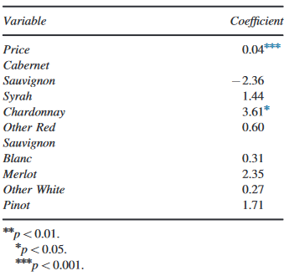
Motivation
Investigate the scaling of $τ_{E}$
Checking for all available parameters to tedious
ISS04-scaling empirical confinement scaling with few data of big stellarators [H. Yamada et al; 2004; NF45]
Investigation is executed using Akaike‘s method
Data-driven information criterion [H. Akaike, 1973]
Compares how different models „perform“ given a set of data
Model: a function recreating data using explanatory variables
Applied many areas of research, e.g. wine research
[M. Snipes, D.C. Taylor; 2014]

Slide 4
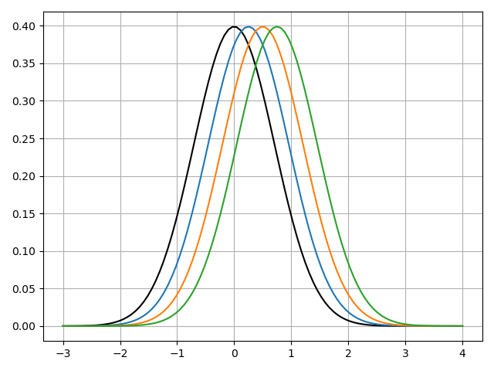
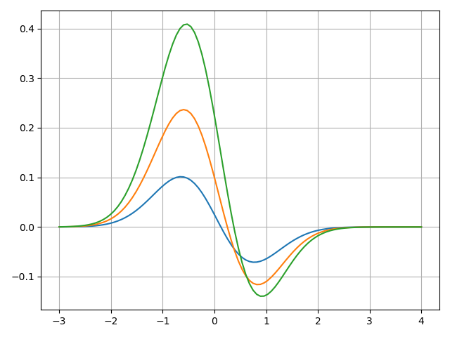
Akaike‘s method
Assume two models: „real“ model f, test model $g(θ)$
Assume $f$ is a special case of $g(θ)$ with „true“ parameters $θ_{0}$, i.e. $f\left(x\right)=g\left(x | θ_{0}\right)$
A measure of difference between probability distributions is the Kullback-Leibner divergence:
$D\left(f,g\right)=\int{f\left(x\right)log\left(\frac{f\left(x\right)}{g\left(x|θ\right)}\right)dx}$, $D≥0$
Goal: given data $y$, estimate $\hat{θ}=\hat{θ}(y)$ via maximum-likelihood to minimize $D(f,g)$,
$min D\left(f,g\right)\sim \min{\int{f\left(x\right)log\left(g\left(x|\hat{θ}\right)\right)dx} }$
f$⋅$log(f/g($θ$))

Slide 5
Akaike‘s method
Using taylor expansions and maximum-likelihood leads to a general solution
$min D\left(f,g\right)≈tr\left(I⋅Σ\right)−log\left(g\left(x | \hat{θ}\right)\right)$
Fisher-Information matrix $I\left(g\left(θ\right)\right)$
Covariance matrix $Σ\left(g\left(θ\right)\right)$
Assuming model g and f are of the same type gives $I^{−1}≈Σ$, thus
$min D\left(f,g\right)≈NV−log\left(g\left(x | \hat{θ}\right)\right)$,
with NV being number of variables in $\hat{θ}$

Slide 6
Akaike‘s method
Akaike‘s method balances quality and complexity
$AIC=−2ln\left(L\right)+2NV$
L represents the likelihood, i.e. how well the model fits to data
NV represents the number of variables, i.e. complexity of the model
Better models have a lower AIC score, i.e. they better reproduce the data
Facts to consider:
For calculations L can be replaced by a residual or variance
AIC only gives clues to the relative quality of the model
Results have to be interpreted in context
AICc for insufficient amount of data

Slide 7
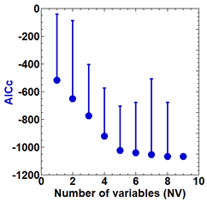
Investigating $χ$ at LHD
Method was employed for LHD data
Goal: find scaling law for describing thermal diffusivity $χ$
Use physical quantities for log-linear regression analysis:
$$\log_{10}\left(\frac{χ}{r_{eff}^{2}ω}\right)=a_{0}+a_{1}\log_{10}\left(x_{1}\right)+…$$
Result:
AICc saturates for NV > 5
$χ_{i}$ appears to be accurately described by 5 parameters with $R^{2}=0.914$
[M. Yokoyama, H. Yamaguchi NF60 (2020)]

Slide 8
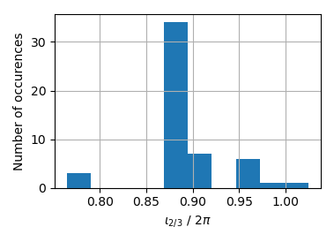
Investigating $τ_{E}$ in W7-X
Log-linear regression analysis:
$log_{10}\left(τ_{E}\right)=a_{0}+a_{1}\left(x_{1}\right)+…$
Use data set with „reasonable“ set of parameters:
R, a, B, $P_{heat}$, ${\overline{n}}_{e}$, $T_{e,i}$, $n_{e,i}$, $R/L_{T,n}$, $β$, $ι$, $ε_{eff}$, $ν_{e,i}^{∗}$, $ρ_{e,i}^{∗}$, $χ_{neo,e,i}$, $ε$ …
Currently 55 data points, most points from standard configuration
Data taken from diagnostics, VMEC and profiles
Uses only W7-X data
Expectations regarding results:
Results should be close to ISS04-scaling for „usual“ parameters
Limited data and little variation in parameters, e.g. B, a, R, $ι_{2/3}$, will influence robustness of results

Slide 9
Testing ISS04 parameters
$$τ_{E}^{ISS04}∝a^{2.28}R^{0.64}P^{−0.61}{\overline{n}}_{e}^{0.54}B^{0.84}ι_{2/3}^{0.41}$$
Tested parameters used in ISS04-scaling:
PECH most important parameter, followed by ${\overline{n}}_{e}$
PECH exponent approaches ISS04
${\overline{n}}_{e}$ exponent smaller than expected: independently verified [G. Fuchert, NF60 2020]
However: a, R, B and $ι_{2/3}$ do not significantly improve model!
a, R, B, $ι_{2/3}$ data values do not vary a lot
Optimal result here is NV=2 with robust result.
NV | a | R | PECH | $${\overline{n}}_{e}$$ | B | $$ι_{2/3}$$ | AICc | $$R^{2}$$
1 | 4.18 | -9.6 | -0.45 | 0.01 | -1.73 | 2.05 | -90.32 | 0.4
2 |  |  | -0.64 | 0.33 |  |  | -109.31 | 0.59
3 | 2.59 |  | -0.62 | 0.34 |  |  | -110.98 | 0.61
4 | 3.23 | 39.24 | -0.65 | 0.36 |  |  | -114.38 | 0.64
5 | 3.49 | 36.3 | -0.61 | 0.35 |  | 0.61 | -113.40 | 0.65
6 | 3.22 | 40.4 | -0.61 | 0.35 | -0.18 | 0.51 | -110.68 | 0.64

Slide 10
Testing ISS04 parameters
ISS04-scaling has a normalized form: $τ_{E}/τ_{Bohm}∝{ρ^{∗}}^{−0.79}β^{−0.19}{ν_{b}^{∗}}^{0.00}ι_{2/3}^{1.06}ε^{−0.07}$
AICc similar for all models
$ν_{p}^{∗}$ contains the most information
Other parameters do not add quality:
Low variation in $ρ^{∗}$, $ι_{2/3}$, $ε$
Variation in $β$ but already insignificant in ISS04
Takeaway: $ν_{p}^{∗}$ appears to be important for $τ_{E}$
NV | $$ρ^{∗}$$ | $$β$$ | $$ν_{p}^{∗}$$ | $$ι_{23}$$ | $$ε$$ | AICc | $$R^{2}$$
1 |  |  | -0.22 |  |  | -77.53 | 0.48
2 |  |  | -0.23 | 1.87 |  | -77.25 | 0.53
3 |  |  | -0.21 | 1.98 | 4.63 | -81.93 | 0.58
4 | -0.2 |  | -0.24 | 1.98 | 4.83 | -79.47 | 0.57
5 | -0.57 | 0.08 | -0.31 | 2.08 | 5.43 | -77.06 | 0.56

Slide 11
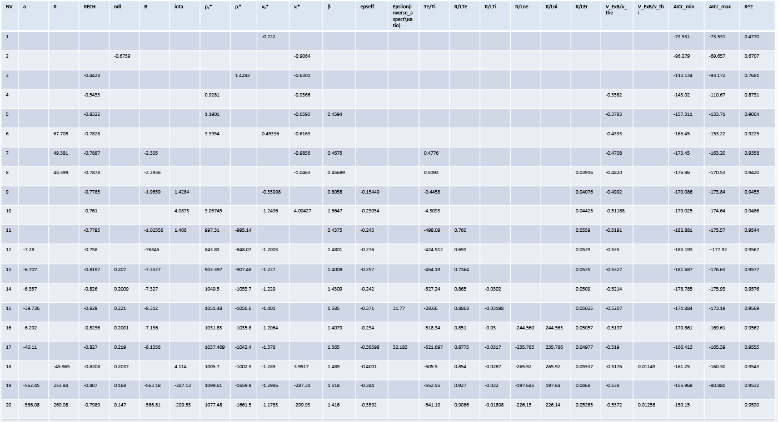
General parameter analysis
Analyze all parameters in data set:
Limiting to only partial set of parameters creates bias
Let statistics determine significance of parameters
A lot to see here…let‘s summarize

Slide 12
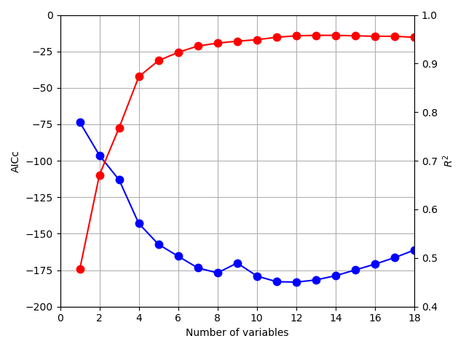
General parameter analysis
AICc, R2 slowly saturate:
Past NV=12 AICc penalty term shows
Appropriate models should be given for NV=5-8
Partially overfitted exponents are observed for NV > 8
Several stable parameters observed:
Takeaway: possible new parameters for further investigation identified!
PECH | $$ν_{i}^{∗}$$ | $$R/L_{Er}$$ | $$R/L_{Te}$$ | $$v_{ExB}/v_{th}$$ | $$ε_{eff}$$
-0.8 | -0.6 to -1 | 0.05 | 0.8 | -0.45 | -0.3
Only for NV=2-8 in result
ISS04-paper predicts -0.4

Slide 13
Summary
Akaike‘s information criterion has been employed for $τ_{E}$ in W7-X:
Both types of ISS04-scaling are statistically reproducable to a certain degree
Some results predicted or independently verified
55 data points already allow for identification of key parameters and possible further candidates
What the investigation showed about the AIC method:
Good tool for data driven analyses
Complex models need sufficient number of data points
Individual parameters have to vary sufficiently for stable results
For the future:
AIC method should be employed more frequently
Expanded data set for improved quality of investigation regarding $τ_{E}$

Slide 14
Extra Slide 1 [Why does $tr\left(I\left(θ\right)Σ\right)=K$?]
Covariance matrix for $log\left(g\left(x | \hat{θ}\right)\right)≈$ ….
Fisher matrix for $log\left(g\left(x | \hat{θ}\right)\right)≈$ ….

