Slide 1
Analysis of the fast-ion distribution in W7-X from the Balmer-alpha spectrum
Peter Zs. Poloskei*, O. Ford, B. Geiger and many important others
*peter.poloskei@ipp.mpg.de

Slide 2
Motivation
W7-X was designed for good fast-ion confinement in high-β:
Optimized, „good” neoclassical particle orbits
Diagnosing this feature is a goal of W7X
Tasks to be done:
Investigate the current capabilities of the CXRS system to infer properties of fast-ions
Support observation with predictive modelling with FIDASIM
Understand fast-ions behavior in current low-β plasmas (what influences their confinement)
Carry out predictive modelling for future high-β plasmas
Fine-tuning the current system for (even) „better” measurements

Slide 3
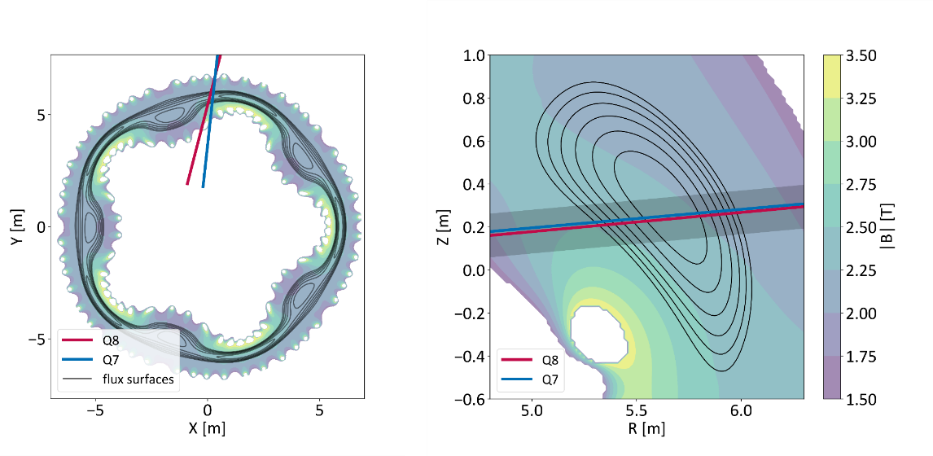
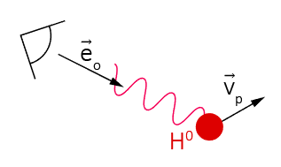
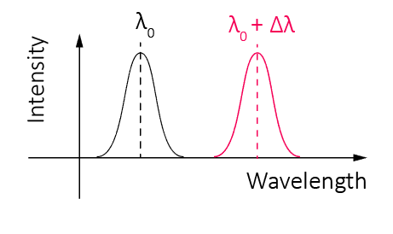
How do we want to diagnose confined fast-ions?
We need fast-ions… → NBI
Provides fast-ions (E_{inj} ~ 50 keV)
Provides neutrals what…
…makes active charge-exchange possible
By investigating hydrogen Balmer-alpha emission (H_{α})
n = 3→2 transition, λ₀ = 656.281 nm
max(Δλ) ≈ 6 nm (from fast-neutrals)
Broad spectral feature expected
CXRS system happens to have a „red“ spectrometer measuring 647-667 nm range
NBI geometry
AUG – cold H_{α}

Slide 4
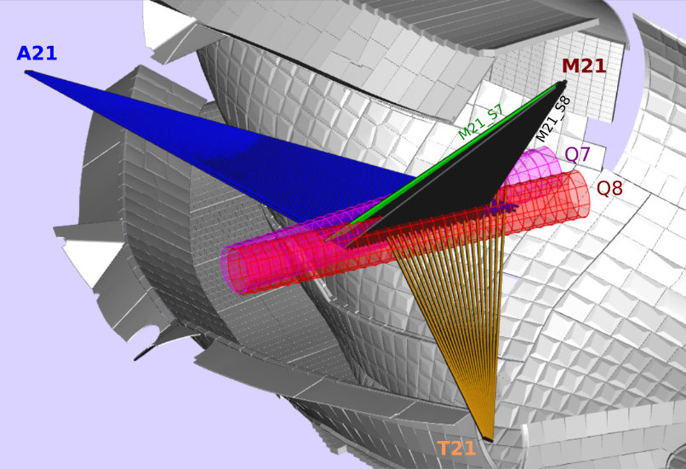
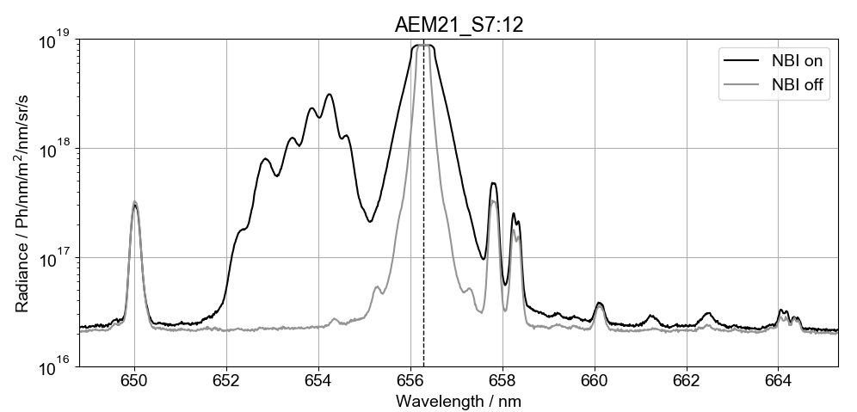
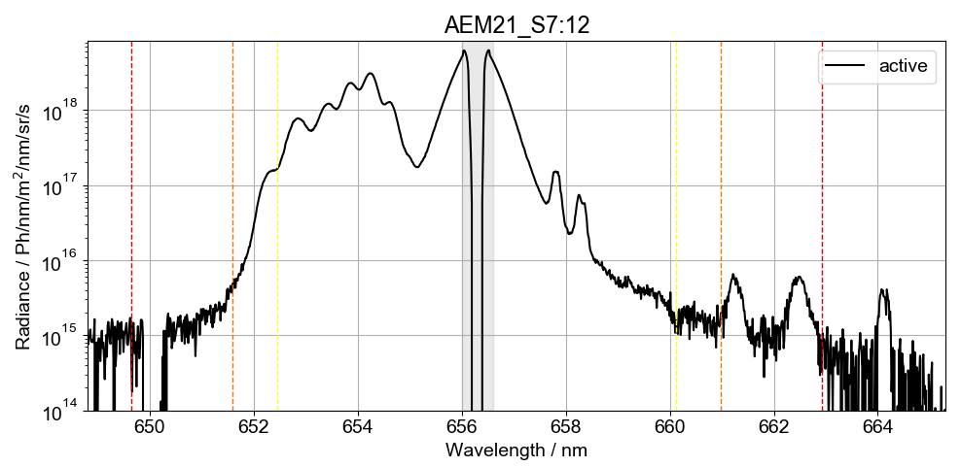
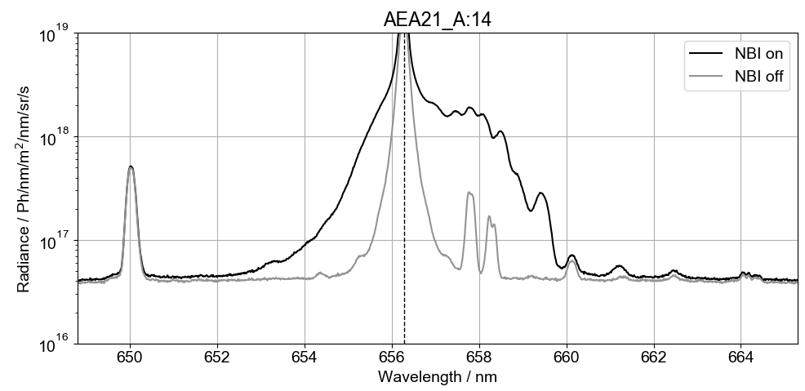
CXRS system in W7-X for detecting H_{α}
3 different observation directions:
53 line of sights (LOS) total
Covering most of the confined region along the NBI
Different characteristic Doppler-shifts
Absolute intensity calibrated measurement → [Ph/sr/nm/m²/s]
Detailed modelling required for the understanding of the spectrum
FIDASIM → predicts the H_{α} spectrum
Impurity lines
Cold H_{α}
Bremsstrahlung
Thermal H_{α} (Halo)
Radiance Ph/sr/nm/m²/s
Beam emission
Fast-ion H_{α} (FIDA)

Slide 5
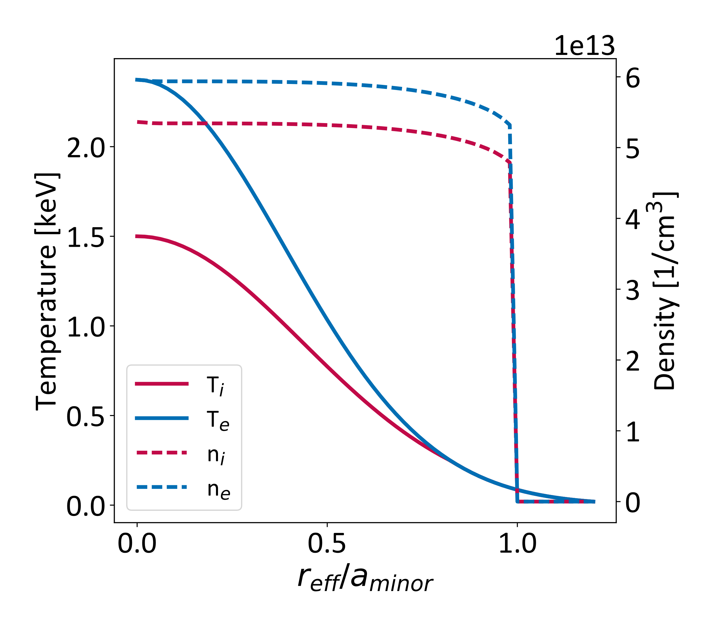
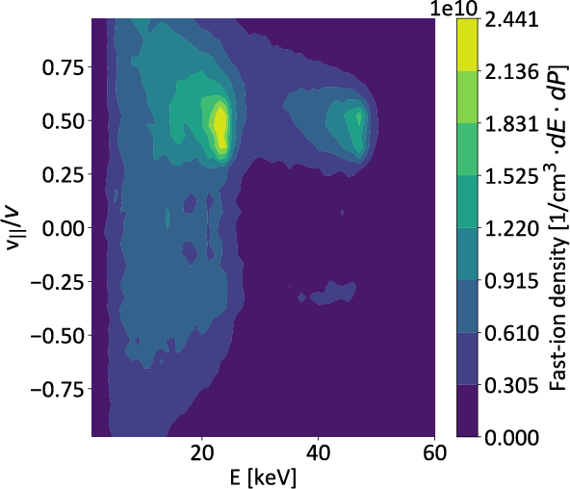
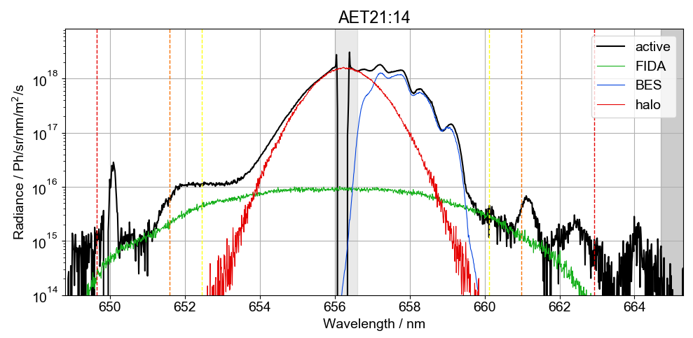
FIDASIM – Monte Carloing neutrals
@ASCOT fi distribution
FIDASIM models spatial evolution of different neutral populations, state resolved, solving a collisional-radiative model (excitation, ionization, CX):
Magnetic equilibrium
Assumed plasma profiles
Beam- and observation parameters required
Predicts emissivity of characteristic neutral populations:
Beam neutrals → from NBI
Halo neutrals →
Fast-neutrals →
Predicted spectral shape matches well
20180823.037@5.6s
E_{full}
E_{third}
E_{half}

Slide 6
How „good“ is FIDASIM‘s H_{α} estimate?
Checking absolute intensities
By scaling predicted spectral intensity to match CXRS measurement
BES predicted matches
Both with measurement
And calorimetry power prediction
Halo emission discrepancies
Currently assuming Z_{eff} = 1.5 flat
Cold neutral – thermal CX?
FIDA emission discrepancies
Significant O(10²) more measured intensity in the edge than predicted
Too low ASCOT predicted fast-ion density?
Too low amount of neutrals (for CX)?

Slide 7
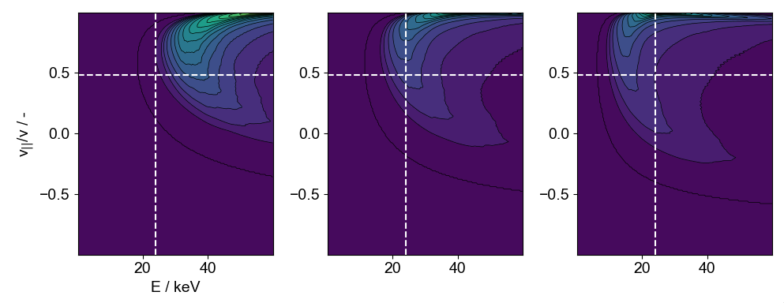
Weight-function estimates of different ports
Current LOS setup is not optimized for FIDA measurements
Typically high BES Doppler-shift
No observable temporal evolution τ_{sd} < 1/f_{sampl}
Which part of the fast-ion distribution can contribute to given wavelength bin
Co-passing particles
Port | BES (Doppler-shift) | Co-passing ptc emission | Cntr-passing ptc emission
A | Red (+) | Red | Blue
M | Blue (-) | Blue | Red
T | Red (+) | Blue | Red
Weight functions – AET21:14
650.9 nm
651.9 nm
652.9 nm
Counter-passing particles

Slide 8
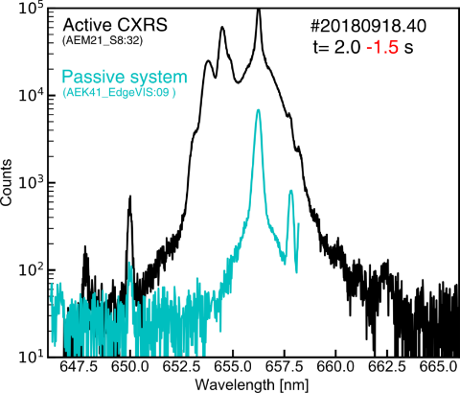
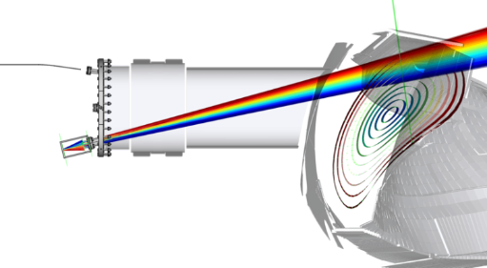
Discrepancies in the FIDA spectra
What we observe:
Too low amount of predicted emission (discrepancy increases towards the edges)
„Missing“ hump in the co-passing 2nd energy component (fall off responds to changing acceleration voltage)
No passive FIDA emission observed in different segment (cold neutrals + fast-ions)
Significant amount of edge neutrals?
Hypothesis:
NBI causes intensive, local recycling
Causing significant, local passive FIDA emission
Causing further fast-ion losses through CX
Passive CXRS
[courtesy A. J. van Vuuren]

Slide 9
Summary
FIDASIM was successfully adapted to W7X geometry, providing:
Predictive modelling for the Balmer-alpha spectra
Support for other CX based measurements
Different spectral shapes (BES, halo, FIDA) are well-reproducible with FIDASIM
Minor discrepancies in absolute intensities, causes under investigation
Major discrepancies in the edge FIDA observations → missing cold, local neutrals? Possible to be included in the modelling
Sensitivity of the current CXRS LOS setup was investigated
Current alignment only allows limited investigation of the fast-ion distribution
T and M port are useful in current setup
Optimization of the system would be possible for FIDA measurements
focusing on co-passing particles
Optimizing BES Doppler-shift with better channel allocation

Slide 11
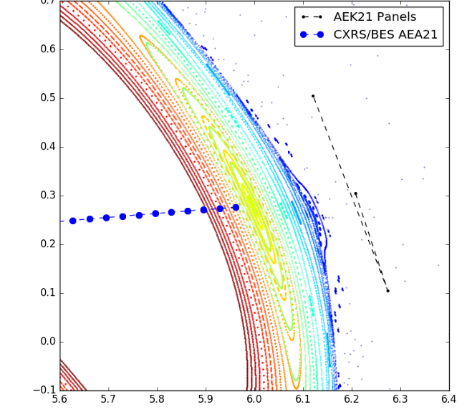
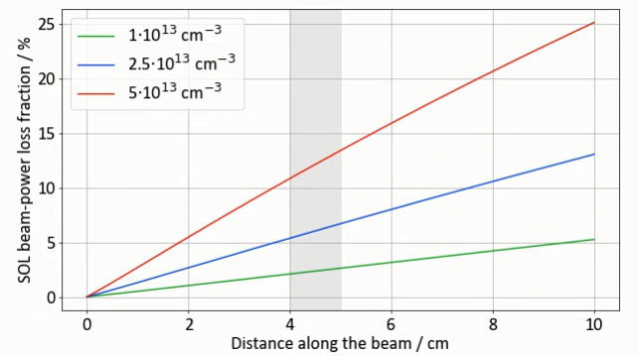
Island power losses
In „high-mirror” NBI fires across island
Electron density can be still high (n_{e} ~ O(10¹³) cm⁻³)
Δl = 4-5 cm
Investigating beam attenuation in a marginal case
Assuming flat profile based on Thomson’s last measured point in the confined region
20180823.037 @5.2s
E₀ = 48 keV, n_{e} = 4.6 10¹³ cm⁻³, T_{e} = 100 eV
SOL NBI power losses 2-12%
Low SOL density is desirable for proper core heating
Δl
z [m]
R [m]

Slide 12
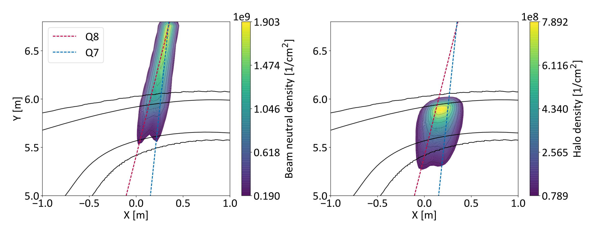
Neutral densities

