Slide 1
Influence of plasma parameters on sawtooth instabilities at W7-X
Written and presented by Tilly Smith
Supervision: Prof. Robert Wolf, Dr. Marco Zanini

Slide 2
Motivation
Continuation into research of unexpected sawtooth instabilities at W7-X

Slide 3
Motivation
Continuation into research of unexpected sawtooth instabilities at W7-X
Gain better understanding of when and how instabilities occur

Slide 4
Motivation
Continuation into research of unexpected sawtooth instabilities at W7-X
Gain better understanding of when and how instabilities occur
Control of sawtooth instabilities is twofold:
Minimize effect on overall plasma performance
For instance make use of sawtooth instabilities for impurity control of the plasma

Slide 5
Motivation
Continuation into research of unexpected sawtooth instabilities at W7-X
Gain better understanding of when and how instabilities occur
Control of sawtooth instabilities is twofold:
Minimize effect on overall plasma performance
For instance make use of sawtooth instabilities for impurity control of the plasma
Specifically: examination of the crash interval Δt with respect to other plasma parameters

Slide 6
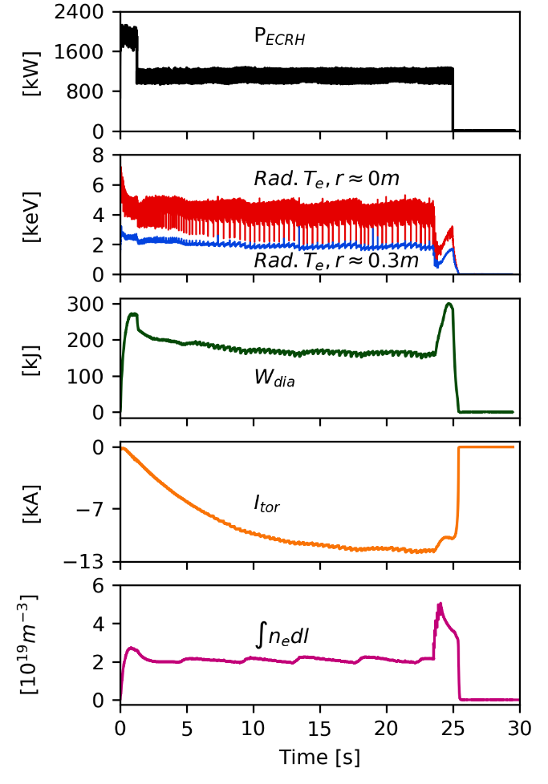
Introduction
Crash of plasma electron temperature T_{e} coincides with electron cyclotron current drive (ECCD) experiments
20171206.025
M. Zanini

Slide 7
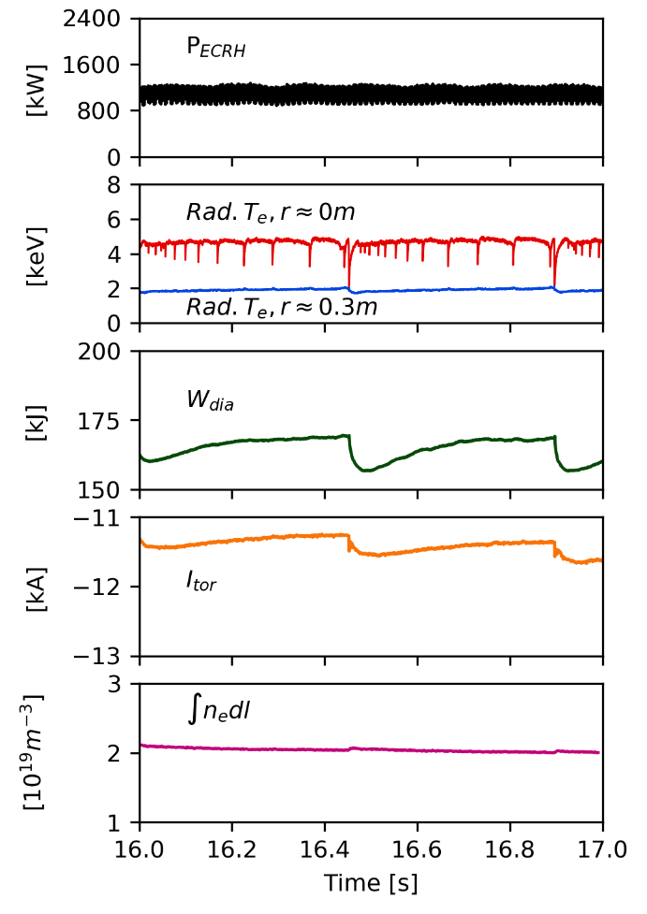
Introduction
Crash of plasma electron temperature T_{e} coincides with electron cyclotron current drive (ECCD) experiments
20171206.025
20171206.025
M. Zanini
M. Zanini

Slide 8
Introduction
Crash of plasma electron temperature T_{e} coincides with electron cyclotron current drive (ECCD) experiments
20171206.025
20171206.025
Strong and repetitive crashes (up to 65% of T_{e})
M. Zanini
M. Zanini

Slide 9
Introduction
Crash of plasma electron temperature T_{e} coincides with electron cyclotron current drive (ECCD) experiments
20171206.025
20171206.025
Strong and repetitive crashes (up to 65% of T_{e})
Diamagnetic energy W_{dia} and toroidal current I_{tor} affected
M. Zanini
M. Zanini

Slide 10
Introduction
ECE central channel temperature profile:
M. Zanini

Slide 11
Introduction
ECE central channel temperature profile:
M. Zanini
Crash amplitude ΔT_{e}: relative electron temperature change in percent
Inversion radius r_{inv}: radial position where T_{e}=const. before and after a crash

Slide 12
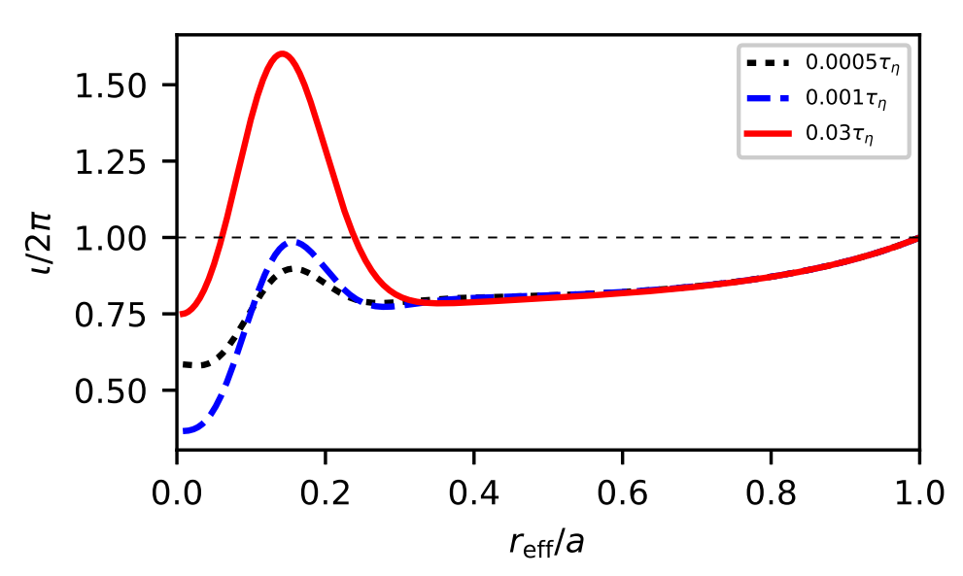
Introduction
Iota-profile:
M. Zanini

Slide 13
Introduction
Temporal evolution of iota-profile (1d cylindrical system):
Iota-profile:
M. Zanini

Slide 14
Introduction
Temporal evolution of iota-profile (1d cylindrical system):
Dimensional analysis results in the resistive time:
Iota-profile:
M. Zanini

Slide 15
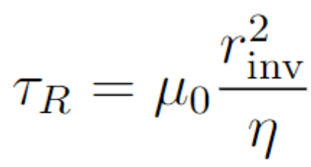
Introduction
Temporal evolution of iota-profile (1d cylindrical system):
Dimensional analysis results in the resistive time:
Iota-profile:
assuming L²~r_{inv}²:
M. Zanini

Slide 16
Introduction
Temporal evolution of iota-profile (1d cylindrical system):
Dimensional analysis results in the resistive time:
Iota-profile:
assuming L²~r_{inv}²:
→ hypothesis: τ_{R}~Δt
M. Zanini

Slide 17
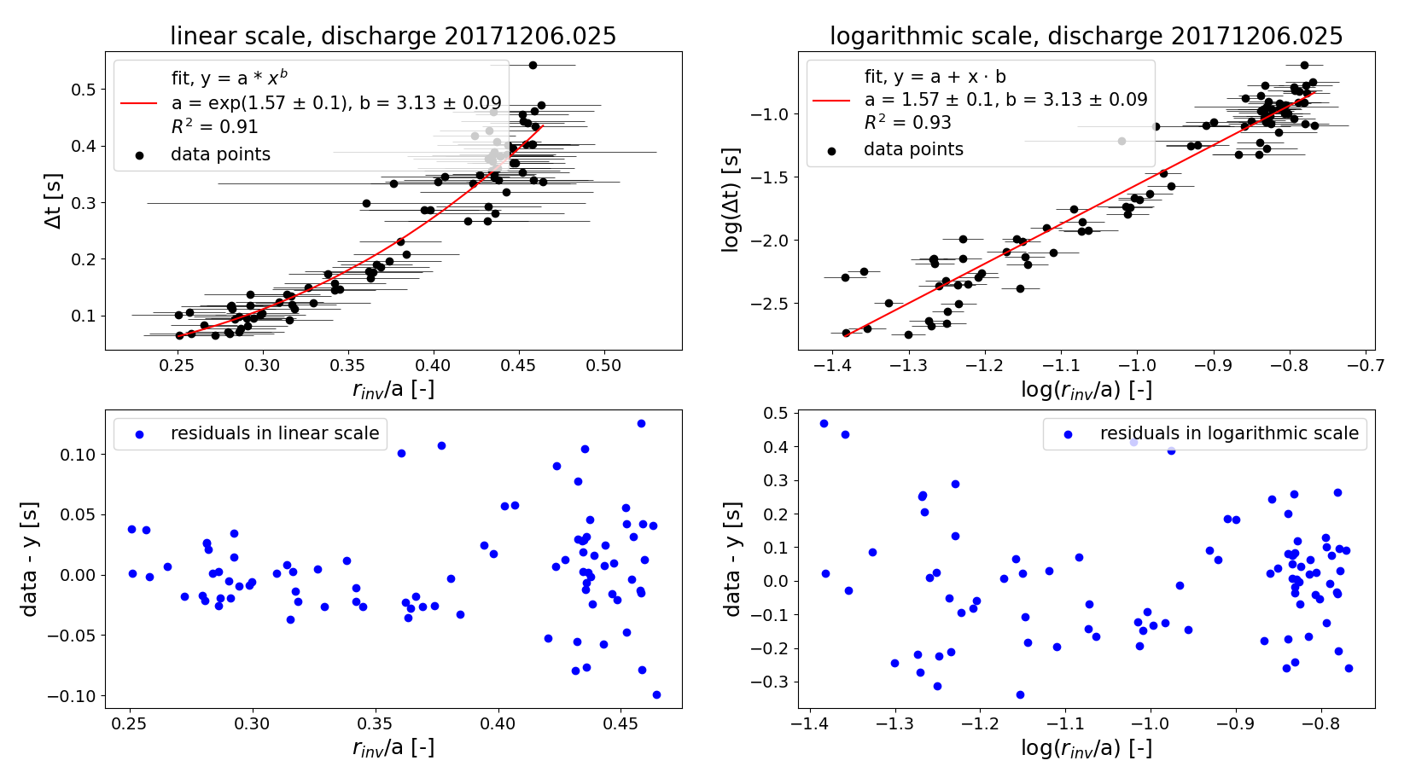
Plotting Δt over r_{inv}/a
Linear fit in logarithmic scale: y = a + x∙b
Residuals in logarithmic scale
Power fit and residuals in linear scale

Slide 18
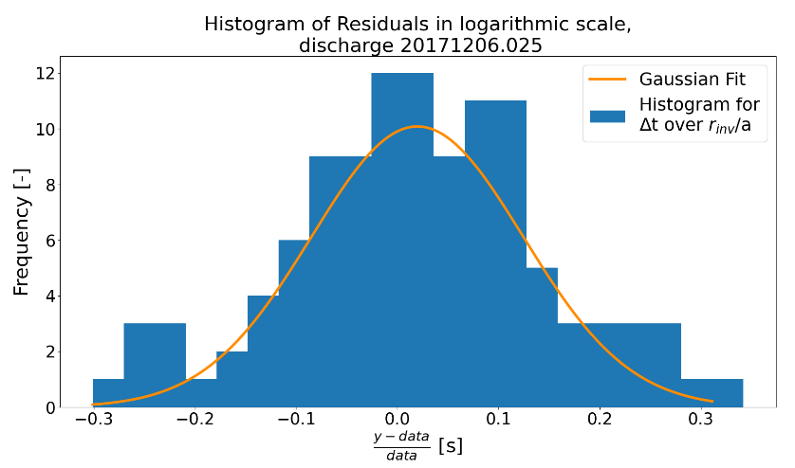
Plotting Δt over r_{inv}/a
Linear fit in logarithmic scale: y = a + x∙b
Residuals in logarithmic scale
Power fit and residuals in linear scale
Histogram of residuals resembles a Gaussian distribution

Slide 19
Plotting Δt over r_{inv}/a – all discharges
Improve statistic by plotting all discharges together

Slide 20
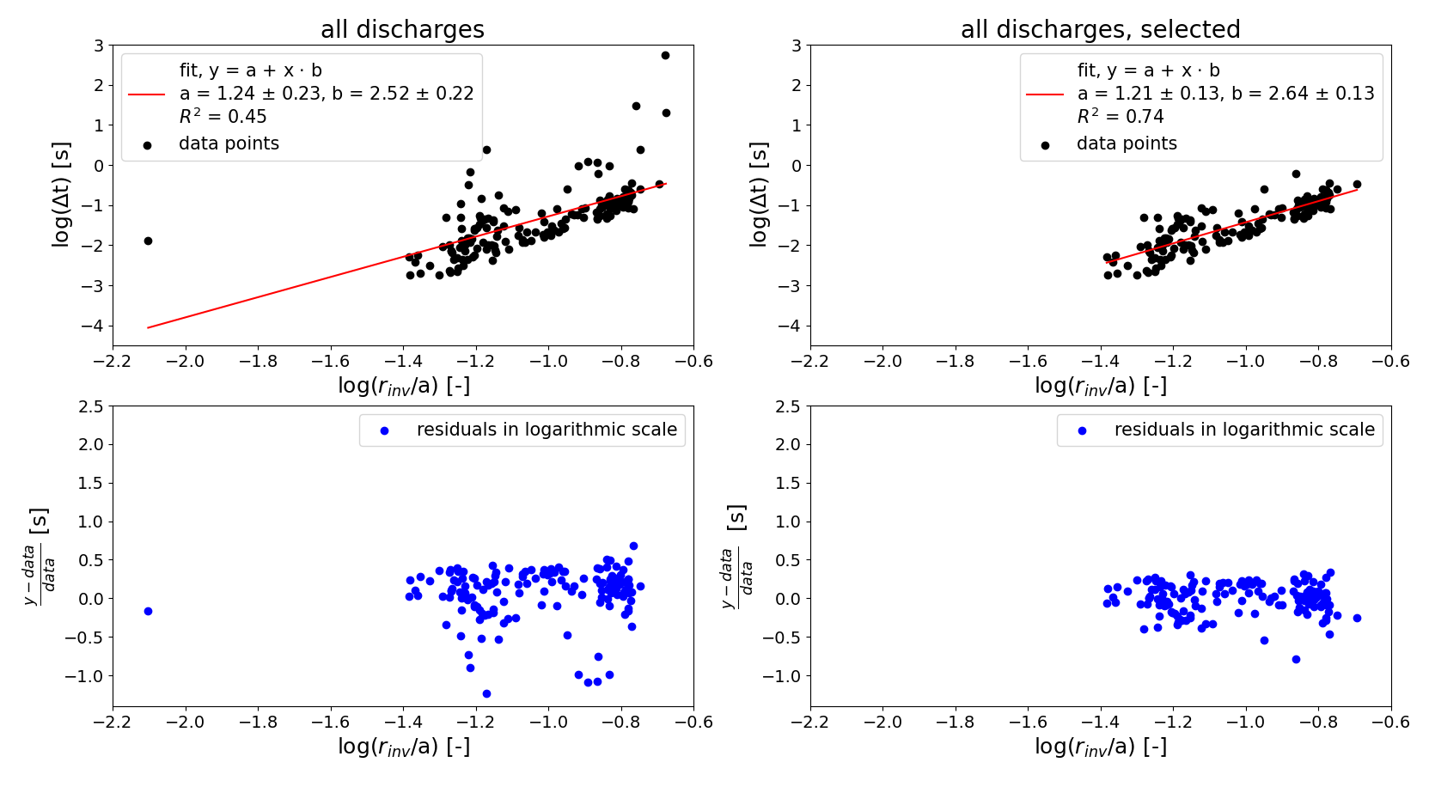
Plotting Δt over r_{inv}/a – all discharges
Improve statistic by plotting all discharges together

Slide 21
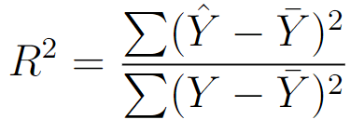
Results Δt over r_{inv}
Coefficient of determination: ϵ[0,1]
Observed quantity $Y$
Predicted value $\hat{Y}$
Mean value $\overline{Y}$

Slide 22
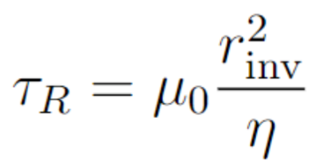
Results Δt over r_{inv}
Coefficient of determination: ϵ[0,1]
Observed quantity $Y$
Predicted value $\hat{Y}$
Mean value $\overline{Y}$
Fit parameters (y = a + x∙b) and R² for all discharges:
data sets small, error margins large

Slide 23
Results Δt over r_{inv}
Coefficient of determination: ϵ[0,1]
Observed quantity $Y$
Predicted value $\hat{Y}$
Mean value $\overline{Y}$
Fit parameters (y = a + x∙b) and R² for all discharges:
data sets small, error margins large
Average exponent: b = 3.12±0.98
→ hidden r_{inv} dependency to decrease discrepancy?

Slide 24
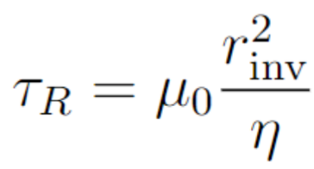
Plotting η⁻¹ over r_{inv}/a
What other parameters influence τ_{R}?

Slide 25
Plotting η⁻¹ over r_{inv}/a
What other parameters influence τ_{R}?
Spitzer plasma resistivity:

Slide 26
Plotting η⁻¹ over r_{inv}/a
What other parameters influence τ_{R}?
Spitzer plasma resistivity:
Coulomb logarithm ln(Λ)=17
Effective atomic number deemed to be Z_{eff}=2.5
Electron temperature estimated at the inversion radius:
Central electron temperature T_{e,0}

Slide 27
Plotting η⁻¹ over r_{inv}/a
What other parameters influence τ_{R}?
Spitzer plasma resistivity:
Coulomb logarithm ln(Λ)=17
Effective atomic number deemed to be Z_{eff}=2.5
Electron temperature estimated at the inversion radius:
Central electron temperature T_{e,0}
→ what dependency does η have on r_{inv}?

Slide 28
Results η⁻¹ over r_{inv}/a
Fit parameters (y = a + x∙b) and R² for all discharges:

Slide 29
Results η⁻¹ over r_{inv}/a
Fit parameters (y = a + x∙b) and R² for all discharges:
Average exponent: b = -2.18±0.83
Opposite of necessary trend to decrease discrepancy
→ scaling method or hypothesis insufficient?

Slide 30
Results η⁻¹ over r_{inv}/a
Fit parameters (y = a + x∙b) and R² for all discharges:
Average exponent: b = -2.18±0.83
Opposite of necessary trend to decrease discrepancy
→ scaling method or hypothesis insufficient?
Further scaling methods are performed

Slide 31
Plotting Δt over τ_{R,inv}
Aim is to obtain a “local” resistive time at r_{inv}
Calculate with previously introduced η

Slide 32
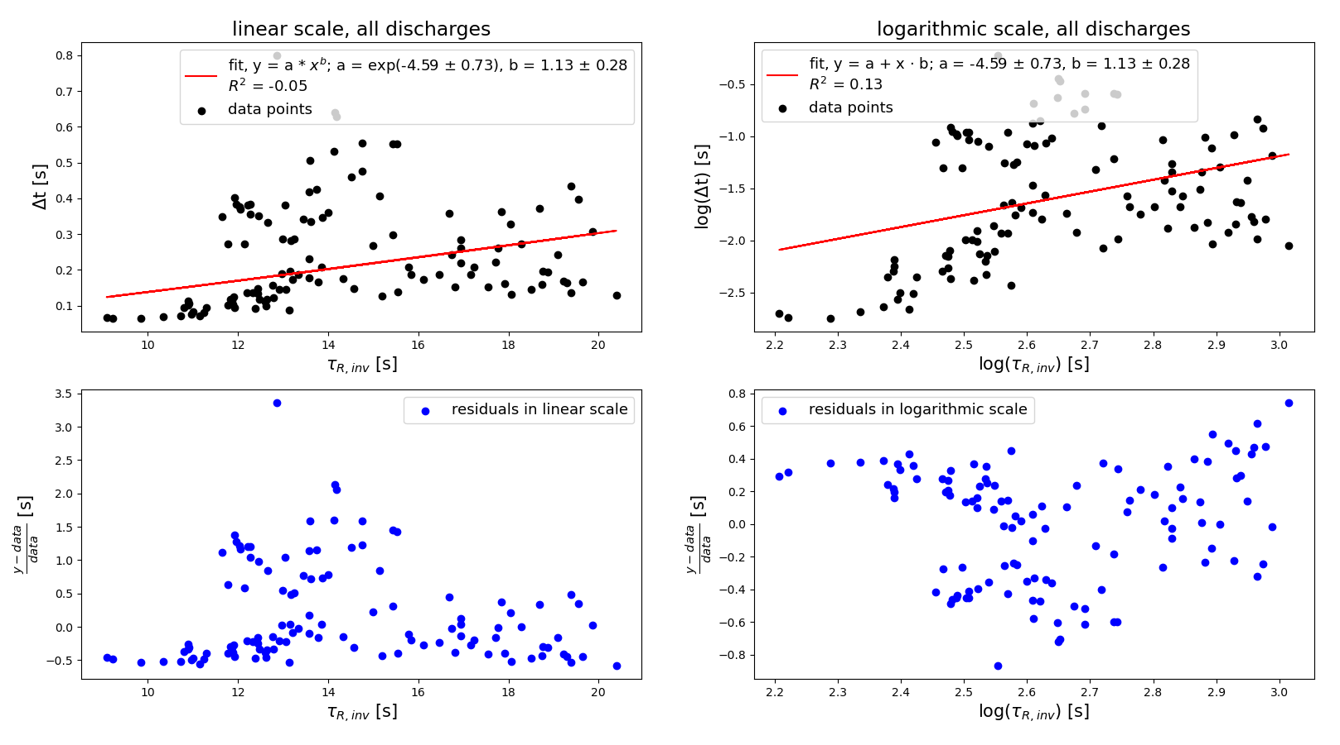
Plotting Δt over τ_{R,inv}
Aim is to obtain a “local” resistive time at r_{inv}
Calculate with previously introduced η
Large scattering in linear and logarithmic scale

Slide 33
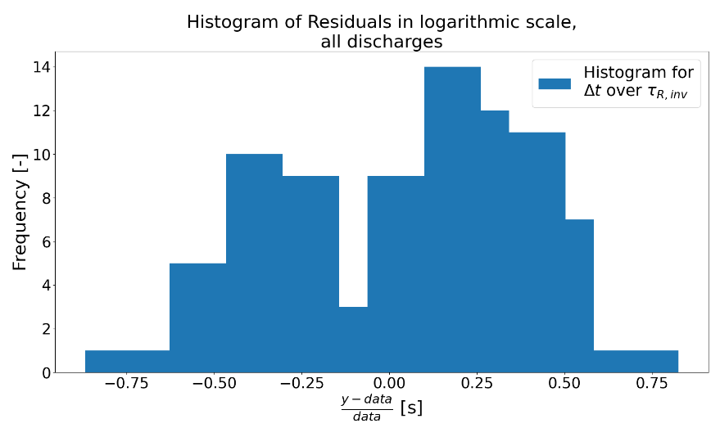
Plotting Δt over τ_{R,inv}
Aim is to obtain a “local” resistive time at r_{inv}
Calculate with previously introduced η
Large scattering in linear and logarithmic scale
Two Gaussian distributions can be identified

Slide 34
Plotting Δt over τ_{R,inv}
Aim is to obtain a “local” resistive time at r_{inv}
Calculate with previously introduced η
Large scattering in linear and logarithmic scale
Two Gaussian distributions can be identified
→ where do the cluster formations come from?

Slide 35
Plotting Δt over τ_{R,Zsingle} and τ_{R,Zavg}
Variation for Z_{eff} value in τ_{R,inv} :
Using individual values Z_{single} for each crash
Using an average value $\overline{Z} for each discharge$

Slide 36
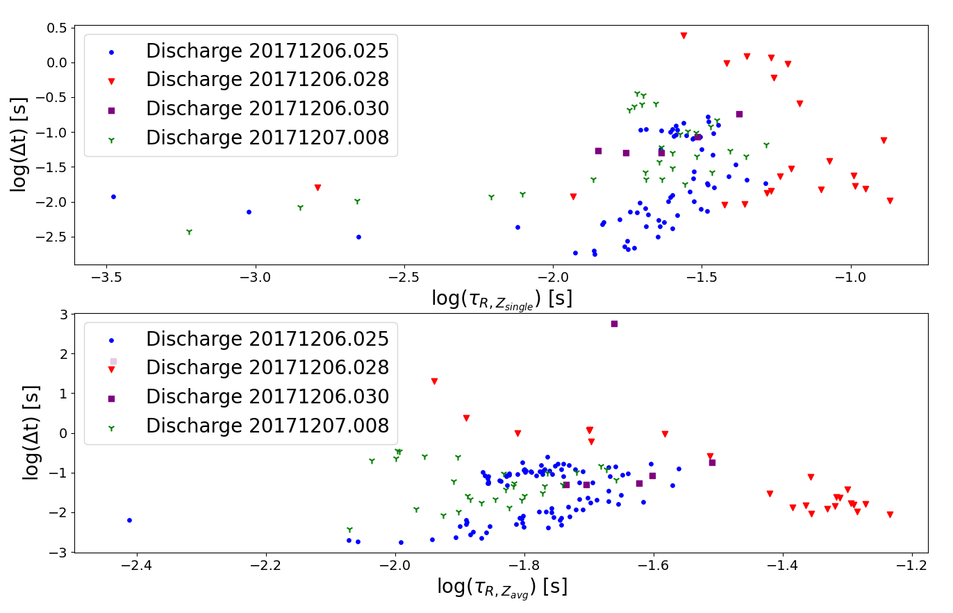
Plotting Δt over τ_{R,Zsingle} and τ_{R,Zavg}
Variation for Z_{eff} value in τ_{R,inv} :
Using individual values Z_{single} for each crash
Using an average value $\overline{Z} for each discharge$
τ_{R,Zsingle} still has
cluster formations
τ_{R,Zavg} shows no
reliable dependency

Slide 37
Results Δt over τ_{R,inv}
R² for all discharges:

Slide 38
Results Δt over τ_{R,inv}
R² for all discharges:
Z_{eff} value has an effect on the data, but:
τ_{R,Zsingle} and τ_{R,Zavg} improve goodness in individual discharges

Slide 39
Results Δt over τ_{R,inv}
R² for all discharges:
Z_{eff} value has an effect on the data, but:
τ_{R,Zsingle} and τ_{R,Zavg} improve goodness in individual discharges; overall
unreliable scaling methods

Slide 40
Results Δt over τ_{R,inv}
R² for all discharges:
Z_{eff} value has an effect on the data, but:
τ_{R,Zsingle} and τ_{R,Zavg} improve goodness in individual discharges; overall
unreliable scaling methods
Fit parameters (y = a + x∙b) for all discharges:
Negative exponent unexpected, no explanation found

Slide 41
Results Δt over τ_{R,inv}
R² for all discharges:
Z_{eff} value has an effect on the data, but:
τ_{R,Zsingle} and τ_{R,Zavg} improve goodness in individual discharges; overall
unreliable scaling methods
Fit parameters (y = a + x∙b) for all discharges:
Negative exponent unexpected, no explanation found
Average exponent: b = 2.73±0.79
Deviates from expected exponent of 1

Slide 42
Plotting Δt over <τ_{R}>
Aim is to mitigate fluctuations of individual quantities throughout the instability region

Slide 43
Plotting Δt over <τ_{R}>
Aim is to mitigate fluctuations of individual quantities throughout the instability region
Effective resistive time:

Slide 44
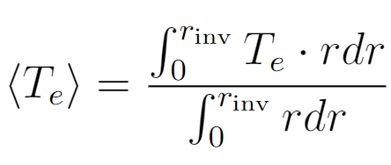
Plotting Δt over <τ_{R}>
Aim is to mitigate fluctuations of individual quantities throughout the instability region
Effective resistive time:
Integrated over instability volume
Using the effective electron temperature:

Slide 45
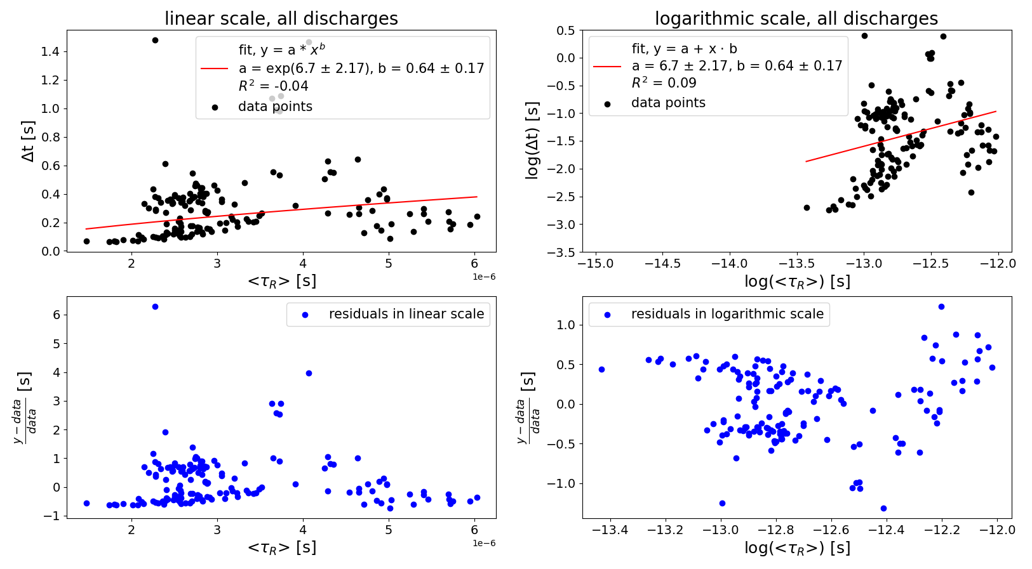
Plotting Δt over <τ_{R}> - all discharges

Slide 46
Plotting Δt over <τ_{R}> - all discharges
Cluster formations can be identified

Slide 47
Results Δt over <τ_{R}>
Variations in Z_{eff} values:
Has an influence on data
Only influence causing the scattering?

Slide 48
Results Δt over <τ_{R}>
Variations in Z_{eff} values:
Has an influence on data
Only influence causing the scattering?
Fit parameters (y = a + x∙b) for all discharges:
Negative exponent unexpected, no explanation found

Slide 49
Results Δt over <τ_{R}>
Variations in Z_{eff} values:
Has an influence on data
Only influence causing the scattering?
Fit parameters (y = a + x∙b) for all discharges:
Negative exponent unexpected, no explanation found
Average exponent: b = 1.07±1.15
Percentage error of >100%

Slide 50
Results Δt over <τ_{R}>
Variations in Z_{eff} values:
Has an influence on data
Only influence causing the scattering?
Fit parameters (y = a + x∙b) for all discharges:
Negative exponent unexpected, no explanation found
Average exponent: b = 1.07±1.15
Percentage error of >100%
→ unreliable results

Slide 51
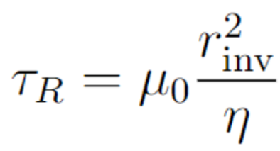
Plotting Δt over η⁻¹
Is the assumption L²~r_{inv}² correct?

Slide 52
Plotting Δt over η⁻¹
Is the assumption L²~r_{inv}² correct?
Plot Δt over η⁻¹ directly to inspect assumption, r_{inv} = const.

Slide 53
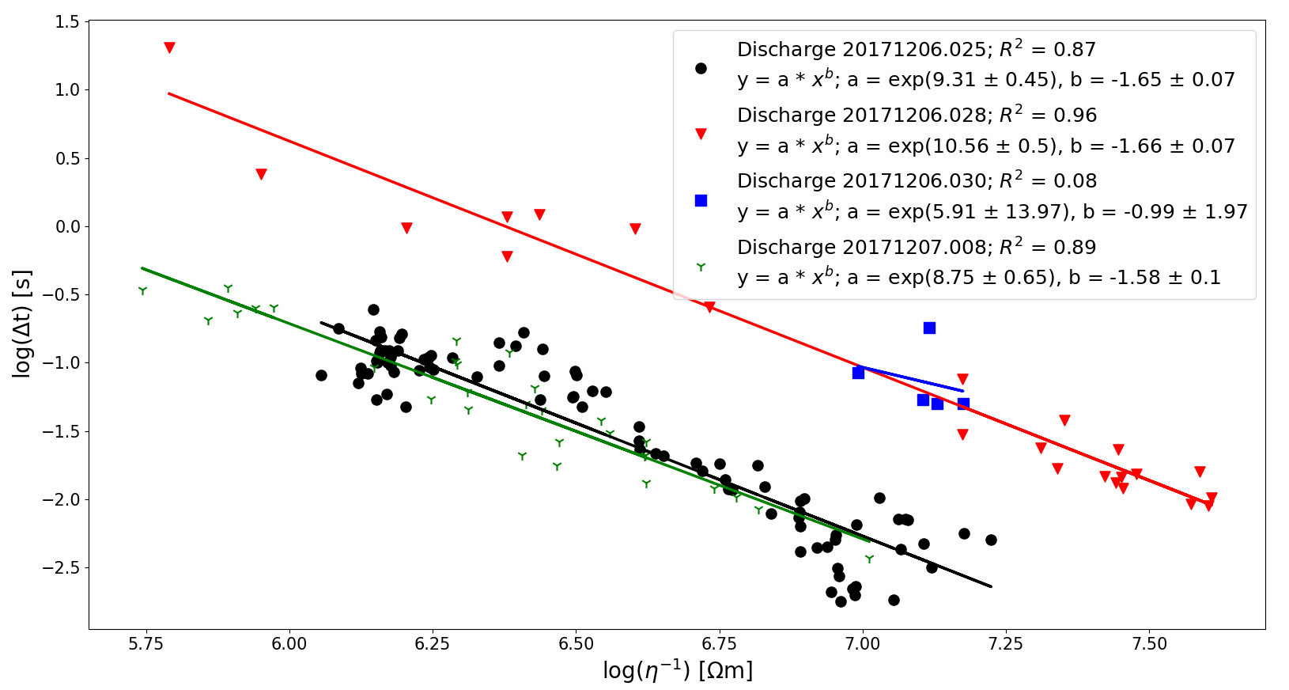
Plotting Δt over η⁻¹
Is the assumption L²~r_{inv}² correct?
Plot Δt over η⁻¹ directly to inspect assumption, r_{inv} = const.

Slide 54
Plotting Δt over η⁻¹
Fit parameters (y = a + x∙b) and R² for all discharges:

Slide 55
Plotting Δt over η⁻¹
Fit parameters (y = a + x∙b) and R² for all discharges:
Small data set causes low R² value

Slide 56
Plotting Δt over η⁻¹
Fit parameters (y = a + x∙b) and R² for all discharges:
Small data set causes low R² value
Overall very good reliability

Slide 57
Plotting Δt over η⁻¹
Fit parameters (y = a + x∙b) and R² for all discharges:
Small data set causes low R² value
Overall very good reliability
Average exponent of b = -1.63±0.14

Slide 58
Plotting Δt over η⁻¹
Fit parameters (y = a + x∙b) and R² for all discharges:
Small data set causes low R² value
Overall very good reliability
Average exponent of b = -1.63±0.14
Disadvantages of scaling method:
several hidden dependencies in η
Dependencies influence each other
Difficult to examine

Slide 59
Plotting Δt over η⁻¹
Fit parameters (y = a + x∙b) and R² for all discharges:
Small data set causes low R² value
Overall very good reliability
Average exponent of b = -1.63±0.14
Disadvantages of scaling method:
several hidden dependencies in η
Dependencies influence each other
→ assumption L²~r_{inv}² may be incorrect
Difficult to examine

Slide 60
Summary
Most reliable scaling method: Δt over r_{inv}/a

Slide 61
Summary
Most reliable scaling method: Δt over r_{inv}/a
Results deviate from hypothesis
→ hypothesis could not be confirmed

Slide 62
Summary
Most reliable scaling method: Δt over r_{inv}/a
Results deviate from hypothesis
→ hypothesis could not be confirmed
Scaling method Δt over η⁻¹ very reliable

Slide 63
Summary
Most reliable scaling method: Δt over r_{inv}/a
Results deviate from hypothesis
→ hypothesis could not be confirmed
Scaling method Δt over η⁻¹ very reliable
Possibly the assumption L²~r_{inv}² is incorrect
→ what is L?

Slide 64
Summary
Most reliable scaling method: Δt over r_{inv}/a
Results deviate from hypothesis
→ hypothesis could not be confirmed
Scaling method Δt over η⁻¹ very reliable
Possibly the assumption L²~r_{inv}² is incorrect
→ what is L?
Dependencies in η unknown

Slide 65
Summary
Most reliable scaling method: Δt over r_{inv}/a
Results deviate from hypothesis
→ hypothesis could not be confirmed
Scaling method Δt over η⁻¹ very reliable
Possibly the assumption L²~r_{inv}² is incorrect
→ what is L?
Dependencies in η unknown
Which parameters influence τ_{R} and how? Could this help verify τ_{R}~Δt?

Slide 66
PCA
Principal Component Analysis (PCA):
Orthogonal linear transformation reduces dimensionality of data sets

Slide 67
PCA
Principal Component Analysis (PCA):
Orthogonal linear transformation reduces dimensionality of data sets
Principal components:
Describe the data set through linear functions
Preserve as much variance as possible

Slide 68
PCA
Principal Component Analysis (PCA):
Orthogonal linear transformation reduces dimensionality of data sets
Principal components:
Describe the data set through linear functions
Preserve as much variance as possible
Parameters used in the PCA:
Inversion radius r_{inv}
Electron temperature T_{e}
Respective radial derivative dT/dr
Crash amplitude ΔT
Electron density n_{e}
Toroidal current I_{tor}
Heating power P_{ECRH}
Diamagnetic energy W_{dia}
Effective resistive time <τ_{R}>
Plasma resistivity η_{Zavg} with an average atomic number $\overline{Z}$

Slide 69
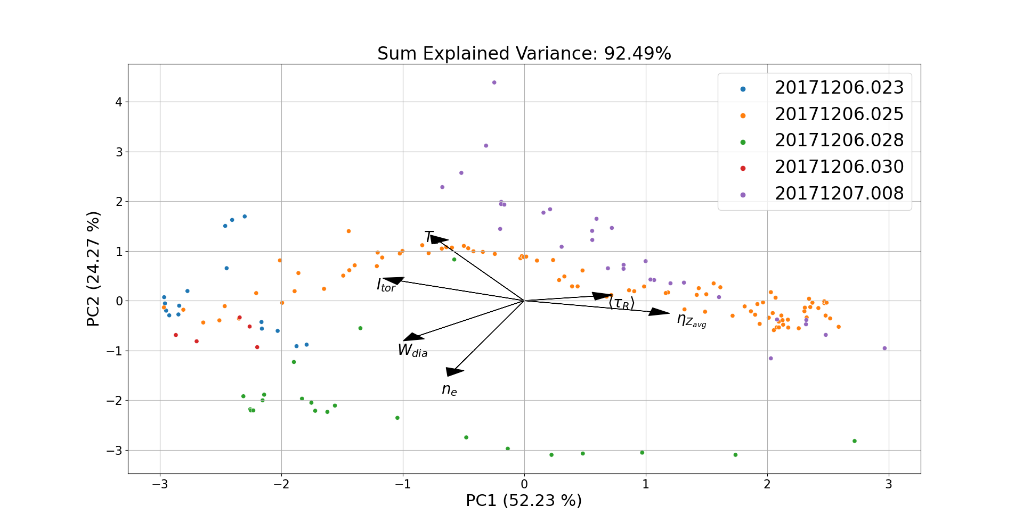
PCA – PC1 and PC2
10 parameters reduced to 6 through PCA analysis

Slide 70
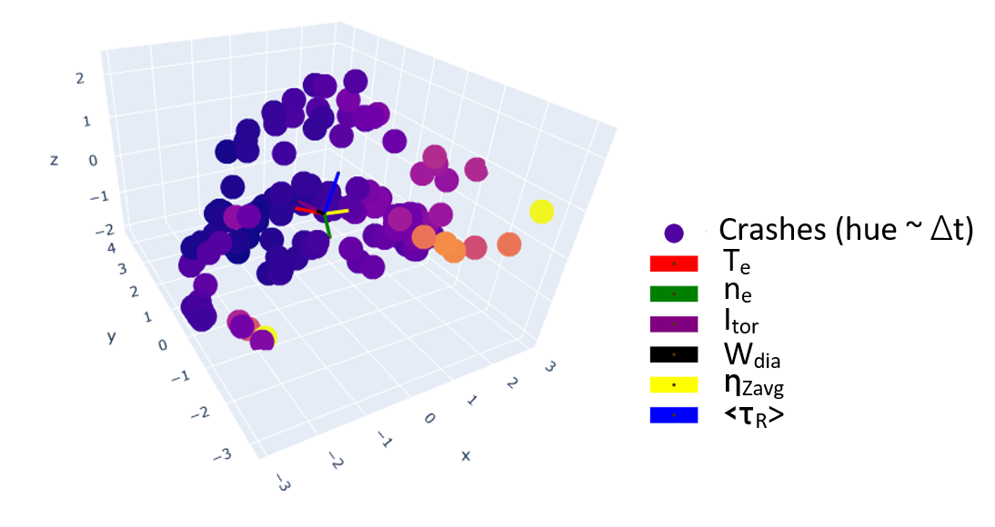
PCA – 3D plot
PCA results compared with Δt
Δt given in the color gradient of the crashes (lighter dots ~ larger Δt)

Slide 71
Conclusion
Hypothesis of Δt ~ τ_{R} couldn’t be confirmed, with
Obvious trend BUT same scaling not found

Slide 72
Conclusion
Hypothesis of Δt ~ τ_{R} couldn’t be confirmed, with
Obvious trend BUT same scaling not found
Plotting Δt over η⁻¹ yields very reliable results
Assumption of L² ~ r_{inv}² incorrect?
→ what is L?

Slide 73
Conclusion
Hypothesis of Δt ~ τ_{R} couldn’t be confirmed, with
Obvious trend BUT same scaling not found
Plotting Δt over η⁻¹ yields very reliable results
Assumption of L² ~ r_{inv}² incorrect?
→ what is L?
Larger data sets needed for further research and more reliable results → future experiments planned

Slide 74
Conclusion
Hypothesis of Δt ~ τ_{R} couldn’t be confirmed, with
Obvious trend BUT same scaling not found
Plotting Δt over η⁻¹ yields very reliable results
Assumption of L² ~ r_{inv}² incorrect?
→ what is L?
Larger data sets needed for further research and more reliable results → future experiments planned
PCA is a good starting point for further research into sawtooth instabilities
→ Could a multiple-parameter fit verify the hypothesis?

Slide 75
Comparison of all scaling methods
Δt over r_{inv}/a
Δt over <τ_{R}>
Δt over τ_{R,inv}
Δt over <τ_{R}>
Δt over r_{inv}/a
Δt over τ_{R,inv}
Average R²: 0.79
Average R²: 0.79
Average R²: 0.35
Average R²: 0.35
Average R²: 0.64
Average R²: 0.64
Highest reliability
Highest reliability
Unreliable scaling method
Unreliable scaling method
Average exponent: b = 1.07±1.15
Expected is 1
Average exponent: b = 3.12±0.98
Expected is 2
Average exponent: b = 1.07±1.15
Expected is 1
Average exponent: b = 3.12±0.98
Expected is 2
Average exponent: b = 2.73±0.79
Expected is 1
Average exponent: b = 2.73±0.79
Expected is 1
b deviates from expected value
η(r_{inv}) increases discrepancy
b deviates from expected value
η(r_{inv}) increases discrepancy
Influence of Z_{eff} shown
Unreliable results
Other influences possible
Influence of Z_{eff} shown
Unreliable results
Other influences possible
b nears expected value BUT percentage error >100%
→ unreliable results
b nears expected value BUT percentage error >100%
→ unreliable results

