Slide 1
Submerged divertor design tool
Menzel-Barbara, A.
Fellinger, J.
Neu, R.
Naujoks, D.
Kharwandikar, A.

Slide 2
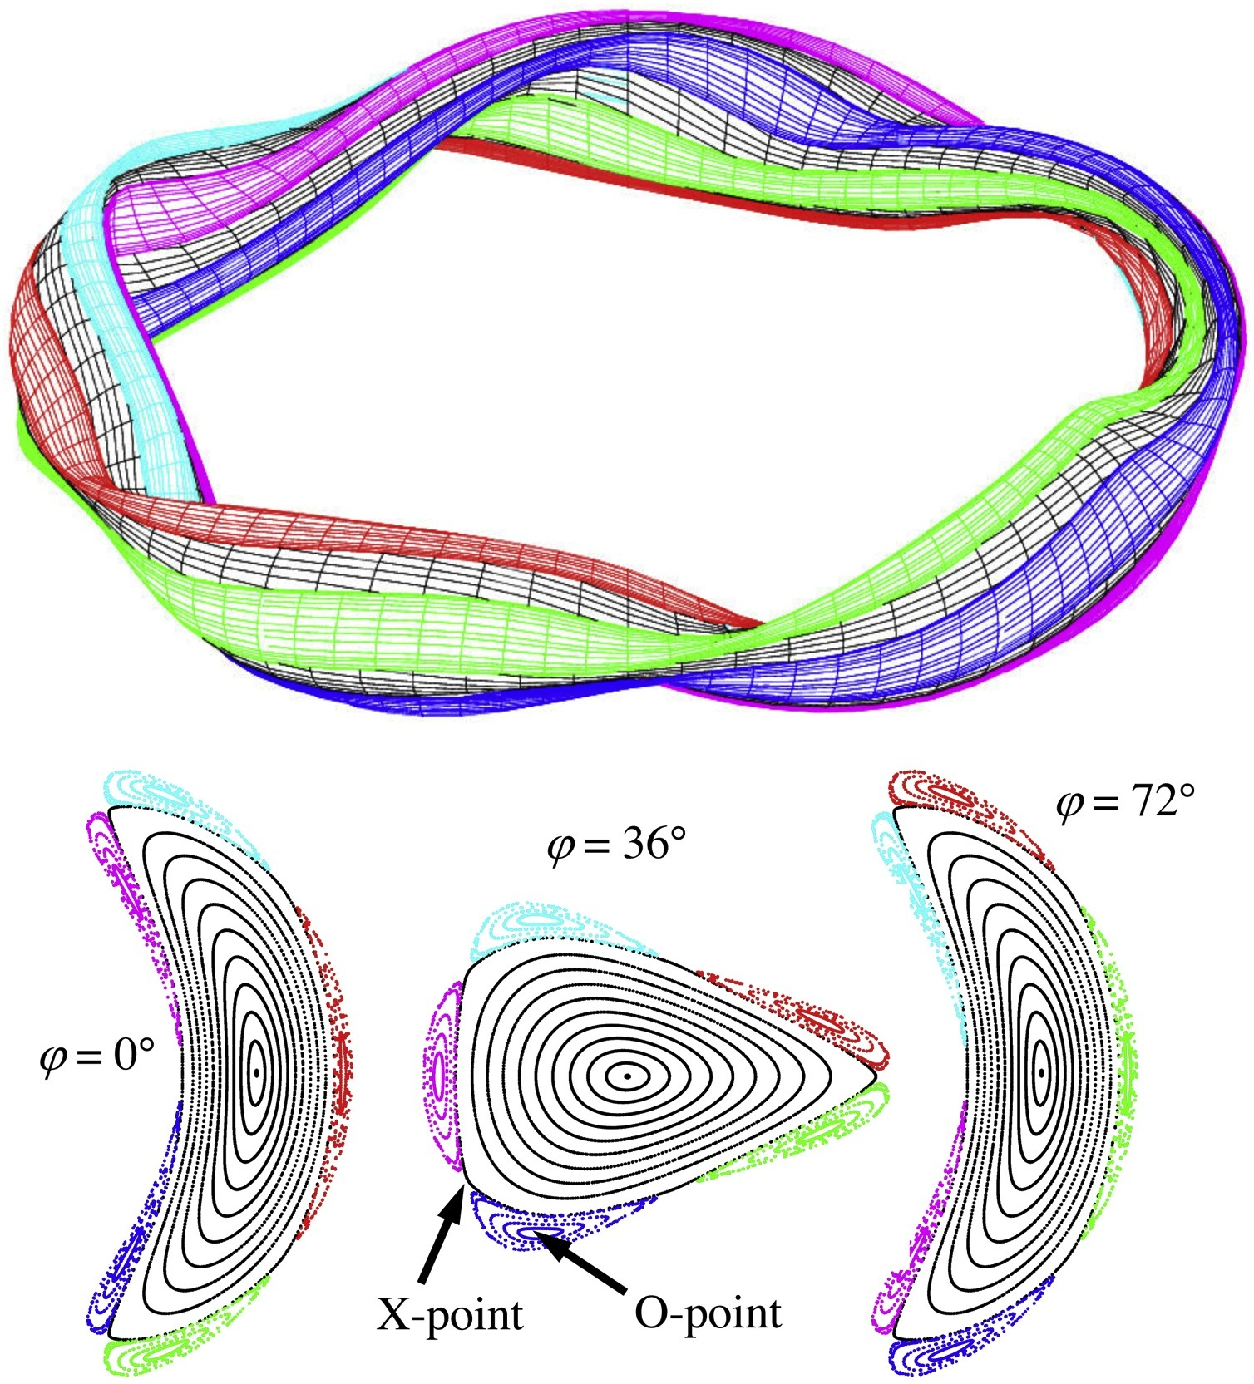
W7-X islands, standard configuration
Notes:
Now lets jump into the next problem to be addressed : how to design a divertor
To not get lost in the large 3d design space, need a general framework
Leading idea is to leverage trajectories of stationary points of a given magnetic topology
Let’s take the example of the O-line class of divertors wherein we first locate the O-point and nearest LCMS point to build a basis vector
And eventually an island reference frame that moves with the island
Useful to create 3d shapes

Slide 3
W7-X islands, standard configuration
Notes:
Now lets jump into the next problem to be addressed : how to design a divertor
To not get lost in the large 3d design space, need a general framework
Leading idea is to leverage trajectories of stationary points of a given magnetic topology
Let’s take the example of the O-line class of divertors wherein we first locate the O-point and nearest LCMS point to build a basis vector
And eventually an island reference frame that moves with the island
Useful to create 3d shapes

Slide 4
W7-X islands, standard configuration
Notes:
Now lets jump into the next problem to be addressed : how to design a divertor
To not get lost in the large 3d design space, need a general framework
Leading idea is to leverage trajectories of stationary points of a given magnetic topology
Let’s take the example of the O-line class of divertors wherein we first locate the O-point and nearest LCMS point to build a basis vector
And eventually an island reference frame that moves with the island
Useful to create 3d shapes

Slide 5
W7-X islands, standard configuration
Notes:
Now lets jump into the next problem to be addressed : how to design a divertor
To not get lost in the large 3d design space, need a general framework
Leading idea is to leverage trajectories of stationary points of a given magnetic topology
Let’s take the example of the O-line class of divertors wherein we first locate the O-point and nearest LCMS point to build a basis vector
And eventually an island reference frame that moves with the island
Useful to create 3d shapes

Slide 6
W7-X islands, standard configuration
Notes:
Now lets jump into the next problem to be addressed : how to design a divertor
To not get lost in the large 3d design space, need a general framework
Leading idea is to leverage trajectories of stationary points of a given magnetic topology
Let’s take the example of the O-line class of divertors wherein we first locate the O-point and nearest LCMS point to build a basis vector
And eventually an island reference frame that moves with the island
Useful to create 3d shapes

Slide 7
W7-X islands, standard configuration
Pump
Notes:
Now lets jump into the next problem to be addressed : how to design a divertor
To not get lost in the large 3d design space, need a general framework
Leading idea is to leverage trajectories of stationary points of a given magnetic topology
Let’s take the example of the O-line class of divertors wherein we first locate the O-point and nearest LCMS point to build a basis vector
And eventually an island reference frame that moves with the island
Useful to create 3d shapes

Slide 8
W7-X islands, standard configuration
Notes:
Now lets jump into the next problem to be addressed : how to design a divertor
To not get lost in the large 3d design space, need a general framework
Leading idea is to leverage trajectories of stationary points of a given magnetic topology
Let’s take the example of the O-line class of divertors wherein we first locate the O-point and nearest LCMS point to build a basis vector
And eventually an island reference frame that moves with the island
Useful to create 3d shapes

Slide 9
W7-X islands, standard configuration
Notes:
Now lets jump into the next problem to be addressed : how to design a divertor
To not get lost in the large 3d design space, need a general framework
Leading idea is to leverage trajectories of stationary points of a given magnetic topology
Let’s take the example of the O-line class of divertors wherein we first locate the O-point and nearest LCMS point to build a basis vector
And eventually an island reference frame that moves with the island
Useful to create 3d shapes

Slide 10
W7-X islands, standard configuration
Notes:
Now lets jump into the next problem to be addressed : how to design a divertor
To not get lost in the large 3d design space, need a general framework
Leading idea is to leverage trajectories of stationary points of a given magnetic topology
Let’s take the example of the O-line class of divertors wherein we first locate the O-point and nearest LCMS point to build a basis vector
And eventually an island reference frame that moves with the island
Useful to create 3d shapes

Slide 11
W7-X islands, standard configuration
Notes:
Now lets jump into the next problem to be addressed : how to design a divertor
To not get lost in the large 3d design space, need a general framework
Leading idea is to leverage trajectories of stationary points of a given magnetic topology
Let’s take the example of the O-line class of divertors wherein we first locate the O-point and nearest LCMS point to build a basis vector
And eventually an island reference frame that moves with the island
Useful to create 3d shapes

Slide 12
W7-X islands, standard configuration
Notes:
Now lets jump into the next problem to be addressed : how to design a divertor
To not get lost in the large 3d design space, need a general framework
Leading idea is to leverage trajectories of stationary points of a given magnetic topology
Let’s take the example of the O-line class of divertors wherein we first locate the O-point and nearest LCMS point to build a basis vector
And eventually an island reference frame that moves with the island
Useful to create 3d shapes

Slide 13
W7-X islands, standard configuration
Notes:
Now lets jump into the next problem to be addressed : how to design a divertor
To not get lost in the large 3d design space, need a general framework
Leading idea is to leverage trajectories of stationary points of a given magnetic topology
Let’s take the example of the O-line class of divertors wherein we first locate the O-point and nearest LCMS point to build a basis vector
And eventually an island reference frame that moves with the island
Useful to create 3d shapes

Slide 14
W7-X islands, standard configuration
Notes:
Now lets jump into the next problem to be addressed : how to design a divertor
To not get lost in the large 3d design space, need a general framework
Leading idea is to leverage trajectories of stationary points of a given magnetic topology
Let’s take the example of the O-line class of divertors wherein we first locate the O-point and nearest LCMS point to build a basis vector
And eventually an island reference frame that moves with the island
Useful to create 3d shapes

Slide 15
W7-X islands, standard configuration
Notes:
Now lets jump into the next problem to be addressed : how to design a divertor
To not get lost in the large 3d design space, need a general framework
Leading idea is to leverage trajectories of stationary points of a given magnetic topology
Let’s take the example of the O-line class of divertors wherein we first locate the O-point and nearest LCMS point to build a basis vector
And eventually an island reference frame that moves with the island
Useful to create 3d shapes

Slide 16
W7-X islands, standard configuration
Notes:
Now lets jump into the next problem to be addressed : how to design a divertor
To not get lost in the large 3d design space, need a general framework
Leading idea is to leverage trajectories of stationary points of a given magnetic topology
Let’s take the example of the O-line class of divertors wherein we first locate the O-point and nearest LCMS point to build a basis vector
And eventually an island reference frame that moves with the island
Useful to create 3d shapes

Slide 17
W7-X islands, standard configuration
Notes:
Now lets jump into the next problem to be addressed : how to design a divertor
To not get lost in the large 3d design space, need a general framework
Leading idea is to leverage trajectories of stationary points of a given magnetic topology
Let’s take the example of the O-line class of divertors wherein we first locate the O-point and nearest LCMS point to build a basis vector
And eventually an island reference frame that moves with the island
Useful to create 3d shapes

Slide 18
W7-X islands, standard configuration
Measure of toroidal procession Φ
Measure of poloidal procession θ*
Notes:
Now lets jump into the next problem to be addressed : how to design a divertor
To not get lost in the large 3d design space, need a general framework
Leading idea is to leverage trajectories of stationary points of a given magnetic topology
Let’s take the example of the O-line class of divertors wherein we first locate the O-point and nearest LCMS point to build a basis vector
And eventually an island reference frame that moves with the island
Useful to create 3d shapes

Slide 19
W7-X islands, standard configuration
Notes:
Now lets jump into the next problem to be addressed : how to design a divertor
To not get lost in the large 3d design space, need a general framework
Leading idea is to leverage trajectories of stationary points of a given magnetic topology
Let’s take the example of the O-line class of divertors wherein we first locate the O-point and nearest LCMS point to build a basis vector
And eventually an island reference frame that moves with the island
Useful to create 3d shapes

Slide 20
W7-X islands, standard configuration
Measure of toroidal procession Φ
Notes:
Now lets jump into the next problem to be addressed : how to design a divertor
To not get lost in the large 3d design space, need a general framework
Leading idea is to leverage trajectories of stationary points of a given magnetic topology
Let’s take the example of the O-line class of divertors wherein we first locate the O-point and nearest LCMS point to build a basis vector
And eventually an island reference frame that moves with the island
Useful to create 3d shapes

Slide 21
W7-X islands, standard configuration
Measure of toroidal procession Φ
Notes:
Now lets jump into the next problem to be addressed : how to design a divertor
To not get lost in the large 3d design space, need a general framework
Leading idea is to leverage trajectories of stationary points of a given magnetic topology
Let’s take the example of the O-line class of divertors wherein we first locate the O-point and nearest LCMS point to build a basis vector
And eventually an island reference frame that moves with the island
Useful to create 3d shapes

Slide 22
W7-X islands, standard configuration
Measure of toroidal procession Φ
Notes:
Now lets jump into the next problem to be addressed : how to design a divertor
To not get lost in the large 3d design space, need a general framework
Leading idea is to leverage trajectories of stationary points of a given magnetic topology
Let’s take the example of the O-line class of divertors wherein we first locate the O-point and nearest LCMS point to build a basis vector
And eventually an island reference frame that moves with the island
Useful to create 3d shapes

Slide 23
W7-X islands, standard configuration
Measure of toroidal procession Φ
Catastrophic leading edge!
Notes:
Now lets jump into the next problem to be addressed : how to design a divertor
To not get lost in the large 3d design space, need a general framework
Leading idea is to leverage trajectories of stationary points of a given magnetic topology
Let’s take the example of the O-line class of divertors wherein we first locate the O-point and nearest LCMS point to build a basis vector
And eventually an island reference frame that moves with the island
Useful to create 3d shapes

Slide 24
W7-X islands, standard configuration
Measure of toroidal procession Φ
Notes:
Now lets jump into the next problem to be addressed : how to design a divertor
To not get lost in the large 3d design space, need a general framework
Leading idea is to leverage trajectories of stationary points of a given magnetic topology
Let’s take the example of the O-line class of divertors wherein we first locate the O-point and nearest LCMS point to build a basis vector
And eventually an island reference frame that moves with the island
Useful to create 3d shapes

Slide 25
W7-X islands, standard configuration
Measure of toroidal procession Φ
Notes:
Now lets jump into the next problem to be addressed : how to design a divertor
To not get lost in the large 3d design space, need a general framework
Leading idea is to leverage trajectories of stationary points of a given magnetic topology
Let’s take the example of the O-line class of divertors wherein we first locate the O-point and nearest LCMS point to build a basis vector
And eventually an island reference frame that moves with the island
Useful to create 3d shapes

Slide 26
W7-X islands, standard configuration
Measure of toroidal procession Φ
Tip is shadowed!
Notes:
Now lets jump into the next problem to be addressed : how to design a divertor
To not get lost in the large 3d design space, need a general framework
Leading idea is to leverage trajectories of stationary points of a given magnetic topology
Let’s take the example of the O-line class of divertors wherein we first locate the O-point and nearest LCMS point to build a basis vector
And eventually an island reference frame that moves with the island
Useful to create 3d shapes

Slide 27
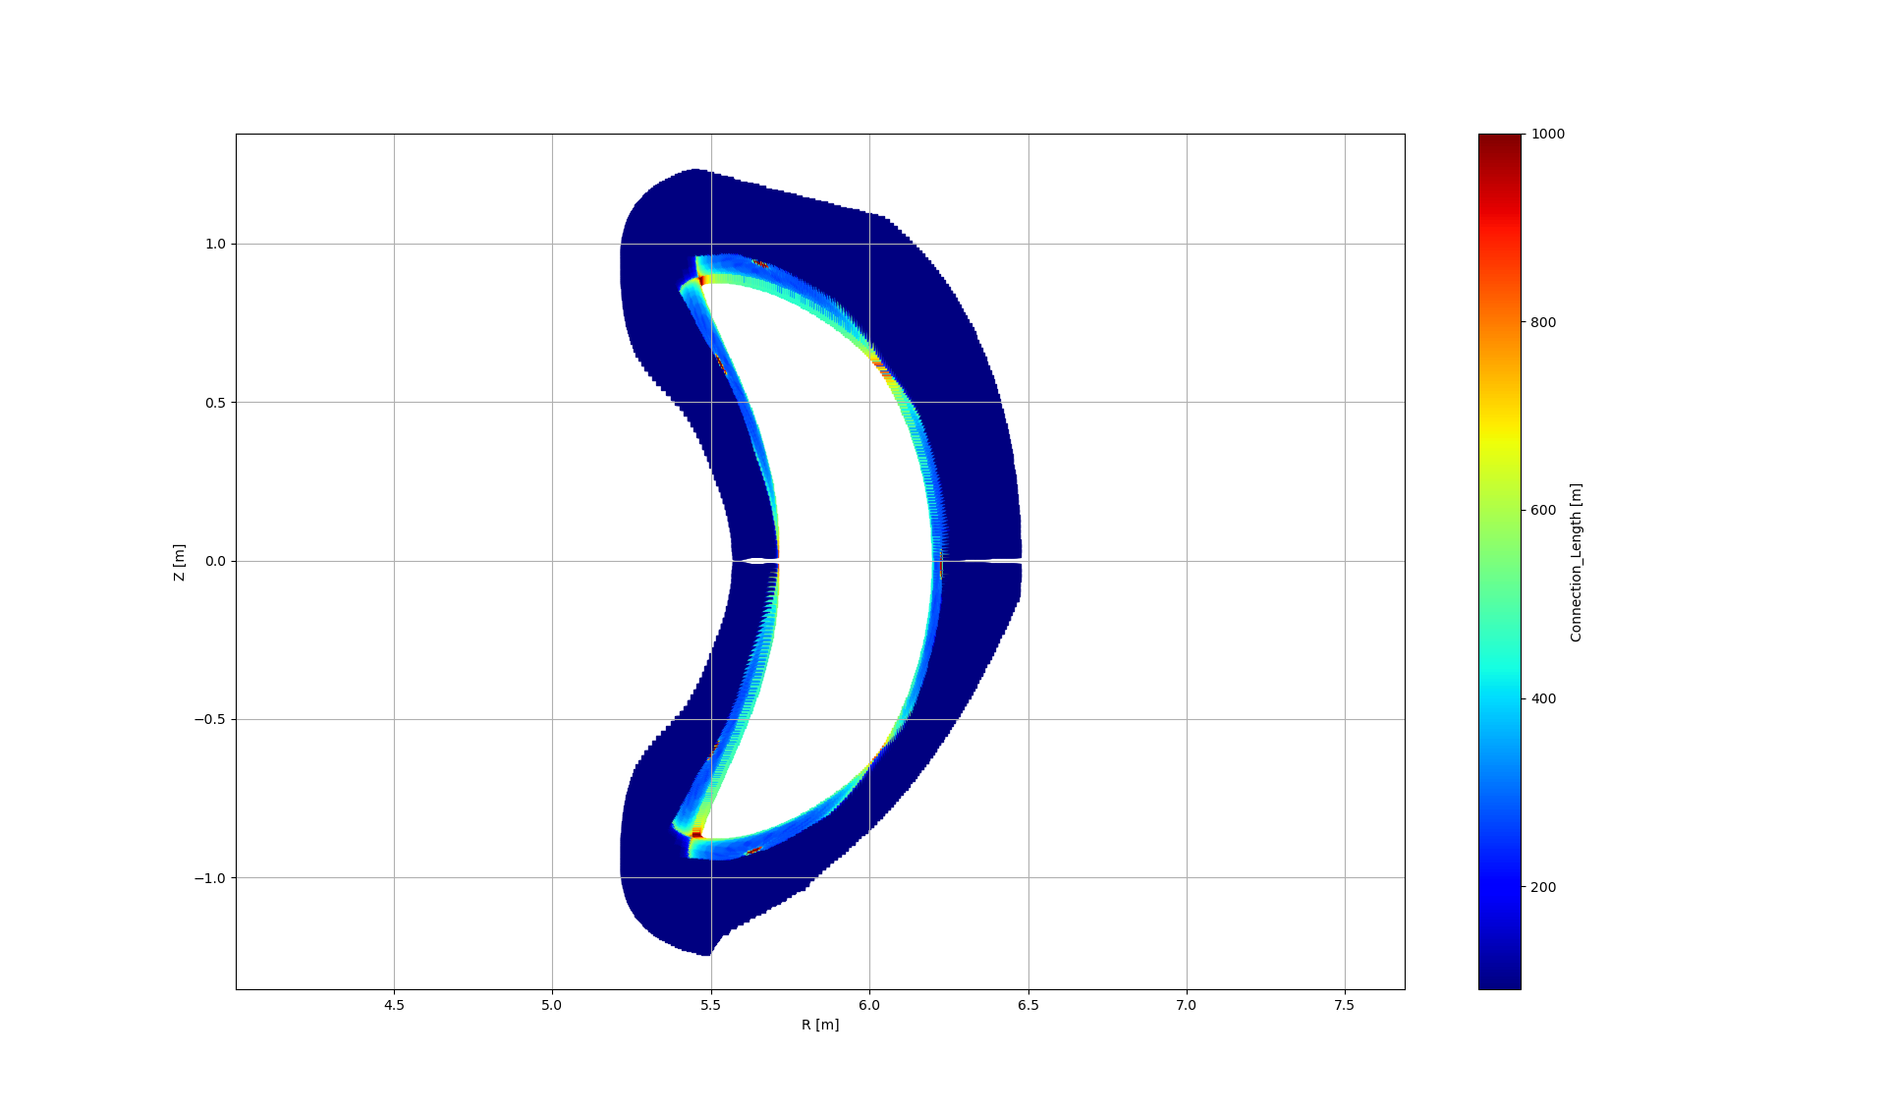
Identifying the points of interest
Find O-point of desired island
Notes:
Now lets jump into the next problem to be addressed : how to design a divertor
To not get lost in the large 3d design space, need a general framework
Leading idea is to leverage trajectories of stationary points of a given magnetic topology
Let’s take the example of the O-line class of divertors wherein we first locate the O-point and nearest LCMS point to build a basis vector
And eventually an island reference frame that moves with the island
Useful to create 3d shapes

Slide 28
Identifying the points of interest
Find O-point of desired island
Notes:
Now lets jump into the next problem to be addressed : how to design a divertor
To not get lost in the large 3d design space, need a general framework
Leading idea is to leverage trajectories of stationary points of a given magnetic topology
Let’s take the example of the O-line class of divertors wherein we first locate the O-point and nearest LCMS point to build a basis vector
And eventually an island reference frame that moves with the island
Useful to create 3d shapes

Slide 29
Identifying the points of interest
Find O-point of desired island
Find X-point_1
Notes:
Now lets jump into the next problem to be addressed : how to design a divertor
To not get lost in the large 3d design space, need a general framework
Leading idea is to leverage trajectories of stationary points of a given magnetic topology
Let’s take the example of the O-line class of divertors wherein we first locate the O-point and nearest LCMS point to build a basis vector
And eventually an island reference frame that moves with the island
Useful to create 3d shapes

Slide 30
Identifying the points of interest
Find O-point of desired island
Find X-point_1
Notes:
Now lets jump into the next problem to be addressed : how to design a divertor
To not get lost in the large 3d design space, need a general framework
Leading idea is to leverage trajectories of stationary points of a given magnetic topology
Let’s take the example of the O-line class of divertors wherein we first locate the O-point and nearest LCMS point to build a basis vector
And eventually an island reference frame that moves with the island
Useful to create 3d shapes

Slide 31
Identifying the points of interest
Find O-point of desired island
Find X-point_1
Find X-point_2
Notes:
Now lets jump into the next problem to be addressed : how to design a divertor
To not get lost in the large 3d design space, need a general framework
Leading idea is to leverage trajectories of stationary points of a given magnetic topology
Let’s take the example of the O-line class of divertors wherein we first locate the O-point and nearest LCMS point to build a basis vector
And eventually an island reference frame that moves with the island
Useful to create 3d shapes

Slide 32
Identifying the points of interest
Find O-point of desired island
Find X-point_1
Find X-point_2
Notes:
Now lets jump into the next problem to be addressed : how to design a divertor
To not get lost in the large 3d design space, need a general framework
Leading idea is to leverage trajectories of stationary points of a given magnetic topology
Let’s take the example of the O-line class of divertors wherein we first locate the O-point and nearest LCMS point to build a basis vector
And eventually an island reference frame that moves with the island
Useful to create 3d shapes

Slide 33
Constructing the divertor
Notes:
Now lets jump into the next problem to be addressed : how to design a divertor
To not get lost in the large 3d design space, need a general framework
Leading idea is to leverage trajectories of stationary points of a given magnetic topology
Let’s take the example of the O-line class of divertors wherein we first locate the O-point and nearest LCMS point to build a basis vector
And eventually an island reference frame that moves with the island
Useful to create 3d shapes

Slide 34
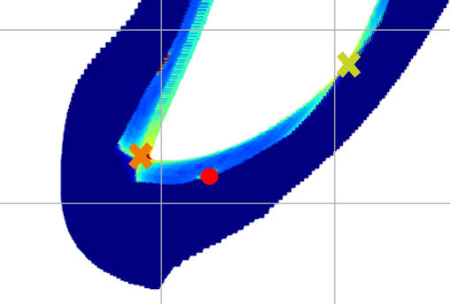
Constructing vectors
Construct vector
O-point - X-point_1
Notes:
Now lets jump into the next problem to be addressed : how to design a divertor
To not get lost in the large 3d design space, need a general framework
Leading idea is to leverage trajectories of stationary points of a given magnetic topology
Let’s take the example of the O-line class of divertors wherein we first locate the O-point and nearest LCMS point to build a basis vector
And eventually an island reference frame that moves with the island
Useful to create 3d shapes

Slide 35
Constructing vectors
Construct vector
O-point - X-point_1
Construct vector
O-point - X-point_2
Notes:
Now lets jump into the next problem to be addressed : how to design a divertor
To not get lost in the large 3d design space, need a general framework
Leading idea is to leverage trajectories of stationary points of a given magnetic topology
Let’s take the example of the O-line class of divertors wherein we first locate the O-point and nearest LCMS point to build a basis vector
And eventually an island reference frame that moves with the island
Useful to create 3d shapes

Slide 36
Constructing lower points
Finding vector 3:
Constructing average vector of the normalized vectors
Notes:
Now lets jump into the next problem to be addressed : how to design a divertor
To not get lost in the large 3d design space, need a general framework
Leading idea is to leverage trajectories of stationary points of a given magnetic topology
Let’s take the example of the O-line class of divertors wherein we first locate the O-point and nearest LCMS point to build a basis vector
And eventually an island reference frame that moves with the island
Useful to create 3d shapes

Slide 37
Constructing lower points
Finding vector 3:
Constructing average vector of the normalized vectors
Reflecting it
Notes:
Now lets jump into the next problem to be addressed : how to design a divertor
To not get lost in the large 3d design space, need a general framework
Leading idea is to leverage trajectories of stationary points of a given magnetic topology
Let’s take the example of the O-line class of divertors wherein we first locate the O-point and nearest LCMS point to build a basis vector
And eventually an island reference frame that moves with the island
Useful to create 3d shapes

Slide 38
Constructing lower points
Finding point 3:
Along vector 3
Notes:
Now lets jump into the next problem to be addressed : how to design a divertor
To not get lost in the large 3d design space, need a general framework
Leading idea is to leverage trajectories of stationary points of a given magnetic topology
Let’s take the example of the O-line class of divertors wherein we first locate the O-point and nearest LCMS point to build a basis vector
And eventually an island reference frame that moves with the island
Useful to create 3d shapes

Slide 39
Constructing lower points
Notes:
Now lets jump into the next problem to be addressed : how to design a divertor
To not get lost in the large 3d design space, need a general framework
Leading idea is to leverage trajectories of stationary points of a given magnetic topology
Let’s take the example of the O-line class of divertors wherein we first locate the O-point and nearest LCMS point to build a basis vector
And eventually an island reference frame that moves with the island
Useful to create 3d shapes

Slide 40
Tracing the points in the W7-X Webservices
trace (PoincareInPhiPlane):
4 points traced in n planes
Points are offset along the poloidal rotation vector by a certain distance determined by the desired incidence angle

Slide 41
Constructing lower points
Φ1
Notes:
Now lets jump into the next problem to be addressed : how to design a divertor
To not get lost in the large 3d design space, need a general framework
Leading idea is to leverage trajectories of stationary points of a given magnetic topology
Let’s take the example of the O-line class of divertors wherein we first locate the O-point and nearest LCMS point to build a basis vector
And eventually an island reference frame that moves with the island
Useful to create 3d shapes

Slide 42
Constructing lower points
Φ2
Notes:
Now lets jump into the next problem to be addressed : how to design a divertor
To not get lost in the large 3d design space, need a general framework
Leading idea is to leverage trajectories of stationary points of a given magnetic topology
Let’s take the example of the O-line class of divertors wherein we first locate the O-point and nearest LCMS point to build a basis vector
And eventually an island reference frame that moves with the island
Useful to create 3d shapes

Slide 43
W7-X islands, standard configuration
Measure of toroidal procession Φ
Measure of poloidal procession θ*
Notes:
Now lets jump into the next problem to be addressed : how to design a divertor
To not get lost in the large 3d design space, need a general framework
Leading idea is to leverage trajectories of stationary points of a given magnetic topology
Let’s take the example of the O-line class of divertors wherein we first locate the O-point and nearest LCMS point to build a basis vector
And eventually an island reference frame that moves with the island
Useful to create 3d shapes

Slide 44
W7-X islands, standard configuration
Measure of toroidal procession Φ
Φ2
Φ1
Measure of poloidal procession θ*
Notes:
Now lets jump into the next problem to be addressed : how to design a divertor
To not get lost in the large 3d design space, need a general framework
Leading idea is to leverage trajectories of stationary points of a given magnetic topology
Let’s take the example of the O-line class of divertors wherein we first locate the O-point and nearest LCMS point to build a basis vector
And eventually an island reference frame that moves with the island
Useful to create 3d shapes

Slide 45
W7-X islands, standard configuration
Measure of toroidal procession Φ
Measure of poloidal procession θ*
Notes:
Now lets jump into the next problem to be addressed : how to design a divertor
To not get lost in the large 3d design space, need a general framework
Leading idea is to leverage trajectories of stationary points of a given magnetic topology
Let’s take the example of the O-line class of divertors wherein we first locate the O-point and nearest LCMS point to build a basis vector
And eventually an island reference frame that moves with the island
Useful to create 3d shapes

Slide 46
W7-X islands, standard configuration
Measure of toroidal procession Φ
Measure of poloidal procession θ*
Notes:
Now lets jump into the next problem to be addressed : how to design a divertor
To not get lost in the large 3d design space, need a general framework
Leading idea is to leverage trajectories of stationary points of a given magnetic topology
Let’s take the example of the O-line class of divertors wherein we first locate the O-point and nearest LCMS point to build a basis vector
And eventually an island reference frame that moves with the island
Useful to create 3d shapes

Slide 47
W7-X islands, standard configuration
Measure of toroidal procession Φ
We assume a right triangle ➔ trigonometry
$$opposite=adjacent ∗tan⁡(α)$$
Measure of poloidal procession θ*
Notes:
Now lets jump into the next problem to be addressed : how to design a divertor
To not get lost in the large 3d design space, need a general framework
Leading idea is to leverage trajectories of stationary points of a given magnetic topology
Let’s take the example of the O-line class of divertors wherein we first locate the O-point and nearest LCMS point to build a basis vector
And eventually an island reference frame that moves with the island
Useful to create 3d shapes

Slide 48
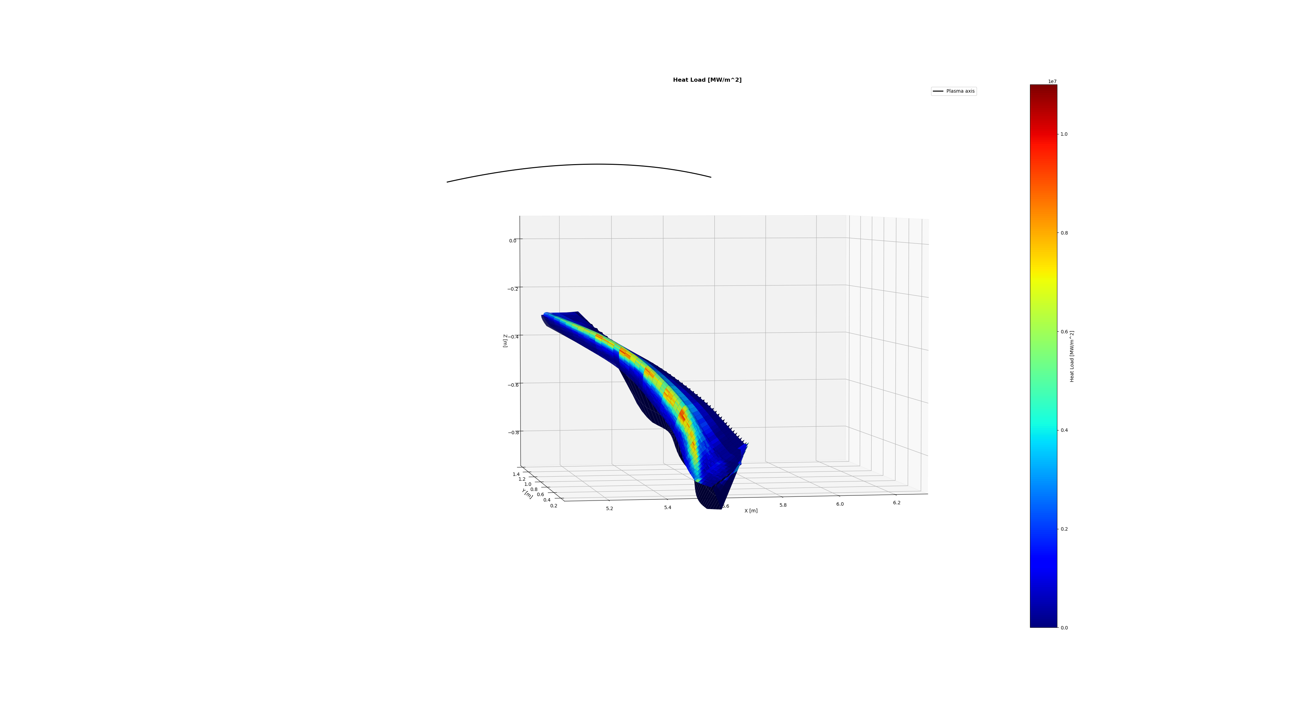
Example target, designed for Standard configuration
Surfaces over 10 MW/m²
No
Collected particles
89%
Plotted metric
Heat flux

Slide 49
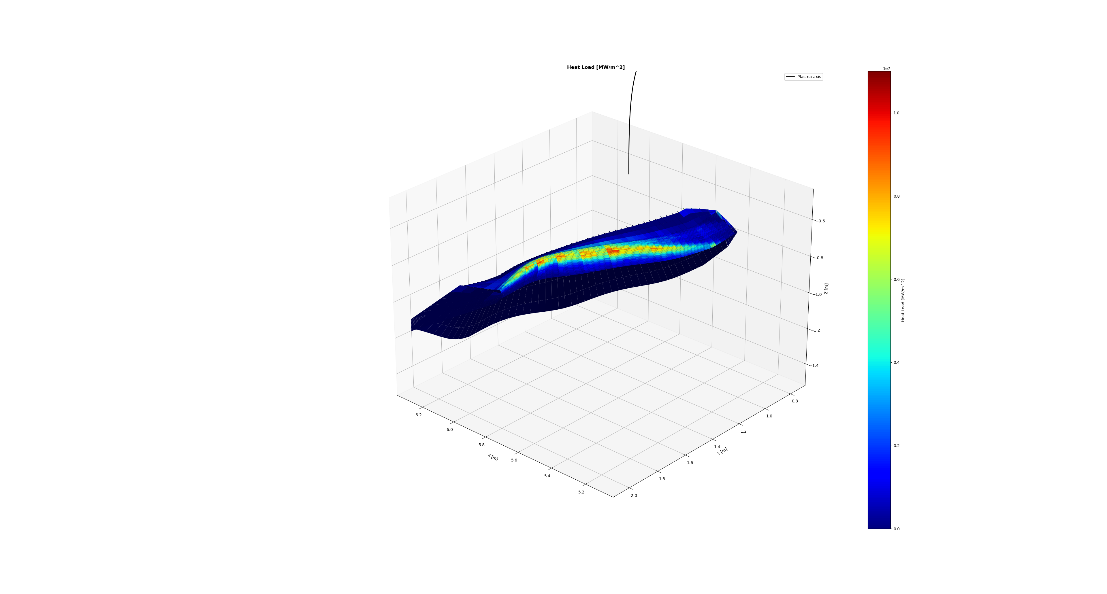
Example target, designed for Standard configuration
Surfaces over 10 MW/m²
No
Collected particles
89%
Plotted metric
Heat flux

Slide 50
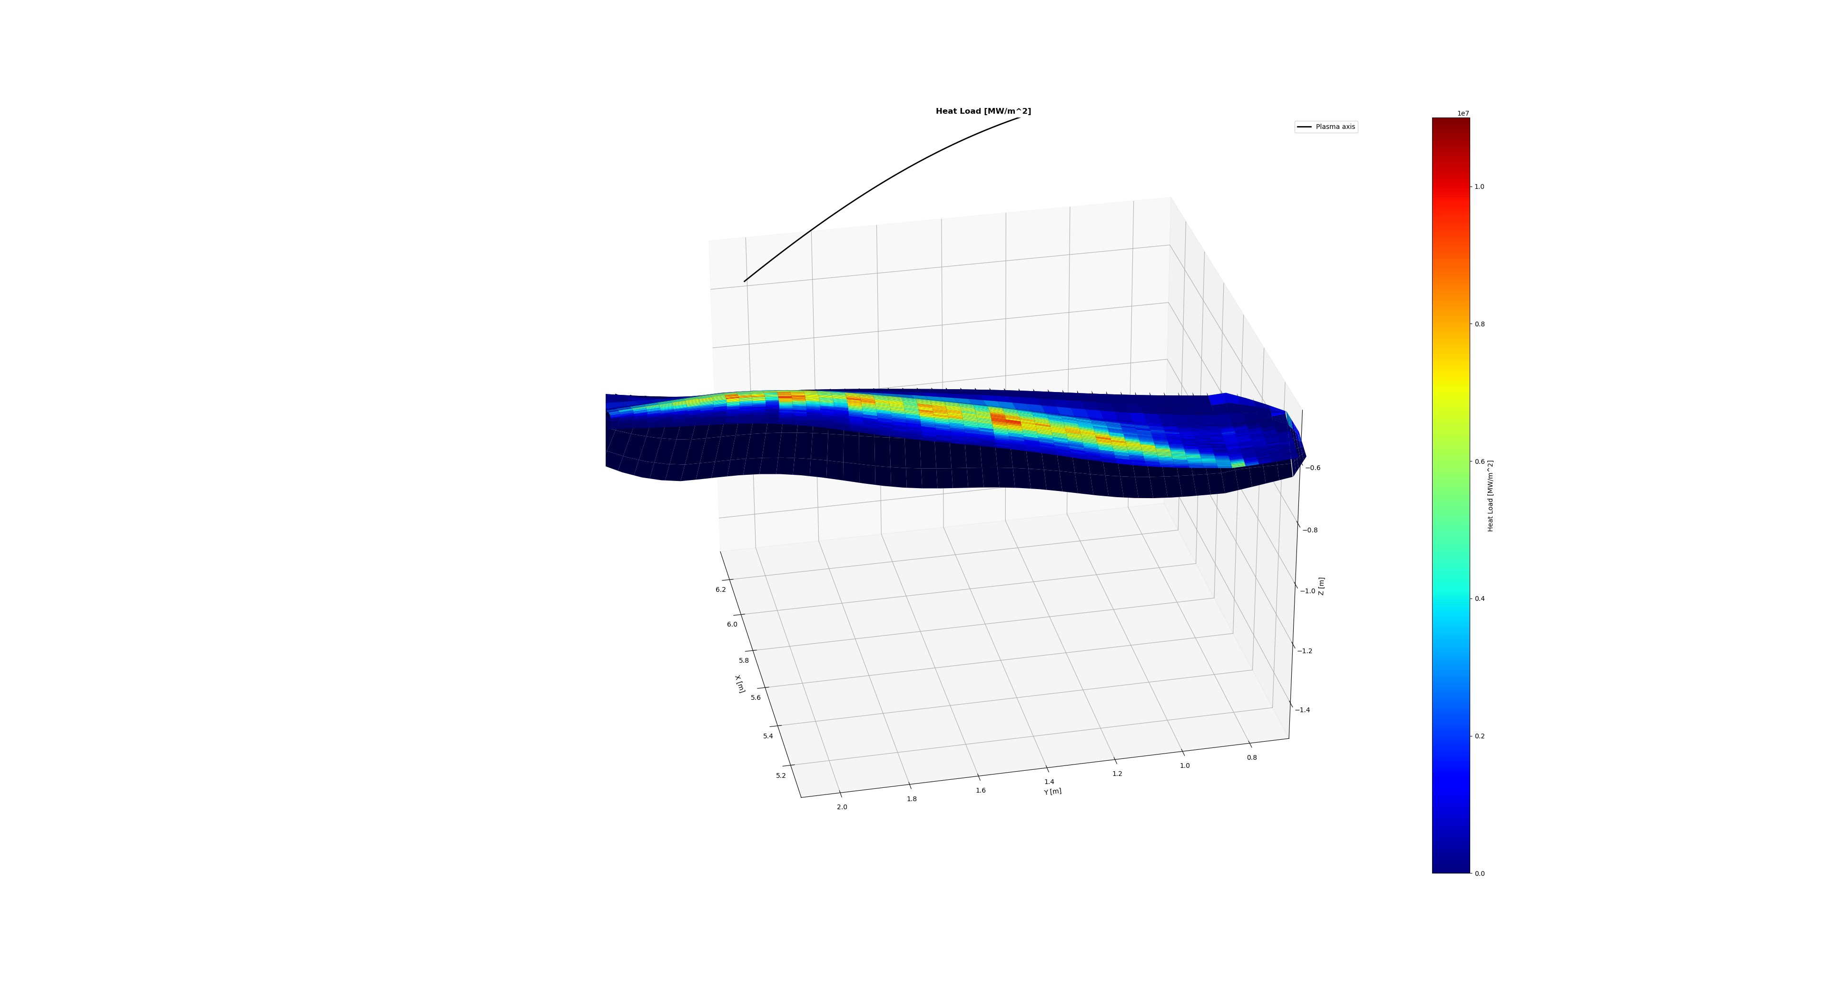
Example target, designed for Standard configuration
Surfaces over 10 MW/m²
No
Collected particles
89%
Plotted metric
Heat flux

Slide 51
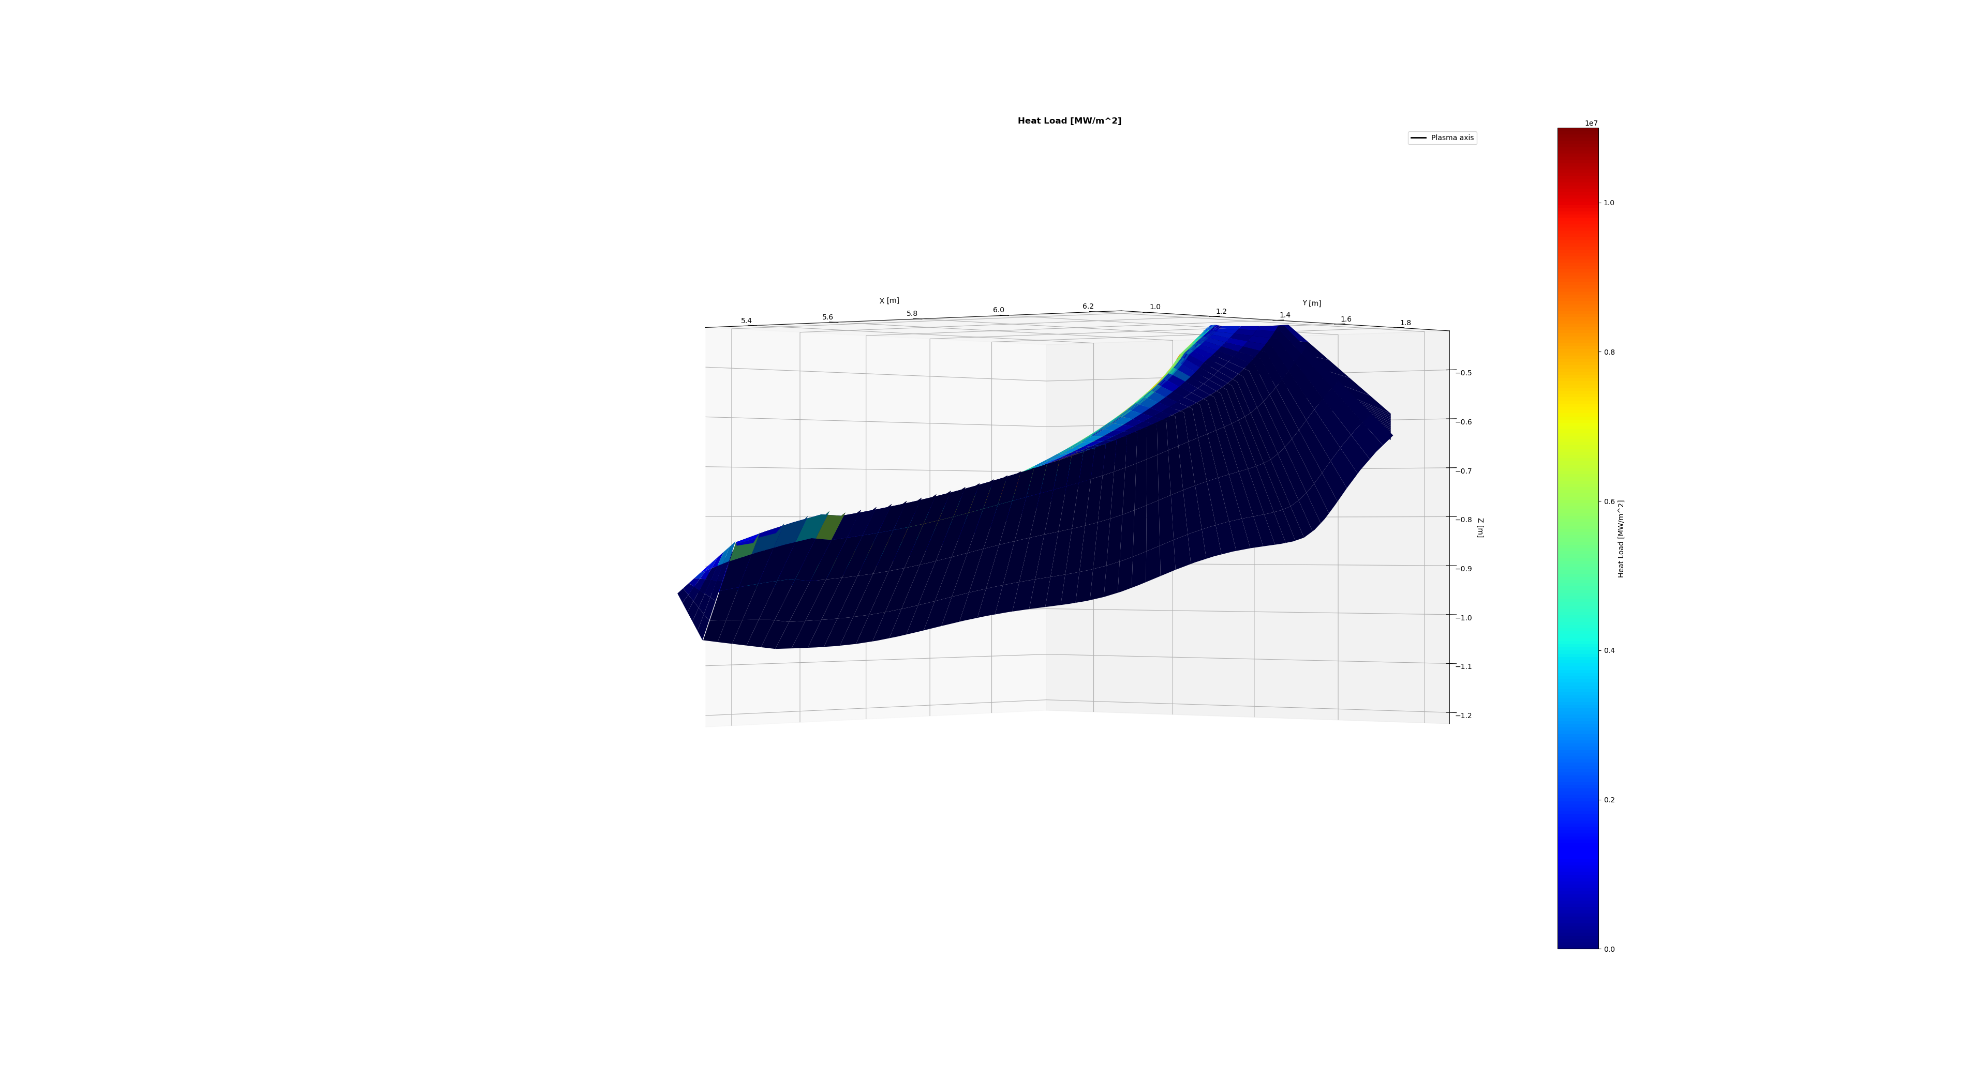
Example target, designed for Standard configuration
Surfaces over 10 MW/m²
No
Collected particles
89%
Plotted metric
Heat flux

Slide 52
W7-X islands, standard configuration
Measure of toroidal procession Φ
Notes:
Now lets jump into the next problem to be addressed : how to design a divertor
To not get lost in the large 3d design space, need a general framework
Leading idea is to leverage trajectories of stationary points of a given magnetic topology
Let’s take the example of the O-line class of divertors wherein we first locate the O-point and nearest LCMS point to build a basis vector
And eventually an island reference frame that moves with the island
Useful to create 3d shapes

Slide 53
W7-X islands, standard configuration
Measure of toroidal procession Φ
Notes:
Now lets jump into the next problem to be addressed : how to design a divertor
To not get lost in the large 3d design space, need a general framework
Leading idea is to leverage trajectories of stationary points of a given magnetic topology
Let’s take the example of the O-line class of divertors wherein we first locate the O-point and nearest LCMS point to build a basis vector
And eventually an island reference frame that moves with the island
Useful to create 3d shapes

Slide 54
W7-X islands, standard configuration
Measure of toroidal procession Φ
Notes:
Now lets jump into the next problem to be addressed : how to design a divertor
To not get lost in the large 3d design space, need a general framework
Leading idea is to leverage trajectories of stationary points of a given magnetic topology
Let’s take the example of the O-line class of divertors wherein we first locate the O-point and nearest LCMS point to build a basis vector
And eventually an island reference frame that moves with the island
Useful to create 3d shapes

Slide 55
W7-X islands, standard configuration
Measure of toroidal procession Φ
Notes:
Now lets jump into the next problem to be addressed : how to design a divertor
To not get lost in the large 3d design space, need a general framework
Leading idea is to leverage trajectories of stationary points of a given magnetic topology
Let’s take the example of the O-line class of divertors wherein we first locate the O-point and nearest LCMS point to build a basis vector
And eventually an island reference frame that moves with the island
Useful to create 3d shapes

Slide 56
W7-X islands, standard configuration
Measure of toroidal procession Φ
Notes:
Now lets jump into the next problem to be addressed : how to design a divertor
To not get lost in the large 3d design space, need a general framework
Leading idea is to leverage trajectories of stationary points of a given magnetic topology
Let’s take the example of the O-line class of divertors wherein we first locate the O-point and nearest LCMS point to build a basis vector
And eventually an island reference frame that moves with the island
Useful to create 3d shapes

Slide 57
W7-X islands, standard configuration
Measure of toroidal procession Φ
Notes:
Now lets jump into the next problem to be addressed : how to design a divertor
To not get lost in the large 3d design space, need a general framework
Leading idea is to leverage trajectories of stationary points of a given magnetic topology
Let’s take the example of the O-line class of divertors wherein we first locate the O-point and nearest LCMS point to build a basis vector
And eventually an island reference frame that moves with the island
Useful to create 3d shapes

Slide 58
W7-X islands, standard configuration
Measure of toroidal procession Φ
Notes:
Now lets jump into the next problem to be addressed : how to design a divertor
To not get lost in the large 3d design space, need a general framework
Leading idea is to leverage trajectories of stationary points of a given magnetic topology
Let’s take the example of the O-line class of divertors wherein we first locate the O-point and nearest LCMS point to build a basis vector
And eventually an island reference frame that moves with the island
Useful to create 3d shapes

Slide 59
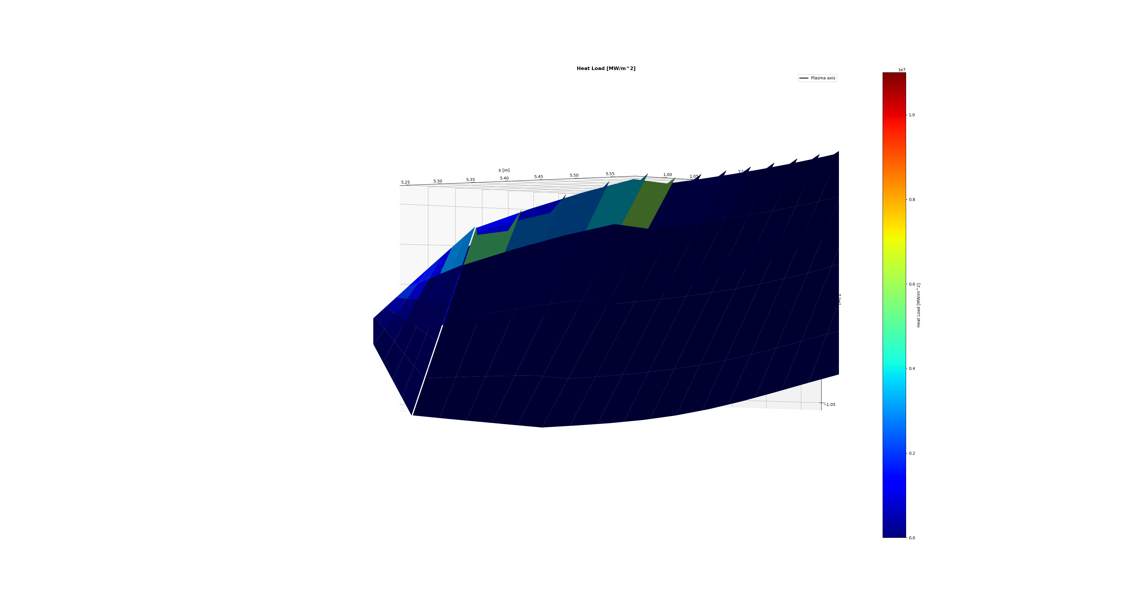
Example target, designed for Standard configuration
Surfaces over 10 MW/m²
No
Collected particles
89%
Plotted metric
Heat flux

Slide 60
Example target, designed for Standard configuration
Surfaces over 10 MW/m²
No
Collected particles
89%
Plotted metric
Incidence angle

Slide 61
Example target, designed for Standard configuration
Surfaces over 10 MW/m²
No
Collected particles
89%
Plotted metric
Incidence angle

Slide 62
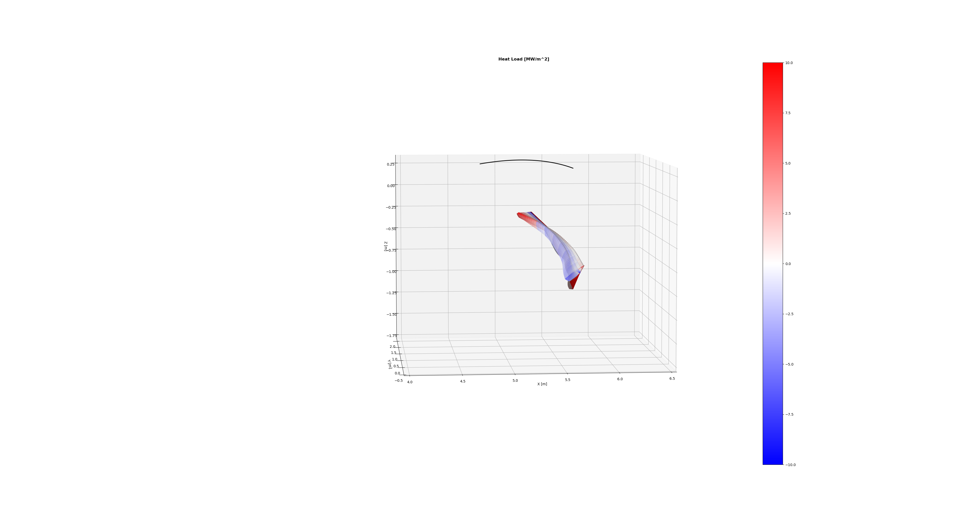
Example target, designed for Standard configuration
Surfaces over 10 MW/m²
No
Collected particles
89%
Plotted metric
Incidence angle

Slide 63
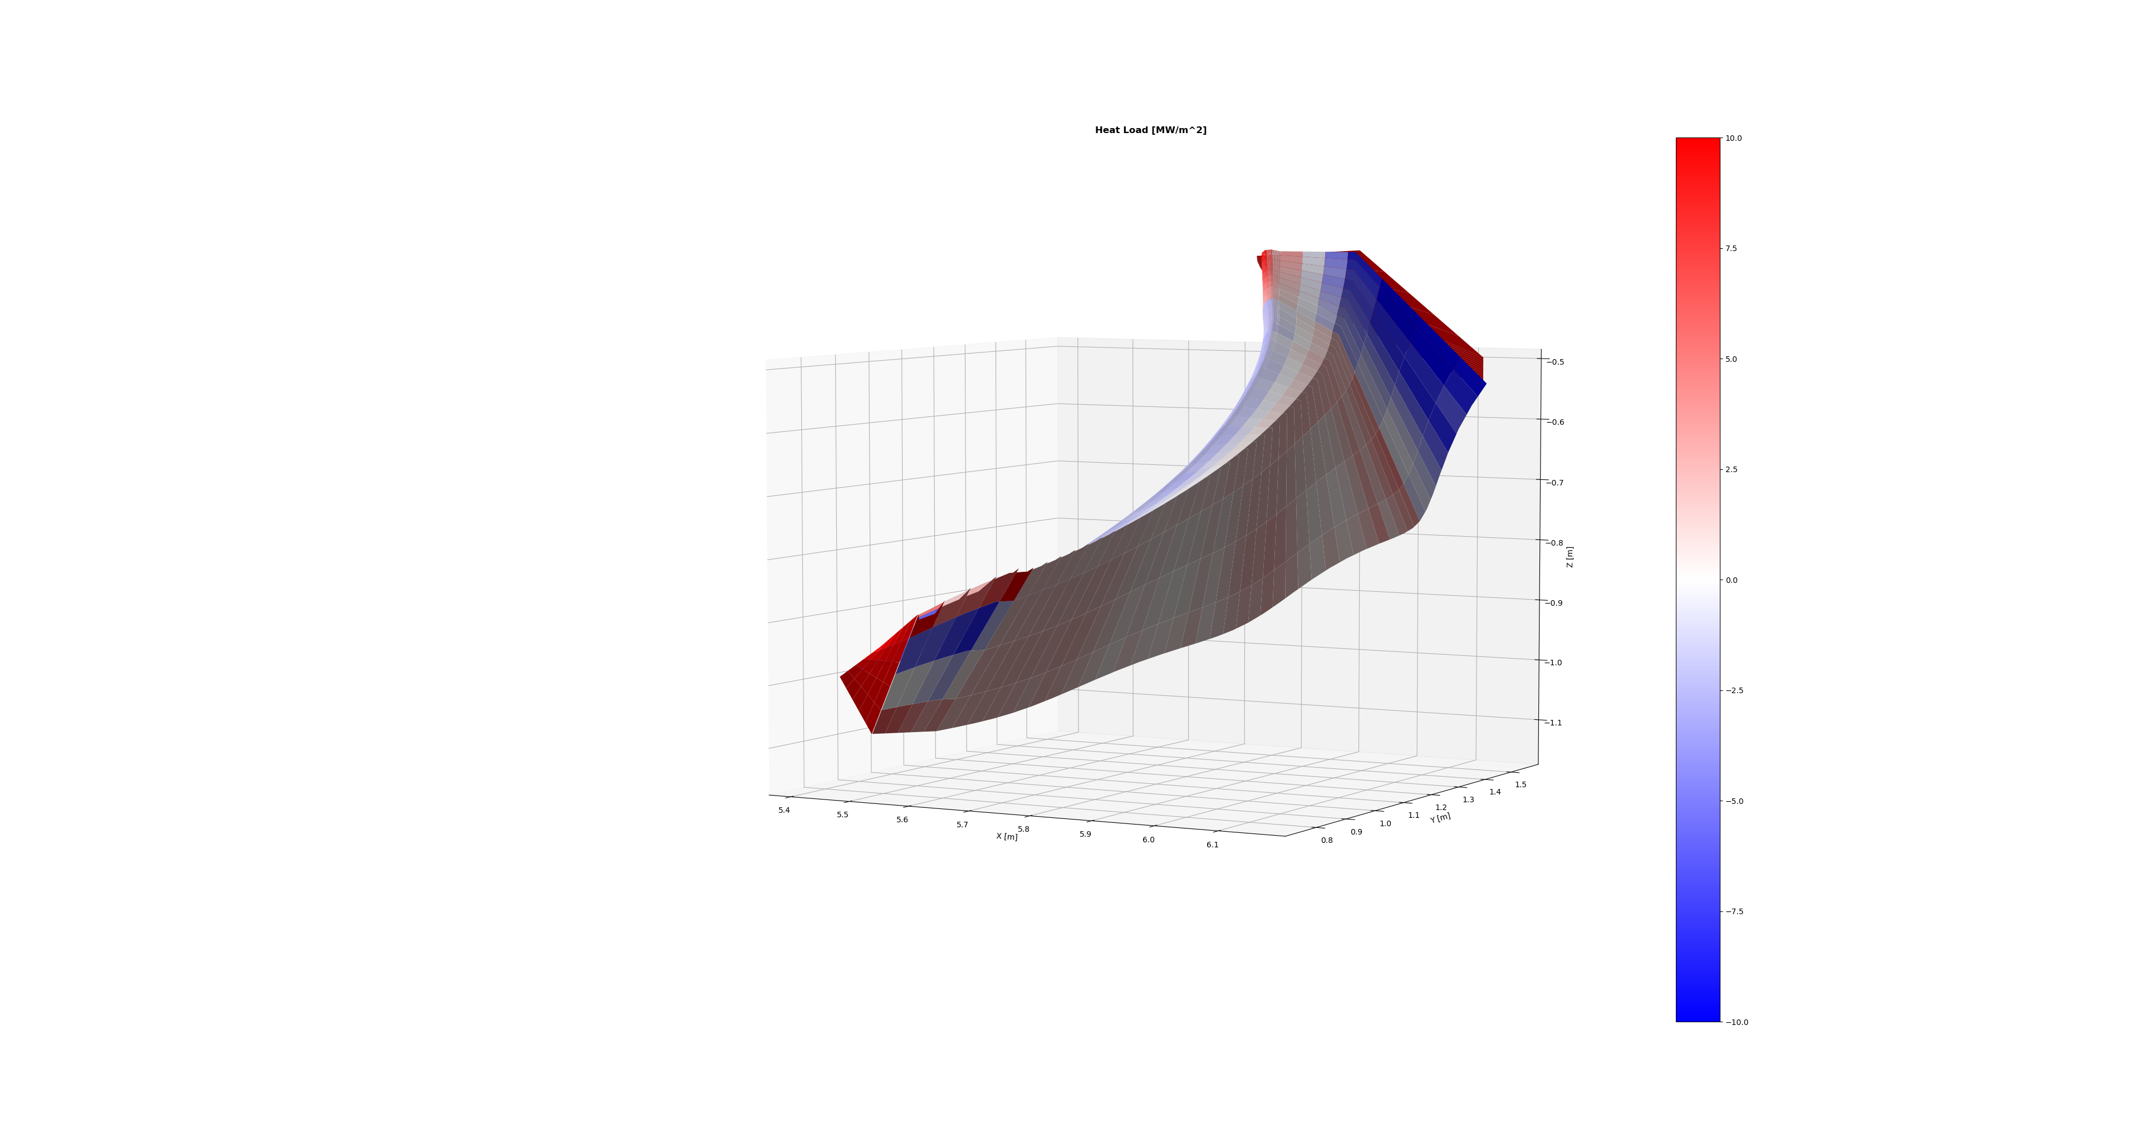
Example target, designed for Standard configuration
Surfaces over 10 MW/m²
No
Collected particles
89%
Plotted metric
Incidence angle

Slide 64
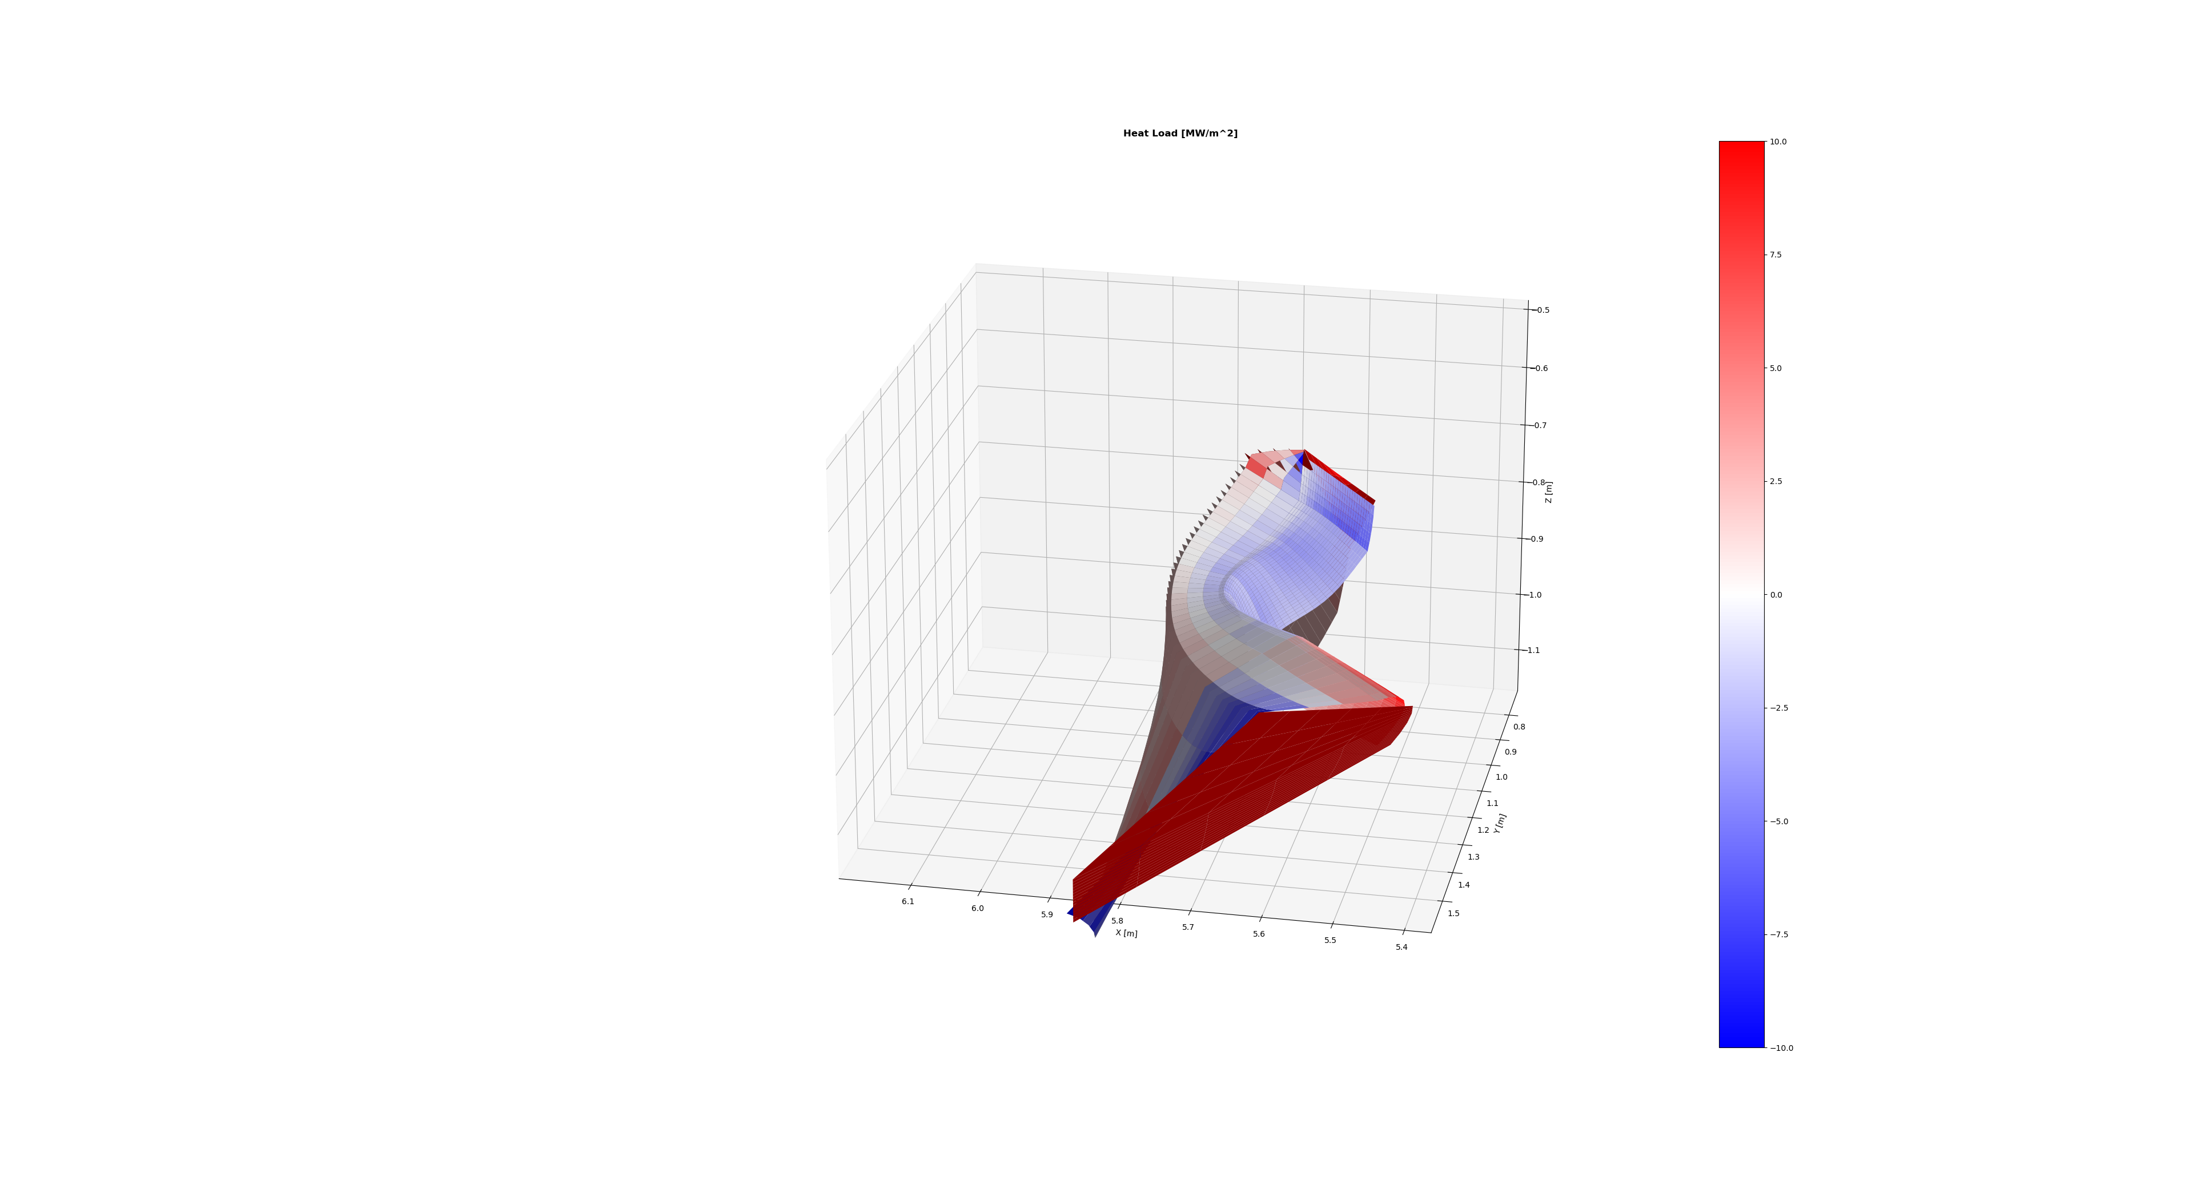
Example target, designed for Standard configuration
Surfaces over 10 MW/m²
No
Collected particles
89%
Plotted metric
Incidence angle

Slide 65
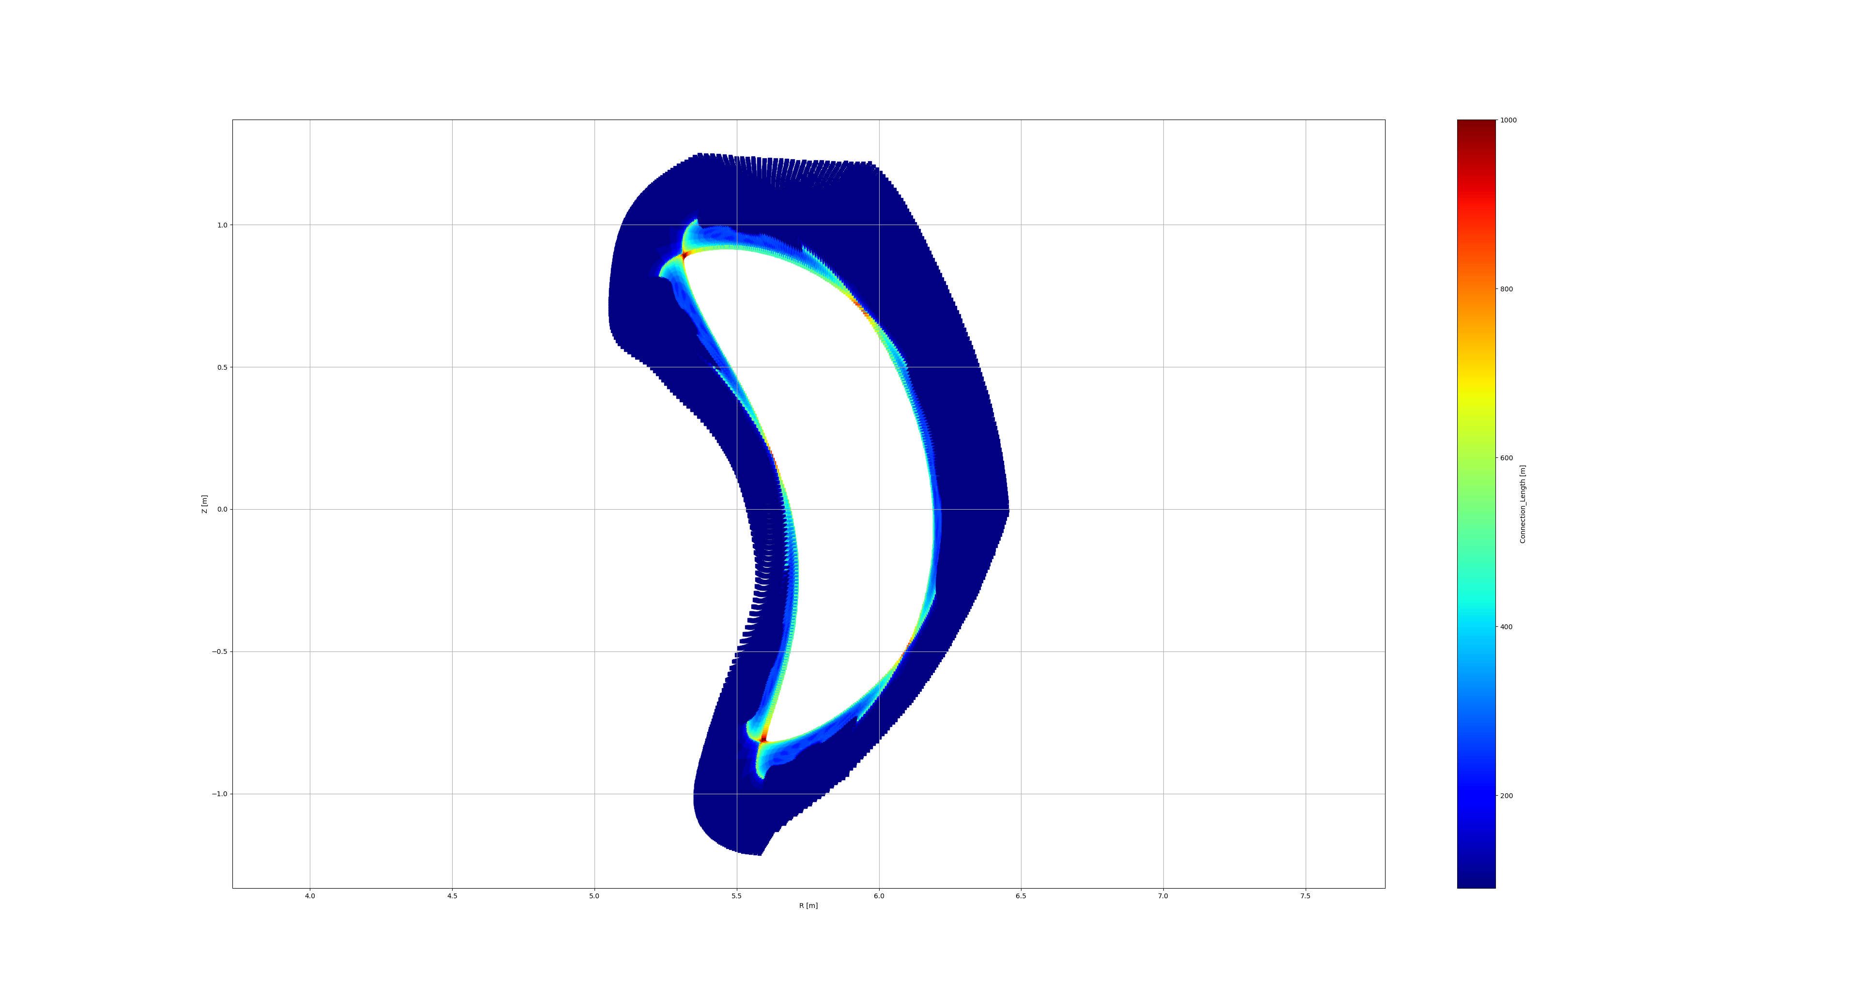
Example target, designed for Standard configuration
Surfaces over 10 MW/m²
No
Collected particles
89%
Plotted metric
Connection length
Toroidal angle
5°

Slide 66
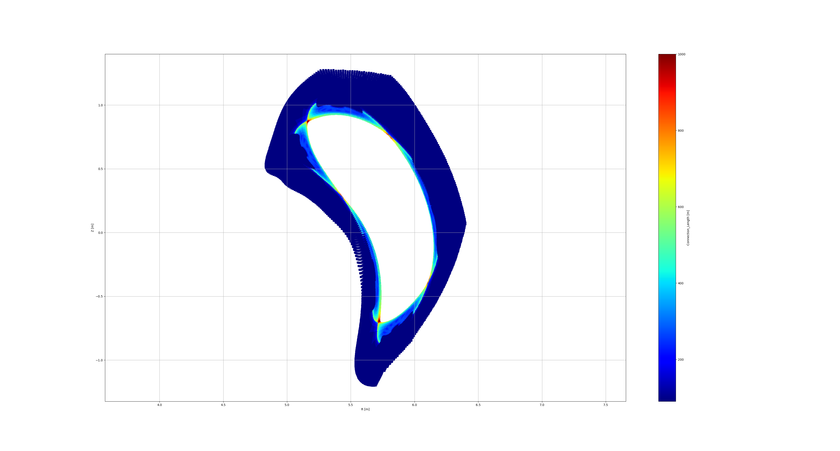
Example target, designed for Standard configuration
Surfaces over 10 MW/m²
No
Collected particles
89%
Plotted metric
Connection length
Toroidal angle
10°

Slide 67
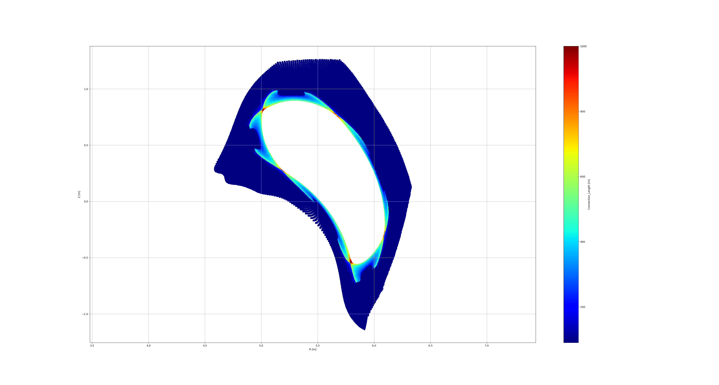
Example target, designed for Standard configuration
Surfaces over 10 MW/m²
No
Collected particles
89%
Plotted metric
Connection length
Toroidal angle
15°

Slide 68
Example target, designed for Standard configuration
Surfaces over 10 MW/m²
No
Collected particles
89%
Plotted metric
Connection length
Toroidal angle
15°

Slide 69
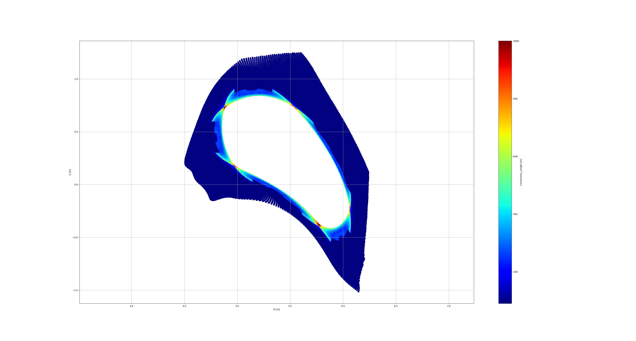
Example target, designed for Standard configuration
Surfaces over 10 MW/m²
No
Collected particles
89%
Plotted metric
Connection length
Toroidal angle
20°

Slide 70
Example target, designed for Standard configuration
Surfaces over 10 MW/m²
No
Collected particles
89%
Plotted metric
Connection length
Toroidal angle
25°

Slide 71
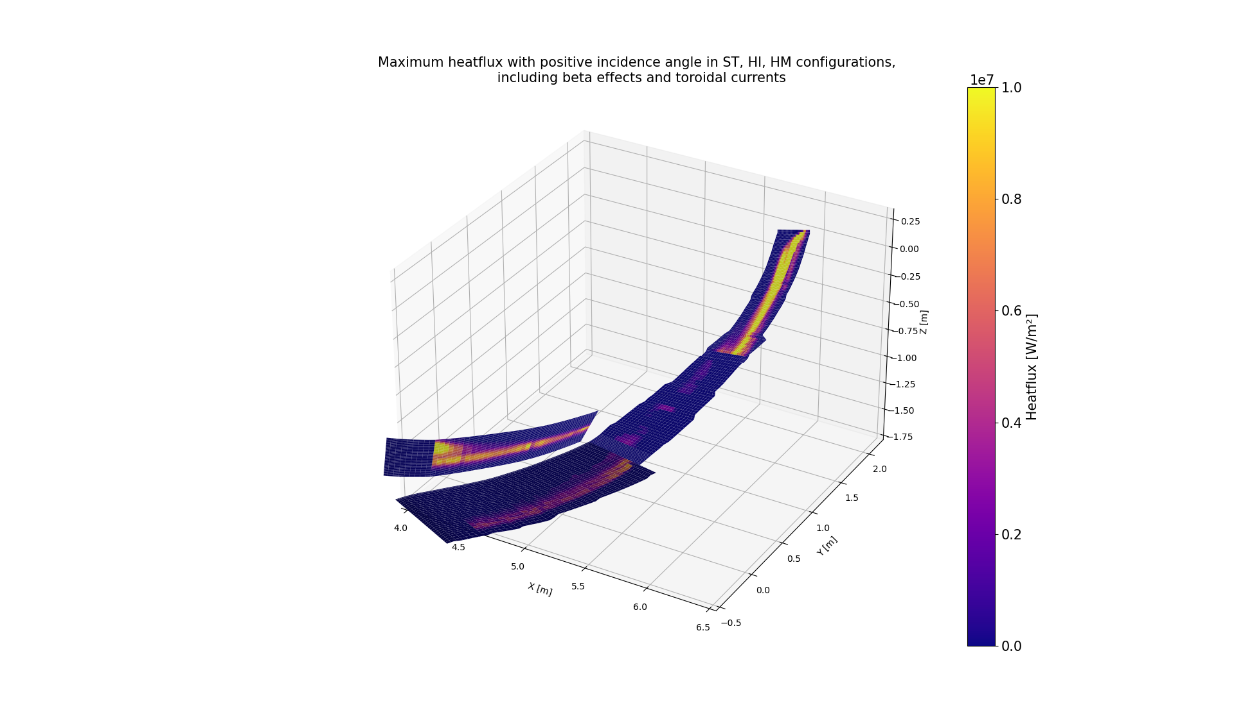
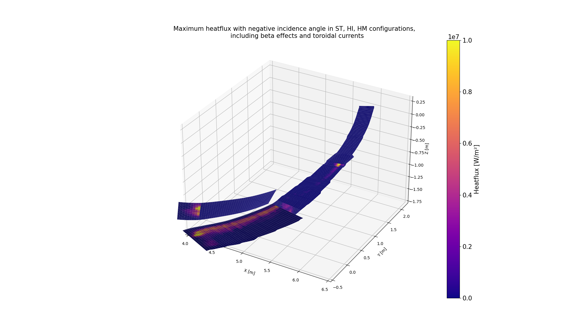
Multiple configurations?

Slide 72
Example target, designed for Standard configuration
Configuration
Standard
Surfaces over 10 MW/m²
No
Collected particles
89%
Plotted metric
Heat flux

Slide 73
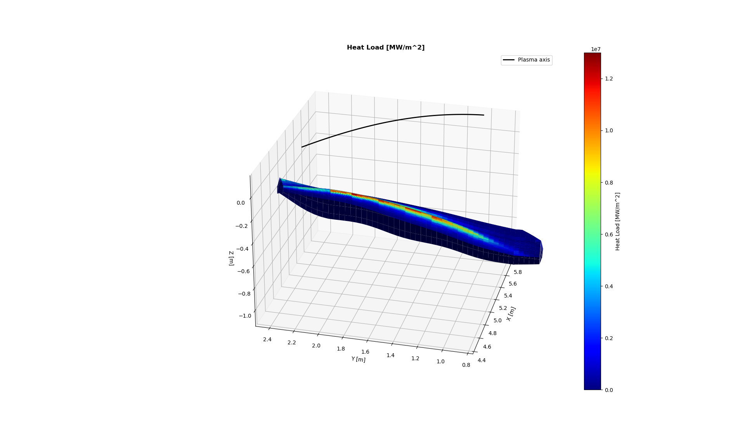
Example target, designed for Standard configuration
Configuration
High-Mirror
Surfaces over 10 MW/m²
Yes
Collected particles
90%
Plotted metric
Heat flux

Slide 74
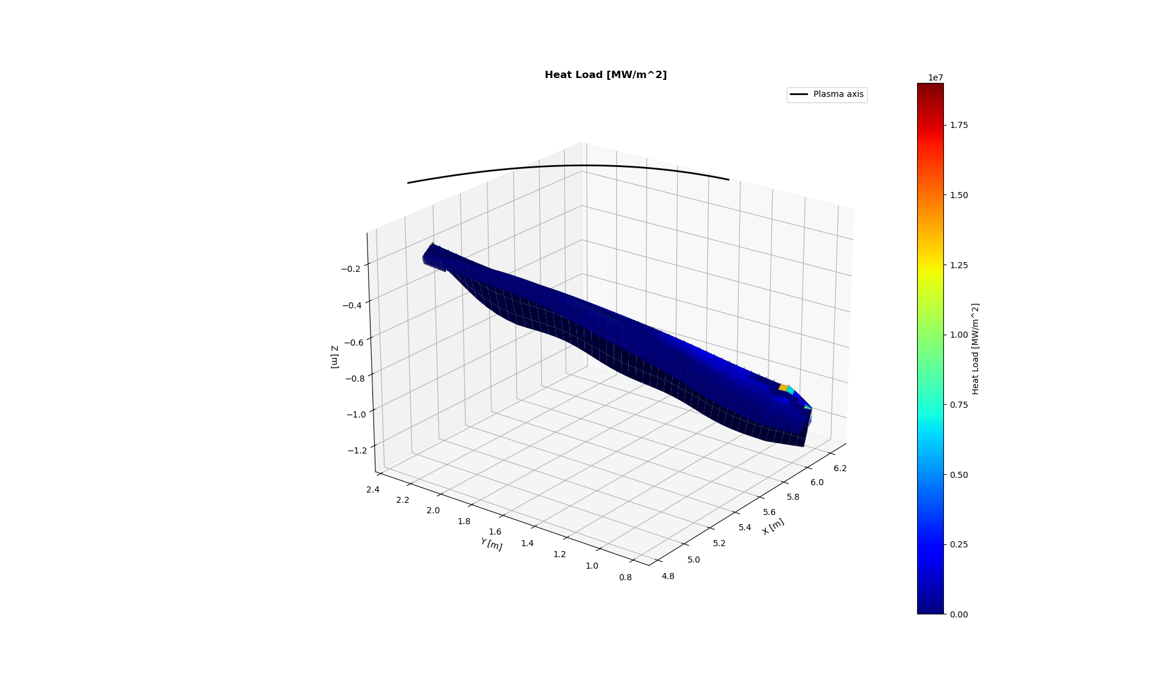
Example target, designed for Standard configuration
Configuration
High-Iota
Surfaces over 10 MW/m²
Yes
Collected particles
70%
Plotted metric
Heat flux

Slide 75
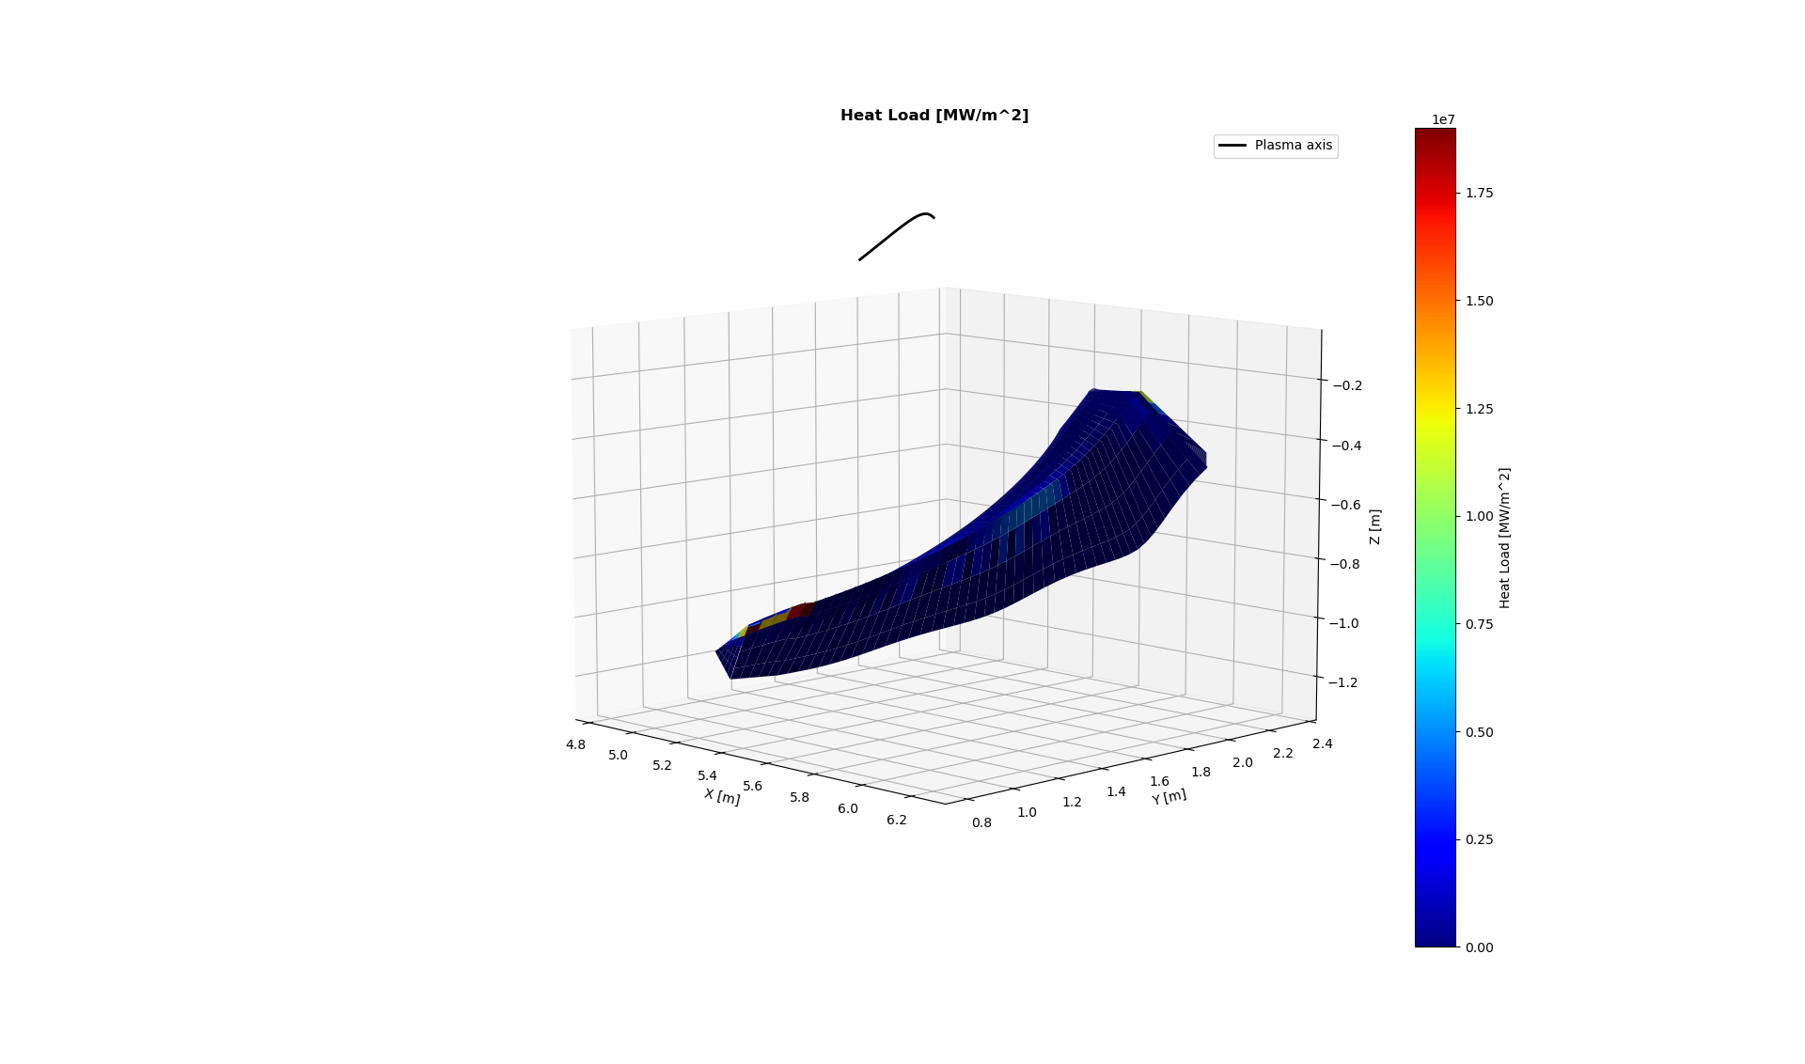
Example target, designed for Standard configuration
Configuration
High-Iota
Surfaces over 10 MW/m²
Yes
Collected particles
70%
Plotted metric
Heat flux

Slide 76
Example target, designed for Standard configuration
Standard
Surfaces over 10 MW/m²
No
Collected particles
89%
Plotted metric
Incidence angle

Slide 77
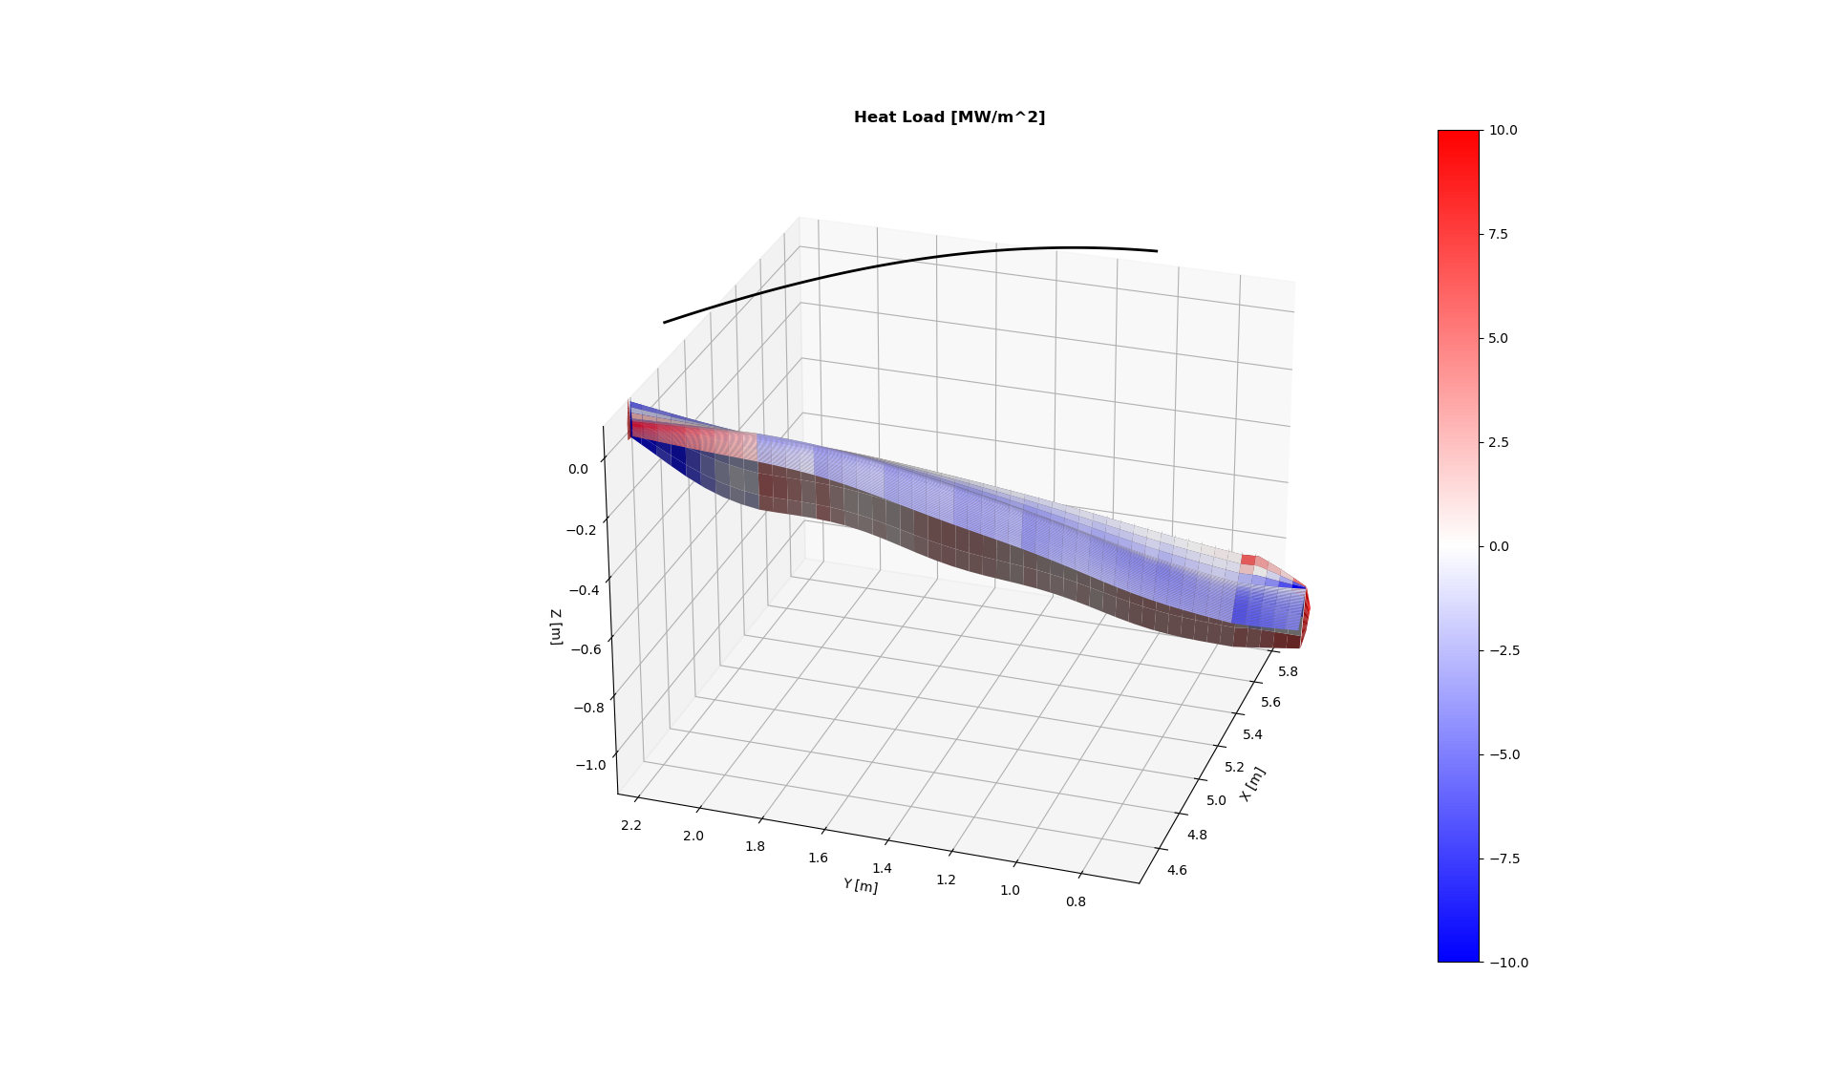
Example target, designed for Standard configuration
High-Mirror
Surfaces over 10 MW/m²
No
Collected particles
89%
Plotted metric
Incidence angle

Slide 78
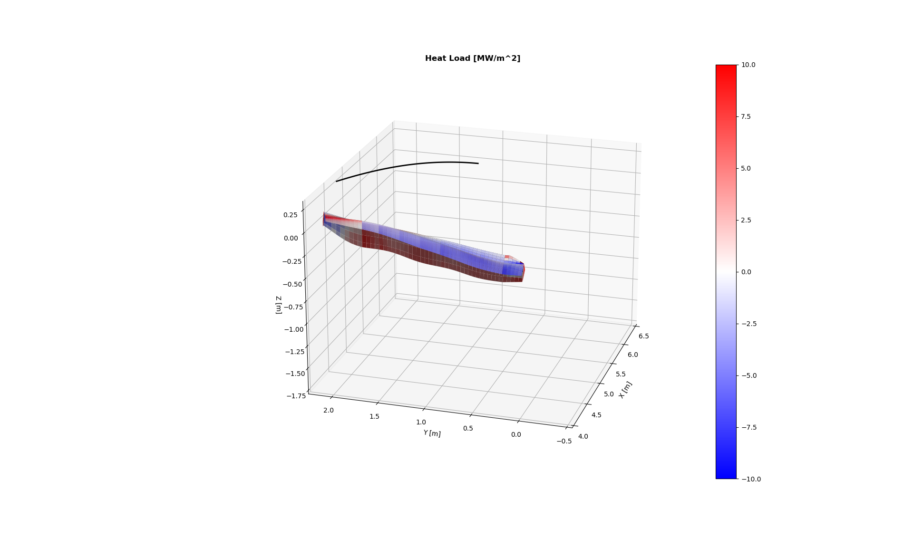
Example target, designed for Standard configuration
High-Iota
Surfaces over 10 MW/m²
No
Collected particles
89%
Plotted metric
Incidence angle

Slide 79
Example target, designed for Standard configuration
Standard
Surfaces over 10 MW/m²
No
Collected particles
89%
Plotted metric
Connection length
Toroidal angle
15°

Slide 80
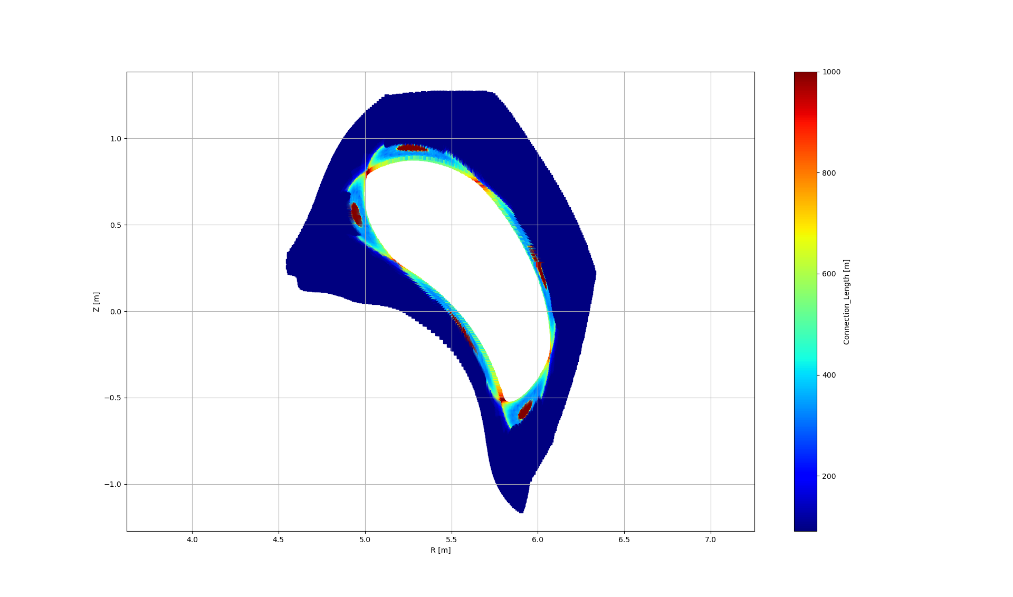
Example target, designed for Standard configuration
High-Mirror
Surfaces over 10 MW/m²
Yes
Collected particles
90%
Plotted metric
Connection length
Toroidal angle
15°

Slide 81
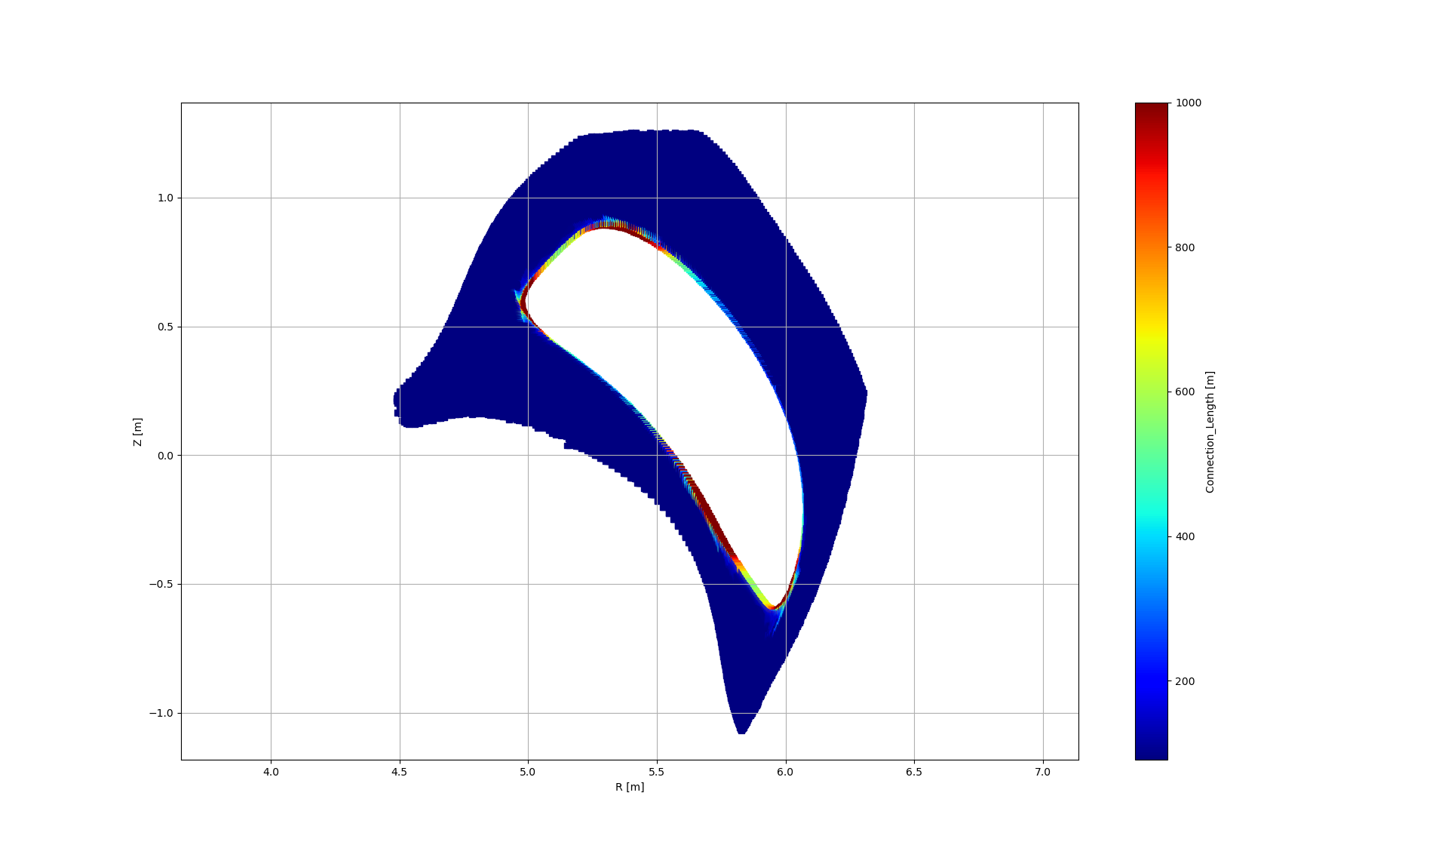
Example target, designed for Standard configuration
High-Iota
Surfaces over 10 MW/m²
Yes
Collected particles
70%
Plotted metric
Connection length
Toroidal angle
15°

Slide 82
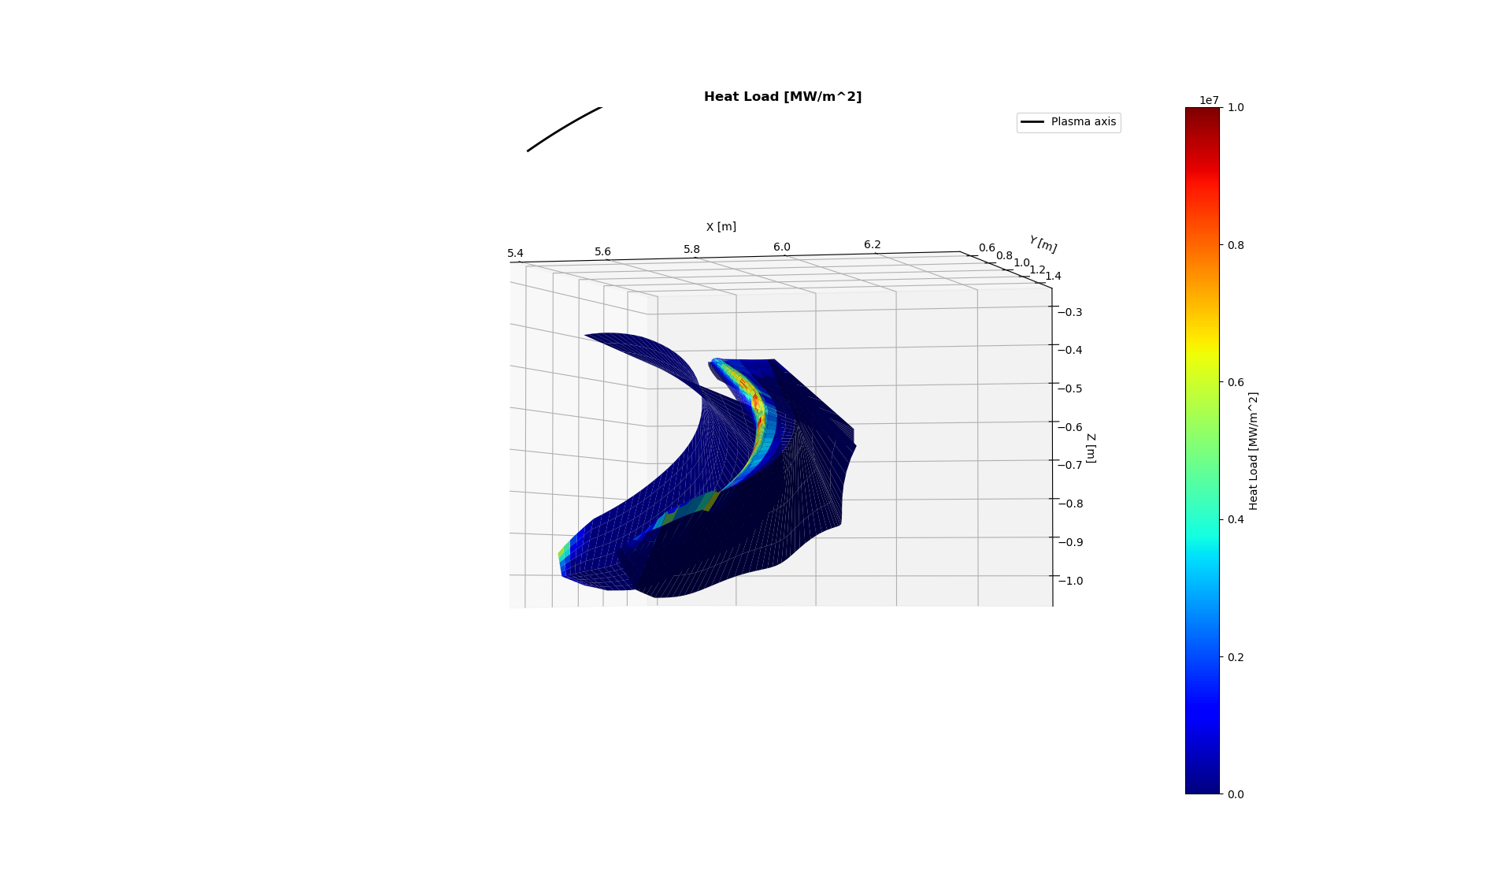
Example target, designed for Standard configuration
Standard
Surfaces over 10 MW/m²
No
Collected particles
89%
Plotted metric
Heat flux

Slide 83
Example target, designed for Standard configuration
Surfaces over 10 MW/m²
No
Collected particles
89%
Plotted metric
Connection length
Toroidal angle
0°

Slide 84
Thank you for your attention!
Any Questions?

