Slide 1
Plasma facing geometry design based on power shell geometry in the SOL
TKT W-divertor development 07.2024
Joris Fellinger, E5-dev/DT
Notes:
Logos !

Slide 2
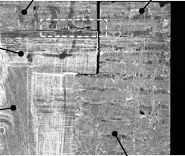
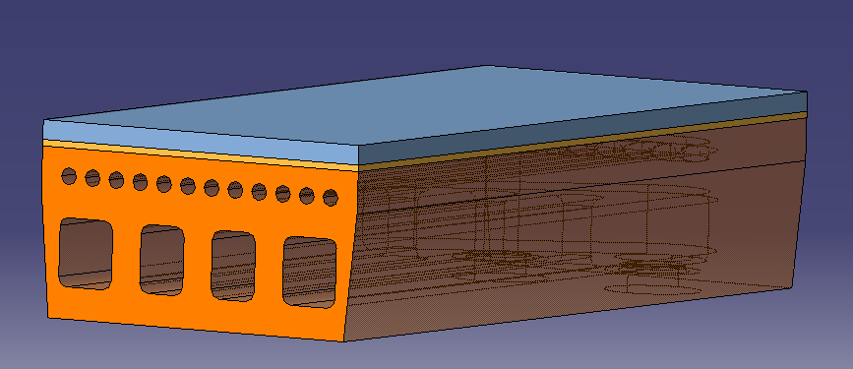
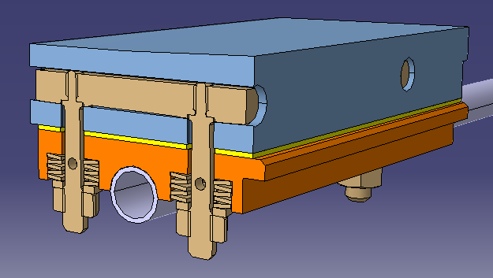
Fundamental differences divertor ⬄ baffle
 | Divertor | Baffle
Plasma facing material | W or W₉₅NiFe
Heat sink material | Cu or CuCrZr
Heat load requirement | 10 MW/m² | < 1-2 MW/m²
W-Cu Interface | Perfect thermal bond required | Cold contact sufficient
Connection type | continuous | Loose bolted connection allowed
Interlayer | 1 mm OFE-Cu ΔT @ 10 MW/m² = ~25 K | Graphite foil ΔT @ 1 MW/m² = 500 K
Key design concern | Thermal expansion mismatch Interface stress singularity | Maximum W temperature Bolt design
CFC – OFE Cu crack example
Notes:
WNiFe ➔ improved machinability and ductility

Slide 3
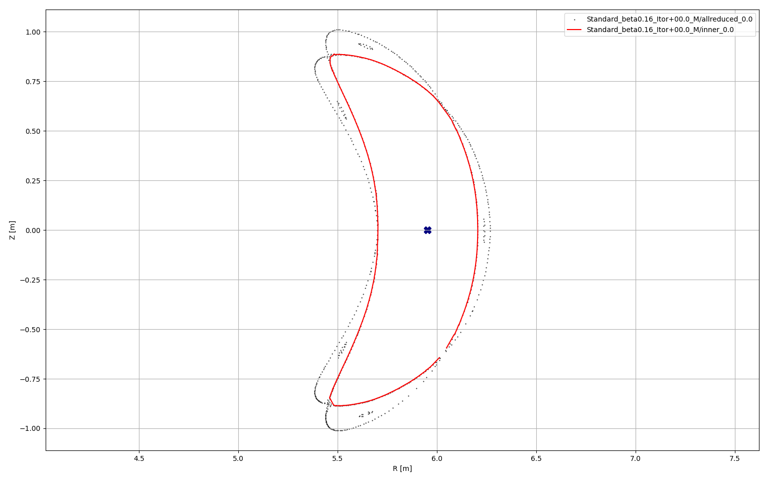
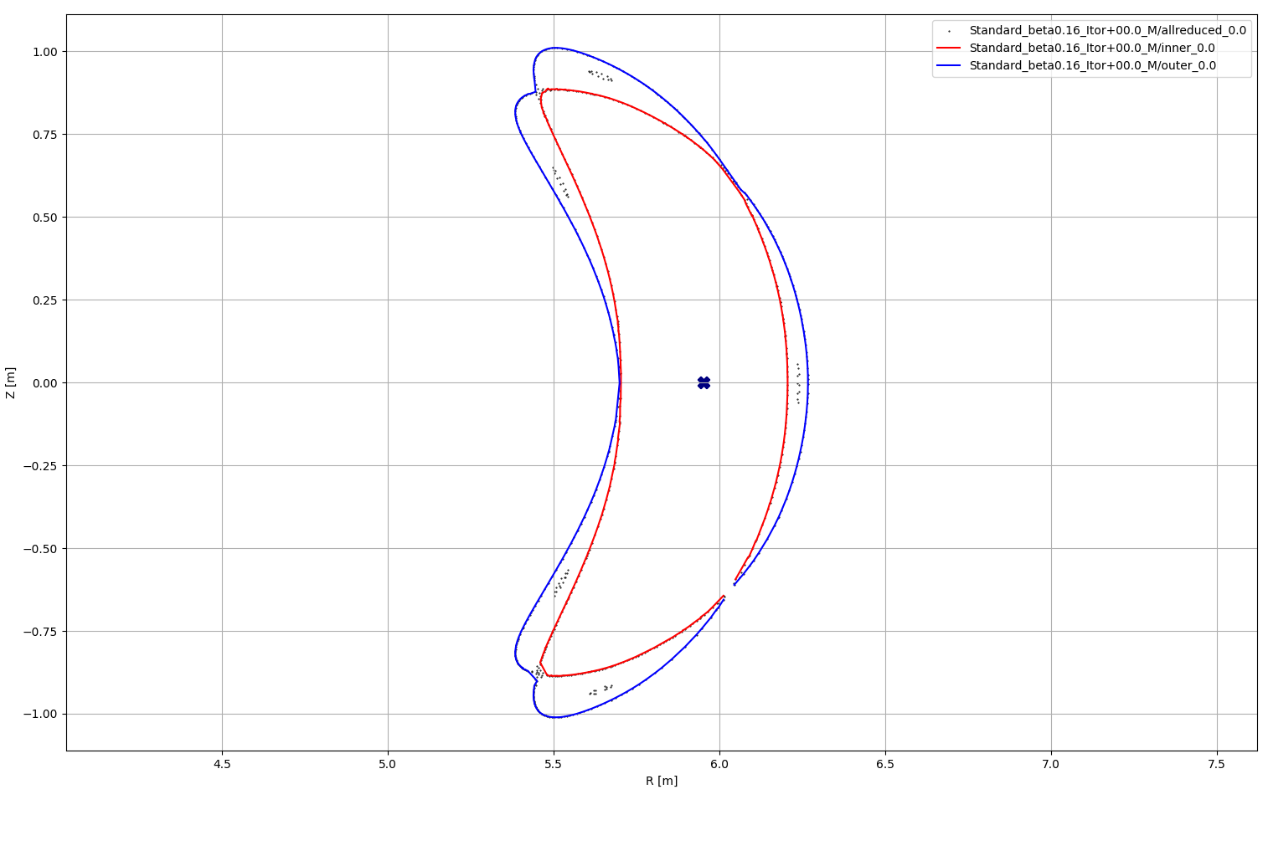
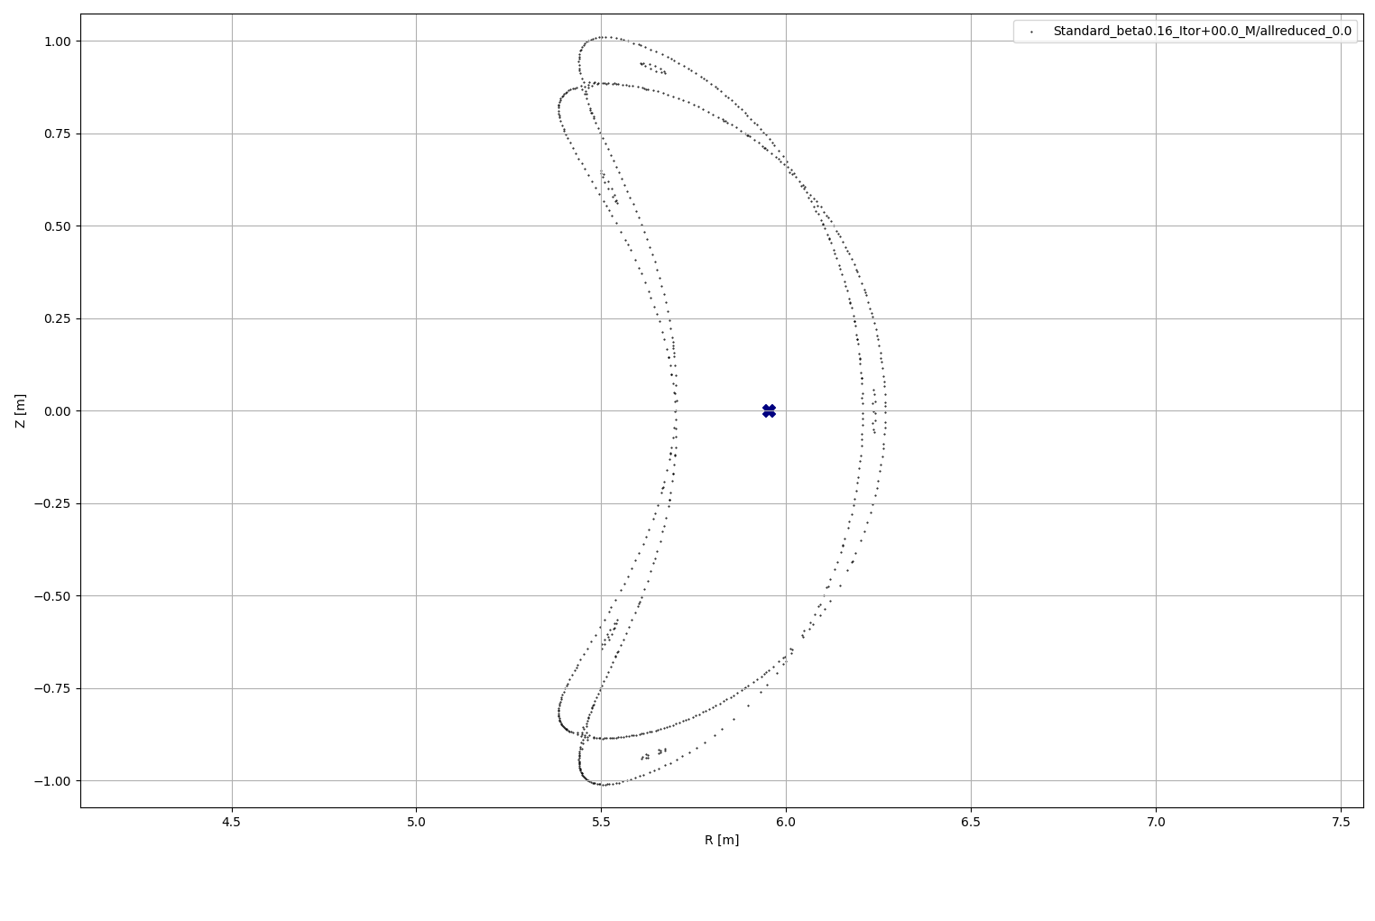
Design strategy divertor and baffle
Calculate separatrix
Independent of target geometry
Divertor does not intersect core plasma
Safe distance to inner envelop of separatrix
Divertor intersects scrape of layer
Intersection of outer envelope of separatrix
Baffle does not intersect separatrix
After optimisation of divertor position, baffles could be repositioned into shadowed area

Slide 4
Calculation of separatrix¹
Calculate magnetic field with VMEC/Extender
200+ runs made by Joachim Geiger.
VMEC model size (XS, S,M, L) iterated so that assumed LCFS agrees reasonably with Extender result
Standard: beta 0 ‒ 4.1%, I_{tor} = -30 ‒ +20 kA
High mirror: beta 0 – 4.0%, I_{tor} = -20 ‒ +20 kA
High Iota: beta 0 – 2.8%, I_{tor} = -70 ‒ +20 kA
Check results by evaluation of power deposition onto OP2 divertor
199/214 cases show >98% of particles deposited on first wall
Calculate connection length L_{c} to OP2.2 target in EMC-lite-universal in toroidal section at 36°
Infinite connection length: closed flux surfaces
Short connection length: private flux region
Intermediate connection length: points on the separatrix, depending on configuration:
L_{c} = 300 ‒ 500 m for high iota
L_{c} = 600 ‒ 960 m for standard and high mirror
Remove target and trace points with intermediate connection length to find complete separatrix
Number of toroidal turns needed to close the separatrix poloidally once depend on configuration
n = 7 turns for high iota
n = 65 turns for standard and high mirror
Reduce number of points to 1 per voxel of 15x15 mm in 36° section
Trace 0.1 toroidal turn (0-36°) and store results for every 0.1°
➔ 3D contour of power carrying layer in the SOL
Calculation approach adopted from approach by A. Kharwandikar

Slide 5
VMEC / Extender runs
Config | Beta[%] | Itor [kA]
Standard | 0.16% | -30 | -28 | -26 | -24 | -22 | -20 | -18 | -16 | -14 | -12 | -10 | -8 | -6 | -4 | -2 | 0 | 2 | 4 | 6 | 8 | 10 | 12 | 14 | 16 | 18 | 20
 | 0.65 |  |  |  | -24 |  |  | -18 |  |  | -12 |  |  | -6 |  |  | 0 |  |  | 6 |  |  | 12 |  |  | 18 |  | 24
 | 1.32 |  |  |  | -24 |  |  | -18 |  |  | -12 |  |  | -6 |  |  | 0 |  |  | 6 |  |  | 12 |  |  | 18 |  | 24
 | 2 |  |  |  | -24 |  |  | -18 |  |  | -12 |  |  | -6 |  |  | 0 |  |  | 6 |  |  | 12 |  |  | 18 |  | 24
 | 2.69 |  |  |  | -24 |  |  | -18 |  |  | -12 |  |  | -6 |  |  | 0 |  |  | 6 |  |  | 12 |  |  | 18 |  | 24
 | 3.4 |  |  |  | -24 |  |  | -18 |  |  | -12 |  |  | -6 |  |  | 0 |  |  | 6 |  |  | 12 |  |  | 18 |  | 24
 | 4.13 |  |  |  | -24 |  |  | -18 |  |  | -12 |  |  | -6 |  |  | 0 |  |  | 6 |  |  | 12 |  |  | 18 |  | 24
High Iota | 0 | -70 | -60 | -50 | -40 | -30 | -20 |  | -15 |  |  | -10 |  | -5 |  |  | 0 |  | 5 |  |  | 10 |  | 15 |  |  | 20
 | 0.4 |  |  |  |  |  | -20 |  | -15 |  |  | -10 |  | -5 |  |  | 0 |  | 5 |  |  | 10 |  | 15 |  |  | 20
 | 0.8 |  |  |  |  |  | -20 |  | -15 |  |  | -10 |  | -5 |  |  | 0 |  | 5 |  |  | 10 |  | 15 |  |  | 20
 | 1.2 |  |  |  |  |  | -20 |  | -15 |  |  | -10 |  | -5 |  |  | 0 |  | 5 |  |  | 10 |  | 15 |  |  | 20
 | 1.6 |  |  |  |  |  | -20 |  | -15 |  |  | -10 |  | -5 |  |  | 0 |  | 5 |  |  | 10 |  | 15 |  |  | 20
 | 2.0 |  |  |  |  |  | -20 |  | -15 |  |  | -10 |  | -5 |  |  | 0 |  | 5 |  |  | 10 |  | 15 |  |  | 20
 | 2.4 |  |  |  |  |  | -20 |  | -15 |  |  | -10 |  | -5 |  |  | 0 |  | 5 |  |  | 10 |  | 15 |  |  | 20
 | 2.8 |  |  |  |  |  | -20 |  | -15 |  |  | -10 |  | -5 |  |  | 0 |  | 5 |  |  | 10 |  | 15 |  |  | 20
High Mirror | 0.0 |  |  |  |  |  | -20 |  | -15 |  |  | -10 |  | -5 |  |  | 0 |  | 5 |  |  | 10 |  | 15 |  |  | 20
 | 1.0 |  |  |  |  |  | -20 |  | -15 |  |  | -10 |  | -5 |  |  | 0 |  | 5 |  |  | 10 |  | 15 |  |  | 20
 | 2.0 |  |  |  |  |  | -20 |  | -15 |  |  | -10 |  | -5 |  |  | 0 |  | 5 |  |  | 10 |  | 15 |  |  | 20
 | 3.0 |  |  |  |  |  | -20 |  | -15 |  |  | -10 |  | -5 |  |  | 0 |  | 5 |  |  | 10 |  | 15 |  |  | 20
 | 4.0 |  |  |  |  |  | -20 |  | -15 |  |  | -10 |  | -5 |  |  | 0 |  | 5 |  |  | 10 |  | 15 |  |  | 20

Slide 6
Runs with less than 98% power on target
Configuration | Beta [%] | LCFS size |  | Itor [kA]
Standard | 1.32 | S |  | -12
 | 2.0 | M |  | 0
 | 2.69 | S |  | 6
 | 3.4 | M | XXS | 0
 | 4.13 | XXS |  | 18
High iota | 0 | M |  | -10
 | 0.4 | M |  | -15 | -10
 | 0.8 | M |  | -15 | -10
 | 1.6 | M |  | -15
 | 2 | M |  | -10
 | 2.4 | M |  | -10
 | 2.8 | M |  | -15 | -10
High iota with negative Itor is actually limiter case ➔ EMC3-lite run unreliable
Error in power deposition for Standard not yet understood

Slide 7
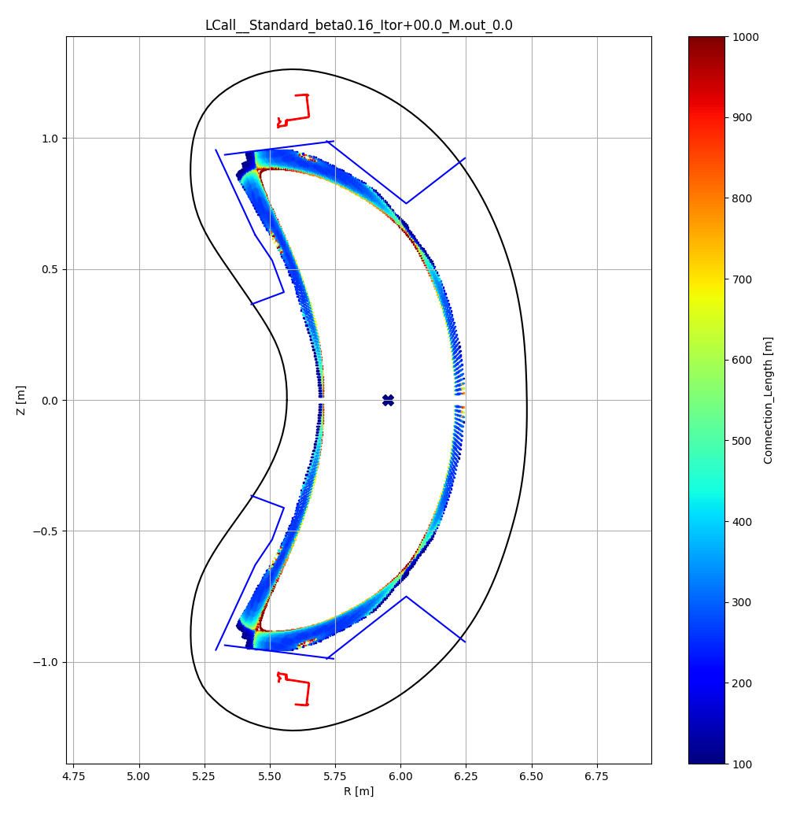
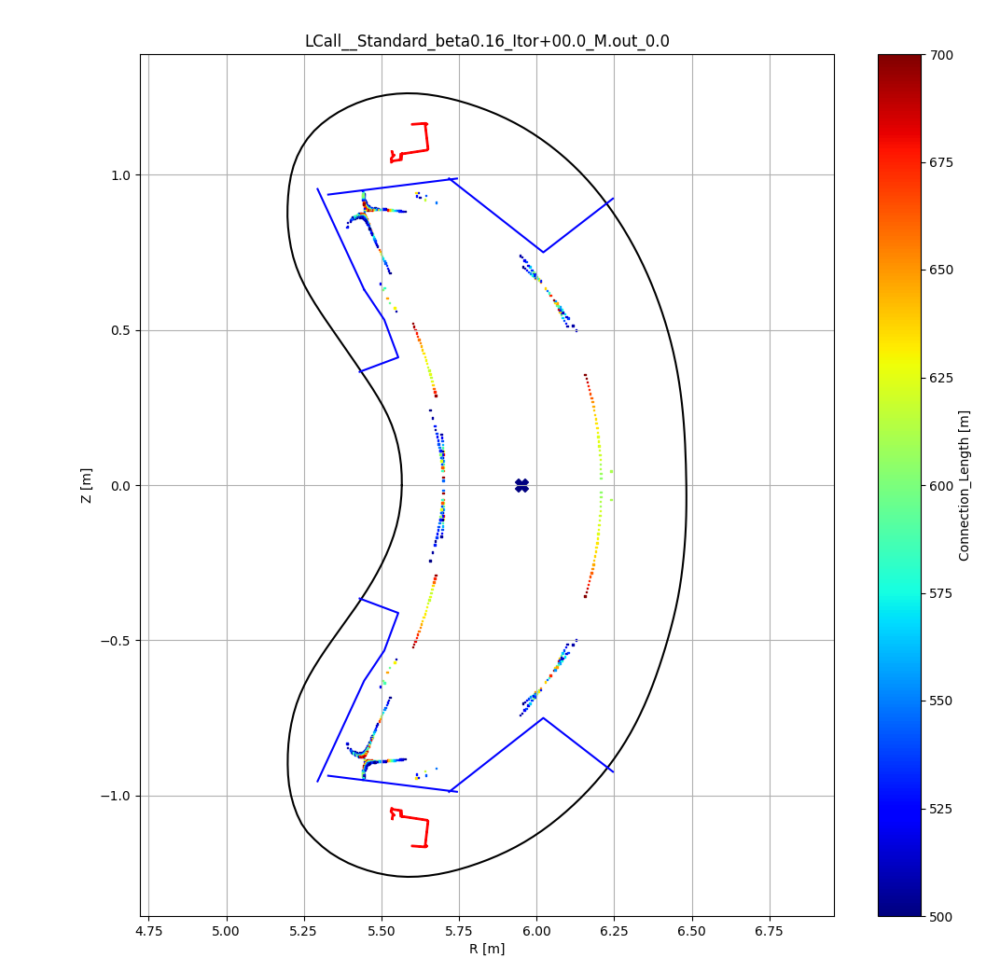
Connection length in OP2: Standard
All
500-700 m only

Slide 8
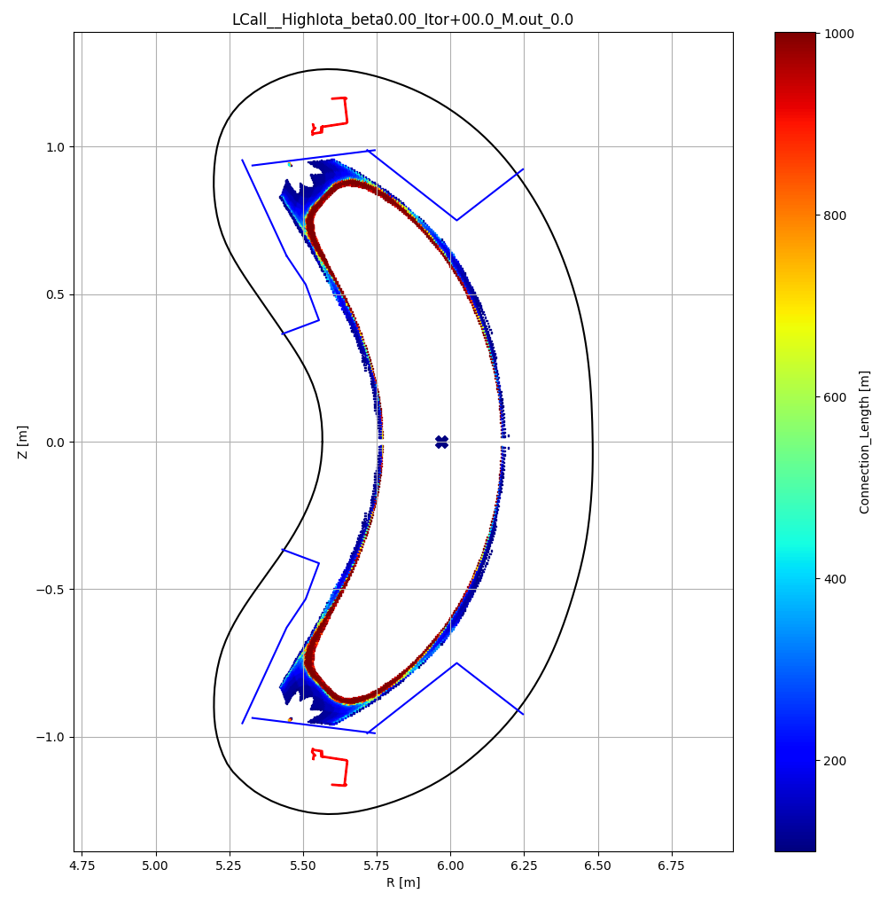
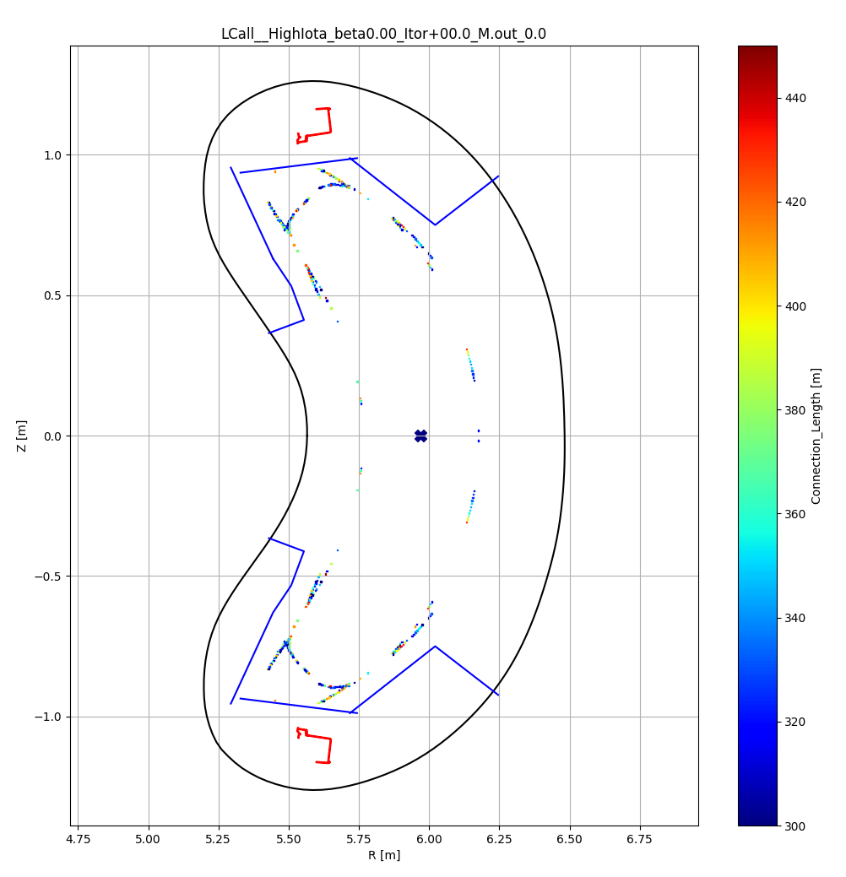
Connection length in OP2: High Iota
All
300-450 m only

Slide 9
Trace selected points n toroidal turns
All points (7k-100k points)
Outliers / inliers
Voxelized (0.5-1k points)
15x15 mm
High iota, beta = 0%, I_{tor} = 0 kA
Asymmetry requires tracing in both directions

Slide 10
Tracing in 2 directions
High iota, beta = 0%, I_{tor} = 0 kA

Slide 11
Separatrix for any config with beta and I_{tor}
Standard – beta variation – toroidal current = 0 kA
Standard – beta = 0 % – toroidal current variation -30 kA to +18 kA
Standard – beta = 3.4% – toroidal current variation -24 kA to +24 kA
High mirror – beta variation – toroidal current = 0 kA
High mirror – beta = 0 % – toroidal current variation -20 kA to +20 kA
High mirror – beta = 4 % – toroidal current variation -20 kA to +20 kA
High iota – beta variation – toroidal current = 0 kA
High iota – beta = 0 % – toroidal current variation -20 kA to +20 kA
High iota – beta = 2.8 % – toroidal current variation -20 kA to +20 kA
Standard / high mirror / high iota – beta = 0 % – toroidal current = 0 kA
Standard / high mirror / high iota – beta = 2.7 / 3.0 / 2.8 % – toroidal current = 0 kA

Slide 12
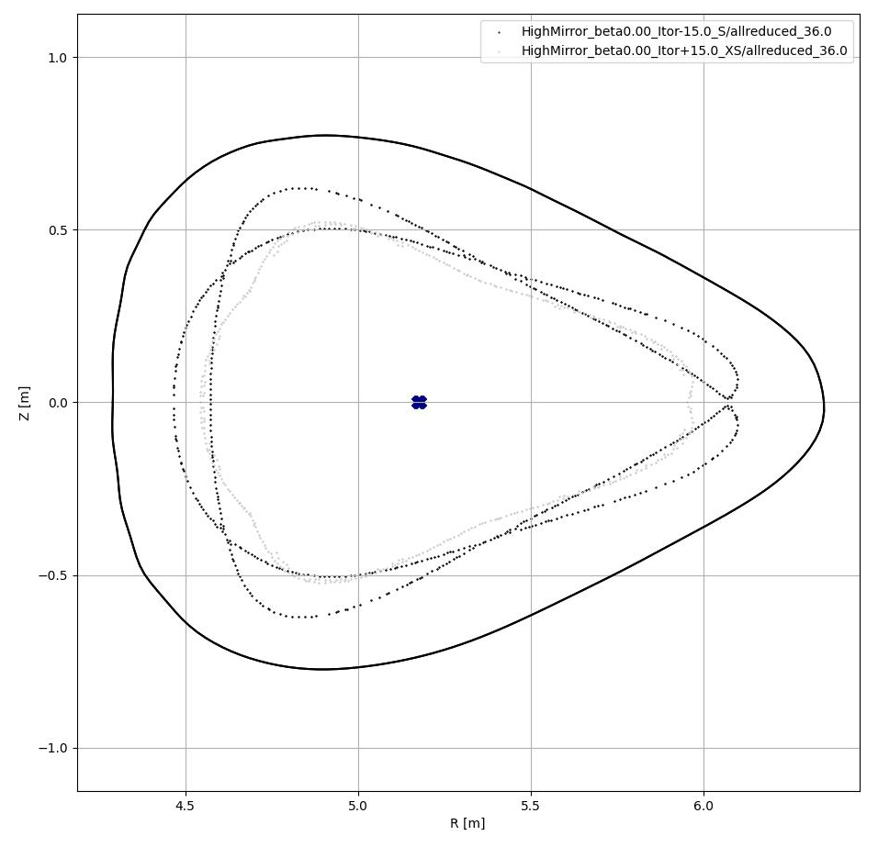
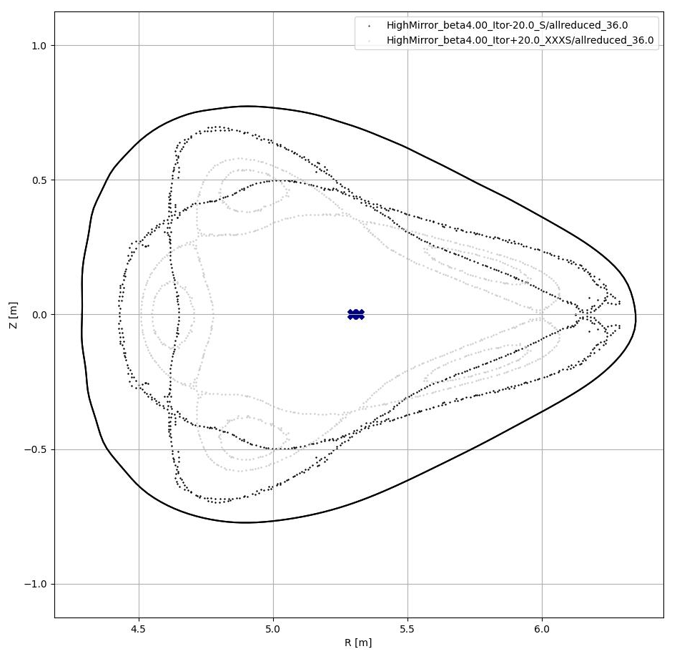
Design limitations
Provided the divertor intersects the outer coontour of the separatrix but does not intersect the LCFS poses a limit on the toroidal current that can be tolerated, especially at low beta
Beta = 0 %
Outside of separatrix @+15 kA < LCFS @-15 kA
Beta = 4 %
Outside of separatrix @+20 kA > LCFS @-20 kA

Slide 13
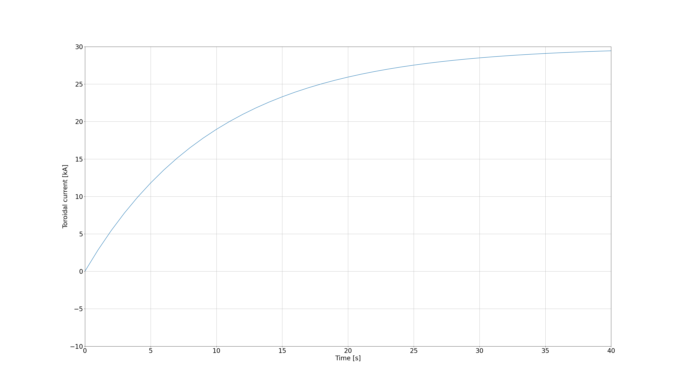
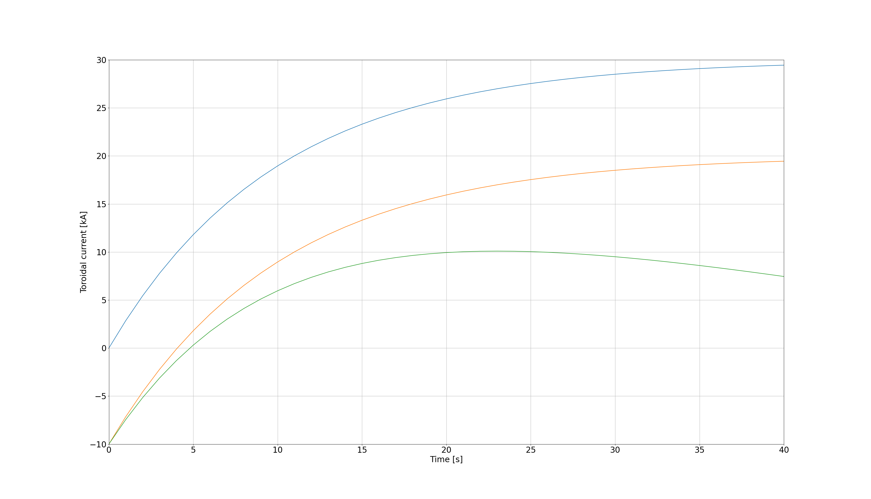
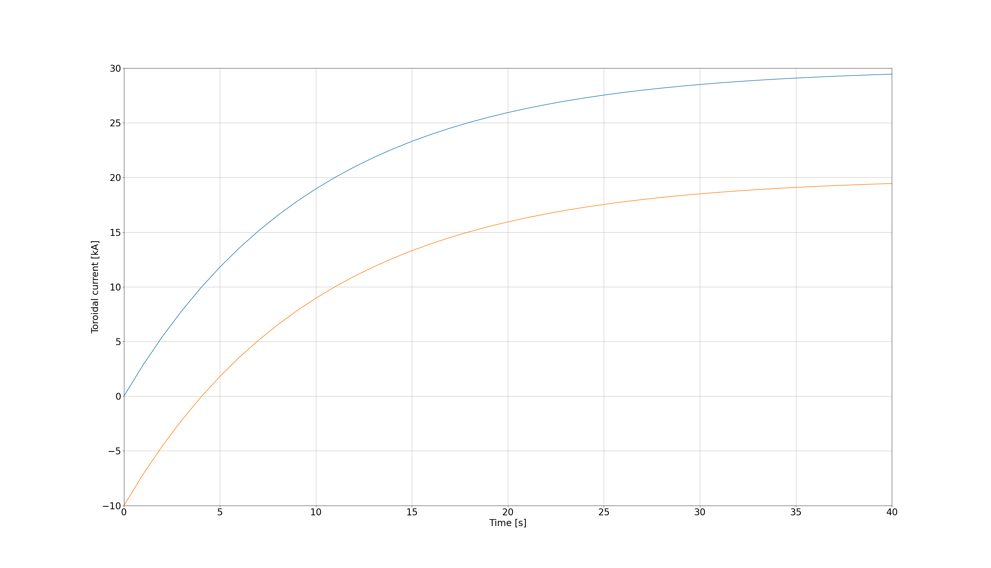
Toroidal current compensation by planar coils
Assuming I∞ = 30 kA, τ = 10s
Compensation by initial iota correction
I₀ = -10 kA
Adding transient planar coil current compensation
With b = ~10 and ramp rate I‘_{AB} = 30 A/s

Slide 14
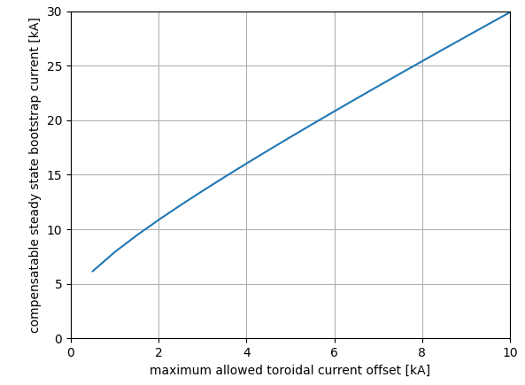
Maximum toroidal current compensation
Toroidal plasma current I_{tor} develops approximately according to
with decay constant τ = ~10s
Planar coil currents I_{AB} can compensate b ∙ I_{tor} with b = ~10
Ramping speed of planar coil currents Iˈ_{AB} = ~30 A/s
Total toroidal current
with I₀ the initial toroidal current offset created by I_{AB,0}
The toroidal current rate is
which can be fully compensated at t = 0 for
Larger toroidal plasma current can be damped, peak value is reached at
and results into
Allowing a maximum toroidal current variation of ±I₀
sets a limit for I∞ of
Power shell geometry variations can be limited to ±10 kA
for |I∞| < 30 kA

