Slide 1
Island coordinate maps
Matt Kriete

Slide 2
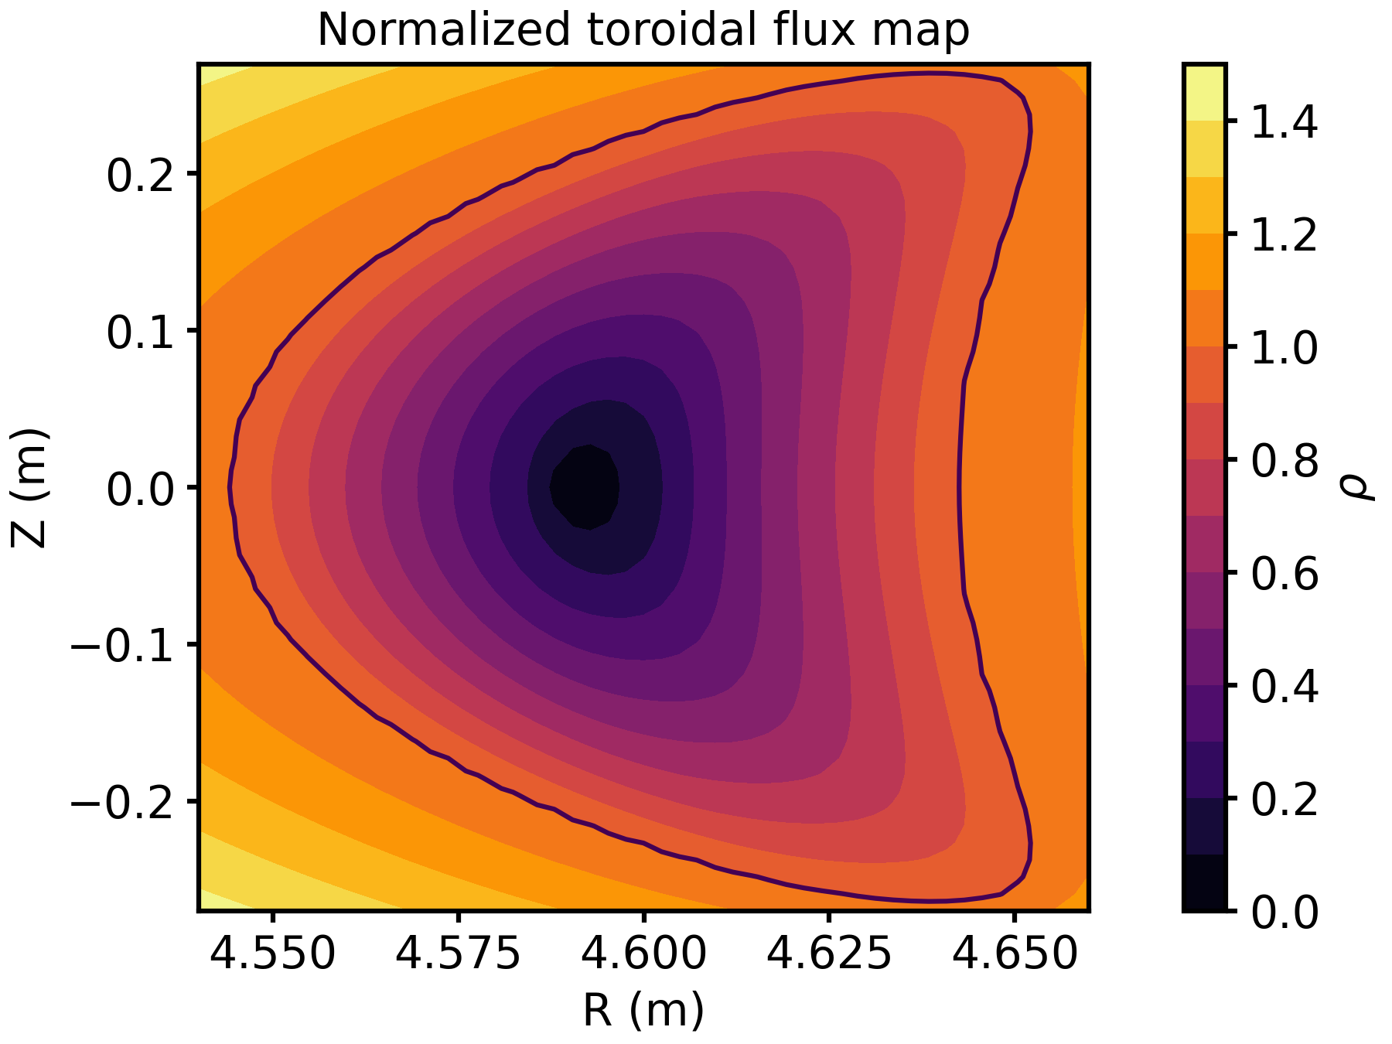
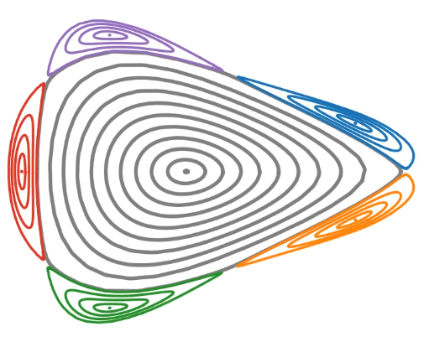
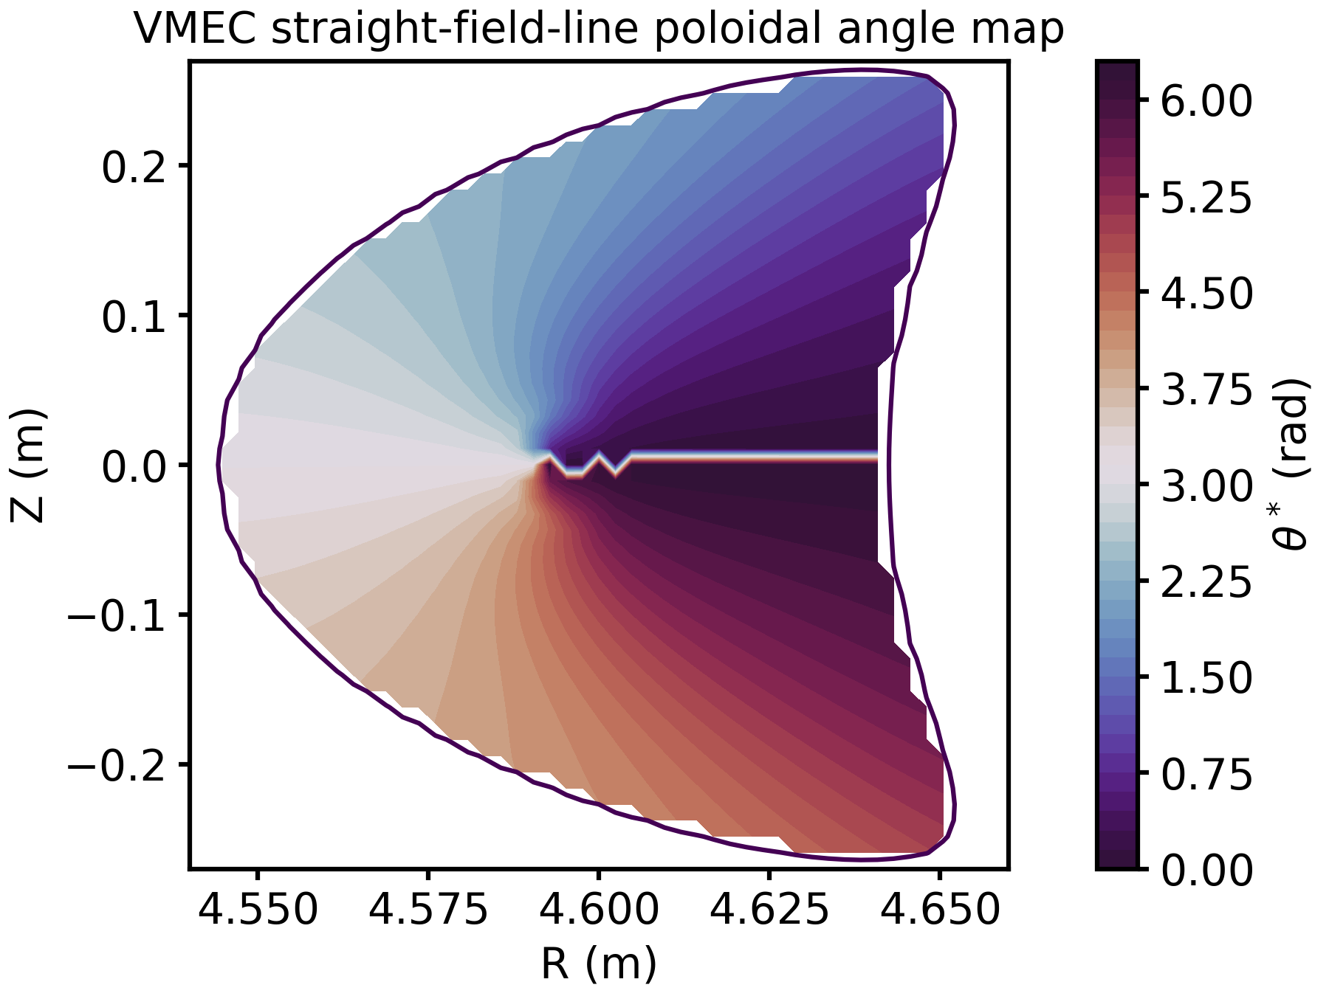
Tools are available for generating maps of island radial and poloidal coordinates using VMEC
Island coordinate system
Radial: 0 at O-point, increasing up to 1 at island separatrix (square root of normalized toroidal flux through island)
Poloidal: VMEC poloidal angle
Toroidal: Usual cylindrical toroidal angle
Routines for generating island coordinate maps were developed by John Schmitt [J.C. Schmitt et al., PPCF 64 055022 (2022)]
Procedure: Field line tracing island surfaces → 2D Fourier fitting of island surfaces → fixed-boundary, zero-beta VMEC solution
CAVEAT: only works currently for 5/5 island configurations (VMEC bug for islands that don‘t close on themselves after 1 toroidal transit)
Alex Knieps also routines for generating island coordinate maps

Slide 3
Where to find John Schmitt‘s island coordinate map routines
Python & Matlab scripts for generating island coordinate maps available on MPCDF gitlab: https://gitlab.mpcdf.mpg.de/krim/vmec_python_demo_set_1
Originally written by John Schmitt, now maintained by M. Kriete (John‘s code does not work with modern python versions)
Required input: wout.nc file from island VMEC solution
VMEC solutions for many 5/5 island configurations are available on VMEC webservice: http://svvmec1.ipp-hgw.mpg.de:8080/vmecrest/v1/run/?filter=jsch (use solutions that begin with „jsch_“)

Slide 4
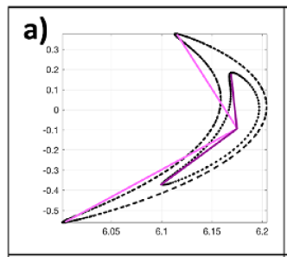
Notes on poloidal angle coordinates
Many possible poloidal angle coordinates
„geometric“ angle
VMEC $θ$
VMEC straight-field-line $θ^{∗}=θ+ιφ$
Geometric angle is easiest to calculate, but is not well-defined for non „star-like“ domains
VMEC straight-field-line poloidal angle is not a well-defined coordinate system unless iota=1 (i.e. island wraps around on itself after one toroidal transit, ($ρ{,θ}^{∗}, φ$) → is a local SFL coordinate system
The original VMEC poloidal angle gives a well-defined global coordinate system, but it is not a straight-field line system
Inner surface = star-like
Outer surface = non star-like

Slide 5
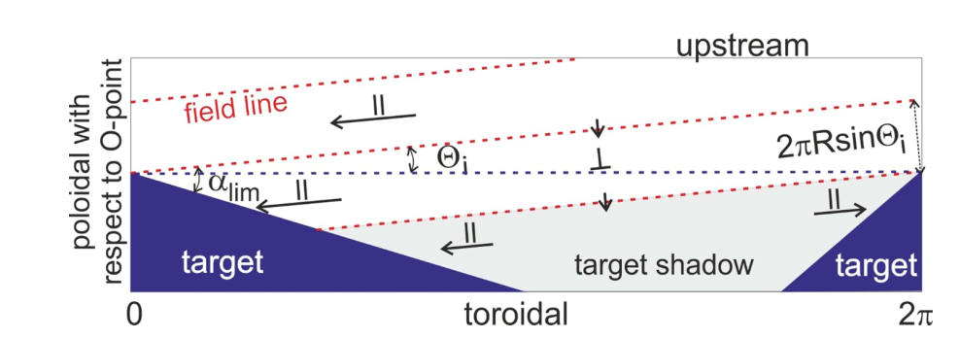
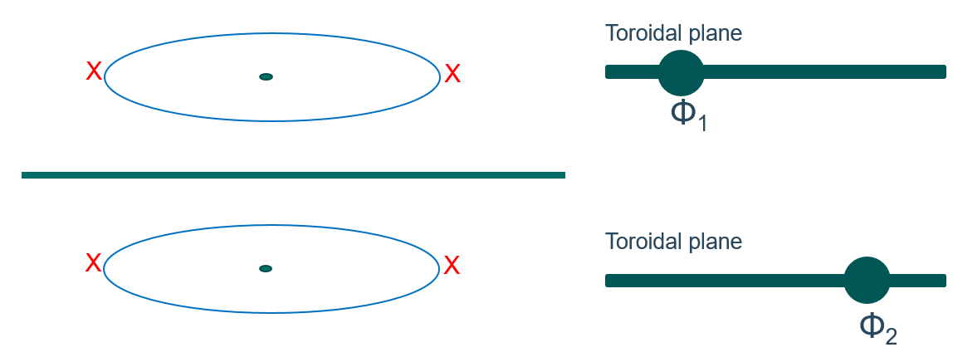
What kind of island coordinate maps are useful for divertor design?
Y. Feng, PPCF 64 125012 (2022)
Possibility to specify shape of divertor in island coordinate space, then transform result to lab coordinate space?
Not clear (to me) that VMEC straight-field-line poloidal angle $θ^{∗}$ produces plots where slope of field lines gives internal island field line pitch $Θ$ (does this actually matter for divertor design?)
A. Kharwandikar & A. Menzel-Barbara, DCD meeting, March 26, 2024
Φ₂
Measure of toroidal procession Φ
Φ₁
θ*
Measure of poloidal procession θ*

Slide 6
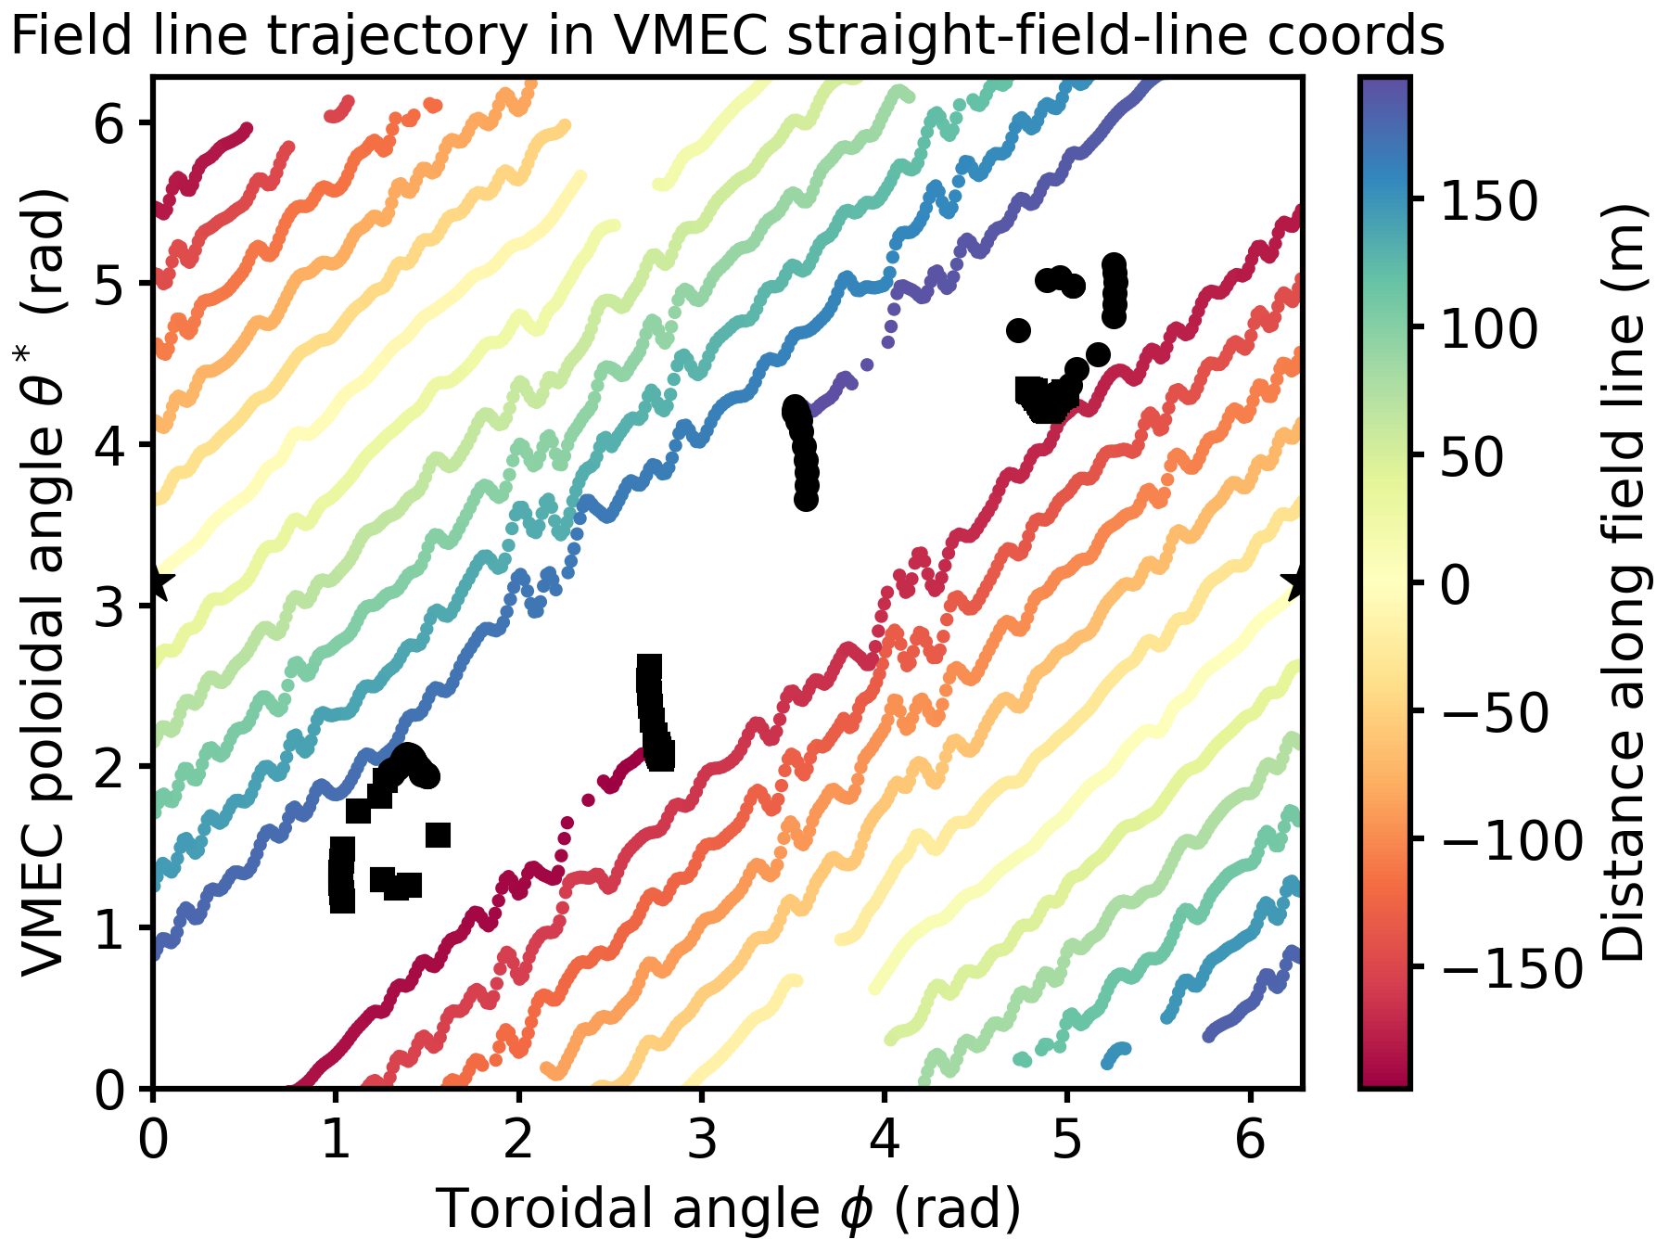
Shape of divertor in island coordinate space
Standard configuration (iota-corrected EJM from J.C. Schmitt‘s paper)
Field line launched at ($ρ_{island}=0.9$, $θ_{island}=π, φ=0$), traced both forward (red direction) and reverse (blue direction) until it strikes a target
Wiggles/gaps in field line trajectory caused by numerical error in VMEC coordinate inversion
lower HT
forward direction
lower VT
Field line strikes vertical targets in upper module 3 (forward direction) and lower module 4 (reverse direction)
File line passes close to horizontal targets in lower module 5 (forward direction) and upper module 2 (reverse direction)
upper VT
reverse direction
upper HT
launch point

Slide 7
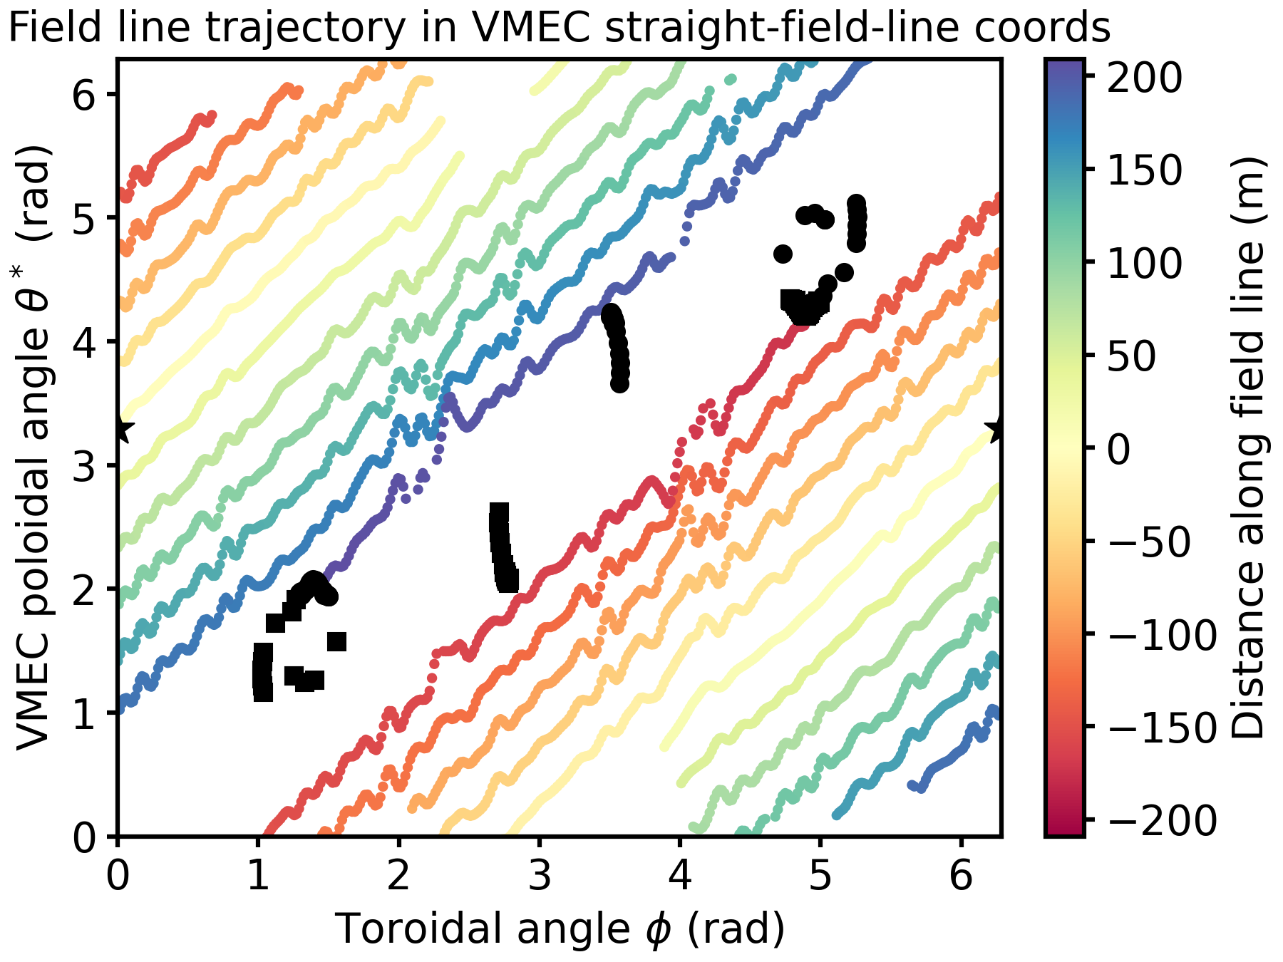
Shape of divertor in island coordinate space (different field line)
Standard configuration (iota-corrected EJM from J.C. Schmitt‘s paper)
Field line launched at ($ρ_{island}=0.9$, $θ_{island}=π+0.1, φ=0$), traced both forward (red direction) and reverse (blue direction) until it strikes a target
Wiggles/gaps in field line trajectory caused by numerical error in VMEC coordinate inversion
lower HT
forward direction
lower VT
Field line strikes horizontal targets in lower module 5 (forward direction) and upper module 2 (reverse direction)
File line passes close to vertical targets in upper module 3 (forward direction) and lower module 4 (reverse direction)
upper VT
reverse direction
upper HT
launch point

